Slide 1
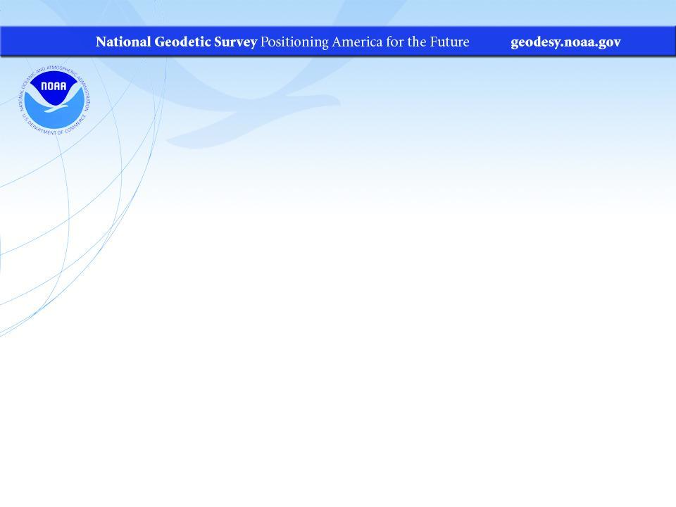
New CORS Station Webpages: Public Feedback Forum
Dr. Kimber DeGrandpre and Jay Howard
August 10 2023

Slide 2
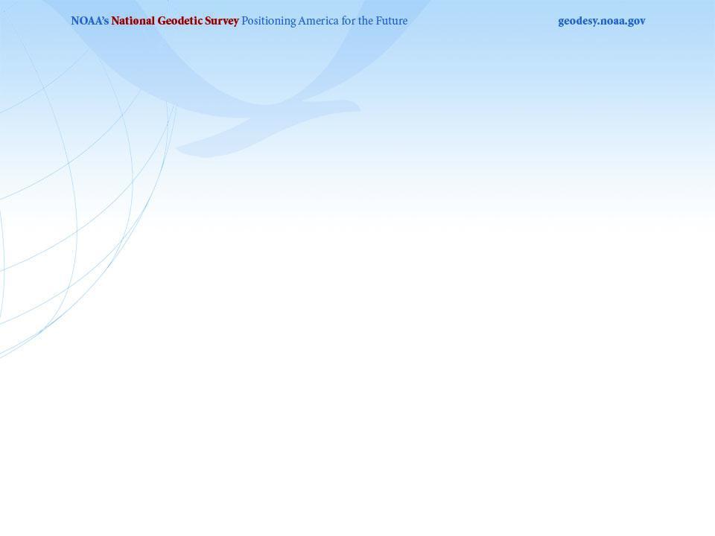
Webinar Outline
Existing CORS Station Pages
Feedback Topics
Live walk through of new CORS Station Pages
*This site is currently in Development*
* This site is not finished and not publicly accessible*
*Public Beta release expected at the beginning of 2024*

Slide 3
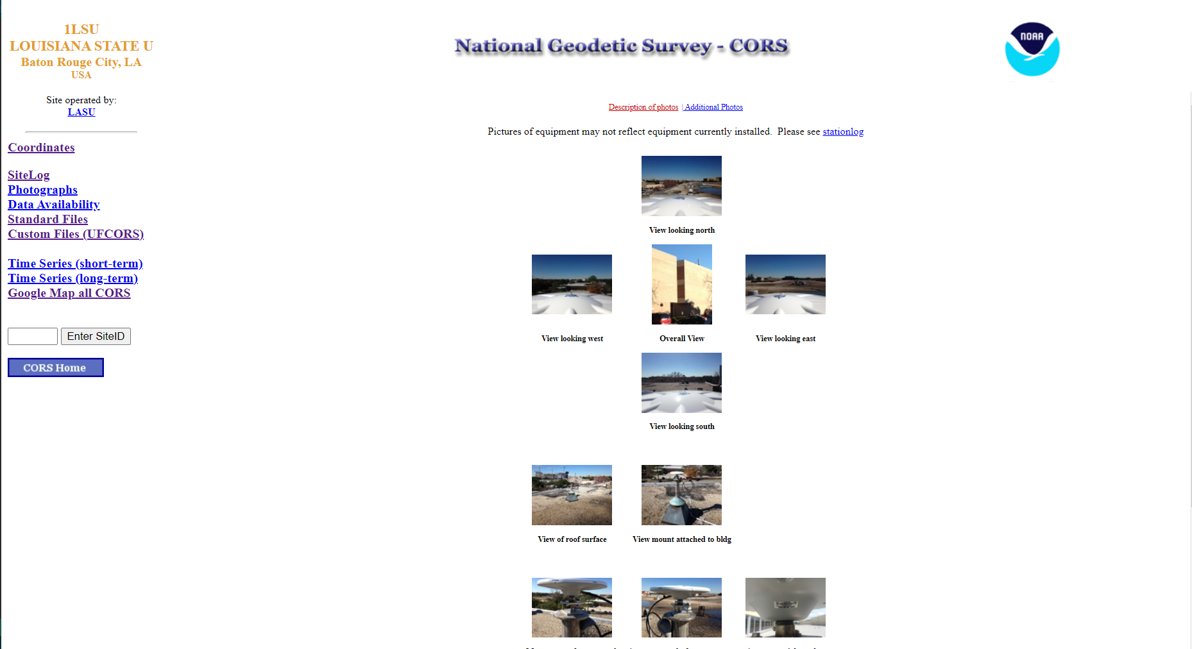
Existing CORS Station Pages
Home Page

Slide 4
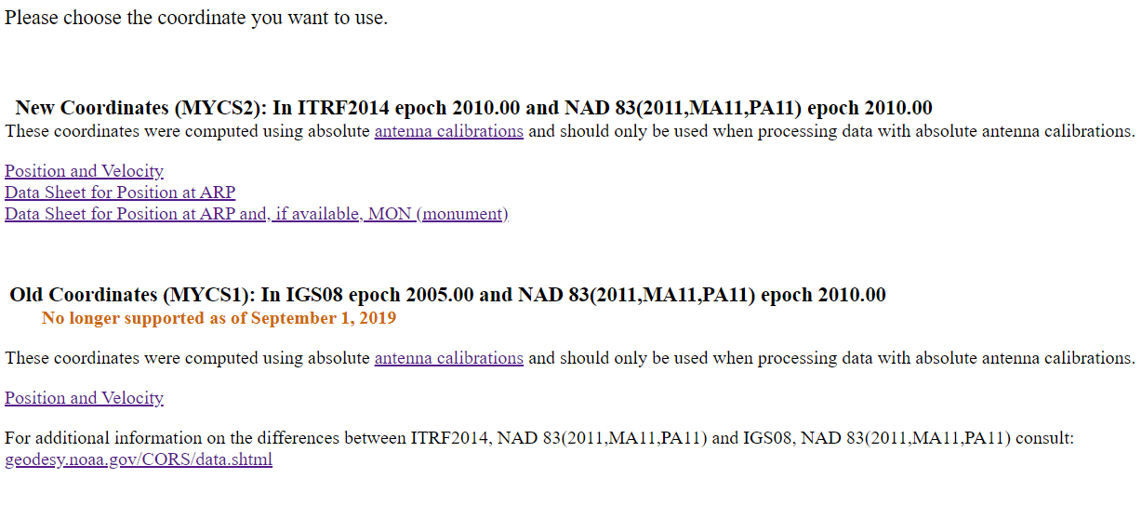
Existing CORS Station Pages
Coordinates Page

Slide 5
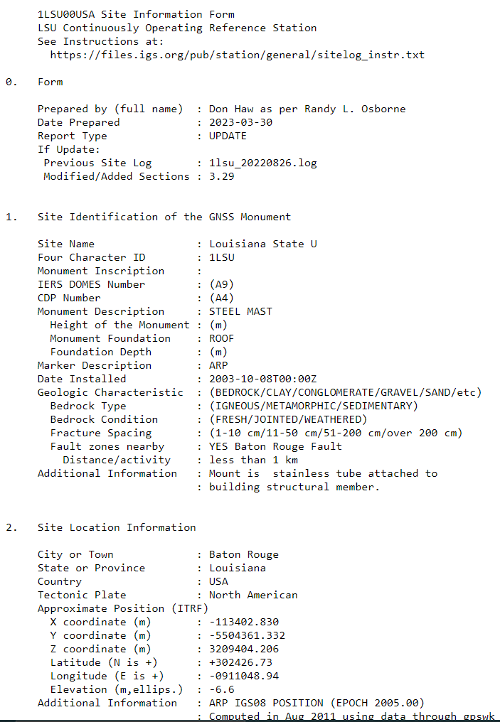
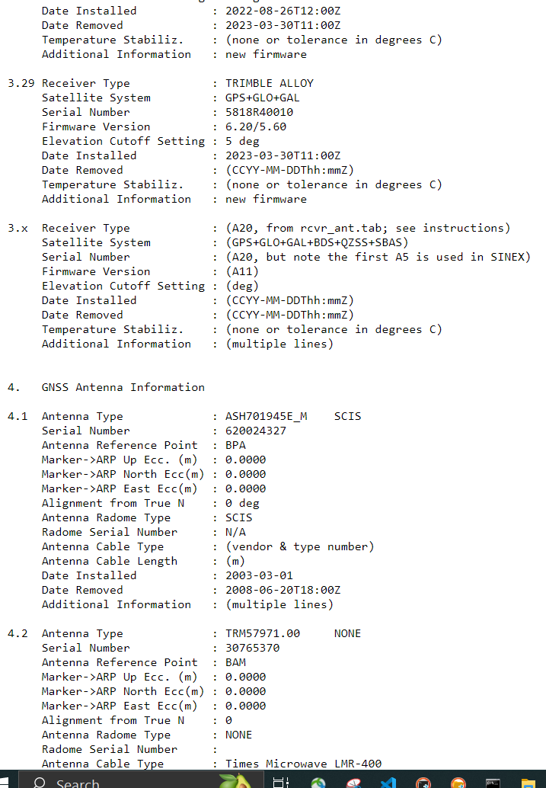
Existing CORS Station Pages
Site Log Page

Slide 6
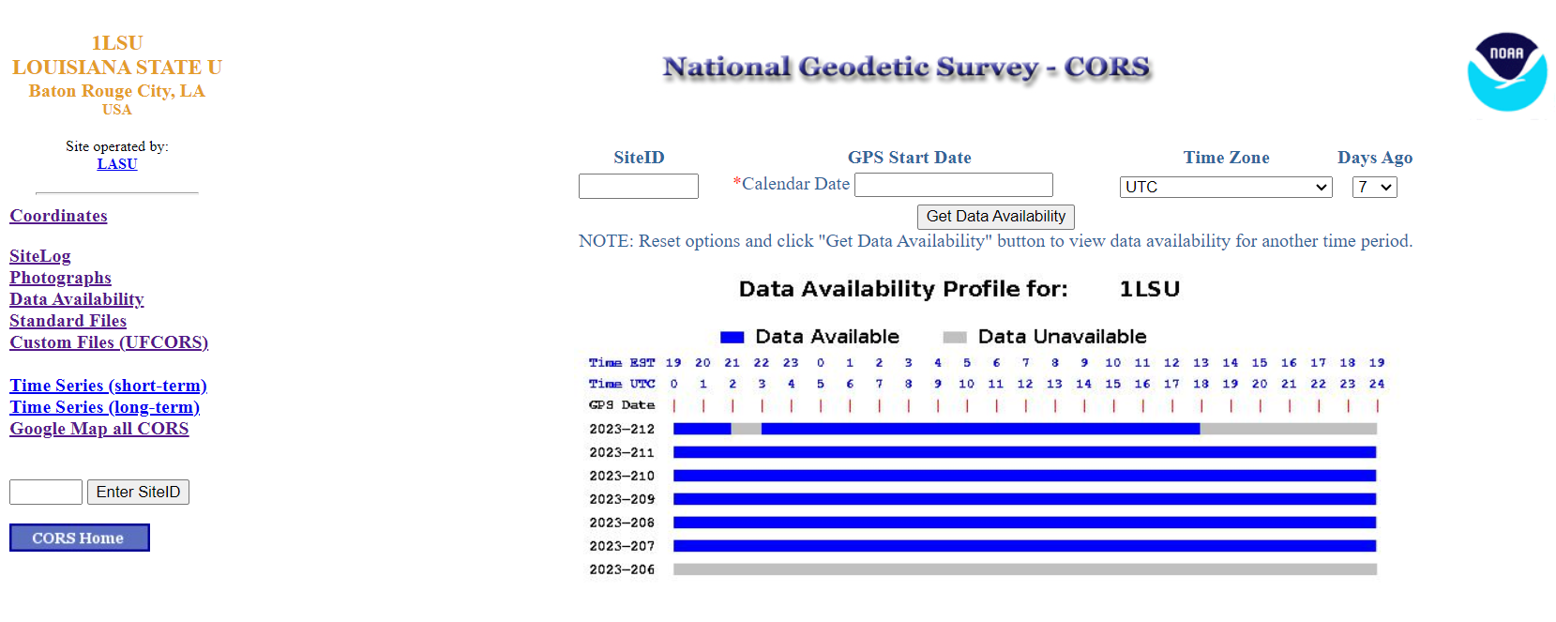
Existing CORS Station Pages
Data Availability

Slide 7
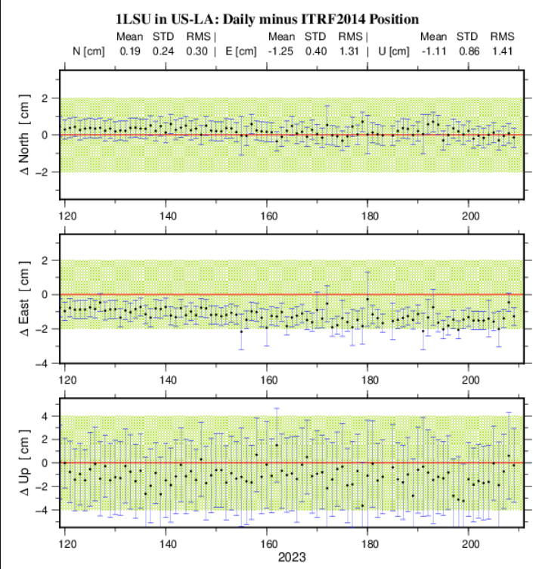
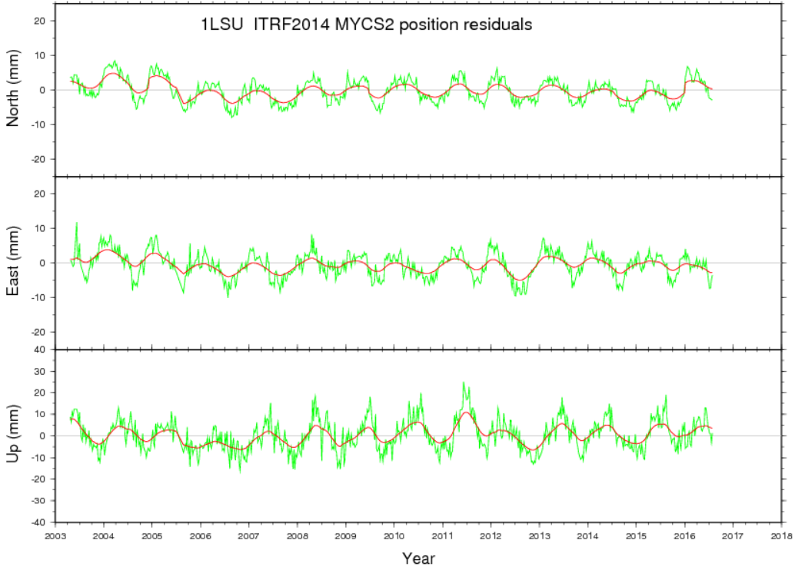
Existing CORS Station Pages
Time Series

Slide 8
Feedback
General polls throughout this Webinar
Submit comments or questions during this webinar in the Questions Box, please reference which section you are talking about
Handout includes slides of the new CORS Station Pages to review later and you can email comments to:
Dr. Kimber DeGrandpre – NGS.Feedback@noaa.gov

Slide 9
Feedback
Content
  Is there information you wish we would include
  Is there information presented you do not need (aka takes up space where more relevant information could go)
Format
  Would you prefer to see this information in a different way (i.e. table vs image vs free form)
  Do you have requirements for significant digits?
  Do you have preferences between units (i.e. decimal degrees, deg min sec, meters, miles, millimeters per year)
Aesthetics
  Do the background and box colors help you identify different topics?
  Are the plot colors clear and logical in their organization?

Slide 10
TIME TO GO TO LIVE EXAMPLE!

Slide 11
Handout includes slides of the new CORS Station Pages to review later and you can email comments to:
Dr. Kimber DeGrandpre – NGS.Feedback@noaa.gov
*This site is currently in Development*
* This site is not finished and not publicly accessible*
*Public Beta release expected at the beginning of 2024*

