Slide 1



NAD What??
The Evolution of the National Spatial Reference System
October 25, 2018
Dan Martin
Northeast Regional Geodetic Advisor
Dan.martin@noaa.gov
240-676-4762

Slide 2

NAD 83
But this is REALY worth taking the time to talk about

Slide 3
U.S. Department of Commerce
National Oceanic & Atmospheric Administration
National Geodetic Survey
Mission: To define, maintain & provide access to the
National Spatial Reference System (NSRS)
to meet our Nation’s economic, social & environmental needs
National Spatial Reference System
& their time variations
      Latitude
      Longitude
      Height
  Scale
  Gravity
  Orientation
Notes:
- NSRS benefit to the nation = $2.5B/year
est. 300K precision GPS users worldwide (2008); ¼ in US
- Very exciting to us at NGS to see how it has evolved over the years – now cm-accuracy capability / tracking with time

Slide 4
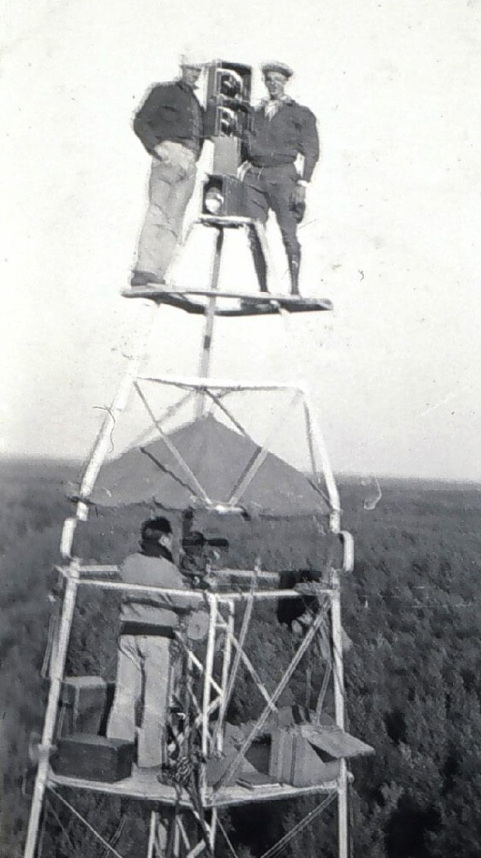
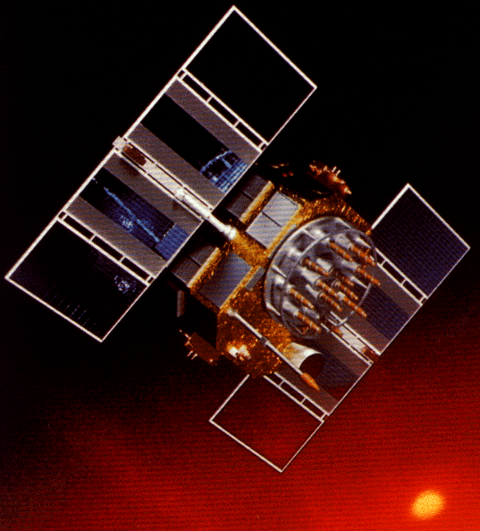
A (very) brief history of NAD 83
Original realization completed in 1986
  Consisted (almost) entirely of classical (optical) observations
“High Accuracy Reference Networks” (HARN) and Federal Base Network (FBN)realizations
  Done in 1990s and early 2000s, essentially state-by-state
  Based on GNSS but classical stations included in adjustments
National Re-Adjustment of 2007
  NAD 83(CORS96) and (NSRS2007)
  Simultaneous nationwide adjustment (GNSS only)
New realization: NAD 83(2011) epoch 2010.00

Slide 5
Why change datums/realizations
NAD27 based on old observations and old system
NAD83(86) based on old observations, some Doppler observations, and new system
NAD83(92, 96) based on new and old observations and same system (HARN/FBN)
NAD83(NSRS2007) based on new observations and same system. Removed regional distortions and made consistent with CORS
NAD83(2011) based on new observations and same system. Kept consistent with CORS

Slide 6
National Spatial Reference System (NSRS) Improvements over time
NETWORK TIME NETWORK LOCAL SHIFT
SPAN ACCURACY ACCURACY
NAD 27 1927-1986 10 meter s (1:100,000) 10-200 m
NAD83(86) 1986-1990 1 meter (1:100,000) 0.3-1.0 m
NAD83(199x)* 1990-2007 0.1 meter (1:1 million) 0.05 m
“HARN”, “FBN” (1:10 million)
NAD83(NSRS2007) 2007-2011 0.01 meter 0.01 meter 0.03 m
NAD83(2011) 2011- 0.01 meter 0.01 meter 0.01 m

Slide 7
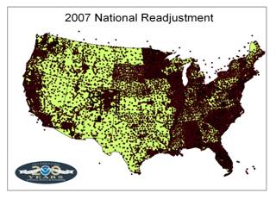

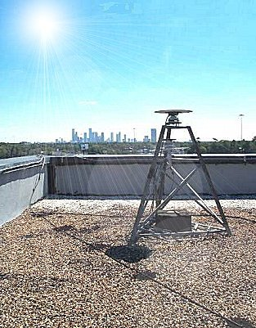
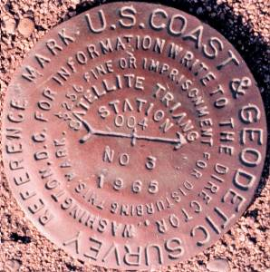
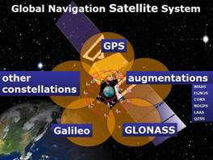
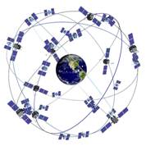
The NSRS has evolved
1 Million Monuments
(Separate Horizontal and Vertical Systems)
70,000
Passive Marks
(3-Dimensional)
→
Passive Marks
(Limited Knowledge of Stability)
≈ 2,000 GPS CORS
(Time Dependent System Possible;
4-Dimensional)
→
GPS CORS → GNSS CORS

Slide 8
International Terrestrial Reference Frame - ITRF2008
For the geodesy, geophysics and surveying communities, the best International Terrestrial Reference Frame is the “gold standard.”
The current expression for the reference frame is the ITRF2008.
ITRF2014 has been released and is soon to be adopted by NGS.
8

Slide 9
Simplified Concept of NAD 83 vs. ITRF08
h₈₃
h₀₈
Earth’s
Surface
ITRF 08
Origin
2.2 meters
NAD 83
Identically shaped ellipsoids (GRS-80)
a = 6,378,137.000 meters (semi-major axis)
1/f = 298.25722210088 (flattening)
Origin
Notes:
ITRF (International Terrestrial Reference Frame) just has an origin; take NAD83 shaped ellipsoid centered at the ITRF origin to derive ITRF97 ellipsoid heights.
Ellipsoid heights NAD83 vs. ITRF97 - Defined origins are best estimate of the center of mass; NAD83 is not geocentric. Move origin; move ellipsoid surface as illustrated.
Ellipsoid height differences reflect the non-geocentricity of NAD83.

Slide 10
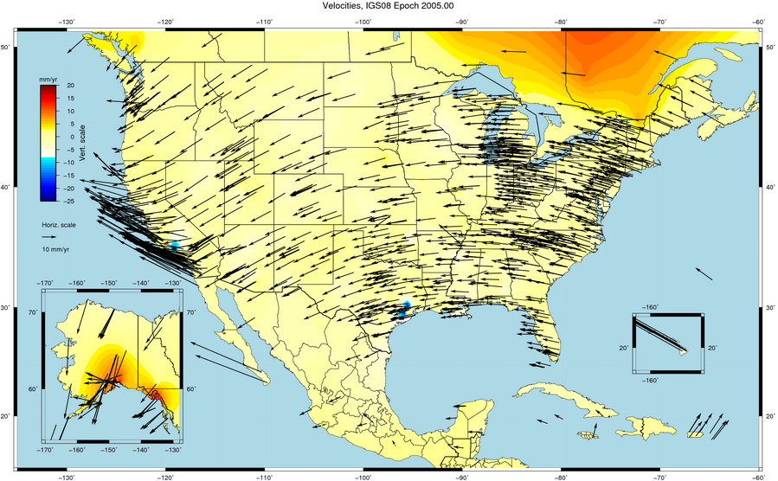

Slide 11
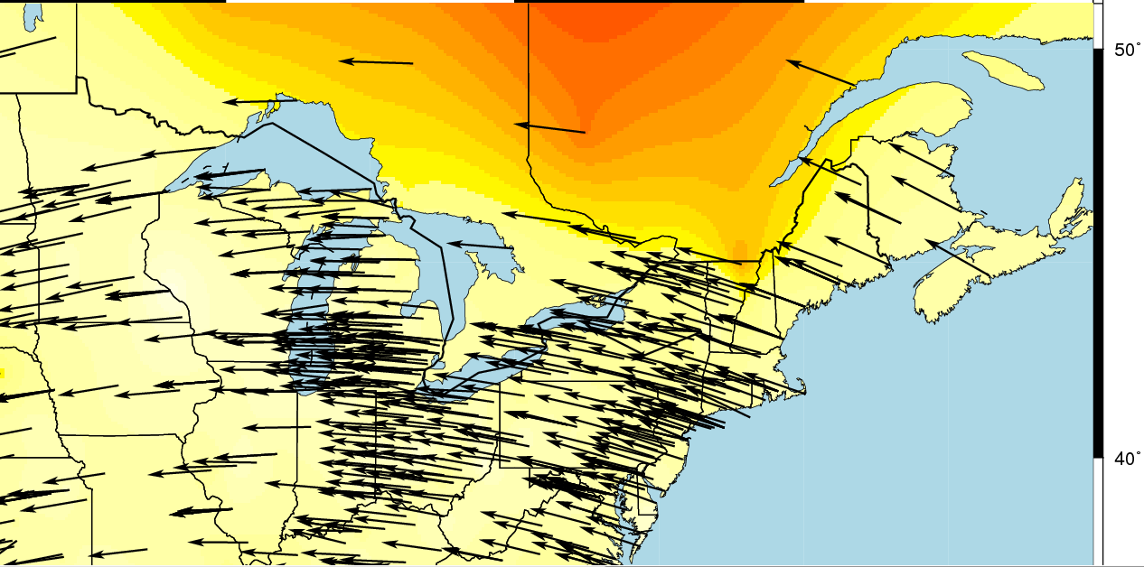
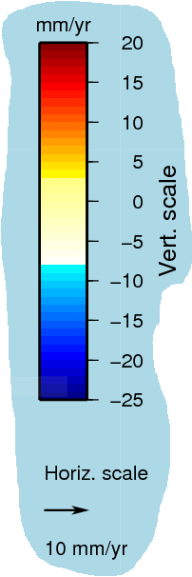

Slide 12
A (very) brief history of WGS 84
Credit Michael Dennis (NGS)
Original realization completed in Jan 1987
  “Same” as original NAD 83 (to within ±2 m)
WGS 84 (G730) — adopted Jun 1994
  Aligned to ITRF91
WGS 84 (G873) — adopted Jun 1997
  Aligned to ITRF94
WGS 84 (G1150) — adopted Jan 2002
  Aligned to ITRF2000 (at epoch 2001.00)
WGS 84 (G1674) — adopted Feb 2012
  Aligned to ITRF2008 (at epoch 2005.00)
Latest: WGS 84 (G1762) — adopted Oct 2013
  Also aligned to ITRF2008 (at epoch 2005.00)
A new one: WGS 84 (Gxxxx) — adopted late 2018…?
  Aligned to ITRF2014 (at epoch 2010.00)

Slide 13
How do you get WGS 84 coordinates?
Credit Michael Dennis (NGS)
Only true access: Broadcast orbits
  Accuracy ~3 to 5 m (10 to 15 ft) horizontal
  Epoch at midpoint of year (e.g., now 2018.5)
Can assume equal to civilian global frames
  International Terrestrial Reference Frame (ITRF)
  International GNSS Service (IGS) frame
Sources for ITRF/IGS coordinates:
  Satellite Based Augmentation Systems (SBAS)
    E.g., WAAS, OmniSTAR HP
  Various post-processed positioning services
    E.g., OPUS, AUSPOS, CSRS-PPP, GAPS, APPS, SCOUT, etc.

Slide 14
So, you think you have WGS 84 coordinates…
Credit Michael Dennis (NGS)
If accuracy worse (larger) than ~3 m (10 ft)
  Can consider same as “generic” NAD 83
  Don’t need realization or epoch date
  No need to transform to NAD 83
If (stated) accuracy better (smaller) than ~3 m
  Must include realization (e.g., G1762)
  Must include epoch date (e.g., 2018.72)
  Otherwise can NOT be at accuracy stated
  May not be able to accurately transform to NAD 83

Slide 15

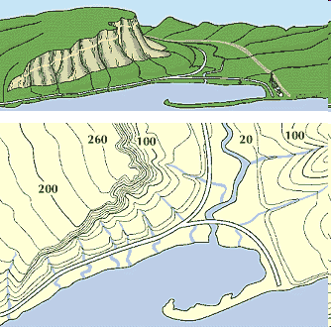
What is a Vertical Datum?
Strictly speaking, a vertical datum is a surface representing zero elevation
Traditionally, a vertical datum is a system for the determination of heights above a zero elevation surface
Vertical datum comprised of:
  Its definition: Parameters and other descriptors
  Its realization: Its physical method of accessibility
"topographic map." Online Art.
Britannica Student Encyclopædia.
17 Dec. 2008
<http://student.britannica.com/ebi/art-53199>

Slide 16
A (very) brief History of vertical datums in the USA
NGVD 29
  National Geodetic Vertical Datum of 1929
  Original name: “Sea Level Datum of 1929”
  “Zero height” held fixed at 26 tide gauges
    Not all on the same tidal datum epoch (~ 19 yrs)
  Did not account for Local Mean Sea Level variations from the geoid
    Thus, not truly a “geoid based” datum

Slide 17
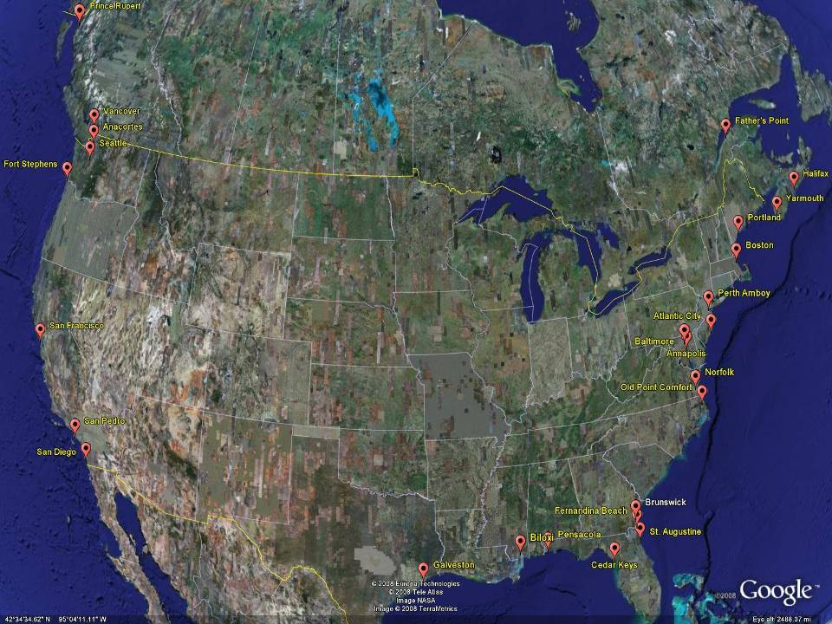
NGVD29
The National Geodetic Vertical Datum of 1929 is referenced to 26 tide gauges in the US and Canada
Notes:
It turns out that MSL is a close approximation to another surface, defined by gravity, called the geoid, which is the true zero surface for measuring elevations. Because we cannot directly see the geoid surface, we cannot actually measure the heights above or below the geoid surface. We must infer where this surface is by making gravity measurements and by modeling it mathematically. For practical purposes, we assume that at the coastline the geoid and the MSL surfaces are essentially the same. Nevertheless, as we move inland we measure heights relative to the zero height at the coast, which in effect means relative to MSL.
Definition: NGVD29 – The National Geodetic Vertical Datum of 1929…
The Sea Level Datum of 1929 was the vertical control datum established for vertical control surveying in the United States of America by the General Adjustment of 1929. The datum was used to measure elevation or altitude above, and depression or depth below, mean sea level (MSL).
Mean sea level was measured at 26 tide gauges: 21 in the United States and 5 in Canada. The datum was defined by the observed heights of mean sea level at the 26 tide gauges and by the set of elevations of all bench marks resulting from the adjustment. The adjustment required a total of 66,315 miles (106,724 km) of leveling with 246 closed circuits and 25 circuits at sea level.
Since the Sea Level Datum of 1929 was a hybrid model, it was not a pure model of mean sea level, the geoid, or any other equipotential surface. Therefore, it was renamed the National Geodetic Vertical Datum of 1929 (NGVD 29) in 1973. The NGVD 29 was subsequently replaced by the North American Vertical Datum of 1988 (NAVD 88) based upon the General Adjustment of the North American Datum of 1988.

Slide 18
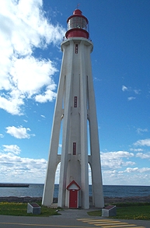
Current Vertical Datum in the USA
NAVD 88: North American Vertical Datum of 1988
Definition: The surface of equal gravity potential to which orthometric heights shall refer in North America*, and which is 6.271 meters (along the plumb line) below the geodetic mark at “Father Point/Rimouski” (NGSIDB PID TY5255).
Realization: Over 500,000 geodetic marks across North America with published Helmert orthometric heights, most of which were originally computed from a minimally constrained adjustment of leveling and gravity data, holding the geopotential value at “Father Point/Rimouski” fixed.
Father Point Lighthouse, Quebec
*Not adopted in Canada
Notes:
By fixing the geopotential value at the origin point, it was possible to ensure that the origins of IGLD 85 and NAVD 88 aligned.
*It should be pointed out that while the datum was defined in such a way as to be usable on the North American continent, it was never actually adopted in Canada. It can be used there, but it’s not their official civilian datum.
Note that the designation of the vertical control point at Father Point is “1250 G=NAVD 88 DATUM POINT” for PID# TY5255 and is not available from the publicly accessible NGSIDB.

Slide 19
History of vertical datums in the USA
NAVD 88
  North American Vertical Datum of 1988
  One height held fixed at “Father Point” (Rimouski, Canada)
  …height chosen was to minimize 1929/1988 differences on USGS topo maps in the eastern U.S.
  Thus, the “zero height surface” of NAVD 88 wasn’t chosen for its closeness to the geoid (but it was close…few decimeters)

Slide 20
History of vertical datums in the USA
NAVD 88 (continued)
  Use of one fixed height removed local sea level variation problem of NGVD 29
  Use of one fixed height did open the possibility of unconstrained cross-continent error build up
  H=0 surface of NAVD 88 was supposed to be parallel to the geoid…(close again)

Slide 21
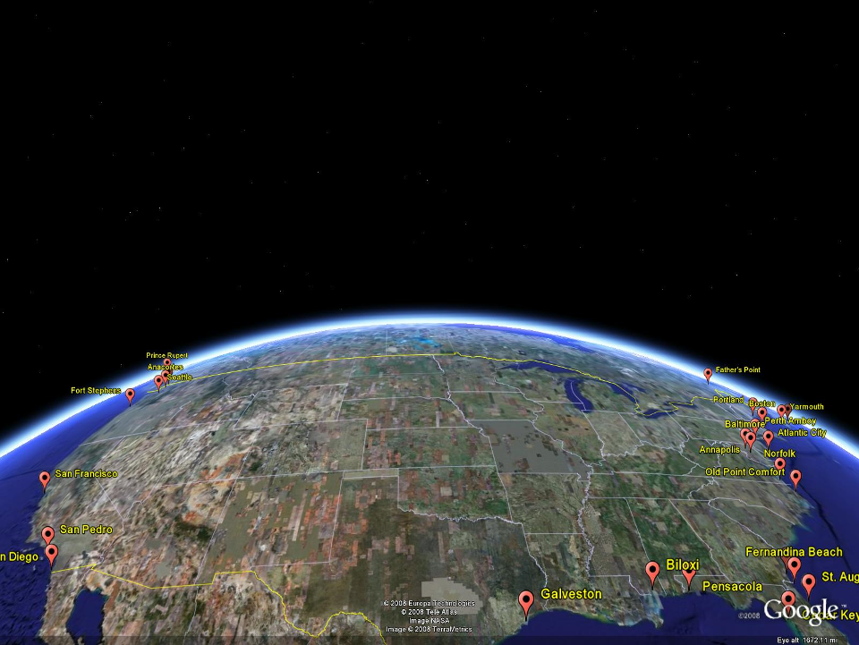
NAVD 88
Referenced to 1 Tide Gage
(Father’s Point)
NGVD 29
Referenced to 26 Tide Gages
-11 cm
125 cm
-23 cm
85 cm
102 cm
NAVD88 minus LMSL(1960-1978)
70 cm
-11 cm
4 cm
-23 cm
Notes:
NGVD29 consisted of the national vertical network referenced to 26 tide stations along the coast of North America
Click
That network was warped or twisted to fit those tide stations. The difference between the geoid (what we run levels on) and LMSL is not the same for every tide station due to prevailing winds, ocean current, etc. It is that difference that warped the network.
Click
NAVD88 utilized additional leveling data along with gravity measurements (to measure the geoid) and was referenced to only one tide station on the St. Lawrence Seaway. As you can see in the graphic, the network was unwarped which changes those reference mark’s elevations (differences between NAVD88 and the local mean sea level shown) This is not the difference between NAVD88 and NGVD29 but it is a representation of what happened.

Slide 22
Problems with NAD 83 and NAVD 88
NAD 83 is not as geocentric as it could be (approx. 2 m)
  Positioning Professionals don’t see this - Yet
NAD 83 is not well defined with positional velocities
NAVD 88 is realized by passive control (bench marks) most of which have not been re-leveled in at least 40 years.
NAVD 88 does not account for local vertical velocities (subsidence and uplift)
  Post glacial isostatic readjustment (uplift)
  Subsurface fluid withdrawal (subsidence)
  Sediment loading (subsidence)
  Sea level rise

Slide 23
Why isn’t NAVD 88 good
enough anymore?
Earth’s
Surface
H (NAVD 88)
H
NAVD 88 reference level
The Geoid
Errors in NAVD 88 : ~50 cm average,
100 cm CONUS tilt,
1-2 meters average in Alaska
Notes:
This slide shows what NGS now knows about the error in NAVD 88 itself. Using a continental geoid computed from the GRACE satellite, a bias and tilt in NAVD 88 has been computed using GPS derived ellipsoid heights on NAVD 88 bench marks. These are now known errors that exist in all NAVD 88 bench marks. This datum realization error, relative to the geoid, is over and above the errors from marks moving.

Slide 24
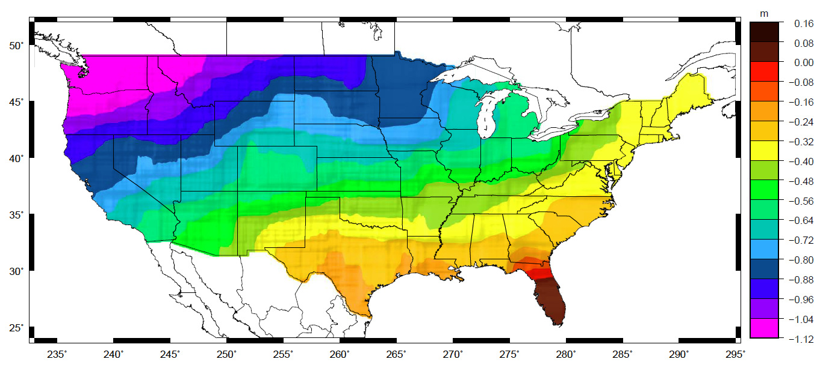
Why isn’t NAVD 88 good
enough anymore?
Approximate level of geoid mismatch known to exist in the NAVD 88 zero surface:
Notes:
This map reflects the sort of height changes that users could expect if NAVD 88 were replaced with a geoid-based vertical datum.
This is only a large scale approximation and should not be used as an absolute guide. Each benchmark might have its own level
Of mismatch, say from uplift or subsidence, not captured by this broad brush.
Also, this is the difference between the zero level of NAVD 88 and the actual geoid. The difference between NAD 83 ellipsoid heights and
ITRF/GRS-80 ellipsoid heights has NO influence on this graph and should not be part of the story.
Updated October 2010

Slide 25
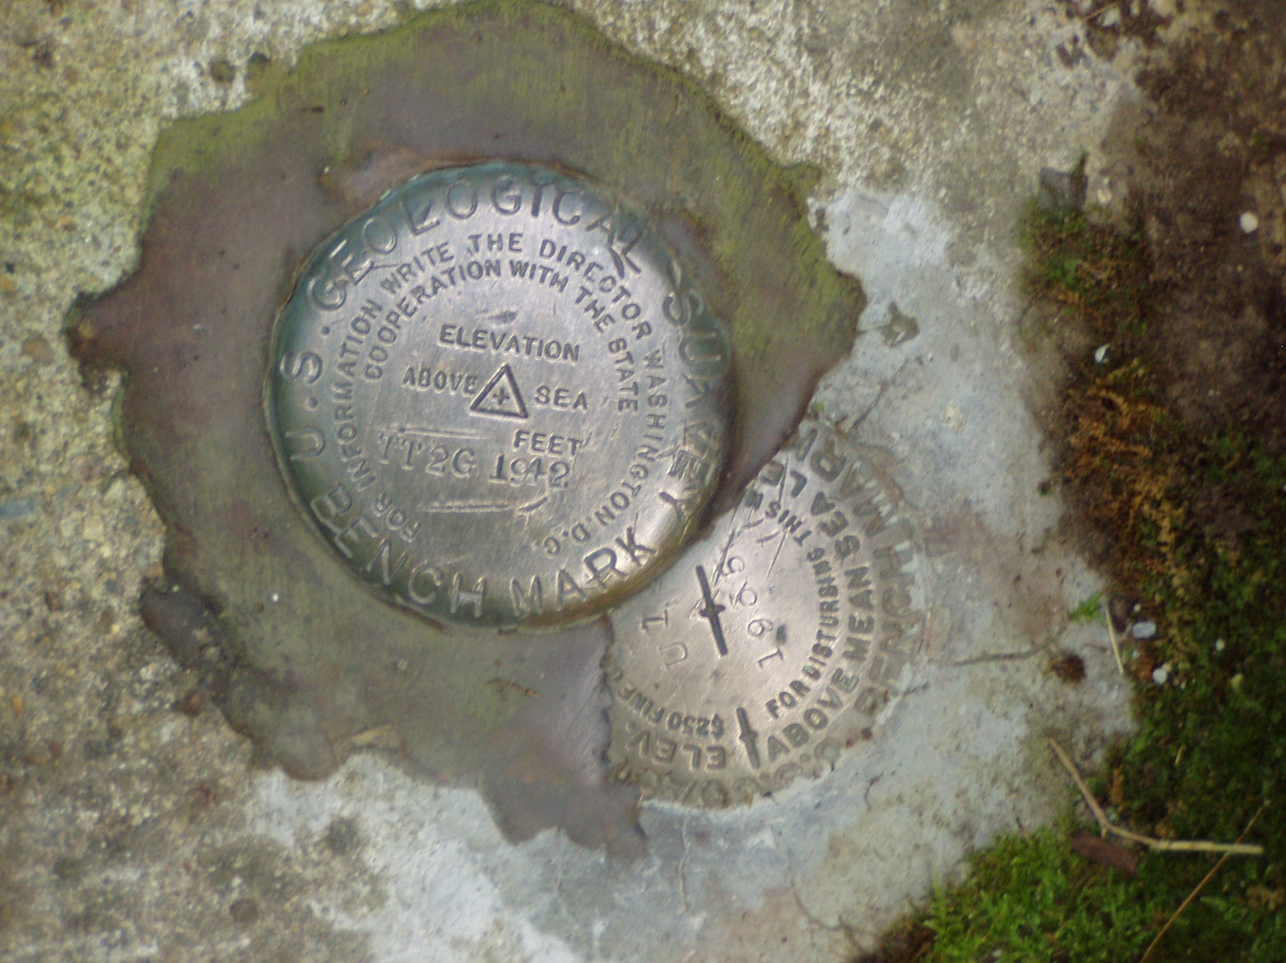
Height-Mod means More Marks?

Slide 26
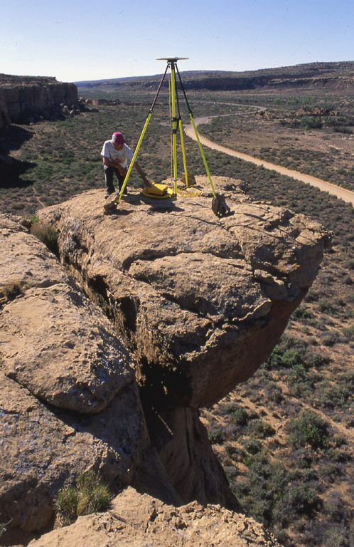
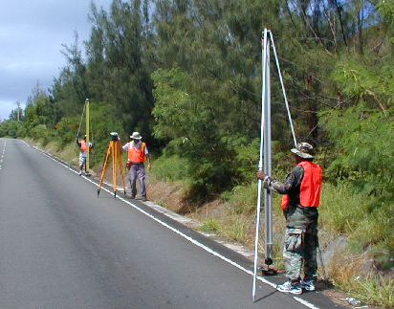
Height Modernization
Height
Modernization
-faster
-cheaper
Differential Leveling
GNSS + …

Slide 27

The National Geodetic Survey 10 year plan
Mission, Vision and Strategy
2008 – 2018, 2013-2023
http://www.ngs.noaa.gov/INFO/NGS10yearplan.pdf
Official NGS policy as of Jan 9, 2008
  Modernized agency
  Attention to accuracy
  Attention to time-changes
  Improved products and services
  Integration with other fed missions
2022 Targets:
  NAD 83 and NAVD 88 re-defined
  Cm-accuracy access to all coordinates
  Customer-focused agency
  Global scientific leadership
Notes:
Realization and unification of NAD83 in Canada and the U.S. via the ITRF.
http://www.geod.nrcan.gc.ca > Geodetic Survey Division > Publications > Papers

Slide 28
Scientific Decisions
Blueprint for 2022, Part 1: Geometric
  Four plate-fixed Terrestrial Reference Frames
    And what “plate fixed” means
  Mathematical equation between IGS and TRFs
    Plate Rotation Model for each plate
    Coordinates at survey epoch
  Intra-frame velocity model
    To compare coordinates surveyed at different epochs

Slide 29
Names
The Old:
NAD 83(2011)
NAD 83(PA11)
NAD 83(MA11)
The New:
The North American Terrestrial Reference Frame of 2022
(NATRF2022)
The Caribbean Terrestrial Reference Frame of 2022
(CTRF2022)
The Pacific Terrestrial Reference Frame of 2022
(PTRF2022)
The Mariana Terrestrial Reference Frame of 2022
(MTRF2022)

Slide 30
Future Geometric Reference Frame
CORS-based, via GNSS
coordinates & velocities in ITRF and official US datum
Identical to the latest IGS reference frame (as available in 2022) at an epoch to be determined
replace NAD 83 with new geometric reference frame – by 2022
passive control tied to new datum; not a component of new datum
address user needs of datum coordinate constancy vs. accuracy
lat / long / ellipsoid height of defining points accurate to 1 mm, anytime
CORS coordinates computed / published daily; track changes
support development of real-time networks

Slide 31
Scientific Decisions!!
Blueprint for 2022, Part 2: Geopotential
  Global 3-D Geopotential Model (GGM)
    Will contain all GRAV-D data
    Able to yield any physical value on/above surface
  Special high-resolution geoid, DoV and surface gravity products consistent with GGM
    Not global: NA/Pacific, American Samoa, Guam/CNMI
  Time-Dependencies
    Geoid monitoring service
      Impacts of deglaciation, sea level rise, earthquakes, etc

Slide 32
Names
  The Old:
  NAVD 88
  PRVD 02
  VIVD09
  ASVD02
  NMVD03
  GUVD04
  IGLD 85
  IGSN71
  GEOID12B
  DEFLEC12B
Orthometric
Heights
  The New:
  The North American-Pacific Geopotential Datum of 2022 (NAPGD2022)
  - Will include GEOID2022
Normal
Orthometric
Heights
Dynamic
Heights
Gravity
Geoid
Undulations
Deflections of
the Vertical

Slide 33
Future Geopotential Reference Frame
replace NAVD88 with new geopotential reference frame – by 2022
gravimetric geoid-based, in combination with GNSS
monitor time-varying nature of gravity field
develop transformation tools to relate to NAVD88
build most accurate ever continental gravimetric geoid model (GRAV-D)
determine gravity with accuracy of 10 microGals, anytime
support both orthometric and dynamic heights
Height Modernization is fully supported

Slide 34
Types Uses and History of Geoid Height Models
Gravimetric (or Gravity) Geoid Height Models
  Defined by gravity data crossing the geoid
  Refined by terrain models (DEM’s)
  Scientific and engineering applications
Composite (or Hybrid) Geoid Height Models
  Gravimetric geoid defines most regions
  Warped to fit available GPSBM control data
  Defined by legislated ellipsoid (NAD 83) and local vertical datum (NAVD 88, PRVD02, etc.)
  May be statutory for some surveying & mapping applications

Slide 35
Which Geoid for Which NAD 83?
NAD 83(2011)
NAD 83(2007)
NAD 83(1996) & CORS96
Geoid12A/12B
Geoid09
Geoid06 (AK only)
Geoid03
Geoid99
Geoid96

Slide 36
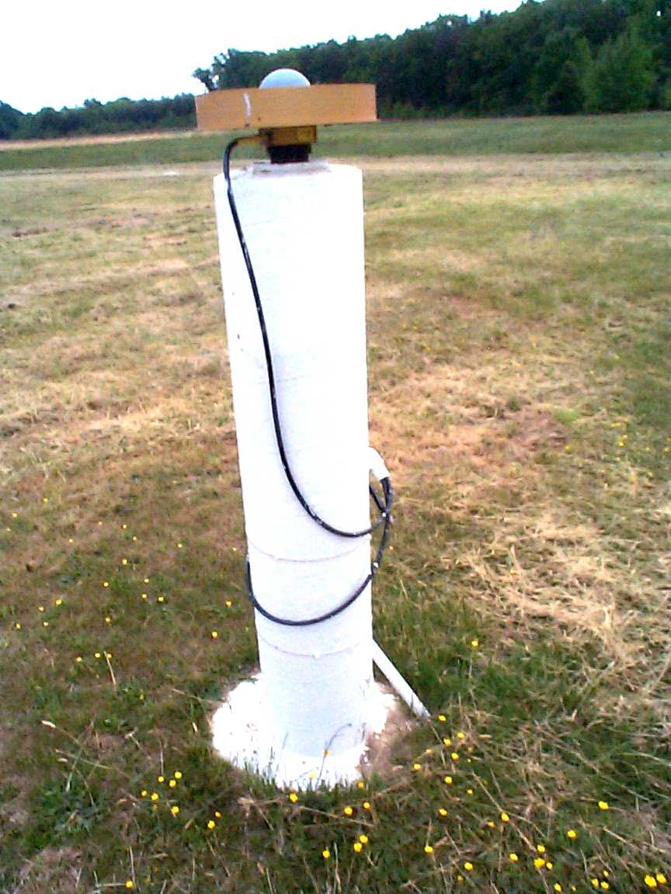
Accessing the New Datums
Primary access (NGS mission)
  Users with geodetic quality GNSS receivers will continue to use OPUS suite of tools
  Ellipsoid heights computed, and then a gravimetric geoid removed to provide orthometric heights in the new datum
  No passive marks needed
  But, could be used to position a passive mark
Secondary access (Use at own risk)
  Passive marks that have been tied to the new vertical datum
  NGS will provide a “data sharing” service for these points, but their accuracy (due to either the quality of the survey or the age of the data) will not be a responsibility of NGS
Continuously Operating Reference Station
Notes:
Multiple questions come up about using the new vertical datum. Two examples are given in the next few slides. The first is the example of how the new datum will address subsidence, say for floodplain mapping. The second example is about how the datum will be accessible when there aren’t bench marks in the immediate region of interest. Both examples rely on this simple formula:
Get an ellipsoid height (h) from GNSS in the latest geometric datum (the replacement for NAD 83)
Remove Subtract the NGS provided geoid model height (N)
The orthometric height in the new datum (H) is just H=h-N
NGS will eventually stop making the claim that we “know” the heights of bench marks as the method of providing access to the vertical datum. What NGS will do is provide the orthometric height to a user on the day of their survey (and with the disclaimer that this height should not be taken as “known” for very long, due to the dynamic nature of the Earth).

Slide 37
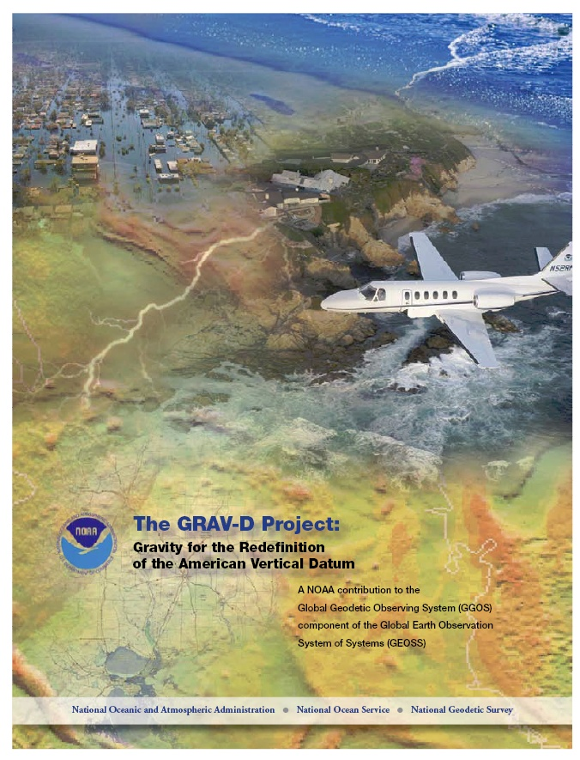
Gravity for the Redefinition of the American Vertical Datum (GRAV-D)
Replace the Vertical Datum of the USA by 2022 (at today’s funding) with a gravimetric geoid accurate to 1 cm
Orthometric heights accessed via GNSS accurate to 2 cm
Three thrusts of project:
  Airborne gravity survey of entire country and its holdings
  Long-term monitoring of geoid change
  Partnership surveys
Working to launch a collaborative effort with the USGS for simultaneous magnetic measurement
Gravity and Heights are
inseparably connected
Notes:
GRAV-D is the NGS project designed to replace NAVD88 with a vertical datum based upon a gravimetric geoid accurate to 1 cm. Heights above this datum will be accessed via GNSS measurements. Three thrusts of project. Launch USGS collaboration for simultaneous mag measurement.

Slide 38
Why replace NAVD 88 and NAD 83?
ACCESS!
  easier to find the sky than a 60-year-old bench mark
  GNSS equipment is cheap and fast
ACCURACY!
  easier to trust the sky than a 60-year old bench mark
  immune to passive mark instability
GLOBAL STANDARDS!
  systematic errors of many meters across the US
  aligns with GPS, international efforts
  aligns with Canada, Mexico
Notes:
Things are looking up! GNSS technologies simplify and improve access to and accuracy of our spatial reference system.
While we can continue to leverage this technology to maintain the old datums, it makes sense to adopt GRAV-D results in an unpolluted form, and align it to modern global standards.

Slide 39
Predicted Positional Changes in 2022
Vicinity of Newark, NJ.
(Computed for station NJIT A, pid AJ5047)
HORIZONTAL = 1.27 m (4.2 ft)
ELLIPSOID HEIGHT = - 1.25 m (- 4.1 ft)
Predicted with HTDP
ORTHOMETRIC HEIGHT = - 0.36 m (- 1.2 ft)
Predicted with HTDP and xGEIOD15B
HTDP
“Coping with Tectonic Motion”
R. Snay & C. Pearson
American Surveyor Magazine, December 2010
www.Ameriserv.com
Notes:
ACURRACY BUT NOT CONSISTENCY!!
To summarize: This slide shows how far we’ve come since 1986, really since 1927.
Unfortunately, --- Next slide ----

Slide 40
Horizontal Datums/Coordinates…What do we (you) use in your state?
NAD 27
NAD 83 (Lat-Lon) SPC
  Which one???
    NAD 83 (1986)
    NAD 83 (1992)
    NAD 83 (1996)
    NAD 83 CORS96(2002)
    NAD 83 (NSRS2007)
    NAD 83 (2011) epoch 2010.00
WGS 84
  Which one???
    WGS 84 (1987)
    WGS 84 (G730)
    WGS 84 (G873)
    WGS 84 (G1150)
    WGS 84 (G1674)
    WGS 84 (G1762)
ITRFxx (epoch xxxx)
IGSxx (epoch xxxx)

Slide 41
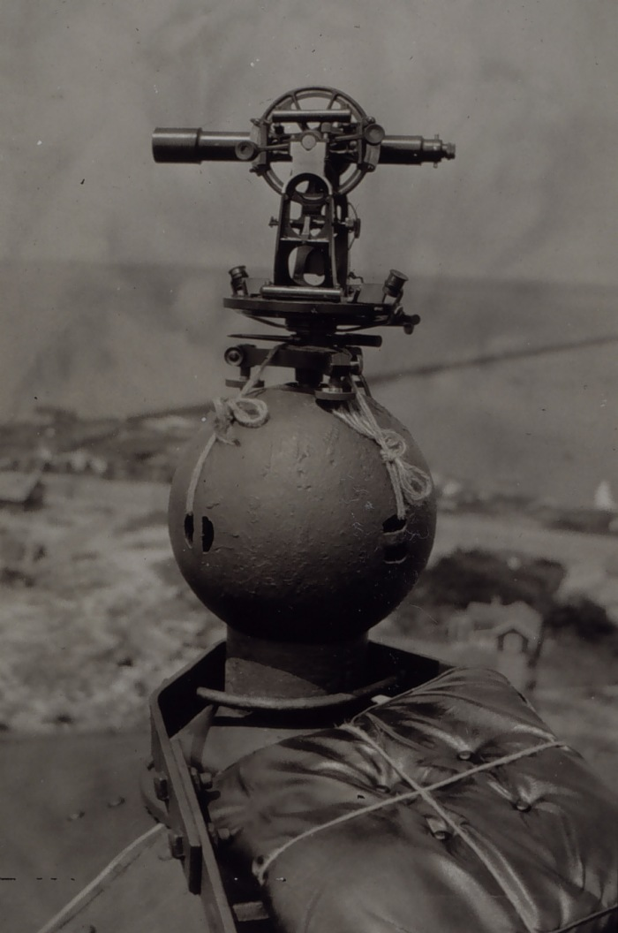
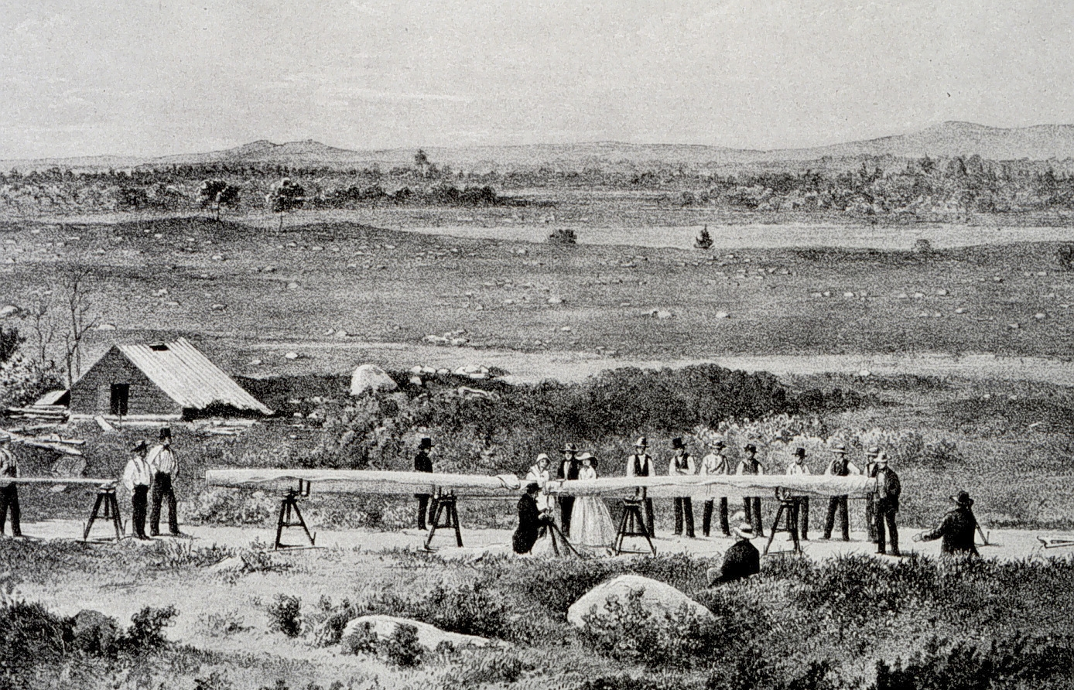
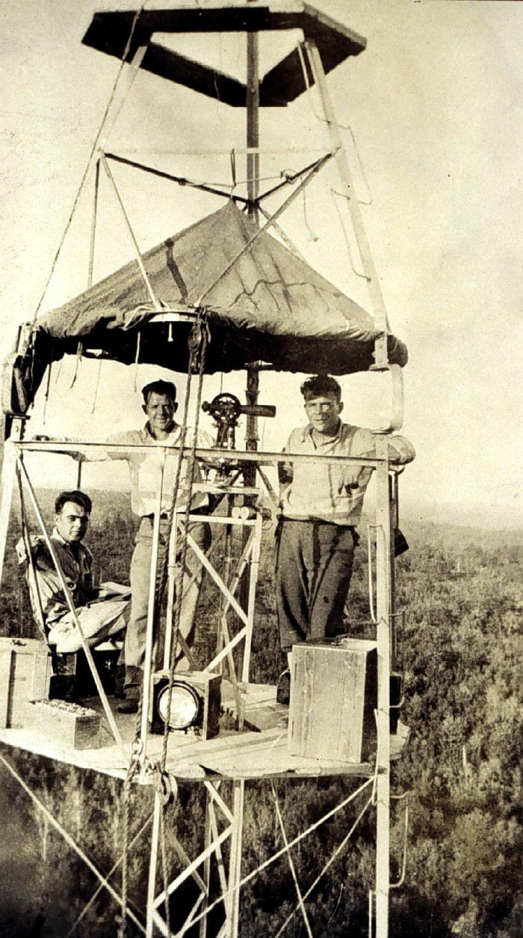
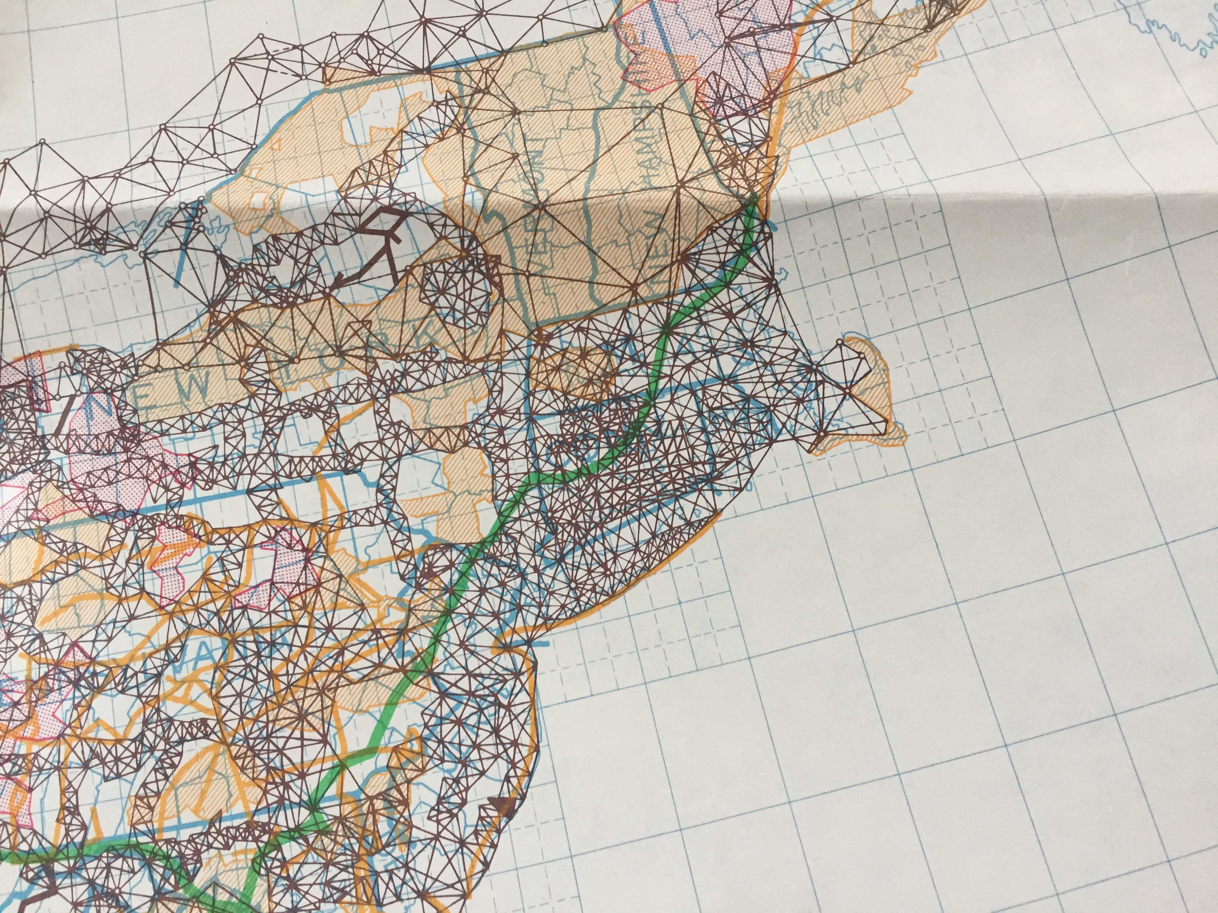
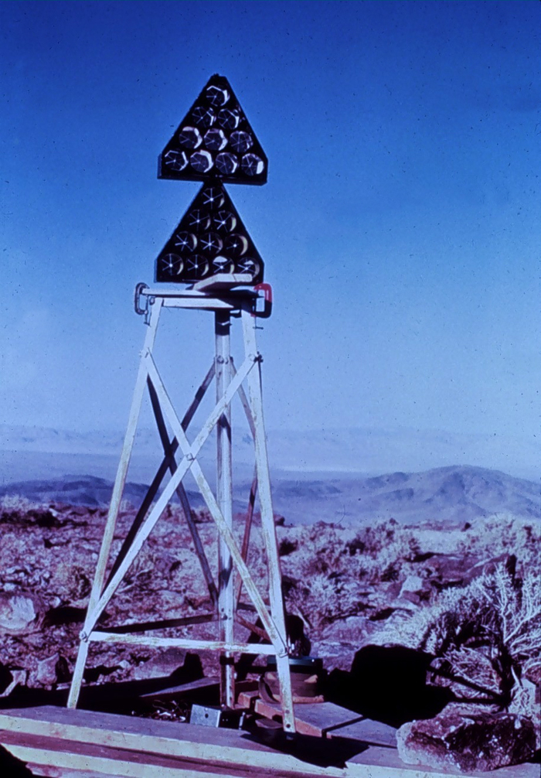
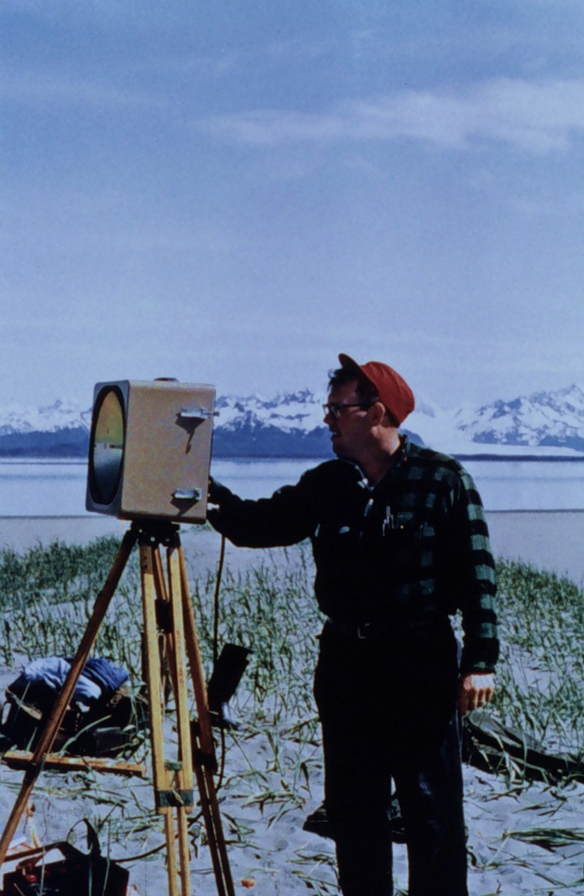
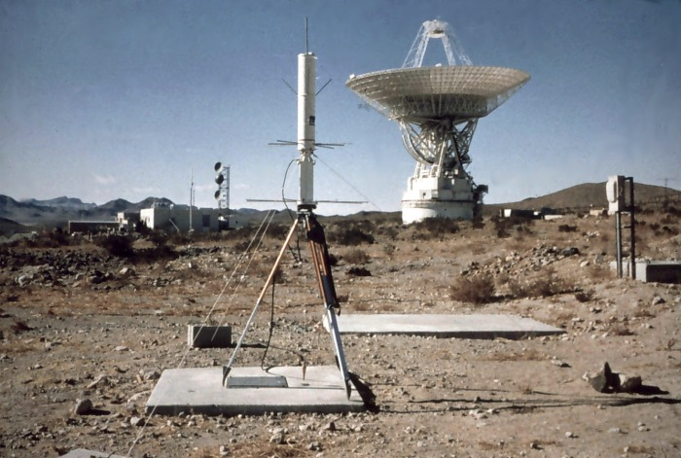
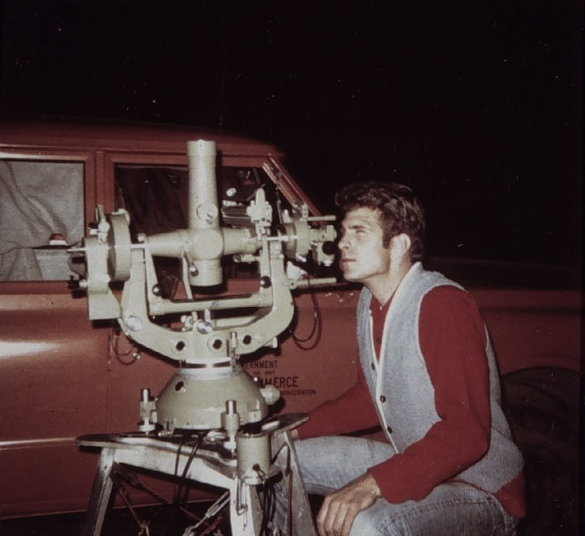
What does NAD 83(86) Imply?

Slide 42
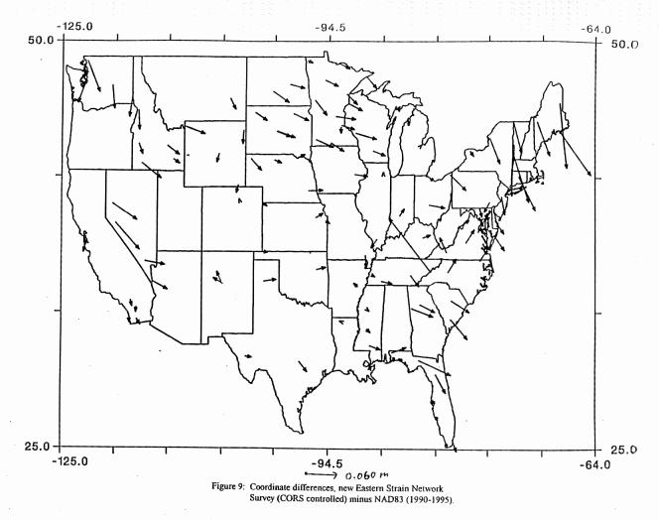
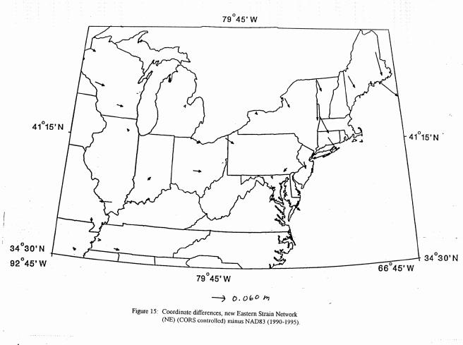
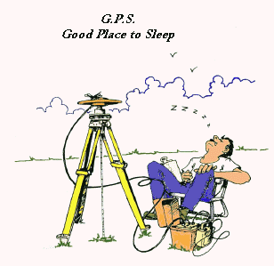
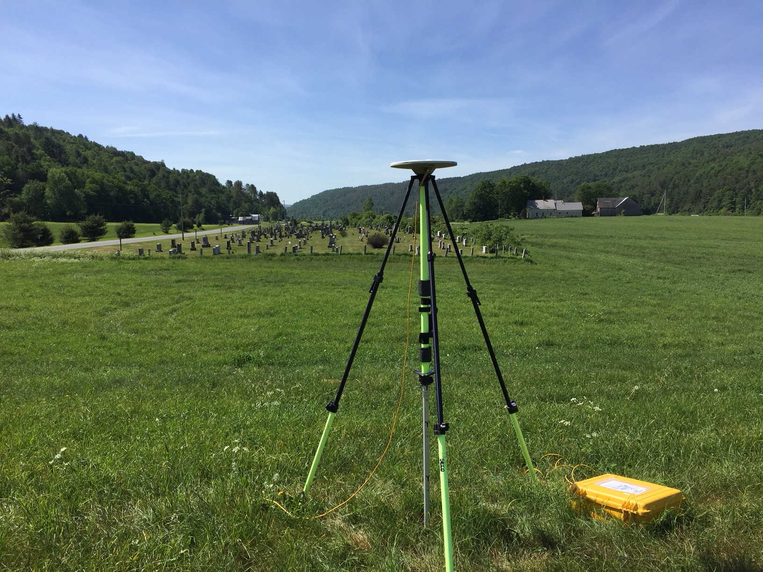
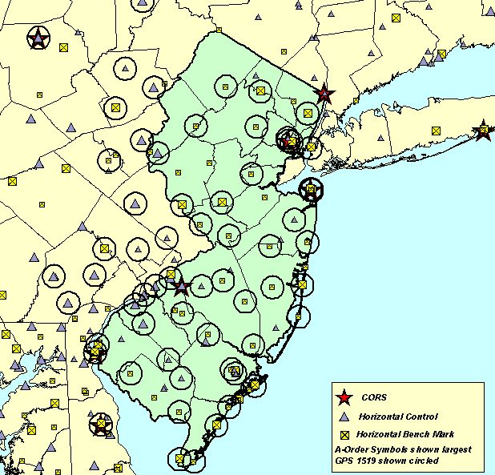
How about NAD 83(HARN)?

Slide 43
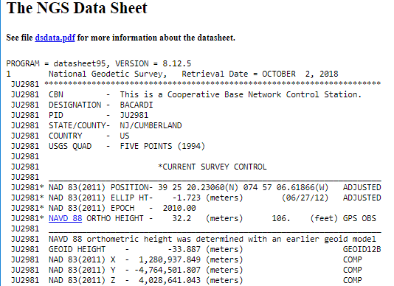
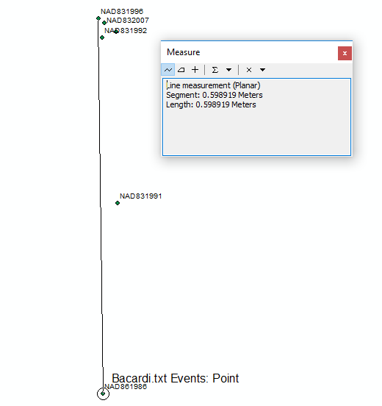
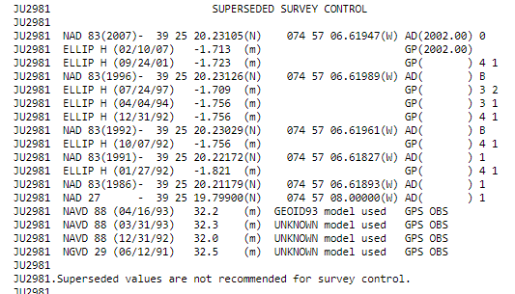
Where on Earth is this Mark?

Slide 44
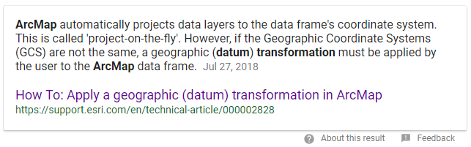
What I Learned

Slide 45
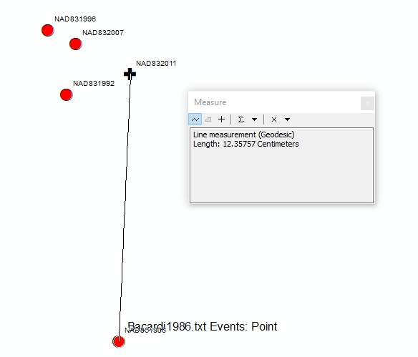
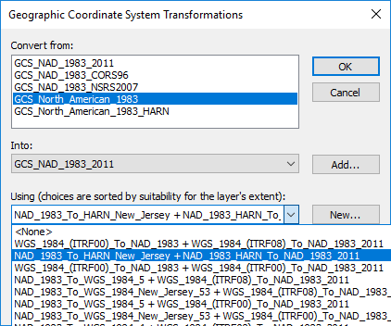
Transforming within ArcMap

Slide 46
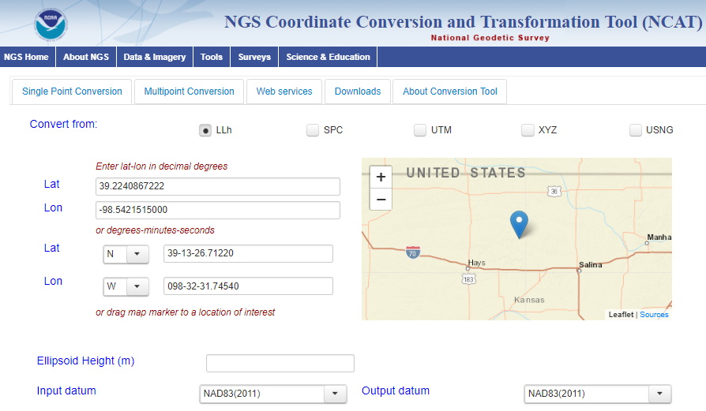
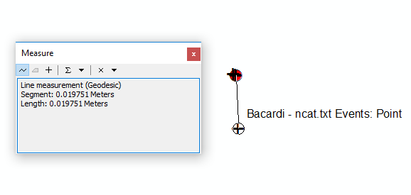
Transformations with NCAT
Actual NAD 83(2011) Position
+ Transformed Positions Using NCAT

Slide 47
metadata to the rescue
your positional metadata should include:
  datum
  epoch
  source
these will facilitate transforming from current to new datum
maintaining your original survey data will provide more accurate results

Slide 48
GOOD COORDINATION BEGINS WITH
GOOD COORDINATES
GEOGRAPHY WITHOUT GEODESY IS A FELONY

