Slide 1

Datums and Reference Frames: the Past, Present, and Future of the NSRS
Jacob Heck, Ph.D., P.S.
NGS Great Lakes Regional Advisor
2024 MSPS Convention
Notes:
100 minutes
Synopsis: NGS is in the process of modernizing the National Spatial Reference System (NSRS), replacing the existing horizontal and vertical datums with a suite of terrestrial reference frames and a new geopotential datum. The NSRS provides a common reference so geospatial data collected at different times by different people can be compared. A set of coordinates does not tell much without including what those coordinates are referenced to, but by specifying information about the reference system used, the data are much more meaningful. I will discuss the basics of datums and reference frames, including how they are created and how they connect at national and global levels.

Slide 2
Overview
Background on coordinate systems
International geodetic efforts
Datum access
Horizontal datums
Geometric reference frames
Vertical datums

Slide 3
NSRS Modernization Timelines
Finish collecting GRAV-D (done!)
Data processing for Multi-Year CORS Solution 3 (ongoing)
Build the geoid model (using software already developed)
2020.0 Reference Epoch Coordinate adjustment
Develop transformation grids
Finalize SPCS2022 (expected 2024)
FGCS votes to adopt it (expected 2025-26)

Slide 4

NSRS Modernization: Delay
It’s official: we are delayed beyond 2022
Will names change?
    No, “GEOID2022”, “NATRF2022”, etc. will remain the same
See the NGS webinar from February 8, 2024 for more details
https://geodesy.noaa.gov/web/science_edu/webinar_series/Webinars.shtml

Slide 5
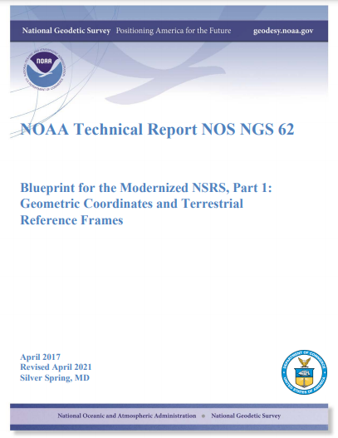
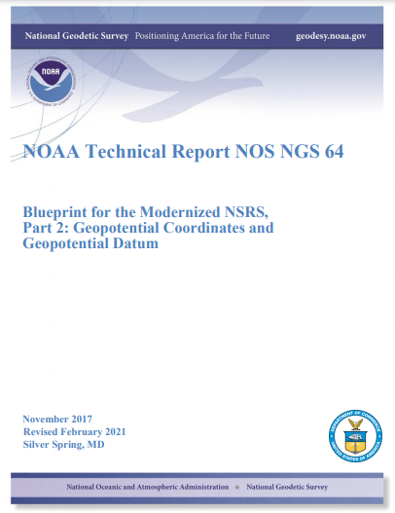
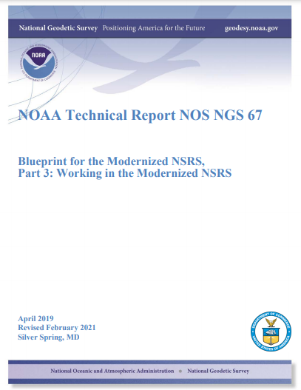
Blueprint Documents
Available in the NGS Publications Library: https://geodesy.noaa.gov/library/
Geopotential:
Nov 2017
Revised Feb 2021
NOAA TR NOS NGS 64
53 pages
Working in the
Modernized NSRS:
April 2019
Revised Feb 2021
NOAA TR NOS NGS 67
133 pages
Geometric:
Sep 2017
Revised April 2021
NOAA TR NOS NGS 62
61 pages
Notes:
Geometric: replacing NAD 83
Geopotential: replacing NAVD 88
Working in: Re-inventing Bluebooking
Improving the Geodetic Toolkit
Better Surveying Methodologies
How NGS will provide the frames/datum in the future
How YOU can use the frames/datum

Slide 6
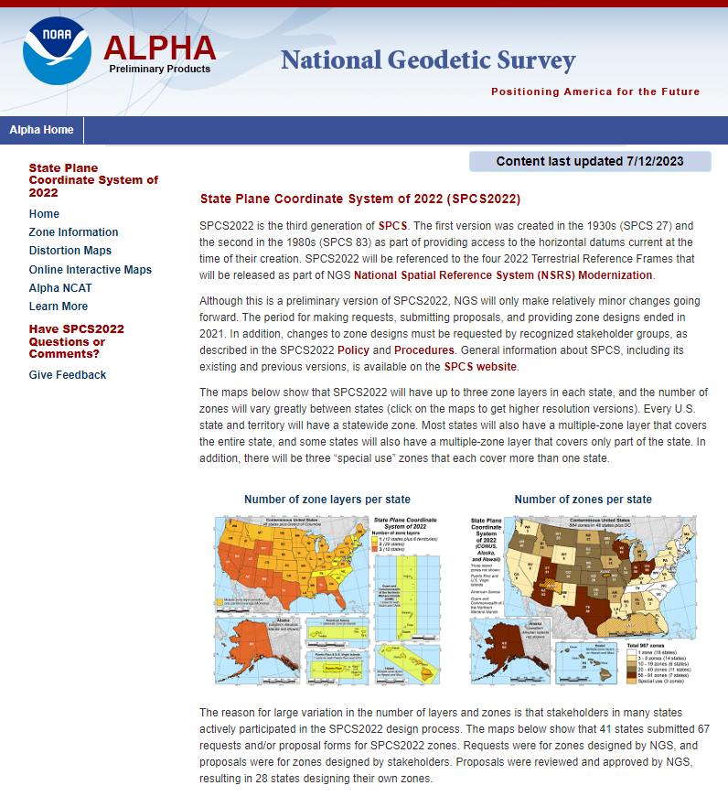
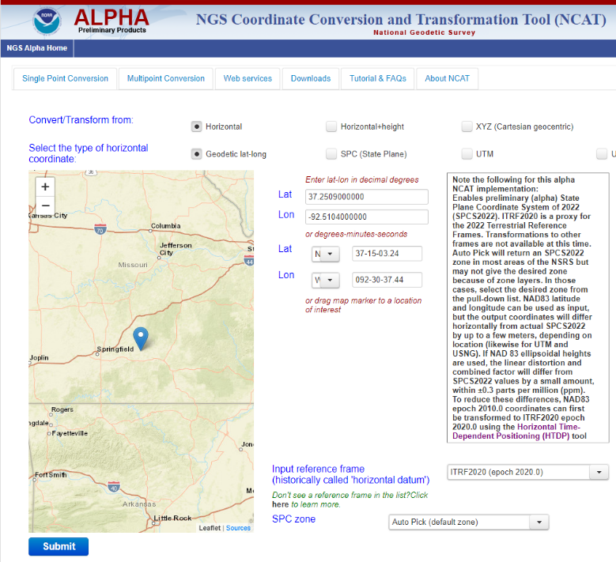
Preliminary 2022 Products on Alpha Site
Public release of preliminary Modernized NSRS products and services as a preview
For illustrative purposes only, not authoritative
Under active development and subject to change without notice
https://alpha.ngs.noaa.gov/index.shtml
Notes:
NGS created this site at the request of industry partners

Slide 7

https://beta.ngs.noaa.gov/
The NGS Beta website is a public-facing testing website for NGS products and services
Send feedback to ngs.feedback@noaa.gov

Slide 8

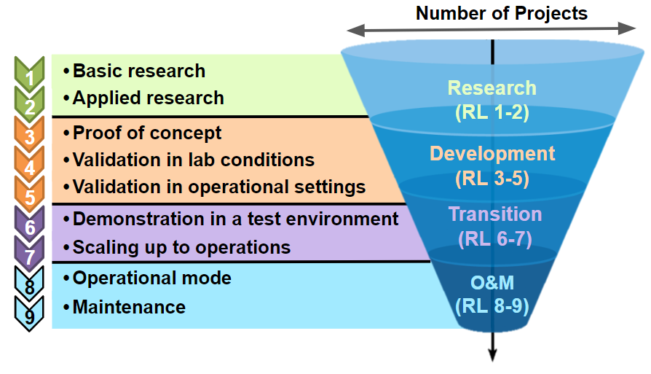
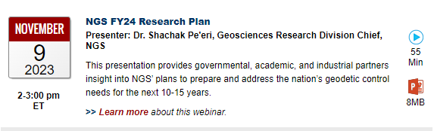
NGS Research Plan
NGS released a new research plan
Available at https://geodesy.noaa.gov/
web/about_ngs/info/documents/
ngs-research-plan-2024-final.pdf
Presented as a webinar on November 9, 2023
Notes:
Focus on not just getting to modernized NSRS, but also beyond

Slide 9




Geospatial Modeling Grant
NGS awarded ~ $4 million in grant funding in response to the Geospatial Modeling Grant
Projects will directly address the nationwide deficiency of geodesists
In addition, these projects will develop tools and models to advance the modernization of the National Spatial Reference System (NSRS)
Michigan State’s project involves setting up a geodesy graduate curriculum

Slide 10
Background on coordinate systems

Slide 11
Datum Fundamentals
Find the coordinate of point A
A

Slide 12
Datum Fundamentals
Find the coordinate of point A
4
A
3
2
1
Datum = 0

Slide 13
Datum Fundamentals
4
Find the coordinate of point A
3
A
2
1
Datum = 0

Slide 14
Geodetic Control Primer
Find the coordinates of point A
Somewhere on Earth…
You are presented with this problem…
Without any other information, the problem is unsolvable.
A

Slide 15
Geodetic Control Primer
Find the coordinates of point A
Wouldn’t it be fantastic if someone just provided you with a coordinate system?
Unfortunately, the Earth doesn’t come with lines of latitude and longitude just drawn all over it…
“The Earth is not a globe”
4
3
A
(x=1.8,y=2.6)
2
1
1
2
3
4

Slide 16
Geodetic Control Primer
Find the coordinates of point A
But what if someone gave you enough other points with pre-determined coordinates?
With a little measuring and trigonometry, you could certainly determine the coordinates of point A!
These “other points with pre-determined coordinates” are “geodetic control”
C (x=2.7,y=3.9)
A
B (x=3.1,y=1.4)
D (x=0.8,y=0.9)

Slide 17
Geodetic Control Primer
Find the coordinates of point A
Although the coordinate axes are not visible, their location and scale are implied by the given coordinates of the points B, C, and D.
It is often the job of surveyors, mappers and other geospatial professionals to determine the coordinates of many points on Earth.
It is the job of NGS to provide the geodetic control to the nation to make those jobs possible.
4
C (x=2.7,y=3.9)
3
2
B (x=3.1,y=1.4)
1
D (x=0.8,y=0.9)
1
2
3
4

Slide 18
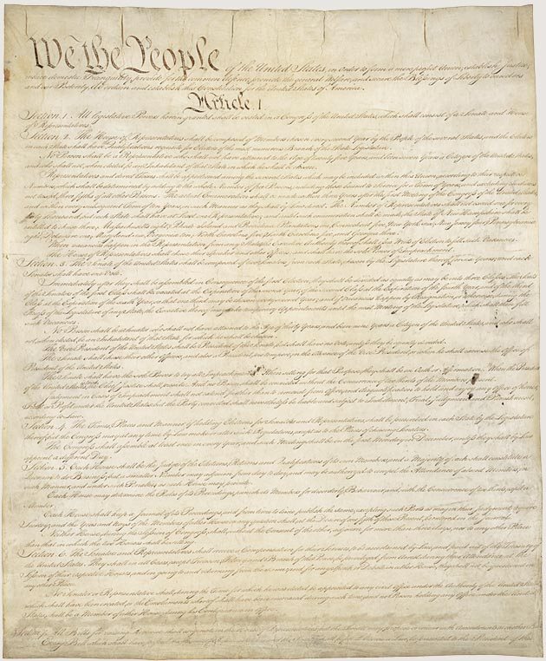
Article 1, Section 8:
“The Congress shall have Power To lay and collect Taxes, Duties, Imposts and Excises, to pay the Debts and provide for the common Defence and general Welfare of the United States; but all Duties, Imposts and Excises shall be uniform throughout the United States;
…
To coin Money, regulate the Value thereof, and of foreign Coin, and fix the Standard of Weights and Measures; ...”
Notes:
OMB Circular A-16: provides direction for federal agencies that produce, maintain, or use spatial data either directly or indirectly in the fulfillment of their mission and provides for improvements in the coordination and use of spatial data.
EO 12906: National spatial data infrastructure
From NGS Strategic plan:
NGS draws its mission and work from numerous executive orders, laws, and mandates, and the goals and objectives in this plan directly relate to these public requirements. NGS’ goals also serve to further the science, service, and stewardship of NOAA as a whole. Indeed, the capabilities and the geodetic framework NGS provides through the NSRS play a crucial role in the success of almost all the goals and objectives held within NOAA’s Strategic Plan. Direct mission-related objectives are drawn from language in Office of Management and Budget (OMB) circular “A-16,” as well as from Executive Order 12906, or from the original legislation used to create NGS’ predecessor agencies, the U.S. Coast and Geodetic Survey Act. NGS complies with additional OMB, Department of Commerce (DOC), and Congressional mandates, including the Air Commerce Act of 1926. OMB A-16 mandated the formation of the Federal Geographic Data Committee (FGDC) as a means to coordinate all U.S. governmental activities related to geospatial information. Numerous subcommittees exist within the FGDC, and NGS leads the Federal Geodetic Control Subcommittee (FGCS). Geodetic Control is fundamental to all of NGS’ work, and it also underpins all geospatial activities of the organizations comprising the FGDC. The United States is a leading member of the UN-GGIM. The UN-GGIM has stipulated that all countries adopt a Global Geodetic Reference Frame (GGRF) to ensure standardized positioning of geospatial information. The effort to implement the GGRF is led by the United Nations Subcommittee on geodesy (UN-GGIM SCoG)

Slide 19
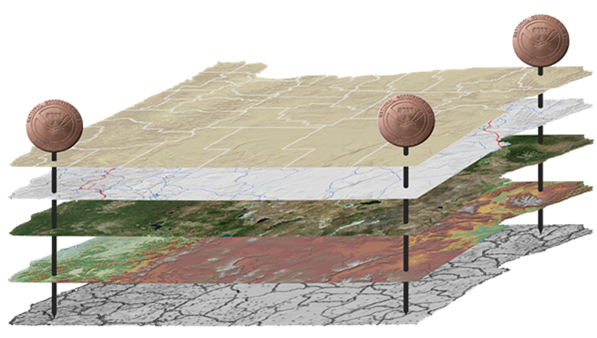
The National Spatial Reference System
NGS defines, maintains and provides access to the NSRS to meet our Nation’s economic, social & environmental needs
North American Datum of 1983 (NAD 83)
North American Vertical Datum of 1988 (NAVD 88)
Latitude • Longitude • Elevation • Gravity • Shoreline Position
+ changes over time
Today’s NSRS

Slide 20
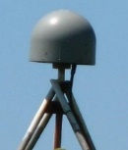
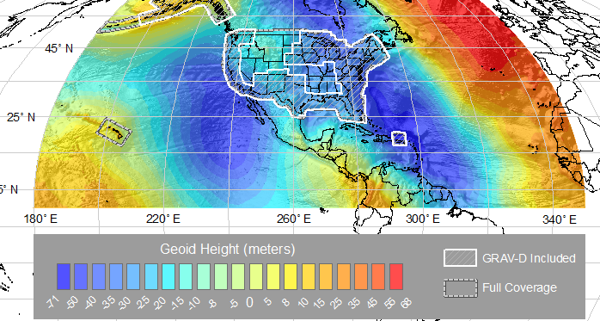
The National Spatial Reference System
NGS defines, maintains and provides access to the NSRS to meet our Nation’s economic, social & environmental needs
Latitude • Longitude • Elevation • Gravity • Shoreline Position
+ changes over time
North American Terrestrial Reference Frame (NATRF2022)
Caribbean Terrestrial Reference Frame (CATRF2022)
Pacific Terrestrial Reference Frame (PATRF2022)
Marianas Terrestrial Reference Frame (MATRF2022)
North America and Pacific Geopotential Datum (NAPGD2022)
Tomorrow’s NSRS

Slide 21
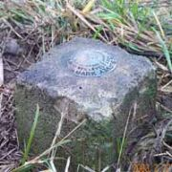
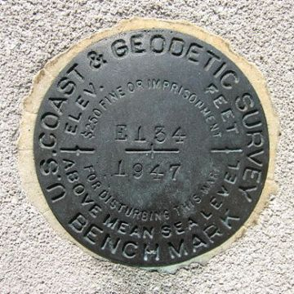
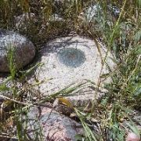
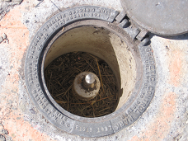
Passive Control
Any geodetic control point that is infrequently or intermittently observed.
Common examples include a metal disk set in concrete or stone, or a stainless steel rod driven into the ground.
Notes:
All marks are passive—in that they sit there doing nothing in and of themselves besides holding a point

Slide 22
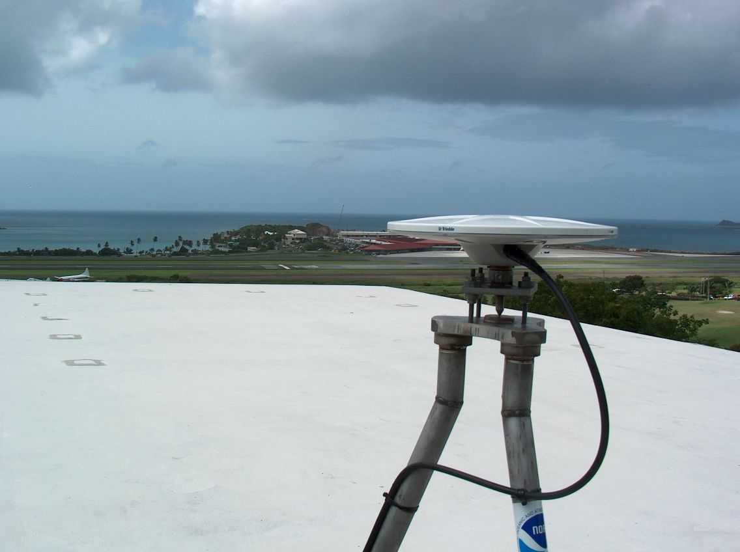
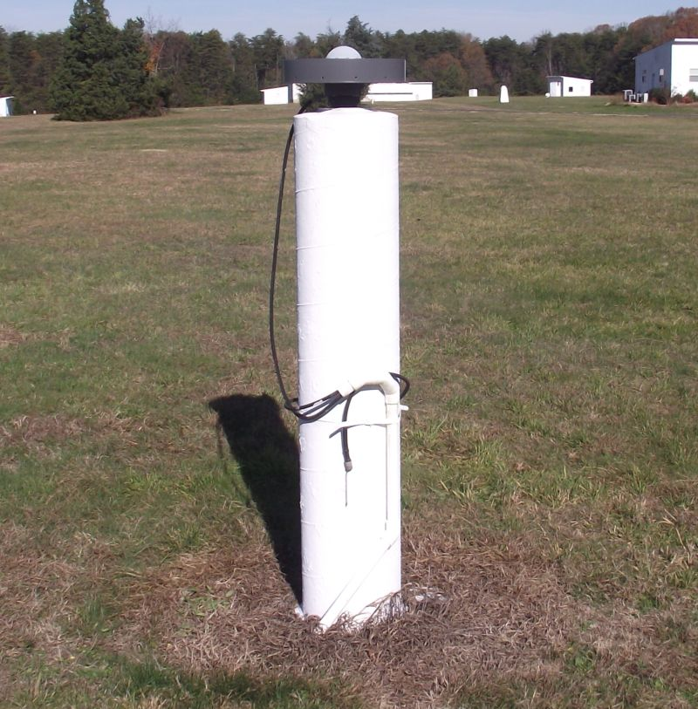
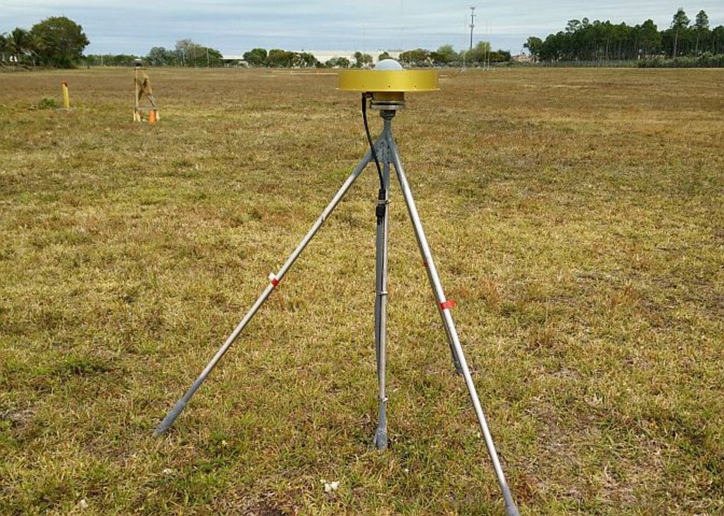
Active Control
A geodetic control point at a station occupied by equipment intended for and capable of continuously collecting geodetic quality data for multiple years.
CORS

Slide 23
Geodetic Stations
Common geodetic stations:
Continuously Operating GNSS Reference Station (CORS)
Satellite Laser Ranging (SLR) Station
Very Long Baseline Interferometry (VLBI) Station
Doppler Orbitography and Radiopositioning Integrated by Satellite (DORIS) Station
Continuously Operating Relative Gravimeter Station
Notes:
Note that only CORS and CORGS are continuous stations, though DORIS might also be. SLR and VLBI are actually just “frequently observed”.

Slide 24
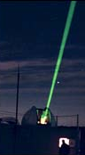
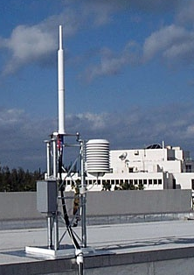
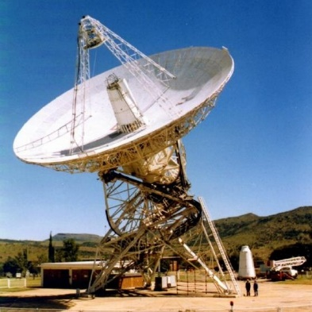
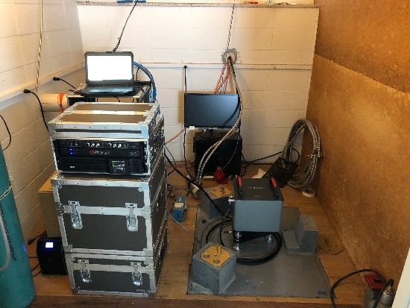
Geodetic Stations
SLR
DORIS
VLBI
Gravity
CORS

Slide 25
UN-GGIM
United Nations
SubCommittee on Geodesy (UN SCoG)
EG on Land Administration and Management
EG on the Integration of Statistical and Geospatial Information
WG on Development of a Statement of Shared Principles for the Management of Geospatial Information
WG on Trends in National Institutional Arrangements in Geospatial Information Management
WG on Geospatial Information and Services for Disasters
WG on Global Fundamental Geospatial Data Themes
WG on Legal and Policy Frameworks for Geospatial Information Management
WG on Marine Geospatial Information
The UN Global Geodetic Reference Frame (UN-GGRF) was adopted by the UN Committee of Experts on Global Geospatial Information Management (UN-GGIM)
The NSRS ties to the UN-GGRF
UN-GGIM adopted the GGRF – that is, all Nations (including USA) have agreed to use a common reference frame based on the ITRS
The UN-SCoG is tasked with implementing the GGRF globally
That agreement and the obligation to adopt the GGRF was also passed through to the Regional Committees (RCs).
Department of Economic and Social Affairs (ECOSOC)
Statistics Division
United Nations Global Geospatial Information Management (UN-GGIM)
UN-GGIM Asia-Pacific | UN-GGIM Americas | UN-GGIM Arab States | UN-GGIM Europe | UN-GGIM Africa
Notes:
Two NGS staff participated in the ninth session meeting of the United Nations initiative on Global Geospatial Information Management (UN-GGIM)-Americas and two side events in Santiago, Chile. UN-GGIM-Americas is the regional committee that implements and coordinates geospatial management for the Americas including the Geodetic Reference Frame for the Americas (SIRGAS). The side events focused on building the regional spatial data infrastructure and capacity development. An NGS regional geodetic advisor represented the United States in the meetings and the NGS Chief Geodesist presented an update on global activities of the U.N. Subcommittee on Geodesy to the Regional Committee. This demonstrated NGS leadership within NOAA and the U.S. government and aided in regional coordination of Geospatial activities.

Slide 26
UN Global Geodetic Reference Frame
GGRF encompasses all aspects of a modernized reference frame including:
  Geodetic infrastructure (GI)
  Education Training and Capacity Building (ETCB)
  Governance (GOV)
  Outreach and Communication (OC)
  Policies Standards and Conventions (PSC)
Includes both International Terrestrial Reference System (ITRS) and the International Height Reference System (IHRS)
  Determined and maintained by the International Association of Geodesy (IAG)
Notes:
A system is how you do things, whereas a frame is a specific realization within the system. ITRF is a scientific construct.
Except in this case the GGRF is actually more of political construct.
While the ITRS is very mature, the infrastructure behind is very mature – to the point of degradation and potential loss of functionality.
ISO – International Standards Organization
OGC – Open Geospatial Consortium
This has been one of the primary motivations for elevating the concerns of the GGRF to the UN. Scientific groups cannot continue sustain this on their own.
The IHRS is still evolving and growing.

Slide 27

Structure of the International Association of Geodesy
International Council for Science (ICSU): 142 Countries, 31 Unions
IAU
IGU
ISPRS
IUGG
IUGS
ICA
other Unions
International Union of Geodesy and Geophysics (IUGG)
IACS
IAG
IAHS
IAGA
IAMAS
IAPSO
IASPEI
IAVCEI
International Association of Geodesy (IAG)
Commissions
1 Reference Frames
2 Gravity Field
3 Earth Rotation
and Geodynamics
4 Positioning and
Applications
Inter-Commission Committee on Theory
Scientific Services
ITRF models
IHRF models (eventually)
Geometry:
IERS
IDS
Gravity:
IGFS
BGI
Combining:
BIPM
IGS
ILRS
IVS
ICGEM
IDEMS
ISG
IGETS
PSMSL
Global Geodetic Observing System (GGOS)
Notes:
IGS: International GNSS Service
IERS: International Earth Rotatoion and reference System Service
ILRS: International Laser ranging Service
IDS: International DORIS Service
DORIS: Doppler Orbitography and Radiopositioning Intergated by Satellite
IVS: International VLBI Service
VLBI: Very Long Baseline Interferometry
ITRS: International Terrestrial Reference System
ITRF: International Terrestrial Reference Frame
IHRS: International Height Reference System
IHRF: International Height Reference Frame
SIstema de Referencia Geocéntrico para las AméricaS (SIRGAS)
Geocentric Reference System for the Americas

Slide 28
Accessing Datums

Slide 29
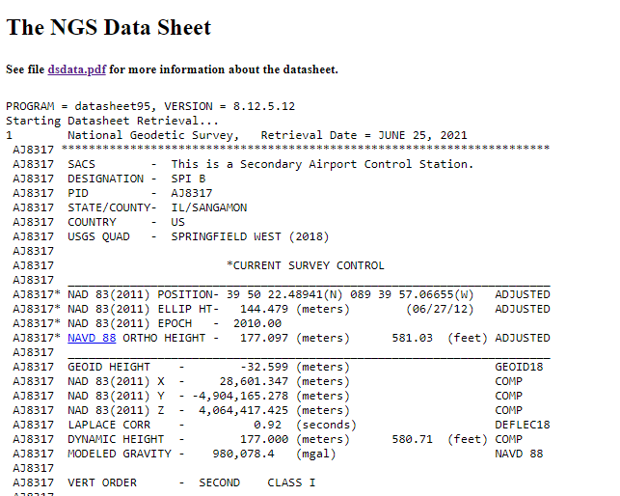
Traditional Access: Passive Control
Horizontal
Vertical

Slide 30
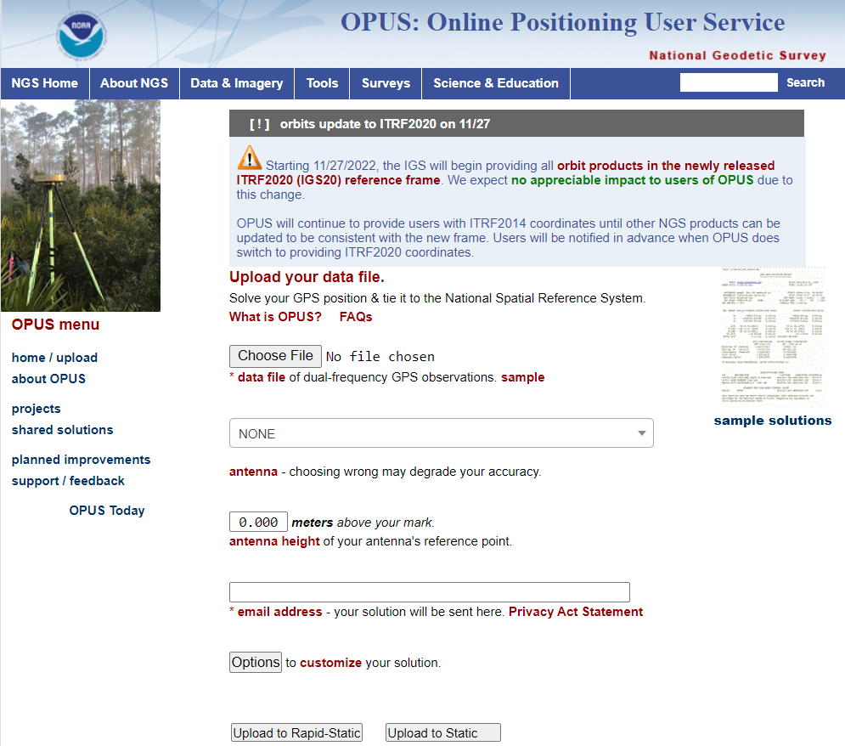
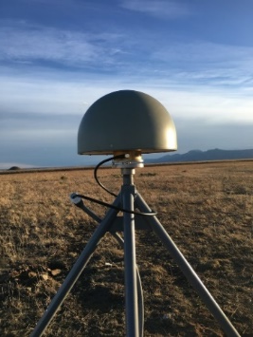
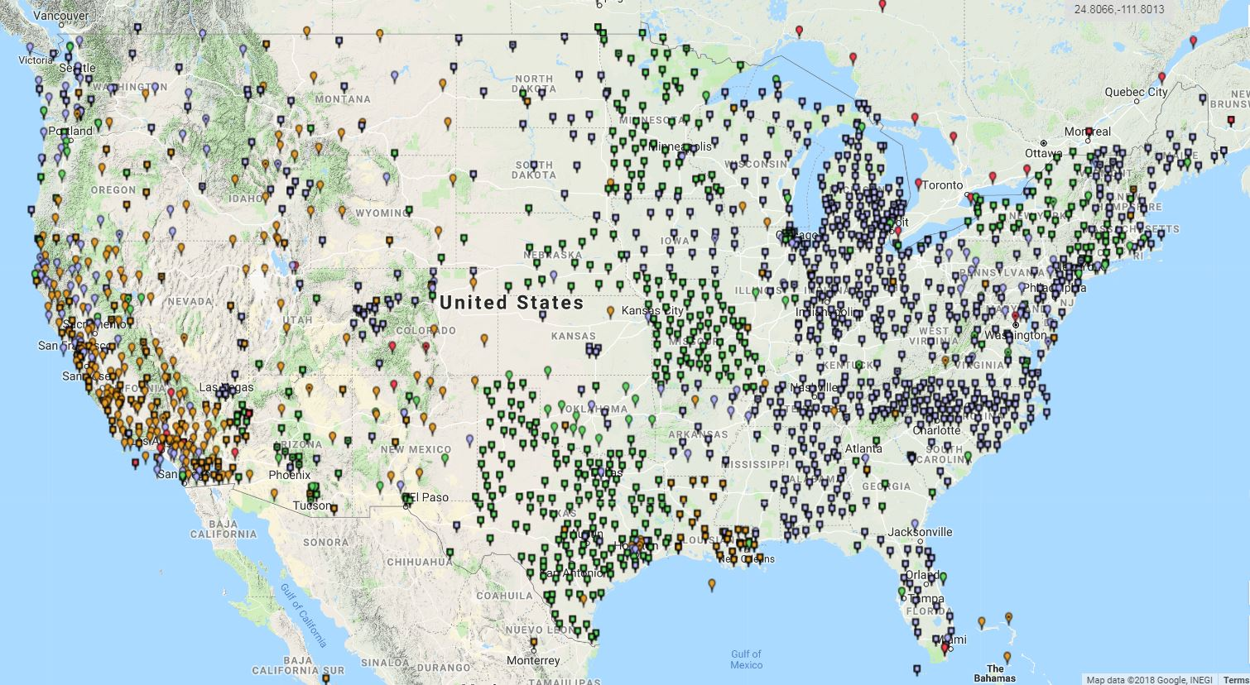
Modernized Access: Through the CORS and OPUS
NGS provides data and coordinate functions with NOAA CORS Network
  And one definitive coordinate function for each one
  And the software (M-PAGES / OPUS / OPUS Projects) to differentially position your GPS receiver to each station
Notes:
Very similar philosophically:
The NSRS remains “geodetic control” for you to “access”
Geospatial information and metadata about various points
Passive control will exist…we aren’t getting out bulldozers and shovels
But gone are the days of getting “the coordinate” on a point from a “datasheet”

Slide 31
Data Delivery System
The Data Delivery System (DDS) is a system for querying the new NSRS database
  The most common query will be for a new version of datasheets
  But other queries will be part of the DDS
    Mark recovery and mark reporting
    Active control (CORSs)
    Projects, observations, data, etc.

Slide 32
The Data in the Datasheet
Starting Datasheet Retrieval...
1 National Geodetic Survey, Retrieval Date = JULY 1, 2022
AC6803 ***********************************************************************
AC6803 HT_MOD - This is a Height Modernization Survey Station.
AC6803 PACS - This is a Primary Airport Control Station.
AC6803 DESIGNATION - AZC A
AC6803 PID - AC6803
AC6803 STATE/COUNTY- AZ/MOHAVE
AC6803 COUNTRY - US
AC6803 USGS QUAD - LOST SPRING MOUNTAIN EAST (2018)
AC6803
…
In ASCII format
{"datasheet":
{
"datasheetHeading":"National Geodetic Survey",
"datasheetRetrievalDate":"JULY 1, 2022",
"htMod":"This is a Height Modernization Survey Station.",
"pacs":"This is a Primary Airport Control Station.",
"determinedProjects":[
{"project":"GPS1154"},{"project":"GPS2300"},{"project":"GPS2507"},{"project":"GPS280"},
{"project":"GPS2846"}
],
"observedProjects":[{"project":"GPS1154"},{"project":"GPS1195/11"},{"project":"GPS2507"}],
"occupiedProjects":[{"project":"GPS1154"},{"project":"GPS1195/11"}],
"designation":"AZC A",
"pid":"AC6803",
"state":"AZ",
"county":"MOHAVE",
"country":"US",
"quad":"LOST SPRING MOUNTAIN EAST (2018)",
…
}
}
In JSON format

Slide 33
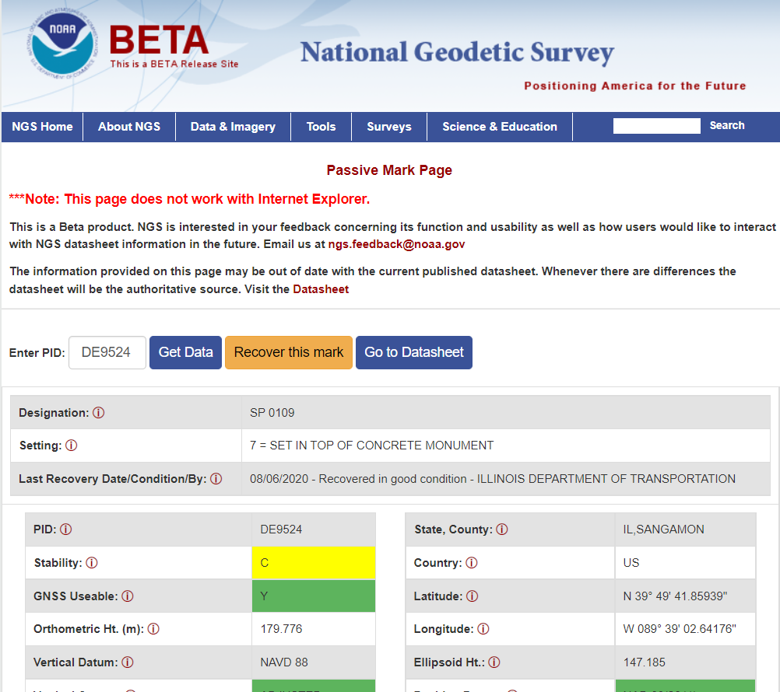
Beta Passive Marks Page
Easier to read
Includes geospatial information
A preview of the future data delivery system
https://beta.ngs.noaa.gov/datasheets/passive-marks/index.html
Notes:
Show DE9524, a mark near Springfield

Slide 34
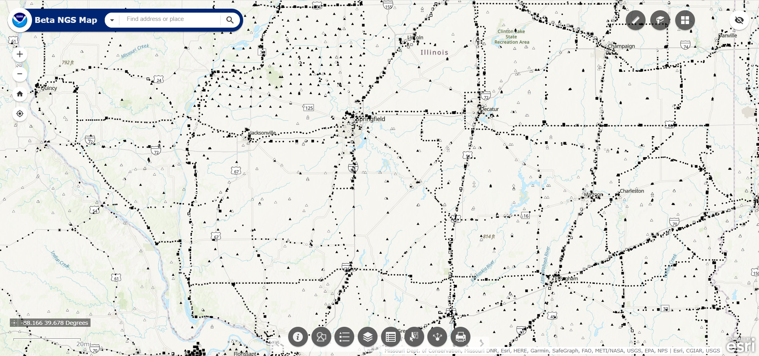
NGS Map
https://geodesy.noaa.gov/datasheets/ngs_map/

Slide 35
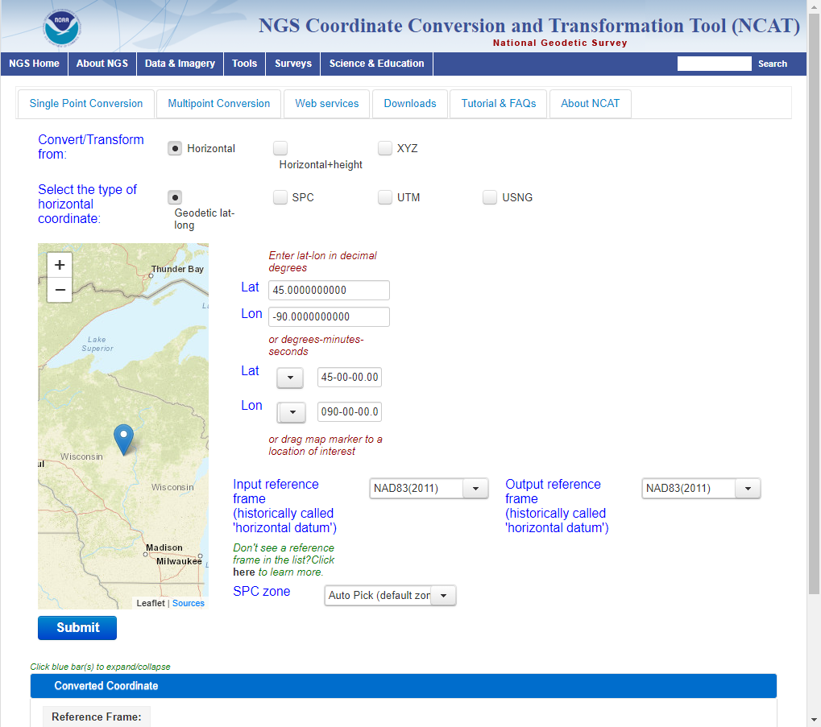
NGS Coordinate Conversion and Transformation Tool (NCAT)
Converts between types of coordinates
Transforms between datums
NADCON & VERTCON built in
Works with vertical and horizontal datums in the NSRS
https://www.ngs.noaa.gov/NCAT/

Slide 36
Horizontal Datums

Slide 37
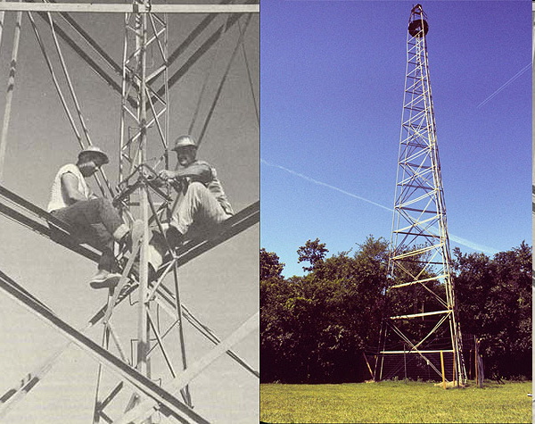
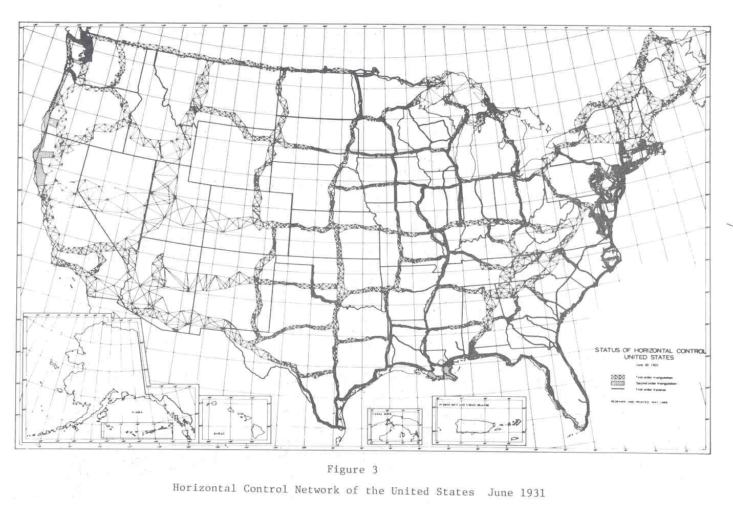
Developing Previous Horizontal Datums

Slide 38
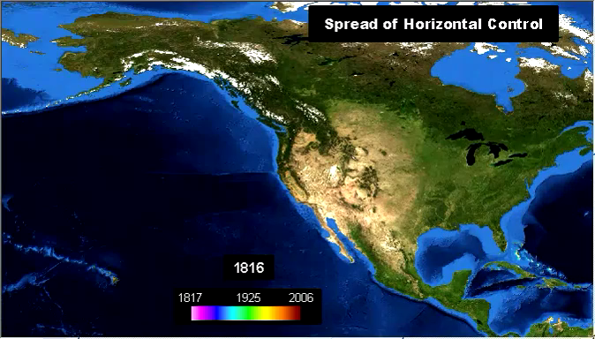
Marks in the NSRS 1816–2006
Watch for:
1849 CA Gold Rush
1895 Systematic
Mapping of Seward’s
Folly
1896 Transcontinental
Arc of Triangulation
(39th Parallel)
1901 Transcontinental
Arc of Triangulation
(98th Meridian)
1933 Public Works
Administration
1950–1980 NAD 83
Project
1990s Statewide HARN and FBN Projects

Slide 39
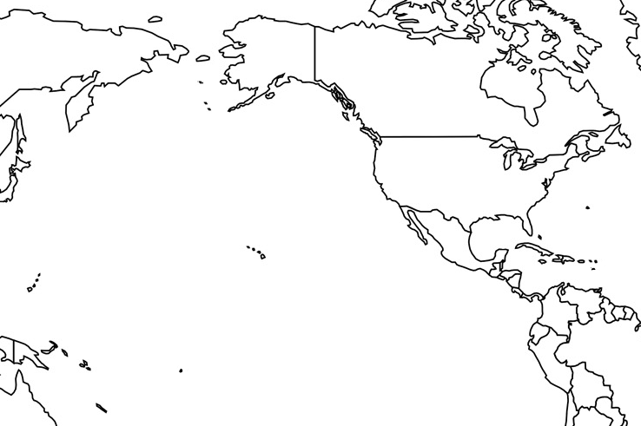
Horizontal Datums of the NSRS
St. Paul I.
St. Paul 1897
St. Paul 1952
NAD 83(1986)
NAD 83(2002:AK)
NAD 83(NSRS2007)
NAD 83(2011) epoch 2010.00
St. Lawrence I.
St. Lawrence 1952
NAD 83(1986)
NAD 83(2002:AK)
NAD 83(NSRS2007)
NAD 83(2011) epoch 2010.00
St. Matthew I.
St. Matthew 1952
Alaska
NAD 27
NAD 83(1986)
NAD 83(2002:AK)
NAD 83(NSRS2007)
NAD 83(2011) epoch 2010.00
St. George I.
St. George 1897
St. George 1952
NAD 83(1986)
NAD 83(2002:AK)
NAD 83(NSRS2007)
NAD 83(2011) epoch 2010.00
CONUS
U.S. Standard Datum
NAD 27
NAD 83(1986)
NAD 83(“HARN”)
NAD 83(“FBN”)
NAD 83(NSRS2007)
NAD 83(2011) epoch 2010.00
Hawaii
Old Hawaiian Datum
NAD 83(1986)
NAD 83(1993:HI)
NAD 83(PA11) epoch 2010.00
CNMI
Guam 1963
NAD 83(1993:GU)
NAD 83(2002:GU)
NAD 83(MA11) epoch 2010.00
Puerto Rico
Puerto Rico 1940
NAD 83(1986)
NAD 83(1993:PR)
NAD 83(1997:PR)
NAD 83(2002:PR)
NAD 83(NSRS2007)
NAD 83(2011) epoch 2010.00
U.S. Virgin Islands
Puerto Rico 1940
NAD 83(1986)
NAD 83(1993:PR)
NAD 83(1997:PR)
NAD 83(2002:PR)
NAD 83(NSRS2007)
NAD 83(2011) epoch 2010.00
Guam
Guam 1963
NAD 83(1993:GU)
NAD 83(2002:GU)
NAD 83(MA11) epoch 2010.00
American Samoa
American Samoa 1962
NAD 83(1993:AS)
NAD 83(2002:AS)
NAD 83(PA11) epoch 2010.00

Slide 40
Replacing the NAD 83s
The Old | The New
NAD 83 (2011) | NATRF2022 - The North American Terrestrial Reference Frame of 2022
NAD 83 (2011) | CATRF2022 - The Caribbean Terrestrial Reference Frame of 2022
NAD 83 (PA11) | PATRF2022 - The Pacific Terrestrial Reference Frame of 2022
NAD 83 (MA11) | MATRF2022 - The Mariana Terrestrial Reference Frame of 2022

Slide 41
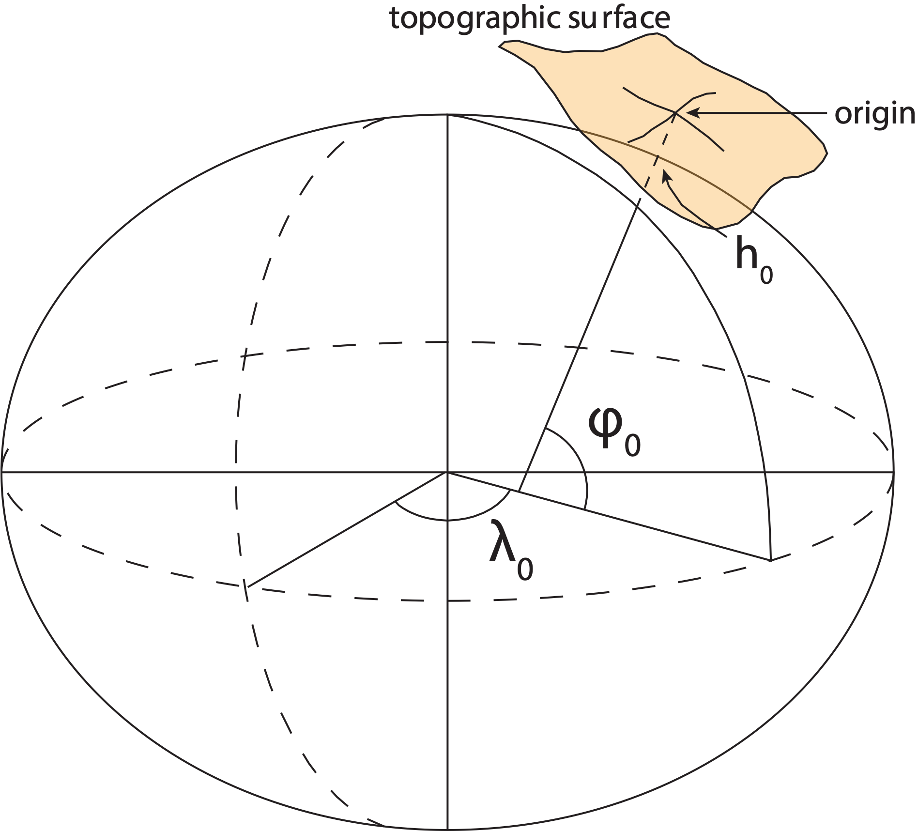
Traditional horizontal geodetic datums
Positions of points on Earth’s surface are reduced to the surface of a reference ellipsoid
The reference ellipsoid roughly matches the shape of the Earth
A reference point is selected as the origin, all other positions are given with respect to that point

Slide 42
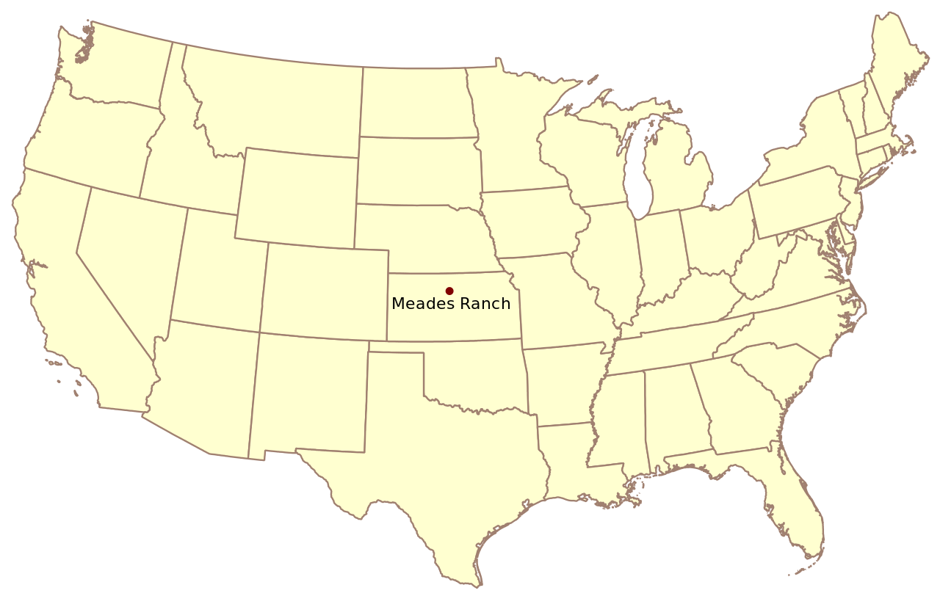
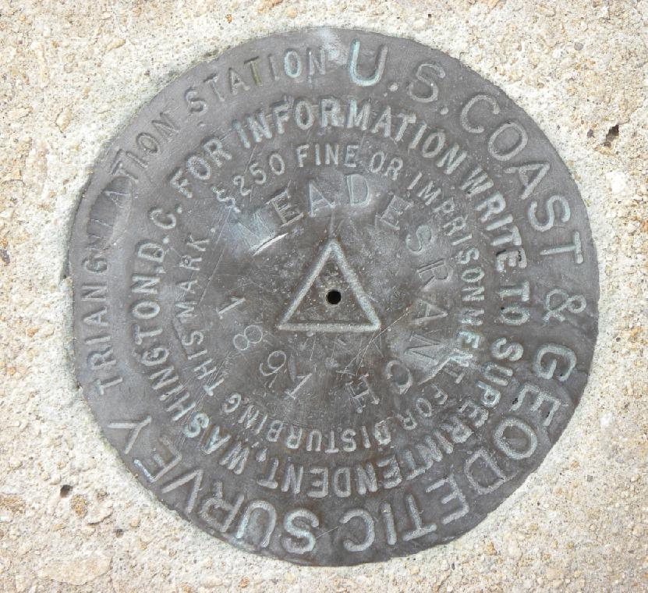
Traditional horizontal geodetic datums
(NAD 27)

Slide 43
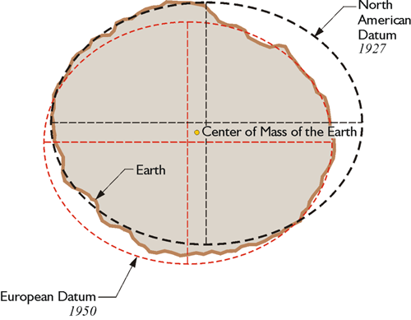
Traditional horizontal geodetic datums
Drawbacks of using this approach:
The reference ellipsoid is optimized for the region; it is not suitable for global positioning
The center of the reference ellipsoid does not coincide with the location of the center of mass of the Earth
Neighboring countries may use different datums which can cause unnecessary complications when dealing with points of interest in border regions
https://www.e-education.psu.edu/geog862/node/1797
Notes:
NAD 83 is non-geocentric

Slide 44
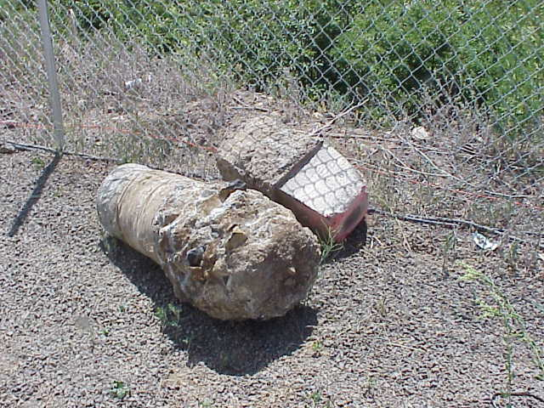
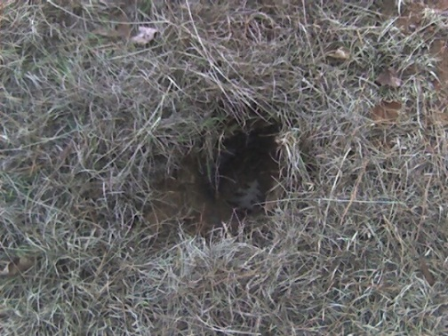
Drawbacks of Passive Control
Traditional horizontal and vertical datums were built upon and accessed through passive control

Slide 45
Geometric Reference Frames

Slide 46
Definitions
Reference System
Reference Frame
A set of prescriptions and conventions together with the modeling required to define at any time a triad of coordinate axes
ITRS: International Terrestrial Reference System
Realizes the system by means of coordinates of definite points that are accessible directly by occupation or observation
ITRF: International Terrestrial Reference Frame
From Springer Handbook of Global Navigation Satellite Systems, Ch. 2, p. 34
Notes:
Reference frames give us a means to assign self-consistent coordinates to physical locations and to describe how those coordinates change over time
Realization is defined as the practical implementation of a concept
Coordinates assigned to points in a way that best represents the mathematically abstract definition
Coordinates come from geodetic surveys of the highest accuracy
Coordinates could stand unchanged for decades (NAD 27, NGVD 29 being the best known examples)
Piecemeal updates from re-surveys

Slide 47
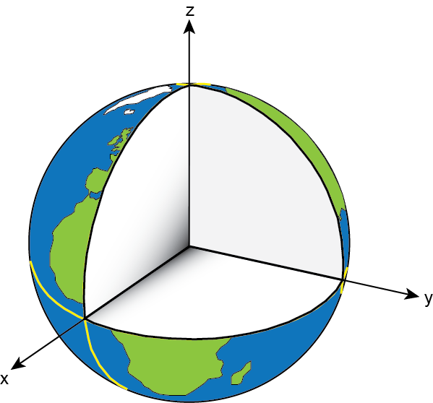
International Terrestrial Reference System (ITRS)
Defined and maintained by the International Earth Rotation and Reference System Service (IERS)
Defines conventions for:
  Origin (Where is the zero point?)
  Scale (What is the measure of length?)
  Orientation (How are the axes oriented in space?)

Slide 48
Ideal Geometric Frames
ITRF
  Combination of four frames (SLR, VLBI, GNSS, DORIS)
IGS
  Post-ITRF frame
  Most accurate GNSS orbits are in this frame
Currently the NSRS is mathematically defined:
  Three NAD 83 frames: North America, Pacific, Mariana plates
  All 3 defined with respect to ITRF94 (same as ITRF96)
  All other ITRFs defined with transformations between ITRFs

Slide 49
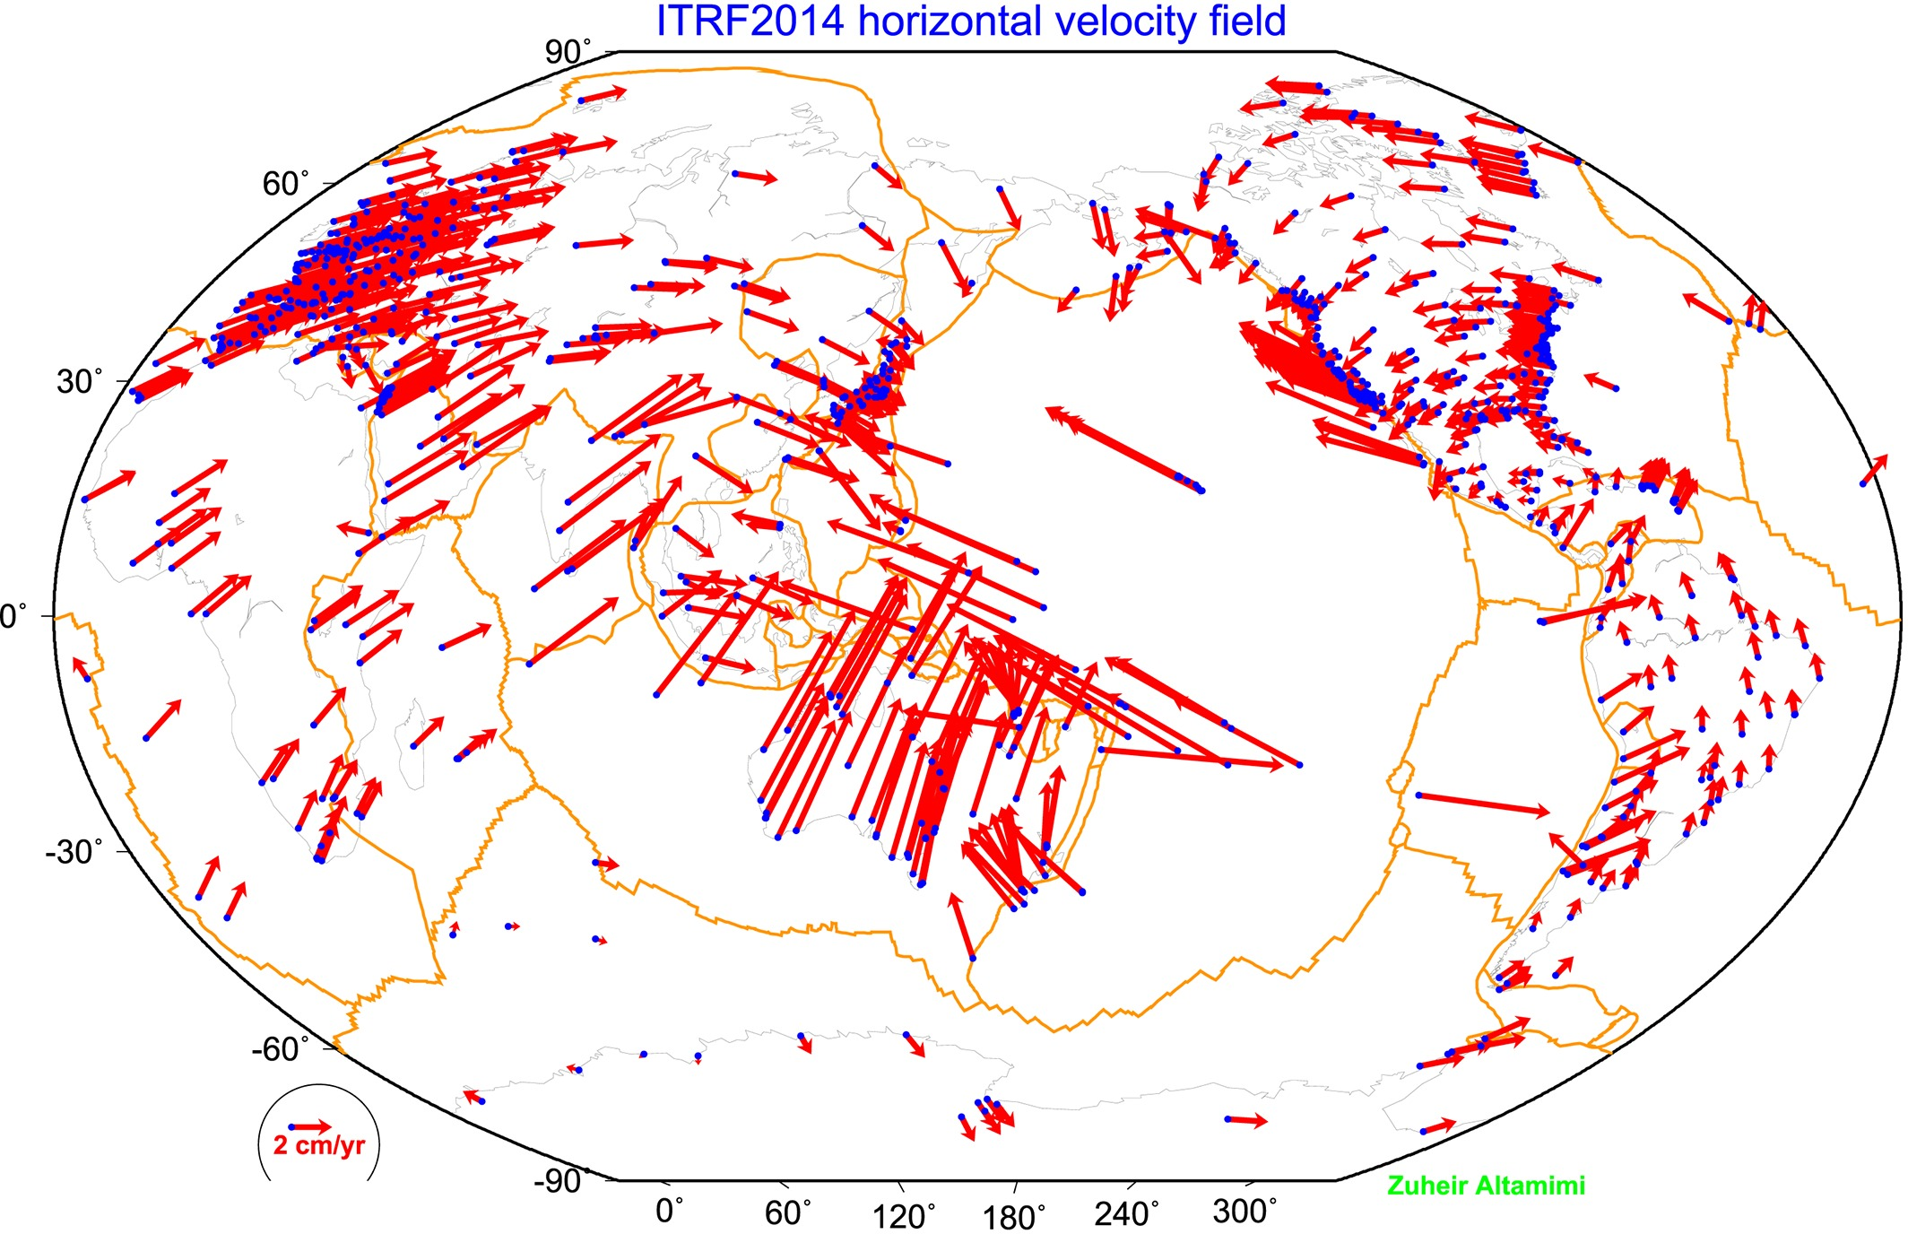
The IGS Reference Frame
The ITRF is defined by reference epoch coordinates AND velocities at stations
The ITRF velocity field very closely resembles absolute plate motion
The ITRF and IGS frames are both no-net-rotation frames – the sum of the angular velocities is constrained to be zero
The Modernized (2022) NSRS Reference Frames will tie to ITRF2020
Altamimi et al., 2016, JGR

Slide 50
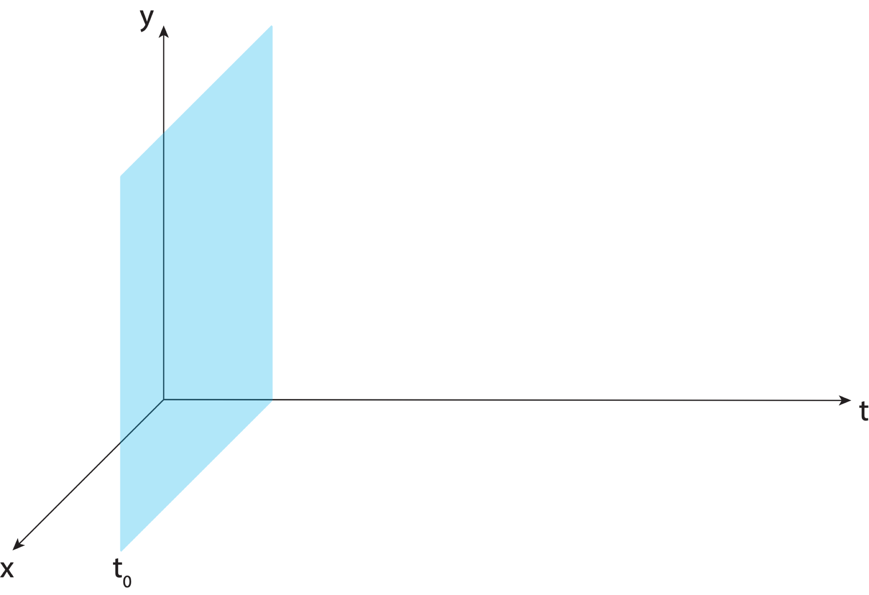
Aligning the NSRS to the IGS Reference Frame

Slide 51
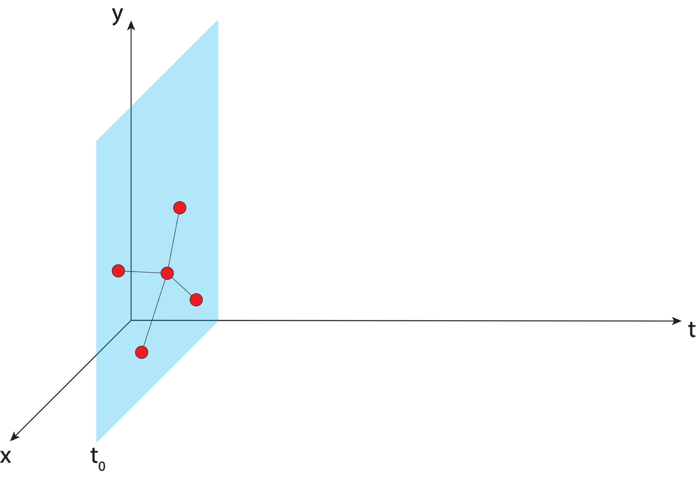
Aligning the NSRS to the IGS Reference Frame
IGS GNSS station
station trajectory

Slide 52
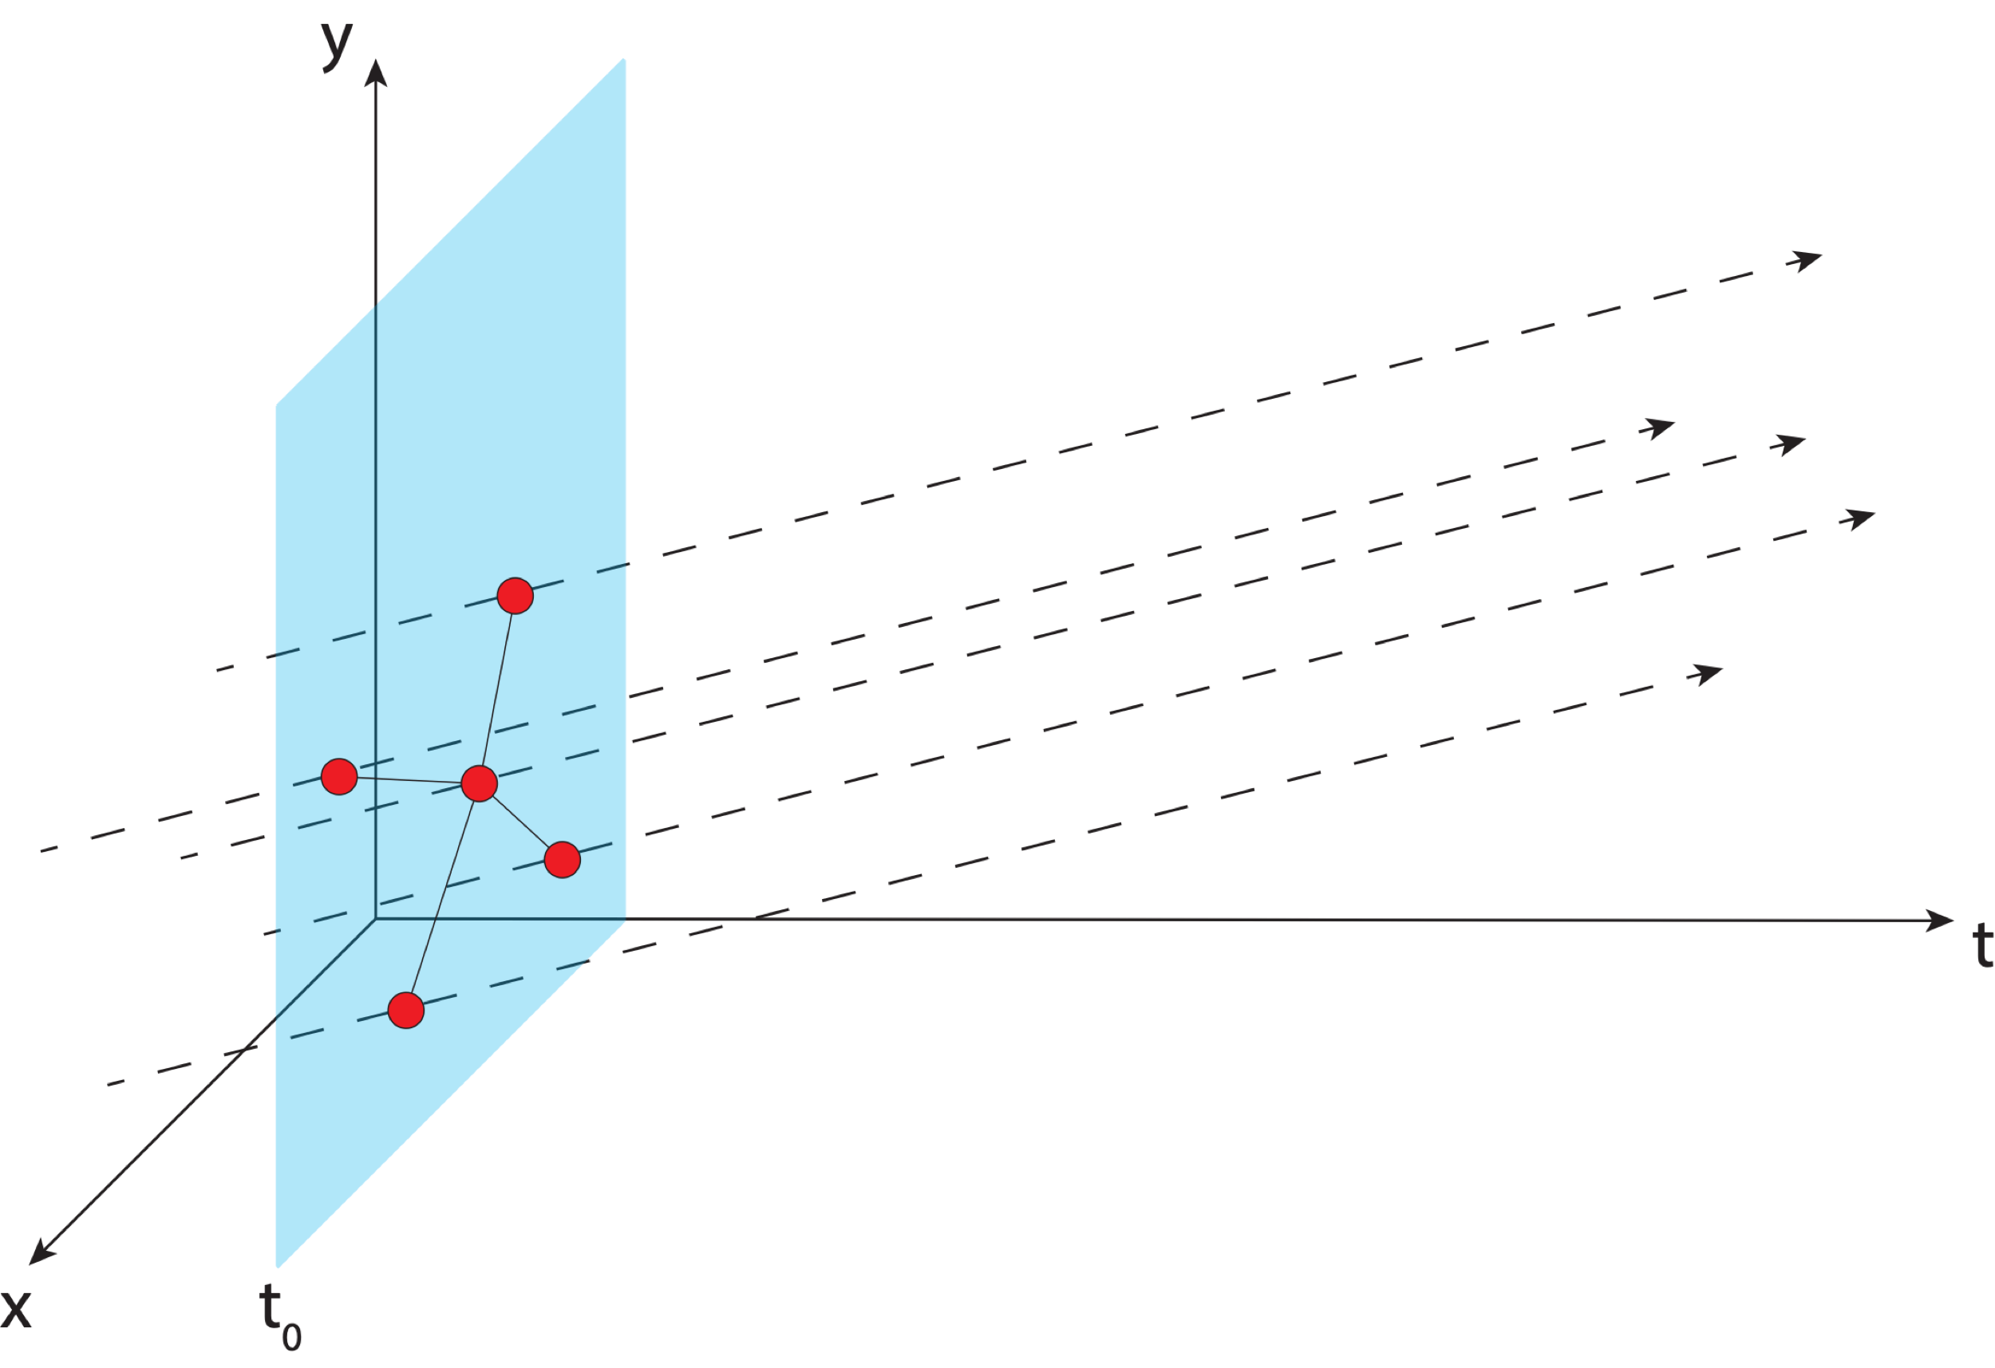
Aligning the NSRS to the IGS Reference Frame
IGS GNSS station
station trajectory

Slide 53
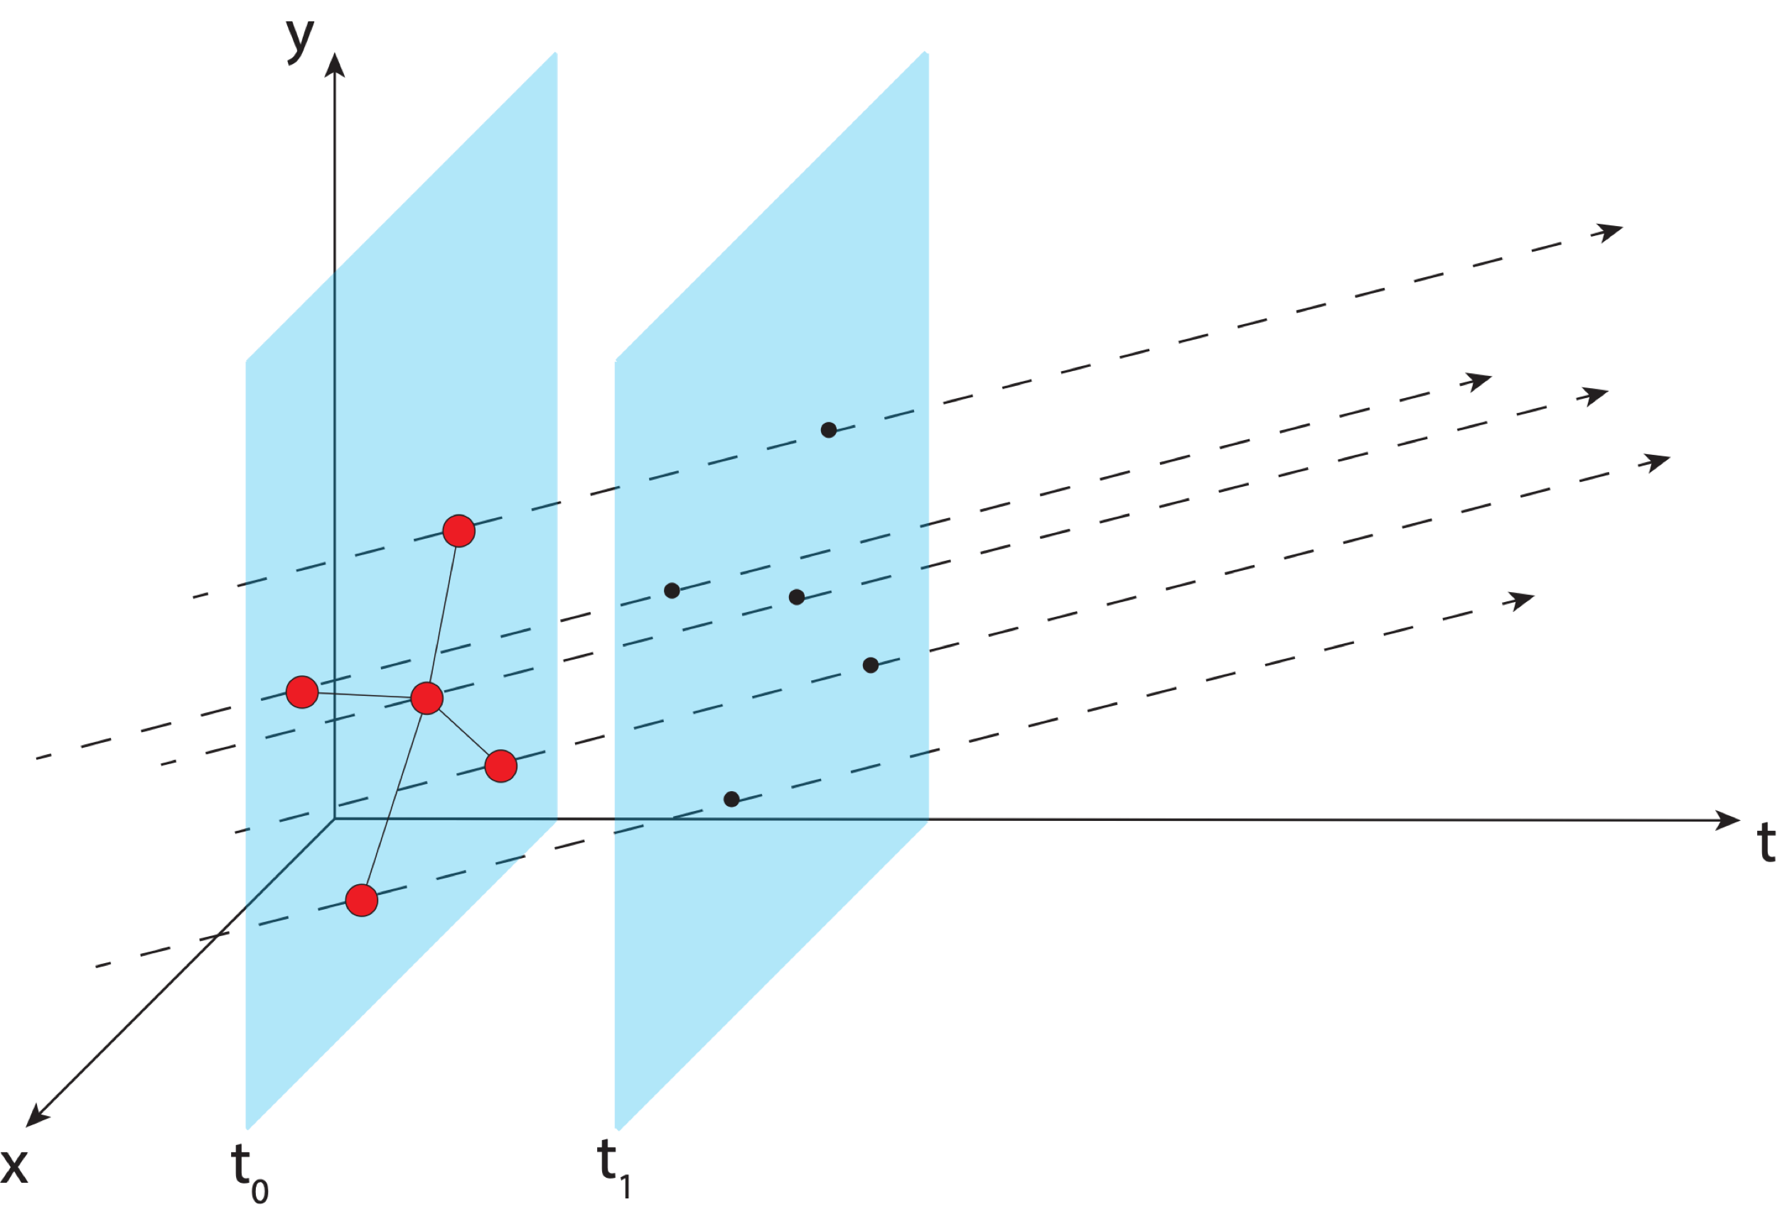
Aligning the NSRS to the IGS Reference Frame
IGS GNSS station
station trajectory
projected IGS station position
Notes:
Trajectory of IGS stations through time

Slide 54
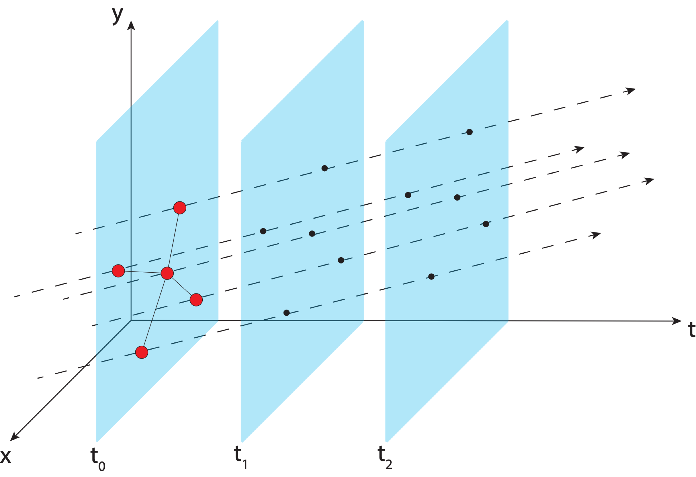
Aligning the NSRS to the IGS Reference Frame
IGS GNSS station
station trajectory
projected IGS station position

Slide 55
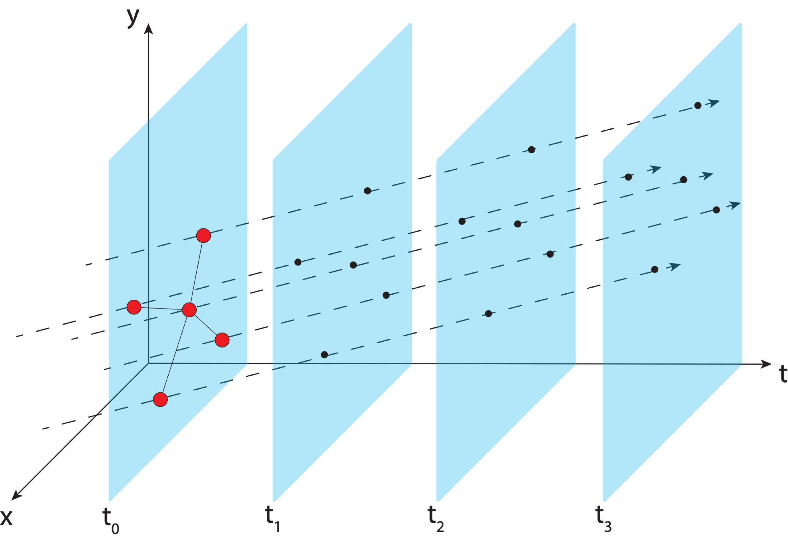
Aligning the NSRS to the IGS Reference Frame
IGS GNSS station
station trajectory
projected IGS station position

Slide 56
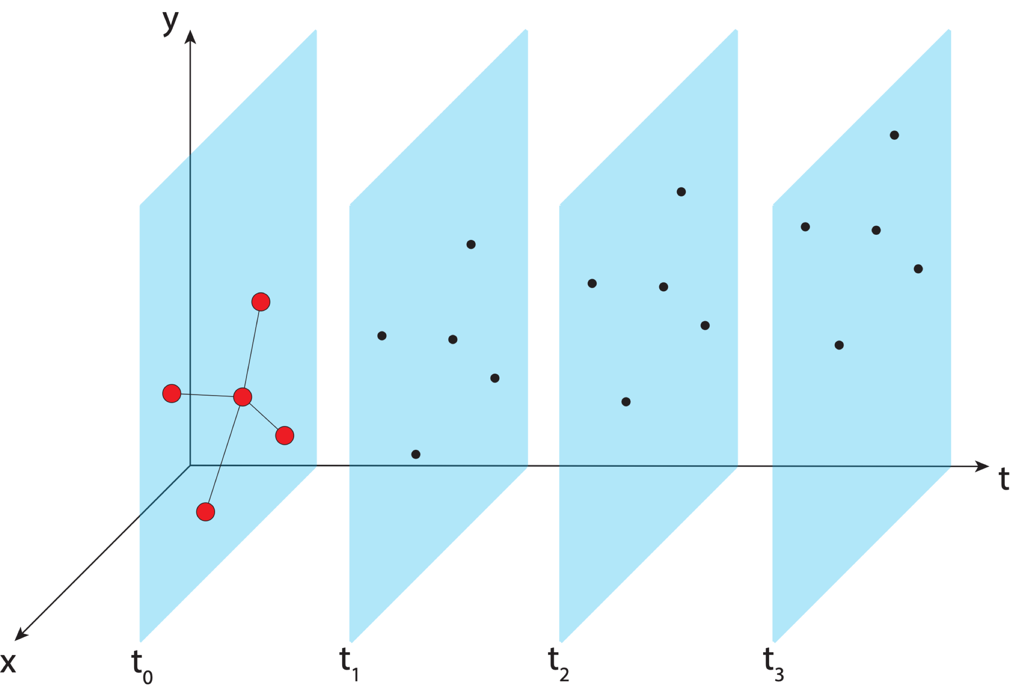
Aligning the NSRS to the IGS Reference Frame
IGS GNSS station
station trajectory
projected IGS station position

Slide 57
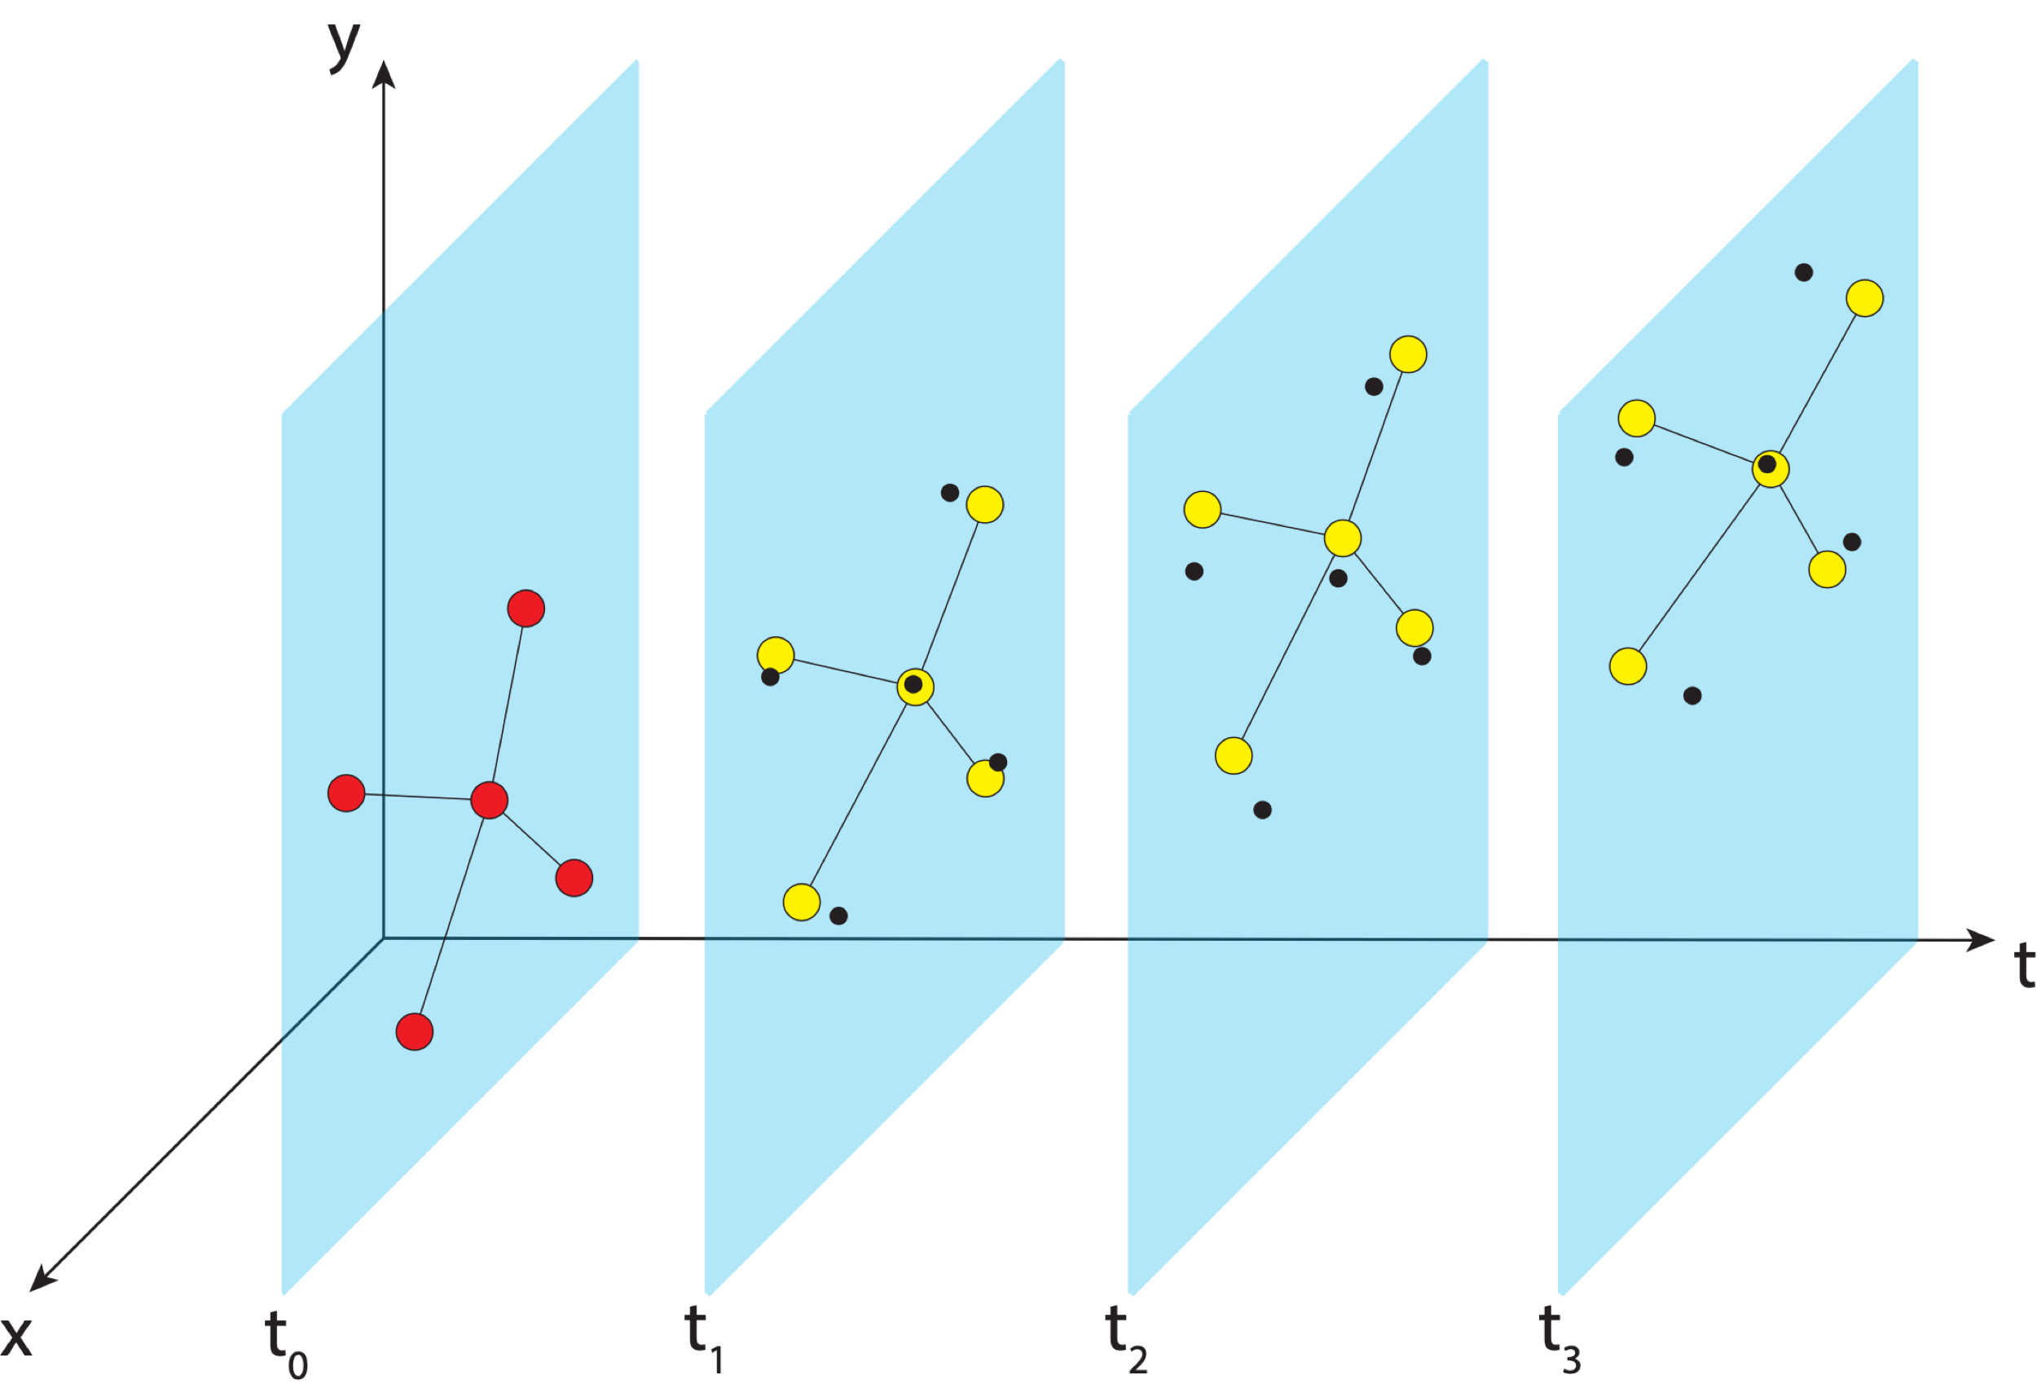
Aligning the NSRS to the IGS Reference Frame
IGS GNSS station
station trajectory
projected IGS station position
NGS estimate of IGS station position
Notes:
NGS estimates positions of IGS stations and compute transformation parameters to get them to align

Slide 58

Aligning the NSRS to the IGS Reference Frame
IGS GNSS station
station trajectory
projected IGS station position
NGS estimate of IGS station position

Slide 59
Aligning the NSRS to the IGS Reference Frame
IGS GNSS station
station trajectory
projected IGS station position
NGS estimate of IGS station position

Slide 60
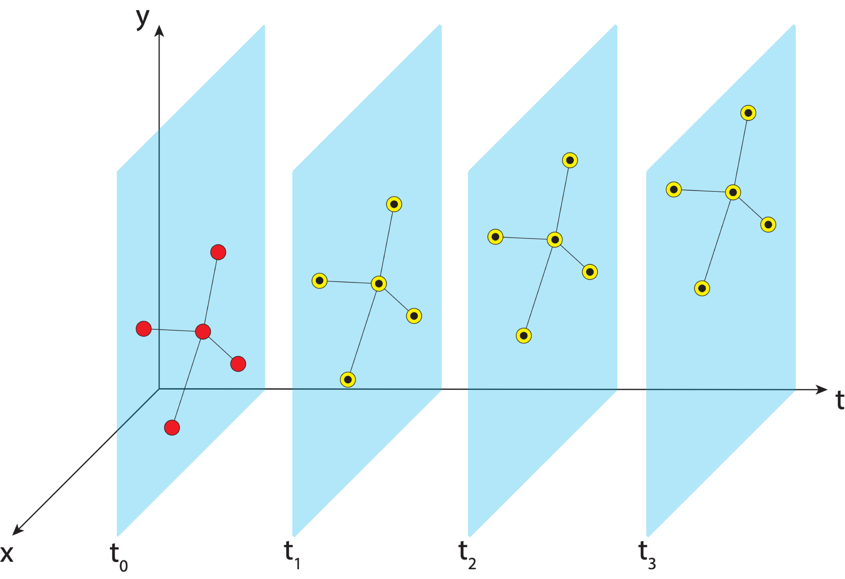
Aligning the NSRS to the IGS Reference Frame
IGS GNSS station
station trajectory
projected IGS station position
NGS estimate of IGS station position

Slide 61
Aligning the NSRS to the IGS Reference Frame
IGS GNSS station
station trajectory
projected IGS station position
NGS estimate of IGS station position
NCN GNSS station

Slide 62

Aligning the NSRS to the IGS Reference Frame
IGS GNSS station
station trajectory
projected IGS station position
NGS estimate of IGS station position
NCN GNSS station

Slide 63

Aligning the NSRS to the IGS Reference Frame
IGS GNSS station
station trajectory
projected IGS station position
NGS estimate of IGS station position
NCN GNSS station

Slide 64
Aligning the NSRS to the IGS Reference Frame
IGS GNSS station
station trajectory
projected IGS station position
NGS estimate of IGS station position
NCN GNSS station

Slide 65

Aligning the NSRS to the IGS Reference Frame
IGS GNSS station
station trajectory
projected IGS station position
NGS estimate of IGS station position
NCN GNSS station
Notes:
We realize the ITRF by using the IGS realization and bringing the NOAA CORS network along with it to snap everything into a self-consistent frame

Slide 66

Aligning the NSRS to the IGS Reference Frame
IGS GNSS station
station trajectory
projected IGS station position
NGS estimate of IGS station position
NCN GNSS station
Notes:
In MYCS, we take those positions at those times and estimate the velocity (trajectory) of the stations through time

Slide 67

Aligning the NSRS to the IGS Reference Frame
IGS GNSS station
station trajectory
projected IGS station position
NGS estimate of IGS station position
NCN GNSS station

Slide 68

Aligning the NSRS to the IGS Reference Frame
IGS GNSS station
station trajectory
projected IGS station position
NGS estimate of IGS station position
NCN GNSS station
Notes:
We provide reference epoch coordinates and velocities for users to align to the NSRS

Slide 69
Aligning the NSRS to the IGS Reference Frame
IGS GNSS station
station trajectory
projected IGS station position
NGS provides access to the NSRS through reference epoch positions and velocities for NCN stations
When users access the NSRS through OPUS, a very similar process is performed using NCN stations as the reference
NGS estimate of IGS station position
NCN GNSS station

Slide 70

Aligning the NSRS to the IGS Reference Frame
IGS GNSS station
station trajectory
projected IGS station position
NGS estimate of IGS station position
NCN GNSS station

Slide 71




Continuously Operating Reference Station (CORS) Network
2000 sites
225 organizations

Slide 72

Euler Poles and “Plate-Fixed”
  In the ITRF, many tectonic plates have a dominant motion: rotation
  Euler Pole - point about which a plate rotates (yellow star)
  Euler Pole Parameters (EPP) define this rotation
  Residual motion is characterized in an Intra-Frame Deformation Model (IFDM)
NATRF2022 Euler Pole
Notes:
We say “NATRF2022” is “fixed” to the N.A. Plate, making it a “plate fixed” frame
-the frame is constant to itself, but rotating within ITRF, and moving in a different direction than the other 3 frames

Slide 73

ITRF2020: Constant Frame, Rotating Plate

Slide 74


NATRF2022: Constant Frame, Rotating Plate “Plate-Fixed”

Slide 75

ITRF2020 or NATRF2022

Slide 76

Residual Velocities – ITRF2020/CONUS
Notes:
This diagram of CONUS shows the IFVM2022 velocities expressed in the ITRF2020 Frame.
Note the arrows are about 20 mm/yr
It can generally be interpreted as “at what velocity are points in CONUS moving relative to the ITRF Frame?”

Slide 77

Residual Velocities – NATRF2022/CONUS
Notes:
This diagram of CONUS shows the IFVM2022 velocities expressed in the NATRF2022 Frame.
Note that even in “stable North America”, these velocities are not absolutely zero!
The IFVM2022 model will contain these tiny deviations from simple plate rotation!
It can generally be interpreted as “at what velocity are points in CONUS moving relative to the North American plate?”

Slide 78

The Future Reference Frames
Will be based on a densified ITRF model (e.g. SIRGAS)
Tectonic Plate based
Each Plate is based on the same densified
ITRF model
North America
Caribbean
Pacific
Mariana
NATRF
CATRF
PATRF
MATRF
Notes:
ITRF fixed PLATE specific reference frame. 5th frame will be SIRGAS
Will rely upon Euler Pole Parameters to related plates to ITRF2020
NSRS Modernization Naming Conventions https://geodesy.noaa.gov/datums/newdatums/naming-convention.shtml

Slide 79
The Relation of 5 Global Reference Frames through Time
MATRF2022
NATRF2022
Rotation of North American Plate
Rotations are not to scale
PATRF2022
CATRF2022
Rotation of Pacific Plate
ITRF2020 frame
ITRF2020 frame through time
ITRF2020 frame
Rotation of Caribbean Plate
PATRF2022
Rotation of Mariana Plate
CATRF2022
NATRF2022
2020.00 : The time when
all four TRFs and
ITRF2020 are identical by definition.
MATRF2022
t = 2020.00 - Dt
(“the past”)
t = 2020.00 + Dt
(“the future”)

Slide 80
Vertical Datums

Slide 81
Vertical Datums of the NSRS
St. Paul I.
- None -
St. Lawrence I.
- None -
St. Matthew I.
- None -
Alaska
NGVD 29
NAVD 88
St. George I.
- None -
CONUS
NGVD 29
NAVD 88
Hawaii
- None -
CNMI
NMVD 03
Puerto Rico
PRVD 02
U.S. Virgin Islands
VIVD 09
American Samoa
ASVD 02
Guam
GVD 63
GUVD 04

Slide 82


Developing the Previous Vertical Datums
Notes:
NGVD 29: 26 Tide gauges in North America
NAVD 88: Father Point in Rimouski, Canada

Slide 83



Developing the Previous Vertical Datums
NGVD 29
NAVD 88

Slide 84



Leveling
Notes:
NAVD 88 is accessed through leveling off of marks with NAVD 88 heights on them.
Those heights were determined by leveling crews.

Slide 85
Other Vertical Datums
International Great Lakes Datum (more on that later)
Pre-1929 General Adjustments (1900, 1903, 1907, 1912)
River datums (Mean Gulf Level, Memphis, others)
Tidal Datums (NTDE)
Notes:
See Pearson and Mick: Legacy height datums on the Mississippi and Illinois river systems https://www.ngs.noaa.gov/PUBS_LIB/Miss_ht%20datums_ACSM_v3.pdf

Slide 86


Datum Plane Charts

Slide 87
Draw a DATUM PROFILE
St. Paul, MN
(PBM 67)
Dresbach, MN
(PBM 182)
Elevation above datum = Depth to datum
NGVD29
NAVD88
0.046 m
0.013 m
NAVD88
NGVD29
0.098 m
0.071 m
Mean Gulf
Mean Gulf
1912
0.003 m
0.078 m
2.222 m
2.148 m
1912
Memphis
Memphis
Notes:
We note that the Datums are not parallel
They do not converge/diverge uniformly
underlying undetected errors in the leveling
underlying undetected errors in the adjustment
by the choice of constraints used in the adjustments.
There is NO single “Correct” conversion between datums!

Slide 88
Replacing NAVD 88
  The Old:
  NAVD 88
  PRVD 02
  VIVD09
  ASVD02
  NMVD03
  GUVD04
  IGLD 85
  IGSN71
  GEOID18
  DEFLEC18
  The New:
  The North American-Pacific Geopotential Datum of 2022 (NAPGD2022)
  Will include:
  GEOID2022
  DEFLEC2022
  GRAV2022
  DEM2022
  More
Orthometric
Heights
Normal
Orthometric
Heights
A HUGE component of this
effort is GRAV-D:
Gravity for the Redefinition of
the American Vertical Datum
Dynamic
Heights
Gravity
Geoid
Undulations
Deflections of
the Vertical

Slide 89

NAVD 88 (epoch ?) to
NAPGD2022 Epoch 2020.00 (estimate)

Slide 90




Gravity for the Redefinition of the American Vertical Datum (GRAV-D)
10 km data lines
70 km cross lines
20,000 ft altitude
230 kt flight speed
Data collection 100% complete!
Notes:
96.78% complete as of 1/11/2023

Slide 91

Experimental Geoids: Preparing for the Future Gravimetric Geoid
Purely gravimetric geoids
Incorporate gravity data from satellites, GRAV-D, and terrestrial measurements
Satellite altimetry used in the open ocean areas
Notes:
here is a fundamental difference between the purely gravimetric xGEOIDs and the series of hybrid geoid models that NGS has produced over the past 20+ years to compute GPS-derived NAVD88 heights (GEOID96 to the current model GEOID18). The primary difference is that GPS on Bench Marks data was used in the hybrid models to constrain/warp a gravimetric geoid model (xGEOID19) to published NAVD 88 heights. While this process enabled GPS users to obtain NAVD88 heights, it also introduced additional error into the overall results. To avoid further error from warping to the NAVD88 surface, the GPSonBM data will NOT be used in defining GEOID2022.

Slide 92


Geoid and Ellipsoid
Z
GRS80 ellipsoid
X
ITRF Axes
Y
Geoid
Notes:
NAPGD2022 will be accessed differently than NAVD 88 is. First, let me explain what is what.
Start with the Earth. The Earth isn’t flat, but it’s more than just a sphere.
We first approximate it as an ellipsoid, which is a sphere that’s been squashed a little bit. The ellipsoid that we use is called GRS 80. With GPS we can measure a height above the ellipsoid. An ellipsoid is defined by a semimajor axis and a flattening coefficient.
A better approximation is a geoid, a surface that closely matches sea level. A geoid is what’s called an equipotential surface. The height above the geoid is called an orthometric height. Leveling gives orthometric height differences. These are more significant than ellipsoidal heights since ellipsoidal heights don’t tell anything about which way water flows.
Both geometric frames and geopotential frames are based on center of the earth, not the surface. Therefore, the geopotential
Old method: leveling from bench mark, plus NAD 83 was not geocentric, so we had to develop “hybrid” geoid models in order to have NAVD 88 and NAD 83 work together
New method – GNSS and Geoid model (defined to work together!) frame can be accessed through the geometric frame

Slide 93
Geoid Height N and Orthometric Height H
N, the geoid height, also called geoid undulation
Separation of ellipsoid and geoid
Provided by geoid models
h=H+ N
h: ellipsoidal height
H: orthometric height
N: geoid undulation
Topography
h
H
The geoid
N
A chosen
ellipsoid
Geoid height is negative in most of CONUS area
Notes:
The geoid is a surface that approximates mean sea level, if you carried it all the way in through under the land. It’s an equipotential surface, meaning that its gravity potential is the same over its entirety. For GEOID2022 of the Modernized National Spatial Reference System (NSRS), the geopotential value selected is W₀ = 62,636,856.0 m²/s², which closely matches sea level around North America. The height that we typically use to show the height above the geoid is an orthometric height, H.

Slide 94

Ellipsoid, Geoid, Orthometric & Dynamic Heights
Equipotential surfaces
$H^{D}$ (Dynamic Height) = Scaled value of geopotential (at P)
Notes:
Image from VDATUM website
I will talk more about dynamic heights shortly

Slide 95
Understanding “Geo-Potential”
h
The resting water has “potential” energy just by being high up on this cliff.
Energy = mgh
That potential energy can turn into real (kinetic) energy by falling.
Energy = ½ mv² (= mgh)
Think of the Earth as creating a “gravity field” that masses experience. I’ve drawn potential “field lines”
Potential = gh
Gravity x Height is “Geopotential”. This is what water “feels”.

Slide 96

Types of Heights Summary
Height | Symbol | Equation | Example of datum
Ellipsoidal | h |  | NAD 83
Orthometric | H | H = h - N | NAPGD2022
Helmert | H | $$H=\frac{C}{\overline{g}}$$ | NAVD 88
Dynamic | $$H^{D}$$ | $$H^{D}=\frac{C}{γ_{45}}$$ | IGLD (1985)
Normal | H* | $$H^{∗}=\frac{C}{\overline{γ}}$$ | NGVD 29

Slide 97


International Great Lakes Datum

Slide 98

Overview of IGLD
International Great Lakes Datum (IGLD) is a common height reference system to measure and relate water levels
Official vertical datum used for water level measurements and navigation charts throughout the Great Lakes, their connecting channels and the St. Lawrence River
Maintained by the Coordinating Committee on Great Lakes Basic Hydraulic and Hydrologic Data, a binational committee with representatives from the Governments of Canada and the United States
IGLD is updated every 25-30 years due to Glacial Isostatic Adjustment (GIA)
Next update will be IGLD (2020), expected for release around 2027
Image credit: IJC

Slide 99



Current IGLD (1985)
Based on NAVD 88
Reference zero is mean sea level at Pointe au Père & Rimouski, Québec
Reference surface (datum) extended inland using leveling
  Very time consuming & cost prohibitive
  Datum accessible only where leveling bench marks exist
  Affected by systematic errors in long leveling loops
Uses dynamic heights for measuring hydraulic
head – dynamic heights are constant along a level surface (e.g., undisturbed lake)
Notes:
Reference surface is each lake (equipotential surface) to which heights are referenced
IGLD 1955 & 1985 used 1000’s miles of geodetic leveling to indirectly define the reference surface
Very time consuming & cost prohibitive
Datum accessible only where leveling exists (benchmarks)
Susceptible to accumulation of systematic errors
Extends the reference zero inland

Slide 100



Why a New IGLD?: Glacial Isostatic Adjustment – (GIA)
Entire basin is:
Uplifting in north, subsiding in south
Overall tilting ~7 mm/year (21cm or 8” over 30 years)
Need to update IGLD every 25-30 years

Slide 101


Dynamic Heights
$H^{D}=\frac{C}{γ_{45}}$
Normal gravity value, $γ$, is a constant

Slide 102


Dynamic vs. Orthometric Heights
South
Dynamic Height
North
  Orthometric Height

Slide 103


New IGLD (2020)
Based on the new North American vertical datum (NAPGD2022)
Reference zero is mean sea level around the coasts of North America
  $W_{0}$ = 62,636,856.00 m²/s²
Reference surface (datum) extended inland using a geoid model
  Geoid model based on gravity data, not leveling
  Defined everywhere, not only where leveling bench marks exist
Using dynamic heights
Heights defined at reference
epoch 2020.0 (mid-point of 7
year water level obs period)
Heights expected to change
30-65 cm (12”-26”) from
existing IGLD (1985)
Expected IGLD (1985) - IGLD (2020) Difference
35 cm tilt in IGLD (1985)

Slide 104


Technical Documents for IGLD (2020) and NAPGD2022
https://geodesy.noaa.gov/library/pdfs/NOAA_TR_NOS_NGS_0064.pdf
http://www.greatlakescc.org/wp36/wp-content/uploads/2017/09/IGLD_Update_20170929_220dpi.pdf

Slide 105


IGLD Online Resources
NOAA Center for Oceanographic Operational Products (CO-OPS) website
  https://tidesandcurrents.noaa.gov/datum-updates/igld/
Great Lakes Coordinating Committee website
  http://www.greatlakescc.org/wp36/home-2/international-great-lakes-datum-update/

Slide 106





Consistent Nationwide Reference System The Modernized NSRS
Revolutionize professional surveying
No more need for installing and locating bench marks
Absolute, consistent positioning autonomously, anywhere
Vastly improved flood plain mapping
Water flows due to differences in gravity
Critically important in low-lying, flat communities
Fundamental support for new technologies
“Smart Highways” for autonomous vehicles
Consistent nationwide reference frame
Support precision agriculture
Absolute, consistent positioning autonomously, anywhere for efficiency
Impacts on infrastructure
Any application requiring precise positioning -- bridges, tunnels, railways, navigation -- will be easier and more accurate

Slide 107
The Unchanging Role of the NSRS
Good surveying practices are not going to change
The purpose of the NSRS, as the foundation of nationwide geodetic control will not change
The reliance on your submissions to NGS for the upkeep of coordinates on passive control will not change
Working in the modernized NSRS will more accurately account for the true dynamic nature of the earth’s surface but requires a robust strategy and detailed metadata to ensure a successful project

Slide 108

Preparing for Modernization
Read the Blueprint Documents
  we also have recorded webinars from NSRS Modernization Manager
Subscribe to NGS news
  https://www.ngs.noaa.gov/INFO/subscribe.shtml
Check out the New Datums web page:
  https://www.ngs.noaa.gov/datums/newdatums/
Reach out to NGS for support as needed
  https://www.ngs.noaa.gov/ADVISORS/
Notes:
Denis also put out this information

Slide 109
Thank You!
Jacob M. Heck, Ph.D., P.S.
Great Lakes Regional Geodetic Advisor (MI, IN, IL, WI )
U.S. National Geodetic Survey, NOAA
jacob.heck@noaa.gov
c/o NOAA Great Lakes Environmental Research Laboratory
4840 S. State Road
Ann Arbor, MI 48108
For more information, visit https://geodesy.noaa.gov
Send feedback to ngs.feedback@noaa.gov

