Slide 1
NSRS Modernization Update
geodesy.noaa.gov
Juliana P. Blackwell
National Geodetic Survey, NOAA
January 15, 2017

Slide 2
Introduction: the NSRS

Slide 3
Overview
The National Spatial Reference System (NSRS) is the official coordinate system for all geospatial work done by the civilian federal government.
Current datums:
  NAD 83 (latitude, longitude, ellipsoid height)
  NAVD 88 (orthometric height)
  IGLD 85 (dynamic heights: predominantly on the Great Lakes)
These datums are often adopted, even legislated, by states, counties and municipalities.
Notes:
There are actually 3 “NAD 83”s, NAD 83(2011), NAD 83(PA11) and NAD 83(MA11)
There are also many more vertical datums than NAVD 88 in the NSRS, each one for specific states or territories that have no line of sight to CONUS/Alaska

Slide 4

























Federal Users of the NSRS
Notes:
Many of these users also sit on the Federal Geodetic Control Subcommittee, so there is a feedback loop between the providers of geodetic control (NGS) and the users of that control.

Slide 5
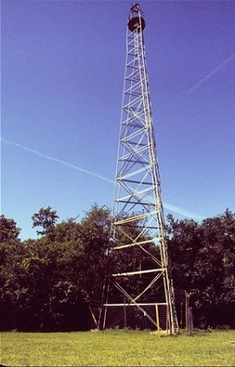
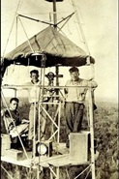
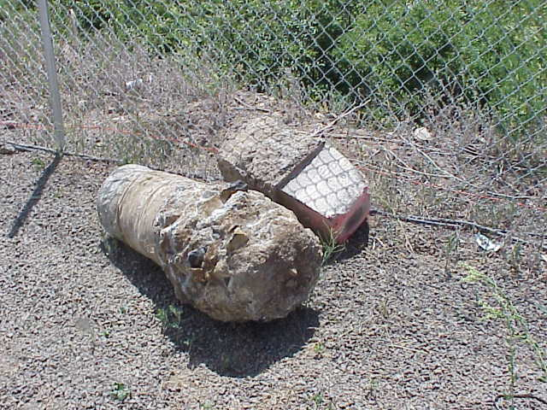
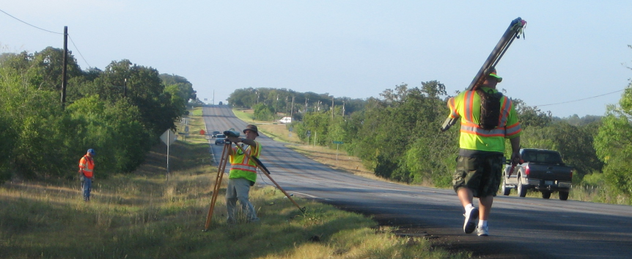
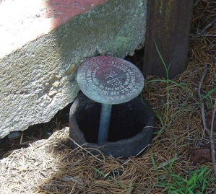
Why Modernize?
Older Methodology
  Terrestrial, pre-space-geodesy, line-of-sight observations
  Easily destroyed, unmonitored passive control marks
Notes:
Leveling and Traverse built NAVD 88 and NAD 83 and both required line of sight, and passive marks. This meant a lot of effort to put a coordinate on a point, but then such a coordinate could become stale without being checked regularly, and all that assumes the mark itself isn’t disturbed or destroyed.

Slide 6
Why Modernize?
Evidence of systematic errors
  Decades of space geodetic observations
    All of the datums contain systematic errors (decimeters to meters)
      At scales larger than today’s accuracy capabilities (centimeters)
  Origin (center of Earth) offset: 2+ meters
  Zero elevation surface: 0.5 to 2+ meters
Notes:
The GRACE satellite has given NGS the ability to know the long-wavelength continent-wide geoid to a few centimeters. Combined with GPS derived ellipsoid heights (in the IGS / GRS 80 frame) of a few cm accuracy, and compared published NAVD 88 heights, it is easy to determine that both a bias and tilt exist in NAVD 88.

Slide 7
What’s Being Replaced?
Horizontal Vertical
  NAD 83(2011)
  NAD 83(PA11)
  NAD 83(MA11)
  NAVD 88
  PRVD 02
  VIVD09
  ASVD02
  NMVD03
  GUVD04
  IGLD 85
Heights
Latitude
Longitude
Ellipsoid Height
State Plane Coordinates
Notes:
Here are all of the height datums being replaced in 2022. Also being replaced are all geoid models, deflection of the vertical models.

Slide 8

Details: Ten Year Plan
Five Goals:
Support the users of the National
Spatial Reference System.
Modernize and improve the National
Spatial Reference System.
Expand the National Spatial Reference
System stakeholder base through
partnerships, education, and outreach.
Develop and enable a workforce with
a supportive environment.
Improve organizational and administrative functionality.

Slide 9
Nomenclature and Legislation

Slide 10
Nomenclature
A chance to increase accuracy in naming!
  “North American”?
    Ignores Guam, Hawaii, American Samoa, Northern Mariana Islands
  Datum vs. Reference Frame?
  Plate-specific?
  Vertical vs. Geopotential?
6/8/2016: NGS and the Canadian Geodetic Survey (CGS) negotiated a naming proposal
  Approved by NGS Executive Steering Committee
  Approved by the CGS leadership (with minor reservations)
  Awaiting final word from Mexico’s INEGI
Notes:
Replacing our datums meant starting with a clean sheet of paper. So we also considered what the proper names for these entities would be. The process took over 6 months of internal and external discussions. The intent was to have a system with names that were not beholden to a specific country, so that they could be adopted by any country in the region.

Slide 11
Legislation
When NAD 83 replaced NAD 27, the Federal NSRS users were required to switch to NAD 83
Through the 1980s and 1990s NGS worked with the states to update their laws
  To encourage use of the new system beyond the feds
48 states now have laws that refer to NAD 83 by name
  A name which will be retired in 2022

Slide 12
Legislation
In 2016, NSPS, AAGS, and NGS formed a committee to address this issue
  The NSPS/AAGS/NGS Advisory Committee on National Spatial Reference System Legislation
New Legislative Template completed June 2016
  Generic terminology: “NSRS or its successor,” etc.
  NSPS will work with the states to adopt the new template between 2017 and 2022

Slide 13
objective 1 of 5:
Replace NAD 83

Slide 14
Replace NAD 83
Simplified concept of NAD 83 vs. “2022”
Earth’s Surface
h_{”2022”}
h_{NAD83}
φ_{NAD83} – φ_{”2022”}
λ_{NAD83} – λ_{”2022”}
h_{NAD83} – h_{”2022”}
all vary smoothly by latitude and longitude
“2022” origin
~2.24 m
NAD 83 origin
Notes:
When NAD 83 was first developed, the intent was to make it as geocentric as possible. However as technology progressed, especially space geodesy, knowledge of the geocenter got better and showed that NAD 83 was over 2 meters non-geocentric. A decision was made at NGS to *not* update the origin, as that would have defined a new datum, and NAD 83 was still in the process of being adopted even 10 years after its debut.
Since then, however, the accessibility of cm level geocentric positioning has grown, and this mismatch (and its related horizontal errors in latitude and longitude) are now becoming more and more obvious. As such, when NAD 83 is replaced in 2022, the new system will be much more geocentric.

Slide 15
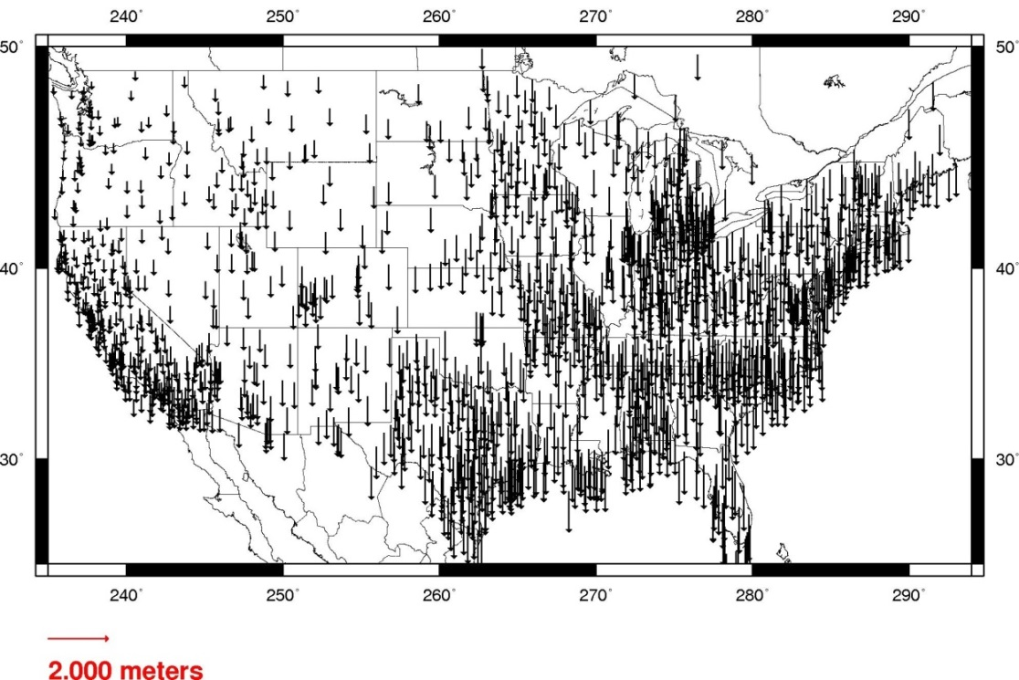
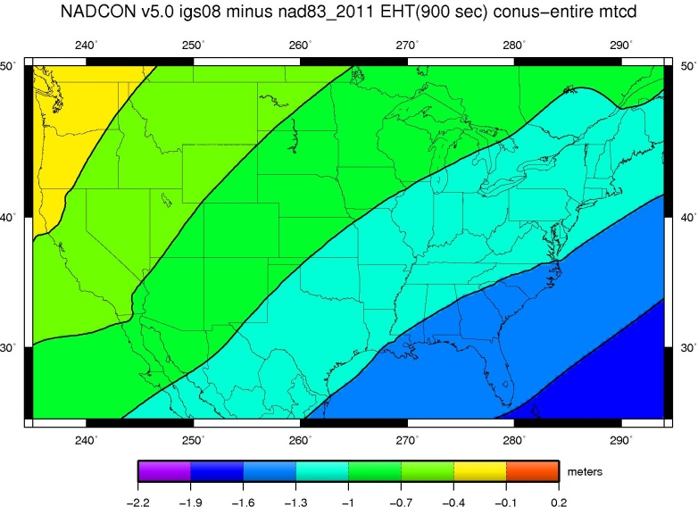
Ellipsoid Height Shifts
Approximate
  IGS08(GRS-80) minus NAD 83(2011)
Notes:
The shifts in ellipsoid heights, due to correcting the non-egocentricity of NAD 83, will manifest as a tilt of 0.5 m to 1.5 m across CONUS

Slide 16
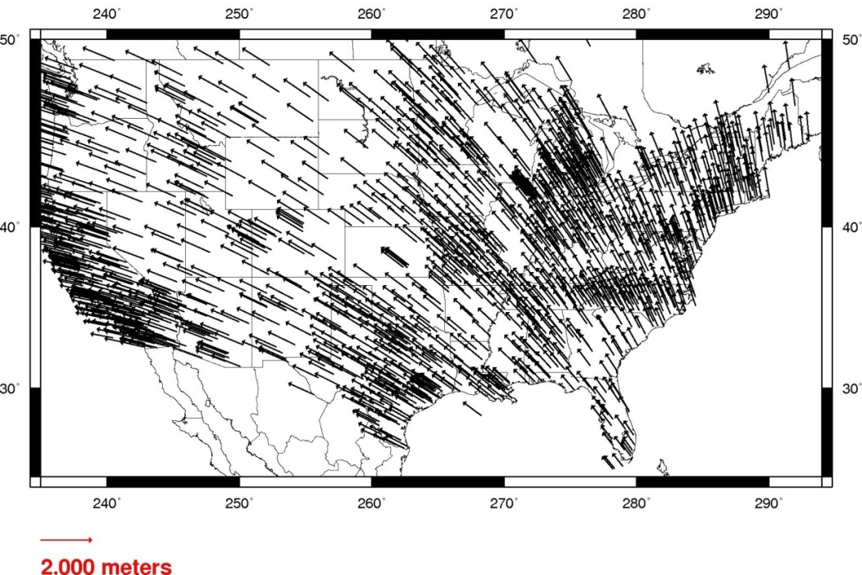
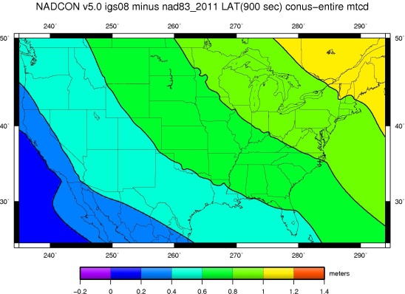
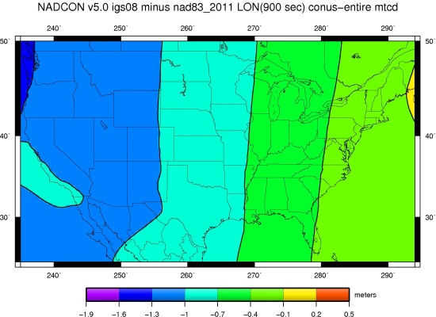
Horizontal Shifts
Approximate
  IGS08(GRS-80) minus NAD 83(2011)
Lat:
Lon:
Notes:
The shifts in latitude and longitude, due to correcting the non-egocentricity of NAD 83, will manifest as gradually changing shifts across CONUS

Slide 17
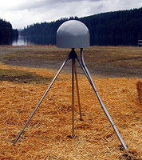
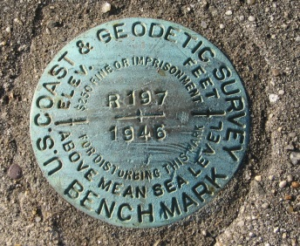
Replace NAD 83
Access and definition
Primary: CORS
  Continuous monitoring
  OPUS
  IGS coordinates
    Transformable to any national reference frame chosen for 2022
  Static Surveys
  RTK/RTN
    Validation service
Secondary: Passive
  Time-tagged coordinates
  Will reflect each occupation of the mark
  Will generally not be accepted as “fixed control” in surveys turned in to NGS
Notes:
In the past, passive control was the way to define and access a datum, with the assumption that coordinates held for a long period of time. That philosophy is being updated to rely on active control where data come in 24/7 on a GNSS receiver. Passive control will still be used, but in a reduced capacity.

Slide 18
Definition of New Frames
“Plate fixed + ” … announcement coming soon!
Plate rotations will tie the new terrestrial reference frames of 2022 to the IGS frame
Deformational velocities will be modeled separately
Notes:
The new frames will remove the dominant latitude/longitude time-dependent change of “plate rotation”. That will still leave residual velocities (including intra-plate horizontal motions and all vertical motions)

Slide 19
Time Dependencies
Track CORS and always know where you are
Surveying to CORS positions at survey epoch
  If we track CORS, we can do this easily
Tectonic rotations
  Easily removed for a “good east of the Rockies” solution
    Latitude/Longitude only
Residual deformations
  Can be modeled many ways and provided for cross-epoch checking between surveys
    3-D
Notes:
All coordinates will be time dependent. However, in many places, that dependency will be very small, as the primary signal (rotation of the plate) will be removed.

Slide 20
Objective 2 of 5:
Replace NAVD 88

Slide 21
Replace NAVD 88
Earth’s
Surface
H (NAVD 88)
H
NAVD 88 reference level
The Geoid
Errors in NAVD 88: ~50 cm average, 100 cm CONUS tilt,
1-2 meters average in Alaska, NO tracking
Notes:
By using the GRACE satellite, NGS has determined both a bias and a tilt in the NAVD 88 zero height surface.

Slide 22
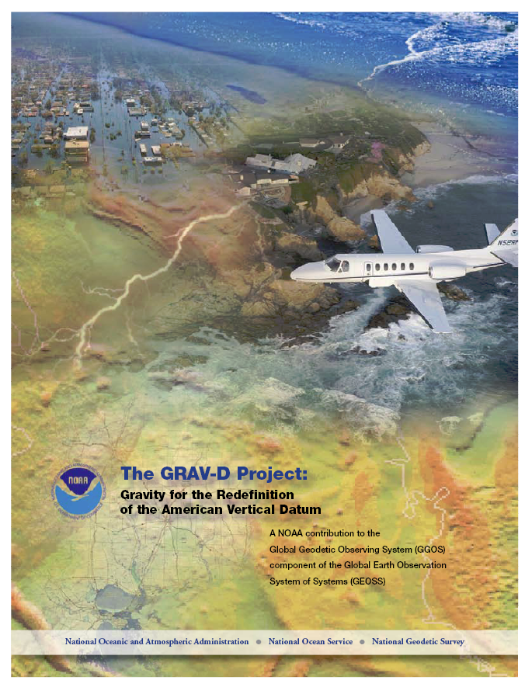
Replace NAVD 88
Changing from a leveling-based to a geoid/GNSS-based vertical datum
Biggest requirement: An updated, accurate, nationwide gravity survey
  Airborne
  GRAV-D!
    Gravity for the Redefinition of the
    American Vertical Datum
Notes:
The way of the future will be to get access to orthometric heights by removing a geoid model from GNSS-determined ellipsoid heights.

Slide 23
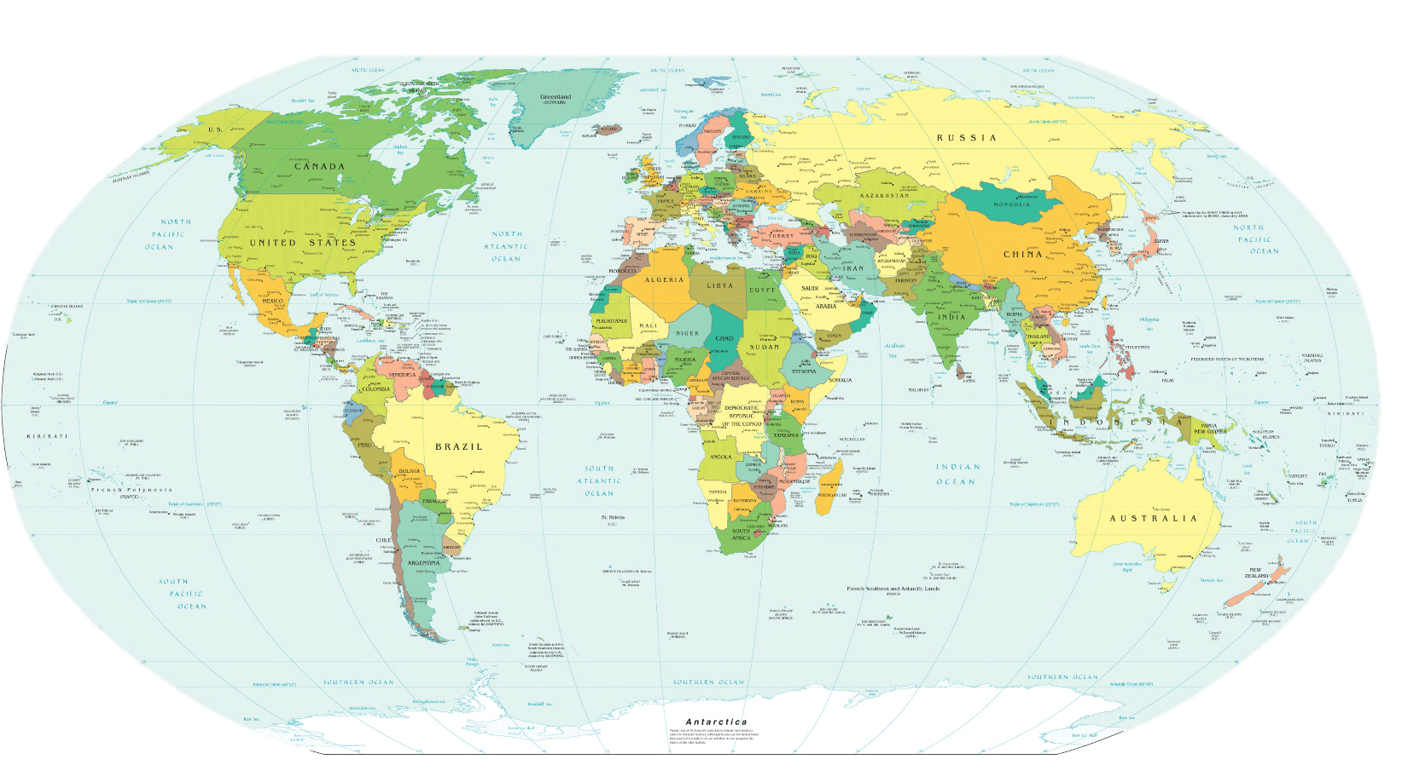
GRAV-D Coverage
Alaska
“CONUS”
Guam/Northern Marianas
Hawaii
Puerto Rico/Virgin Islands
American Samoa
Notes:
These are the areas to be covered prior to 2022.

Slide 24
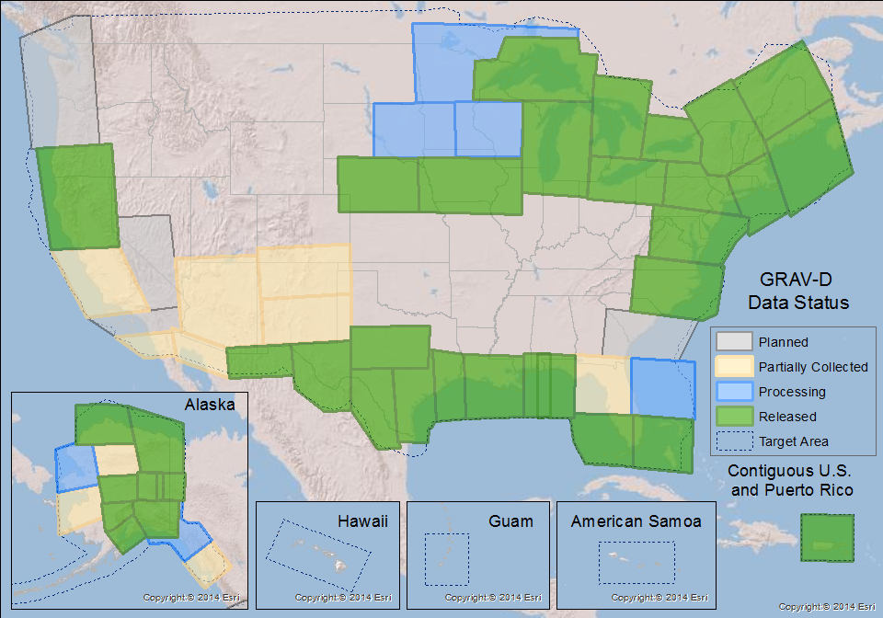
GRAV-D Status
100% by 2022
50% mark hit in FY2016
  FY2017 target: 62%
Two planes at a time
  Occasionally three
Mix of government and private industry collection
Notes:
As each block is finished, it is released on the NGS website.

Slide 25
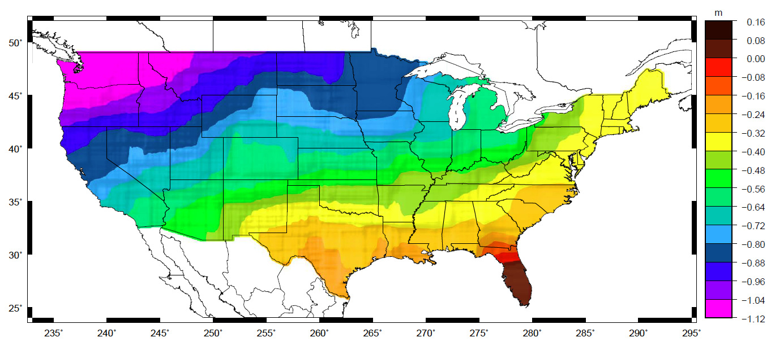
Orthometric Heights
Approximate EXPECTED SHIFTS
Approximate level of geoid mismatch known to exist in the NAVD 88 zero surface
Does not include local subsidence issues
Notes:
This is another way to look at the bias and tilt in NAVD 88, but does not reflect any actual subsidence of points that may have occurred since they were last surveyed.

Slide 26
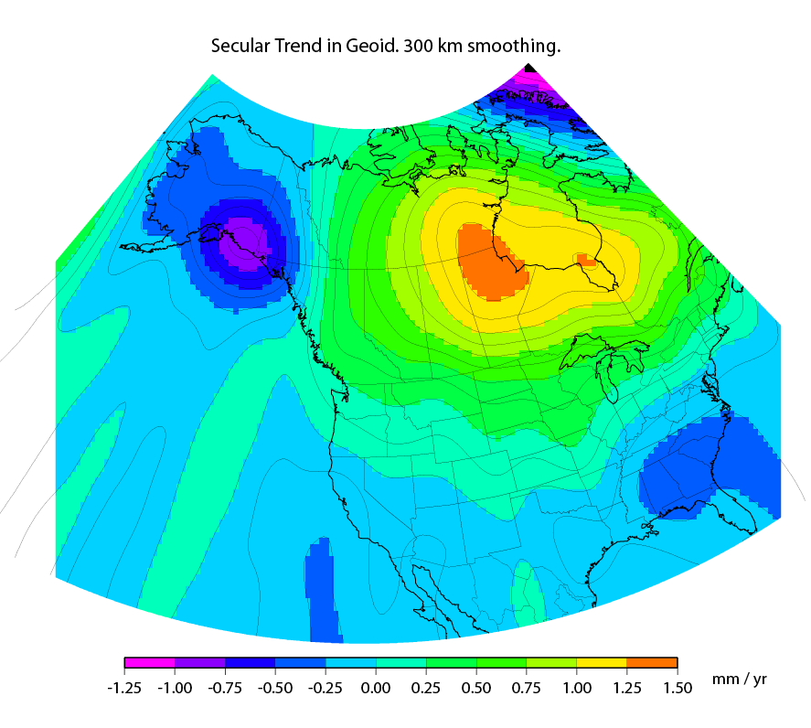
Time Dependencies
Geoid changes cause height changes
The zero elevation surface will change with time
Heights will be time tagged to respect:
  Geoid change
  Subsidence
Notes:
The primary signal here is a mass infusion occurring under Hudson bay, and a mass loss in the glaciers of Alaska, each causing the geoid to change shape in that region.

Slide 27
Objective 3 of 5:
Re-invent Bluebooking

Slide 28
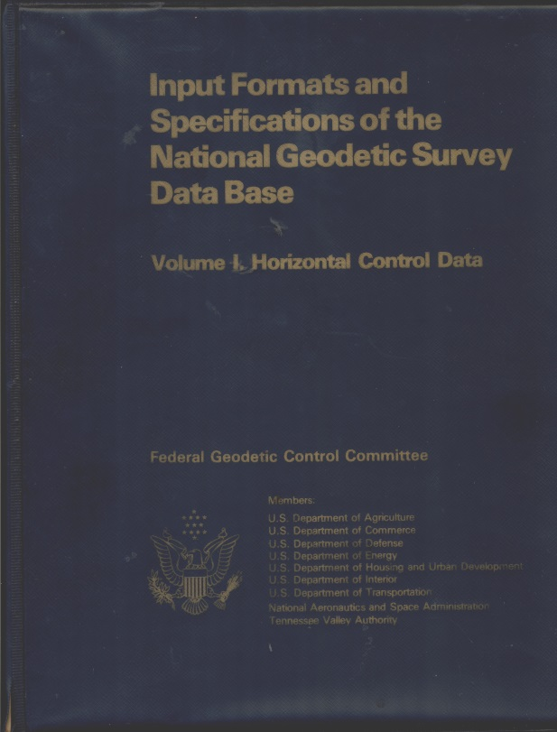
Bluebooking
Refers to the blue cover of Input Formats and Specifications of the National Geodetic Survey Data Base
  The requirements for turning in a geodetic survey to NGS
  Very DOS/FORTRAN heavy
  Horizontal (angles, distances) vertical (leveling) and gravity
    GPS surveys were force-fitted into the horizontal rules
Reputation: “Cumbersome”
  To be fair: All industry standards are cumbersome – it prevents chaos
Notes:
Bluebooking remains the only way for a survey to get into the NGS database as of 2016.

Slide 29
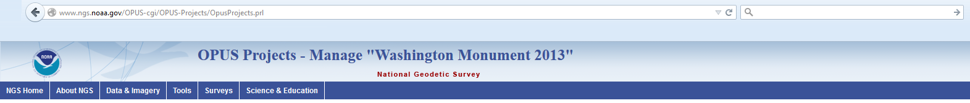
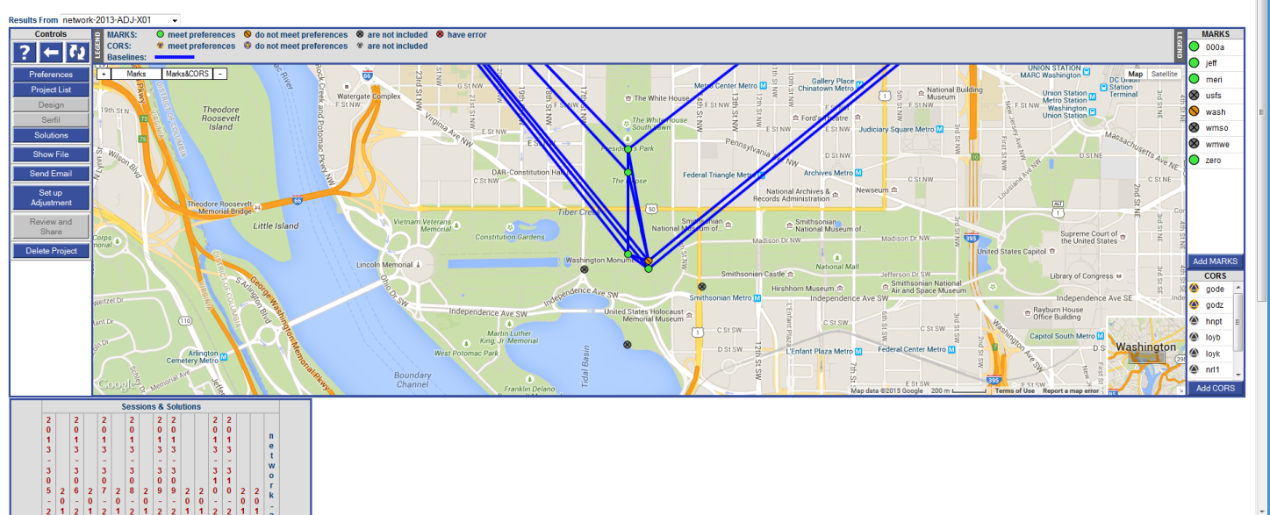
OPUS-Projects
Or “bluebooking for the 21st century”
The 2013 Survey of the
Washington Monument
had GPS, leveling and
traverse components.
An integrated OPUS-Projects might
allow for easier
processing and especially
cross-processing
Notes:
As of right now, OPUS-Projects only processes GPS data and these “tabs” do not exist. This is a mock-up showing the potential for expanding OPUS projects into processing other survey types.
In a survey like the Washington monument, the GPS data could first be processed to determine orthometric heights. This data could then be fed automatically into the ‘leveling tab’…

Slide 30
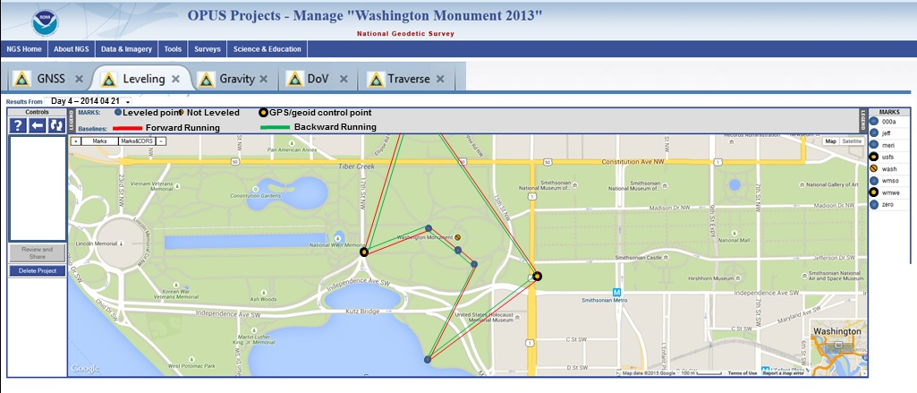
OPUS-Projects
Or “bluebooking for the 21st century”
Notes:
…and in the leveling tab, the pre-determined GPS-derived orthometric heights would be available as stochastic control for the leveling survey, which would then be processed here.

Slide 31
New Database
Replacing the NGS IDB
NGS IDB
  “Integrated Database”
  Current official repository of some (most?) NSRS data
  “Integrated”…2 old DBs:
    Horizontal / Vertical
  Built for
    Passive control
    No time dependencies
    Line of sight techniques
    Points
NSRS DB
  Being built (target: 2020)
  “Spatial” database
  Time tags for everything
  Open design for any type of data
  Things that couldn’t go into the IDB, but can go in the NSRS DB:
    Lines of airborne gravity
    LIDAR clouds
    CORS
    Superconducting Gravimeter data
    Etc.
Notes:
Because the IDB does not support a variety of today’s geodetic applications, an entirely new database is being built. The best of the IDB will be translated over into the new database.

Slide 32
Objective 4 of 5:
Improve the Toolkit

Slide 33
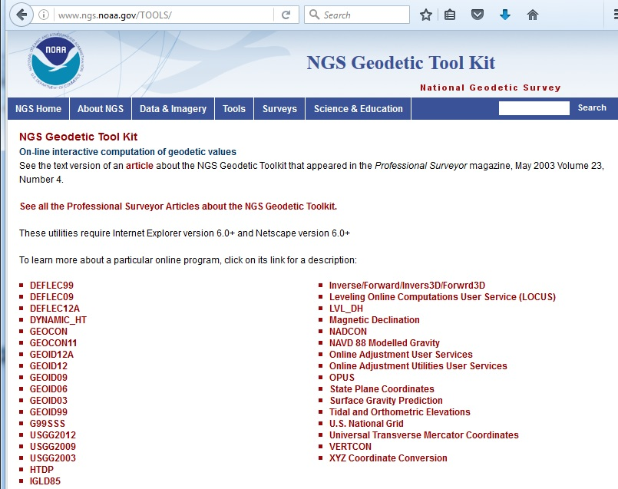
NGS Toolkit
A set of (mostly FORTRAN-based) geodetic tools
Little integration
Many with no online capability
No web services
Notes:
The toolkit is made up of scientifically valid information. However, it is in a language and interface which are both decades old.

Slide 34
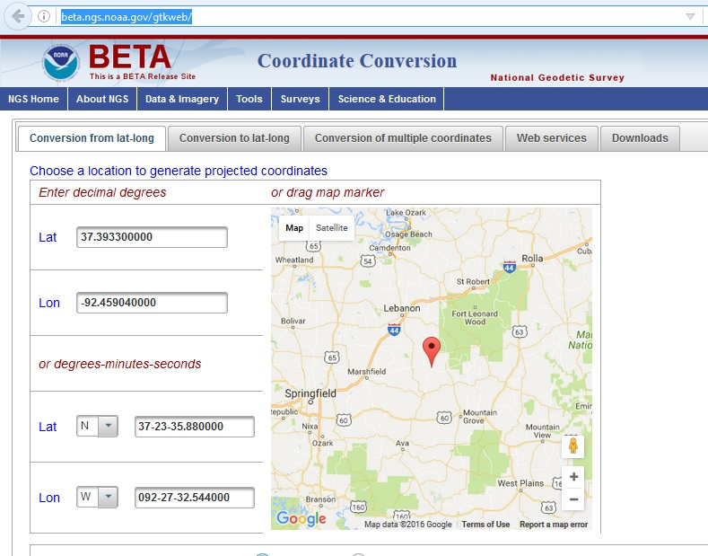
New Toolkit
http://beta.ngs.noaa.gov/gtkweb/
Convert to/from latitude and longitude
  State Plane Coordinates
  UTM
  US National Grid
Upload file of points
Web service
Download and run offline
Notes:
The new interface will begin ingesting more and more components of the original toolkit under one engine.

Slide 35
NADCON 5
Replacing NADCON 4.2 and GEOCON 2.0
Support for nearly all horizontal datums since 1897
  Exceptions: Regional Alaska
No “state by state” grids
Fixing all existing bugs
Web service
Consistent
Documented
Rigorous location-dependent error estimates
Ready to support 2022
Notes:
One of the first things to go into the new toolkit will be NADCON 5, which will transform latitude, longitude and ellipsoid height (when available) between all datums and datum realizations of the USA since 1901, except for some small regional datums.

Slide 36
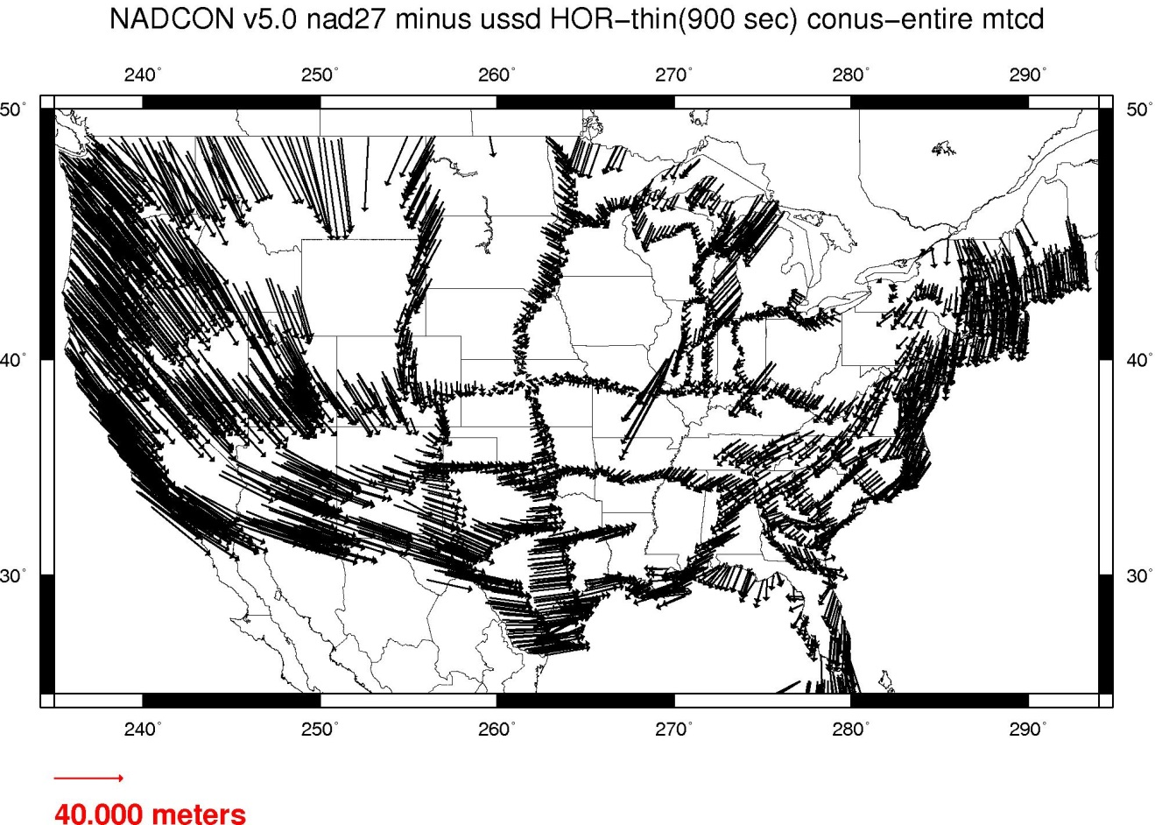
NADCON 5 Example
USSD/NAD 27
Notes:
Shown here are the combined latitude/longitude shifts when converting from USSD to NAD 27

Slide 37
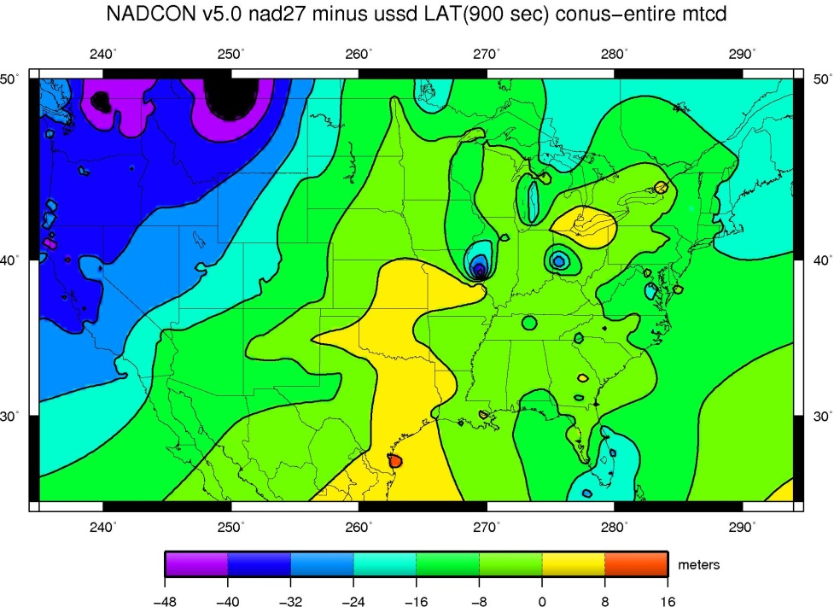
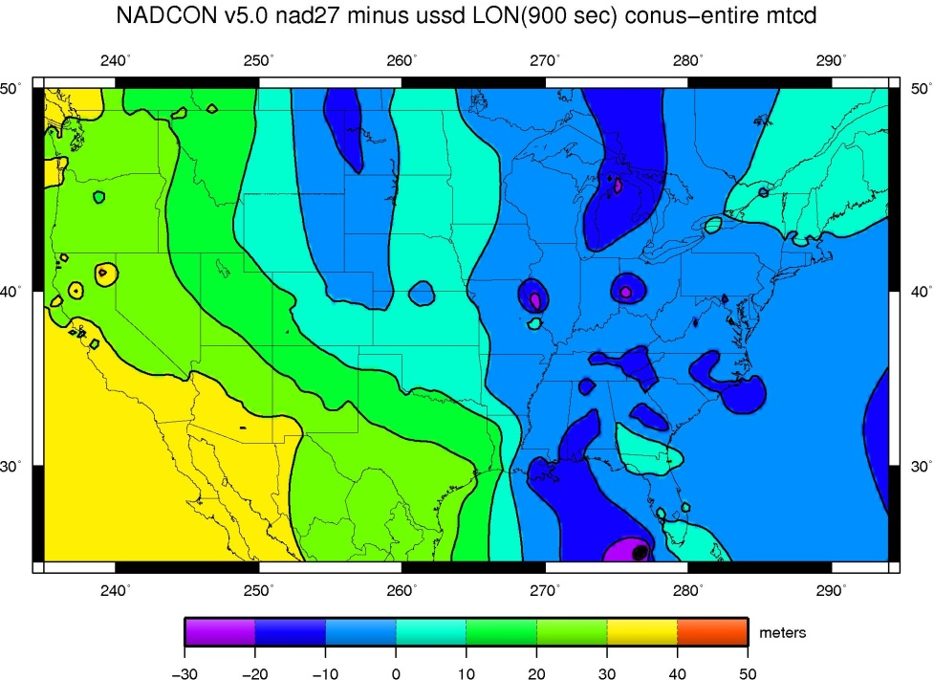
NADCON 5 Example
Transformation shown in meters but actually performed in arcseconds
Notes:
It is easier to visualize changes in meters, so they are plotted here in those units. However, the actual transformations will take place using arcseconds in latitude and longitude. Ellipsoid heights will be transformed using meters.

Slide 38
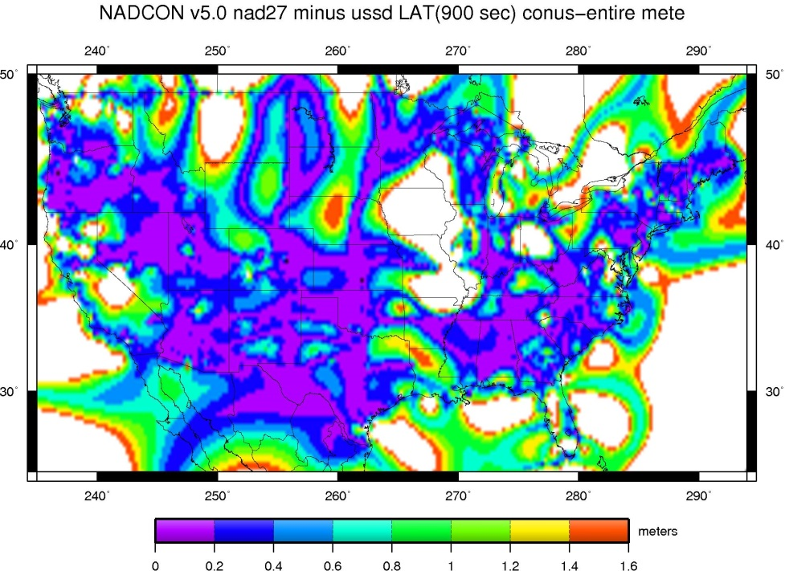
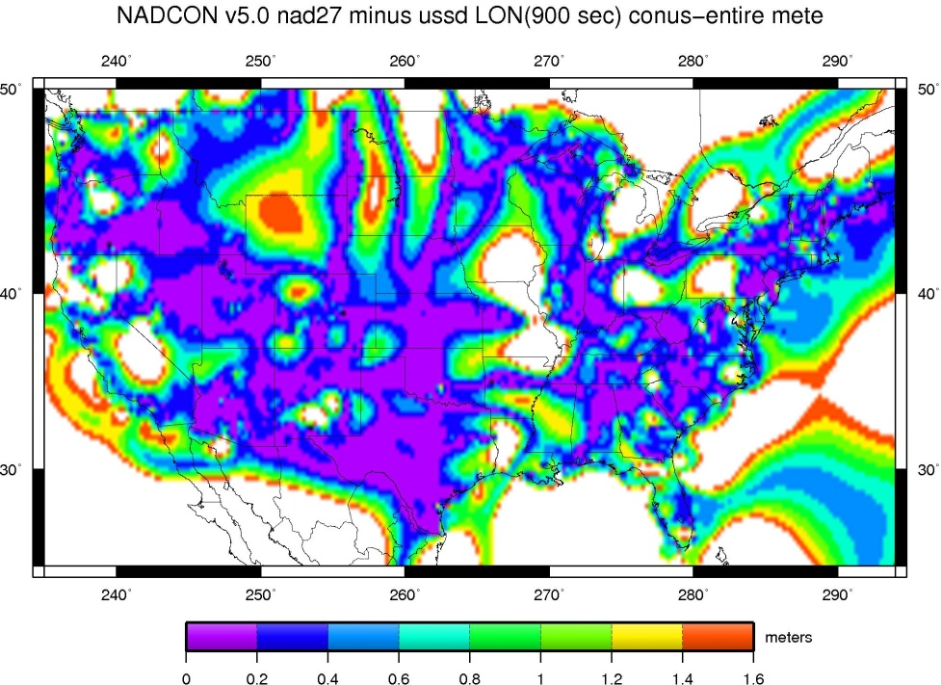
NADCON 5 Example
Errors are no longer generalized (e.g. “15 cm in CONUS”)
Notes:
New to NADCON 5 is the estimation of errors. Each transformation performed will use a geographic grid of errors to express the confidence in that transformation.

Slide 39
Toolkit Future
The entire NGS Toolkit will be integrated eventually
VERTCON 3.0
HTDP
VDatum
All other tools
Notes:
In priority order, these other tools will next be modified for the new toolkit.

Slide 40
Objective 5 of 5:
Better Surveying

Slide 41
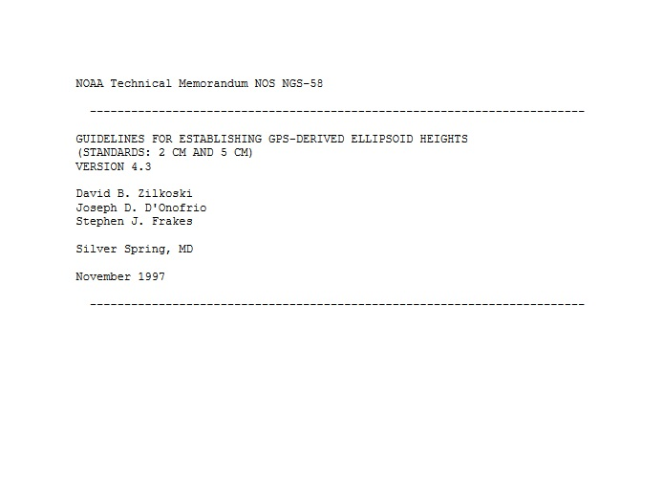
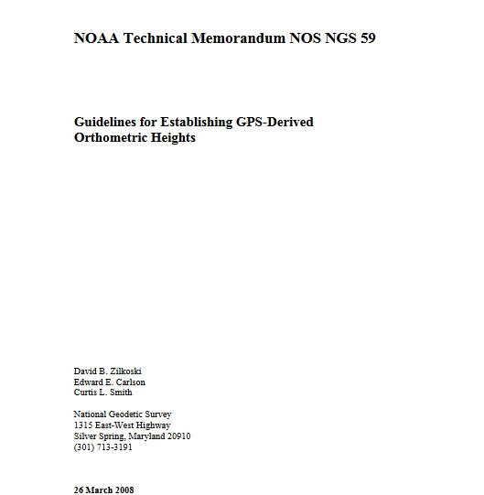
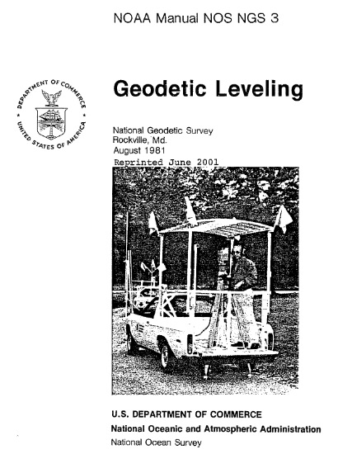
Better Surveying
Overview
A focus on updating technology and field procedures
Field research
New manuals
1997
1981
2008
Notes:
Many of our latest surveying manuals are decades old, and do not reflect the future reference frames and geopotential datum.

Slide 42
Better Surveying
Upcoming project
The role of leveling in a vertical datum defined by a gravimetric geoid and accessed by GNSS
  Acknowledging that leveling cannot yield absolute heights
  Combining GPS and leveling observations
    New adjustment model
    New software (see earlier OPUS-Projects slides!)
Notes:
One of the first new manuals which will be published will be about the use of leveling in a survey where the orthometric control was first determined using GNSS

Slide 43
Summary

Slide 44
Summary
NSRS Modernization
More than just replacing NAD 83 and NAVD 88
Affects most tools, products and services of NGS
Dozens of interdependent, multi-year projects ongoing
Expect rollouts and announcements throughout the next 6 years!

Slide 45
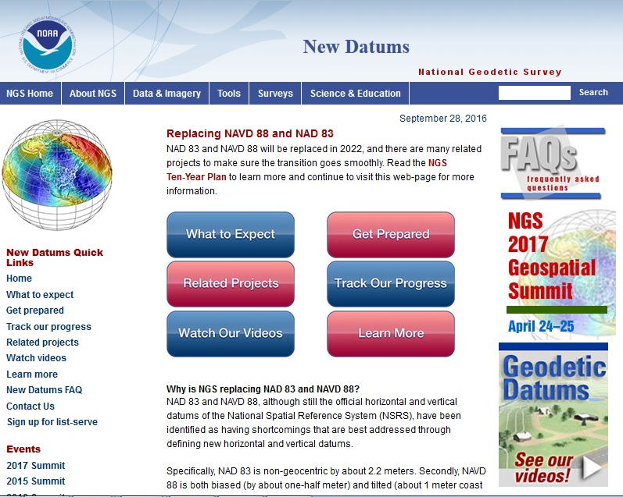
To Learn More
Visit the New Datums web page
geodesy.noaa.gov/datums/newdatums/index.shtml

Slide 46
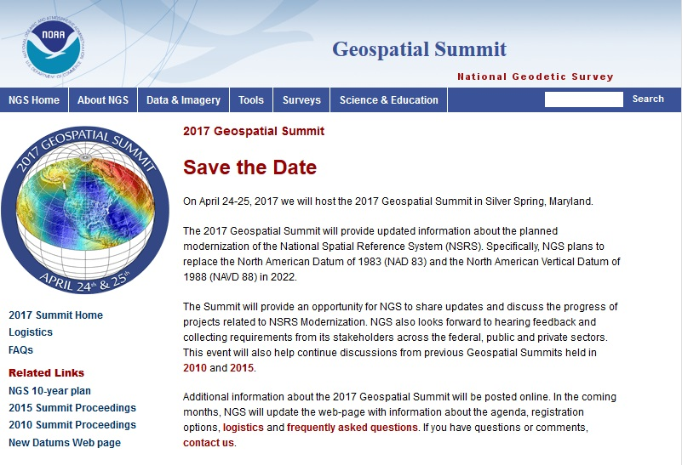
To Learn More
Attend the Geospatial Summit
Silver Spring, MD
April 24-25, 2017
FREE
geodesy.noaa.gov/geospatial-summit/index.shtml

Slide 47
Questions?

