Slide 1
Dealing with Coordinate Drift: Working with Changing Coordinates in the Modernized NSRS
Jacob Heck, Ph.D., P.S.
ISPLS 2024 Convention
January, 2024
Notes:
1:15 for coordinate drift (3 hours total, but with a 30-minute break
The “2022” Datums of the Modernized National Spatial Reference System (NSRS) will be time dependent. Unlike with NAD 83 and NAVD 88, coordinates in NATRF2022 and NAPGD2022 will change with time. This talk will dig into the Passive Control for a Multi-year Corridor Project Use Case from the NGS Blueprint for the Modernized NSRS, Part 3, which looks at a hypothetical project scenario that take place over a long period of time accounts for changing coordinates in the project control. The goal of this presentation is to encourage surveyors to start considering how they will accommodate “drift” over time on long duration projects and discuss the further impacts of time-dependent coordinates with other disciplines and organizations involved in these types of projects.

Slide 2
Overview
Recent NGS updates and announcements
Brief overview of NSRS modernization
Coordinate drift and coordinate types
How NGS tools help deal with changing coordinates
Part 2 (after the break): Heights & vertical datums

Slide 3
NSRS Modernization: Delay
It’s official: we are delayed beyond 2022
Will names change?
    No, “GEOID2022”, “NATRF2022”, etc. will remain the same

Slide 4
NSRS Modernization Timelines
Finish collecting GRAV-D (done!)
Data processing for Multi-Year CORS Solution 3 (ongoing)
Build the geoid model (using software already developed)
2020.0 Reference Epoch Coordinate adjustment
Develop transformation grids
Finalize SPCS2022 (expected 2024)
FGCS votes to adopt it (expected 2025)

Slide 5

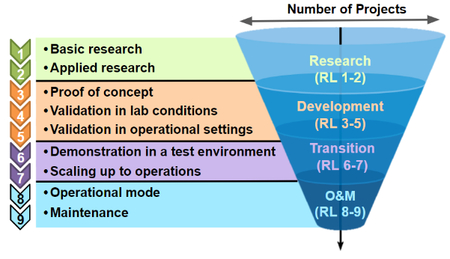
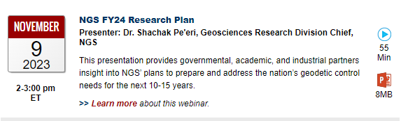
NGS Research Plan
NGS released a new research plan
Available at https://geodesy.noaa.gov/
web/about_ngs/info/documents/
ngs-research-plan-2024-final.pdf
Presented as a webinar on November 9, 2023
Notes:
Focus on not just getting to modernized NSRS, but also beyond

Slide 6
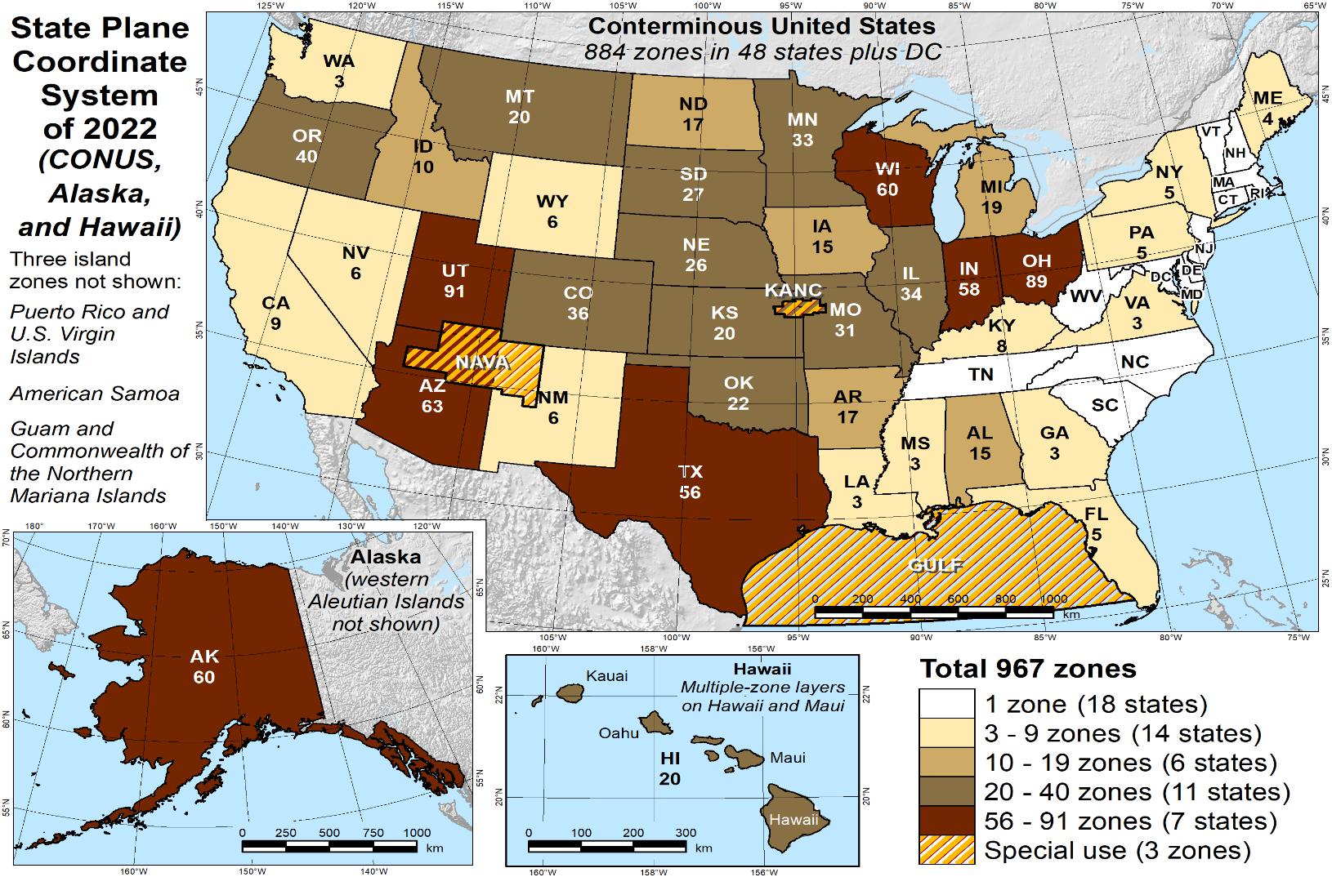
SPCS2022 zones (preliminary)
967 total zones nationwide
Indiana has 2 zone layers:
  A statewide zone
  57 LDP zones
Notes:
Designs by NGS
165 zones
Includes 54 statewide zones…
…and 3 “special use” zones
(in more than one state)
Designs by state stakeholders
802 zones in 28 states
Total = 967 zones
for 56 states
and territories
Compare to 125
zones in existing
State Plane

Slide 7
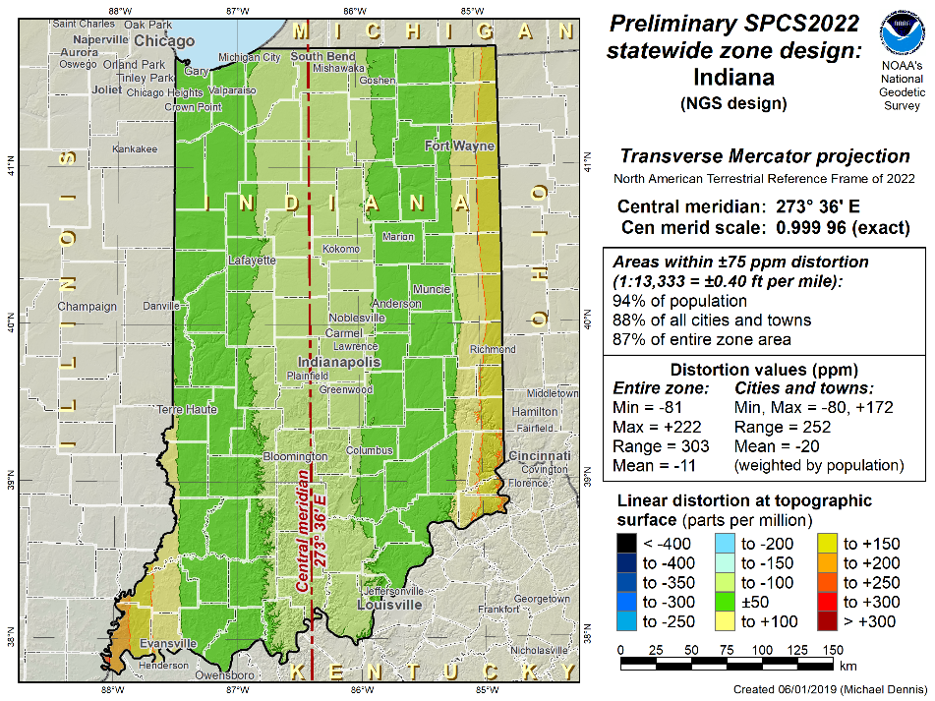
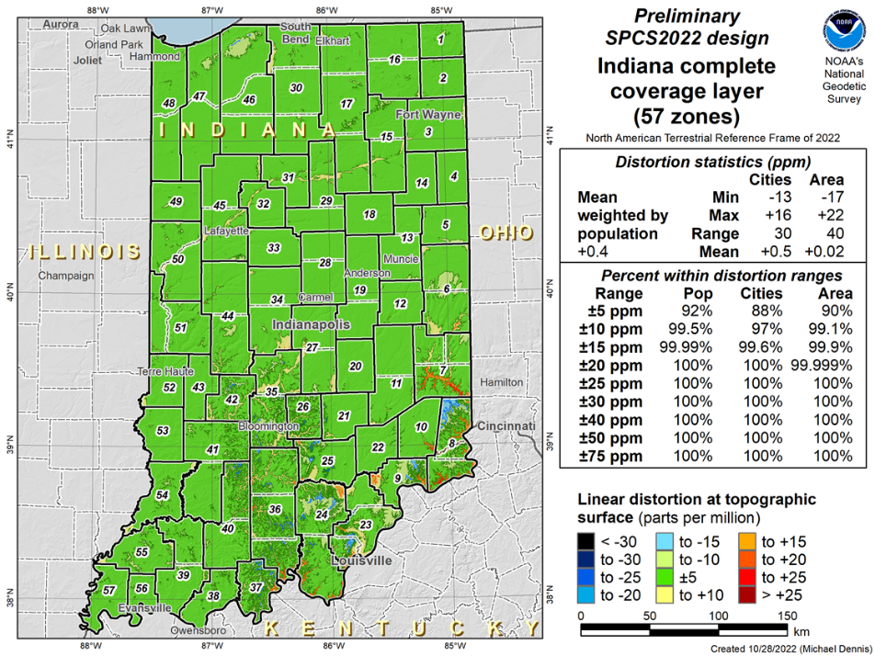
Indiana SPCS2022 Layers
Statewide Zone
LDP Zones Layer

Slide 8
Next Step: Legislation
Proposed to state legislatures in 1945 by Council of State Governments to:
  Establish legal status, insure uniformity and definiteness in use
  Impose reasonable standards when coordinates become part of public record
Use of system is permissive, not mandatory
Uniformity of legislation is desirable
Legislation not required to establish State Plane

Slide 9
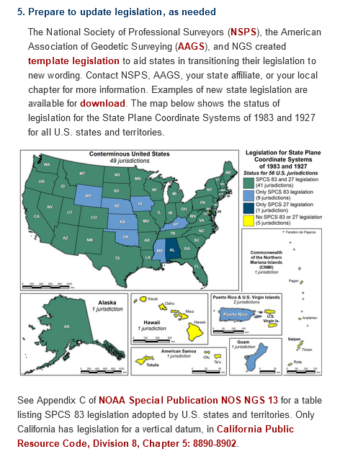
Template and Example State Legislation
https://geodesy.noaa.gov/datums/newdatums/GetPrepared.shtml
Created by NSPS, AAGS, and NGS
  Intended to augment existing legislation
  Defined by NGS OR by state (not both)
Reduce need for later legislation updates
  Do not include specific names of datums, etc.
  Do not include zone projection parameters
Foot version
  Must be 1 ft = 0.3048 m for new State Plane
  Can be 1 ft = 1200/3937 m for previous
  State Plane

Slide 10
NGS’s Mission
Define, maintain, and provide access to the National Spatial Reference System (NSRS)
The NSRS is a consistent coordinate system that defines latitude, longitude, height, scale, gravity, and orientation throughout the United States
This talk focuses on the “provide access” part

Slide 11
NSRS Modernization … not just new datums
Replacing NAD 83
Replacing NAVD 88
Re-inventing Bluebooking
Improving the Geodetic Toolkit
Better Surveying Methodologies
Blueprint for Modernized NSRS, Part 1
Blueprint for Modernized NSRS, Part 2
Blueprint for Modernized NSRS, Part 3
  How NGS will provide the frames/datum in the future
  How YOU can use the frames/datum

Slide 12
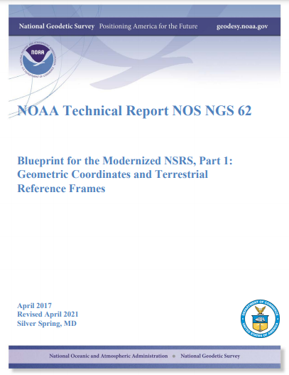
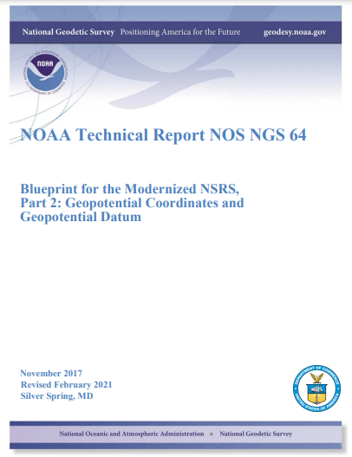

Blueprint Documents
Available in the NGS Publications Library: https://geodesy.noaa.gov/library/
Geopotential:
Nov 2017
Revised Feb 2021
NOAA TR NOS NGS 64
53 pages
Working in the
Modernized NSRS:
April 2019
Revised Feb 2021
NOAA TR NOS NGS 67
133 pages
Geometric:
Sep 2017
Revised April 2021
NOAA TR NOS NGS 62
61 pages
Notes:
Geometric: replacing NAD 83
Geopotential: replacing NAVD 88
Working in: Re-inventing Bluebooking
Improving the Geodetic Toolkit
Better Surveying Methodologies
How NGS will provide the frames/datum in the future
How YOU can use the frames/datum

Slide 13
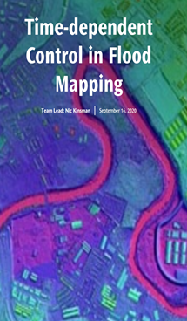
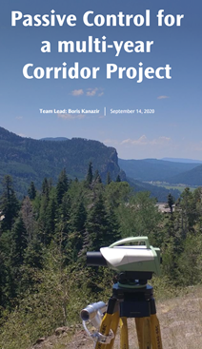

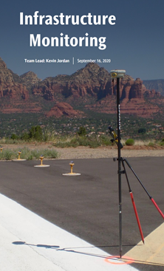
Use Cases

Slide 14
Replacing the Existing Datums
The Old | The New
NAD 83 (2011) | NATRF2022 - The North American Terrestrial Reference Frame of 2022
NAD 83 (2011) | CATRF2022 - The Caribbean Terrestrial Reference Frame of 2022
NAD 83 (PA11) | PATRF2022 - The Pacific Terrestrial Reference Frame of 2022
NAD 83 (MA11) | MATRF2022 - The Mariana Terrestrial Reference Frame of 2022
NAVD 88 | NAPGD2022 - The North American-Pacific Geopotential Datum of 2022

Slide 15
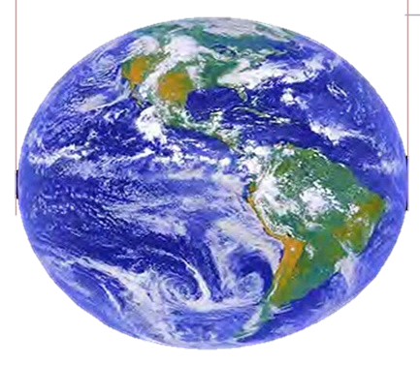
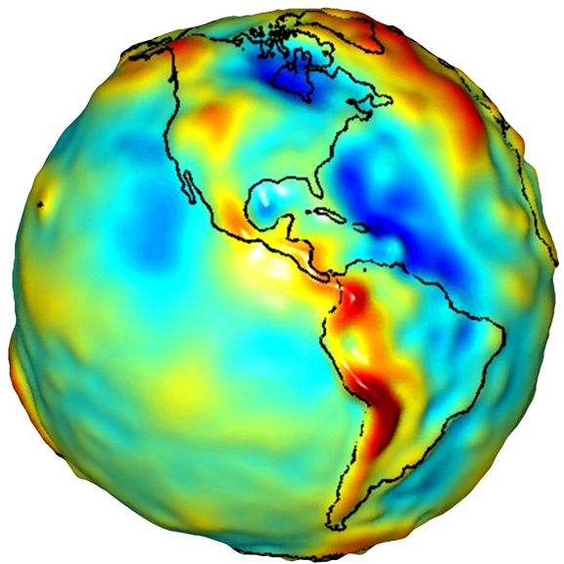
Geocentric Datums
Z
Ellipsoid
X
Y
Geoid
Notes:
Both geometric frames and geopotential frames are based on center of the earth, not the surface. Therefore, the geopotential
Old method: leveling from bench mark, plus NAD 83 was not geocentric, so we had to develop “hybrid” geoid models in order to have NAVD 88 and NAD 83 work together
New method – GNSS and Geoid model (defined to work together!) frame can be accessed through the geometric frame

Slide 16
The Geoid, and Heights
h
= H
+ N
h: ellipsoidal height (from GNSS)
H: orthometric height
N: geoid undulation (from geoid model)
Topography
h
H
The geoid
N
A chosen
ellipsoid
Notes:
Fundamental changes to how we access the vertical datum

Slide 17
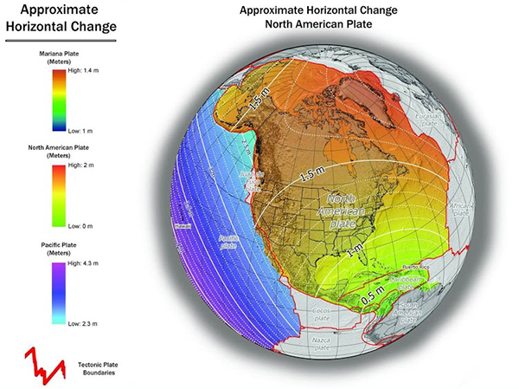
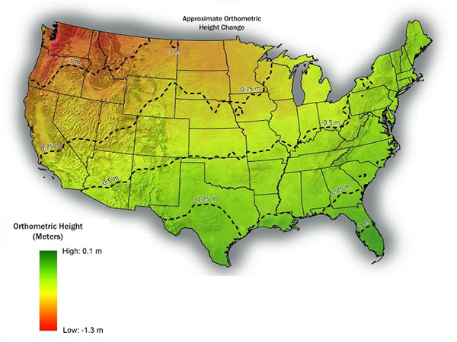
Modernized NSRS: Shift and Drift
Notes:
Fundamental changes to the datums
Then embrace time-dependency
Much of the initial coordinate change comes from making the datums geocentric

Slide 18
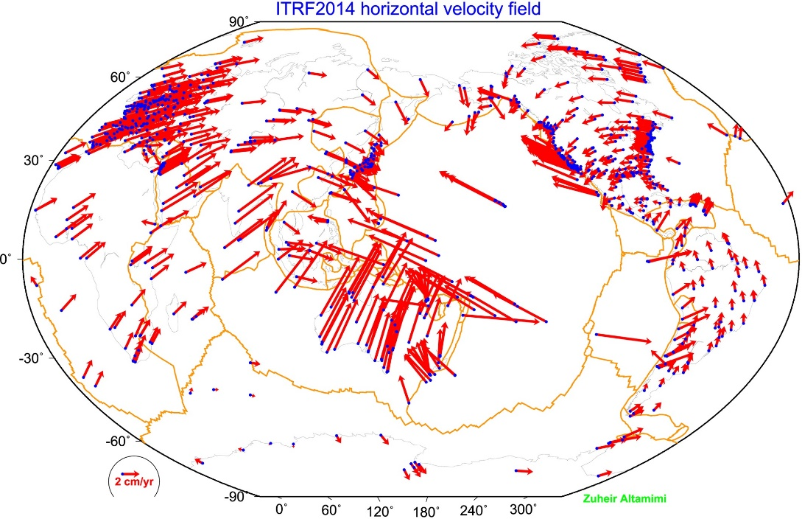
Connection to ITRF
The International Terrestrial Reference Frame (ITRF) is defined by reference epoch coordinates AND velocities at stations
The ITRF velocity field very closely resembles absolute plate motion
The ITRF and IGS frames are both no-net-rotation frames – the sum of the angular velocities is constrained to be zero
Altamimi et al., 2016, JGR

Slide 19
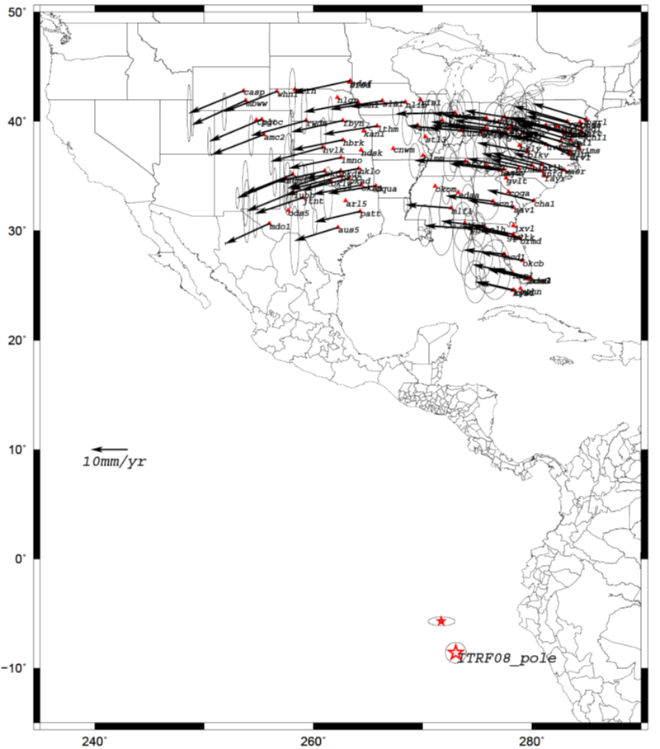
Euler Poles and “Plate-Fixed”
  In the ITRF, many tectonic plates have a dominant motion: rotation
  Euler Pole - point about which a plate rotates (yellow star)
  Euler Pole Parameters (EPP) define this rotation
  Residual motion is characterized in an Intra-Frame Deformation Model (IFDM)
NATRF2022 Euler Pole
Notes:
We say “NATRF2022” is “fixed” to the N.A. Plate, making it a “plate fixed” frame
-the frame is constant to itself, but rotating within ITRF, and moving in a different direction than the other 3 frames
To model the change of coordinates in time, NATRF2022 will include an Intra-Frame Deformation Model (IFDM), to account for any residual and/or local motions within the plate-fixed reference frame. The IFDM can be used for propagating coordinates to different epochs

Slide 20
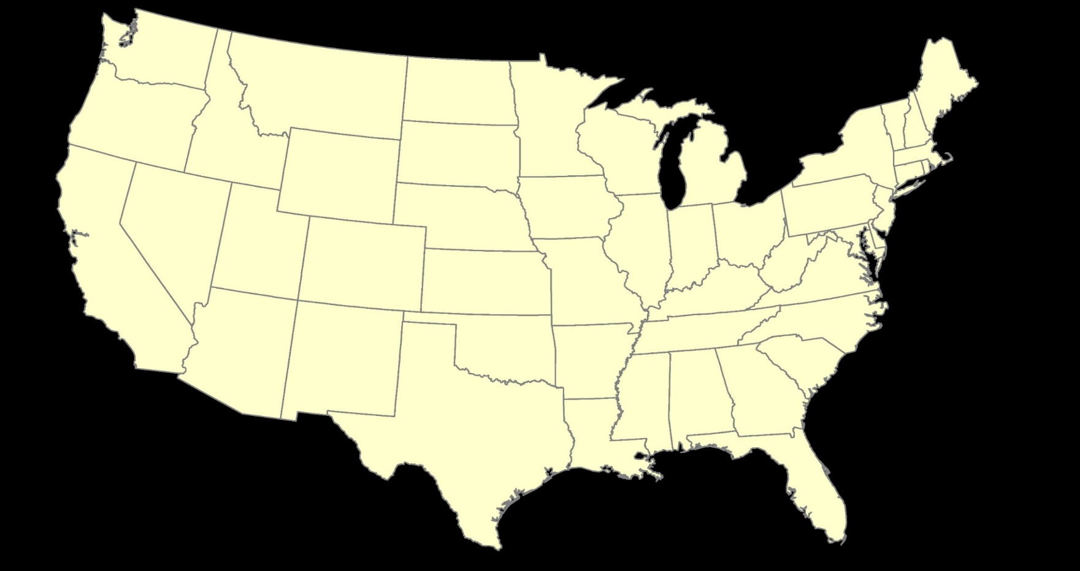
ITRF2020 or NATRF2022

Slide 21
Why do Coordinates Drift?
Notes:
Long-term motion (GIA)
Seasonal motion
Episodic events (earthquakes)

Slide 22
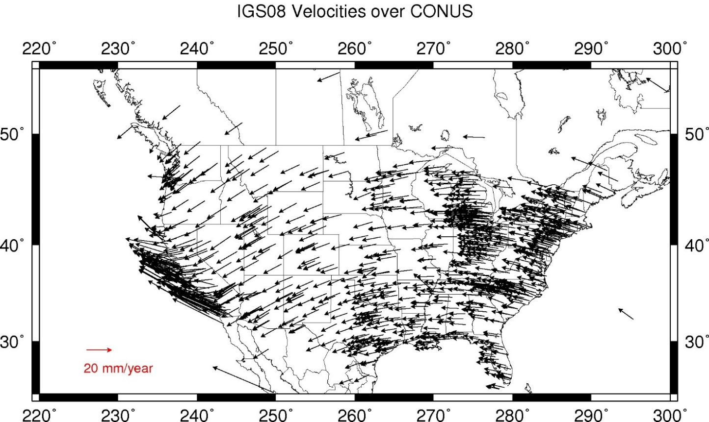
Residual Velocities – ITRF2020/CONUS
Notes:
This diagram of CONUS shows the IFVM2022 velocities expressed in the ITRF2020 Frame.
Note the arrows are about 20 mm/yr
It can generally be interpreted as “at what velocity are points in CONUS moving relative to the ITRF Frame?”

Slide 23
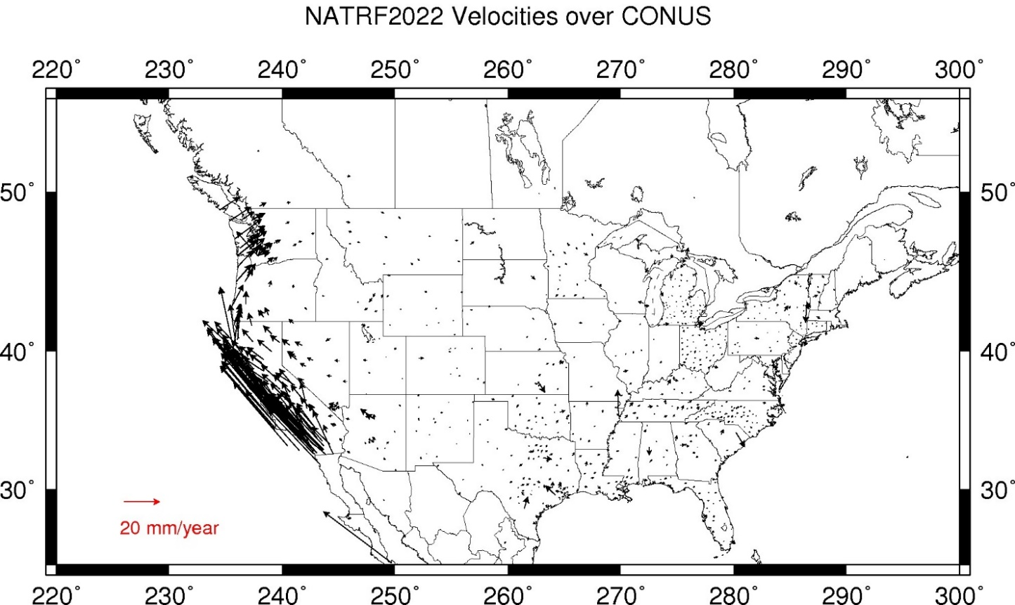
Residual Velocities – NATRF2022/CONUS
Notes:
This diagram of CONUS shows the IFVM2022 velocities expressed in the NATRF2022 Frame.
Note that even in “stable North America”, these velocities are not absolutely zero!
The IFVM2022 model will contain these tiny deviations from simple plate rotation!
It can generally be interpreted as “at what velocity are points in CONUS moving relative to the North American plate?”

Slide 24
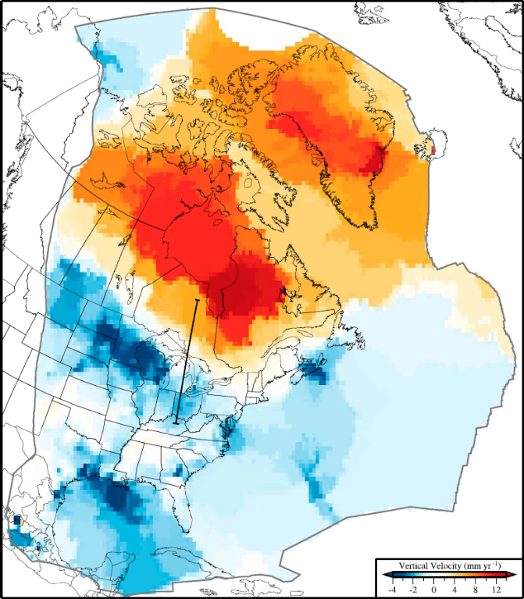
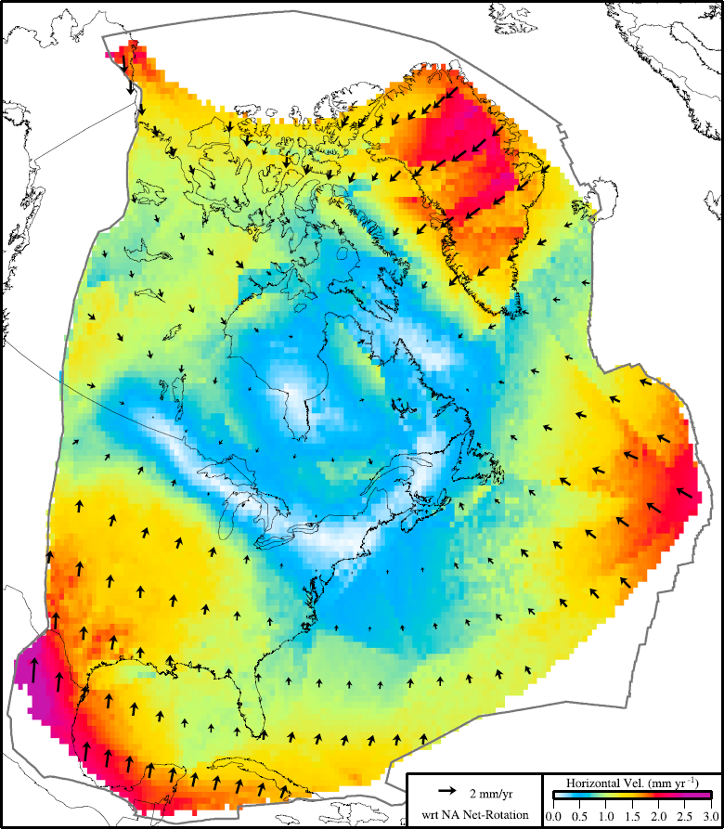
Movement within the Stable North American Plate
  Example of long-term motions
  Glacial Isostatic Adjustment (GIA) in this case
From Kreemer, Hammond, & Blewitt, 2017

Slide 25

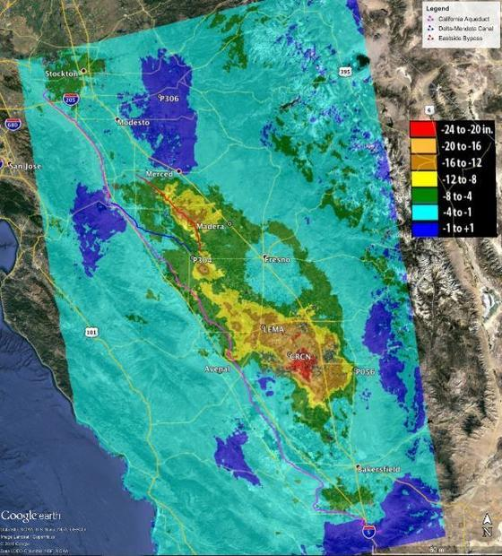
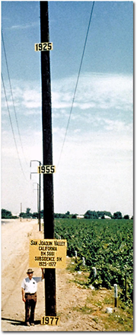
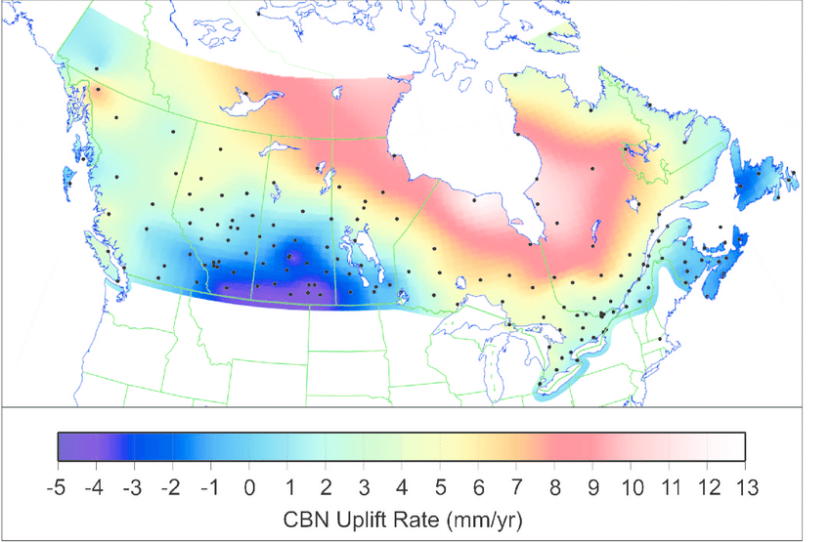
Vertical Motion
8.5 meters
50 years
May 2015
to
Sept 2016
Hudson Bay Uplifting
8 -13 mm/year
San Joaquin Subsiding
20-24” in 16 months
Notes:
San Joaquin Subsidence article
http://www.digitaljournal.com/tech-and-science/technology/sinking-san-joaquin-valley-of-california-seen-from-space/article/487393
Hudson Bay Uplift article
https://www.researchgate.net/figure/Contour-map-of-observed-CBN-vertical-rates-Preliminary-results-from-the-combination-of_fig3_286867540
GIA

Slide 26
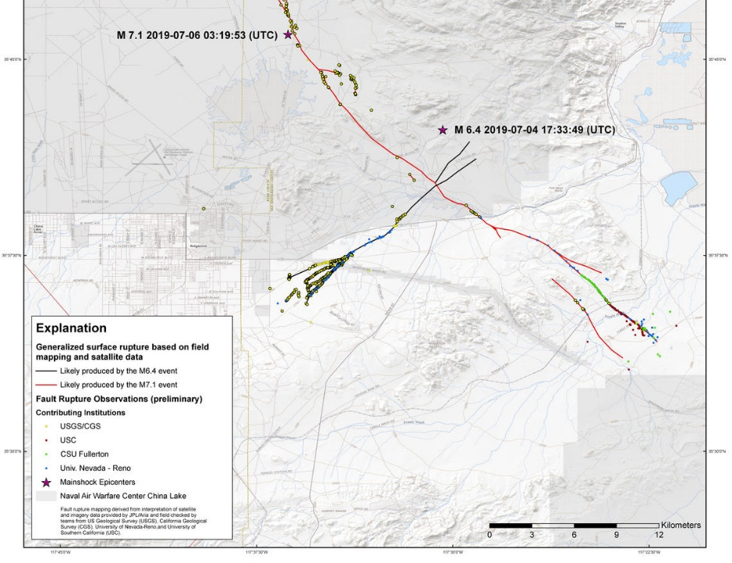
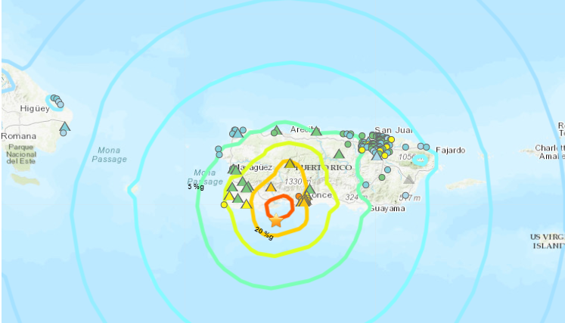
Episodic Motion - Earthquakes
China Lake, CA
6-10 feet Horizontally
Puerto Rico
16 cm Vertically
Notes:
China Lake Earthquake
https://www.usgs.gov/news/update-magnitude-71-earthquake-southern-california?qt-news_science_products=7#qt-news_science_products
Puerto Rico Earthquake
https://cunycis.maps.arcgis.com/apps/webappviewer/index.html?id=5f516f41baa84f9ba9e8207c2005ee4d

Slide 27
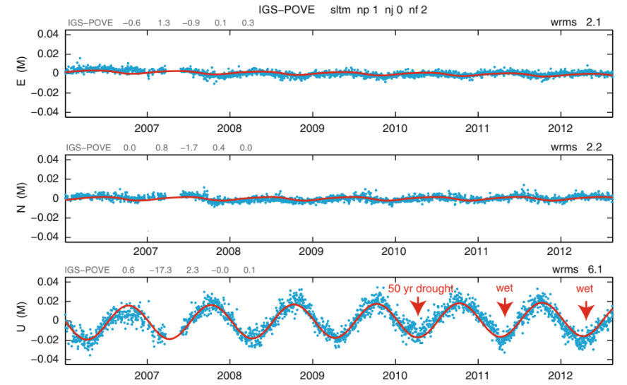
Seasonal Motion
Continuous GNSS stations generally show seasonal trends, especially in the vertical
ITRF2020 is incorporating non-linear terms as part of its station trajectories
  Seasonal signals, post-seismic transients
NSRS implementation is being evaluated at NGS
From Bevis & Brown (2014)

Slide 28
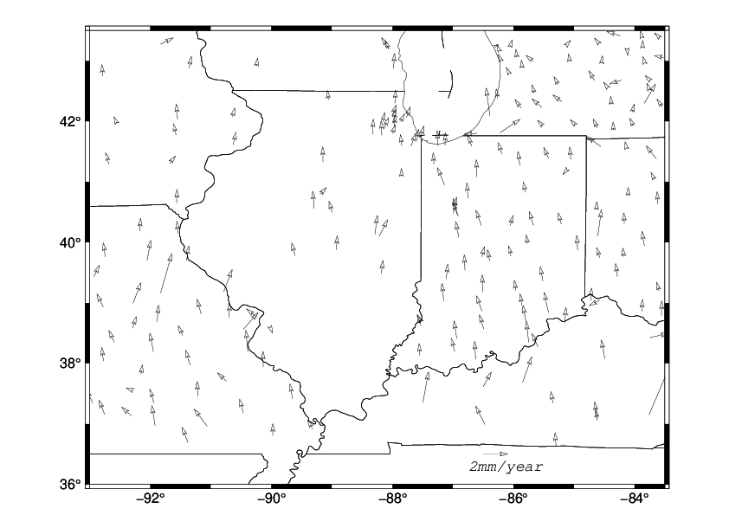
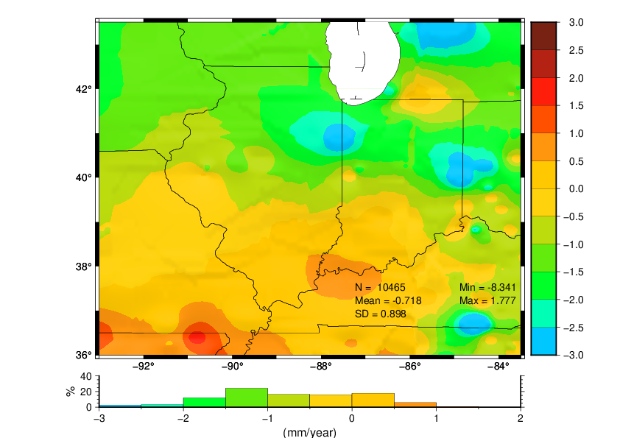
Regional Coordinate Drift
Notes:
Hz velocity relative to the stable NA plate, computed as: V_MYCS2 minus V_NA_plate, where the latter is based on the Kreemer et al. 2014 Euler pole. As you know, this Euler pole is computed with GIA in mind. In other words. it does not ignore GIA like Altamimi usually does when he comes up with plate models with his ITRFs. Notice that most arrows clearly point north with a magnitude of ~1 mm/yr, as they should, due to Hz GIA.
An interpolated map of MYCS2 vertical velocity. As you know, the interpolation of continental vertical velocity is kind of a VERY rough operation and should be taken with a grain of salt, even though it is done based only on the closest CORS. So, nobody should use this map to see how there little town is doing. The values in it might correctly reflect long trends, and that is it. N in the figure is the number of pixels with data.

Slide 29
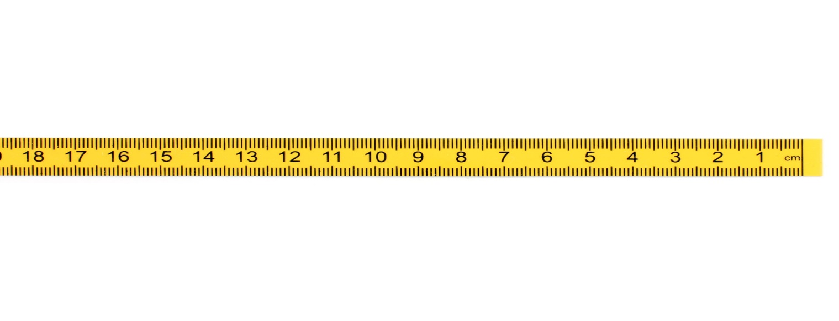

Coordinates, Frames, Epochs, EPP2022 and IFDM2022
A survey done Jan 1, 2023 and reported at epoch 2020.0
New Survey (same point) done Jan 1, 2030
Position of point in NATRF2022(2030)
Position of point in NATRF2022(2020)
If IFDM = 0, then NATRF2022 (2030) = NATRF2022 (2020)
Position from 2023 survey NATRF2022 (2020.0)
ITRF2020 (2020.0)
(V)
ITRF2020 (2030.0)
IFDM 2030-2020
NATRF2022
(2020.0)
Epp2022
fframe
NATRF2022 (2030)
fEpoch
(H)
Notes:
At 2020, ITRF and NATRF are identical.
CLICK
As time goes on the North American plate moves, resulting in new ITRF coordinates at epoch (say 2030) for the same point.
CLICK
If I remove 10 years of plate motion (ITRF velocity) it puts me back where NATRF used to be....EXCEPT, there has been local motion.
That is why we call the it NATRF epoch 2030, because it is where NATRF IS in 2030.
CLICK
We now have to apply IFVM to get back to 2020, or any other date relative to NATRF.
* EPP2022 changes the FRAME
* IFVM2022 changes the EPOCH
To model the change of coordinates in time, NATRF2022 will include an Intra-Frame Deformation Model (IFDM), to account for any residual and/or local motions within the plate-fixed reference frame. The IFDM can be used for propagating coordinates to different epochs

Slide 30
Coordinates in the Modernized NSRS
Five types:
  Active: Continuous functions at a CORS
  Survey Epoch: “Time dependent coordinates”
  Reference Epoch: “Estimated at 2020, 2025, 2030, …”
  OPUS: Computed by you, and as accurate or inaccurate as the choices you make
    Tied to the NSRS if you follow OPUS recommendations
  Reported: Good for finding a point somewhere on Earth.
    Not to be used as geodetic control
Notes:
Coordinates are the derived value

Slide 31
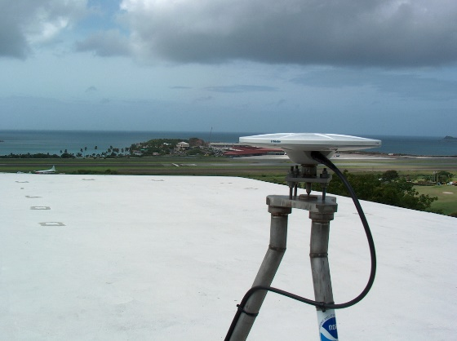
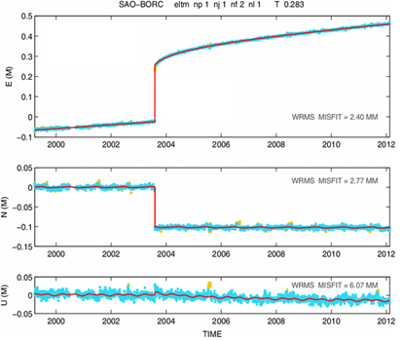
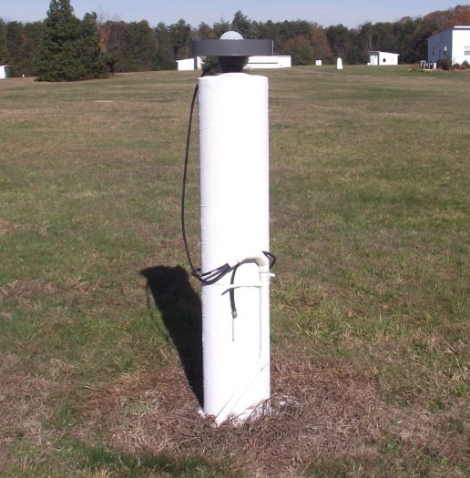
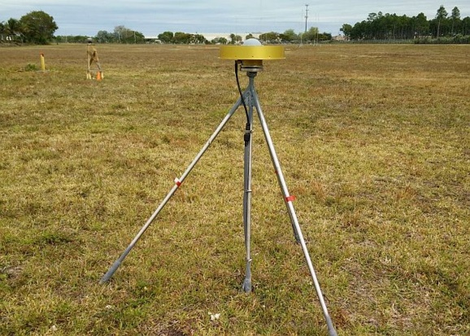
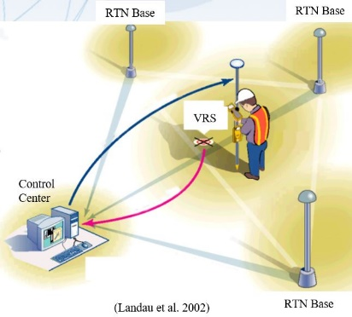
Active Control

Slide 32
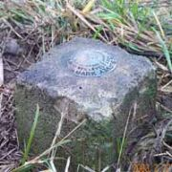
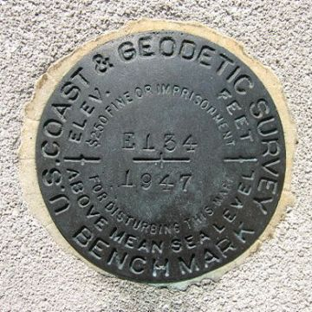
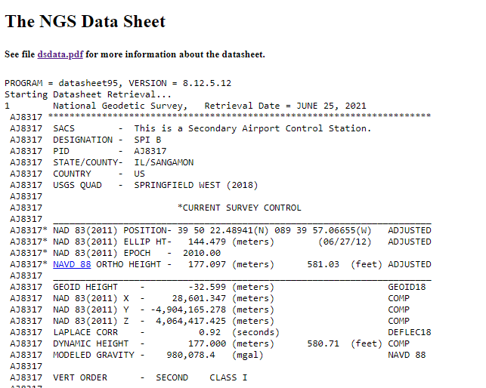
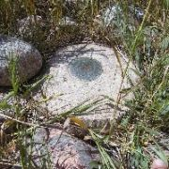
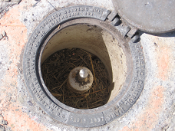
Passive Control
Notes:
Any geodetic control point that is not active control. Common examples include a metal disk set in concrete or stone, or a stainless steel rod driven into the ground.
Can be easily destroyed or damaged, though.
Not available everywhere
Passive control benefits in Modernized NSRS:
Time series analysis
Epoch definitions
Trusted control marks
Project location selection
Infrastructure monitoring
More reliable and accurate data

Slide 33
Published Coordinates - Passive Control
Reference Epoch Coordinates
Survey Epoch Coordinates
Part of the NSRS
Based on “snapshot” of entire NSRS control network
Published every 5 or 10 years (regular intervals)
RECs can be used to “hide” changes over time
Familiar to many users…
Part of the NSRS
Time-dependent coordinates, time being at “survey epoch”
Published on short intervals (4 weeks)
SECs can be used to highlight changes over time

Slide 34
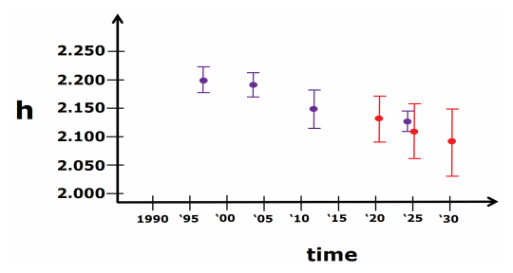
RECs and SECs
SECs: adjusted to a midpoint epoch near the survey
RECs: adjusted to a ref. epoch (2020.00, etc.)
REC adjustments will include Some age-limited span of data
Purple = SEC
Red = REC

Slide 35
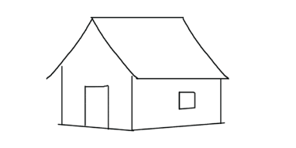
Published Coordinates
RECs ‘stable’ at project scales (5-10 years)

Slide 36
Published Coordinates
RECs ‘stable’ at project scales (5-10 years)
SECs reflective of narrow window in time
ACs or Coordinate Function at CORS
height
time

Slide 37
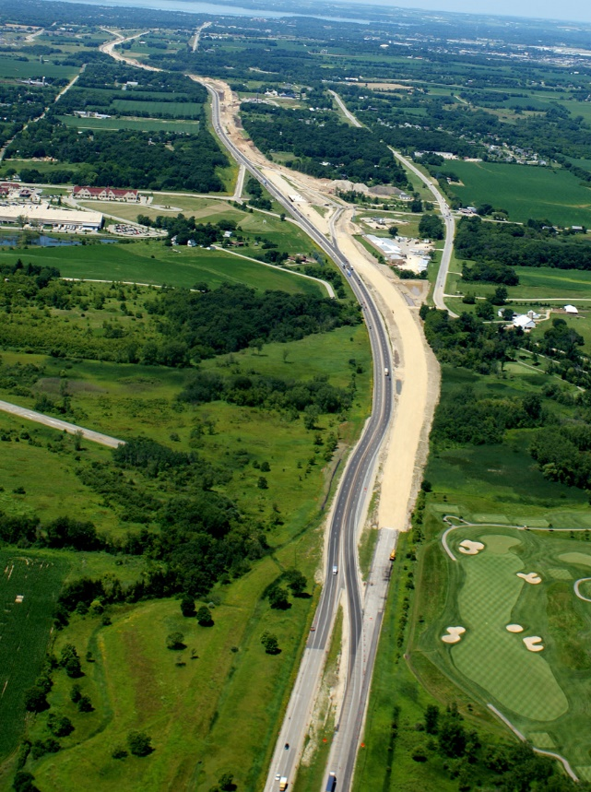
Consider this Scenario…
New road built over 10-year period 2025-2035
Contract requires project be tied to NSRS
Using a RTN aligned with NSRS at epoch 2020.00
Intend to use 2020.00 epoch for entire duration of project even if the RTN switches epochs
Established rules for how much drift could be tolerated before moving to a new epoch

Slide 38
Workflow
Recover existing passive control surrounding the project
Establish primary and secondary project control
Use RTN to occupy and assess existing control and observe on added control
Differential leveling between control is used to derive orthometric heights
Compute and publish project control referenced to selected reference epoch matching RTN broadcast epoch

Slide 39
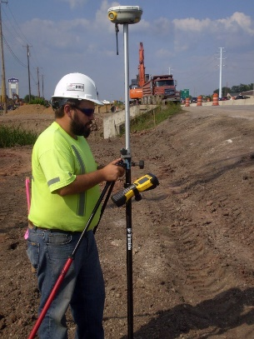
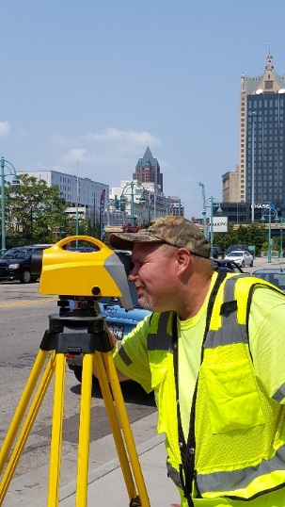
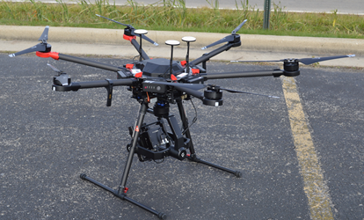
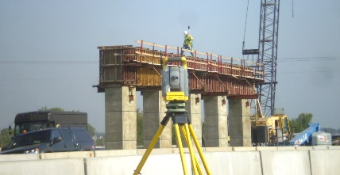
Survey Data
CONTROL
GNSS
CONVENTIONAL
LEVELING
OTHER
Total Station
Static
RTK
Differential Leveling
Mobile LiDAR
Aerial LiDAR/Photogrammetry
Terrestrial Laser Scanning
RTN

Slide 40
Control Surveys and Coordinate Types
Control Surveys
Survey Epoch Coordinates
Survey Epoch Coordinates
RTN Alignment
Reference Epoch Coordinates
Leveling Control
Reference Epoch Coordinates
Reference Epoch Coordinates
GNSS Control
Notes:
All survey control should be tied to a common reference epoch.
The idea is to use one set of coordinates (assuming they have not changed).
This will allow for a proper QA/QC throughout all of the phases of the project.

Slide 41
Combining Geodetic Leveling & GNSS
REC = Reference Epoch Coordinates
SEC = Survey Epoch Coordinates
IFDM = Intra-Frame Deformation Model
PC = Primary Control
Leveling
Begin
Mid
End
SEC
IFDM
SEC
2.250
GNSS
on PC
2.200
GNSS
on PC
SEC
h
2.150
REC
2.100
GNSS
on PC
2.050
IFDM will be used to move primary control (PC) coordinates and
observations to REC 2020.00, and geometric and orthometric
values on all primary control points will be adjusted at REC 2020.00
2.000
REC
2020.00
Jan
2024
Jun
2024
Dec
2024
time

Slide 42
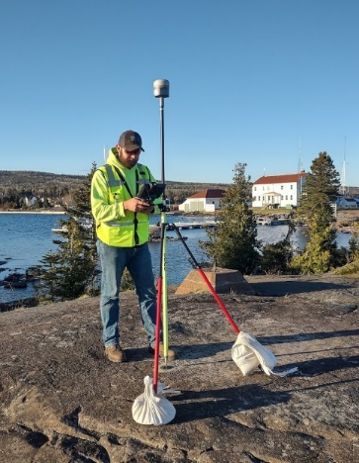
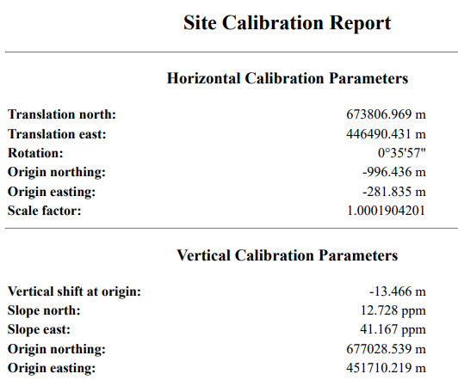
Monitor Project Control
The project control must be monitored over time by doing test GPS calibrations to detect the amount and uniformity of drift in coordinates and orthometric heights

Slide 43



Think About Others in the Process
CAD manager
Design engineers
Construction inspector
Contractor using machine control
GIS/mapping coordinator
Other downstream users of the data
Notes:
It is crucial that all the project participants either contributing survey data to the project or doing construction staking based on the project bid documents and plans be on the same page.
Everyone must be using the same coordinate values for the passive control and have all equipment set to the correct coordinate system, datums, reference epoch, units etc. and use the same RTN to participate in the project.
There is also the possibility of error if they are not using the correct coordinates for the passive control or have erroneous coordinate system or unit settings in their data collector.
Whoever participates in the project with RTN GNSS must verify their surveying equipment settings and loaded control and 3D models by verifying observations on the project passive control.
Non-survey personnel utilizing machine control graders or pavers must have their equipment and the 3D models verified against the passive project control.

Slide 44

Tools and Models Provided by NGS
Intraframe Deformation Model (IFDM2022)
  Model to move coordinates through time
Dynamic Geoid Model (DGEOID2022)
  Model to move geoid heights through time ($\dot{N}$)
NGS Coordinate Conversion and Transformation Tool (NCAT)
  Move between datums and coordinate types
Data delivery (data sheets) is also getting updated
Pay attention to uncertainty in the tools as NSRS Modernization rolls out
Will be built into NGS tools such as OPUS and OPUS Projects
Notes:
Pay attention to the uncertainly in the tools
Watch the accuracy! All values will be published to .001, but the sigmas will tell you how good the information is

Slide 45

Modernized OPUS Workflow

Slide 46
Metadata
Metadata Statement Tomorrow
Horizontal Datum
Horizontal Datum Epoch
Vertical Datum
Vertical Datum Epoch
2020.00
Coordinates & Bearings
NATRF2022
NAPGD2022
2020.00
SPCS2022
2025.00
2030.00
2025.00
2030.00
Unit
Foot
Data cannot be fully understood without metadata
Insist on including metadata with any outgoing data including on the face of project plans and ask for it to be included with any incoming data
Notes:
Build a culture at your firm where metadata is considered a crucial component of project documentation.
To reiterate what Mike M said

Slide 47
Metadata Information That Could Be Included
Latitude, longitude, and ellipsoid heights: North American Terrestrial Reference Frame of 2022 (NATRF2022)
Orthometric heights: North American-Pacific Geopotential Datum of 2022 (NAPGD2022)
Epoch: 2020.0000
Linear unit: International foot, ift (1 foot = 0.3048 meter)
Projected coordinate system: State Plane Coordinate System of 2022 (SPCS2022), Kentucky North Central zone (KY NC, 211007)
Notes:
Orthometric heights (elevations) were determined using GNSS with NGS geoid model GEOID2022 combined with differential and trigonometric leveling.

Slide 48

Datasheets
Datasheets are the current way to access the NSRS
Give information about passive marks, including coordinates

Slide 49

Beta Passive Marks Page
Easier to read
Includes geospatial information
A preview of the future data delivery system
https://beta.ngs.noaa.gov/datasheets/passive-marks/index.html
Notes:
Show DE9524, a mark near Springfield

Slide 50


Beta Passive Marks Page

Slide 51

Easy to Use Mark Recovery Tool
https://geodesy.noaa.gov/cgi-bin/mark_recovery_form.prl

Slide 52

NGS Map
https://geodesy.noaa.gov/datasheets/ngs_map/

Slide 53
Tools for Modernization
Re-survey
  Return to the field, and survey points of interest, relying on the modernized NSRS control
    Definitely can yield new “geodetic control” (for a while) for you to use
Re-adjust
  Using pre-existing observations, load them up to OPUS, and re-adjust them to modernized NSRS control
    Probably yields new “geodetic control” (for a while) for you to use
Transform
  Using tools like NADCON and VERTCON (NGS models) estimate mass-changes to your datasets.
    Does not yield new “geodetic control”

Slide 54

NGS Coordinate Conversion and Transformation Tool (NCAT)
Converts between types of coordinates
Transforms between datums
NADCON & VERTCON built in
Works with vertical and horizontal datums in the NSRS

Slide 55
NCAT https://www.ngs.noaa.gov/NCAT/
X, Y, Z
φ, λ, h
X, Y, Z
SPC
φ, λ, h
NATRF2022
epoch 2020.00
UTM
USSD
USNG
UTM
φ, λ, h
φ, λ, h
NAD 27
NAD 83 (2011)
epoch 2010.00
X, Y, Z
SPC
X, Y, Z
SPC
USNG
UTM
Transformations in RED
Conversions in BLACK
USNG
UTM
NAD 83 (NSRS2007)
φ, λ, h
NAD 83 (1986)
φ, λ, h
NAD 83 (FBN)
NAD 83 (HARN)
φ, λ, h
X, Y, Z
SPC
X, Y, Z
SPC
φ, λ, h
USNG
UTM
USNG
UTM
X, Y, Z
SPC
X, Y, Z
SPC
USNG
UTM
USNG
UTM
Notes:
9 CLICKS slowly
RED are “transformations”. Black are “conversions”. ALL are inside of NCAT.
2 CLICKS slowly
When it is released, NATRF2022 will be added to NCAT.

Slide 56


Preliminary 2022 Products on Alpha Site
https://alpha.ngs.noaa.gov/index.shtml

Slide 57
Alpha Preliminary Release
Public release of preliminary Modernized NSRS products and services
  Preview of Modernized NSRS for NGS partners and customers (for illustrative purposes only, not authoritative)
  ONLY used for Modernized NSRS
  Under active development
  Subject to change without notice
SPCS2022 is first alpha product
  Possible because SPCS2022 design is nearly done
  More coming as modernization products get closer to completion
Feedback to: ngs.feedback@noaa.gov

Slide 58

https://beta.ngs.noaa.gov/
The NGS Beta website is a public-facing testing website for NGS products and services
Send feedback to ngs.feedback@noaa.gov

Slide 59
The Unchanging Role of the NSRS
Good surveying practices are not going to change
The purpose of the NSRS, as the foundation of nationwide geodetic control will not change
The reliance on your submissions to NGS for the upkeep of coordinates on passive control will not change
Working in the modernized NSRS will more accurately account for the true dynamic nature of the earth’s surface but requires a robust strategy and detailed metadata to ensure a successful project

Slide 60
Part 2: The Ups and Downs of Heights and Vertical Datums
Notes:
Synopsis: Heights are pretty simple, right? Just go up and down and watch water flow. In reality, they can be more complicated than that, and given the variety of vertical datums that are out there, it’s easy to see how important it is to understand the system you are working in. This talk will discuss the theoretical and practical aspects of vertical datums, including the different types of heights, the current height datums including NAVD 88 and IGLD (1985), upcoming changes to those datums, as well as how to work within these datums. Progress from the recent GPS on Bench Marks campaign will also be covered, as well as how the data collected in that campaign will help improve the connection between old and new datums.

Slide 61
Overview of Part 2
Gravity and geopotential
Types of heights
Current and previous NSRS datums
The update to NAPGD2022
International Great Lakes Datum and its update

Slide 62
Height Fundamentals

Slide 63
Geoid and Ellipsoid
Z
GRS80 ellipsoid
X
ITRF Axes
Y
Geoid
Notes:
NAPGD2022 will be accessed differently than NAVD 88 is. First, let me explain what is what.
Start with the Earth. The Earth isn’t flat, but it’s more than just a sphere.
We first approximate it as an ellipsoid, which is a sphere that’s been squashed a little bit. The ellipsoid that we use is called GRS 80. With GPS we can measure a height above the ellipsoid. An ellipsoid is defined by a semimajor axis and a flattening coefficient.
A better approximation is a geoid, a surface that closely matches sea level. A geoid is what’s called an equipotential surface. The height above the geoid is called an orthometric height. Leveling gives orthometric height differences. These are more significant than ellipsoidal heights since ellipsoidal heights don’t tell anything about which way water flows.
Both geometric frames and geopotential frames are based on center of the earth, not the surface. Therefore, the geopotential
Old method: leveling from bench mark, plus NAD 83 was not geocentric, so we had to develop “hybrid” geoid models in order to have NAVD 88 and NAD 83 work together
New method – GNSS and Geoid model (defined to work together!) frame can be accessed through the geometric frame

Slide 64


Ellipsoidal Height h
Accessible through GNSS
Height above simple mathematical surface (ellipsoid)
Geometric coordinate (has nothing to do with water flow)
Semiminor axis (b)
Semimajor axis (a)
Flattening $f=\frac{a−b}{a}$
Notes:
It’s the ellipsoid
An ellipsoidal height can come directly from a GNSS observation. GNSS data processed in OPUS or other software first are computed as XYZ Cartesian coordinates in the International Terrestrial Reference Frame (ITRF) and then can be transformed into a realization of NAD 83. From there the coordinates are converted from XYZ to longitude, latitude, and ellipsoidal height by applying the Geodetic Reference System of 1980 (GRS 80) ellipsoid. Ellipsoidal heights are purely geometrical quantities and are represented by h as the distance above the ellipsoid along a straight line running perpendicular to the surface of the ellipsoid.
normal, perpendicular to the surface.

Slide 65

Ellipsoid, Geoid, Orthometric & Dynamic Heights
Equipotential surfaces
$H^{D}$ (Dynamic Height) = Scaled value of geopotential (at P)
Notes:
Image from VDATUM website

Slide 66

More Height Surfaces
From Jekeli (2000)
Notes:
Illustrative to show how much more complicated it can be
Jekeli (November 2000): Heights, the Geopotential, and Vertical Datums. Ohio Sea Grant Technical Report

Slide 67

Understanding “Geo-Potential” (C)
h
The resting water has “potential” energy just by being high up on this cliff.
Energy = mgh
That potential energy can turn into real (kinetic) energy by falling.
Energy = ½ mv² (= mgh)
Think of the Earth as creating a “gravity field” that masses experience. I’ve drawn potential “field lines”
Potential = gh Units: $m^{2}/s^{2}$
Gravity x Height is “Geopotential”. This is what water “feels”.
Notes:
Geopotential is potential energy per unit mass. Units are m^2 per s^2. Divide that by gravity acceleration (m/s^2) and you are left with meters

Slide 68


Geopotential: $W=U+T$
U is the normal gravity potential
T is the anomalous gravity potential
A geopotential number is the difference between the geopotential on the ground (W) and the geopotential at the geoid (W₀) and is represented by the symbol C
$C=W_{0}−W$
Units of m²/s², energy per unit mass
Dividing C by gravity acceleration results in a unit of meters (height)
Notes:
The acceleration due to gravity has the unit of m/s², so dividing C by a gravity value will give a quantity with meters as a unit, a height. Depending on the value of gravity used, you will get a different type of height. I’ll get to that soon. That W I’ve been mentioning is made up of two parts: the normal gravity potential, U, and the anomalous gravity potential, T. The normal gravity potential is the expected gravity potential on the ellipsoid. It’s a function of latitude. The anomalous gravity potential is the difference between the expected gravity potential on the ellipsoid and the gravity potential at the surface.

Slide 69
Geoid Height N and Orthometric Height H
N, the geoid height, also called geoid undulation
Separation of ellipsoid and geoid
Provided by geoid models
h=H+ N
h: ellipsoidal height
H: orthometric height
N: geoid undulation
Topography
h
H
The geoid
N
A chosen
ellipsoid
Geoid height is negative in most of CONUS area
Notes:
The geoid is a surface that approximates mean sea level, if you carried it all the way in through under the land. It’s an equipotential surface, meaning that its gravity potential is the same over its entirety. For GEOID2022 of the Modernized National Spatial Reference System (NSRS), the geopotential value selected is W₀ = 62,636,856.0 m²/s², which closely matches sea level around North America. The height that we typically use to show the height above the geoid is an orthometric height, H.

Slide 70

Experimental Geoids: Preparing for the Future Gravimetric Geoid
Purely gravimetric geoids
Incorporate gravity data from satellites, GRAV-D, and terrestrial measurements
Satellite altimetry used in the open ocean areas
Notes:
here is a fundamental difference between the purely gravimetric xGEOIDs and the series of hybrid geoid models that NGS has produced over the past 20+ years to compute GPS-derived NAVD88 heights (GEOID96 to the current model GEOID18). The primary difference is that GPS on Bench Marks data was used in the hybrid models to constrain/warp a gravimetric geoid model (xGEOID19) to published NAVD 88 heights. While this process enabled GPS users to obtain NAVD88 heights, it also introduced additional error into the overall results. To avoid further error from warping to the NAVD88 surface, the GPSonBM data will NOT be used in defining GEOID2022.

Slide 71

Current Hybrid Geoid: GEOID18
Converts NAD 83 ellipsoidal height to NAVD 88 orthometric height
Constrains a gravimetric geoid model to published heights using GPS observations on leveled bench marks
Notes:
NAVD 88 consists of about 800,000 benchmarks and ~2.2M km of leveling. Data was collecting over many decades by roving bands of surveyors who walked across the country multiple times over the years, east to west, north to south and back again. It is currently the official vertical datum of the US and is required for federal mapping projects.
GPS data on those leveled marks was used to create GEOID18 – the model used to derive NAVD88 heights from GPS ellipsoid heights, as well as the transformation tools that will be released with NAPGD2022.

Slide 72


Gravity Anomalies
$Δg=g_{P}−γ_{Q}$
$γ_{Q}$ is normal gravity, the expected gravity on the ellipsoid
$g_{P}$ is the gravity measured at (or above) the surface and reduced to the geoid
$Δg$ is the gravity anomaly
Gravity anomaly is the gradient of the disturbing potential, T
Notes:
When it comes to gravity, the value that gets used really depends on the surface you refer to. Expected gravity on the ellipsoid is the normal gravity (the derivative of U, the normal gravity potential), which is represented by the symbol $γ$ (gamma). Normal gravity is a function of latitude, and is constant at a common latitude. The difference between normal gravity (at the ellipsoid point Q) and the gravity measured on the surface and reduced to the geoid (point P) is the gravity anomaly, which is represented by $Δg$. This is the gradient of T, the disturbing potential.
$$Δg=g_{P}−γ_{Q}$$

Slide 73


Deflection of the Vertical
perpendicular to geoid = direction of gravity
geoid
perpendicular to ellipsoid
ellipsoid
$ξ$ is the north-south component
$η$ is east-west component
Angular difference is a few arc-seconds
Laplace correction:
  geodetic azimuth = astronomic azimuth + Laplace correction
Notes:
Gravity is the vertical derivative of potential. Since it’s an acceleration, it has vector components, a magnitude and a direction. Its units are m/s². The deflection of the vertical is the difference in direction between the gravity vector at the surface and the normal gravity vector at the ellipsoid. The deflection of the vertical is broken into two parts: one in the north-south direction ($ξ$) and a part in the east-west direction ($η$).
North-South component of deflection of the vertical is the meridional component (\xi) and affects the geodetic/astronomic latitudes.
East-west component (\eta) is the prime vertical component and is used to determine the Laplace correction

Slide 74

Helmert Orthometric Height
Geopotential number divided by the mean gravity along the plumb line at the location
Approximates the real orthometric height to the mm level in low elevation regions
$H=\frac{C}{\overline{g}}=\frac{C}{g+0.0424 H}$
Notes:
A Helmert orthometric height, H, is what you get when you divide the geopotential number by the mean gravity along the plumb line at the location. The Helmert orthometric height approximates the real orthometric height to the mm level in low elevation regions, but it can cause decimeter differences in high mountains. Refined methods have been developed for computing the mean gravity more accurately.
$$H=\frac{C}{\overline{g}}=\frac{C}{g+0.0424 H}$$

Slide 75

Normal Height
$H^{∗}=\frac{C}{\overline{γ}}$
$\overline{γ}$ is the mean normal gravity at that location (based on latitude)
Similar to the orthometric height above the geoid, the normal height is a height above a surface called the quasigeoid
The quasigeoid is a surface close to the geoid, and it is not an equipotential surface
Notes:
Here you might need to explain why it is used since it is not an equipotential one based system

Slide 76

Types of Heights Summary
Height | Symbol | Equation | Example of datum
Ellipsoidal | h |  | NAD 83
Orthometric | H | H = h - N | NAPGD2022
Helmert | H | $$H=\frac{C}{\overline{g}}$$ | NAVD 88
Dynamic | $$H^{D}$$ | $$H^{D}=\frac{C}{γ_{45}}$$ | IGLD (1985)
Normal | H* | $$H^{∗}=\frac{C}{\overline{γ}}$$ | NGVD 29

Slide 77
Vertical Datums

Slide 78

Vertical Datums of the NSRS
St. Paul I.
- None -
St. Lawrence I.
- None -
St. Matthew I.
- None -
Alaska
NGVD 29
NAVD 88
St. George I.
- None -
CONUS
NGVD 29
NAVD 88
Hawaii
- None -
CNMI
NMVD 03
Puerto Rico
PRVD 02
U.S. Virgin Islands
VIVD 09
American Samoa
ASVD 02
Guam
GVD 63
GUVD 04

Slide 79


Previous Vertical Datums: Reference Zero
Notes:
NGVD 29: 26 Tide gauges in North America
NAVD 88: Father Point in Rimouski, Canada

Slide 80



Developing the Previous Vertical Datums
NGVD 29
NAVD 88
Notes:
The current vertical datums we built by leveling, which involved walking all across the country, and it decades. Traveling bands of surveyors lived out of their campers and raised their families on the road.

Slide 81



Leveling
Notes:
NAVD 88 is accessed through leveling off of marks with NAVD 88 heights on them.
Those heights were determined by leveling crews.

Slide 82

NAVD 88 Issues
NAVD 88 suffers from a known bias (50 cm) and tilt (about 1 meter across CONUS) relative to the gravimetric geoid
Approximate level of geoid mismatch known to exist in the NAVD 88 zero surface

Slide 83
Replacing NAVD 88 with NAPGD2022
  The Old:
  NAVD 88
  PRVD 02
  VIVD09
  ASVD02
  NMVD03
  GUVD04
  IGSN71
  GEOID18
  DEFLEC18
  The New:
  The North American-Pacific Geopotential Datum of 2022 (NAPGD2022)
  Will include:
  GEOID2022
  DEFLEC2022
  GRAV2022
  DEM2022
  More
Orthometric
Heights
Normal
Orthometric
Heights
Gravity
Geoid
Undulations
Deflections of
the Vertical
  NAPGD2022 will be accessible primarily through GNSS

Slide 84

Parameters used for NAPGD2022
Parameters | NAPGD2022
W₀ | 62,636,856 m²s⁻²
GM | 3.986004415x10¹⁴ m³s⁻²
Realization | GEOID2022
Geometric RF | NATRF2022
Height (type) | Orthometric H = h - N
Tide system | Tide Free
Velocity of height
Velocity of geoid height
Reference epoch | 2020.0 (update 5-10 years)
Notes:
From Yan Wang’s 2022 NGS webinar on GEOID2022

Slide 85




Gravity for the Redefinition of the American Vertical Datum (GRAV-D)
10 km data lines
70 km cross lines
20,000 ft altitude
230 kt flight speed
Data collection 100% complete!
Notes:
96.78% complete as of 1/11/2023

Slide 86




Common Data Sets Used for NAPGD2022
Canada
~255 k pts
NGA/NGS
~1.5 M pts
ARCGP20
Mexico ~110 k pts
Notes:
From Yan Wang’s 2022 NGS webinar on GEOID2022

Slide 87


Altimetric Gravity Anomalies (DTU21) used
DTU17 1 arcmin used in xGEOID2020
DTU21 – DTU17
Notes:
From Yan Wang’s 2022 NGS webinar on GEOID2022

Slide 88
Geoid-Based Vertical Datum
 | Passive Control | Geoid-Based / GNSS accessed
Available everywhere? | No | Yes
Safe from being bulldozed? | No | Yes
Accurate to a few cm everywhere? | No | Yes
Differentially accurate to few mm < 50 km? | Yes | No
Differentially accurate to few mm 50-200 km? | Yes | Yes
Differentially accurate to few mm > 200 km? | No | Yes
Change to the way people do business? | No | Yes
Fast? | No | Yes
Notes:
From 2020 NSRS Modernization Roadshow

Slide 89

GPS vs Leveling…
At <50 Km GPS remains steady over longer distances
Differential leveling
errors build
by distance
Differential GPS
errors are larger
(at first), but
don’t change
with distance
Notes:
From 2020 NSRS Modernization Roadshow
Primary access via GNSS
This is a plot from GSVS11 showing how Leveling errors are better than GPS at the < 50 km level, but that GPS remains steady over longer distances.
This is why we will keep pushing LEVELING as the most accurate way to do differential height determination at short (< 50 km) distances.

Slide 90
Other Vertical Datums
International Great Lakes Datum (more on that later)
Pre-1929 General Adjustments (1900, 1903, 1907, 1912)
River datums (Mean Gulf Level, Memphis, others)
Tidal Datums (NTDE)
Notes:
See Pearson and Mick: Legacy height datums on the Mississippi and Illinois river systems https://www.ngs.noaa.gov/PUBS_LIB/Miss_ht%20datums_ACSM_v3.pdf

Slide 91



Slide 92
Draw a DATUM PROFILE
St. Paul, MN
(PBM 67)
Dresbach, MN
(PBM 182)
Elevation above datum = Depth to datum
NGVD29
NAVD88
0.046 m
0.013 m
NAVD88
NGVD29
0.098 m
0.071 m
Mean Gulf
Mean Gulf
1912
0.003 m
0.078 m
2.222 m
2.148 m
1912
Memphis
Memphis
Notes:
We note that the Datums are not parallel
They do not converge/diverge uniformly
underlying undetected errors in the leveling
underlying undetected errors in the adjustment
by the choice of constraints used in the adjustments.
These towns are only 127 miles apart
There is NO single “Correct” conversion between datums!

Slide 93
International Great Lakes Datum

Slide 94


What is IGLD?
International Great Lakes Datum (IGLD) is a common height reference system by which water levels can be measured and meaningfully related to each other
Joint effort between the United States and Canada
Maintained by the Coordinating Committee on Great Lakes Basic Hydraulic and Hydrologic Data
Due primarily to Glacial Isostatic Adjustment, IGLD is updated every 25-35 years
The next update will be IGLD (2020)

Slide 95

Current IGLD
IGLD (1985) replaced IGLD (1955) in 1992
Same reference zero as NAVD 88 (at Pointe au Père, Québec)
Surface determined by leveling
Dynamic heights
Hydraulic correctors

Slide 96



IGLD (1985) Reference Surface
Reference surface is each lake (equipotential surface) to which heights are referenced
IGLD 1955 & 1985 used 1000’s miles of geodetic leveling to indirectly define the reference surface
  Very time consuming & cost prohibitive
  Datum accessible only where leveling exists (benchmarks)
  Susceptible to accumulation of systematic errors
Extends the reference zero inland

Slide 97


Why a new IGLD?: Glacial Isostatic Adjustment – (GIA)
Process of Glacial Isostatic Adjustment (left) and the resulting tilting of the entire Great Lakes region (right) as determined by high accuracy GPS measurements in units of mm/year. M. Craymer and C. Wisotzkey, 2021.
Entire basin is:
Uplifting in north
Subsiding in south
Overall tilting ~7 mm/year
(21cm or 0.7’ over 30 year)
Need to update IGLD
every 25-30 years

Slide 98


Dynamic Height
$H^{D}=\frac{C}{γ_{45}}$
Normal gravity value, $γ$, is a constant

Slide 99


Dynamic vs. Orthometric Heights
South
Dynamic Height
North
  Orthometric Height

Slide 100

Definition of IGLD (2020)
Reference Zero
  $W_{0}$ = 62,636,856.00 m²/s² that the U.S. and Canada have adopted for the new geoid-based North American-Pacific Geopotential Datum of 2022 (NAPGD2022) & Canada has already adopted for the Canadian Geodetic Vertical Datum of 2013 (CGVD2013)
Realization of the Reference Surface
  NAPGD2022 geoid model representing the reference zero everywhere over the Great Lakes – St. Lawrence River system, not only where leveling and bench marks exist
Reference Epoch
  2020.0, the central epoch of the 7-year water level observation period of 2017–2023
Dynamic Height
  IGLD (2020) will use dynamic heights derived from GNSS occupations
  The dynamic height represents the difference in potential above the reference surface and is the same at all points on a level surface
Notes:
IGLD (2020) will be completely compatible with dynamic heights in CGVD2013

Slide 101
Status of IGLD Update
GNSS field campaign took place in 2022 – data processing continues
Seasonal gauging continues
Hydraulic corrector working group is investigating the need for HCs in IGLD (2020)
IGLD (2020) is planned for release about one year after the release of the NAPGD2022 vertical datum (around 2026)

Slide 102


Technical Documents for IGLD (2020) and NAPGD2022
https://geodesy.noaa.gov/library/pdfs/NOAA_TR_NOS_NGS_0064.pdf
http://www.greatlakescc.org/wp36/wp-content/uploads/2017/09/IGLD_Update_20170929_220dpi.pdf

Slide 103


IGLD Online Resources
NOAA Center for Oceanographic Operational Products (CO-OPS) website
  https://tidesandcurrents.noaa.gov/datum-updates/igld/
Great Lakes Coordinating Committee website
  http://www.greatlakescc.org/wp36/home-2/international-great-lakes-datum-update/

Slide 104
Webinars to revisit
https://geodesy.noaa.gov/web/science_edu/webinar_series/
December 14, 2023: The Gravity for the Redefinition of the American Vertical-Datum Target Area is 100% Complete! What's next?
October 13, 2022: Progress of GEOID2022
January 13, 2022: GPSonBM: NSRS Modernization Campaign Continues through 2022
July 15, 2021: Vertical Datums: An Overview & Planned Updates
February 25, 2019: GEOID18 Improvements and a Look Ahead
February 1, 2018: Blueprint for 2022, Part 2: Geopotential Coordinates

Slide 105




Consistent nationwide reference frame The Modernized NSRS
Revolutionize professional surveying
No more need for installing and locating bench marks
Absolute, consistent positioning autonomously, anywhere
Vastly improved flood plain mapping
Water flows due to differences in gravity
Critically important in low-lying, flat communities
Fundamental support for new technologies
“Smart Highways” for autonomous vehicles
Consistent nationwide reference frame
Support precision agriculture
Absolute, consistent positioning autonomously, anywhere for efficiency
Impacts on infrastructure
Any application requiring precise positioning -- bridges, tunnels, railways, navigation -- will be easier and more accurate

Slide 106

Preparing for Modernization
Read the Blueprint Documents
  we also have recorded webinars from NSRS Modernization Manager
Subscribe to NGS news
  https://www.ngs.noaa.gov/INFO/subscribe.shtml
Check out the New Datums web page:
  https://www.ngs.noaa.gov/datums/newdatums/
Reach out to NGS for support as needed
  https://www.ngs.noaa.gov/ADVISORS/
Notes:
Denis also put out this information

Slide 107
Thank You!
Jacob M. Heck, Ph.D., P.S.
Great Lakes Regional Geodetic Advisor (IN, IL, WI, MI)
U.S. National Geodetic Survey, NOAA
jacob.heck@noaa.gov
c/o NOAA Great Lakes Environmental Research Laboratory
4840 S. State Road
Ann Arbor, MI 48108
For more information, visit https://geodesy.noaa.gov

