Slide 1

Heights Suppression and
Primary Network Design
Boris Kanazir, Geodesist, RPLS
boris.kanazir@noaa.gov
Southeast Texas Subsidence Area Control Workshop
March 05, 2021

Slide 2

Outline
Texas Control Issues
Heights Suppression
Height Modernization Survey
Primary Network Design
TX Control Issues
Heights Suppression
Ht Mod Survey
Primary Network Design

Slide 3
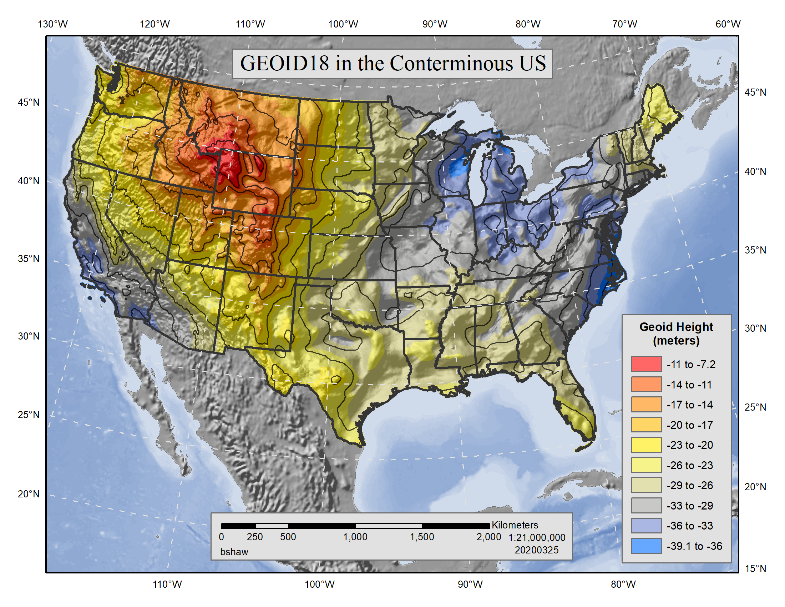
GEOID18 in the Conterminous US
TX Control Issues
Heights Suppression
Ht Mod Survey
Primary Network Design

Slide 4
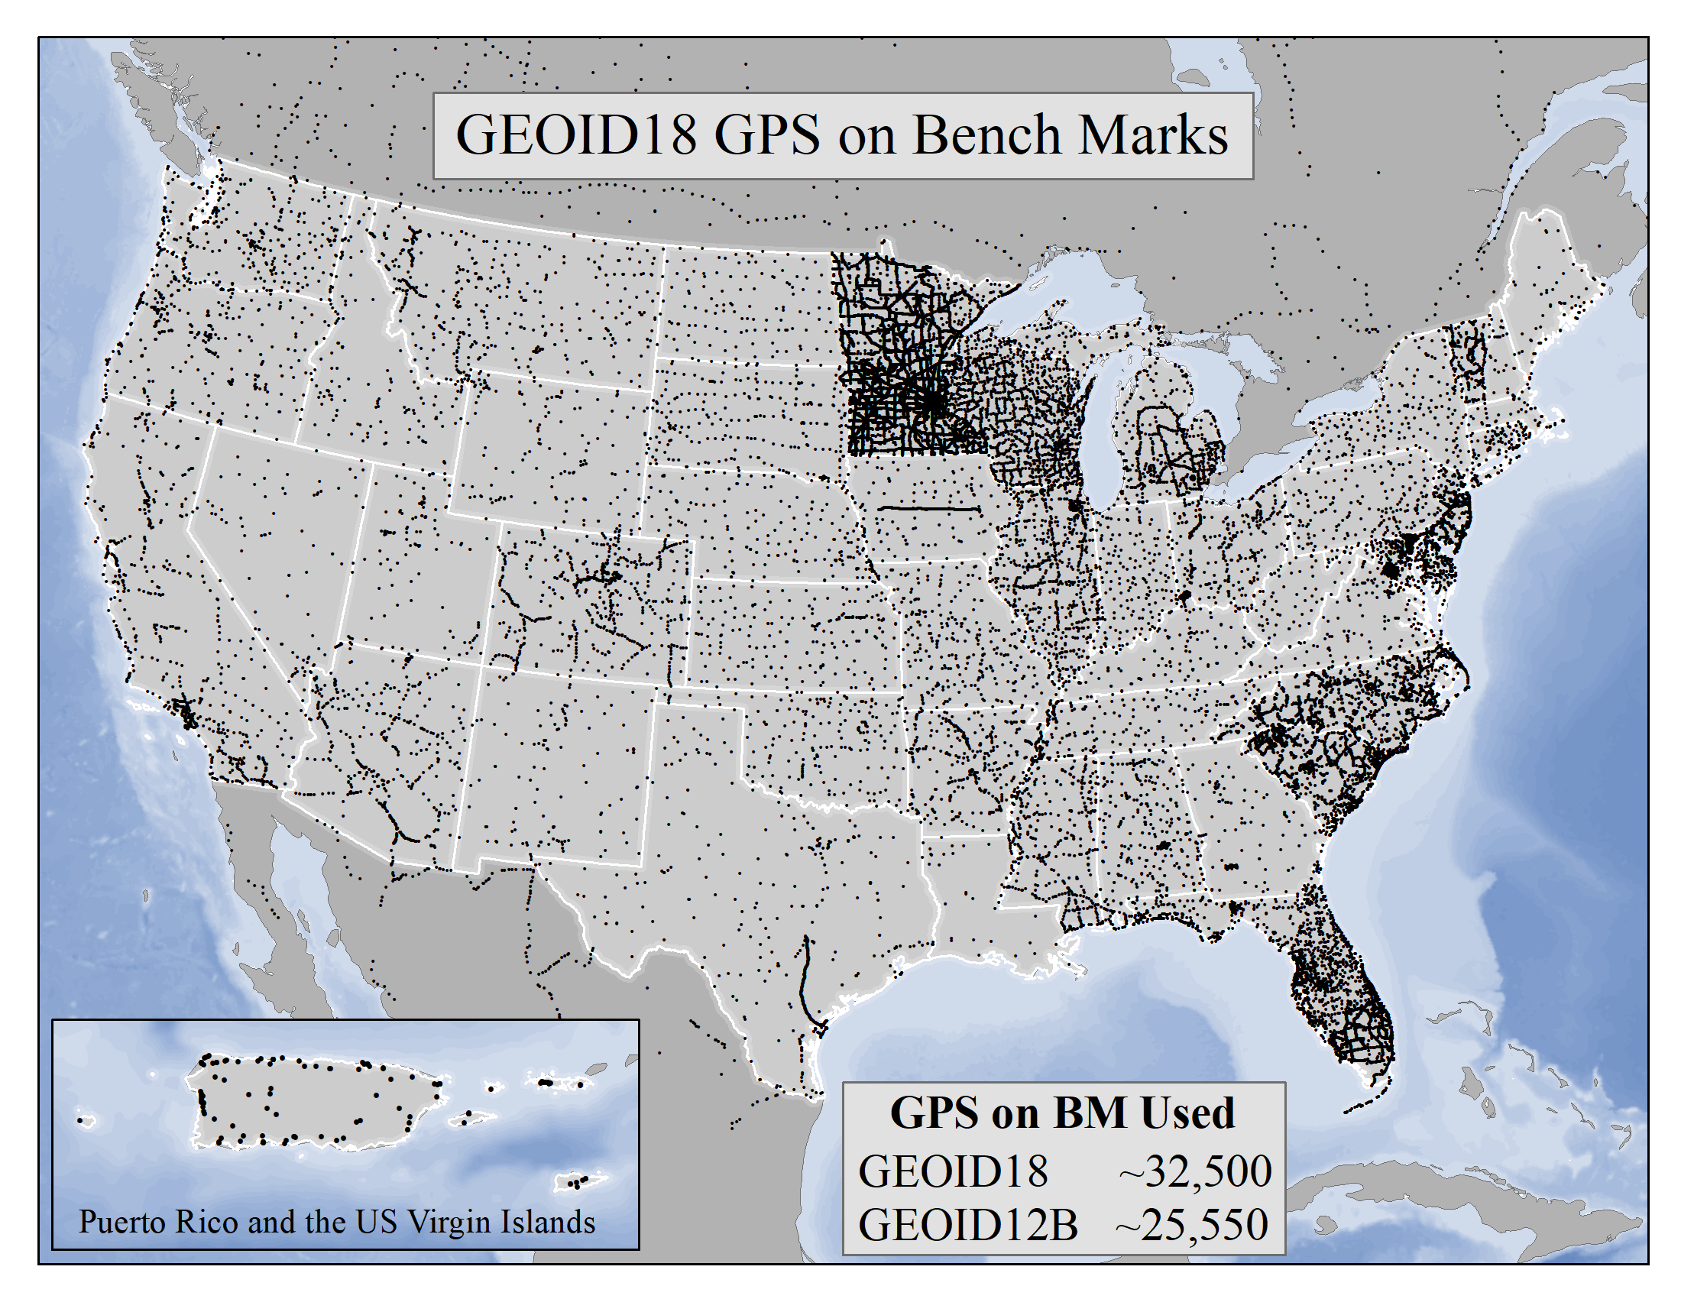
GEOID18 GPS on Benchmarks
TX Control Issues
Heights Suppression
Ht Mod Survey
Primary Network Design

Slide 5
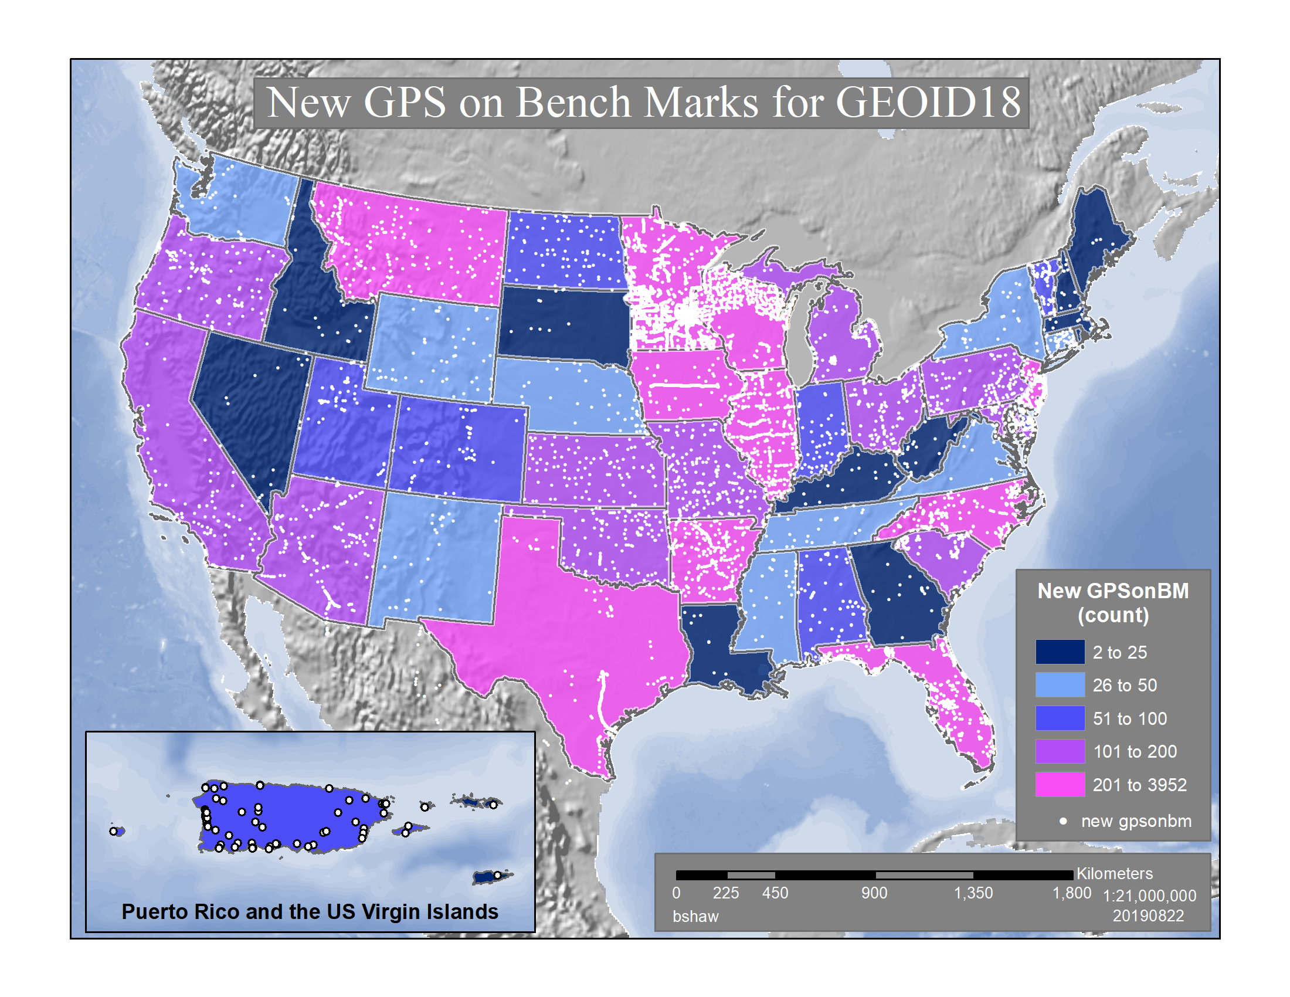
New GPS on BM for GEOID18
TX Control Issues
Heights Suppression
Ht Mod Survey
Primary Network Design

Slide 6
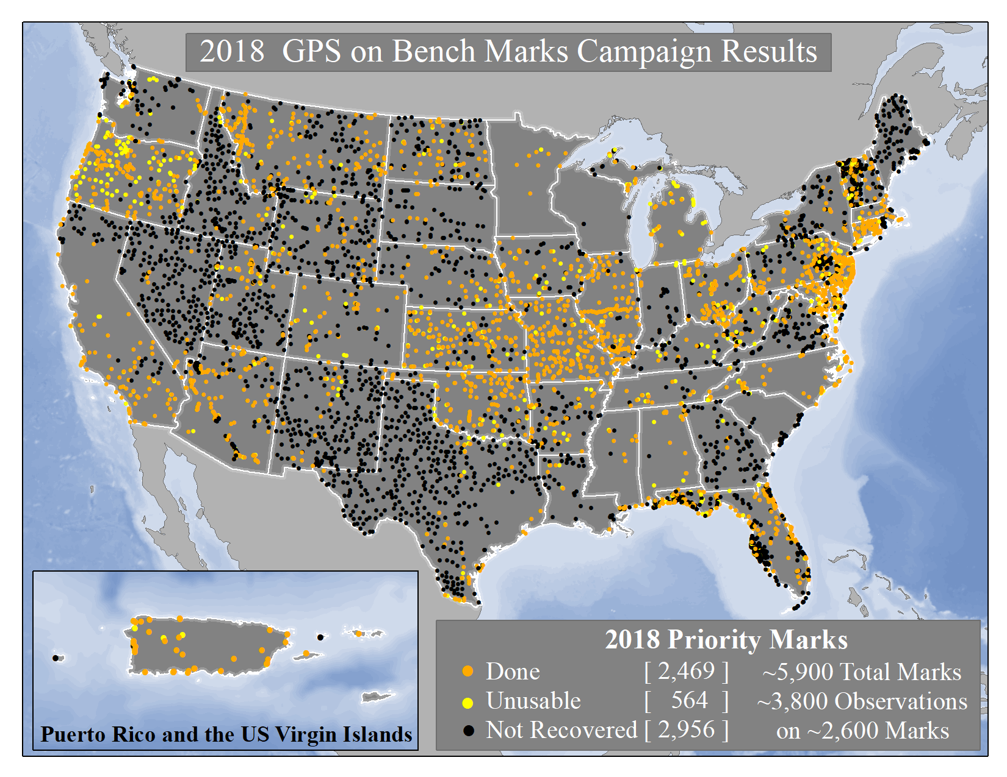
2018 GPS on BM Campaign Results
TX Control Issues
Heights Suppression
Ht Mod Survey
Primary Network Design

Slide 7
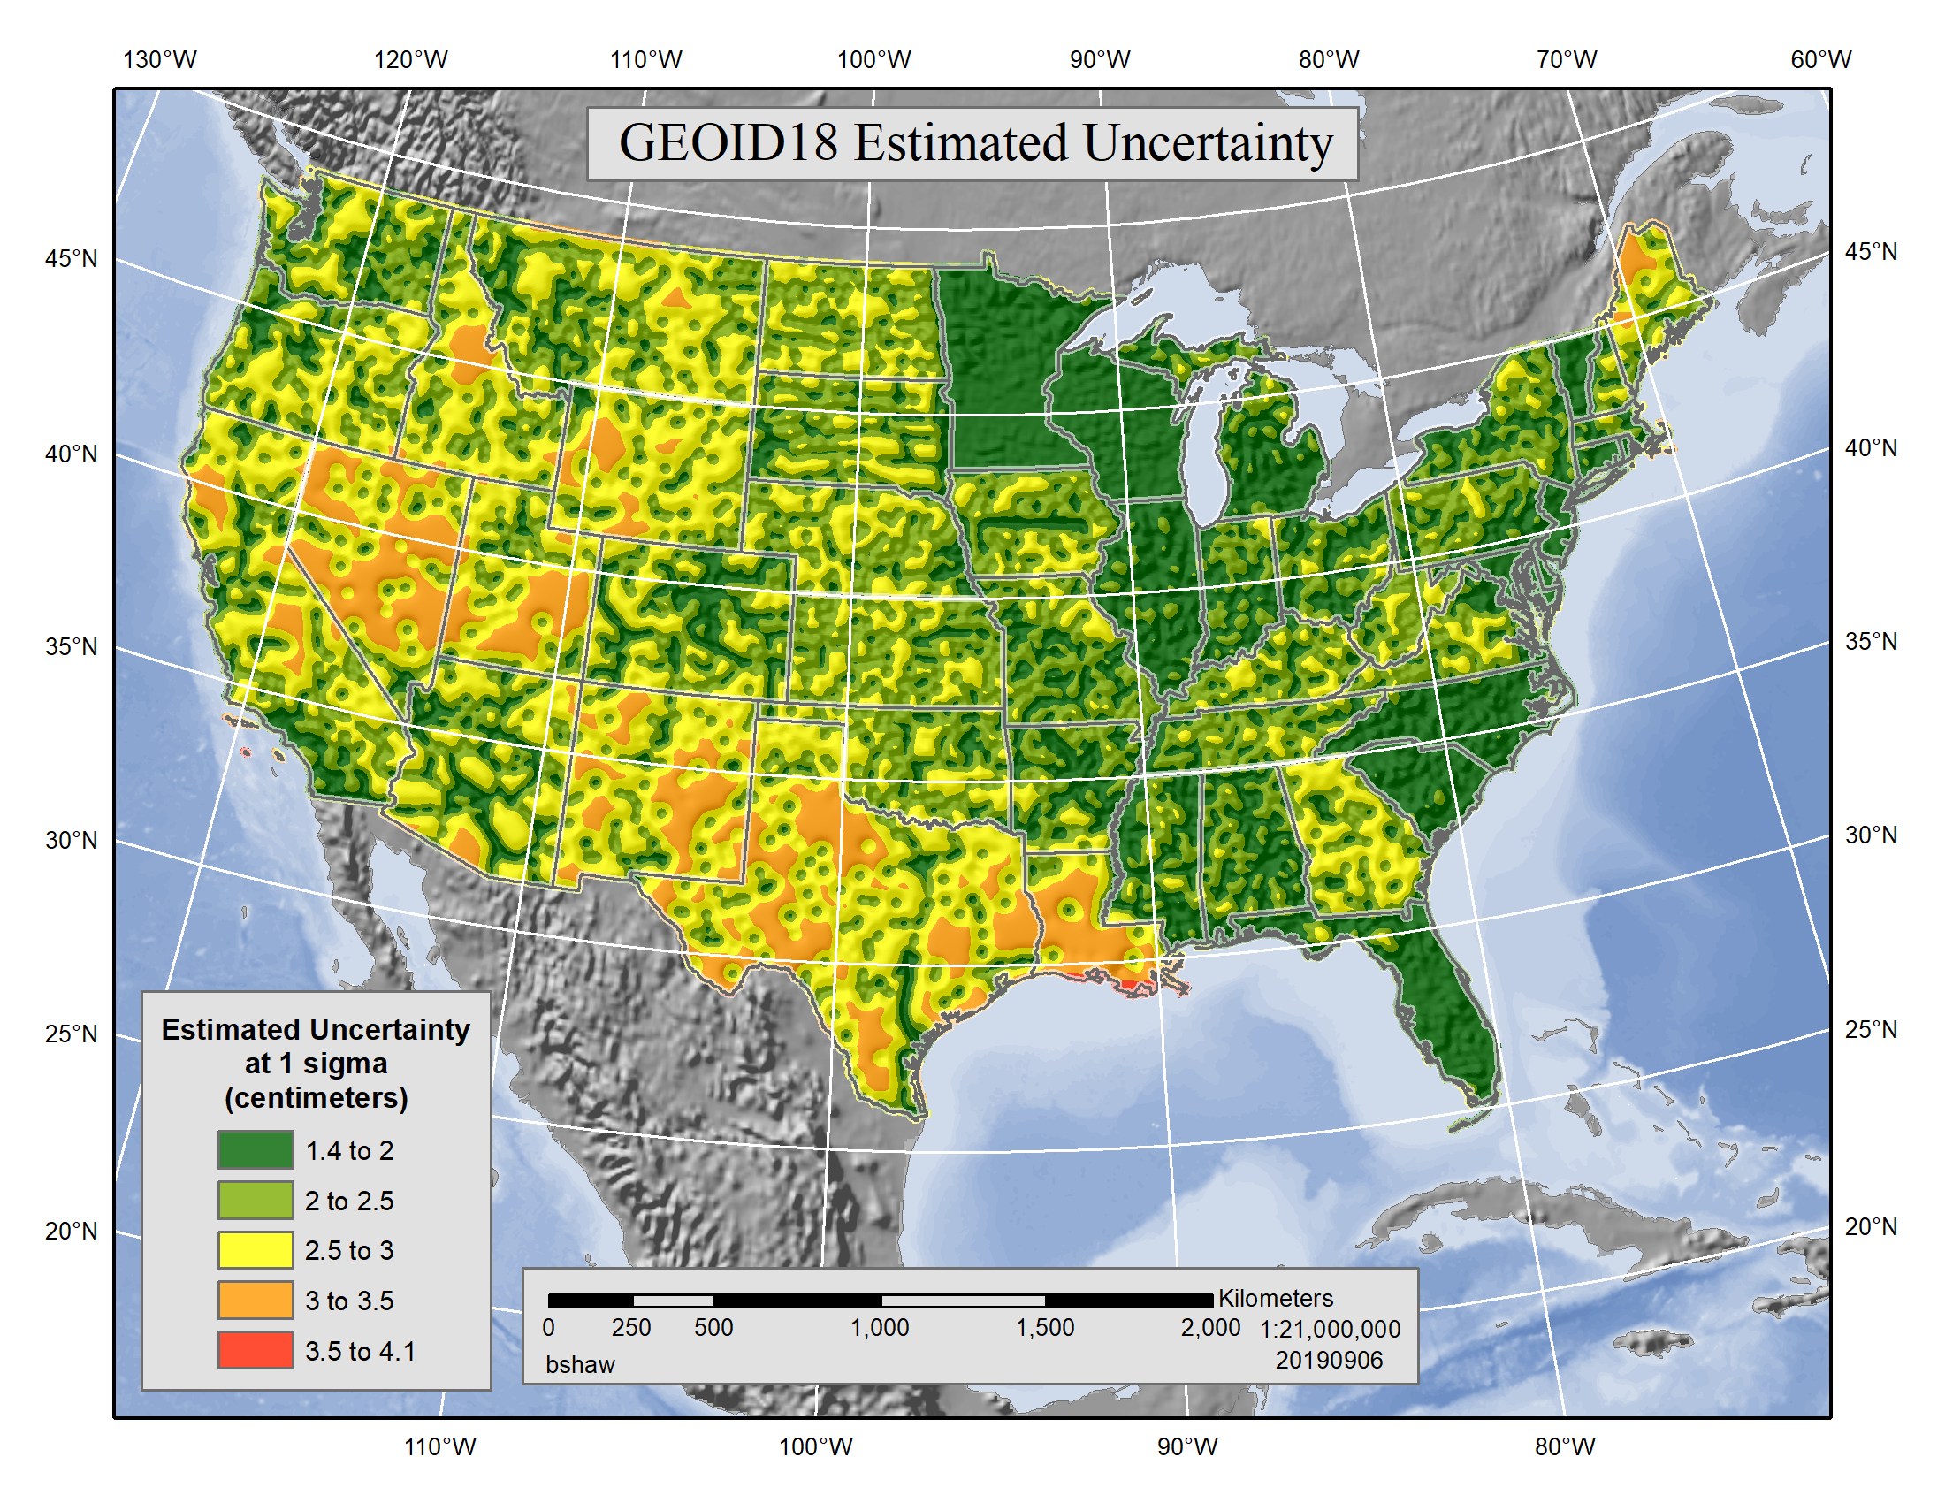
GEOID18 Estimated Uncertainty
TX Control Issues
Heights Suppression
Ht Mod Survey
Primary Network Design

Slide 8
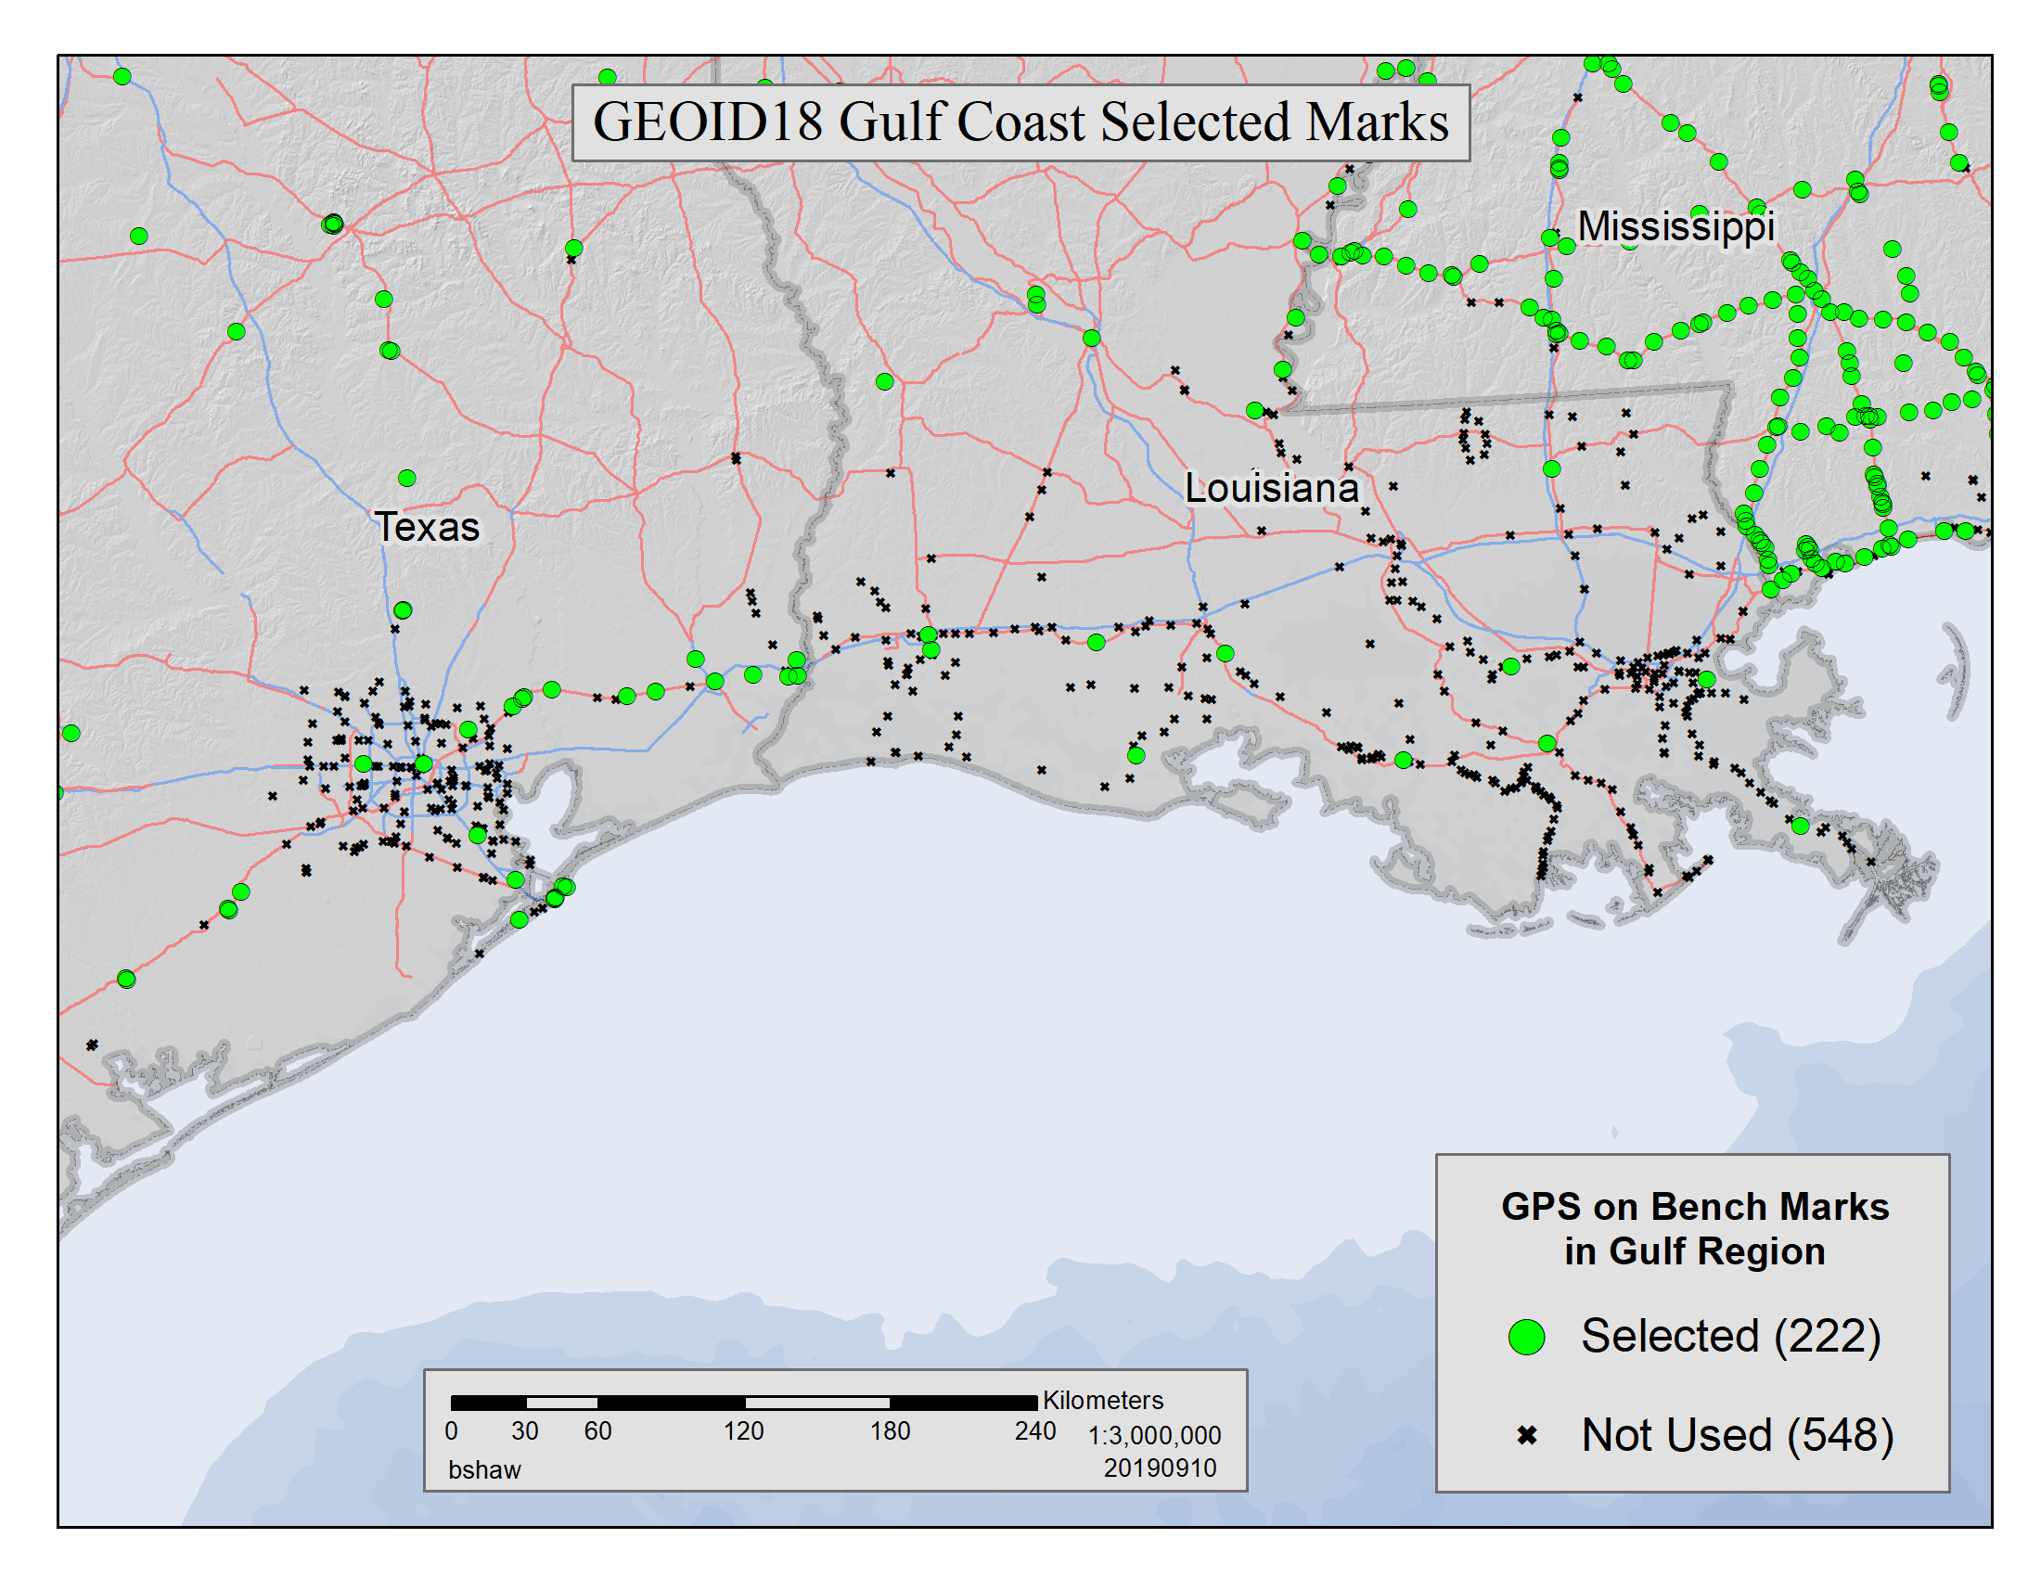
GEOID18 Gulf Coast Selected Marks
TX Control Issues
Heights Suppression
Ht Mod Survey
Primary Network Design

Slide 9
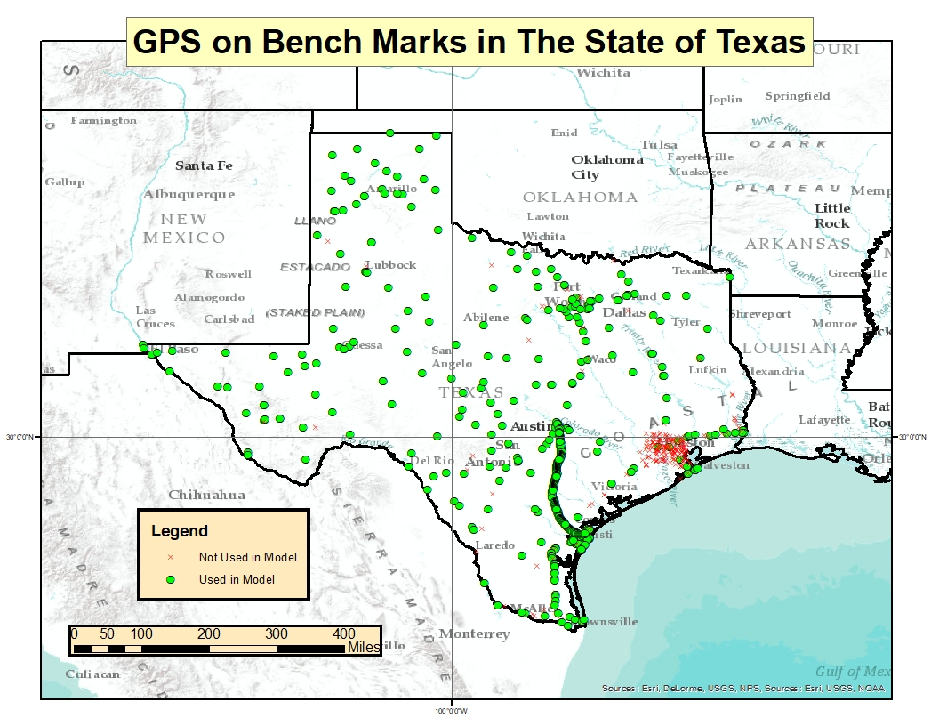
GPS on BM in Texas
TX Control Issues
Heights Suppression
Ht Mod Survey
Primary Network Design

Slide 10
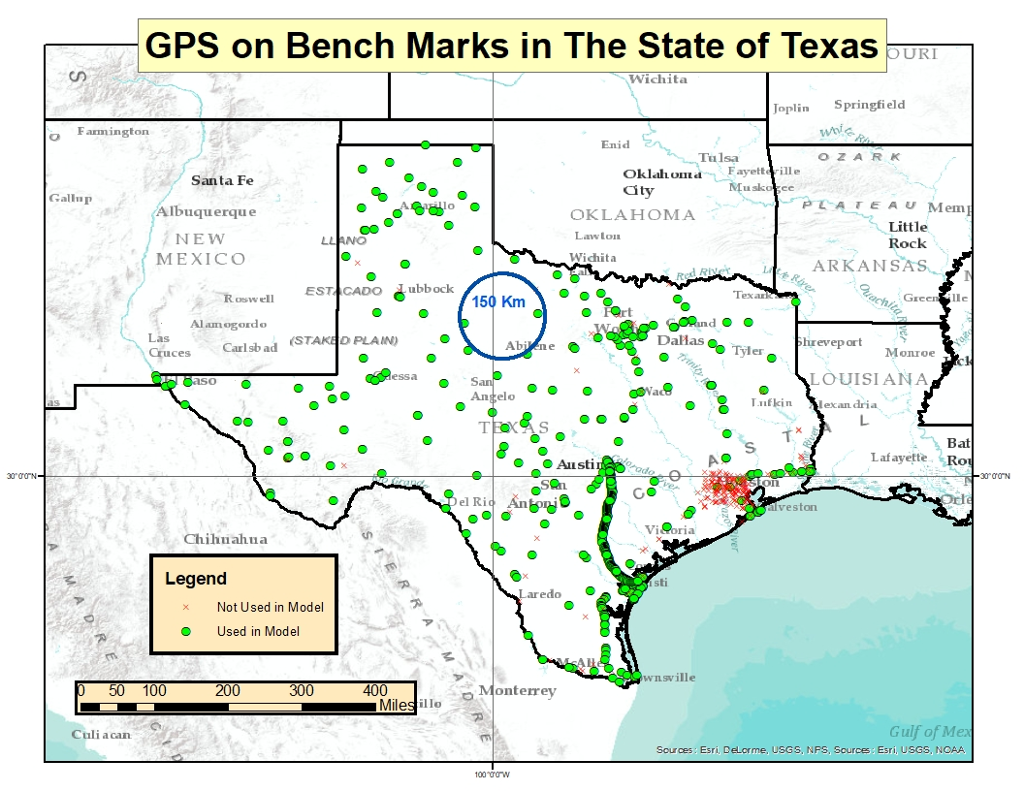
GPS on BM in Texas
TX Control Issues
Heights Suppression
Ht Mod Survey
Primary Network Design

Slide 11
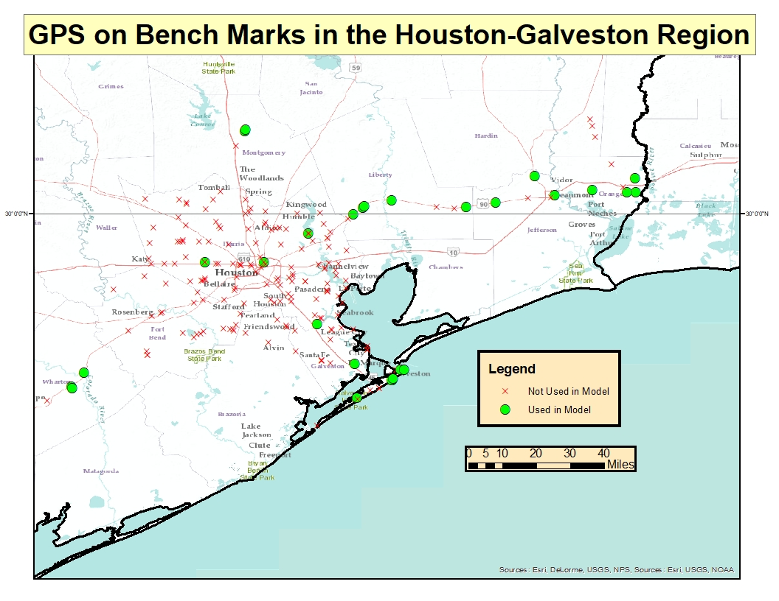
GPS on BM in Houston-Galveston
TX Control Issues
Heights Suppression
Ht Mod Survey
Primary Network Design

Slide 12
Houston Case
Harris County Floodplain Reference Marks and Flood Insurance Rate Maps (FIRMs) are referenced to locally defined NAVD88 2001 elevations (not published by NGS)
Elevation errors and outdated maps could have a major effect on flood zones determination and flood risk assessment
This highlights the reasons for and the importance of NGS’ shift to time-dependent positioning in the NSRS Modernization in 2022
TX Control Issues
Heights Suppression
Ht Mod Survey
Primary Network Design

Slide 13
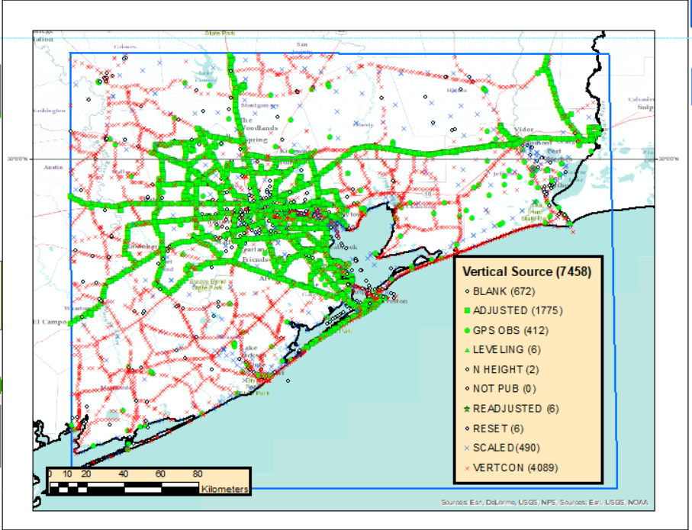
Good published heights in the SE Texas
The box includes approximately 7,500 marks in the NGS database
More than 4,000 heights created by VERTCON (Vertical Datum Conversion) = suspect heights!
Only 28 marks out of 7,500 in this box are considered to have good heights!
TX Control Issues
Heights Suppression
Ht Mod Survey
Primary Network Design

Slide 14
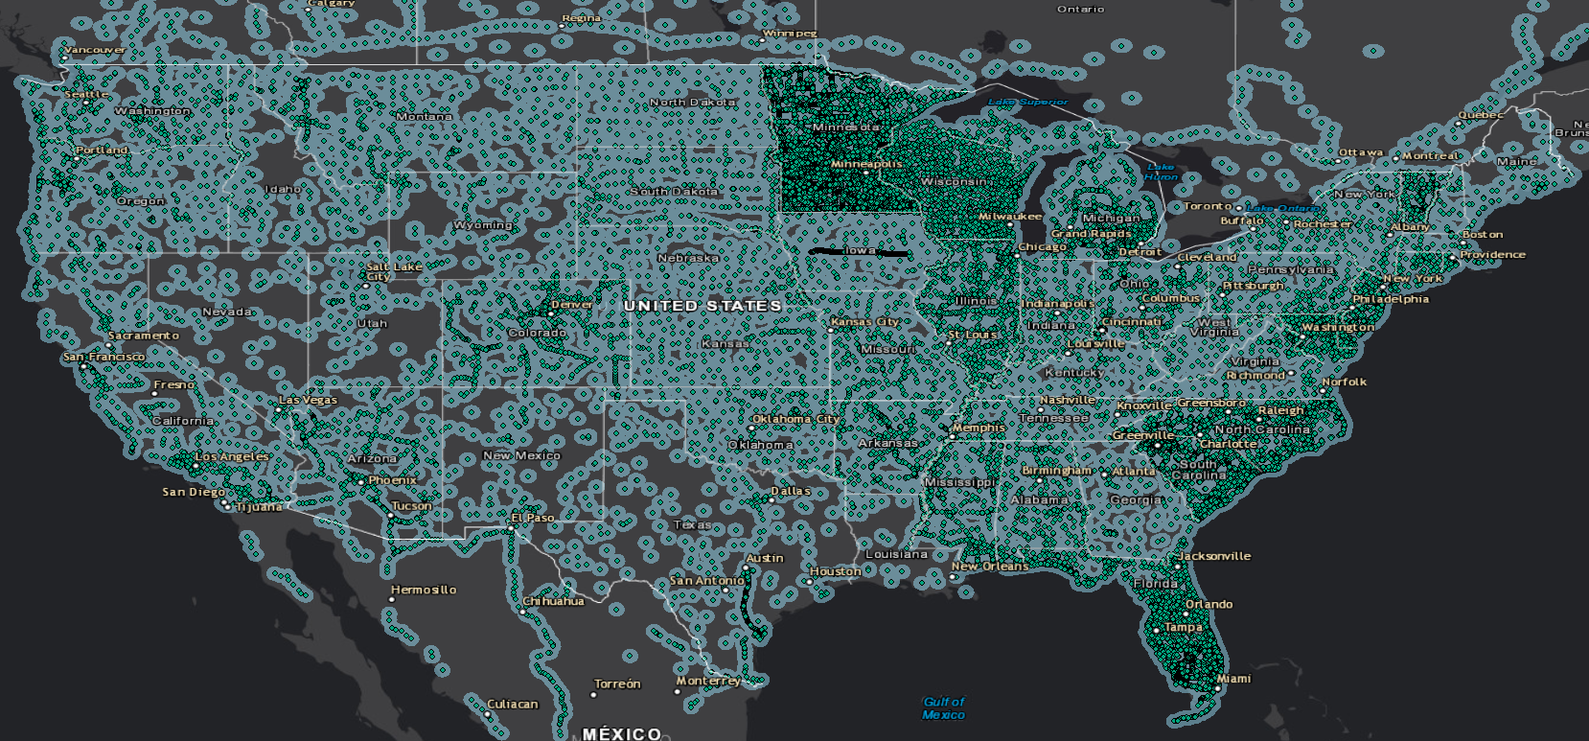
Good heights in the US - 30 km buffer
TX Control Issues
Heights Suppression
Ht Mod Survey
Primary Network Design

Slide 15
Can I just use LiDAR and OPUS?
It really depends. Assume scenario where you are working on a project in the southeast Texas outside of 30 km buffer:
  Relative accuracy of your LiDAR dataset (95% confidence) ≈ 10 cm
  GEOID18 accuracy in that area (95 % confidence) ≈ 7 cm (AT BEST!)
  OPUS-derived ellipsoid height for 2 hr occupation (95% confidence) ≈ 5 cm
    NOTE: peak-to-peak errors provided by OPUS can be used to estimate standard deviation (1 sigma) - peak-to-peak range is a approximately 70% larger than 1 sigma
Combined error is around 15 cm or 6 inches!
TX Control Issues
Heights Suppression
Ht Mod Survey
Primary Network Design

Slide 16
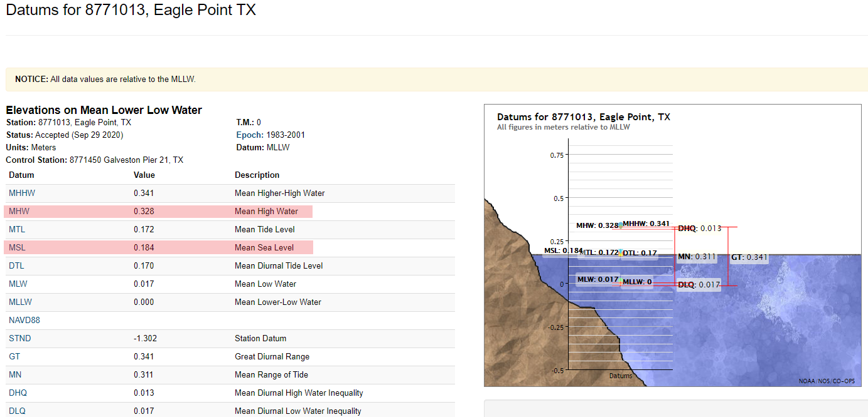
15 cm is difference between MSL & MHW!
TX Control Issues
Heights Suppression
Ht Mod Survey
Primary Network Design

Slide 17
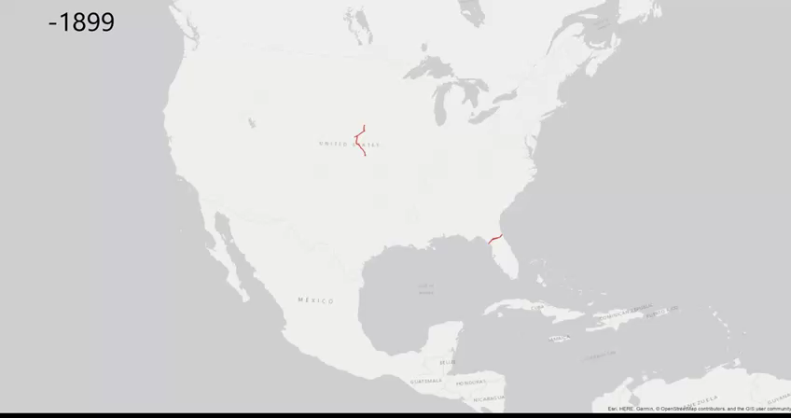
History of Leveling in the U.S.
TX Control Issues
Heights Suppression
Ht Mod Survey
Primary Network Design

Slide 18
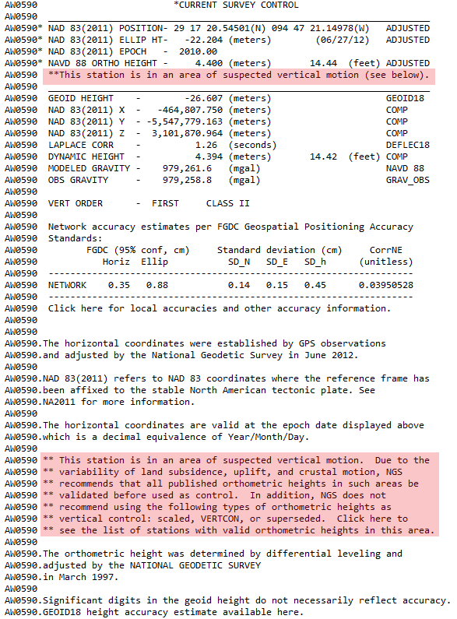
What NGS did about it
TX Control Issues
Heights Suppression
Ht Mod Survey
Primary Network Design

Slide 19
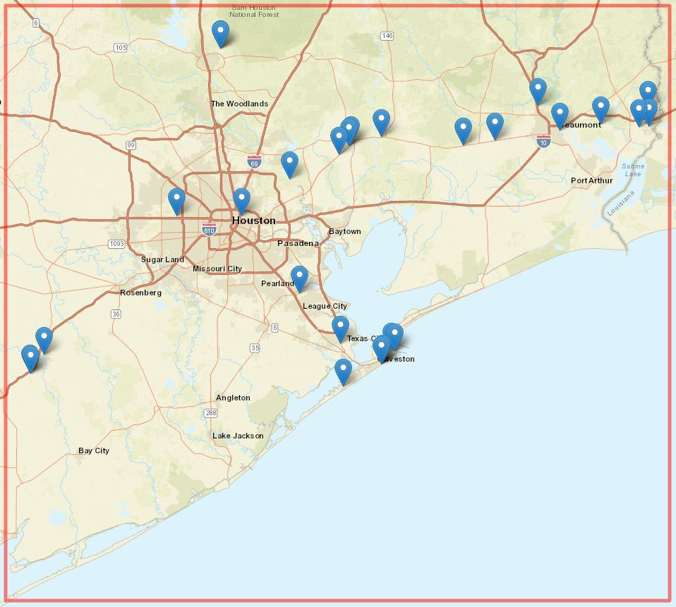
What NGS did about it
TX Control Issues
Heights Suppression
Ht Mod Survey
Primary Network Design

Slide 20
What NGS did about it
Valid NAVD 88 heights are published
  Only 28 marks (until new surveys are completed) will remain published in Current Survey Control section
Suspect NAVD 88 heights are suppressed
  Current Survey Control will not show NAVD 88 height
  If requested, NAVD 88 height will be shown in Superseded Survey Control section
TX Control Issues
Heights Suppression
Ht Mod Survey
Primary Network Design

Slide 21
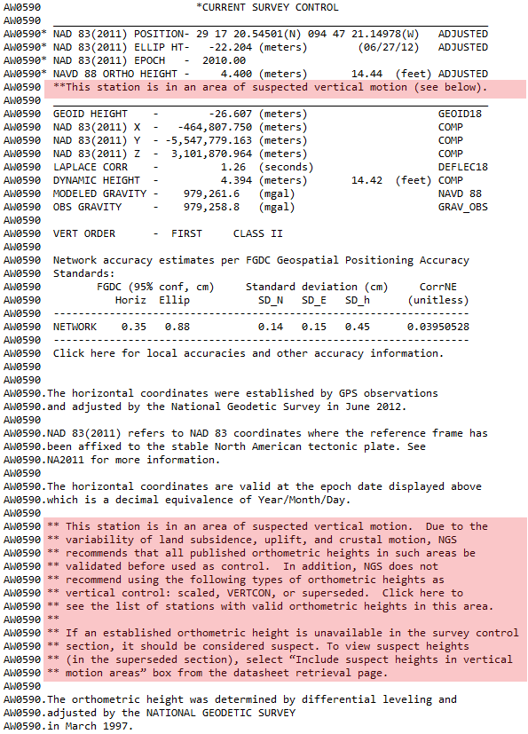
Valid NAVD 88 Heights
TX Control Issues
Heights Suppression
Ht Mod Survey
Primary Network Design

Slide 22
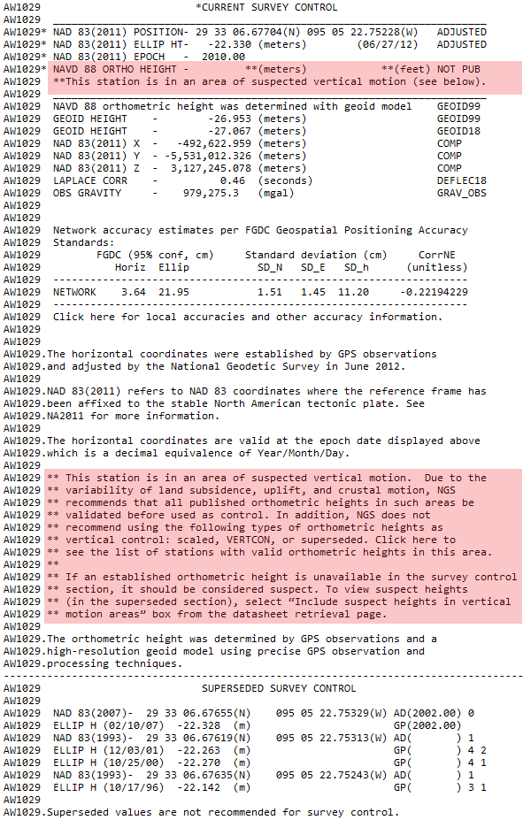
Suspect NAVD 88 heights (not requested)
TX Control Issues
Heights Suppression
Ht Mod Survey
Primary Network Design

Slide 23

Suspect NAVD 88 heights (requested)
TX Control Issues
Heights Suppression
Ht Mod Survey
Primary Network Design

Slide 24
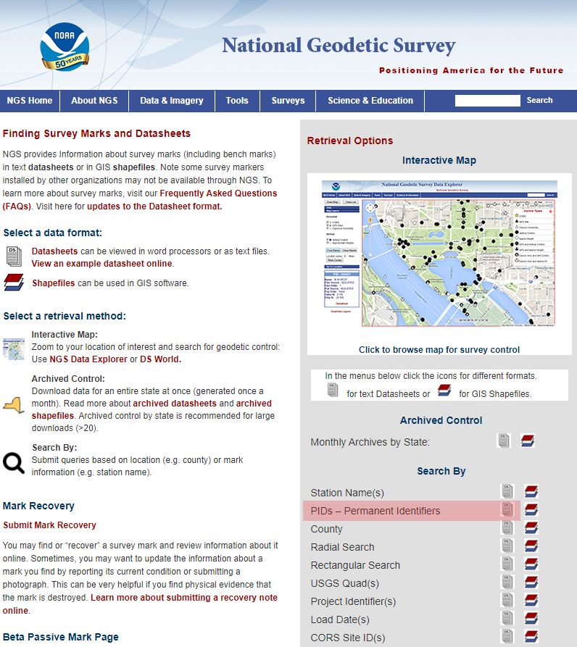
Suspect NAVD 88 heights (requested)
TX Control Issues
Heights Suppression
Ht Mod Survey
Primary Network Design

Slide 25
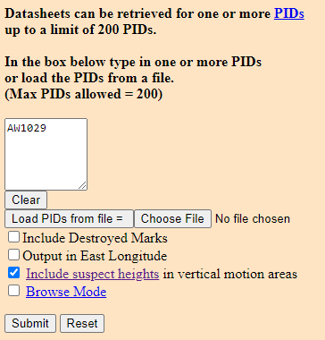
Suspect NAVD 88 heights (requested)
TX Control Issues
Heights Suppression
Ht Mod Survey
Primary Network Design

Slide 26
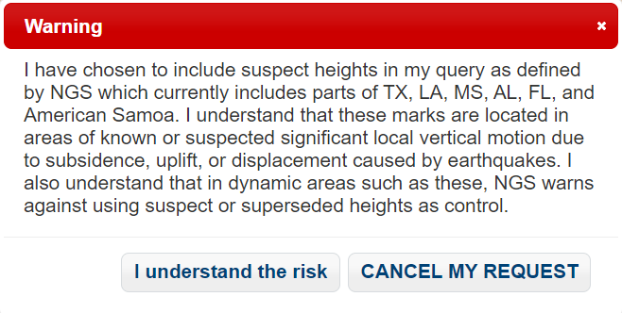
Suspect NAVD 88 heights (requested)
TX Control Issues
Heights Suppression
Ht Mod Survey
Primary Network Design

Slide 27
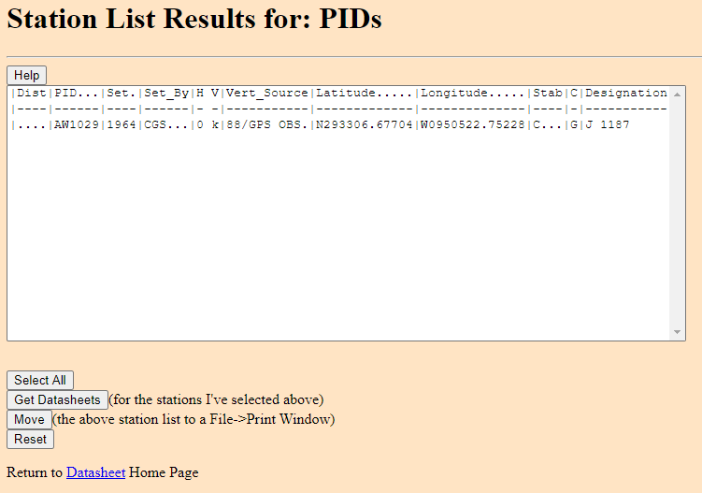
Suspect NAVD 88 heights (requested)
TX Control Issues
Heights Suppression
Ht Mod Survey
Primary Network Design

Slide 28
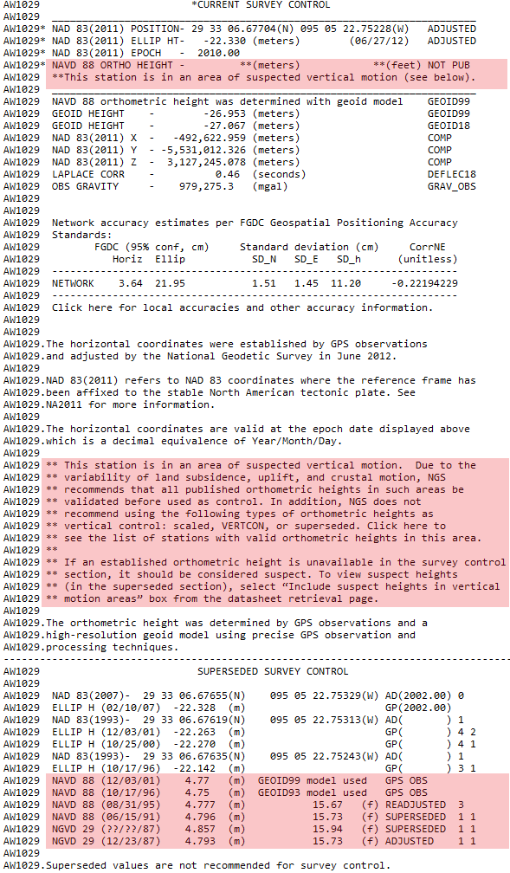
Suspect NAVD 88 heights (requested)
TX Control Issues
Heights Suppression
Ht Mod Survey
Primary Network Design

Slide 29

TX Datasheets and GIS Shapefiles
TX Control Issues
Heights Suppression
Ht Mod Survey
Primary Network Design

Slide 30
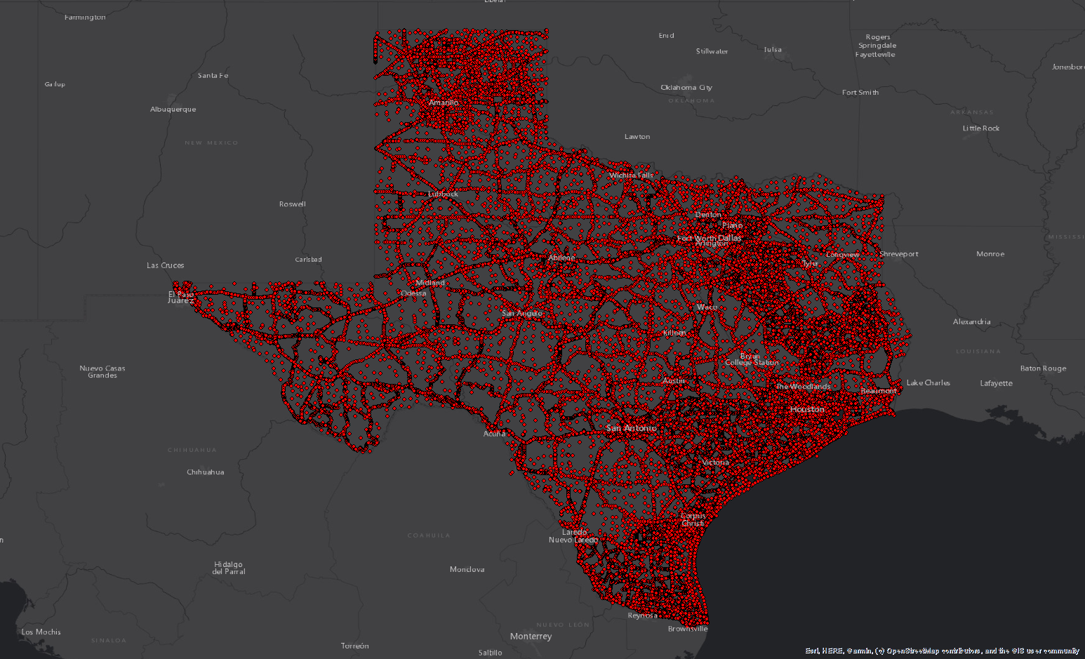
TX Marks from GIS Shapefile
TX Control Issues
Heights Suppression
Ht Mod Survey
Primary Network Design

Slide 31
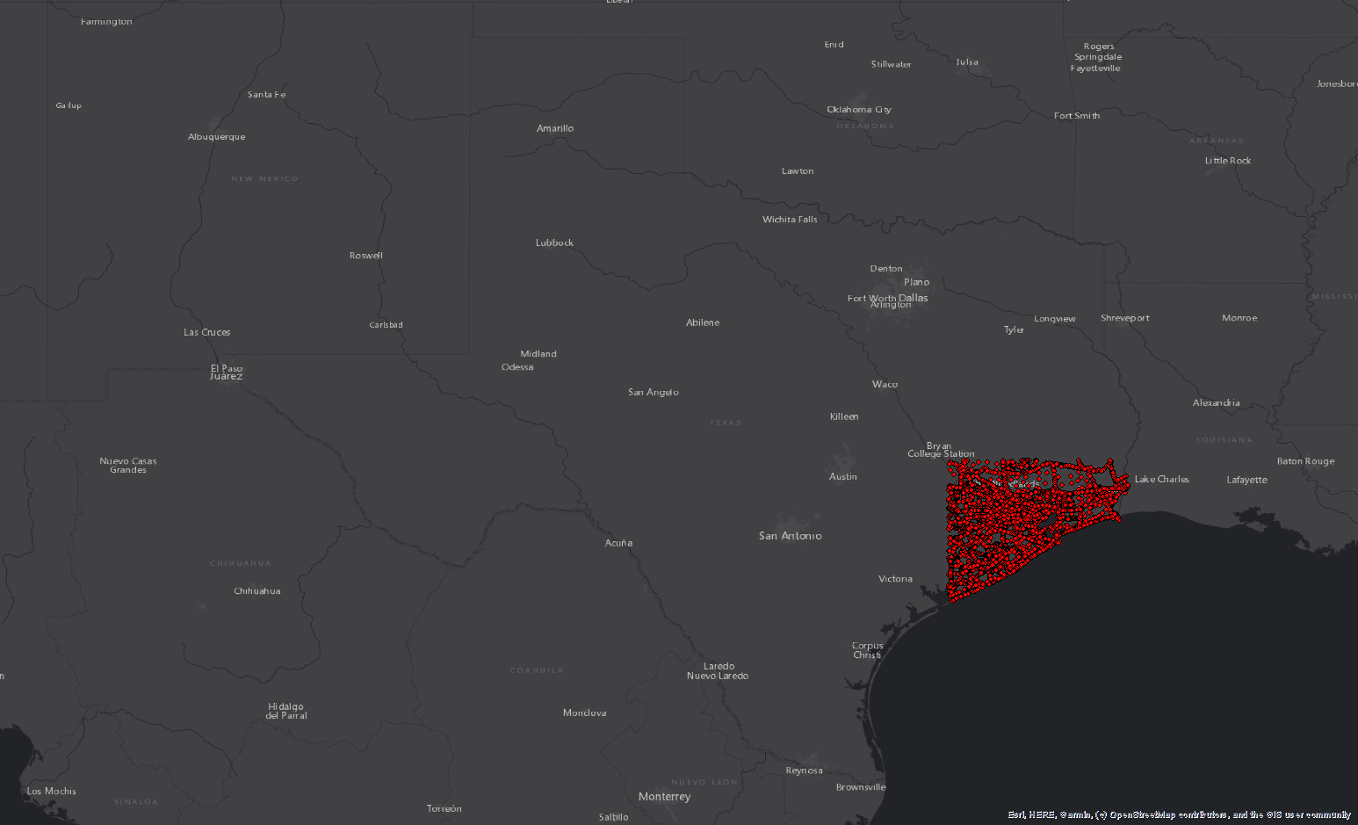
Suspect (suppressed) NAVD 88
TX Control Issues
Heights Suppression
Ht Mod Survey
Primary Network Design

Slide 32
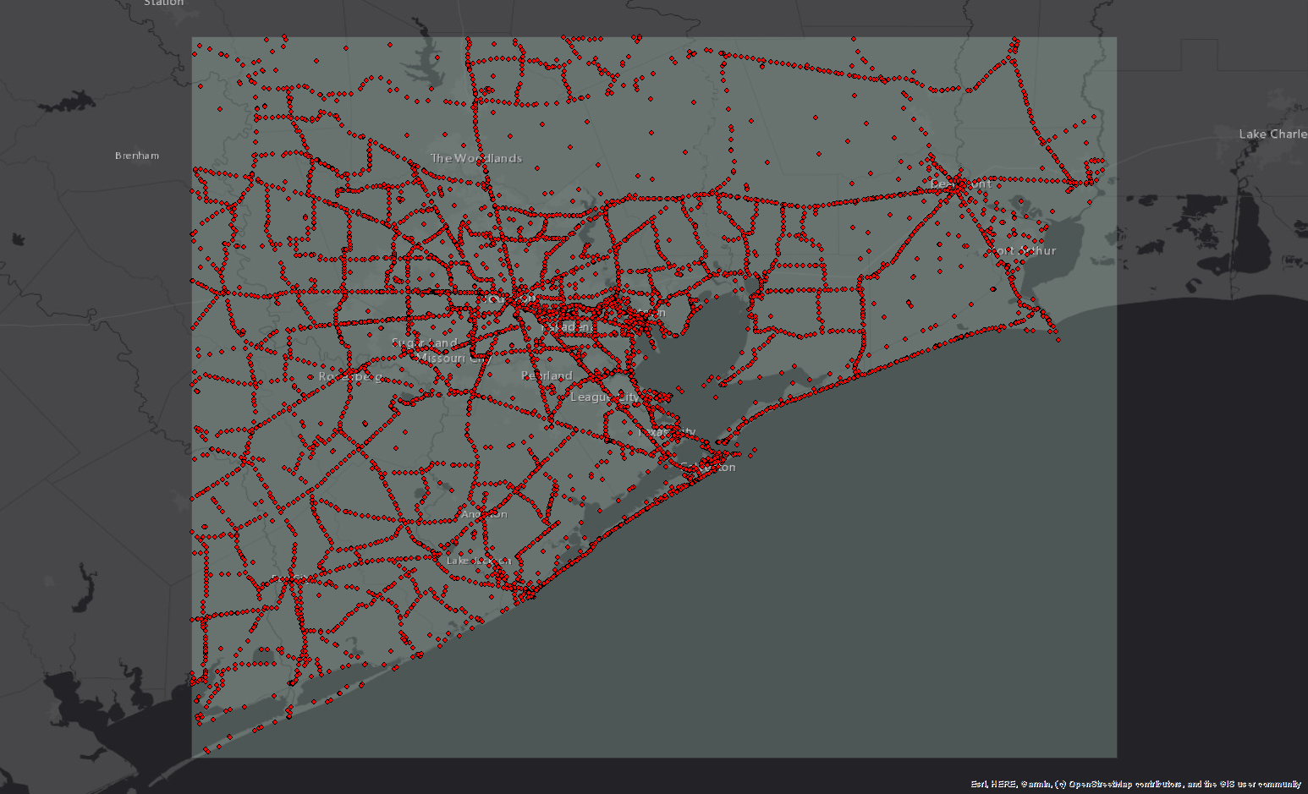
Suspect (suppressed) NAVD 88
TX Control Issues
Heights Suppression
Ht Mod Survey
Primary Network Design

Slide 33
What can Texas do about it?
Densify geodetic control (with good heights) by conducting new Leveling & GPS projects
  Submit data for inclusion into the NSRS (FCGS Bluebook)
  Update elevations on a select set of marks (where good heights don’t exist)
  Improved survey network will provide enhancements for rebuilding and improvement of infrastructure in the area
  It will help with flood plain management, flood hazard identification and risk assessment, elevation certificates…
TX Control Issues
Heights Suppression
Ht Mod Survey
Primary Network Design

Slide 34
How can NGS support these efforts?
NGS can provide:
  Trainings
  Technical support
  Projects QA/QC
  Analyzing, ingesting and storing new data
  Online tools to access the NSRS
NGS cannot conduct field work for you!
TX Control Issues
Heights Suppression
Ht Mod Survey
Primary Network Design

Slide 35
What tools can Texas use?
BETA OPUS Projects - New way of Bluebooking!
  Makes bluebooking process easier and less intimidating
  Provides an interactive visual interface
  Automates the processing and creation of complex files
  Provides improved QA/QC process and better display & visualization of statistics
TX Control Issues
Heights Suppression
Ht Mod Survey
Primary Network Design

Slide 36
What tools can Texas use?
BETA OPUS Projects
  It requires minimum of two 2-hours sessions for your stations
  It is used for submitting static, campaign-style GNSS surveys resulting in network survey solution intended for inclusion in the NGS database
  New stations will have published adjusted position on a datasheet
TX Control Issues
Heights Suppression
Ht Mod Survey
Primary Network Design

Slide 37
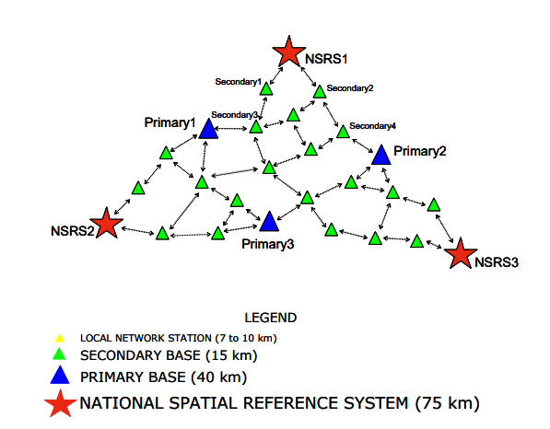
Height Modernization Surveys
NGS-58
  guidelines for establishing GPS-derived ellipsoid heights
NGS-59
  guidelines for establishing GPS-derived orthometric heights
TX Control Issues
Heights Suppression
Ht Mod Survey
Primary Network Design

Slide 38
Relationship of Heights
Note: Geoid height is negative everywhere in the conterminous US
TX Control Issues
Heights Suppression
Ht Mod Survey
Primary Network Design

Slide 39
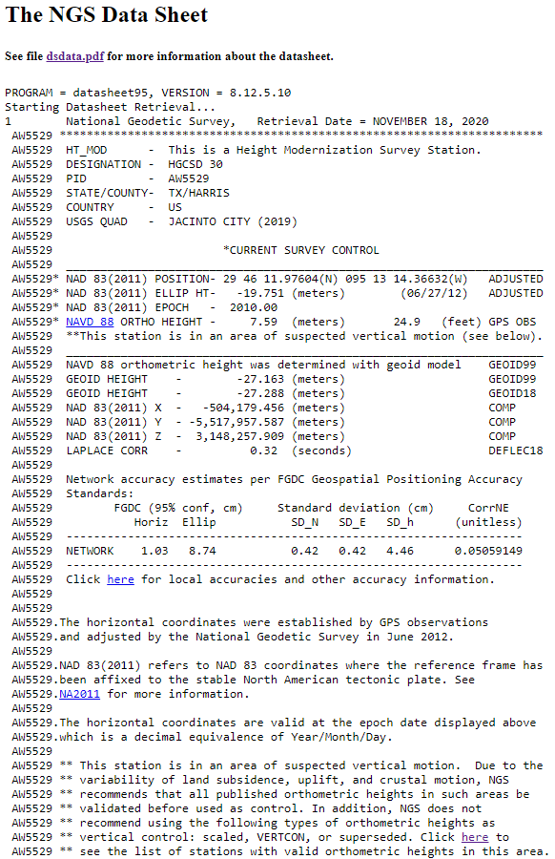
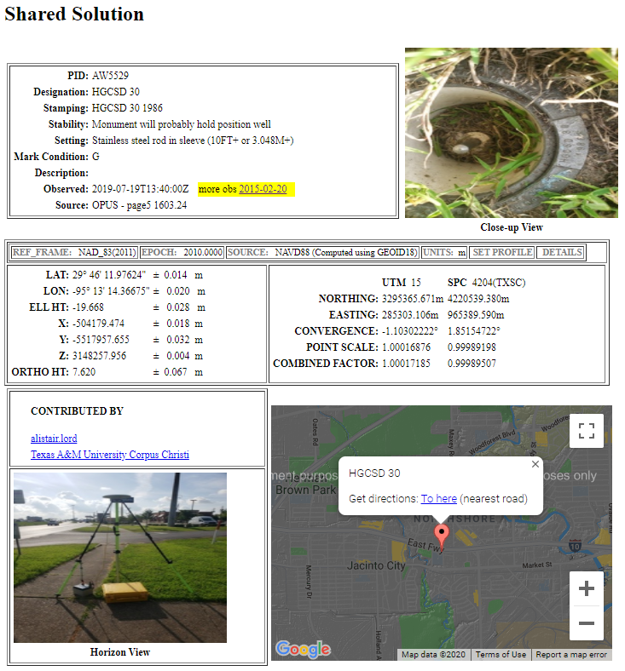
Datasheet and Shared Solution
Geodetic Control
Not Geodetic Control
TX Control Issues
Heights Suppression
Ht Mod Survey
Primary Network Design

Slide 40

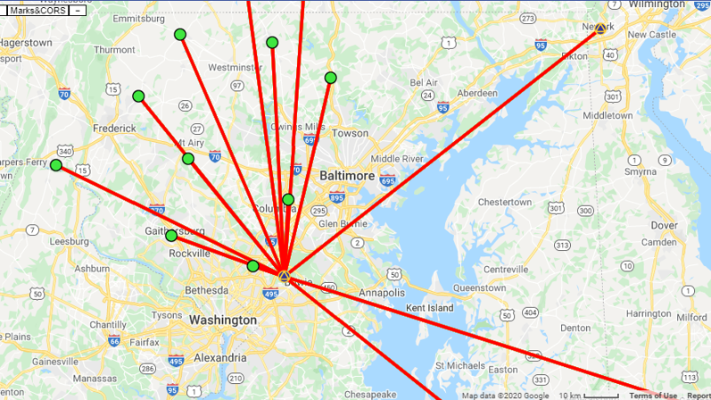
Project Objectives
What are your objectives?
Accurate lat/lon/Eh on new “passive marks”
Accurate GNSS-derived NAVD 88 heights on passive marks
Accurate positions on active GNSS stations (not CORS; e.g. RTN stations)
TX Control Issues
Heights Suppression
Ht Mod Survey
Primary Network Design

Slide 41
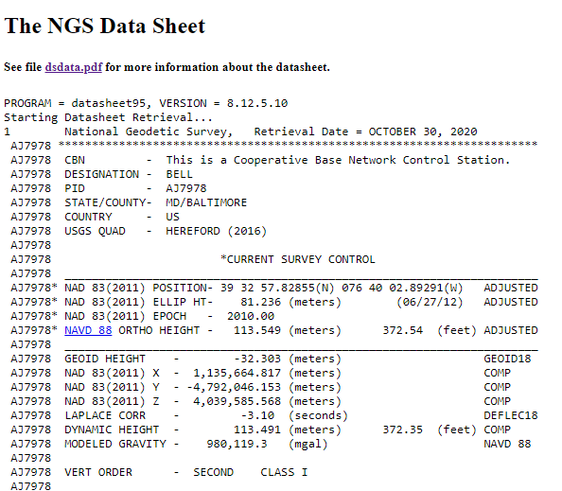
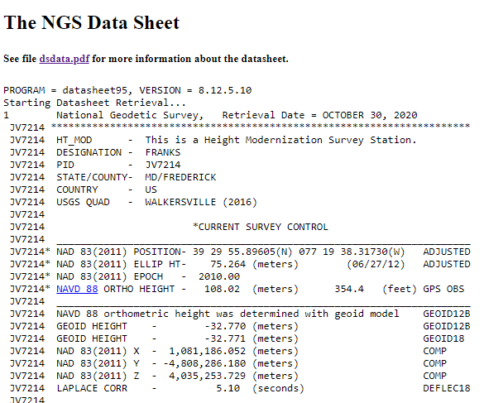
Project Control
Leveled heights (Adjusted and Reset, Orders One - Three)
Height Mod Heights
“HT_MOD”
Height accurate to 2 decimal places
TX Control Issues
Heights Suppression
Ht Mod Survey
Primary Network Design

Slide 42
Planning Your Project
Orthometric Height Accuracy Requirements
Number of occupations
Length of occupations
Spacing of valid control
Recommended/Permitted
Minimum of 2 NAVD 88 control marks per new mark observed
OPUS is currently restricted to a minimum of 2-hour occupations
Maximum distance between new marks and NAVD 88 control is between 30-50 km, based on occupation length
Not Permitted*
*Future developments of OP will permit real-time vectors from shorter occupations
TX Control Issues
Heights Suppression
Ht Mod Survey
Primary Network Design

Slide 43
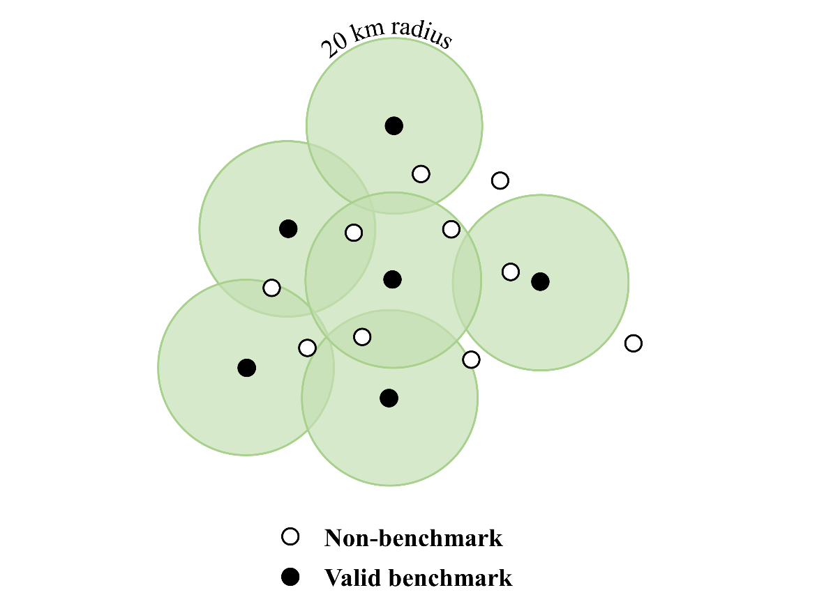
Planning Your Project
Orthometric Height Accuracy Requirements: a look at control mark spacing
Occupy bench marks with “valid” NAVD 88 orthometric heights
  Distributed every ~30-50 km
  Two (2) valid control marks per new mark
  Adhere to distance-occupation requirement
Use latest hybrid geoid model (i.e., GEOID18)
Perform constrained vertical least squares adjustments of the GNSS network holding the bench marks as control
30
TX Control Issues
Heights Suppression
Ht Mod Survey
Primary Network Design

Slide 44
Planning Your Project
How many valid NAVD 88 bench marks would you need at a 30 km spacing?
30
TX Control Issues
Heights Suppression
Ht Mod Survey
Primary Network Design

Slide 45
Planning Your Project
How many valid NAVD 88 bench marks would you need at a 30 km spacing?
30
6 valid NAVD 88 control marks within 30 km would cover requirements for only three new marks!
30 km spacing require a minimum of only 2-hr occupations
TX Control Issues
Heights Suppression
Ht Mod Survey
Primary Network Design

Slide 46
Planning Your Project
Increasing your spacing to 50 km would require only 4 valid NAVD 88 control marks to cover 9 new marks.
Only one mark would require additional control
However, minimum occupation time would increase from 2 to 6 hours
50 km radius
30
TX Control Issues
Heights Suppression
Ht Mod Survey
Primary Network Design

Slide 47
Planning Your Project
Now that we’ve discussed distance (X-axis), let’s talk Occupation Length (Y-axis)
Recommended/Permitted
Two important considerations:
Redundancy (how many reps)
Duration (how long an observation)
Not Permitted*
*Future developments of OP will permit real-time vectors from shorter occupations
TX Control Issues
Heights Suppression
Ht Mod Survey
Primary Network Design

Slide 48
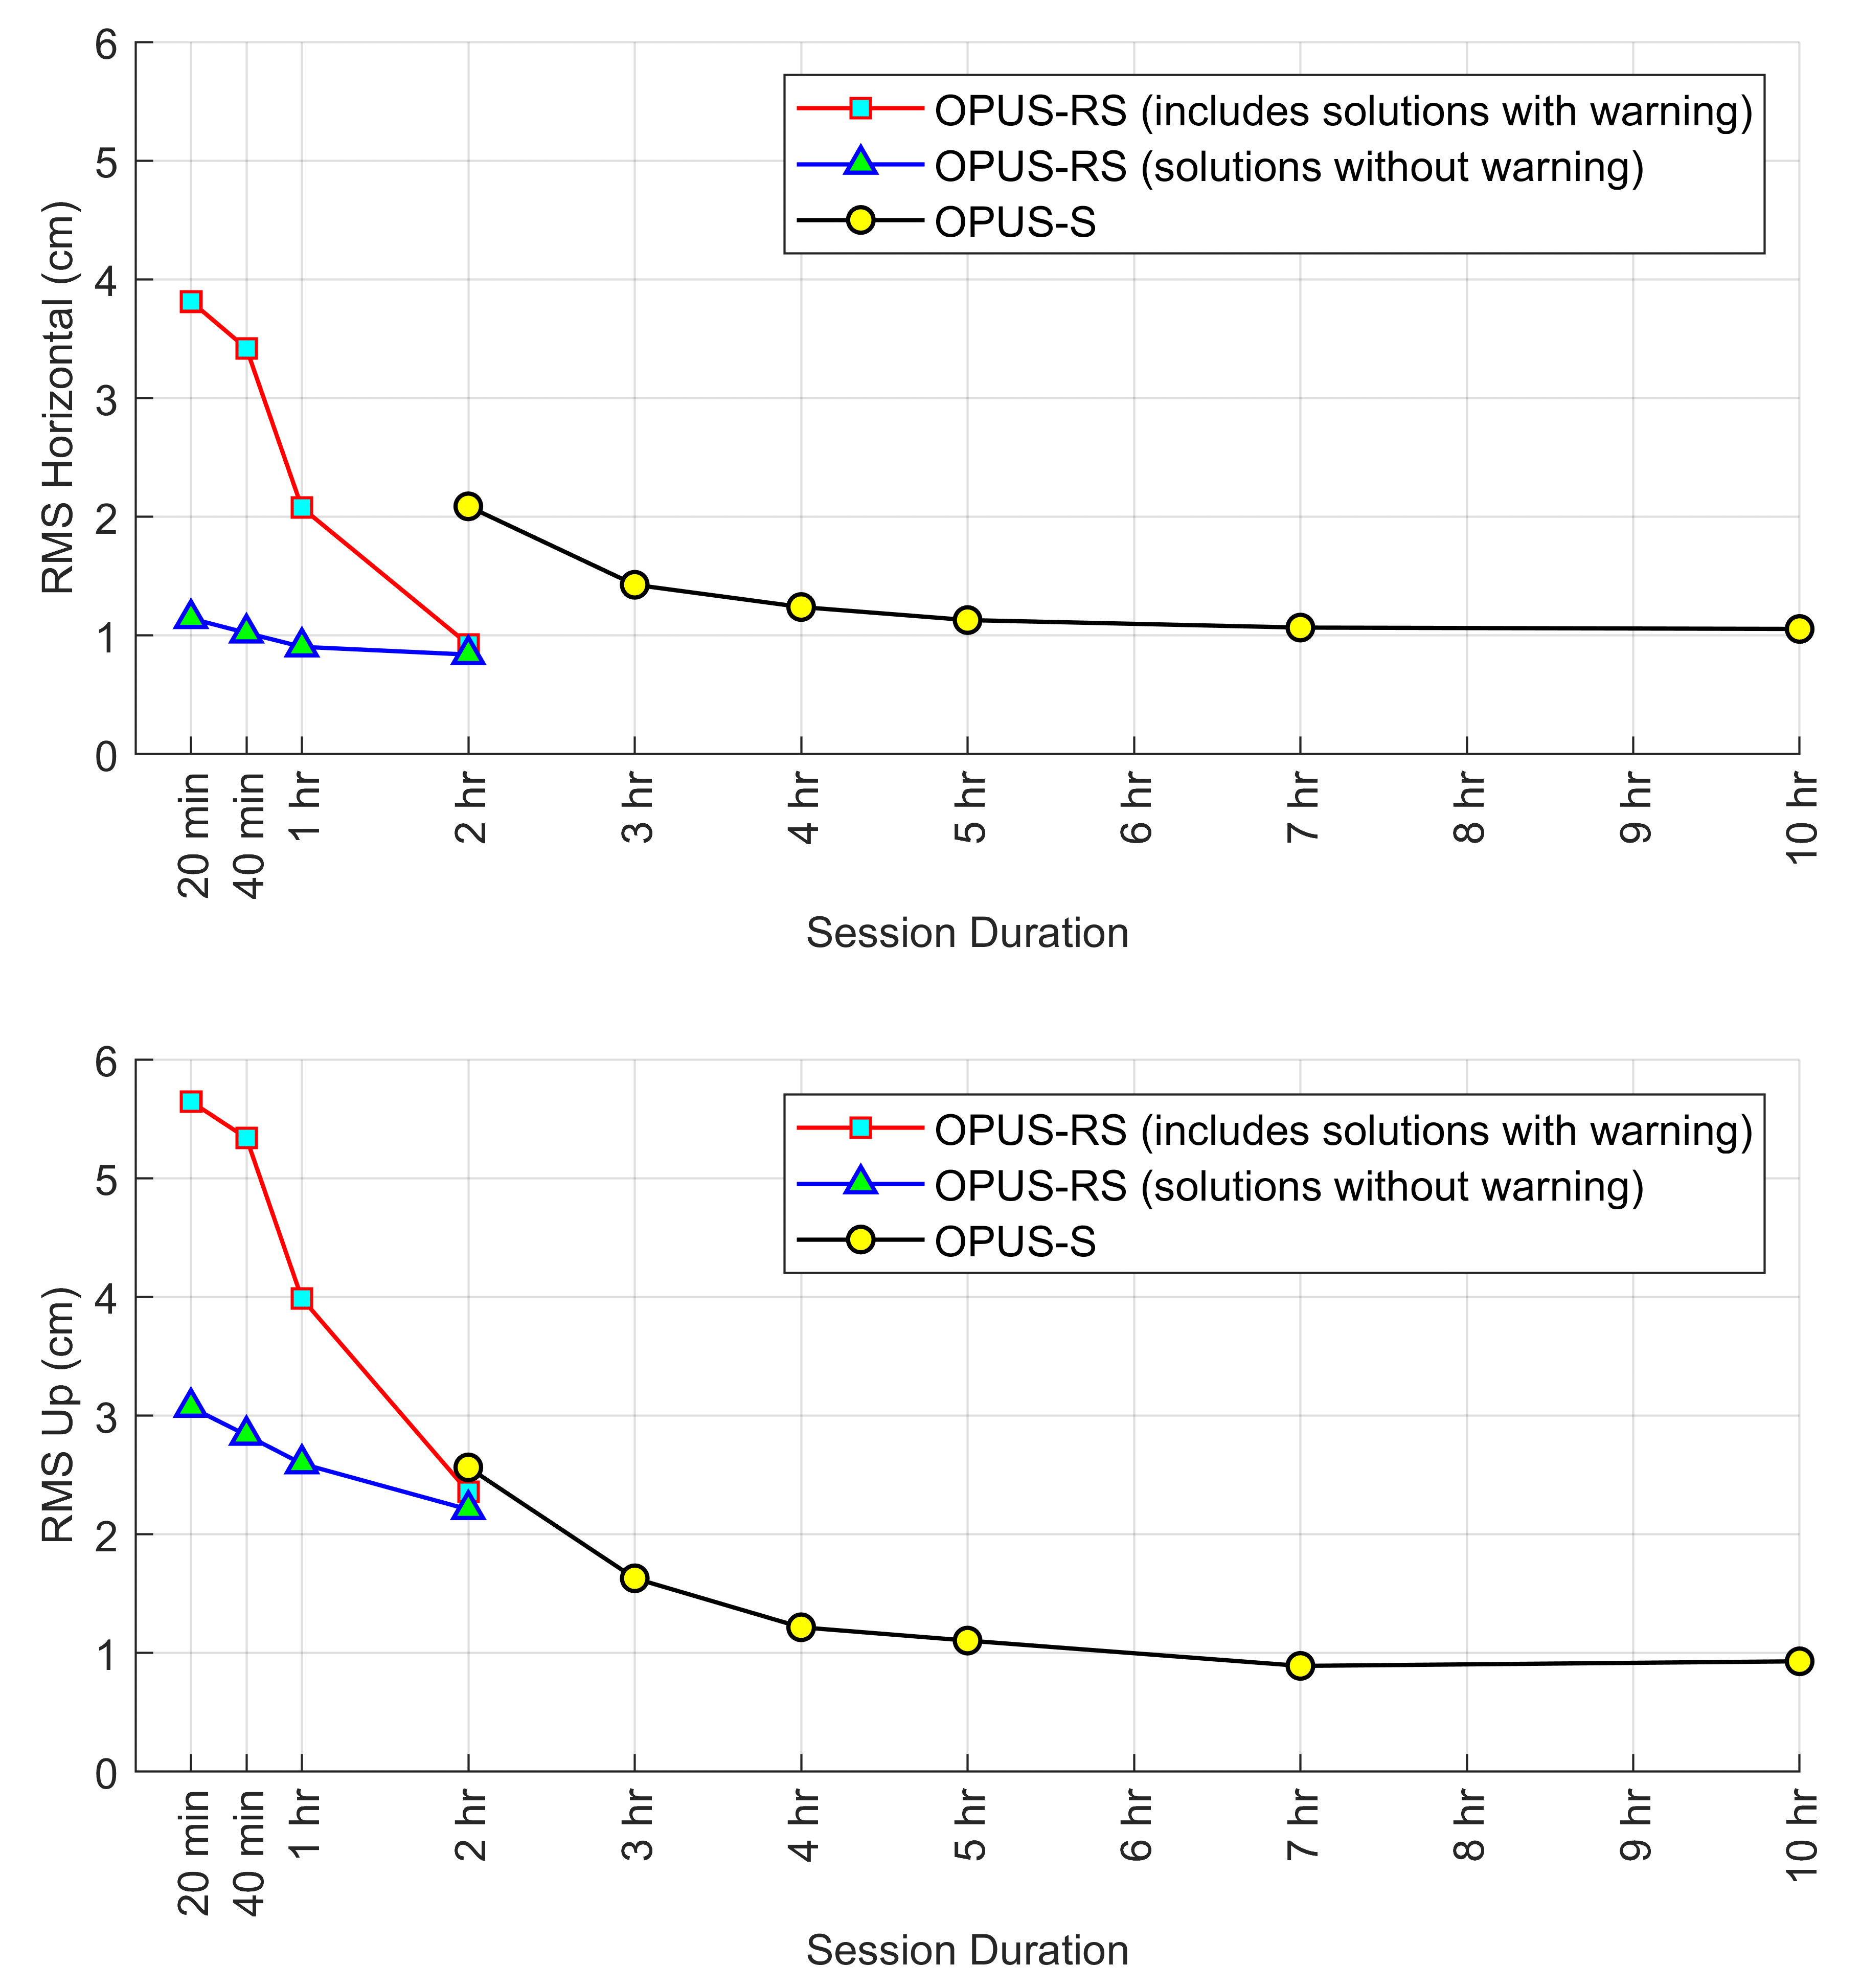
OPUS Accuracies
How long should each occupation be?
-A look at OPUS Accuracies
RMS at 1σ
TX Control Issues
Heights Suppression
Ht Mod Survey
Primary Network Design

Slide 49
Occupation Time
Vertical Network Accuracies, OPUS Projects
95% CI values shown
TOTAL time on mark
TX Control Issues
Heights Suppression
Ht Mod Survey
Primary Network Design

Slide 50
Project Recommendation
Summary of Vertical Accuracy of OPUS Projects
Vertical Standard | Total Time on Mark (h) | Recommended Sessions and duration
3.0 cm | 4 | (2) 2-h
2.5 cm | 8 | (2) 4-h or (3) 3-h
2.0 cm | 22 | (2) 10-h or (3) 7-h
1.7 cm | 48 | (2) 24-h
TX Control Issues
Heights Suppression
Ht Mod Survey
Primary Network Design

Slide 51
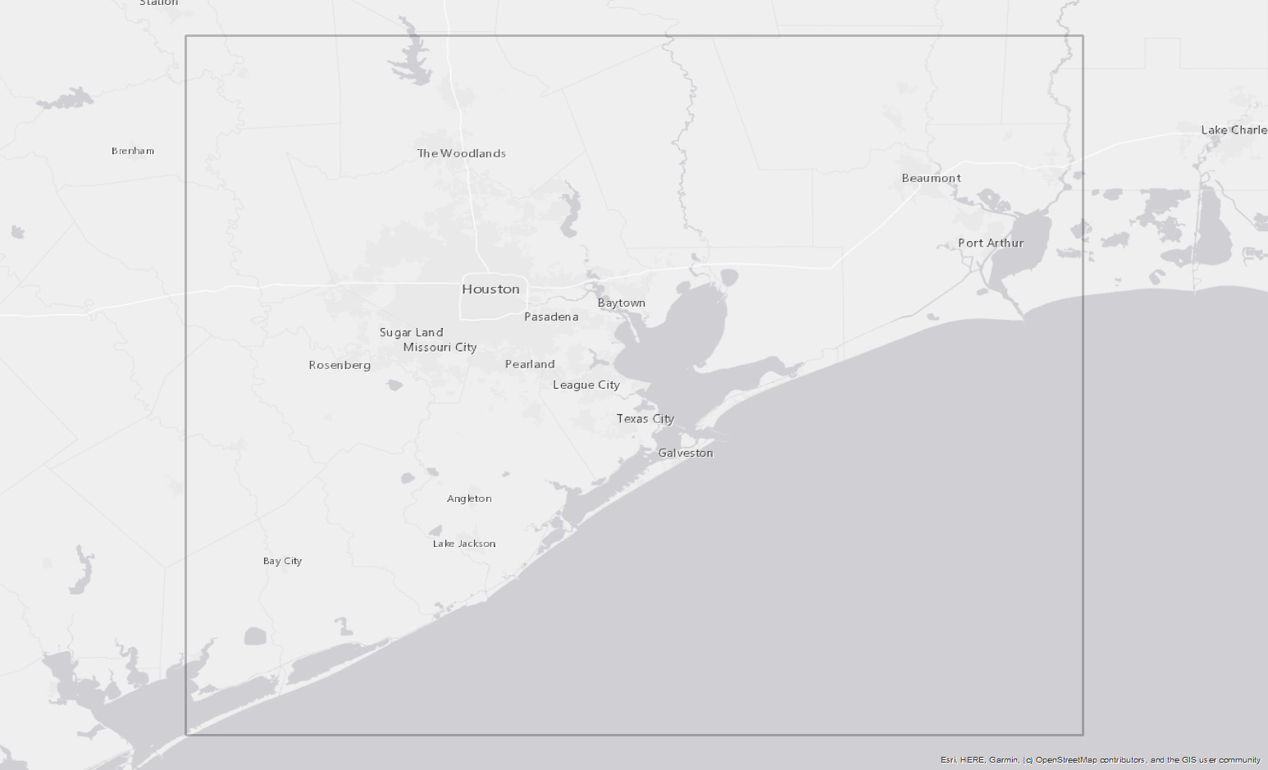
Area of Suspected Vertical Motion
TX Control Issues
Heights Suppression
Ht Mod Survey
Primary Network Design

Slide 52
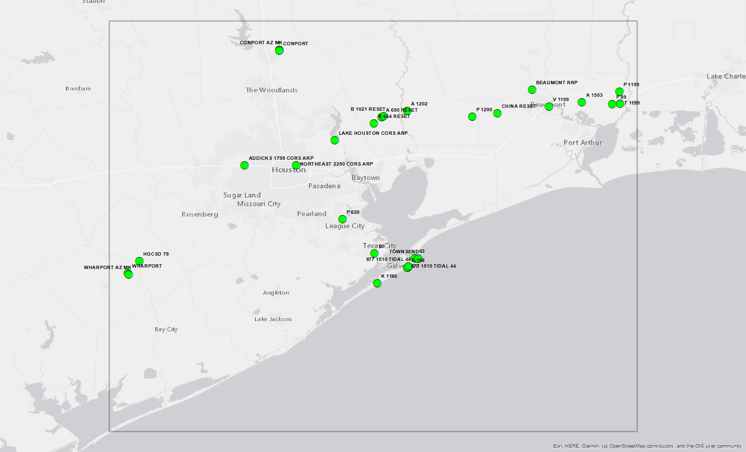
28 Marks with Valid NAVD 88 Heights
TX Control Issues
Heights Suppression
Ht Mod Survey
Primary Network Design

Slide 53
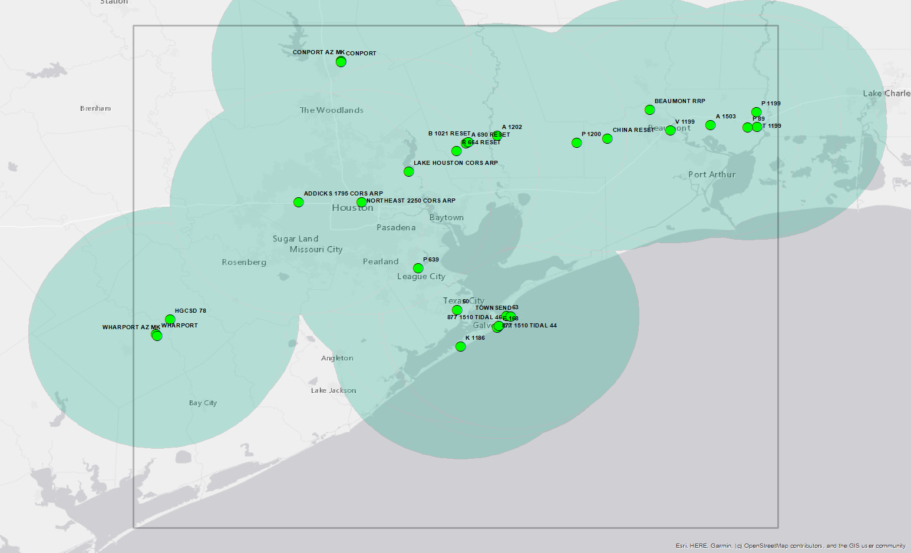
50 km Buffers
TX Control Issues
Heights Suppression
Ht Mod Survey
Primary Network Design

Slide 54

Add Southeast TX CORS
TX Control Issues
Heights Suppression
Ht Mod Survey
Primary Network Design

Slide 55
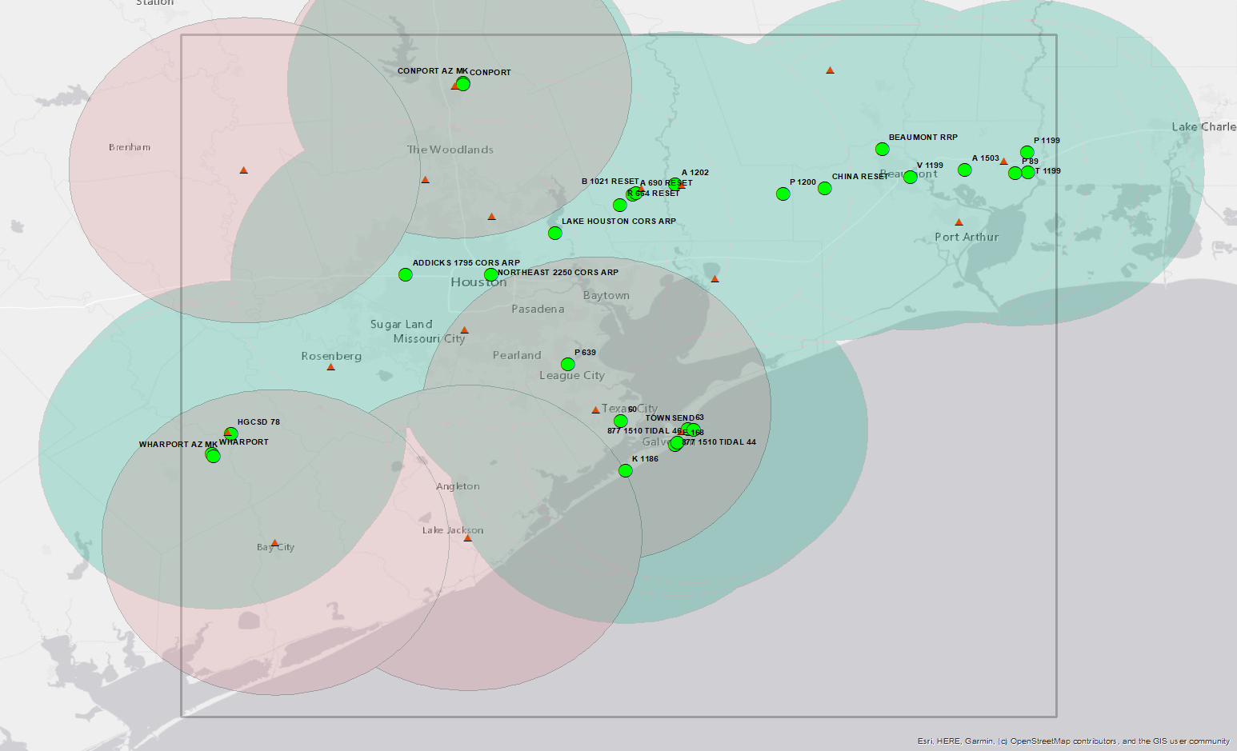
CORS with Ht Mod Heights for Consideration
TX Control Issues
Heights Suppression
Ht Mod Survey
Primary Network Design

Slide 56
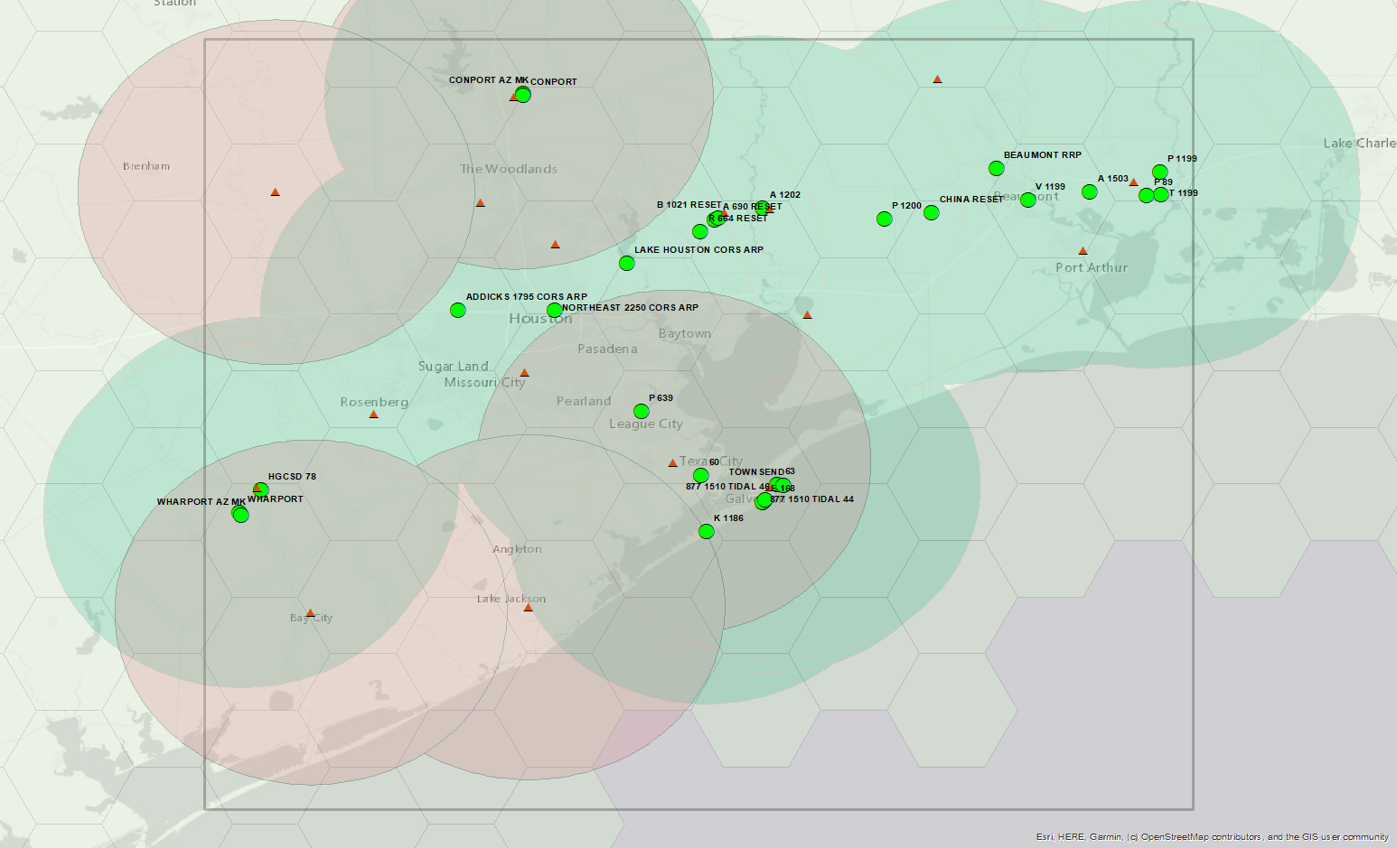
30 km Spacing Hexagons
TX Control Issues
Heights Suppression
Ht Mod Survey
Primary Network Design

Slide 57
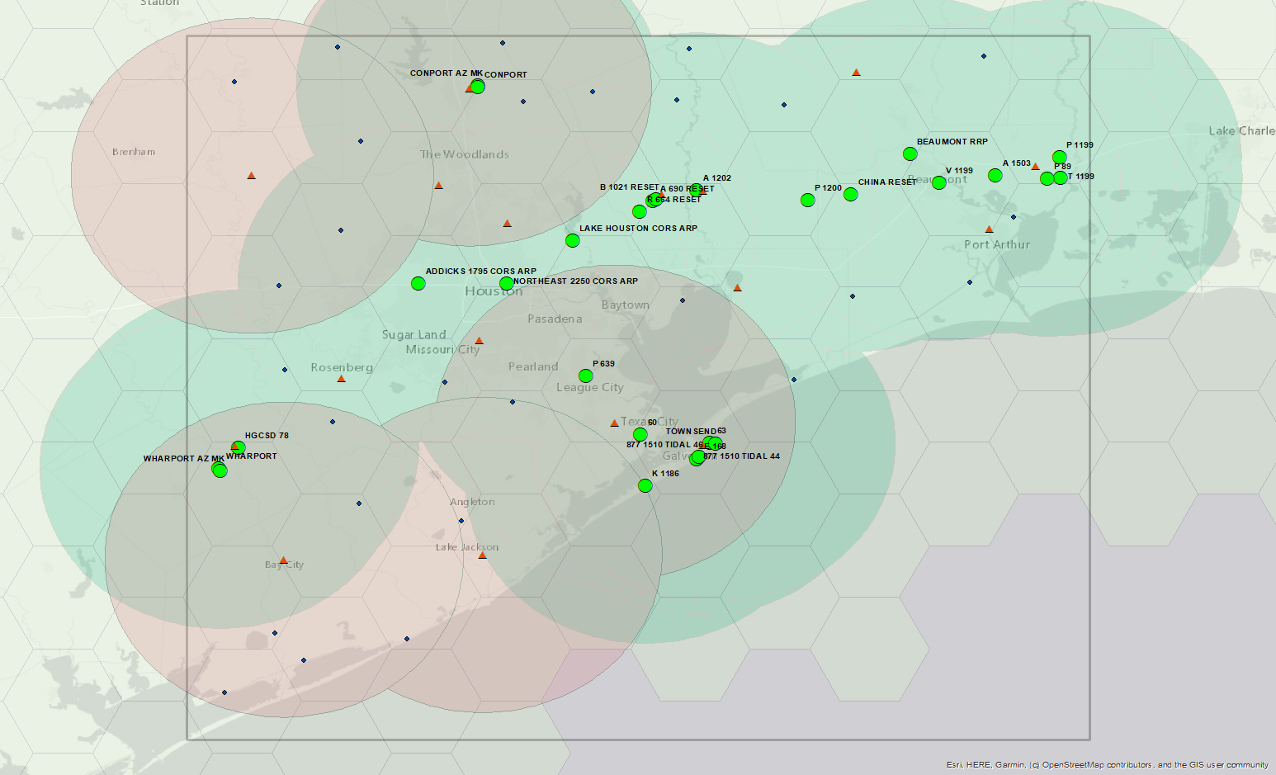
27 Additional Passive Marks
TX Control Issues
Heights Suppression
Ht Mod Survey
Primary Network Design

Slide 58
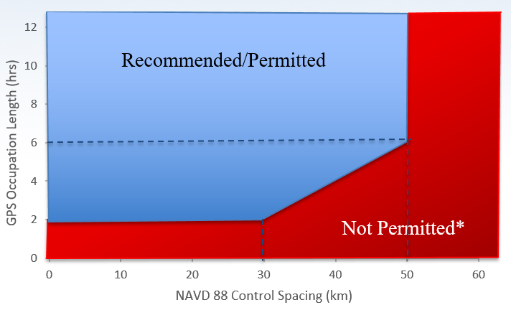
Primary Control Network Summary
52 passive marks
  28 control marks with valid NAVD 88 heights
    25 passive marks
    3 CORS
  27 other passive control marks to maintain 30 km spacing
6-hour sessions (1 session per day) for 50 km buffers
52 marks x 2 full day sessions
104 days for 1 receiver
21 days with 5 receivers
TX Control Issues
Heights Suppression
Ht Mod Survey
Primary Network Design

