Slide 1
Development of GPS on BM Observation Campaign in Wisconsin 2020-2022
Mick Heberlein, PLS, PS, CFedS
NGS State Geodetic Coordinator for Wisconsin
WisDOT, Office of Surveying & Mapping
3502 Kinsman Blvd Madison, WI 53704-2549
Ph. 608-243-5994 E-mail: mick.heberlein@dot.wi.gov

Slide 2
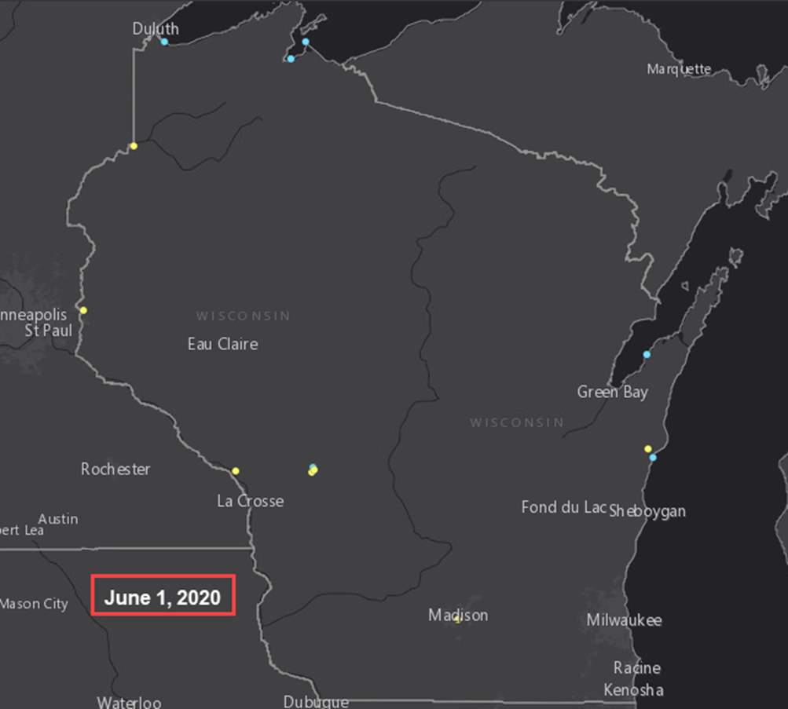
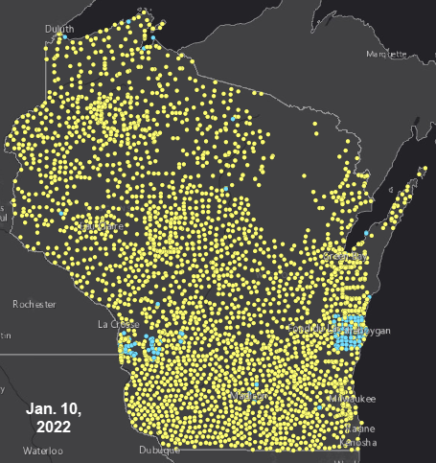
How did we get from here?
To here?

Slide 3
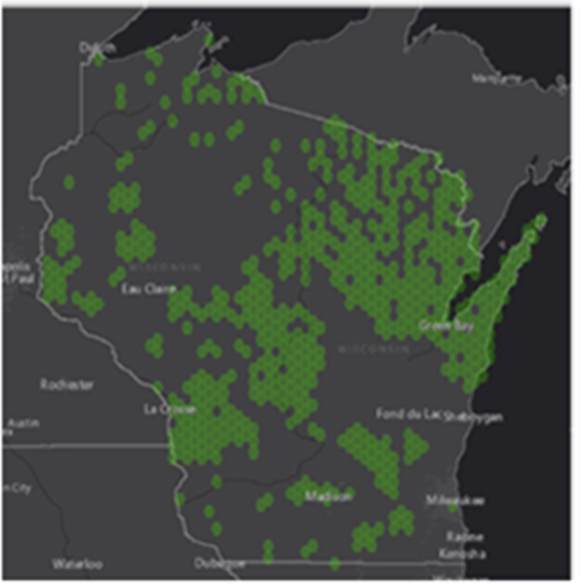
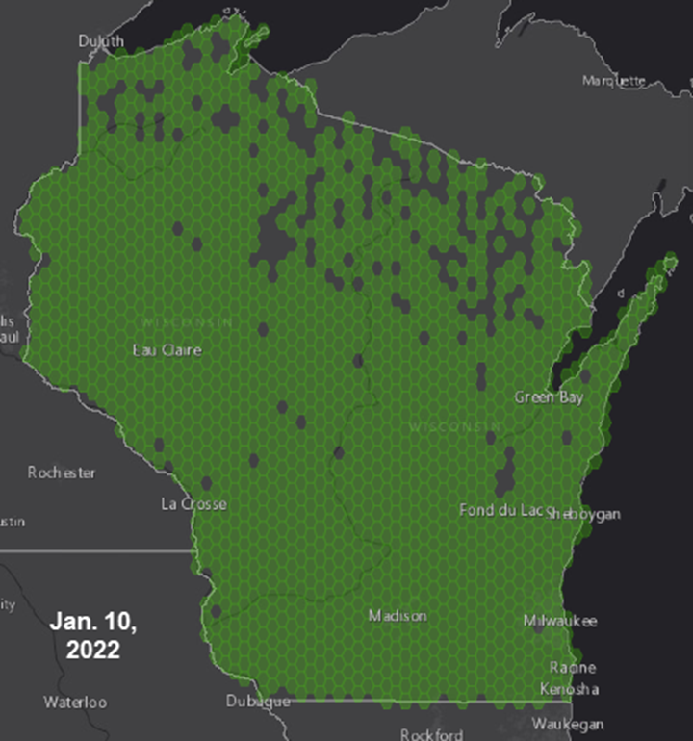
How did we get from here?
To here?
Feb. 1, 2021

Slide 4
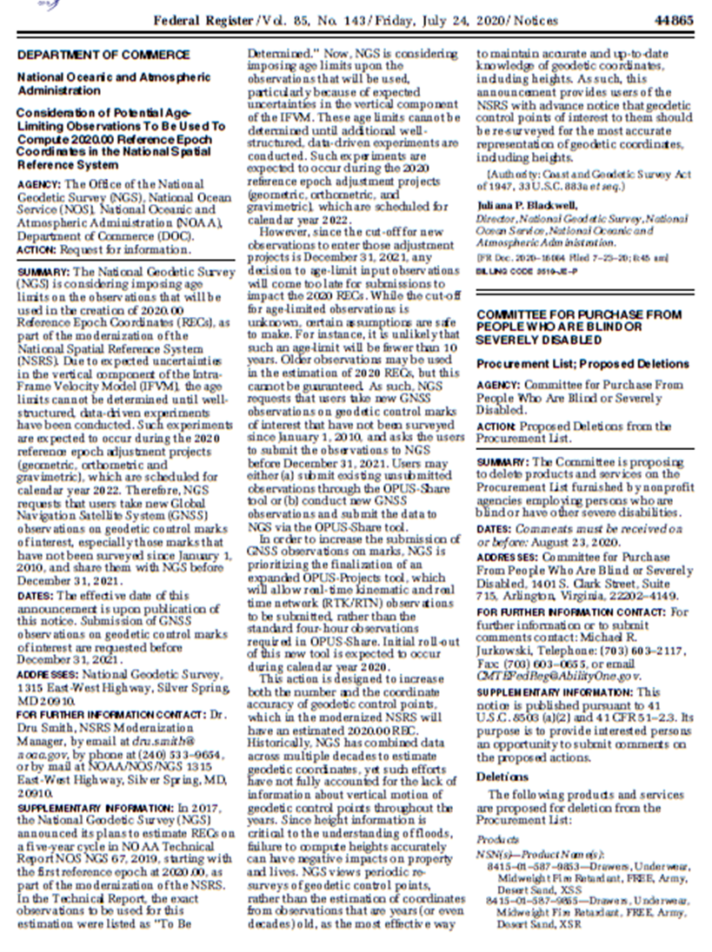
July 24, 2020-
Federal Register Notice Published

Slide 5
July 24, 2020-
Federal Register Notice Published
Set the framework of what NGS required for passive station coordinates to be considered ‘current’ for 2022 datum and be used in the forthcoming transformation tool.
There must be two consistent GNSS observations on a station with at least one since 2014.
In Wisconsin, most of our Wisconsin Height Modernization Program (WI-HMP) projects were submitted before 2010.

Slide 6
July 24, 2020-
Federal Register Notice Published
Wisconsin Height Modernization Program (WI-HMP) has over 9,000 horizontal and vertical passive stations.
Approximately 3,600 of these are horizontal stations requiring only one additional GPS on BM observation.
There are 80 High Accuracy Reference Network (HARN) stations across the state of the Wisconsin. The HARN stations are the initial stations used for the WI-HMP densification of geodetic control.

Slide 7
2020- July 24 Federal Register Notice
As such, this announcement provides users of the NSRS (NATIONAL Spatial Reference system) with notice that Passive geodetic control points of interest should be re-surveyed for the most accurate representation of geodetic coordinates, including heights.

Slide 8
Wisconsin DOT Plan
Development of an observation plan for GPS on BM.
  Minimum 4-1/2 hour observation period
  WisDOT Region Application Specialists (surveyors) set up an observation receiver on their way to the job site and pick it up on the way back with minimal disruption to their workday.
  Equipment- Trimble NET R5s that were no longer used in the WISCORS network. Region survey staff still had their RTK units for normal WisDOT region work.
  2.0 meter constant height poles. Many from the older base/rover RTK workflow.
  Created equipment list and operating instructions for observations.

Slide 9
Wisconsin DOT Plan
Development of an observation plan for GPS on BM.
  Region field people will do the observations, and central office people will download the RINEX file and process.

Slide 10
Wisconsin DOT Plan
  WisDOT Priority List
Not necessarily NGS’, not necessarily yours
Original HARN stations or replacements
Any (horizontal) station inside an uncompleted NGS GPSonBM 10 km hexagon
Horizontal WI Height Modernization (WI-HMP) stations
  With leveled elevations- GPSonBM A-1 Priority
  Without leveled elevations- GPSonBM B-1 Priority
WI-HMP vertical bm (GPSonBM A-2 Priority)
Others
  Non WI-HMP stations in the NSRS
  New stations not currently in the NSRS

Slide 11
WisDOT Plan
Wisconsin DOT Region observations began in the Fall of 2020 with two selected regions. These 2 regions helped us to refine the procedures prior to dispersing equipment to the other region offices state-wide.
Someone from Central Office would meet up with the region surveyors and download RINEX files for processing.
Eventually the region surveyors indicated that if they had more sets of equipment, they could do more observations.
More equipment was cobbled together, so when time was available, more observations could be done.

Slide 12
Additional WisDOT Partners to Obtain Observations

Slide 13
Wisconsin Society of Land Surveyors (WSLS) Chapter Meetings
  Due to Covid 19, most WSLS chapter meetings in the fall of 2020/spring 2021 were available virtually.
  Solicited local surveyors to obtain observations, again stressing the importance of observing stations that were important to their work, not necessarily WisDOT or NGS.
  Survey observations completed by the deadline would ensure good quality geodetic control and transformation tools for their area.
  Allowed users to have a larger ‘ownership’ role in geodetic survey control stations.

Slide 14
Wisconsin County Surveyors Association (WCSA)
  Not all county surveyors are full-time or have the resources to perform observations.
  Emphasized the local control aspect of this campaign. We asked them to observe stations that were important to them, whether or not they were WI-HMP stations.
  GPSonBM is a method to get existing county survey marks into the 2022 database. Some counties stations were not included in the WI-HMP program.
  New stations could be created in strategic locations that will be very beneficial in the coming years.

Slide 15
Wisconsin County Surveyors Association (WCSA)
  Counties surveyed and processed their observations. If a county were to get all their existing stations observed, then they will have very good 2022 datum coordinates and an excellent transformation tool for conversion of section corner data, lidar data orthophoto data etc.

Slide 16
Wisconsin Society of Land Surveyors Annual Institute
  Reviewed information on the Federal Registry Notice of July 2020 and emphasized timely observations of passive stations are going to be the new standard.
    The days of determining a coordinates for a station and not revisiting it for 40 years unless there are issues are done.
  Ultimate impact
    The most accurate transformation tool from NAD 83 and NAVD 88 to 2022 Datum.
    The most up-to-date passive control network 2022 datum coordinates.

Slide 17
Wisconsin Society of Land Surveyors Annual Institute
  Reviewed the WisDOT Plan
  Reviewed the WisDOT station priority list
  Reviewed OPUS Share submittals
      Need to have
        RINEX File
        Antenna type
        Up close and Horizon Images
        Antenna Height- Need Rod Height not Slant Height
  Process data via NGS OPUS Share website
    https://www.ngs.noaa.gov/OPUS/index.jsp
  Respond to follow-up emails from NGS

Slide 18
Wisconsin Society of Land Surveyors Annual Institute
    Very good instructional video on processing with OPUS Share by Dave Zenk, NGS Northern Plains (IA, MN, NE, ND, SD) Regional advisor.
    https://www.ngs.noaa.gov/corbin/class_description/opus-share-tutorial/

Slide 19
Big Finish
    At the WSLS conference, we realized that bouncing back and forth between the GPS on BM Map, OPUS Share Map and our WI-HMP database was not very efficient, we needed to combine the following into one GIS map
    WI-HMP stations
    NGS 10 KM Hexagons and status
    Number of Station Observations
    Station Status (Completed or not)

Slide 20
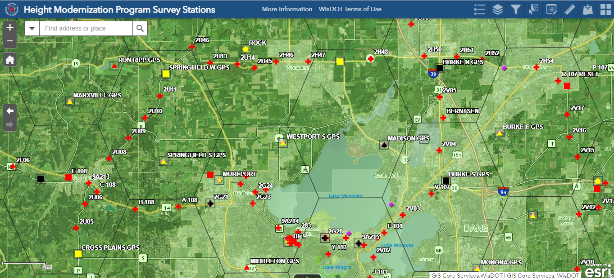
Big Finish

Slide 21
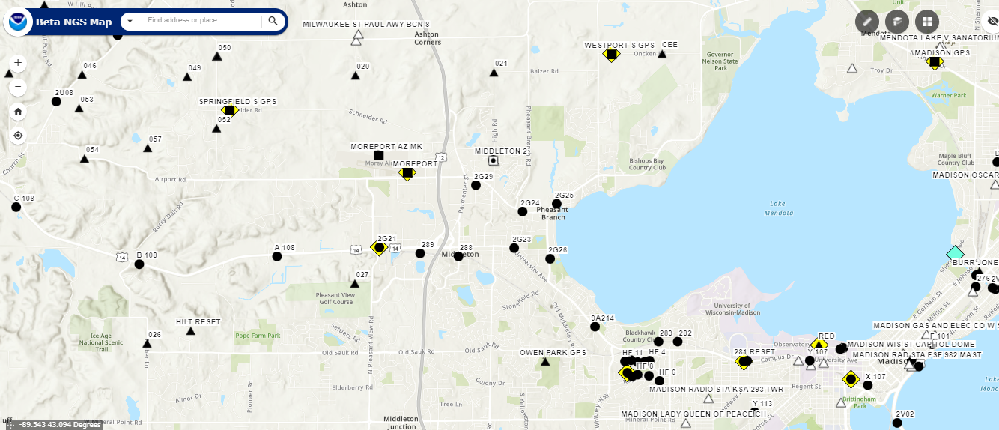
Big Finish

Slide 22
Big Finish
Link to WisDOT GIS GPSonBM map
https://wisdot.maps.arcgis.com/apps/webappviewer/index.html?id=9f00da9c32da4e519bd035591abc09c9

Slide 23
Links
NGS video on submitting OPUS Share observations
https://geodesy.noaa.gov/corbin/class_description/opus-share-tutorial/
Wisconsin GIS GPS on BM Map
https://wisdot.maps.arcgis.com/apps/webappviewer/index.html?id=9f00da9c32da4e519bd035591abc09c9
Federal Registry Notice
https://www.govinfo.gov/content/pkg/FR-2020-07-24/pdf/2020-16068.pdf

Slide 24
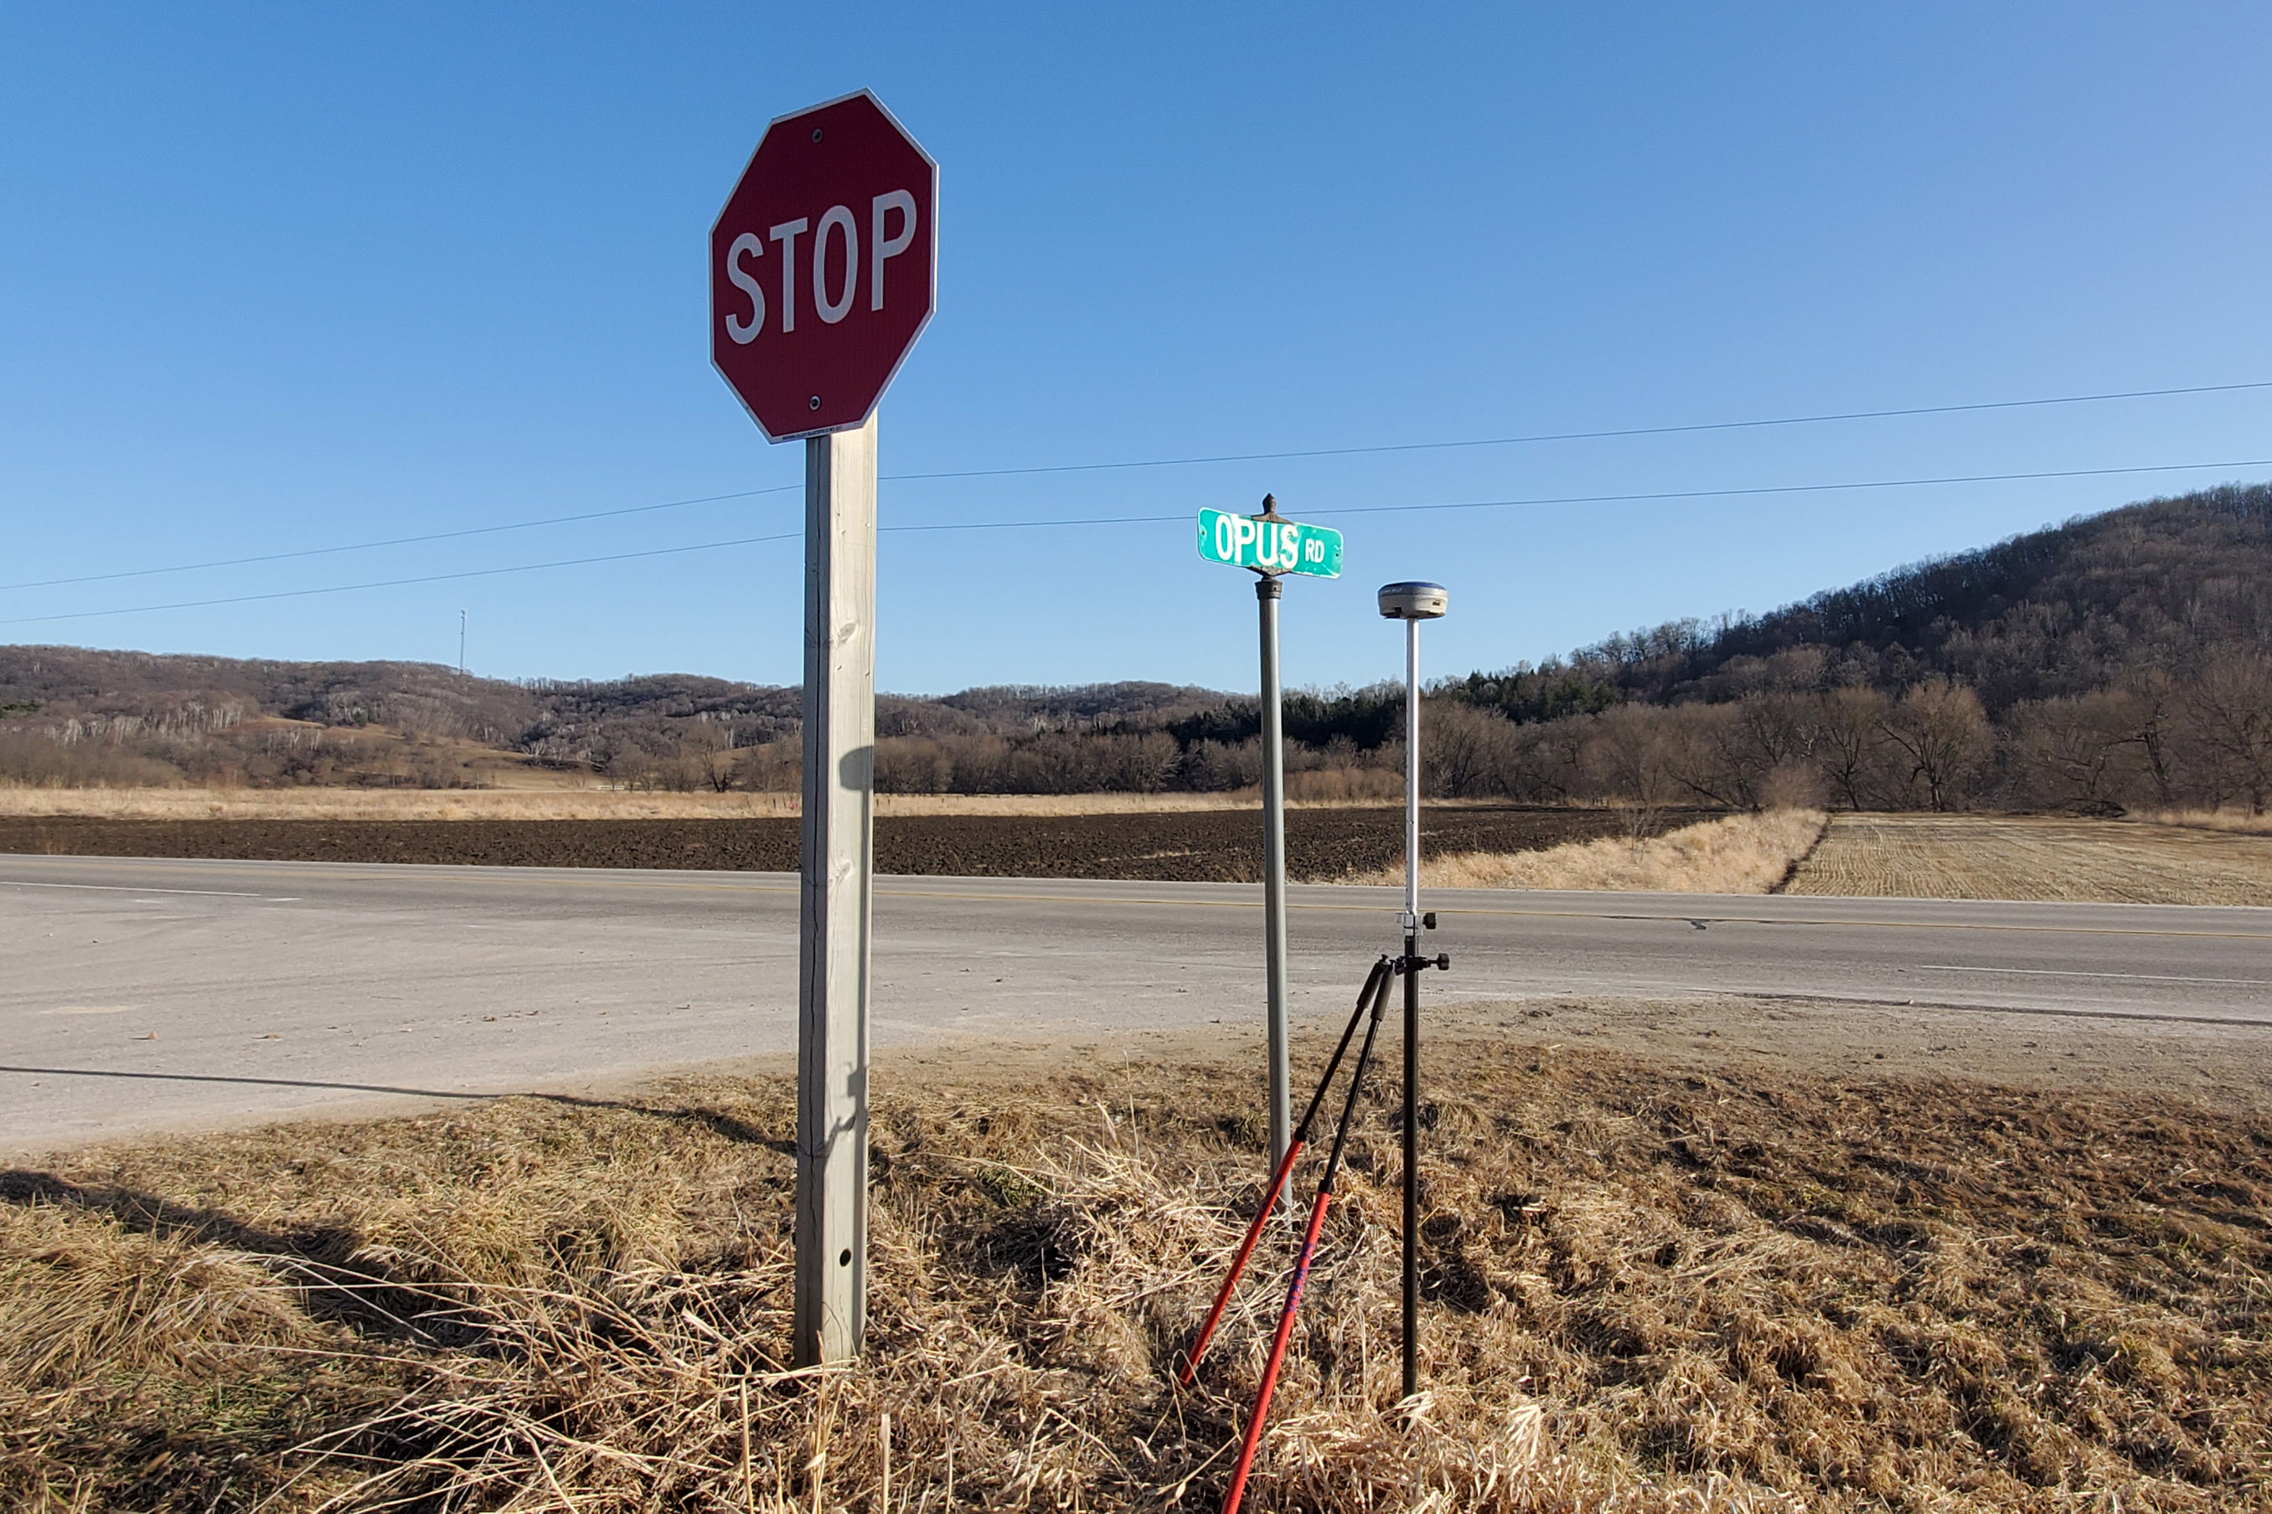
Big Finish

