Slide 1
Results the Geoid Slope Validation Survey 2014 in Iowa
Wang YM, C Becker, G Mader, T Hanson, D. Martin, S Holmes, X Li, T Jiang, S Breidenbach, C Geoghegan and D Winester
National Geodetic Survey, NOAA, USA
26th General Assembly of the International Union of
Geodesy and Geophysics (IUGG)
Prague Czech Republic
June 22 – July 2 2015

Slide 2
Presentation Outline
Objective of the survey
What was surveyed
Accuracy assessment of the survey
Computation of gravimetric geoid with
GRAV-D airborne gravity
Validation results
Conclusions and future work

Slide 3
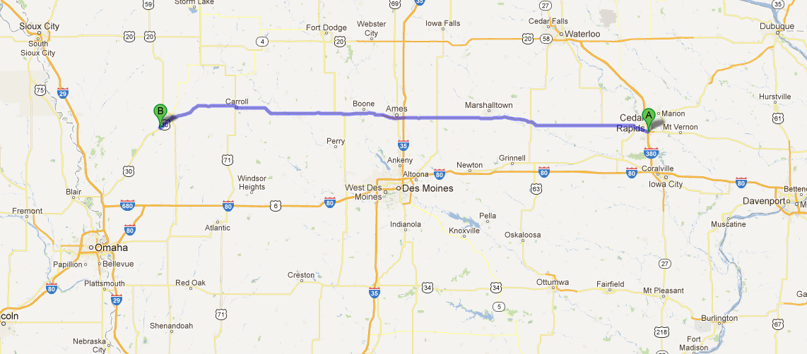
Objective of the Survey
The next North America Vertical Datum will be GRAV-D airborne gravity geoid based. To validate the geoid accuracy, three traverses in flat, medium and rough terrain are planed.
GSVS14 is in medium mean elevation (350m) and medium roughness area in Iowa that crosses the Midcontinent Rift. Length of the line is 320km.

Slide 4
The Survey
Long Session GPS at 204 Official Points
356 kilometers of first order class II leveling tied 226 bench marks to 14 NAVD88 bench marks
Gravity survey includes: FG-5/A-10 absolute gravity at Gravity End Points, Lacoste-Romberg relative gravity connecting Gravity End Points and also all Official Points
Deflections of the vertical using the CODIAC camera at Eccentric Camera Points
Airborne gravity over entire line

Slide 5
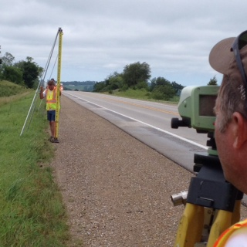
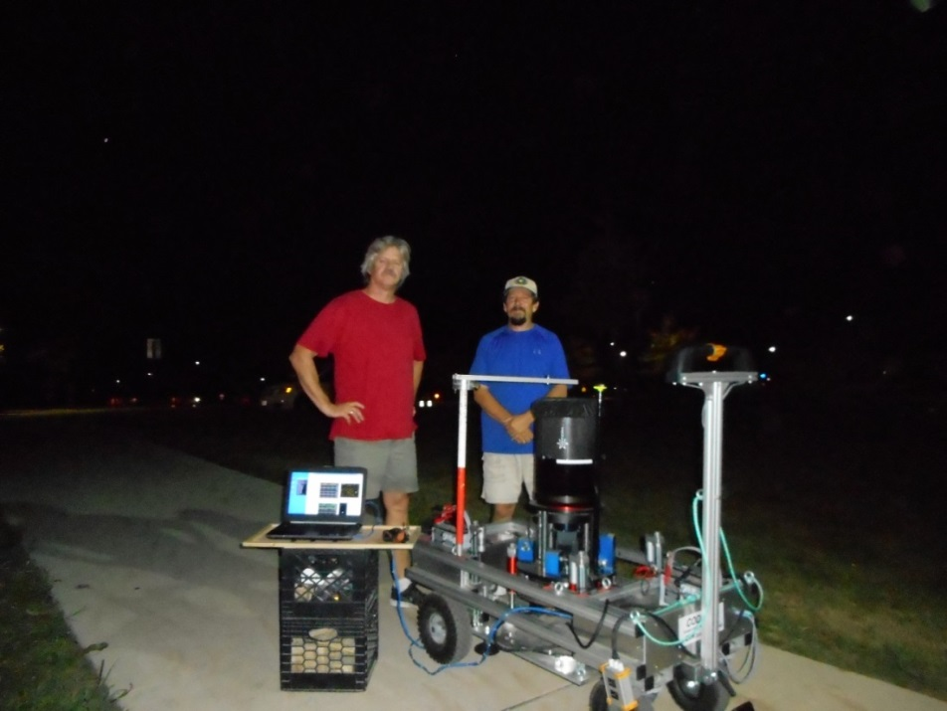
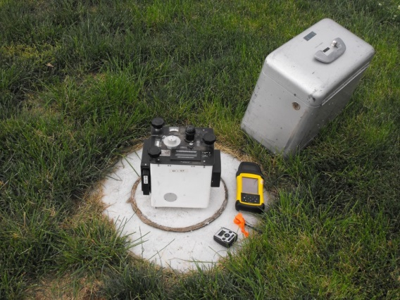
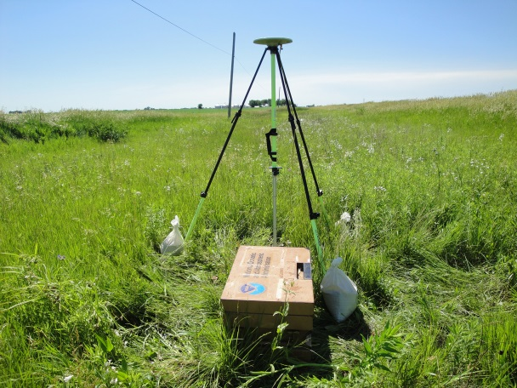
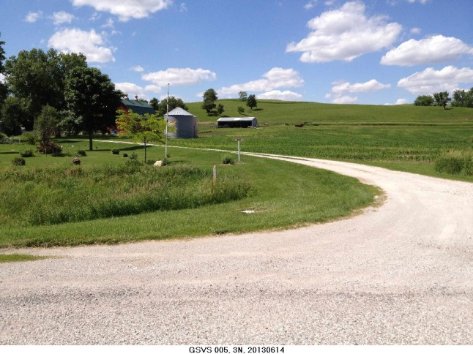
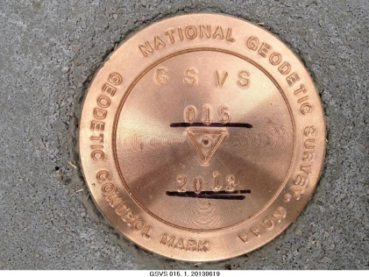
The Survey Equipment

Slide 6

Empirical Error Estimates
σ_{Δh} (OPUS-S) : ±2 - 6 cm
  GPSCOM combination: ~ 4 mm
  (no significant baseline dependency)
=> 12.5mm RMS over GSVS14
σ_{ξ} , σ_{η}: ± 0.05”; : ± 0.07”
  ~ ± 0.336 mm / 1 km => 6.0 mm RMS over GSVS14
Notes:
These values are empirical estimates coming from various sources.
For the differential ellipsoid height accuracies, these come from either the OPUS-S runs, showing peak-to-peak error, or else
from a least squares adjustment of all the data, showing a baseline-length-independent ~4mm (give or take 2 mm) error
between any two of the 204 points.
For the differential orthometric height accuracy, the value quoted is the 1st Order, Class II relative maximum
elevation difference accuracy is 0.7 mm per (sq.rt. km) based on Table 2.2 of FGCC Standards and Specifications
for Geodetic Control Networks.
For the Deflections of the Vertical, the expected error for the DIADEM camera was 0.1 arc seconds, but the
empirically determined accuracy estimates from the data itself were 0.06 arcseconds. This corresponds to about 0.43 mm over 1.5 km, which, added in an RMS sense over 218 points yields a highly optimistic 6.6 mm of RMS over the entire line.

Slide 7
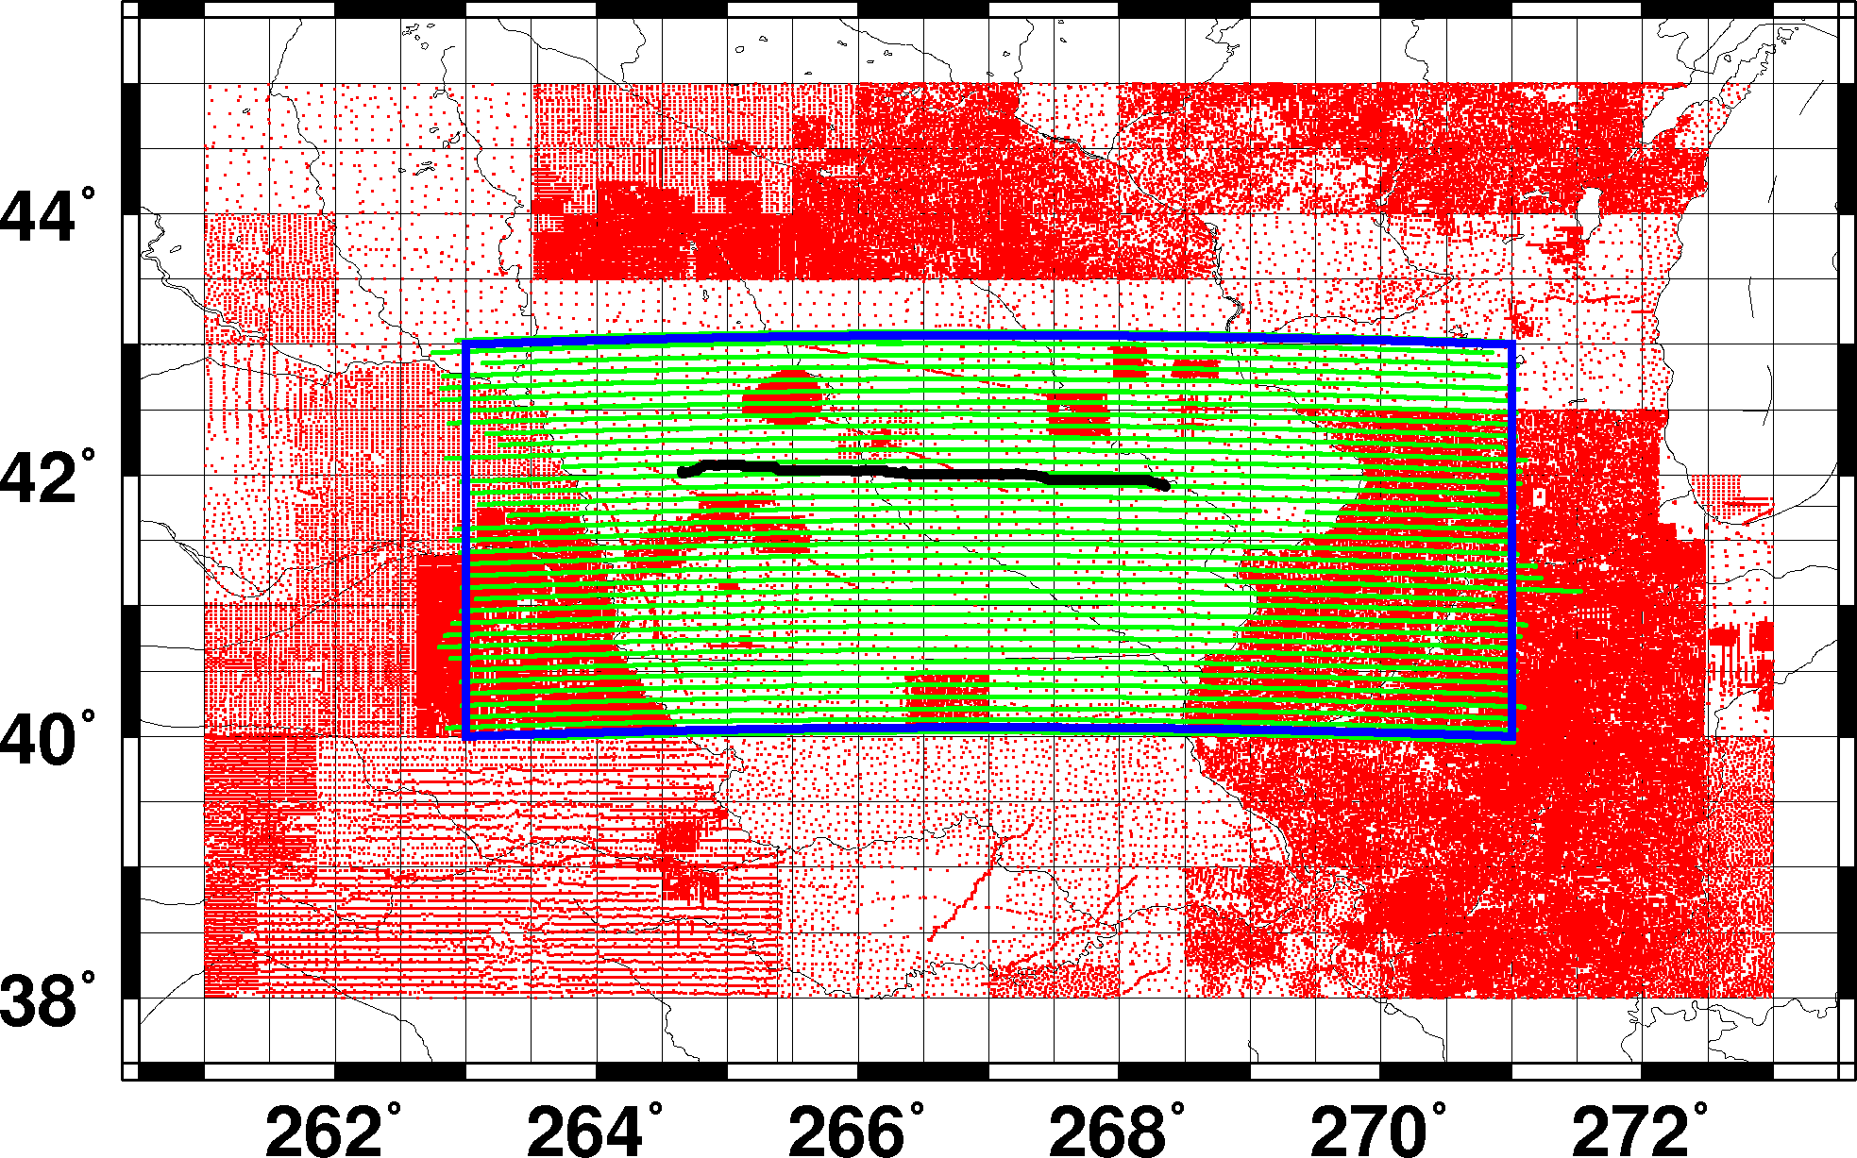
Gravity Data Coverage

Slide 8
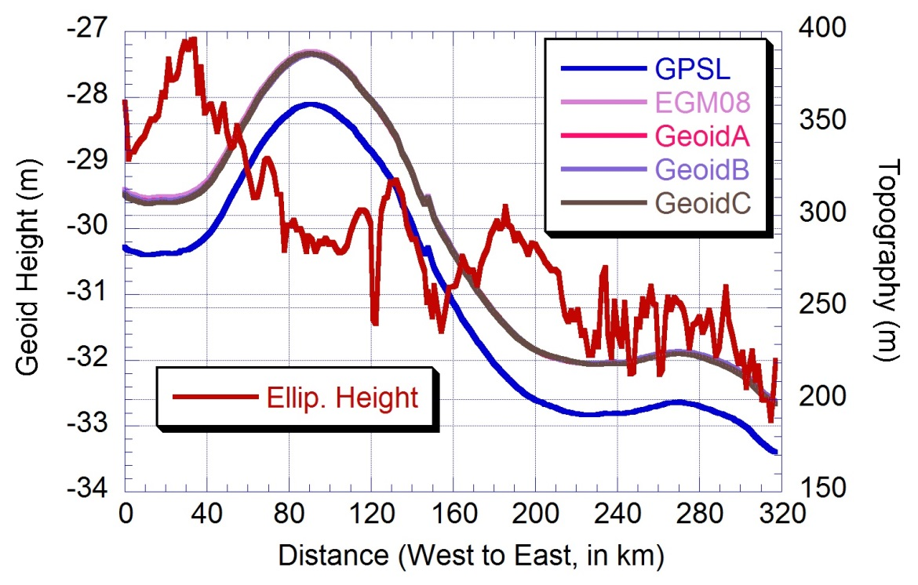
Geoid Models vs GSVS14

Slide 9
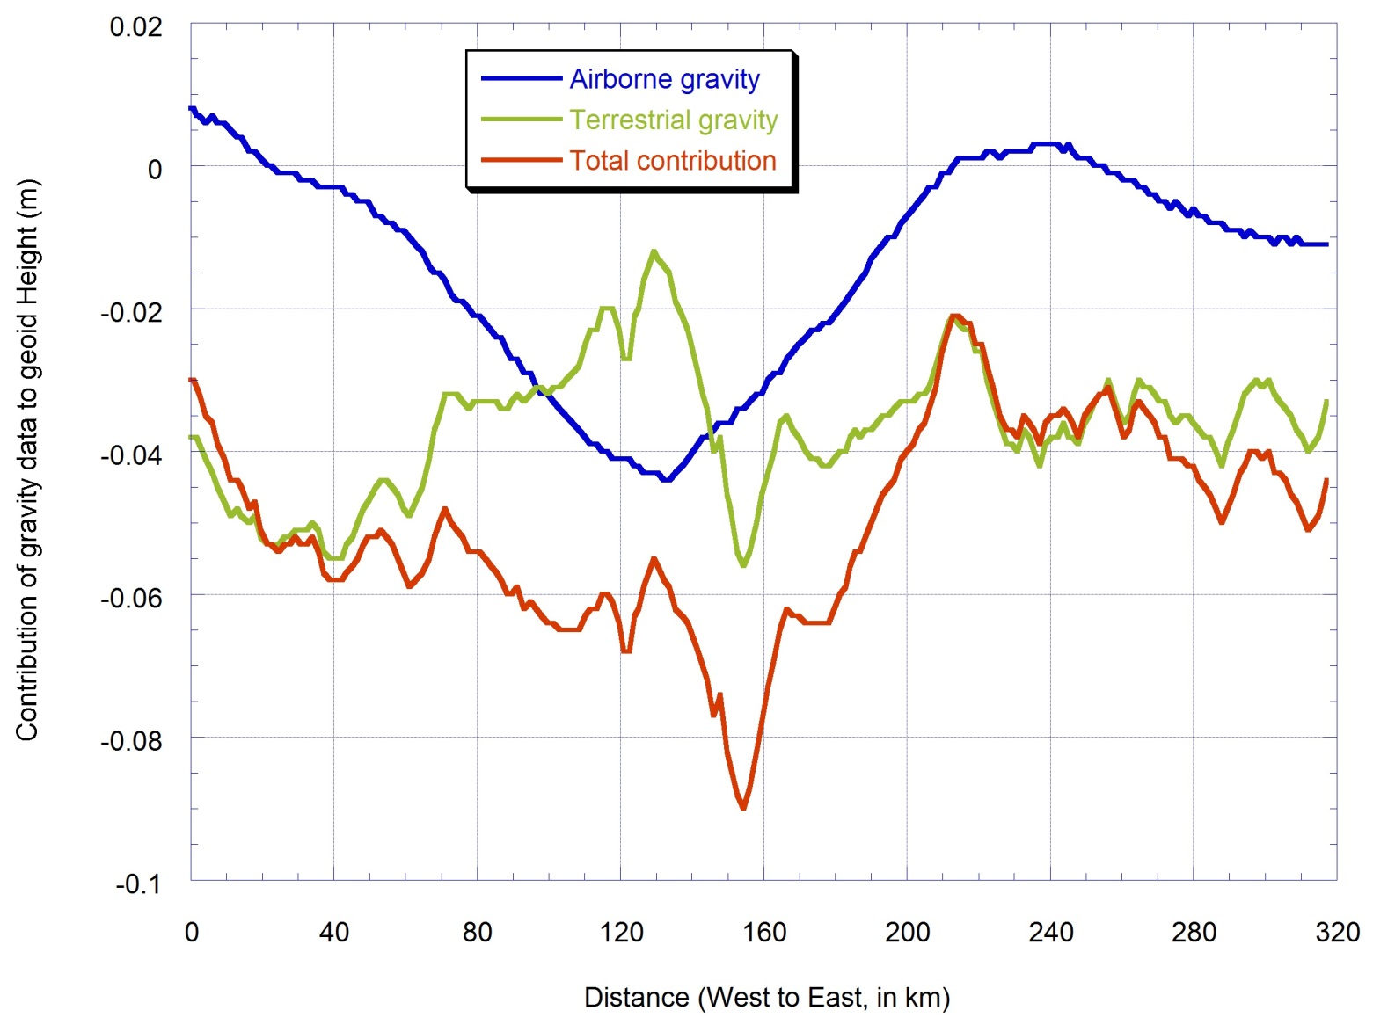
Residual Geoid by Data Type

Slide 10
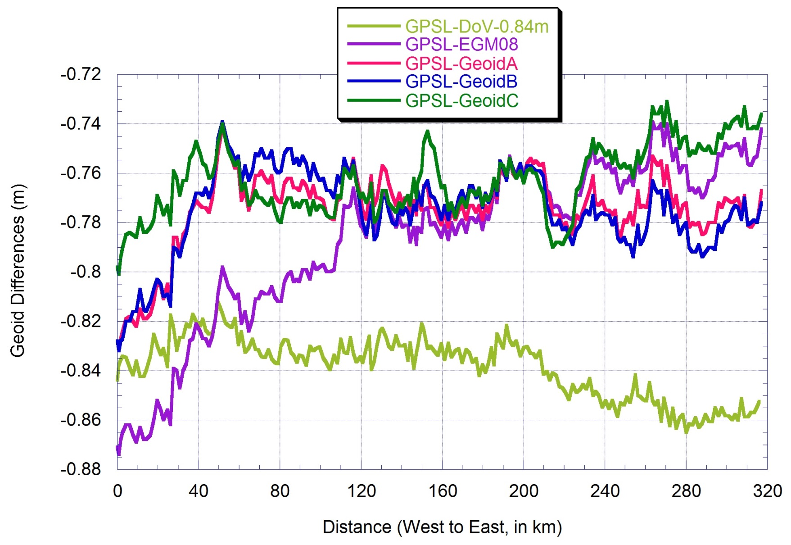
Geoid Differences (GPSL-model)

Slide 11
Statistics of Geoid Differences at 204 Official Marks
 | EGM08 | GEOIDA | GEOIDB | GEOIDC | DoV
Mean | -78.6cm | -77.4 | -77.5 | -76.3 | 0.0
STD | ±3.4cm | ±1.6 | ±1.7 | ±1.4 | ±1.2

Slide 12
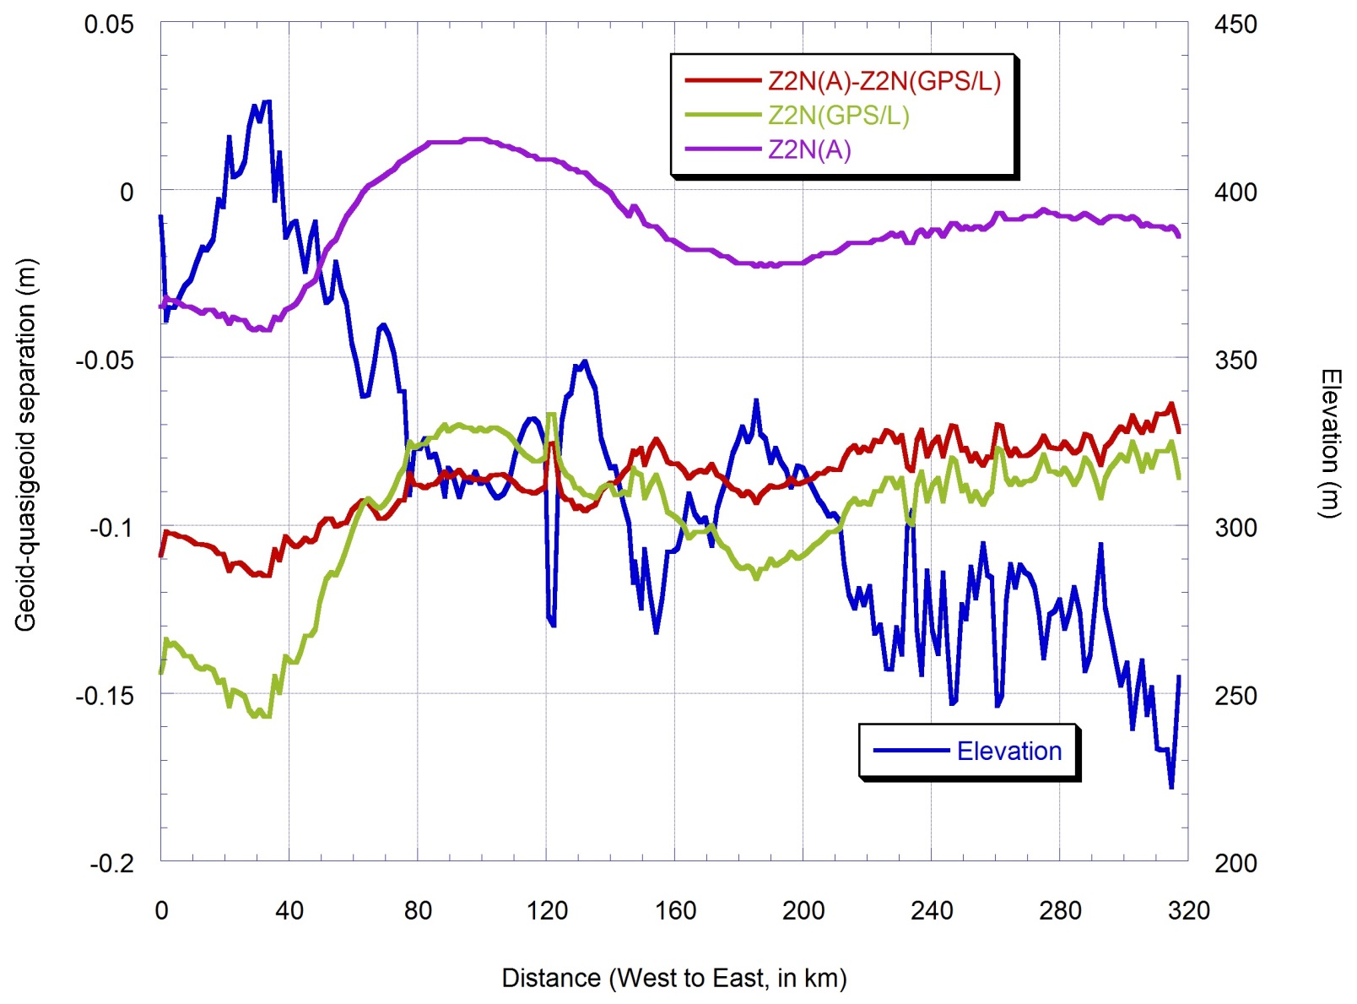
Geoid-quasigeoid Separation

Slide 13
Statistics of Geoid-quasigeoid Separation at 204 Official Marks
 | GPS/L | Bouguer Anom. | GPS/L-Bouguer Anom
Mean | -9.8cm | -1.1 | -8.7
STD | ±2.3cm | ±1.5 | ±1.2
Min. | -15.7cm | -4.2 | -11.5(-2.8)
Max. | -6.7cm | 1.5 | 6.4(2.3)
Notes:
The max and min numbers in parenthesis are centered.

Slide 14
Differential Geoid Comparison
Notes:
Geoid A, B and C are Simon, Tao and Xiaopeng’s solutions

Slide 15
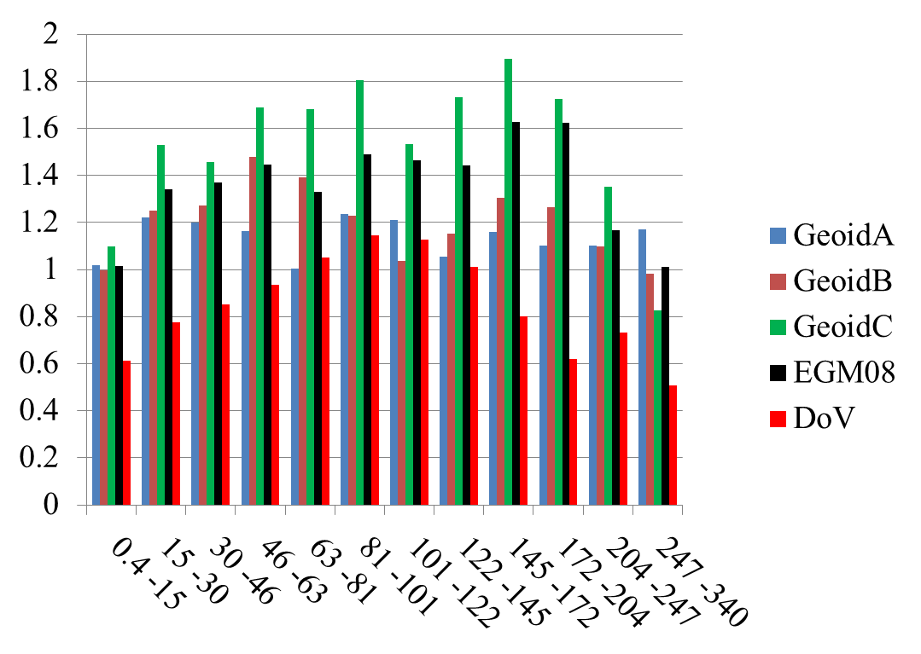
Differential Comparison
(removing 40km at west side)

Slide 16
Conclusions
GPS/L geoid profile of GSVS14 should have an accuracy better than ±1.0 cm between any two marks.
CODIAC camera accuracy may be at ± 0.05”, implying a ± 6mm accuracy between any two marks.
GRAV-D airborne gravity and satellite model GOCO3S help improve the geoid accuracy by more than 50% in Iowa.
1- 1.5 cm geoid is achievable in a medium mean elevation area. A larger discrepancy is shown at the west side of the survey near the Rocky Mountains.

Slide 17
Future Work
Validate the accuracy of GPS height and leveled height by using independent DoV and gravity data
Study the effect of constant density assumption on leveled height.
Investigate the causes of the larger discrepancy at the west side of the survey.
Validate and calibrate error degree variances of satellite gravity models using GSVS surveys.
GSVS16 – High elevation, rough topography (Rocky Mountains!)

