Slide 1



Which way is UP?
Geoid Slope Validation Survey of 2014
New Hampshire Land Surveyors Association
December 05, 2014
Dan Martin
NGS Vermont State Geodetic Advisor
Dan.martin@noaa.gov
802-828-2952
www.aot.state.vt.us/geodetic/Advisor/advisorpresent.htm

Slide 2
Genesis of the survey
“...the gravimetric geoid used in defining
the future vertical datum of the United States should have an absolute accuracy of 1 centimeter at any place and at any time.”
-- The NGS 10 year plan (2008-2018)
Admirable!...Achievable?
Notes:
The above quote refers to one of many ambitious goals in the NGS 10 year plan. While admirable, its achievability remains an open question. In order to begin addressing the actual achievable accuracy of a gravimetric geoid model, NGS will engage in a variety of testing methods prior to the 2022 date when the gravimetric geoid will serve as the reference surface for a new vertical datum. The first such testing method took place in the summer of 2011 and is known as the Geoid Slope Validation Survey of 2011, or GSVS11. As its name implies, this survey tested the accuracy of differential geoid undulations between points ("geoid slopes") from NGS's gravimetric geoid models. The baseline for comparison will be independently computed geoid slopes from two methods, GPS and leveling as well as Deflections of the Vertical.

Slide 3
Goal of the survey
Observe geoid shape (slope) using multiple independent terrestrial survey methods
  GPS + Leveling
  Deflections of the Vertical
Compare observed slopes (from terrestrial surveys) to modeled slopes (from gravimetry or satellites)
  With / Without new GRAV-D airborne gravity
Notes:
Although a geoid slope validation survey won’t validate the absolute accuracy of the geoid model, it will help point out weakness in data and theory. The accuracy of the terrestrial surveys will be best achievable, and formal accuracy estimates will be used to bound allowable disagreements with modeled geoid slopes.

Slide 4
The ellipsoid, the geoid, and you
Deflection of the vertical
You are here
Earth surface
Ellipsoid height, h
Orthometric height, H
Alaska
Mean
sea level
Geoid height, N_{G}
Ellipsoid
Geoid
h ≈ H + N_{G}
h = H + N_{G}
Note: Geoid height is negative everywhere in the coterminous US
(but it is positive in most of Alaska)

Slide 5
Why not rely on existing surveys?
Most existing marks are not GPS or gravity friendly
Existing leveling is decades old
Existing leveling and GPS are tied to unmonitored passive control coordinates
Overlap of existing gravity, GPS or leveling is minimal in space and widely separated in time
Notes:
The standard method of validating gravimetric geoid models (and creating hybrid geoid models) is through a comparison with existing GPS-derived heights on benchmarks with leveling-derived orthometric heights. However such data has many disadvantages, listed here.

Slide 6
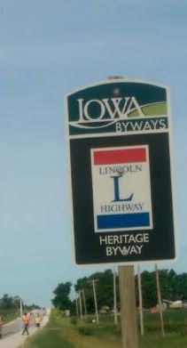




Choosing the Place and Time for a New Survey
Criteria:
  Significantly exceed 100 km
  Under existing GRAV-D data
  Avoid trees and woods
  Along major roads
  Cloud-free nights
  No major bridges along the route
  Low elevations
  Significant geoid slope
  Inexpensive travel costs
Notes:
The reasons for the above are:
>100 km : to allow for direct comparison to GOCE and GRACE
Under GRAV-D : So that geoids with/without airborne gravity can be compared
Avoid woods: Better GPS visibility
Roads: Ease of accessibility
Cloud-Free Nights: For the DoV camera to see the stars
Bridges: To avoid “river crossings” in the geodetic leveling
Low Elevations: So the errors from correcting from surface data to the geoid are minimized
Geoid slope: To have an interesting signal to choose from
Travel costs: To minimize cost of survey

Slide 7
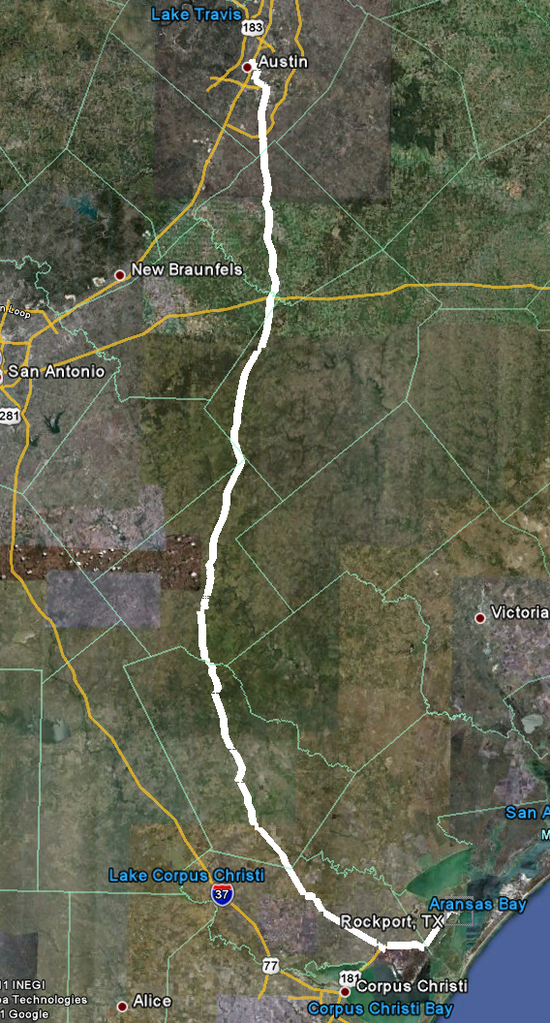
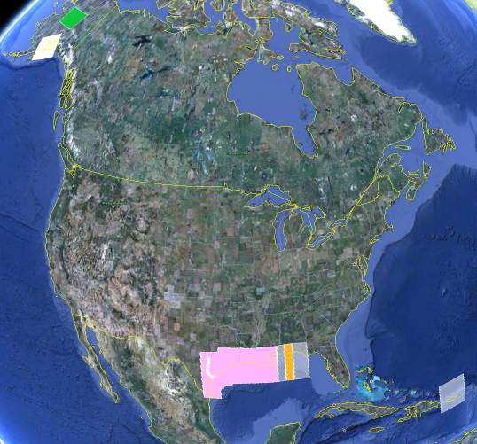
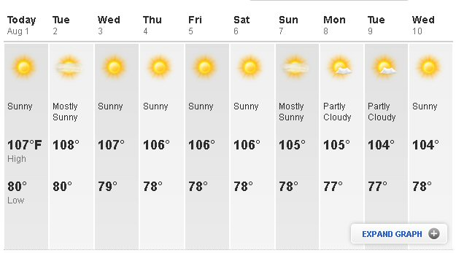
The Chosen Line in 2011
325 km
218 points
1.5 km spacing
South Texas
July-October, 2011
hot…Hot…HOT!
Notes:
The final line was a 325 km stretch from downtown Austin, Texas (North end) to Rockport, Texas (South end). There were 218 official survey points along the line, with an average spacing of 1.5 km between them. The shaded areas in the above picture were the existing GRAV-D data at the time of planning GSVS11 (since expanded). Although the weather report looks extreme, most surveying was done in the milder times of day.

Slide 8
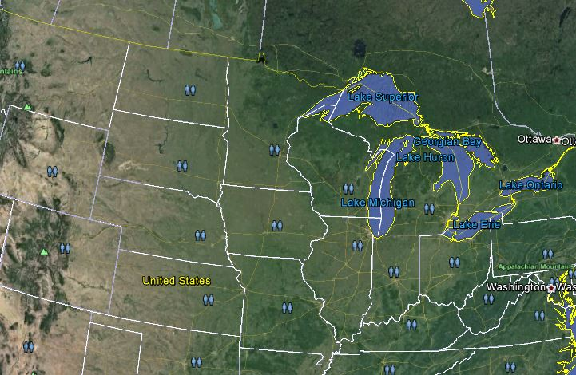
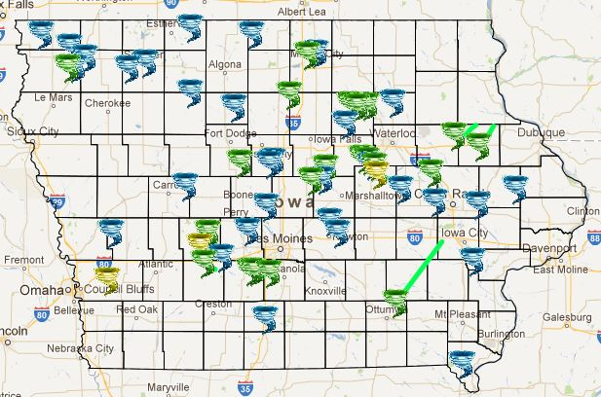
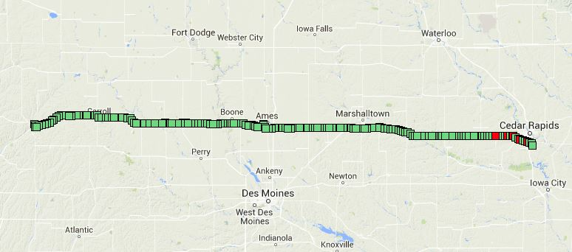
The Chosen Line in 2014
Central Iowa
330 km
205 points

Slide 9
Recon and Mark Setting

Slide 10
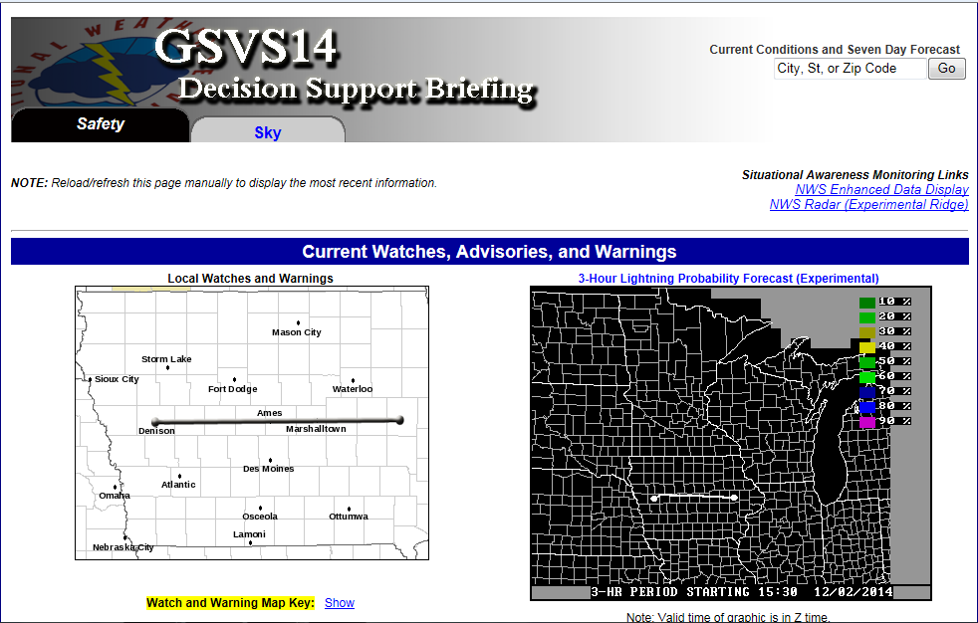
Partnership with NWS

Slide 11
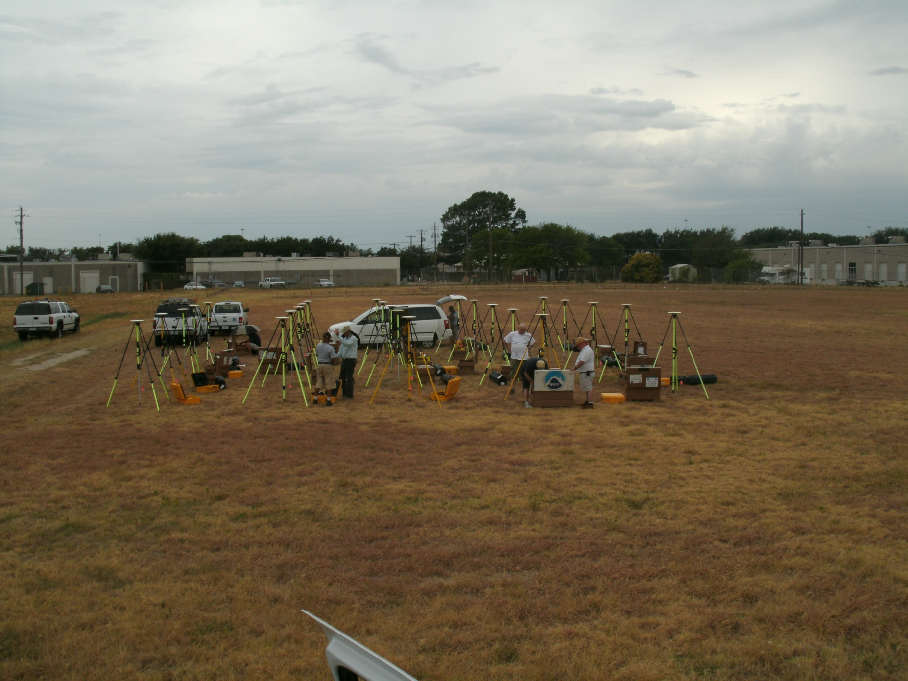
Campaign GPS

Slide 12
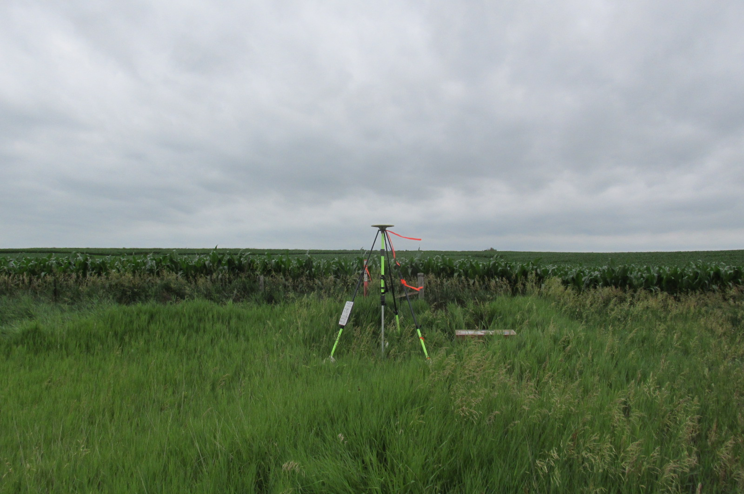
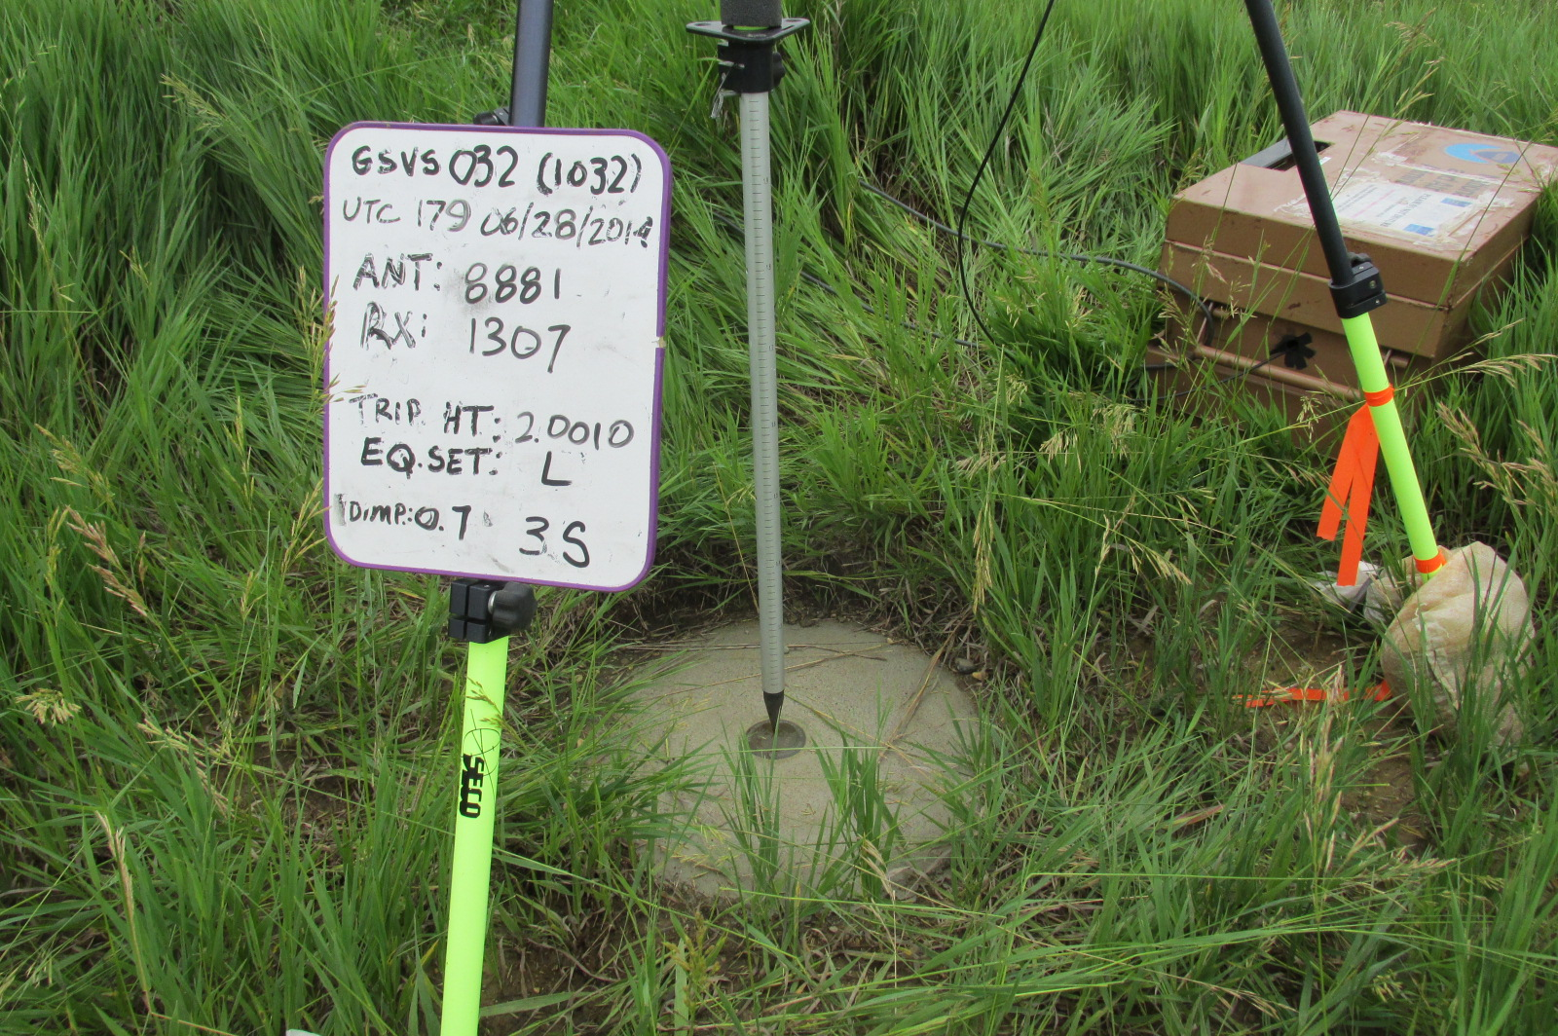
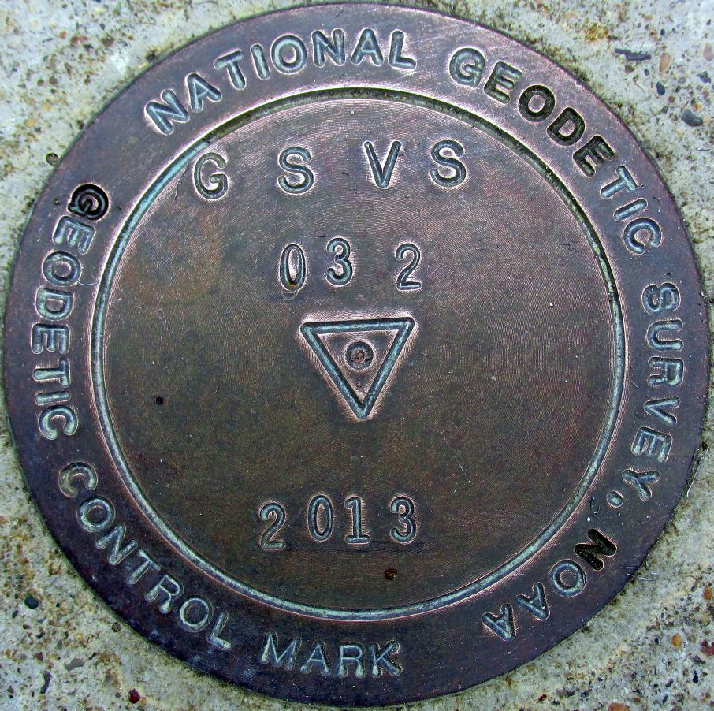
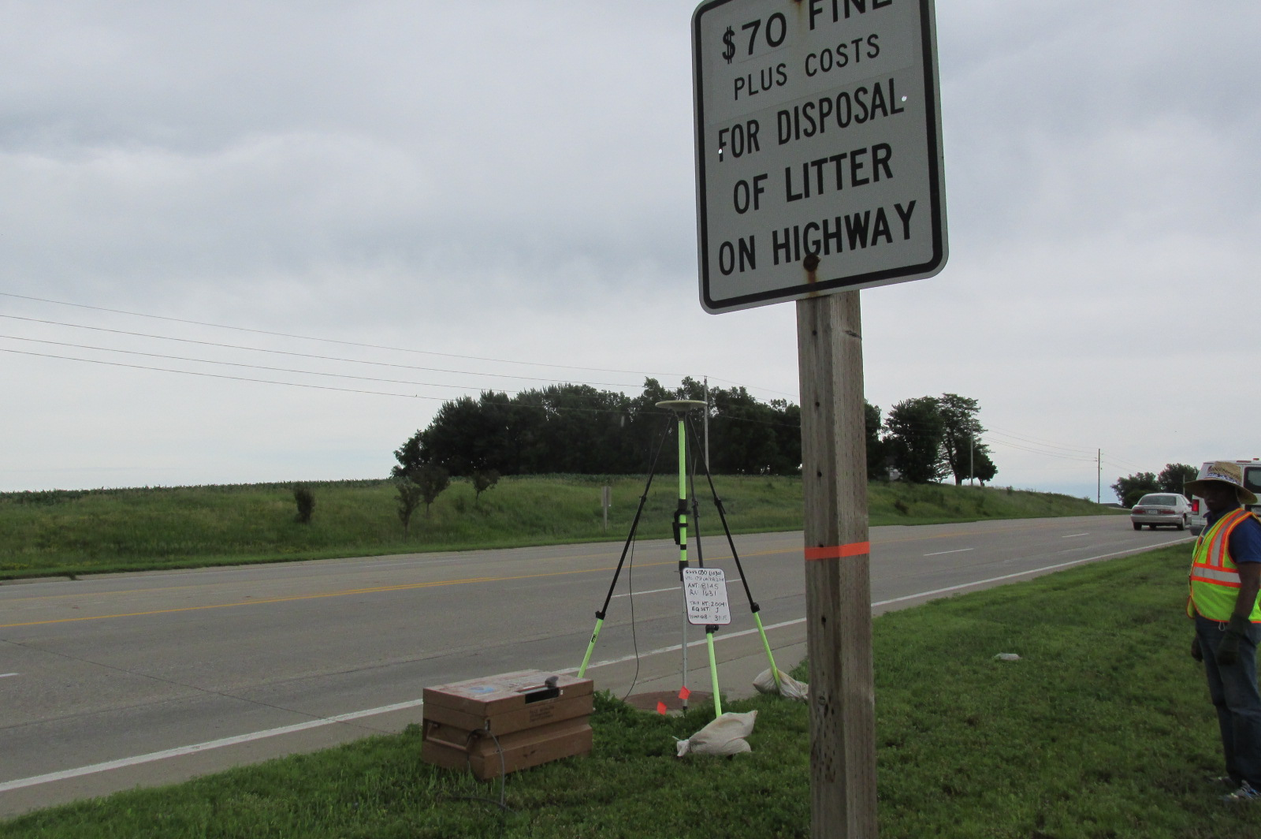

Slide 13
Campaign GPS
Full antenna recalibration check before survey
Each fixed height tripod height
measured before and after
20 complete sets of equipment -
2 parties (10 sets each)
Each party observe 5 new and 5
repeat stations each day
30 observation days
Project processed with OP
ID | before | after | a - b | avg.
A | 2.0028 | 2.0029 | 0.0001 | 2.0029
B | 2.0019 | 2.0018 | -0.0001 | 2.0018
C | 2.0005 | 2.0002 | -0.0003 | 2.0004
D | 2.0079 | 2.0079 | 0.0000 | 2.0079
E | 2.0011 | 2.0010 | -0.0001 | 2.0010
F | 1.9999 | 1.9998 | -0.0001 | 1.9998
G | 2.0006 | 2.0009 | 0.0003 | 2.0008
H | 2.0016 | 2.0017 | 0.0001 | 2.0017
I | 2.0020 | 2.0020 | 0.0000 | 2.0020
J | 2.0041 | 2.0041 | 0.0000 | 2.0041
K | 2.0003 | 2.0004 | 0.0001 | 2.0003
L | 2.0010 | 2.0007 | -0.0003 | 2.0008
M | 2.0000 | 2.0002 | 0.0002 | 2.0001
N | 1.9964 | 1.9963 | -0.0001 | 1.9963
O | 2.0005 | 2.0005 | 0.0000 | 2.0005
P | 2.0003 | 2.0002 | -0.0001 | 2.0002
Q | 2.0024 | 2.0029 | 0.0005 | 2.0027
R | 1.9999 | 1.9999 | 0.0000 | 1.9999
S | 2.0052 | 2.0052 | 0.0000 | 2.0052
T | 2.0026 | 2.0023 | -0.0003 | 2.0024
U | 2.0031 | 2.0031 | 0.0000 | 2.0031
V | 1.9995 | 1.9995 | 0.0000 | 1.9995
W | 2.0002 | 2.0003 | 0.0001 | 2.0003
X | 2.0020 | 2.0022 | 0.0002 | 2.0021
Y | 2.0053 | 2.0053 | 0.0000 | 2.0053
Z | 2.0016 | 2.0014 | -0.0002 | 2.0015

Slide 14
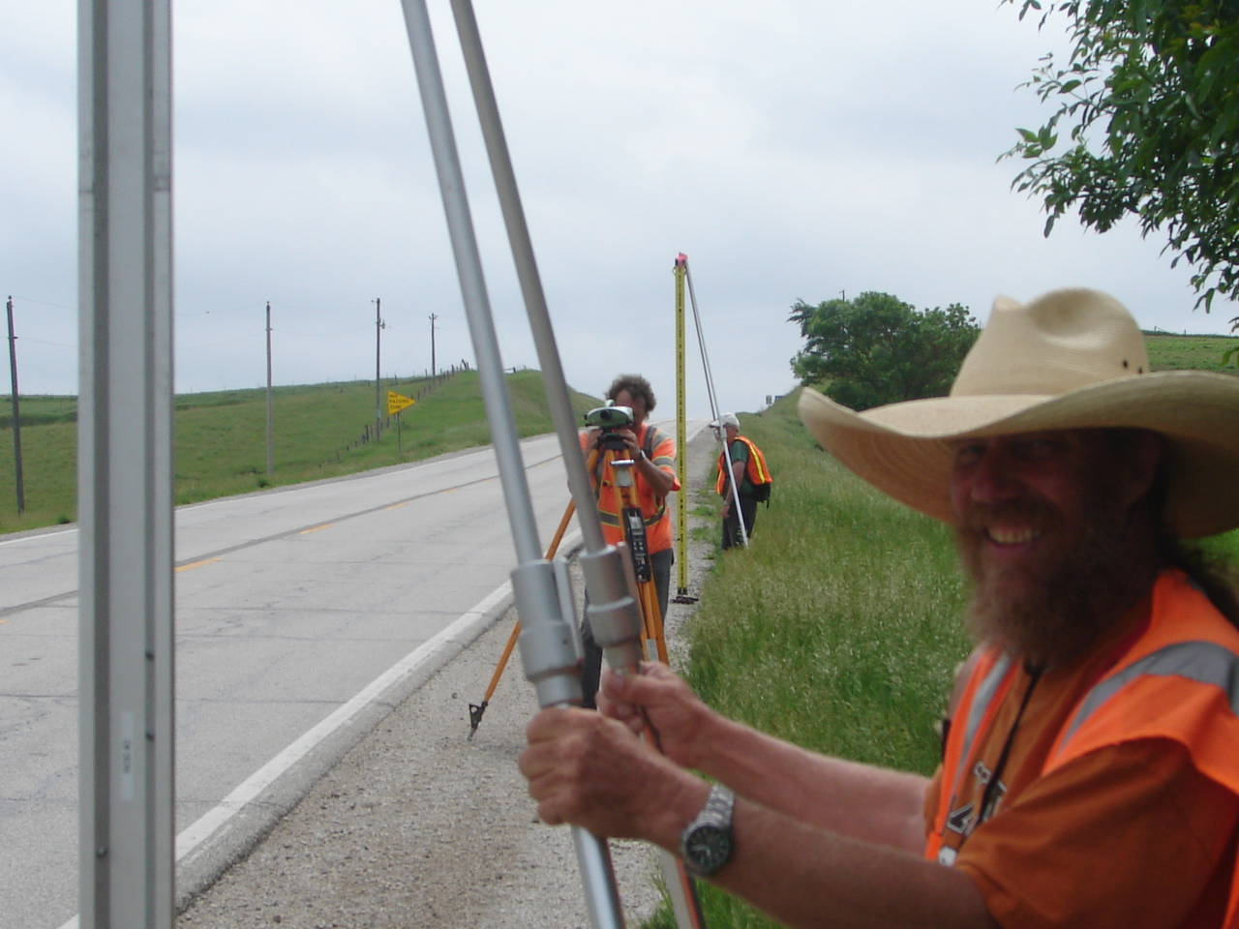
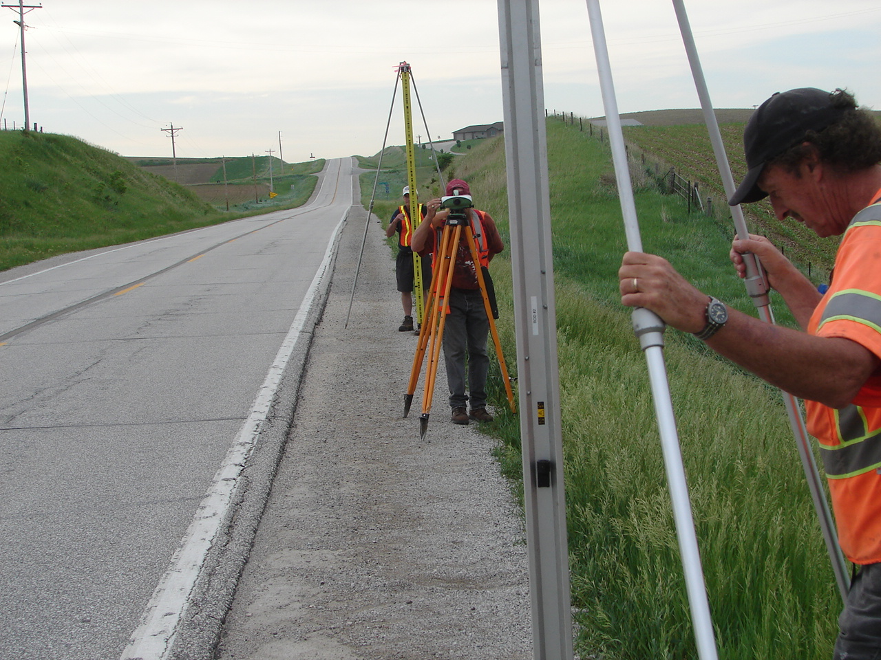
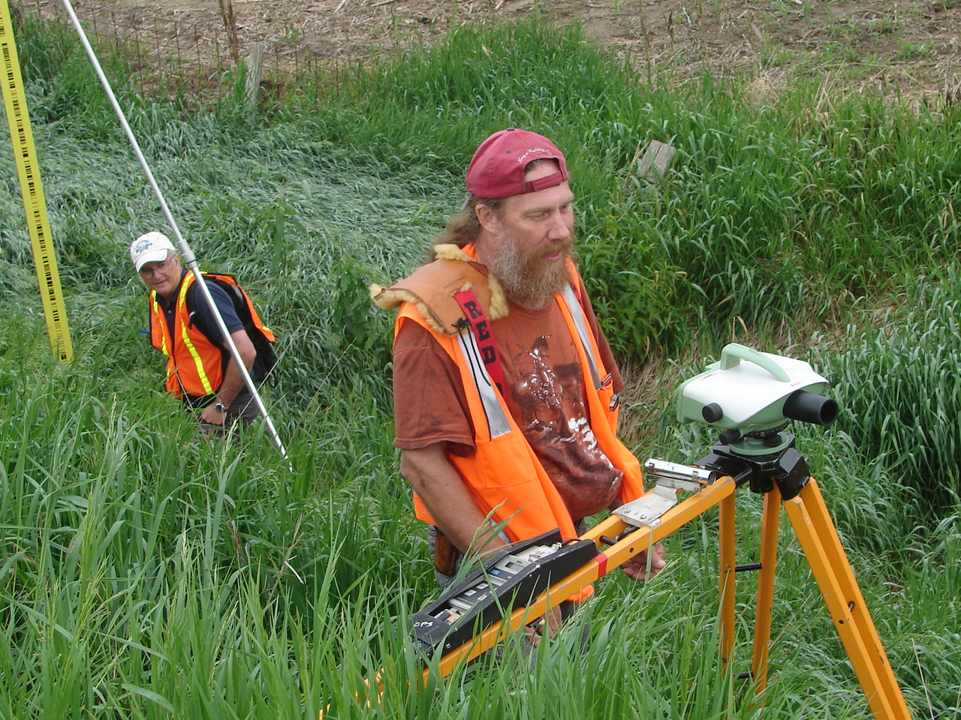
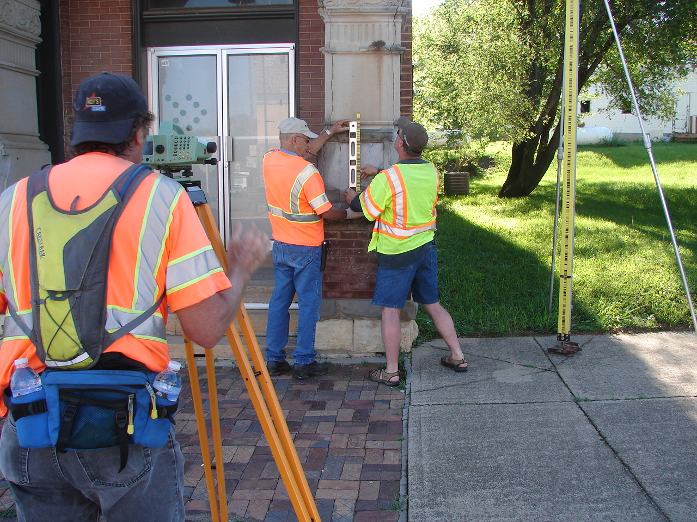
Geodetic Leveling

Slide 15
Geodetic Leveling
Two crews of 4-5 people/crew
1st order Class II
749 km
105 crew days
7.1 km/day/crew

Slide 16
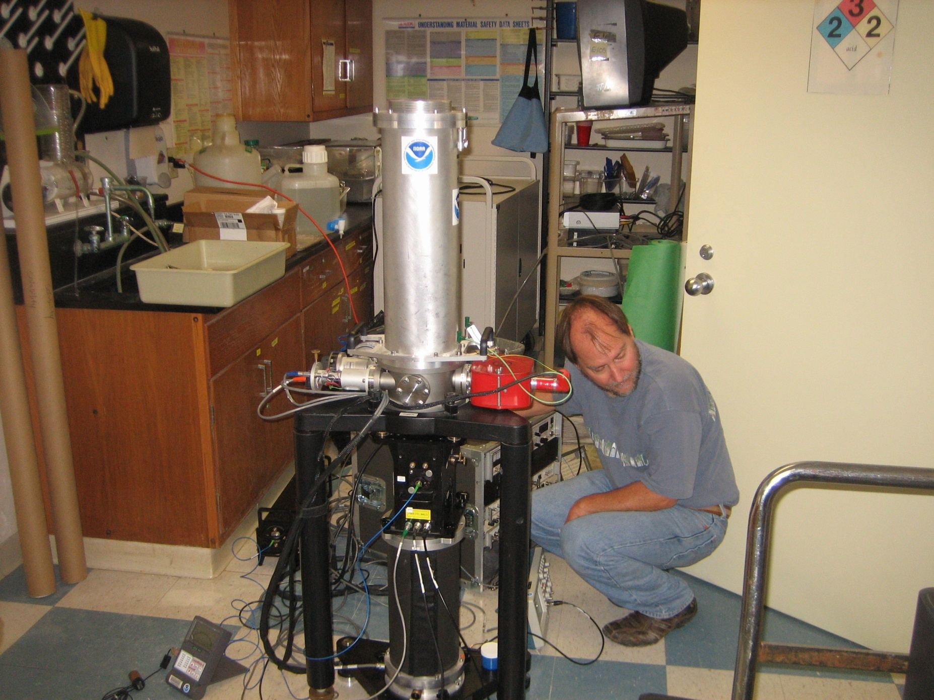
Gravity Observations

Slide 17
Gravity Observations
3 1st-order Class II stations
  Dennison, Ames, Cedar Rapids
A-10 Absolute stations (every 7th station)
  Survey still underway
Gravity Gradients (every 7th station)
  2 stations per day, 31 days to observe
Relative Gravity (205 stations)
  10 per day, 23 days to observe

Slide 18
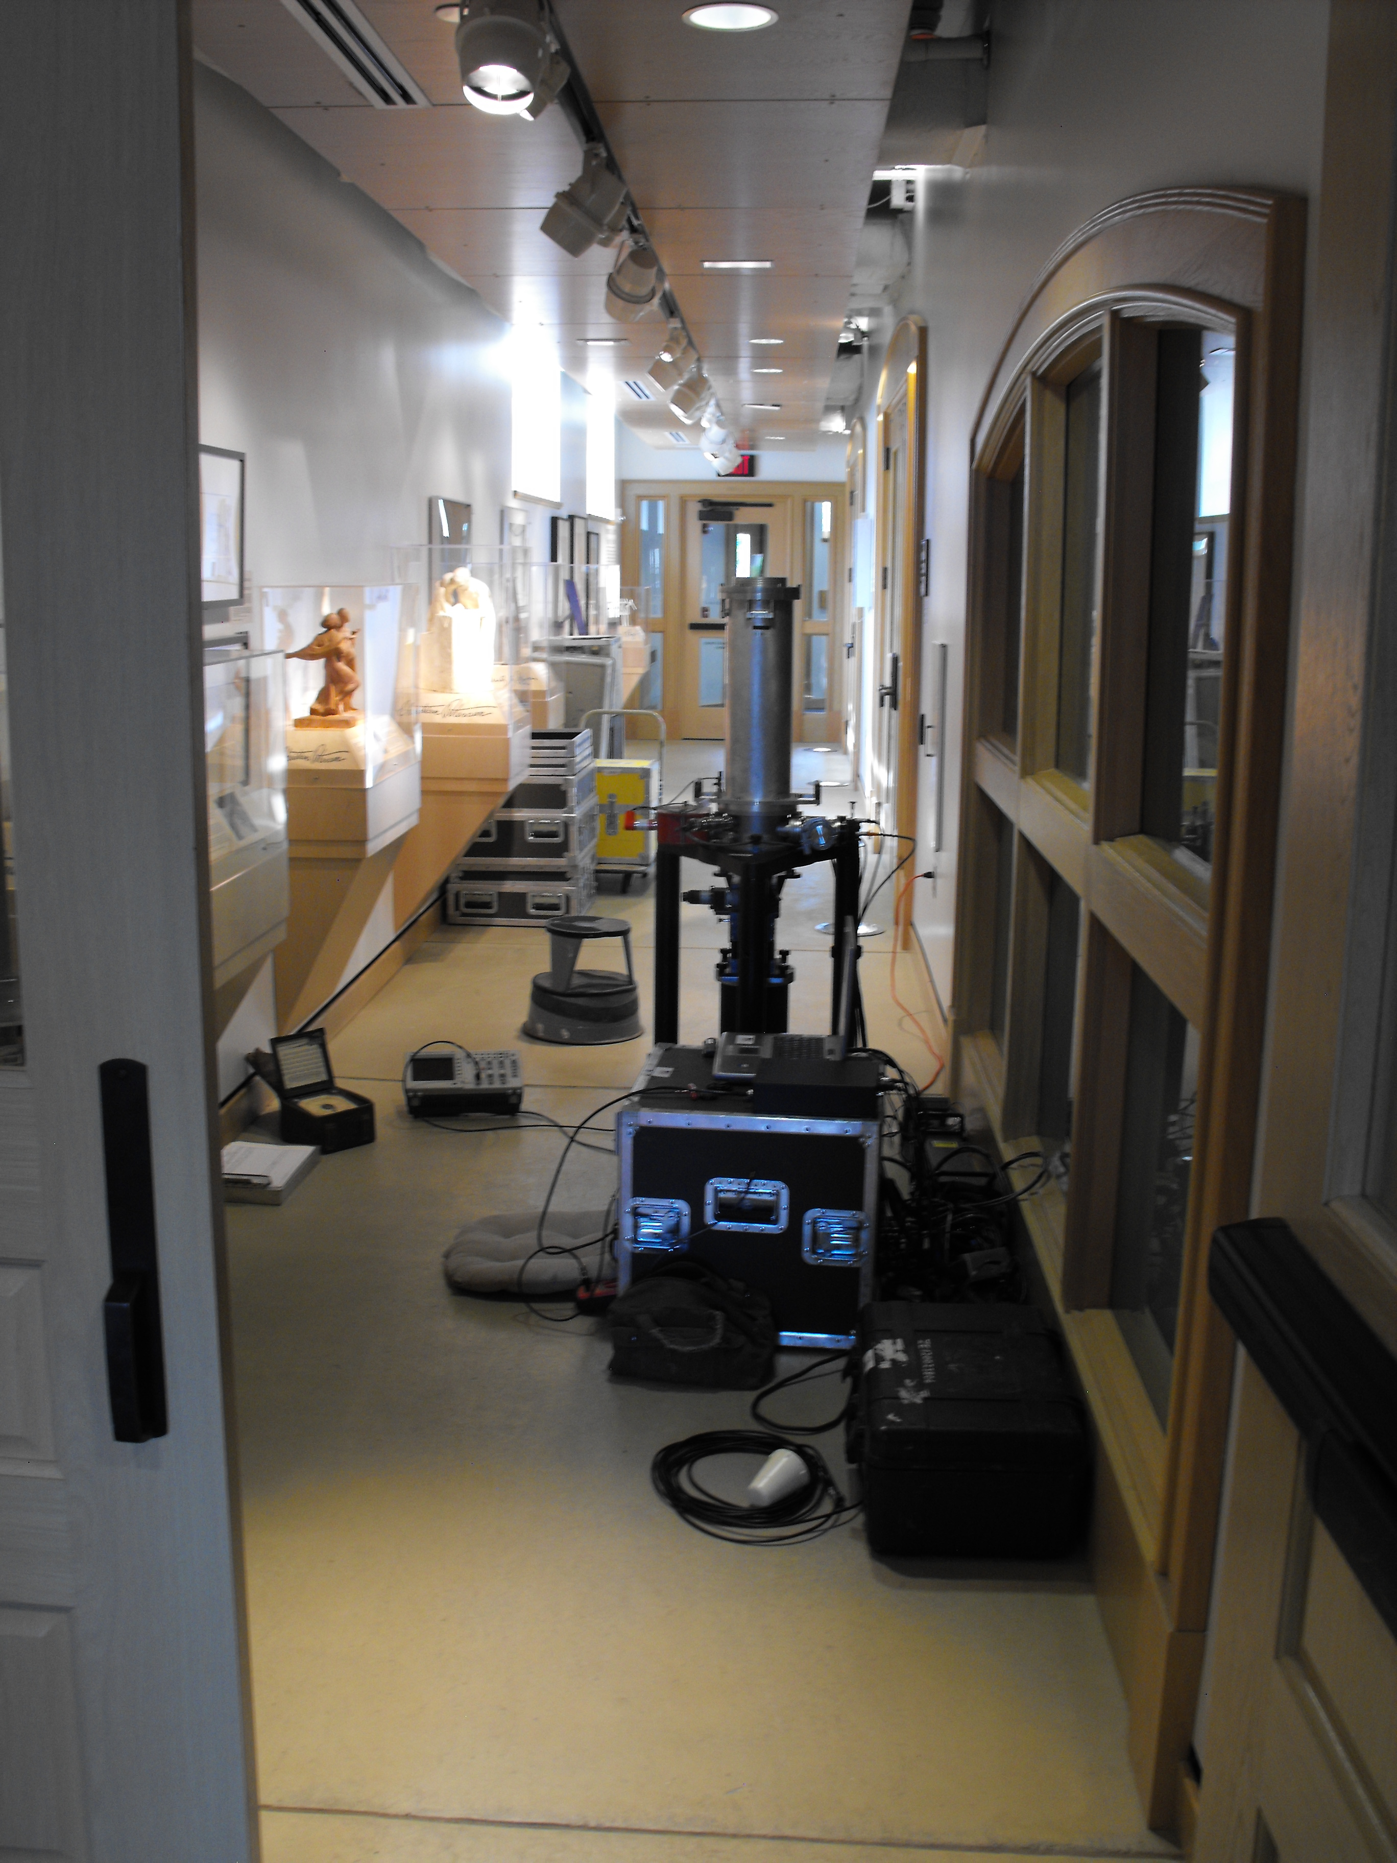
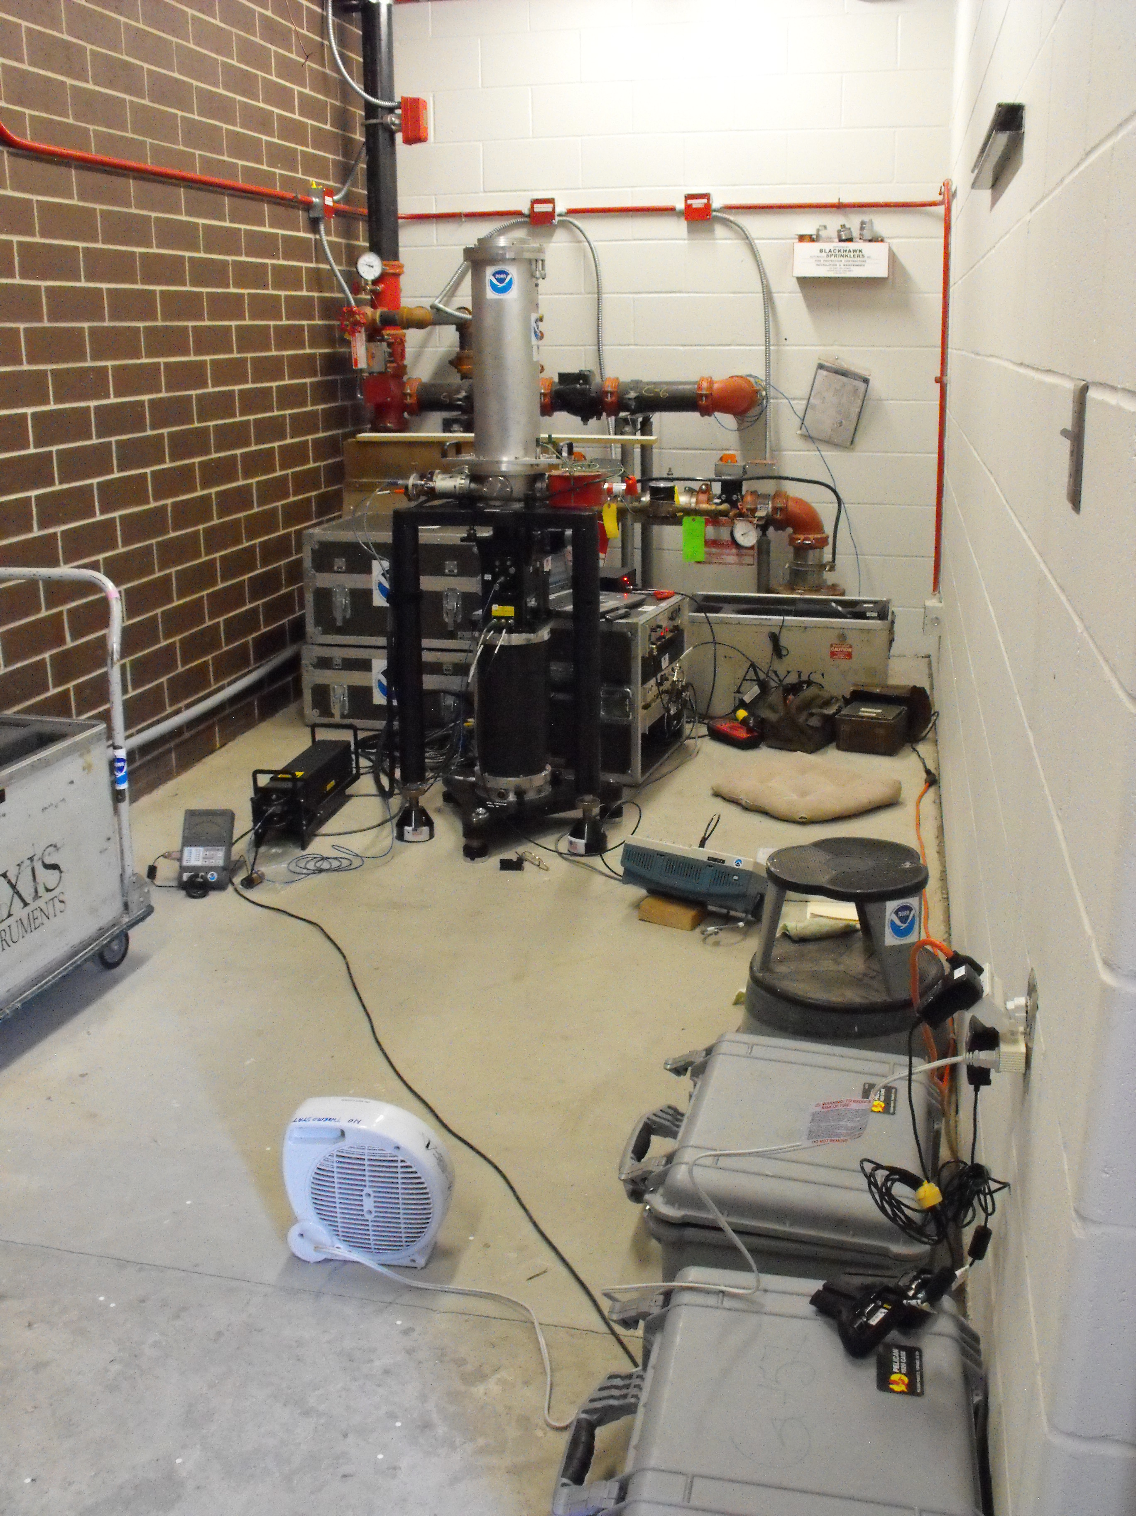

Slide 19
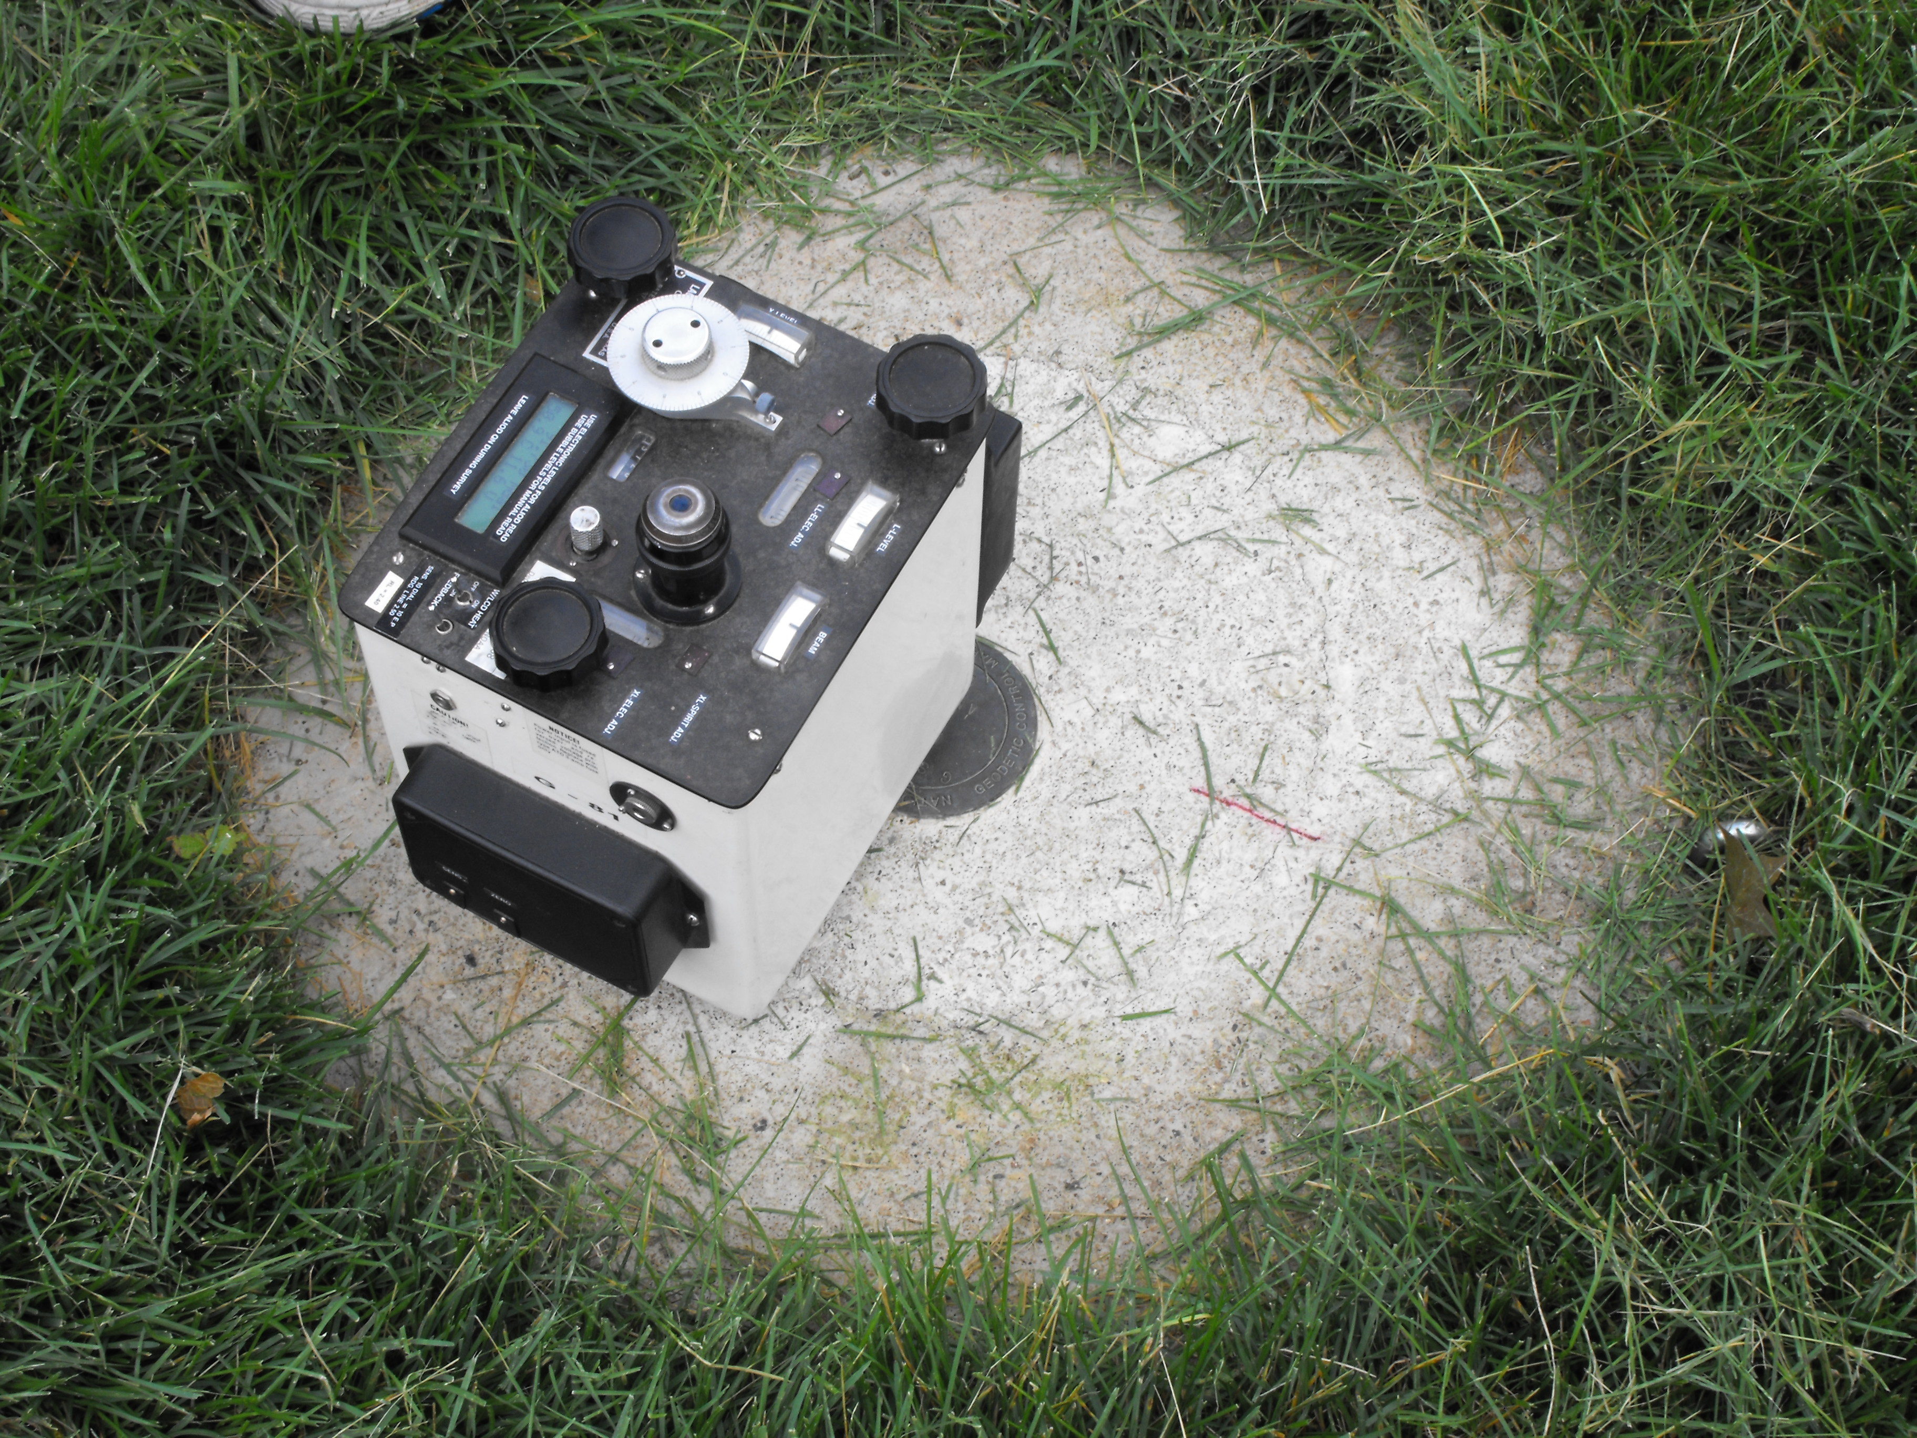

Slide 20
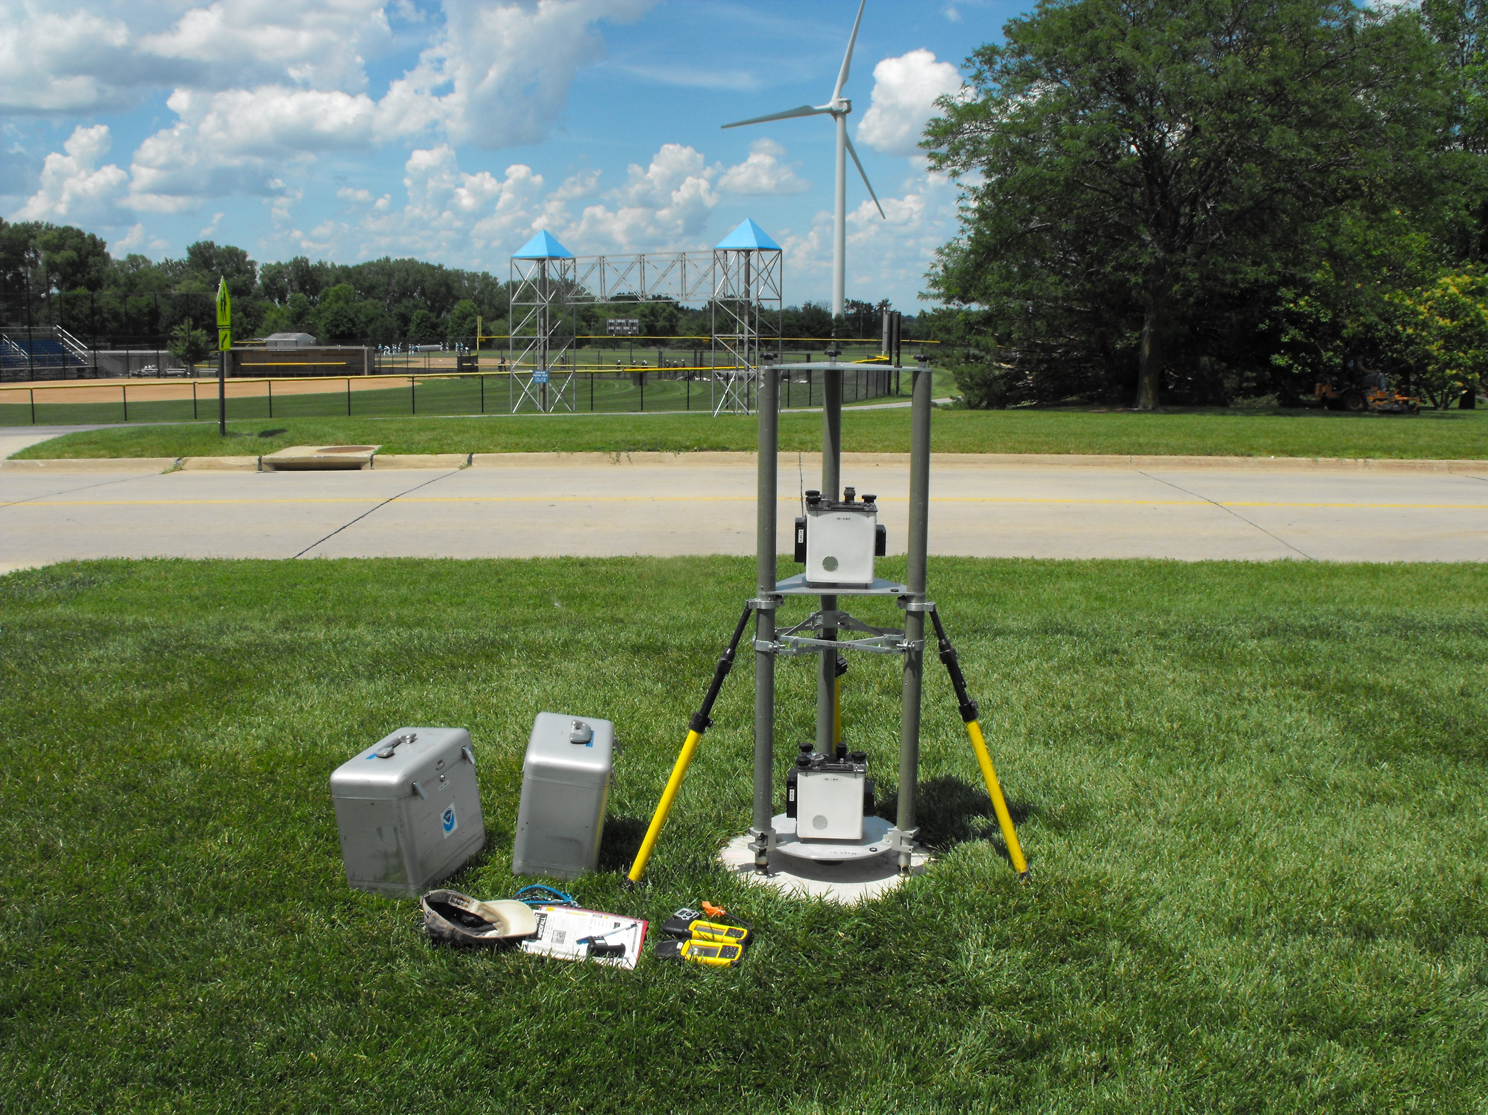

Slide 21
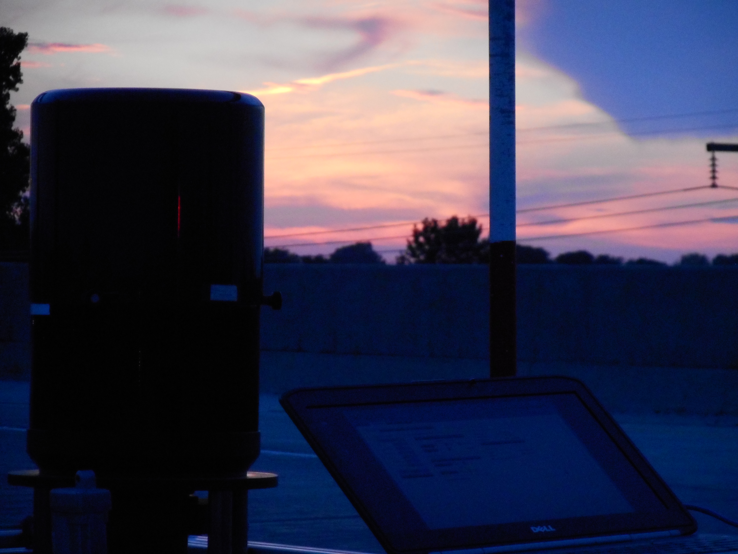
Astrogeodetic Deflecions of the Vertical (DoV)

Slide 22
DoV
228 stations (204 official points, 11 redundant observations, 3 reobservations)
31 nights
7 stations/night
Observing with Swiss CODIAC COmpact DIgital Astrometric Camera

Slide 23
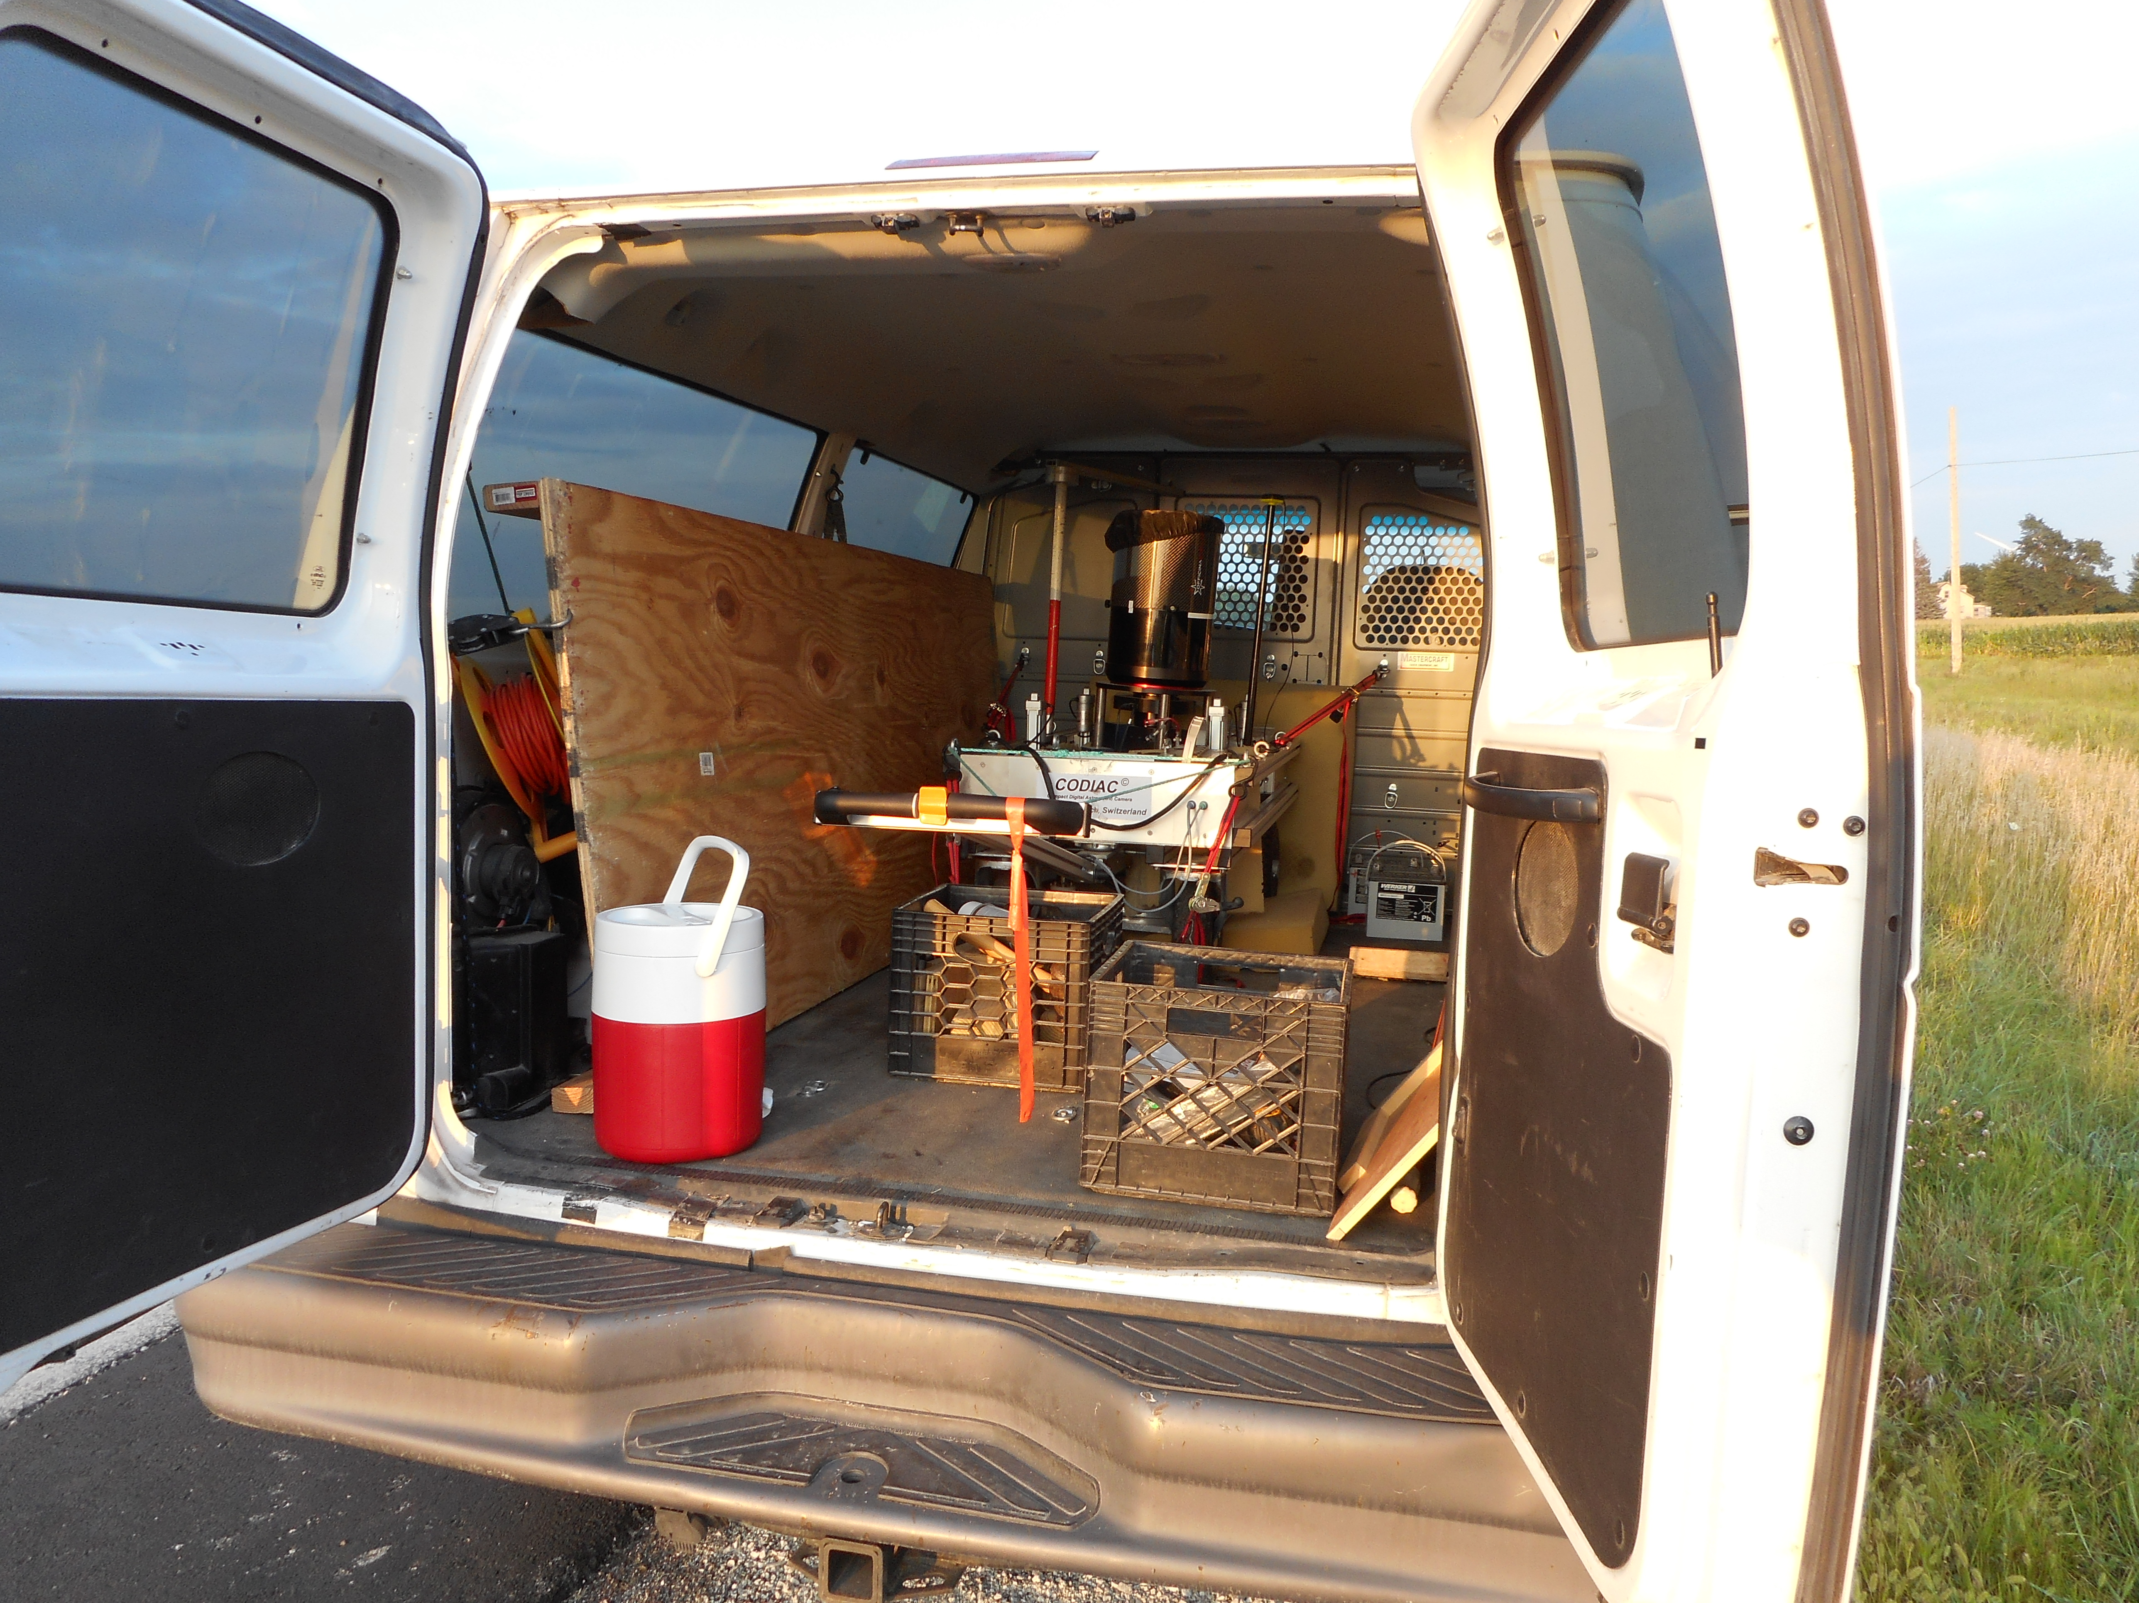
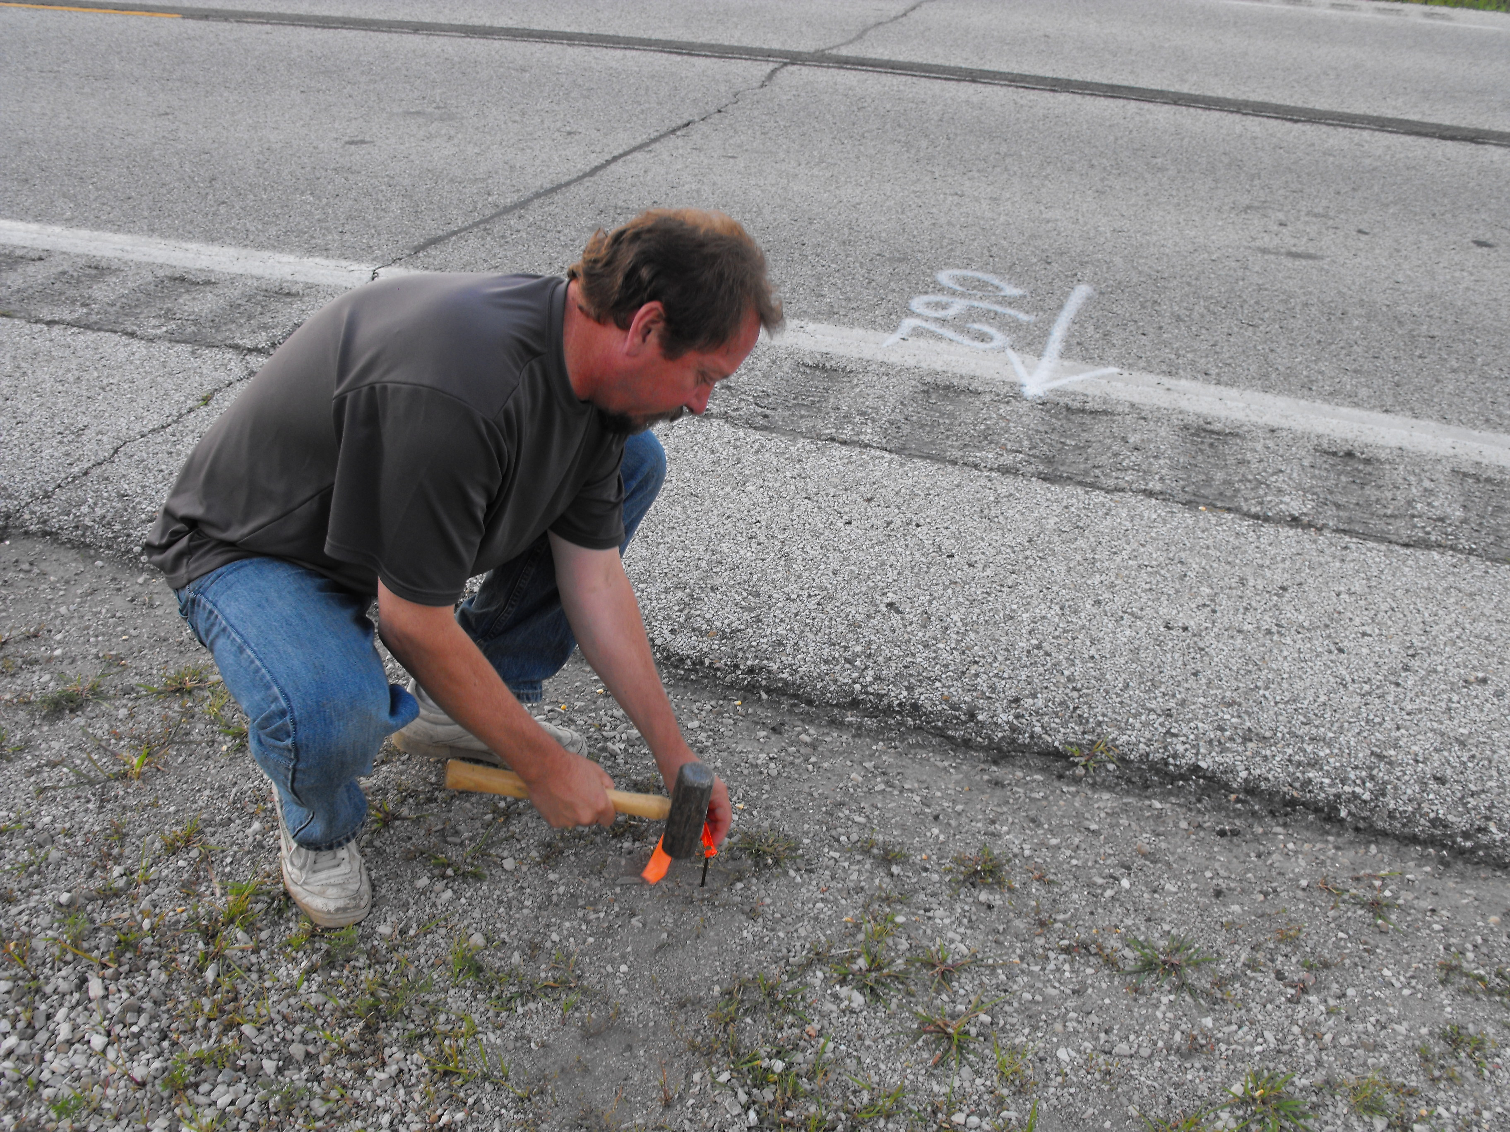
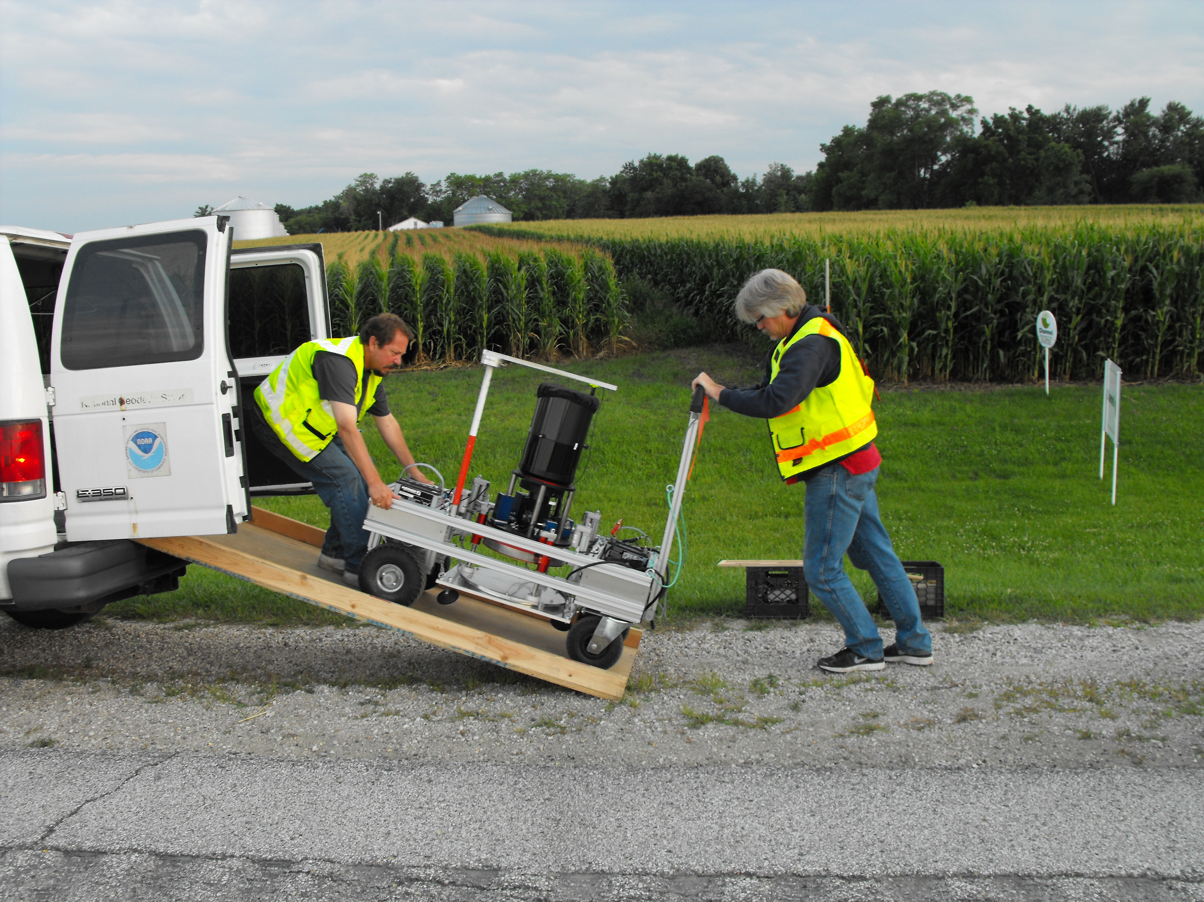
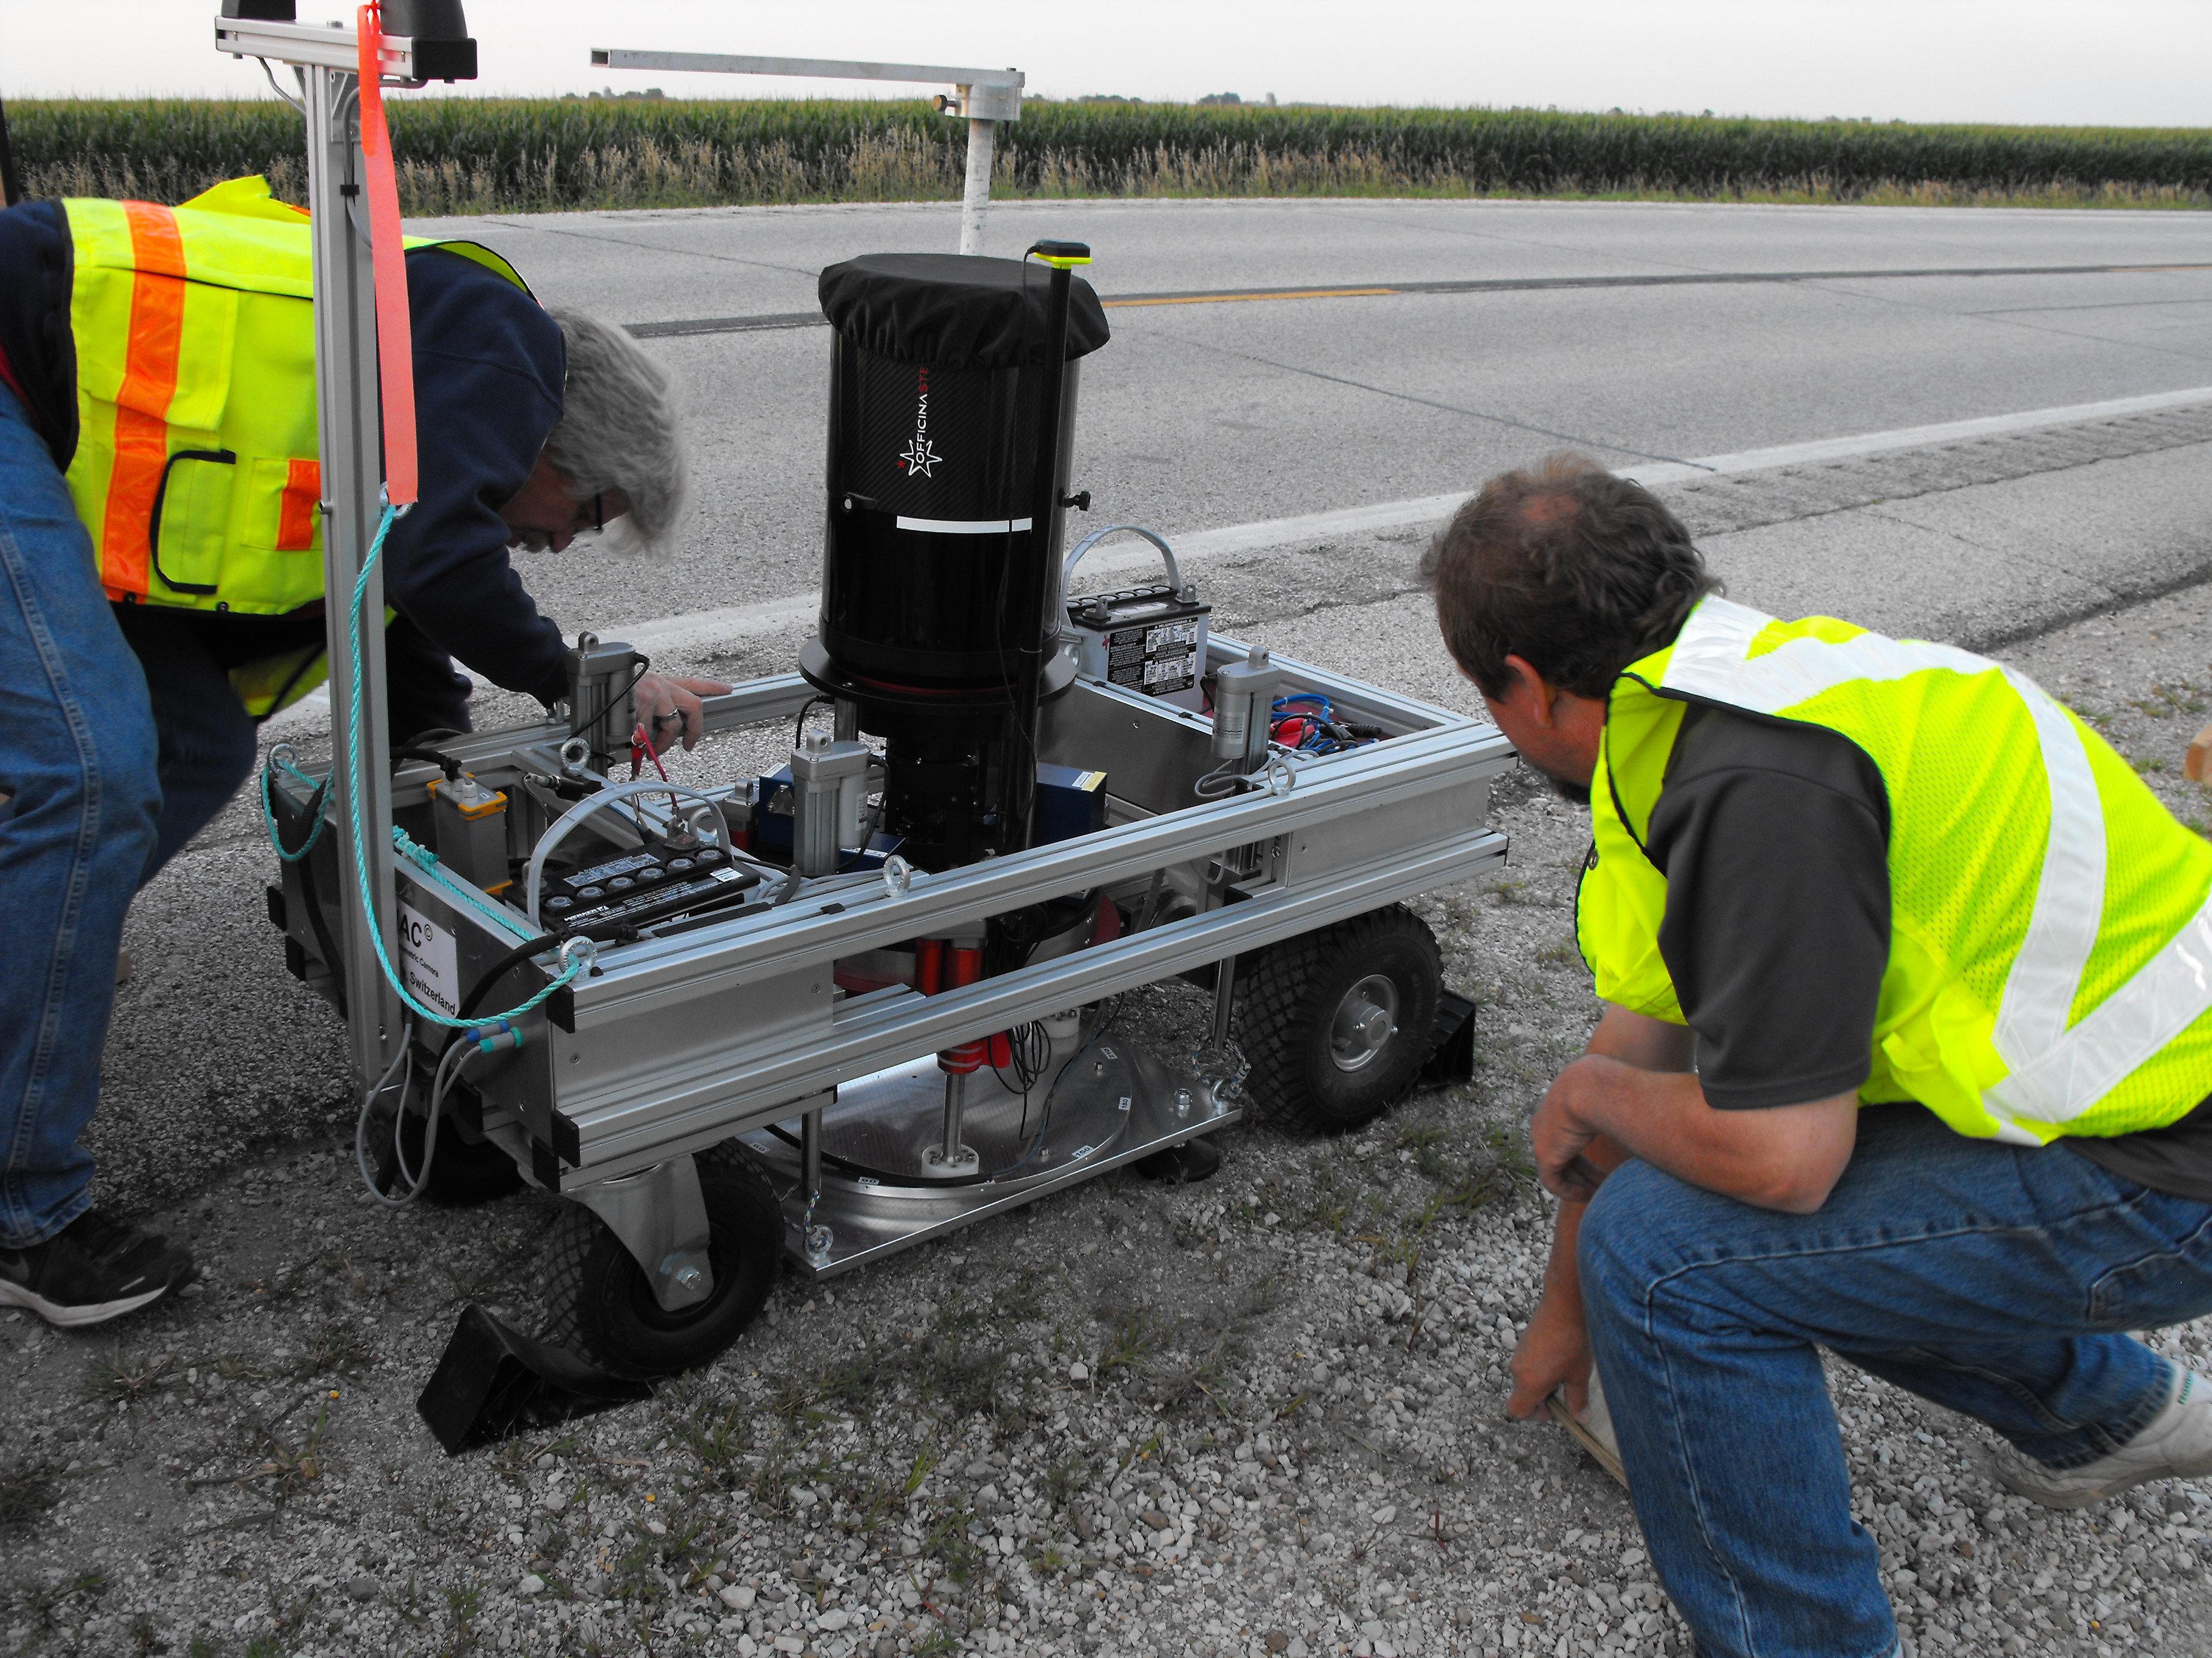

Slide 24
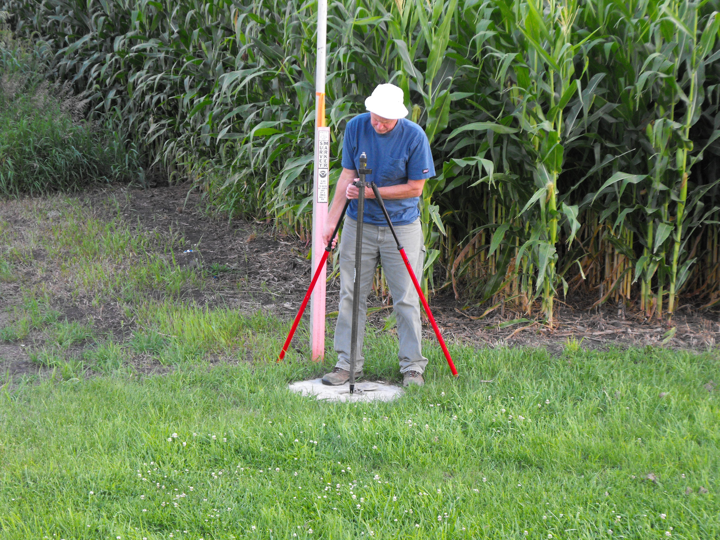
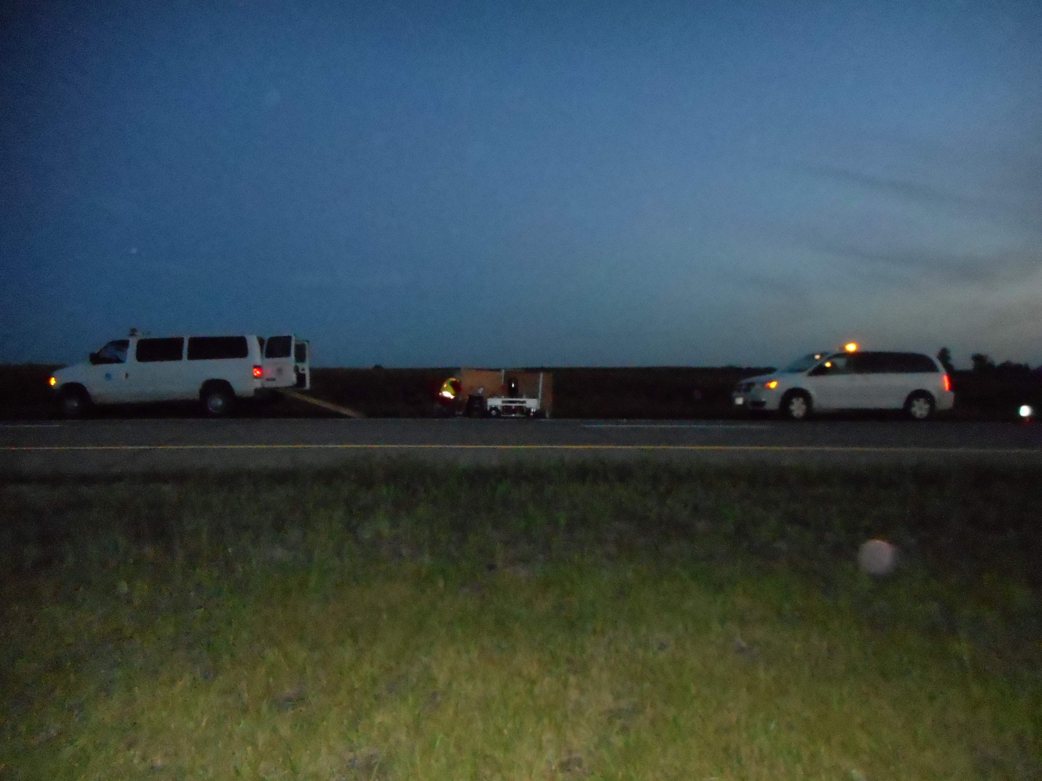
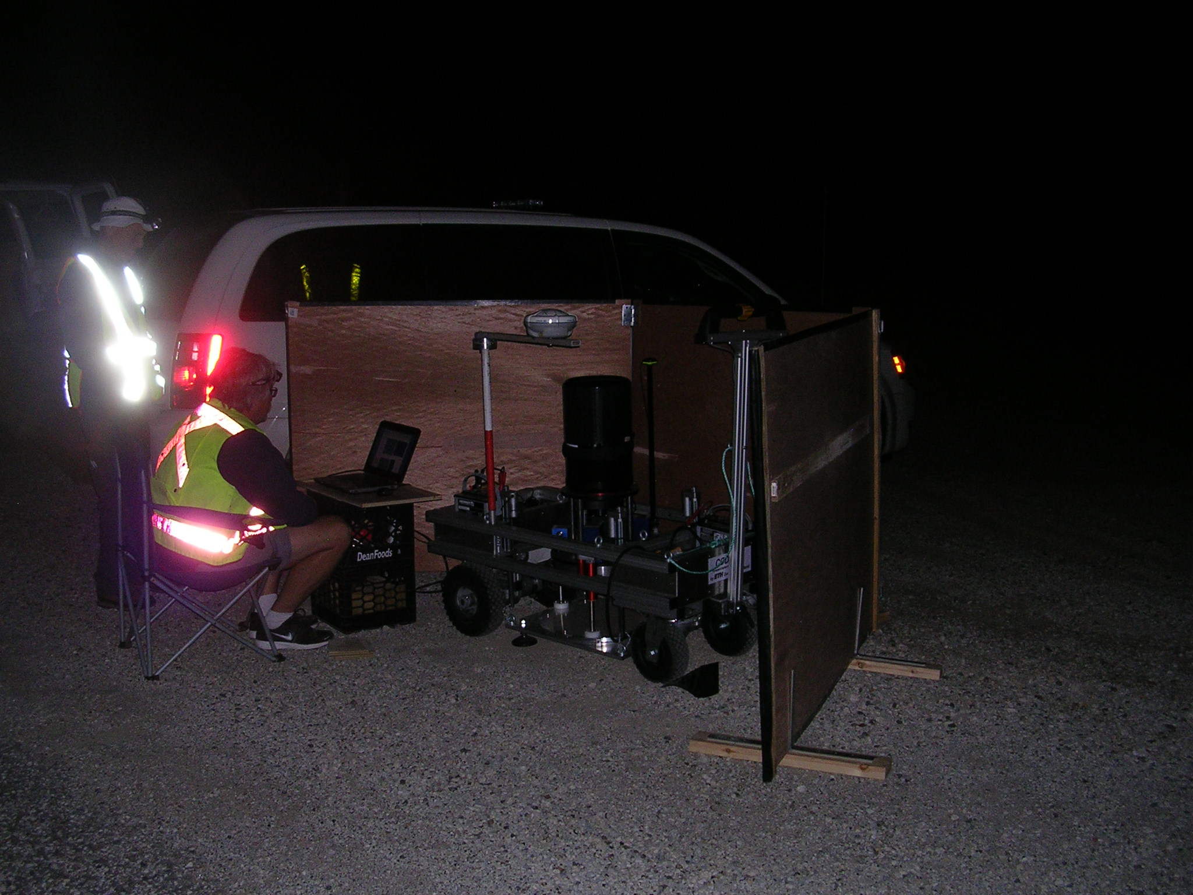
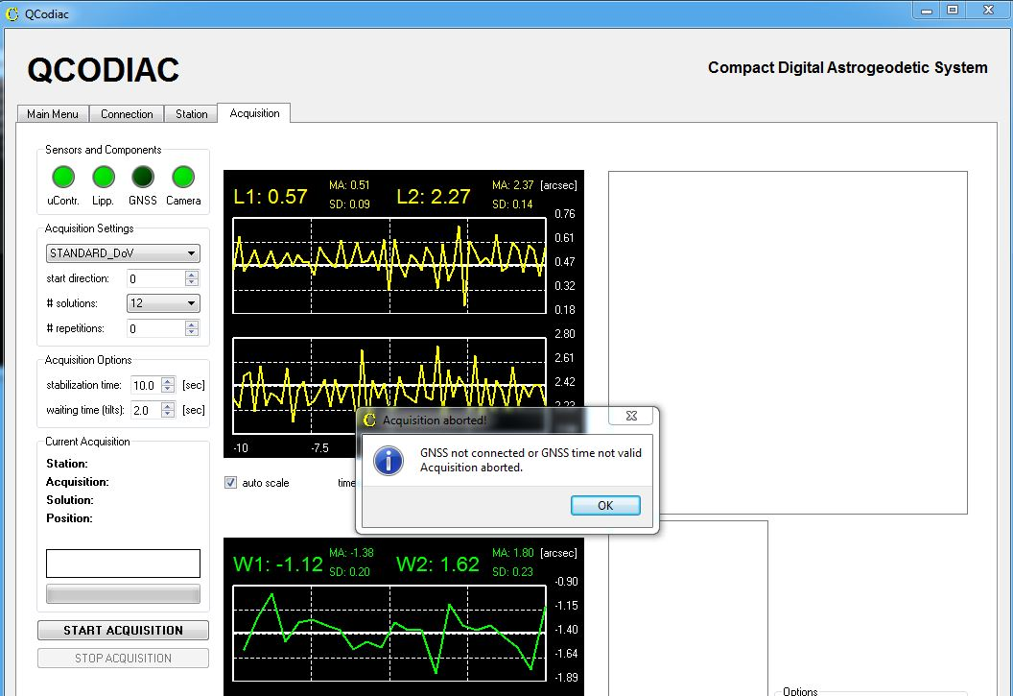

Slide 25
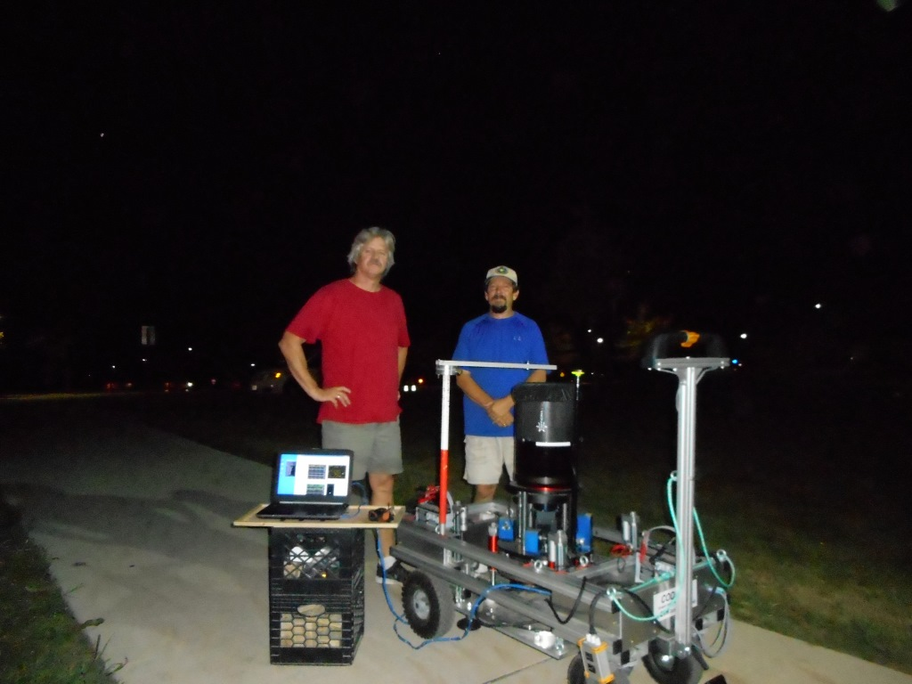

Slide 26
Conclusions - Problems
Flooding (access to marks) in June
One damaged fixed-height tripod
Tall grass, ticks, mosquitoes
Trains, Trains, Trains on Western 1/3rd of line

Slide 27
Conclusions-Successes
Over a year of planning and preparation
Two Co-Project Managers (Scientific/Admin)
Single Team-Lead for each activity
Frequent Team meetings (pre-deployment)
Team-Leads wrote the project instructions
Field work was successfully completed on time and was of high quality

