Slide 1
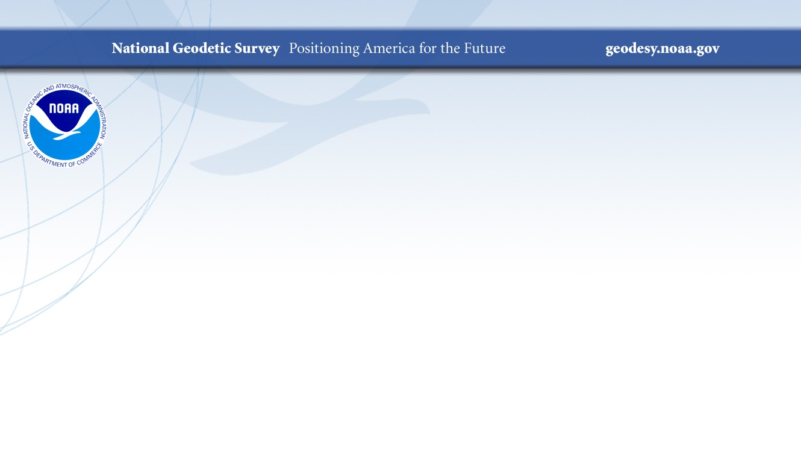
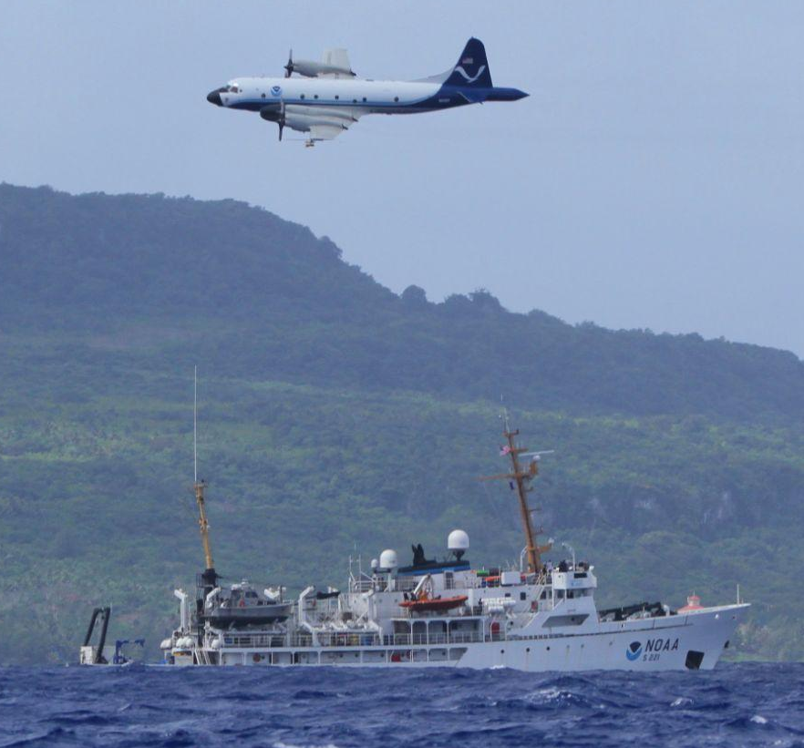
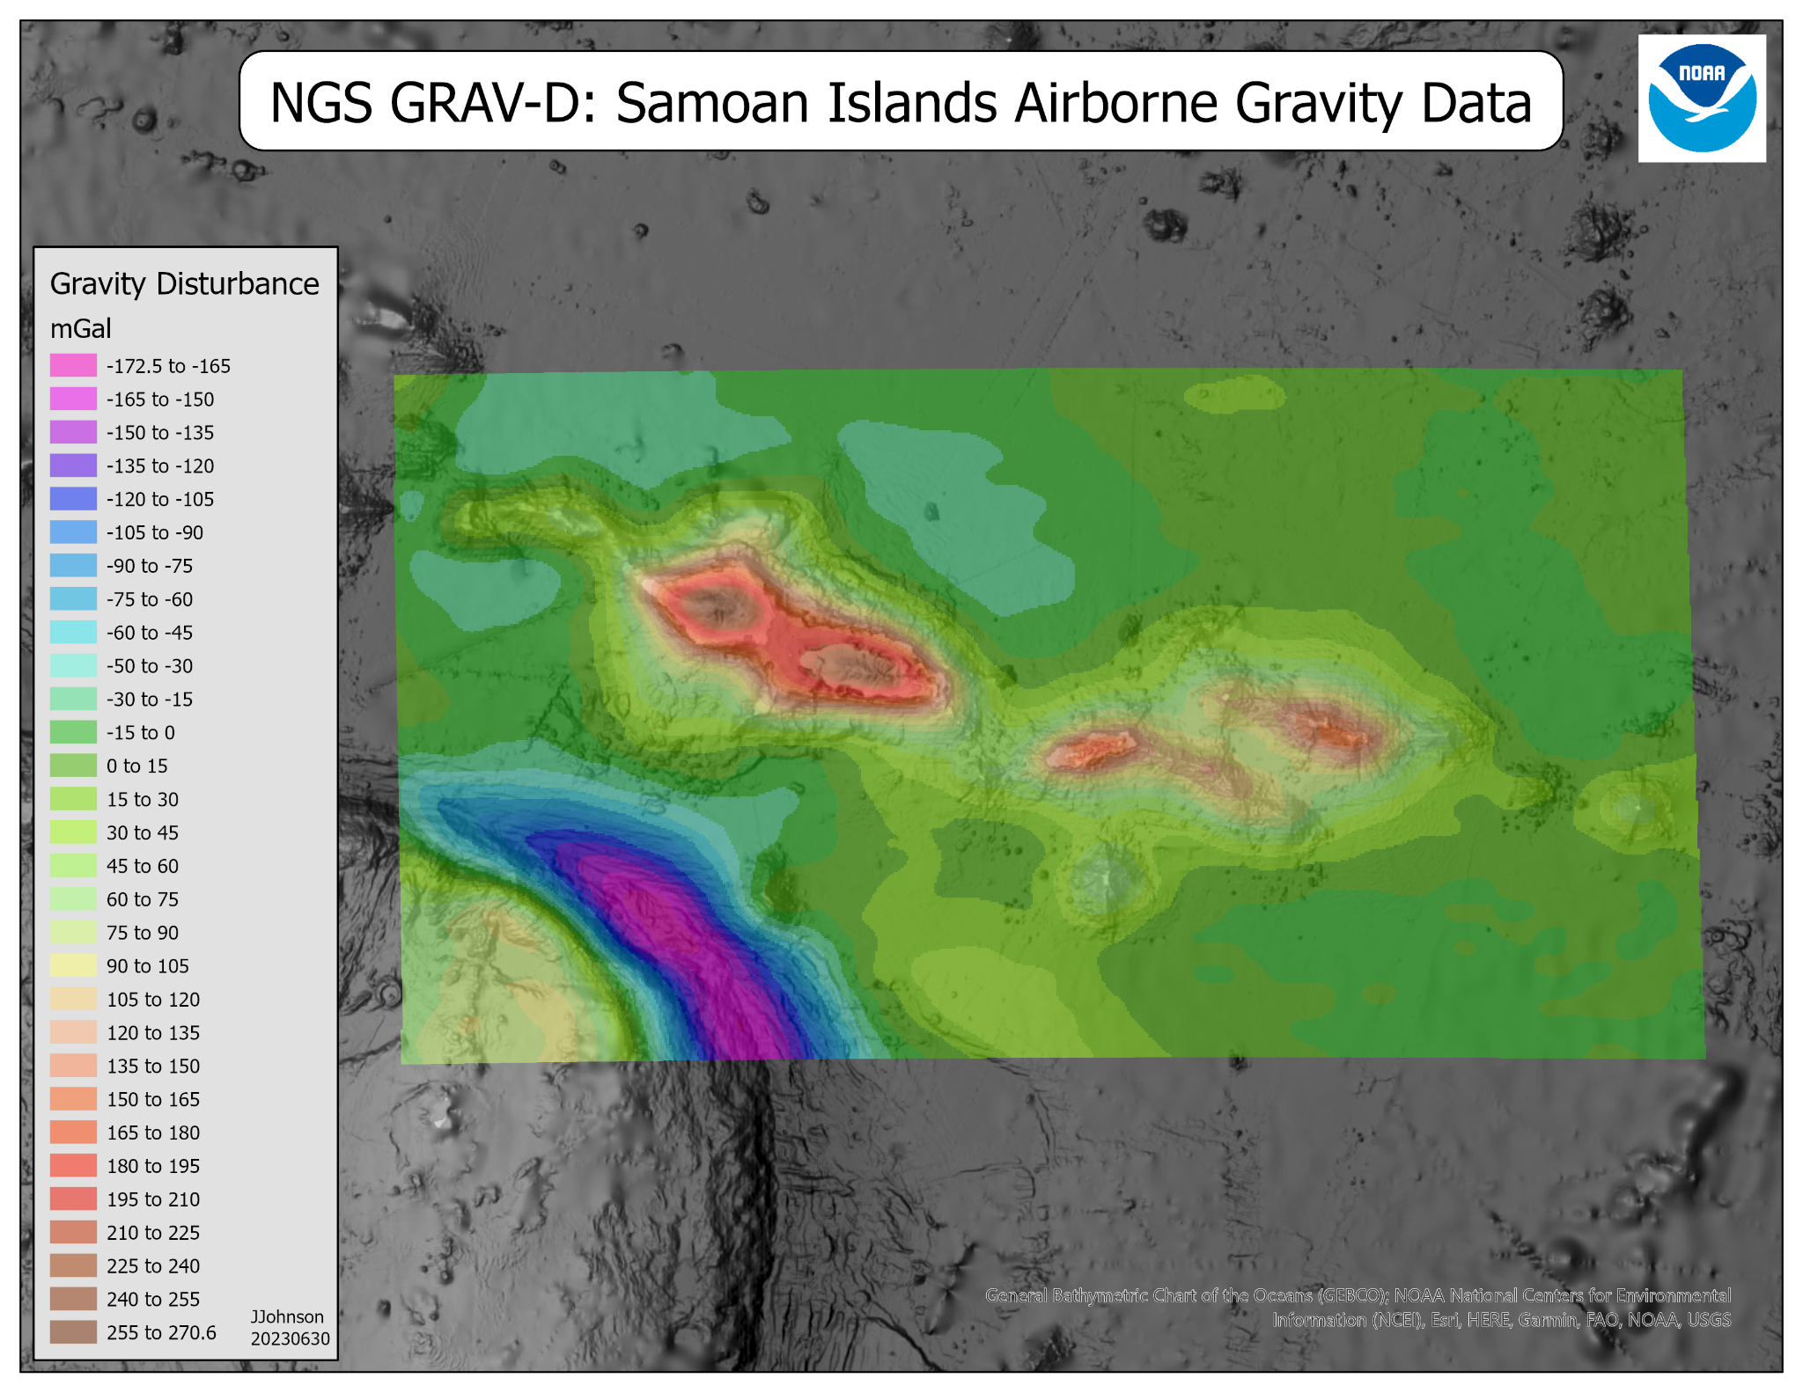
GRAV-D Target Area 100% Complete!
What’s next?
Jeff Johnson (Jeffery.Johnson@noaa.gov)
Spatial Reference Systems Division
Gravity and Heights Branch Chief
GRAV-D Project Manager

Slide 2
Topics Covered
Why GRAV-D?
What is GRAV-D?
How does NGS collect airborne gravity data?
Various Aircraft Used over the Years
Processing Airborne Gravity Data
Current Status of GRAV-D
Plans to publish final GRAV-D data set.
Showcase some GRAV-D Data
What’s next for gravity data collection at NGS?

Slide 3
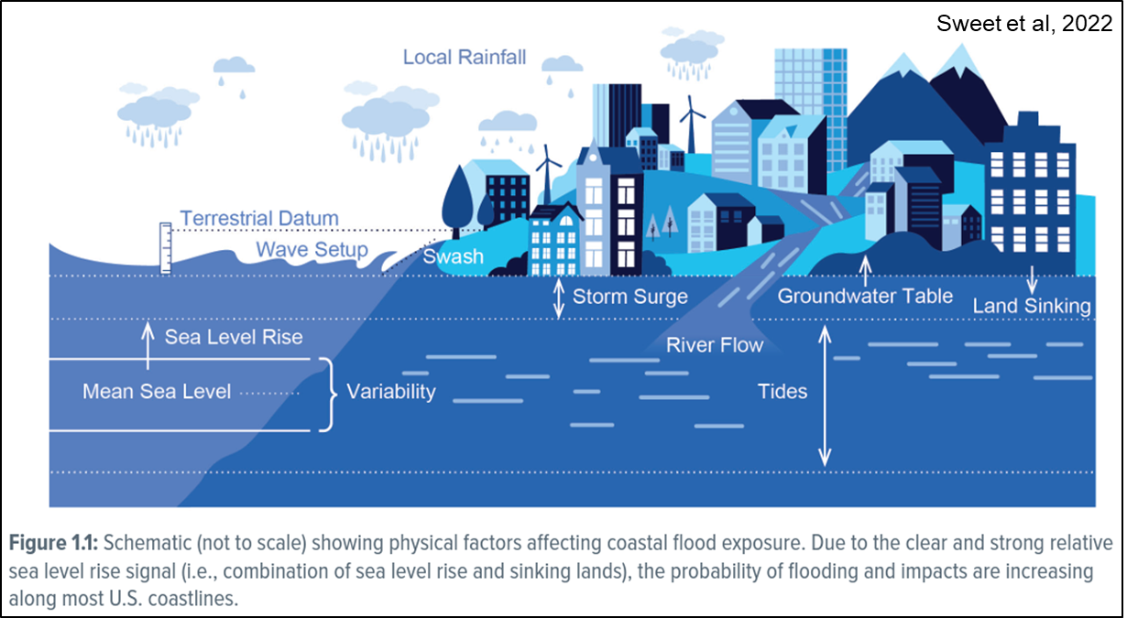
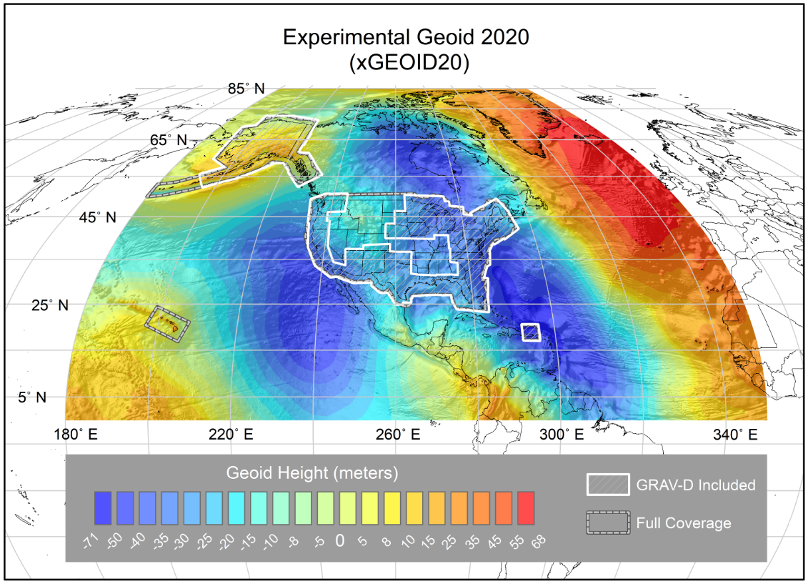
Why GRAV-D? Where will water flow?
Many complex problems related to infrastructure and water management require accurate height (elevation) information.
NGS is modernizing how heights (elevations) are determined by using gravity data to model a gravimetric equipotential surface called the Geoid.
The new vertical datum will be called the North American-Pacific Geopotential Datum of 2022 (NAPGD2022).
The Geoid portion of NAPGD2022 will be called GEOID2022.
https://beta.ngs.noaa.gov/GEOID/xGEOID20/

Slide 4
NGS Geoid Resources
This presentation is not primarily about the geoid. Here are some webinars about the geoid if you would like more information:
Progress of Geoid2022 Webinar by Yan Ming Wang
Geod Change in Alaska Webinar by Ryan Hardy
The NGS Geoid Monitoring Service (GeMS) by Kevin Ahlgren
GEOID18 Improvements and a Look Ahead by Kevin Ahlgren and Galen Scott

Slide 5
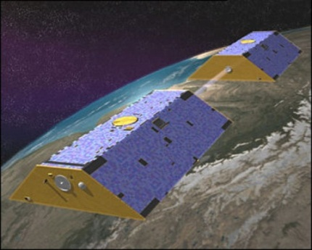
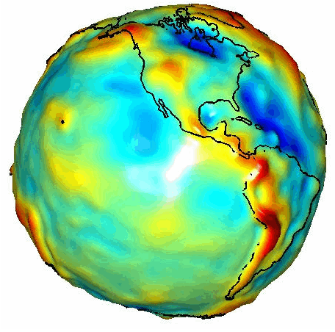
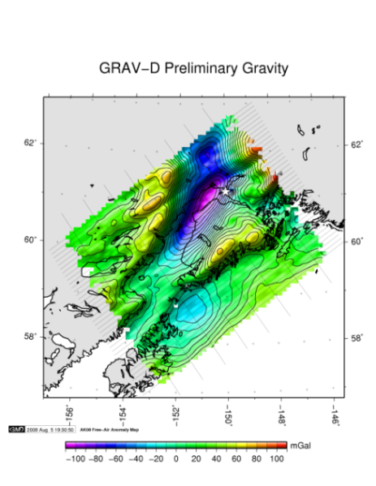
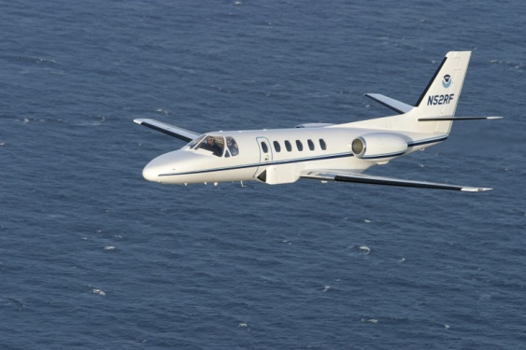
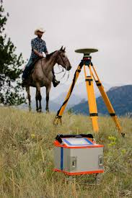
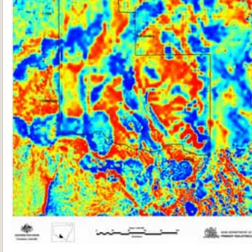
Why GRAV-D: Building a Gravity Field for NAPGD2022’s GEOID2022
Long Wavelengths
(≥ 250 km)
GRACE/GOCE/Satellite Altimetry
+
Intermediate Wavelengths
(500 km to 20 km)
Airborne Measurement
+
Short Wavelengths
(< 100 km)
Surface measurements, marine gravity and predicted gravity from topography

Slide 6
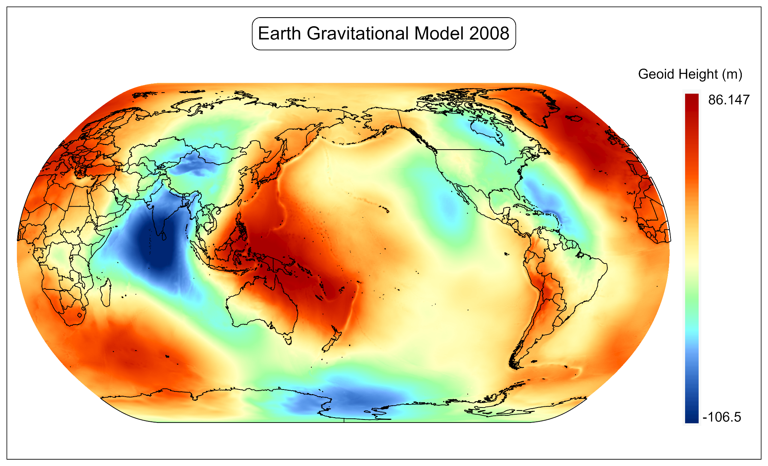
Why GRAV-D: Improve Global Gravity and Geoid Models
The Earth Gravitational Model 2008 from the National Geospatial Intelligence Agency (NGA).
Much of the data is from satellites and disparate ground, airborne, and marine surveys.
NGS was interested collecting a comprehensive airborne gravity data set over the entire US and territories to provide mid wavelength gravity data.
NGA will release a new EGM in the coming years and it will include NGS’s aerial gravity data.

Slide 7
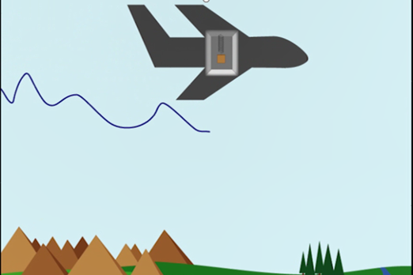
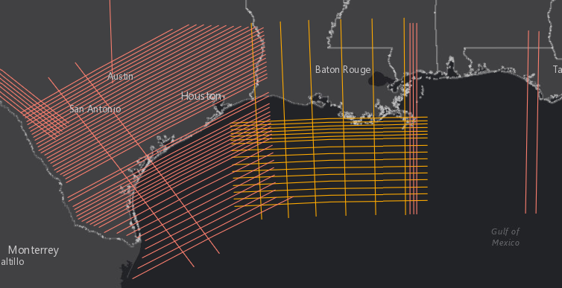
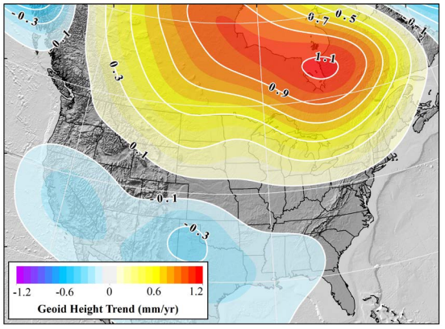
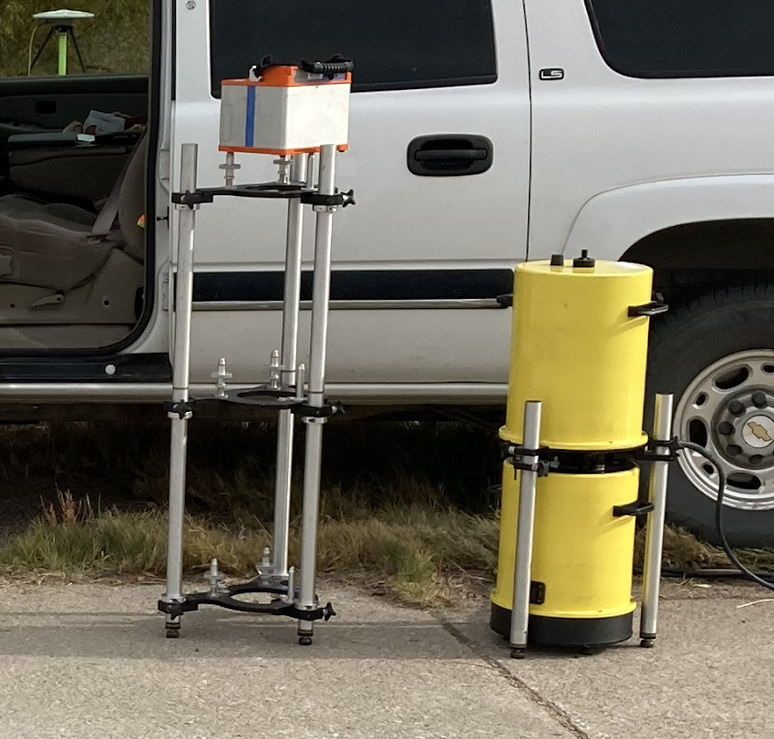
What is GRAV-D?
Gravity for the Redefinition of the American Vertical Datum (GRAV-D):
Step 1: NOAA initiative to collect airborne gravity data over the entire US and territories started circa 2007. Referred to as a “high-resolution snapshot” on the website.
GRAV-D Project Plan
Step 2: A “low-resolution movie” of gravity changes over time: Now a project in its own right as the Geoid Monitoring Service (GeMS)
Webinar: The NGS Geoid Monitoring Service (GeMS)
Webinar GeMS Validation Survey
NOAA Technical Report NOS NGS 69: A preliminary Investigation of the NGS’s Geoid Monitoring Service (GeMS)
GeMS informs the dynamic DGEOID2022 part of NAPGD2022.
Notes:
Note: GRAV-D is an airborne gravity campaign, not the actual vertical datum.

Slide 8
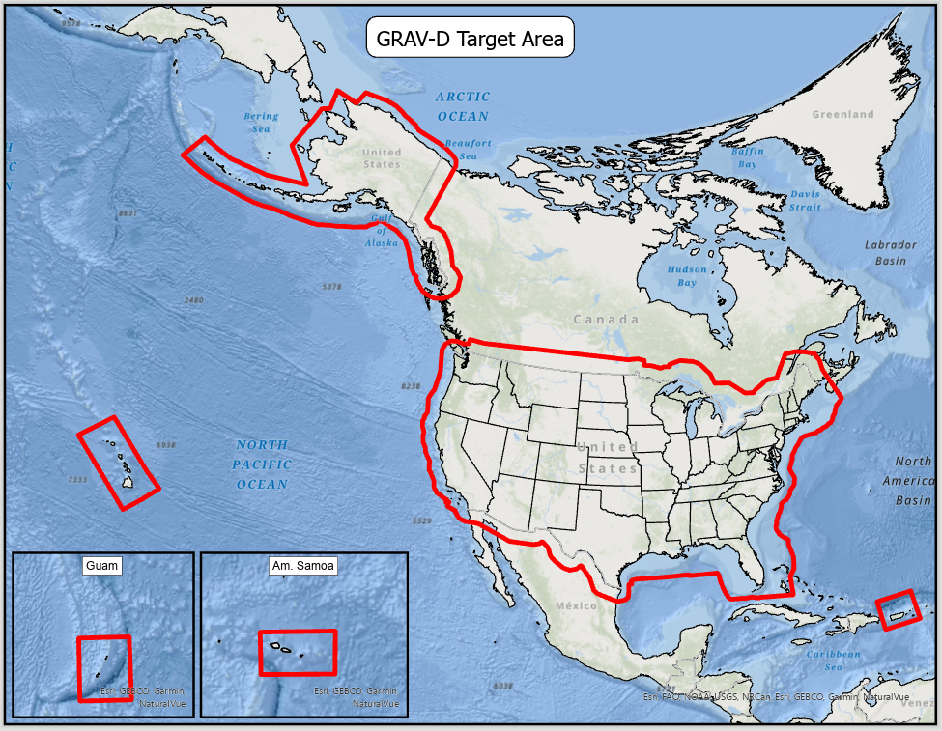
What is GRAV-D: GRAV-D Target Area
Littoral Gap between shipbourne and terrestrial gravity: Fly out past shelf break (Typically ~150 km).
Extended into neighboring countries by ~150 km.
Covers CONUS and Hawaii
Covers Alaska including most of the US Aleutian Islands.
Covers territories: American Samoa, Commonwealth of the Northern Mariana Islands, Guam, Puerto Rico, and the US Virgin Islands.

Slide 9
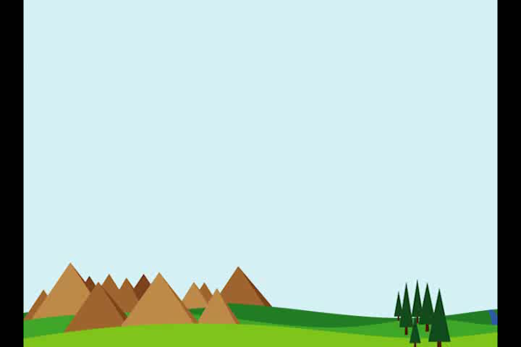
How does airborne gravity data collection actually work?

Slide 10
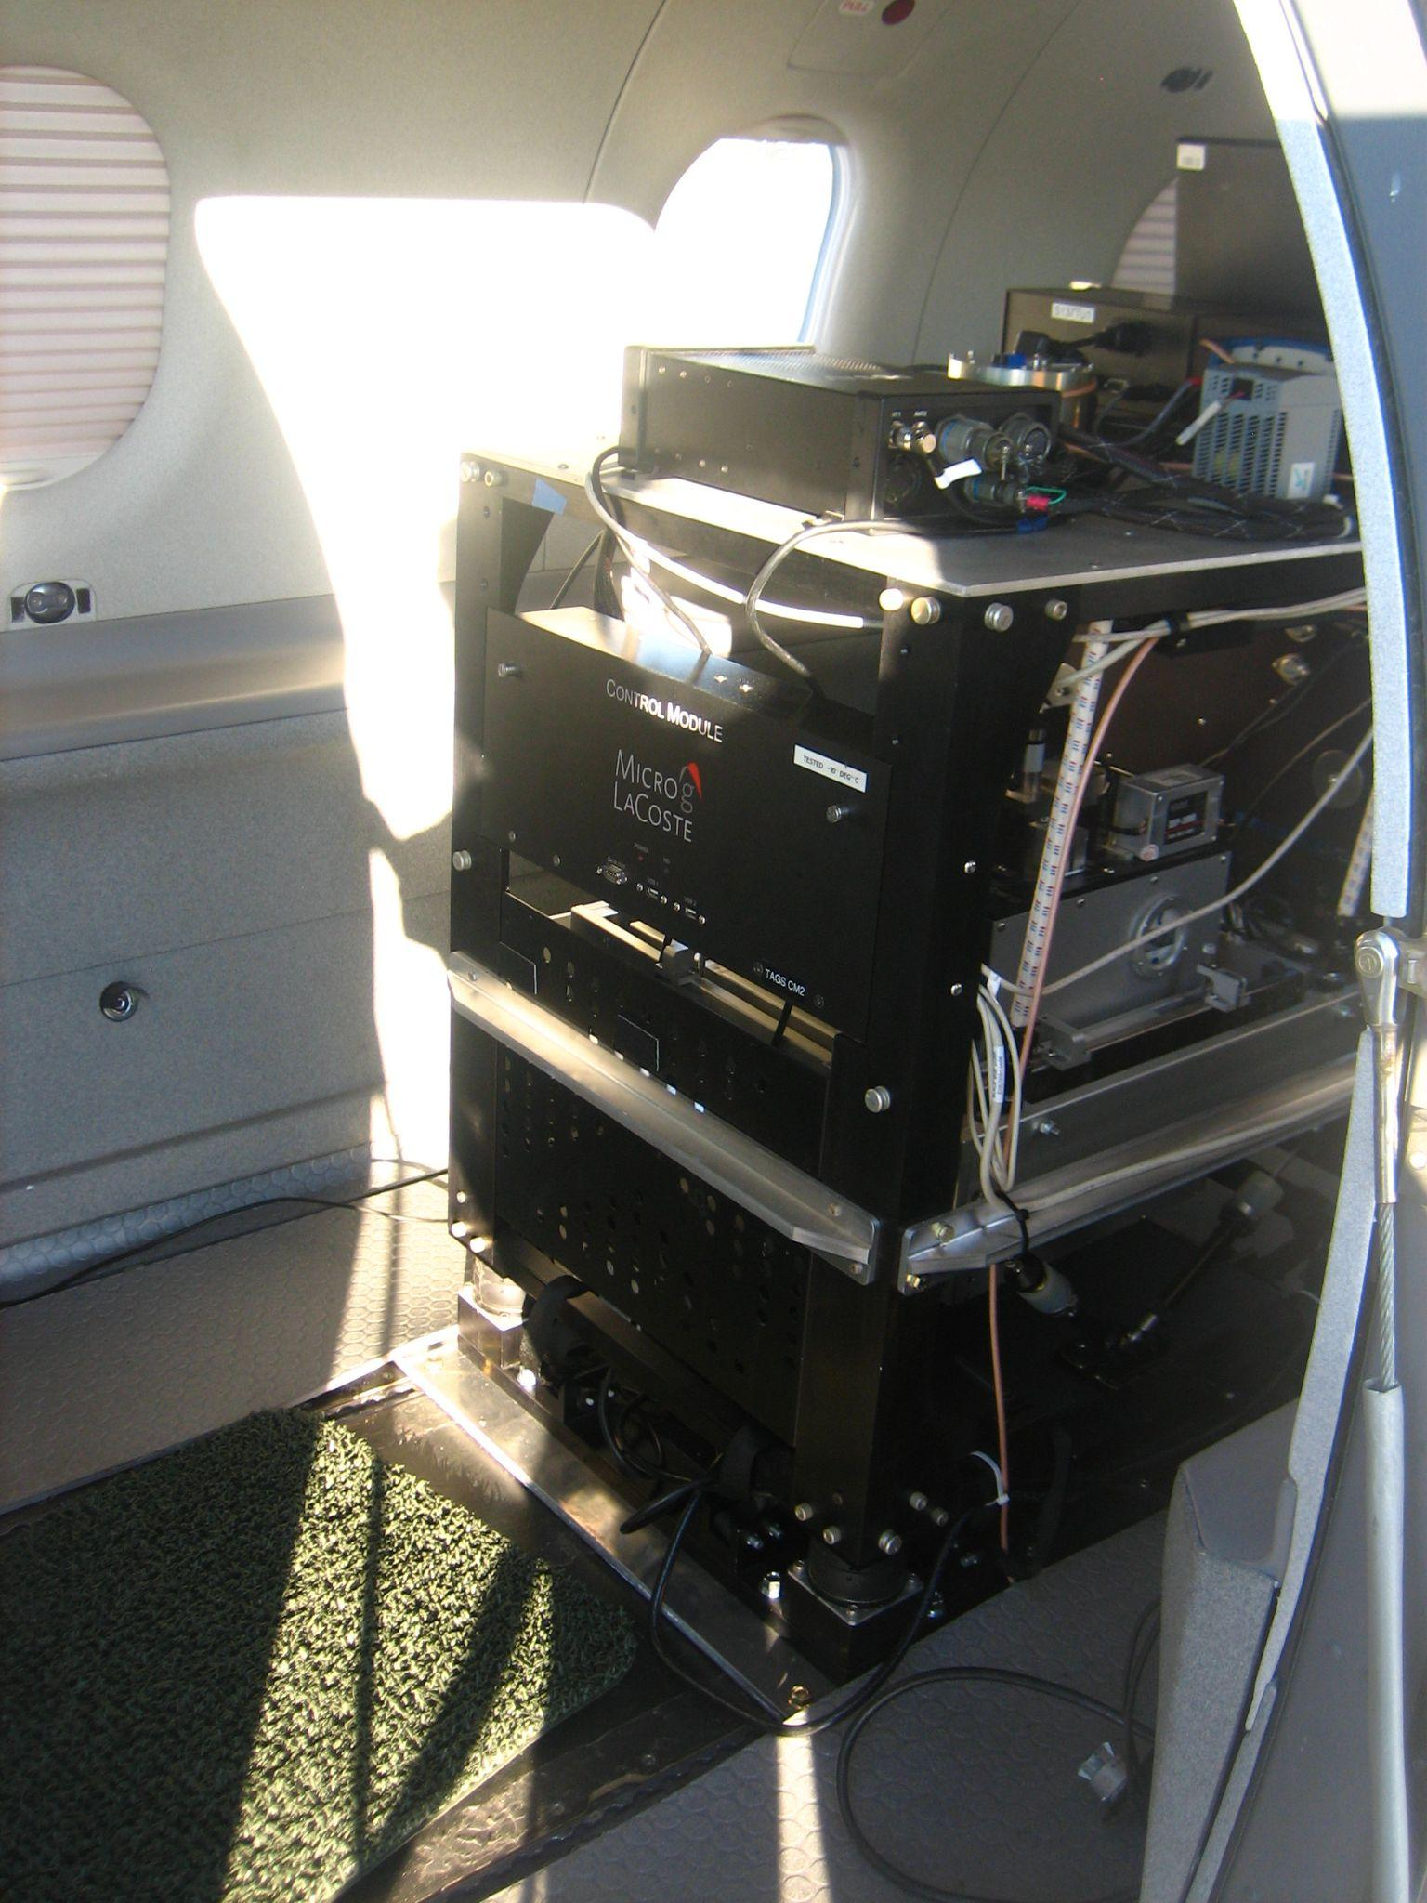
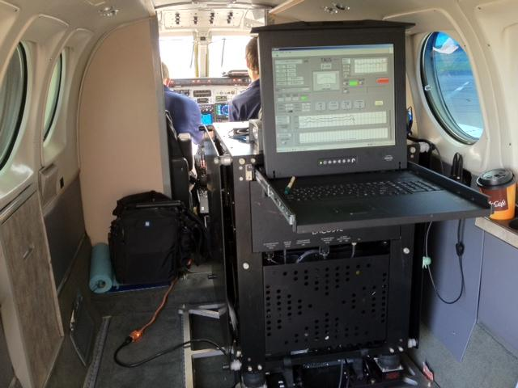
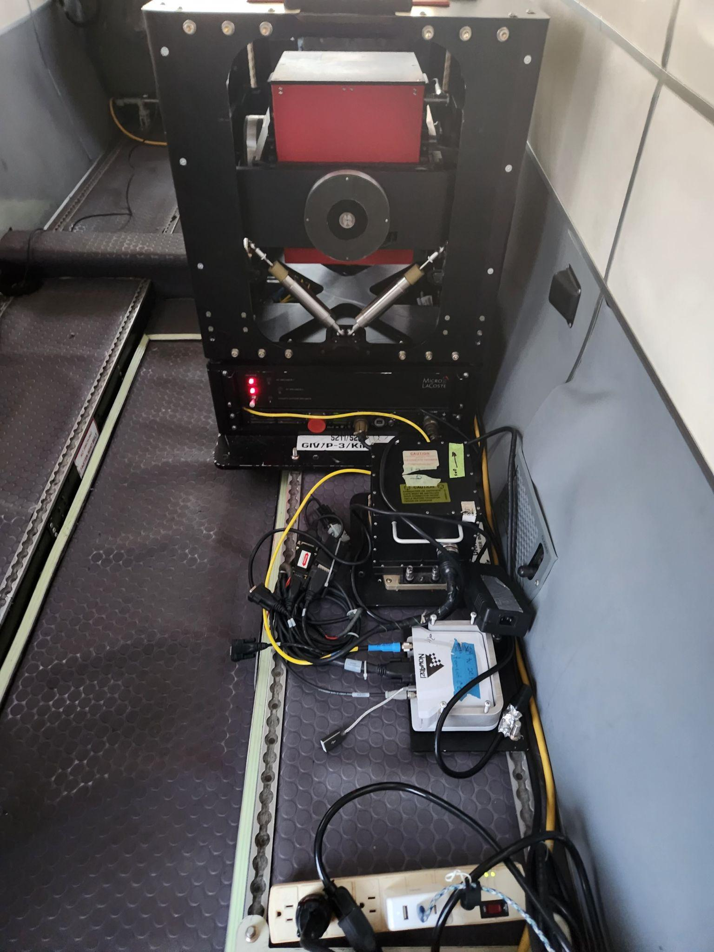
How: 3 Types of Airborne Sensors Used by NGS
All zero length spring gravimeters, with double axis gimbal frames, but some other differences…
TAGS with electromagnetic damping and measurements from calibrated spring tension.
TAGS with air damper and measurements from calibrated spring tension.
TAGS: Turnkey Airborne Gravity System (Micro-g LaCoste, Inc.)
TAGS6 and TAGS7 with force feedback damping and voltage calibrated measurements.

Slide 11
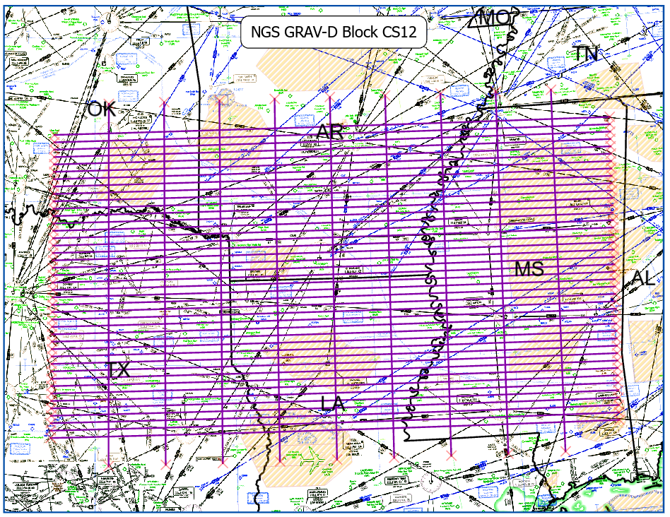
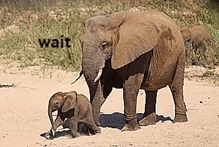
How: Block layout
Able to be released in smaller chunks with internal quality control while the project was ongoing.
Blocks named for time zone and which side of an latitude line they were on: 40°N in CONUS and 63°N in Alaska (Example: CS12 is the 12th block planned in the central time zone south of 40°N).
10 km spaced data lines
~80 km spaced quality control lines.
Lines typically 500-650 km long.
There is only one way to eat an elephant: a bite at a time. -Desmond Tutu

Slide 12
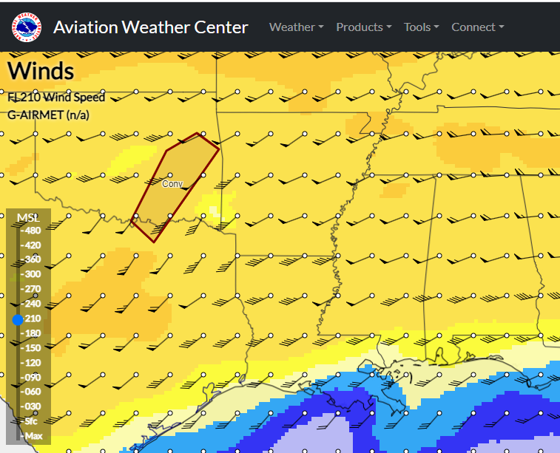
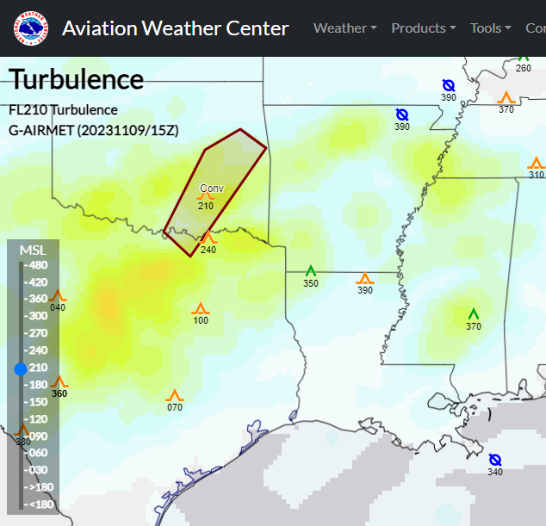
How: Flight Selection and challenges
Aviation Weather
Little to no Turbulence
Winds less than ~45 knots
No icing
Work around US Special use airspace.
Some airspace can only be accessed on nights or weekends.
Some airspace required DOD support to gain access.
It can be challenging to find places to fly that meet all the requirements on any given day. It becomes necessary to alter the schedule and fly at nights sometimes.

Slide 13
Background: First, a note on gravity units…
Gravity is commonly referred to as 9.8 m/s² or 10 m/s² in some textbooks.
Gravity can be observed to many more decimal places with modern gravimeters.
The Gal unit (to honor Galileo) is defined as 1 cm/s², so the magnitude of gravity on Earth can also be estimated as 980 Gal.
NGS’s FG5-X gravimeter is capable of measuring accurately to ~1 microGal (μGal) which is the same as 10 nanometers/s² or, for example, gravity at our lab is 9.79 622 742 m/s² (That 2 on the end is in the 10 nanometers/s² position. This could also be written as 979,622,742 μGal
This presentation will primarily refer to the unit milliGal (mGal) since we’ll be talking about airborne gravimetry.
NGS’s airborne gravimeters are capable of measuring precisely to 1-2 milliGal (mGal) which is the same as 10-20 μm/s² (micrometers per second squared).
1 mGal = 10 μm/s²

Slide 14
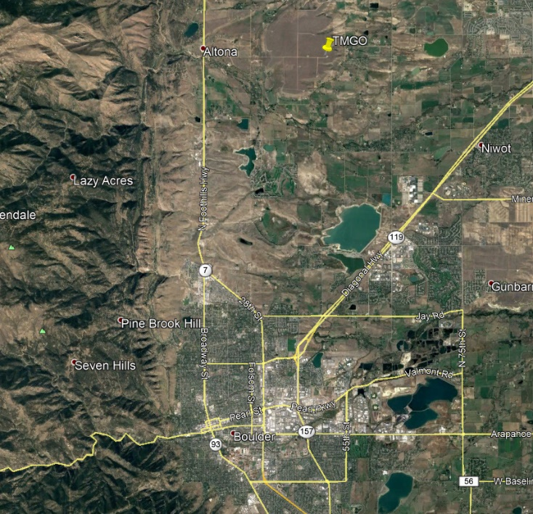
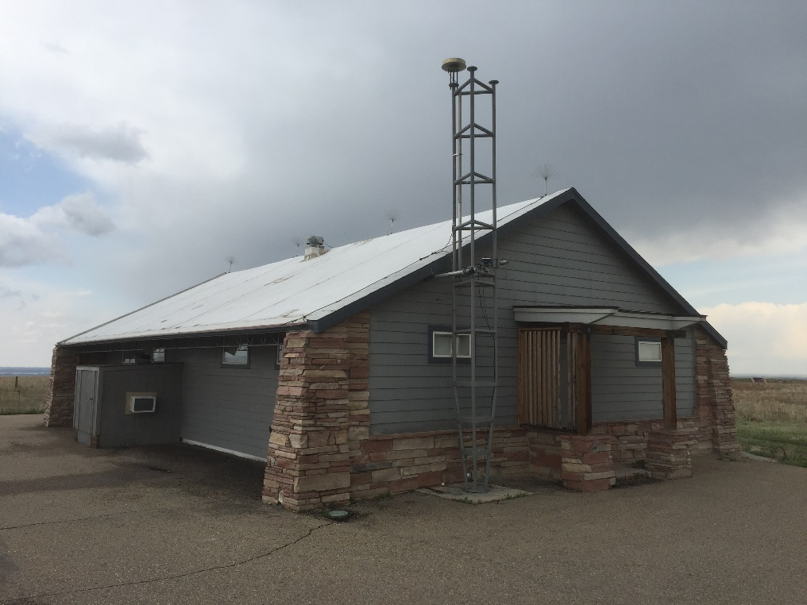
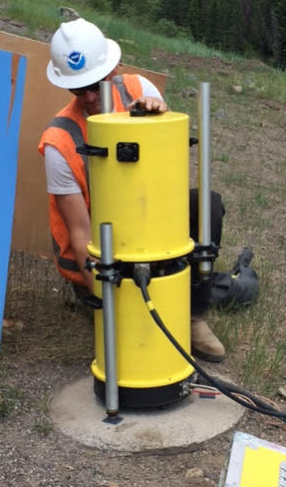
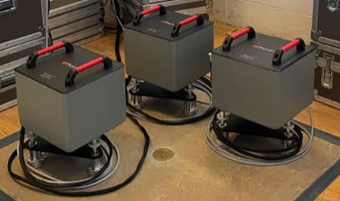
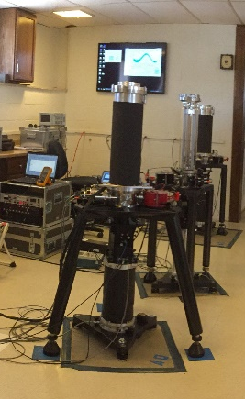
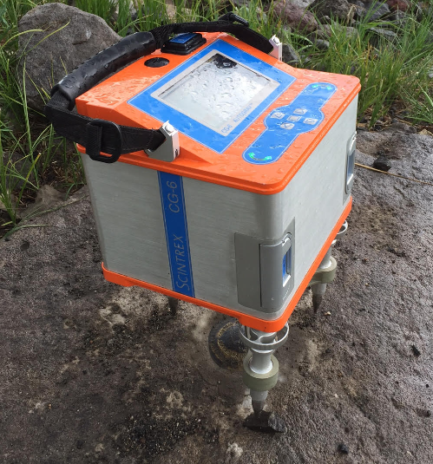
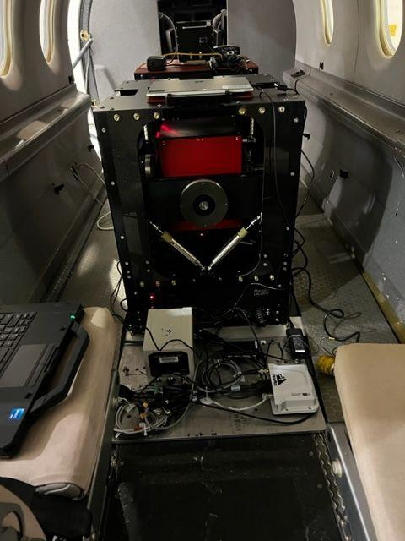
How: From TMGO to hunting gravity in the wild
g = 9.79 622 742 m/s², more or less!
NGS’s Gravity Hub is located at Table Mountain Geophysical Observatory near Boulder, Colorado.
TMGO features:
Continuous relative gravity
Absolute gravity
Calibration Line
International and Regional Comparisons of Absolute Gravimeters.
A10 Absolute Gravimeter (Field)
gPhoneX Lab Relative Gravimeter
CG-6 Field Relative Gravimeter
FG5-X Absolute Gravimeter (Lab)
Turnkey Airborne Gravimeter 7 (Relative)

Slide 15
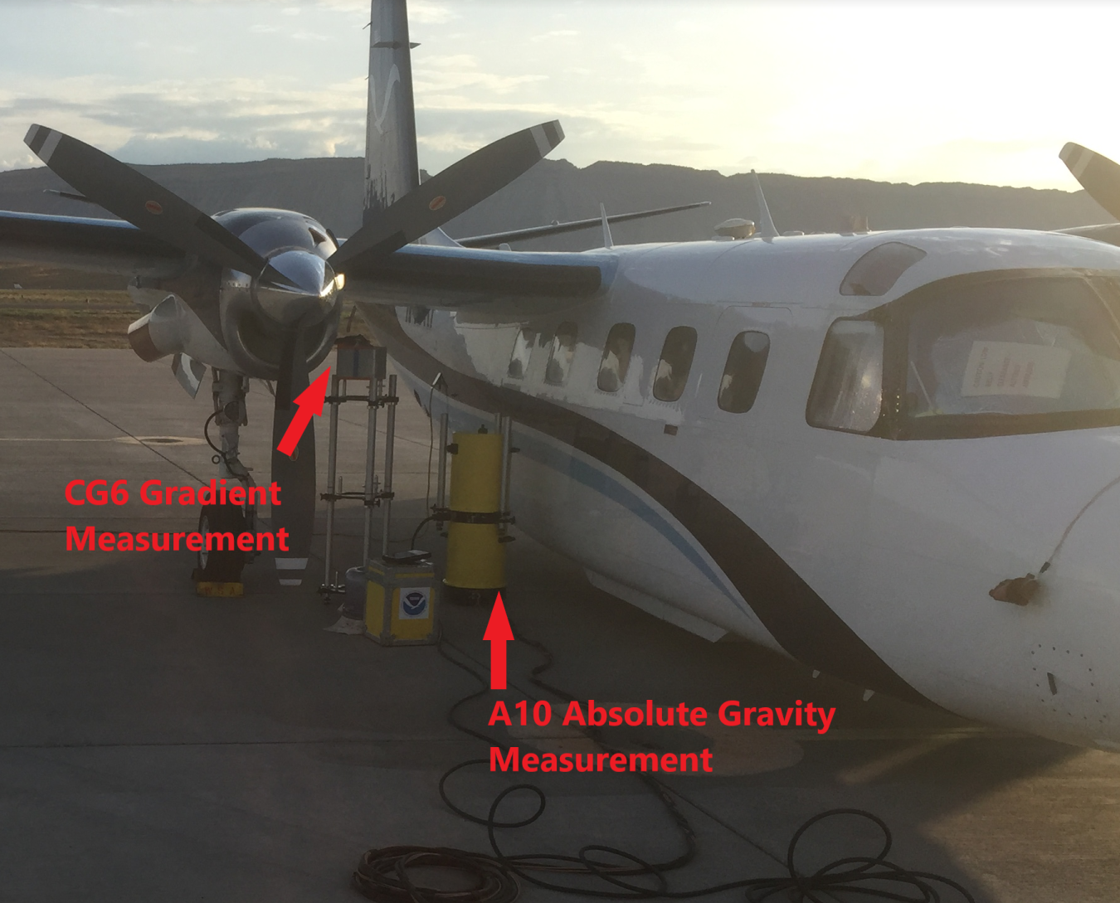
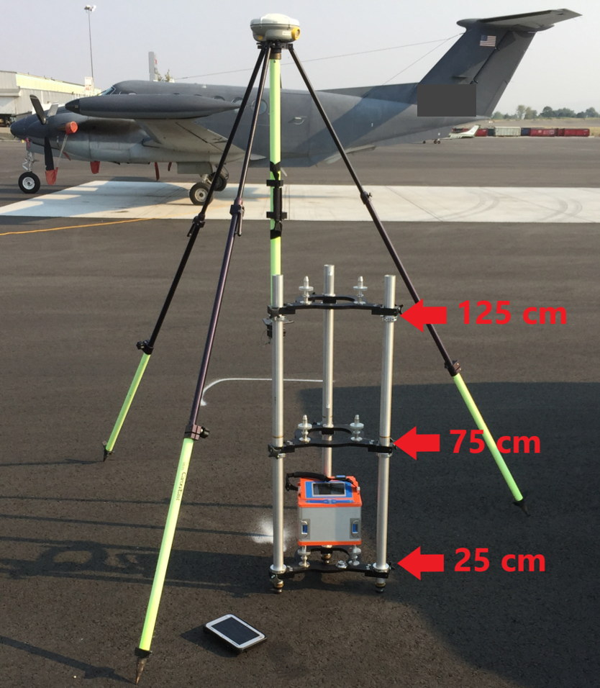
How: Airport Gravity Tie
Purpose
Provide an absolute gravity measurement to tie relative airborne gravity measurements
Measurement
Absolute gravity
A10 or FG5
Two independent setups for blunder check
15 min of measurements
Vertical gravity gradient
Relative gravity meter
Three heights for a quadratic fit
2 - 6 loops to improve precision
Use gradient to transfer absolute measurement to height of the meter in the aircraft

Slide 16
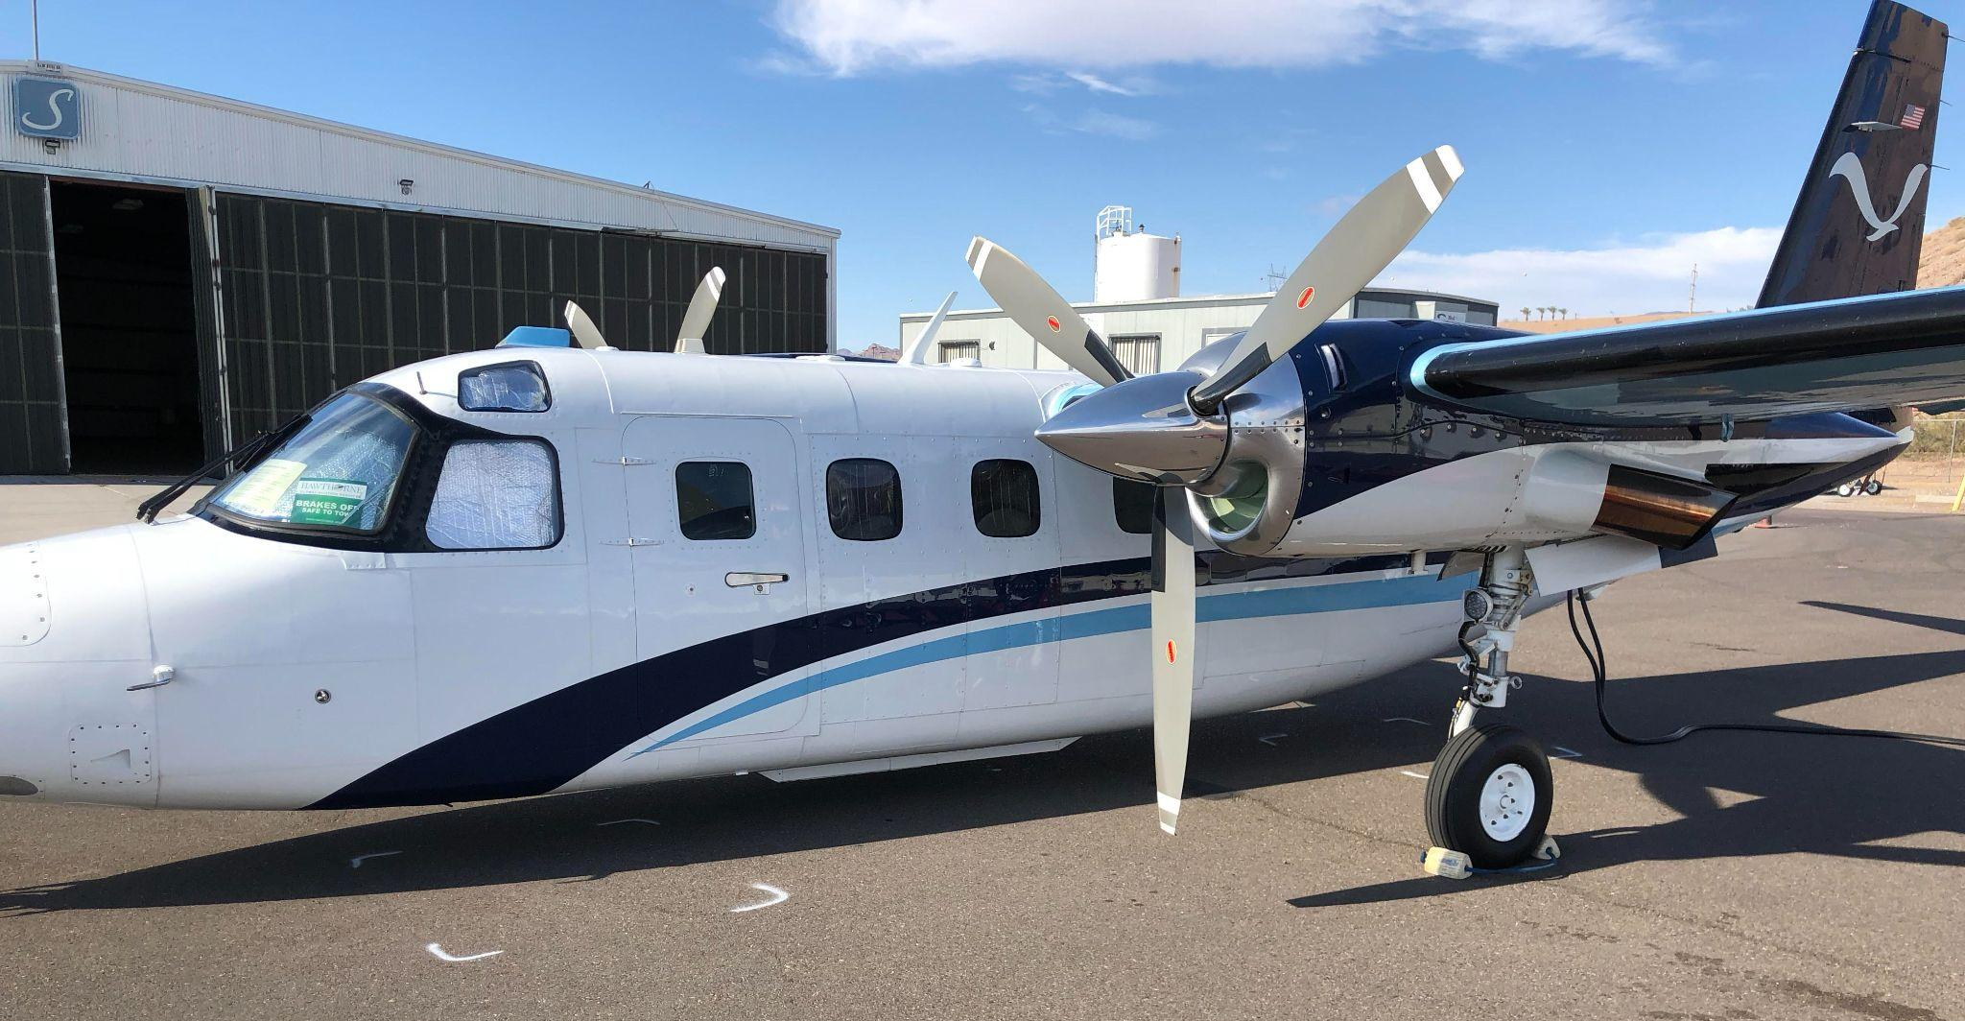
How: Relative Gravity Tied to Absolute Gravity
NGS’s airborne gravimeters are relative meters (show change in gravity).
Before and after each flight the gravimeter in the aircraft is parked over the site with known absolute gravity value and an observation occurs. This is called a “still-reading.”
The still reading is used to tie relative values to an absolute value and correct for drift in the relative measurement (modeled linearly with time).

Slide 17
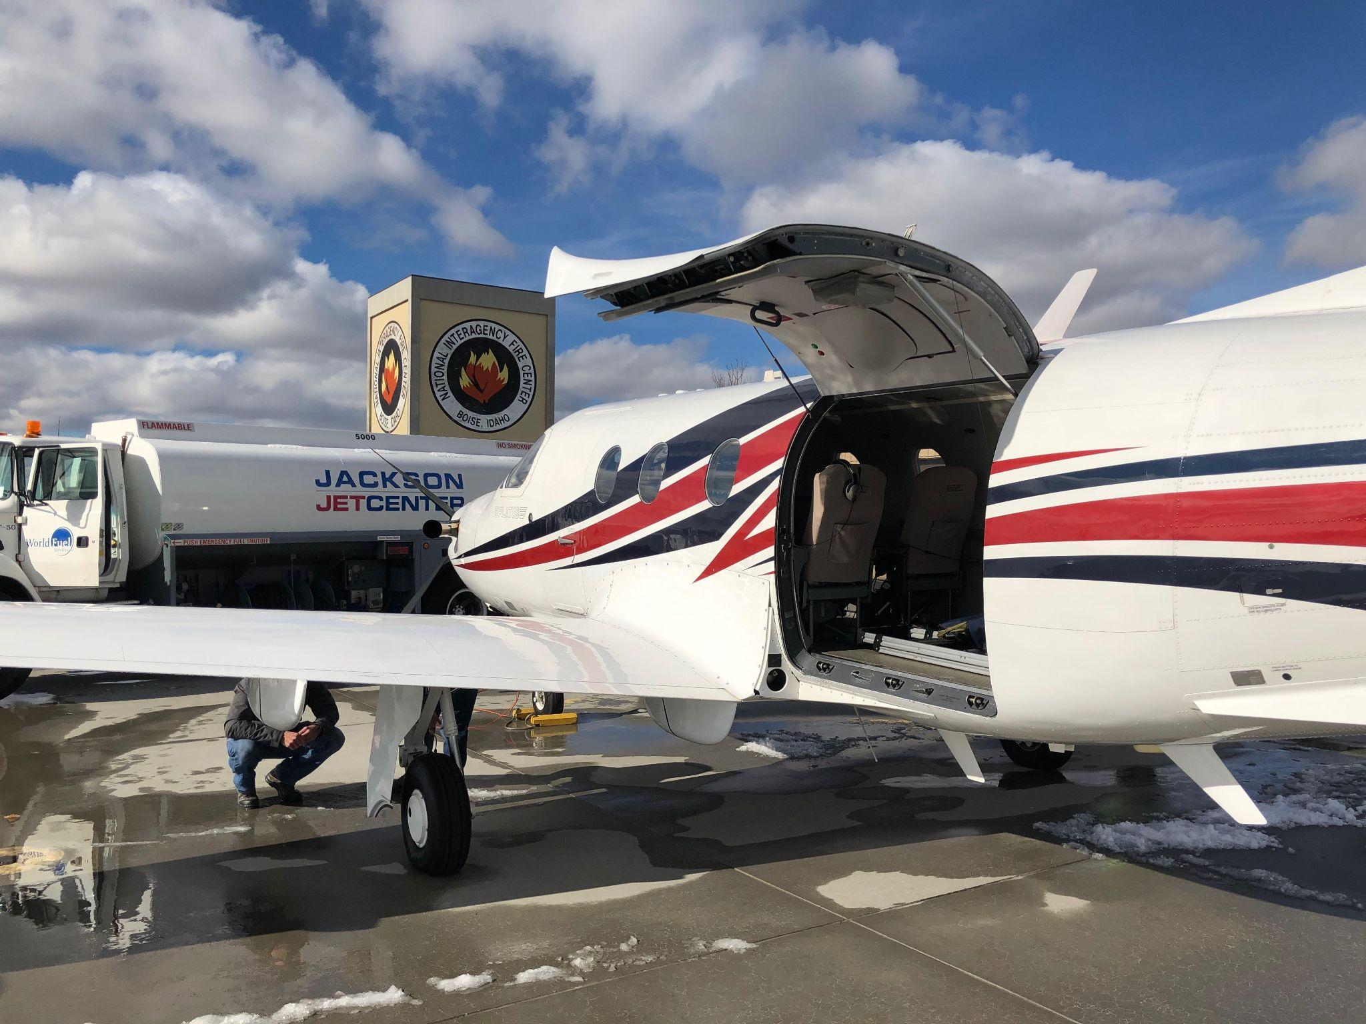
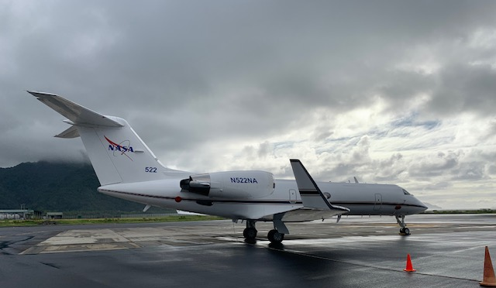
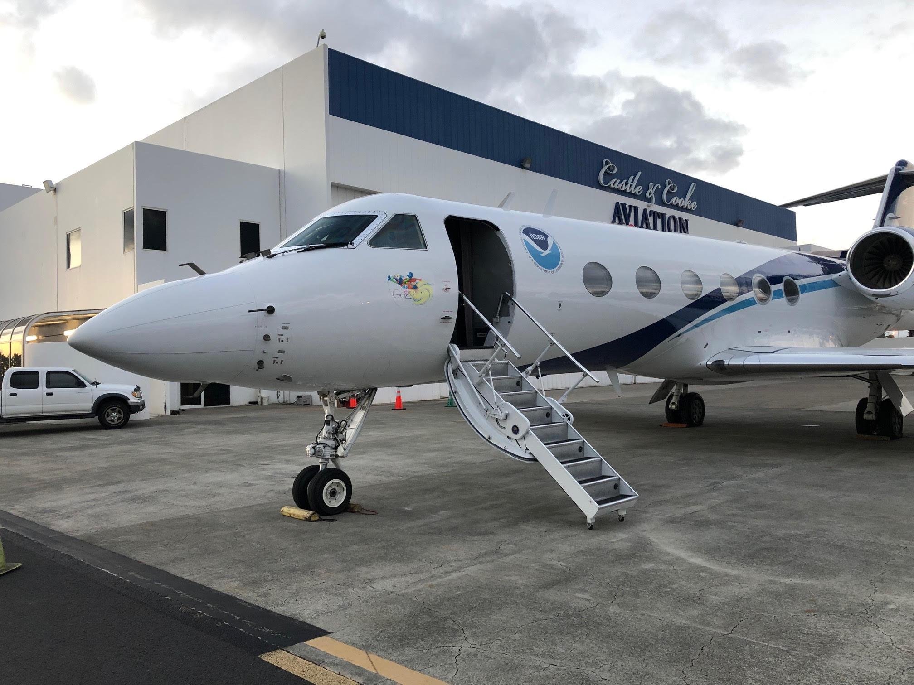
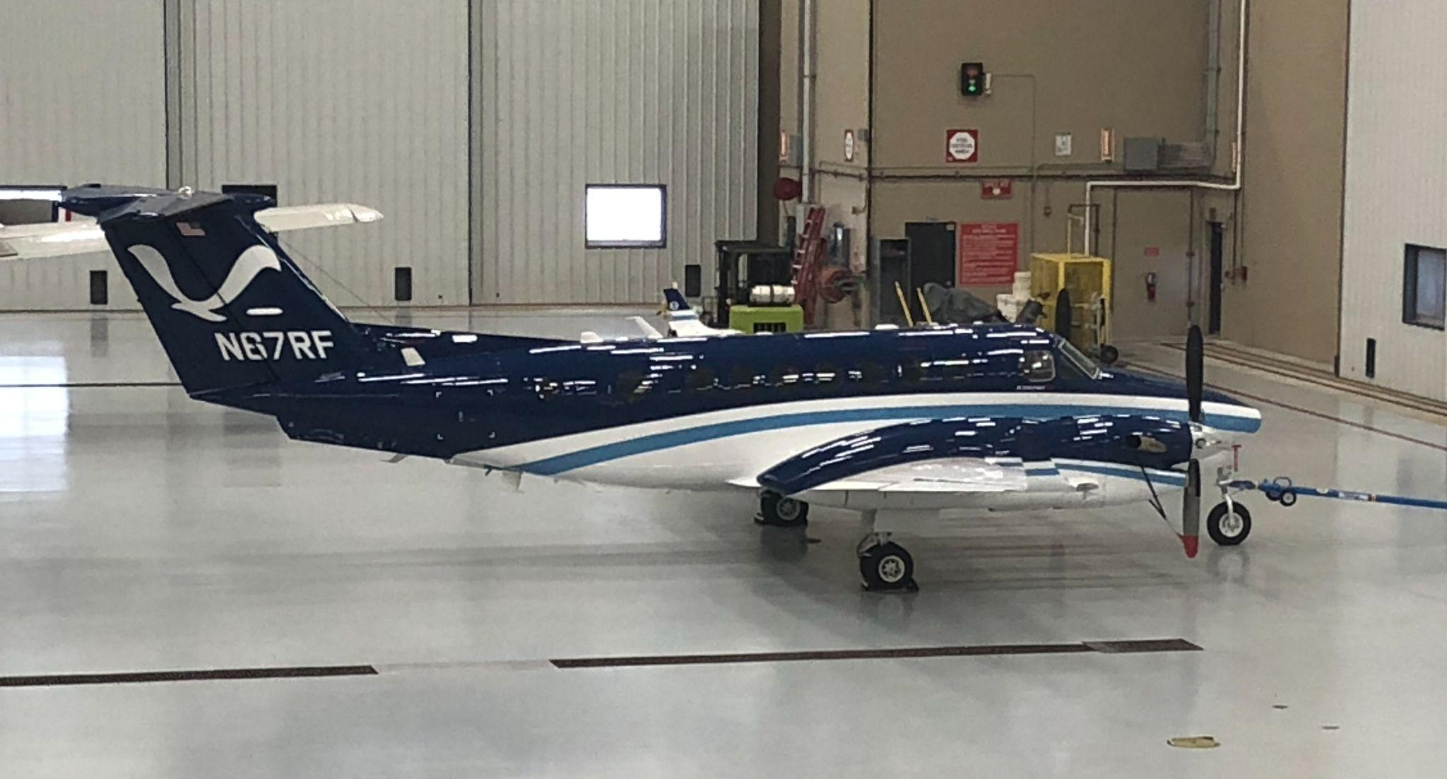
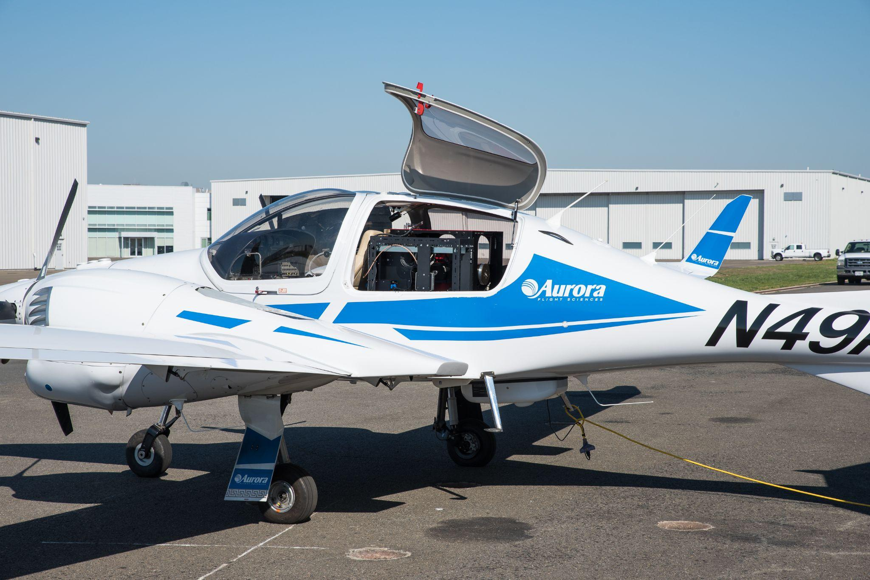
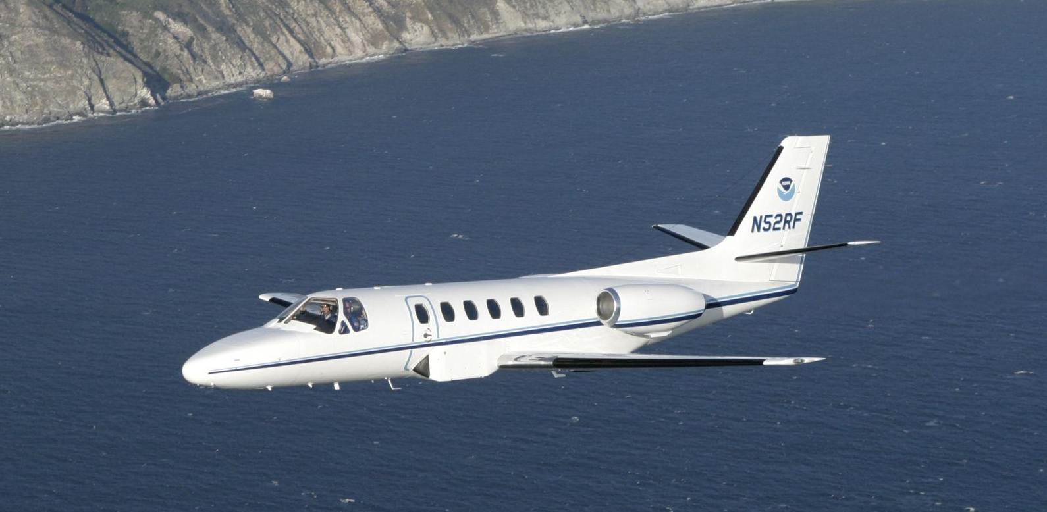
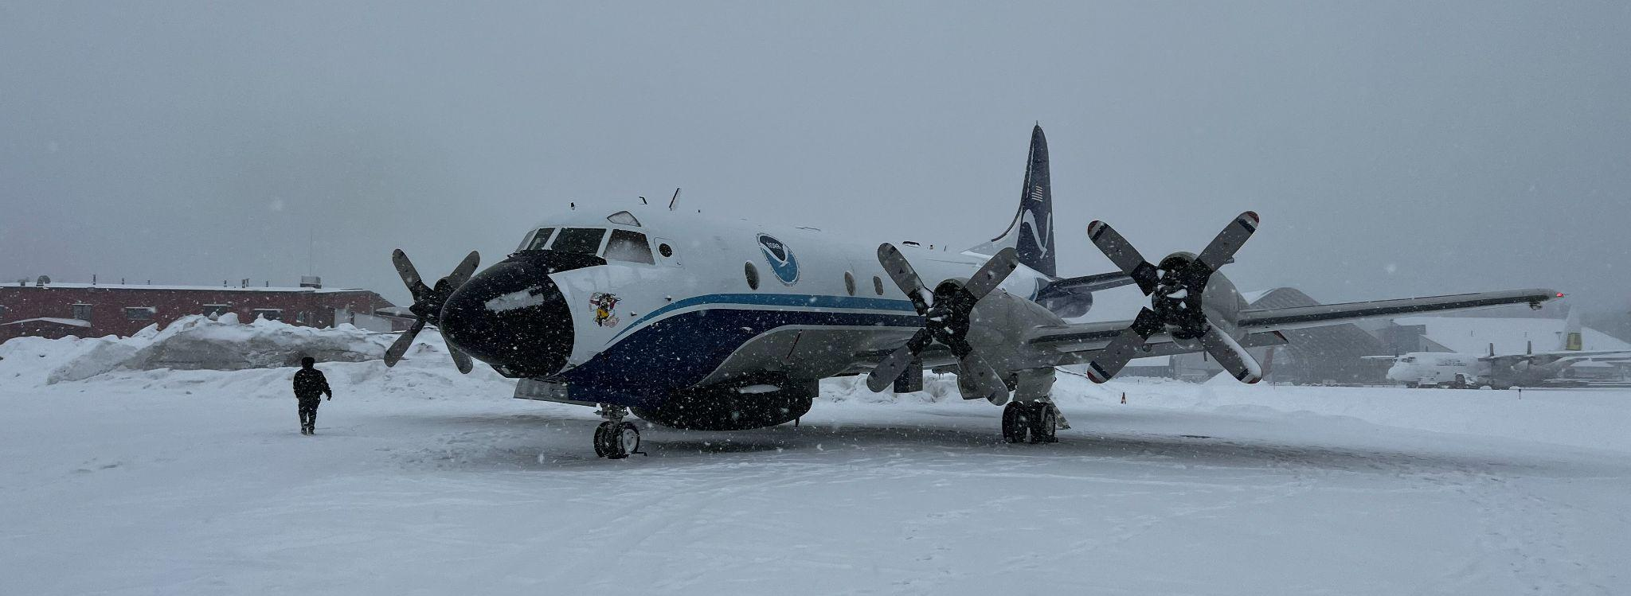
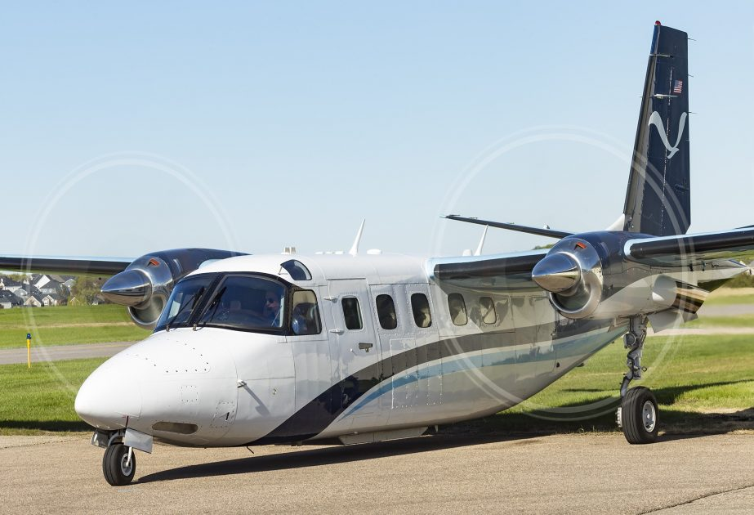
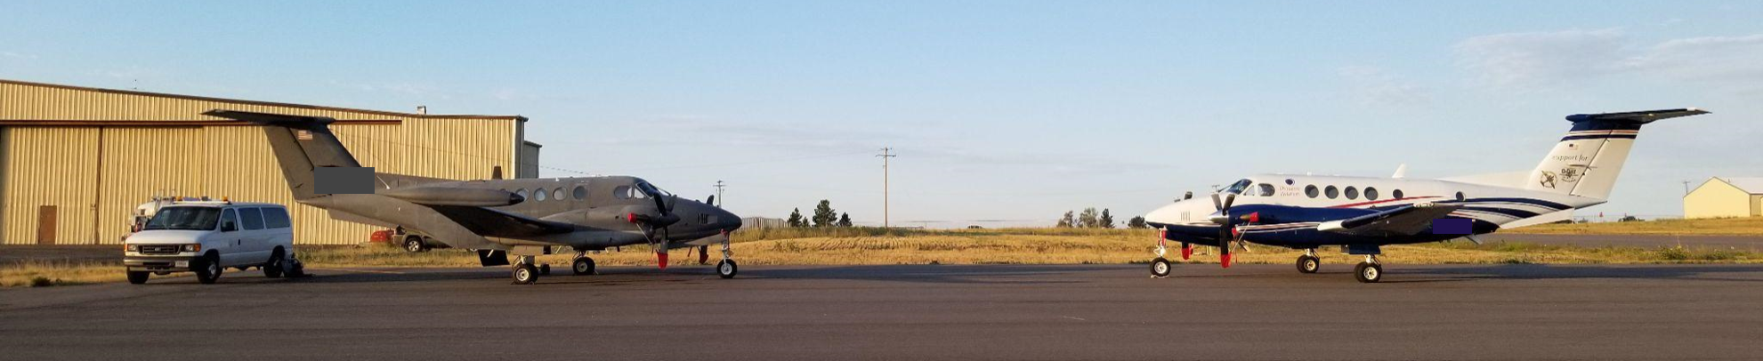
Various Aircraft Over the Years…
NASA LaRC Gulfstream IV
NOAA King Air 350
DOI PIlatus PC-12
NOAA Gulfstream IV
NOAA Cessna Citation II
NOAA WP-3D Orion
NOAA Turbo Commander
Aurora Centaur (Pilot Optional)
Dynamic Aviation King Air 200s

Slide 18
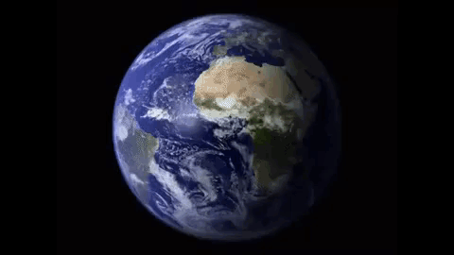
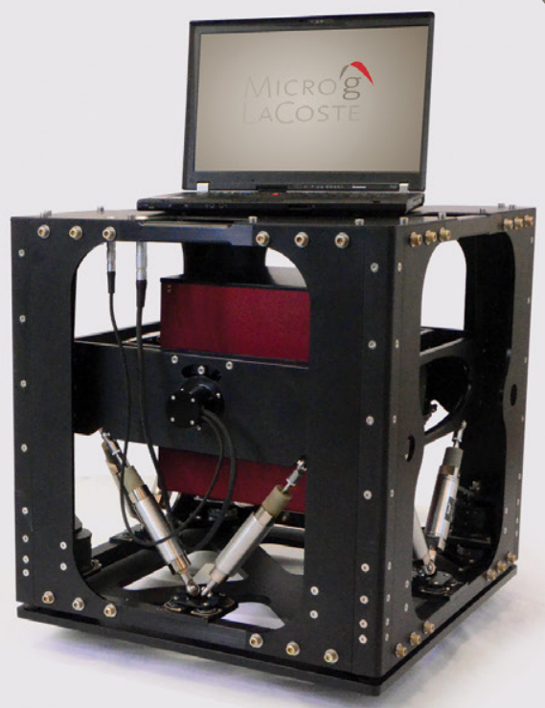
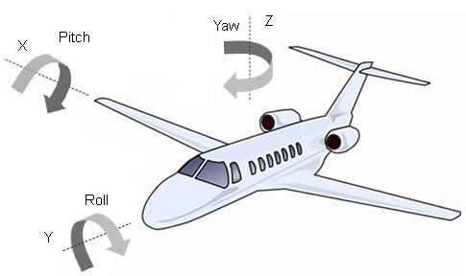
Processing gravity data collected on a moving platform around a moving earth
The airborne gravimeter is very similar to a land based relative gravity meter that is actively stabilized to counteract common aircraft motions
Active Gimbal Levelled
Dynamic Reading Capable
http://www.circuitstoday.com/interfacing-gyroscope-arduino
TAGS7 Airborne Brochure

Slide 19
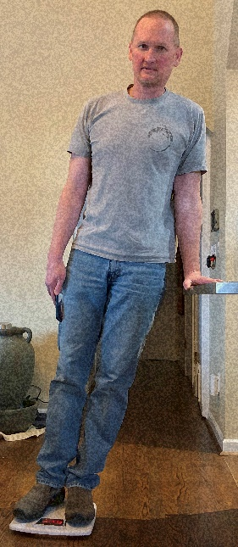
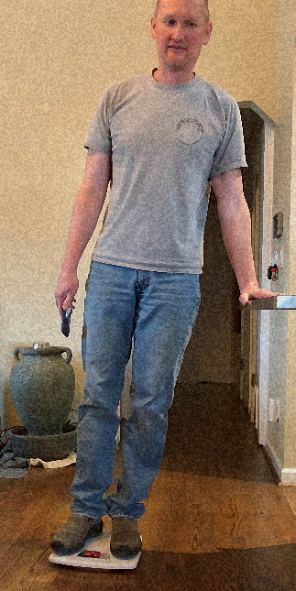
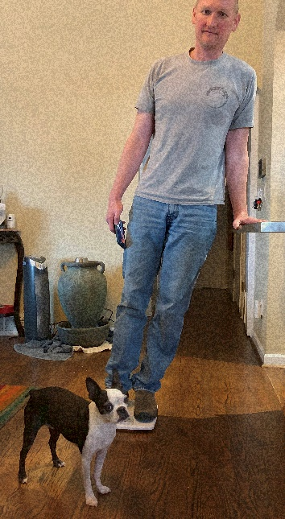

Processing: Off Level Correction
θ
W_{est} = Scale reading + OL correction
θ
θ
OL corr = ƒ(h,θ,d)
Reading: 138
162
143
OL corr:
55
26
53
W_{est} :
193
188
196
Notes:
To borrow Derek’s bathroom scale gravimeter analogy, what happens if when you stand on the scale, you lean over and put your hand on a counter. Your ‘gravimeter’ will still give you a reading, but you know that it is probably not right. What can you do to get a better value? (next) You can take additional observations, like the angle you are leaning, center of mass estimate, distance from counter, etc and come up with a way to estimate the error, in this case how much weight is on the counter, and with this ‘Off level correction’ you can add to the scale reading and come up with a better estimate. But how good is your estimate? One way to test is to take multiple measurements (next), make multiple correction calculations (next), and you can look at the consistency of your final values to give you an idea of how well your corrections are performing. You can do much the same thing with airborne gravity (next). With the airborne sensor, there are multiple angles, accelerations in three dimensions to account for, but it is the same basic principle.

Slide 20

Airborne Gravity Processing: Eӧtvӧs Effect
Gravity on earth is related to gravitational pull towards the earth and towards other large celestial bodies along with centrifugal force due to earth’s rotation. When an object moves in an easterly or westerly direction, centrifugal force is increased or decreased respectively resulting in a change to observed or ‘felt’ gravity. Eӧtvӧs effect most be removed from airborne gravity to know what a stationary object would experience.
West bound motion results in less centrifugal force and greater gravity observed
Eastbound motion results in increased centrifugal force and weaker gravity observed.

Slide 21



Processing: Raw Gravity and GPS Signals
Notes:
Upon Arrival: This slide shows the raw gravity signal. The high frequency noise has very large amplitude, due to accelerations due to aircraft motion and vibration.
Click 1: The orange signal is GPS derived vertical accelerations. You can see that the these vertical accelerations closely match the raw gravity signal in amplitude and frequency.
Click 2: The new yellow squiggles are what we get when we subtract the gps vertical accelerations from raw gravity. Also, Eotvos and off level have been dealt with along with drift and a few other items. It still contains high frequency noise at a larger amplitude then we need for fully reduced gravity data. Let’s get rid of the orange and blue signals and focus on the yellow corrected gravity data. (CLICK)

Slide 22





Processing: Filtered Gravity and GPS Signals
Notes:
Upon Arrival: Now we can zoom in on y axis scale and get a better idea of the high frequency noise and its amplitude
Click 1: At this point we apply a two minute filter that specializes in removing high frequency noise.
Click 2: The purple line is fully reduced GRAV-D data. (CLICK 3) The green line is the EGM2008 data. You can see, at this y axis scale EGM2008 and our data look identical. Let’s zoom in on the y axis again to get a better look at it.
Click 4: Now we can see the interesting gravity signal that we’ve collected for this line. On the next slide we’ll remove the yellow hash so we can see what’s going on more clearly. (CLICK 5).

Slide 23


Processing: Measured versus Modeled
Notes:
Upon Arrival: At this scale we can more clearly see there are differences between EGM2008 and our data. That blue line represents the difference between EGM2008 and our data. Let’s zoom in one more time to get a better idea of those differences.
Click 1: You can see the blue line ranges between -5 and about 3 mGal. For this line, this is the extra higher frequency information that GRAV-D data is contributing.

Slide 24






GRAV-D Complete!
Target Area is 100% Complete, and
NGS continues to collect data to improve the dataset
In 2023, NGS completed data collection in American Samoa, Hawaii, the Aleutian Islands and in CONUS! Plan to have a complete processed data set by mid February 2024.

Slide 25
Plan to Publish the complete GRAV-D data set in coming years
Our Goal is a leveled Data Products approach. This will depend on availability of resources. A complete GRAV-D data set will be made available in some way in the coming years.
GRAV-D Level 0: Instrument files and data collection metadata. Will be available upon request from the National Centers for Environmental Information (NCEI).
GRAV-D Level 1: Raw data aligned with GPS data and instrument output calibrated to gravity units. Includes NGS’s suggested corrections and effects. (TBD whether this will be available upon request or published for easy access).
GRAV-D Level 2: All full field gravity data available on a web map platform. Select data with lasso or rectangle feature for download along with metadata.
GRAV-D Level 3: GRAV-D Gridded Product. Also available on a web map platform. Select data and download along with metadata.

Slide 26


GRAV-D Data Showcase: Grand Canyon

Slide 27


GRAV-D Data Showcase: Mountainous Idaho

Slide 28

GRAV-D Data Showcase: Lake Michigan

Slide 29



GRAV-D Data Showcase: Midcontinent Rift
https://geonarrative.usgs.gov/mrs_mineral_deposits/

Slide 30
GRAV-D Data Showcase: Islands

Slide 31
What’s next for Airborne and Terrestrial Gravity data collection at NGS?

Slide 32



What’s Next? Improving the GRAV-D Dataset
Complete Gulf Coast GRAV-D flights at 20,000.
Some lines flagged for reflight remain to be flown.
Several regions in the mountainous western CONUS need further investigation with aerial gravity data.

Slide 33


What’s Next? Geoid Monitoring Service
Supports the DGEOID2022 product: How are geoid heights, gravity, orthometric heights, potential, and DoV changing over time? (NOAA Technical Report 69)
Alaska GeMS Validation Survey: 5 year frequency
Continuous relative gravity observations.
Proposed, preliminary absolute gravity network with geoid rates from GRACE in mm/yr (contour interval = 0.1 mm/yr)
Absolute gravity observation. Alaska also includes DoV and GNSS observations.

Slide 34



What’s Next? Terrestrial Relative Gravity Densification
Goal: To densify relative gravity data in regions with significant geoid slope variation, higher population density, and relatively low terrestrial gravity data density.
Select regions based on scientific analysis (Ahlgren heat map, Hardy error grid)

Slide 35



What’s Next? Canadian Aerial Gravity Work
Funding through an Interagency Agreement for aerial gravity work in Canada.
Data Collection in three blocks planned for FY24 and FY25.
Future work will likely include 3 blocks in the Yukon Territory and blocks along the southern border between Canada and the United States.

Slide 36

What’s Next? Mexico Aerial Gravity Work
Potentially funded by Interagency Agreement, but in the more distant future…
Priority will likely be given to the northernmost blocks.
Also interest in:
The Caribbean
Central America
Various Pacific Islands

Slide 37
Big Thanks to the GRAV-D Team Past and Present!!
Field Crew and Scientific Support
Kevin Ahlgren
Dhairya Chokshi
Justin Dahlberg
Theresa Damiani
Luke Downey
Jeff Johnson
Jeff Kanney
Kevin McGraw
Sandy Preaux
Tim Salisbury
Brian Shaw
Chris Villarreal
Project Managers
Vicki Childers
Theresa Damiani
Gretchen Imahori
Jeff Johnson
Dan Roman
Dru Smith
Monica Youngman
Greg Watson
Carly Weil
Derek van Westrum
Dan Winester
Tim Wilkins

Slide 38











GRAV-D has been a partnership between many groups…

Slide 39

Thanks!!
Please reach out to us at
ngs.gravd@noaa.gov
With any questions
NOAA Gulfstream IV in American Samoa

Slide 40

Background: Relative vs Absolute…
Relative Gravimeters
Measure differences in gravity.
Changes over time in one location
Or between one location and another
Absolute Gravimeters
Measure actual acceleration due to gravity at a given location.
When a relative gravimeter is tied to an absolute measurement, it can provide accurate and precise results.
For more information, Gravity at NGS: Why We Need it and How we Measure It by Derek van Westrum.
FG5-X Absolute Gravimeter (Lab)
https://www.forecast.app/blog/difference-between-accuracy-precision
CG-6 Field Relative Gravimeter
Notes:
Talk about why absolute gravimeters are not great in aircrafts. Falling mass, etc.

Slide 41


Background: Gravity Disturbance
A homogeneously dense ellipsoid would have a consistent gravity field.
Actual gravity field varies based on distribution of mass.
Normal Gravity is the theoretical value of gravity on a homogeneously dense ellipsoid.
Gravity Disturbance is the difference between observed gravity and the normal gravity calculated at the same point (latitude, longitude, ellipsoid height).
NGS uses a confocal ellipsoid method to calculate Normal Gravity.
Graphics from https://www.meted.ucar.edu
NGS uses a low pass filter on the gravity disturbance instead of the observed gravity values.

Slide 42

Processing: Overview
Coordinate timestamps between gravity and GPS data through correlating GPS derived vertical accelerations and raw gravity.
Remove GPS derived accelerations due to aircraft motion from the observed vertical accelerations from the gravimeter.
Eӧtvӧs Effect: Vertical component of Coriolis Effect, there is a reduction or increase in measured gravity related to centrifugal force depending on whether a vehicle is moving east (more centrifugal force-less gravity) or west (less centrifugal force-more gravity) bound.
Off level: Must correct for tilt.
Filtering: NGS uses a two minute filter to remove high frequency noise.

