Slide 1
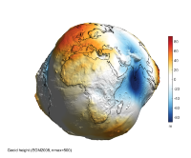
Terminology
Earth Geoid Model of 2008
  Developed by NGA
    Since there is no gravity “truth” to compare to, EGM2008 is used as the benchmark for gravity measurements
    Used GRACE satellite data and terrestrial gravity data worldwide
  EGM2008 used as the starting point for developing most geoid models
  More recent satellite gravity measurements have shown errors
Current United States Geoid Models
  USGG12: gravitmetric geoid that used EGM08, satellite, and terrestrial data
  Geoid12B: hybrid geoid using USGG12 and GPS/leveling data to tie to NAVD88

Slide 2
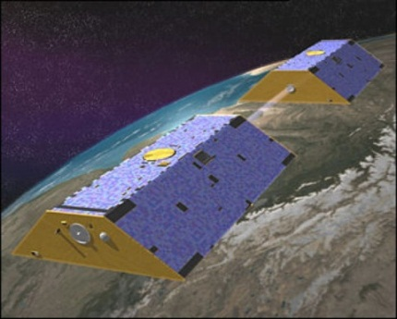
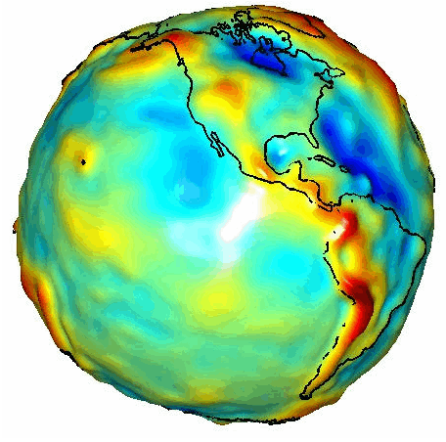


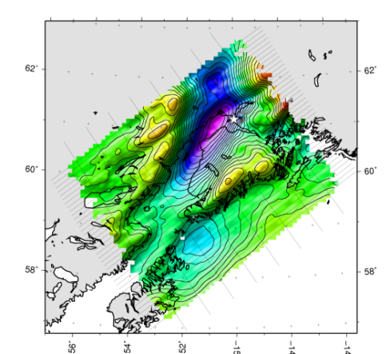
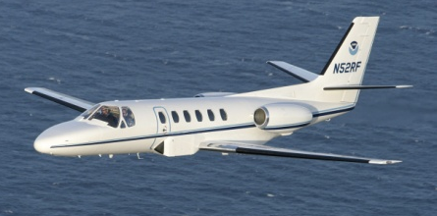

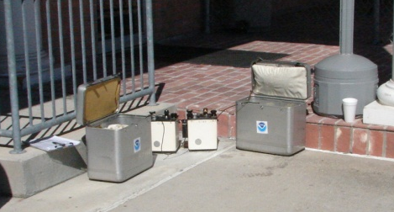
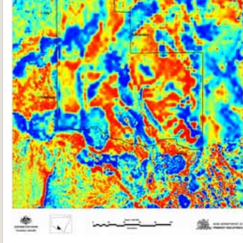

Building a Gravity Field
Long Wavelengths
(≥ 250 km)
GRACE/GOCE/Satellite Altimetry
+
Intermediate Wavelengths
(300 km to 20 km)
Airborne Measurement
+
Short Wavelengths
(< 100 km)
Surface Measurement and
Predicted Gravity from Topography

Slide 3
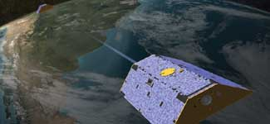
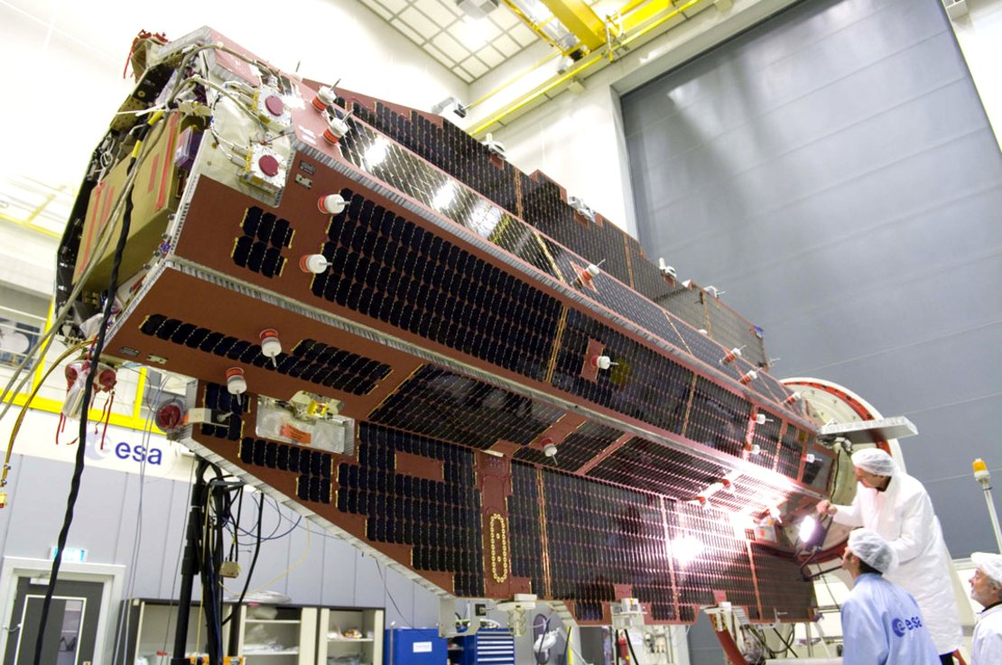
Terminology
Satellite Gravity Missions/Models
  GRACE: Gravity Recovery and Climate Experiment, launched by NASA in March 2002, reaching end of life
  GOCE: European gravity satellite mission dedicated to get a snapshot of gravity, gradiometric satellite that measures the curvature or change in gravity in various axes (Mar 2009 - Nov 2013)
  GOCO5S: product that combines GRACE and GOCE data

Slide 4
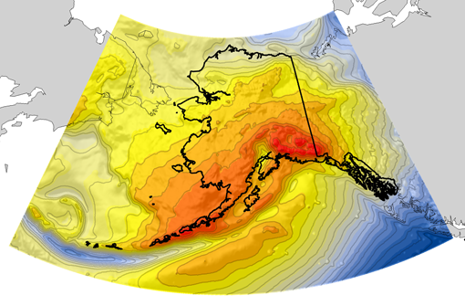
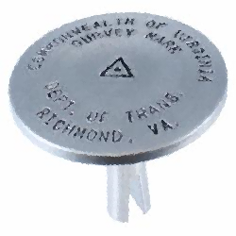
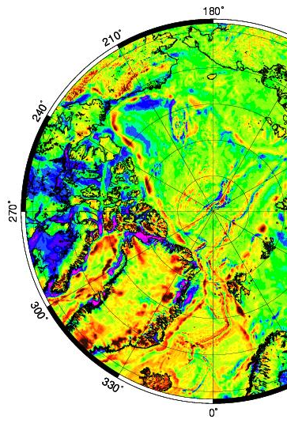
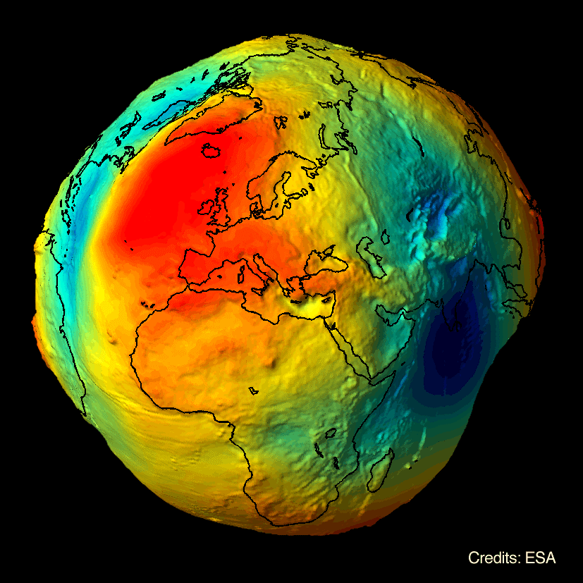

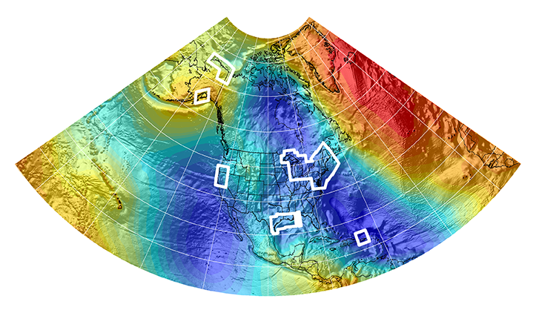
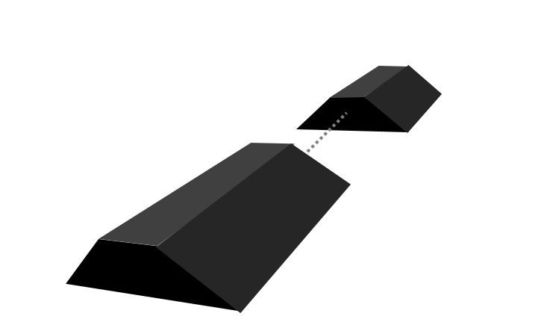

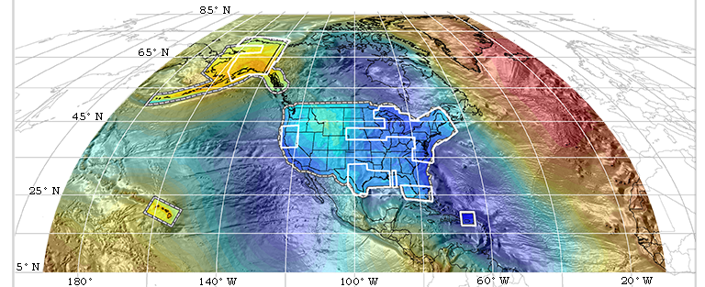

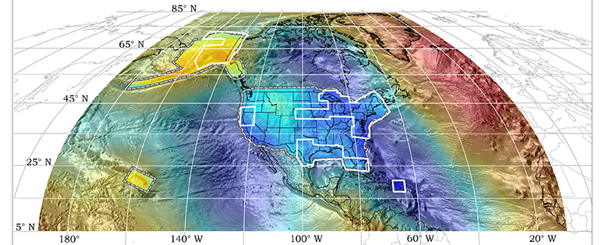
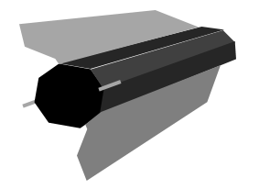

Evolution of the Gravimetric Geoid
EGM08
USGG2012
GEOID12A/B
NGA
ArcticGP
GRAV-D
2008
2012
2014
GOCO05S
2015
2016
xGeoid14B
GRACE
xGeoid15B
xGeoid16B
+
GOCE
Notes:
NGA Arctic Gravity Grid (2017)

Slide 5
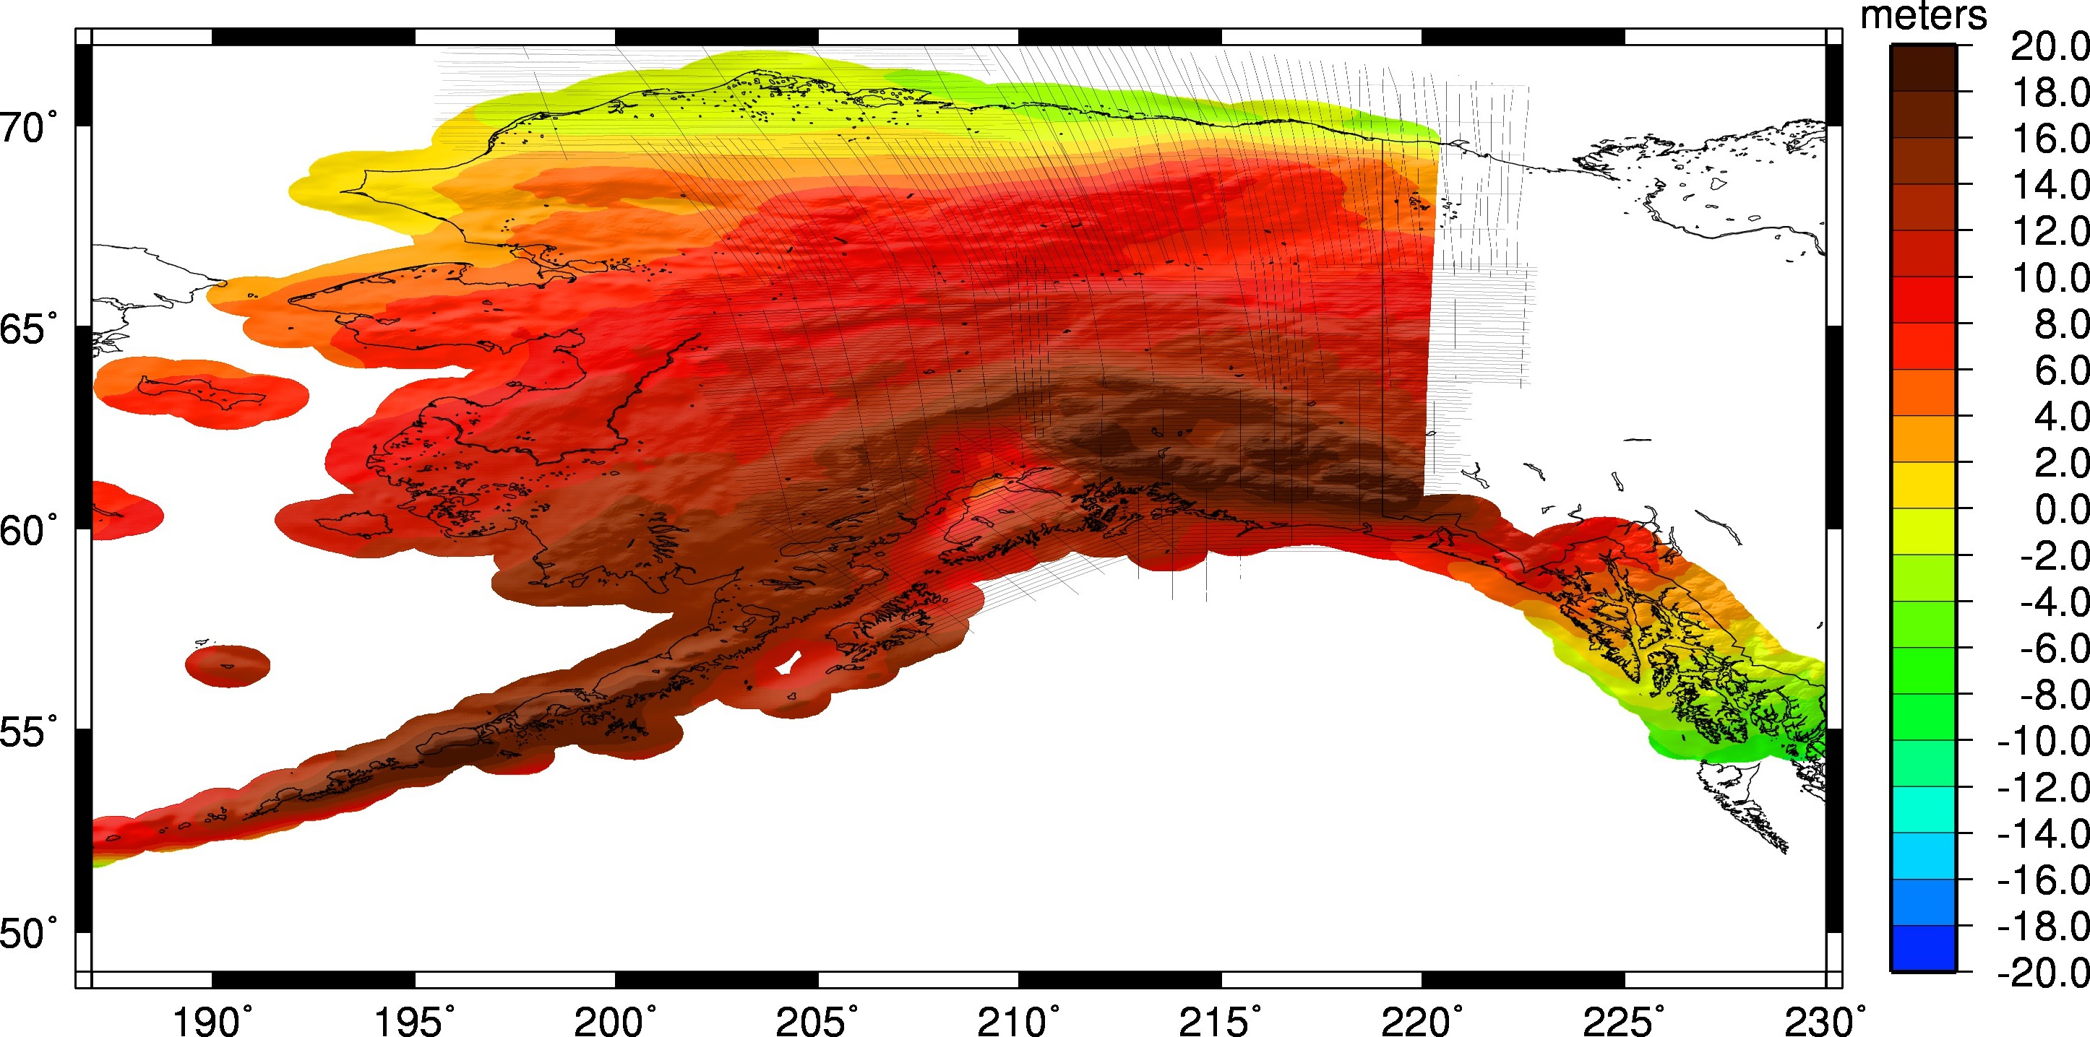
Geoid in Alaska
Current Experimental Geoid: xGeoid16B
+
+
+
(all best available)

Slide 6

Geoid in Alaska
Satellite Contribution to Geoid: GOCO05S

Slide 7
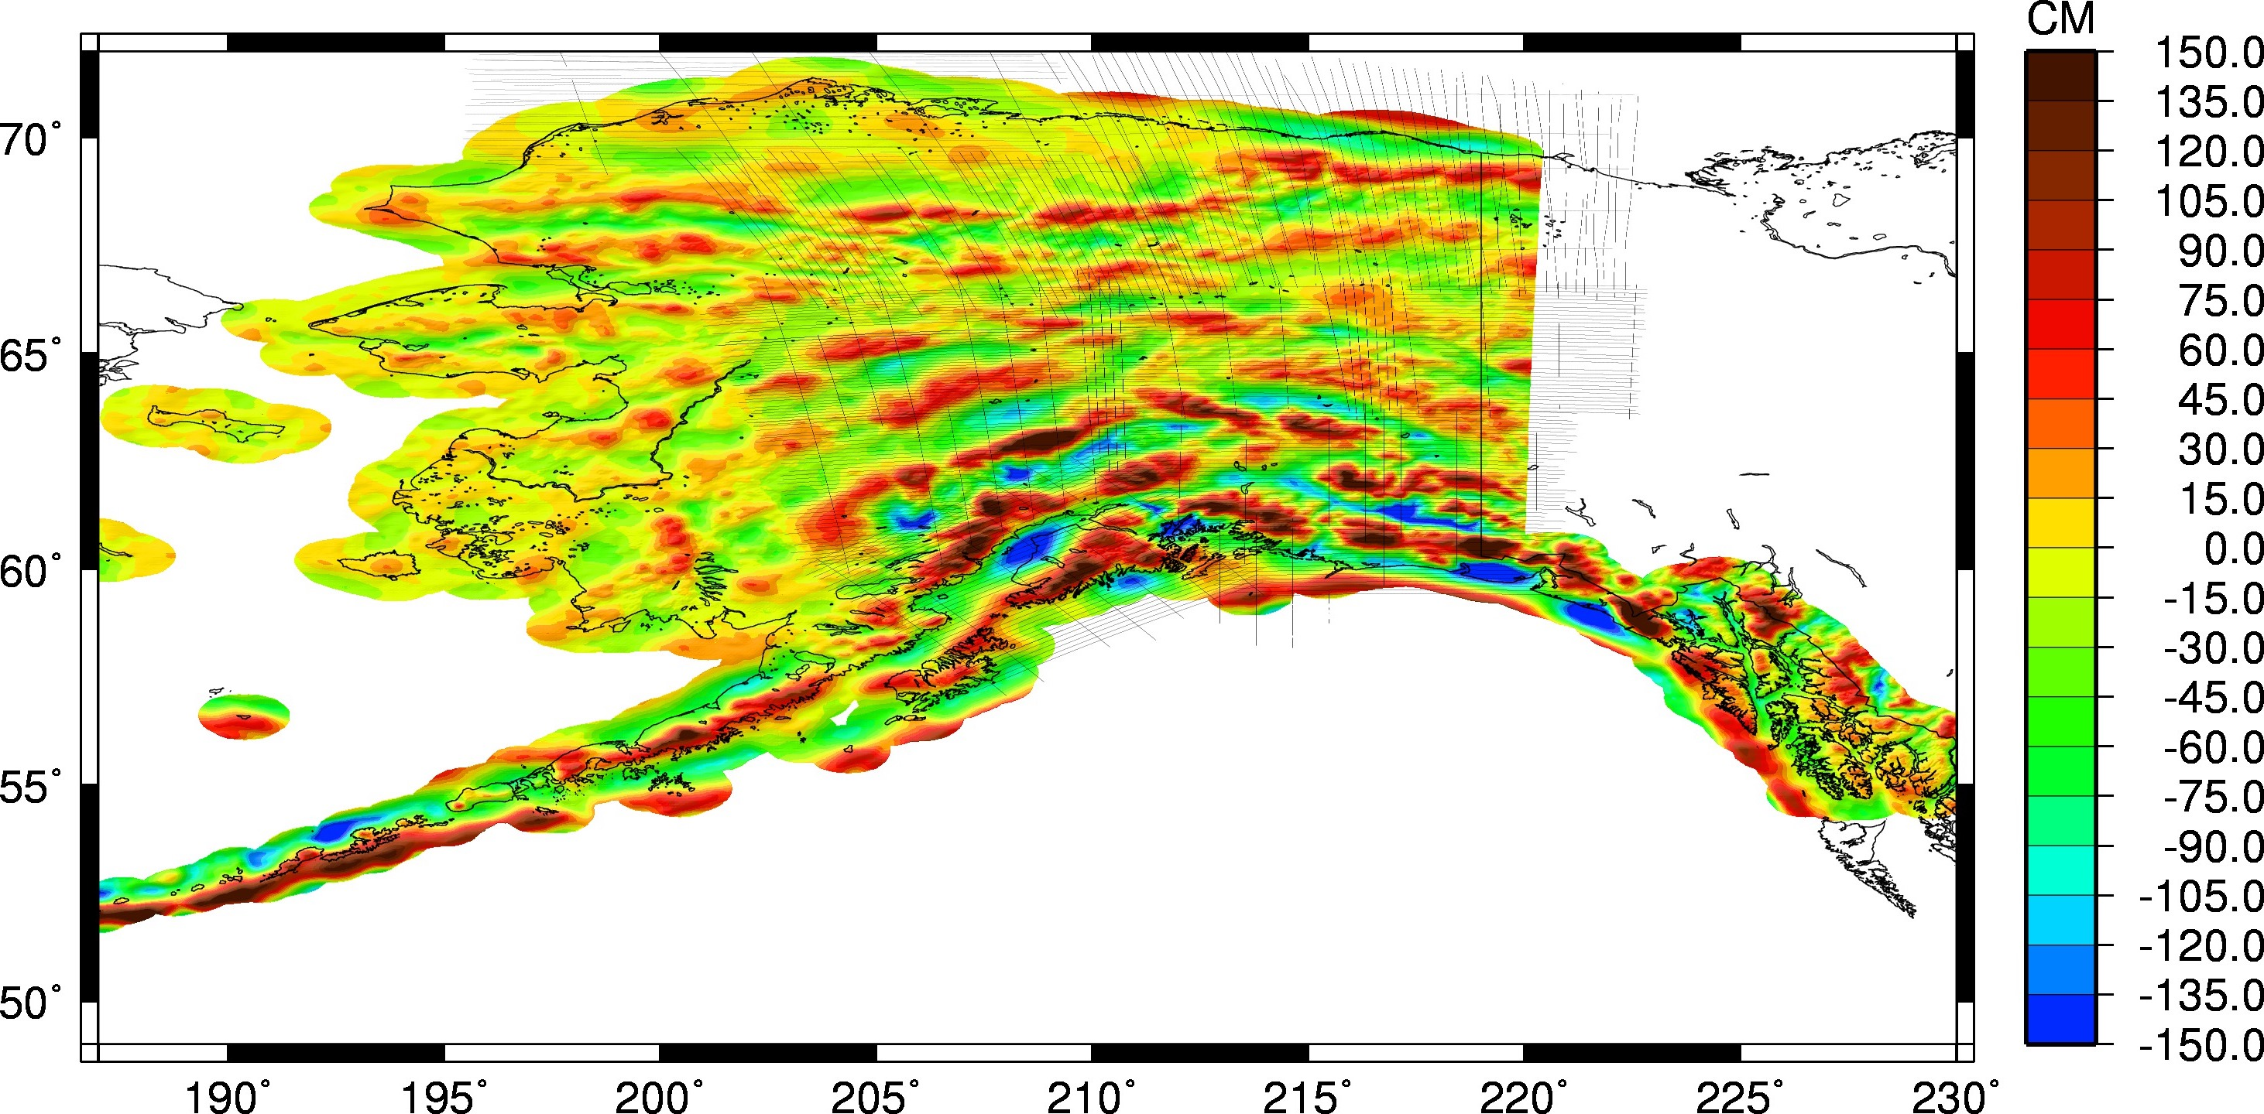
Geoid in Alaska
EVERYTHING BUT … Satellite Contribution to Geoid: GOCO05S
+
+
(all best available)

Slide 8
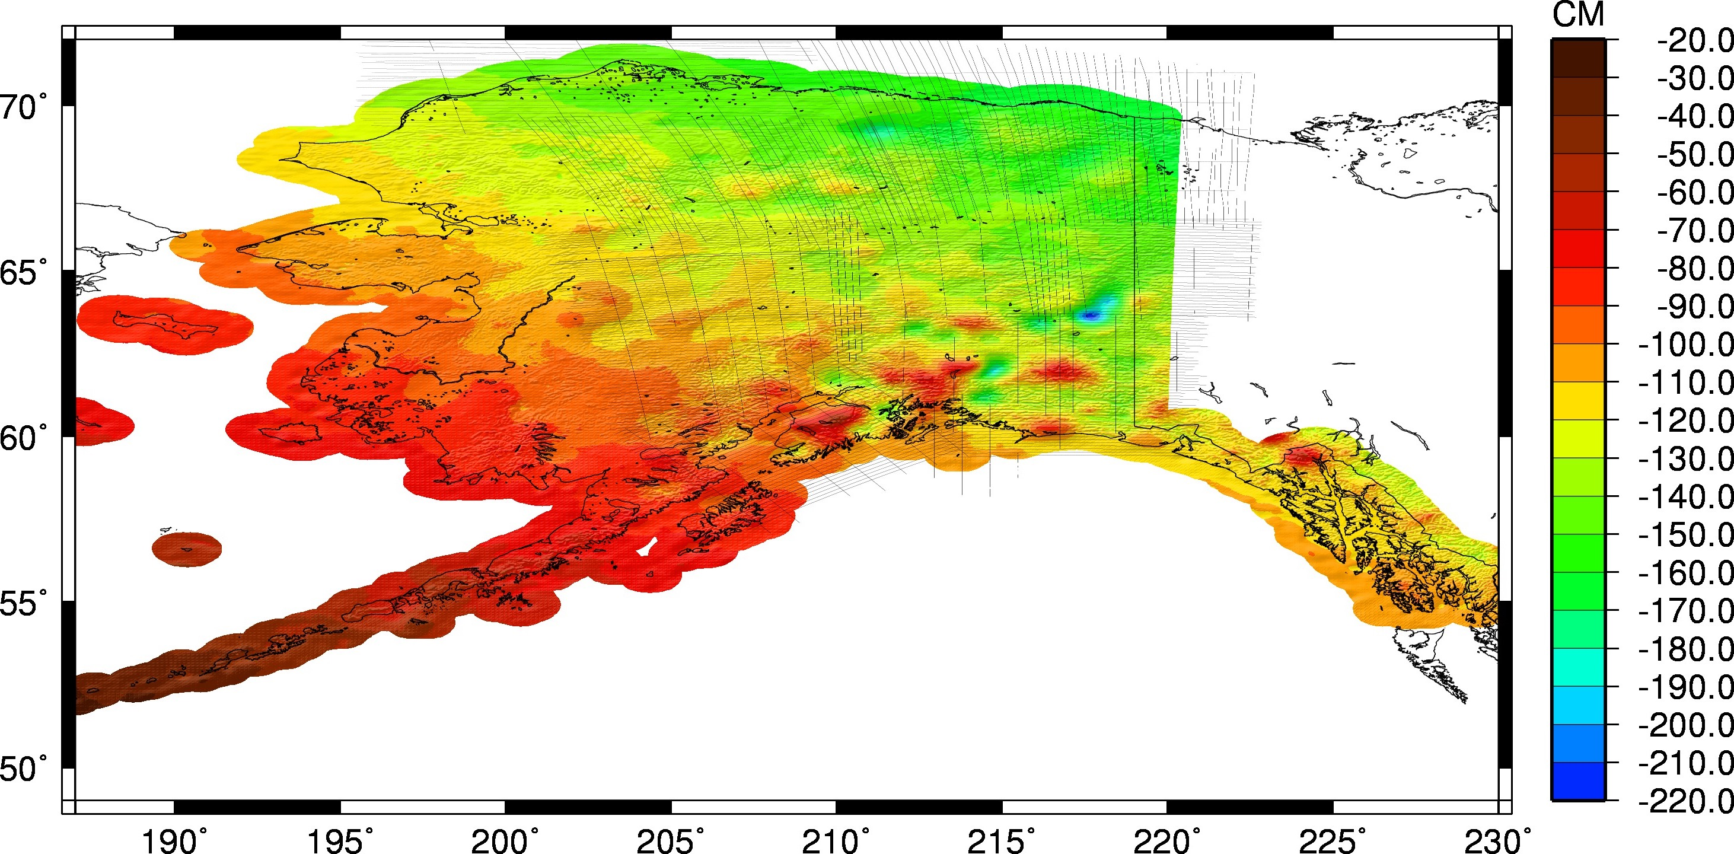
Geoid in Alaska
Current Experimental Geoid Compared to Hybrid Geoid: Hybrid Geoid12B - xGeoid16B
HYBRID → GRAVIMETRIC
Notes:
This is the big change plot!! Going from the hybrid Geoid12B to the most recent experimental geoid. Huge change, 2 meters with a lot of areas between 0.8 and 1.7 meters.

Slide 9
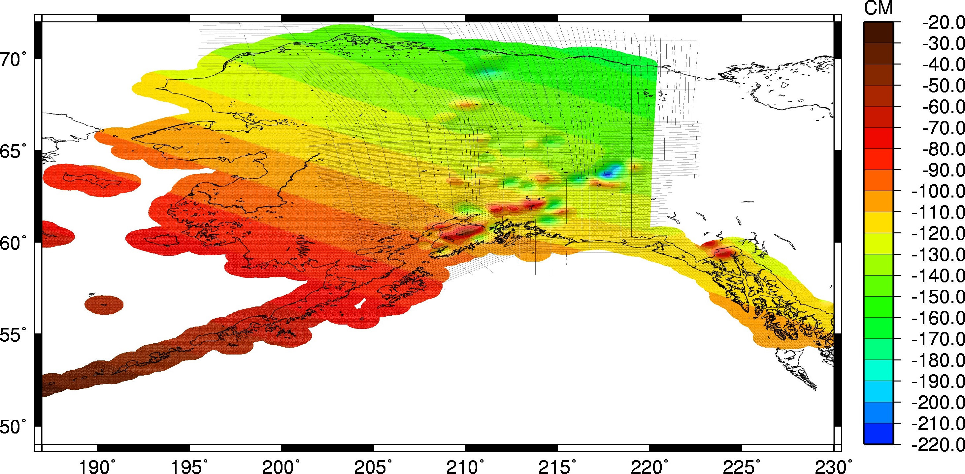
Geoid in Alaska
Current Gravimetric Geoid Compared to Hybrid Geoid: Hybrid Geoid12B - USGG2012
HYBRID vs. GRAVIMETRIC
Notes:
Why do we use the hybrid geoid? To reference heights relative to NAVD88. The points that tie the gravimetric geoid to NAVD88 are the GPS on leveling points, which is why there is a GPS on Benchmark campaign to improve the hybrid geoid until 2022. Once we replace the vertical datum so that it is based on a pure gravimetric geoid this will no longer be an issue.

Slide 10
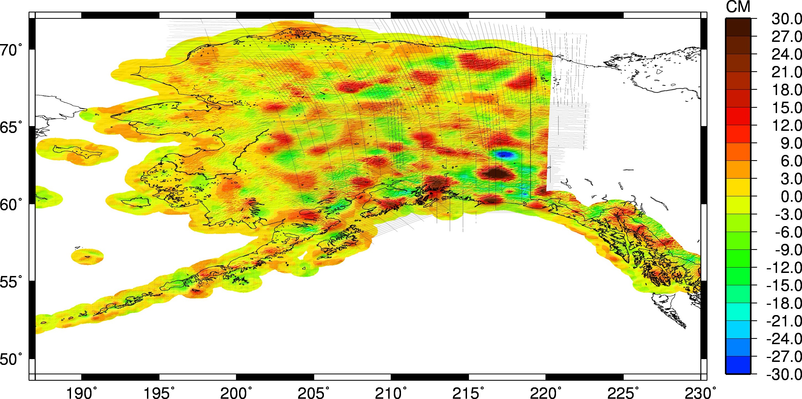
Geoid in Alaska
Current Experimental Geoid Compared to Gravimetric Geoid: xGeoid16B – USGG12
GRAVIMETRIC REFINEMENT
Notes:
Shows the information being added gravimetrically to the 2012 GRAVIMETRIC GEOID model.

Slide 11
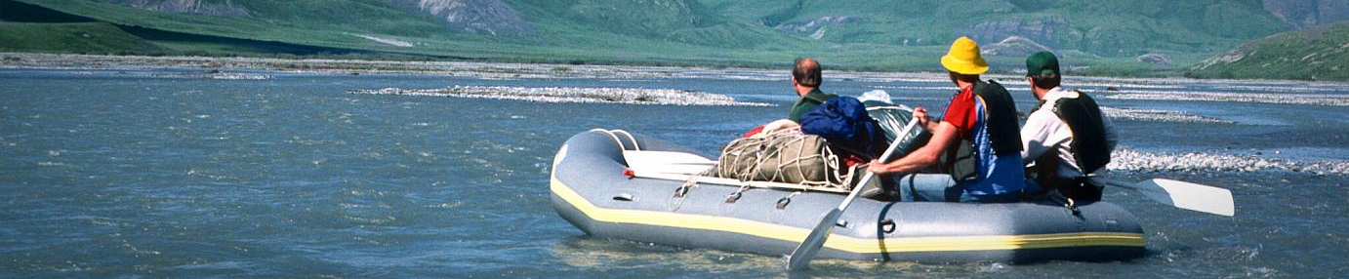
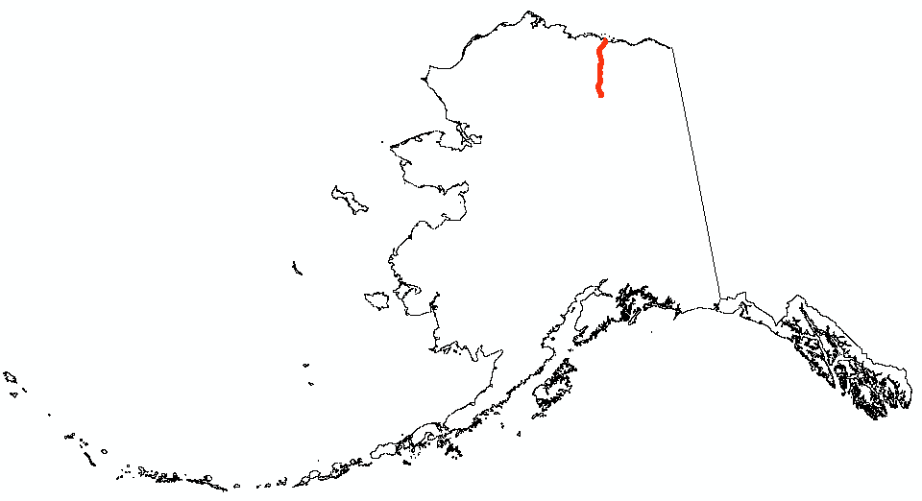
Sagavanirktok River
image from Alaska.org
Geoid12B
xGeoid16B
*hybrid
Notes:
Note:
Virtual float down the Sag river w/ a GNSS = different ortho. heights depending on the geoid used.
Sag River is on the North ‘slope’ of Alaska; flows north from its source in the Brooks range 305 km to the Beaufort Sea.
Note differences between absolute hts. of gravimetric (x16B & 99) vs. hybrid (06, 09, 12B), with gravimetric the river mouth is at ~0 m (xG16B) but with hybrid, river mouth is at 1.45 m at confluence with the ocean (this is not a societally-relevant ht.)
Also note in the low-grade portion near the mouth of the river (km 297-301; I will sample this at higher res. for the paper) that the river appears to flow “UP GRADE’ when the geoid 12B is used to obtain ortho hts., but properly flows downhill with xGeoid16B
**I’ll make much better plots for our paper!**

Slide 12
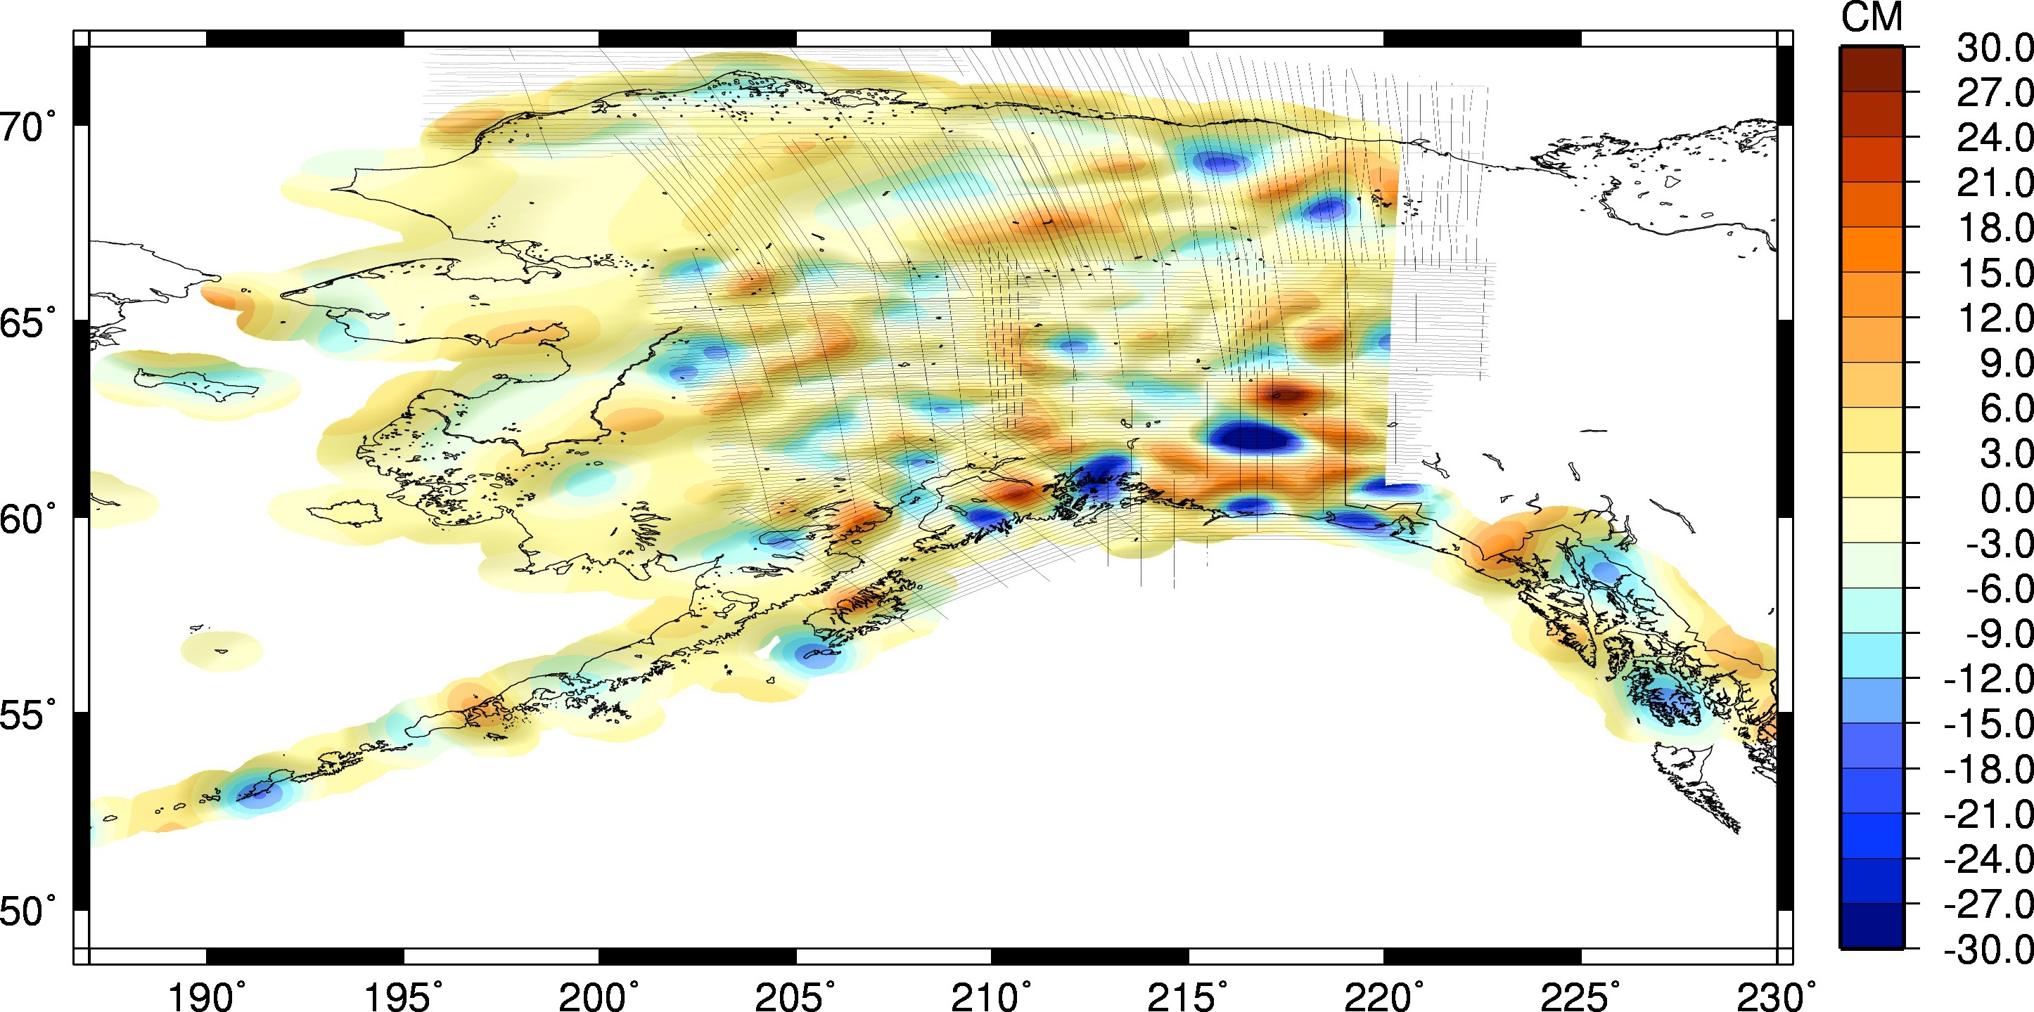
Geoid in Alaska
With Airborne Gravity Comparison to EGM2008: xGeoid16B – EGM2008
(last 10 years)
+
CONTRIBUTION
Notes:
Updates from GOCE and airborne, additional correction being provided by airborne gravity.
THIS SHOWS THE EXTENT TO WHICH THE 2 NEW DATASETS FROM THE LAST 10 YEARS (GOCE AND GRAV-D) HAVE CHANGED THE GEOID MODEL.

Slide 13
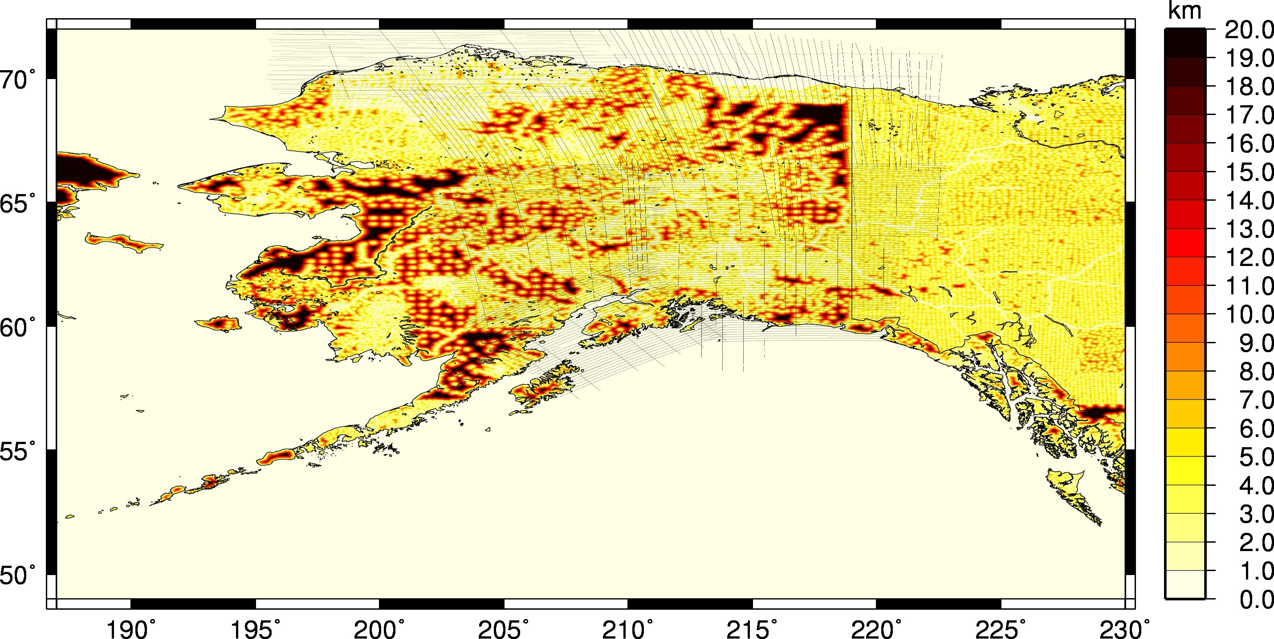
Geoid in Alaska
Distance to Terrestrial Gravity Data Used in EGM2008

Slide 14
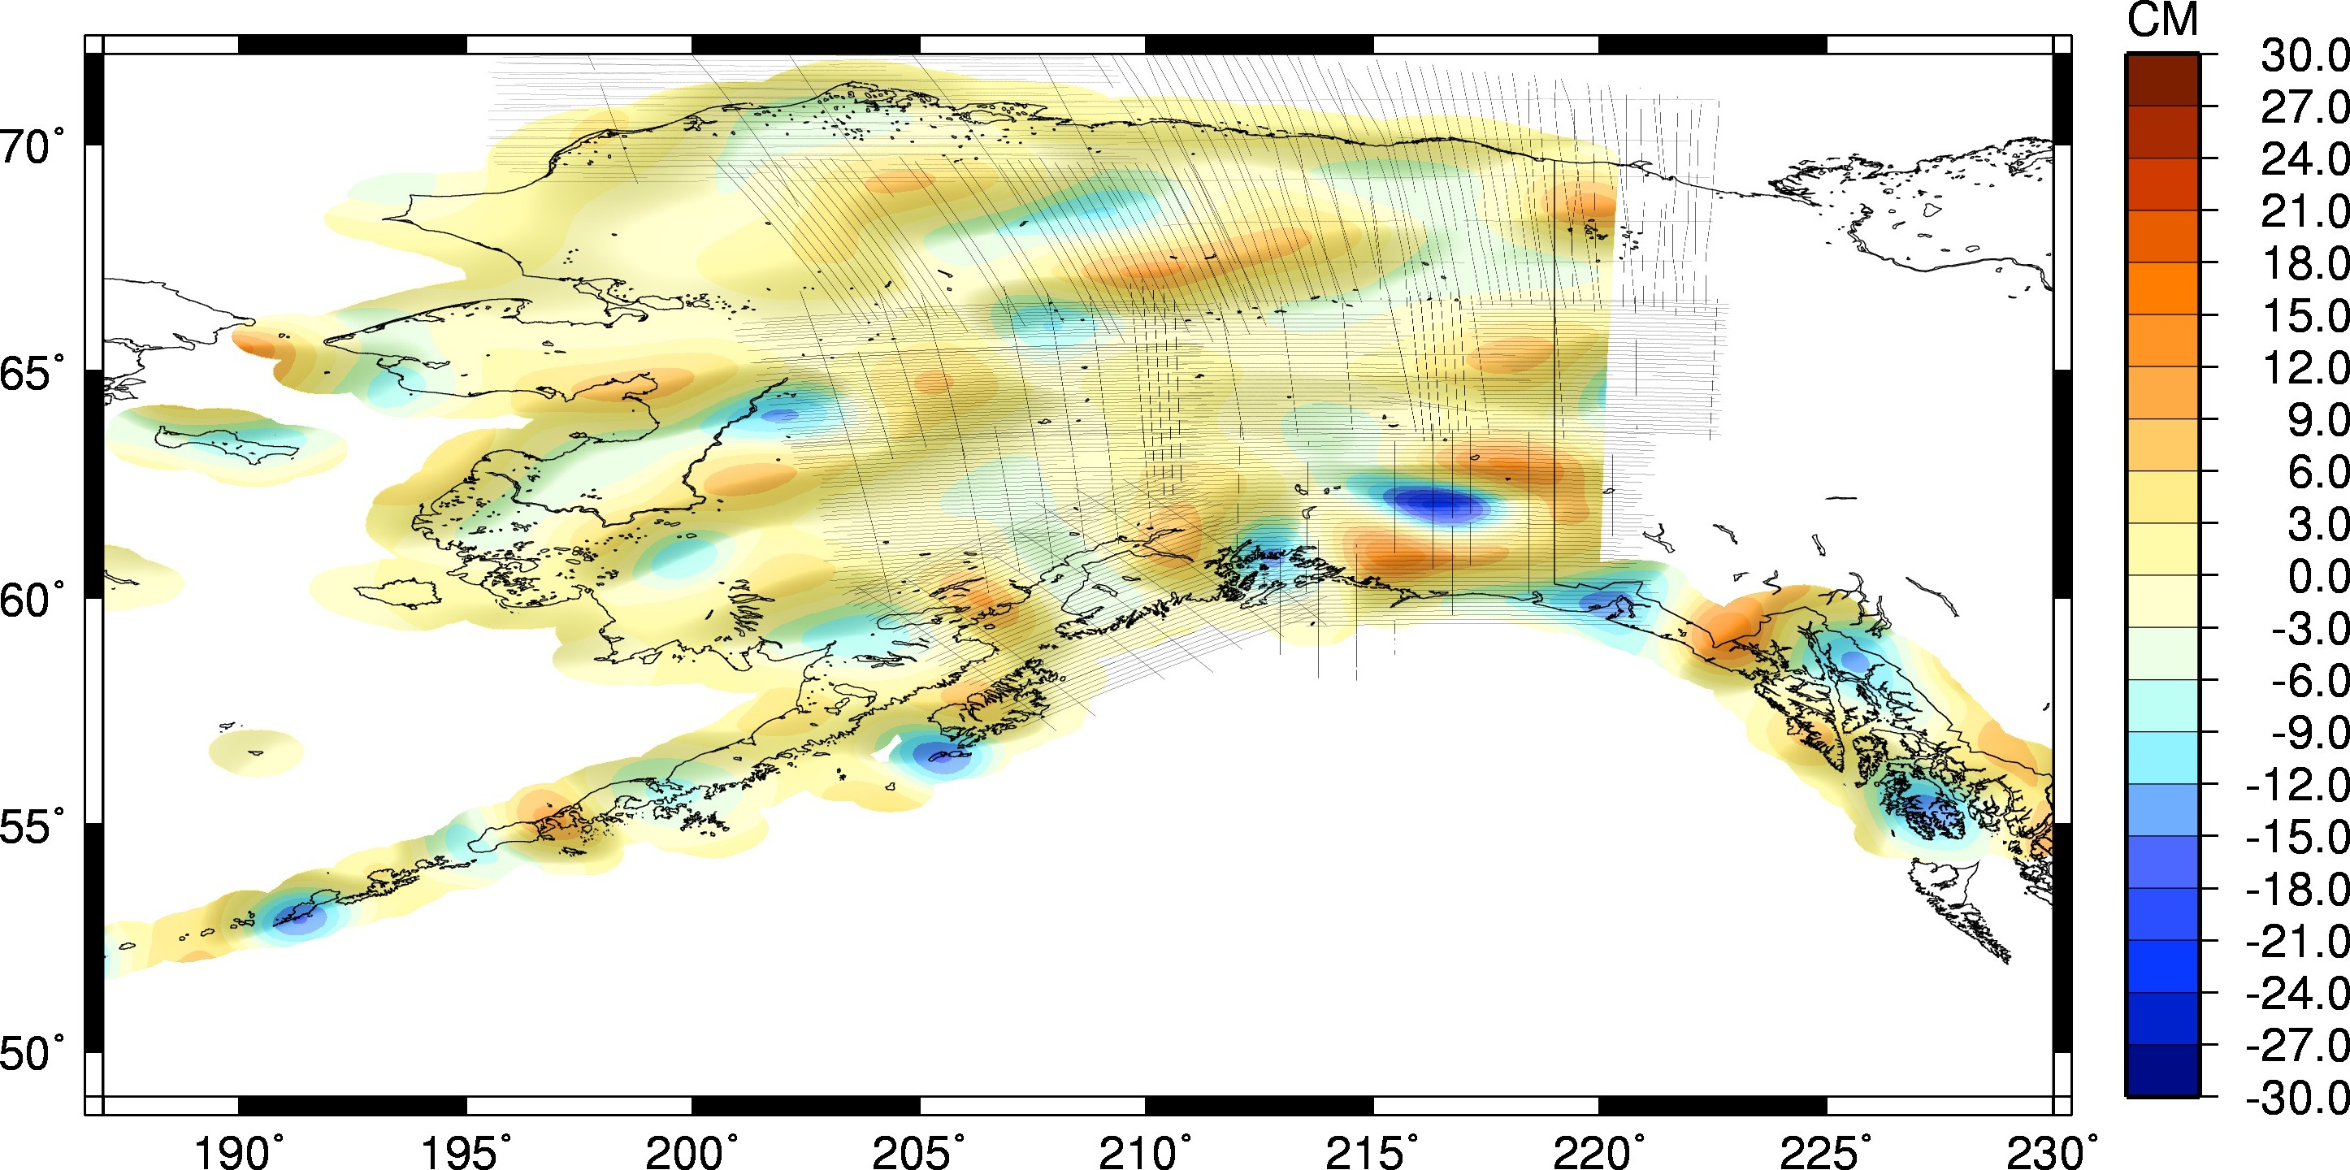
Geoid in Alaska
Contribution of Satellite Gravity Improvements: xGeoid16A – EGM2008
(last 10 years)
CONTRIBUTION
Notes:
Extent to which new GOCE information is updating the geoid – EGM2008 had GRACE in it, but not GOCE. Extent to which GRACE and terrestrial data were wrong.
EXTENT TO WHICH GRACE AND TERRESTRIAL DATA WERE WRONG AT LOW RESOLUTIONS (LONG WAVELENGTH) PART OF THE SPECTRUM.

Slide 15
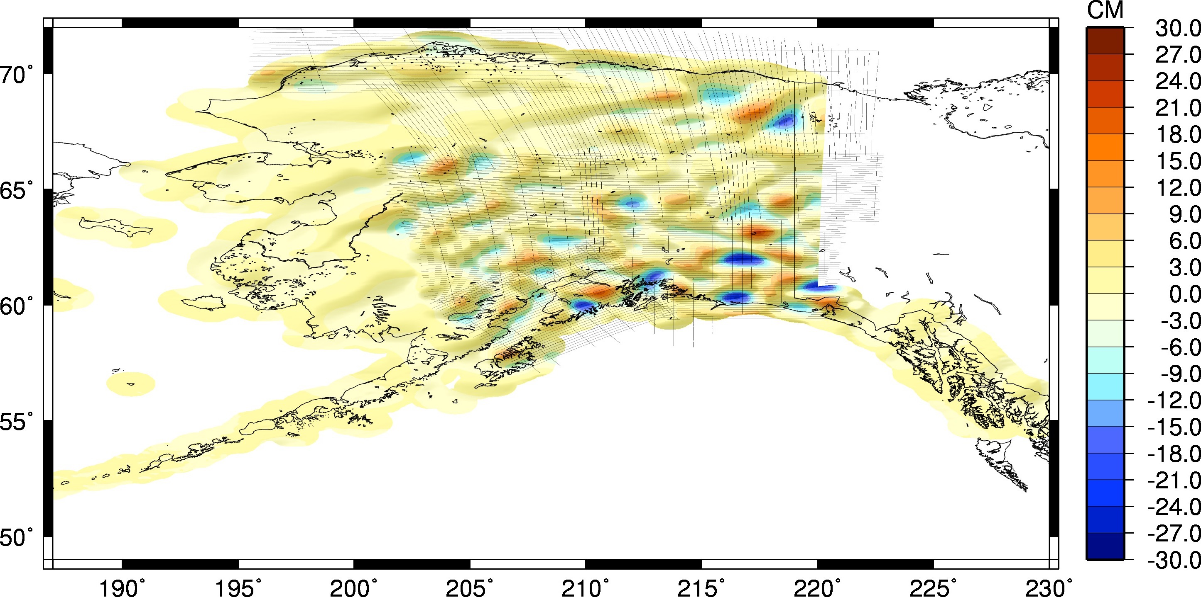
Geoid in Alaska
Contribution of Airborne Gravity (GRAV-D): xGeoid16B - xGeoid16A
CONTRIBUTION
Notes:
EXTENT TO WHICH JUST GRAV-D DATA HAS CHANGED THE GEOID MODEL. THESE ARE MEDIUM-RESOLUTION CHANGES THAT LIE IMMEDIATELY BEYOND THE RESOLUTION OF THE GOCO05S SATGRAV MODEL.

Slide 16
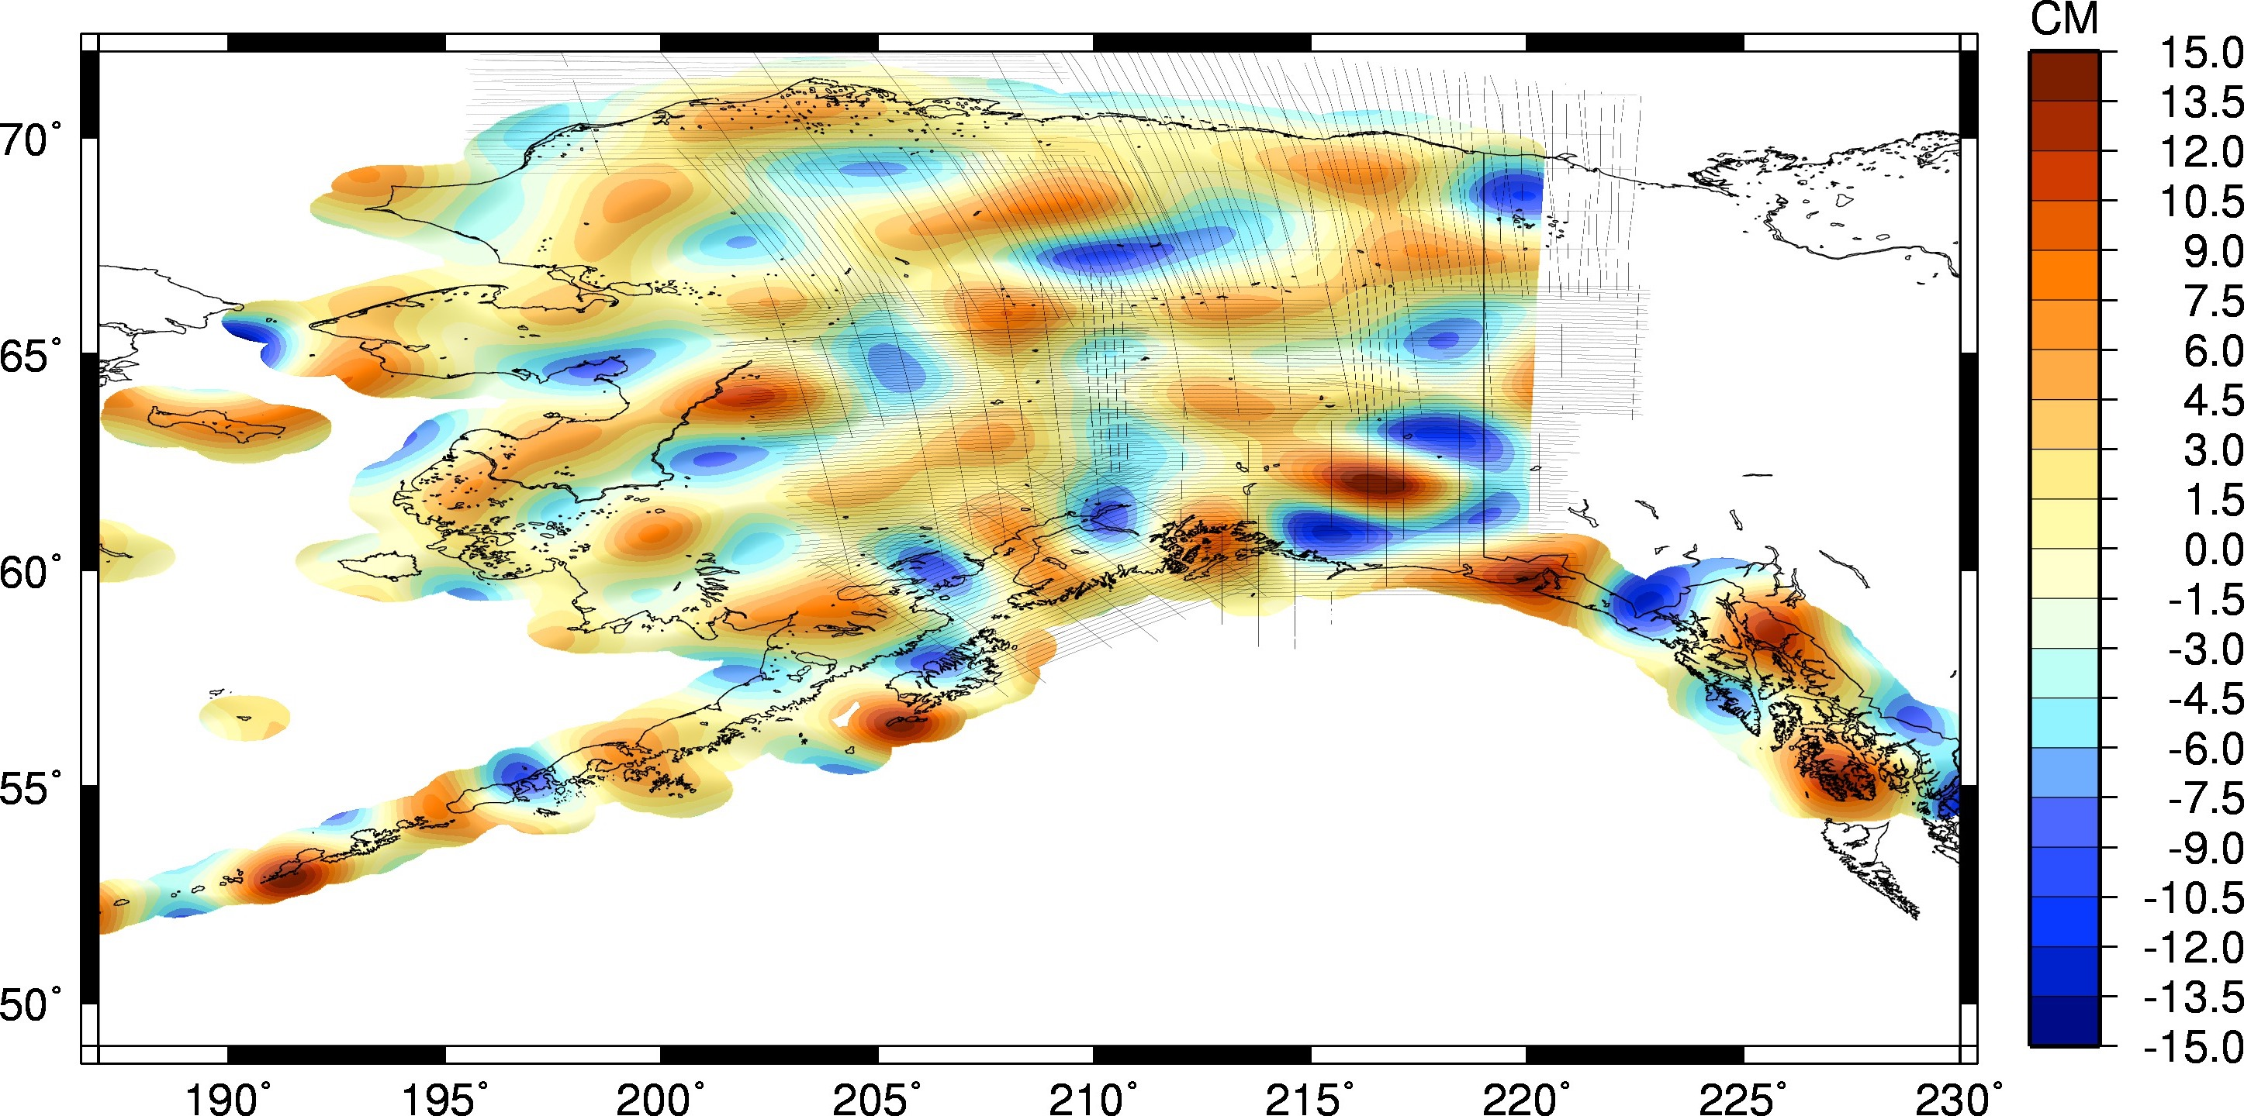
Geoid in Alaska
EGM2008 to Satellite: EGM2008 – GOCE
(last 10 years)
Notes:
EGM2008 VS GOCO05S IN THE LONG WAVELENGTHS. AT THIS RESOLUTIUON GOCO05S HAS VERY LITTLE ERROR, SO MOST OF THIS IS ERROR IN EGM2008.

Slide 17
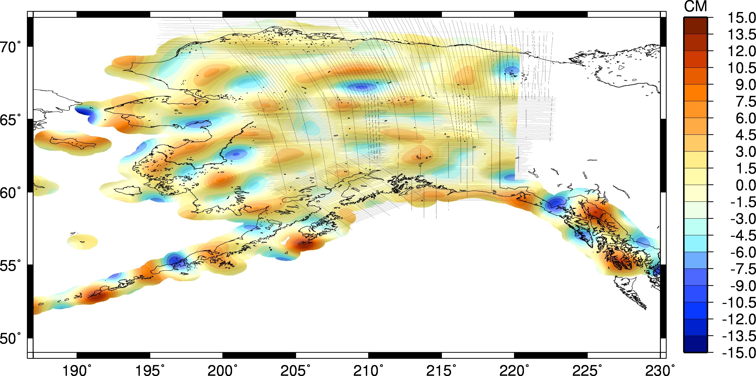
Geoid in Alaska
Current Experimental Geoid to Satellite: xGeoid16B – GOCE
Notes:
Airborne data helping in GOCE band, definitely helping in adjacent bands where GOCE doesn’t help. Large wavelength features remaining are some errors in GOCE and some in airborne.
(EGM2008 UPDATED WITH GRAV-D AIRBORNE) VS GOCO05S. GRAV-D SHOWS MUCH BETTER MATCH TO GOCO05S. THIS IMPROVEMENT ALSO EXPECTED AT ADJACENT HIGHER RESOLUTIONS WHERE GOCO)5S CAN’T HELP US. GOOD NEWS FOR GEOID IMPROVEMENT.

Slide 18
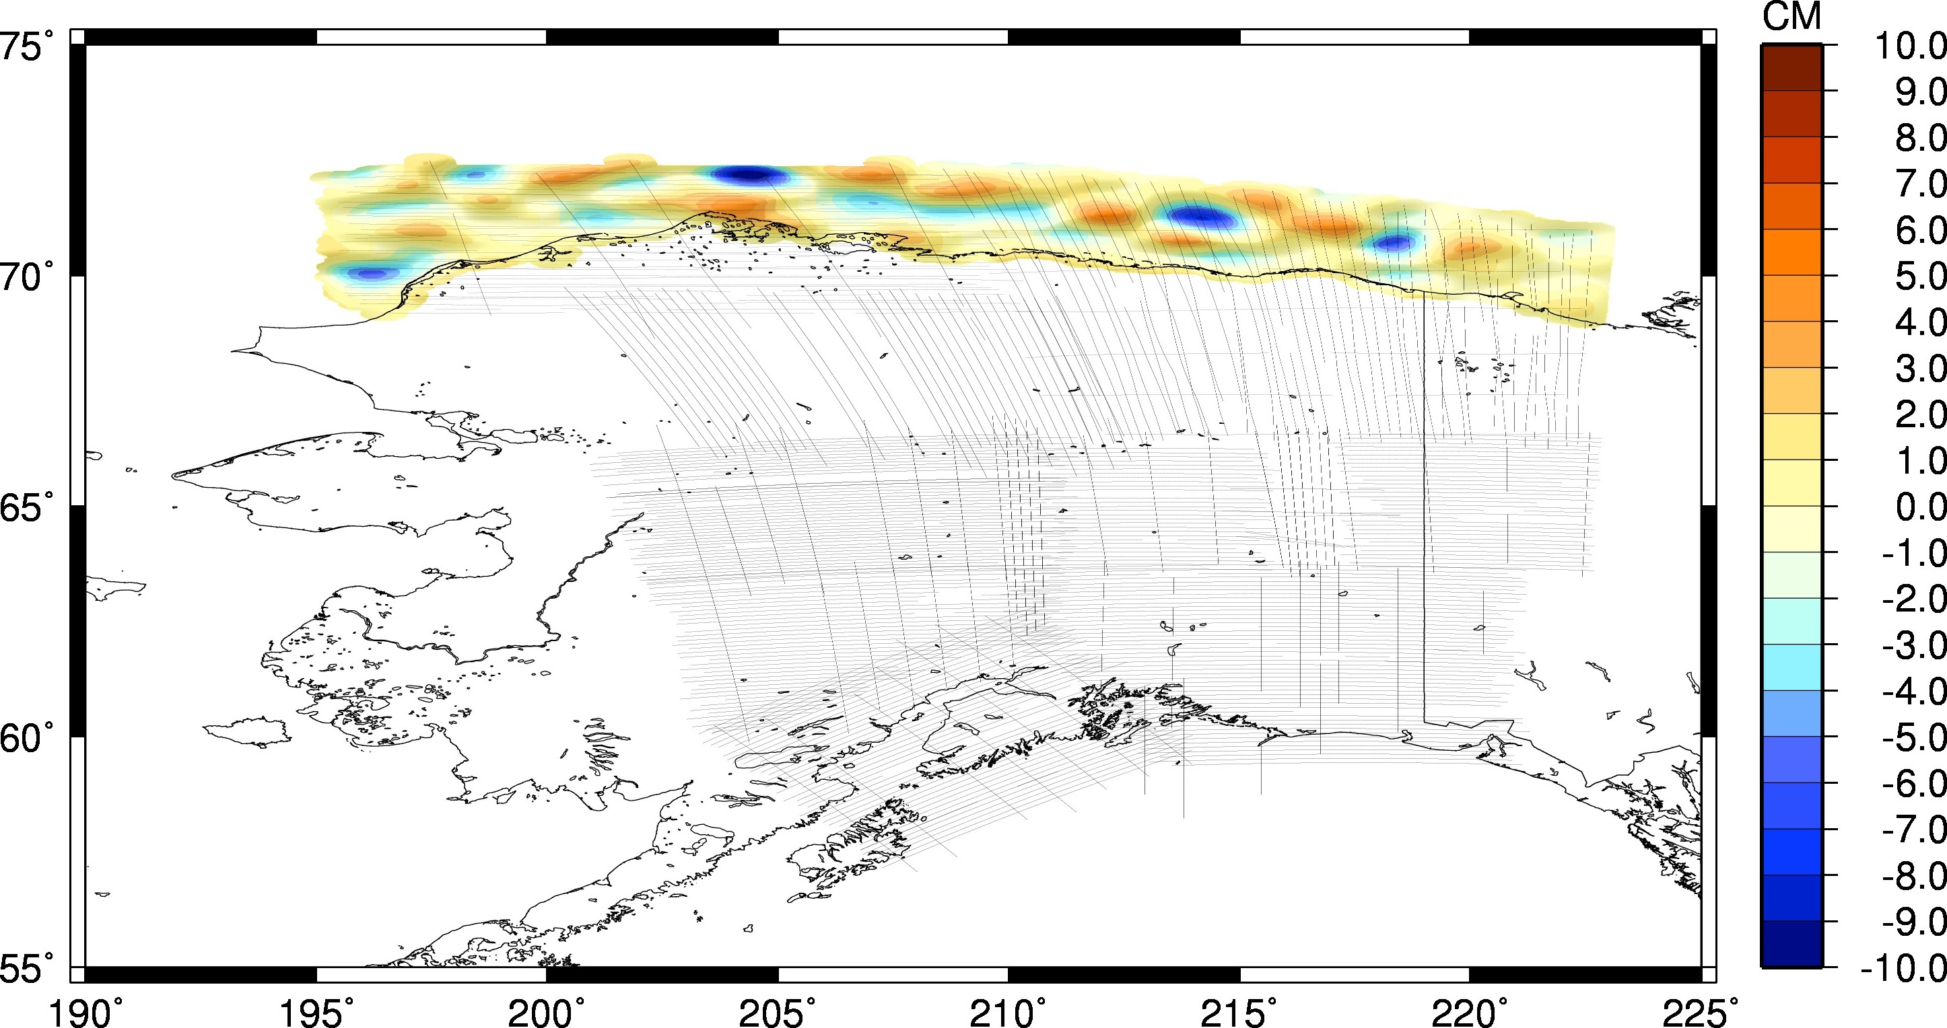
Geoid in Alaska
Contribution of Airborne Gravity: GRAV-D – EGM2008
Notes:
All geoid information we will get from the airborne versus the same bandwidth from

Slide 19

Geoid in Alaska
Difference between: EGM2008 – NGA ArcGP

Slide 20
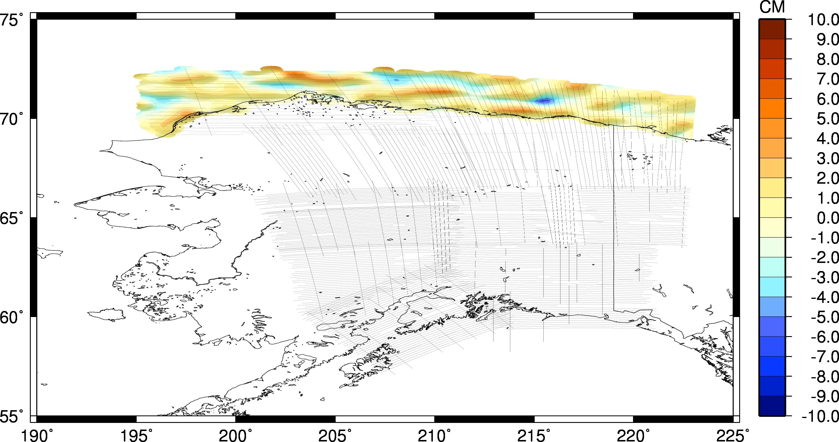
Geoid in Alaska
Current Experimental Geoid Compared to Shipborne Gravity: GRAV-D – NGA ArcGP

Slide 21
Geoid in Alaska
Current Experimental Geoid Compared to Hybrid Geoid: xGeoid16B – Hybrid Geoid12B
HYBRID → GRAVIMETRIC
Notes:
This is the big change plot!! Going from the hybrid Geoid12B to the most recent experimental geoid. Huge change, 2 meters with a lot of areas between 0.8 and 1.7 meters.

