Slide 1



Update on GRAV-D and
Progress toward a New Vertical Datum
October 11, 2023
Dan Martin
Northeast Regional Geodetic Advisor
ME, NH, VT, MA, CT, RI, NY, NJ
Dan.martin@noaa.gov
240-676-4762

Slide 2
U.S. Department of Commerce
National Oceanic & Atmospheric Administration
National Geodetic Survey
Mission: To define, maintain & provide access to the
National Spatial Reference System (NSRS)
to meet our Nation’s economic, social & environmental needs
National Spatial Reference System
& their time variations
      Latitude
      Longitude
      Height
  Scale
  Gravity
  Orientation
Notes:
- NSRS benefit to the nation = $2.5B/year
est. 300K precision GPS users worldwide (2008); ¼ in US
- Very exciting to us at NGS to see how it has evolved over the years – now cm-accuracy capability / tracking with time

Slide 3
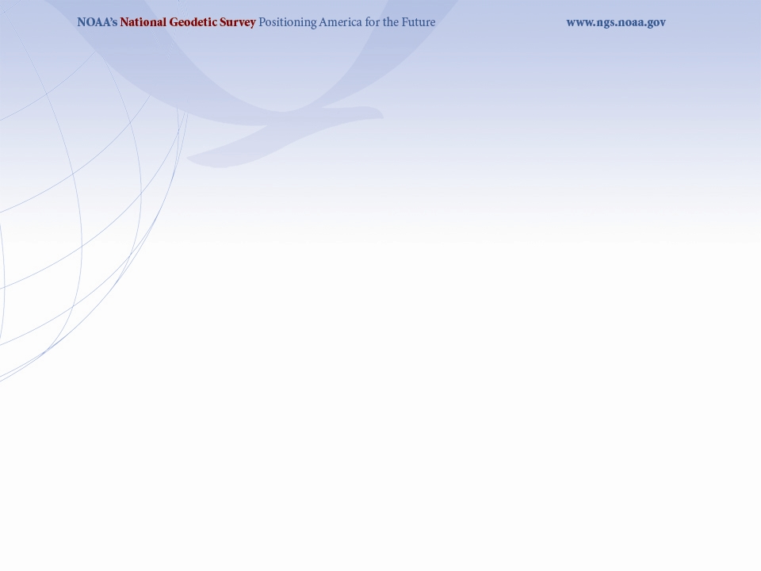
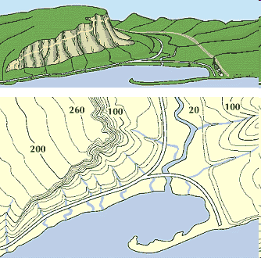
What is a Vertical Datum?
Strictly speaking, a vertical datum is a surface representing zero elevation
Traditionally, a vertical datum is a system for the determination of heights above a zero elevation surface
Vertical datum comprised of:
  Its definition: Parameters and other descriptors
  Its realization: Its physical method of accessibility
"topographic map." Online Art.
Britannica Student Encyclopædia.
17 Dec. 2008
<http://student.britannica.com/ebi/art-53199>

Slide 4
History of vertical datums in the USA
NGVD 29
  National Geodetic Vertical Datum of 1929
  Original name: “Sea Level Datum of 1929”
  “Zero height” held fixed at 26 tide gauges
    Not all on the same tidal datum epoch (~ 19 yrs)
  Did not account for Local Mean Sea Level variations from the geoid
    Thus, not truly a “geoid based” datum

Slide 5
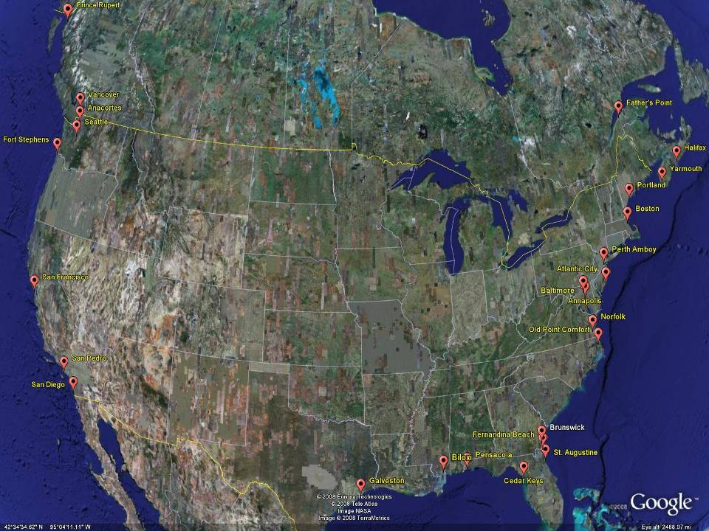
NGVD29
The National Geodetic Vertical Datum of 1929 is referenced to 26 tide gauges in the US and Canada
Notes:
It turns out that MSL is a close approximation to another surface, defined by gravity, called the geoid, which is the true zero surface for measuring elevations. Because we cannot directly see the geoid surface, we cannot actually measure the heights above or below the geoid surface. We must infer where this surface is by making gravity measurements and by modeling it mathematically. For practical purposes, we assume that at the coastline the geoid and the MSL surfaces are essentially the same. Nevertheless, as we move inland we measure heights relative to the zero height at the coast, which in effect means relative to MSL.
Definition: NGVD29 – The National Geodetic Vertical Datum of 1929…
The Sea Level Datum of 1929 was the vertical control datum established for vertical control surveying in the United States of America by the General Adjustment of 1929. The datum was used to measure elevation or altitude above, and depression or depth below, mean sea level (MSL).
Mean sea level was measured at 26 tide gauges: 21 in the United States and 5 in Canada. The datum was defined by the observed heights of mean sea level at the 26 tide gauges and by the set of elevations of all bench marks resulting from the adjustment. The adjustment required a total of 66,315 miles (106,724 km) of leveling with 246 closed circuits and 25 circuits at sea level.
Since the Sea Level Datum of 1929 was a hybrid model, it was not a pure model of mean sea level, the geoid, or any other equipotential surface. Therefore, it was renamed the National Geodetic Vertical Datum of 1929 (NGVD 29) in 1973. The NGVD 29 was subsequently replaced by the North American Vertical Datum of 1988 (NAVD 88) based upon the General Adjustment of the North American Datum of 1988.

Slide 6
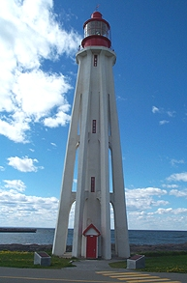
Current Vertical Datum in the USA
NAVD 88: North American Vertical Datum of 1988
Definition: The surface of equal gravity potential to which orthometric heights shall refer in North America*, and which is 6.271 meters (along the plumb line) below the geodetic mark at “Father Point/Rimouski” (NGSIDB PID TY5255).
Realization: Over 500,000 geodetic marks across North America with published Helmert orthometric heights, most of which were originally computed from a minimally constrained adjustment of leveling and gravity data, holding the geopotential value at “Father Point/Rimouski” fixed.
Father Point Lighthouse, Quebec
*Not adopted in Canada
Notes:
By fixing the geopotential value at the origin point, it was possible to ensure that the origins of IGLD 85 and NAVD 88 aligned.
*It should be pointed out that while the datum was defined in such a way as to be usable on the North American continent, it was never actually adopted in Canada. It can be used there, but it’s not their official civilian datum.
Note that the designation of the vertical control point at Father Point is “1250 G=NAVD 88 DATUM POINT” for PID# TY5255 and is not available from the publicly accessible NGSIDB.

Slide 7
History of vertical datums in the USA
NAVD 88
  North American Vertical Datum of 1988
  One height held fixed at “Father Point” (Rimouski, Canada)
  …height chosen was to minimize 1929/1988 differences on USGS topo maps in the eastern U.S.
  Thus, the “zero height surface” of NAVD 88 wasn’t chosen for its closeness to the geoid (but it was close…few decimeters)

Slide 8
History of vertical datums in the USA
NAVD 88 (continued)
  Use of one fixed height removed local sea level variation problem of NGVD 29
  Use of one fixed height did open the possibility of unconstrained cross-continent error build up
  But the H=0 surface of NAVD 88 was supposed to be parallel to the geoid…(close again)

Slide 9
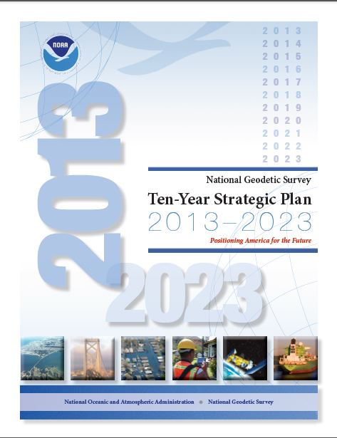
The National Geodetic Survey 10 year plan
Mission, Vision and Strategy
2008 – 2018
http://www.ngs.noaa.gov/INFO/NGS10yearplan.pdf
Official NGS policy as of Jan 9, 2008
  Modernized agency
  Attention to accuracy
  Attention to time-changes
  Improved products and services
  Integration with other fed missions
2022 Targets:
  NAD 83 and NAVD 88 re-defined
  Cm-accuracy access to all coordinates
  Customer-focused agency
  Global scientific leadership
Notes:
Realization and unification of NAD83 in Canada and the U.S. via the ITRF.
http://www.geod.nrcan.gc.ca > Geodetic Survey Division > Publications > Papers

Slide 10
Names
  The Old:
  NAVD 88
  PRVD 02
  VIVD09
  ASVD02
  NMVD03
  GUVD04
  IGLD 85
  IGSN71
  GEOID12B
  DEFLEC12B
Orthometric
Heights
  The New:
  The North American-Pacific Geopotential Datum of 2022 (NAPGD2022)
  - Will include GEOID2022
Normal
Orthometric
Heights
Dynamic
Heights
Gravity
Geoid
Undulations
Deflections of
the Vertical

Slide 11
NAVD 88 is not alone
NAVD 88 North American Vertical Datum of 1988
PRVD02 Puerto Rico Vertical Datum of 2002
ASVD02 American Samoa Vertical Datum of 2002
NMVD03 Northern Marianas Vertical Datum of 2003, 3 each
GUVD04 Guam Vertical Datum of 2004
VIVD09 Virgin Islands Vertical Datum of 2009, 3 each
Hawaii … Hawaiian Islands Vertical Datum (coming soon)
various local datums, as national datum is inaccessible
IGLD 85 International Great Lakes Datum of 1985
IGSN71 gravity dataset
GEOID12B geoid undulations
DEFLEC12B deflection of the vertical
one vertical datum
pole-to-equator

Slide 12
Error in NAVD 88 Orthometric Height (H)
The distance along the plumb line from the geoid up to the point of interest
Earth’s
Surface
H (NAVD 88)
H
NAVD 88 reference level
The Geoid
Errors in NAVD 88 : ~50 cm average,
100 cm CONUS tilt,
1-2 meters average in Alaska
NO tracking

Slide 13
Why isn’t NAVD 88 good
enough anymore
NAVD 88 suffers from use of bench marks that:
  Are almost never re-checked for movement
  Disappear by the thousands every year
  Are not funded for replacement
  Are not necessarily in convenient places
  Don’t exist in most of Alaska
  Weren’t adopted in Canada
  Were determined by leveling from a single point, allowing cross-country error build up
Notes:
Clarification on the word “convenient” – this is used to mean “there isn’t always a bench mark around when you need one – sometimes you have to find one far away and level from it to your site of interest”

Slide 14
Height Modernization Bottom line
Using GNSS is cheaper, easier than leveling
To use GNSS we need a good geoid model
That model will be independent of physical marks, i.e., not biased/not a hybrid
  Current Geoid Models are intentionally biased to produce NAVD88 Heights

Slide 15
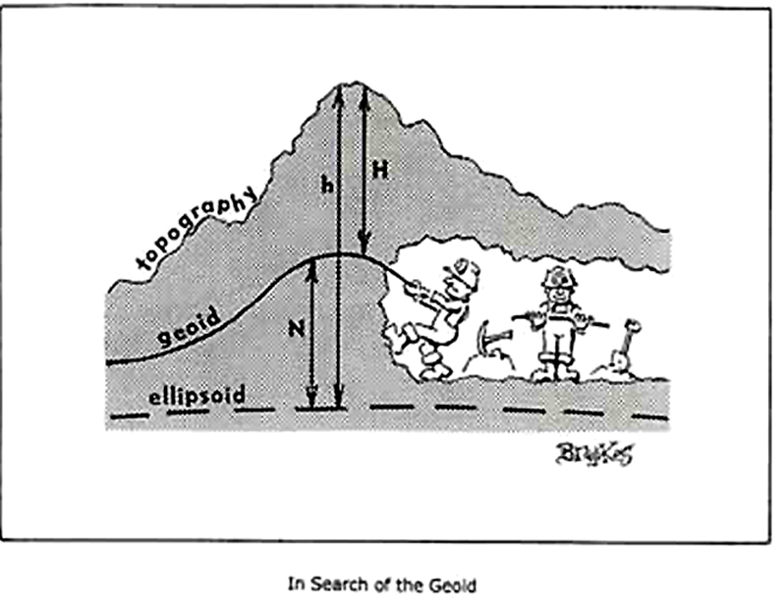

Slide 16
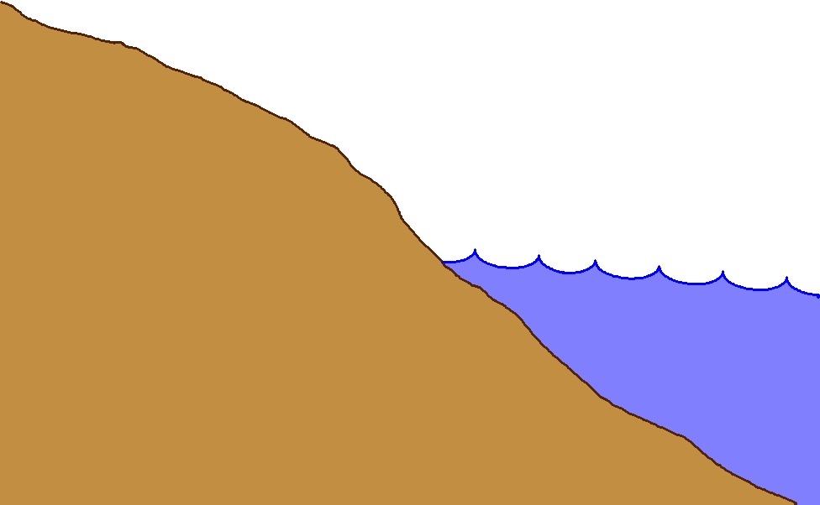
Gravity measurements help answer two big questions…
How “high above
‘sea level’ ” am I?
(FEMA, USACE,
Surveying and
Mapping)
How large are
hydrodynamic processes?
(Coast Survey, CSC,
CZM)
Earth’s
Surface
Geoid
Coast
Ocean
Surface
Ellipsoid
From
Gravity
From
GPS
From
Satellite Altimetry
Notes:
This slide is an idealized situation demonstrating the usefulness of near-shore gravity, specifically the use of such gravity to accurately compute a gravimetric geoid model. (The geoid is the one unique equipotential surface of the Earth’s gravity field which best fits, in a least-squares sense, global mean sea level).
On land, the use of the Global Positioning System (GPS) for fast, accurate surveying is well documented. However the height determined by GPS refers to a highly idealized, mathematically simple surface known as the ellipsoid. Thus GPS heights are “ellipsoid heights”. Unfortunately, ellipsoid heights are non-intuitive in many ways. First, they can be dozens of meters different from heights above the geoid (known as orthometric heights, or more colloquially, but less correctly as “heights above sea level”). Secondly, ellipsoid heights do not give an accurate portrayal of how water will flow, due to their complete disconnect from the gravity field of the Earth. If one has an accurate model of geoid undulations (the separation between the geoid and ellipsoid), then one can take the GPS-derived ellipsoid heights, remove the geoid undulation, and arrive at your orthometric height (a.k.a. “height above sea level”). This is a significantly faster method of determining orthometric heights compared to traditional surveying methods of spirit leveling.
On the ocean, satellite altimetry is used to monitor sea level. However, because the satellite orbits are known relative to the ellipsoid, and the altimetric measurement is from satellite to sea surface, the resulting information is the height of the sea surface above the ellipsoid, often called the “sea surface height” or SSH. If one is interested, however, in the impact of winds, heating, currents and other phenomena on the ocean surface, then one must remove the gravitational impact on the ocean surface. That is, one must know the separation between the ellipsoid and the geoid over the ocean in order to remove this signal, and arrive at the residual value. This residual, the distance from the geoid up to the sea surface, is known by many names, the most common being “sea surface topography” (SST) or “dynamic ocean topography”.
Coastal areas prone to flooding would benefit both by knowing accurate land elevations (to aid in construction planning, floodplain mapping, etc) as well as knowing accurately how the near shore ocean processes work (to better model responses to hurricanes and other dynamic ocean phenomena). It is an unfortunate fact that the largest areas missing accurate gravity measurements are those areas immediately offshore. This is because ships with gravimeters can not get into these shallows, altimetrically derived gravity models are unreliable due to the inability to accurately compute near-shore tides, and terrestrial gravimeters can not measure in the water. The only practical option to collecting the near-shore ocean gravity data is through airborne based technologies.
Dr. Dru A. Smith
Chief Geodesist
NOAA, National Geodetic Survey
Dru.Smith@noaa.gov
1/11/2006

Slide 17
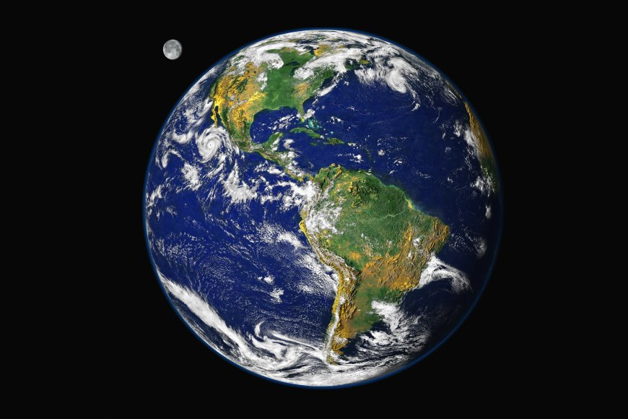
Gravity Field Metaphor
Orbit View
Continent-Scale
Features:
Mountain
Ranges
Deserts
Large Rivers
Coastlines
Large Islands
Not detailed;
Continental
Courtesy of NASA

Slide 18

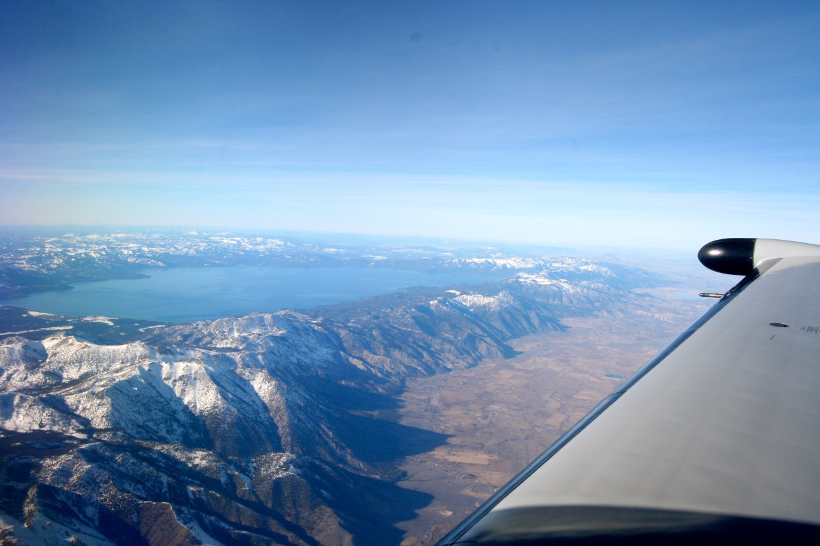
Gravity Field Metaphor
Airplane View
Individual Peaks
Large Lakes
Human Activity
Mountain Ranges
Regional
Denali (Mt. McKinley), AK
Lake Tahoe (CA/NV)

Slide 19
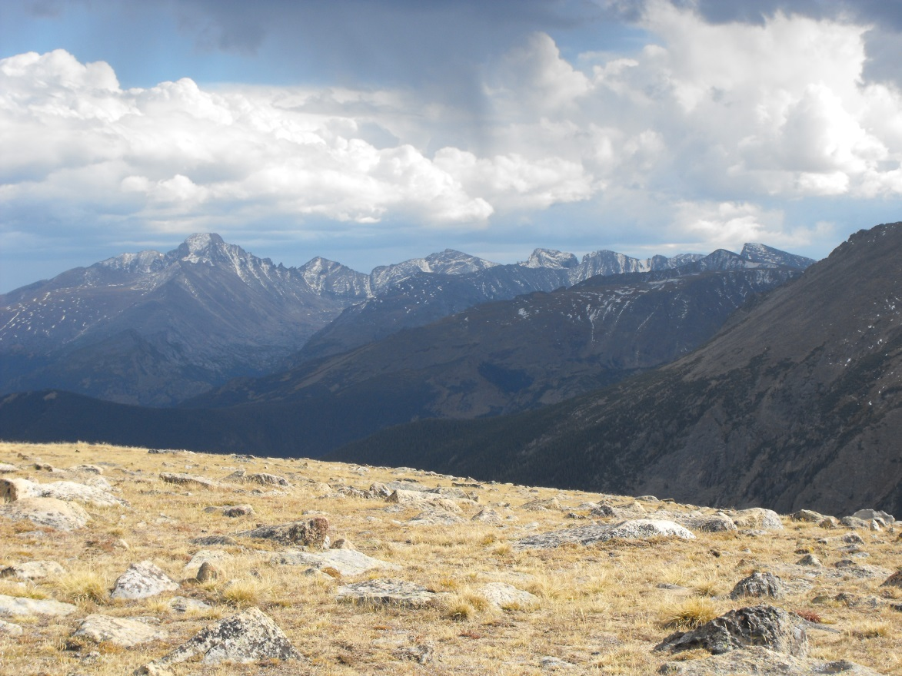
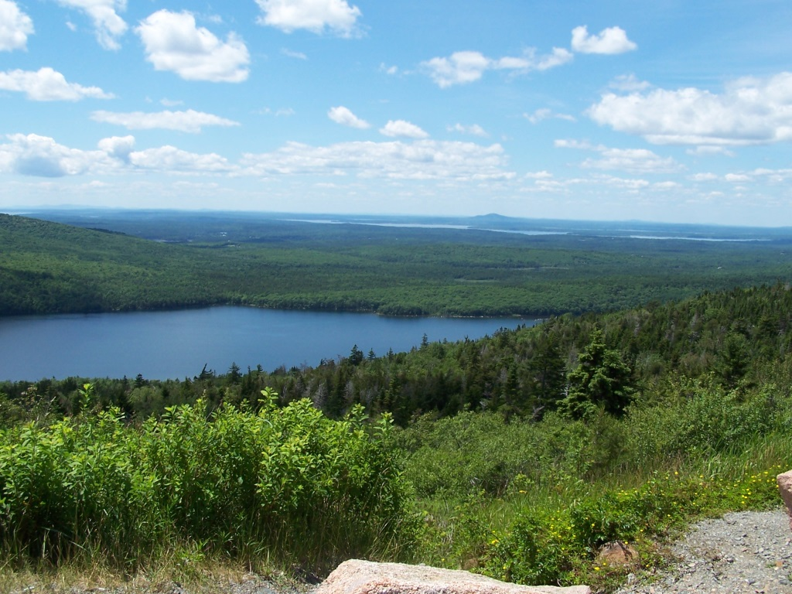
Gravity Field Metaphor
Ground View
Rocks/Boulders
Plants
Mountains, Valleys, Lakes, etc
Local
Rocky Mountain National Park, Colorado
Acadia National Park, Maine

Slide 20
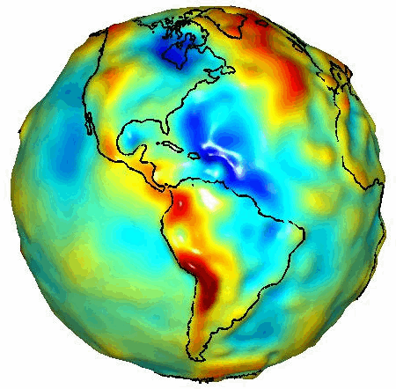
GRACE Gravity Model 01
- Released July 2003
Image credit:
University of Texas Center
for Space Research and NASA
Notes:
To fully appreciate the reasoning for many of strict requirements for geodetic leveling we must begin with understanding what are orthometric heights.
A realistic “view” of our very irregular shaped Earth as depicted in this gravity model determined from space borne gravity measurements by GRACE, gravity recovery and climate experiment.
Every time we set up and plumb our level equipment we are then determining our horizon through the optics of the instrument perpendicular to the attraction of gravity at that point. Now, envision about 26 setups per mile and hundreds and thousands of setups over distances covering a County, each perpendicular to the attraction at that point on our irregular shaped, curved Earth and you can begin to get the feeling that leveling must be much more than a “simple” routine of backsights minus foresights.

Slide 21
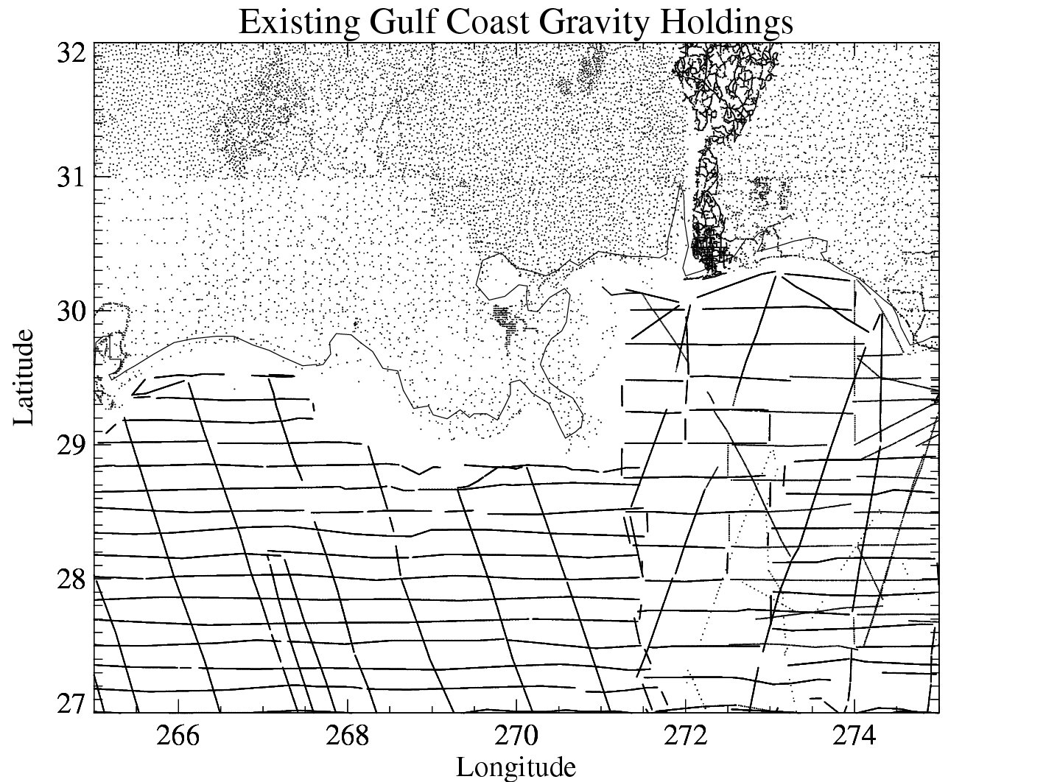
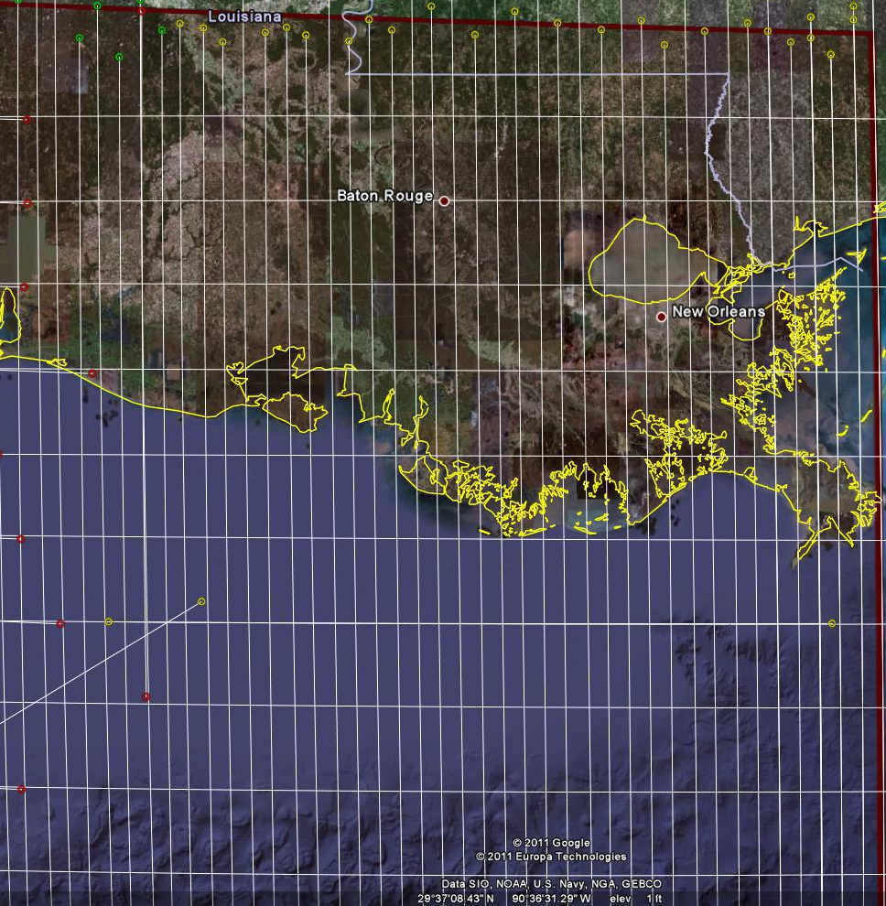
Problems with Gravity Holdings
Terrestrial gravity
20-100 km gravity gaps along coast
Field is not sampled uniformly
Data range in age and quality, some w/o metadata
Some surveys have systematic errors
Data gaps in littoral areas
Ship gravity
New Orleans

Slide 22
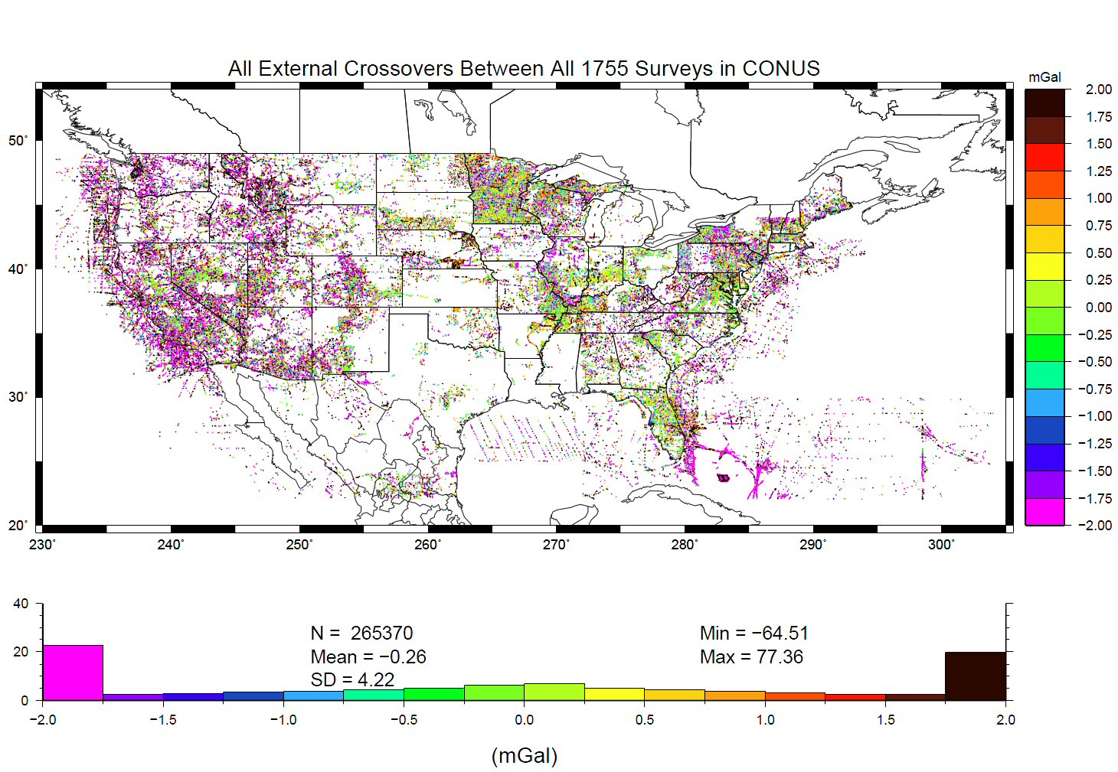
Problems with Gravity Holdings
Decades of gravity surveys are inconsistent with one another
Airborne gravity will provide a baseline for removing these inconsistencies
%
Notes:
This slide shows “crossovers” between any of the 1755 terrestrial gravity surveys which NGS holds in its database. These are
basically mismatches between surveys that overlap one another, plotted at the point of overlap. Note that the color bar
is +/- 2 mGals, and how many surveys disagree with one another at that level. GRAV-D flights should yield about 2 mGal
accuracy surveys, and help reduce the level of disagreement to that range.
The vertical axis of the lower plot is “Percent of points with this level of crossover error” So while it is bell-shaped around -0.26 mGals, the “wings” at the >+2 or <-2 range contain a good 45-50% of all crossovers.
Added October 2010.

Slide 23
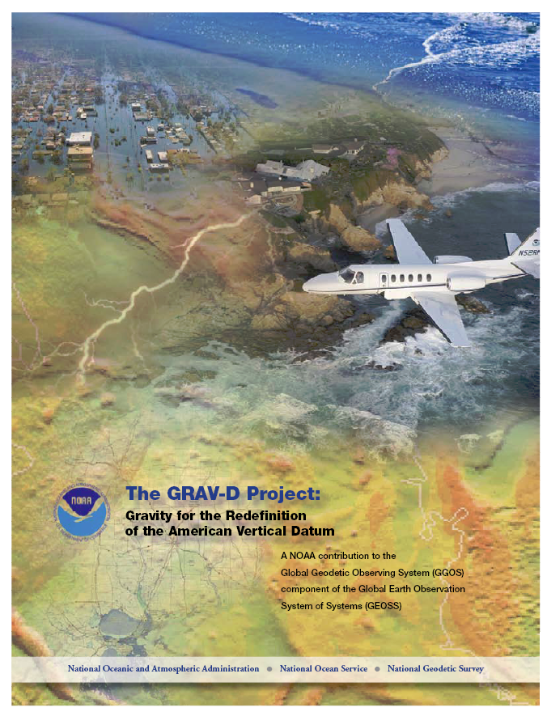
GRAV-D Project Overview
Overall Target: 2 cm accuracy orthometric heights from GNSS and a geoid model
GRAV-D Goal: Create gravimetric geoid accurate to 1 cm where possible using airborne gravity data
GRAV-D: Two thrusts of the project
  Airborne gravity survey of entire country and its holdings
  Long-term monitoring of geoid change
Leveraging partnerships to improve and validate gravity data
Notes:
Target is to be able to achieve 2 cm accuracy orthometric heights (where possible) using a GNSS receiver and a geoid model
Roughly 1 cm uncertainty from GNSS and 1 cm from the geoid model
GRAV-D
Phase 1: snapshot of the entire country to provide a consistent data set
Phase 2: long term monitoring of geoid change – in development
Work with partners to incorporate additional gravity data, particularly surface gravity data, validate existing data, and monitor change

Slide 24
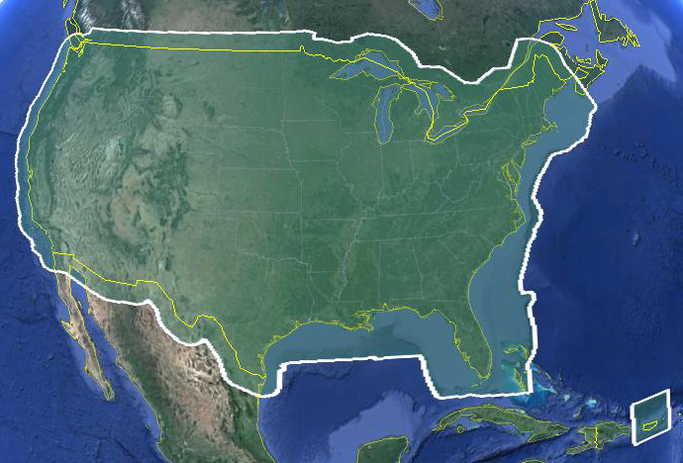
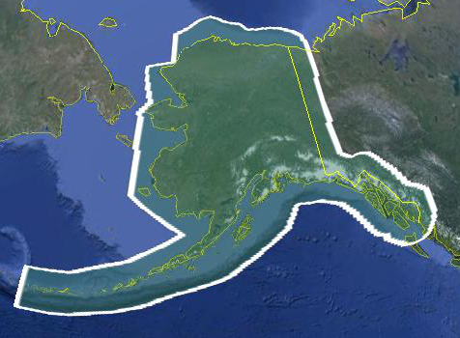
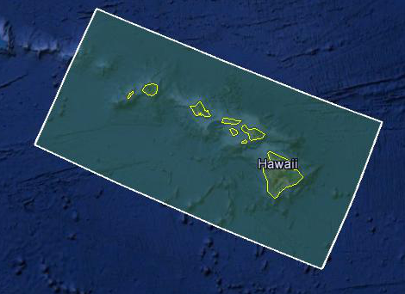
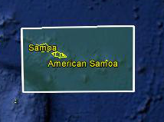
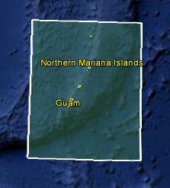
Data Collection Scope
Entire U.S. and territories
  Total Square Kilometers: 15.6 million
  Initial target area for 2022 deadline
  ~200 km buffer around territory or shelf break if possible
Notes:
Project Scope:
Scope of the project: cover roughly 15.6 million square kilometers – contiguous united states, Alaska, Hawaii, Guam, and American Samoa
In order to blend with satellite altimetry data the airborne survey is done to the continental shelf where possible or ~ 200 km beyond the shoreline or border, whichever is further
Deadline of 2022 for datum rollout, which means a target of 2021 to finish the airborne survey
Priority areas were defined as Alaska and coastal areas
Challenges:
Fixed annual budget and time → design of surveys had to fit within an annual budget of $3.5 million and meet the deadline
This was a major factor in setting altitude and line spacing

Slide 25
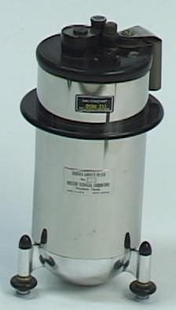
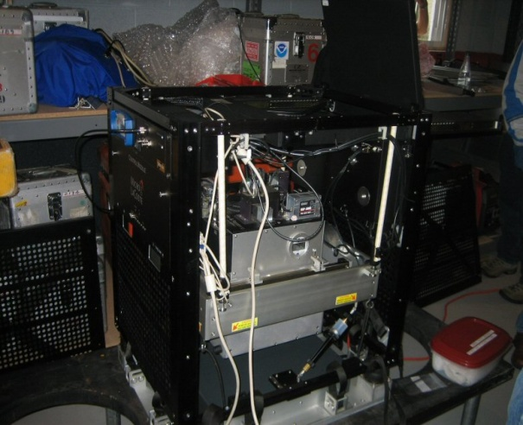
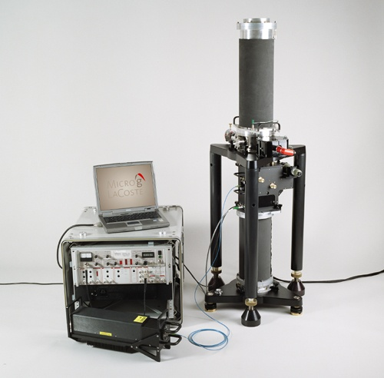
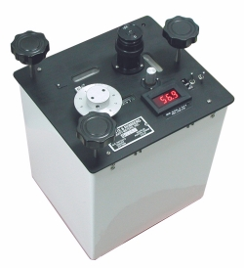
Gravity Survey Plan
National Scale Part 1
  Predominantly through airborne gravity
  With Absolute Gravity for ties and checks
  Relative Gravity for expanding local regions where airborne shows significant mismatch with existing terrestrial

Slide 26
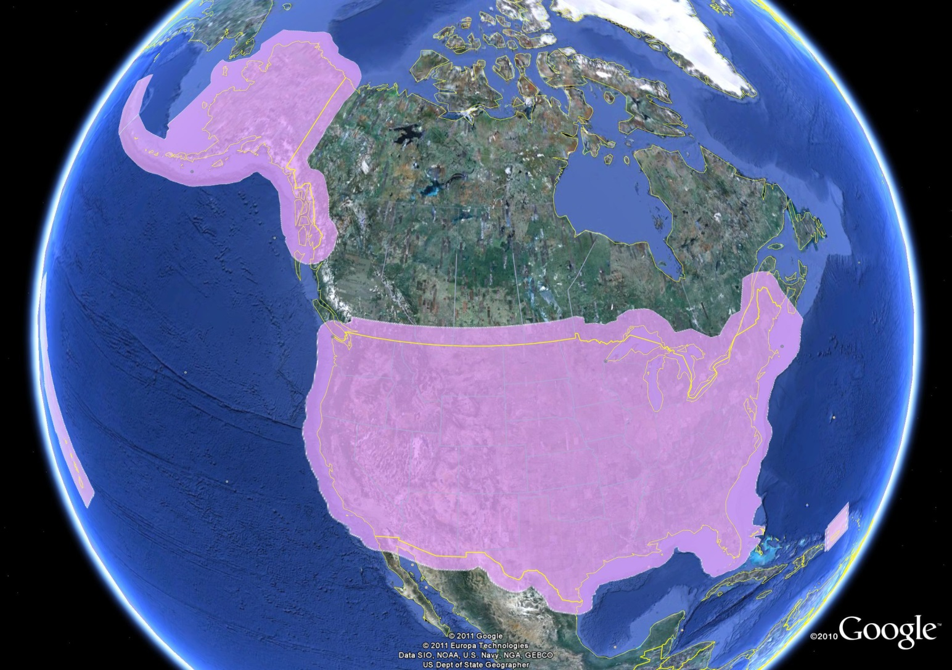
GRAV-D Coverage
Puerto Rico
US Virgin Is.

Slide 27
Priority- Greatest Datum Need
Alaska
Puerto Rico/US Virgin Islands (PRVI)
Coastal US and Great Lakes
  Great Lakes
  Gulf of Mexico & FL
  Eastern Seaboard
  Western Seaboard
Hawaii and Pacific Islands
Aleutian Islands
Interior CONUS
  Mountainous areas first

Slide 28
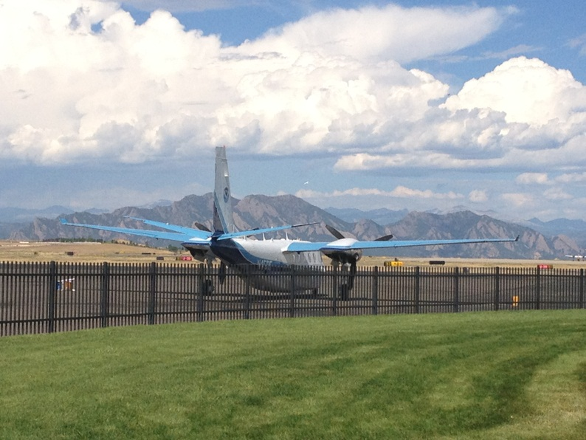
Other Variables to Consider
Time of Year, Need Smooth Air
  Likelihood of Turbulence: Hurricanes, Tornados
  Prevailing winds and weather patterns, especially wintery conditions and
  thunderstorms
Aircraft Available
  Differing Capabilities
Funding
Areas already completed
GPRA
NOAA TurboCommander at
Denver Rocky Mountain Airport
September 2012
*GPRA = Government Performance and Results Act of 1993

Slide 29
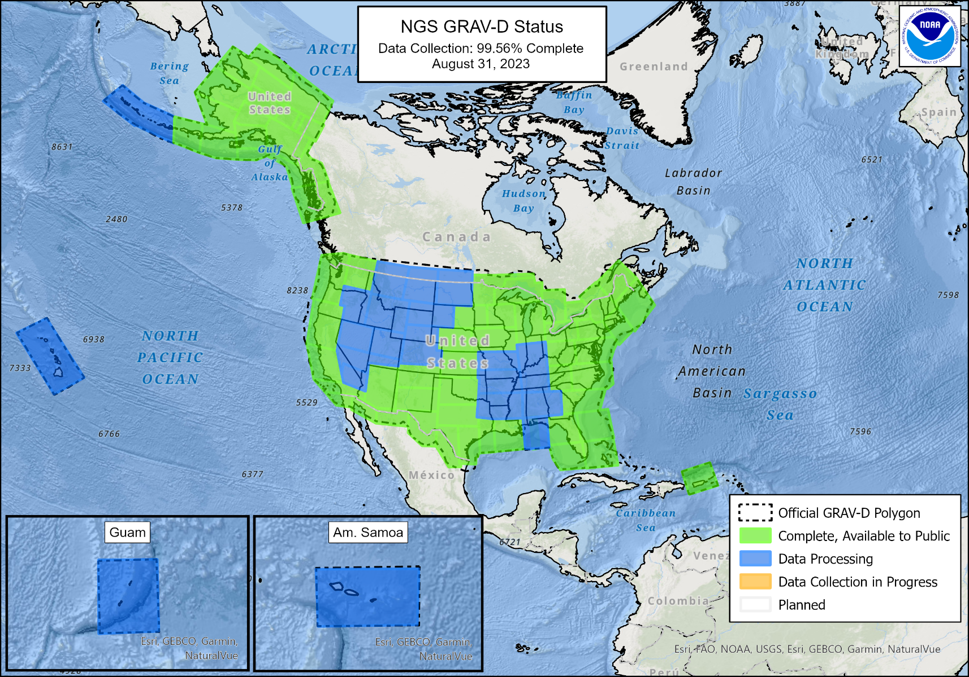
Airborne Gravity Current Coverage
http://www.ngs.noaa.gov/GRAV-D/data_products.shtml

Slide 30
GRAV-D Progress
100% of target area flown
Currently re-flying older, lower quality lines
Will continue to improve data holdings as schedule permits

Slide 31
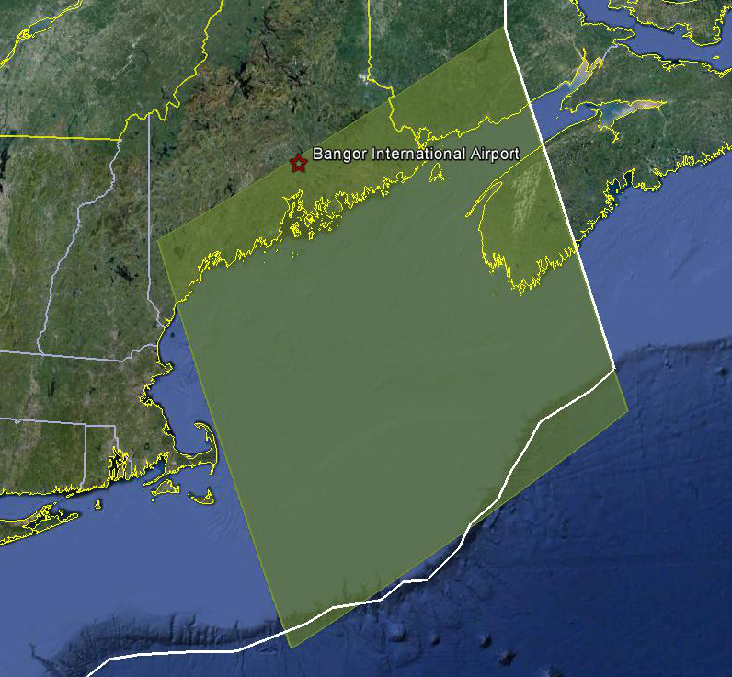
Survey and Block Plans
Layout rectangular survey 400 x 500 km
Extends beyond the shelf break
Block size will reflect the endurance of the aircraft
Notes:
Size of survey based on aircraft legs (how far it can go)
Location dependent on aircraft (over water?), in this case only a 2 engine aircraft

Slide 32
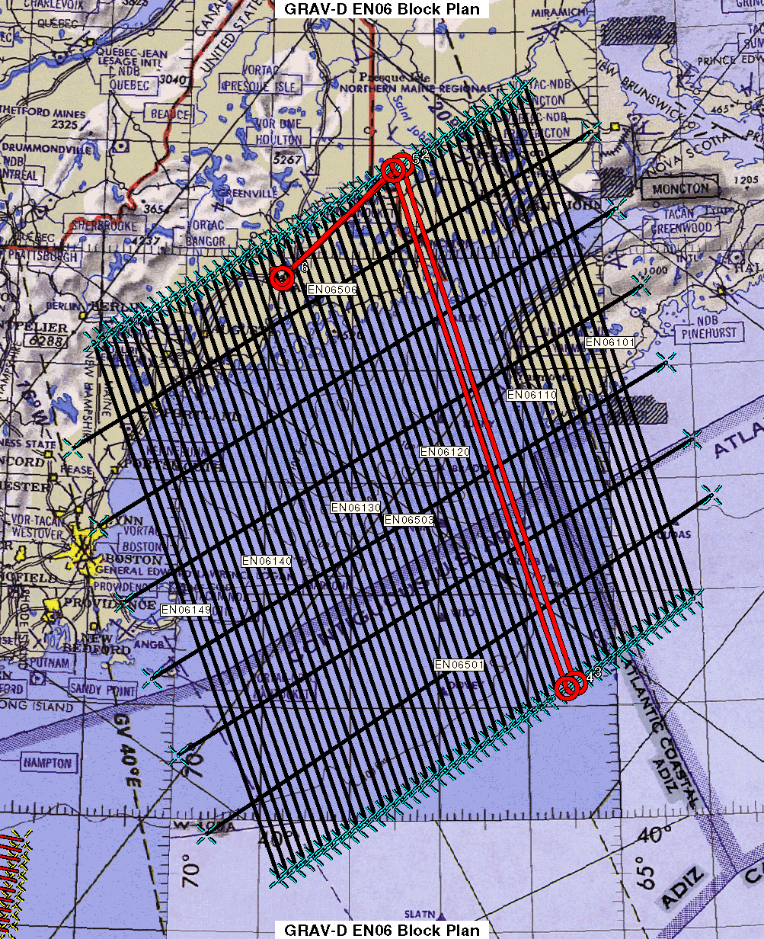
Survey and Block Plans
Data lines spaced 10 km apart
Cross lines spaced 60-80 km apart
Flight altitude 20,000 ft
Nominal speed 220-250 kts ≈ 250-290 mph
Notes:
Block layout based on aircraft, adjust size of block if needed

Slide 33
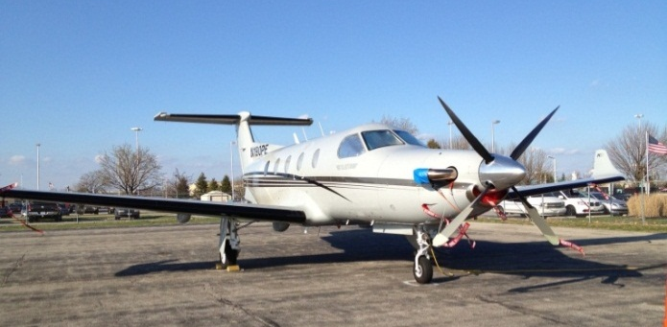
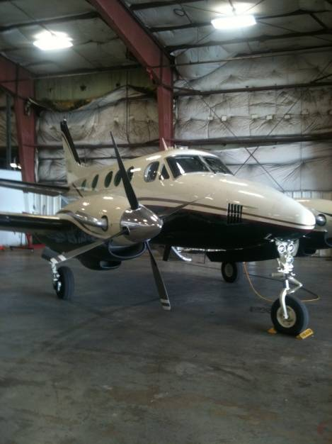

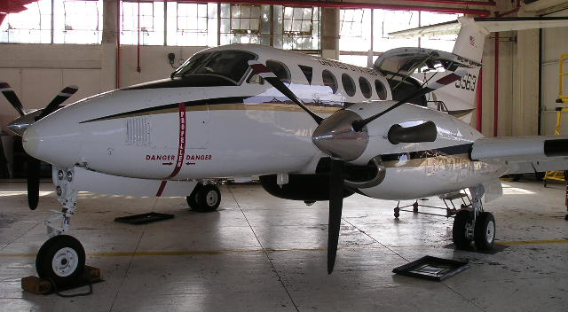

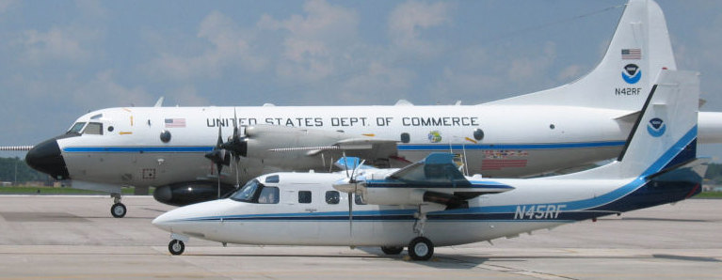
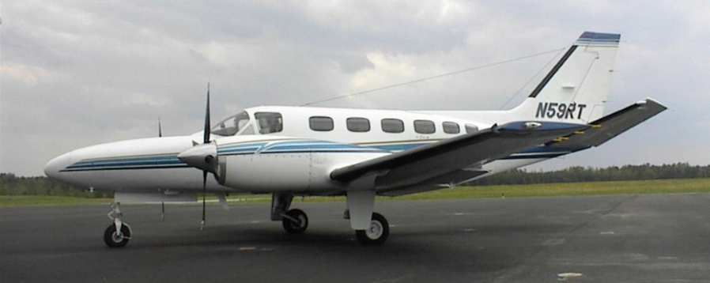
GRAV-D Aircraft
Bureau of Land Management Pilatus PC-12
Dynamic Aviation King Air 200T
Fugro King Air E-90A
Naval Research Laboratory
King Air RC-12
Aurora Flight Sciences Centaur Optionally Piloted Aircraft
NOAA P-3 (background)
NOAA Turbo Commander (foreground)
Fugro Cessna Conquest
Notes:
GRAV-D surveys have been operating on a number of aircraft. In order to accomplish our objectives within budget, we utilize a “portfolio” of aircraft of both government and contract origin. We’ve used the NOAA Jet Prop and the P-3, although little opportunity exists for further use of these aircraft. We operate about five months/year aboard the BLM Pilatus PC-12 aircraft. This aircraft is used for fire-spotting during warmer weather months in AK and the western US. This year we began working with Fugro to provide us aircraft services. We plan also to work this year with the Naval Research Lab and the VXS-1 Navy Squadron aboard their RC-12 King Air aircraft.

Slide 34
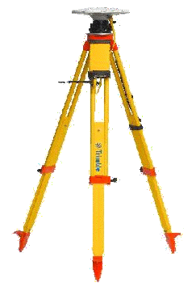
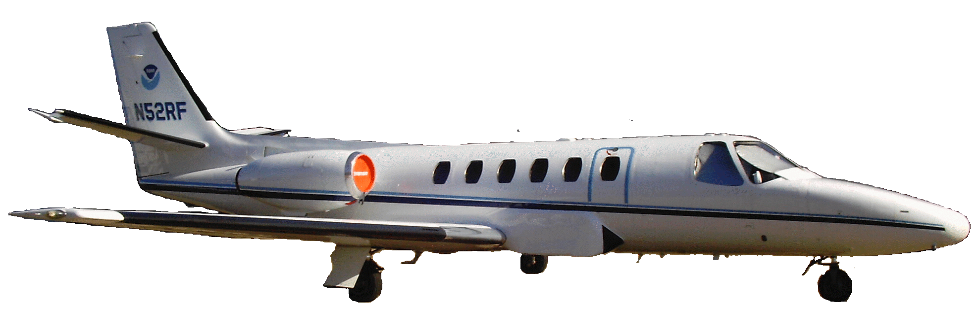
Requirements
Geodetic quality results require accurate aircraft positions, velocities, and accelerations
High-altitude, high-speed, long baseline flights for gravimetry
INS
GPS Antenna
Gravimeter
Absolute Gravity Tie

Slide 35
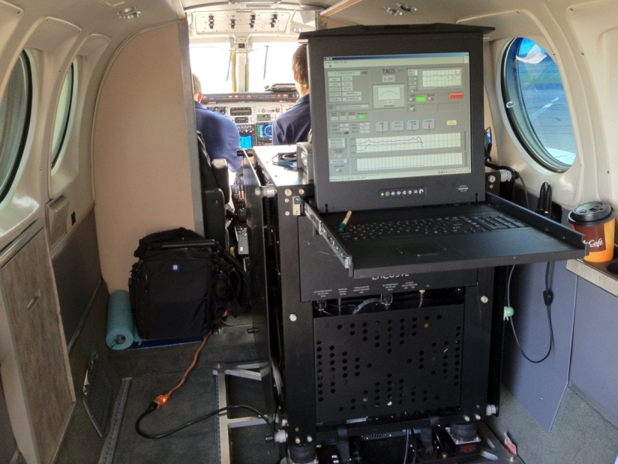
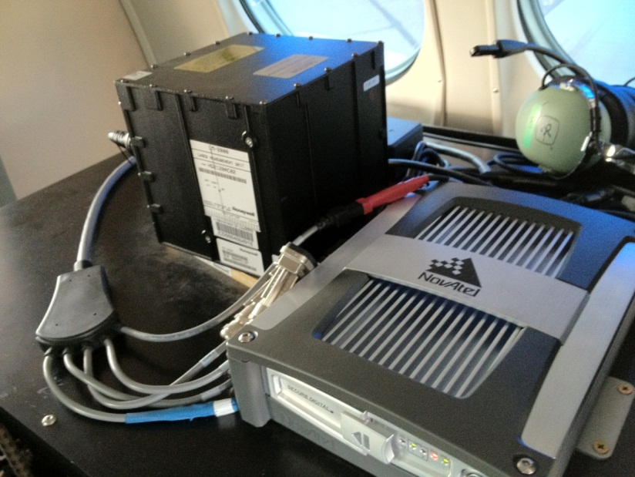
GRAV-D Instrumentation
Micro-g LaCoste
TAGS Gravimeter
NovAtel SPAN-SE
w/ Honeywell µIRS IMU
Both instruments include GNSS receivers
SPAN system allows for tightly coupled GPS/IMU solutions

Slide 36
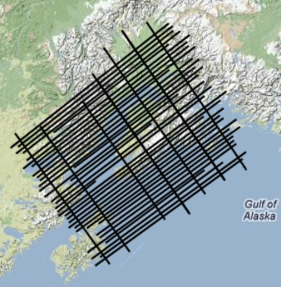
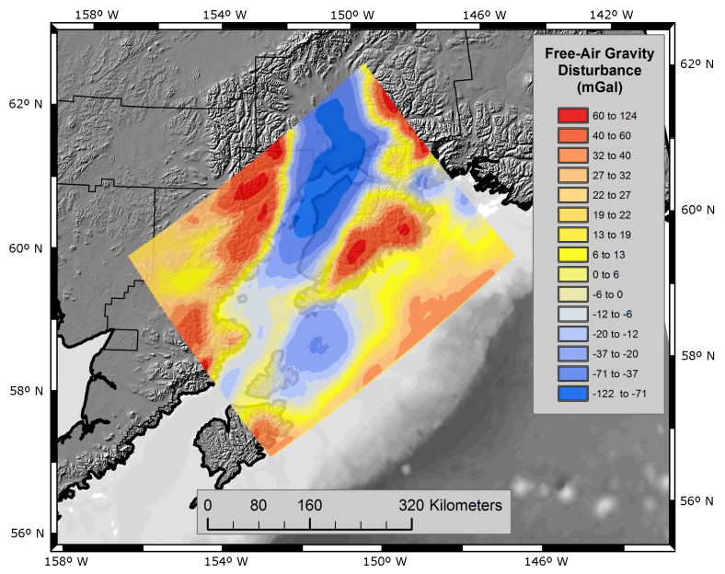
From Measurement to Product
Airborne Gravity Collection
GPS and Gravity Data Processing
  Kinematic positioning is critical
  NGS-developed software
More info: http://www.ngs.noaa.gov/corbin/class_description/GRAVD_0213.shtml
Gravity Data Release to Public
Inclusion in Yearly Experimental
Gravimetric Geoid Models

Slide 37
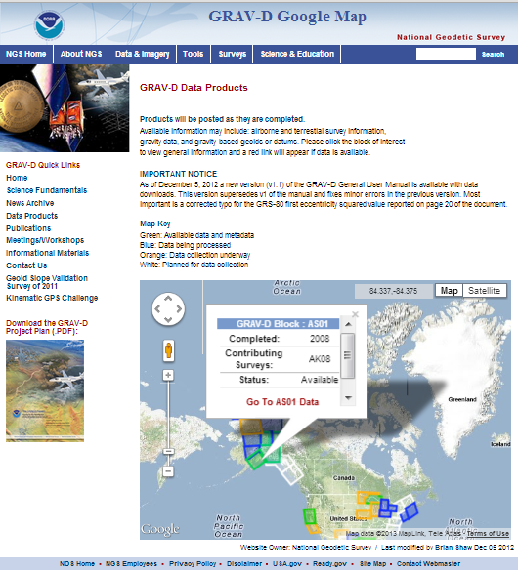
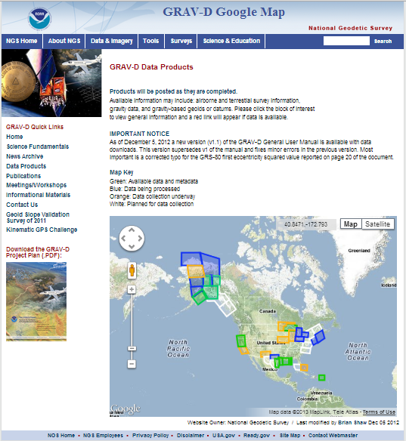
Online Data Portal http://www.ngs.noaa.gov/GRAV-D/data_products.shtml
Interactive Google Map:
  Up-to-date info on all blocks
  Clicking a block pops up basic info and a link to the block’s page if data is available

Slide 38
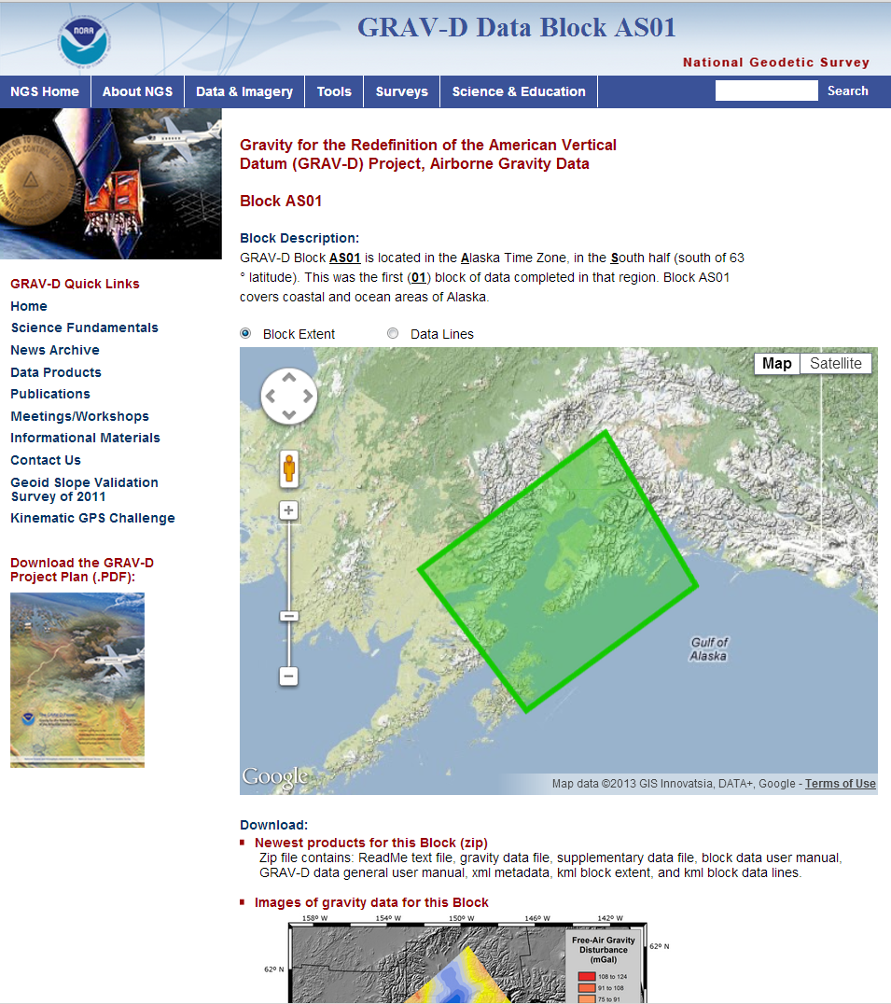
Online Data Portal
Example Block Site: http://www.ngs.noaa.gov/GRAV-D/data_as01.shtml
Data Available Now:
  Airborne gravity at altitude
  GIS Images
  .kmls of block extent and data lines
  Two user manuals (one general, one specific to block)
  FGDC metadata
Future Data:
  Experimental geoid products, similar to USGG official products
  Will incorporate GRAV-D data

Slide 39
Validating Geoid Accuracy
“...the gravimetric geoid used in defining
the future vertical datum of the United States should have an absolute accuracy of 1 centimeter at any place and at any time.”
-- The NGS 10 year plan (2008-2018)
Admirable!...Achievable?
Notes:
The above quote refers to one of many ambitious goals in the NGS 10 year plan. While admirable, its achievability remains an open question. In order to begin addressing the actual achievable accuracy of a gravimetric geoid model, NGS will engage in a variety of testing methods prior to the 2022 date when the gravimetric geoid will serve as the reference surface for a new vertical datum. The first such testing method took place in the summer of 2011 and is known as the Geoid Slope Validation Survey of 2011, or GSVS11. As its name implies, this survey tested the accuracy of differential geoid undulations between points ("geoid slopes") from NGS's gravimetric geoid models. The baseline for comparison will be independently computed geoid slopes from two methods, GPS and leveling as well as Deflections of the Vertical.

Slide 40
Validating Geoid Accuracy
NGS planed 3 surveys to validate the accuracy of the gravimetric geoid model
  GSVS11
    2011; Low/Flat/Simple: Texas; Done; Success!
  GSVS14
    2014; High/Flat/Complicated: Iowa; Field work Complete
  GSVS17
    2016 - 2017; High/Rugged/Complicated: Colorado

Slide 41
Objective of the GSVSs
How do we know that GRAV-D is working?
The Geoid Slope Validation Surveys (GSVSs) use high precision, high resolution (~1.5km spacing), ground-based survey techniques to determine the shape of the geoid consistently along a large (~300km) distance.
This allows for the direct comparison of the geoid shape predicted by various, gravity-based geoid models.
This also allows for a quantification of the airborne gravity’s contribution to the improvement of these models.

Slide 42
























Objective of the GSVSs (cont.)
Why compare the shape of the models?
Rather than using “absolute” values of the geoid at specific locations to compare models, it is actually more useful to look at the changes in the shape of the geoid over various distance scales (i.e. looking at the slope between various pairs of survey points separated by 1, 2, 5, 10, 20, 50, 100, 200 km, etc.) . Hence the name…
Example of slopes over various distance scales:
Every 1 interval
Every 2 intervals
Every 3 intervals
Every 4 intervals

Slide 43


Choosing the Place and Time for a New Survey
Criteria:
  Significantly exceed 100 km
  Under existing GRAV-D data
  Avoid trees and woods
  Along major roads
  Cloud-free nights
  No major bridges along the route
  Low elevations
  Significant geoid slope
  Inexpensive travel costs
Notes:
The reasons for the above are:
>100 km : to allow for direct comparison to GOCE and GRACE
Under GRAV-D : So that geoids with/without airborne gravity can be compared
Avoid woods: Better GPS visibility
Roads: Ease of accessibility
Cloud-Free Nights: For the DoV camera to see the stars
Bridges: To avoid “river crossings” in the geodetic leveling
Low Elevations: So the errors from correcting from surface data to the geoid are minimized
Geoid slope: To have an interesting signal to choose from
Travel costs: To minimize cost of survey

Slide 44
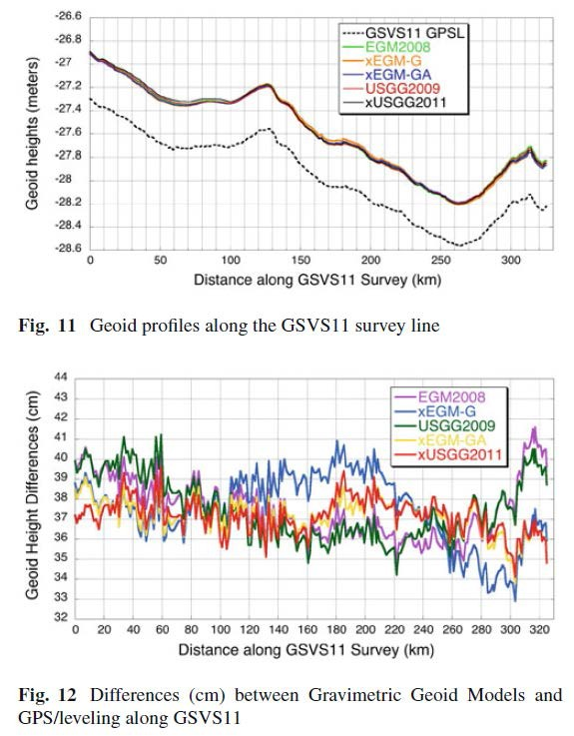
GSVS11, South Texas
The first survey was performed in south Texas in 2011
Low (close to the geoid) and flat.
Results were excellent!
"Confirming regional 1 cm differential geoid accuracy from airborne gravimetry: the Geoid Slope Validation Survey of 2011", Smith et al., Journal of Geodesy,
2013.

Slide 45
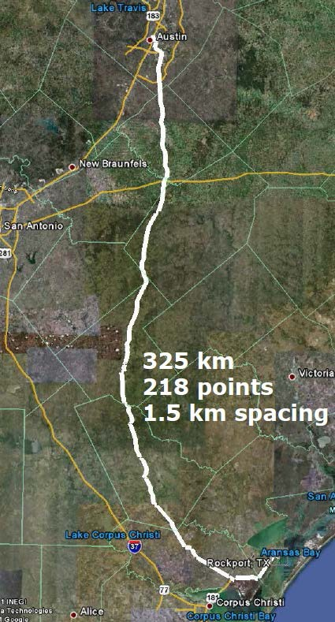
GSVS Survey Techniques
7
Survey techniques employed:
  Bechmarks installed ~1.5km
  Leveling
  Absolute/Relative Gravity
    Vertical Gravity Gradient
  Long-session GPS
  Deflection of Vertical

Slide 46
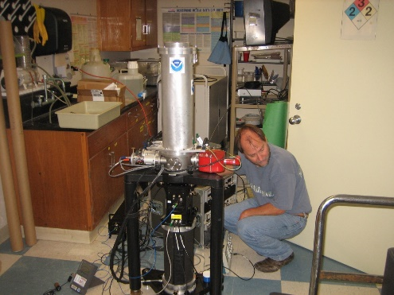
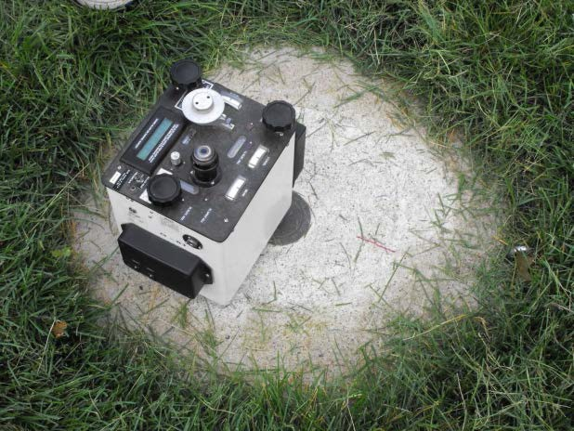
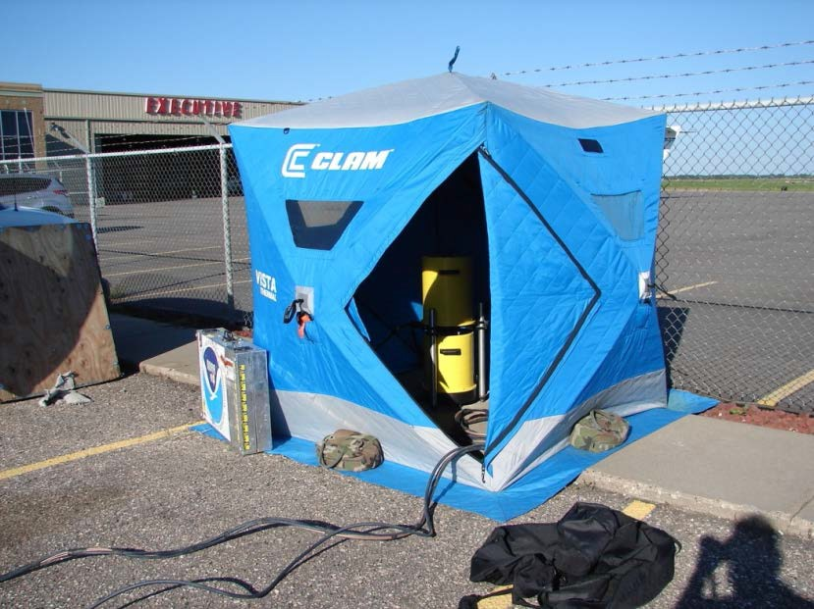

Leveling and Gravity
The entire line was leveled (double-run). Geodetic heights provided at each benchmark.
Leveling and gravity are both needed for orthometric height determination. Usually gravity is modeled, but in this case was actually measured at every point.
  Relative gravity and vertical gravity gradient at every benchmark
  Absolute gravity (A10 and/or FG5) at ~every 7th benchmark
8

Slide 47

Long Period GPS
Calibrated, fixed-height antennas, all identical models
In Texas 2011:
  20 complete sets of equipment (2 parties, 10 sets each)
  Each party observed 10 new stations each day
  20 hours of observation each day
  Project processed with OPUS Projects
9

Slide 48
Campaign GPS
Full antenna recalibration check before survey
Each fixed height tripod height
measured before and after
20 complete sets of equipment -
2 parties (10 sets each)
Each party observe 5 new and 5
repeat stations each day
30 observation days
Project processed with OP
ID | before | after | a - b | avg.
A | 2.0028 | 2.0029 | 0.0001 | 2.0029
B | 2.0019 | 2.0018 | -0.0001 | 2.0018
C | 2.0005 | 2.0002 | -0.0003 | 2.0004
D | 2.0079 | 2.0079 | 0.0000 | 2.0079
E | 2.0011 | 2.0010 | -0.0001 | 2.0010
F | 1.9999 | 1.9998 | -0.0001 | 1.9998
G | 2.0006 | 2.0009 | 0.0003 | 2.0008
H | 2.0016 | 2.0017 | 0.0001 | 2.0017
I | 2.0020 | 2.0020 | 0.0000 | 2.0020
J | 2.0041 | 2.0041 | 0.0000 | 2.0041
K | 2.0003 | 2.0004 | 0.0001 | 2.0003
L | 2.0010 | 2.0007 | -0.0003 | 2.0008
M | 2.0000 | 2.0002 | 0.0002 | 2.0001
N | 1.9964 | 1.9963 | -0.0001 | 1.9963
O | 2.0005 | 2.0005 | 0.0000 | 2.0005
P | 2.0003 | 2.0002 | -0.0001 | 2.0002
Q | 2.0024 | 2.0029 | 0.0005 | 2.0027
R | 1.9999 | 1.9999 | 0.0000 | 1.9999
S | 2.0052 | 2.0052 | 0.0000 | 2.0052
T | 2.0026 | 2.0023 | -0.0003 | 2.0024
U | 2.0031 | 2.0031 | 0.0000 | 2.0031
V | 1.9995 | 1.9995 | 0.0000 | 1.9995
W | 2.0002 | 2.0003 | 0.0001 | 2.0003
X | 2.0020 | 2.0022 | 0.0002 | 2.0021
Y | 2.0053 | 2.0053 | 0.0000 | 2.0053
Z | 2.0016 | 2.0014 | -0.0002 | 2.0015

Slide 49


The “Dimple-ometer”

Slide 50

Deflection of Vertical

Slide 51

GSVS14 Iowa
After the success of GSVS11, Iowa was chosen for the next test in 2014. (Cedar Rapids to Denison)
Higher elevation and geologically interesting terrain (traversing the Midcontinent Rift System).
(Very) similar survey techniques were employed.
Preliminary results again show excellent (<2 cm geoid discrepancy) agreement and noticeable improvement when airborne data are included. March 2017: Accepted for publication in Journal of Geodesy
11

Slide 52
Geodetic Leveling
Two crews of 4-5 people/crew
1st order Class II
749 km
105 crew days
7.1 km/day/crew

Slide 53
Gravity Observations
3 1st-order Class II stations
  Dennison, Ames, Cedar Rapids
A-10 Absolute stations (every 7th station)
Gravity Gradients (every 7th station)
  2 stations per day, 31 days to observe
Relative Gravity (205 stations)
  10 per day, 23 days to observe

Slide 54


Deflection of the Vertical (DoV)
Measure the slope of the geoid directly!
Precision tilt meters provide alignment “level” to the geoid.
Celestial almanacs provide predicted alignment with star field (relative to ellipsoid).
The difference between the two vectors (broken into orthogonal components) are the Deflections of the Vertical (or “slopes”).
In Iowa 2014:
  228 stations (204 official points, 11 redundant
observations, 3 reobservations)
  31 nights
  7 stations/night
  Observing with Swiss CODIAC (COmpact DIgital Astrometric Camera)
10

Slide 55



GSVS17 Colorado
The third (and likely final) GSVS took place along US160, from Durango to Walsenburg, in southern Colorado.
High elevation and rugged topography. “Worst case” for geoid modeling.
Variation from 6,000’ (MSL) to 11,000’, over two passes.
12

Slide 56


GSVS17 Colorado (cont.)
220 benchmark locations (approximately 1 per mile) were installed
The survey took place in overlapping phases beginning May 2017 and continued through September (a few last DoV conducted in Oct.

Slide 57
Differences with GSVS17
Numerous “extra” bench marks had to be installed for leveling accuracy purposes (very steep terrain in some sections).
Absolute gravity (A10) and quadratic (3 tier) gravity gradients measured at all benchmarks.
Topographic corrections are being developed to aid in field DoV quality control as well as post-survey geoid modeling.

Slide 58





New DoV Configuration

Slide 59
NEW VERTICAL DATUM
(Rationale)
  A move away from differentially leveled passive control as the defining mechanism of the reference surface
  To be consistent with the shift in the geometric reference frame/ellipsoid (2022)
  Improvement in our technical abilities in reference surface realization (geopotential gravimetric reference surface - 1cm accuracy of geoid (GNSS/GRAV-D))
  The new geopotential reference surface will be aligned with the geometric reference frame/ellipsoid (i.e., no hybrid geoid)

Slide 60
NEW VERTICAL DATUM
(Rationale)
  The technology to make accurate vertical heights measurements with GNSS technology
  To provide vertical access to formerly prohibitive places
  To allow monitoring of physical or geophysical datum deformation

Slide 61
NEW VERTICAL DATUM
(Components)
Design and adopt new geometric reference frame (Geometric Datum Project)
Realize new geometric datum with existing passive/active control, i.e., a horizontal (geometric) adjustment
Definition of the W₀ surface as the new datum reference surface
Build a gravimetric geoid with an overall accuracy of 1 cm (GRAV-D Project)
Make orthometric heights easily available

Slide 62


Agreement on W₀ Value

Slide 63
Experimental Models
Annually update an experimental gravimetric geoid with GRAV-D data
  Evolution as we move
    from USGG2012 (last non-GRAV-D gravimetric geoid)
    through xGG202x? (annual experimental geoid)
    to USGG2022 (the final geoid with GRAV-D)
  Starting 2014: National Ocean Service Requirement

Slide 64
















Evolution of the Geoid
xGeoid16B…xGeoid20B
EGM08
USGG2012
GEOID12A/B
NGA
ArcticGP
GRAV-D
2008
2012
2014-2018
GOCO05S
2019
2021
xGeoid14B…xGeoid18B
xGeoid19B
GRACE
xGeoid20B
GEOID18
+
GOCE
Notes:
NGA Arctic Gravity Grid (2017)

Slide 65

xGeoid14
  First experimental geoid model released June 30, 2014
  Online tools for accessing it (GRAV-D website)

Slide 66

xGEOID20

Slide 67


The effect of airborne gravity

Slide 68
How much will heights change?
How much will NSRS ellipsoid height change?
  Geometric Datum will be aligned to ITRF
  Approx -1.9 m (Puerto Rico) to +2.0 m (Guam)
How much will NSRS CONUS orthometric height change?
  Approx +0.1 m (Florida) to -1.3 m (Washington)
  Approx -0.35 m (East NY) to -0.48 m (West NY)
  More than 2 meters of change in Alaska

Slide 69
Metadata is Critical
Your positional metadata should include:
  datum
  epoch
  source
These will facilitate transforming from current to new datum
Maintaining your original survey data will provide more accurate results

Slide 70
How to Plan for the Future
Move to newest realizations
  NAD 83(2011) epoch 2010.00
  USGG12 (gravimetric geoid) / GEOID12A (hybrid geoid)
Obtain precise ellipsoid heights on NAVD 88 bench marks (OPUS-DB, contact NGS Geodetic Advisor)
  Provides data to create new transformation models (think VERTCON)
  Follow new NGS Guidelines when released (discuss next week!!)
Move off of NGVD 29 to NAVD 88
  Understand the accuracy of VERTCON in your area
Move away from passive marks to GNSS
  Especially move off of classical passive control
Require/provide complete metadata for all mapping contracts
  How did they get the positions/heights? Document it!!

Slide 71
Geoid Monitoring Service
GeMS
Following slides taken from presentations by Kevin Ahlgren, GeMS Project Manager

Slide 72

Monitoring Geoid Change: Static vs. Dynamic
From Damiani, 2017 Geospatial Summit
Measured with GPS
Deforms, subsides, uplifts at all length scales
Static, except for model updates
Changes along with large-scale gravity change (caused by mass movement)
Calculated from geoid models
The height that U.S. National Spatial
Reference System Users need
h = ellipsoidal height;
N = geoid height (undulation);
H = orthometric height
In a static world, H ≈ h - N
2022 aim is to achieve 1 cm geoid height accuracy (wherever possible) and 1 cm ellipsoidal height accuracy.
In a changing world, Ḣ ≈ ḣ - Ṅ.
Option 1: Provide a series of static geoids, updated whenever change somewhere in the U.S. reaches 0.5 cm. [Not NGS’ choice]
Option 2: Provide a static geoid (N₀) and geoid change over time (Ṅ) so that orthometric heights remain accurate to 1 cm at all times.
H_{t} = h_{t}-(N₀+ Ṅ*t) [NGS’ choice]

Slide 73


GeMS
Project
Dynamic components are associated with the Geoid Monitoring Service
NGS Project to estimate time-dependent quantities and incorporate into vertical reference system (NAPGD2022)
Quantities: $\dot{N},\dot{∆g},\dot{H},\dot{W},\dot{η},\dot{ξ}$
Notes:
Stress: Need a lot of mass and (gravity) change over large areas to get ‘significant’ geoid change. It is not just a surface deformation event. There actually has to be mass redistribution causing gravity change.
Need to validate how well this changes reflect what is happening on the ground.

Slide 74

GeMS
Motivation
Initially proposed as the 2nd component of Gravity for the Re-definition of the American Vertical Datum (GRAV-D)
  “low-resolution movie to track the temporal changes to the gravity field on a broad scale—a re-occurring survey with very coarse spatial coverage and a long temporal span”
Specified in NGS Strategic Plan 2019-2023: Objective 2-2: “Replace NAVD 88”
  Define and provide access to a geocentric, time-dependent, geopotential datum by year 2022.
Notes:
GeMS is not a ‘new’ project as it was originally proposed as the 2nd component of the GRAV-D project.

Slide 75
GeMS Project
Status
Research and Development
  Scope:
    What can NGS do? What can NGS not do?
    What are the costs, benefits, and risks of doing or not doing a particular element within GeMS?
  Status:
    Nearly completed (95% done).
  Deliverables:
    NOS NGS Technical Report 69: A Preliminary Investigation of the NGS’s Geoid Monitoring Service (GeMS)
    Alpha Products: xDGEOID19 – a dynamic geoid model will be available for testing with xGEOID19.
    Supporting Tools: Software, documentation, and details.
    Recommendations that will drive subsequent GeMS stages.
Operations and Development (TBD)
Refinement and Improvement (TBD)

Slide 76

xDGEOID19
Alpha model based on secular trend from GRACE (NASA GSFC mascon v02.4, Luthcke, et al. 2013)).
Units: mm/yr.
Contour Interval: 0.5 mm/yr
Notes:
Stress: Need a lot of mass change over large areas to get ‘significant’ geoid change
Need to validate how well this changes reflect what is happening on the ground.

Slide 77

xGEOID19 BETA Model
Sample Output:
Static Geoid Model Output (same as previous xGEOIDs): value from Model A and B
xDGEOID19 Component:
DN = geoid rate * (t-t₀)
User Inputted Coordinates
User Inputted Epoch

Slide 78



GRACE/GRACE-Follow-on
NASA/GFZ missions to monitor temporal gravity field at 200 km wavelengths
GRACE: 2002 – 2017
GRACE-FO: 2018 –
Foundation for GeMS models. Use monthly gravity fields to estimate a trend and produce $\dot{N}(φ,λ,t)$
GRACE/GRACE-FO – Twin satellites that measure distance between one another at few μm (a tenth of the thickness of a human hair). (Image courtesy of NASA)
Relationship between gravity change, geographic size of change, and geoid change. Combinations to the right of the blue line will cause a 1 cm geoid change. Shaded area is specifically needed through non-GRACE techniques.

Slide 79
Types of
Geoid Change
Shape Change - most common and most of what GeMS will capture
  change in the shape of the geoid (W=W₀) without changing W₀
  Analogy: Squeezing a balloon – depressions and bulges occur but volume is maintained
Size Change – quite rare with limited amount of change
  Change in the size of the geoid (W=W₀) without changing W₀.
  Increasing or decreasing the volume contain by the geoid or geopotential field
  Analogy: Adding or removing air to a balloon – increased or decreased volume or size
W₀ Change
  Any long term sea level change (up or down).
  This would result in a new datum definition…
Not to Scale:
Size change
Shape change
Notes:
Stress: Need a lot of mass change over large areas to get ‘significant’ geoid change

Slide 80


Modeling: Secular Component ($\dot{N}$)
Rely on GRACE / GRACE-FO
Foundation for GeMS models.
Full time series (15+ years) used
Alpha Product: xDGEOID19 which uses GSFC v02.4 model (Luthcke, et al. 2013)
GRACE-FO satellite conception (courtesy: NASA)
xDGEOID19 – Alpha product for evaluation purposes. Units: mm/yr. Contour interval: 0.5 mm/yr.

Slide 81

Modeling:
Episodic Events
Earthquakes, Volcanoes, Landslides…
Handled on a case by case basis…
Possibly warrant a geodetic response
Very rarely occur at levels of significance
  1992 Landers M7.3 Earthquake produced ~0.1 mm
  1964 Alaska M9.2 had ~10 mm
  Mount St. Helens Eruption:
    Flank collapse: 10+ cm geoid change
    Material redistribution: 2 cm geoid change
Modeled geoid change in mm for (a) the 1964 Alaska earthquake and (b) the 1992 Landers earthquake. (from Jacob, et al., 2012)

Slide 82

GeMS Options in Near-Term
How does GeMS get built? Modeling / Model components
  GRACE/GRACE-FO Only
    CSR RL06 Model (Save, et al. 2018)
    GSFC v02.4 Model (Luthcke, et al. 2013)
  GRACE/GRACE-FO + subset of geophysical models
  Geophysical models only (GIA, ice-mass model, hydrology, etc.)
How does NGS confirm that GeMS products are OK? Validation
  Absolute gravity + GNSS: U.S. Network of $\dot{g}$ and $\dot{h}$ observations
  GeMS Validation Surveys (GeMS-VS): High spatial resolution $\dot{g}$ and $\dot{h}$ and possibly DoV observations repeated in time.
  Continuous gravity observations at high impact locations.
  Optical atomic clock network
  GRACE / GRACE-FO
Notes:
Two simple questions that have very complicated answers:
How does NGS build GeMS?
How does NGS have any confidence in GeMS products?
These are complicated answers because there are no ‘slam-dunks’. These are all complicated elements that haven’t been done operationally by NGS or other geodetic agencies around the world.

Slide 83
Components of a Long-Term Monitoring Plan
1. What and Where to Monitor
For all gravity change signals, need to know:
  - How big (magnitude)? - How big (spatial)?
  - Other characteristics (constant change, sudden change, etc.)
Which signals do we monitor to maintain geoid accuracy at the 1 cm level over the next 100 years?
2. How to Monitor in the Near-Term (next 1 to 3 decades)
Which monitoring methods are available?
Are they reliable, replaceable (if there’s a failure), and cost effective?
How much do the signals vary (e.g. seasonality) and how accurately can they be measured, to estimate accumulation of error over time?
3. Which Products Need to be Available
How do we integrate geoid/vertical datum maintenance for NSRS users?
4. Long-Term Program Adaptation
What future technologies may become available for use in monitoring later this decade & this century?
Notes:
Three components of a plan. For what to monitor, need to understand which gravity signals are affecting the geoid, in what way, where, and over what time scale. Then select which ones need monitoring and estimate the accumulation of error over time. Then put together a plan that uses current technology (with backups) that’s reasonable and effective. Finally, propose technologies that may be a game-changer in the future. This presentation will walk through these three components, focusing mostly on #1.

Slide 84


1. What to Monitor?
Question:
What changes affect the geoid in North America?
Based on current trends in snowfall, soil moisture, and groundwater withdrawal
Complex,
Multi-Decadal
Three Timescales of Geoid Change
Continuous, Sub-Decadal
Effects from present glaciers and the last glacial cycle
Magnitude 9 thrust earthquakes
Mount St. Helens equivalent or larger eruptions
Episodic,
Cataclysms
Notes:
What to Monitor. There is a study we can use as a guide in N. America.
Cataclysm: Magnitude 9+ earthquakes (Only 8, Mw 8+ earthquakes in US in recorded history; only 1 above 9; and all in Alaska); or Mount St. Helens-sized eruptions
Note prevalence of GRACE in suggested observations
Note non-linearity of rates (dependent on climate change or on water pumping)
If a geoid undulation velocity model is desired, it will be the combination of these signals

Slide 85



1. Where: Cataclysms
11
All Recorded Magnitude 8 + Earthquakes, Last 110 Years
https://earthquake.usgs.gov/earthquakes/browse/
(Thrust)
http://eqseis.geosc.psu.edu/~cammon/HTML/Classes/IntroQuakes/Notes/faults.html
Notes:
Shows all 8+ magnitude earthquakes in North America in recorded history. Reminder: Richter scale, earthquake of 1 magnitude larger is 100 times stronger, runs from 0 to 10. The largest in N America was a 9.2 magnitude in 1964; the 2nd most powerful ever recorded in the world.
The Alaska earthquakes result from the motion of the Pacific Plate, which if you hold N America still, is sliding next to the US in CA and subducting under AK.
The largest earthquakes in the work occur at subduction zones, where the motion looks like a reverse fault. The mass movement from these earthquakes does indeed affect the geoid, but only for near 9 magnitude quakes (or a series of quakes in the same area that add up to the equivalent). Transform boundaries (where the motion is strike-slip, like at the San Andreas) can have large earthquakes too but not quite as cataclysmic and without vertically displacing much mass. These have very small affects on the geoid.

Slide 86



1. Where: Cataclysms
https://www2.usgs.gov/faq/node/2691
Explosive eruptions occur at volcanoes along plate boundaries when gas (often water vapor) is trapped in the magma.
Notes:
Like earthquake magnitudes, there is a scale for measuring the explosiveness of a volcanic eruption (Volcanic Explosivity Index). It runs from zero to 8, with eruptions increasing in material ejected by 100 times for each number increase. Novarupta and Krakatoa were a 6, Mt. St. Helens and Vesuvius (Pompeii) a 5. Last Yellowstone eruption 640,000 years ago was an 8, “supervolcanic”.

Slide 87


1. What is Glacial Isostatic Adjustment?
In North America, the ground (and geoid) are adjusting after the melting of the Laurentide Ice Sheet, which was largest at the Last Glacial Maximum ~21,000 years ago.
Wouters, et al., 2014
Image courtesy of Byrd Polar Research Center, The Ohio State University

Slide 88

1. Where: Glacial Isostatic Adjustment
Geoid Height Trend (from GIA only)
From the ICE-5G GIA Model Created by Dr. Peltier at the Univ. of Toronto
Jacob, et al., 2012

Slide 89


1. Where: Present Day Ice Mass Loss
Canadian
Arctic
2 cm/
decade
“If these computed geoid trends remain more or less constant into the future, one might expect
a geoid change of 10 mm every 3.5–6.5 years
immediately over the glaciated regions of North America.”
SE Alaska
3 cm/decade
Jacob, et al., 2012
Emphasis added
Greenland 3.5 cm/decade

Slide 90
1. What to Monitor?
Jacob, et al. 2012 considered the next 100 years of change.
To maintain 1 cm accuracy:
  For the next 30 years, only glacial isostatic adjustment and present-day ice mass loss continuously affect the geoid.
  For the next 30 years, local, episodic adjustments will be needed after cataclysmic disasters, likely only affecting Alaska and the volcanic portions of the Western US.
  From 30-100 years, we must also account for: hydrology and climate-related change, the slow eruptions of Hawaiian volcanos, and global sea level rise.
Notes:
Sea level rise will create a 1 cm geoid shape change in 150 - 400 years (negligible for the next 75 years).

Slide 91
2. How to Monitor?
Possibility 1: Combined Models + Data
Identify each significant gravity change source.
Use specialized models to estimate mass change, then predict gravity and geoid change over time from each source.
Add results together to get total geoid change over time.
Validate with terrestrial gravity data, to be sure the models are correct.
Can we do it?
Should we do it?
Yes.
- 6 significant sources already identified from Jacob, et al., 2012.
- Models exist for 2 near-term sources (GIA and glacier melting) and can be used to predict geoid change.
- A validation network for terrestrial gravity can be created with existing technology.
Maybe.
- Relies on models created and maintained by others.
- Could be expensive to set up and maintain a terrestrial gravity network, depending on the size of the network.
- This is how Canada already monitors geoid change, to upkeep their geoid-based vertical datum.
Notes:
Now that we know what to monitor, we examine the next plan component: How to monitor in the near-term (a few decades).
Back of the envelope suggests we use GRACE to calculate most of the geoid height change, but the monthly solutions miss some signal.

Slide 92
How Accurate are Glacial Isostatic Adjustment Models?
Comparison of GIA Model to Satellite Data, Geoid Height Trend
Geoid Height Trend,
ICE-5G GIA Model Created by Dr. Peltier at Univ. of Toronto
Jacob, et al., 2012
GRACE and GIA Models are very similar in error.
Using current GIA models (not GRACE) would introduce a 10 mm geoid offset over 18 years, centered mostly in N. Canada.

Slide 93
2. How to Monitor?
Possibility 2: Direct Measurement
Estimate most of the geoid change from satellite gravity measurements, which measures total change regardless of the source.
Add in “small” gravity signals that the satellites can’t detect but do affect the geoid, from models or data.
Create a combined gravity model of change over time and estimate the geoid change over time from that.
Can we do it?
Should we do it?
Yes.
- Satellite gravity from GRACE exists from 2008 – present, but it is at end-of-life.
- Satellite gravity will be provided by GRACE Follow-On starting in early 2019, if all goes well.
- We can research which “small” signals are needed; data and models mostly exist.
- NGS has experts at merging gravity data and making geoid models.
Very likely.
- Relies on satellite gravity data that is either freely available or highly-likely to be available soon.
- Requires building some in-house expertise but mostly relies on existing expertise.
- Only a small portion of the monitoring relies on models or data created outside NGS.

Slide 94


Geoid Change Based on Monthly GRACE Solutions 2002-2014
Trend in cm
Accumulated Change Over 1 Decade
Annual Change Amplitude in mm
-1 to -0.5
4+
1 to 1.5
0.5 to 1
0 to 0.5
-0.5 to 0
AK: Up to 1 cm per decade
Canada: 1.5 cm per decade
AK & W. Canada: Up to .45 cm annual cycle
Images courtesy of Ryan A. Hardy, pers. comm.

Slide 95
Possible Monitoring Scenarios
Primary Operations (Proposal 2):
For next 30 years: Estimate geoid change rate from GRACE/GRACE-FO. Add in “small” signals from surface gravity and models.
(85% modeling, 15% new campaigns)
Emergency Response Operations:
For cataclysmic events, measure with satellite gravity, surface gravity, and GNSS instruments. (100% new campaigns)
Backup Operations (Proposal 1, if failure of gravity satellites):
Estimate gravity change from 1. mass change models and
2. co-located vertical velocity measurements (GNSS) and surface gravity measurements.
(33% existing data, 33% modeling, 33% new campaigns)
Caveat: With Current Technology!

Slide 96

Validation: Proposed Absolute Gravity Network
Proposed Network
~60 locations
Observe every 1-3 years
Build off existing NOAA FCORS Network
Densify in areas with most geoid change (Great Lakes and Alaska)
Additional benefits:
  Supports relative gravity efforts nationwide
Proposed, preliminary absolute gravity network with geoid rates from GRACE in mm/yr (contour interval = 0.1 mm/yr)

Slide 97

Validation: Proposed Absolute Gravity Network
Proposed Network
~30 locations
Observe every 1-3 years
Build off existing NOAA FCORS Network
Densify in areas with most geoid change (Great Lakes and Alaska)
Additional benefits:
  Supports relative gravity efforts nationwide
Proposed, preliminary absolute gravity network with geoid rates from GRACE in mm/yr (contour interval = 0.1 mm/yr)

Slide 98
3. Vision for Vertical Datum Products, 2022 +
NGS has released an “S” and “D” geoid models: static and dynamic.
The “S” static will be a typical geoid model, aimed to capture the 1 cm-accurate model at a TBD epoch.
The “D” dynamic will capture the rate of change of the geoid at all places. In 2022, it will capture at least the continuous, permanent change signals such as GIA.
Both models will be integrated into OPUS, mostly invisible to users. Orthometric heights provided by OPUS will be time-sensitive, so that they are the combination of the static geoid model plus the geoid rate of change indicated by the dynamic model.
We’ll provide separate tools to directly access both the “S” and “D” models.
H_{t} = h_{t}-(N₀+ Ṅ*t)

Slide 99
4. Future of Monitoring, 2052 and beyond
NGS plans to re-evaluate our “S” and “D” models periodically to see if they are meeting our constituents’ needs and maintaining accuracy.
Future advances in satellite gravimetry, quantum gravimetry, airborne gravimetry/IfSAR, and unmanned vehicles will eventually replace current monitoring technology, necessitating a flexible monitoring plan.
Monitoring will likely evolve, as understanding of gravity changes and technology also improves.

Slide 100
Questions?
Dan Martin
Northeast Regional Geodetic Advisor
ME, NH, VT, MA, CT, RI, NY, NJ
Dan.martin@noaa.gov
240-676-4762

