Slide 1

GPS on Bench Marks:
GEOID18 Improvements and a Look Ahead
National Geodetic Survey Webinar Series
February 28th, 2019 2:00 – 3:00 pm
Galen Scott – GEOID18 Project Lead
Kevin Ahlgren – GEOID18 Technical Lead
Brian Shaw – GEOID18 Cartographer

Slide 2
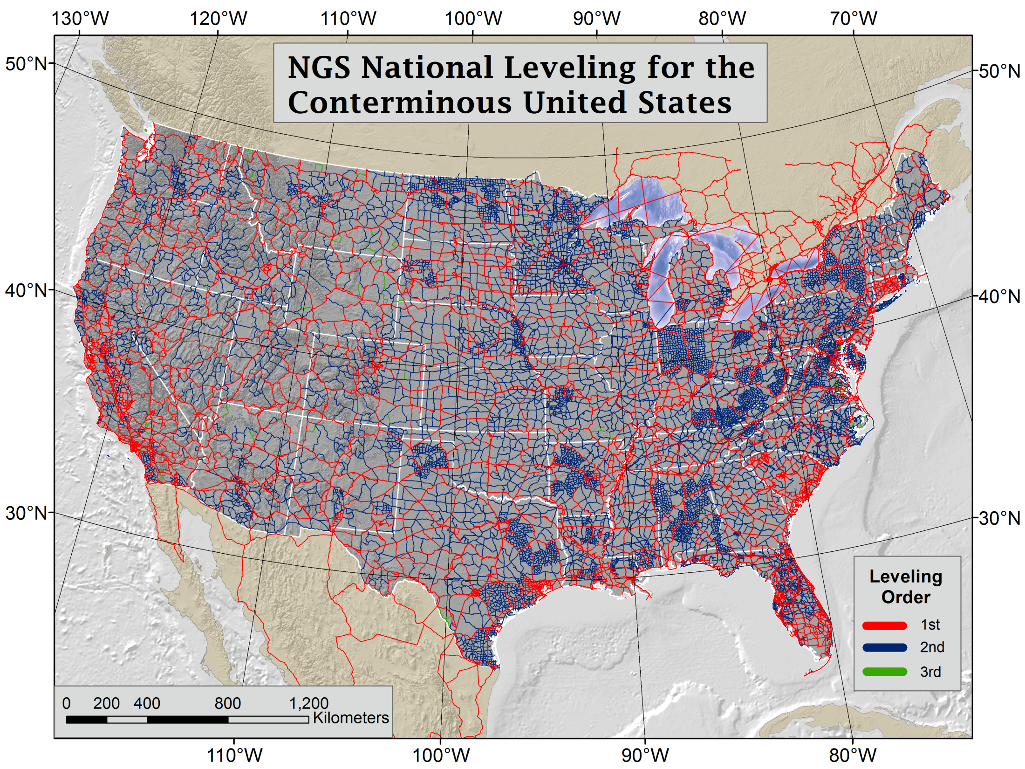
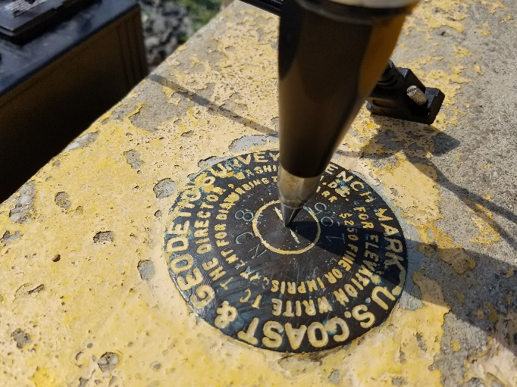
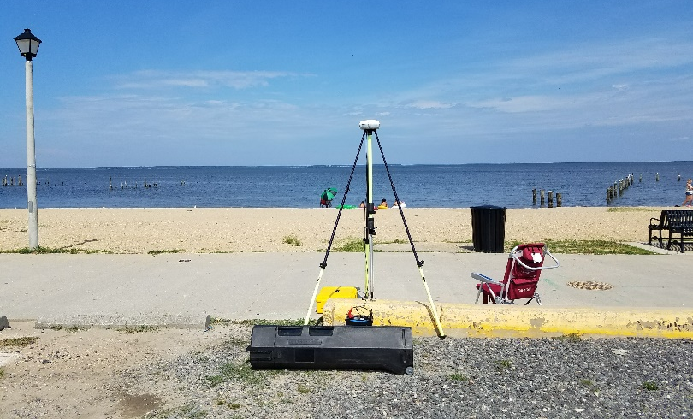
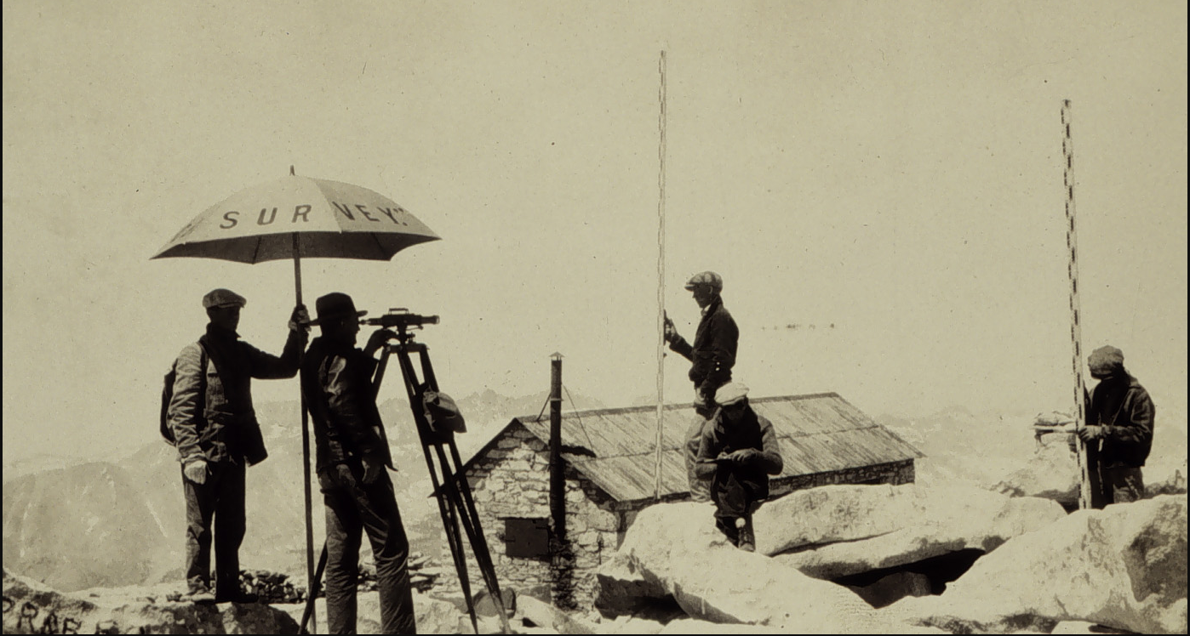
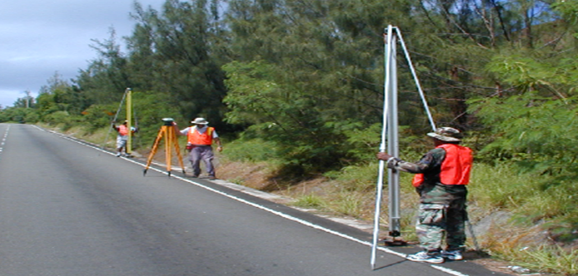
GPS Data on NAVD 88 leveled marks will support development of GEOID18 and the transformation tools to NAPGD2022
Notes:
NAVD 88 consists of about 800,000 benchmarks and ~2.2M km of leveling. Data was collecting over many decades by roving bands of surveyors who walked across the country multiple times over the years, east to west, north to south and back again. It is currently the official vertical datum of the US and is required for federal mapping projects.
GPS data on those leveled marks will be used to create GEOID18 – the model used to derive NAVD88 heights from GPS ellipsoid heights, as well as the transformation tools that will be released with NAPGD2022.

Slide 3
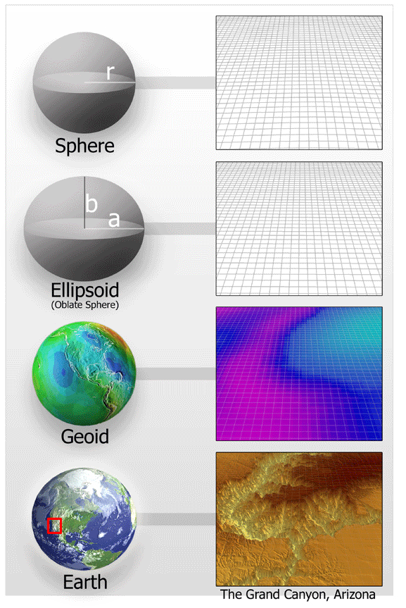
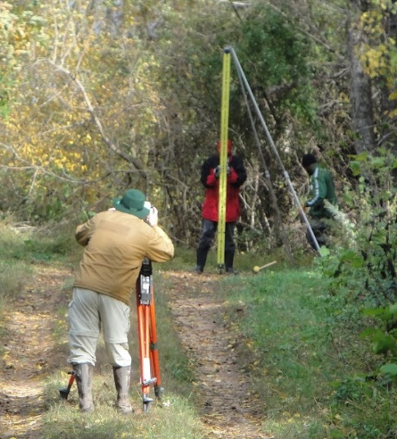
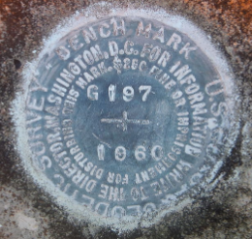
Extensive Residual Analysis used to create a Prioritized List
Residual = h - H - N
-
-
h is ellipsoid height measured using GPS
H is an NAVD 88 Orthometric Height from Leveling
N is from a geoid model
Theoretically, the difference between these three values should be zero. In practice, using actual observations gives a residual, or measure of the misfit between the three. We use the residual to evaluate the observations.
Notes:
Move up to intro

Slide 4
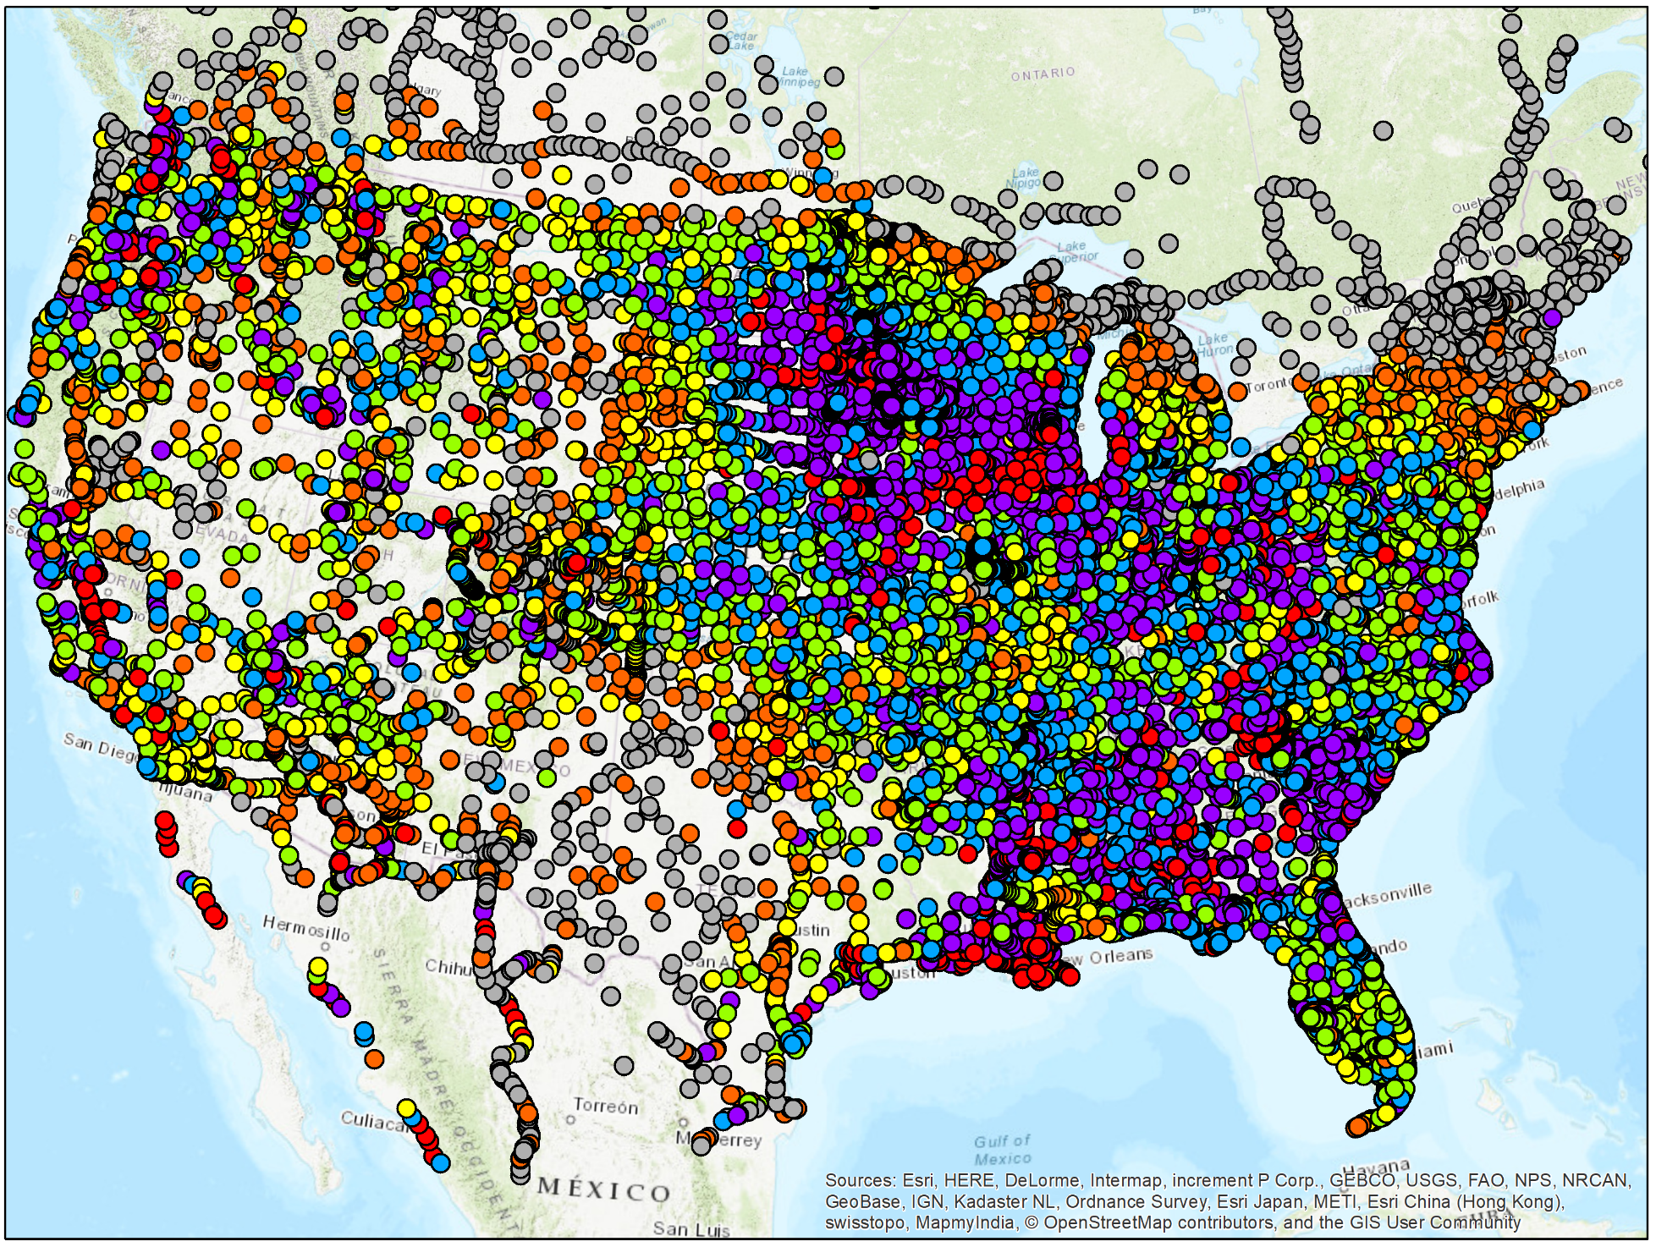
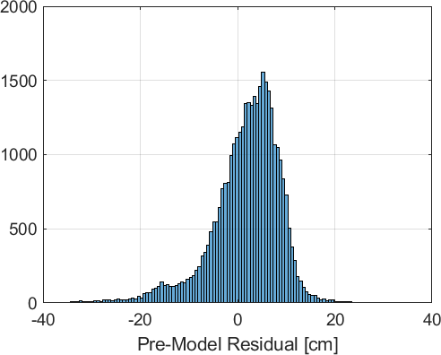
Pre-Model Residual
N is from xGEOID18 (gravimetric geoid model)

Slide 5
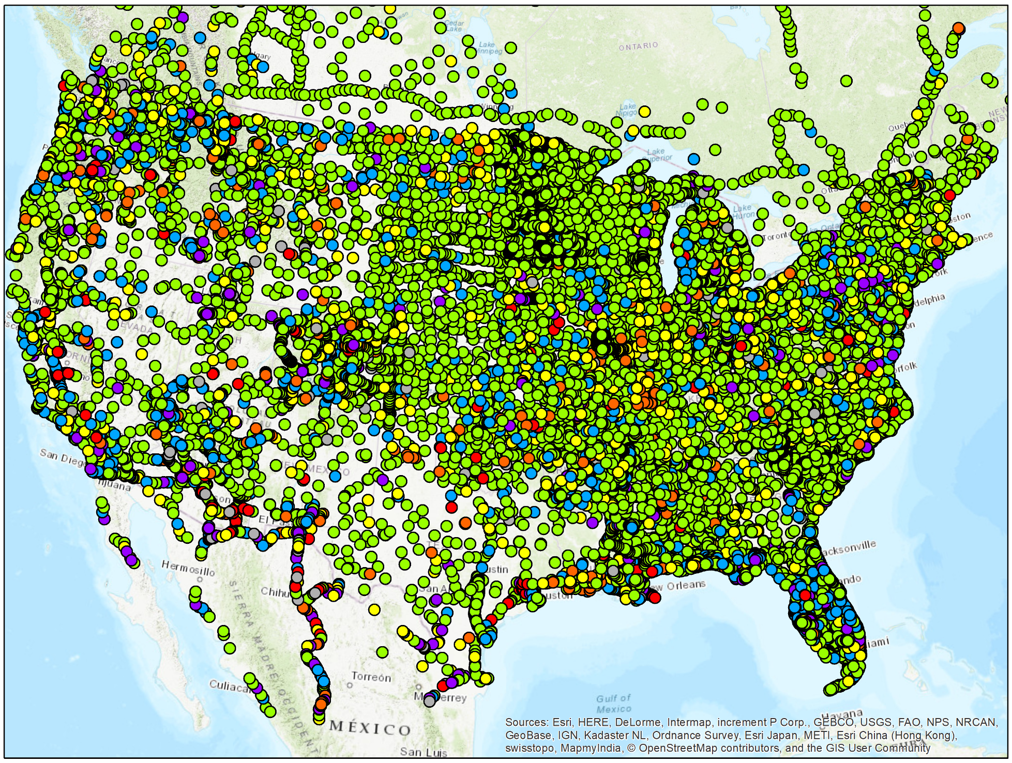
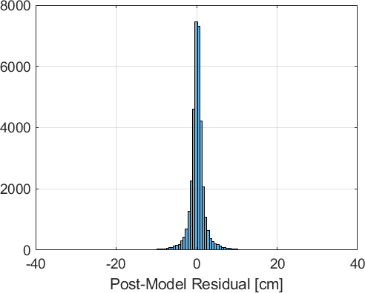
Post-Model Residual
N is from prototype hybrid geoid model
Notes:
After the OPUS Share info to show improvement

Slide 6
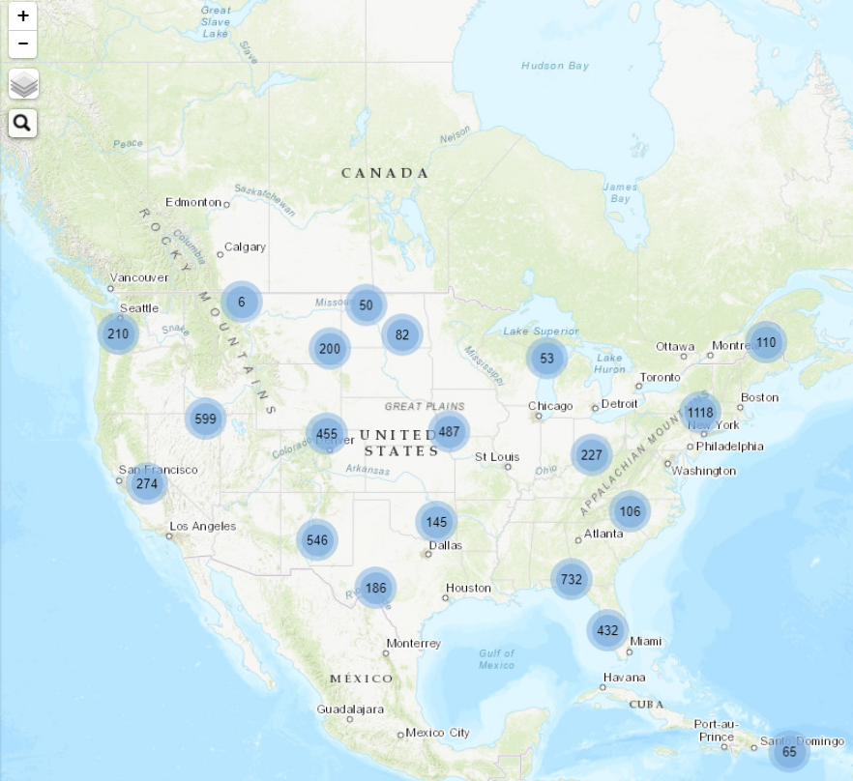

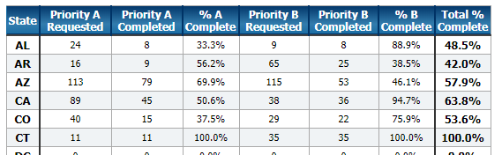
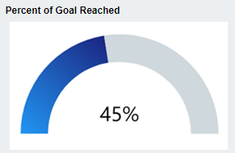
GPSonBM Priority List:
We asked for ~5,700
You delivered ~2,600
Tracking Map
Click on Clusters to Zoom In
Agency Type | % of Marks Submitted
State Agency | 76%
Private Sector | 14%
Federal Agency | 6%
County Agency | 4%
Academic | 2%
City Agency | 2%
Professional Society | 0.5%
Utility | 0.5%
Notes:
Use at end with teaser for new Priority List

Slide 7
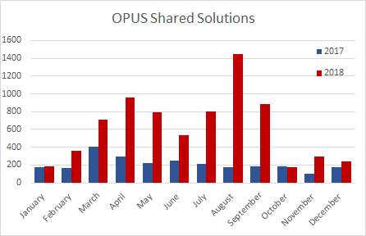
OPUS Share broke records every month in 2018
Thanks to you!
Notes:
Waiting for Amy

Slide 8
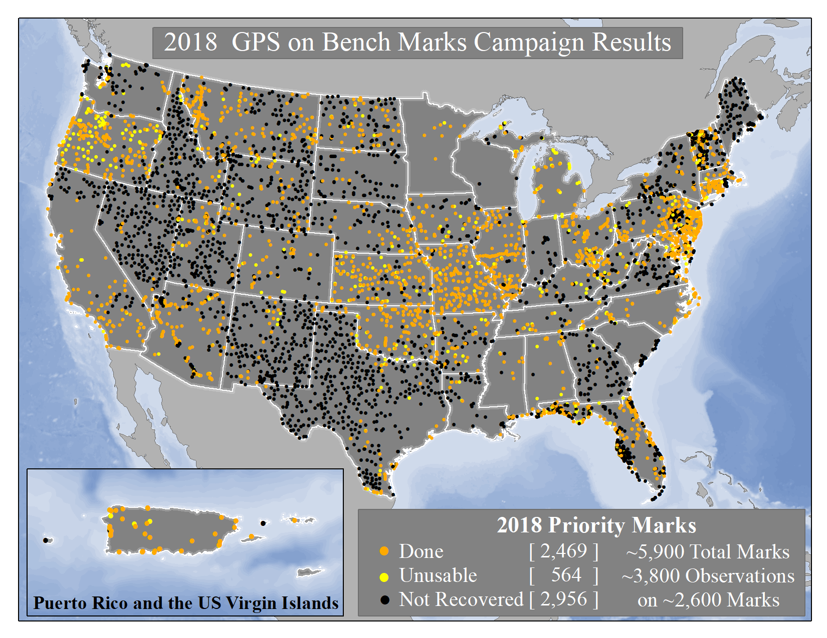

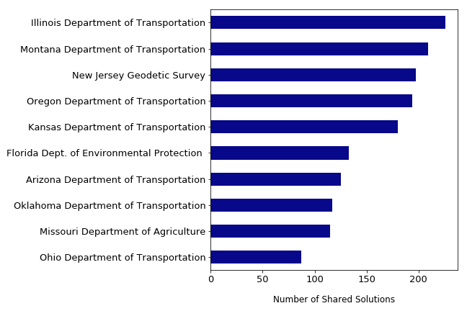
In 2018 NGS released a list of ~5,700 marks for crowd sourced data collection.
We received ~3,800 4+ hour observations on ~2,600 marks
Top 10 Submitters
Notes:
The 2019 GPSonBM Campaign will be kicking off during Surveyor’s Week in March.
Local data improves the local accuracy of national scale products and tools.
2018 GPSonBM Priority marks were targeted to fill data gaps and reduce uncertainty in GEOID18 which will replace GEOID12B
New GSPonBM efforts in 2019 will focus on collecting data to improve the transformation tools to the new datums in 2022

Slide 9
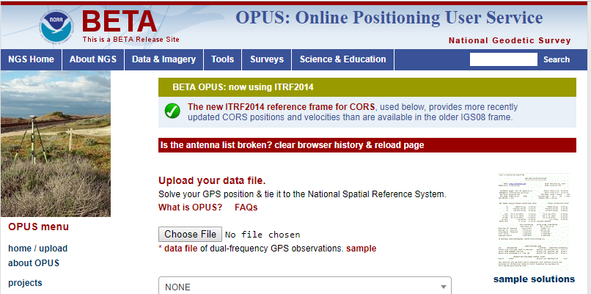

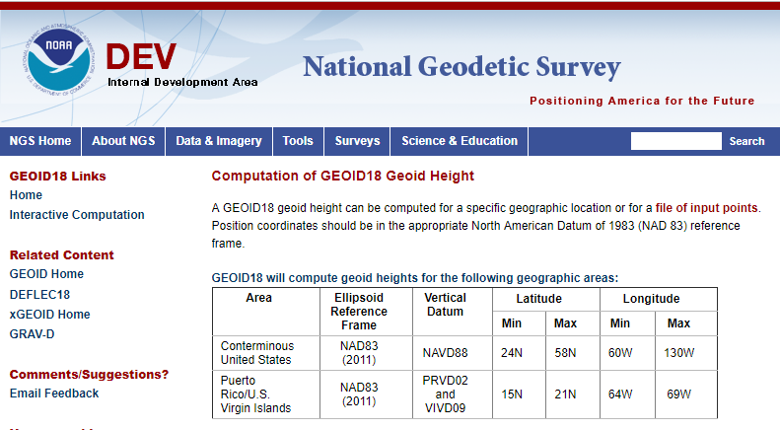
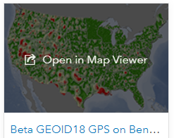
Review the results: Beta Test GEOID18
Explore the data for your local area:
  Beta OPUS
  Online computation pages for GEOID18 & DEFLEC18
  ArcGIS Online webmap
Send us feedback: ngs.feedback@noaa.gov

Slide 10
GEOID18

Slide 11
Beta GEOID18 Statistics
GPS on BM | Available | Flagged as bad fit | Used in Model | Number since GEOID12B | Used since GEOID12B
NGS IDB: | 30,128 | 1,987 (6.6%) | 28,141 | 6,610 | 6,324
OPUS Share: 2+ Obs. | 3,313 | 288 (8.7%) | 3,025 | 3,009 | 2,748
OPUS Share: 1 Obs. | 2,350 | - | 212 | 2,141 | 186
Canada | 579 | 14 | 565 | 0 | 0
Mexico | 247 | 41 | 206 | 0 | 0
Total: | 36,617 | 2,330 | 32,149 | 11,760 | 9,258
IDB Data through 5 Dec. 2018
OPUS Share Data through 10 Dec. 2018

Slide 12
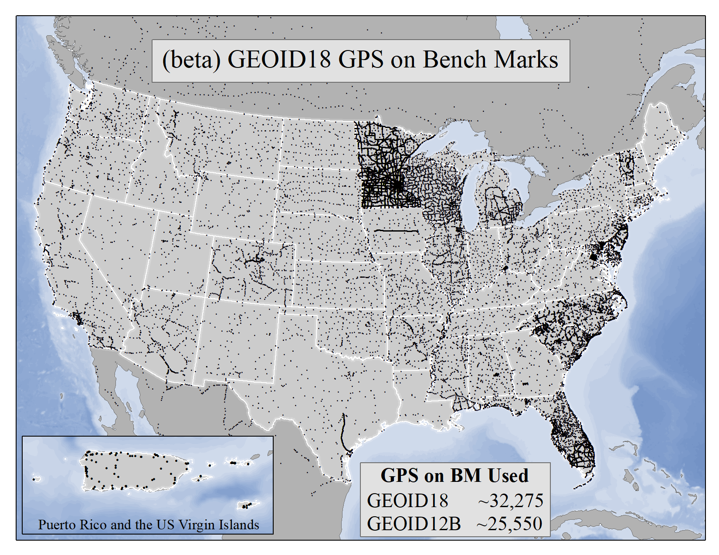
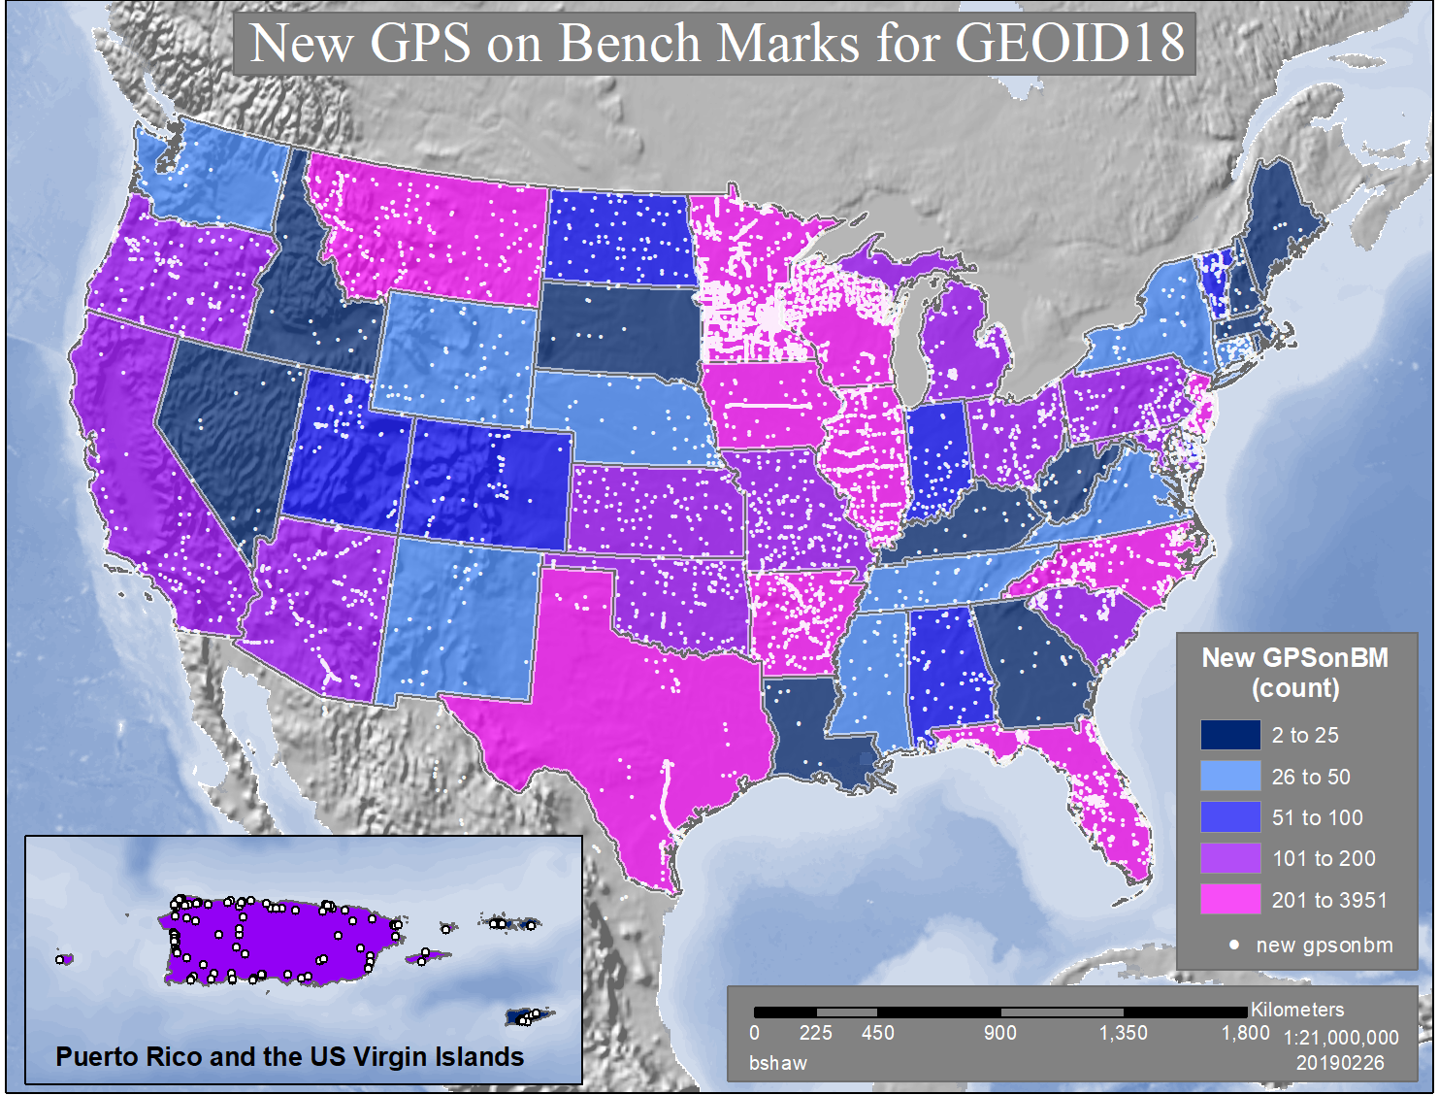
This map shows all new GPSonBM data since 2012, both OPUS Share and Bluebooked data, that were evaluated for inclusion in GEOID18

Slide 13
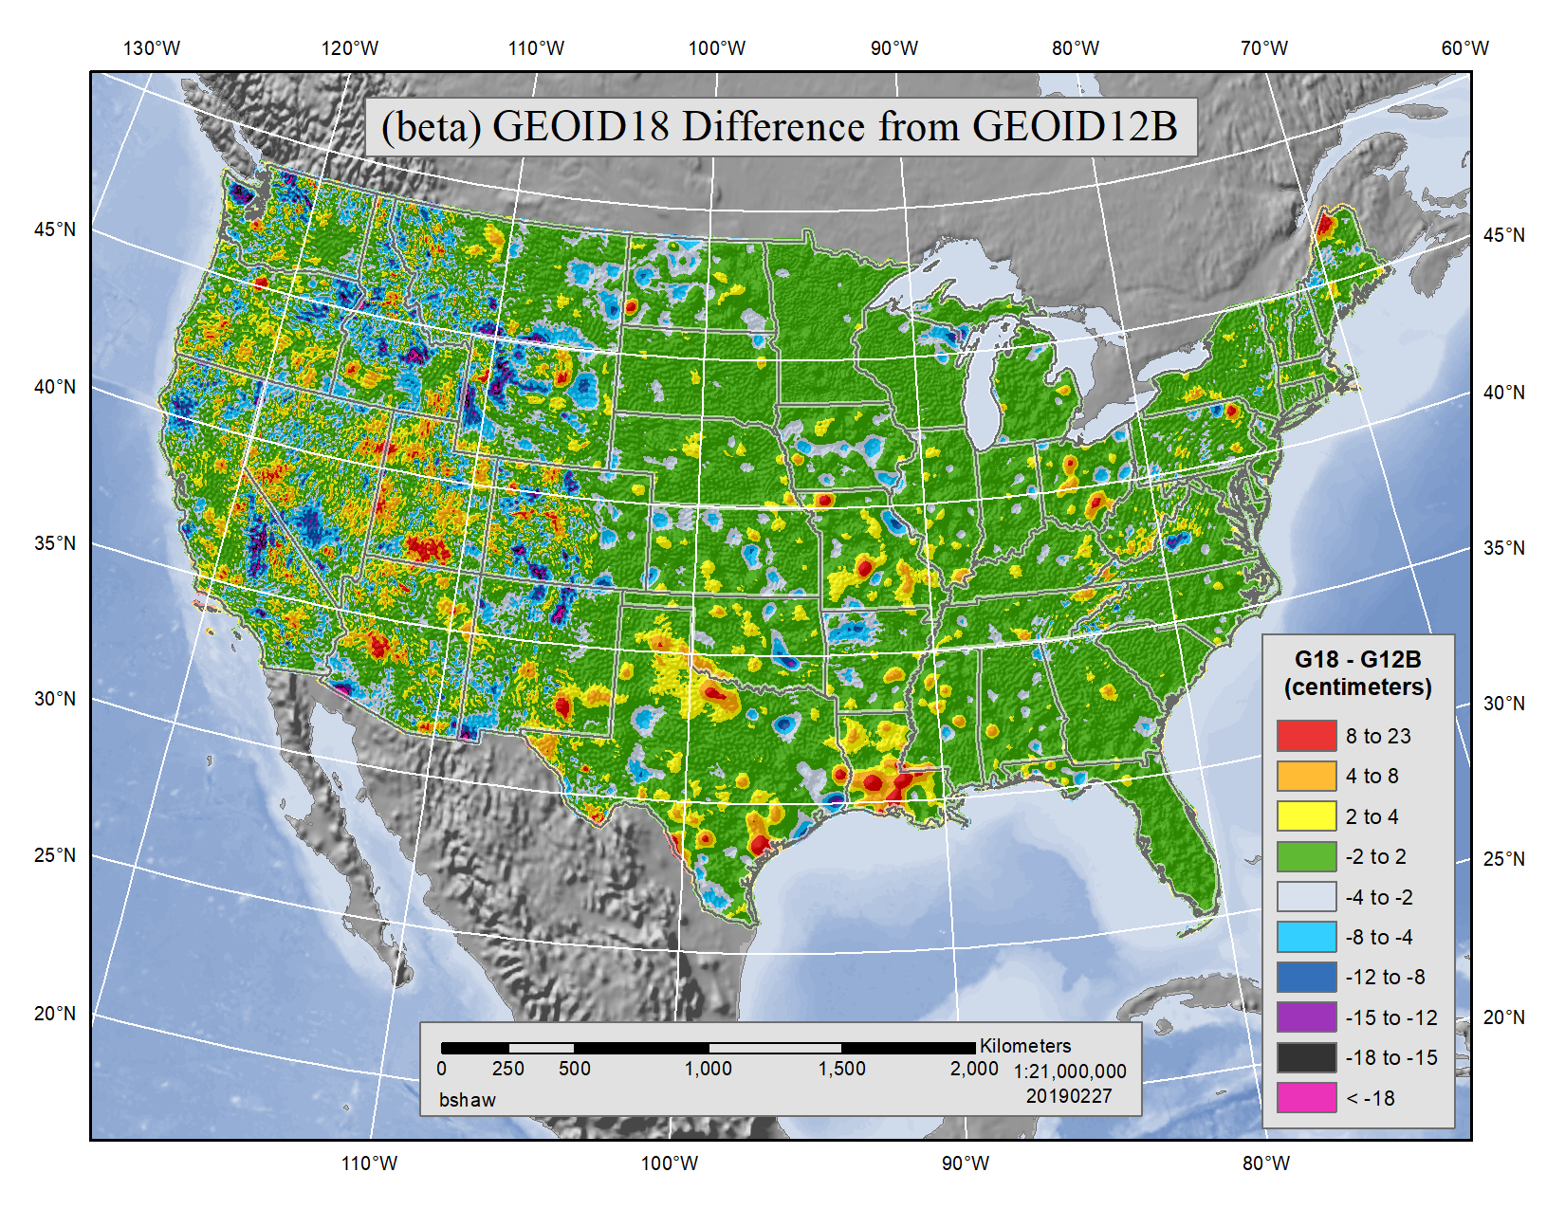
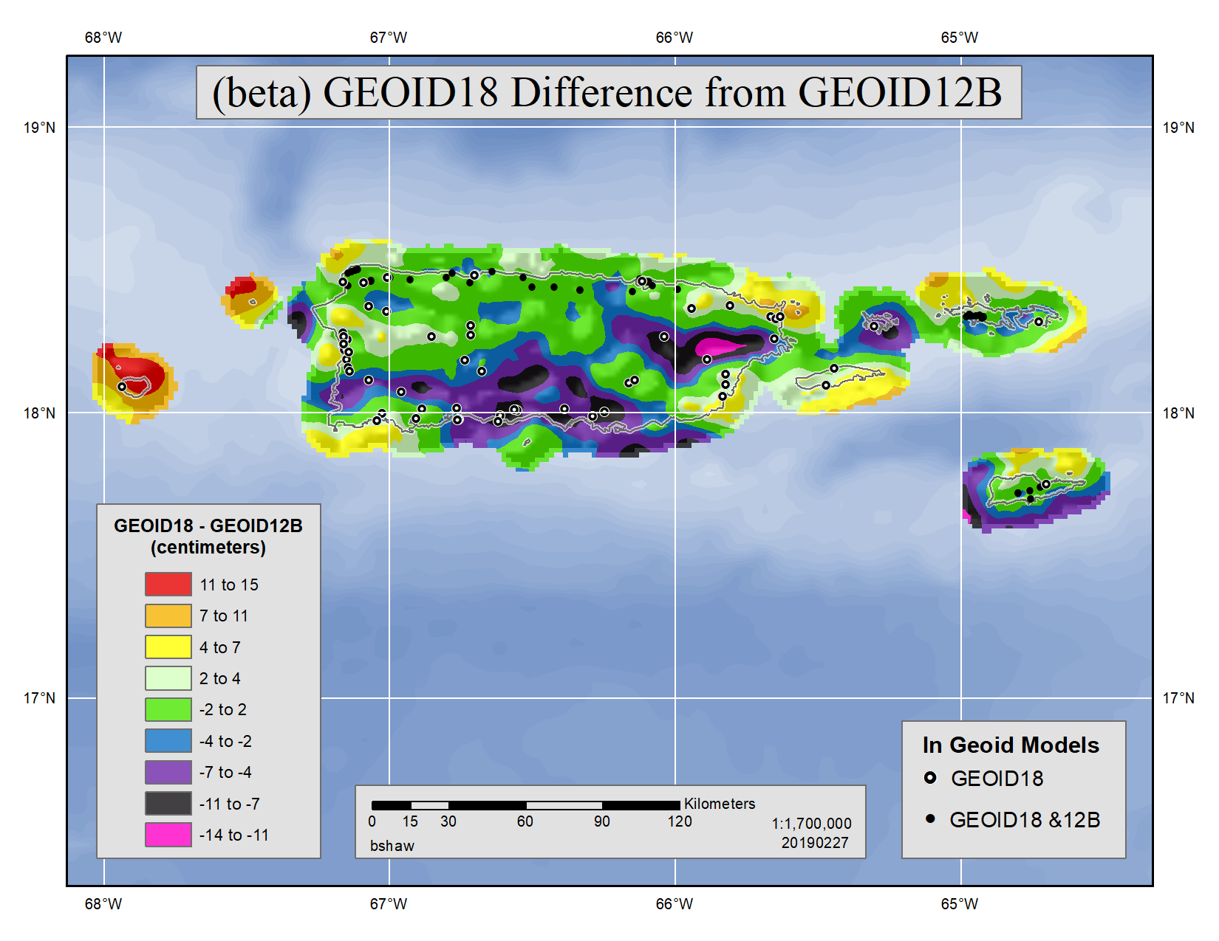
This map shows the magnitude of the differences / improvements from the previous hybrid geoid model, GEOID12B
Notes:
Add PR

Slide 14
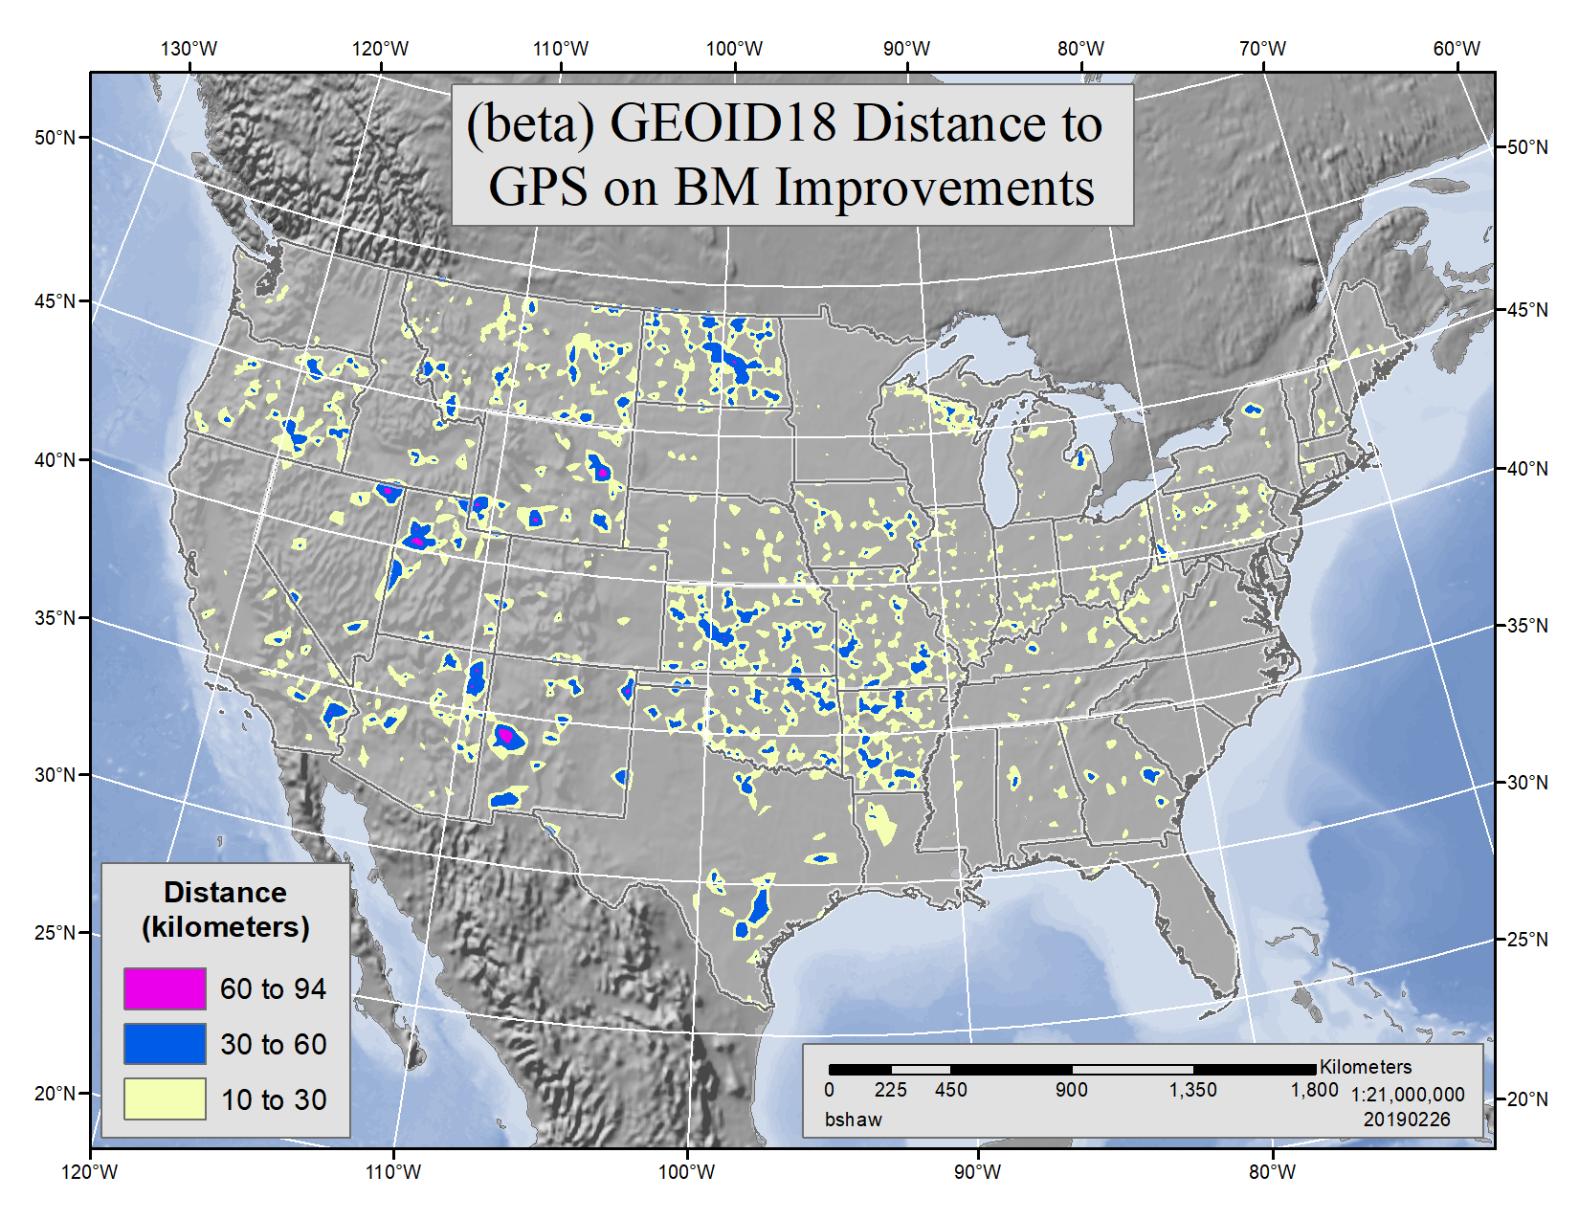
Hybrid geoid models need GPSonBM data at 30km spacing to properly constrain to NAVD88 published heights.
This maps shows data gaps filled by new GPSonBM data

Slide 15
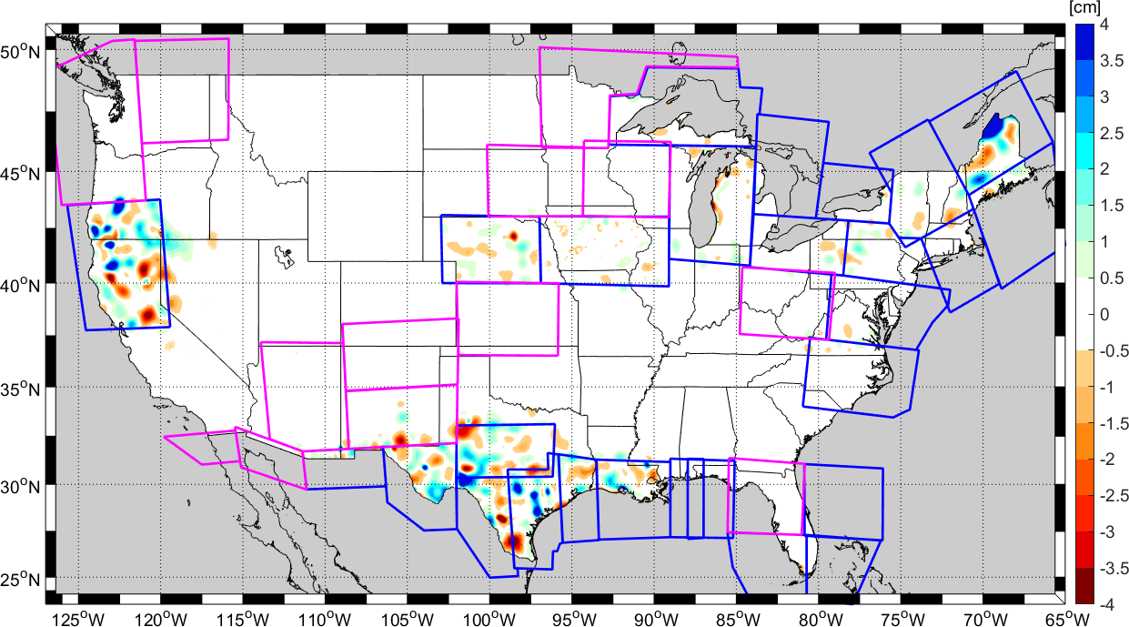
Impact of GRAV-D
Notes:
Blue boxes illustrate areas where GRAV-D is currently being used in the underlying gravimetric geoid model (and the hybrid geoid model). Magenta boxes show areas where NGS has GRAV-D data currently available and plans to incorporate into an updated gravimetric geoid model (→ xGEOID19).

Slide 16
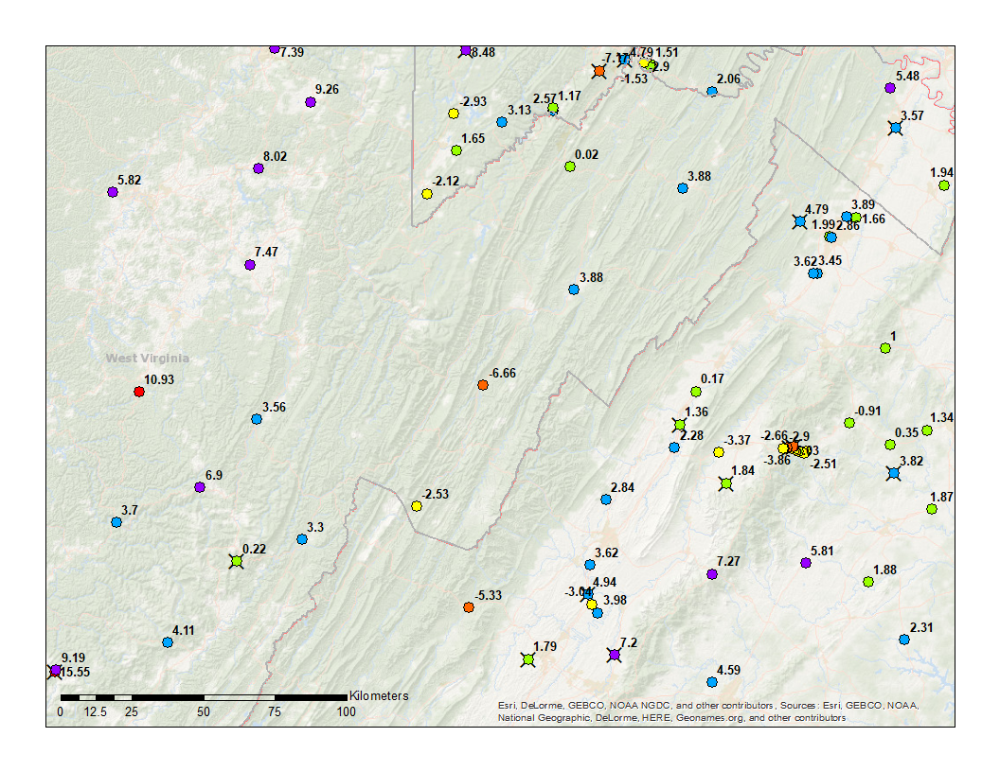
HW1435
Two solutions from WVDOH in 2018 in OPUS Share
Ellip. Heights: 384.810 & 384.835
HW1435

Slide 17
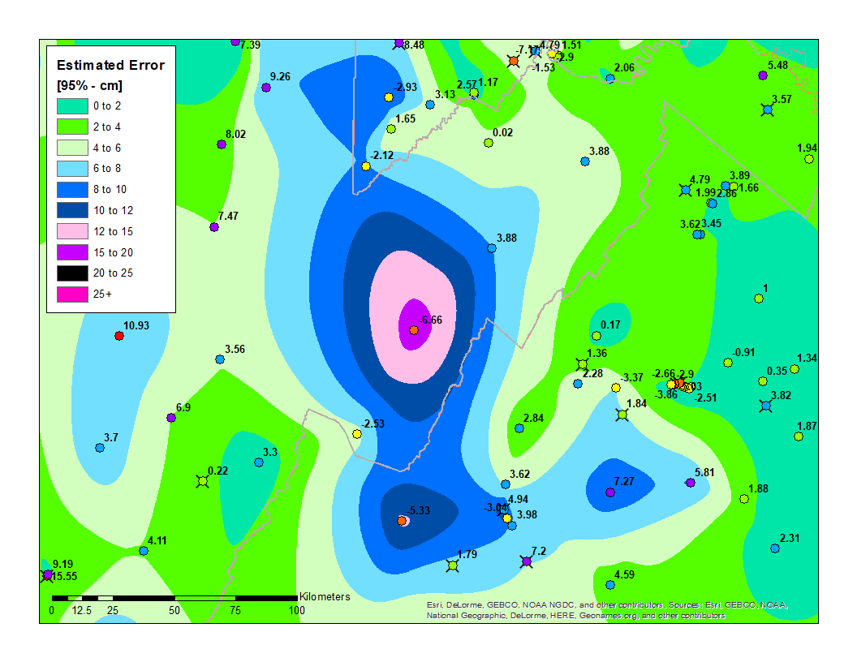
Location Specific Error Estimates
Cross Validation (“Leave-one-out”)
32,149 Geoid Model Runs
For HW1435 (it is removed for the calculation):
Estimated residual = -17.34 cm
The observed residual = -25.98 cm
For a small uncertainty (on HW120) →
Estimate = -17.89 cm vs Observed = -18.94 cm
HW1435
HW1200
Notes:
Estimate the residual from a run of the geoid modeling w/o a given mark then compare an estimate with the observed residual. Areas with large values signify a larger disagreement between the residual values in neighboring bench marks and thus higher uncertainty in the hybrid geoid model
This map shows the location-specific estimated error. This is largely based on a cross-validation (aka “leave-one-out”) estimation technique. In this technique, an individual geoid model is created for each individual bench mark with the suspect bench mark removed from the modeling. This results in an estimate of the GPS-leveling (h-H) value that can be compared against the observed GPS-leveling value. Doing this for every bench mark (32,000+), we get a sense of the general location-specific consistency of the model.
This is NOT a true error propagation. All error estimations are imperfect - full of assumptions and shortcuts. One issue with this technique is that it breaks down significantly in areas far from a bench mark. At distances of 30 km+, the Least Squares Collocation error estimate based on the covariance of the residuals is used.

Slide 18
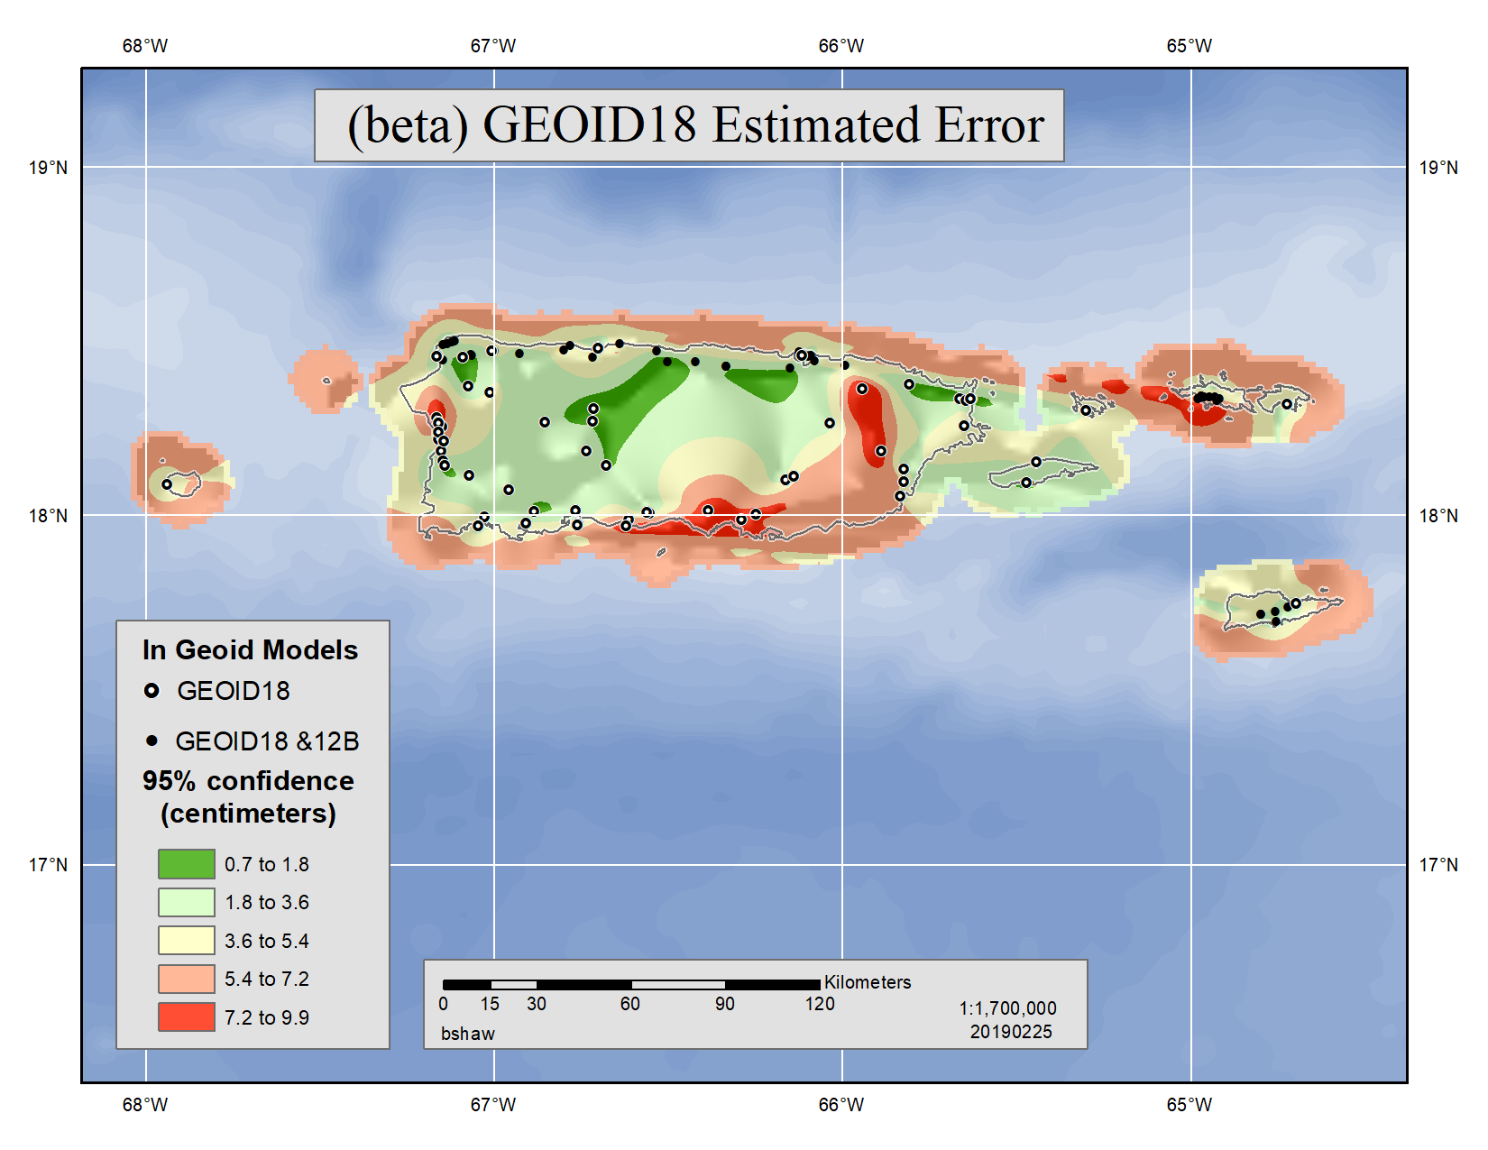
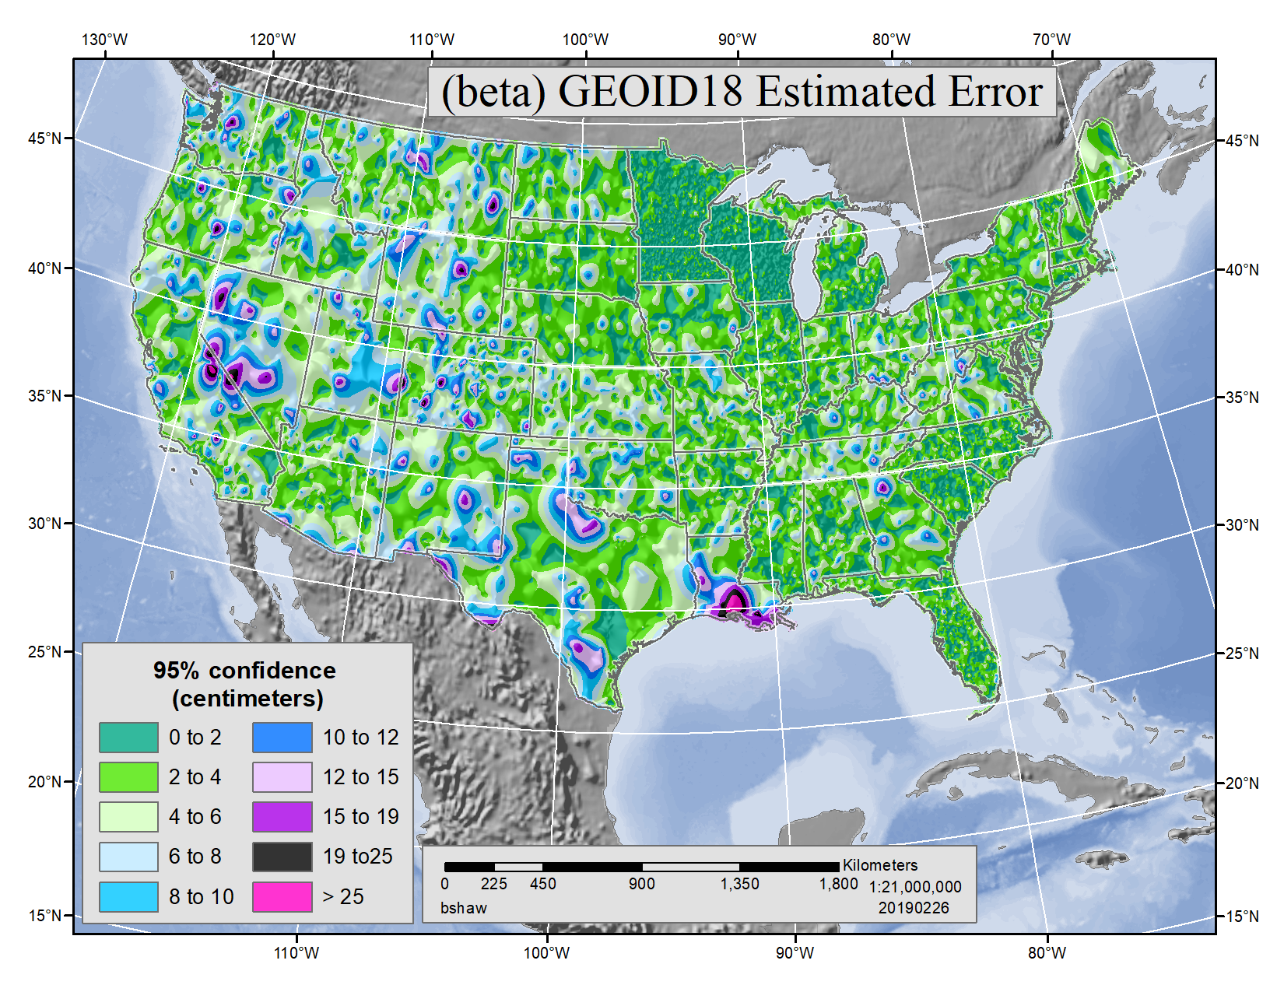
This map shows the location-specific estimated error. This is largely based on a cross-validation (or “leave-one-out”) estimation of the error in the model.
Areas with large errors signify a larger disagreement between the residual values in neighboring bench marks and thus higher uncertainty in the hybrid geoid model.
Notes:
This map shows the location-specific estimated error. This is largely based on a cross-validation (aka “leave-one-out”) estimation technique. In this technique, an individual geoid model is created for each individual bench mark with the suspect bench mark removed from the modeling. This results in an estimate of the GPS-leveling (h-H) value that can be compared against the observed GPS-leveling value. Doing this for every bench mark (32,000+), we get a sense of the general location-specific consistency of the model.
All error estimations are imperfect - full of assumptions and shortcuts. One issue with this technique is that it breaks down significantly in areas far from a bench mark. At distances of 30 km+, the Least Squares Collocation error estimate based on the covariance of the residuals is used.

Slide 19
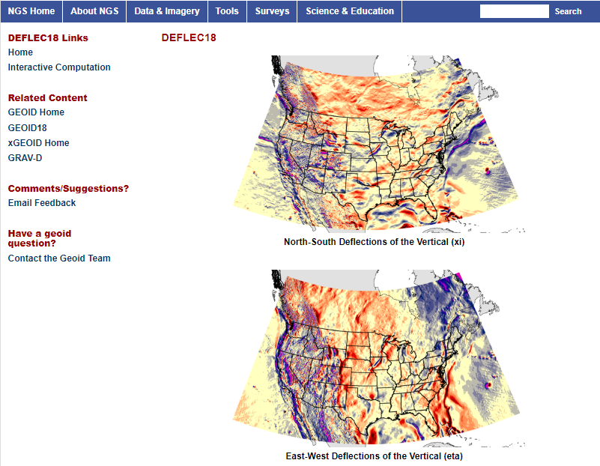
DEFLEC18
DEFLEC18 is a companion product derived from the 2018 hybrid geoid model (GEOID18), and represents the deflections of the vertical (DOV's) at the surface of the Earth. These DOV's are also in the NAD 83 (2011) reference frame. These quantities are typically a few arc seconds, but can reach an arc minute of departure.

Slide 20
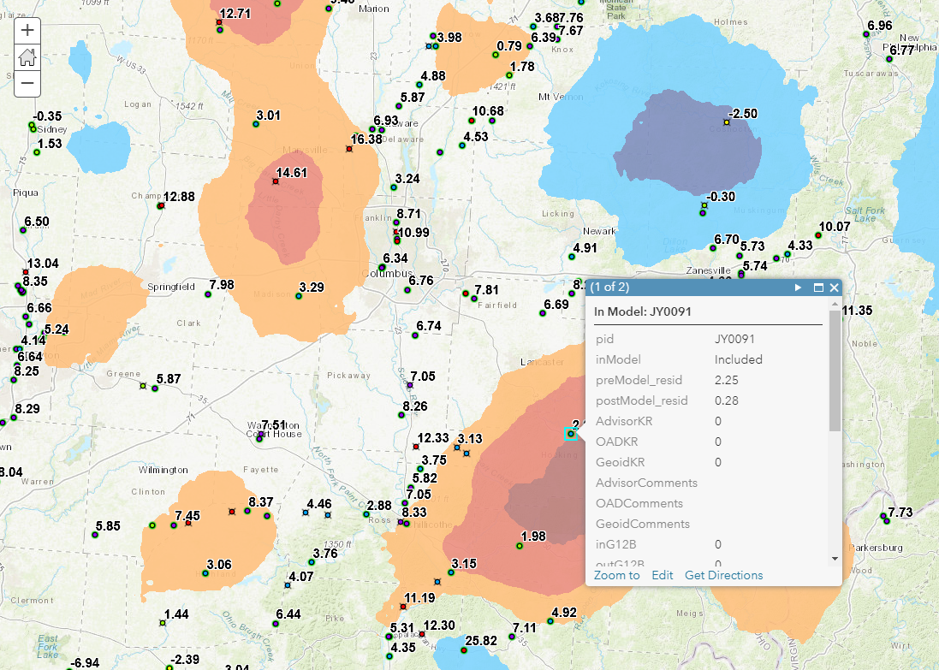
Data Sharing Tools
GEOID12B GeoPDF
Public facing ArcGIS Online Webmap will be released to enable evaluation of GPSonBM data used and the improvements in the model resulting from new data

Slide 21
GEOID 18 Project Time Line
Beta GEOID18 released for public comment (Beta OPUS and online computation pages) | 3/4/2019
Incorporate feedback & make necessary fixes
Integrate new geoid into other NGS products (OPUS, datasheets)
Final Product Release* | Summer 2019
*Final release of GEOID18 is pending progress on xGEOID19 for the added GRAV-D blocks.

Slide 22
GPSonBM Look ahead

Slide 23
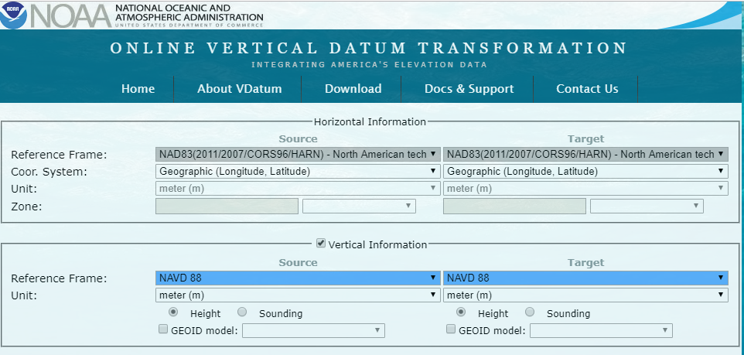
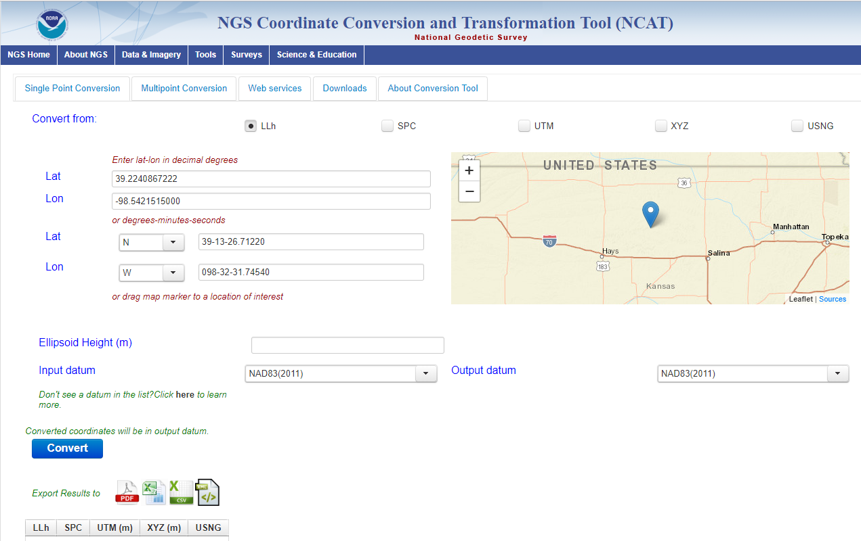
GPSonBM Lives On!
The GPSonBM program will now shift gears to focus on collecting data to provide local improvements to other national scale NGS products. A new Priority List will be released for National Surveyor’s Week

Slide 24
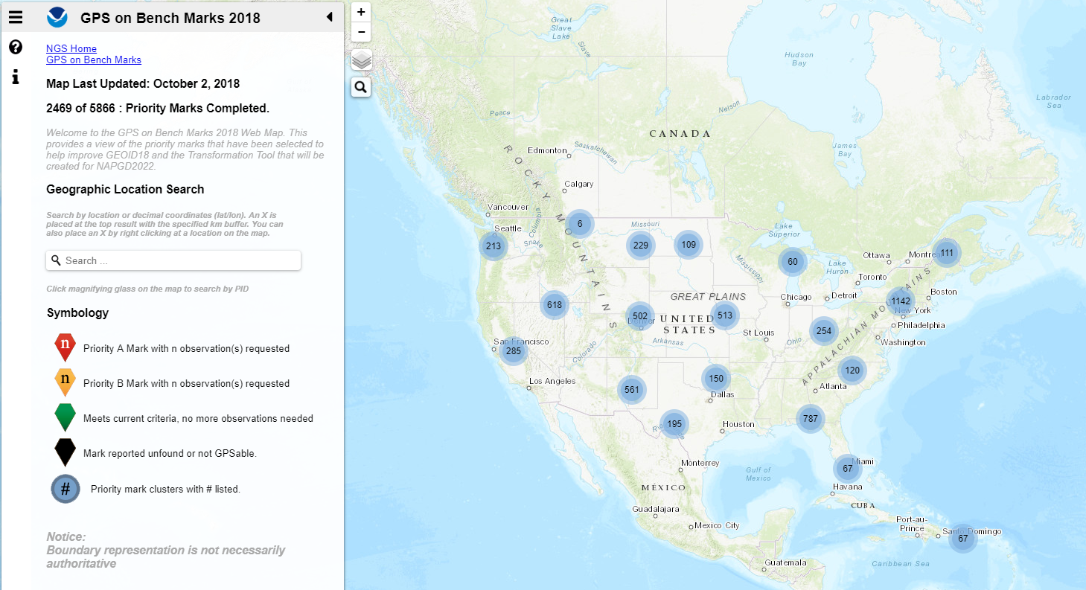
Get Involved!
Consult the GPSonBM webpage for the latest Prioritized List
Contribute static data through OPUS Share
Submit Mark Recoveries using new Online Mark Recovery webpage

Slide 25
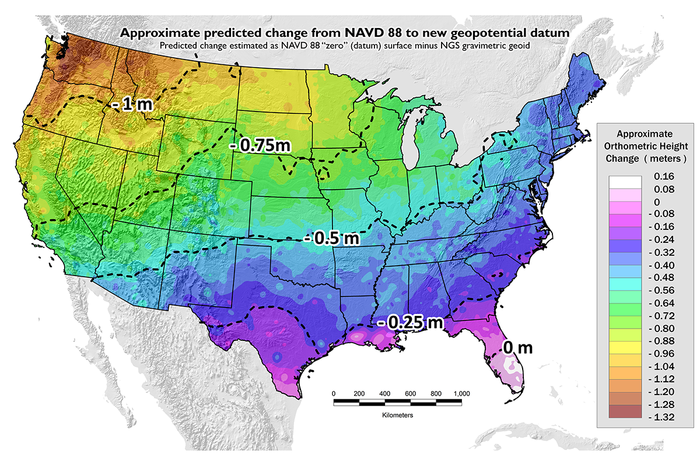
Change in Height from NAVD 88 to NAPGD2022
GPSonBM data will be used create the transformation tool for NAPGD2022
Notes:
Swap for new map

Slide 26
Additional Benefits of GPSonBM Data
Improve NCAT and VDatum
Update Passive Control Status
Automatic Reprocessing in 2022
Identify marks suspected of movement
Establish RTN Check Stations
Test and Evaluate Intra-frame Velocity Model (IFVM)
Validate Static Gravimetric Geoid
Notes:
Improve NCAT and VDatum (GPS for Transformation Tool PRB Project): Shared solutions provide local data to improve the local quality of Transformation Tools that will be developed with the New Datums.
Update Passive Control Status: shared solutions provide NGS and other users with a window to the health of the passive control network and form a reconnaissance tool for project planning.
Identify marks suspected of movement: With a background processing scheme that includes age and quality of leveling and historic GPS observations, GPSonBM data could be used to automatically flag unstable marks.
Automatic Reprocessing in 2022: Shared data will be reprocessed after New Datums release in 2022 and shared marks will be given new coordinates automatically
Establish RTN Check Stations: Marks with required observation length and data quality standards can be used as RTN Check Stations (for X amount of time after the Shared observation)
Test and Evaluate Intra-frame Velocity Model (IFVM): repeat OPUS shared solutions over time can provide NGS with a way to evaluate IFVM performance in modeling land motion in gaps between CORS.
Validate Static/Dynamic Gravimetric Geoid: GPS\Leveling data is one of the few independent datasets and one of the most common ways to validate a gravimetric geoid model. Assuming high-quality data, NGS will continue to use GPS on Bench marks to perform this external validation.

Slide 27
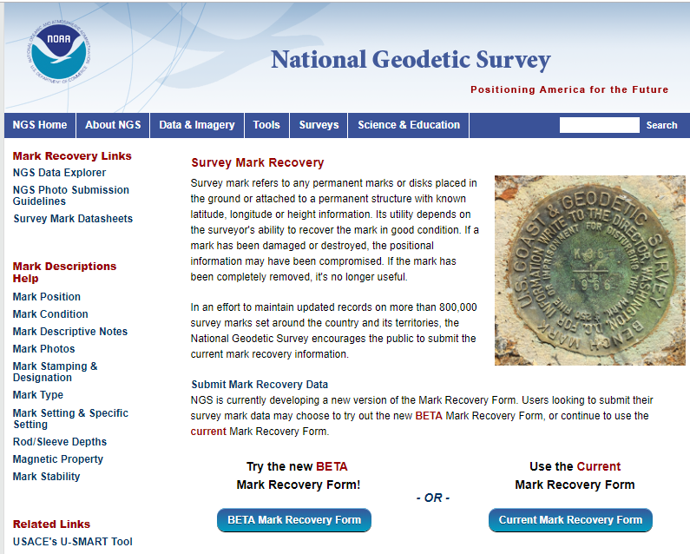
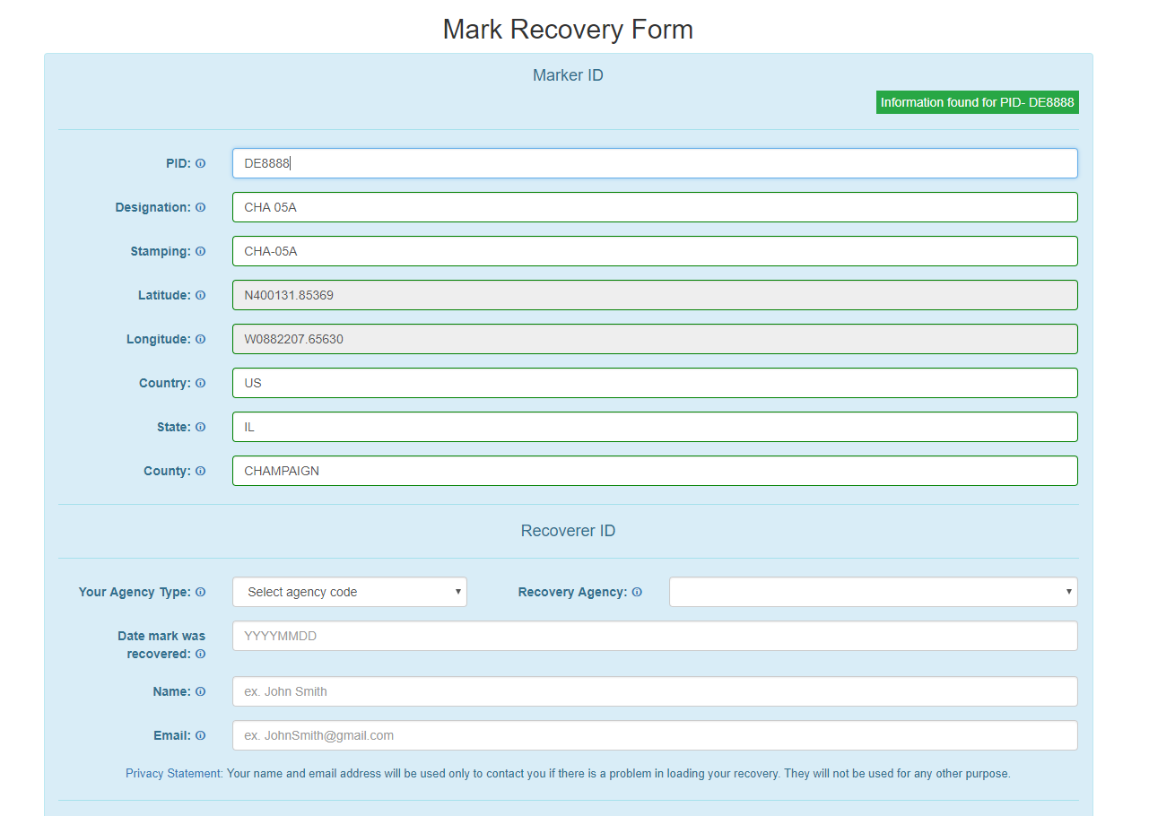
New Mark Recovery Webpage
Submitting recovery information will let NGS and others know if the mark is still usable and pictures will make it easier to find.
www.ngs.noaa.gov/surveys/mark-recovery
Notes:
Add link to new beta Mark Recovery page

Slide 28
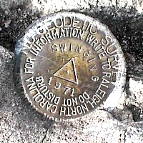
OPUS Requirements for Sharing
GPS Observation: Collect 4+ hours of data on a bench mark
Description: Provide details of how to locate mark (To Reach)
  Example: Located in the SW corner of a 2 ft square concrete pad projecting 0.3 ft above ground, 3.3 ft S from S edge of sidewalk...
Accurate antenna height and type values
2 photos:
  close-up photo (avoid dark/blurry/dirt-covered)
  horizon photo (show equipment in use)
Notes:
- We keep the minimum session time at 4 hours for OPUS share
- Longer sessions = better probability of fixing ambiguities and cancelling some errors in GNSS
Incorrect antenna height is often the cause of an inaccurate orthometric height
Example description at the top
OPUS share requirements
https://geodesy.noaa.gov/OPUS/about.jsp#sharing
OPUS webinar from Dec 2016
https://geodesy.noaa.gov/web/science_edu/webinar_series/understanding-opus.shtml

Slide 29
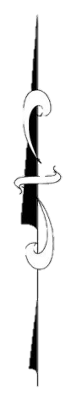
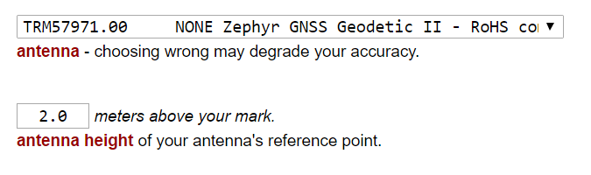
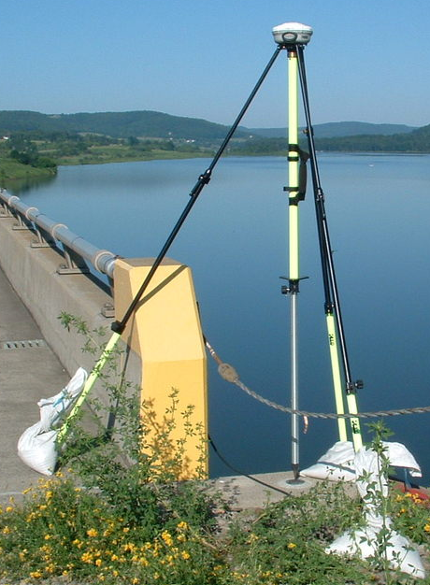
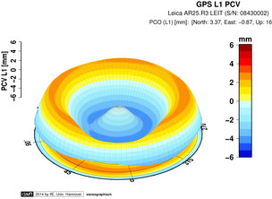
Antenna Type & Antenna Height are crucial for accurate results
rotate NRP to face true north
ARP
Each Antenna Type has unique biases
antenna height
For antenna calibrations, photos,
ARP and NRP diagrams, see geodesy.noaa.gov/ANTCAL/
mark
JGE, 2015

Slide 30
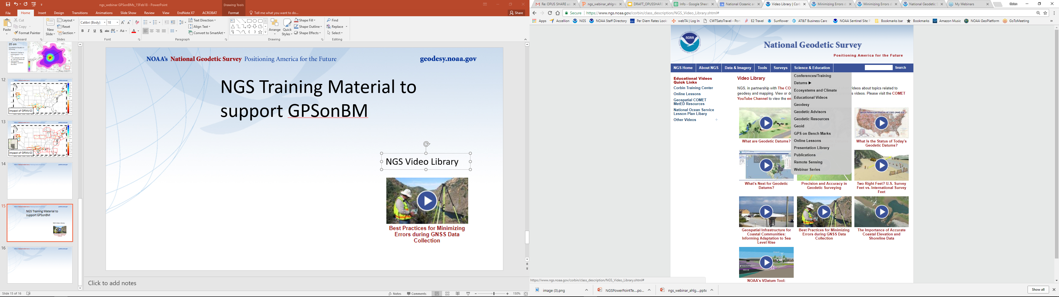
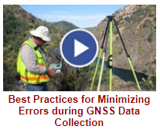

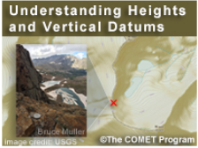
NGS Training Material
GPS on Bench Marks Webpages
NGS Video Library
NGS Online Lessons

Slide 31
Questions?
GEOID18 Feedback: ngs.feedback@noaa.gov
GPSonBM Team: ngs.gpsonbm@noaa.gov

Slide 32
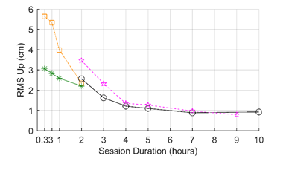

Why do we need 4 hours of data?
NGS is working on OPUS for RTK that will accept 3 minute observations, however the accuracy will NOT be as good as 4 hour observations.
1 sigma
Graph Courtesy of Dr. Daniel Gillins
Notes:
Better solutions with lower RMS are important for creating the hybrid geoid model. The Transformation Tools will need a higher density of data, so we are willing to trade a decrease in accuracy for the ability to get data on many more marks.

