Slide 1
GPS on BenchMarks:
Building on the Past to Prepare for the Future
2021 NGS Geospatial Summit
May 5th, 2021
NOAA’s National Geodetic Survey
GPSonBM Team:
Galen Scott, NGS Constituent Resources Manager
Dr. Kevin Ahlgren, Geodesist & Geoid Modeler
Brian Shaw, Rocky Mountain Regional Geodetic Advisor

Slide 2
Poll Question
Have you participated in GPSonBM program

Slide 3
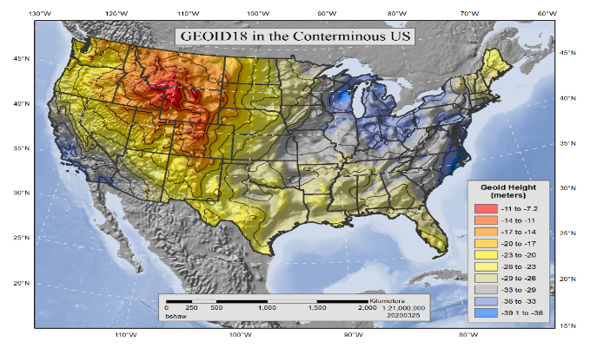
GPSonBM is Driving a Surge in Shared OPUS Solutions
Modernized NSRS will be Realized through Shared GNSS Data
2021 NSRS Mod Campaign
2018 GEOID18 Campaign
2020 Transformation Tool Campaign
2019 Transformation Tool Campaign Launch
Notes:
GPSonBM History overview:
2007- Launched OPUS Database / Sharing
2014 -2017 – Outreach event for National Surveyor’s Week – People asked for specific target marks – started with static lists
2018 – GEOID 18 Campaign – Priority marks & 30km spacing goal
2019 – 2021 – Transformation Tool Campaign – 10km goal
2021 and on – NSRS Modernization Preparation –REC’s & SEC’s

Slide 4

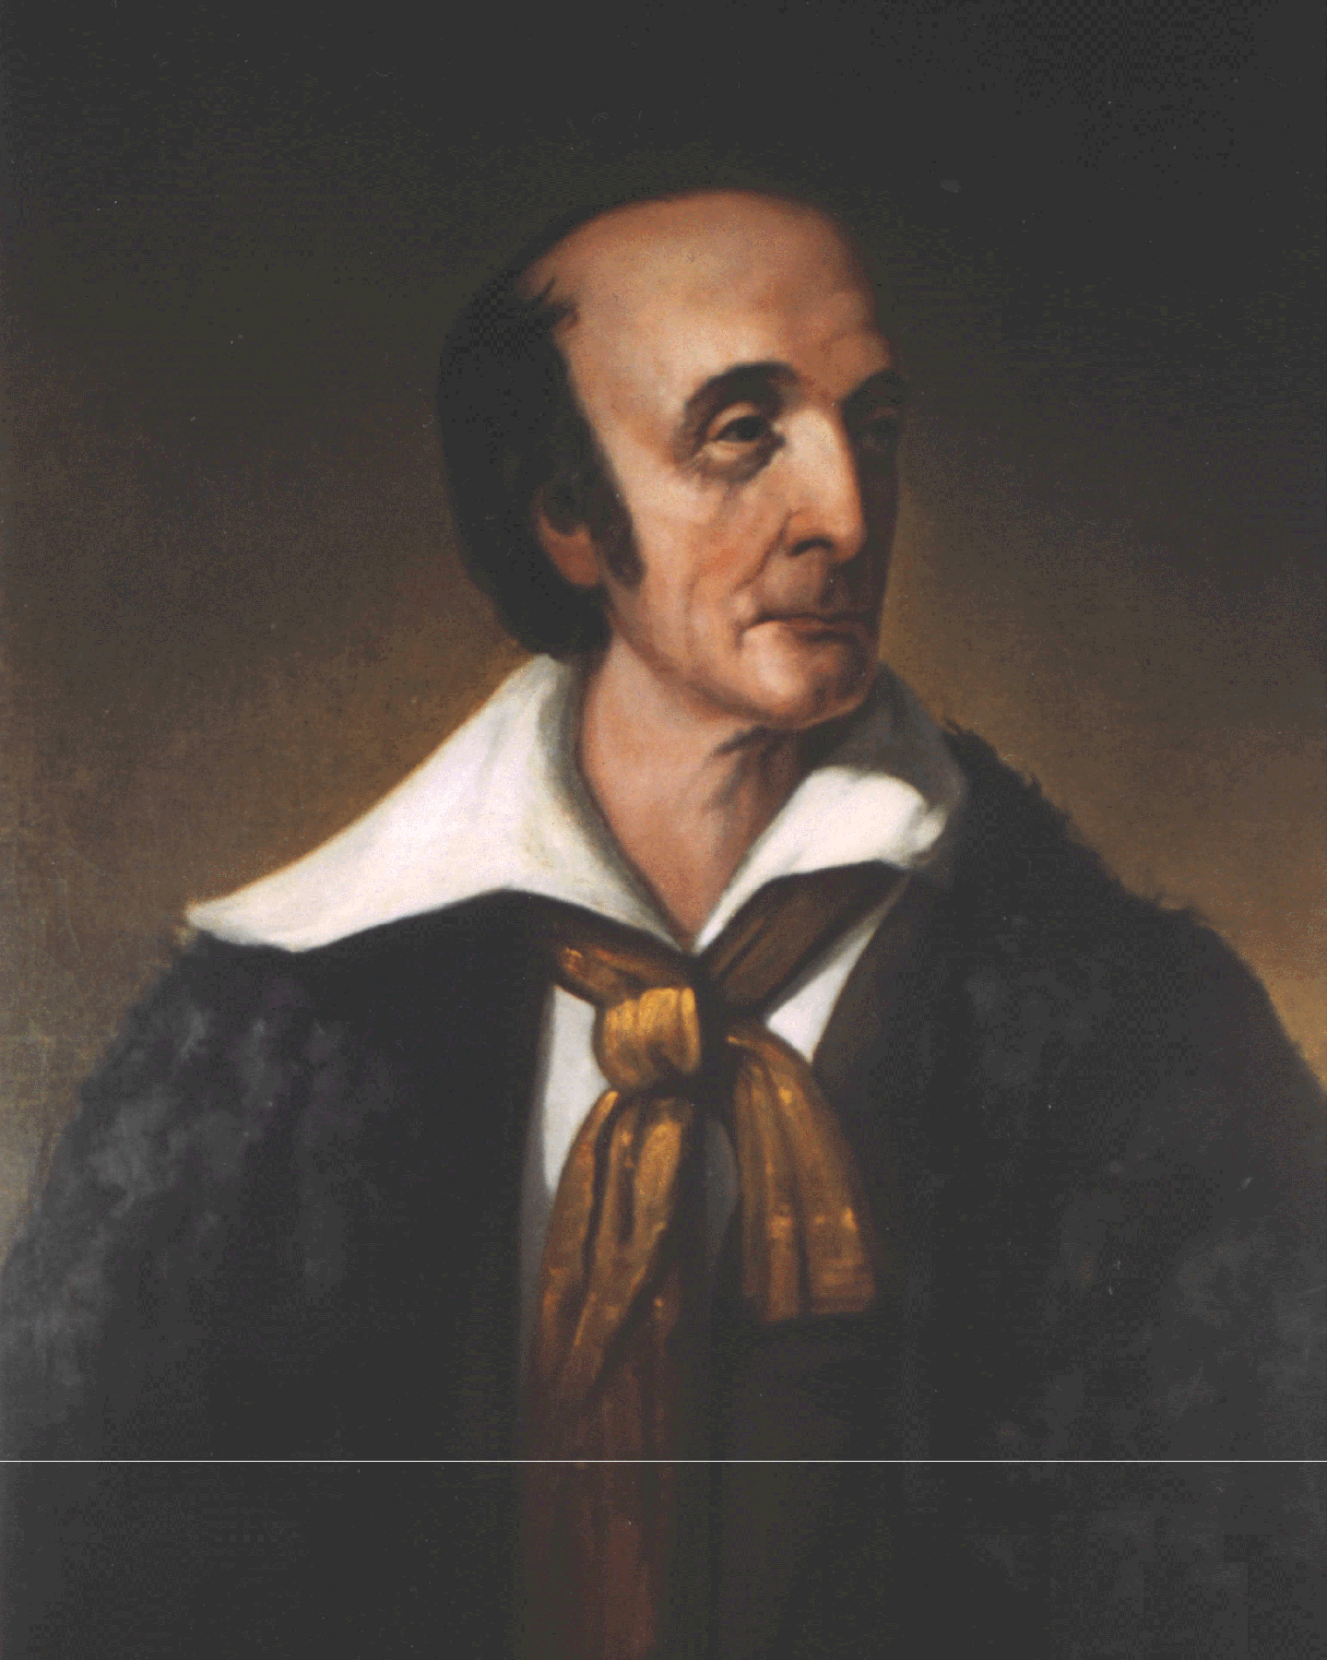




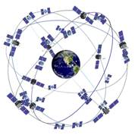
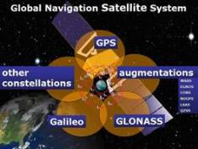
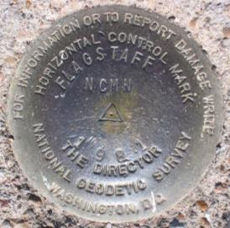
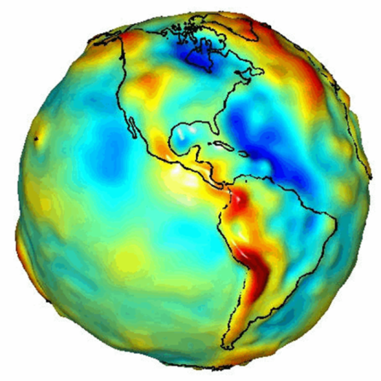
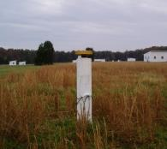
National Geodetic Survey and the NSRS
Part of our Nation’s first civilian science agency.
  1807
  Thomas Jefferson
  Survey of the Coast
  1878
  Ferdinand Hassler
  U.S. Coast and Geodetic Survey
  1970
  NOAA is established in US Department of Commerce
The National Spatial Reference System continues to evolve with us.
Active
Control
(CORS)
Passive
Control
(Monuments)
  GNSS
  GPS
  GEOID
Notes:
(Pictured are Thomas Jefferson and Ferdinand Hassler, the first Superintendent of the Coast Survey).
The National Geodetic Survey, part of our Nation's first civilian scientific agency, the Survey of the Coast, which was established by President Thomas Jefferson in 1807 after Lewis and Clarke came back and they discussed the importance of accurate maps to support commerce.
What started as a Mission to survey the U.S. coastline and create nautical charts of the coast to help increase maritime safety expanded as the Nation grew westward and surveys of the U.S. interior began. In 1878 the agency was given a new name, the U.S. Coast and Geodetic Survey (USC&GS), which it maintained until 1970. At that point, the National Geodetic Survey became part of the National Oceanic and Atmospheric Administration, NOAA. For much of our history, NGS and its predecessor agencies have collaborated with public and private organizations to establish reference stations at precisely determined locations.
Traditionally, precise positioning locations have been identified by setting a survey mark—usually a brass, bronze, or aluminum disk. Locations might also be identified by a deeply driven rod, or a prominent object, such as a water tower or church spire. Over the years, NGS has collected and stored survey data on over a million of these survey marks around the US.
In the 1980’s NGS helped usher in the modern era of positioning by finding new civilian uses for the GPS system which DoD designed to allow them to put a missile through a window anywhere in the world. First by using multiple GPS receivers and putting them on the known locations of our existing survey control marks, NGS helped to unlock GPS as a surveying tool for the civilian market.
Since then, NGS has fostered a network of continuously operating reference stations (CORS), where each CORS includes a highly accurate receiver that continuously collects radio signals broadcast by GPS. In addition, over the past decade, many other countries have launched their own satellite systems and they are collectively known as Global Navigation Satellite System (GNSS) satellites. These systems include:
GPS (United States)
Compass (China)
GLONASS (Russia)
Galileo (European Union)
GPS and the other GNSS systems provide what are called “ellipsoid heights” or heights relative to a specific mathematical model of the earth which is smooth, and of course ellipsoidal. Strange as it sounds, by themselves, ellipsoid heights won’t always tell you which way water will flow, which is a very important questions for many applications (think sewer pipes and flood maps). For that, you also need to account for gravity. So, by the 1990’s NGS started developing geoid models, or models of gravity, for surveyors to use with the ellipsoid heights from GPS. As we began to add GPS into the Surveyor's toolbox and use it with the existing datums of NAD 83 and NAVD 88, NGS used GPS data on existing survey control marks to create what are called hybrid geoid models. Starting with GEOID96 NGS has produced a series of 9 hybrid geoid models over 23 years, each one incorporating the newest data and latest advances in modeling. GEOID18 is currently the official hybrid geoid model for determining GPS derived NAVD88 orthometric heights.
Looking to the Future in the Modernized NSRS, NGS will provide a purely gravimetric geoid model, unencumbered by the warping to the existing network of survey marks and the datums from the last century. GEOID2022, or geoid unchained!, will provide the foundation for the promised 2cm GNSS heights in the Modernized System.

Slide 5

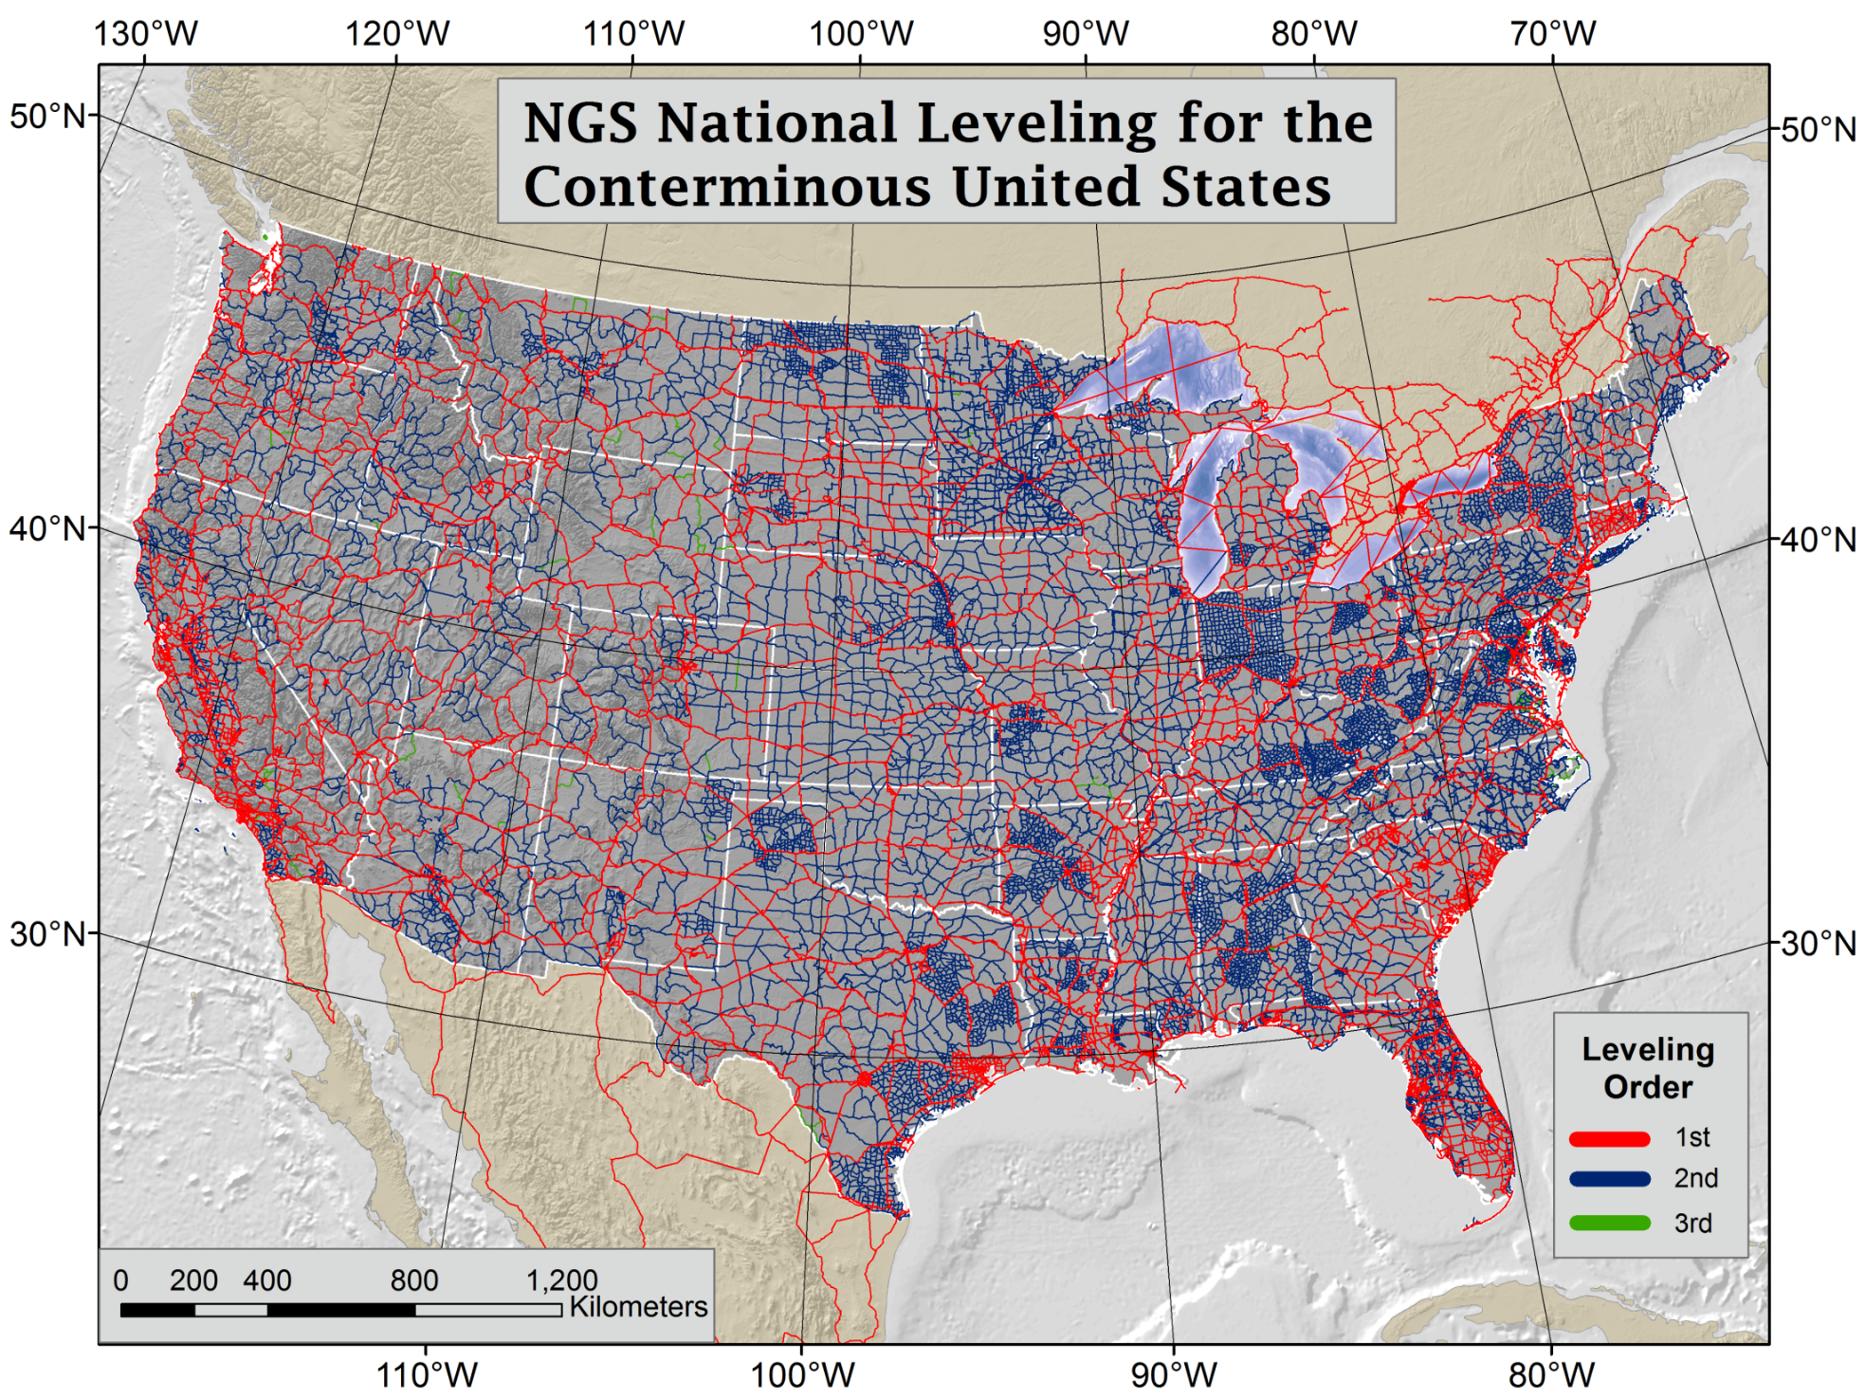
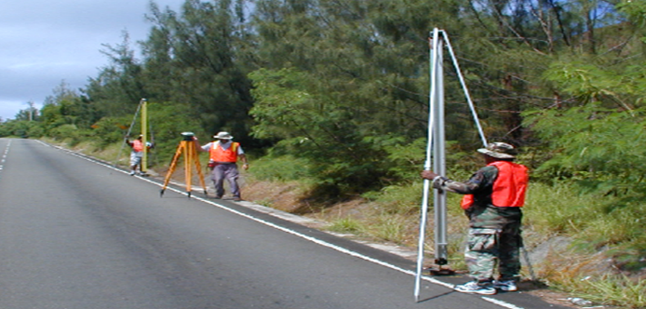
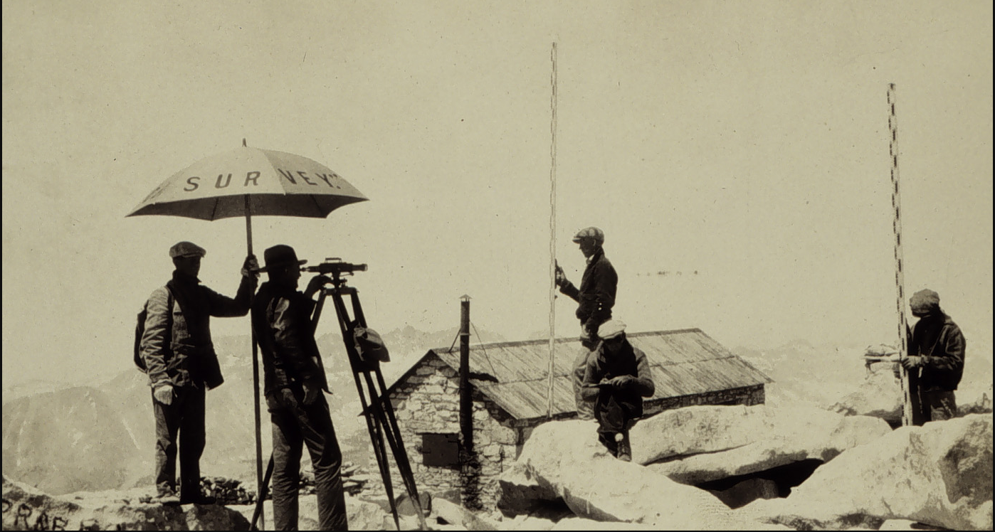
NAVD 88 is Based on
Continental Scale Geodetic Leveling
Current Vertical Datums:
NAVD88
CONUS & AK
PRVD02
Puerto Rico
VIVD09
US Virgin Islands
GUVD04
Guam
NMVD03
Commonwealth of the Northern Marianas
NAVD 88 consists of about 800,000 bench marks connected by about 2.2M km of leveling conducted over 80+ years
Notes:
NAVD 88 consists of about 800,000 bench marks and ~2.2M km of leveling. Data was collecting over many decades by roving bands of surveyors who walked across the country multiple times over the years, east to west, north to south and back again. It is currently the official vertical datum of the US and is required for federal mapping projects.
GPS data on those leveled marks will be used to create GEOID18 – the model used to derive NAVD88 heights from GPS ellipsoid heights, as well as the transformation tools that will be released with NAPGD2022.
GPS data on those leveled marks will be used to create the transformation tools that will be released with NAPGD2022.
Incredible effort – best tech at the time
BUT:
ACCESS!
Leveling is time intensive and expensive
Access has historically been through passive control, bench marks that you must find
Accuracy!
Distance dependent errors can build up, making the overall network less reliable
Bench mark can move over time , Only as reliable as the last observation
Consistency!
Modernized NSRS will eliminate systematic errors in current datums
Aligned with global reference frames
Integrated system for both positions and heights (“elevations”)
But, long time period during which things were moving that we could not adequately account for
New reference frames will give coordinates at specific reference epochs and the IFVM will move coordinates through time from the survey epoch to the reference epoch.

Slide 6

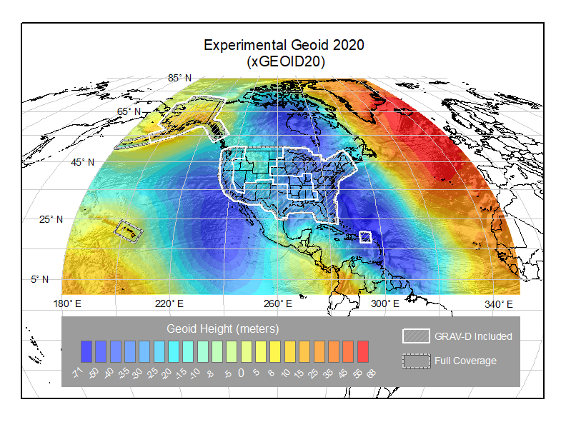
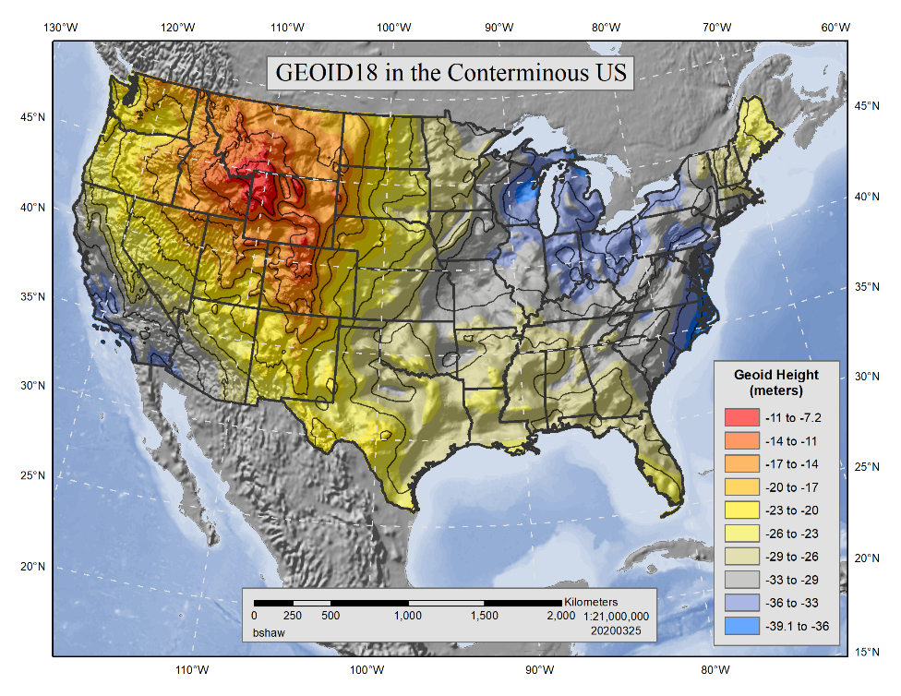
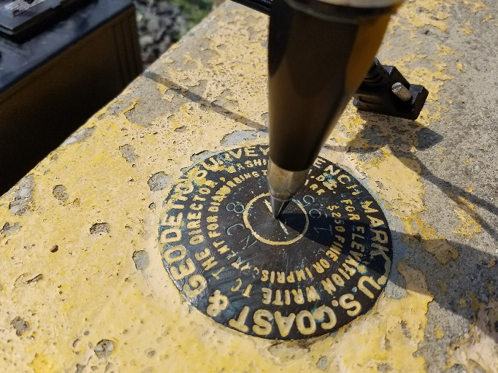
Building on the Past to Prepare for the Future
GPS on Bench Marks is about building the Transformation Tool to connect the past and future Datums and preparing the country and our communities to take full advantage of the benefits of the Modernized NSRS
Benefits of Participating in GPSonBM:
Improve local results of NAVD 88 – NAPGD2022 Transformation Tools
2020.0 Reference Epoch Coordinates (REC’s) with initial release of Modernized system
Go 4D - Track changes over time with Survey Epoch Coordinates (SEC’s)
GEOID18
Update Passive Control Status
Check your RTN results
What is GPSonBM? New GPS / GNSS data on existing NGS marks with published NAVD 88 orthometric heights
Notes:
Historically used to create the hybrid geoid models used to provide GPS derived NAVD 88 orthometric heights (GEOID99 – GEOID18)
Evaluate the experimental gravimetric geoid models (xGEOIDs) as team iterates toward GEOID2022, the foundation for NAPGD2022
Create transformation tools between NAVD88 and NAPGD2022
Gathering data to generate 2020.0 Reference Epoch Coordinates and (eventually) a series of Survey Epoch Coordinates

Slide 7

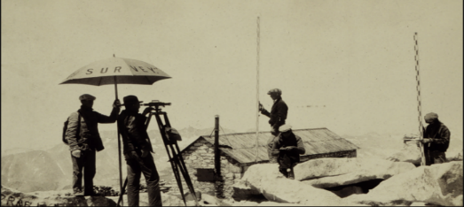
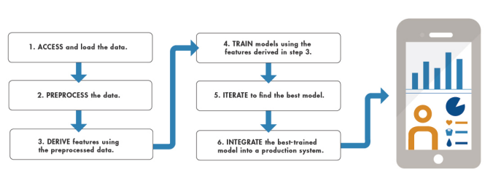

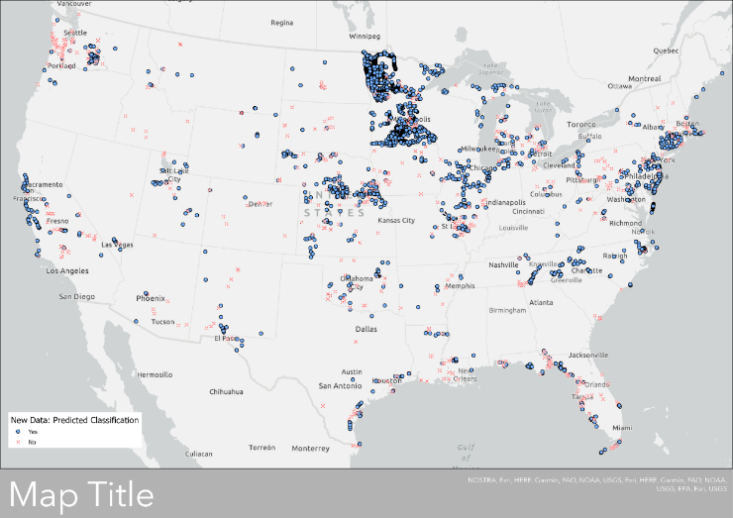
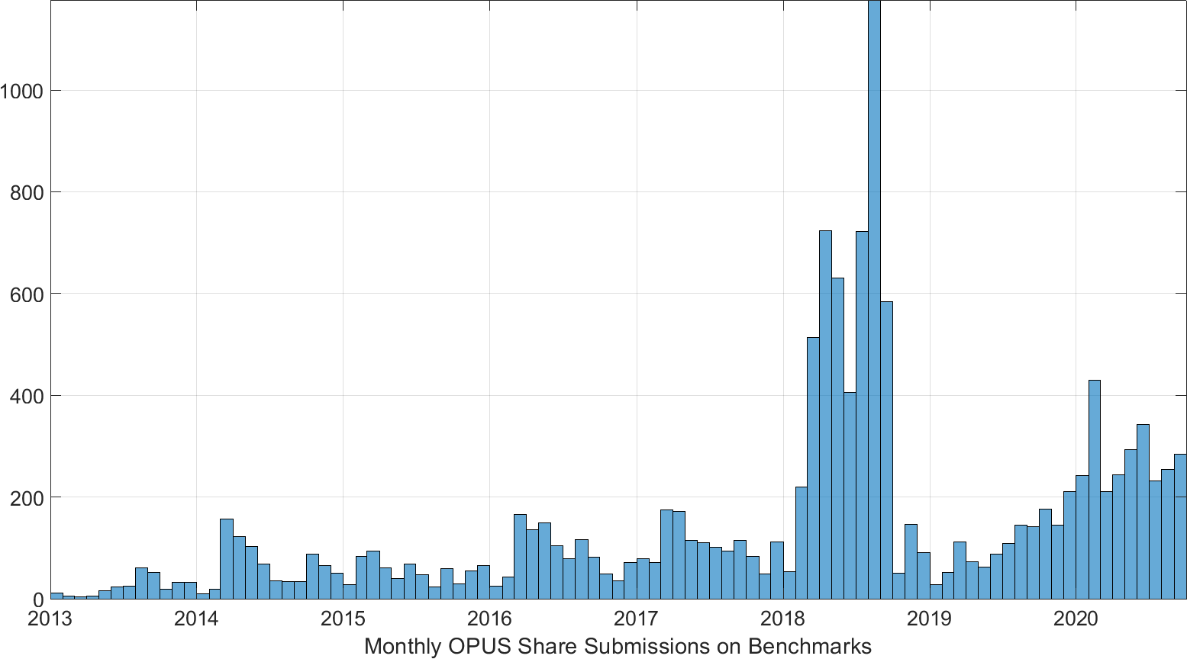
Automatic Evaluation of New GPS on BenchMark data with Machine Learning
Use results from GEOID18 to ‘train’ a model
  “Supervised Classification” - based on previous manual editing/cleaning process
  Binary Class: ‘Use/Yes’ or ‘Not Use/No’
Use model on new data going forward
  Automate evaluation of ~250 new submissions on benchmarks each month
  Reduce need for human review
Notes:
GPS/leveling (GPS on benchmarks)
Applications: geoid model validation
Imperfect dataset: GNSS, leveling
Lots of observations/classes
Cleaning: Hybrid Geoid Models (GEOID18)
Machine Learning
Use results from GEOID18 to ‘train’ a model
“Supervised Classification” with MATLAB R2020a
Binary Class: ‘Use/Yes’ or ‘Not Use/No’
Use model on new data going forward
Have ~250 new submissions on bench marks each month
Avoid going back through manual editing/cleaning process
Our goal in this application though is to separate the good and the bad observational benchmarks using machine learning. In this machine learning model, we rely on a set of pre-determined classifications to train the model. So, what we have in this case is a set of 35,000 GPS on benchmarks that were evaluated for use in NGS’s latest hybrid geoid model, GEOID18, which have already been given Yes/No designations. We are using MATLAB software to perform the machine learning with a SUPERVISED CLASSIFICATION framework.
Ultimately, the goal is to then take an appropriately trained and accurate machine learning model – and apply it to new dataset that it hasn’t seen before.

Slide 8
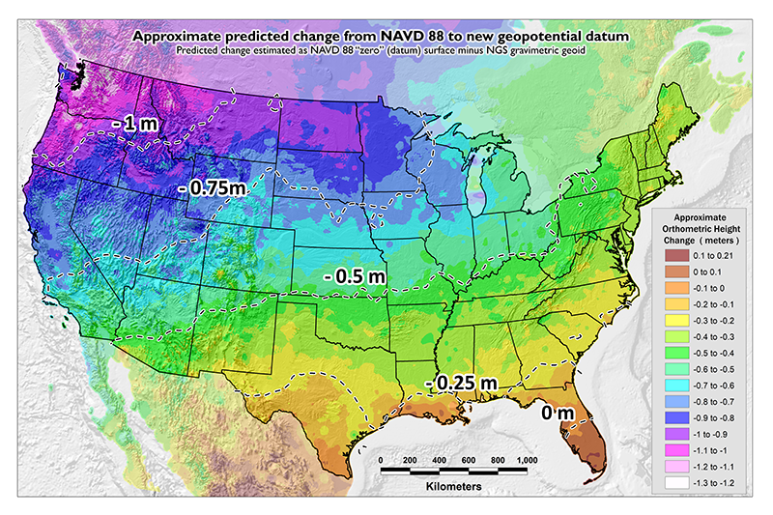
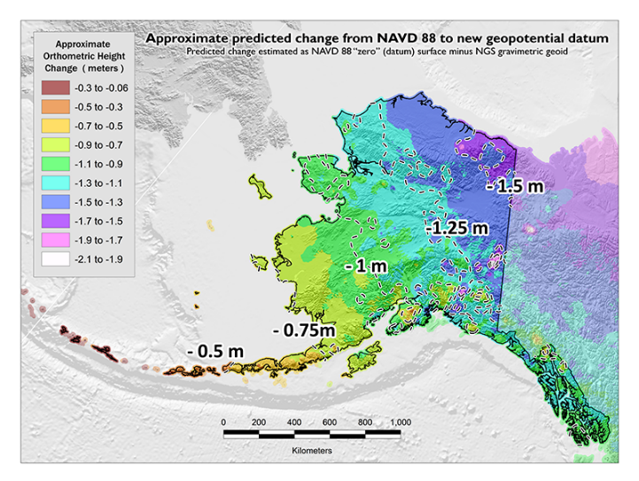
GPSonBM Measurements Connect
Current and Future Datums
Because the relationships between the old and new datums vary by location, the accuracy of the transformations in any particular place is directly related to the density of GPSonBM data available in that area.
  In moving from NAVD 88 to NAPGD2022, there will be a Shift: A one-time jump in the 0 to 2 meter range (orthometric height)
    From fixing biases and/or tilts in NAVD 88
PID: EZ0840
GPSonBM data is used to measure the Shift

Slide 9
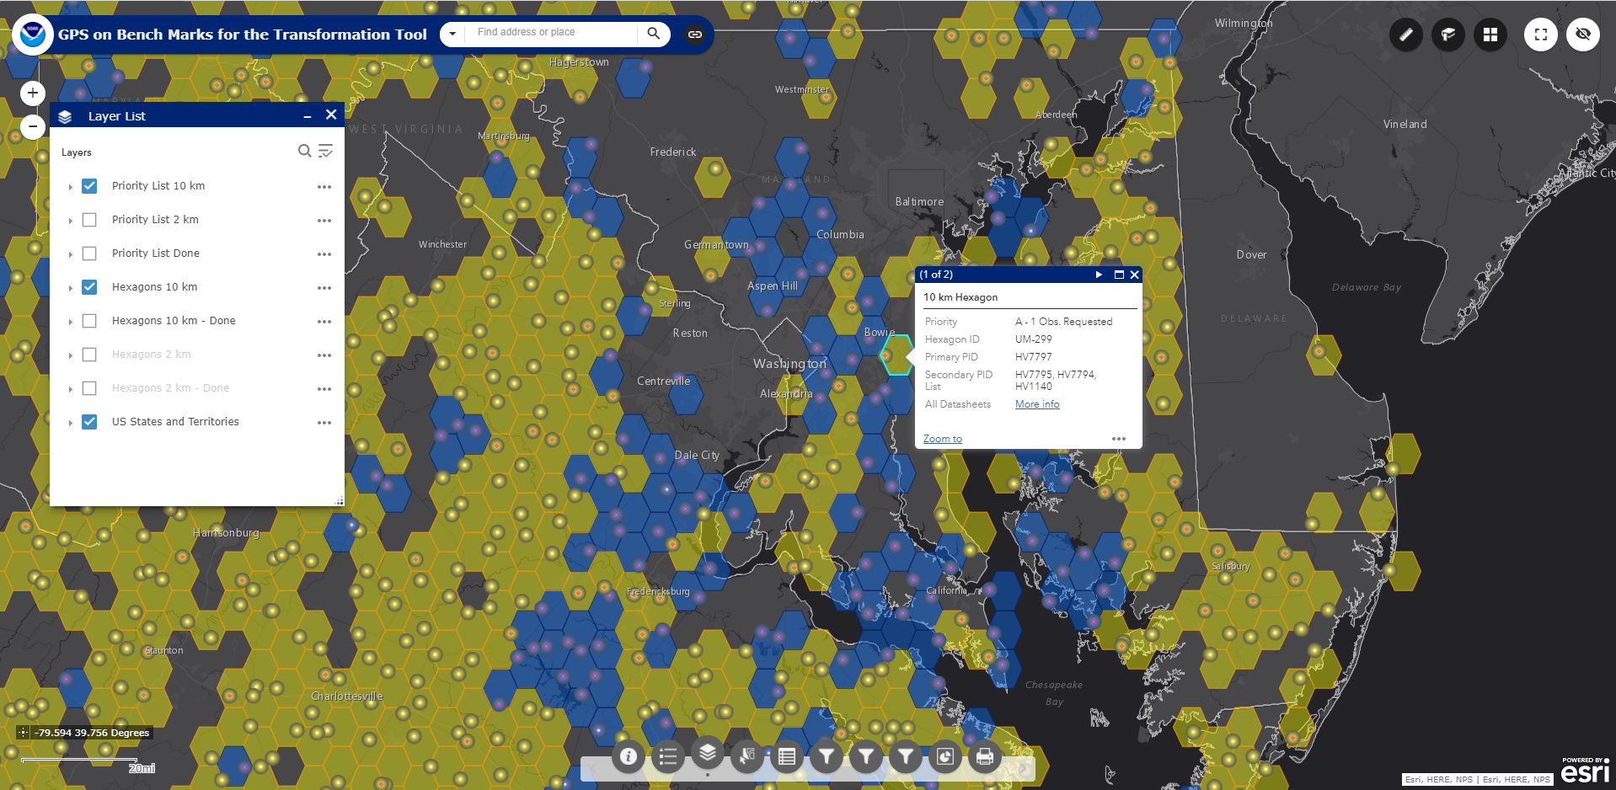
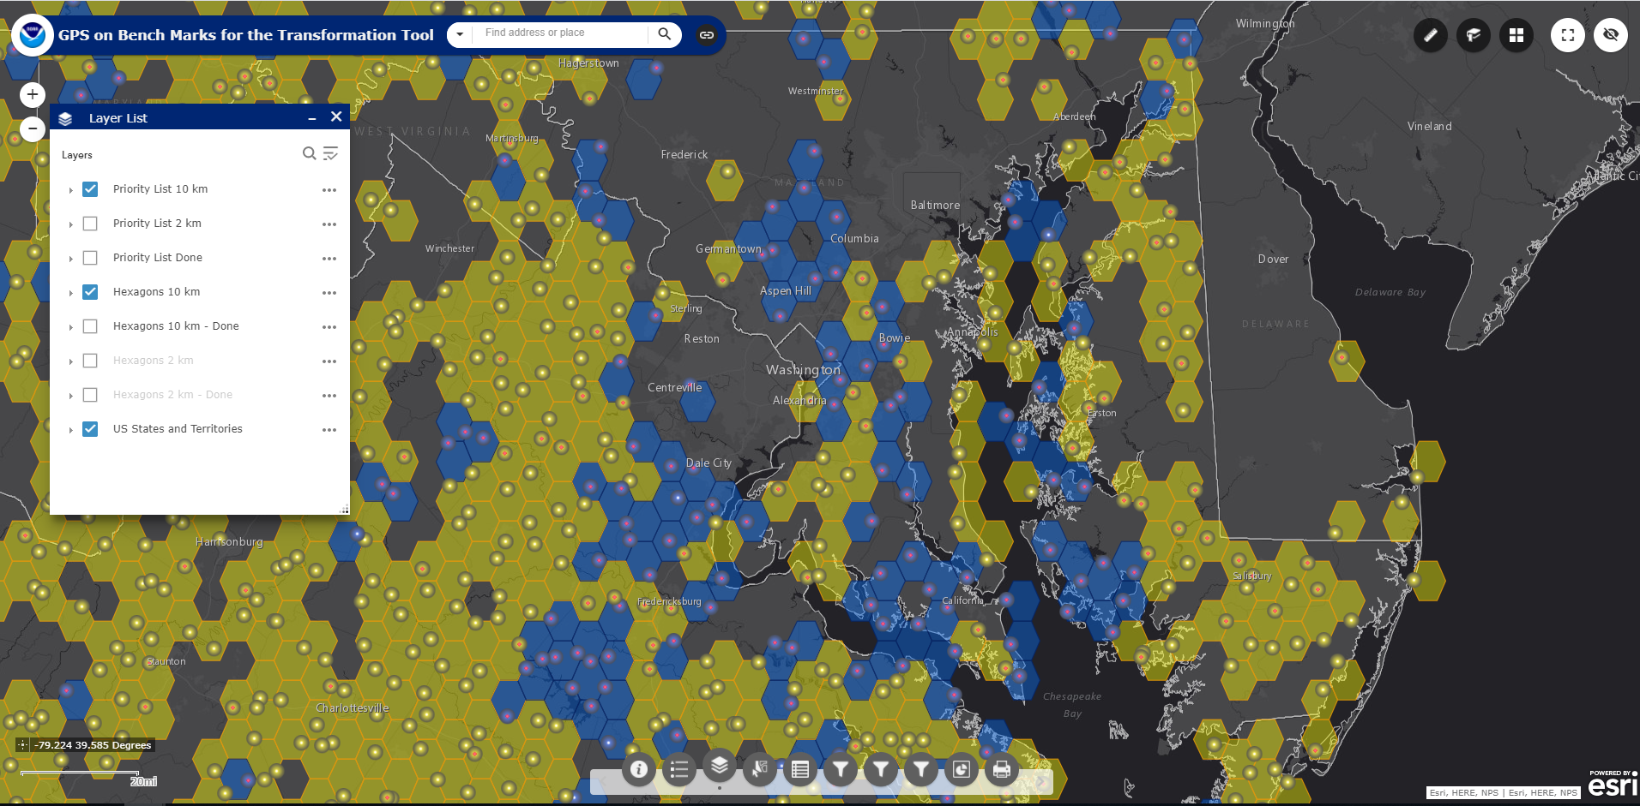
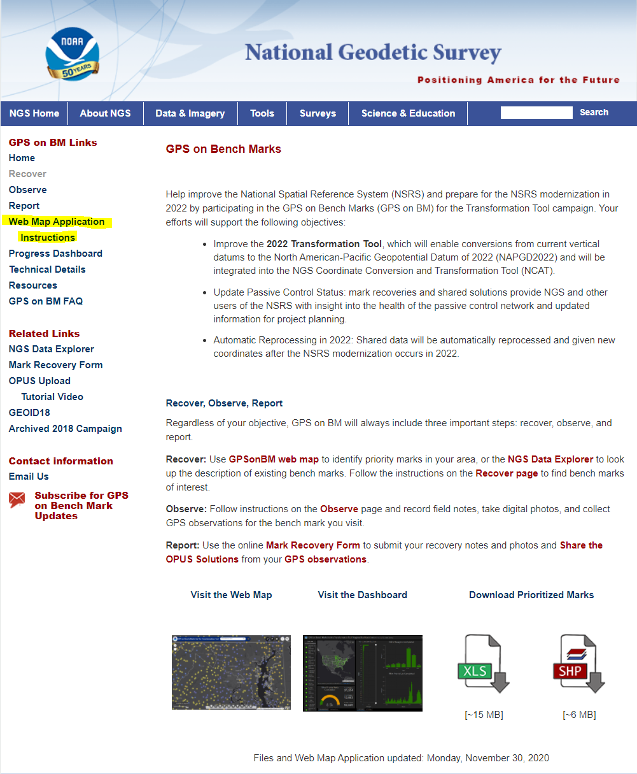
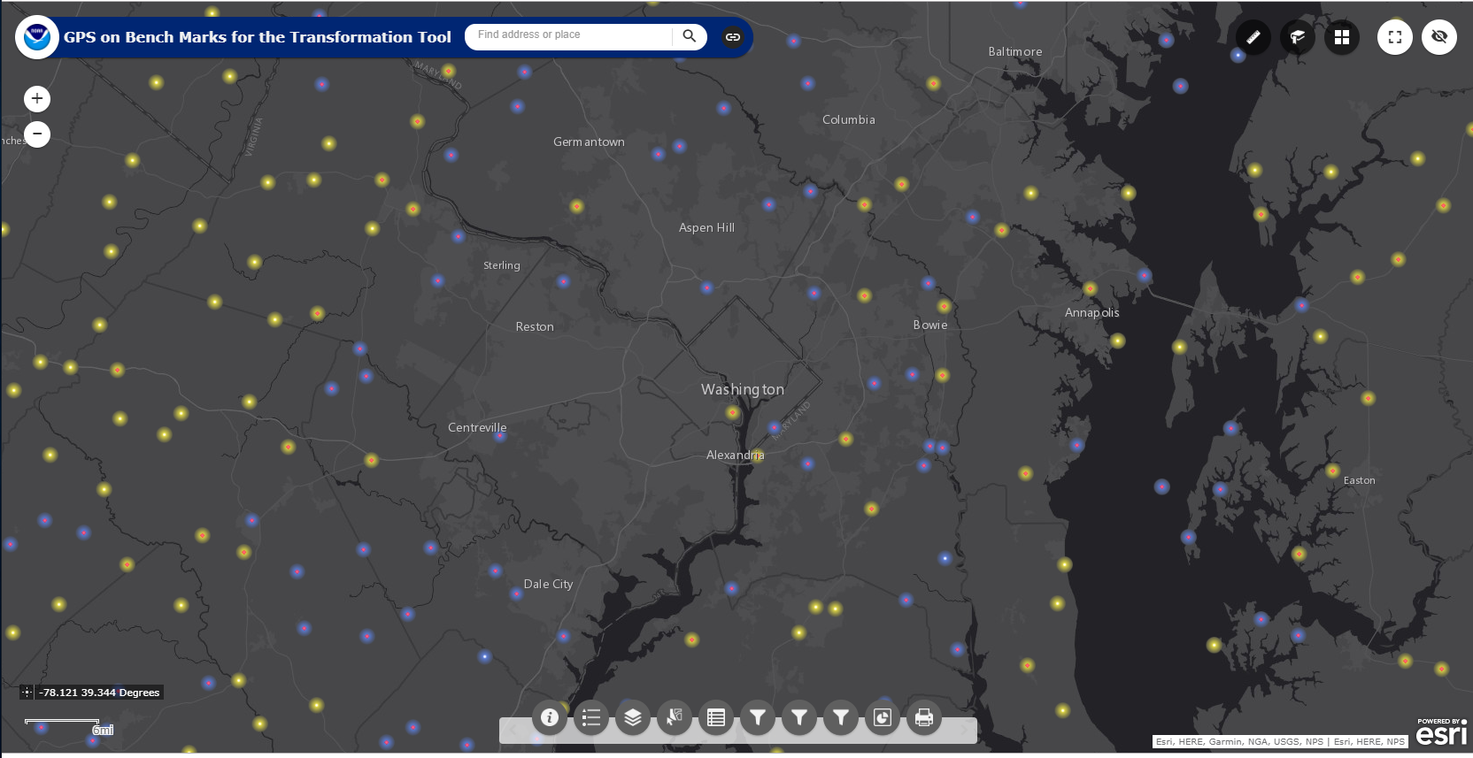
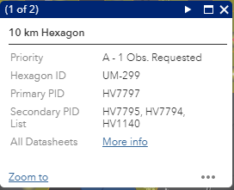
Transformation Tool Campaign Priority List and Web Map
Layer List
The web map has several functions that allow users to search, explore, filter, and export the data
Check out the GPSonBM webpage:
www.ngs.noaa.gov/GPSonBM/

Slide 10
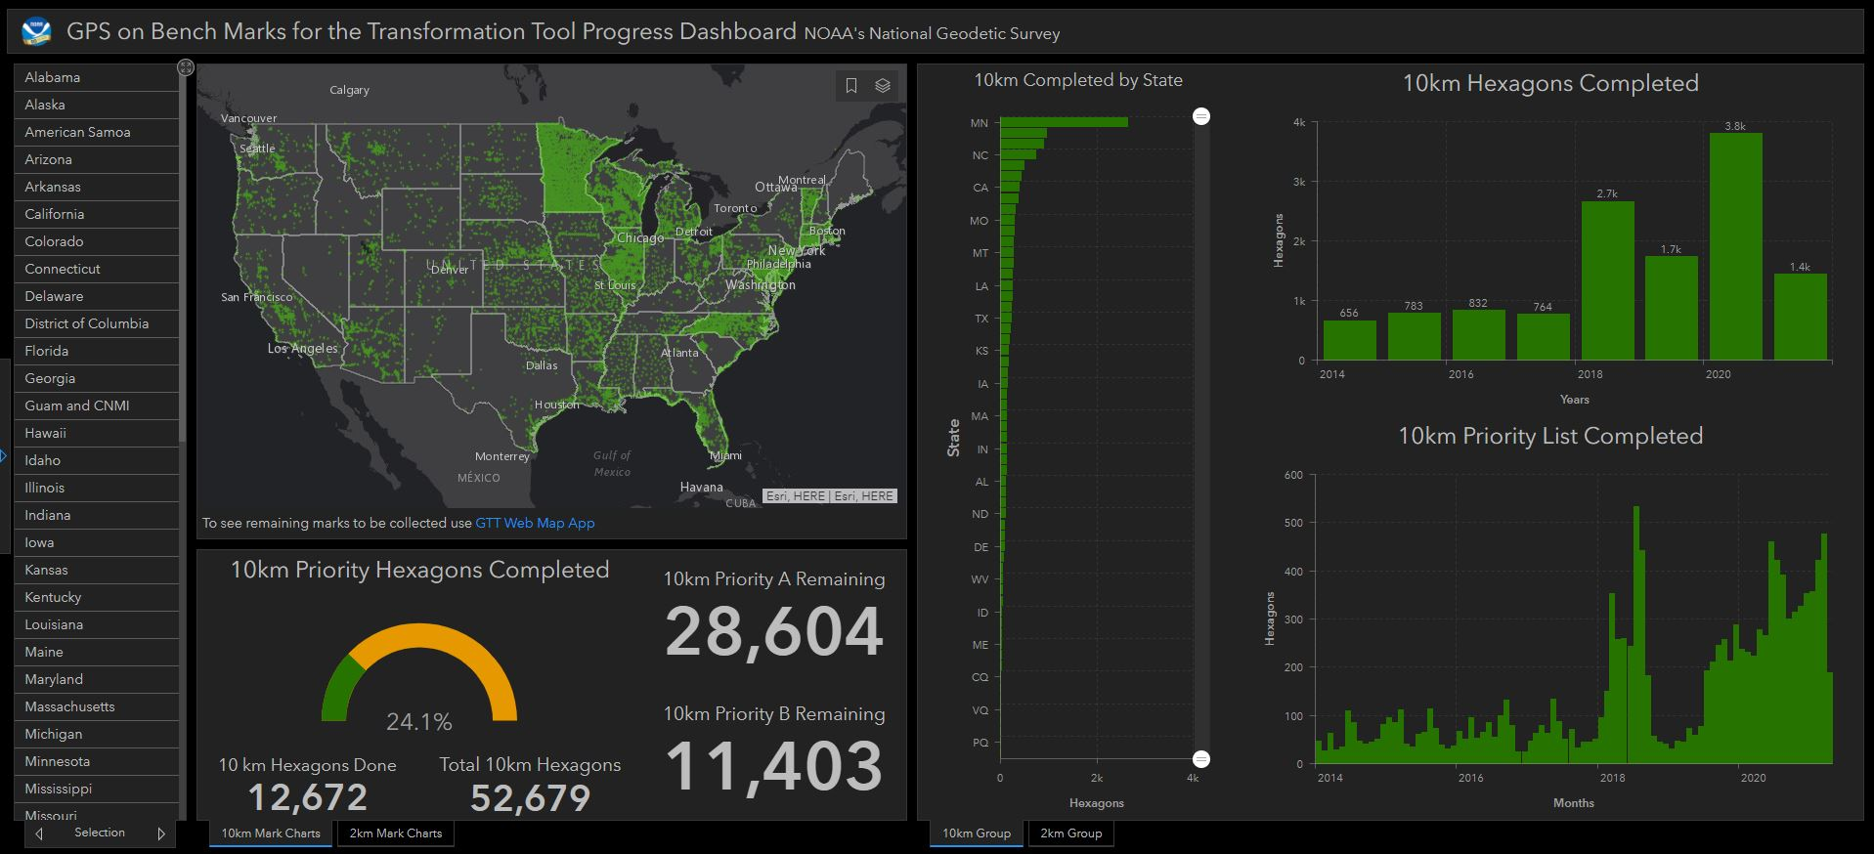
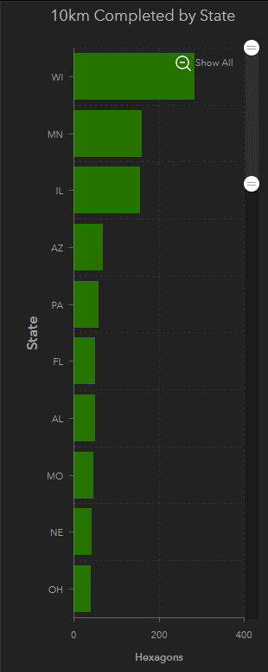
GPSonBM Transformation Tool Campaign: Progress Dashboard
2021 Top 10 List
10 km Hexagons Closed in 2021
Rank | State
1 | WI
2 | MN
3 | IL
4 | AZ
5 | PA
6 | FL
7 | AL
8 | MO
9 | NE
10 | OH
Notes:
States that have submitted very little GPSonBM data so far:
AL
NM
NV
WV
PR
KY
ID
NH
ME
GA
HI
RI

Slide 11
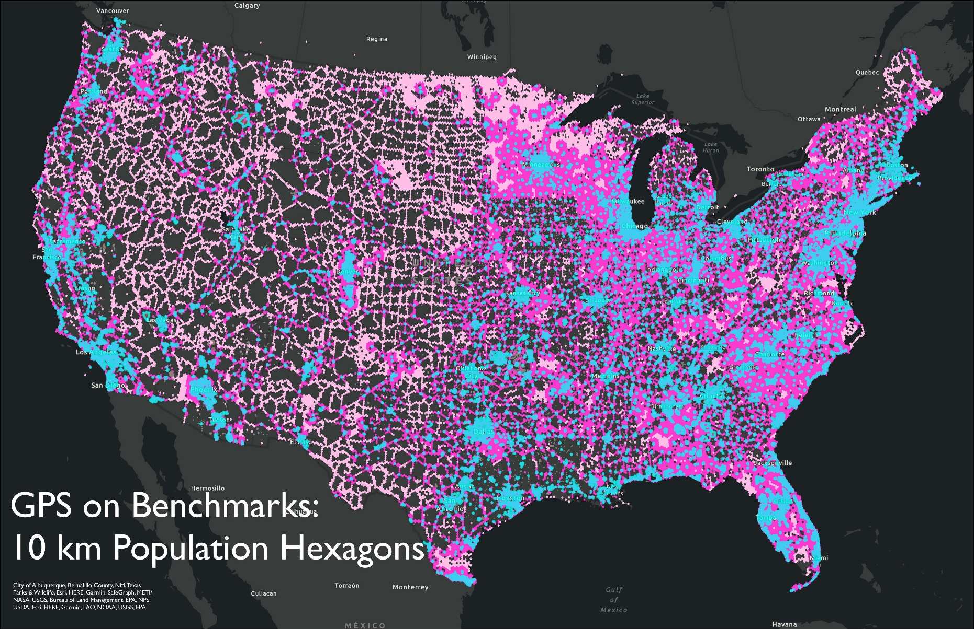
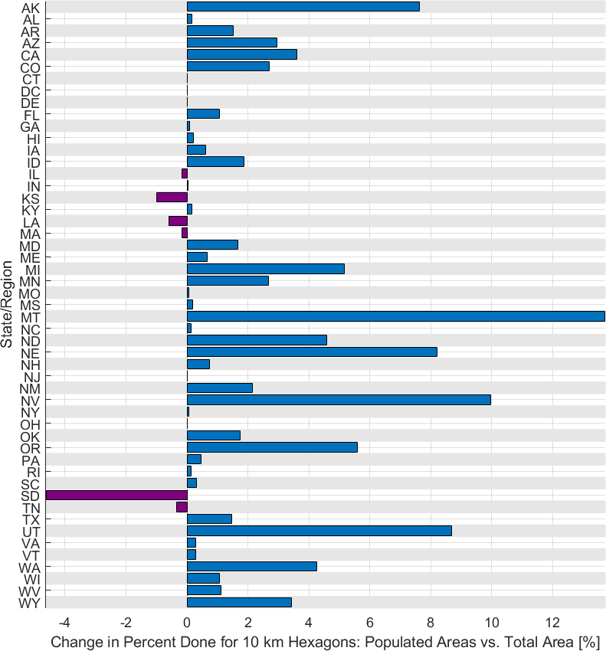
Tracking Progress in Populated Areas
Blue represents populated areas (>2,500). Dark Pink are the 10 km hexagons within 20 km of the populated areas. Light Pink are those outside the 20 km areas, away from populated areas.

Slide 12
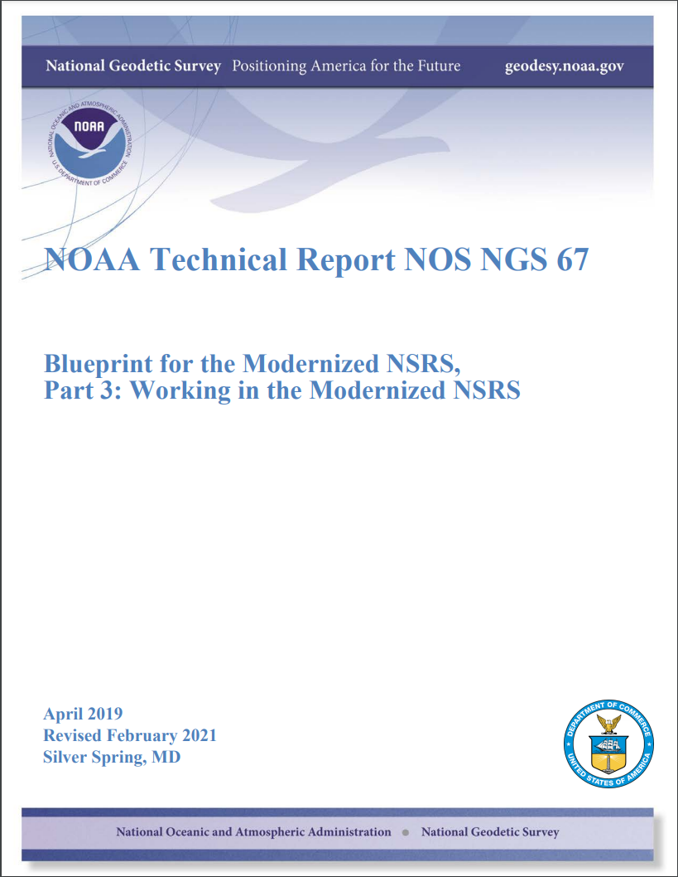


GPSonBM Helps You Prepare for the Modernized NSRS
Resurvey: Return to the field and collect new observations to compute REC’s
Readjust: Using existing observations, re-compute new coordinates based upon geodetic control with published REC’s
Transform: Take finished products which have coordinates in the old datum and use transformation software to estimate coordinates in the new datum
Working in the modernized NSRS:
April 2019
Revised February 2021
NOAA TR NOS NGS 67
Notes:
Listed in decreasing order of accuracy, but also in decreasing order of cost and increasing order of simplicity

Slide 13
Data Submission Route Comparison
Shared OPUS Solution
Bluebooking through OPUS 4.0 & 5.0
Individual Observation – not for use as geodetic control
Will NOT update NGS Datasheet
Will be harvested for inclusion in adjustment and receive 2020.0 REC to be released with modernized NSRS
Will be used to create transformation tool, only if mark has published NAVD 88 height (not suppressed heights)
Redundant observations and network adjustment of coordinates
Will provide new NAVD 88 heights published on NGS Datasheets
Will be harvested for inclusion in adjustment and receive 2020.0 REC’s to be released with modernized NSRS
Will be used to create transformation tool
5.0 - Will allow import of RTK vectors

Slide 14
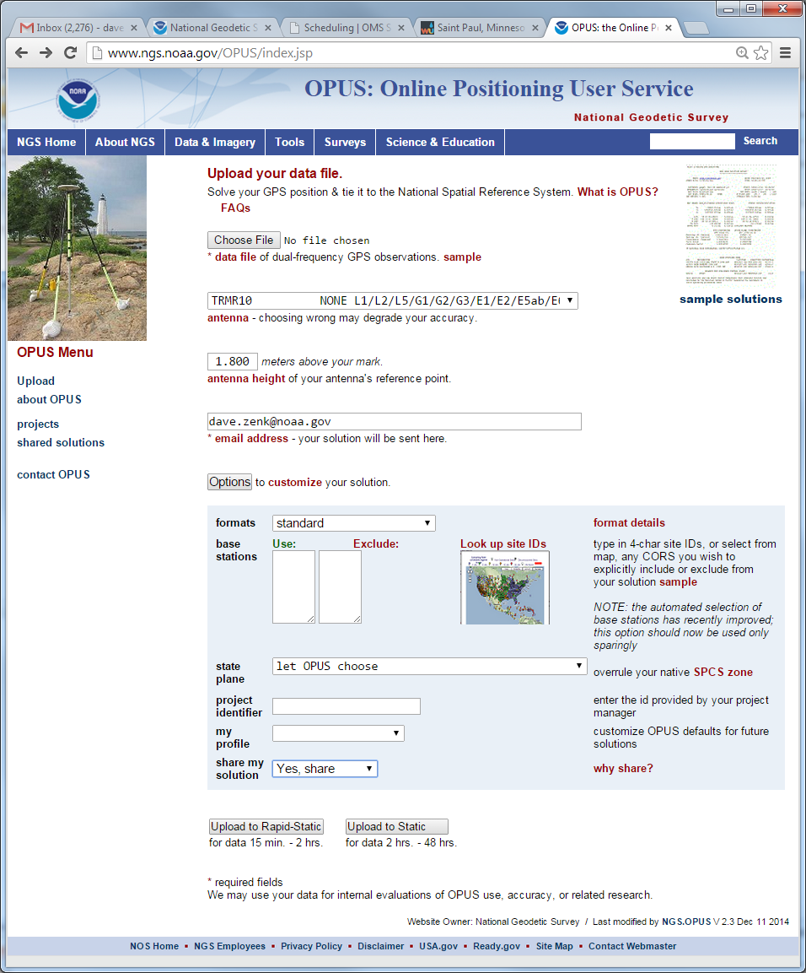
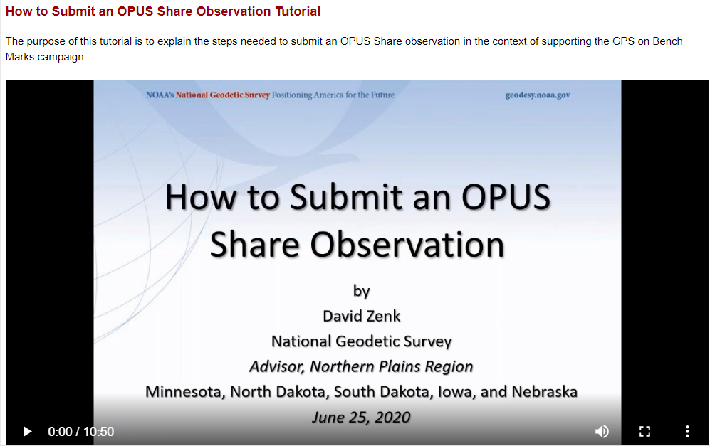
Share GPS Observations through OPUS
Upload 4+hour GPS observation file
Provide antenna type, antenna height, and email address
Click “Options” & Select “Yes, Share”
Identify the Mark by PID
Write a “To Reach” description
Attach 2 photos:
  close-up (avoid dark/blurry/dirt-covered)
  horizon (show equipment in use)
Respond to confirmation email
geodesy.noaa.gov/corbin/class_description/opus-share-tutorial/

Slide 15
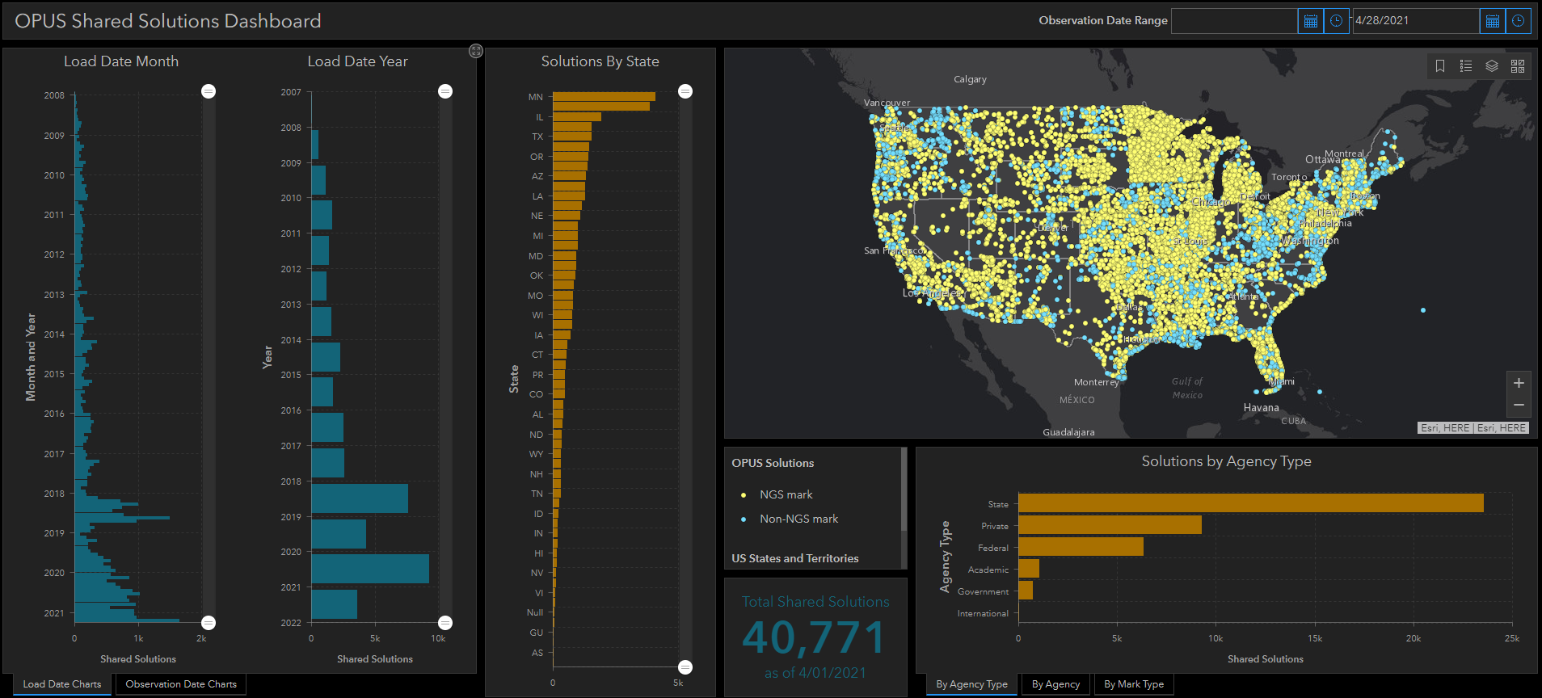
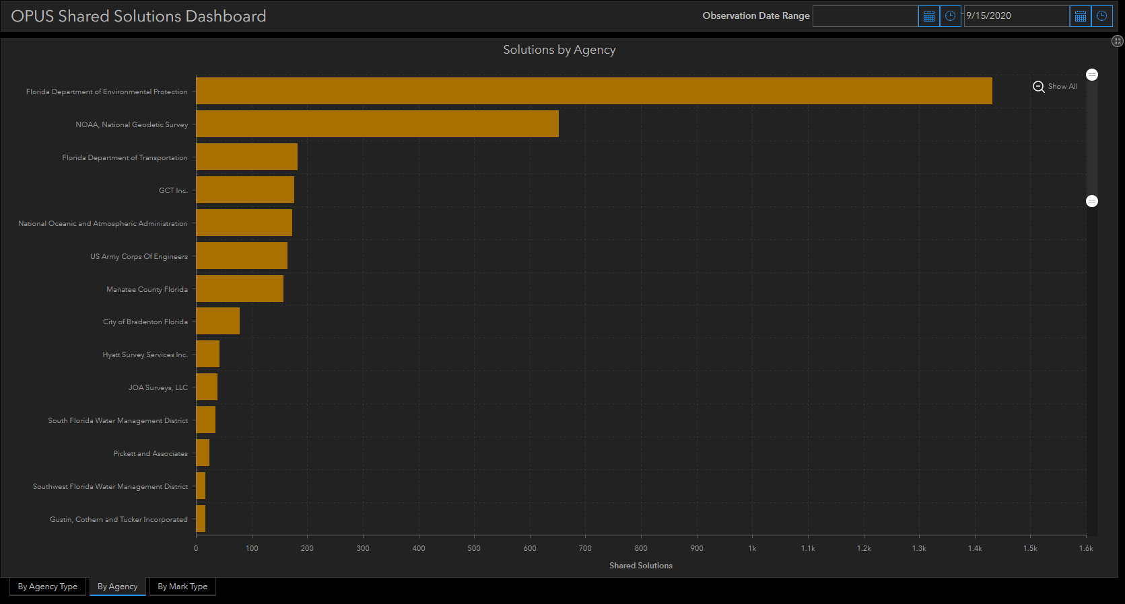
OPUS Shared Solutions Dashboard
Dashboard enables sorting and visualization of Shared Solutions by Month & Year, State, Agency Type, and Submitting Agency
Agency type | # Shared Solutions on NGS marks
State | ~20,400
Private Sector | ~4,400
Federal | ~3,100
Academic | ~800
Note the impact of GPSonBM Campaigns

Slide 16
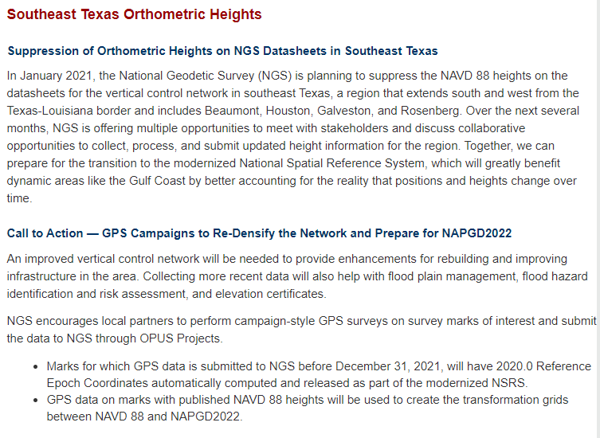
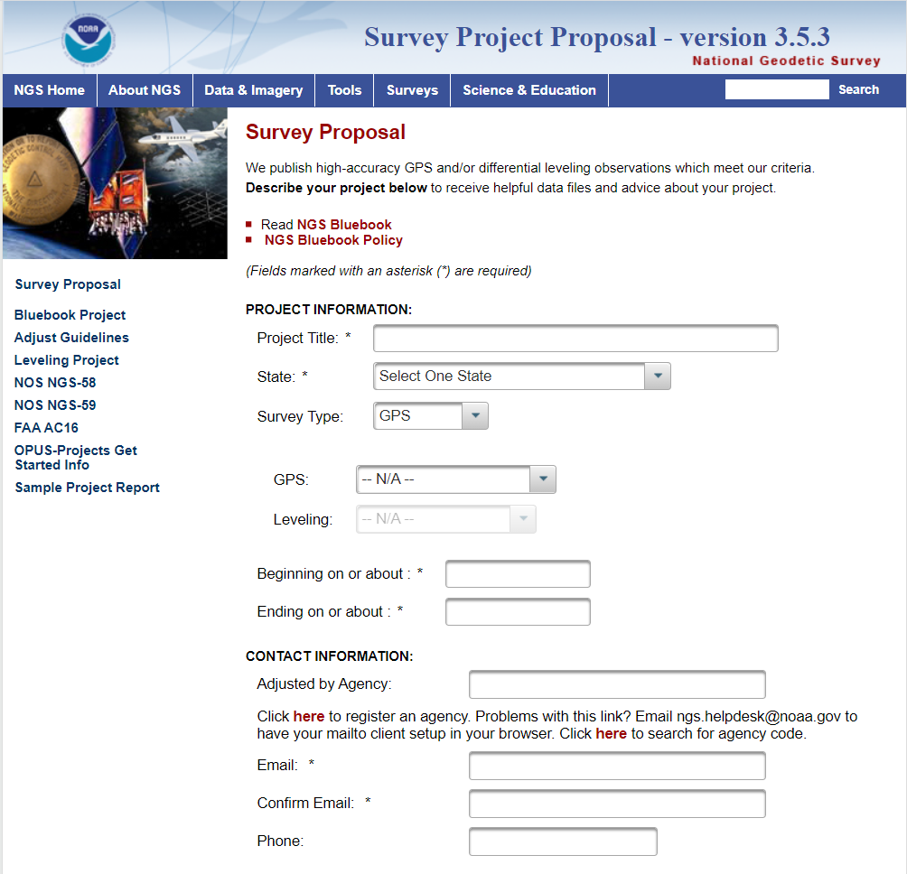
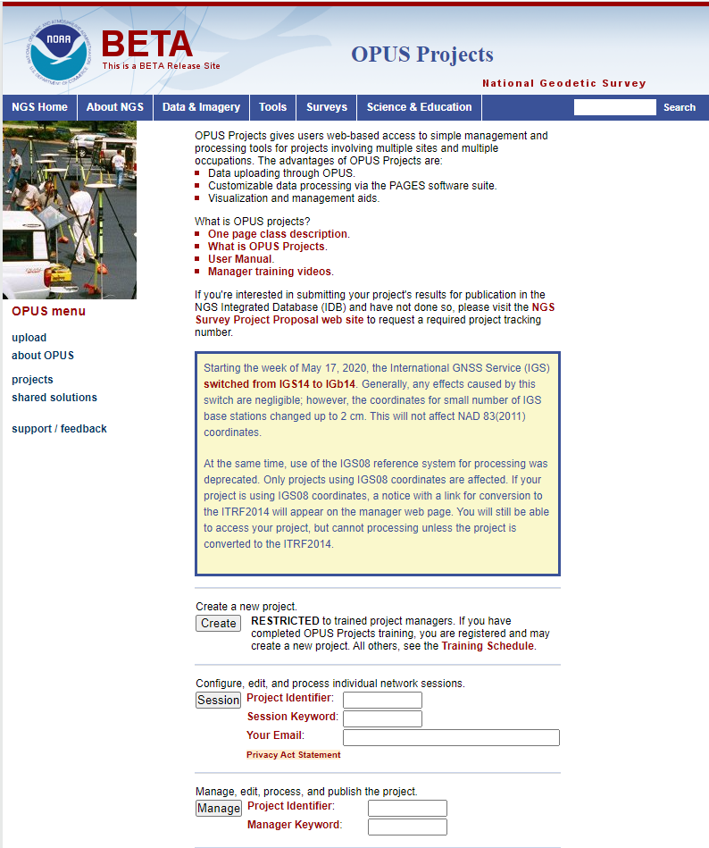
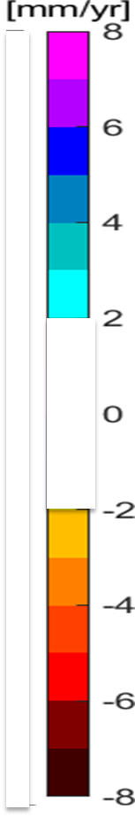
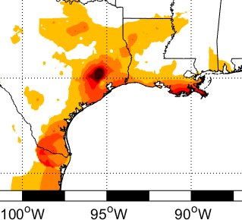
Campaign-Style Bluebooked Surveys
For Areas of Motion & Getting your Local Network into the NSRS
Update NAVD 88 heights on NGS datasheets in areas where the heights have been suppressed or the data is out of date.
Get new current NAVD 88 heights, 2020.0 REC’s, accurate transformation grid and baseline for time series
Notes:
Single Shared OPUS solutions currently provide coordinates tied to the NSRS, including a “No-Check” NAVD 88 height using GEOID18.
For the initial release of the Modernized NSRS, individual Shared solutions will be will be processed together with other observations submitted by December 31st, 2021 to compute the 2020.0 Reference Epoch Coordinates
Eventually, a series of Survey Epoch Coordinates (SEC’s) will also be computed from observations within a series of “adjustment windows” (TBD, but ~ 4 weeks) which is how the Modernized NSRS will provide the time-varying component of coordinates
Areas where the NAVD 88 is old and out of date or has been suppressed should go through Bluebook process to update the heights so they can be used

Slide 17
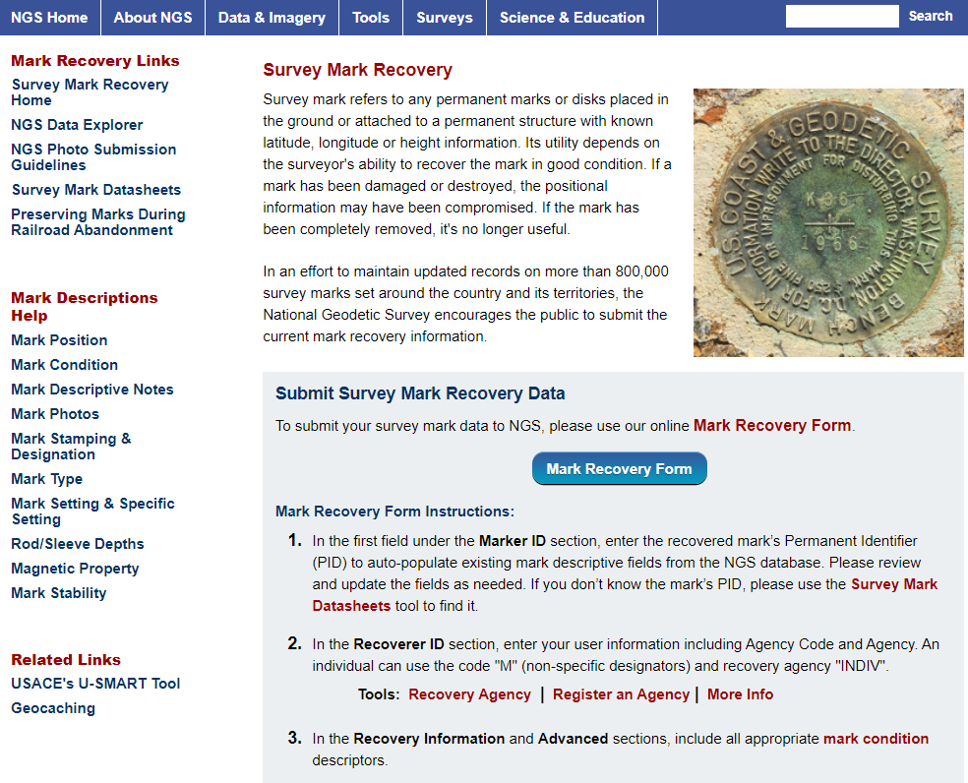
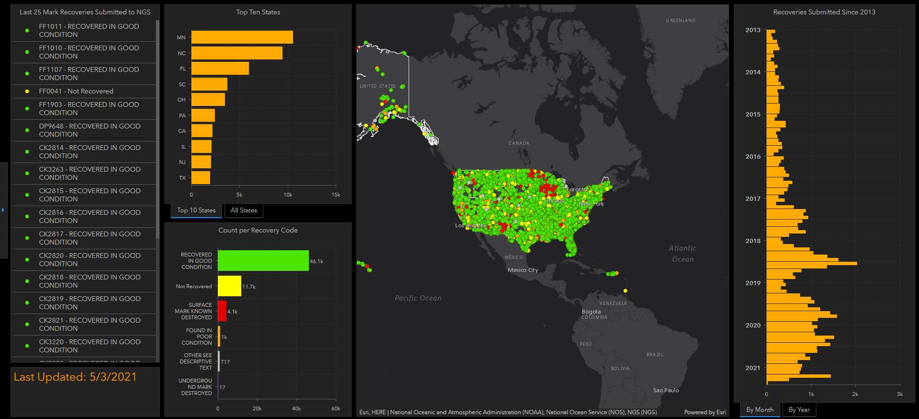
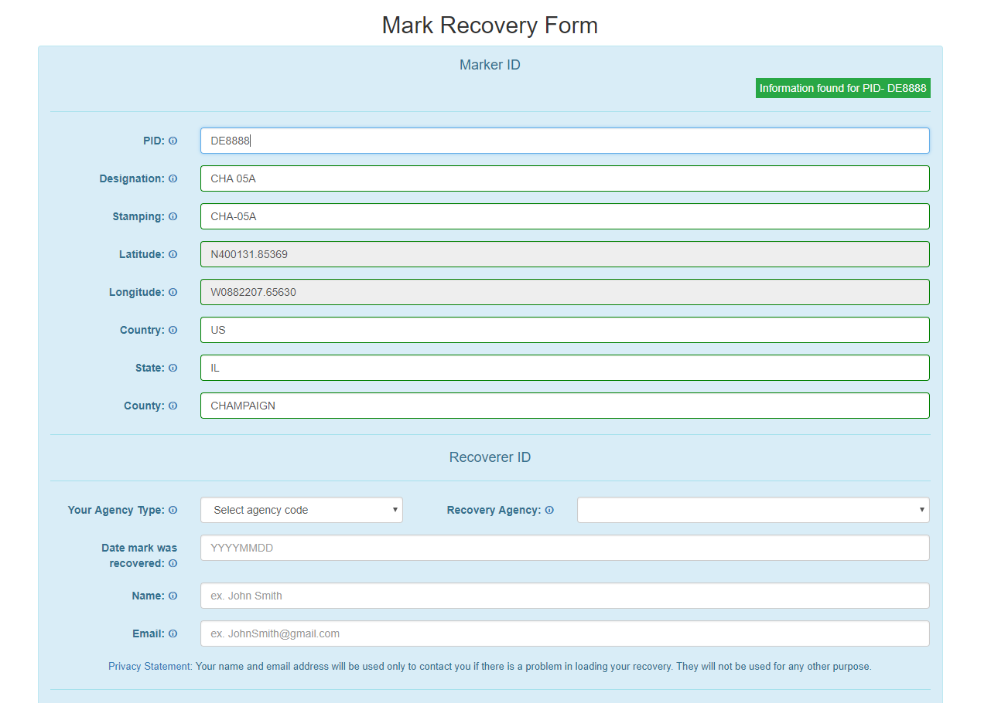
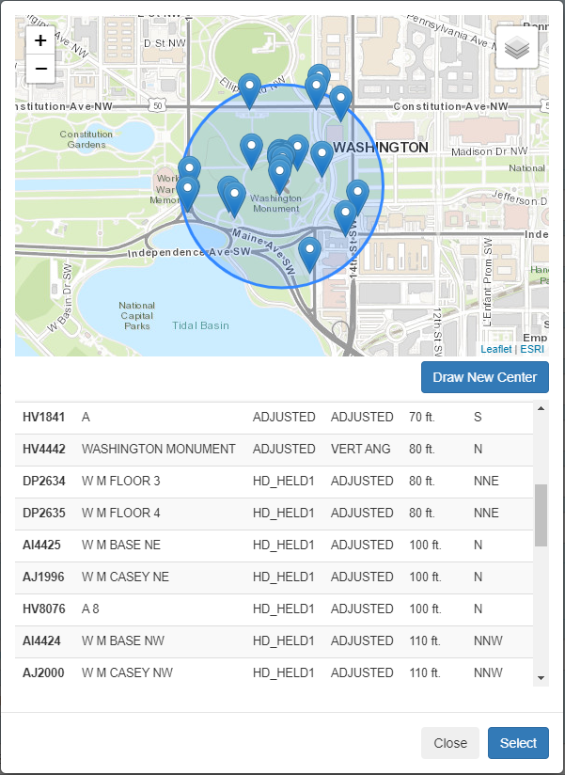
NGS Mark Recovery Webpage and Dashboard
Crowd sourced mark recoveries help update the GPSonBM map, let NGS and others know if the mark is still usable, and pictures make it easier to find.
www.ngs.noaa.gov/surveys/mark-recovery
Now with Find Marks Near Me!
Maintain you local control network: Submit a Recovery Note for each mark you find (up to once per year)
Did you find it?
Is it GPSable?
Got new photos?
Notes:
Using our online Mark Recovery Form, anyone can search for, find, and file a recovery report for our benchmarks. We update our priority list and maps when people report that the marks on our list have been damaged, destroyed, or are not suitable for GPS observations.

Slide 18

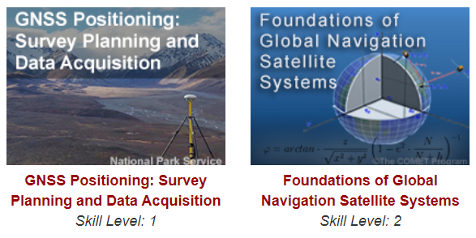
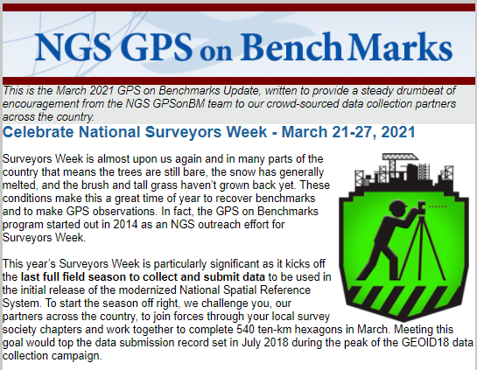
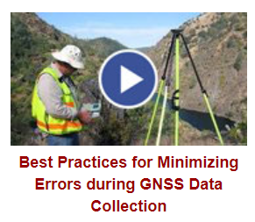

Traversing the Path Toward NSRS Modernization
Collect and Submit GPSonBM data before December 31st, 2021
Find Marks near you and send in Mark Recoveries
Stay in the Loop – Subscribe to NGS News & GPSonBM Updates
Get ahead of the curve with online lessons, videos, & tutorials

Slide 19
The future is already here —
it's just not very evenly distributed.
- William Gibson
Contact the GPSonBM team:
ngs.gpsonbm@noaa.gov
Provide Feedback:
ngs.feedback@noaa.gov
GPS on BenchMarks Page: geodesy.noaa.gov/GPSonBM/
Mark Recovery: geodesy.noaa.gov/surveys/mark-recovery/
GEOID18: geodesy.noaa.gov/GEOID/GEOID18/
OPUS: geodesy.noaa.gov/OPUS/

