Slide 1

Aspects of the Intra-Frame Velocity (Deformation) Models for the U.S. N.S.R.S
Daniel R. Roman, Ph.D.
Chief Geodesist
NOAA’s National Geodetic Survey

Slide 2
Outline
Existing National Spatial Reference System
The Need for Change
Starting Point: a Densified-ITRF
The four TRF’s
NAPGD 2022
Surveying post-2022
Summary

Slide 3
Existing U.S. N.S.R.S.
North American Datum of 1983 (NAD 83)
North American Vertical Datum of 1988 (NAVD 88)
“Static” Reference Frame
80,000 passive control marks
U.S.: NAD 83 (2011/PA11/MA11)
Canada: NAD83 (CSRS)
Processing performed in ITRF14
HTDP transforms to ITRF96
ITRF 96 => NAD 83 transform. based on 12 global sites
NAD 83 Geocenter from Transit
Helmert Orthometric Heights
500,000 passive control marks
Tied at one point in Canada
Adjustment in geopotential numbers
U.S., Canada and Mexico
However, only U.S. adopted
Interpolates static gravity field
Produces consistent heights

Slide 4
The Need for Change
Simplified concept of NAD 83 vs. “2022”
Issues with NAD 83
Earth’s Surface
h_{”2022”}
h_{NAD83}
φ_{NAD83} – φ_{”2022”}
λ_{NAD83} – λ_{”2022”}
h_{NAD83} – h_{”2022”}
all vary smoothly by latitude and longitude
“2022” origin
~2.24 m
NAD 83 origin

Slide 5
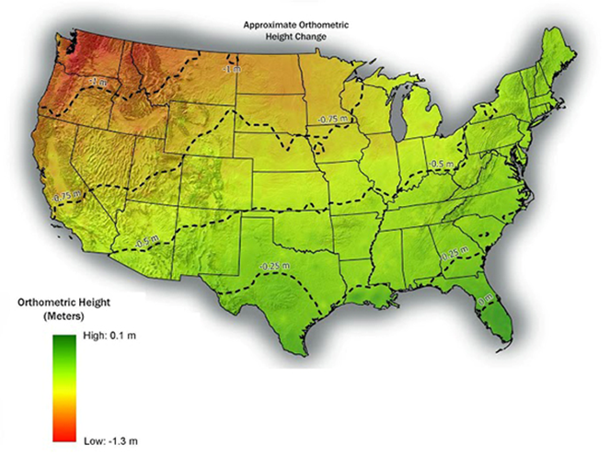
The Need for Change

Slide 6
UN-GGIM (2015-2018)
The UN-GGIM Committee of Experts
  Endorsed the global geodetic roadmap as a “principle-based briefing document for national Governments”
  Welcomed the development of an implementation plan to link the road map recommendations to national policy developments
  Elevated the GGRF working group (WG) to a Sub-Committee on Geodesy (SCoG) to strengthen the GGRF
  Requested the development of a position paper to define the appropriate governance arrangements for the GGRF

Slide 7
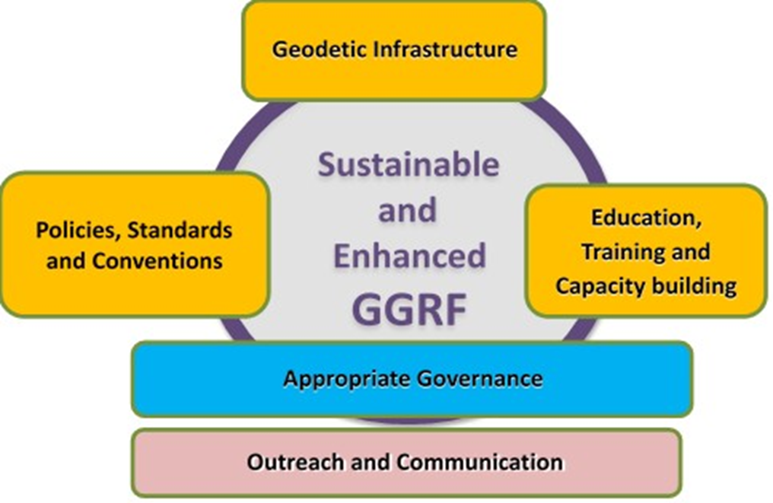
GGRF Roadmap
Global Geodetic Reference Frame
  International Terrestrial Reference Frame (ITRF)
  International Height Reference Frame (IHRF)

Slide 8
NGS Strategic Plan
Blueprint, Part 1:
Geometric Coordinates
  NOAA Tech Rep NOS NGS 62
Blueprint, Part 2:
Geopotential Coordinates
  NOAA Tech Rep NOS NGS 64
Blueprint, Part 3:
Using the modernized NSRS
  forthcoming

Slide 9
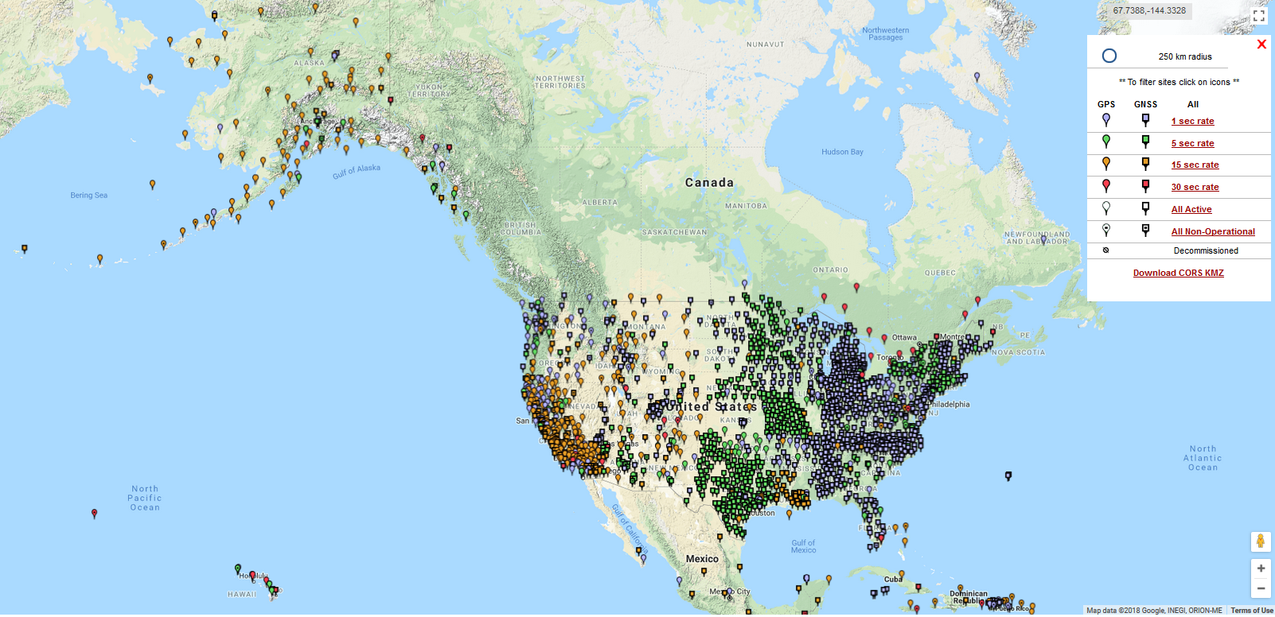
CORS

Slide 10
Foundation CORS (FCORS)
Collocated
+ Densification
+ Plate Rotation
+ Additional

Slide 11
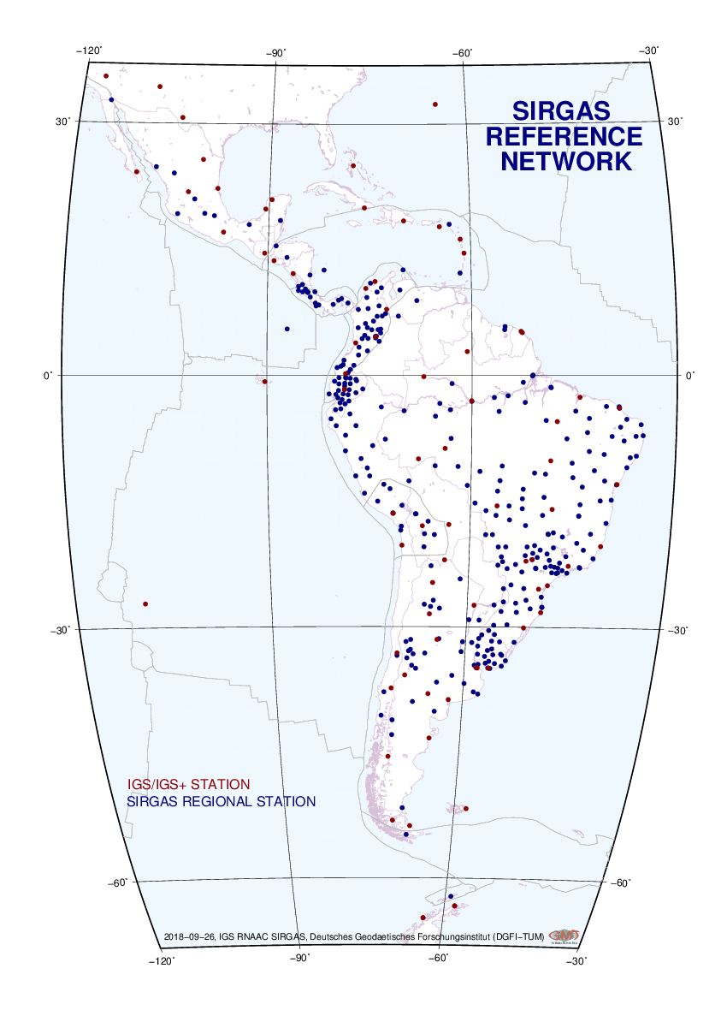
Other CORS in the Americas
SIRGAS-CON
Canadian Active Control (CAC’s)
http://www.sirgas.org/en/sirgas-con-network/

Slide 12
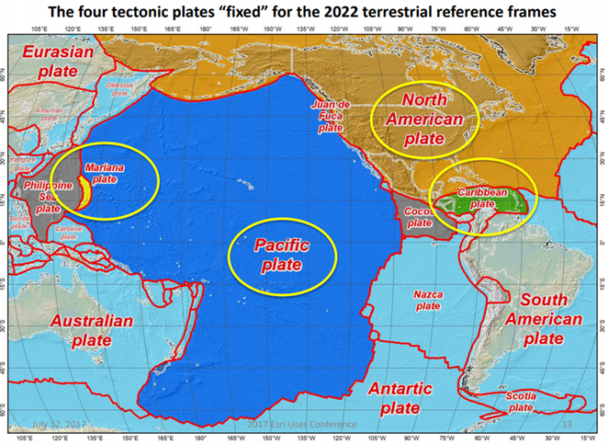
The Four TRF’s
Densified ITRF model
Control stations
  FCORS/IGS sites <=> ITRF
  Subset chosen for EPP
Four Frames after EPP
  CATRF (w/SIRGAS)
  MATRF (~ w/GGIM-AP/C.S.)
  PATRF (w/GGIM-AP)
  NATRF (IAG 1.3c/SNARF 2.0)
Intra-Frame Velocity Models

Slide 13
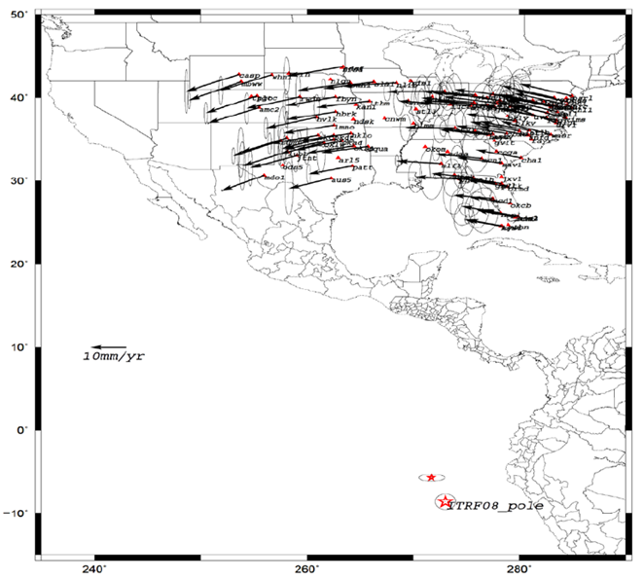
NATRF
Each frame will get 3 parameters
  Euler Pole Latitude
  Euler Pole Longitude
  Rotation rate (rad/yr)
Used to compute time-dependent TRF2022 coordinates from time-dependent ITRF coordinates
To calculate a Stable North America Reference Frame, you need “stable” points

Slide 14
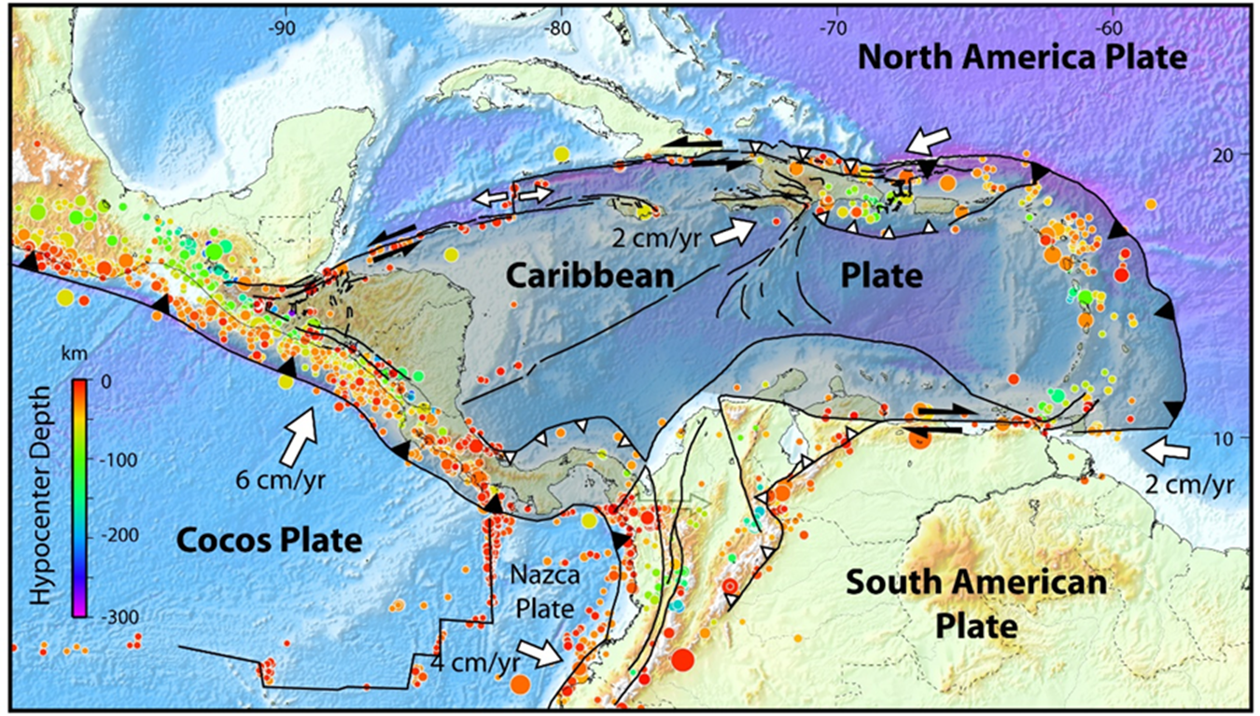
CATRF (DEMETS 2007)

Slide 15
PATRF

Slide 16
MATRF

Slide 17
NAPGD2022

Slide 19
IFVM (Deformation) Modeling
Gridding CORS
CORS+Geophysical Modeling (Canadian)
CORS+InSAR

Slide 20
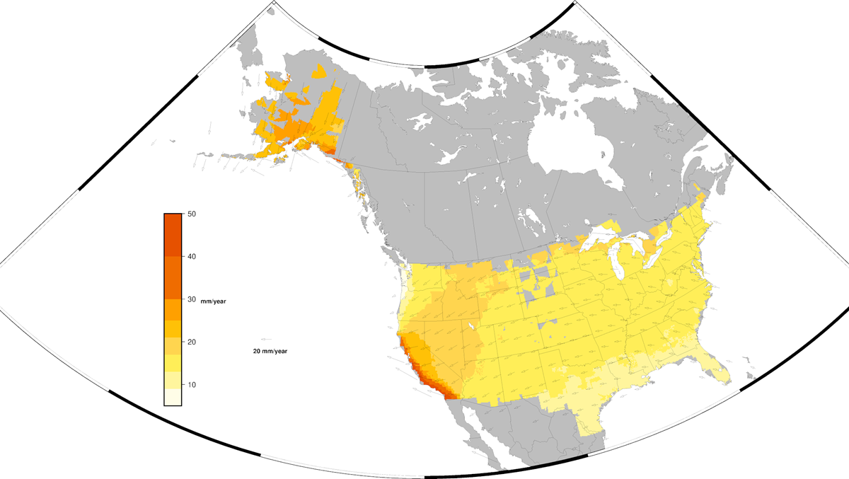
CORS Horizontal Velocities-REPRO2

Slide 21
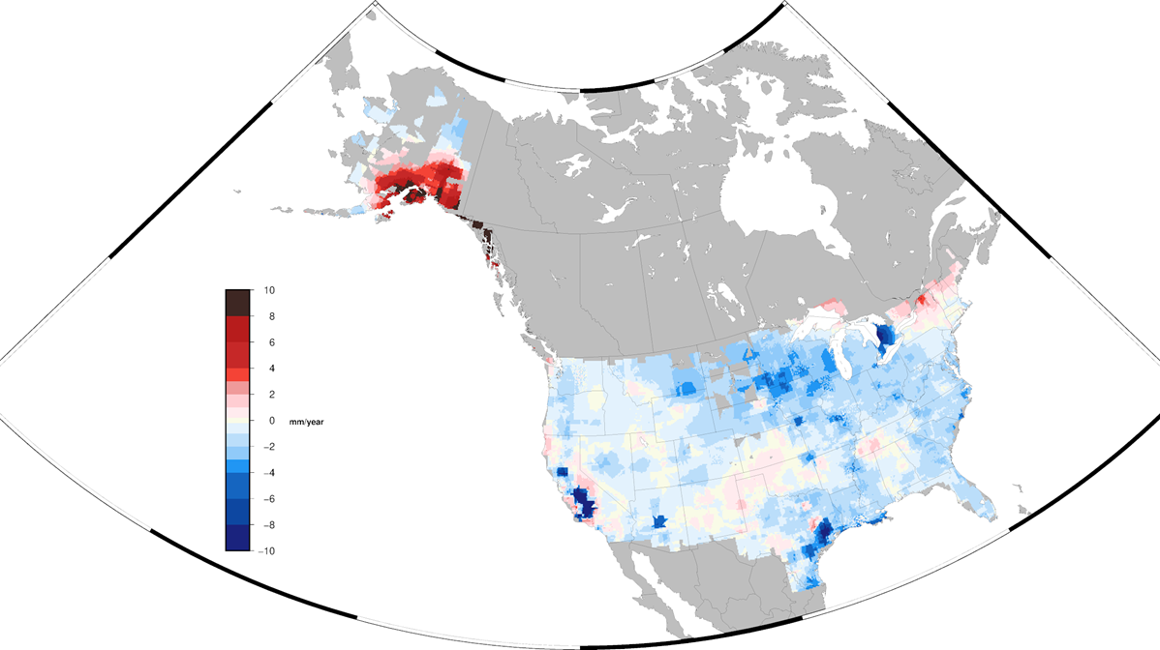
CORS Vertical Velocities-REPRO2

Slide 22
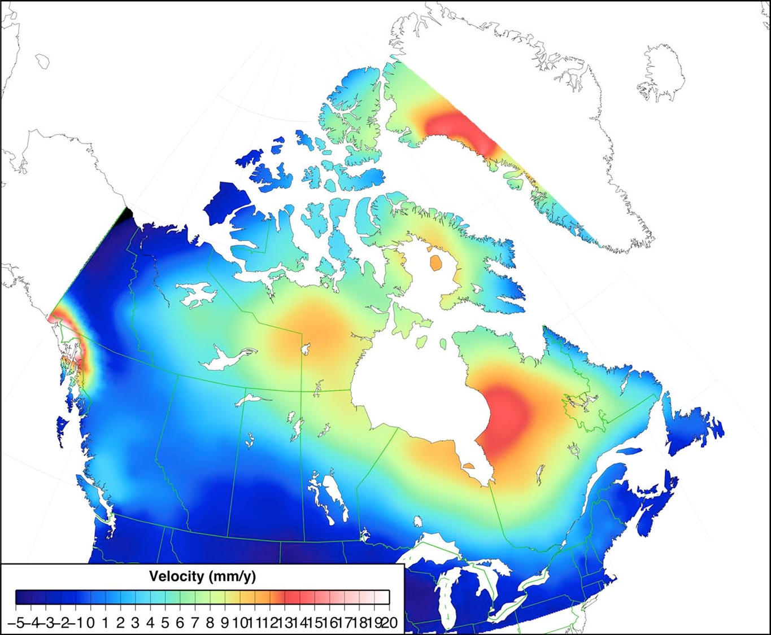
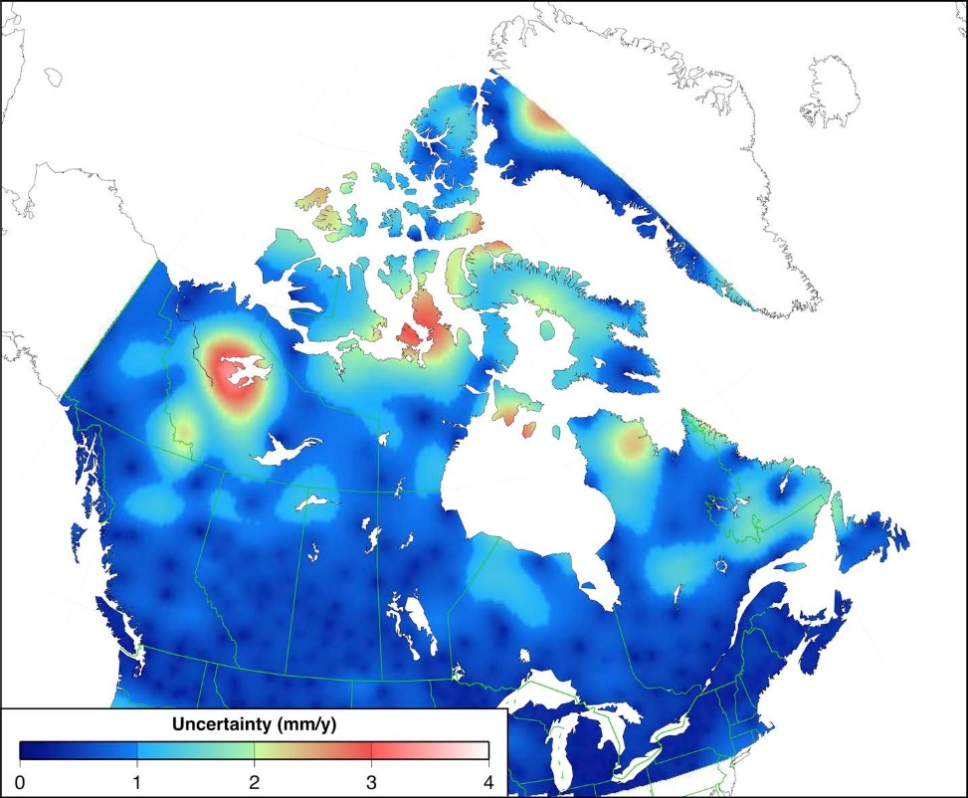
Canadian Vertical Velocity Model
ICE6G GIA model is fit to CAC
Fills in areas between CACs for vertical motion

Slide 24
Questions?

