Slide 1
Progress of the GEOID2022
Yan Ming Wang
Geodesist
National Geodetic Survey, U.S.A.
NGS Webinar 10/13/2022

Slide 2
GEOID2022 development teams
National Geodetic Survey (NGS)
Yan Ming Wang
Xiaopeng Li
Kevin Ahlgren
Ryan Hardy
Jordan Krcmaric
Canadian Geodetic Survey (CGS)
Marc Véronneau (retired)
Jianliang Huang
National Institute of Statistics and Geography (INEGI)
David Naranjo Avalos

Slide 3
Outline
NAVD88 to the North American-Pacific Geopotential Datum of 2022 (NAPGD2022)
Definition of GEOID2022
Data used (Common datasets)
The experimental geoid computation
Computation methods of NGS and CGS/ INEGI
The first joint geoid model xGEOID2020 and its validation
GEOID2022 schedule

Slide 4
Why NAPGD2022? Replacing NAVD 88 (and ASVD02, PRVD02, NMVD03, GUVD04, VIVD09, all geoid models, all deflection of the vertical models, all surface gravity models, and IGLD85)
See: Blueprint for 2022, Part 2
https://geodesy.noaa.gov/datums/newdatums/policy.shtml

Slide 5
Replacing NAVD 88
The Old:
NAVD 88
PRVD 02
VIVD09
ASVD02
NMVD03
GUVD04
IGLD 85
IGSN71
GEOID18
DEFLEC18
The New:
NAPGD2022
Realization:
GEOID2022
SGEOID2022: The geoid in 2020.00
DGEOID2022: Time-dependent geoid changes from 2020.00
DEFLEC2022
SDEFLEC2022: The DoVs in 2020.00
DDEFLEC2022: Time-dependent DoV changes from 2020.00
GRAV2022
SGRAV2022: Surface gravity in 2020.00
DGRAV2022: Time-dependent surface gravity changes from 2020.00
More
Orthometric
Heights
Normal
Orthometric
Heights
Dynamic
Heights
Gravity
Geoid
Undulations
Deflections of
the Vertical

Slide 6
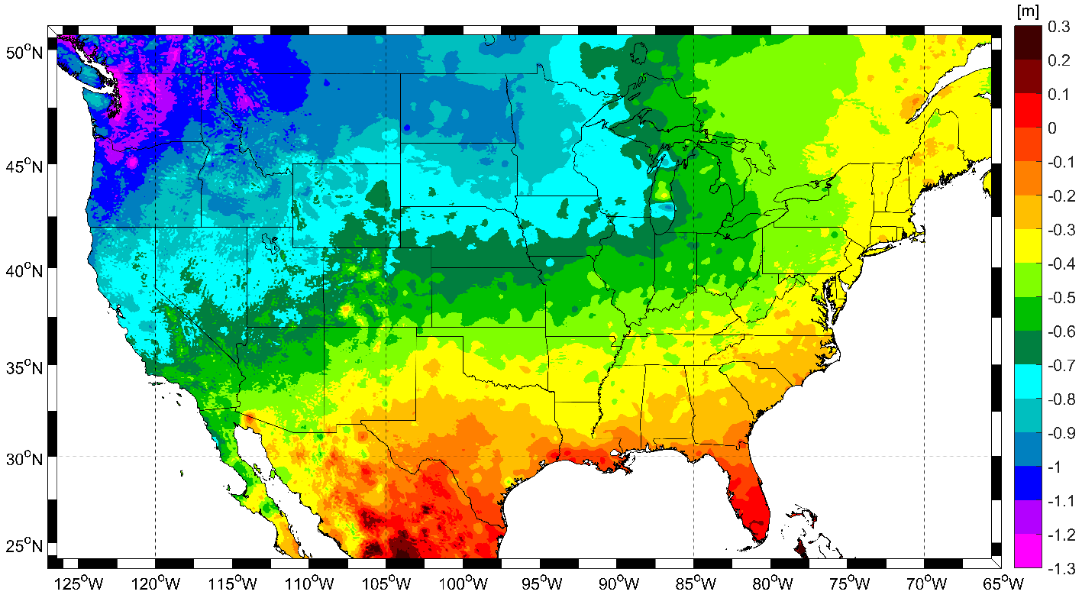
Expected changes to orthometric heights

Slide 7
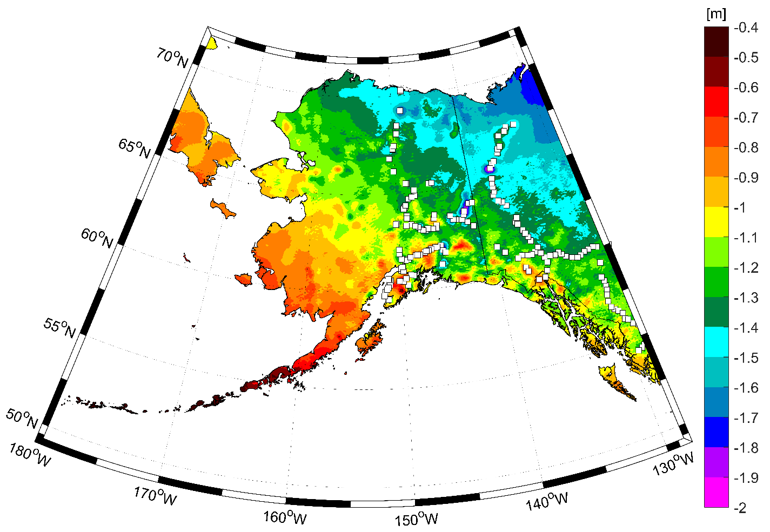
Expected changes to orthometric heights

Slide 8
Definitional Relationship
Time-dependent ellipsoid heights
come from time-dependent
CORS coordinates which serve as control for your time-dependent GNSS survey.
They will be modeled in the IFVM
Time-dependent geoid undulations
are modeled in the dynamic component of GEOID2022 (“DGEOID2022”), which will come from the geoid monitoring service, or GeMS.

Slide 9
Definition of GEOID2022
It is a realization of NAPGD2022
Same as the North-American Terrestrial Reference Frame 2022 (NATRF2022), it contains a dynamic component.
Reference ellipsoid: GRS80
Geographic coverage
NA and Pacific: lat 0°N to 90°N, lon 170° to 350°
Guam: lat 11°N to 22°N, lon 143° to 148°
America Samoa: lat 10°S to 16S°, lon 186° to 193°
Spatial resolution: 1’x1’

Slide 10
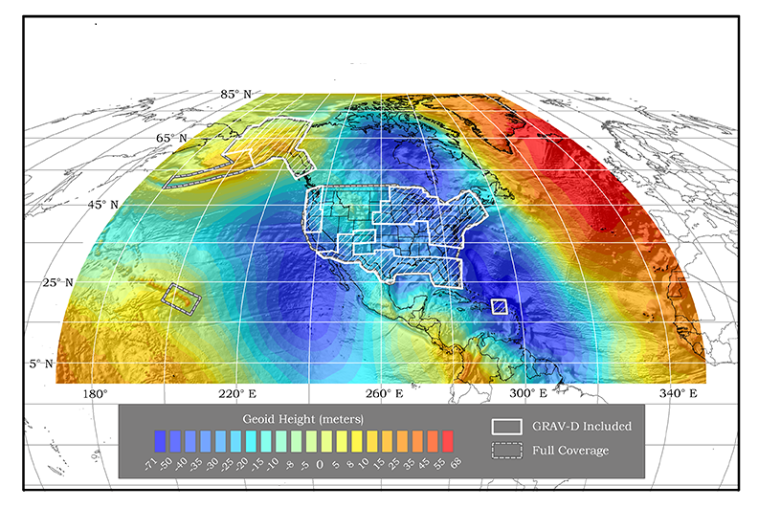
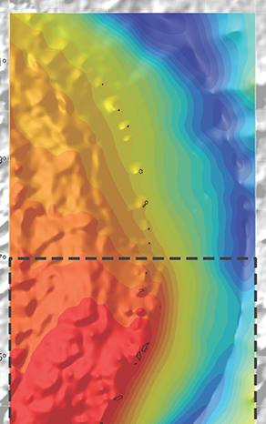
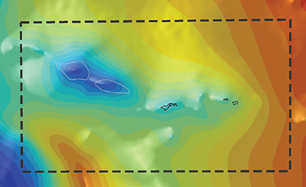

Slide 11
Parameters used in GEOID2022
Parameters | GEOID2022
W₀ | 62,636,856 m²s⁻²
GM | 3.986004415x10¹⁴ m³s⁻²
Geometric RF | NATRF2022
Height (type) | Orthometric H = h - N
Tide System | Tide Free
Velocity of height
Velocity of Geoid height
Reference Epoch | 2020.0 (update 5-10 years)

Slide 12
Data for GEOID2022 (common data sets)
The latest satellite gravity model (GOCO06s)
Terrestrial gravity data (1.65 million, a combination of NGA, NGS, CGS, and INEGI)
Selected shipborne gravity data
Altimetric gravity (DTU21&Grav_32.1)
xG20DEM (3”)
ArcGPv2020
Ice thickness data set, lake bathymetry

Slide 13
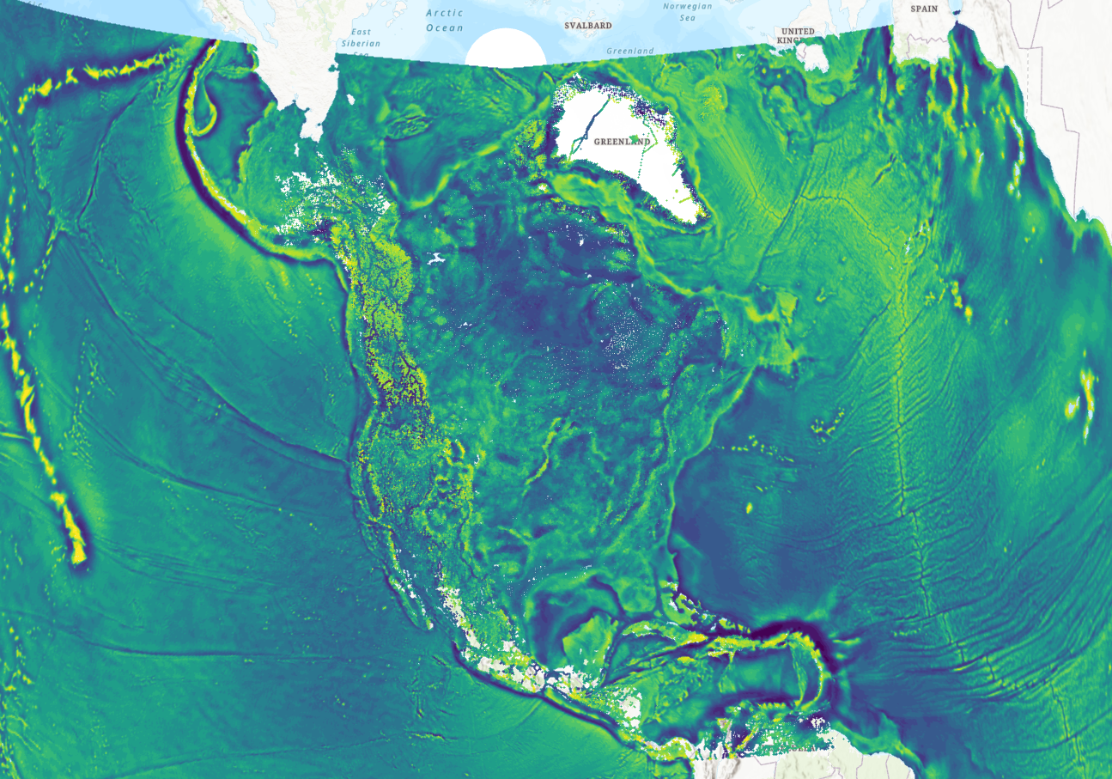

Slide 14
Gravity for the Redefinition of the Vertical Datum(GRAV-D)
Collect the airborne gravity over all territories of the U. S. A. for geoid modeling since 2007
95.72% completion (8/24/2022)
Processed data are available at https://geodesy.noaa.gov/GRAV-D/data_products.shtml
Repro data will be available later this year

Slide 15
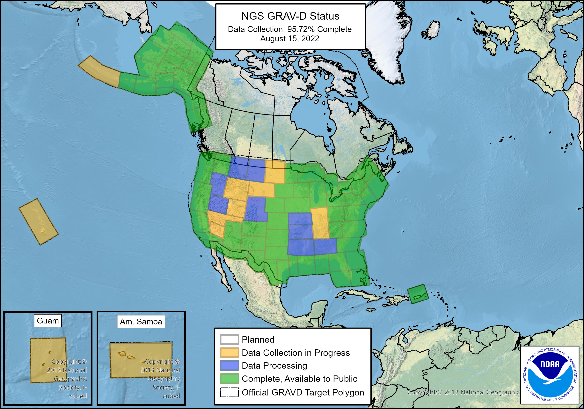

Slide 16
Annual experimental geoid computation
The experimental geoid models (xGEOID) were computed annually from 2014 to 2020 by taking increasing GRAV-D airborne gravity coverage into account and using refined computation methods.
The most recent satellite gravity models (e.g., GOCO05s, GOCO06s) have been used
Uncertainty grids are also estimated
Models are available on the NGS beta site
For more information, visit
https://beta.ngs.noaa.gov/GEOID/xGEOID/index.shtml

Slide 17
Geoid computation at NGS, CGS/INEGI
NGS, CGS and INEGI have been working together on geoid computation
- technical meeting on monthly basis
- each agency working independently, but sharing all computation details
- using the common data sets, the same parameters and reference frame
- contributing geoid models towards GEOID2022

Slide 18
Geoid computation methods
NGS
GRAV-D data is modeled at the flight altitude into a reference model (refB, d/o 2160). Height anomalies are computed first, then converted into the geoid by adding the geoid-quasigeoid separation.
CGS/INEGI
Stokes-Helmert scheme, refB and spherical harmonic expansion of the topographic effect used as the Helmert reference field, indirect effect is applied.
These are the most commonly used methods, more details refer to the IAG WG 2.2.2 “1-cm geoid experiment” https://www.isgeoid.polimi.it/Projects/colorado_experiment.html

Slide 19
Computation methods
Approach | CGS models | NGS models
GBVP type | Stokes-Helmert | Molodensky
Remove-Compute-Restore | Yes | Yes
Kernel Modification | 2159 | L=1040
Geoid-quasigeoid separation | No | Yes
Gravity Data Interpolation | Complete Bouguer Anomalies | RTM residual Free-air Anomalies
Glacial Ice Correction | Yes (over Greenland) | No
Mass Density Anomalies Effect | No | No

Slide 20
xGEOID20 – the first joint model
The NGS and CGS geoid models have a 1'×1' spatial resolution, but the node points are registered differently. The CGS models are interpolated into cell-cornered registration before the combination.
xGEOID20 was computed using the simple arithmetic mean between CGS’s and NGS’s Models. More details is referred to NOAA Technical Report 78 https://geodesy.noaa.gov/library/pdfs/NOAA_TR_NOS_NGS_0078.pdf

Slide 21
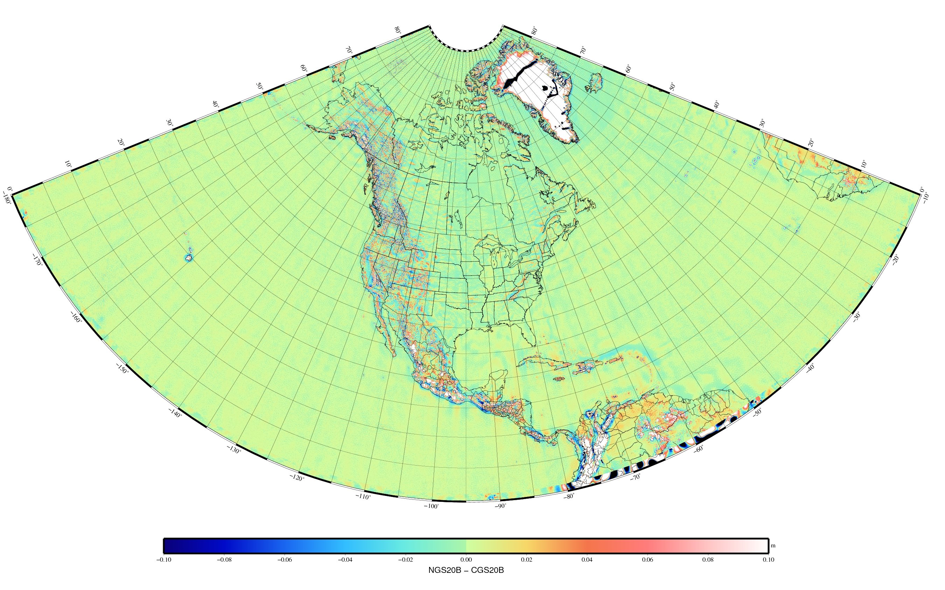
Geoid differences (NGS – CGS) (2020B)
Statistics (Unit: m)
Min = -0.664
Max = 1.233
Mean = 0.009
STD = 0.059
RMS = 0.060

Slide 22
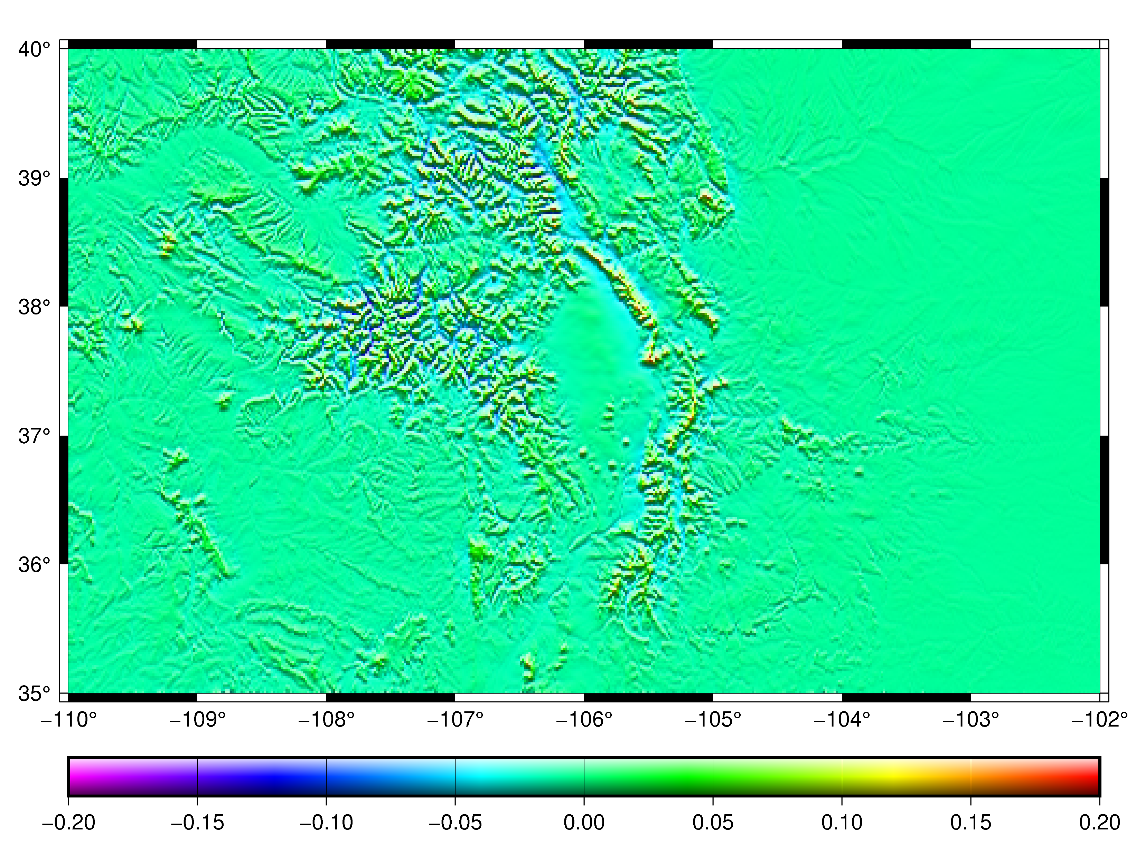
Geoid differences (NGS – CGS) in Colorado
Statistics (Unit: m)
Min = -0.122
Max = 0.213
Mean = 0.005
STD = 0.027
RMS = 0.027

Slide 23
Geoid validation
Validation data sets used
- historical GPS on benchmarks
- three “geoid slope validation survey” in 2011,2014 and 2017
- thirty years mean of TOPEX/POSEIDON altimetry data over the Great Lakes
- Water gauges data sets over Lake Michigan and Ontario
- Icesat2 altimetry data over large water bodies

Slide 24
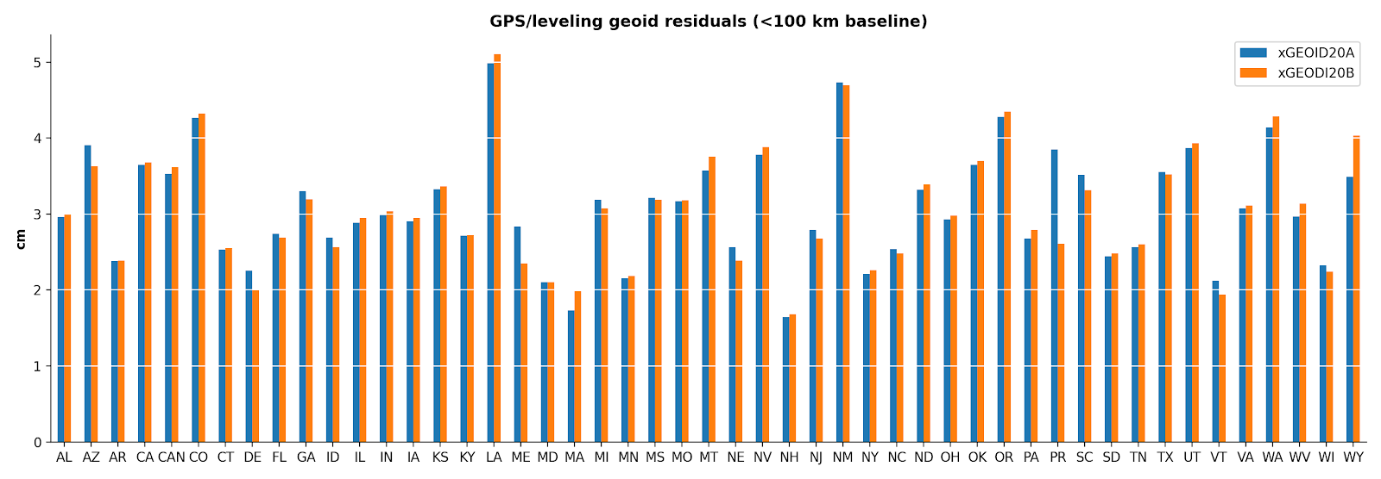
STD of h–H–N state by state (U.S.A.)

Slide 25
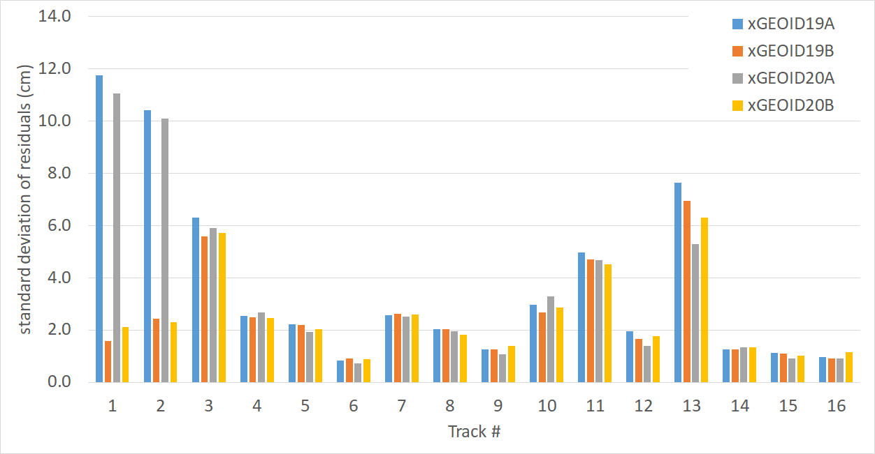
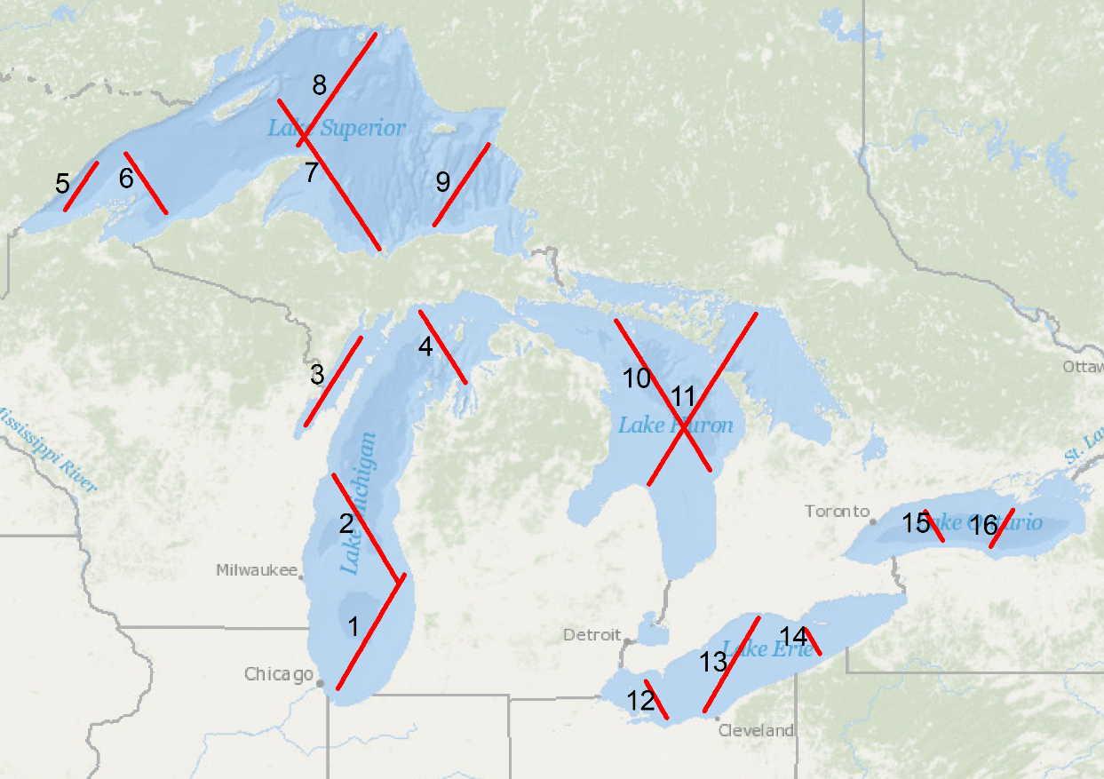
Great Lakes satellite altimetry comparisons
TOPEX/Poseidon ground track over the Great Lakes

Slide 26
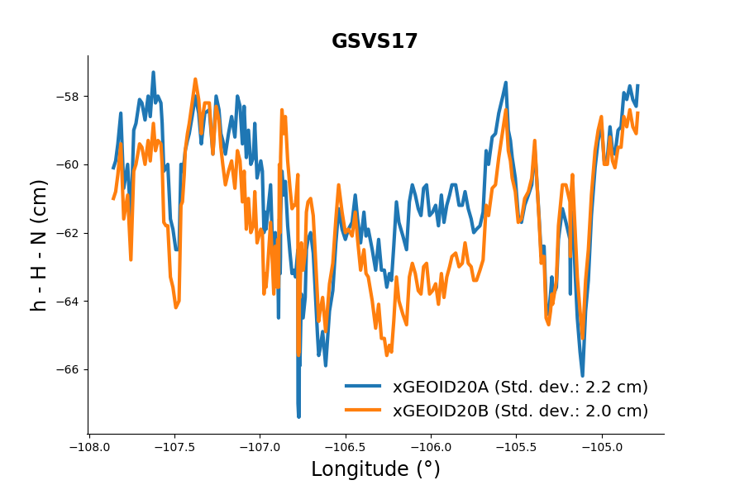
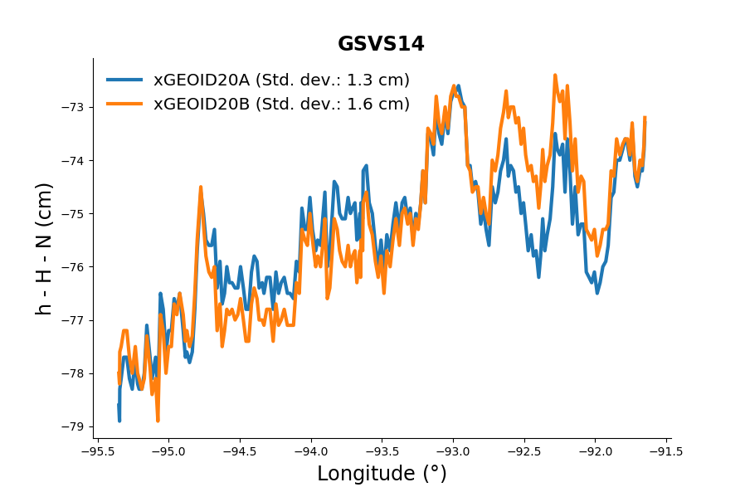
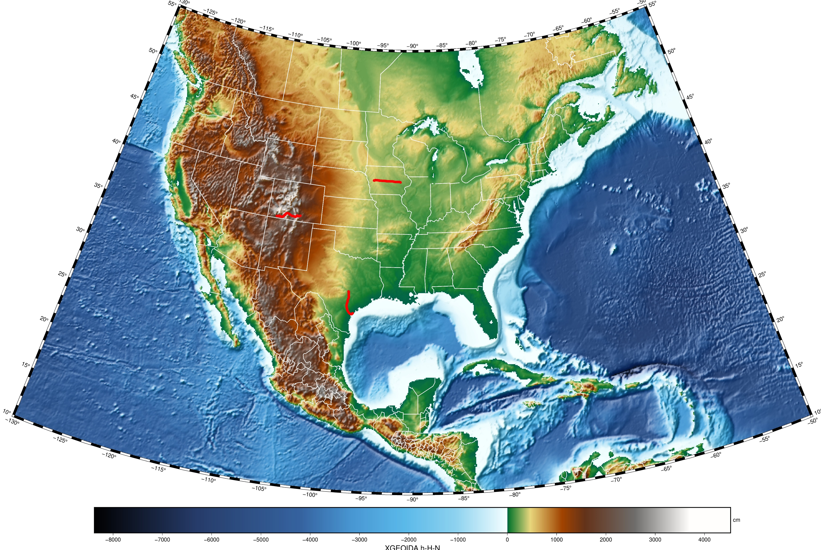
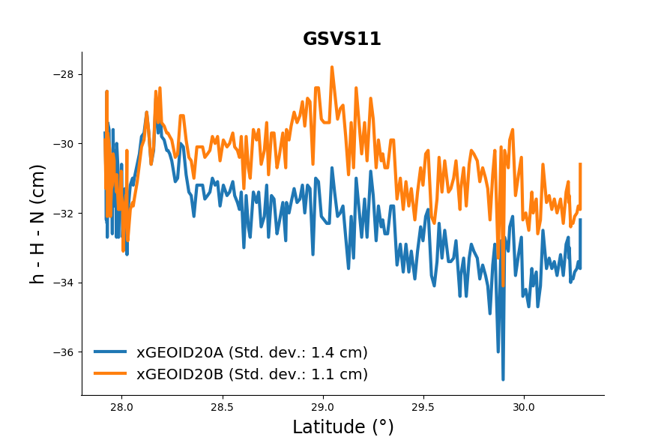
Residual geoid along three GSVS lines

Slide 27
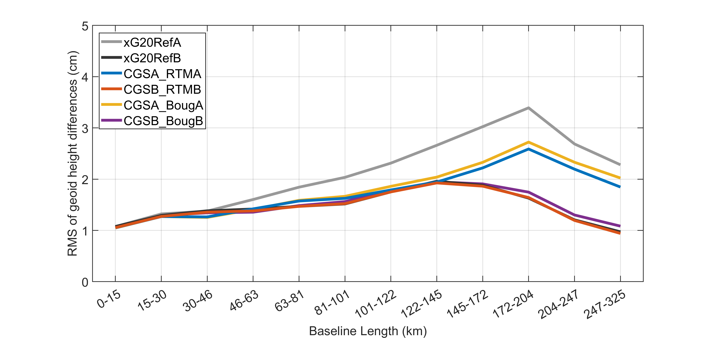
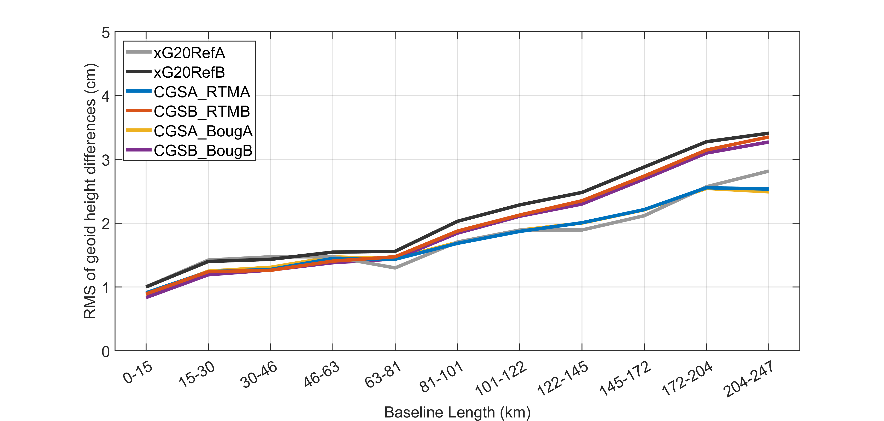
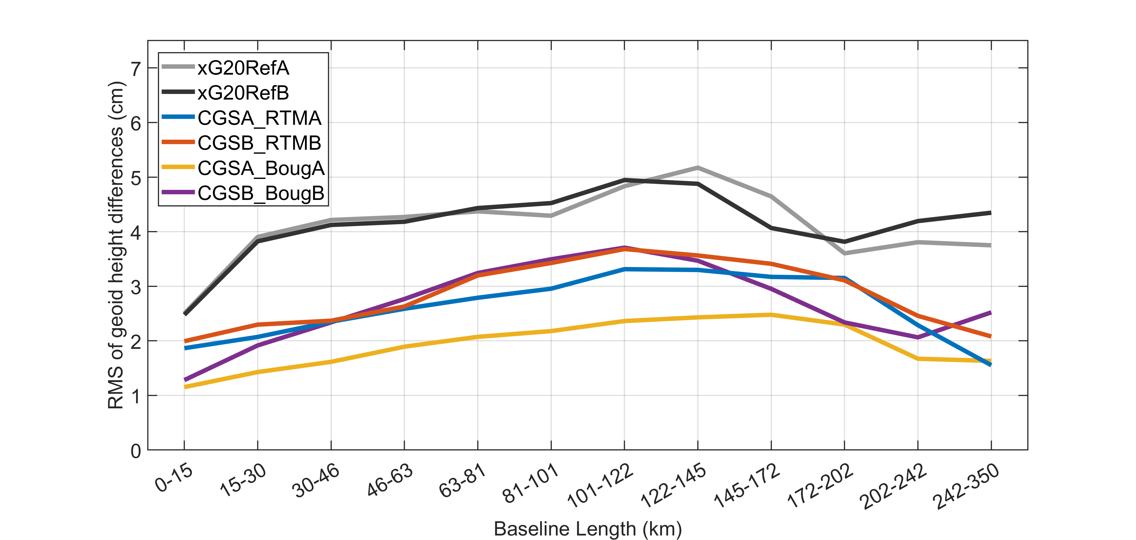
Geoid slope comparisons of three GSVS lines
GSVS11
GSVS14
GSVS17

Slide 28
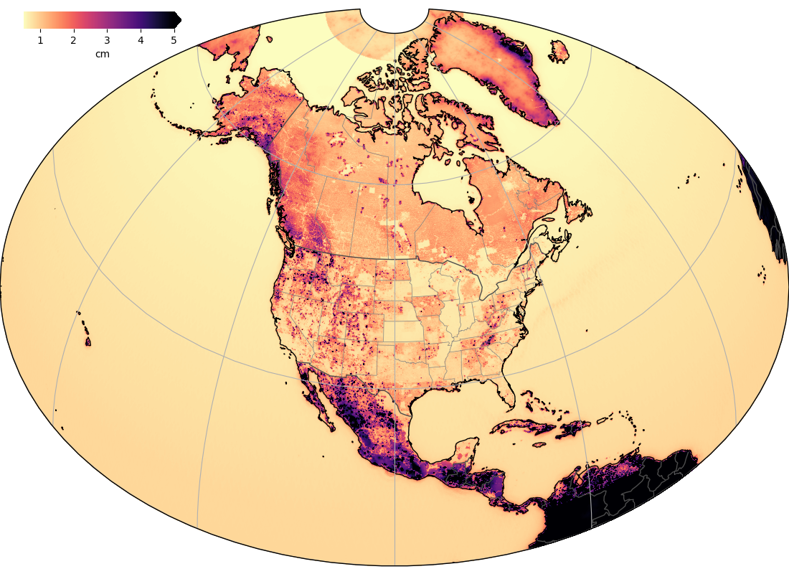
xGEOID20 1σ error grids

Slide 29
Conclusions
Large geoid differences between NGS and CGS models are caused by gravity interpolation and ice correction over Greenland. In Colorado, both models agree within 2.7 cm (1σ).
After removing the biases for every state, standard deviations of GPS/leveling comparisons are mostly around 2-3 cm, worst at 5 cm.
The Great Lakes satellite altimetry comparisons show 1-2 cm agreement on most tracks, but larger differences are on track 3 (Green Bay), 11 (Lake Huron), and 13 (Lake Erie).
The xGEOID20 agrees with the GSVS lines within 1-2 cm (1σ). However, the 4 cm slope over 300 km baseline of GSVS14 is not known.

Slide 30
On-going research
Optimizing spectral weights of GRAV-D surveys in development of Ref coefficient model
Reducing the geoid differences over the mountainous regions between the solutions from NGS, CGS/INEGI
Computing the effects of density contrasts from land ice and inland water bodies
Refining the dynamic geoid model from GRACE, glacial mass balance, hydrological and GIA models
Validating the geoid models using new types of independent data (e.g., Wisconsin GPS on benchmarks, water gauge data sets over other lakes)
Computing the polar geoid

Slide 31
GEOID2022 schedule
2023
- GEOID2022.beta v0.1 to be computed
- GRAV-D 100% completion
2024
GEOID2022 v1.0 to be computed and validated
2025
GEOID2022 v1.0/NAPGD2022(v1.0) be published
Beyond 2025
Update GEOID2022 locally or regionally Update w0 value when 20 cm of the sea level rise threshold is reached.

Slide 32
More information can be found at
https://beta.ngs.noaa.gov/GEOID/xGEOID/index.shtml
Any questions, please email to
ngs.geoid.team@noaa.gov

