Slide 1
GEOID12 Technical Details
Daniel Roman¹, Xiaopeng Li², and Simon Holmes³
1 Geosciences Research Division, NGS, NOAA, Silver Spring MD
2 Earth Resources Technology (ERT), Inc., Silver Spring MD
3 Stinger Ghaffarian Technology (SGT) Inc., Greenbelt MD
^{The Survey Summit}
Sunday, 22 July 2012 (Manchester Grand Hyatt), Geodesy Session, 1030-1200

Slide 2
Basic Concepts on Modeling
Start with a gravimetric geoid (USGG2012)
Use control data to fit to local datums
  Appropriate versions of NAD 83
  Respective local Vertical Datum (if one exists)
Use LSC to determine correlated signal
For complex areas (e.g., CONUS), use MMLSC
Apply grid of correlated signal to USGG2012
Results in GEOID12 with high frequency nature from USGG2012 but fit to local control

Slide 3
Hybrid Geoid Height Models (e.g., GEOID12), Gravimetric Geoid Height Models (e.g., USGG2012) and Conversion Surfaces using GPS on BM data
Earth’s Surface
h
h
h
h
h
H
H
Ellipsoid
H
H
H
N
N
N
N
N
Hybrid Geoid
Gravimetric Geoid
-0.737 M in
Salt Lake –
2009 model
Gravimetric Geoid systematic misfit to BM’s but best fits “true” heights
Hybrid Geoid “converted” to fit local BM’s, so best fits NAVD 88 heights
Conversion Surface model of systematic misfit derived from BM’s in IDB
Notes:
Salt Lake City North ZLC A AA3680 40 47 06.80308 (N) 111 57 09.07339 (W)
GEOID09: -16.943 + -0.717 - -16.923 = -0.737
GEOID03: -16.958 + -0.717 - -17.266 = -0.409

Slide 4
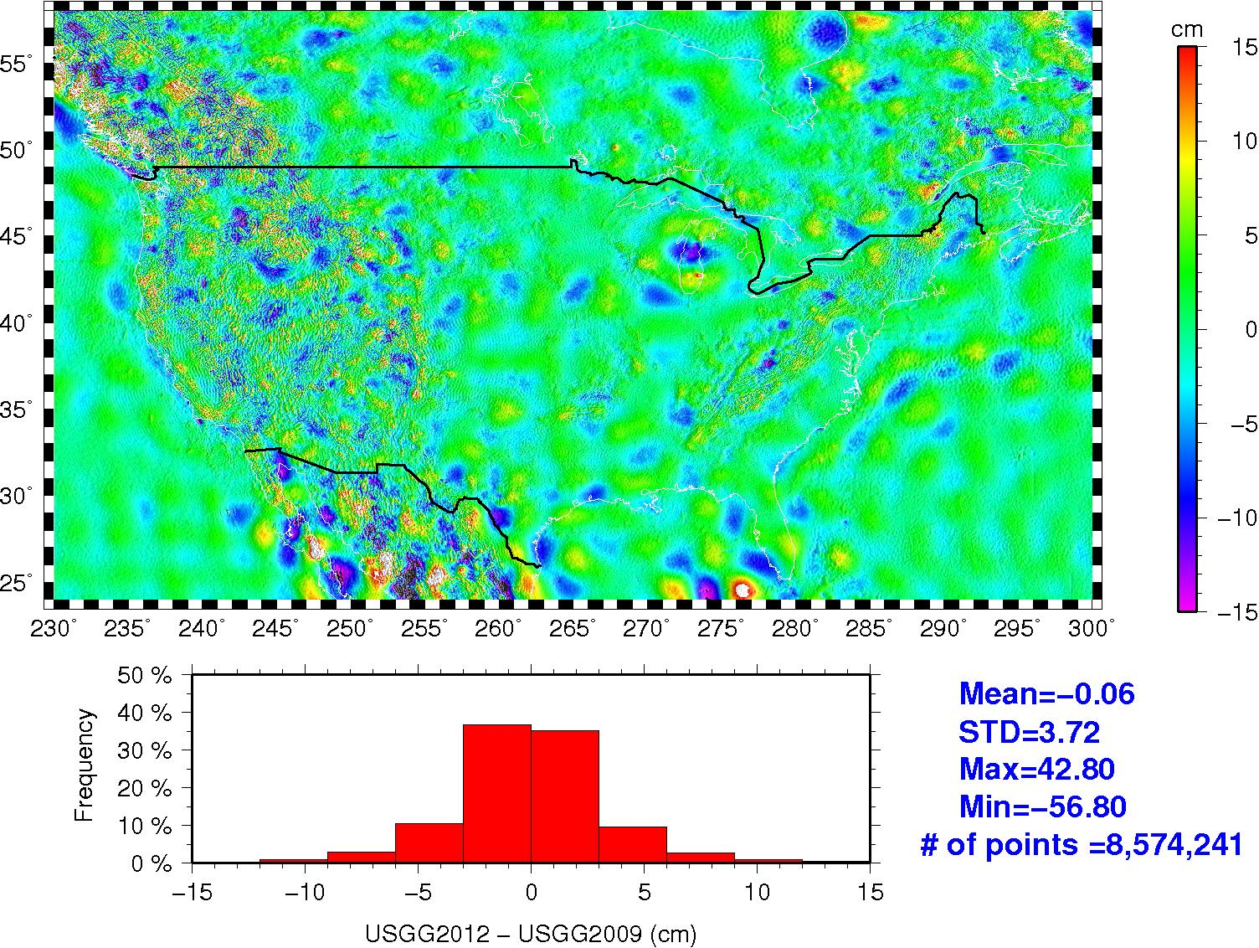
USGG2012 – USGG2009
Notes:
-USGG2009-USGG2003 changes were about an order of magnitude greater – reflecting incorporation of GRACE
-Now changes derive from GOCE – more at the dm-level and below
-future changes will likewise be smaller still

Slide 5
Control Data for GEOID12 Modeling
Region | Reference Frame | Vertical Datum | # GPSBM used (# Rejected) | #OPUSDB used (# Rejected)
CONUS | NAD 83 (2011) | NAVD 88 | * 24,003 (868) | 478 (258)
- VTDP Region | NAD 83 (2011) | NAVD 88/VTDP | 357 (153) | 1 (17)
Alaska | NAD 83 (2011) | NAVD 88 | ** 105 (4) | 2 (1)
Puerto Rico | NAD 83 (2011) | PRVD 02 | 38 | 0
U.S. Virgin Islands | NAD 83 (2011) | VIVD 09 | 21 (3) | 0
Hawaii | NAD 83 (PA11) | Geoid (W₀) | n/a | n/a
American Samoa | NAD 83 (PA11) | ASVD 02 | 19 (3) | 0
Guam | NAD 83 (MA11) | GUVD 04 | 33 | 0
CNMI | NAD 83 (MA11) | NMVD 03 | 55 | 0
* Supplemented by 574 (5 rejected) in Canada and 674 (70 rejected) in Mexico
** Supplemented by 88 (2 rejected) in Canada
http://www.ngs.noaa.gov/GEOID/GEOID12/GPSonBM12.shtml

Slide 6
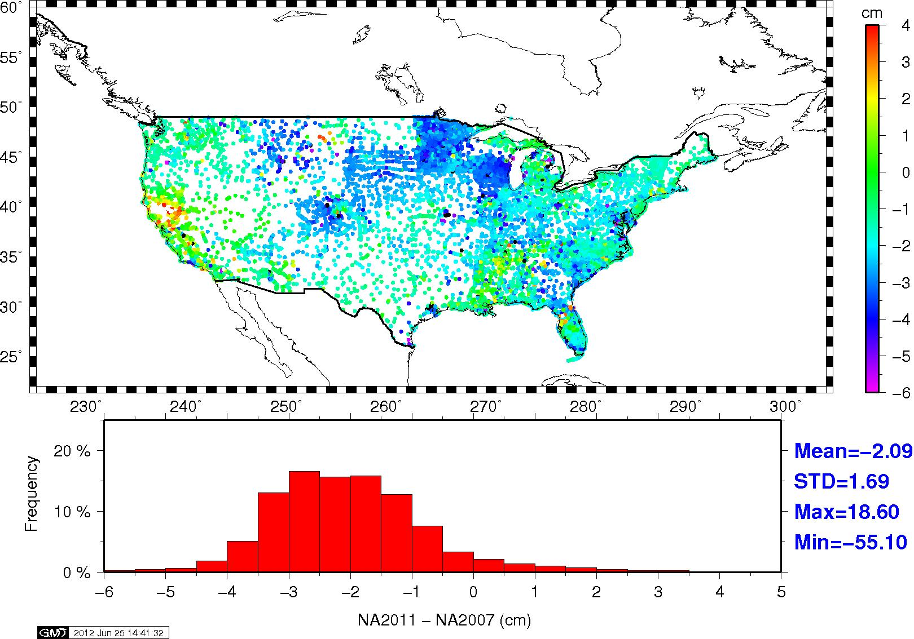
Ellipsoid Height Changes
(NA2011-NA2007)

Slide 7
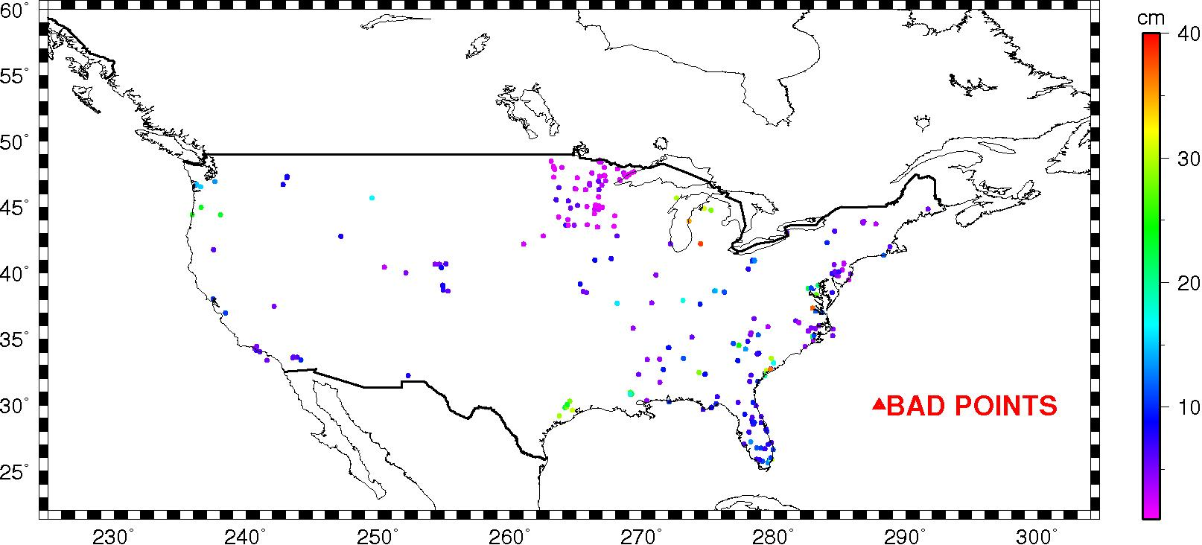
Rejections based on adjustment error (NA2011 => ‘h’ Reject code)

Slide 8
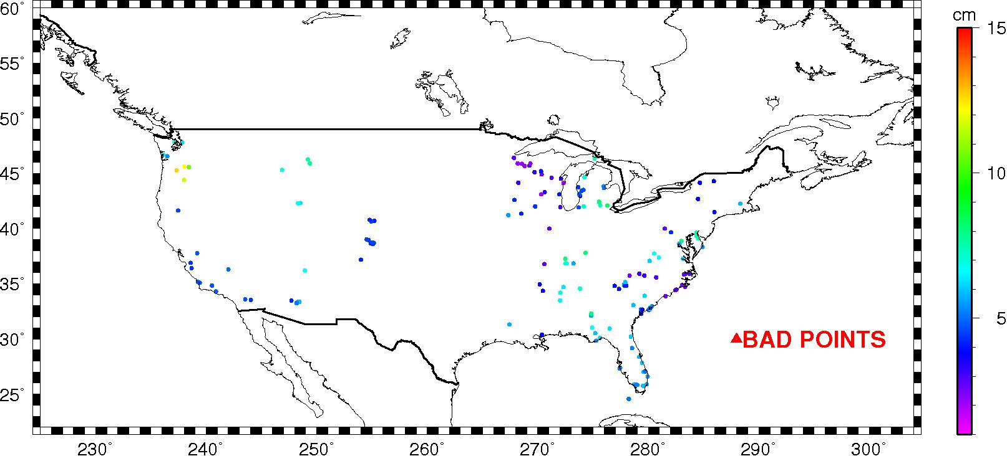
Rejections based on adjustment error (NA2011 => ‘h’ Reject code)

Slide 9
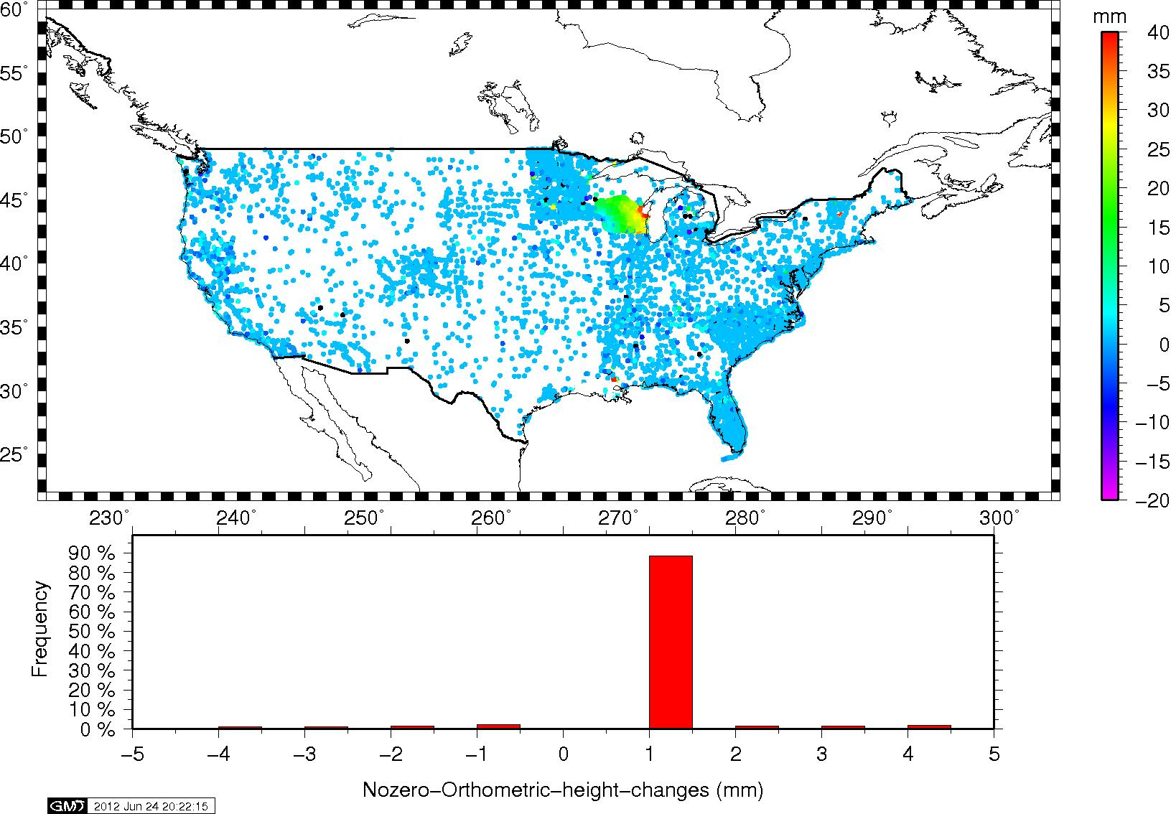
Orthometric Height Changes (mm)

Slide 10
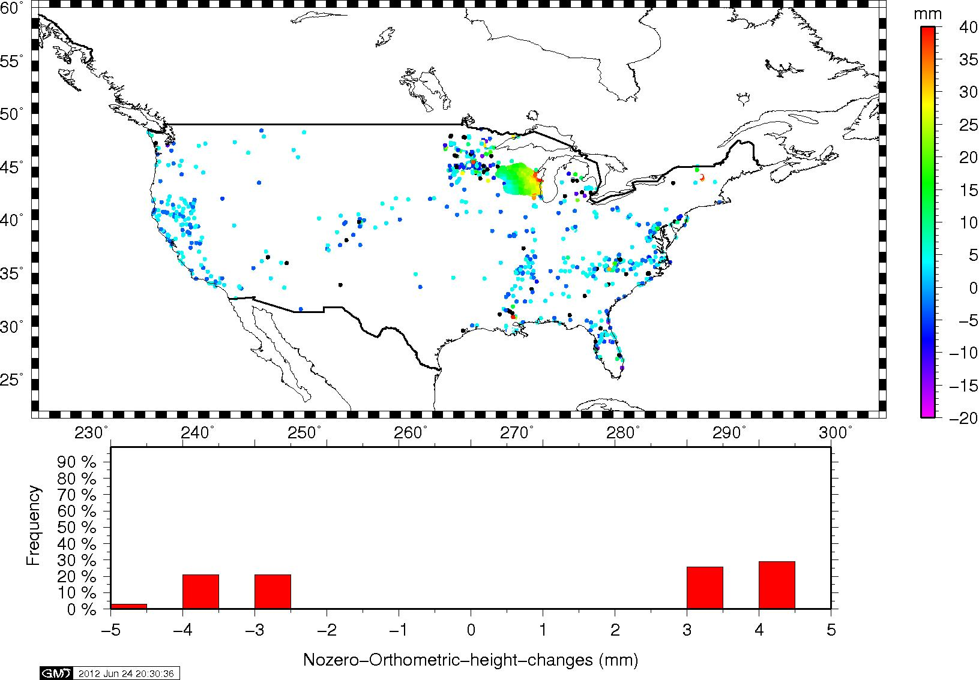
Orthometric Height Changes (mm)

Slide 11
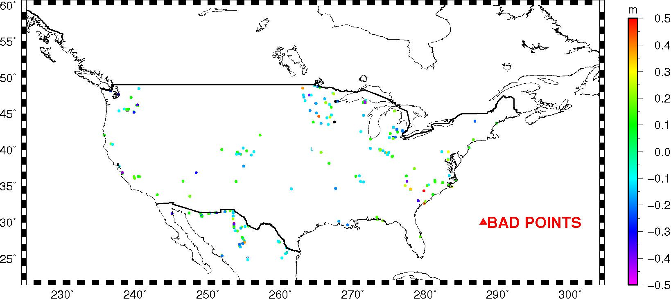
Large error points (‘H’ Reject)

Slide 12
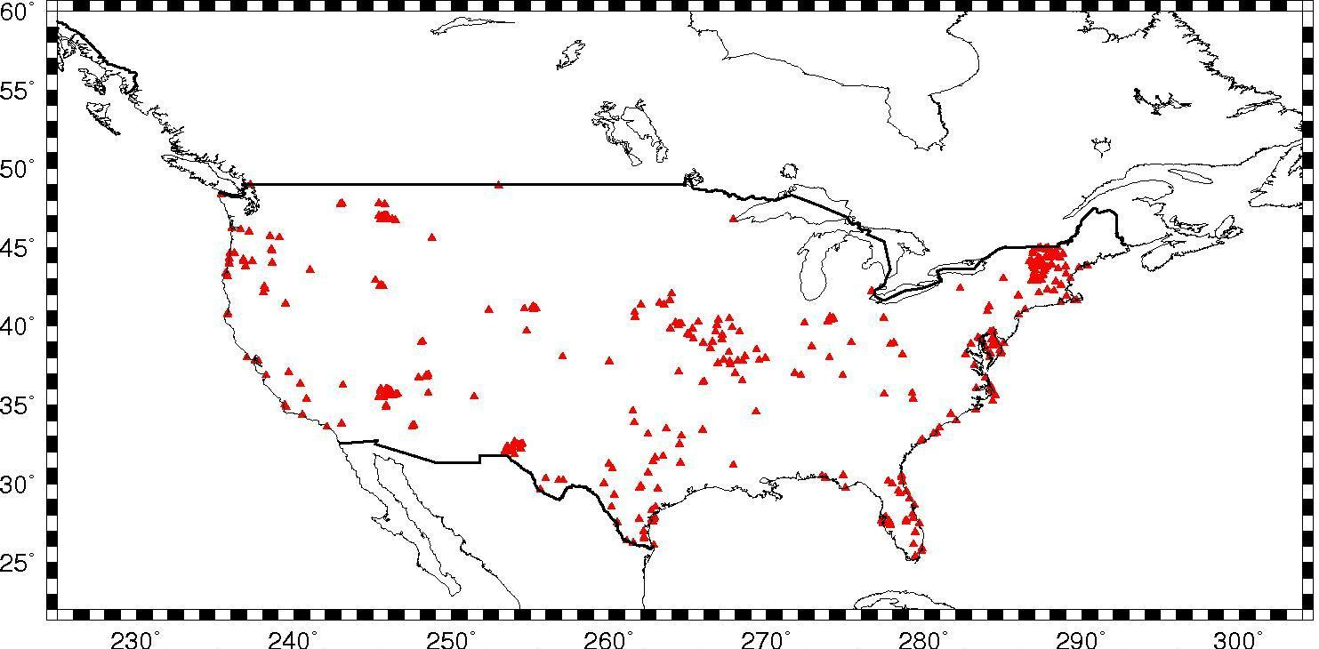
Distribution of OPUSDBBM12

Slide 13
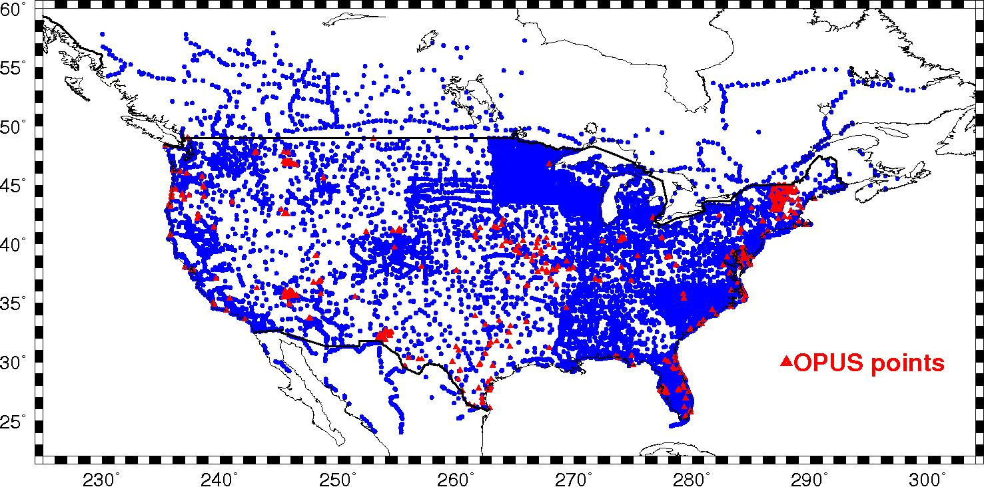
Distribution of OPUSDBBM12

Slide 14
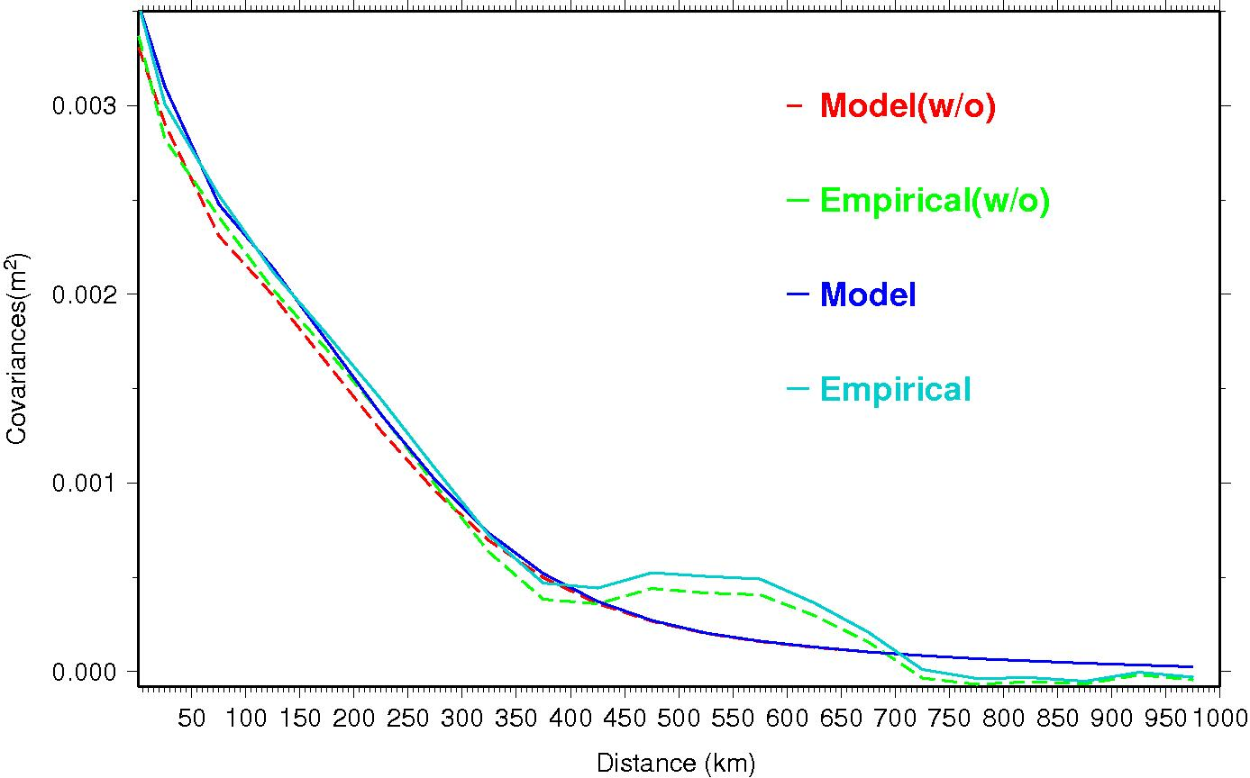
MMLSC for CONUS with and without (w/o) OPUSDBBM12

Slide 15
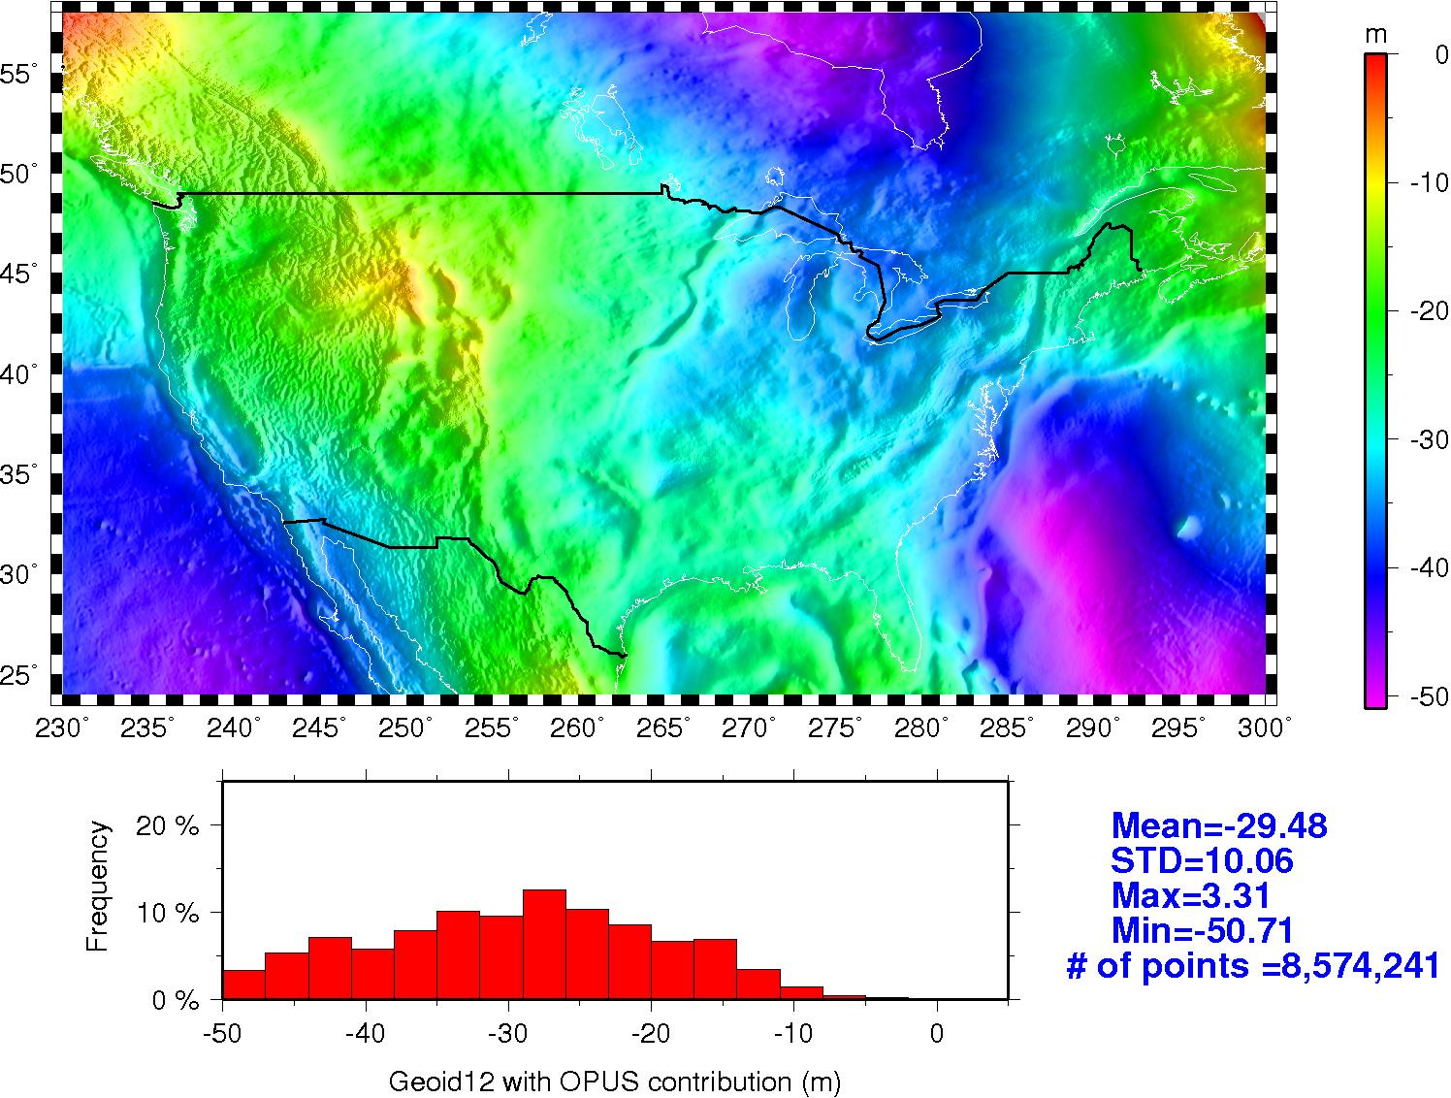
GEOID12 with OPUS

Slide 16
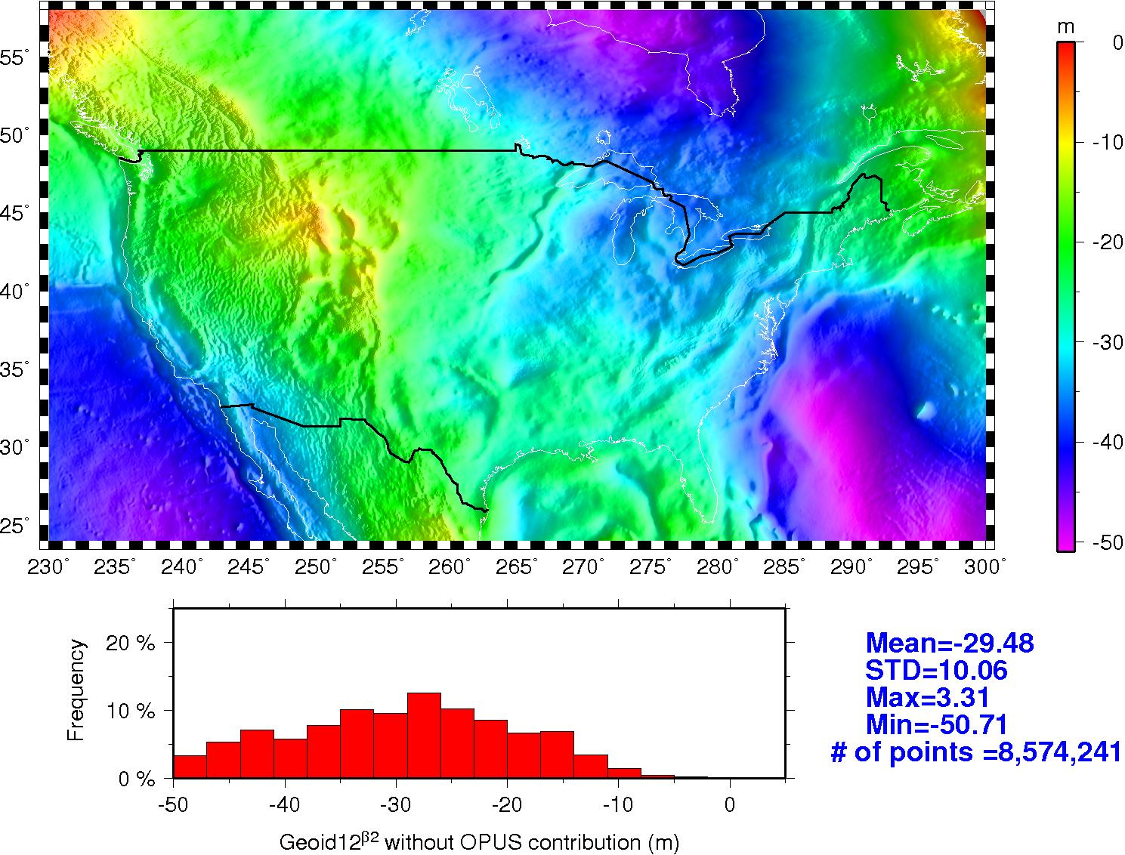
GEOID12 without OPUS

Slide 17
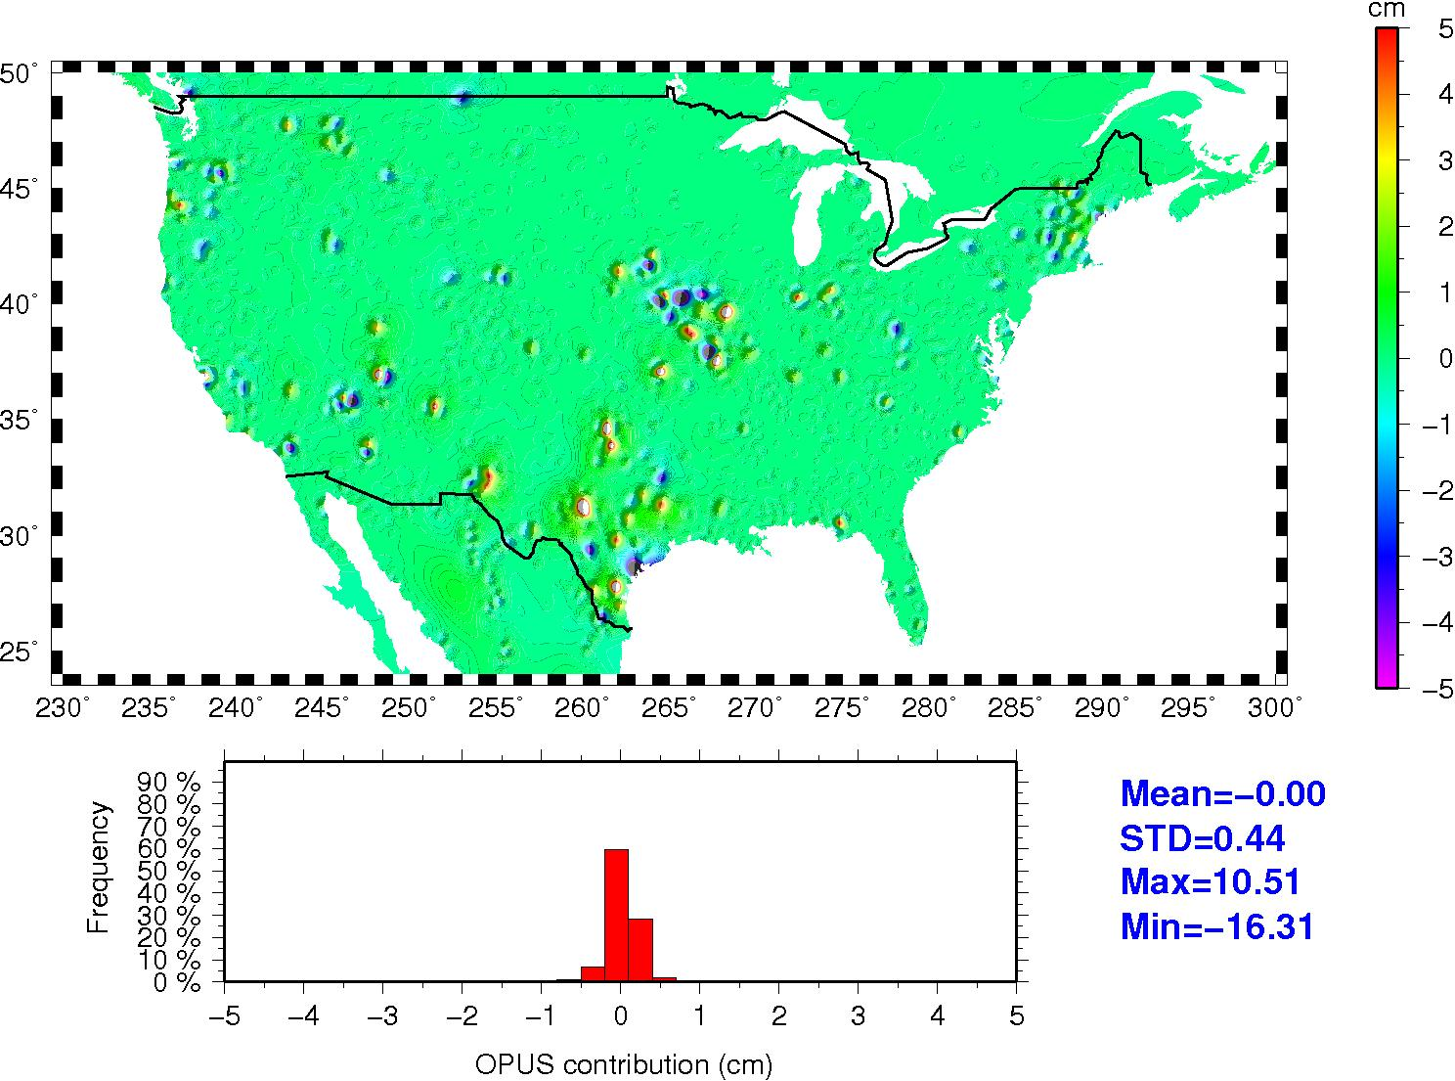
The Impact of OPUS

Slide 18
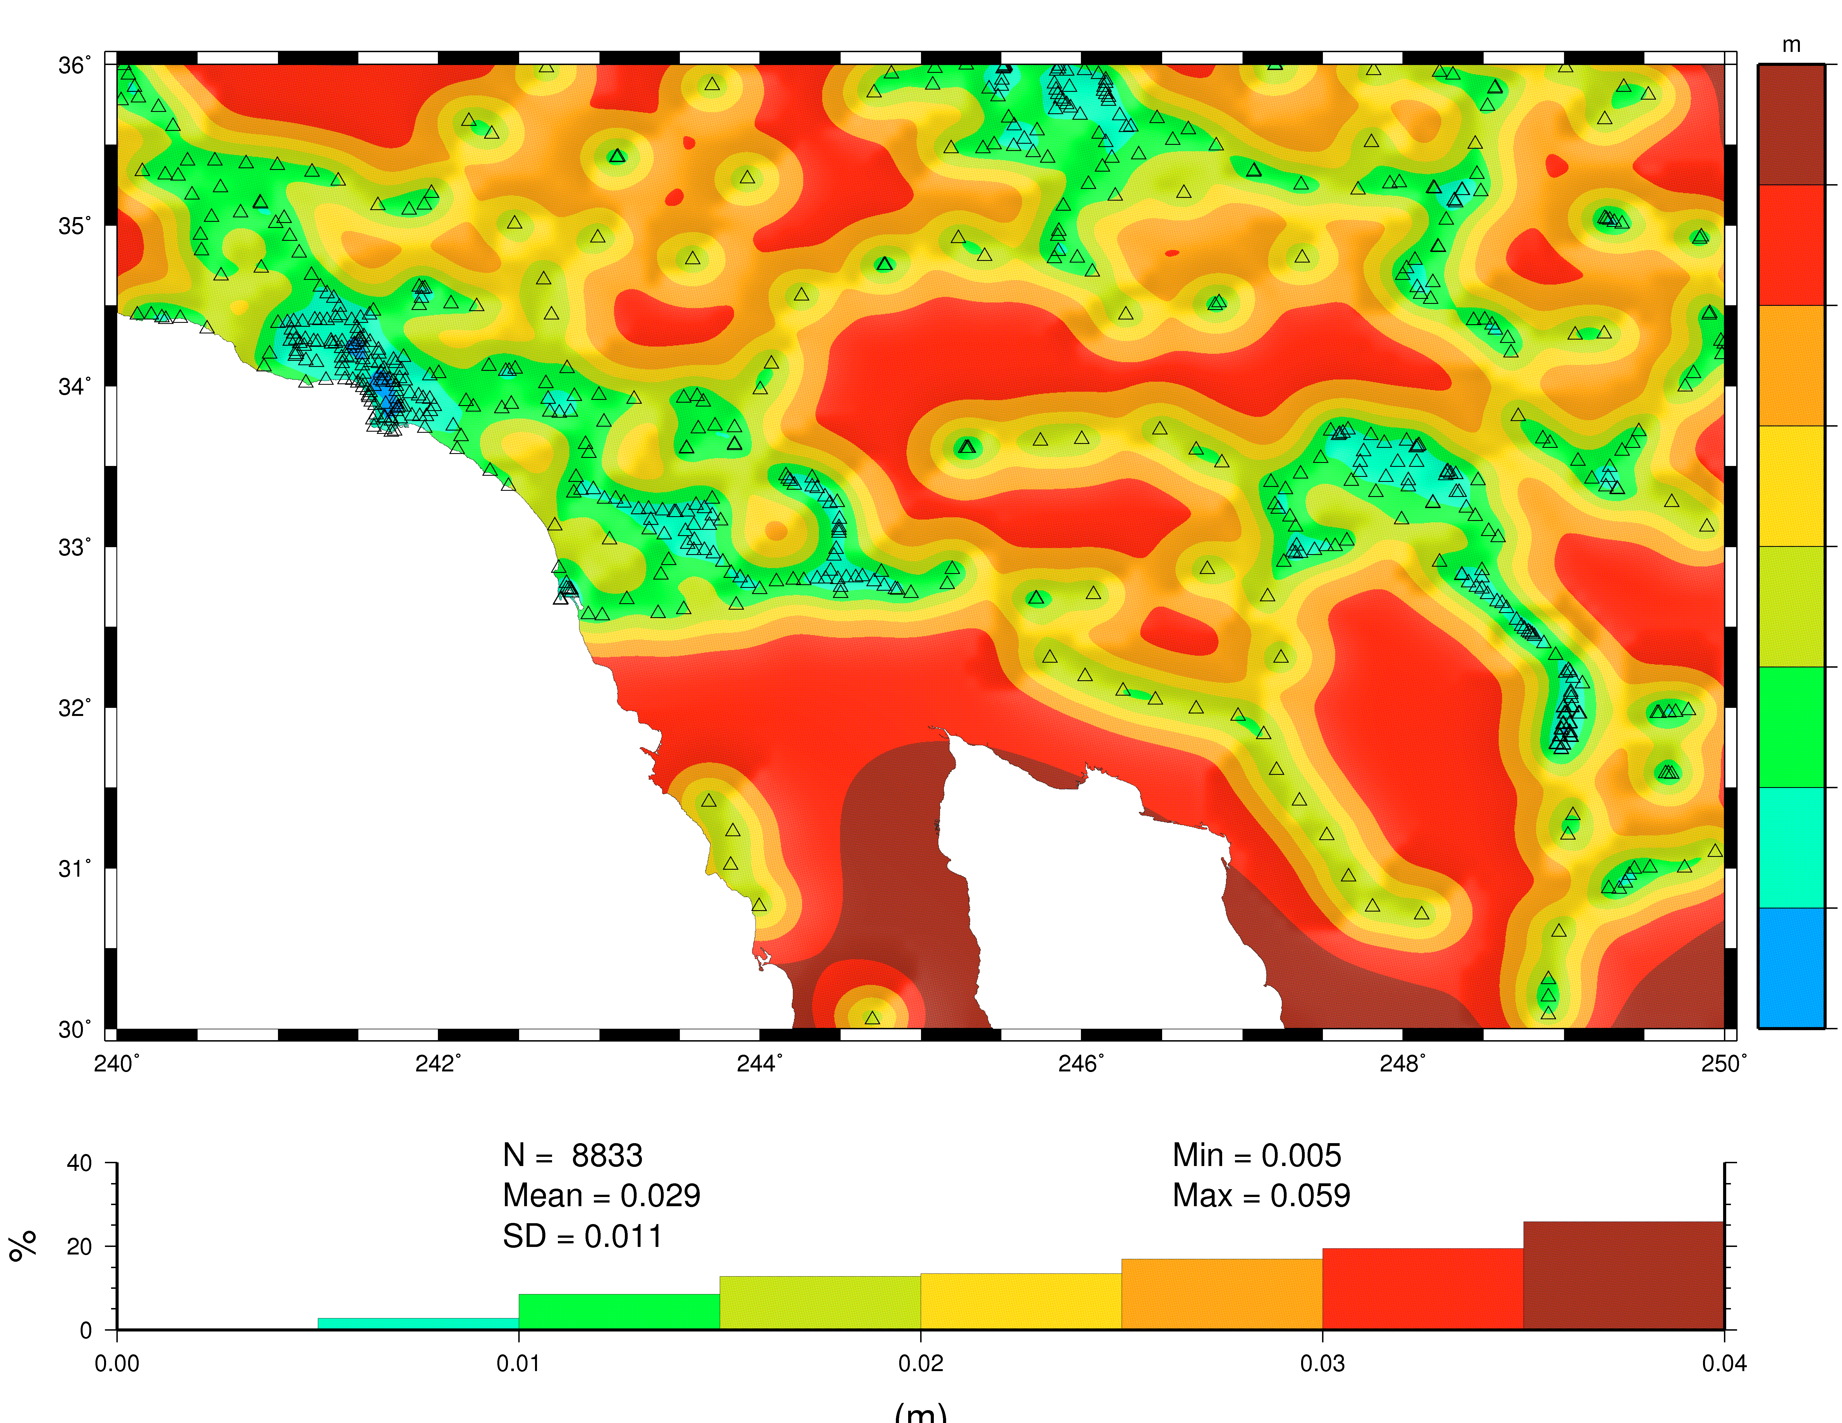
GEOID12 Error Map for Southwest
Triangles show locations of GPSBM2012 & OPUSDBBM12 control points.
Error increases based on the size of the gap.
Dense coverage yields < 1 cm.
Errors will be provided with GEOID12 hts.

Slide 19
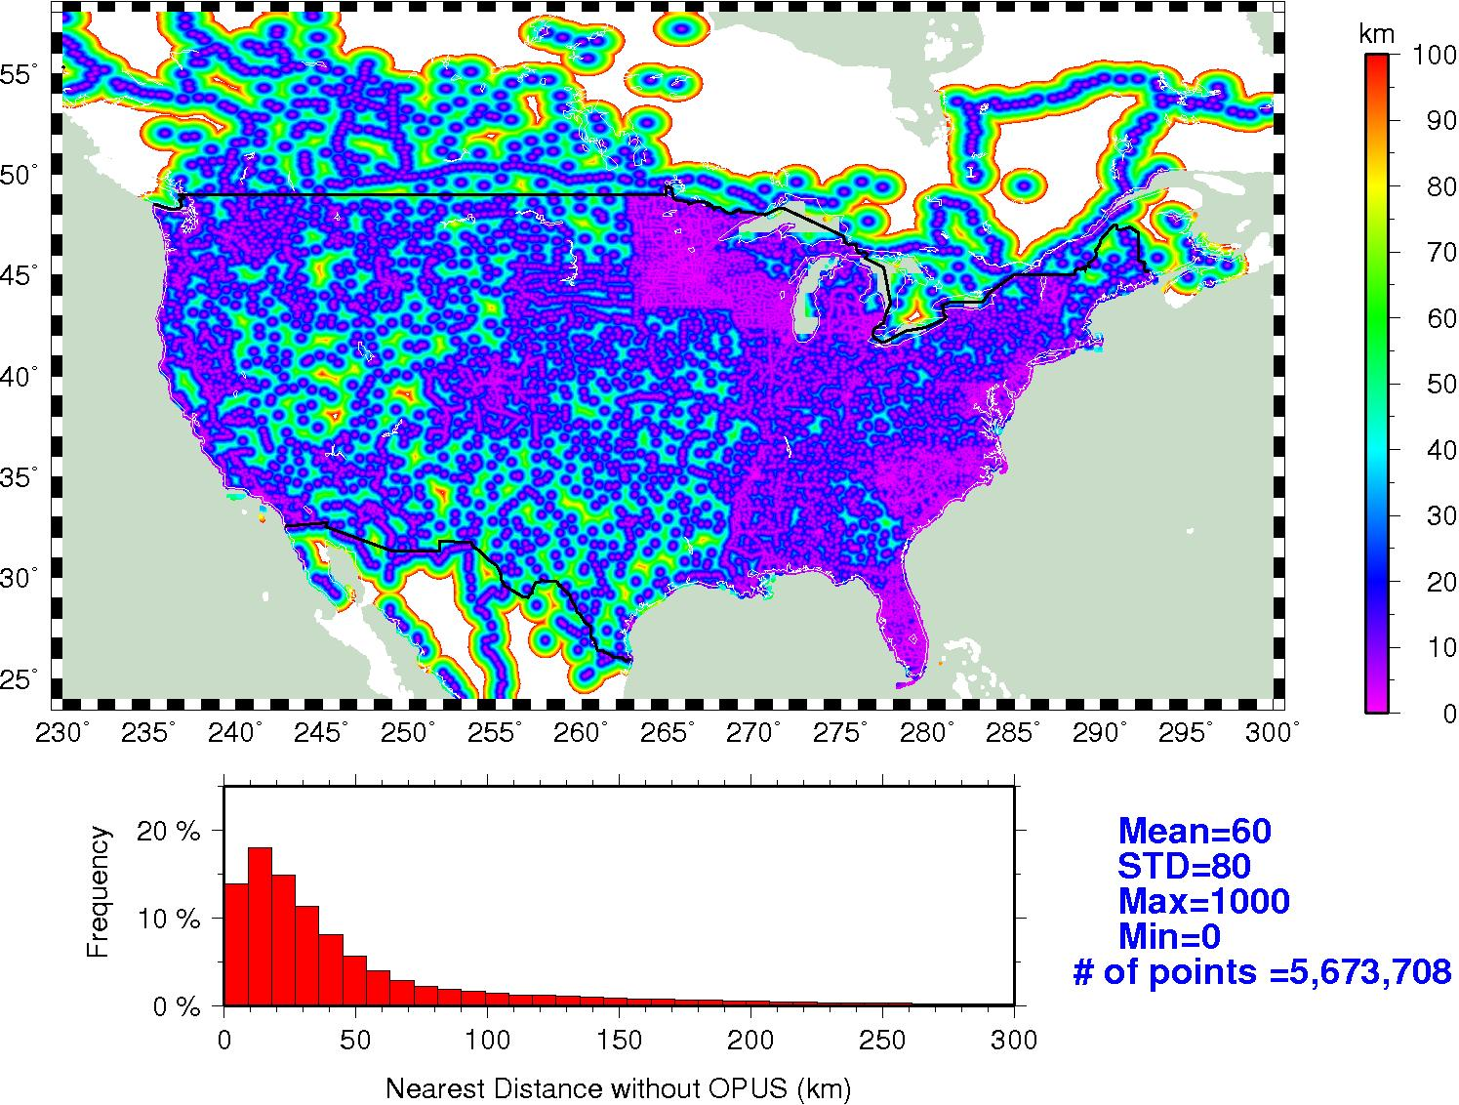
Inverse Distance Plot to Control Data (Interpolation Gap Magnitude)

Slide 20
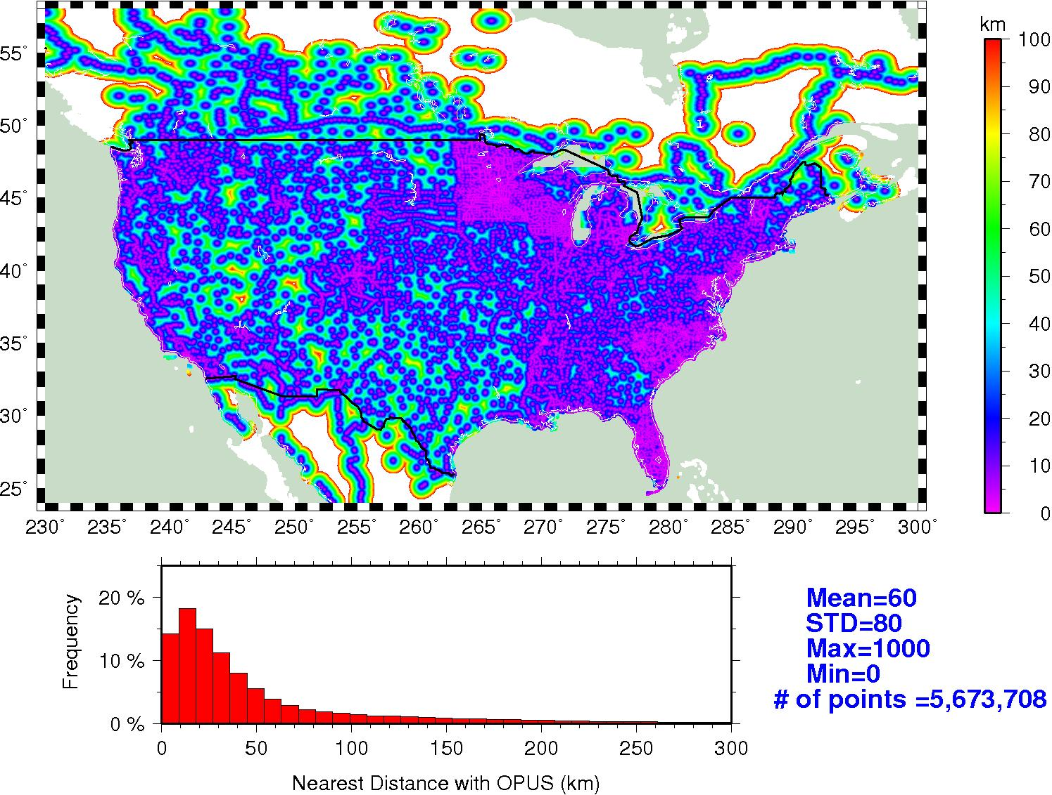
Inverse Distance Plot to Control Data (Interpolation Gap Magnitude)

Slide 21
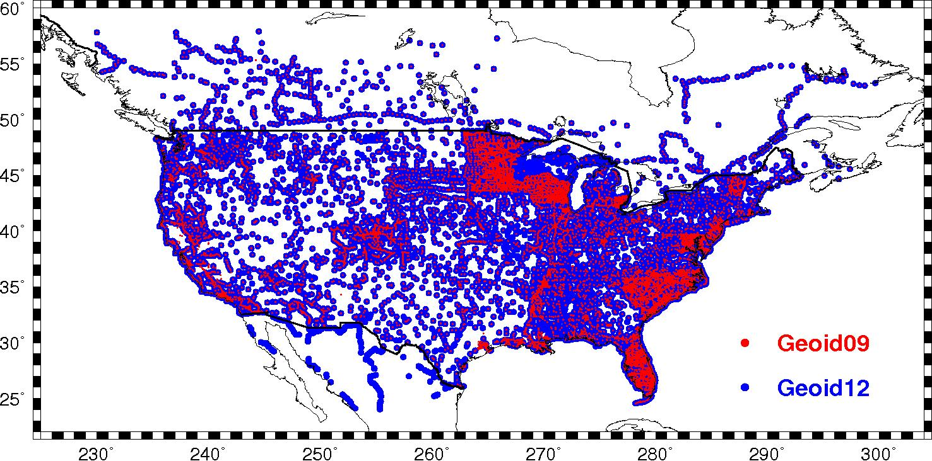
An additional 6,000 points?

Slide 22
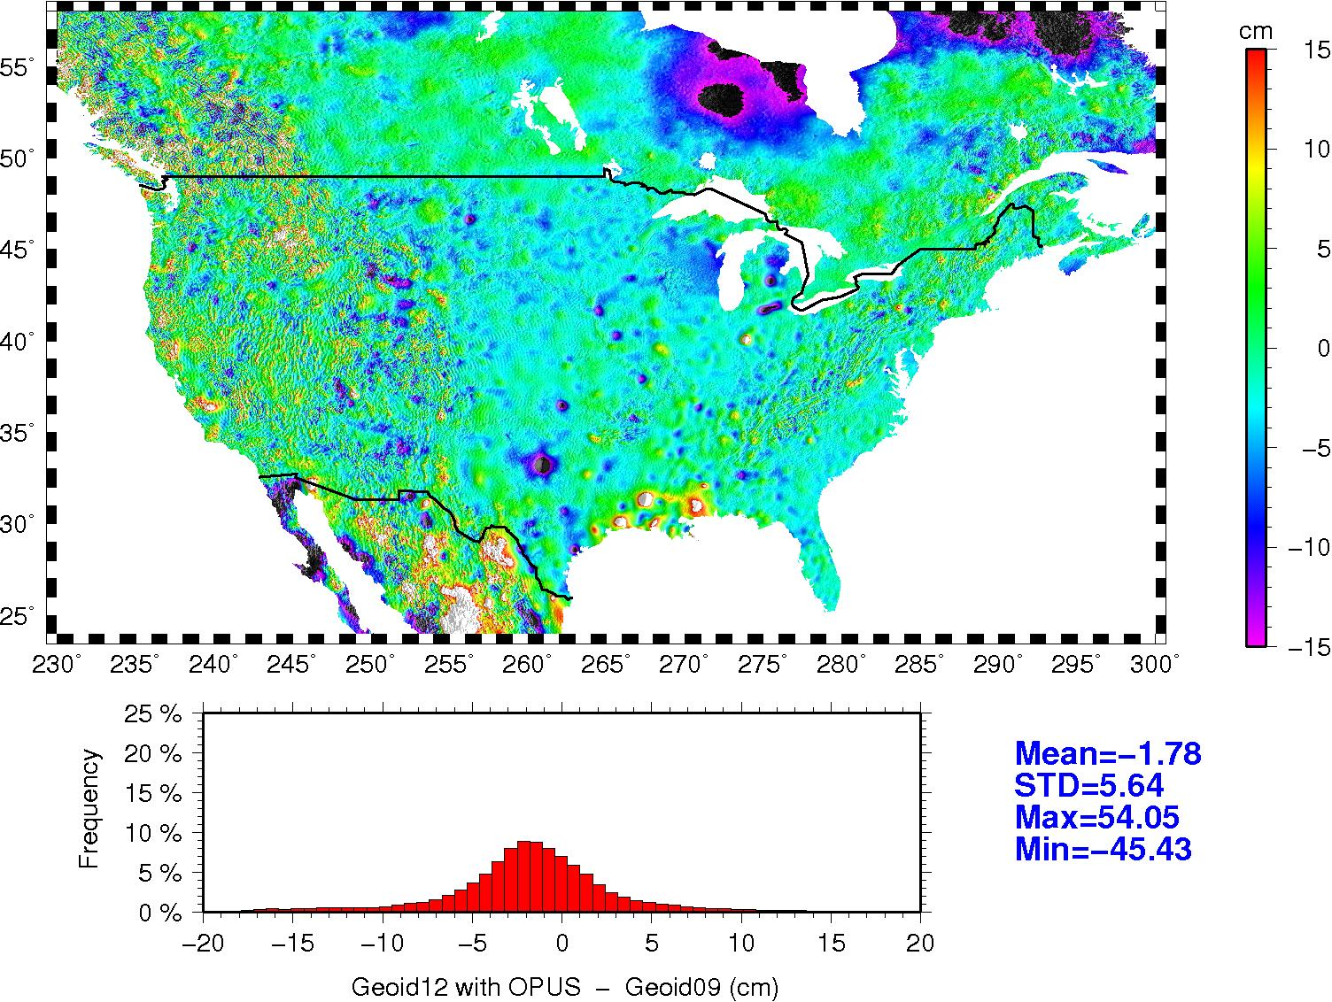
GEOID12 – GEOID09

Slide 23
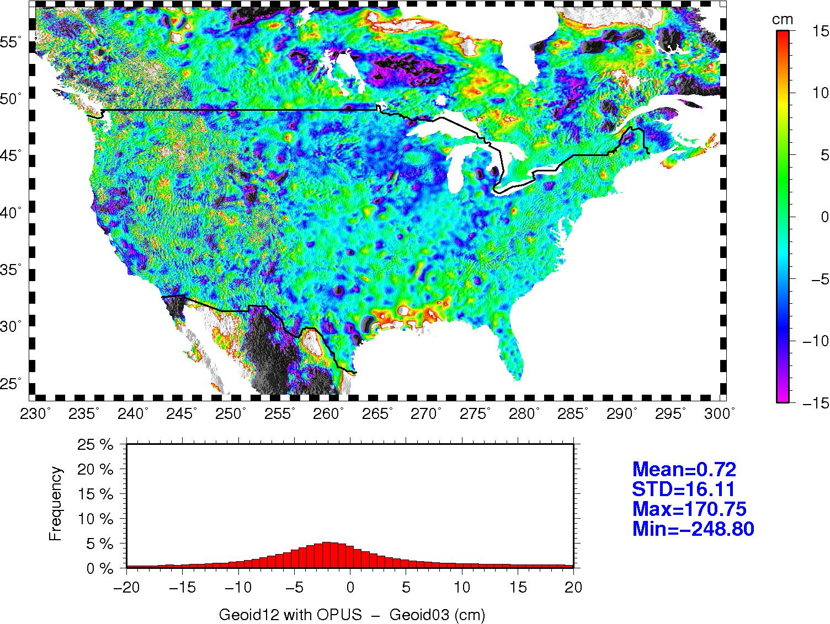
GEOID12 – GEOID03
Same
Scale
as 12-9

Slide 24
Summary
GEOID12 is complete for all regions
It converts between NAD 83 (**11) and the local vertical datum (NAVD 88 in CONUS)
Modeling is much the same as before (MMLSC)
Incorporation of data in Mexico and OPUSDBBm12 is new and has had an impact
Error maps will be available to provide estimated errors along with geoid heights

Slide 25
Questions?
Geoid Models Page:
  http://www.ngs.noaa.gov/GEOID/
GRAV-D Page:
  http://www.ngs.noaa.gov/GRAV-D/
Geoid Team: 301-713-3202
  Dan Roman (x161), Yan Wang (x127), Xiaopeng Li (x210)

