Slide 1

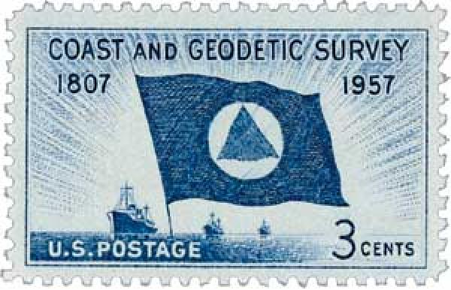
The NGS
Regional Geodetic Advisor Program
NGS Webinar Series
February 10, 2022
Ross Mackay, Branch Chief
Lynda Bell, Southwest Advisor
Jeff Jalbrzikowski, Appalachian Advisor
Dan Martin, Northeast Advisor
Notes:
Happy Birthday NGS!
On February 10, 1807, President Thomas Jefferson signed legislation to establish the Survey of the Coast, which became the US Coast & Geodetic Survey and later the National Geodetic Survey.
Sesquicentennial stamp issued in 1957.

Slide 2

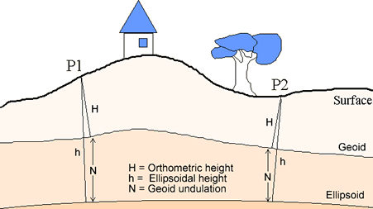
Geodesy and the NGS Mission
Geodesy is the science of accurately measuring and understanding the Earth's geometric shape, orientation in space, and gravity field,
as well as the changes of these properties with time.
…………………………………………….........................
Our mission is to define, maintain and provide access to the
National Spatial Reference System (NSRS)
to meet our nation’s economic, social, and environmental needs.
…………………………………………….........................
Notes:
Geodesy is the business of the NGS.
And our flagship product is the NSRS,
the national coordinate system
that provides the foundation for
transportation, navigation, land record systems,
mapping and charting efforts,
and scientific and engineering applications.

Slide 3
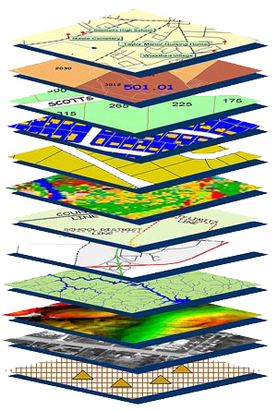
The National Spatial Reference System
Accurate positioning begins
with accurate coordinates
…………………………………………….........................
The NSRS is a consistent coordinate system
that defines
latitude, longitude, height,
scale, gravity, orientation,
and shoreline throughout the United States.
…………………………………………….........................
Notes:
The NSRS provides the foundation
for all positioning and navigation activities
in the United States
There are many layers of information
for decision makers to consider.
The Geodetic Layer is what holds it all together!

Slide 4
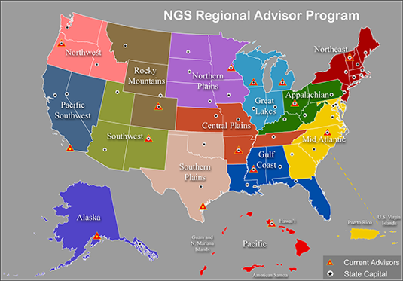
NGS Regional Geodetic Advisor Program
The Regional Geodetic Advisor is a federal employee of NOAA’s National Geodetic Survey serving as a liaison between NGS and its public, academic, and private sector constituents who are managing the geodetic component of geospatial activities tied to the NSRS.
Notes:
These are the 14 Regions.
The Regional Geodetic Advisors are known by many names, including…
NGS Advisors
Geodetic Advisors
The Advisors

Slide 5
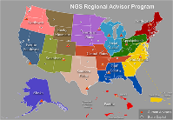
Geodetic Advisor Duties
Provide expert guidance and assistance to local partners/constituents performing geospatial activities that are tied to the NSRS on tectonic movement and geospatial issues in their region.
Provide training, feedback, and geodetic expertise to state and local partners that require regional geospatial activities that are tied to the NSRS.
Provide administrative direction in guidelines, decisions, methodology, interpretation and evaluation processes caused by changes in program, technological development, unknown phenomena, or conflicting requirements.
Notes:
Geodetic Advisors provide
expert guidance, training, and administrative direction
for geospatial activities and accessing the NSRS
1. Primarily Through Regional outreach:
They Advise and assist constituents
with access to the NSRS
serving in a liaison role to regional constituents
2. And also with Collaboration within NGS and NOAA
across NGS divisions and with other entities of NOAA ...
and by
Maintaining awareness of current developments in
geodetic science and technology,
updates geodetic reference systems,
and application to geospatial activities.

Slide 6
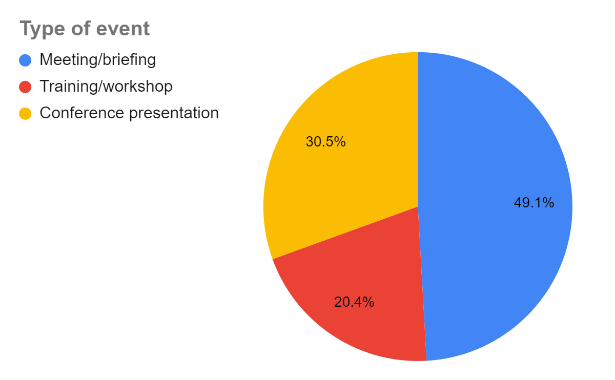
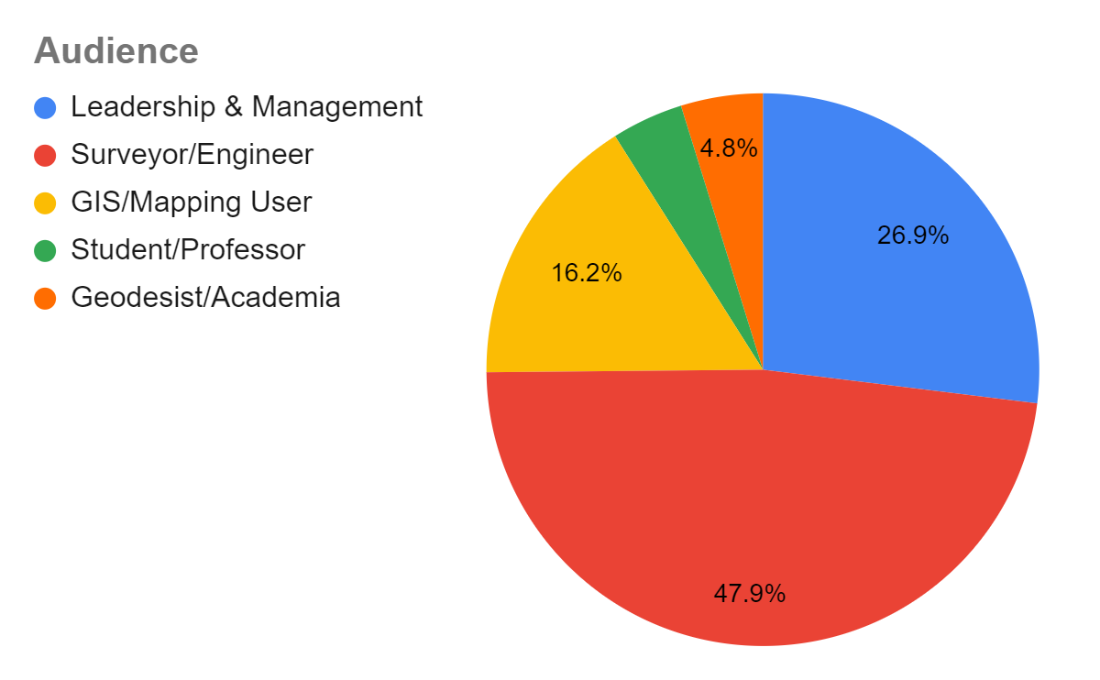
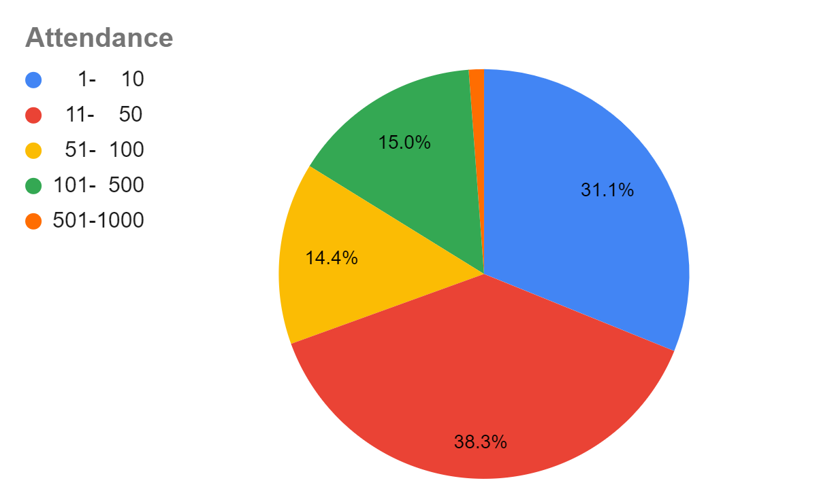
Advisor Outreach and Training Events in 2021
10,557 total attendance
167 events
2 – 1,000 audience size
Notes:
In 2021 these interactions were overwhelming done virtually by phone, video conference or webinar.
WHO: Half of the audience were surveyors
next largest sectors were with
Leadership (decision makers), and GIS professionals
WHAT: Half of events were meetings and briefings,
the other half were conferences and training sessions
HOW MANY: Two-thirds of events were for 50 or less
with one-third more than 50,
averaging about 110 participants

Slide 7
2021 Alaska Virtual Geospatial Gathering
2021 Tribal GIS Virtual Education Symposium
2022 SPCS Meeting
3C GIS Day [universities in Cleveland, Columbus, and Cincinnati]
AAGS General Membership Meeting
AK Geodetic Technical Working Group
Alabama Society of Prof. Land Surveyors Annual Conf.
Alaska BLM Annual Geospatial Field User Network Meeting
Alaska Geodetic TWG Fall 2021 Meeting
Alaska GPS on Bench Marks Regional Workshop
American Electric Power Survey Seminar
ARDOT CORS Leveling
ARDOT Meeting
ARDOT Project Planning OP 4_VRS
ARDOT Updates
Arizona Geographic Information Council Education and Training Symposium
Arizona SPCS Discussion
Arkansas State Surveyor meeting
ASPLS Fairbanks Chapter Meeting
Association of State Floodplain Managers (ASFPM) Cooperating Technical Partners Information Exchange Webinar
Big 10 Academic Alliance (BTAA) GIS Conference
Big Sky Geospatial Conference (MAGIP)
BPP3 Reading Club
Briefing with WisDOT leadership
Briefing, ARDOT, TDOT and Memphis USACE
CA Bench Mark and Monument preservation committee
CDOT SAC Meeting
CDOT Survey Coordinators GPS Procedures
Connecticut Association of Land Surveyors General Membership Meeting
Coordination meetings with ARDOT and TDOT
CoP Meeting Missouri State Surveyors Office
CoP Recon & Planning
County Engineers Association of Ohio Annual Winter Conference
CSRC Coordinating Council Meeting
CSRC Executive Committee
CSRC strategy workshop
CT GIS Network Meeting
Digital Leveling Overview with CALTRAN
Digital Leveling Safety Meeting
Digital Levels Workshop
Educational Seminar
Elevations Geospatial Summer Series
EPSG informational discussion
Federal-State GIS Meeting
FIG Young Surveyors Conference
Florida Floodplain Managers Quarterly Meeting
Florida Geographic Information Office Quarterly Meeting
Florida Surveying and Mapping Council Quarterly Meeting
GA Gwinnett SAMSOG (Survey Society)
Georgia Climate Conference
Geospatial Modeling Grant Partner Meeting
GIS and University Personnel
GIS Colorado Fall Meeting
GIS in the Rockies Conference
GKI Summit: Mapping our way to 4IR
GNSS course at Northwest Michigan College
GPS on Bench Marks Great Lakes Regional Workshop
GPS on BM Webinar CA (training)
GPS on BM Webinar: Nevada (training)
GPS techniques to get elevations of sea level impact sites
HalfMoon Seminars
HI DOT RTN meeting
HI Well elevations
HLSA
HSRP
Idaho DOT Digital Leveling Discussion
Illinois Professional Land Surveyors Association Annual Conference
Illinois Society of Professional Engineers Virtual Conference
Illinois State Plane Coordinate System Committee
Indiana Society of Professional Land Surveyors Annual Conference
Indiana Young Surveyors Roundtable Tuesday
Industry Workshop Presentation
KDOT OP 4.0 Workshop planning.
Kentucky Geographic Information Advisory Council meeting
Kentucky Geological Survey Annual Seminar
LCSO Geospatial Symposium 2021
LCSO Southern Region Meeting
Leveling across Mississippi River on closed I-40 Bridge
Leveling of GNSS at Estuary
Professional Surveyors Conference
Regional GPS on BM's Webinar
Rep. Levin (D-CA-49) Staff Briefing Resilience & Railways
RIGIS User Group
RISPLS Annual Meeting
RMI, Marshall Islands Conservation Society
SC Society of Professional Land Surveyors Chapter Meeting
SC Society of Professional Land Surveyors Conference
SE Nebraska Land Surveyors Association
Society of Land Surveyors of Iowa
State Surveyors Office Center Of Population briefing
Statewide Forum: Modernization of the State Plane Coordinate System in Alaska
TDOT Meeting GPS on BM's
TDOT OPUS Share Workshop
Tennessee Geographic Information Council Annual Meeting
Texas DoT Survey and GIS Conference
UACCM Advisory Board Meeting
UACCM Advisory Board Meeting
UN-GGIM U.S. Delegation
UN-GGIM-AP WG1 Asia Pacific Regional Geodesy Forum
UN-SCoG update to UN-GGIM-Americas
University of Akron surveying class session
University of Florida NSRS Modernization Workshop
URISA Texas Speaker Series
US Delegation for UN-GGIM
USACE OP Planning
Virtual Digital Leveling Workshop
VSLS Annual Conference
VT GPSonBM Webinar
Webinar - GPS on Bench Marks - Arizona 2021
West Virginia Association of Geospatial Professionals Biennial Conference
West Virginia Department of Highways Professional Surveyors Conference
Western Regional Conference
Wisconsin County Surveyors Association quarterly meeting
Wisconsin Society of Land Surveyors Annual Institute
WV Society of Professional Surveyors Annual Convention
WV Society of Professional Surveyors Membership Meeting
WY RTN Discussion
Little Rock USACE Updates
Long Island GIS User Group Conference
Mapping the Great Lakes Webinar Series
Massachusetts Association of Floodplain Management
MDOT summer intern orientation
Meeting with Hartville, MO Mayor and City Leaders
Memphis District USACE OPUS 4.0 & 5.0 Updates
Memphis USACE Planning meeting
Memphis USACE Updates
Michigan Society of Professional Surveyors Annual Convention
Michigan Society of Professional Surveyors Southeast Chapter meeting
Michigan Tech Into to Surveying class
Missouri State Surveyors and MODOT meeting
MNDOT Survey Technical Workshop
MODOT & MO-State Surveyors Office Project Planning
MODOT CORS Discussion
MoDOT CORS Meeting
MODOT CORS Updates
MSLS Annual Conference
MSPS Central Chapter monthly meeting
NC Geodetic Advisory Committee
NE Region GPSonBM
NGS Webinar Series
NHLSA Annual Conference
NSPS/URISA Survey and GIS Summit
NYSAPLS Virtual Annual Conference
OGC CRS GGXF Meeting
OGC CRS-DWG Deformation Models
Ohio Statewide Floodplain Management Annual Conference
OP 4.0 Training and Project Planning for CoP NSRS Survey
OPUS Projects training
OPUS User Forum Panel
OSU Seminar in Field Data Acquisition and Processing
PAIGH USNS: Annual Meeting
Pennsylvania GIS Conference
Pennsylvania Society of Land Surveyors Webinar Wednesday
Planning Meeting
PLSC Board Meeting
Professional Land Surveyors of Colorado Northern Chapter Meeting
Professional Land Surveyors of Ohio Annual Conference
Notes:
This is where the number came from.
From Alaska to Wyoming, Geodetic Advisors work with
surveyors, GIS professionals,
state agencies, federal partners, and universities.
discussing geodesy and NSRS basics,
geodetic surveying techniques and best practices,
and guidance with the use of
NGS products and services.

Slide 8
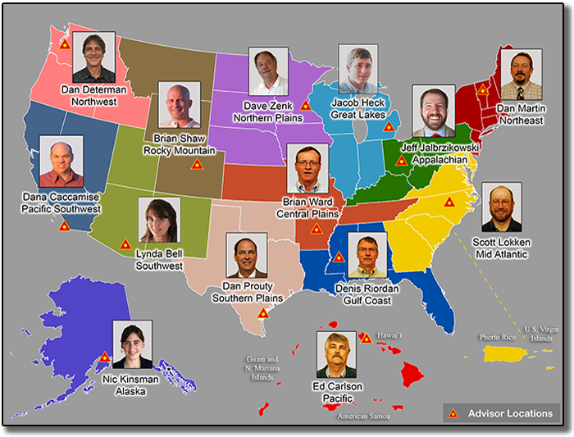
Geodetic Advisors Support the NGS Mission
Notes:
The Regional Geodetic Advisors,
are living and working in regions across the US
and they are there to assist you
with questions or problems related NSRS.
They are our NSRS salesforce,
customer service reps, and subject matter experts
They might not necessarily have the answer to
all your geodetic questions
BUT
The Advisors as a group
have a very wide body of knowledge
AND
They work collaboratively to solve problems

Slide 9
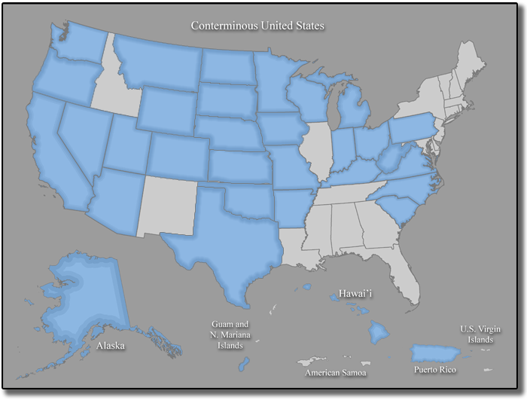
State Geodetic Coordinators
Notes:
Shout out to the State Geodetic Coordinators
Recognizing that a Regional Advisor supports an entire region in which individual states may have local and unique geodetic needs or priorities, NGS recommends that each state identify someone to serve as a State Geodetic Coordinator.
A State Coordinator is not an NGS employee
They serves as a liaison between
a state’s geospatial community and the NGS Advisor
Most are from the public sector,
state DOTs, academia, or professional societies
We at NGS appreciate our State Geodetic Coordinators.
THANK YOU!

Slide 10
Advisor Overviews
    CORS, Lynda Bell, Southwest Advisor
      - Supporting constituents
      - Supporting NGS’ CORS Branch
    OPUS, Jeff Jalbrzikowski, Appalachian Advisor
      - Assisting users with problems
      - Providing training to users
      - Doing beta-testing for NGS’ OPUS Team
    Maintaining and strengthening the NSRS,
    Dan Martin, Northeast Advisor
      - Liaison
      - Guidance and Assistance
      - SME – Collaborate across ranks
      - Stay abreast of technology/users
Notes:
But Advisors do much more than attend meetings.
Lynda, Jeff and Dan will tell us how they are helping in their regions and across the nation.

Slide 11
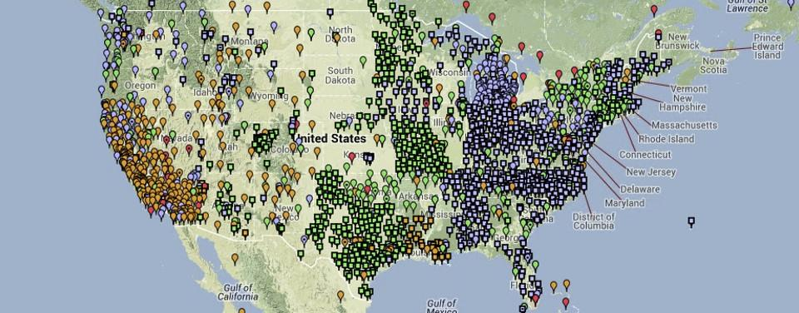
Advisor Support for the CORS Network
The Regional Geodetic Advisor is a federal employee of NOAA’s National Geodetic Survey serving as a liaison between NGS and its public, academic, and private sector constituents who are managing the geodetic component of geospatial activities tied to the National Spatial Reference System (NSRS) in their region. Assistance in management of CORS stations in an advisor’s region is an integral part of supporting the NSRS.
Notes:
The Regional Advisor serves as a liaison between NGS and its public, academic, and private sector constituents who are managing the geodetic component of geospatial activities tied to the NSRS. Assistance in management of NOAA’s Continuously Operating Reference Station (CORS) Network in an advisor’s region is an integral part of supporting the NSRS.

Slide 12
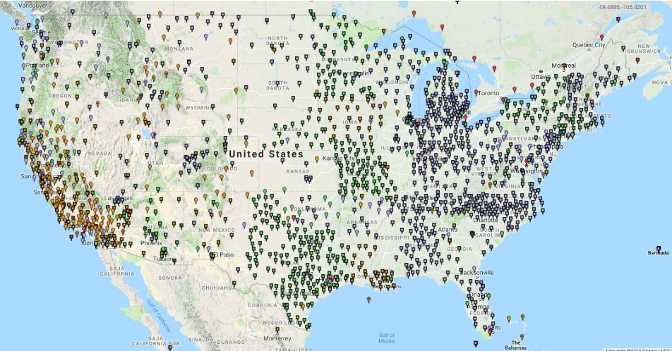
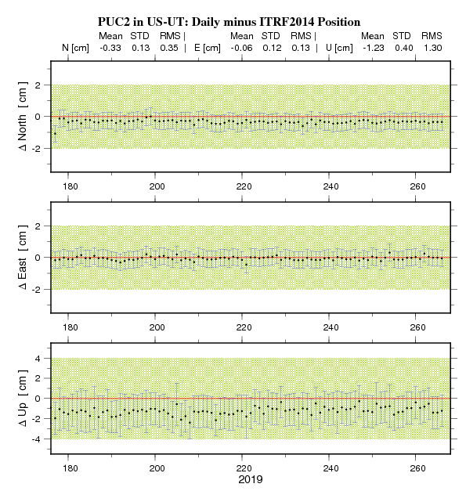
NOAA’s Continuously Operating Reference Station Network (NCN)
NOAA’s Continuously Operating Reference Stations (CORS): NGS provides GNSS data files, station coordinates, and velocities from this nationwide array of tracking stations which are used for survey processing and geophysical research
Notes:
NOAA’s Continuously Operating Reference Station (or CORS) Network provides GNSS data files, station coordinates, and velocities from this nationwide array of tracking stations which are used for survey processing and geophysical research.
Surveyors, GIS users, engineers, scientists, and other people who collect GPS/GNSS data can use NCN data, acquired at fiducial geodetic control stations, to improve the precision of their positions, and align their work within the National Spatial Reference System (NSRS). NCN enhanced post-processed coordinate accuracies can approach a few centimeters, both horizontally and vertically.

Slide 13
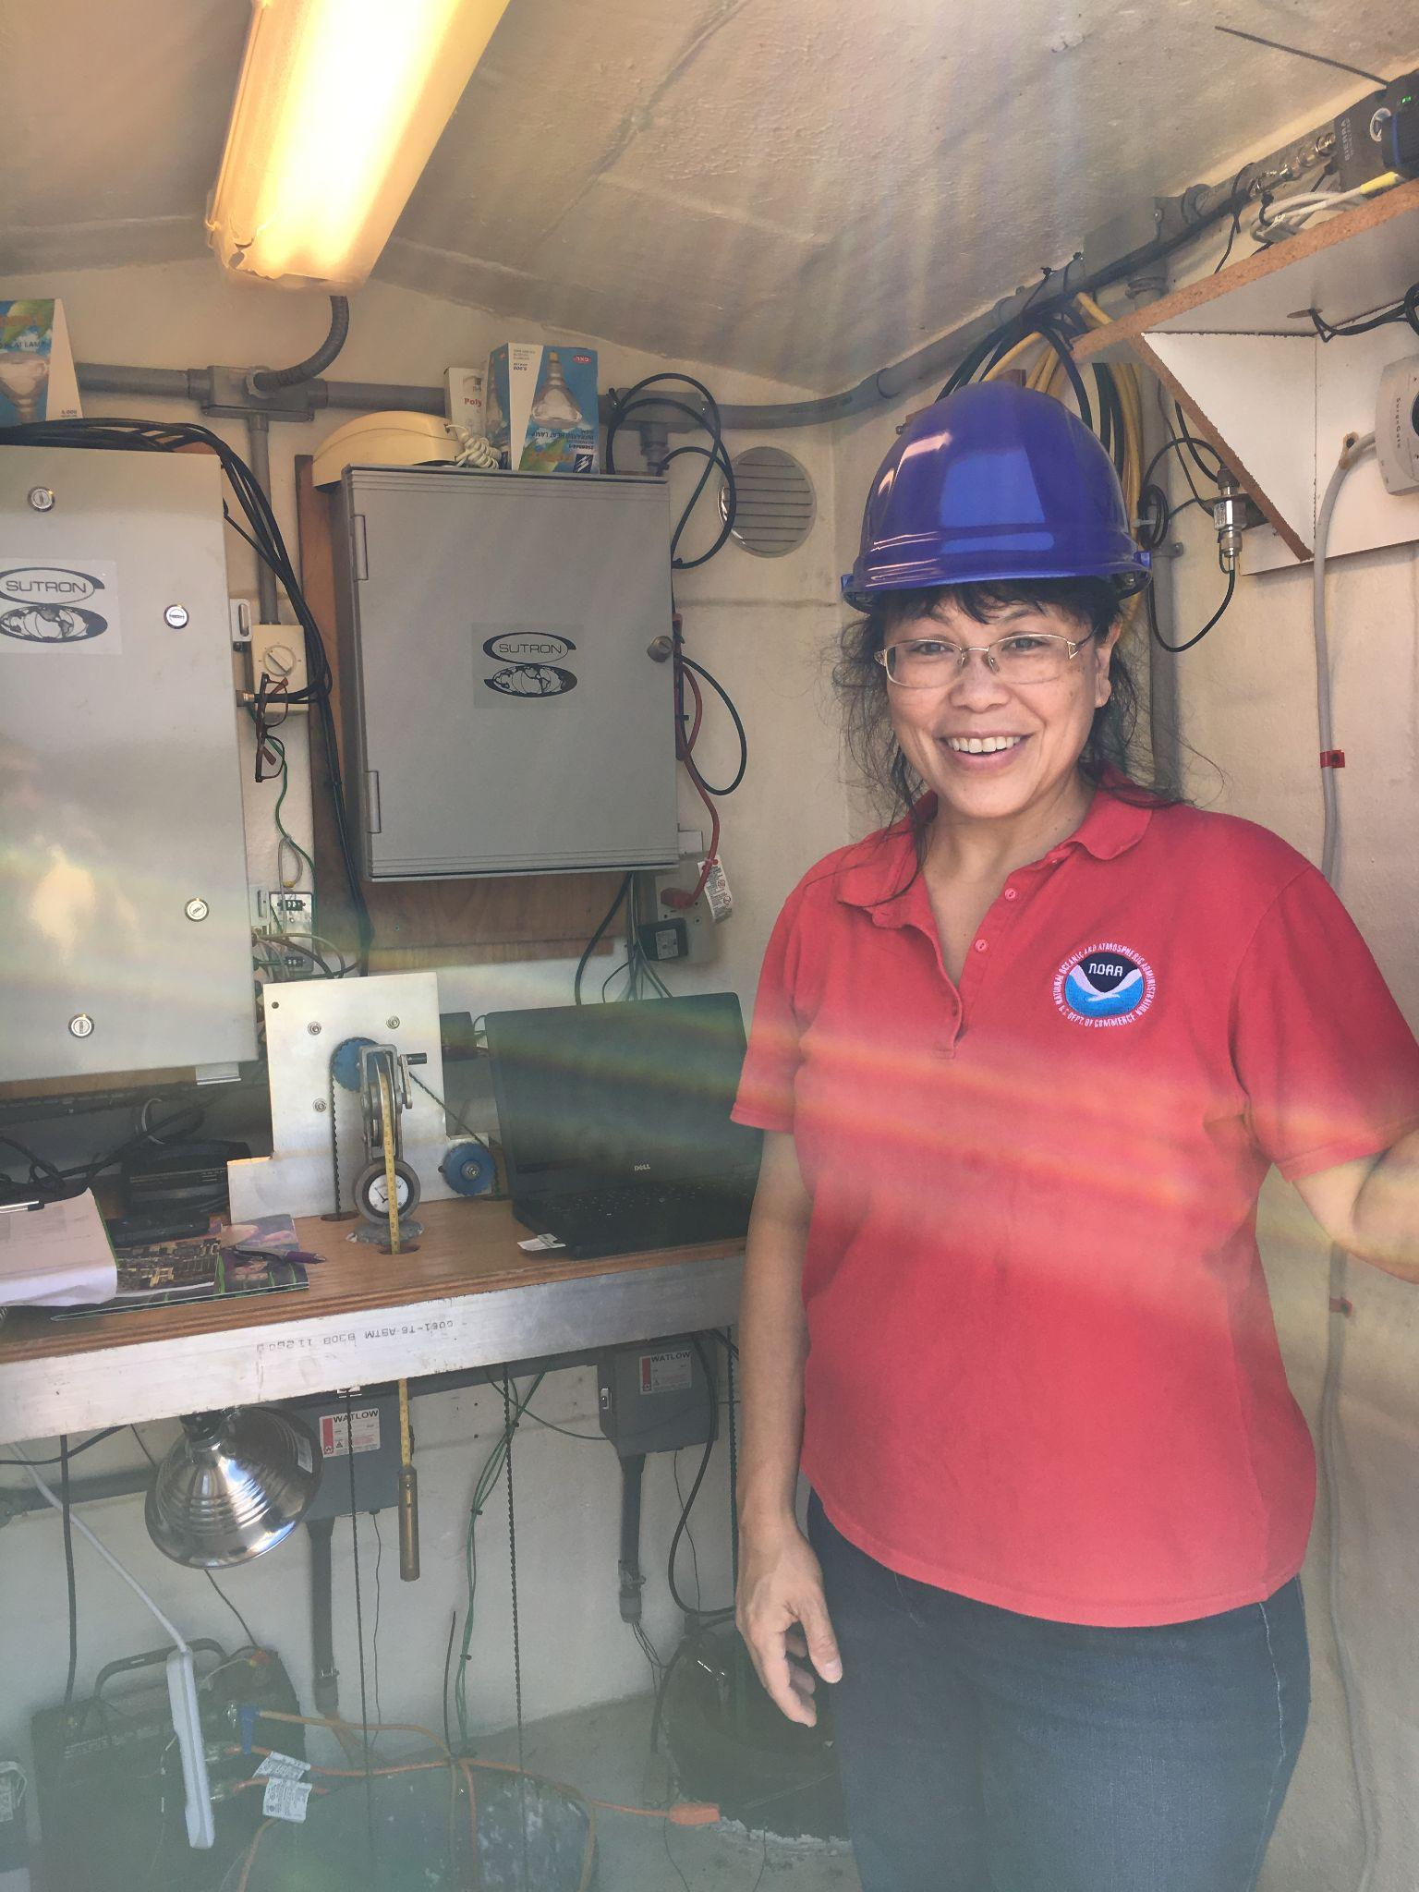
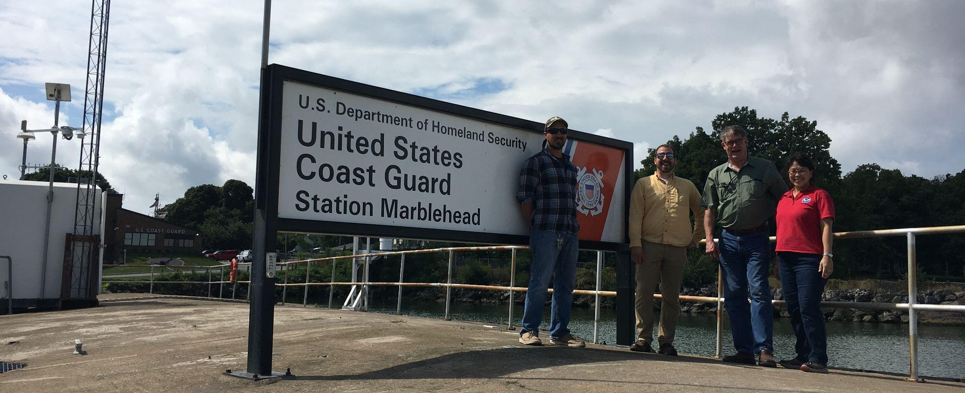
Advisor Support for CORS Activities
Assist the NGS CORS team with:
Technical support for station operators such as receiver / antenna changes, firmware updates, connectivity issues
Building out networks, collaborating with groups, email and phone calls to troubleshoot other issues
Albert Sanford (NOAA CO-OPS), Jeff Jalbrzikowski (NGS Appalachian Advisor), John Ellingson (retired NGS Great Lakes Advisor), Francine Coloma (NGS/CORS)
Notes:
Advisor’s support the NGS CORS team by working closely with CORS station operators and agencies in their region requesting technical support. This could include advising operators on receiver/antenna changes, firmware updates, and connectivity issues. Additionally, the advisor can assist the CORS team in building out networks, collaborating with stakeholder groups, and aiding in troubleshooting with other issues.

Slide 14
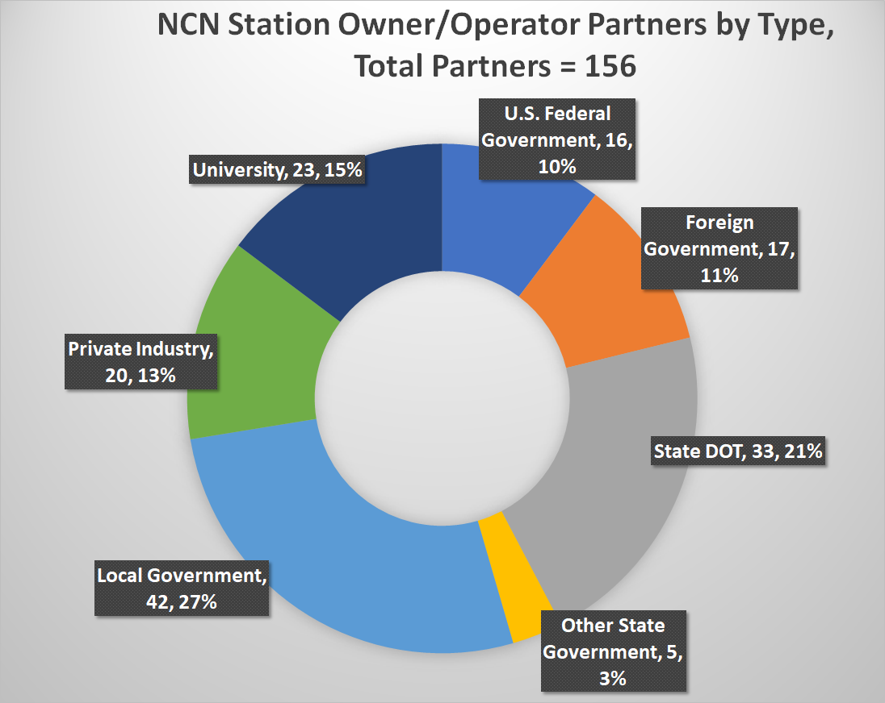
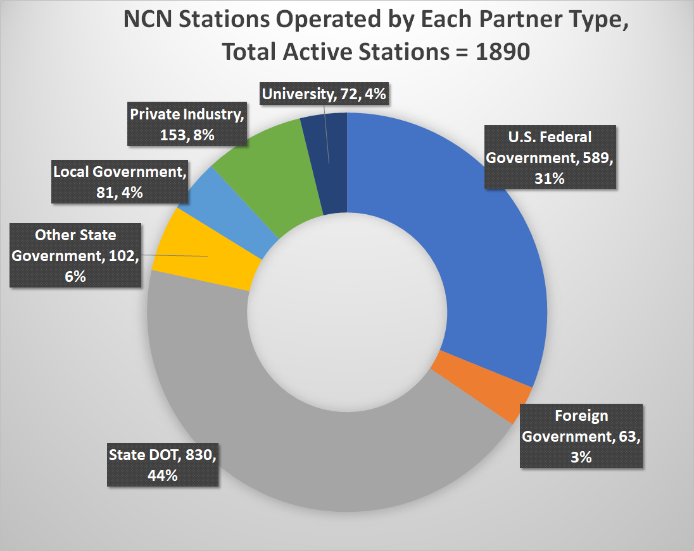
Partners and Stations by the Numbers
Notes:
The CORS network is a multi-purpose, multi-agency cooperative endeavor, combining the efforts of hundreds of government, academic, and private organizations. The stations are independently owned and operated. Each agency shares their GNSS/GPS carrier phase and code range measurements and station metadata with NGS, which are analyzed and distributed free of charge.
There are currently 1890 total active NCN stations operated by a total of 156 partners

Slide 15
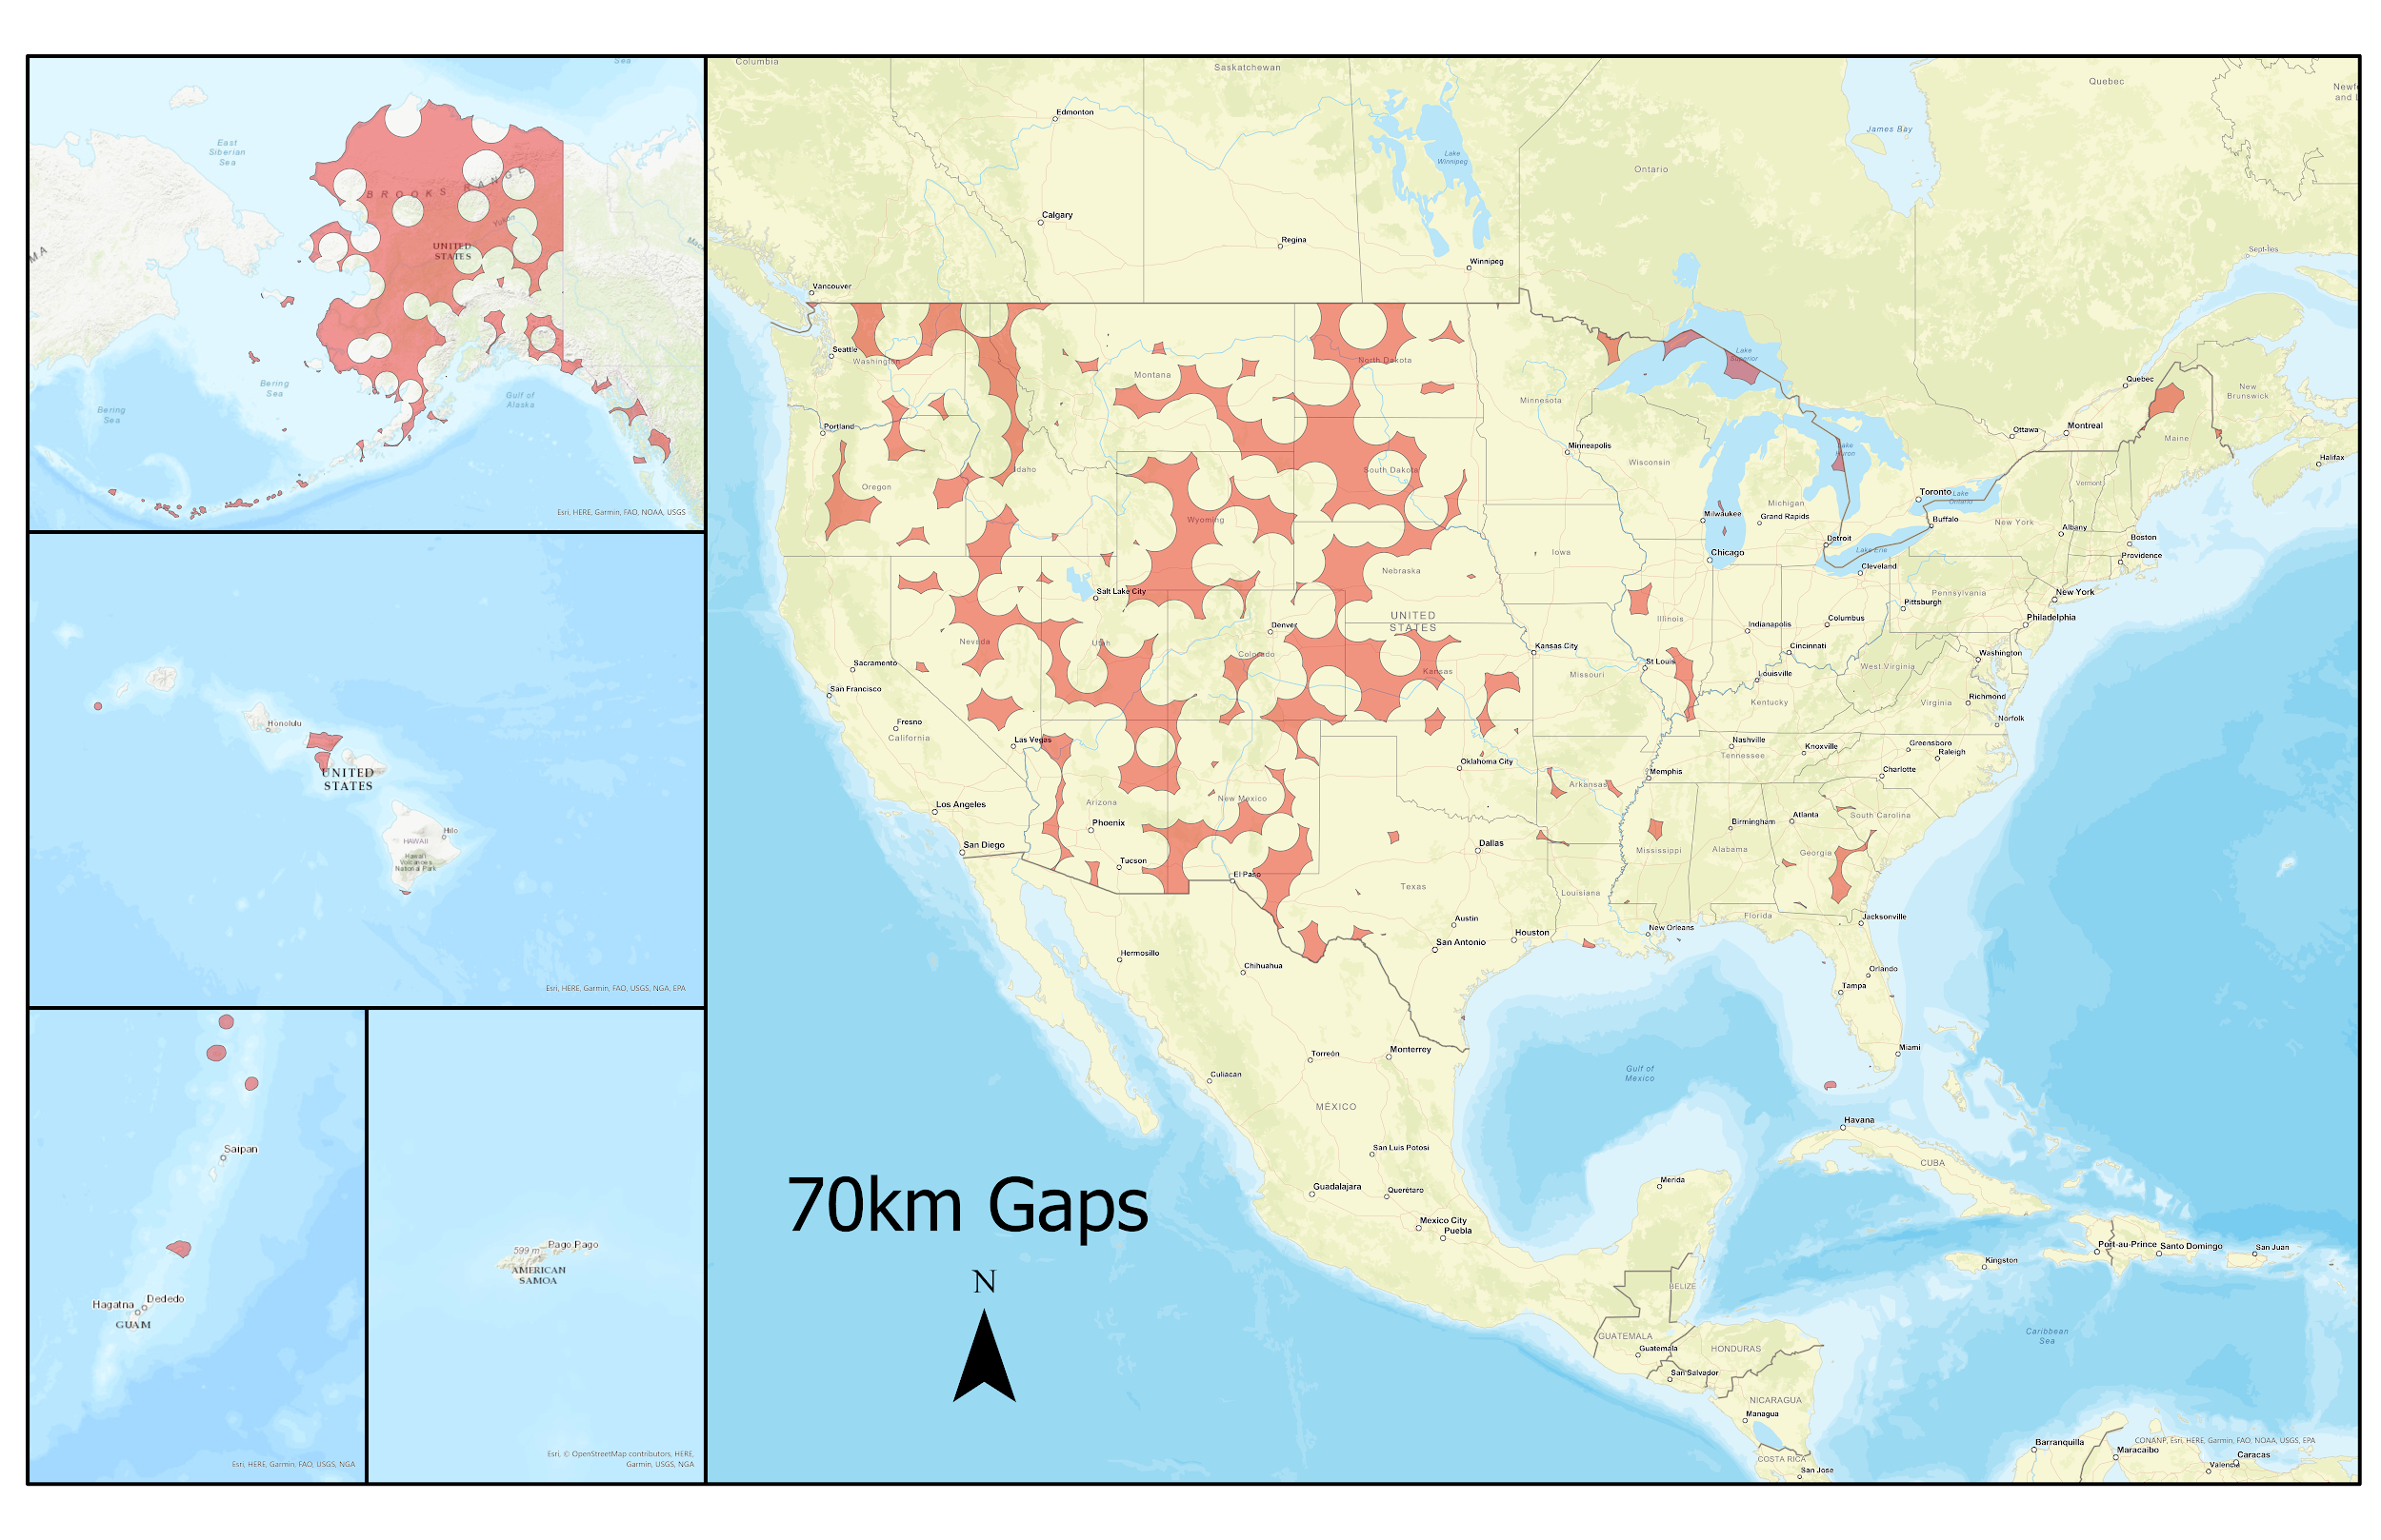
NCN Gaps in the SW Region (AZ-NM-UT)
With the SW Region having gaps in NCN coverage, partly due to vast areas of open land with limited infrastructure, this region is currently actively adding new CORS stations
There are also four candidate sites in the SW for Foundation CORS at Space Geodetic Observatories in AZ and NM
Gaps assume CORSs adequately “cover” a 70 km radius circle around them.
Notes:
Of the 33 states and territories with gaps in NCN coverage, the SW Region houses three states (AZ, NM, and UT) that have NCN gaps within the 70 km restriction, with 28.55% in Utah, 16.21% in Arizona, and 23.32% in New Mexico. These gaps are partly due to the SW Region housing vast areas of open land with limited infrastructure. However, this region is currently actively adding new CORS stations to begin to close those gaps. Additionally, there are four candidate sites in the SW Region for Foundation CORS being planned at several space geodetic observatories in AZ and NM.

Slide 16
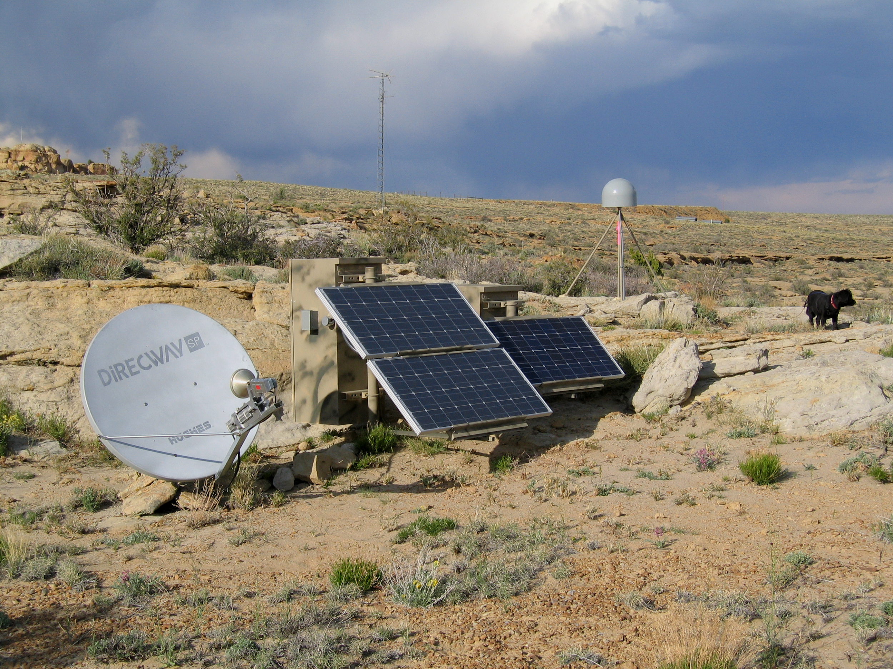
Management of the AZ CORS Network: A Welcome Discussion between AGIC, ADOT, APLS, and NGS
Stakeholders/Users/Managers
Current Needs
Arizona Geographic Information Council (AGIC)
Arizona Professional Land Surveyors (APLS)
Arizona Dept. of Transportation (ADOT)
Private Surveying and Engineering Community
NOAA’s National Geodetic Survey (NGS)
Standards
A) Construction
B) COM and Data management
C) Maintenance Plan – maintenance and response plan. Assigning a single point site coordinator for each site.
Support – financial and management
A) State Agencies
Private – paid subscription user
Federal – NGS can advise as well as provide guidance on new build, or rebuilds at sites to meet NGS NCN standards, which can bring a site into NGS care.
Notes:
Case Study: In AZ, a recent welcome discussion between AGIC, APLS, ADOT, NGS, and the private surveying and engineering community resulted in the formation of several new best practices committees. By examining current needs in the AZ State CORS network, a new AGIC working group – AZ CORS was formed to begin addressing some of these needs. NGS is assisting with guiding state standards to meet NCN standards of CORS station construction, COM and data management, and maintenance and response plans. NGS can advise as well as provide guidance on new build, or rebuilds at state CORS sites to meet NGS NCN standards which can bring a site into NGS care.

Slide 17
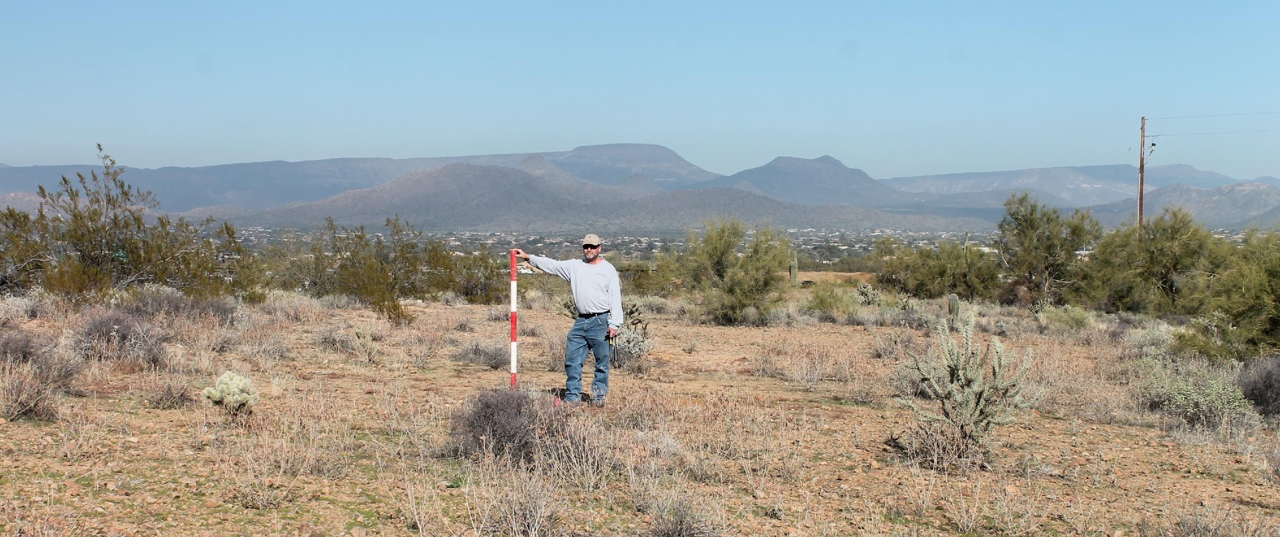
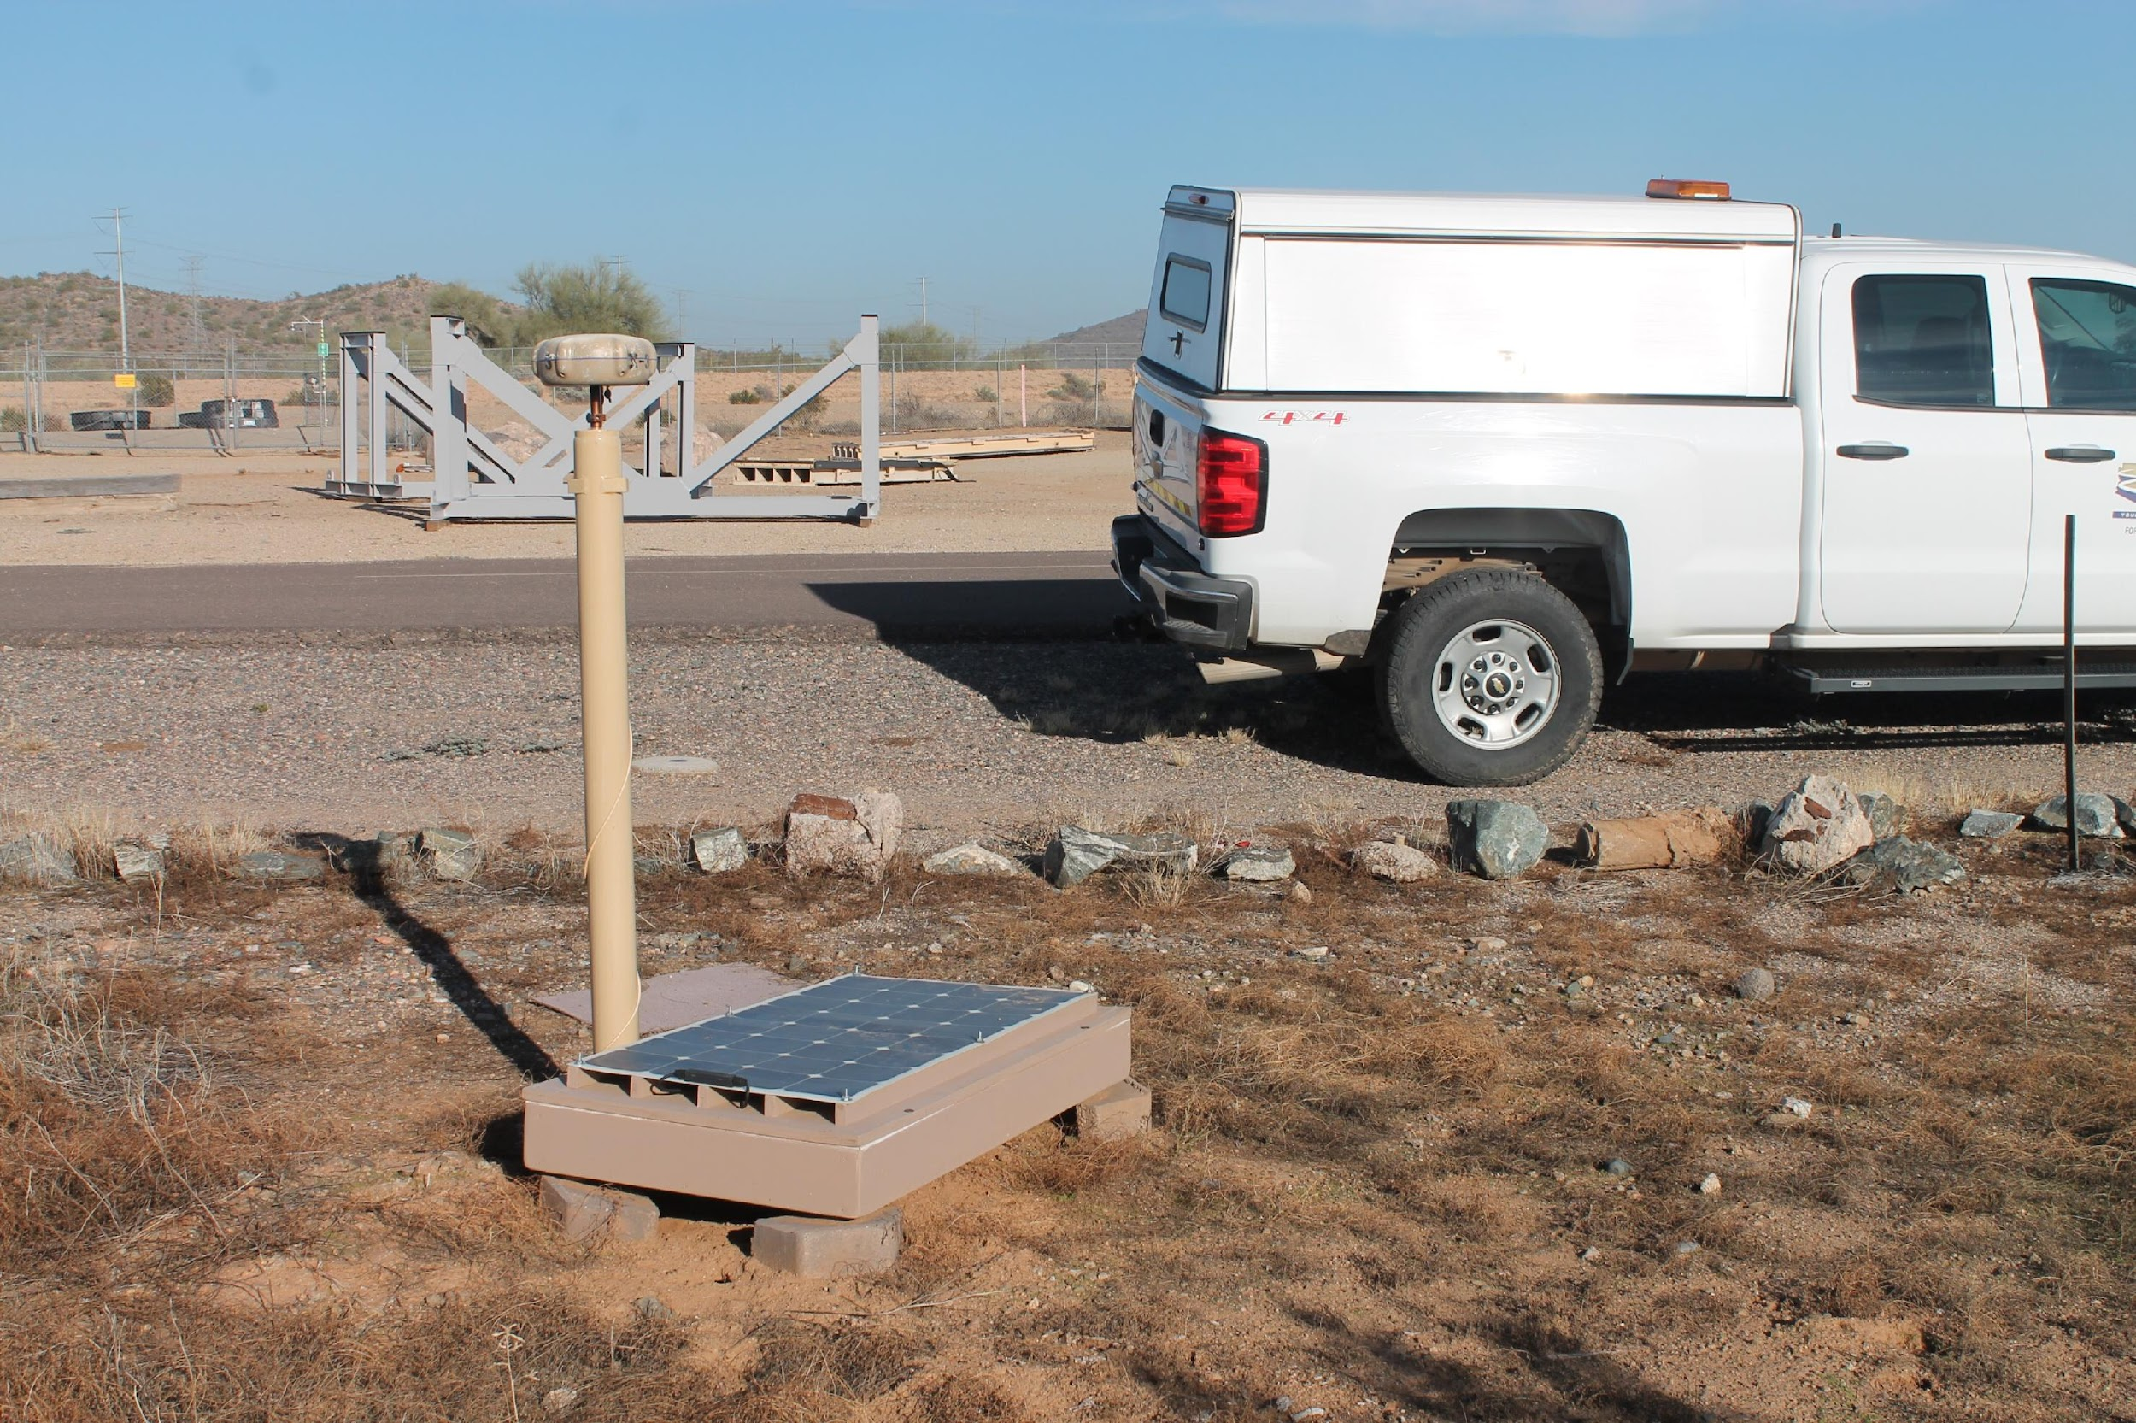
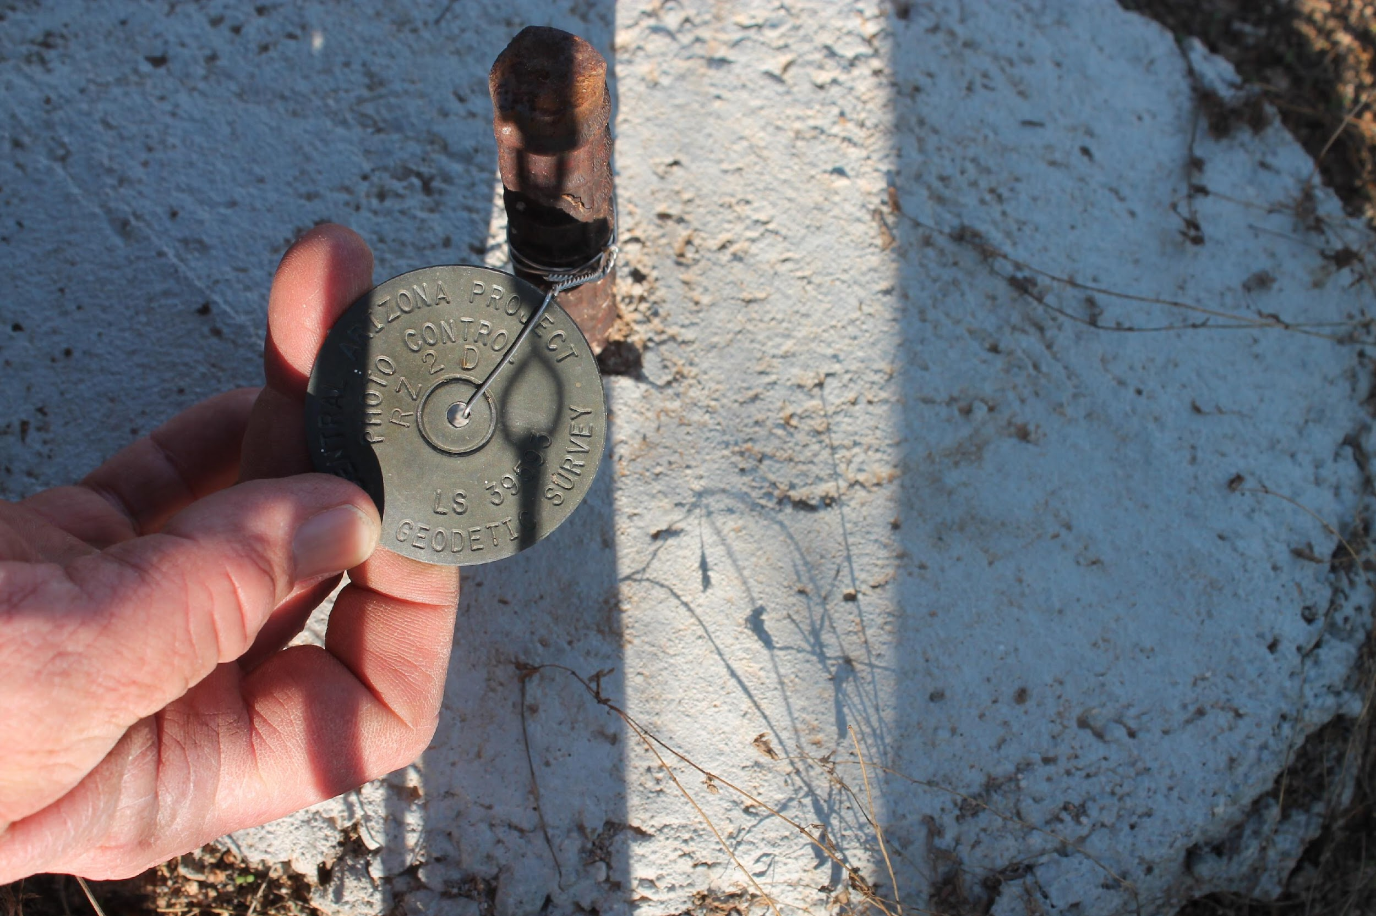
City of Phoenix, CAP, and NGS partner to build new CORS in AZ
Notes:
The City of Phoenix, CAP (The Central Arizona Project), and NGS are partnering to build new NCN standard CORS stations in Arizona. Pictured here is our NGS State Coordinator, Brian Fisher helping to site a new NCN CORS station at a city of Phoenix open space park. This will be the site of a future workshop with the NOAA CORS team illustrating the construction of a braced monument CORS station.

Slide 18
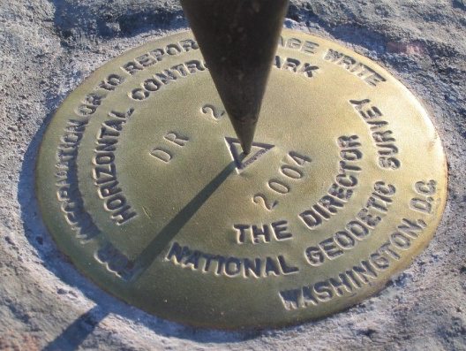
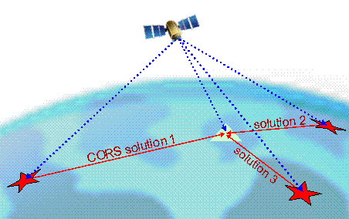
Management of the AZ CORS Network
Stakeholders/Users/Management
Education Outreach
Arizona Geographic Information Council (AGIC)
Arizona Professional Land Surveyors (APLS)
Arizona Dept. of Transportation (ADOT)
Private Surveying and Engineering Community
NOAA’s National Geodetic Survey (NGS)
Leveraging NGS presence in the region over the next year and a half as the Foundation CORS network is being developed at our national geodetic observatories such as Kitt Peak in AZ, or at National Parks in the region.
Workshops/Training
Consistent training on standards and datum changes in the NSRS
Use Cases –PBO, 3DEP
Forming Committees of Best Practices – APLS, AGIC
Forming a committee on AZ CORS Management
Notes:
By leveraging NGS presence in the region over the next year and a half during the development of the foundation CORS network, stakeholders can benefit. When the NGS CORS team is in the field, advisors will be facilitating workshops and training opportunities on standards and best practices. By improving geodetic control and data quality in our regions, advisors can help our constituents better prepare for future datum changes in the NSRS.

Slide 19
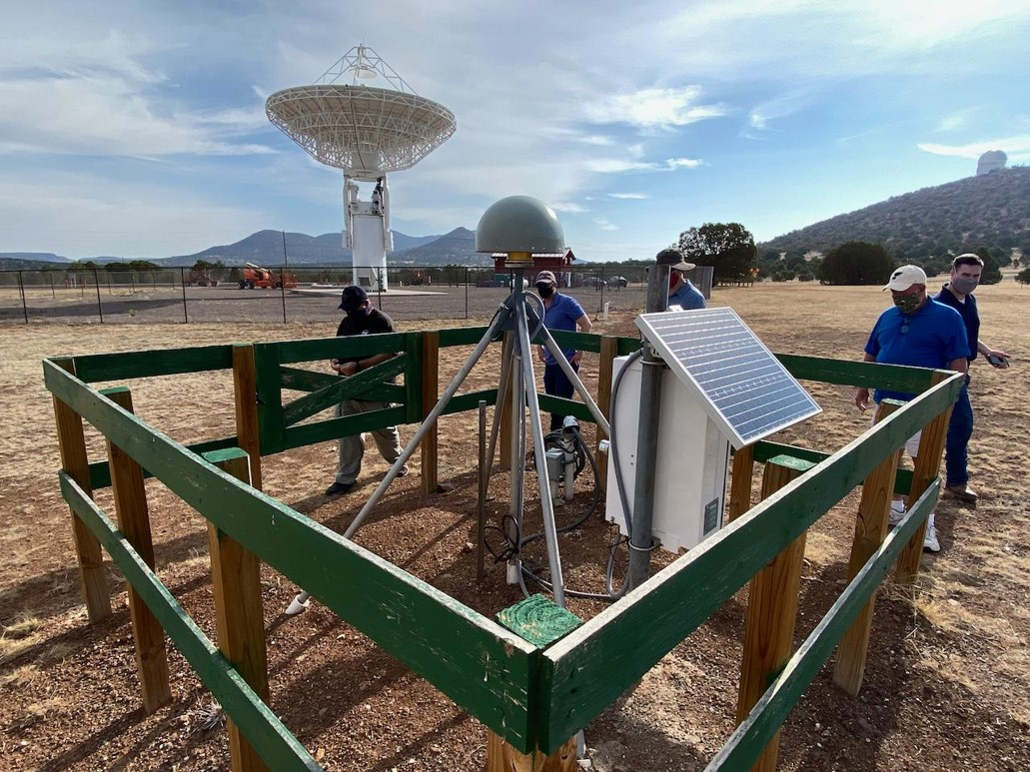
The Future CORS Program
The NOAA CORS Network must transform to meet our NGS mission for the next decade
  Used to define (ITRF/IGS and U.S. TRFs), maintain (geometric coordinate updates and IFDM), and provide access (via OPUS and alignment service) to meet national needs.
  Needs: Serve surveyors and a broader base of stakeholders needing geodetic control such as transportation and commerce across federal/state governments (DOC, DOT, USACE, USGS, more); geospatial industry; and scientific users.
Notes:
The NOAA CORS Network must transform to meet our NGS mission for the next decade as it will be used to define, maintain, and provide access to the NSRS. In order to do this, high quality stations must comprise the NCN to achieve excellence on critical geodetic tasks while creating a sustainable CORS Program system: people, data, hardware, software, computing. By providing automated, fast, and reliable coordinates to a high volume of stations for NSRS adoption, the needs of the nation and the community can be served. This network will serve surveyors and a broader base of stakeholders needing geodetic control.

Slide 20
Notes:
Pictured here is a Foundation CORS site built at the McDonald Observatory in Texas

Slide 21
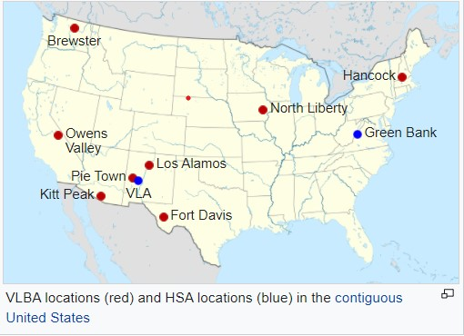
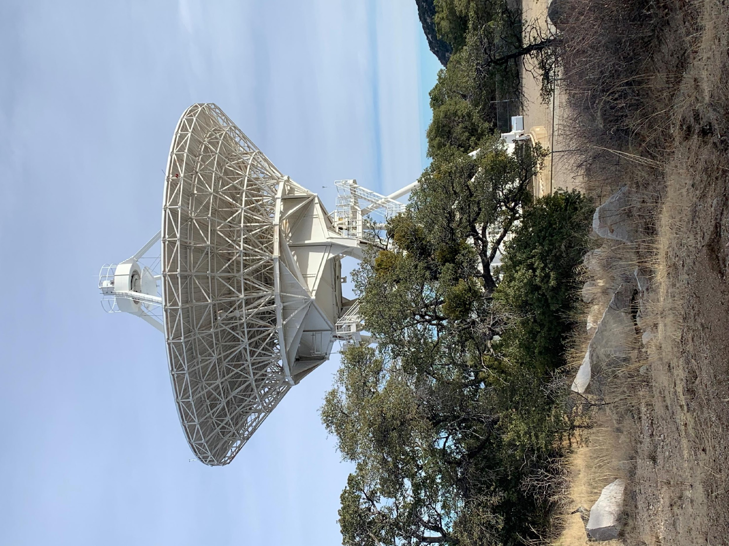
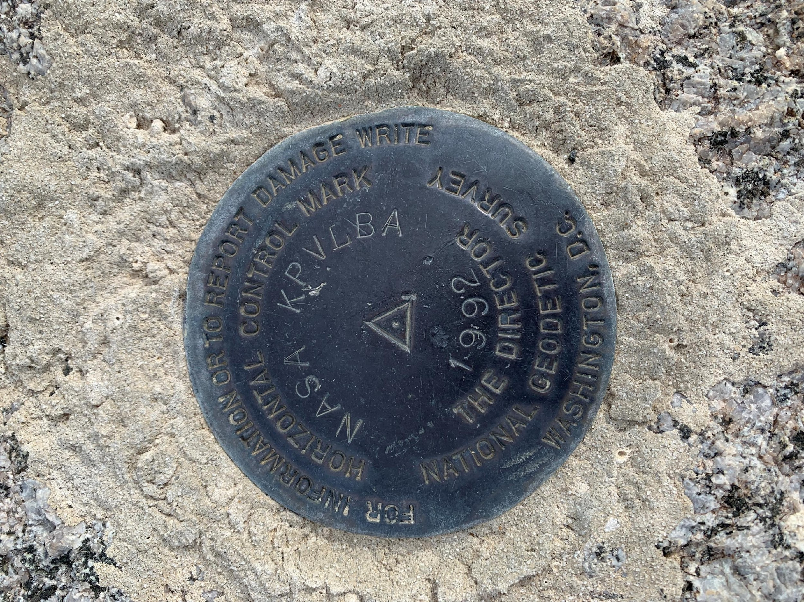
4 Proposed Foundation CORS Sites in the SW Region
Notes:
There are four proposed Foundation CORS sites in the SW region – at the Los Alamos VLBA, the Pie Town VLBA, and the Apache Point VLBA in NM, and the Kitt Peak VLBA in Tucson, AZ. The Very Long Baseline Array is an interferometer consisting of 10 identical antennas on transcontinental baselines up to 8000 km. By collocating these GNSS stations with space geodetic observatories, a long term consistency between the NSRS and the ITRF can be obtained.

Slide 22
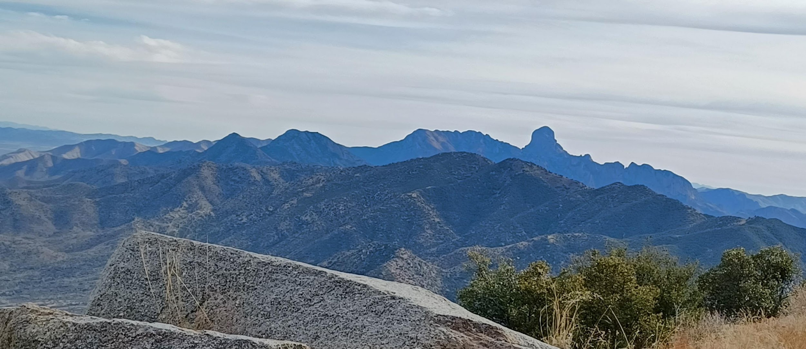
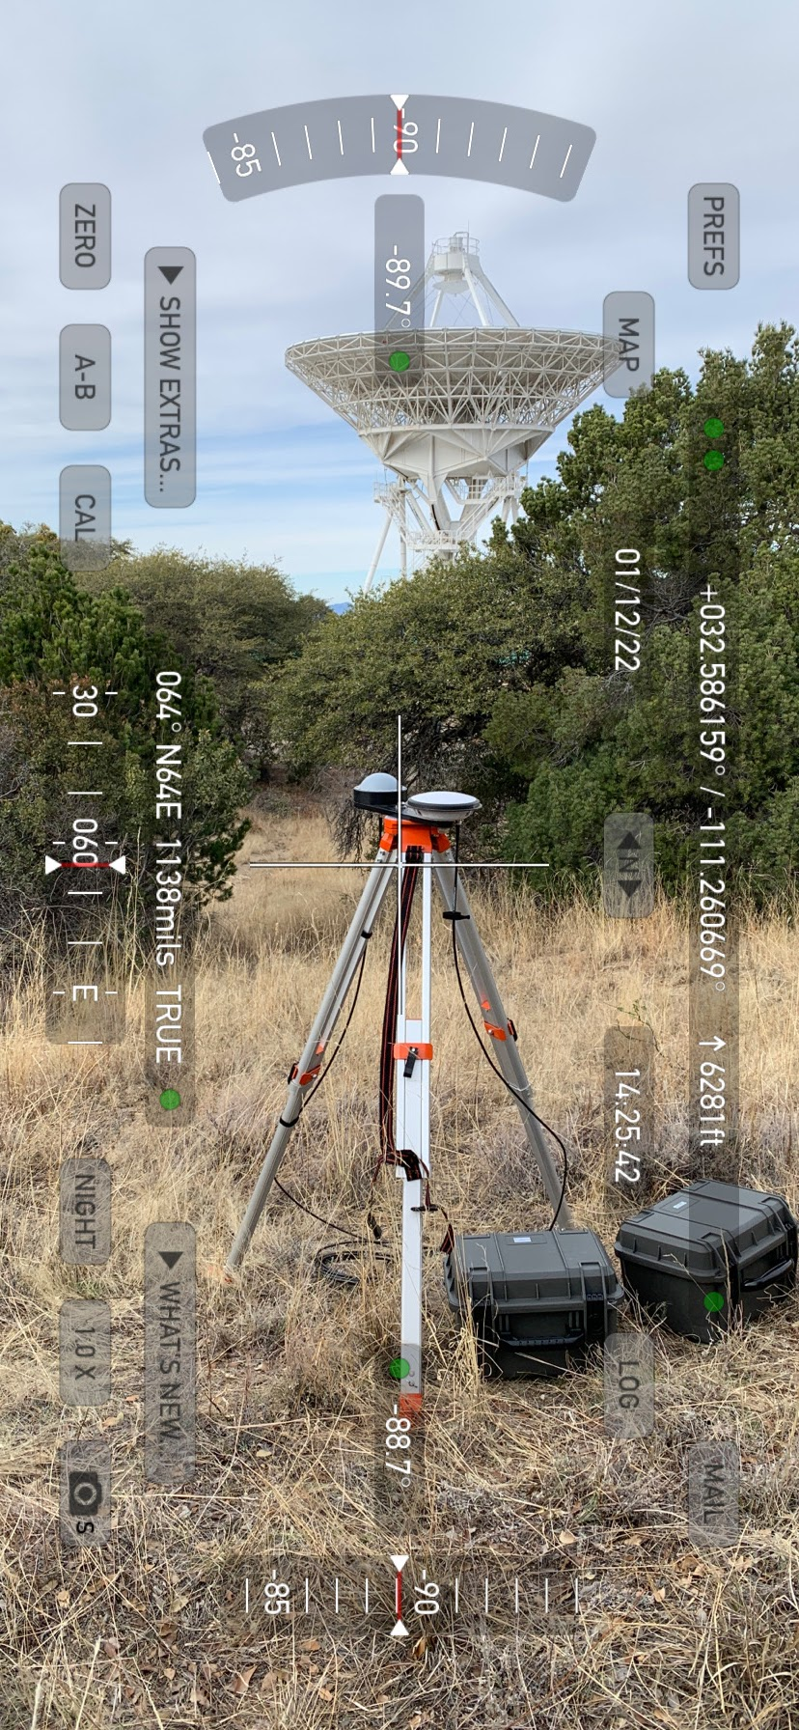
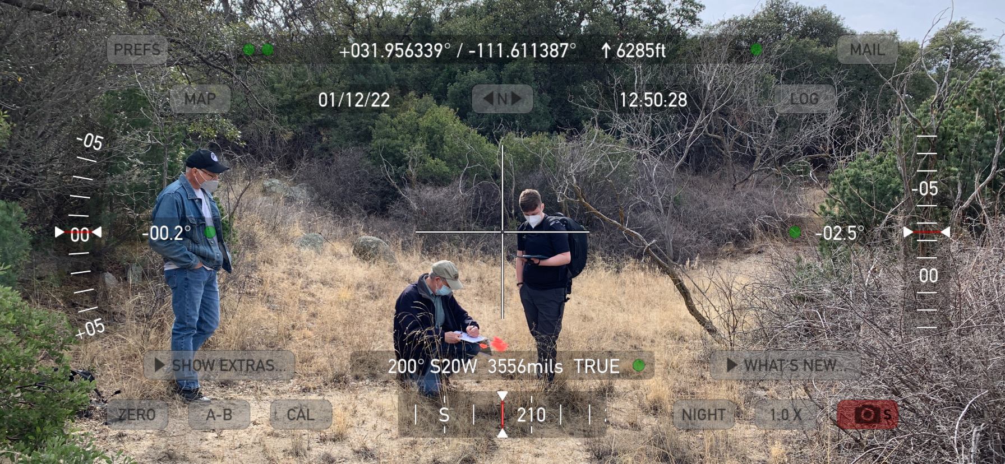
Kitt Peak National Observatory Tucson, AZ
Foundation CORS Reconnaissance 2022
Notes:
Reconnaissance Team included partners from the Kitt Peak NRAO, the University of Texas’s Army Research Lab, and the NGS SW Regional Advisor.

Slide 23
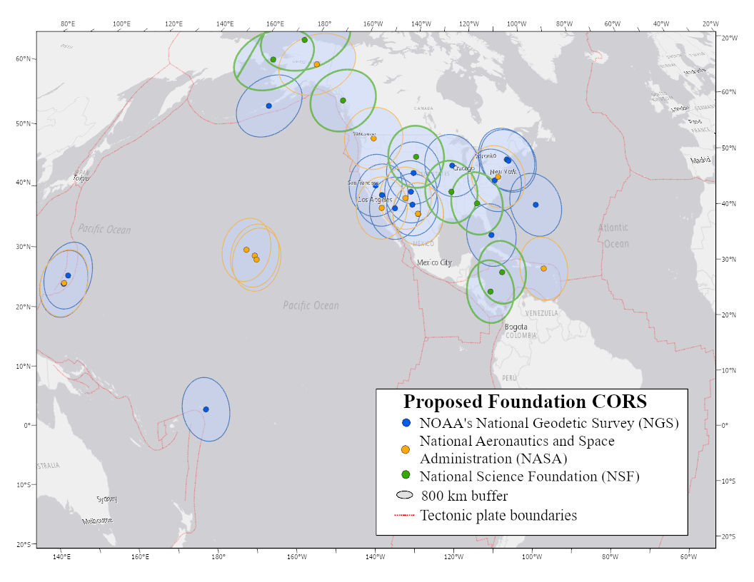
The Future : NOAA Foundation CORS Network (NFCN)
To maintain long-term consistency between the NSRS and the ITRF, a specific set of stations must be operated at the highest standards and federally-owned to ensure longevity. NGS has identified a set of 36 stations across the U.S. and its territories that meets this criteria and provide consistent national access to the NSRS. This subnetwork of the NCN will be known as the NOAA Foundation CORS Network, or NFCN.
Notes:
To maintain long-term consistency between the NSRS and the ITRF, a specific set of stations must be operated at the highest standards and federally-owned to ensure longevity. NGS has identified a set of 36 stations across the U.S. and its territories that meets this criteria and provide consistent national access to the NSRS. This subnetwork of the NCN will be known as the NOAA Foundation CORS Network, or NFCN.
(Jeff Jalbrzikowski, our Appalachian Regional Advisor, will now explain what we do with our NCN data by taking us through a tutorial on NGS’s most popular product, the Online Positioning User Service, or OPUS.)

Slide 24
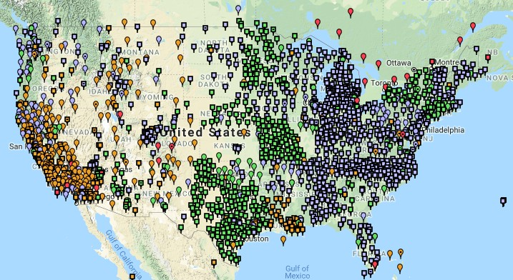
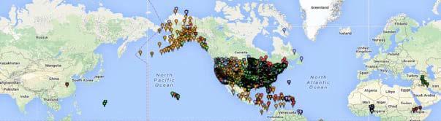
NOAA CORS Network (NCN)
2000+ sites
200+ organizations
Notes:
Transition from Lynda’s talk…
“suite of OPUS products”

Slide 25
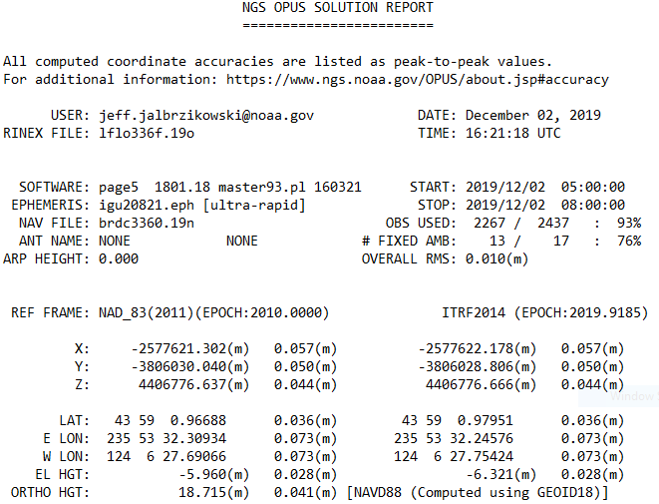
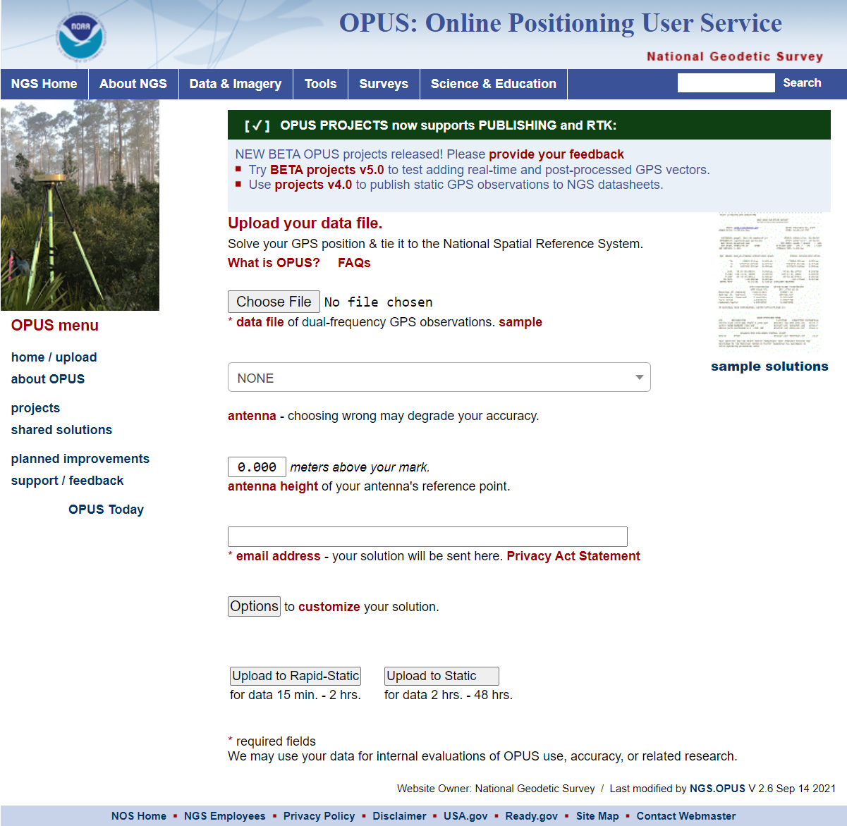
NOAA CORS Network (NCN)
Without the NCN there would be no OPUS!
  OPUS: Online Positioning User Service
  Streamlined user access to the NCN via internet & email
OPUS Solution takes:
  NCN
  Satellite Orbit Data
  PAGES
  (a few other things)
  Your GPS Data
Notes:
Ok, that’s great, we have these CORS… now what?
Well, without the NCN there would be no OPUS! → Perhaps our most popular product

Slide 26


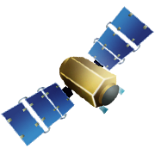
OPUS-RS – 15 min to 2 hours
Rapid-static: OPUS first creates an atmospheric delay model from surrounding CORS data.
  -Atmospheric model
  -Delivered 179,000 solutions in 2021
Notes:
OPUS-RS or Rapid Static performs two calculations.
1st - creates an atmospheric delay model from surrounding CORS data (white circle)
2nd - Your position is determined via a differential GPS static solution

Slide 27
OPUS-S – 2 to 48 hours
  -Best 3 of 5 baselines
  -Delivered 1,268,000 solutions in 2021
  206,000 solutions in 2011
baseline 5
baseline 4
baseline 1
baseline 3
baseline 2
Notes:
-OPUS Static takes the best 3 of 5 baselines and provides you their peak-to-peak average
-1.2 million solutions delivered in 2021, compared to in 2011 when we first broke the 200,000 solutions milestone
CLICK FOR SECOND NUMBER

Slide 28
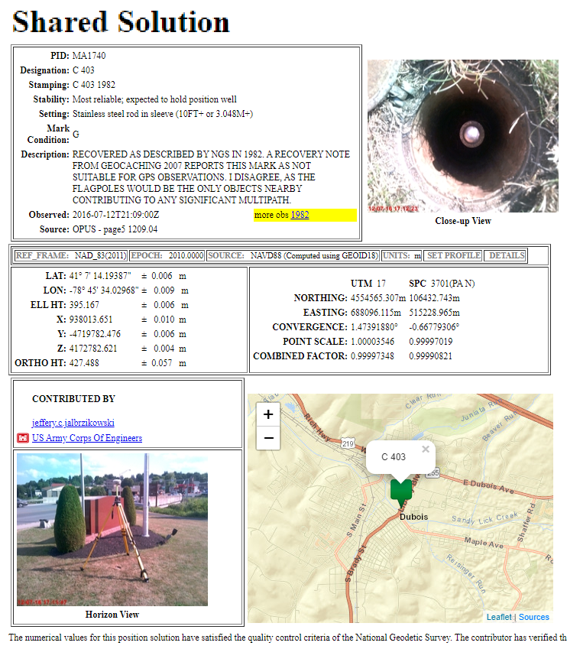
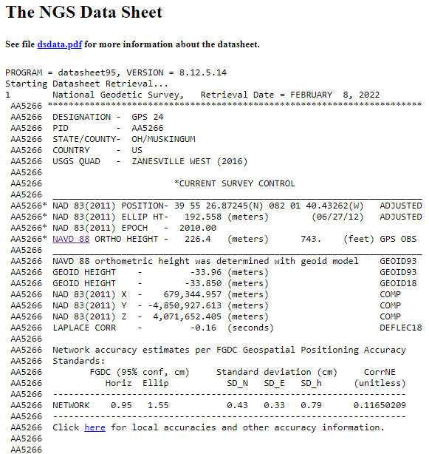
OPUS Share – 4 to 48 hours
  Based on OPUS-S
  2 photos
  Brief description
?
baseline 5
baseline 3
Shared Solution ≠ Datasheet
baseline 1

Slide 29
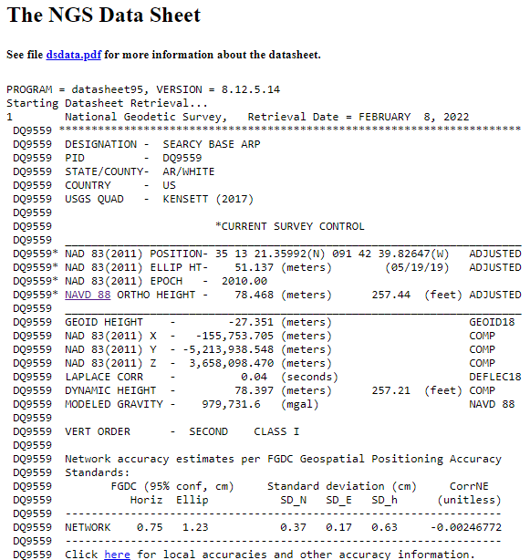

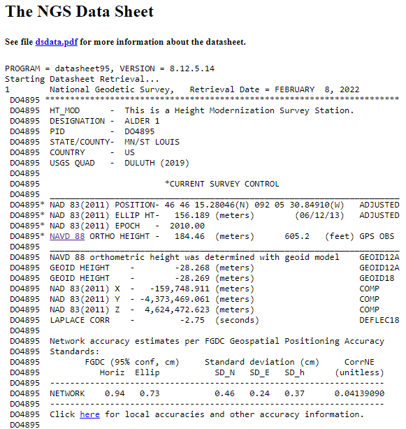
OPUS Projects – 2 to 48 hours
  Based on OPUS-S
  Control network
    Solutions tied together
Notes:
Ties your observations together via multi-baseline processing and least squares adjustment

Slide 30
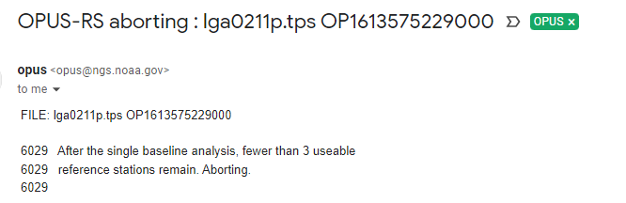
Online Positioning User Service
  OPUS Rapid Static (OPUS-RS)
      15 minutes to 2 hours of GPS data
  OPUS Static (OPUS-S)
      2 to 48 hours of GPS data
  OPUS Projects (OP)
      adds session processing and network adjustment
      Submitting to NGS → Datasheets?
≥4 hours?
Geodetic Advisors can help!
Planning & Preparation
OPUS Share
      2 photos
      brief description
Additional FGCS Requirements
Notes:
So let’s look at some existing resources we have for you

Slide 31
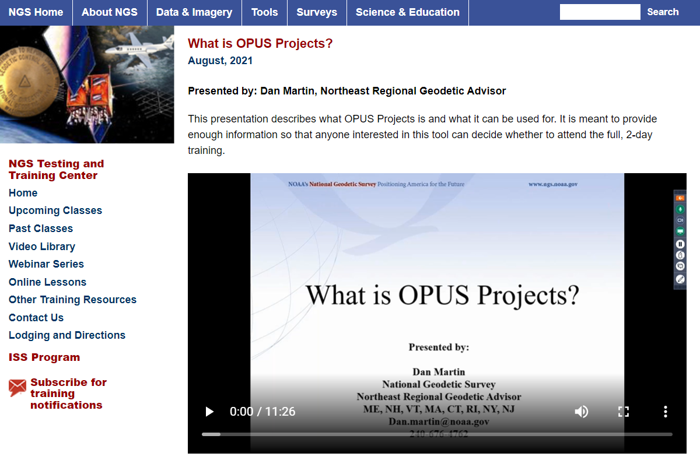
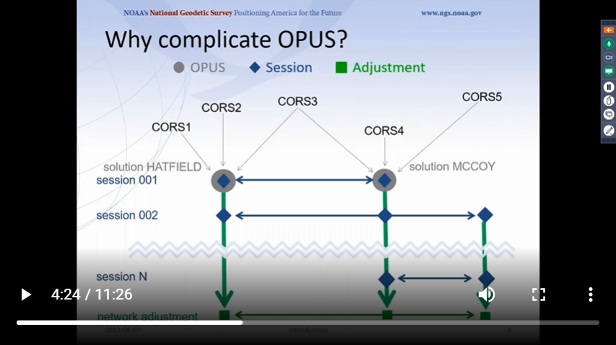
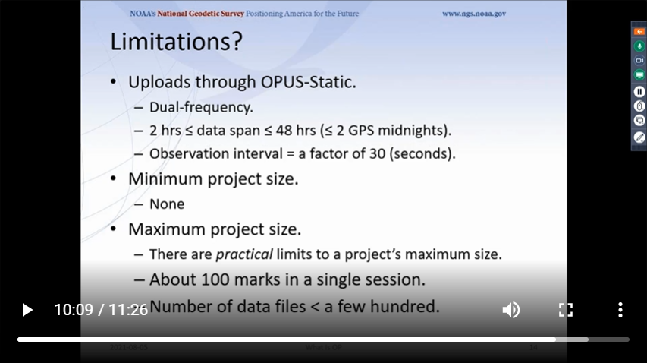
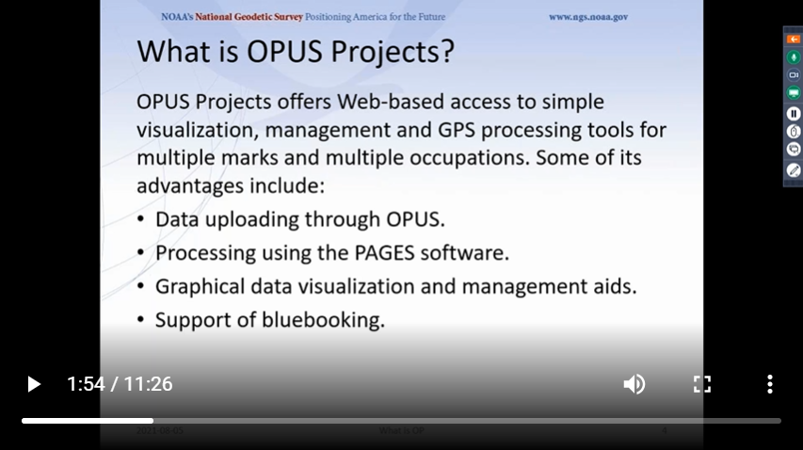
OPUS – Advisors’ Contributions
Basic intro to concept of OPUS Projects
  Is this tool right for you? What are its capabilities?
  Dan Martin – Northeast
  ~11 minutes
Notes:
11 minute video explanation

Slide 32
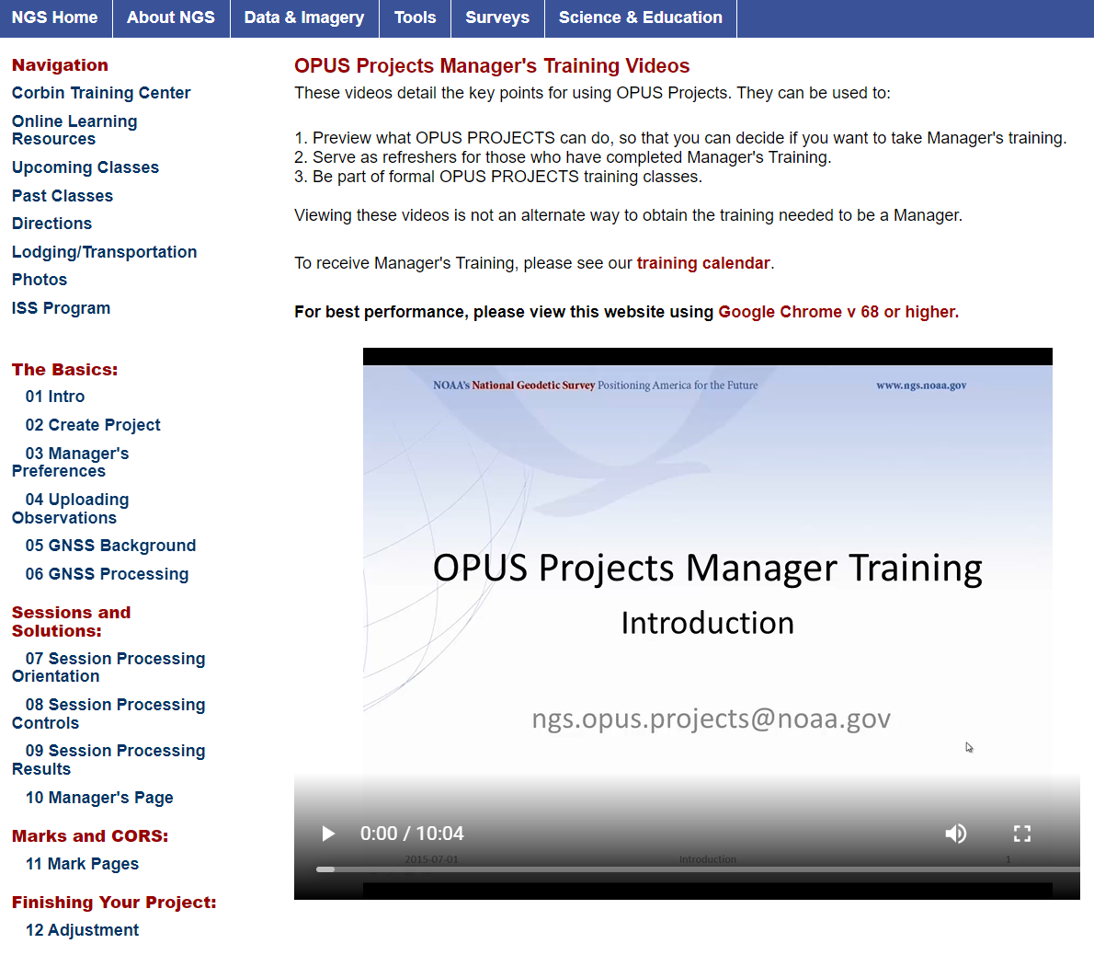
OPUS – Advisors’ Contributions
Pre-recorded OPUS Projects training
  Detailed look via slide-based narrative
  Dave Zenk – Northern Plains
  8 – 20 minutes each
Notes:
This is more than an overview, this is a detailed look at OP via a slide-based narrative

Slide 33
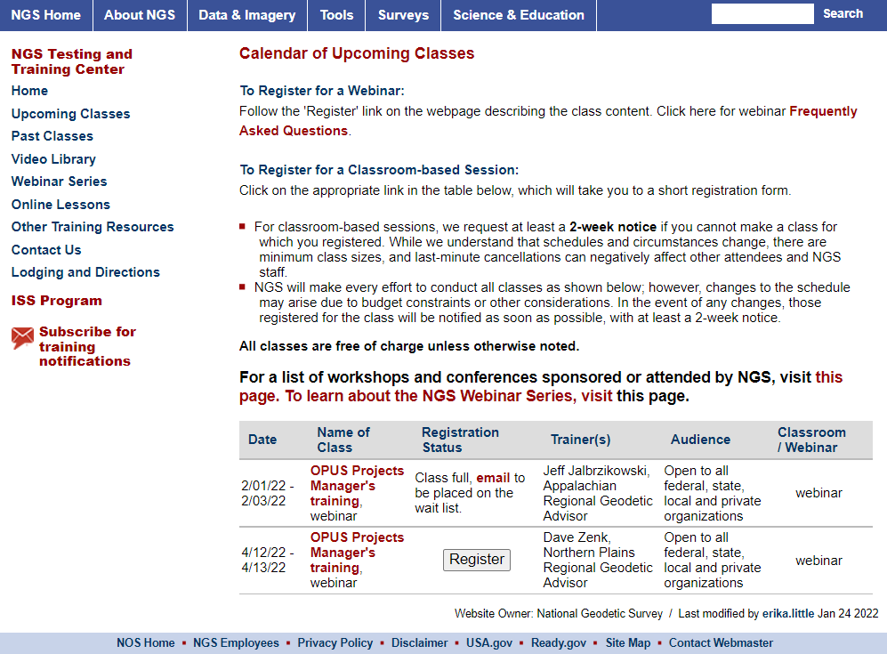
OPUS – Advisors’ Contributions
Instructor-led OPUS Projects training
  ~12 hours per session
  In-person and Web-based
  No minimum class size
  Recent Groups
    ODOT (Ohio)
    KDOT (Kansas)
    USACE
    ASPS (Arkansas)
  6 sessions in 2021
  9 sessions in 2020
Note: Our Advisors are not your only OP Trainers!
Notes:
Some of the organizations who have hosted or requested group training the past few years.
ODOT – Ohio Dept of Transportation
KDOT - Kansas Dept of Transportation
USACE
ASPS - Arkansas Society of Professional Surveyors
→we’ve had everyone from the average sole-proprietor company in smalltown, USA to GNSS hardware manufacturers, folks from a few of the country’s National Laboratories, even international organizations
Advisors conducted
6 sessions in 2021
9 sessions in 2020
We’ve been averaging almost 300 OP trainees per year since 2014
Agency Grand Total of over 200 sessions which adds up to over 3500 constituents, stakeholders, and Federal partners trained since 2014
Our next scheduled web-based training is in mid April, check our Training Opportunities page for details and registration

Slide 34
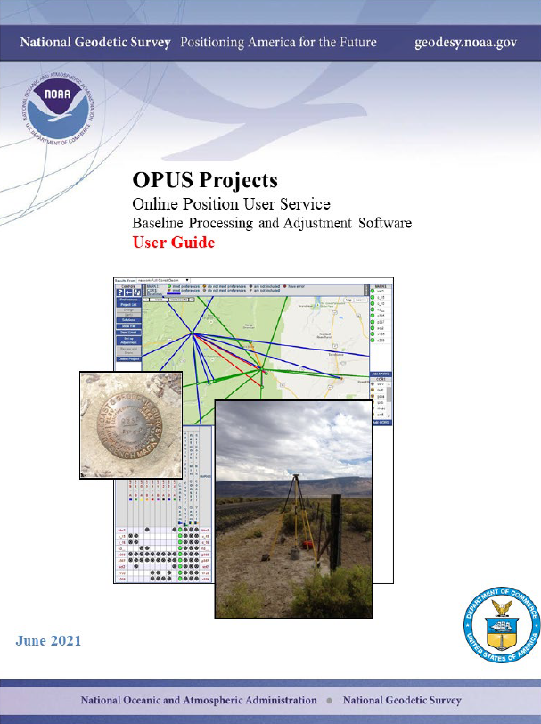
OPUS – Advisors’ Contributions
OPUS Projects User Guide – updated June 2021
  Quick Start section
  Details on each phase
  Update Team included:
    Dave Zenk, PE, LS
    Bill Stone (retired)
    Jeff Jalbrzikowski, P.S., GISP
    Dan Prouty, PhD
    Ed Carlson
Note: many others outside the Advisor Team also contributed!
Notes:
-the “quick start” section is very much like what you get when you buy a new headset or one of those indoor/outdoor thermometers… but in this case I recommend reading it instead of tossing it aside ☺
-11 detailed Chapters plus 6 Appendices all contained within 241 pages of
Update Team included:
Dave Zenk – Northern Plains
Bill Stone (retired) – Southwest, the role that Lynda now fills
Myself – Appalachian
Dan Prouty – Southern Plains
Ed Carlson – Pacific, can’t forget about Ed out there in Hawaii, he really is always looking out for our constituency in the far reaching territories of the US. And in the case of a comprehensive User Guide like this, for a complete processing and adjustment package like OPUS Projects, it is important to consider our customers outside the “lower 48” who want or need to tie their projects to the NSRS.

Slide 35
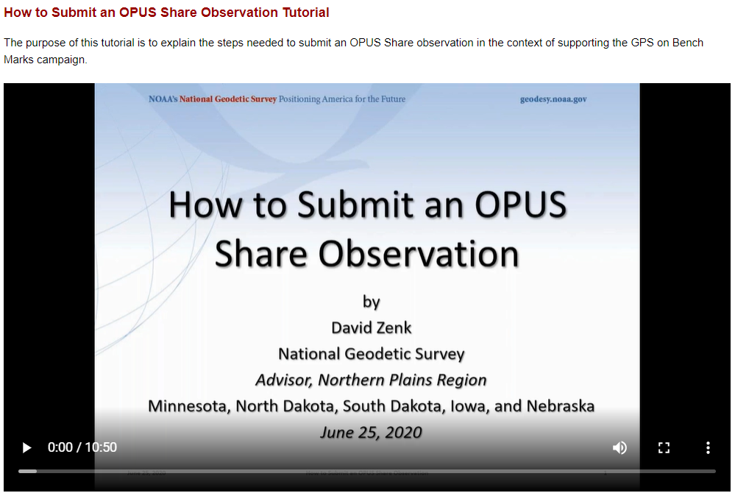




OPUS – Advisors’ Contributions
OPUS Shared Solution Tutorial
  Targeted at GPSonBM, relevant to any OPUS-S user
  Details whole process (field to results)
  < 11 minutes
  Mr. Zenk again!
Notes:
OPUS Shared Solution Tutorial
Targeted at GPSonBM, relevant to any OPUS-S user
Details whole process (field to results)
11 minutes
Mr. Zenk also!
I’ll mention real quick that you can download the video, or the slides, for later viewing also
→ it’s also pretty neat that you can speed up or slow down the video to make Dave talk real fast or real slow ☺

Slide 36








OPUS – Advisors’ Contributions
Beta OPUS Projects (currently v5.0 aka “OP5.0”)
  Assist HQ with testing of GVX in Beta
  Reporting issues/problems
  Jeff Jalbrzikowski
  Support anyone interested in OP5
    NCGS
    ODOT
    WSRN
  Please contact a Geodetic Advisor
Huh?!

Slide 37
Sidebar: What is this GVX thing?
GNSS Vector EXchange (GVX)
Website: https://www.ngs.noaa.gov/data/formats/GVX/index.shtml
Detailed documentation, Schema, and Example File available
any major search engine: “ngs gvx file format”
…think of GVX as RINEX for RTK/RTN data
Collect RTK, RTN, or PPK, data with your GNSS receiver and field software
  Data must be logged and stored as vectors, not points!
Use your office (or field) software to export vectors to a .gvx file
Upload .gvx to OP5.0

Slide 38




OPUS – Advisors’ Contributions
WinDesc Tutorial
  Necessary to submit descriptive mark data via OP
  Brian Ward – Central Plains
Notes:
I wanted to highlight this recording, and you might not think of OPUS at first when you see WinDesc mentioned, but as I”ve got there, if you intend to submit your data to us at NGS for publication on Datasheets then youwill

Slide 39

So… you need a GVX to tie your RTK-GNSS to the NSRS via the NCN using OP?
Our Geodetic Advisor team is here to assist!
Notes:
Whether you understand every acronym there or not, our team of Geodetic Advisors is out here to guide you through your utilization of our Nation’s geodetic infrastrucutre

Slide 40
Activities Supporting Mission
“A day in the life”
Liaison
Guidance and Assistance
SME – Collaborate across ranks
Stay abreast of technology/users

Slide 41
Liaison
Advisors are active participants on NGS committees/working groups and development teams and conduct alpha/beta testing to help ensure NGS products and services meet our user’s needs and expectations.
  International Committees (GLCC, SIRGAS)
Engage with constituent committees and working groups.
Advisors actively advocate on behalf of our constituents while keeping NGS’ greater mission at the front of the discussion.
Notes:
Advisors on writing teams for BPs 1, 2, and 3. Significant participation in testing and training for OP. Work with states to grow the GPSonBM initiative, organizing xx meetings across the US to inform and instruct on the GPSonBM process. Advisors are in a unique position to advise both our constituents AND NGS.

Slide 42
Facilitate GPSonBM Outreach
Advisors worked with GPSonBM Team to organize 19 State/Regional Workshops
  Over 1200 Participants from over 30 States
Additional “local” workshops/training were conducted by Advisors
Advisors often the first line of contact for constituents who have GPSonBM questions
Notes:
Use Jeff’s talk on OPUS_Share to link to this activity

Slide 43
Who Do We Support/Advise?
Surveying and GIS Communities
  State Societies, National Associations, State Government, Local/Municipal/Tribal Government, Federal Agencies, Academia, Geospatial Industry
Floodplain Managers, Planners, Surveyors, Engineers, GIS Professionals, Coastal Restoration and Research
The Public at Large
  Landowners, Historians, Authors, Nautical Navigation, Hobbyists, Scouts, High School Students

Slide 44
Guidance and Assistance
NSRS NSRS NSRS_Modernization OPUS CORS CORS_Guidelines Bluebooking OPUS_Projects
OPUS CORS NSRS Bluebooking
GNSS GPS Best_Practices Adjustments Data_Processing Standards_and_Specifications
Transformations
State_Plane_Coordinates
Heights Heights Datasheets VERTCON IGLD85
Benchmarks Benchmarks Calibration_Baselines
GPSonBenchmarks
Destroyed_Marks
IGLD
Datums GRAV-D Orbits
RR_Abandonment
NCAT NCAT
Geoid_Models
Realtime_GNSS
Tidal Datums
NAVD_88
NGVD_29
NAD_83
NAD_27
Airport_Surveys
Projections
Leveling
LiDAR
VDATUM
HTDP
ITRF
Magnetic_Declination
Antenna_Calibrations
Gravity
Historic_Surveys

Slide 45

Guidance and Assistance

Slide 46
Subject Matter Experts (SME)
Jack/Jill of all trades, masters of some
Geodetic Advisors as a group have a very wide body of knowledge
Often work collaboratively within the group to solve problems
I might not know the answer…but I know, or I will find out who does!!
  Refer to other SME’s within NGS or NOAA, or sometimes outside of NOAA

Slide 47
Email Groups
Many Advisors are included in NGS email Groups as SME’s
  ngs.opus.projects@noaa.gov
  ngs.spcs@noaa.gov
  ngs.infocenter@noaa.gov – Infocenter will forward to appropriate SME
Notes:
Advisors may respond to questions sent to group email lists. They may answer as a SME, or to questions generated from within their region

Slide 48
Special Projects/Field
Center of Population
Geoid Slope Validation Surveys
IGLD GNSS Surveys
GPS Verification Stations for USCG
Repair/Maintenance on NOAA CORSs
Southern Louisiana Leveling

Slide 49













Slide 50
Keeping Up With the times, While Remembering the Past
New emerging positioning techniques, technologies, and methodologies
  NGS not necessarily leading the charge
How are our products being used?
New “non-traditional” users of NSRS
Many questions require “historic” research
Notes:
GNSS and “Geospatial intelligence” has become ubiquitous in today’s society. Has given society the knowledge of where they are.

Slide 51


