Slide 1

G52A-08: An Update to Dynamic Heights Estimation on the Great Lakes
Daniel R. Roman
Xiaopeng Li
G52A - Integration of GNSS into Water Level Observation Networks: Priorities, Technologies, and Benefits II

Slide 2
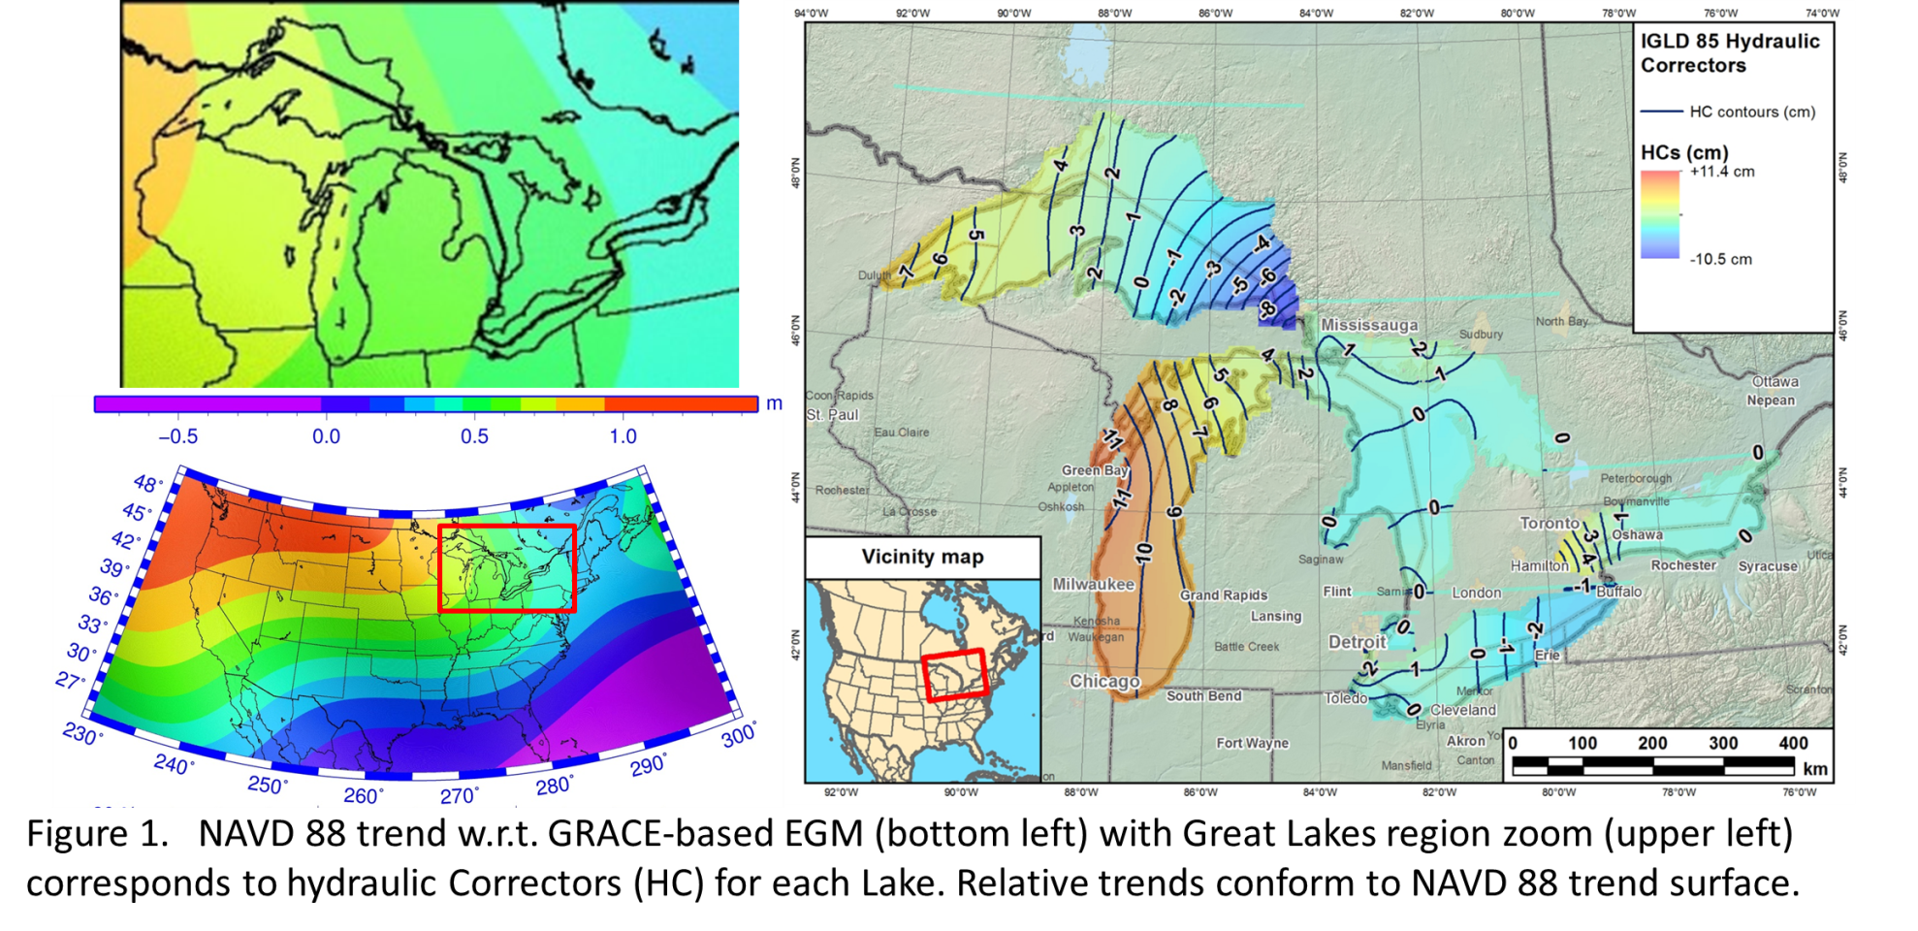
HC vs. NAVD 88 Datum Defect

Slide 3
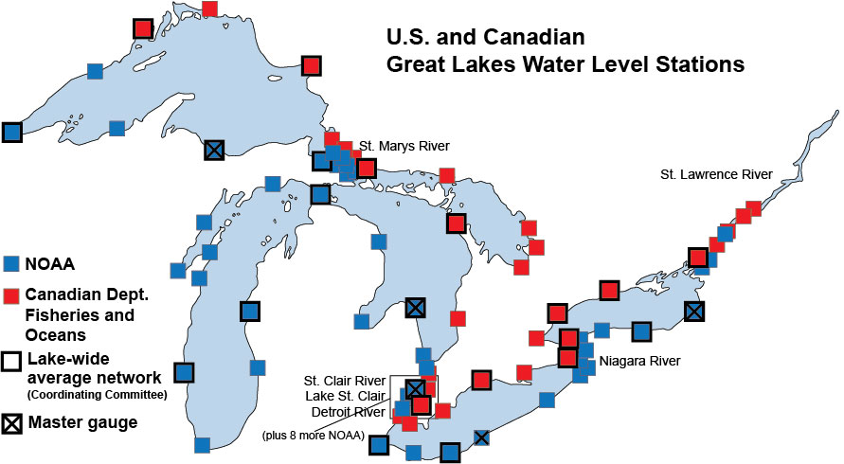
GL WLS Stations
Notes:
Of 53 WLS, 14 are CORS. At all sites, BM are adjacent to WLS. CO-OPS levels between BM’s and WLS table. NGS GPS’ BM. Results in transfer of geometric coordinates to table and then to water surface.
Will be exchanging CO-OPS leveling on US side with Canada for their WLS. Canada has completed their GPS analysis on BM (US still processing). Will look at various averages (Summer, yearly). Look forward to models removing metorological impacts as well as any standing topography.

Slide 4
Conceptual Plan
Each Lake surface conforms to a specific geopotential value (W_{i}) and dynamic height
C₃
C₂
DH3 = W₀ – W₃
gamma₄₅
C₁
DH2 = W₀ – W₂
gamma₄₅
DH1 = W₀ – W₁
gamma₄₅
C₀ (geoid)
ellipsoid
Notes: (1) Neglects any standing water topography (wind set)
(2) Assumes sufficient resolution of geopotential number

Slide 5
Method
GNSS(GPS) observed at bench mark control
Adjusted as campaign data (1-3 cm vert.)
Leveling transfers ellipsoid heights to WLS
WLS observes height to water surface of Lakes
Summer mean of WLS observations used
  2015 Campaign data for US
  2010 Campaign data for Canada
Geopotential values determined at the mean geometric coordinates yield dynamic heights

Slide 6
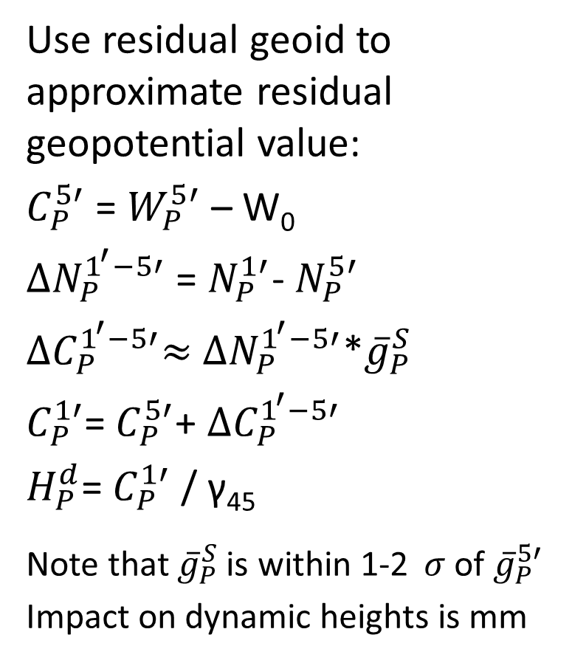
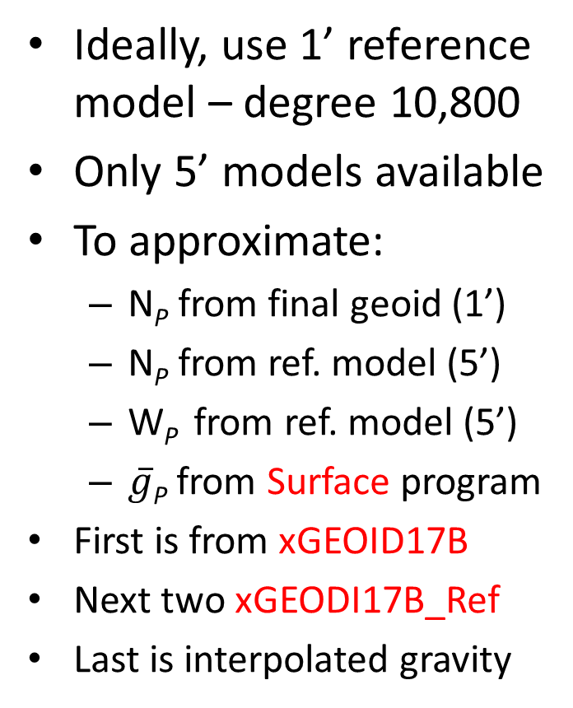
Method
Ideally, use 1’ reference model – degree 10,800
Only 5’ models available
To approximate:
  N_{P} from final geoid (1’)
  N_{P} from ref. model (5’)
  W_{P} from ref. model (5’)
  $\overline{g}$_{P} from Surface program
First is from xGEOID17B
Next two xGEODI17B_Ref
Last is interpolated gravity
Use residual geoid to approximate residual geopotential value:
$C_{P}^{5′}$ = $W_{P}^{5′}$ – W₀
${∆N}_{P}^{1^{′}−5′}$ = $N_{P}^{1′}$- $N_{P}^{5′}$
${∆C}_{P}^{1^{′}−5′}≈$ ${∆N}_{P}^{1^{′}−5′}$*${\overline{g}}_{P}^{S}$
$C_{P}^{1′}$= $C_{P}^{5′}$+ ${∆C}_{P}^{1^{′}−5′}$
$H_{P}^{d}$= $C_{P}^{1′}$ / γ₄₅
Note that ${\overline{g}}_{P}^{S}$ is within 1-2 $σ$ of ${\overline{g}}_{P}^{5′}$
Impact on dynamic heights is mm

Slide 7
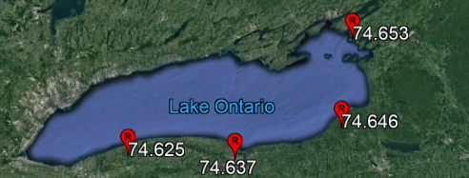
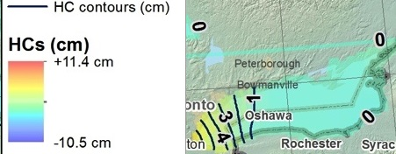
Lake Ontario
+1 cm
74.394 m
PID’s
  AH9233
  AH9232
  AH9231
  <F Reset>
Trend W-E is +3 cm
Consistent w/ GLERL MDT expectations
Not consistent with HC Map
Sense of sign is flipped from HC to MDT
-1 cm
+1 cm
-2 cm
+1 cm
+1 cm
0 cm
74.640 m
0 cm
-2 cm

Slide 8
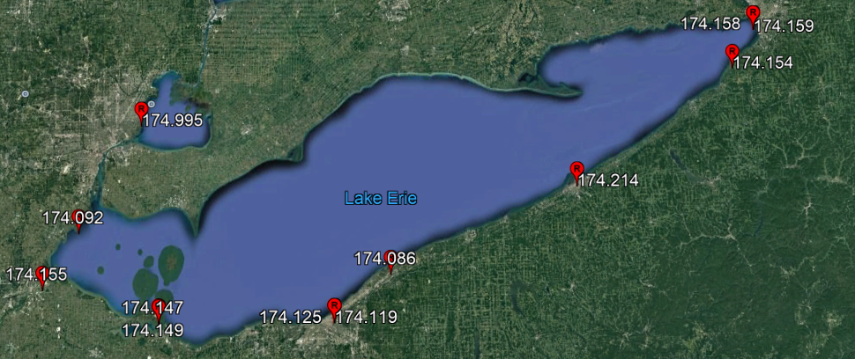
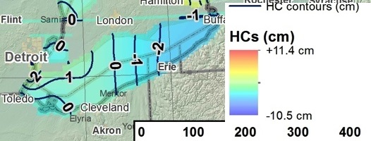
Lake Erie
+2 cm/+2 cm
173.684 m
+1 cm
-1 cm
0 cm
PID’s
  NE0898
  AH9238. AH9237
  DG9751-AB6927
  DH8999-MB1563
  MB1622, DN2578
  DE7802
  DE1764-AH9234
Trend W-E flat
Consistent w/ GLERL MDT expectations
Consistent w/ HC Map but that is flat, too
0 cm
+1 cm
-5 cm
-1 cm
+7 cm
0 cm
-6 cm
174.142 m
+1 cm
+1 cm
+1 cm
-2 cm/-2 cm

Slide 9
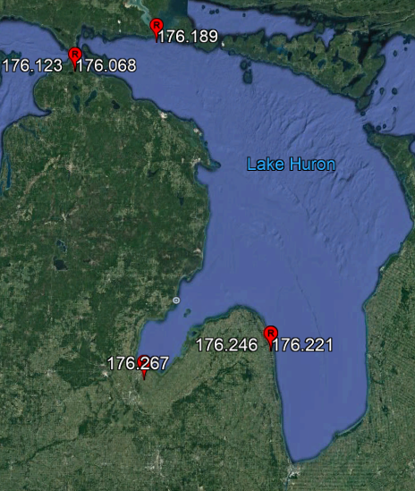
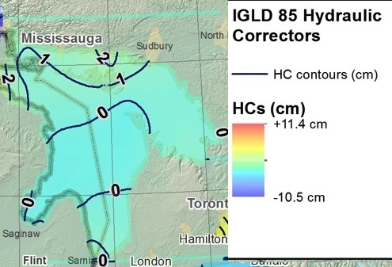
Lake Huron
-1 cm
-3 cm
+1 cm
-4 cm
0 cm
+3 cm
175.707 m
176.231 m
PIDS: DN2580-QK0258, AH9228, PK0233, DF5769-OJ0219
Trend NW-SE is up 10 cm – but only 3 cm ignoring Mackinaw City
A little higher than expected MDT unless you ignore Mackinaw City
Lakes Michigan and Huron treated as one system – Mackinaw City is at transition
Not consistent with HC
+2 cm/-1 cm
+3 cm

Slide 10
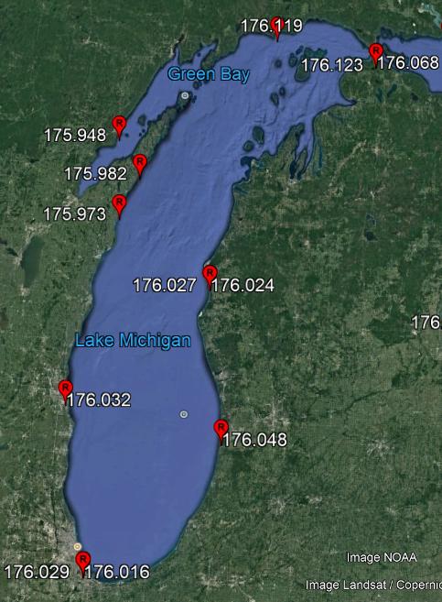
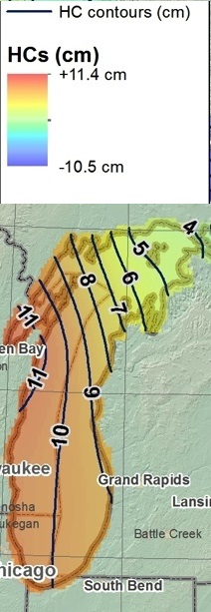
Lake Michigan
PID’s (CCW from North)
  DJ1577, DI7590, AA8057
  AH5304, AA8061
  DF5765-AE9231, AH5303
  DH3764-OL0303
Note Mackinaw City in NE is similar to DJ1577 In North
South end of Lake fairly flat
Possible step up from Lake Michigan to Lake Huron (10-15 cm)
Consistent with expected MDT
Relatively similar to HC
+9 cm
-8 cm
+9 cm/+3 cm
-5 cm
-1 cm/-1 cm
-6 cm
176.032 m
0 cm
+2 cm
0 cm/-2 cm

Slide 11
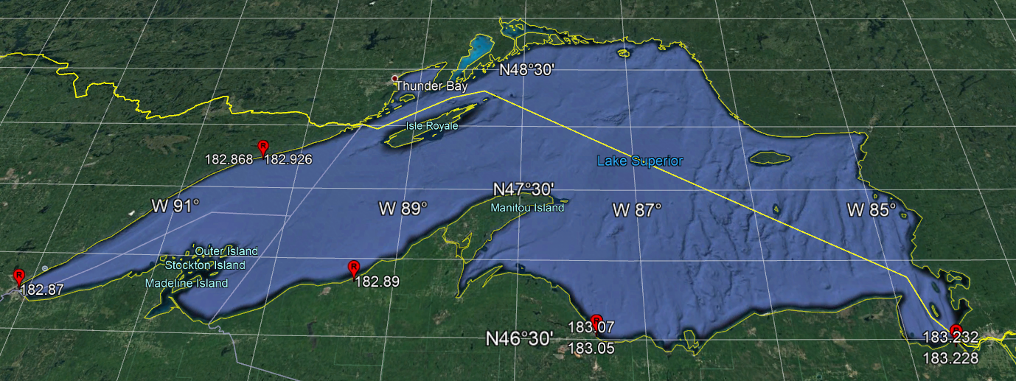
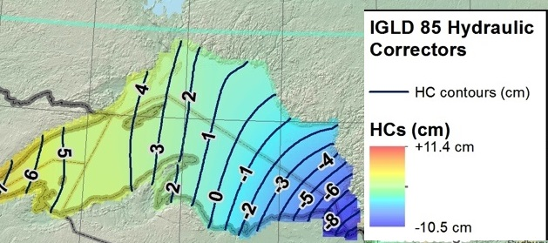
Lake Superior
-4 cm
-3 cm
+2 cm
182.547 m
-17 cm/ -11 cm
+5 cm
-15 cm
-17 cm
183.039 m
+3 cm
+1 cm
+19 cm
+19 cm
PIDS
  AE8289, DE6003-AA2869, DJ1575
  DG9743-AH7272, DF5377-RJ0586
30 cm difference West-East is more of a step function
Not consistent with expected MDT nor HC map

Slide 12
Summary and Future Work
Relative comparisons between US (2015) and Canadian (2010) solutions
  Lake Ontario flat and similar slopes
  Lake Erie shows anomalous features on US side
  Lake Huron slopes 5-10 cm on both sides of Lake
  Lake Michigan to Lake Huron difference 10-15 cm
  Lake Superior potential two zones (east and west)
Reprocess all four GPS campaigns in ITRF2014
  1997, 2005, 2010, & 2015
Comparisons to Canadian and Seasonal data

Slide 13
Questions?

Slide 14
Method
Geometric coordinates of water surface
Inverted rod
CORS Antenna
WLS Housing
ETG
Receiver
ETG Table
(datum)
Great
Lake
leveling
BM
IGLD 85 Datum surface

Slide 15
2015 GPS Campaign Comparisons
Solutions from same geometric data:
  Canadian Bernese (Mike Craymer)
  US PAGE-NT/ADJUST (Dan Callahan)
  US Modified OPUS Projects (Dan Gillins)
Majority within 0.3 cm hor. & 1.0 cm vert.
Nearly all were 1.0 cm hor. & 2.5 cm vert.
Five outliers exceeded this (GLER, ESSE, FTWB, RETA, FTWA)
Uncertainties of 1-3 cm for dynamic heights

Slide 16

Blueprint Part 2
North American-Pacific Geopotential Datum of 2022 (NAPGD2022)
Four primary products:
  A global model (5’)- GM2022
  Regional geoids (1’) - GEOID2022
  Regional DoV’s (1’) - DEFLEC2022
  Surface gravity (1’) - GRAV2022
Three regions:
  North America
  American Samoa
  Guam/CNMI

Slide 17
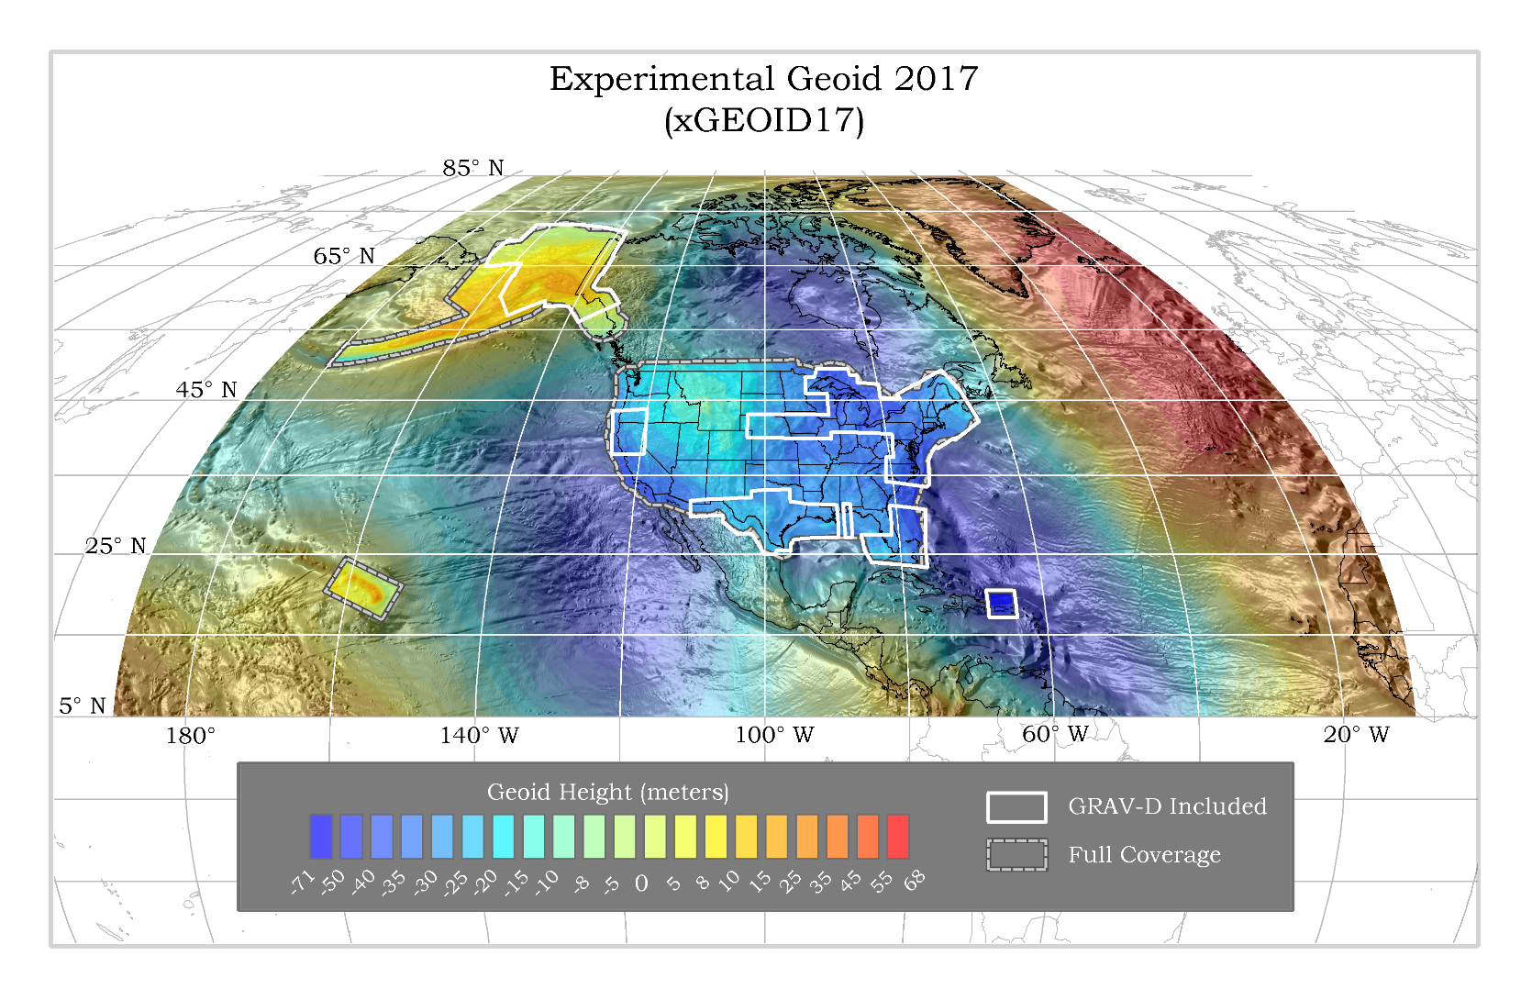

Slide 18
Practical Aspects
Need 1’ resolution⁽¹⁾ (d/o 10,800) SHM
Only have 5’ resolution ⁽²⁾ (d/o 2160) SHM plus 1’ geoid grid
W_{(5’)} g_{(5’)}
C₃
C₂
C₁
N _{(5’)}
N _{(1’)}
C₀ (geoid)
ellipsoid
Notes: (1) Previous analysis shows that omission from > 1’ resolution exceeds cm-level
(2) xGEOID17B available at https://beta.ngs.noaa.gov/GEOID/xGEOID17/
(3) W₀ by is defined as 62,636,856.00 m²/s²

Slide 19
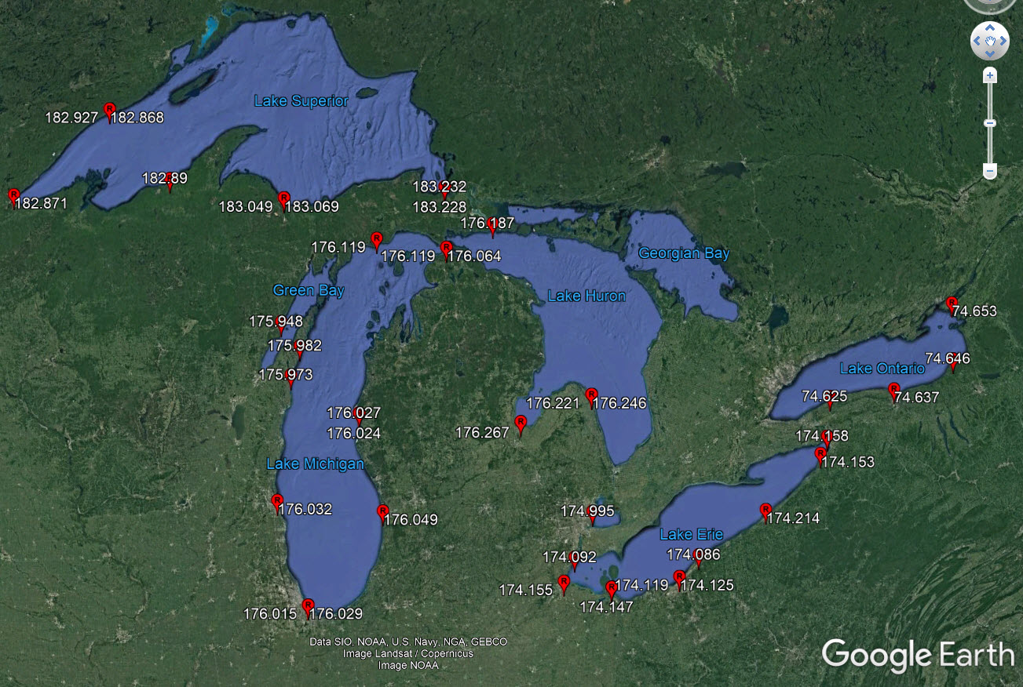
Dynamic Heights on the Lakes

