Slide 1
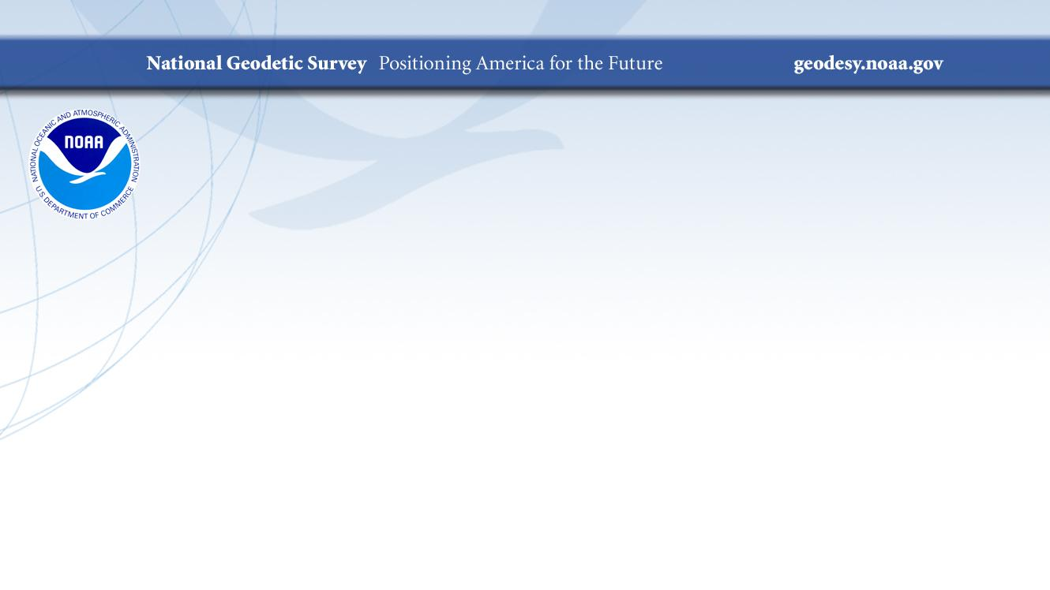
Quarterly All-Hands Meeting
Juliana Blackwell
National Geodetic Survey, NOAA
April 2, 2019

Slide 2

Overview
NGS Headquarters Update
NOAA/NOS Leadership Changes
2019 Mid Year Accomplishments
NGS Strategic Plan
FEVS Update
CAPS Progress Reviews
Records Management Update
Safety Update
FGDC / FGCS Update
NGS Leadership Summit
2019 NGS Geospatial Summit and Convocation
Recognition and Awards
Guest Speaker: NGS Socio-economic Studies

Slide 3
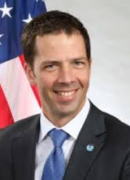
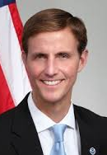


NOAA/NOS Leadership/Staff Changes
Tim Gallaudet, Ph.D., Rear Admiral, U.S. Navy (Ret.)
Assistant Secretary of Commerce for Oceans and Atmosphere / Deputy NOAA Administrator
Tricia Hooper,
NOS Program Coordination Officer
Neil A. Jacobs, Ph.D.
Assistant Secretary of Commerce for Environmental Observation and Prediction, Under Secretary and Acting NOAA Administrator
Jeffrey L. Payne, Ph.D.
acting Deputy Assistant Administrator for NOS

Slide 4

2019 Accomplishments so far
Finished an Update to the NGS Strategic Plan
Collected, processed, and posted 9,580 images covering 10,756 square km of areas affected by Hurricane Michael
GRAV-D project surpassed 75% collection goal
GRAV-D collection in the Pacific began in February
Expended ~$10M out of $12.M in Hurricane Supplemental funds to update the National Shoreline and nearshore bathymetry in Texas, Florida, and Puerto Rico
Delivered approx 250,000 OPUS solutions through end of February
Hosted 4 webinars totaling 2,810 attendees
10 new hires / staff changes
Completed 1 IERS / Foundation CORS geodetic site survey and reconnaissance for 3 more
Released GEOID18 for Beta Testing
Survived 35 day government shutdown
And many more!

Slide 5
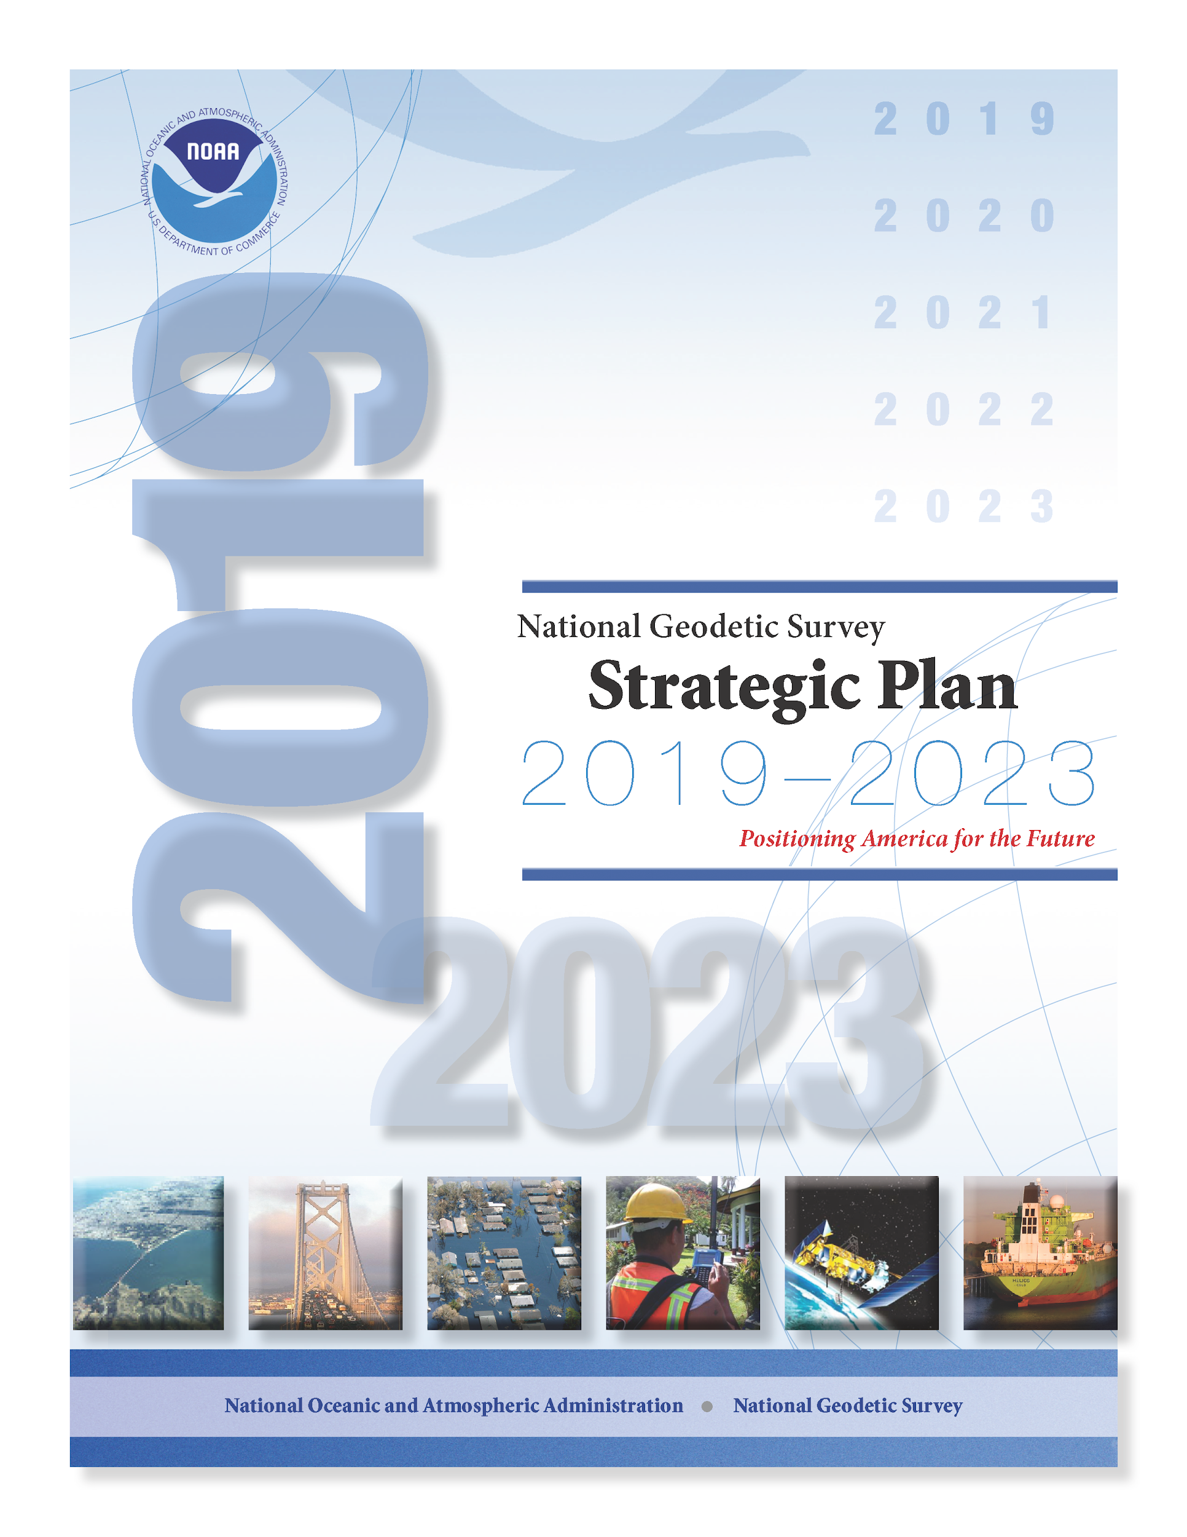
Strategic Plan Update
NGS Strategic Plan
Completed and published
Largely an update of the previous plan
Focus is on those tasks required for 2022 completion
Additional tasks noted and will be addressed in follow-on plan post-2022 roll-out
Strategic Human Resource Plan (SHRP)
Working closely with WFMO to develop a SHRP that will mirror the structure of the NGS Strategic Plan.

Slide 6

2018 FEVS Update
Greatest POSITIVE change from 2017-2018
(Q34) Policies and programs promote diversity in the workplace (for example, recruiting minorities and women, training in awareness of diversity issues, mentoring).
(Q56) Managers communicate the goals and priorities of the organization.
(Q59) Managers support collaboration across work units to accomplish work objectives.
(Q67) How satisfied are you with your opportunity to get a better job in your organization?
Notes:
NGS response rate 71.9% (NOS 63%, NOAA 50%). in 2017, 28 persons responded to the survey and 21 responded in 2016.

Slide 7
2018 FEVS Update
Greatest NEGATIVE change from 2017-2018
(Q14) Physical conditions (for example, noise level, temperature, lighting, cleanliness in the workplace) allow employees to perform their jobs well.
(Q17) I can disclose a suspected violation of any law, rule or regulation without fear of reprisal.
(Q25) Awards in my work unit depend on how well employees perform their jobs.
(Q31) Employees are recognized for providing high quality products and services.
Notes:
NGS response rate 71.9% (NOS 63%, NOAA 50%). in 2017, 28 persons responded to the survey and 21 responded in 2016.

Slide 8
CAPS Progress Reviews
Performance Review Meeting: The first of two required appraisal meetings between a rating official and employee.
Purpose: To discuss the employee’s accomplishments and give the employee and opportunity to present and assessment of the results achieved against the critical elements and standards established in the approved performance plan.
Completed by April 30, 2019

Slide 9
Progress Reviews
At a minimum, rating officials must conduct a formal progress review with their employees at approximately the midpoint of the appraisal cycle. Additional progress reviews may be conducted at the request of the employee or when the rating official determines them to be necessary.
The progress review must include discussion of:
          (a) The employee's progress toward meeting the objectives of the critical elements in the performance plan;
        (b) The rating official's identification of any performance deficiencies and guidance on how to improve performance; and
        (c) If appropriate, the need for changes in the plan to reflect changes in responsibilities.

Slide 10
Progress Reviews
A rating official must submit any changes in writing to the pay pool manager or, if appropriate, the reviewing official. All changes must be initialed or signed and dated by the rating official, pay pool manager, reviewing official, if appropriate, and the employee, in that order.
Changes can be made directly to the plan or attached to it. Pen-and-ink changes must be initialed and dated by the rating official, pay pool manager, reviewing official (if appropriate), and the employee, in that order. In both cases, the employee must be given a copy of the revised plan.

Slide 11
Progress Reviews
A record of the progress review, including any deficiencies, must be recorded on the Form CD-541 and initialed by both the rating official and the employee. Completed by April 30, 2018
If deficiencies are identified, the rating official should contact the servicing human resources (HR) office to receive advice on handling the performance problem.
A progress review should also be initiated by the rating official as soon as it is recognized that an employee's performance of one or more critical elements is not acceptable. The rating official must contact the servicing HR office to receive advice on handling the performance problem.

Slide 12
Professional Development
Mid-Year Reviews are a good time to talk to your Supervisor about Professional Development. All Employees must complete two identified professional development opportunities (Performance Plan “Organizational Excellence” Element). Examples include but are not limited to:
attending professional development training
presenting at conferences
publishing papers
participation in Leadership Development Programs (like NOAA LCDP)
taking Commerce Learning Center courses
doing details
attending technical, scientific, policy and/or administrative seminars
participating in professional organizations that support agency mission
creating and executing Individual Development Plans

Slide 13
Records Management Update
Records/Data Management Program and the NGS Library Charter was approved by the PRB on August 2018.
Records/Data Management Program and the NGS Library Project Plan was approved by the PRB on February 2019.
Brad, Joe, David and Kevin are in the process of a records inventory - i.e., labeling and identifying what records we have in cubicles, file cabinets, etc, and what Division they belong to; developing a spreadsheet to distribute to each Division with due dates.
Director granted consent to NOAA Records Officer (Andre Sivels) to conduct a Records Management (RM) program review/evaluation. Begins 4/8/2019 and Ends 8/30/2019.
Preparing our first 50 boxes to transfer to NARA of permanent paper records (which coincides with our NARA deadline of transferring all permanent paper and digital records by December 31, 2019).

Slide 14
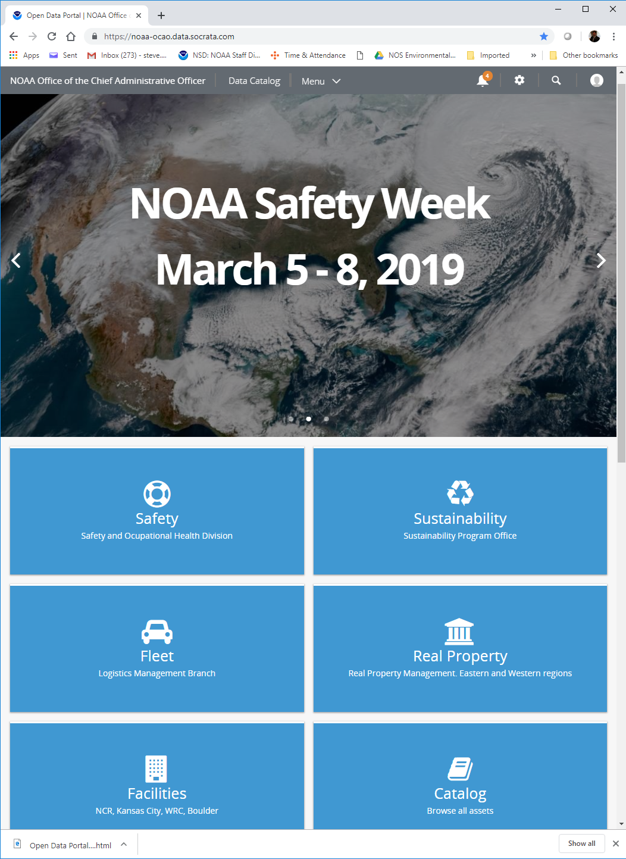
Safety Update
New NOAA OCAO portal which includes Safety, Real Property and Facilities menu items within https://noaa-ocao.data.socrata.com/login (sign in with NOAA SSO)
Once you access the OCAO portal, visit the Safety and Occupational Health Division tab at https://noaa-ocao.data.socrata.com/stories/s/gm8h-9nkp to:
  Report an Incident Here - covers reporting requirements for supervisors of workplace illness, injury and/or facility damages, as well as workplace hazards or near mishap
  Safety Links containing many safety resources and compliance information
Under the NOAA Safety and Health Week 2019 tab there are links to the CLC for available classroom training for supervisors (NOAA Safety Skills for Supervisors) at locations around the country

Slide 15
FGCS / FGDC Update
In October 2018, Congress passed the Geospatial Data Act as part of the FAA Reauthorization Act (H.R. 302, P.L. 115-254). The GDA does the following:
Codifies FGDC roles and responsibilities
Codifies and strengthens the National Geospatial Advisory Committee (NGAC) and overall standing of non-Federal sectors
Establishes requirements for:
  National Spatial Data Infrastructure (NSDI) and NSDI Strategic Plans
  National Geospatial Data Asset (NGDA) Data Themes
  Geospatial Data Standards
  GeoPlatform
  Covered Agency planning and reporting requirements
Until the language of the GDA is interpretted into specific action plans and further guidance is received from FGDC, the FGCS has been put "on hold."
Notes:
FGDC MESSAGE ON THE PASSAGE OF THE GEOSPATIAL DATA ACT OF 2018
“In the coming weeks and months, we will be working with FGDC agencies and with partners to develop thoughtful implementation strategies for the GDA. The GDA includes new responsibilities and processes, and will change the way that we manage geospatial programs across government.”

Slide 16


2019 Geospatial Summit and Convocation
Save the Dates!
Geospatial Summit (Public Event)
May 6 - May 7
Silver Spring Civic Center
Yes, webinar available
NGS employees must register!
Convocation (NGS All Hands)
May 8 - May 9
NOAA Auditorium & Science Center
No webinar available
Posters/Exhibit Hall POC - Daniel.Winester@noaa.gov
Coming soon: registration for Concurrent Sessions
AGENDAS ARE ONLINE!!!

Slide 17
NGS Leadership Summit
Topics discussed at the annual event held March 27-29, 2019
Challenges faced by front office leadership and division chiefs
Progress on NSRS Modernization
Organizational structure
Hiring priorities
Long-term training
NGS budget and trends
NGS Research Plan
NGS Outreach Roadmap
Implementation and progress reporting on strategic plan
Diversity and Inclusion
Time and Attendance policy

Slide 18

Recognition and Awards

Slide 19
FY 2019 New Hires and Staff Changes (Federal and Affiliate) at NGS
Jeffrey Quarrick (RSD)
Brian Madore (RSD)
Colin Becker (M&B)
Xiaopeng Li (GRD)
Carla Kirby (M&B)
Phillip McFarland (SRSD)
Clement Ogaja (GRD)
Weibing Wang (SDD) Lijuan Huang (RSD) Bobbi Simmons (ERT Employee)

Slide 20




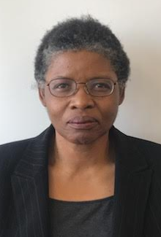
Farewells
Dan Callahan
(OAD)
Robert Hayes
(OAD)
Riva San Juan
(RSD)
Kevin Choi
(SRSD)
Bessie Thompson
(SDD)

Slide 21



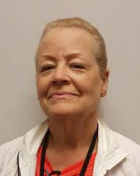

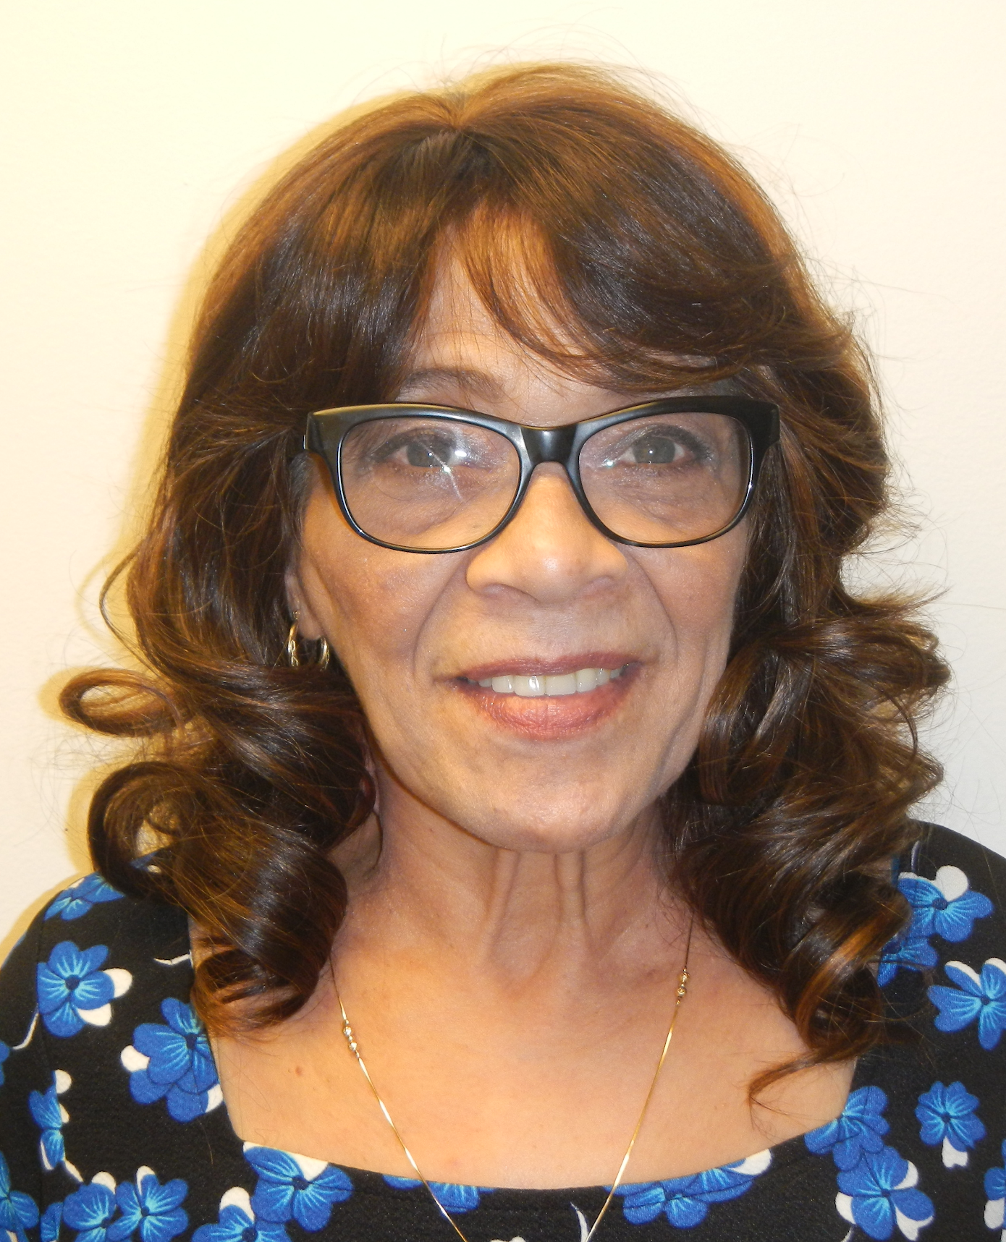
Years of Service
10 Years
15 Years
20 Years
Theresa Damiani
Andrew Halbach
Gretchen Imahori
35 Years
40 Years
Joyce Turpin
Demetria Thomas
Edith Bradley

Slide 22
Questions?

Slide 23
Guest Speaker

Slide 24
National Geodetic Survey
Socio-economic Studies
Galen Scott
Brett Howe
March 2019

Slide 25
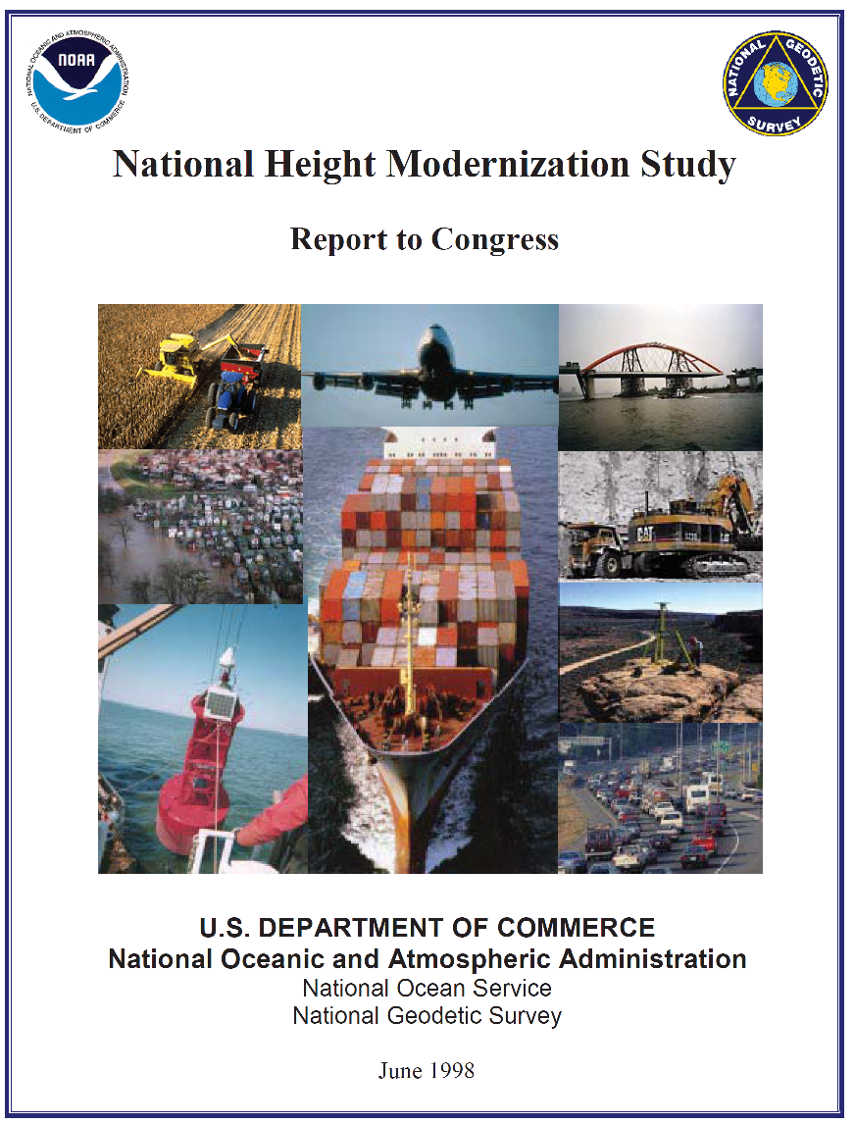
Our first study: “Height Mod”
1998 Height Mod Report to Congress
Estimated “value to constituents” from a modernized National Height System at over $12 billion.
State-by-state earmark funding began 2001, by 2007 stood at 10 states/year
2008 First year “National Height Mod” budget line in President's Budget
2010 GRAV-D begins under “Height Modernization” that will lead to a new Geopotential (“Vertical”) Datum in 2022.
Complete report available at: https://geodesy.noaa.gov/PUBS_LIB/1998heightmodstudy.pdf
25

Slide 26
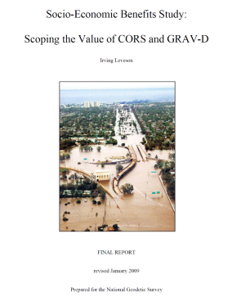
Location, Location, and Elevation!
NGS Positioning Products Worth Billions!
Importance of modernization through “GRAV-D”
http://www.geodesy.noaa.gov/PUBS_LIB/Socio-EconomicBenefitsofCORSandGRAV-D.pdf
Rollout to Congress June 15, 2009
NSRS worth $2.4 billion per year,
$22 billion over 15 years at a discounted rate.
CORS worth $758 million per year;
$6.9 billion over 15 years at a discounted rate.
GRAV-D worth $522 million per year through implementation of a new national vertical datum; $4.8 billion over 15 years at a discounted rate, including $2.2 billion for improved floodplain management alone.
One-page handout available at: http://www.geodesy.noaa.gov/INFO/OnePagers/socio_eco_handout.pdf
26

Slide 27
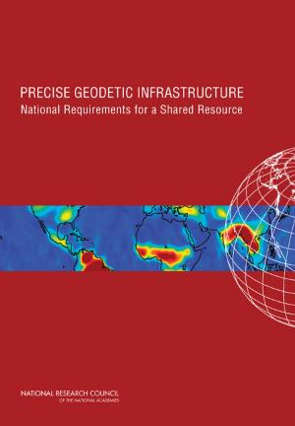
Precise Geodetic Infrastructure
National Requirements for a Shared Resource
2010 National Research Council (NRC) Report commissioned by NGS, NASA, U.S. Naval Observatory, U.S. Geological Survey, National Geospatial Intelligence Agency, and the National Science Foundation.
Made recommendations that included specific support for GRAV-D and CORS:
  Make the most of existing instruments
  Augment current infrastructure
  Collaborate on the global stage
  Maintain the ITRF
  Investigate workforce and education challenges
  Establish a federal geodetic service
A four-page summary of the report is available at:
http://dels.nas.edu/resources/static-assets/materials-based-on-reports/reports-in-brief/GeodeticInfrastructure-ReportBrief-Final.pdf
The complete pdf is available here (click on download free pdf): http://www.nap.edu/catalog.php?record_id=12954
27

Slide 28
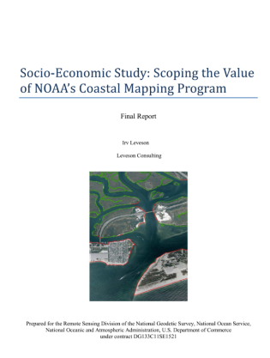
Coastal Mapping Program Benefits
Released in March, 2012
Total economic benefits estimated in excess of $200 million
per year
Combined direct and indirect return of $35 for every $1
in program cost
CMP supports ~1500 jobs including 40 full-time jobs
(CMP and contractors)
https://geodesy.noaa.gov/web/news/Big_Benefits_from_NGS_Coastal_Mapping.shtml
28

Slide 29
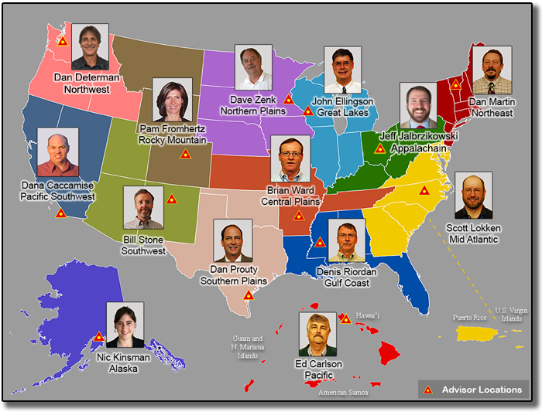
NGS Regional Geodetic Advisor Program
2018 Socioeconomic Study recently complete of the NGS Geodetic Advisor Program, which currently provides coverage to 14 U.S. regions.
Geodetic advisors guide and assist states’ geodetic and surveying programs.
Advisor program transitioned
to a regional approach in FY16 to provide nationwide coverage.
https://geodesy.noaa.gov/ADVISORS/
29

Slide 30
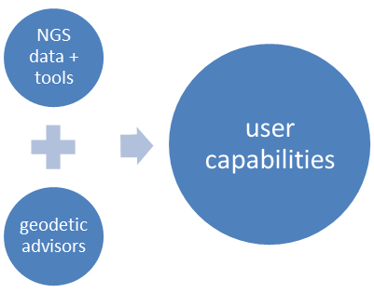
NGS Regional Geodetic Advisor Program
June 2018 Study Results
The NGS Geodetic Advisor Program currently provides benefits of services to clients ranging from $18.6 - $38.7 million annually.
The above includes, the training effort of Geodetic advisors for OPUS Projects, a major online tool for precise positioning, which is estimated to provide benefits of $1.4 - $1.9 million annually.
https://www.ngs.noaa.gov/PUBS_LIB/reg-geodetic-advisor-prog-socio-economic-scoping-study-6-1-18.pdf
30

Slide 31
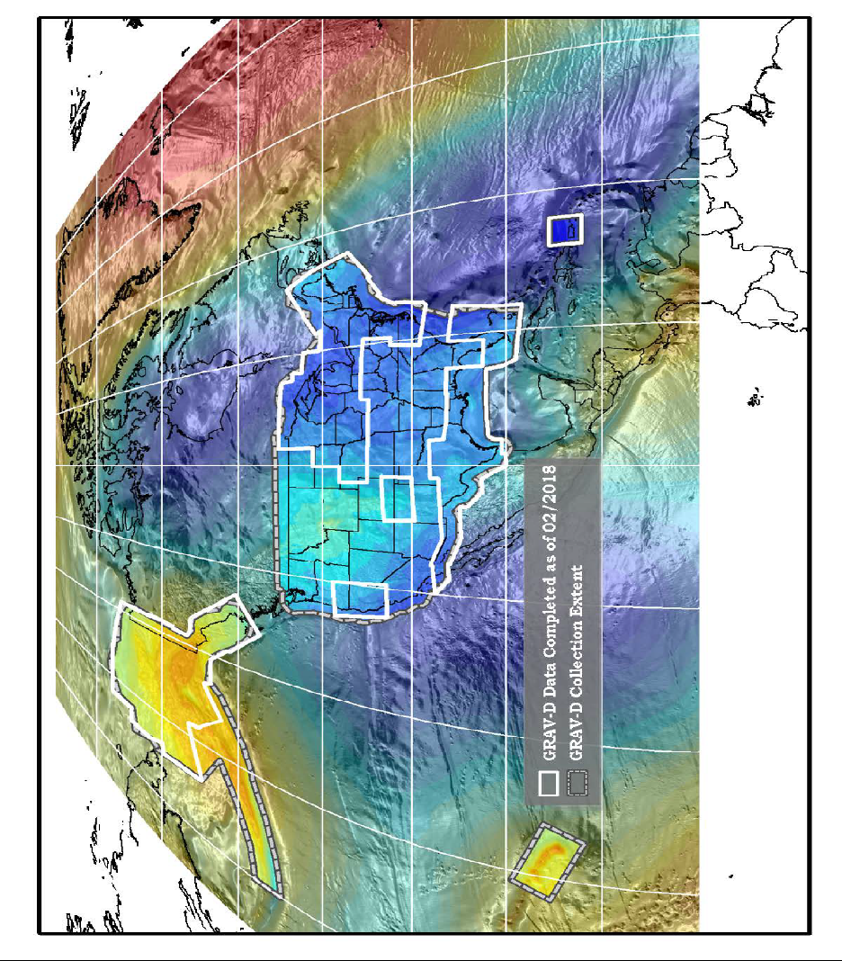
NGS Gravity Program
Underway in FY2019
Currently underway. A benefits study of the
NGS Gravity Program:
- Gravity Data Management
- Collect Gravity Data to Support Geoid Modeling
- Table Mountain Geospatial Observatory
- Geoid Monitoring Service
https://www.ngs.noaa.gov/GRAV-D/
31

Slide 32

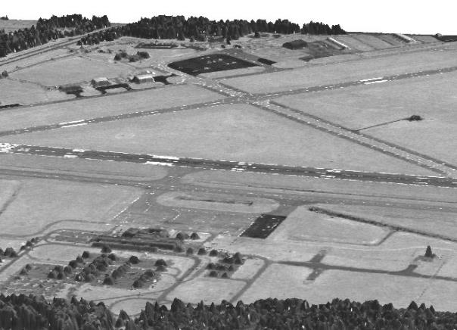
NGS Aeronautical Survey Program
Next Proposed Study:
Also anticipated in FY2019 will be a study of NGS’ Aeronautical Survey Program.
The NGS ASP provides the FAA with critical runway, obstruction, navigation aid, and airport feature information needed to safely fly into airports.
https://www.ngs.noaa.gov/AERO/aero.html
32

Slide 33
THANK YOU!
Questions?

