Slide 1
NOAA CORS Network
History & Current Status
John GALETZKA, Ira SELLARS, William FREEMAN,
Francine COLOMA, Don HAW, Lijuan SUN, Jarir SALEH
NOAA/NGS/SRSD/Geodetic Infrastructure Branch
Silver Spring, MD 20910
USA
Notes:
Good afternoon everyone! I’m Ira Sellars, a geodesist at the National Geodetic Survey in the USA. I’m delighted to be here today to discuss the NOAA CORS Network, including its historical background and current status.

Slide 2
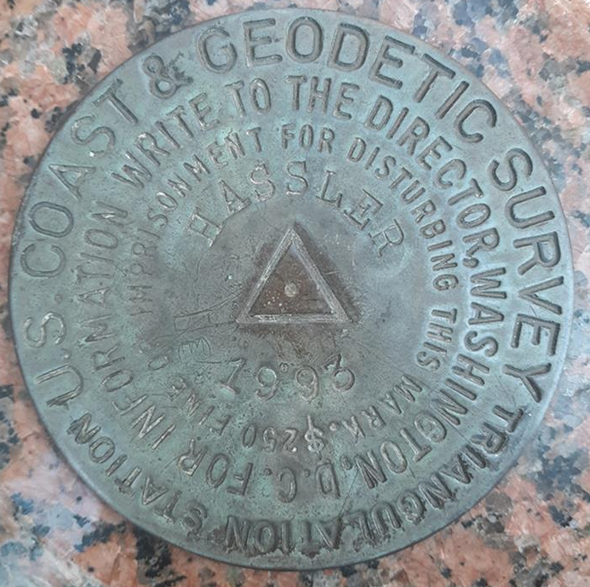
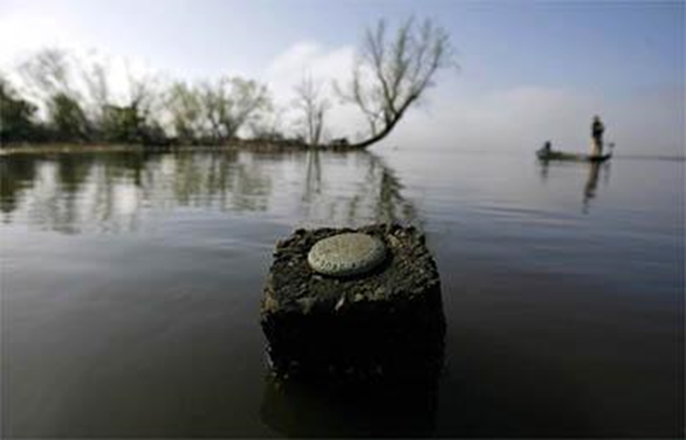
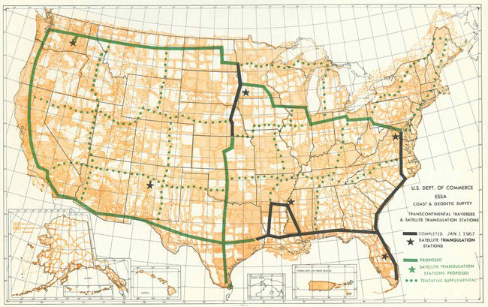
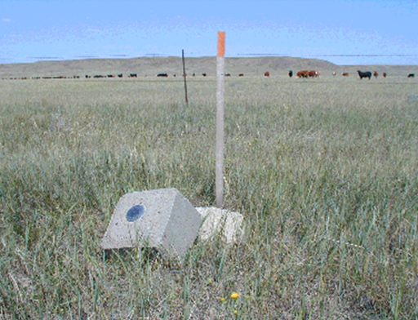
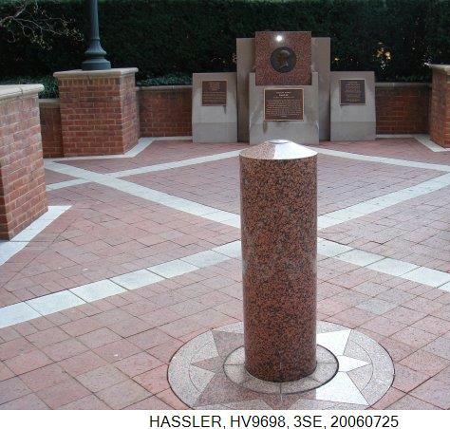
NSRS: Passive Geodetic Controls
Hard to access
Passive Monument
Destroyed Geodetic Control
No Coordinates/Elevation!
Notes:
In 1807, the Survey of the Coast undertook the immense responsibility of mapping the entire shoreline and coastal features of the United States, including water depth. To achieve this, surveyors had to establish precise survey points on land to accurately position survey vessels at sea. These points needed to be part of a common reference system to ensure seamless surveys along the coastlines. Fast forward to today, the NOAA/National Geodetic Survey manages the National Spatial Reference System (NSRS), which comprises a vast network of over 1 million geodetic control points created through collaboration between NGS and surveyors in both the public and private sectors throughout the country.
These survey marks, often identified by brass discs, serve as passive reference points that can be occupied with survey equipment. However, these marks were horizontally referenced to the 2-dimensional North American Datum 1983 (1986), while their elevation was referenced to the 1-dimensional North American Vertical Datum of 1988. Many “high accuracy” triangulation survey stations were located in the remote, GPS-unfriendly areas. Easily accessible national survey points were usually of “low accuracy”, and/or had short lines-of-sight to nearby survey stations due to obstruction by tall buildings or similar objects. In the early 1990s, NGS began to reconsider its traditional approach to making the NSRS available to the nation.

Slide 3
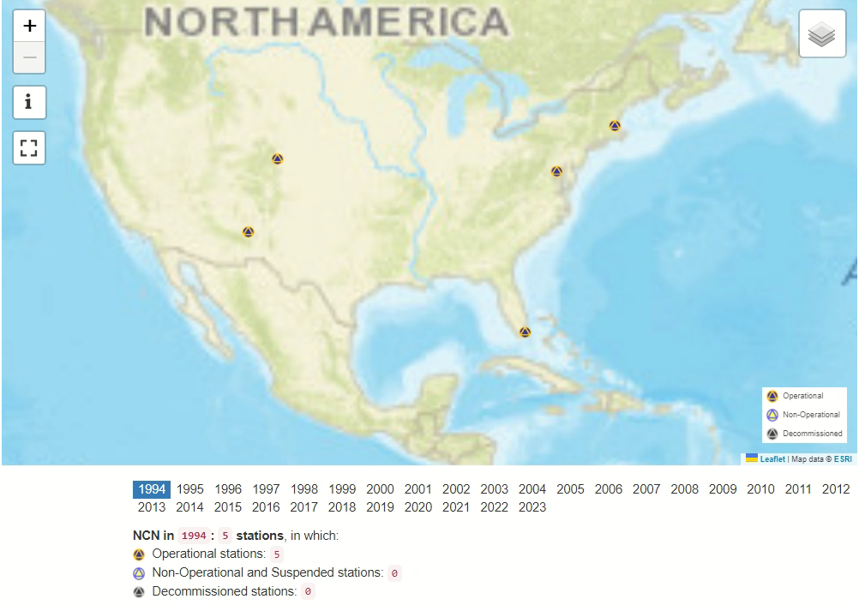
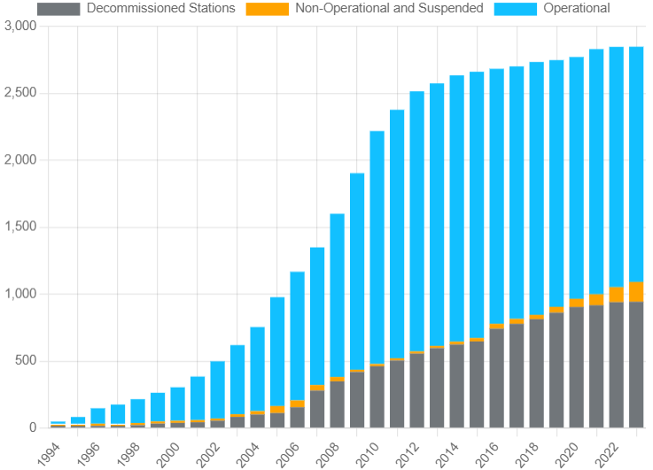
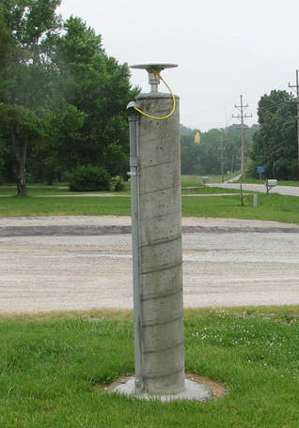
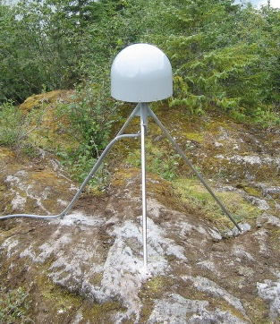
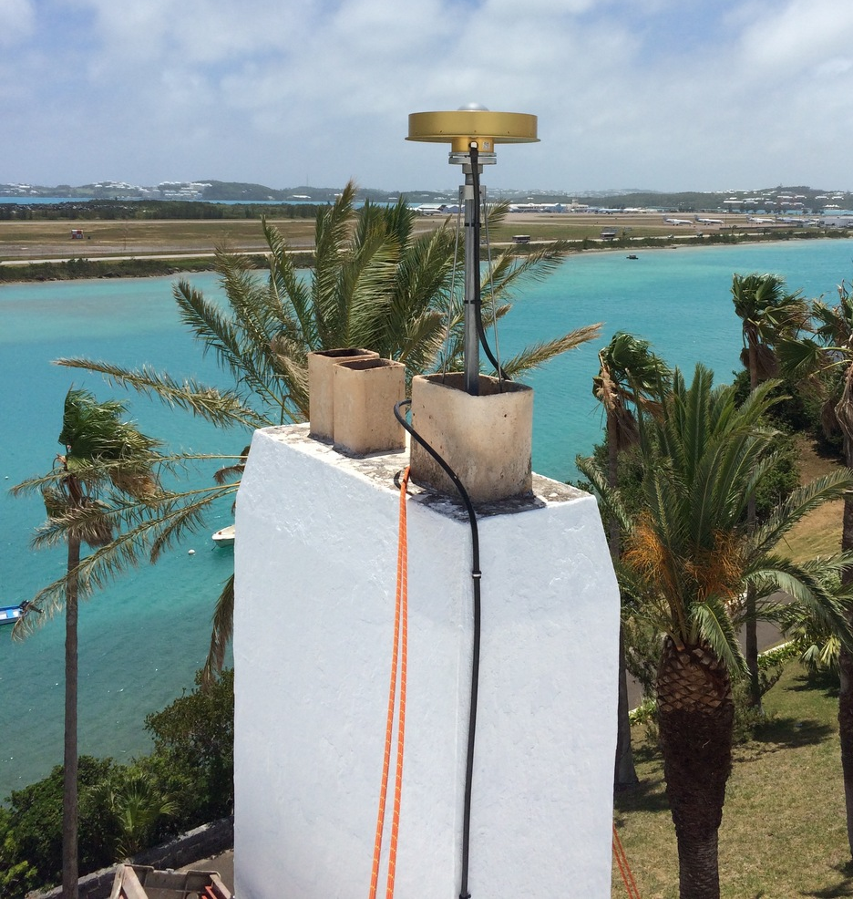
NSRS: NOAA CORS Network
Notes:
During the early stages of GPS development, NGS recognized the potential of GPS for enhancing the NSRS. In February 1994, NGS initiated the first site of the Continuously Operating Reference Station (CORS) network with the Trimble Navigation Corporation’s site, GAIT, in Maryland. In 1995, William Strange and Neil Weston proposed a network of CORS covering the entire United States. However, establishing such a network was a significant financial challenge for NGS, as geodetic quality GPS receivers cost by then between $35000 to $50000 each. At the same time, several federal agencies also sought to build their own GPS base station networks for different purposes. To reduce expenses for the federal government and taxpayers, the US General Accounting Office directed NGS, U.S. Coast Guards (USCG) and U.S. Army Corps of Engineers (USACE) to coordinate their activities and equipment procurement. As of now, the network has expanded to include over 2800 stations, a remarkable increase from its initial size of just 5 stations in 1994.

Slide 4
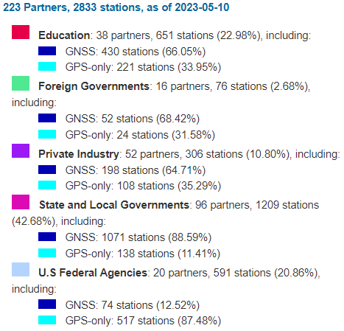
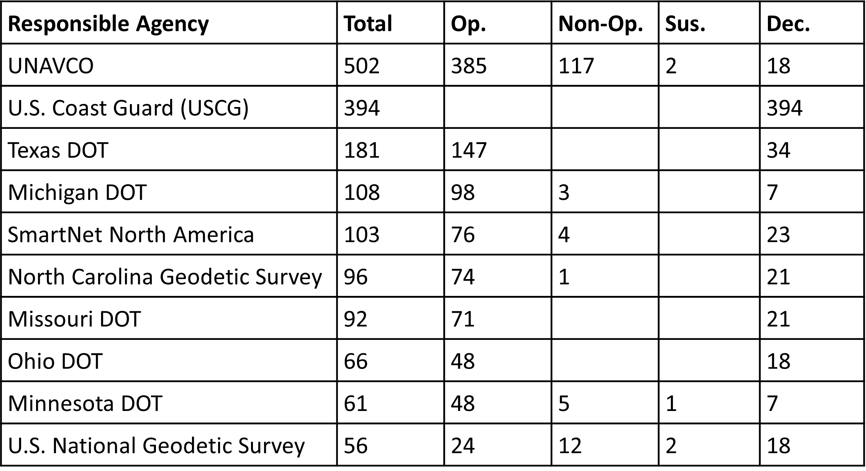
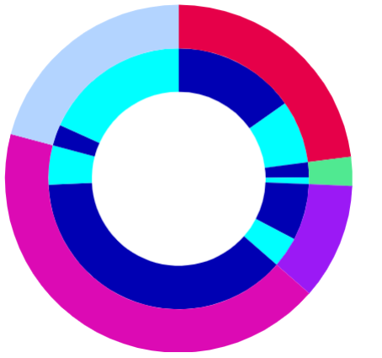
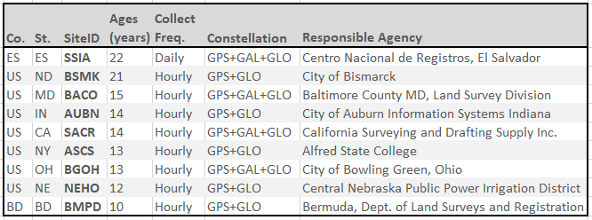
Participating Agencies
Each contribution is important & valuable for enhancing
the quality & accuracy of the NSRS
Notes:
The NCN brings together a diverse range of organizations including federal, state, and local governments, academic institutions, and private industry. This collaborative approach provides a broad range of expertise and ensures that the NCN is not reliant on any single agency, communication system, or type of equipment. However, this diverse participation requires closer communication with all involved parties.
As of May 10, 2023, NGS has received contributions from over 200 organizations, resulting in a total of 2833 stations. The contributions from these organizations have been distributed across various partner types, each making a significant contribution to the overall size and scope of the network. The largest portion of the NCN is made up of 96 state and local governments, collectively contributing for approximately 43% of the network. We would like to extend a special acknowledgement to our host state, Florida, which has been a dedicated contributor since 2002 with a total of 74 stations. Our agency, NGS, owns and operates 56 stations in total, making up about 2% of the total stations in the NCN. We also have 38 colleges, universities, and research organizations actively participating, contributing 651 stations which represents approximately 23% of the NCN.
It is worth noting that more than half of our partners contribute a single station each. Regardless of the number of stations contributed, each and every contribution is a testament to the providers’ commitment to supporting the National Spatial Reference System and enhancing the quality and accuracy of the network. We greatly appreciate the contributions and ongoing support from all our partners. Thank you to all of our partners for their valuable contributions!

Slide 5


NOAA Big Data Project on AWS:
https://noaa-cors-pds.s3.amazonaws.com/index.html
USERS
NGS website:
https://geodesy.noaa.gov/corsdata/
Ingest RINEX
Update/maintain station metadata
QA/QC RINEX
Archive
Distribute
NOAA’s CLASS (at-sampling rate, 30-day delay): https://www.avl.class.noaa.gov/saa/products/search?datatype_family=CORS
CDDIS (IGS-NCN sites): https://cddis.nasa.gov/Data_and_Derived_Products/index.html
NGS
Notes:
NGS offers public access to all data that has been collected from the NCN since February 09, 1994, which includes GPS/GNSS observations, station logs and photos, and NGS published coordinates and velocities for each station. The entire collection of NCN data are available to the public free of charge, through the Internet. There are multiple ways to access NCN data. One option is to download it directly from the station providers, who are responsible for collecting and archiving the data at their respective stations. Alternatively, users can also access NCN data through various online storage options provided by NOAA/NGS and other sources.

Slide 6
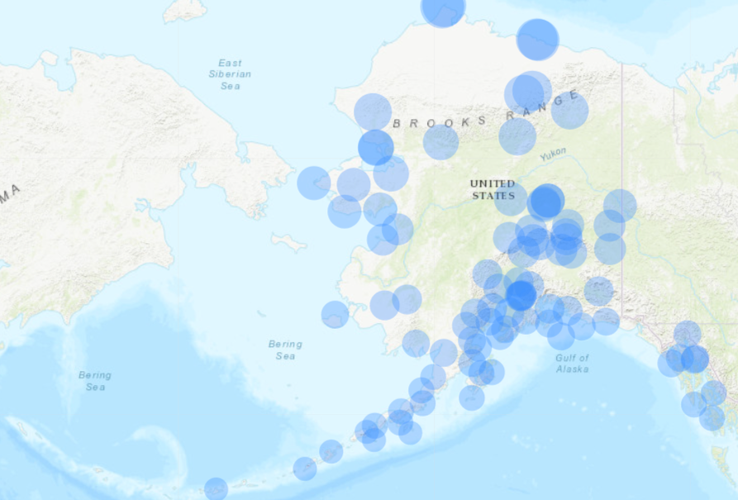
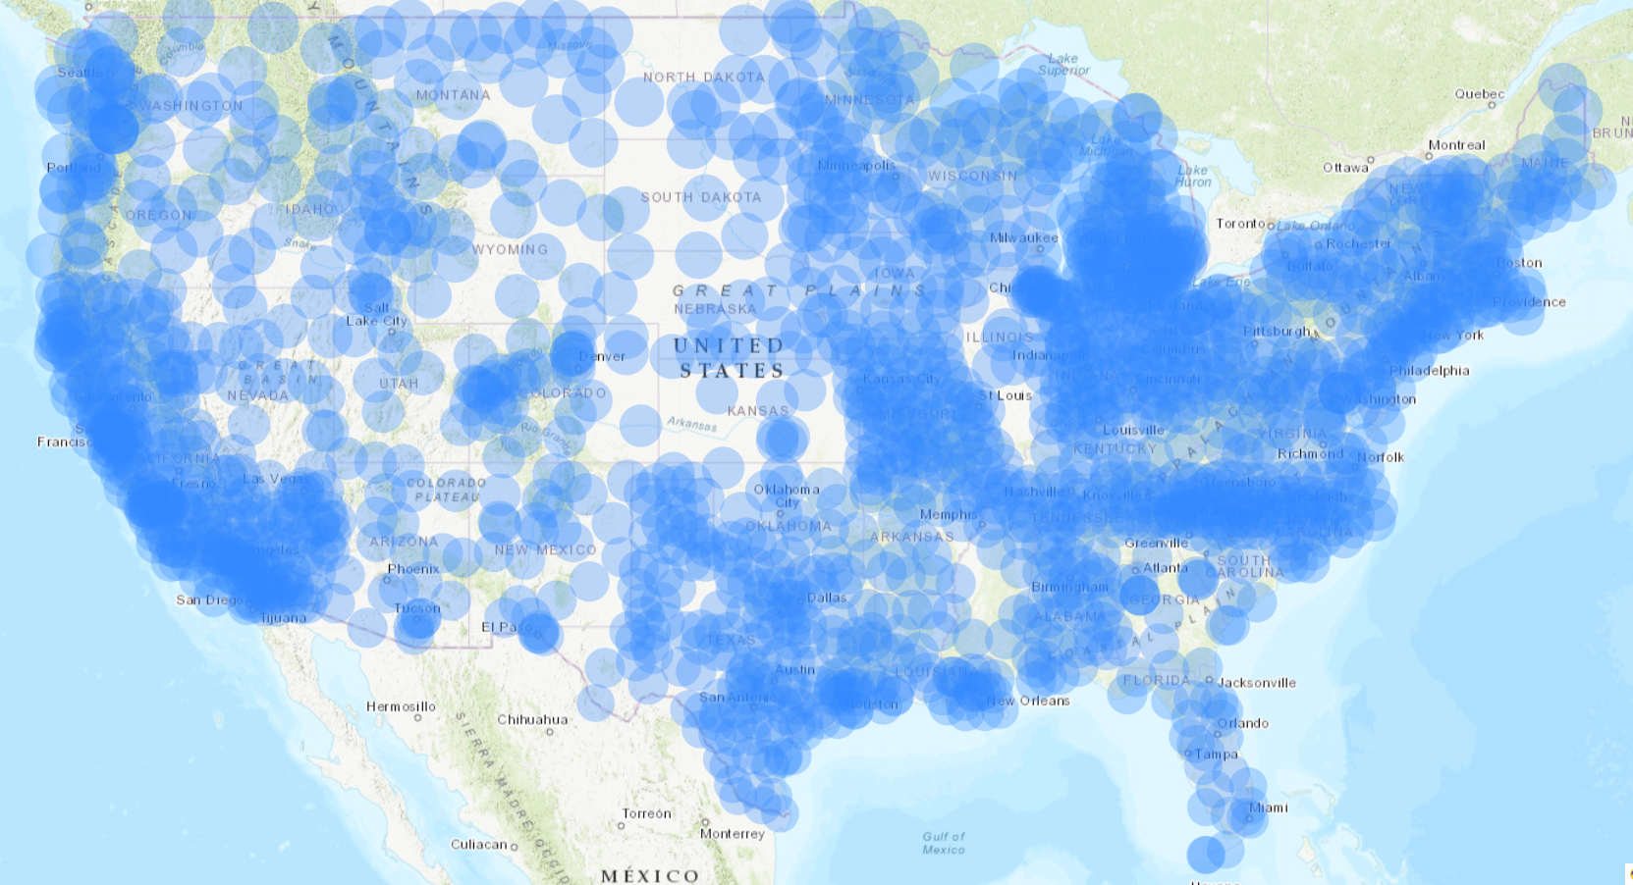
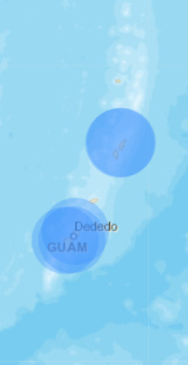
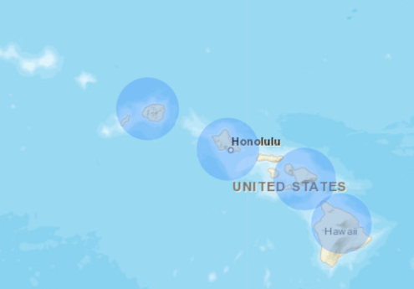
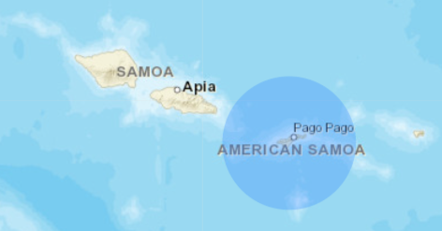
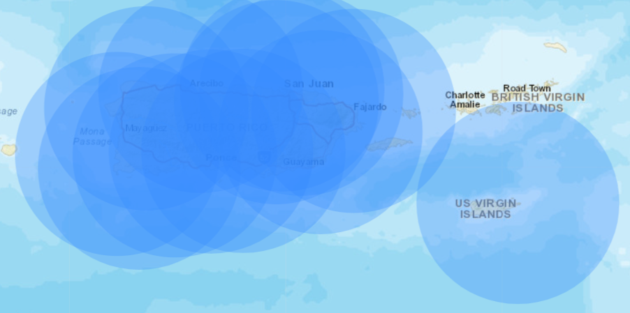
(USA) NCN 70-km coverage of Operation stations (May 10, 2023)
Notes:
NCN stations are concentrated along the coastlines due to their location and the importance of the ports, shipping and transportation infrastructure. The network is heavily congested in North Carolina, Tennessee, Missouri, Michigan, and Indiana due to the population, infrastructure and economic importance. On the other hand, the network is thin in the mid-western states due to their lower population density and less infrastructure.

Slide 7
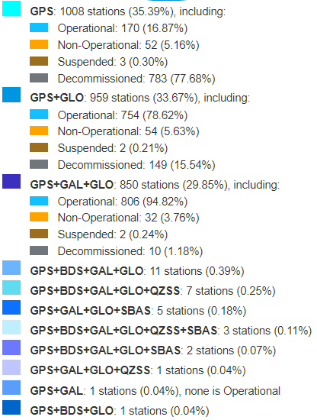
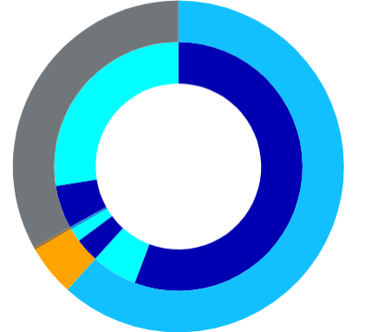
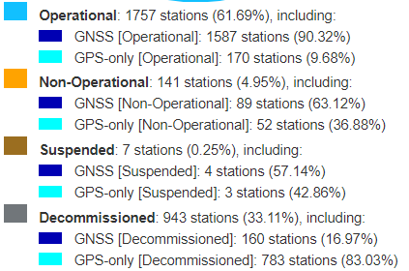
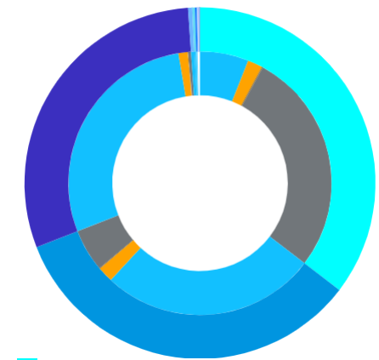
Notes:
As of May 10, 2023, the NCN has a total of 2833 stations. Among these, 1757 stations are actively providing RINEX data in the last 30 days and are classified as Operational stations. 90% of these Operational stations are providing GNSS observation data.

Slide 8
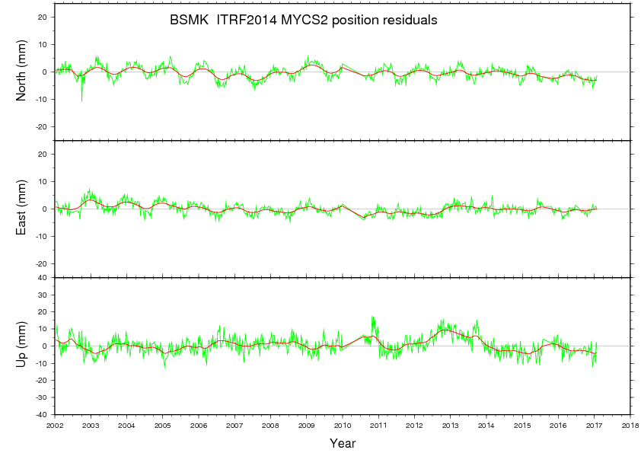
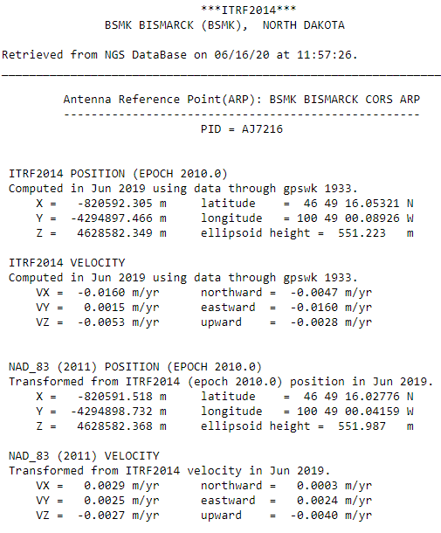
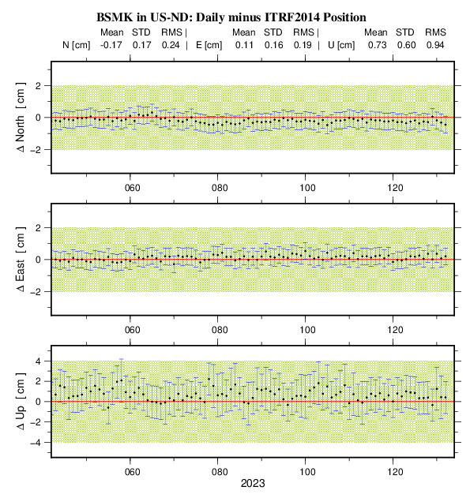
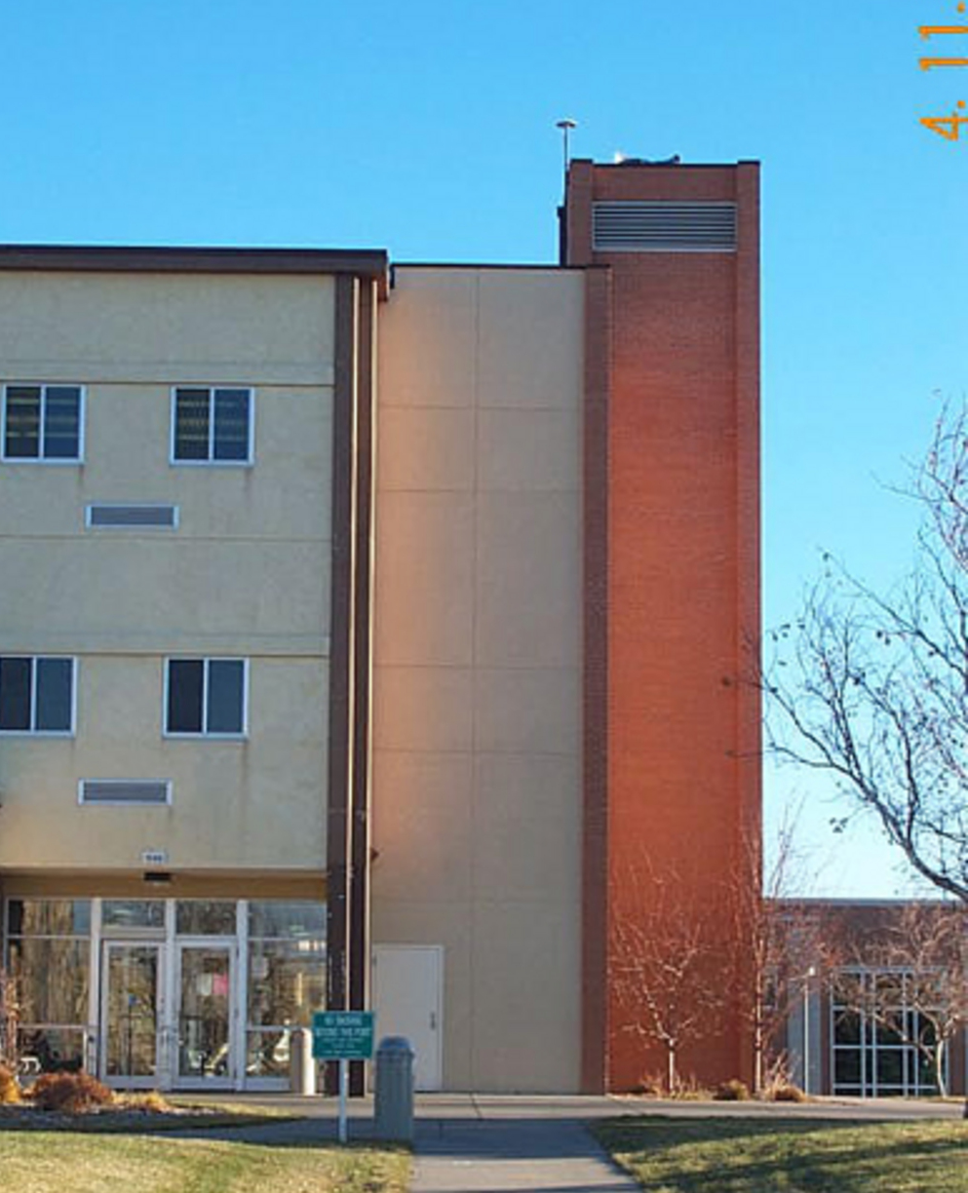
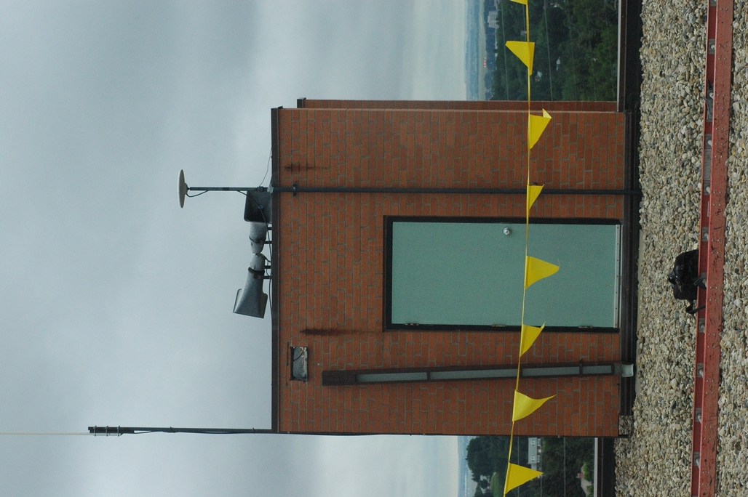
BSMK - City of Bismarck,
North Dakota, USA
Notes:
Each of NCN stations currently has two sets of coordinates and velocities: in the national NAD83 and in the international terrestrial reference frames. Every few years, NGS reprocesses all NCN data collected since 1994 to compute provisional positions and velocities for all NCN stations relative to the current ITRF realization. If the provisional ITRF coordinates differ from the currently adopted ITRF coordinates by more than 1cm horizontally and/or 2cm vertically, NGS adopts the provisional position and velocity to supersede the previously adopted ITRF position and velocity. Our most recent processing campaign, known as Multi-Year CORS Solution 2 or MYCS2, involved analyzing data from 1996 to 2016, spanning 1100 weeks or 21 years. This campaign included approximately 3050 stations, consisting of those from the NCN and other networks such as the IGS.
In addition to this validation process, NGS conducts daily solutions to monitor the quality of the adopted coordinates. Each solution is calculated from a 24-hour data of the most current date. NGS then generates plots showing differences between the published ITRF coordinates and the values obtained from the daily solutions, corrected for crustal motion, for the last 90 days. If the trend observed in the 90-day series of daily estimates differ from the station’s published coordinates by more than the tolerances, NGS carefully analyzes the available data to determine whether or not this station’s published coordinates and velocities should be updated.
When movements of the antennas are detected, NGS notifies the NCN providers. Conversely, the station providers inform NGS about any changes in equipment or software, planned outages, and alterations to the space surrounding the antennas.

Slide 9
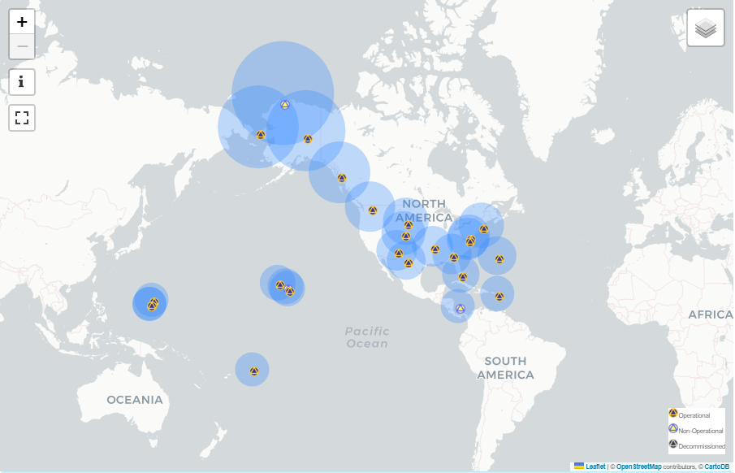
NOAA Foundation CORS Network (NFCN)
A federally controlled network
Provide support for the ITRF and plate rotation models
Target Operational Time:
  Network availability >90% at all times;
  Individual station down time < 14 days;
In 2022, NGS received enough funding from BIL to complete installations of NGS’s owned stations.
NOAA Foundation CORS Network (NFCN) 800-km coverage.
As of February 23, 2023, there are 25 stations in the NFCN.
Notes:
As previously mentioned, the NCN stations are installed and operated by different collaborators, resulting in varying configurations to meet specific application needs, and may be disconnected at any time. To ensure a long-term consistency between the NSRS and the International Terrestrial Reference Frame (ITRF), it is crucial to maintain a set of reference frame sites at the highest standard to archive a robust, enhanced, and long-lasting national reference frame. This set of reference frame sites, classified as the NOAA Foundation CORS Network (NFCN), is designed to provide the reliable “backbone” for the NCN. The positions of all NCN stations that do not belong to the NFCN will be adjusted to the NFCN in order to maintain the integrity of the entire NCN.
Funding for the NFCN program has been limited since its inception. However, in 2022, the NFCN program received enough program funding from the Bipartisan Infrastructure Law (BIL) to complete the installation of the remaining NGS’s owned NFCN stations. These efforts will begin in the summer of 2023, and we anticipate it taking about four years to complete. During this time, NGS will focus on new NFCN installations, but also upgrading the hardware at existing NGS-owned CORS, as well as looking for opportunities to provide reliability and redundancy in the NFCN.

Slide 10
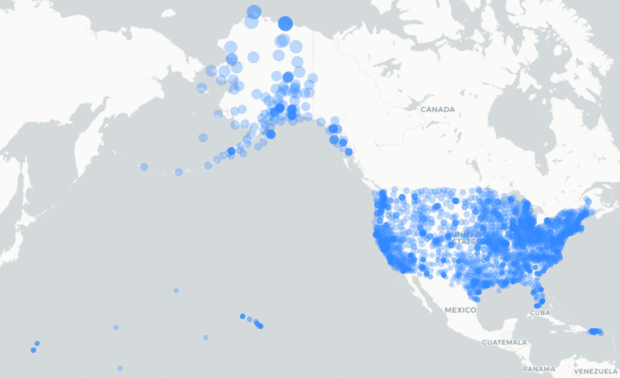
(USA) NCN 70-km coverage
Notes:
We are grateful for the contributions and ongoing support from all our partners. It is through this collective effort that we are able to maintain and expand the NCN, enhance the quality and accuracy of the National Spatial Reference System. Thank you once again to all NCN station providers!

