Slide 1
NGS Activities in Colorado
Federal Surveyors Workshop
February 28, 2012
P. Fromhertz@noaa.gov

Slide 2
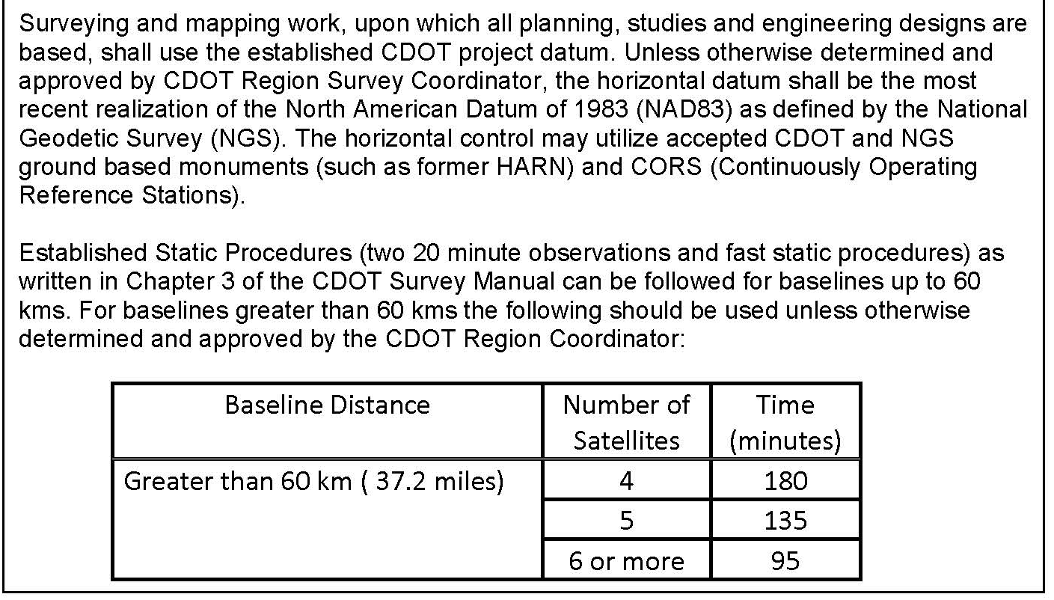
CDOT CORS/OPUS Team
DRAFT
DRAFT
Proposed Addendum

Slide 3
CDOT CORS/OPUS Team
DRAFT
DRAFT
Recommendations
  OPUS tools are valuable and use of them should be further explored and encouraged where appropriate and incorporated into re-write of Chapter 3.
  Encourage publishing of control using OPUS-DB especially on NGS vertical marks to prepare the vertical datums for the future.
  Additional CORS should be added in Colorado
  Microstation control diagrams be edited to reflect the language in the proposed (approved) Addendum
  Training to Support these Changes

Slide 4
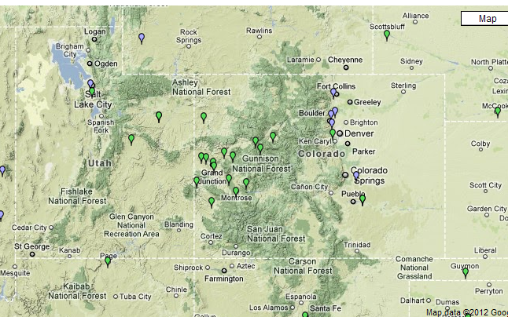
NGS CORS in Colorado

Slide 5
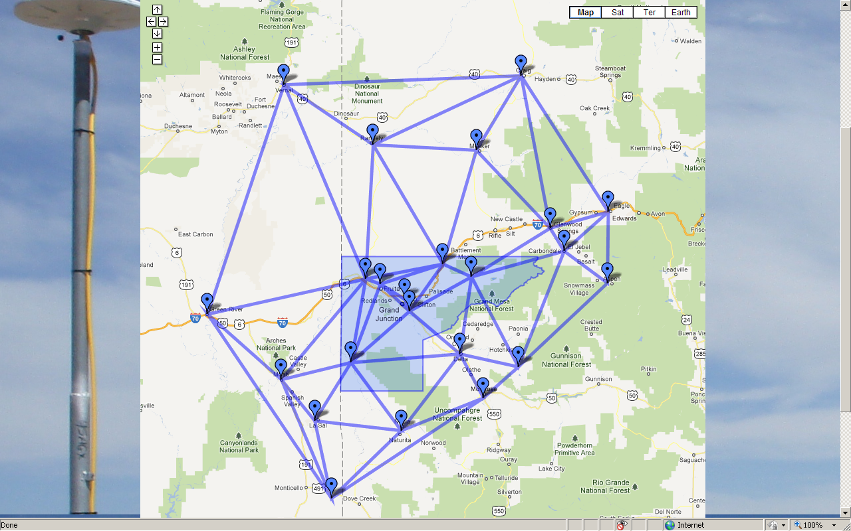
Mesa County RTN

Slide 6
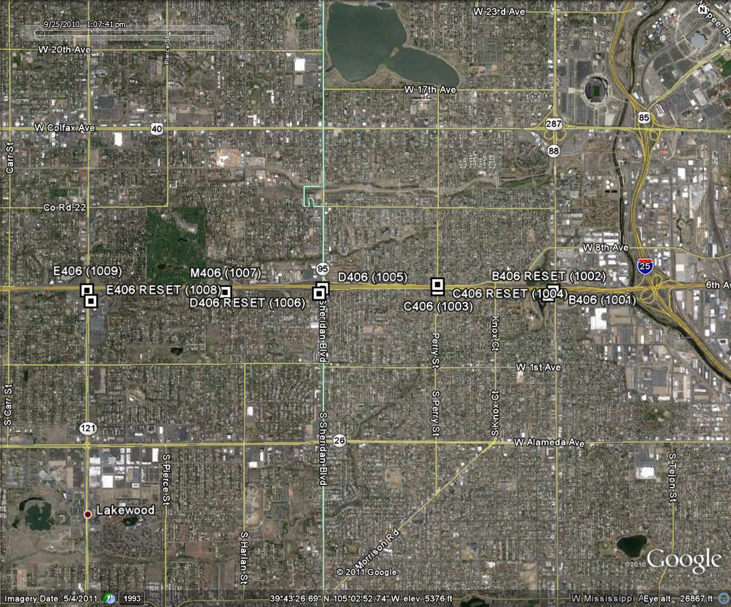
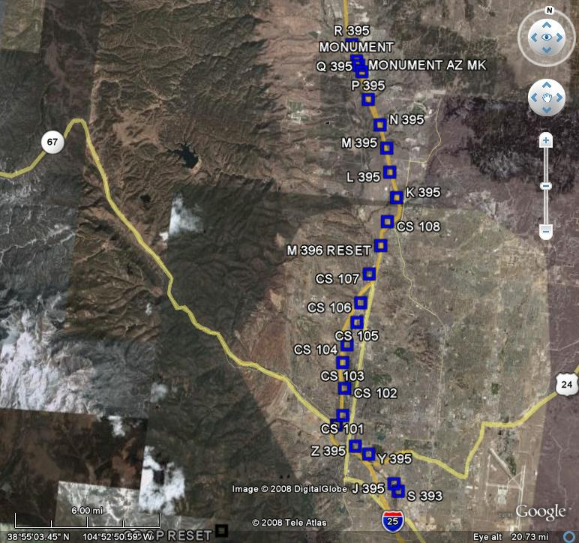
Leveling Projects
CDOT Region 6
6th Avenue Federal - Sheridan
CDOT Region 2
Monument – south side of Colorado Springs

Slide 7
LOCUS
Leveling OnLine Calculations User Service
Provides a means to process and adjust level data
  Has been done at NGS Headquarters
Requires *.hgz file from Translev
  Error free
Requires Description file from WinDesc
You pick stations to constrain
Helps expedite entire process
Beta Version – Needs to be tested
Data is not submitted to NGS (at this time)

Slide 8
Work to be Done
(Ht Modernization)
Big Picture
Assessment of Vertical Issues in CO
Gap Analysis of Where we need better vertical measurements, whether orthometric or ellipsoidal
Collect Data in those Key areas, using OPUS-DB, and determine what other means (leveling)
In the meantime, collect what you can using OPUS-DB
Write a report capturing all of this

Slide 9
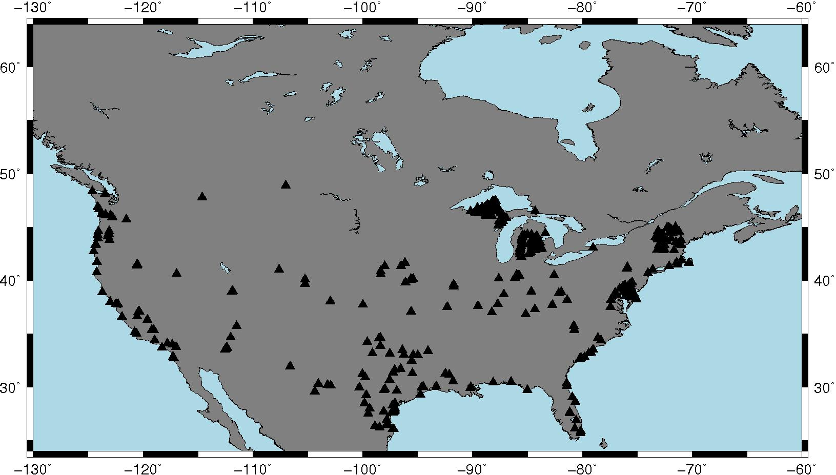
Leveled Bench Marks Occupied by GPS and stored in OPUS-DB
OPUS-DB shows great promise for filling gaps
Notes:
80 are in common with NGSIDB and were used in making GEOID09
57 are in common with NGSIDB and were *NOT* used in making GEOID09
285 are new points never before occupied with GPS
Distribution is fair, but you can see that some states are more active than others

