Slide 1
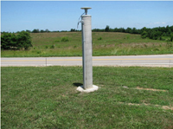
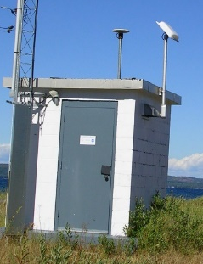
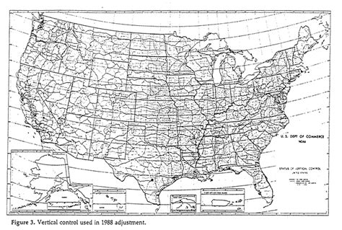
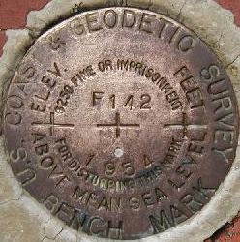
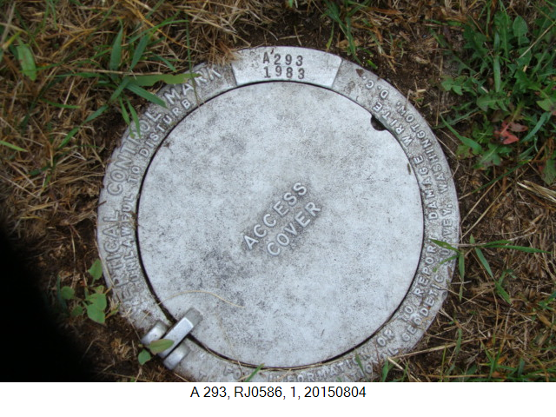
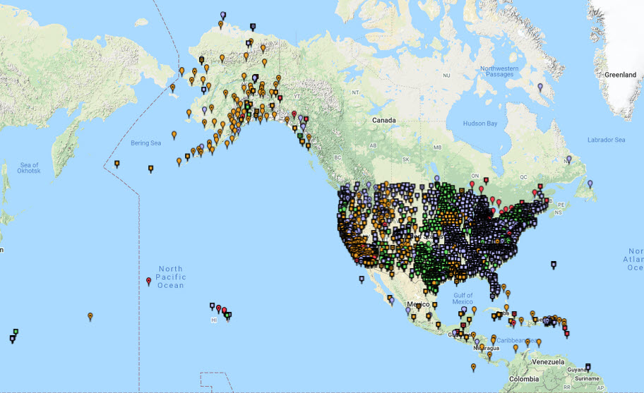
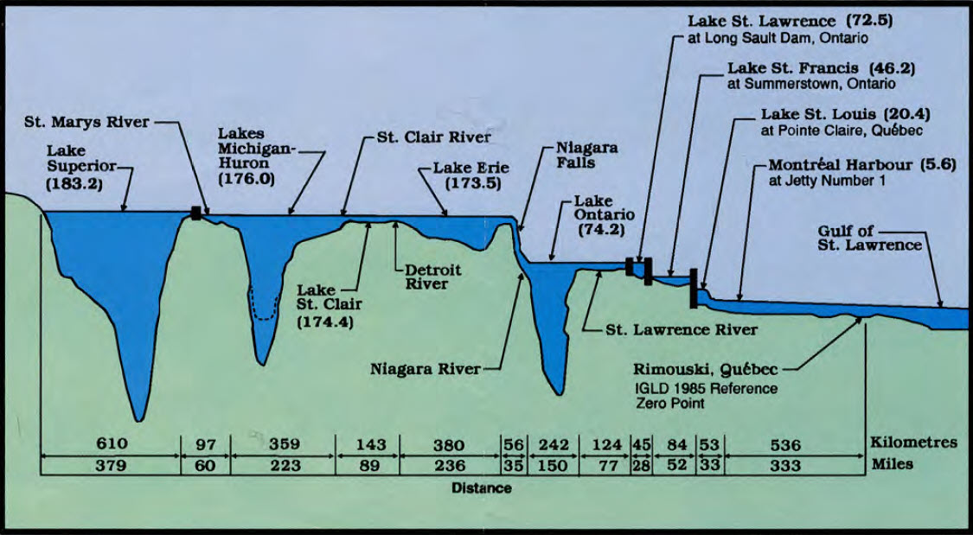
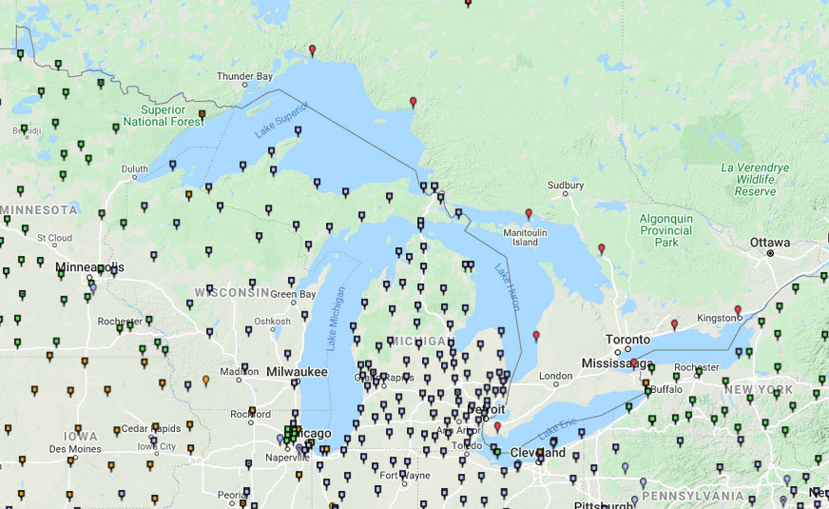
Dynamic Heights From Recent Experimental Geopotential Models
Daniel Roman, Ph.D.
Chief Geodesist
Notes:
- Introduce self –Chief Scientist for US Geodetic Agency tracing heritage back to 1807
NGS mission – define, maintain, provide access to the National Spatial Reference System => currently realized by NAD 83 and NAVD 88
Lower left image – NOAA CORS Network for accessing NAD 83
Upper left image – exemplar CORS (Eldon, MO)
Middle left image – Extents of North American Vertical Datum of 1988 – adjusted geopotential numbers
Middle right images – examples of benchmarks: the more traditional USC&GS marks (near Jacksonville, FL/BC0366) and recessed NGS marks (near Pt. Iroquois, MI/RJ0596)
Lower right image – NCN in the Great lakes region – as you can see the spatial density isn’t quite impressive when you zoom in
Upper right – One of these stations is Pt. Iroquois CORS collocated with NWLON water level station on Lake Superior
Bottom middle image – that station is about here at the outlet of Lake Superior (BR) and here in the image profile (BM)
I bring this up, because I am going to focus on lake Superior as it is the largest, deepest and has the most significant features to model

Slide 2
slides:
* 1) title/intro - who I am/NGS - maybe a stock image
* 3) IGLD 85/IGLD 2020 - COOPS/NGS - USA/CAN
* 4) Show stations around Lake Superior
* 5) Show errors in NAVD 88 => HC [sets up the [problem]
6) xGEOID20 => NAPGD2022 to fix above
* 7) show GIA trends
8) Show GLERL/CO-OPS trends on LS
9) Show Lake Map w/ stations - give numbers before/after de-trend
10) Show ideas behind dynamic heights calculation - image?
11) Show revised dynamic heights
12) Show NetCDF image (theirs if need be) [coverage beoynd points)
*13) Summary/conclusions/image of HC or revised Dynamic height numbers with NetCDF overlay

Slide 3
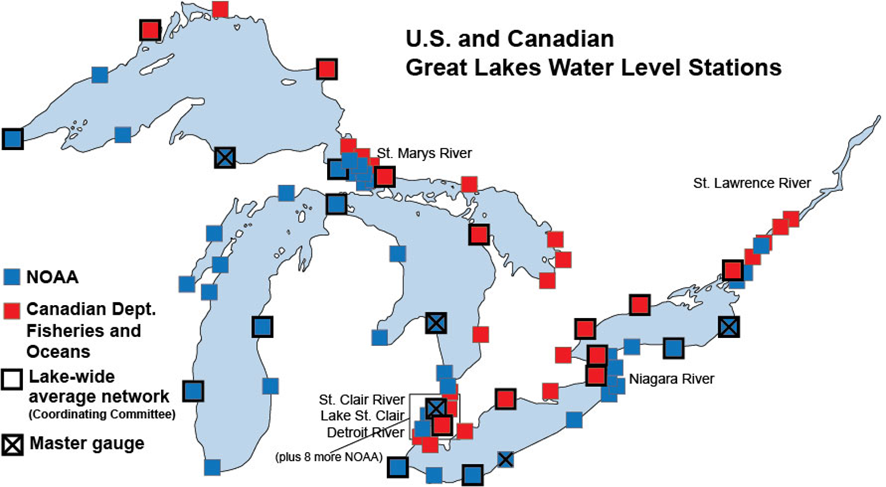
Monitoring the International Great Lakes
Lake Superior
Distribution of 53 U.S. (NOAA) and 34 Canadian (CHS) Water Level Stations in the Great Lakes region.
These sites collect continuous water level measurements. A few have collocated CORS
Notes:
Shown here are all the US and Canadian water level stations on the Greta Lakes. Lake Superior is the westernmost. The Pt. Iroquois station is in the bottom right corner of the red box (large blue dot).

Slide 4
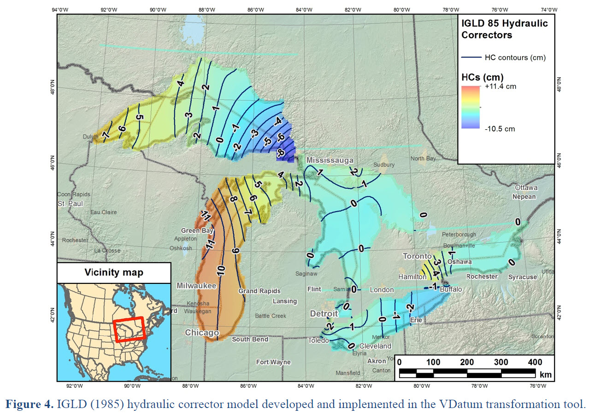
IGLD 85 Dynamic Heights (H_{d})
International Great Lakes Datum of 1985 (IGLD 85)
Realized from same geopotential numbers from NAVD 88
Each Lake generally is equipotential => H_{d}=constant
Hydraulic Correctors (HC) were required to “level” the Lakes
Causes: NAVD 88 defect, GIA-based changes and gravity field errors
From “Updating the International great Lakes Datum” by VC-WL-SC of the Great lakes Coordinating Committee
Notes:
http://www.greatlakescc.org/wp36/wp-content/uploads/2017/09/IGLD_Update_20170929_Exec_220dpi.pdf

Slide 5
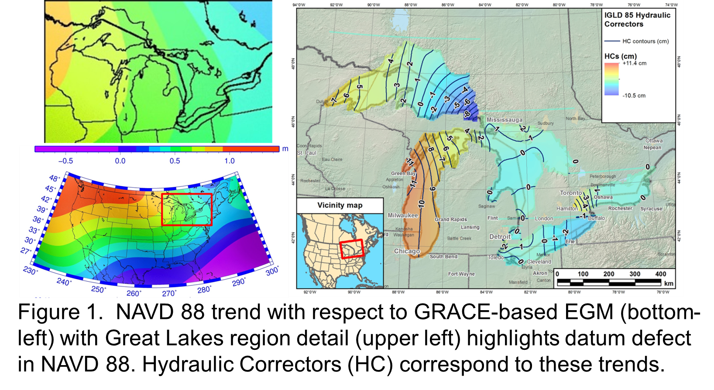
Errors in NAVD 88 as a datum

Slide 6
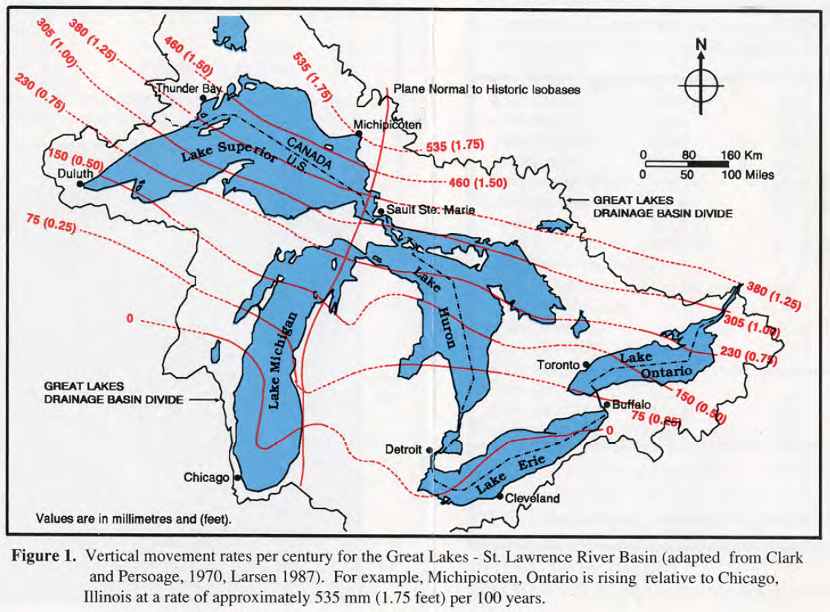
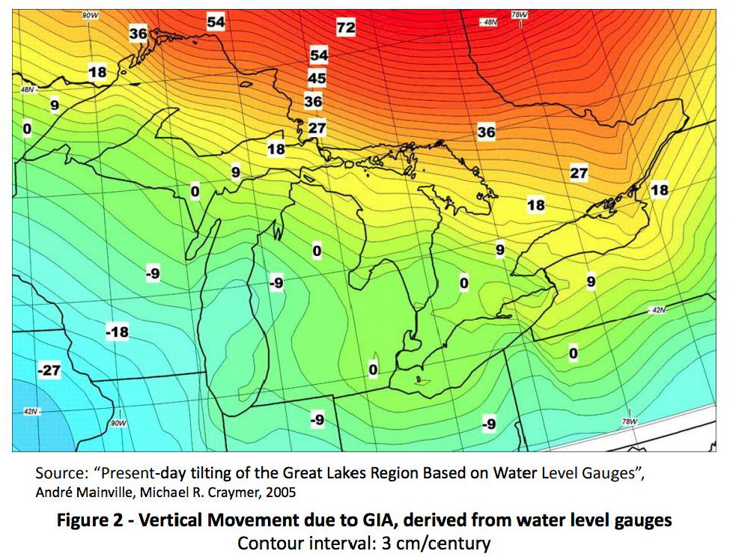
The Earth isn’t Static – GIA Affects Dynamic Heights
Vertical Movement in the Great Lakes as Noted in IGLD 85 Literature
Vertical Movement in the Great Lakes due to Glacial Isostatic Adjustment
Notes:
Glacial Isostatic Adjustment has caused the movement of mass and a shift in the geopotential values and, therefore, a shift in the Great Lakes surfaces

Slide 7
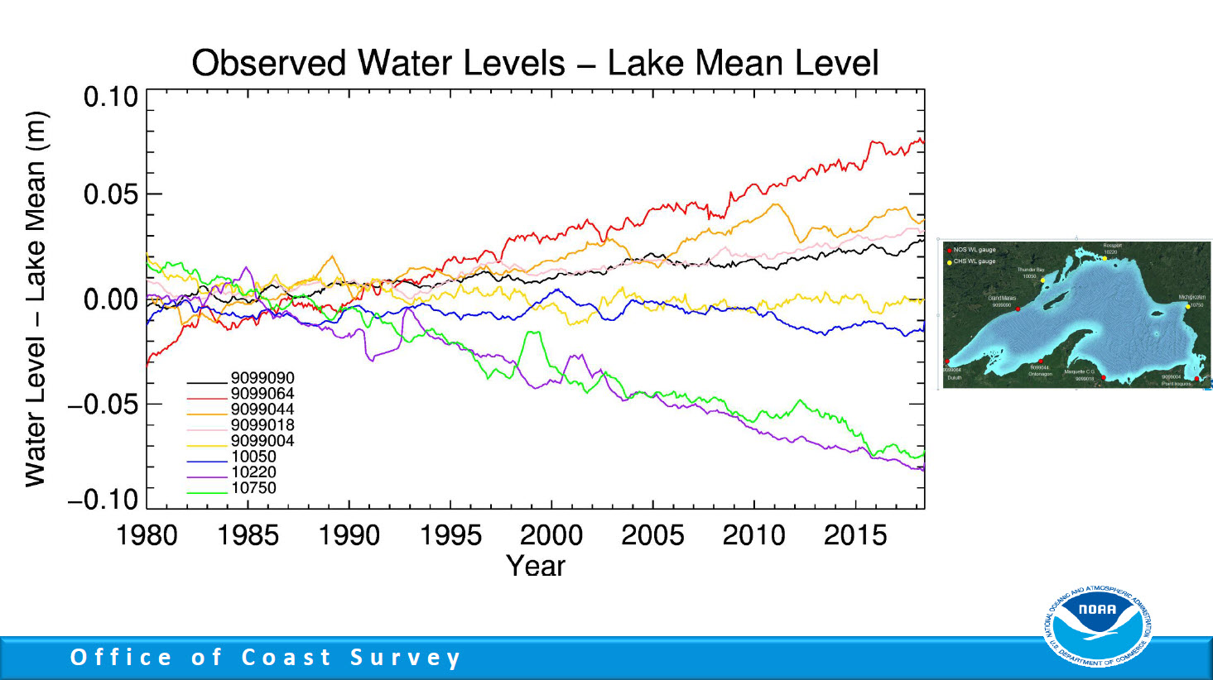
Notes:
Upgrade of NOS Lake Superior Operational Forecast System
Hindcast Skill Assessment Results
John G.W. Kelley, Eric Anderson, Yi Chen, and Greg Lang
NOAA/NOS/CSDL/CMMB and NOAA/GLERL
April

Slide 8
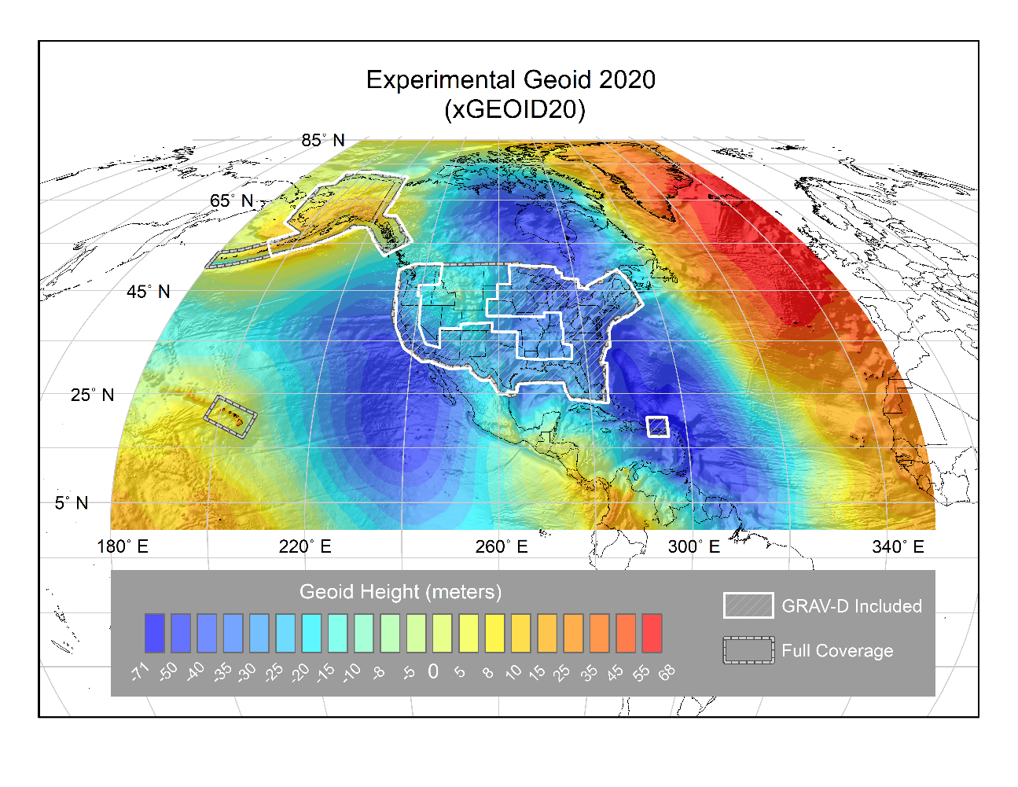
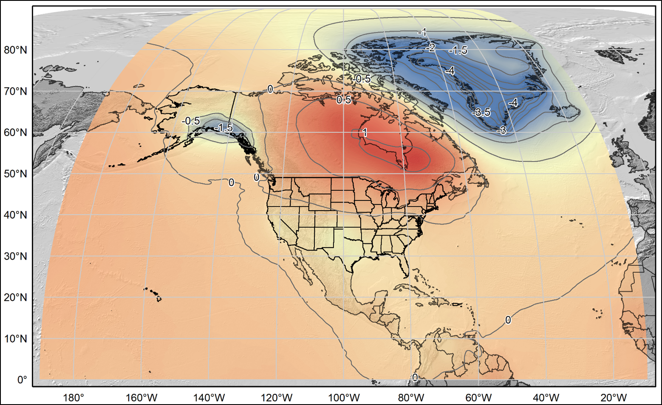
Solution: NAPGD 2022 (Static and Dynamic)
xGEOID20: Gravimetric Geoid in a series leading to NAPGD 2022 (epoch 2020.0)
xDGEOID19: Alpha model based on secular trend from GRACE
From NASA GSFC mascon v02.4, Luthcke, et al. 2013
Units: mm/yr. Contour Interval: 0.5 mm/yr
Notes:
NAPGD 2022 should resolve issues regarding both the datum defect and time varying aspects. The ties to global gravity field models will ensure the long wavelength trends. Local gravity and aerogravity will resolve smaller features. The DGEOID2022 will resolve the variation through time from GIA.

Slide 9
Detrended Long Term NWLON Series

Slide 10
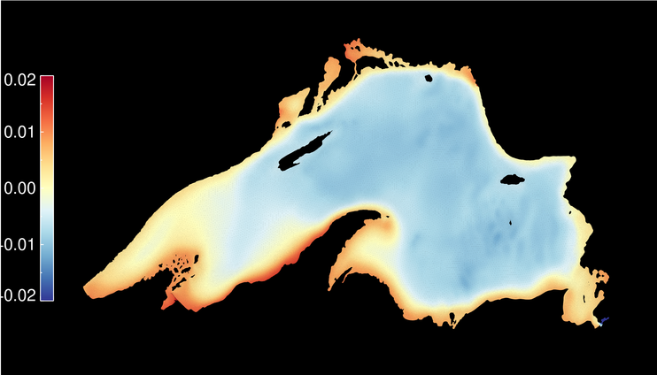
Color contours of Lake topography for all of 2017
183.633
0.433
From Eric Anderson, GLERL (2020).
Low Water Datum (LWD) for Lake Superior is 183.2 m in IGLD 85
Summer means are given at eight stations
183.631
0.431
183.630
0.430
183.637
0.437
Meters
183.627
0.427
183.640
0.440
183.639
0.439
183.640
0.440
Notes:
Water run-up do wind and currents – Lake water topography. There is only a few cm drop off from the West and very North down to the Southeast.
This all internally consistent. However, this doesn’t solve the problem of absolute accuracy.
IGLD 85 was based on (flawed) leveling that we cannot afford to repeat.
Hence, a geopotential model must be used to obtain the external positioning no longer available through leveling and adjustments.

Slide 11
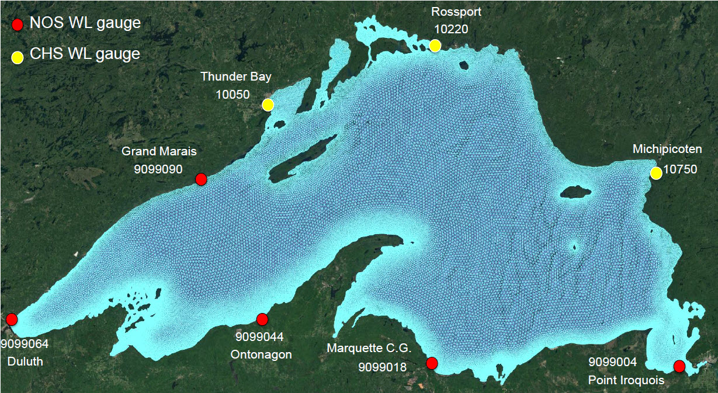
Comparison of Geopotential Heights
Values from xGEOID20B including aerogravity
Ortho Ht (H) from ellips. ht (h) minus Geoid Ht (N): H = h – N
Dynamic Ht from Geop. Numbers (C)
Based on datum of 62,636,856.0 m²/s²
182.864
182.869
183.184
183.193
182.752
182.778
182.811
182.839
182.974
182.990
Notes:
Geoid Heights and Dynamic Heights determined from the xGEOID20B model, which includes aerogravity over Lake Superior
Orthometric Heights aren’t ideal for determining water flow, because they vary based on local gravity
Whereas Dynamic Heights are more useful because they scale the geopotential surface into meters. Water conforms to the lowest geopotential surface
A flat lake, ideally has the same geopotential everywhere. The slight tilt seen in the water topography indicates that the water does drain from the Lake
However, what is needed are absolute values for the heights measured from Geodesy.
For the Orthometric Heights in red
North South tilts are about 5 cm between Grand Marais and Ontonagon are consistent with those seen in altimeter profiles
From West to East, the tilt is uphill by 42 cm. Seemingly very unlikely.
Likewise for the Dynamic Heights in blue:
North South tilt is still about 5 cm and the East West tilt is also about 42 cm
There is a marginal improvement in the dynamic heights with STDev. reducing from 17 to 16 cm RMSE.
The East-West tilt is 64 cm. Again up from West to East and seemingly unlikely.

Slide 12
Summary
IGLD 85 => IGLD 2020
Correcting for datum defect of NAVD 88
Correcting for GIA signal over 40 years
Lake surface may indicate new HC =>
Significant tilting occurs (42 cm) E-W
Source of this is yet unresolved
Daniel Roman
dan.roman@noaa.gov
https://geodesy.noaa.gov/
Acknowledgements:
Eric Anderson, Yi Chen, John Kelley,
Jeff Oyler, Dana Caccamise, Jacob Heck
GLERL/CO-OPS/NGS

