Slide 1

GRAV-D and the New Datums:
Coming Your Way in 2022!
Vicki Childers, Ph.D., GRAV-D Project Manager
Theresa Damiani, Ph.D, Airborne Scientist
National Geodetic Survey (NGS)

Slide 2
Agenda
  NGS and Modernizing the Nation’s Datums
  The GRAV-D project
  Impact on Surveying
    Implementation of Datum
    How you will (probably) use it
    How you can prepare now

Slide 3

NGS Mission Statement
To define, maintain and provide access to the National Spatial Reference System (NSRS) to meet our nation’s economic, social, and environmental needs.
The NSRS is a consistent coordinate system that defines latitude, longitude, height, scale, gravity, and orientation throughout the United States.

Slide 4
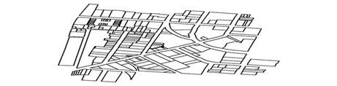
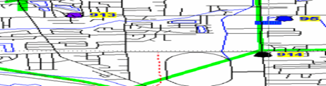
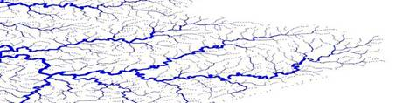
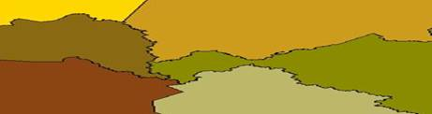
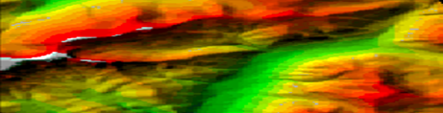

NSRS Provides the Geospatial Foundation
Land Ownership
Transportation
Surface Waters
Boundaries
Elevation
Aerial Imagery
Geodetic Control

Slide 5






The National Spatial Reference System supports
Nautical charts, among many other geospatial applications
National Oceanic and Atmospheric Administration
Emergency Response Imagery, Flood zones for the
National Flood Insurance Program
Federal Emergency Management Agency
Levee Safety Program to determine levee heights & positions
United States Army Corps of Engineers
Topographic Maps and interior water data for the nation
United States Geological Survey
NSRS gravity data for the geospatial mission of NGA
National Geospatial-Intelligence Agency
Aeronautical Data Quality Assurance
Federal Aviation Administration

Slide 6

Federal Geographic Data Committee
Promotes the coordinated development, use, sharing and dissemination of geospatial data nationally
NGS is the lead agency responsible for coordinating geodetic data-related activities among Fed and non-Fed agencies

Slide 7
Geodetic Datums
  Horizontal
  2-D (Latitude and Longitude) (e.g. NAD 27, NAD 83 (1986))
  Vertical/Geopotential
  1-D (Orthometric/Dynamic Height) (e.g. NGVD 29, NAVD 88, IGLD 85)
  Geometric
  3-D (Latitude, Longitude and Ellipsoid Height)
  Fixed and Stable(?) - Coordinates seldom change
  (e.g. NAD 83 (1993), NAD 83 (2007), NAD 83 (2011))
  also
  4-D (Latitude, Longitude, Ellipsoid Height, Velocities)
  Coordinates change with time
  (e.g. NAD 83, ITRF00, ITRF05)

Slide 8

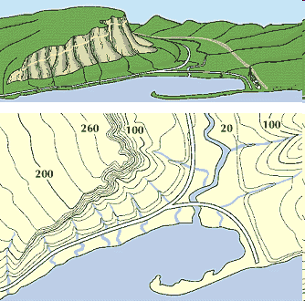
What is a Vertical Datum?
Surface representing zero elevation
System: how are heights determined above the zero elevation surface
Vertical datum must have:
  A definition: parameters
  A realization: how you access it
"topographic map." Online Art.
Britannica Student Encyclopædia.
17 Dec. 2008
<http://student.britannica.com/ebi/art-53199>

Slide 9
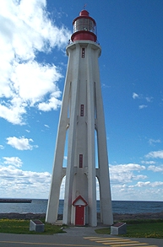
NAVD 88: Current Vertical Datum
NAVD 88: North American Vertical Datum of 1988
  The surface of equal gravity potential to which orthometric heights shall refer in the US
How Defined:
  Massive leveling and gravity campaign across the country in the 1980’s yielded measurements at >500,000 benchmarks
  Minimally constrained adjustment of level/grav data, holding geopotential value fixed at one point: 6.271 meters (along the plumb line) below the geodetic mark at “Father Point/Rimouski” (NGSIDB PID TY5255)
Realization:
  NAVD 88 is only defined at these benchmarks.
Father Point Lighthouse, Quebec
Notes:
By fixing the geopotential value at the origin point, it was possible to ensure that the origins of IGLD 85 and NAVD 88 aligned.
*It should be pointed out that while the datum was defined in such a way as to be usable on the North American continent, it was never actually adopted in Canada. It can be used there, but it’s not their official civilian datum.
Note that the designation of the vertical control point at Father Point is “1250 G=NAVD 88 DATUM POINT” for PID# TY5255 and is not available from the publicly accessible NGSIDB.

Slide 10
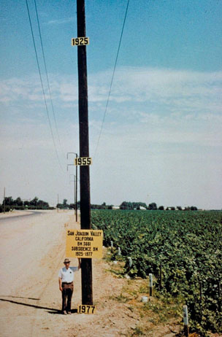
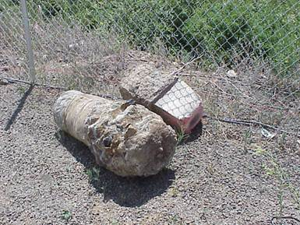
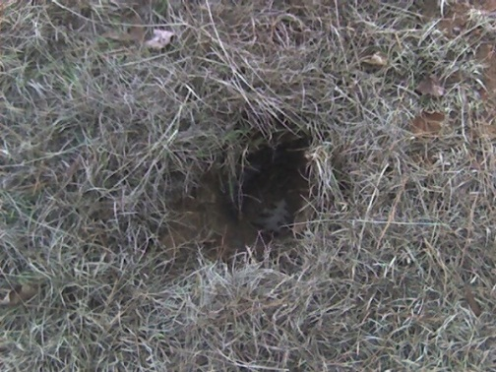
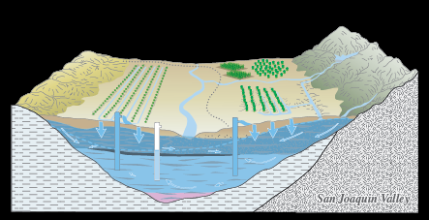
Bench Marks
NAVD 88 is defined at bench marks that:
  Were determined by leveling from a single point, allowing cross-country error build up
  Are not always conveniently located
  Disappear by the thousands every year
  Are not funded for replacement
  Are rarely re-checked for movement
  Don’t exist in most of Alaska
PID: EZ0840
Notes:
Clarification on the word “convenient” – this is used to mean “there isn’t always a bench mark around when you need one – sometimes you have to find one far away and level from it to your site of interest”

Slide 11
Subsidence and Bench Mark Height
1954: Leveling Performed
to bench mark
House
1954-1991: Subsidence
House
BM
BM
1991: Published NAVD 88 height for this BM is from 1954 leveling
H₈₈(published)
H₈₈(true)
NAVD 88 zero height surface
The published NAVD 88 height is no longer the true height for this BM

Slide 12
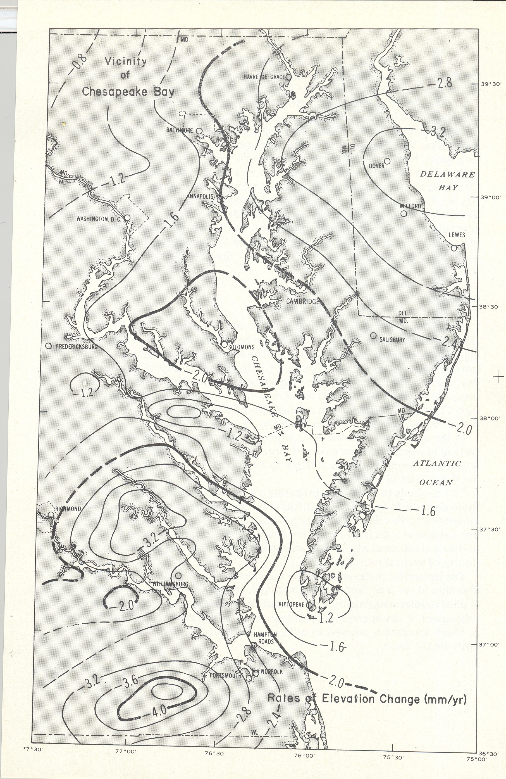
Subsidence in the area of Chesapeake Bay
1973 Report by S. Holdhal and N. Morrison
Rates of Elevation
Change (mm/yr)
IGS08
Vertical Velocity at Selected CORS
BACO = - 0.0032*
CORB = - 0.0010
GODE = - 0.0011
GAIT = - 0.0004
ANP6 = - 0.0016
VAGP = - 0.0027
HNPT = - 0.0024
VAWI = - 0.0043*
VIMS = - 0.0034*
DRV6 = - 0.0033
COVX = - 0.0016
* = Differs by more than 1 mm from
1973 estimates

Slide 13
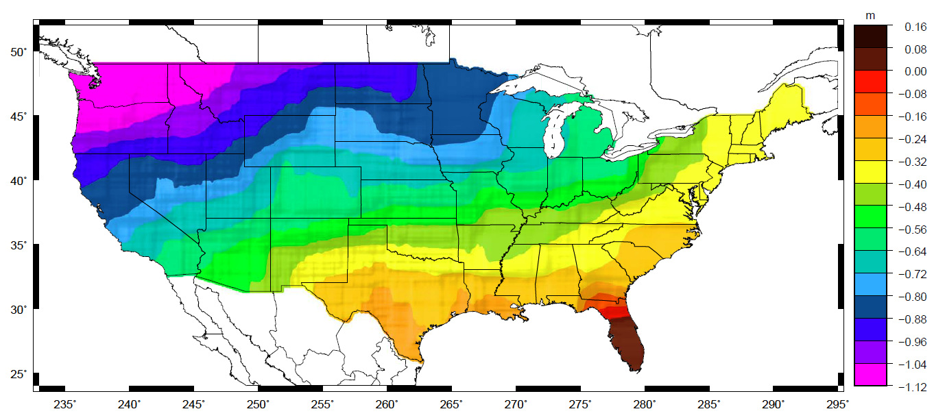
NAVD 88 Problems
Approximate mismatch between NAVD 88
(zero surface) and the global geoid (i.e. sea level)
Notes:
This map reflects the sort of height changes that users could expect if NAVD 88 were replaced with a geoid-based vertical datum.
This is only a large scale approximation and should not be used as an absolute guide. Each benchmark might have its own level
Of mismatch, say from uplift or subsidence, not captured by this broad brush.
Also, this is the difference between the zero level of NAVD 88 and the actual geoid. The difference between NAD 83 ellipsoid heights and
ITRF/GRS-80 ellipsoid heights has NO influence on this graph and should not be part of the story.
Updated October 2010

Slide 14
Simplified Concept of NAD 83 vs. ITRF/IGS
h_{NAD83}
h_{ITRF/IGS}
Earth’s
Surface
Millsboro, DE - DEMI
dX = - 0.683 m
dY = + 1.471 m
dZ = + 0.099 m
3D = 1.622 m
~ 1.54 m +/- 0.19 m CONUS
~ 1.41 m +/- 0.11 m AK
~ 1.92 m +/- 0.01 m PR & VI
~ 2.46 m +/- 0.02 m HI
~ 3.11 m AS
~ 2.30 m +/- 0.09 m GU & NM
ITRF/IGS
Origin
NAD 83
Origin
Identically shaped ellipsoids (GRS-80)
a = 6,378,137.000 meters (semi-major axis)
1/f = 298.25722210088 (flattening)
Notes:
ITRF (International Terrestrial Reference Frame) just has an origin; take NAD83 shaped ellipsoid centered at the ITRF origin to derive ITRF97 ellipsoid heights.
Ellipsoid heights NAD83 vs. ITRF97 - Defined origins are best estimate of the center of mass; NAD83 is not geocentric. Move origin; move ellipsoid surface as illustrated.
Ellipsoid height differences reflect the non-geocentricity of NAD83.

Slide 15

International Gold Standard
International Earth Rotation and Reference System Service (IERS)
Established 1987
Office in Paris, France
Produces the International Terrestrial Reference System
And
International Terrestrial Reference Frame
First ITRF – 1988
Latest ITRF - 2008

Slide 16
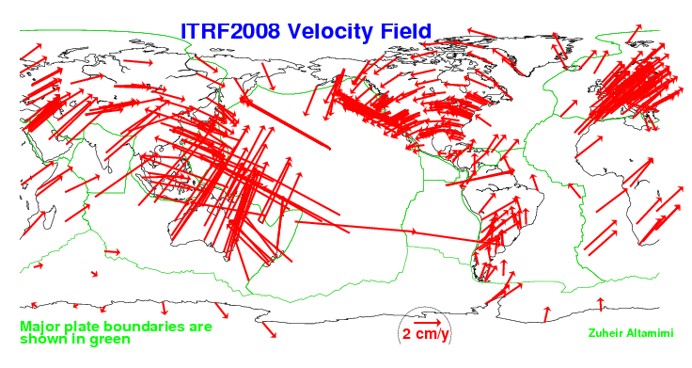
Tectonic Plate Velocities
northward = 0.0020 m/yr
IGS08 Velocities Millsboro, DE
DEMI
N = 0.0045 m/yr
E = - 0.0144 m/yr
U = - 0.0001 m/yr
Major plate boundaries are shown in green

Slide 17
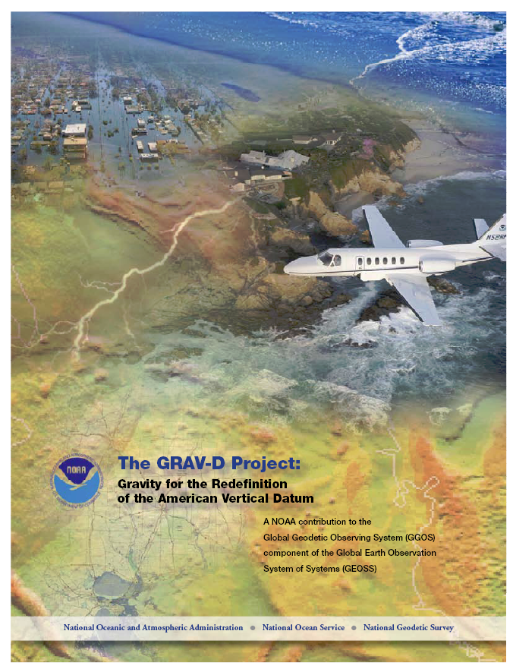
The GRAV-D Project
Gravity for the Redefinition of the American Vertical Datum
Official NGS policy as of Nov 14, 2007
  Airborne Gravity Snapshot
  Absolute Gravity Tracking
Re-define the Vertical Datum of the USA by 2022
  $38.5M projected over 10 years
35% Complete as of 2-28-14

Slide 18
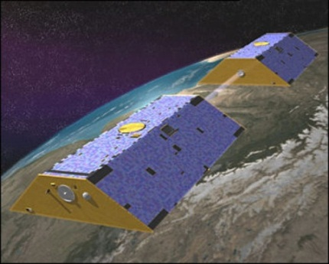
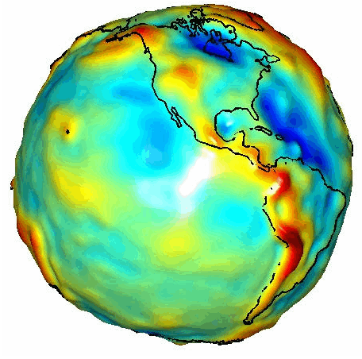
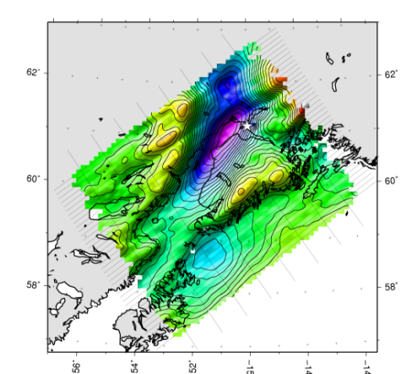

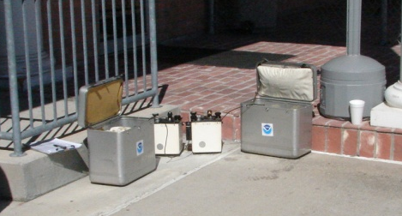
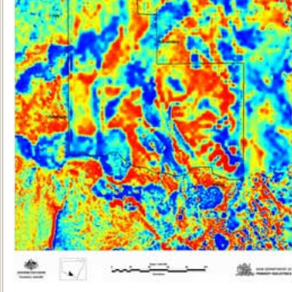
Building a Gravity Field
Long Wavelengths
(≥ 250 km)
GRACE/GOCE/Satellite Altimetry
+
Intermediate Wavelengths
(500 km to 20 km)
Airborne Measurement
+
Short Wavelengths
(< 100 km)
Surface Measurement and
Predicted Gravity from Topography

Slide 19
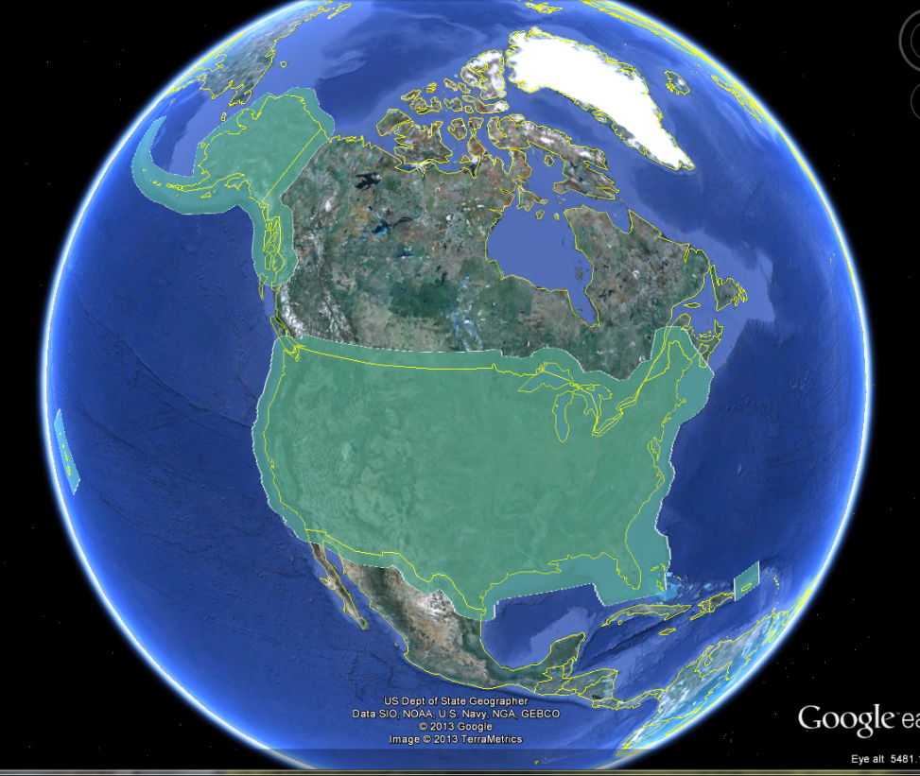
GRAV-D Coverage Area:
CONUS & Alaska
Notes:
Let’s look more closely at the area that must be covered by the GRAV-D airborne survey. The green polygon shows: 1) States and territories, 2) Shallow water areas to the shelf break, 3) 150 km into Canada and Mexico.

Slide 20
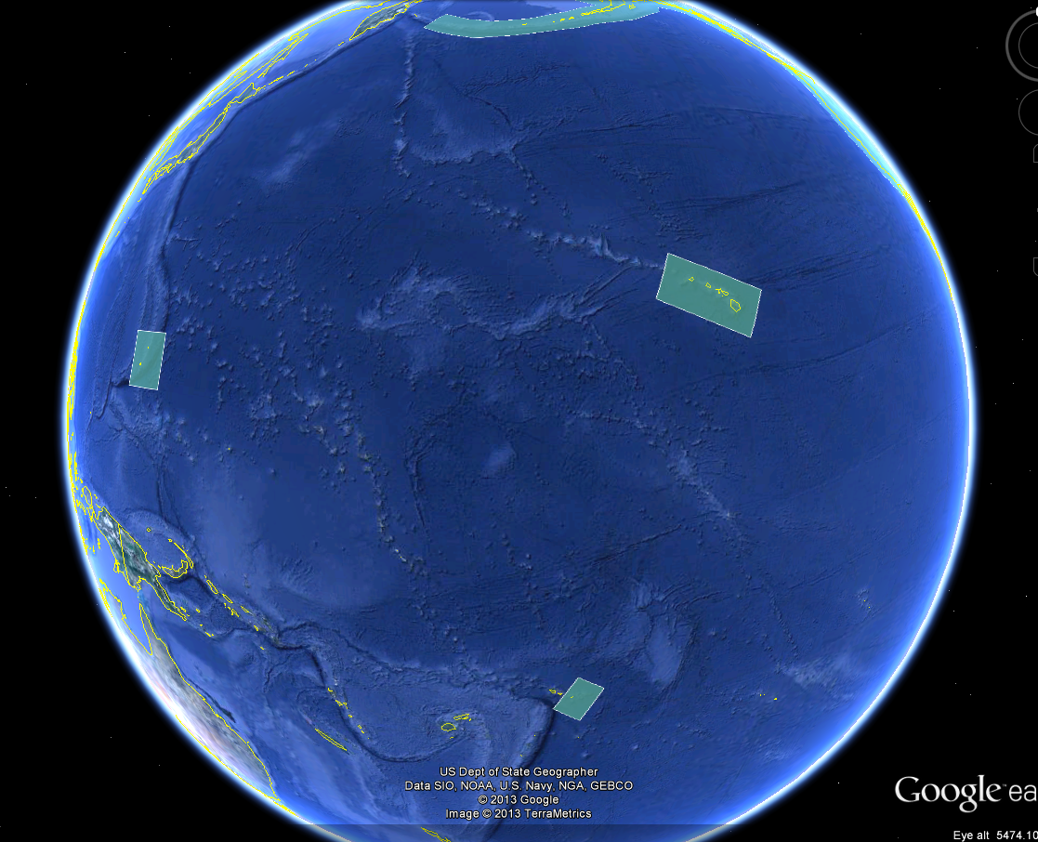
GRAV-D Coverage Area:
Pacific Islands
Notes:
4) For pacific island surveys, the minimum dimension of the surveys is 300-500 km on a side. We always strive to have a block large enough to provide sufficient spectral overlap with the GRACE mission gravity field.

Slide 21
Priority Order for Surveys
Greatest Datum Needs
Other Variables to Consider
Alaska
Coastal US & Great Lakes
Hawaii & Pacific Islands
Aleutians
Interior CONUS
  Mountains first
Need to meet GPRA Objective
Aircraft availability and capability
Appropriate season for measurement
Contract fuel availability
Notes:
NGS evaluated the US and all of its territories and established a priority order according to the where the datum is in greatest need of repair. Alaska has the biggest need, so tops the list. Next in priority are the coastal regions of the US and the Great Lakes. Then the Hawaiian and Pacific Islands, the Aleutians, and then interior CONUS. The mountainous regions have the greatest geoid errors and will get our first attention. The actual order we fly the surveys is also informed by the availability of aircraft, the appropriate seasons for measurement, the availability of government contract fuel, and the coordination of logistical constraints so as to most efficiently use our resources.

Slide 22
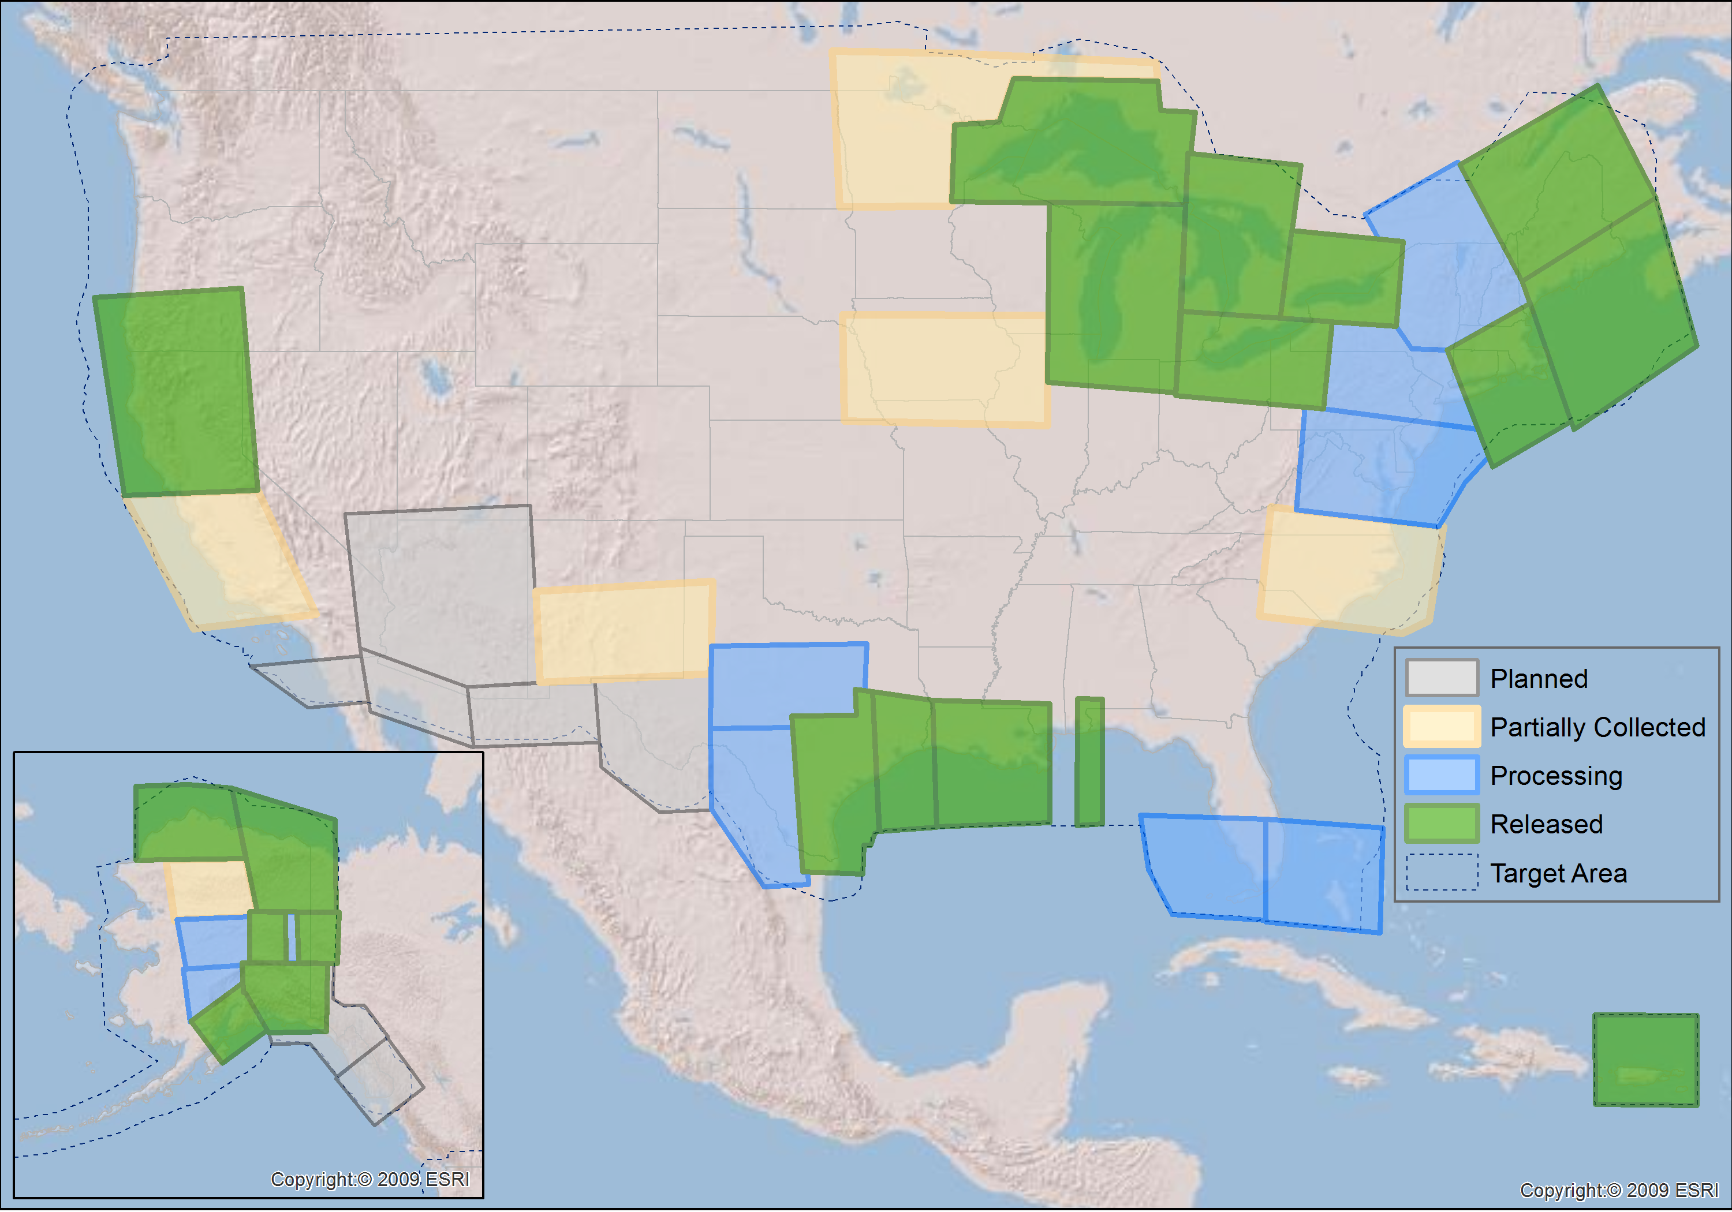
GRAV-D Status 2-28-14: 34%

Slide 23
GPRA* Performance Metric
For Airborne Surveys
FY09 Baseline | Targets vs Actual
 | FY10 | FY11 | FY12 | FY13 | FY14 | FY15 | FY16 | FY17 | FY18 | FY19 | FY20 | FY21 | FY22
6.14% | 7.5% | 12% | 20% | 28% | 36% | 44% | 52% | 60% | 68% | 76% | 84% | 92% | 100% and Implement
6.14 | 7.8 | 14.7 | 23.9 | 31%
Measure: Percentage of the U.S. and its territories with GRAV-D data available
to support a 1 cm geoid supporting 2 cm orthometric heights.
*GPRA = Government Performance and Results Act of 1993
Notes:
We’ve set up a basic GIS GPRA monitoring in the War Room. We will report the coordinates of our survey monthly and they will calculate our percentages.

Slide 24
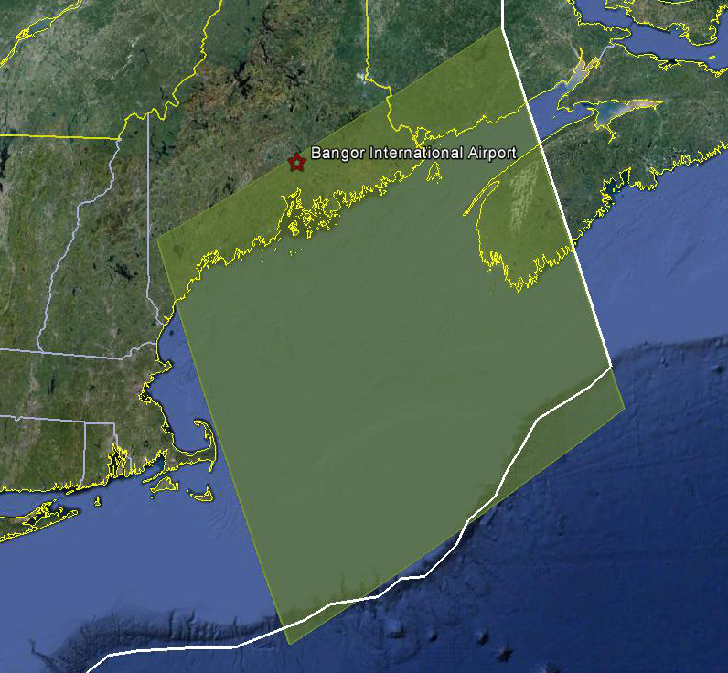
Survey and Block Plans
Layout rectangular survey 400 x 500 km
Extends beyond the shelf break
Block size will reflect the endurance of the aircraft
Notes:
Size of survey based on aircraft legs (how far it can go)
Location dependent on aircraft (over water?), in this case only a 2 engine aircraft

Slide 25
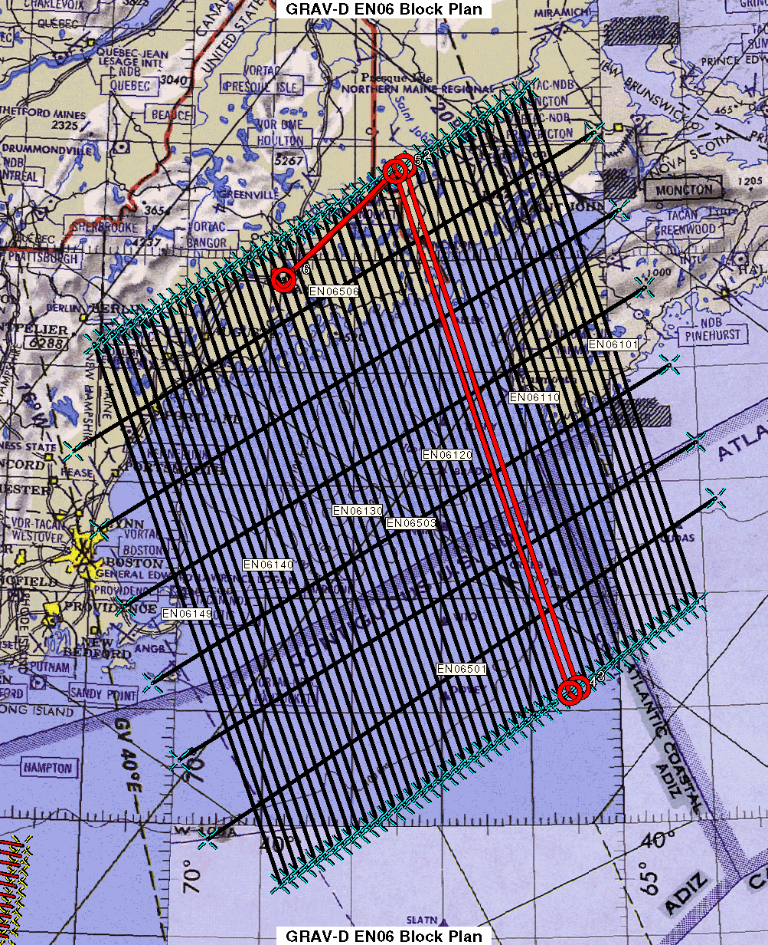
Survey and Block Plans
Data lines spaced 10 km apart
Cross lines spaced 60-80 km apart
Flight altitude 20,000 ft
Nominal speed 220-250 kts
Notes:
Block layout based on aircraft, adjust size of block if needed

Slide 26
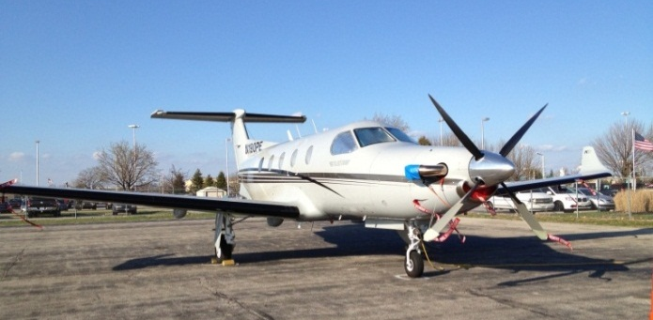



GRAV-D Aircraft
DOI Bureau of Land Management
  Pilatus PC-12
Fugro
  King Air E-90A
  Cessna Conquest
Naval Research Lab
  King Air RC-12
NOAA
  Gulfstream Jet Prop
  NOAA P-3 Hurricane Hunter
Pilatus PC-12
King Air E-90A
King Air RC-12
Notes:
GRAV-D surveys have been operating on a number of aircraft. In order to accomplish our objectives within budget, we utilize a “portfolio” of aircraft of both government and contract origin. We’ve used the NOAA Jet Prop and the P-3, although little opportunity exists for further use of these aircraft. We operate about five months/year aboard the BLM Pilatus PC-12 aircraft. This aircraft is used for fire-spotting during warmer weather months in AK and the western US. This year we began working with Fugro to provide us aircraft services. We plan also to work this year with the Naval Research Lab and the VXS-1 Navy Squadron aboard their RC-12 King Air aircraft.

Slide 27
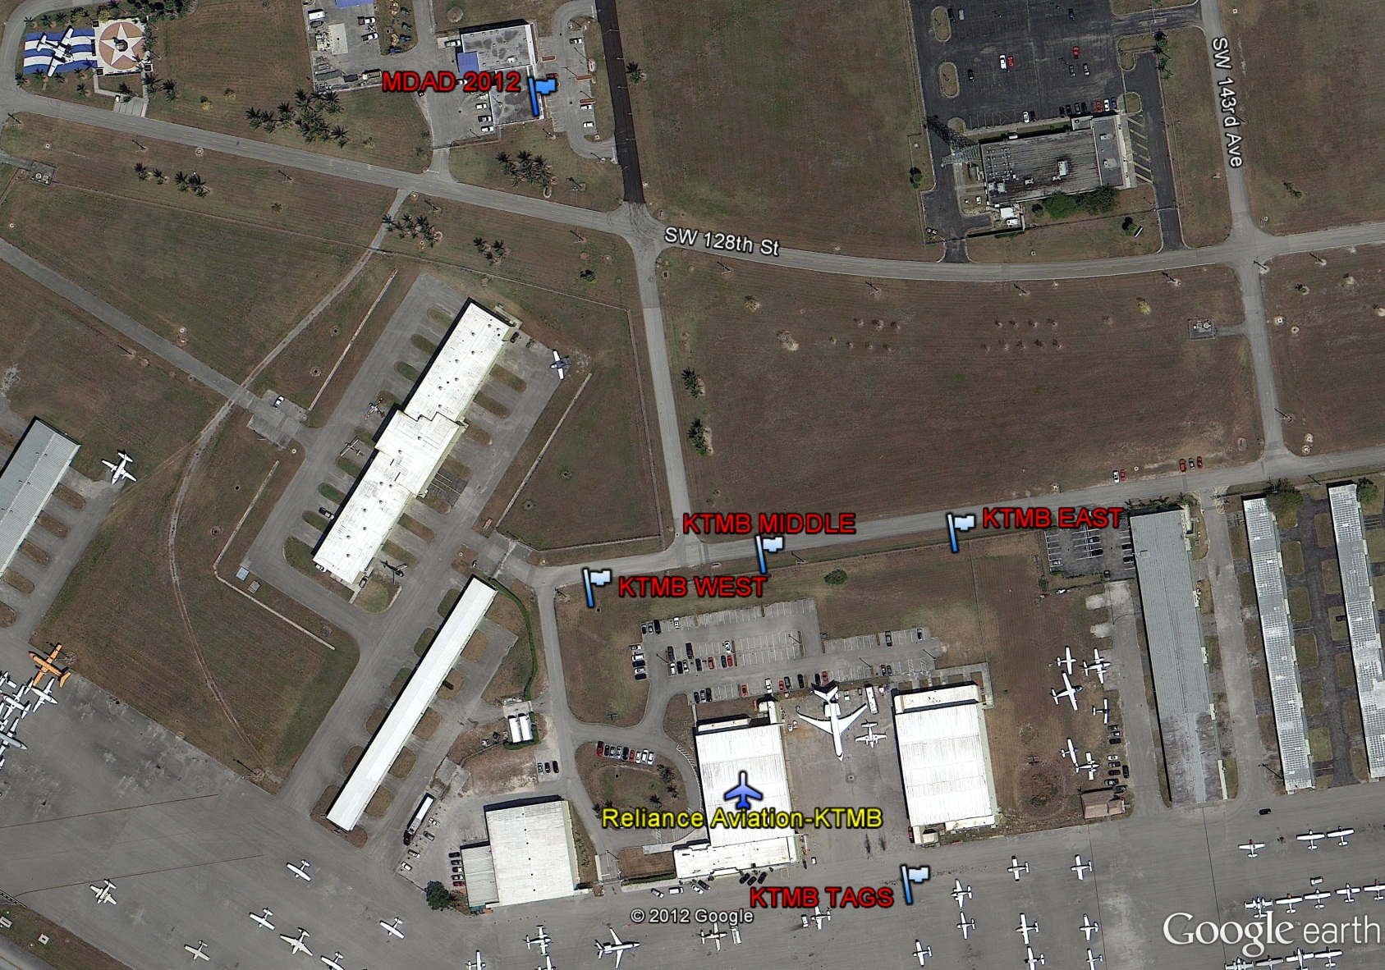
Reconnaissance Survey
Absolute Gravity
Station
GPS Base Stations
Parking Space
Gravity Tie

Slide 28
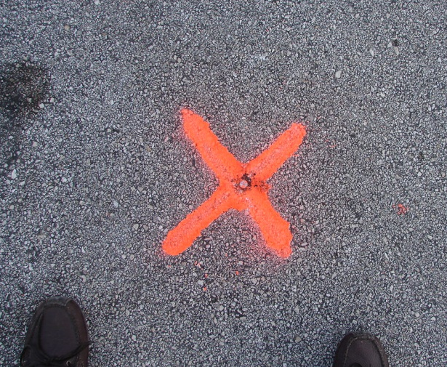
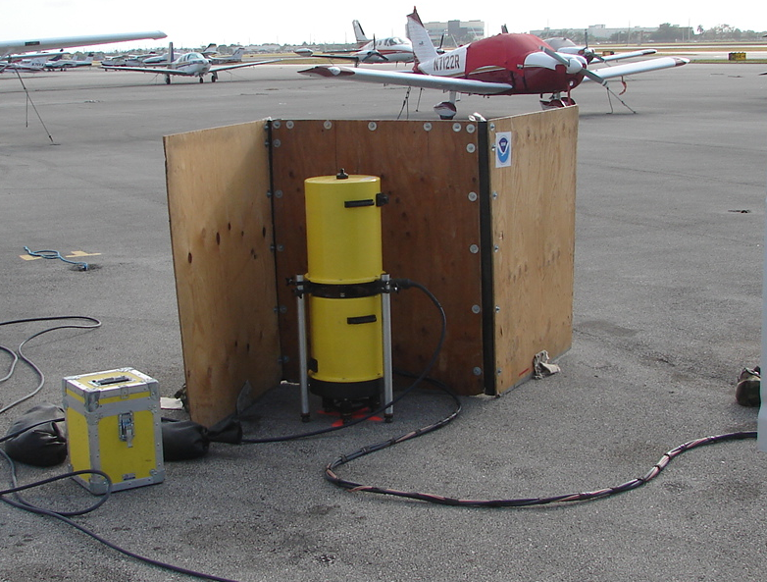
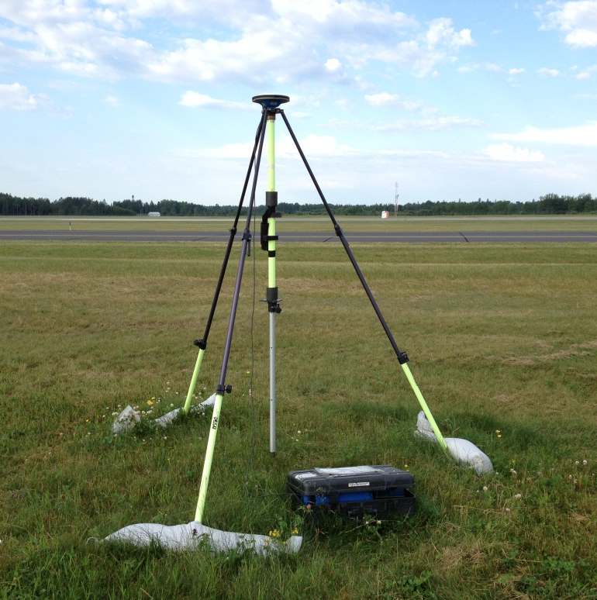
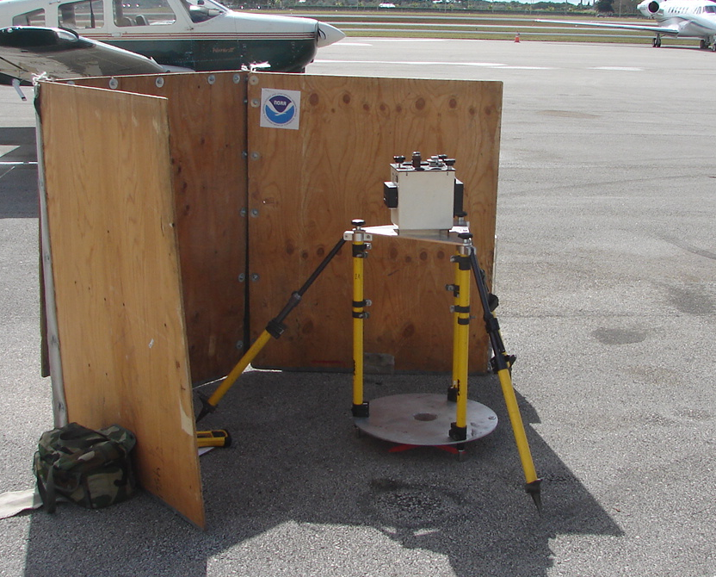
Gravity Tie and GPS Base Stations
Parking spot ID
A10 measurement
GPS Base Stations
Vertical gravity gradient

Slide 29
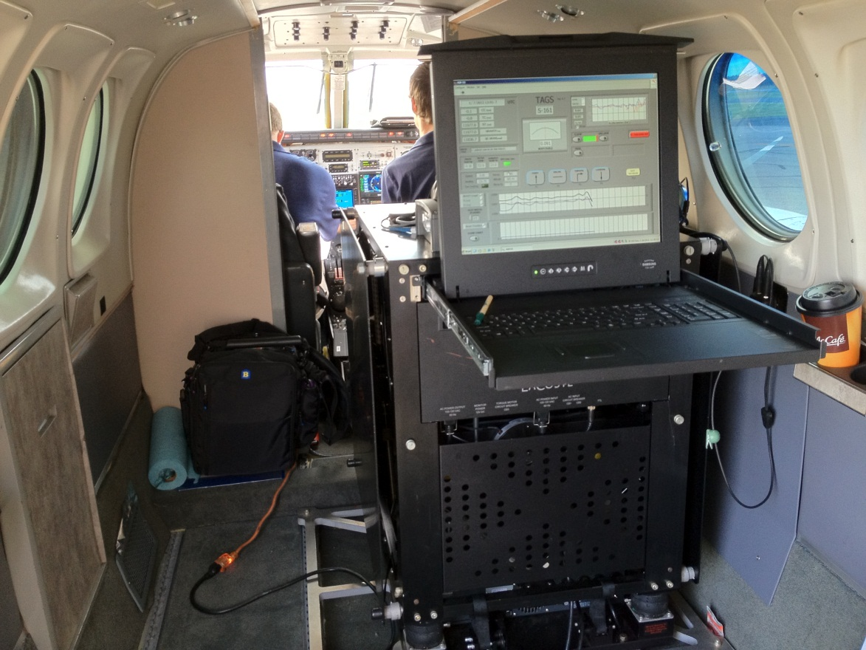
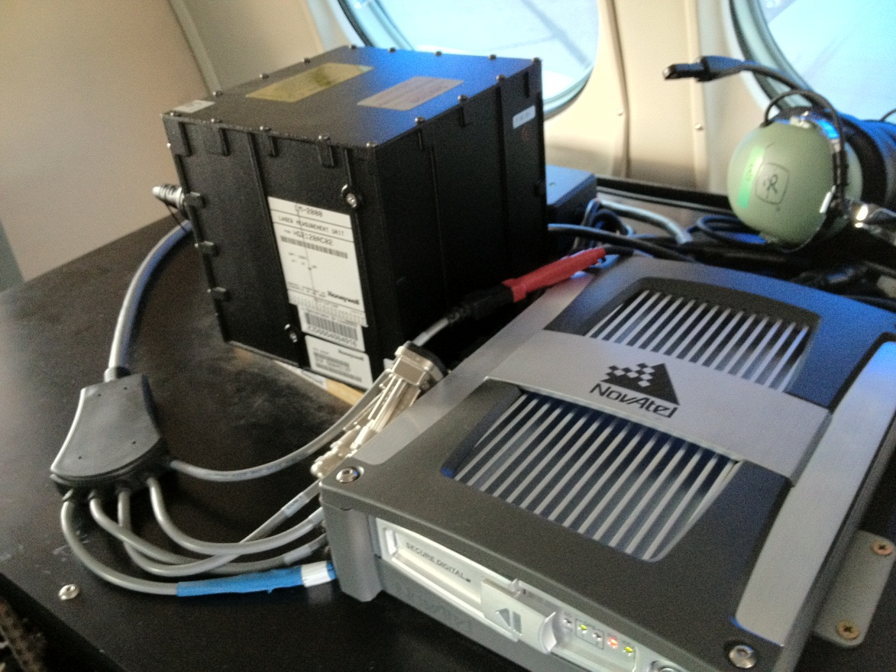
GRAV-D Instrumentation
Micro-g LaCoste
TAGS Gravimeter
NovAtel SPAN-SE
w/ Honeywell µIRS IMU
Both instruments include GNSS receivers
SPAN system allows for tightly coupled GPS/IMU solutions

Slide 30
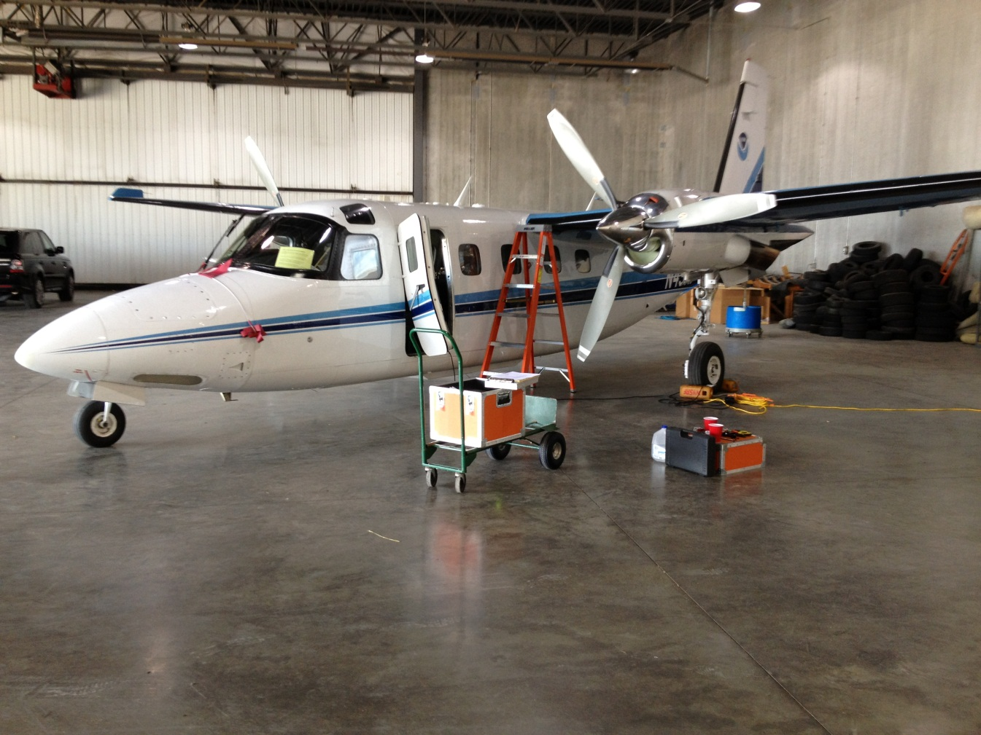
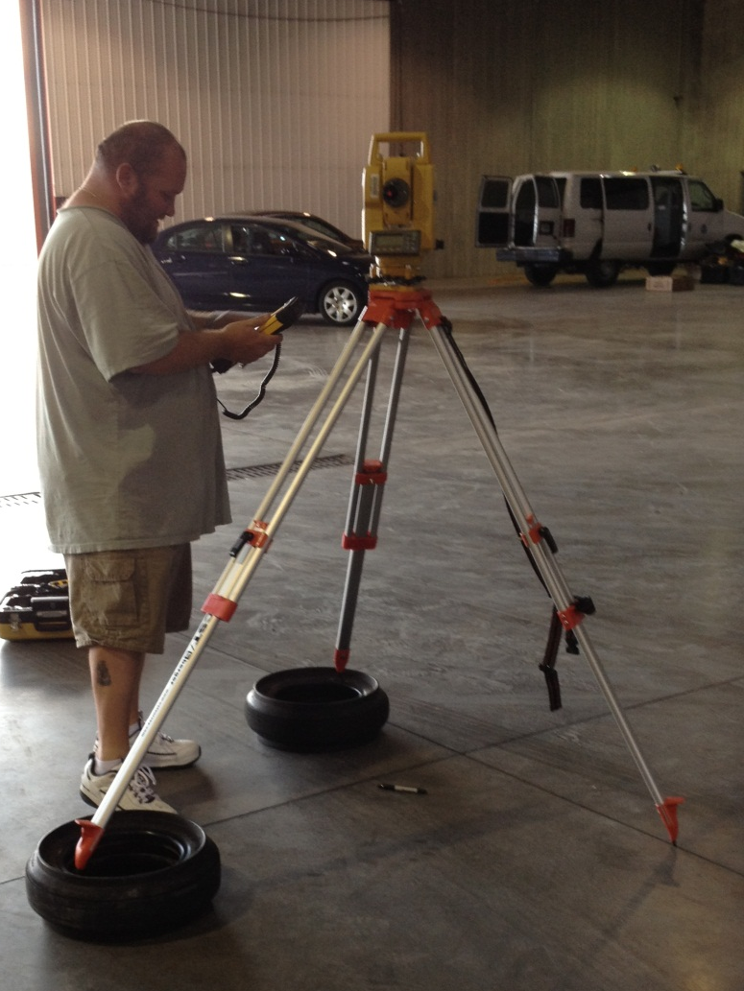
Instrument Installation
Instrument suite installed
Lever arm survey required
Test flight performed

Slide 31
Data Collection and Field Data QC
Goal is two flights per day when/if:
  Weather/atmosphere is calm (TAGS cannot tolerate turbulence)
  Instruments and aircraft are in working order
  Good GPS geometry
  Military airspaces are not “hot”
  We have the operators/pilots to support two flights per day

Slide 32
Data Collection and QC
Data are evaluated to verify instrument performance and data quality
OBJECTIVE: Identify ASAP lines that must be reflown

Slide 33
Data Handling
Complete metadata logs daily and survey report written
Ship the data back to HQ for final processing
GPS/Gravity data reprocessed at HQ with precise orbits
Released to the public via the GRAV-D website
Released to the geoid team
Lake Huron survey

Slide 34
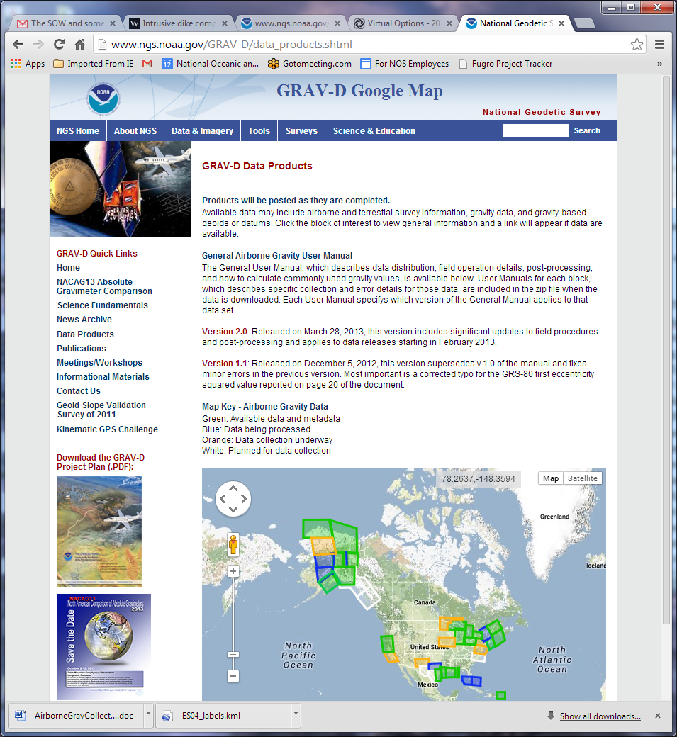
GRAV-D Website
http://www.ngs.noaa.gov/GRAV-D

Slide 35
Creation of New Geoid
The gravity data from satellites, airborne, corrected surface data, and terrain predictions will be blended into a gravity field
As regions are completed, “beta” preliminary geoids will be created and released to the public for local testing
Create a gravimetric geoid that will be the basis of the new vertical datum

Slide 36
New Datums Released
In 2022, the new geometric datum and the new vertical (geopotential) datum will be released
The realization of the new datums will be through GNSS receivers

Slide 37
Part 3: Impact on Surveying

Slide 38
NEW VERTICAL DATUM
(Components)
Design and adopt new geometric reference frame (Geometric Datum Project)
Realize new geometric datum with existing passive/active control, i.e., a horizontal (geometric) adjustment
Definition of the W₀ surface as the new datum reference surface
Build a gravimetric geoid with an overall accuracy of 1 cm (GRAV-D Project)
Make orthometric heights easily available

Slide 39
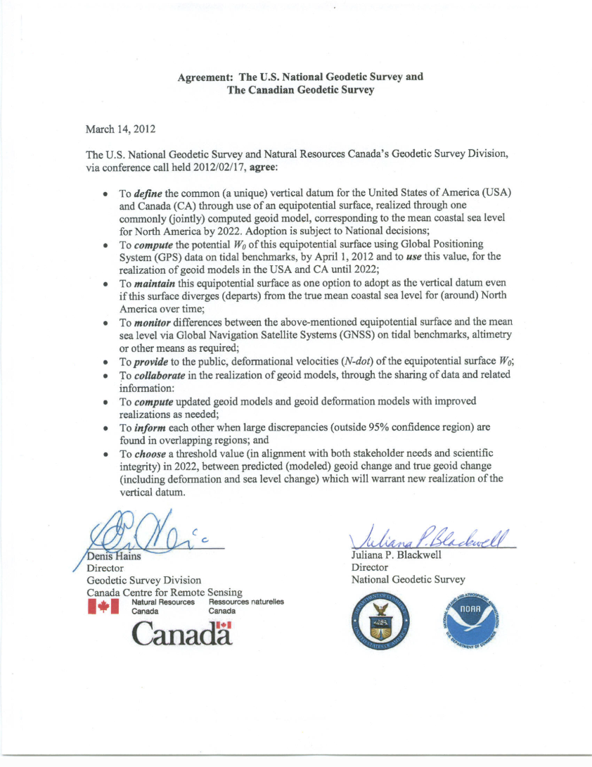
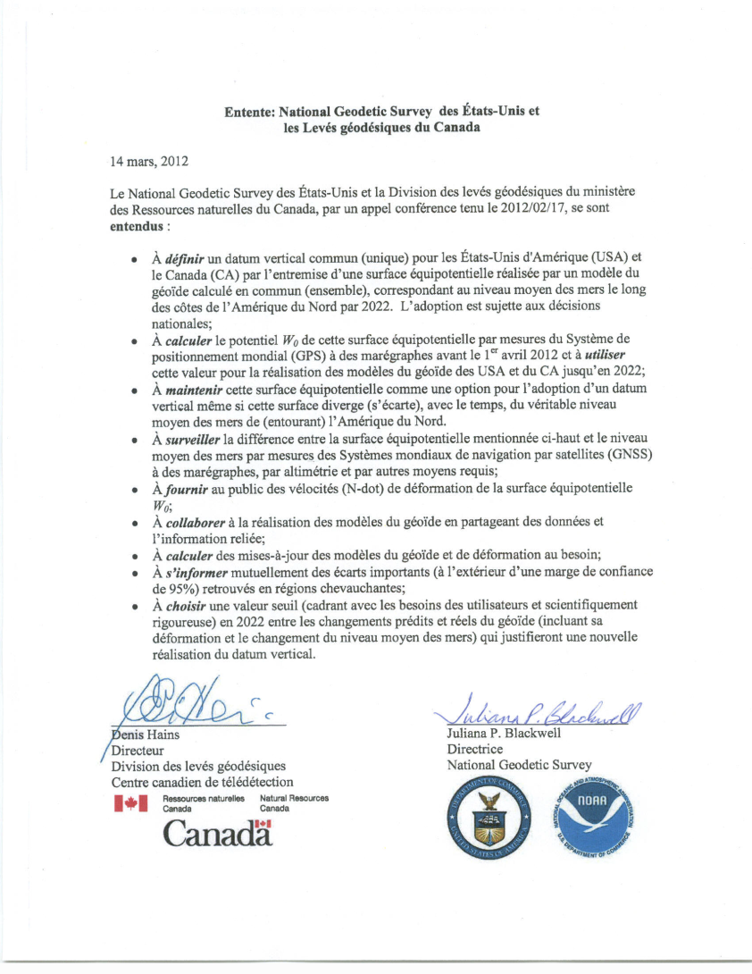
Agreement on W₀ Value

Slide 40
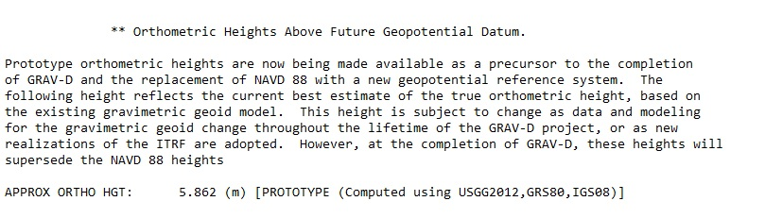
Orthometric Heights from OPUS
Make geoid-based orthometric heights available via OPUS (NGS’ Online Positioning User Service)
  Done, in extended output

Slide 41
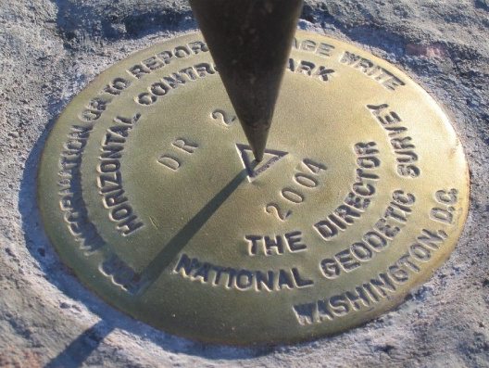
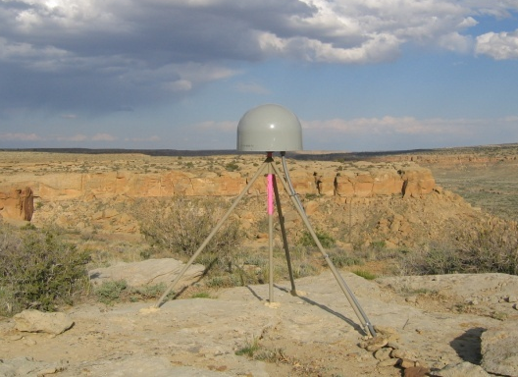
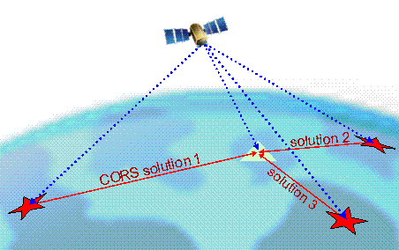
Online Positioning User Service (OPUS)
>15 min of L1/L2 GPS data >>> www.ngs.noaa.gov/OPUS
Processed automatically on NGS computers
Solution via email - in minutes
Fast, easy, consistent access to NSRS

Slide 42
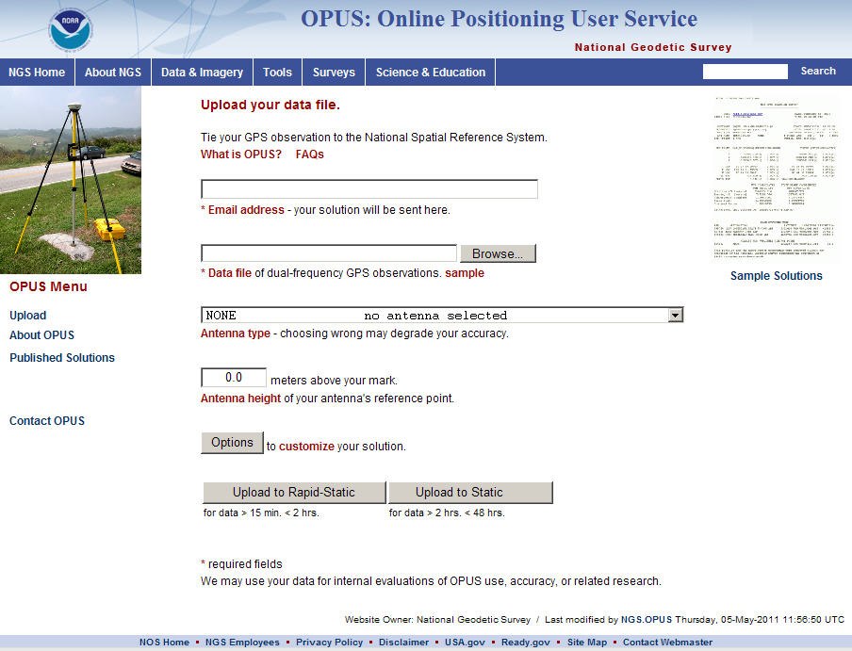
e-mail
GPS file
antenna
antenna height
(OPTIONS)
OPUS-RS or OPUS-Static
(15 min-2 hr) (2-48 hr)

Slide 43
Experimental Models
Annually update an experimental gravimetric geoid with GRAV-D data
  Evolution as we move
    from USGG2012 (last non-GRAV-D gravimetric geoid)
    through xGG201? (annual experimental geoid)
    to USGG2022 (the final geoid with GRAV-D)
  Starting 2014: National Ocean Service Requirement

Slide 44
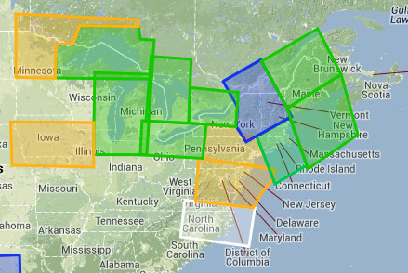
xGG2014
  First experimental geoid model likely to be available this summer
  Online tools for accessing it (GRAV-D website)
  Will include GRAV-D data over the Great Lakes and Northeast, possibly the mid-Atlantic
-
+
+
+ Will be included
? May be included
- Not included
+
+
+
+
+
-
+
+
+
+
?

Slide 45
How much will heights change?
How much will NSRS ellipsoid height change?
  Geometric Datum will be aligned to ITRF
  Approx -1.9 m (Puerto Rico) to +2.0 m (Guam)
How much will NSRS CONUS orthometric height change?
  Approx +0.1 m (Florida) to -1.3 m (Washington)
  More than 2 meters of change in Alaska

Slide 46
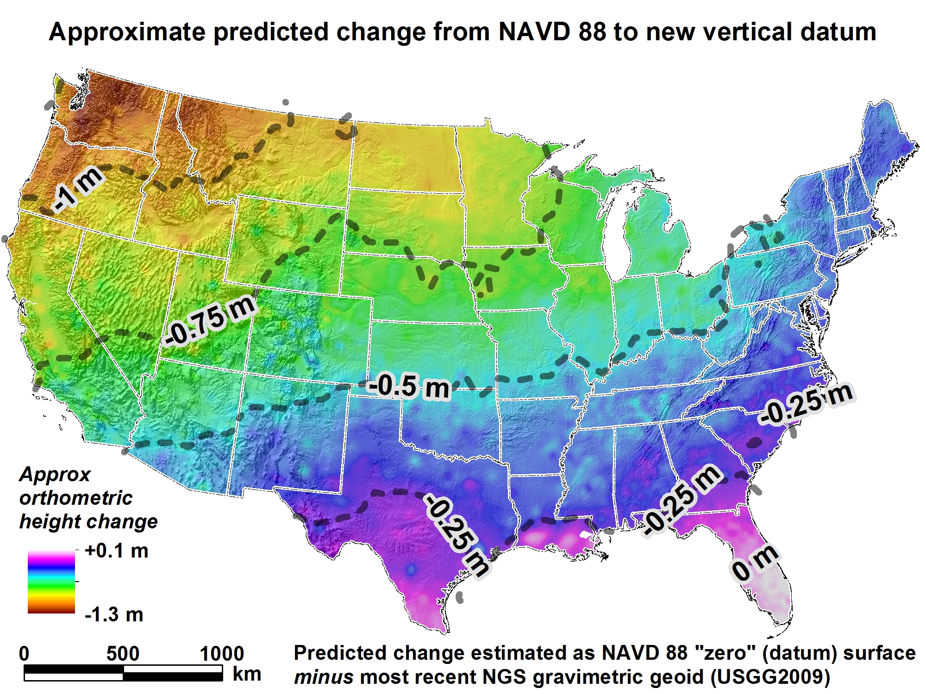
Geopotential Datum Changes
USGG2012

Slide 47
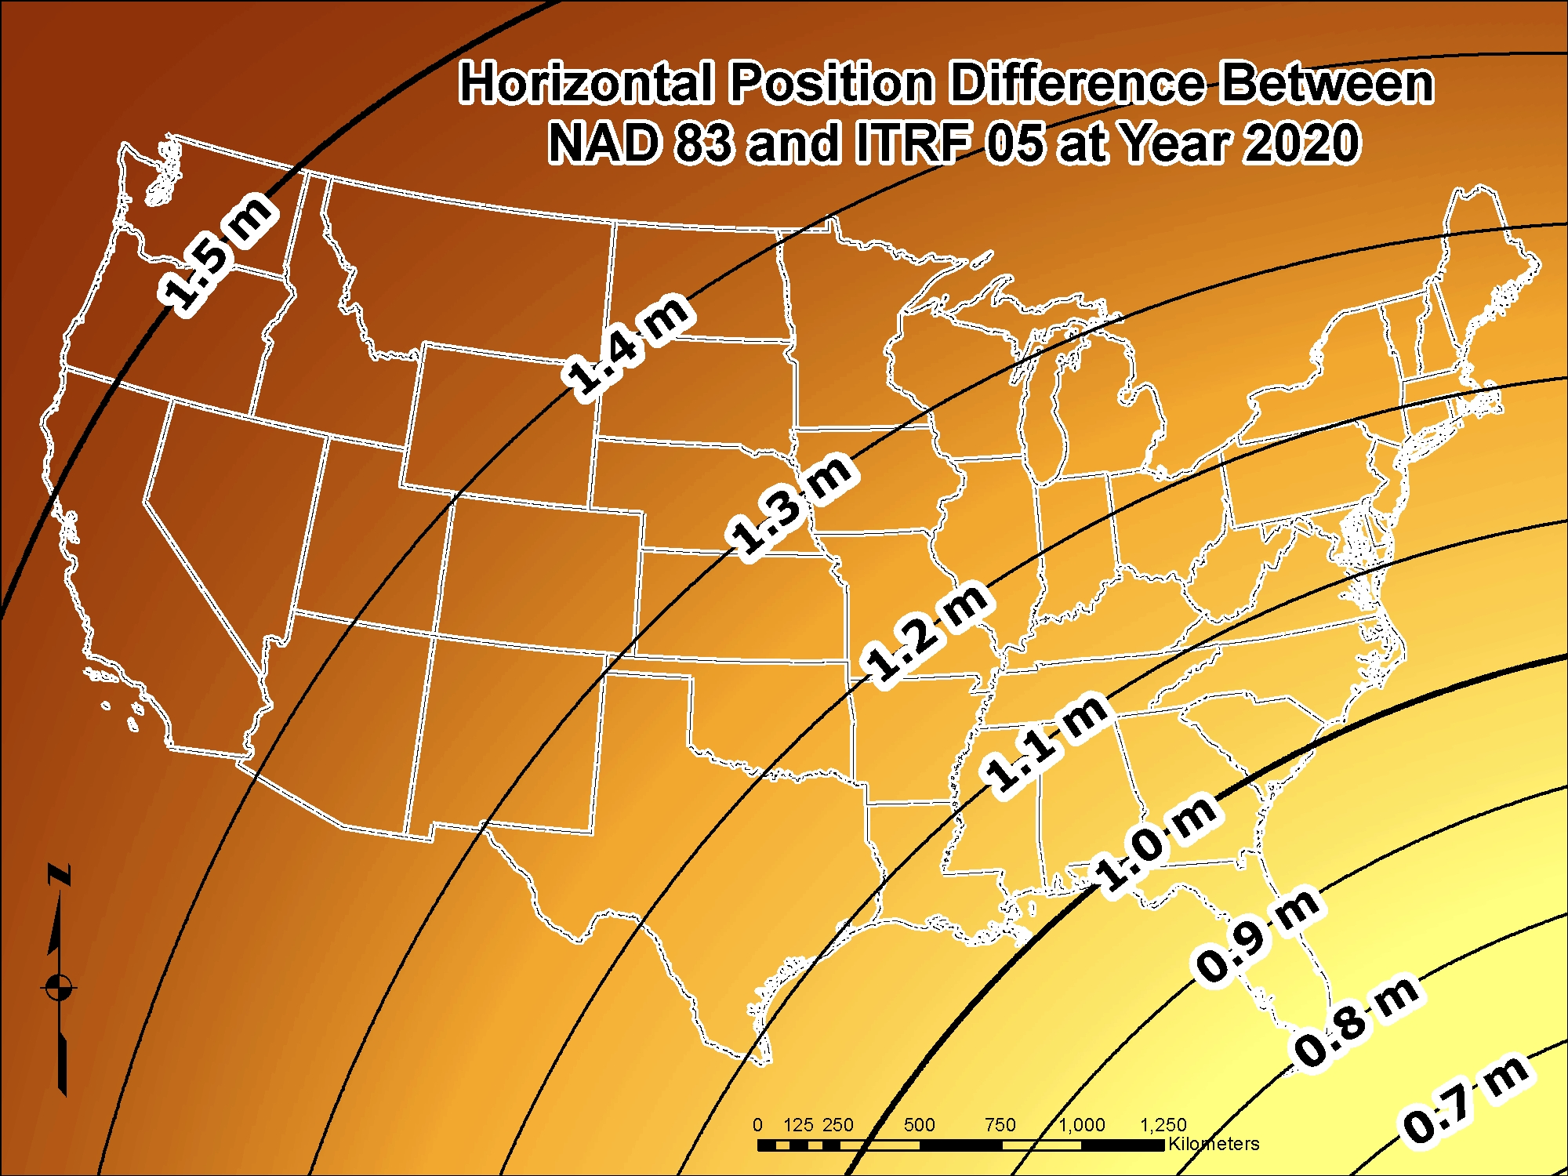

Slide 48
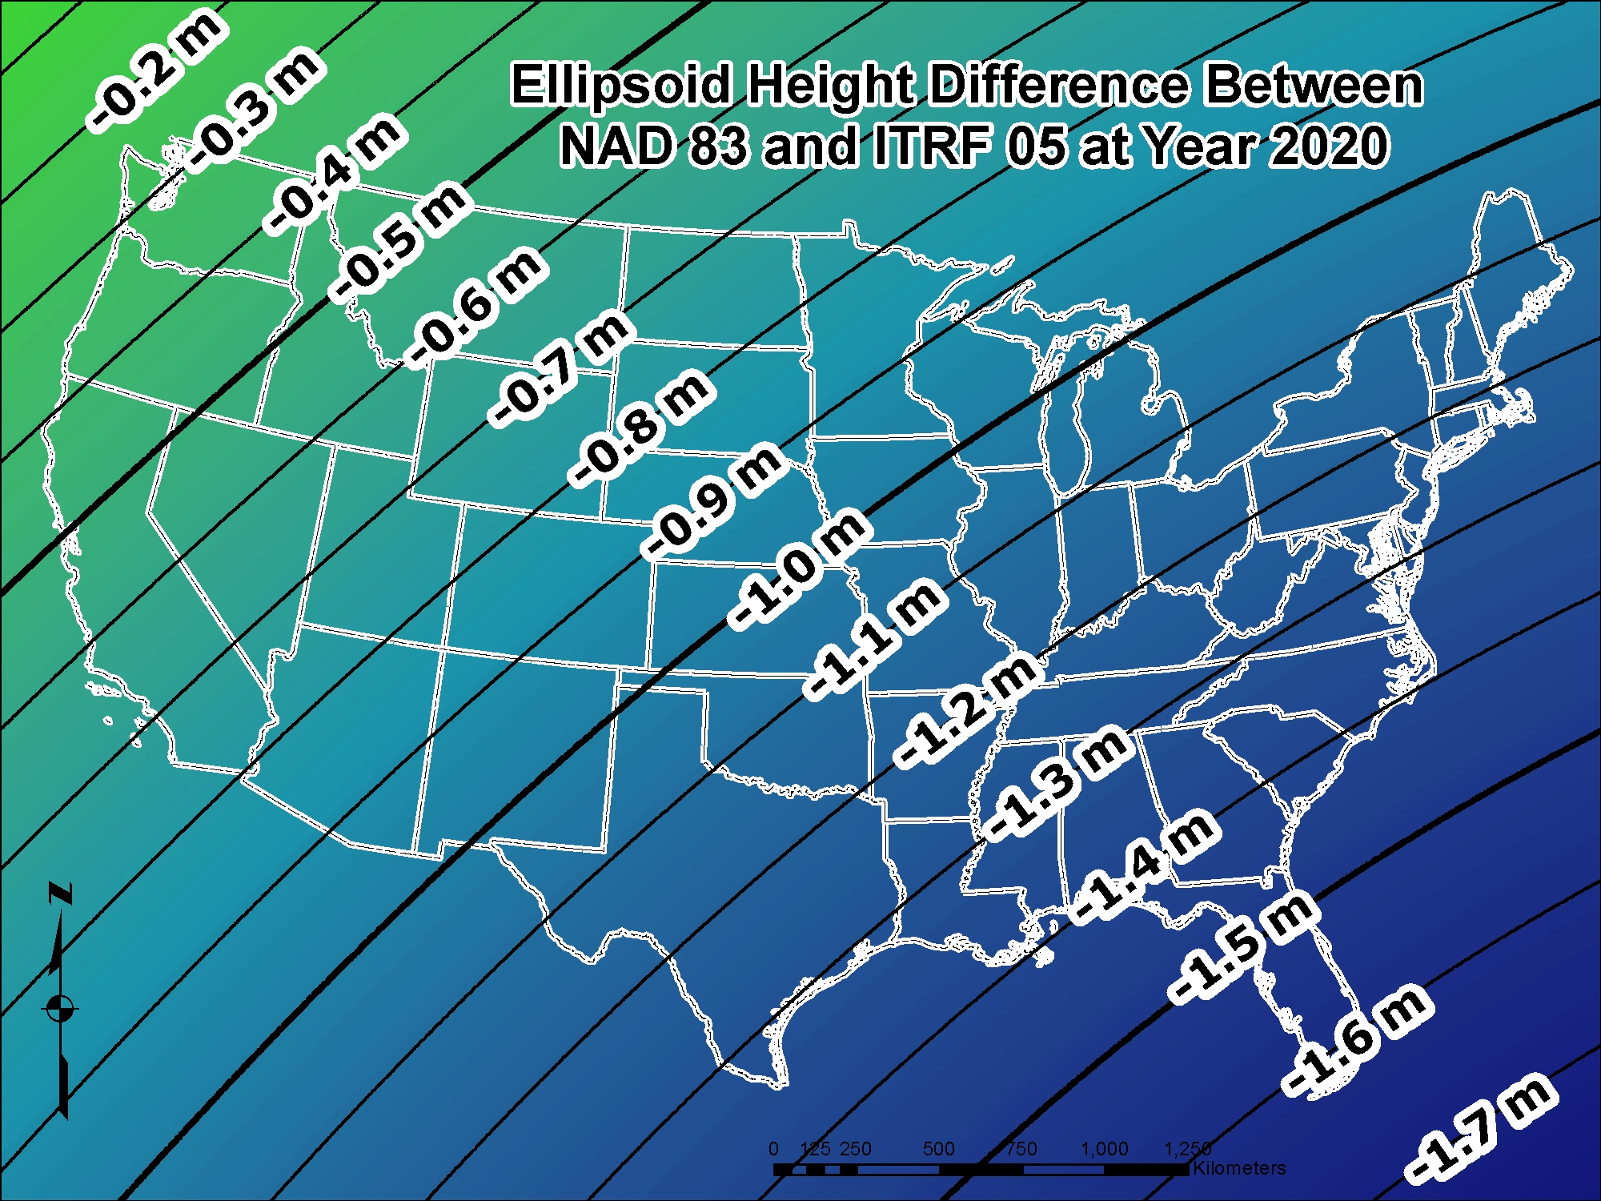

Slide 49
NEW VERTICAL DATUM
(Components)
Prepare a forward and backward vertical datum conversion strategy - points and maps/charts (ref: NC Pilot Project)
Work with FGCS for adoption of new/updated (FGCS Vertical Working Group):
  Standards of Accuracy
  Specifications
  Procedures, and
  Guidelines
Outreach

Slide 50
Metadata is Critical
Your positional metadata should include:
  datum
  epoch
  source
These will facilitate transforming from current to new datum
Maintaining your original survey data will provide more accurate results

Slide 51
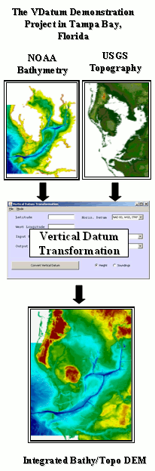
VDatum: Vertical Datum Transformation Tool
Orthometric datums
Ellipsoidal (geometric) datums
Tidal datums
WGS 84 (G1150)
Calibrated Helmert Transformations
WGS 84 (G873)
NGVD 29
Tide Models
WGS 84 (G730)
MHHW
WGS 84 (orig.)
ITRF2000
VERTCON
MHW
ITRF97
ITRF96
NAD83 (CORS96)
NAVD 88
LMSL
MTL
ITRF94
ITRF93
DTL
ITRF92
MLW
ITRF91
ITRF90
GEOID99,
GEOID03,
GEOID09
MLLW
ITRF89
TSS
(Topography of the Sea Surface)
ITRF88
SIO/MIT 92
NEOS 90
PNEOS 90
VDatum is a software tool capable of transforming coastal bathymetry and land topographic elevations between 36 different vertical datums.
http://vdatum.noaa.gov/

Slide 52
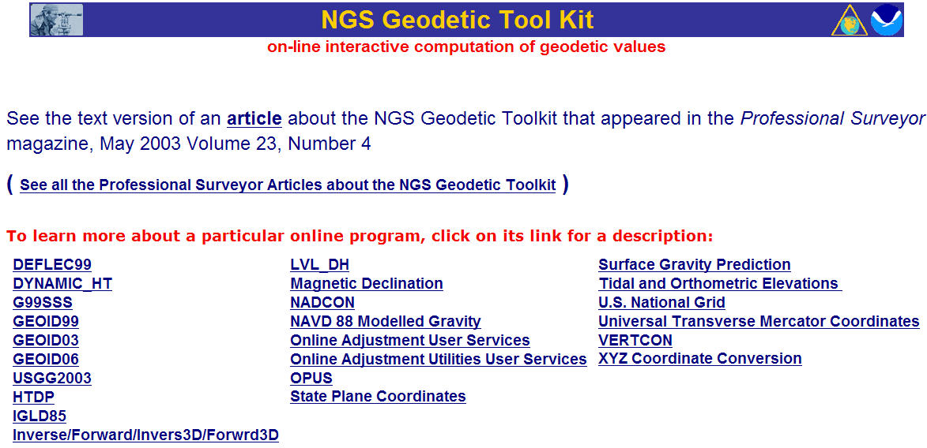
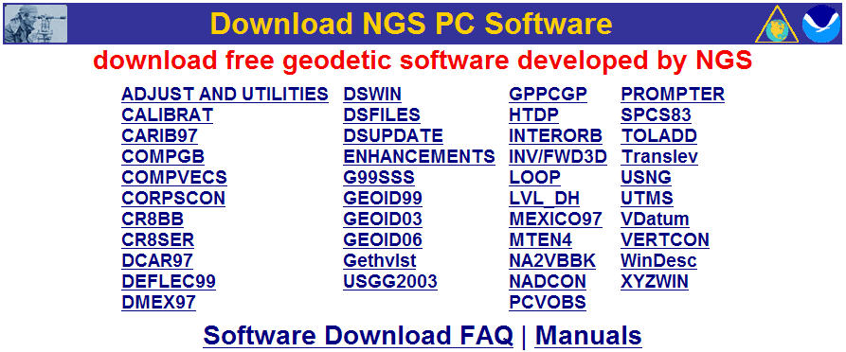
NGS Geodetic Tool Kit &
Geodetic Software Download
datum/coordinate conversion
time-dependent positioning
datasheet utilities
geodetic utilities
geoid modeling
    gravity prediction
    network adjustment
    GPS project analysis
    project submission

Slide 53
How to Plan for the Future
Move to newest realizations
  NAD 83(2011) epoch 2010.00
  USGG12 (gravimetric geoid) / GEOID12A (hybrid geoid)
Obtain precise ellipsoid heights on NAVD 88 bench marks (OPUS-DB, contact NGS Geodetic Advisor)
  Improves hybrid geoid models and provides “hard points” in new vertical datum
  Follow new NGS Guidelines when released
Move off of NGVD 29 to NAVD 88
  Understand the accuracy of VERTCON in your area
Move away from passive marks to GNSS
  Especially move off of classical passive control
Require/provide complete metadata for all mapping contracts
  How did they get the positions/heights? Document it!!

Slide 54
GNSS-Derived Height Guidelines
Current Technical Memorandum:
- Guidelines for Establishing GPS-Derived Ellipsoid Heights - NOAA TM NOS NGS-58 Nov 1997
- Guidelines for Establishing GPS-derived Orthometric Heights (Standards: 2 cm and 5 cm) NOAA TM NOS NGS-59 Mar 26, 2008
- Available: http://www.ngs.noaa.gov/PUBS_LIB/pub_GPS.shtml
12/02/2013 - Field Campaign Begins in South Carolina to Update NOAA Height Guidelines
Beginning December 2, NOAA and surveying and engineering firm, Gustin, Cothern & Tucker, Inc., (GCT), will begin a field campaign to collect Global Navigation Satellite System (GNSS) observations in South Carolina. Working in collaboration with the South Carolina Geodetic Survey, this effort is part of a larger study to update and improve existing NOAA guidelines to establish GNSS-derived heights. Since the original guidelines were published, many advances in science and technology have prompted a re-examination of how GNSS may be most effectively used to determine elevations.
STAY TUNED: http://www.ngs.noaa.gov/heightmod/

Slide 55
How will I access the new
vertical datum?
Primary access (NGS mission)
  Users with geodetic quality GNSS receivers will continue to use OPUS suite of tools
  Ellipsoid heights computed, and then a gravimetric geoid removed to provide orthometric heights in the new datum
  No passive marks needed
  But, could be used to position a passive mark
Notes:
Multiple questions come up about using the new vertical datum. Two examples are given in the next few slides. The first is the example of how the new datum will address subsidence, say for floodplain mapping. The second example is about how the datum will be accessible when there aren’t bench marks in the immediate region of interest. Both examples rely on this simple formula:
Get an ellipsoid height (h) from GNSS in the latest geometric datum (the replacement for NAD 83)
Remove the NGS provided geoid model (N)
The orthometric height in the new datum (H) is just H=h-N

Slide 56
How will I access the new
vertical datum?
Secondary access (Use at your own risk)
  Passive marks that have been tied to the new vertical datum
  NGS will provide a “data sharing” service for these points (think “datasheets”)
    Modeled velocities over time will mean growing uncertainty in the coordinate at datasheet retrieval
Notes:
NGS will eventually stop making the claim that we “know” the heights of bench marks as the method of providing access to the vertical datum. What NGS will do is provide the orthometric height to a user on the day of their survey (and with the disclaimer that this height should not be taken as “known” for very long, due to the dynamic nature of the Earth). If possible, height changes (velocities) will be computed and provided to
assist in predicting heights in the future.
Updated October 2010.

Slide 57
After 2022- Updates to the Datum
Develop a long-term geoid-monitoring service
  Will there be new satellite data?
  Likely to include:
    A tracking network
      Co-located CORS with gravimeters?
    Geophysical Models
  Working group established
    Boulder conference in 2009
    Unstaffed at the moment

Slide 58

The Dynamic Earth
  Actual Motion as detected by the NGS CORS Network (Continuously Operating Reference Station)

Slide 59


Geoid Height Change Over Time
How often will updates be needed to maintain a 1-2 cm accuracy geoid?
Which areas of U.S. will see the most change?
Their Answer: Approximately every 10 years for the Nation; Local adjustments may be needed after disasters

Slide 60
Education and Outreach
  Get state legislatures to remove all references to “NAVD 88” and/or “NAD 83” on the books
    New wording “National Spatial Reference System”
  Informational Web Pages
    Videos
    Flyers
  Regional Presentations and Webinars
  Priorities for NGS’ 10-Year Plan
  Some Information Already Available

Slide 61


geodesy.noaa.gov

Slide 62

NGS Regional Presence
*New* Regional Advisors
More effective, consistent contact
Outreach support for datum modernization
Previous “State Advisor” focus will shift to regional
Was no advisor for Pennsylvania; nearest was Bill Henning, who retired in 2013
PA will be part of “Eastern Great Lakes”
Will be gradual over the next 5 years (2013 – 2017)

Slide 63

NGS Regional Presence
Height Modernization
http://www.ngs.noaa.gov/heightmod/Regional.shtml
http://www.ngs.noaa.gov/heightmod/Pennsylvania.shtml

Slide 64



http://www.ngs.noaa.gov/corbin/calendar.shtml
NGS Corbin, VA Training Center

Slide 65

Join the Training Center Mailing List

Slide 66
Predicated Positional Changes in 2022 in Washington D.C.
Computed for JEFFERSON PIER (US0024)
HORIZONTAL = 1.14 m (3.7 ft)
ELLIPSOID HEIGHT = - 1.29 m (- 4.2 ft)
Predicted with HTDP
ORTHOMETRIC HEIGHT = - 0.41 m (- 1.3 ft)
Predicted with HTDP and USGG2012
Notes:
ACURRACY BUT NOT CONSISTENCY!!
To summarize: This slide shows how far we’ve come since 1986, really since 1927.
Unfortunately, --- Next slide ----

Slide 67
What can you do to get ready for 2022??
Understand the impact of changing positions and heights for your community, company or agency
Watch for upcoming NGS status reports/webinars
Should NGS continue to publish State Plane Coordinates?
If yes:
Retain or change NAD 83 geometric parameters?
Communicate your issues directly to NGS
Joe Evjen – joe.evjen@noaa.gov – Geometric Datum Manager
Mark Eckl – mark.eckl@noaa.gov – Geopotential Datum Manager

Slide 68
Extra Slides

Slide 69
Example
“Bringing in” the datum
Point where I need
an orthometric height
Nearest level lines
are about 25 km and 50 km
away respectively. Bench marks
may or may not exist,

Slide 70
Example
Choice 1: Leveling
Will we live with a
spur or maybe check
in with another level
line?
Leveling for 50 km
Lucky day, we
find 6
undisturbed
Bench marks!
Leveling for 25 km
Luckily we find 1
undisturbed bench mark!
Now it’s time to bluebook the
data, submit to NGS, wait for
it to be processed and loaded….
And all this assumes the published
heights are correct to begin with…

Slide 71
Example
Choice 2: “Height Mod” survey
Create passive marks
around area of interest
Using progressive
GNSS surveys (NGS 59
Guidelines), transfer
orthometric heights to
Primary, Secondary and
Local marks
Now it’s time to bluebook the
data, submit to NGS, wait for
it to be loaded into the IDB….
And all this assumes the published
heights are correct to begin with…
Notes:
Note that even if this goes off as planned, there may still need to be leveling involved to check existing bench marks or possibly check the GPS results on these new points.

Slide 72
Example
Choice 3: Once GRAV-D is complete
Set up GNSS receiver over mark
Submit data to OPUS and
receive orthometric height
Feeling generous? Share your
results with others using the
NGS online database (no
bluebooking involved). If not,
take your height and walk
away.

Slide 73
Why reoccupy bench marks?
H₂₀₂₂=5.000m +/- 0.020m
(GNSS/geoid)
H₂₀₂₉=4.830m +/- 0.020m
(GNSS/geoid)
Height
H₂₀₂₄=4.960m +/- 0.030m
(GNSS/geoid)
H₂₀₂₉=4.860m +/- 0.150m
(modeled)
2022
2024
Year
2029
V(modeled 22/24) = -2 cm/yr +/- 2.5 cm/yr
V(modeled 22/29) = -2.1 cm/yr +/- 0.3 cm/yr
Notes:
NGS will eventually stop making the claim that we “know” the heights of bench marks as the method of providing access to the vertical datum. What NGS will do is provide the orthometric height to a user on the day of their survey (and with the disclaimer that this height should not be taken as “known” for very long, due to the dynamic nature of the Earth). If possible, height changes (velocities) will be computed and provided to
assist in predicting heights in the future.
Updated October 2010.

Slide 74


GEOID 12A ACCURACY IN MARYLAND

Slide 75
How the New Datums Will Affect You
New geometric datum will change lat, lon, and ellipsoid height by between 1 and 2 meters.
The new vertical datum will change heights on average 50 cm (20”), with a 1 meter (39”) tilt towards the Pacific NW

Slide 76
What to Expect as Datums Roll Out
Both datums will be released together
NGS will provide tools to allow for easy transformation between the new and old datums
We expect to assign values to all BMs that have GPS observations
NGS will develop standards and specifications for how to best blend the controlled leveling survey with the new methods of accessing the datum

