Slide 1

NOAA- NGS
Precise Geodetic Infrastructure
Dr. Theresa M. Damiani
Chief- Spatial Reference System Division
National Geodetic Survey
National Oceanic and Atmospheric Administration
October 18, 2018

Slide 2

NGS Mission Statement
To define, maintain and provide access to the National Spatial Reference System (NSRS) to meet our nation’s economic, social, and environmental needs.
The NSRS is a consistent coordinate system that defines latitude, longitude, height, scale, gravity, and orientation throughout the United States.

Slide 3
Eight NRC 2010 Report Recommendations
Updates since 2010 and current NGS status for:
  #1 Maintaining leadership in geodetic infrastructure
  #3 Twenty-four fundamental (multi-instrumented) stations
  #5 Participation with international geodetic services
  #6 Support the ITRF (GGOS)
  #7 New Federal Geodetic Service for coordination
Limited NGS past/current work for:
  #2 SLR and VLBI Improvements
    None other than IERS site survey support
  #4 Streaming real-time GNSS data
    No current activity
  #8 Workforce Analysis
    Strategic Human Resources Plan in development

Slide 4
Recommendation #1- Maintaining Leadership
“Invest in maintaining and improving the geodetic infrastructure, through
  Upgrades in network design and construction,
  Modernization of current observing systems,
  Deployment of improved multi-technique observing capabilities, and
  Funding opportunities for research, analysis, and education in global geodesy”

Slide 5
Modernizing the NSRS by 2022
The current national datums (NAD 83 and NAVD 88) were established in the 1980s, before satellite technology revolutionized geodesy.
The current datums have errors exceeding 1 meter.
Current datums are defined through passive control (marks).
Modernizing means:
  Replacing the current horizontal datums (NAD 83) with 4 new, plate-fixed reference frames (NATREF, CATREF, PATREF, and MATREF) tied to the ITRF.
  Replacing the current vertical datums (NAVD 88) with a gravimetric geoid-based datum (NAPGD2022)
  Improving data submission, data access, online tools, and survey methodologies (using active control).
Notes:
(particularly GPS) revolutionized surveying, positioning, and gravimetry.

Slide 6
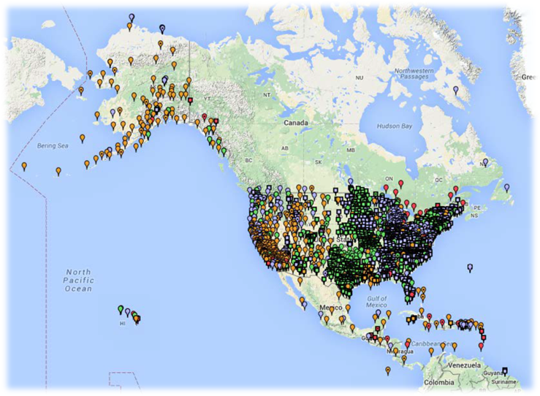
Geodetic Control Datasets - CORS
Continuously Operating Reference Station Network
Run by more than 200 organizations (various government, academic, and private organizations)
2010: ~1400 CORS
2018: ~1800 CORS
70.3% CORS upgraded from GPS to GNSS.
2013: defined a 70 km maximum CORS density
GPS only | 524
GPS+GLO | 1075
GPS+GLO+GAL | 169
Socio-economic value of CORS
2008: $0.55 billion
2017: $2.53 billion
6

Slide 7
Growth in Use of CORS- OPUS and Downloads
Growth in thousands of downloads/uploads
Service | 2008 Useage | 2018 Useage
OPUS-RS | 72.2 | 155.0
OPUS-S | 182.1 | 381.8
UFCORS | 1,042.7 | 1,303.6
CORS FTP | 9,391.0 | 59,262.3
OPUS-Share | 0.0 | 2.4
OPUS: Online Positioning User Service uses the 5 nearest CORS to calculate the position of a user-uploaded GNSS observations
Notes:
OPUS-S: Static, 2-48 hour in duration
OPUS-RS: Rapid static, 15 minutes to 2 hours in duration
OPUS-Share: Publish coordinates to NGS database

Slide 8
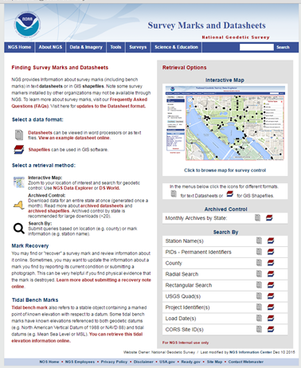
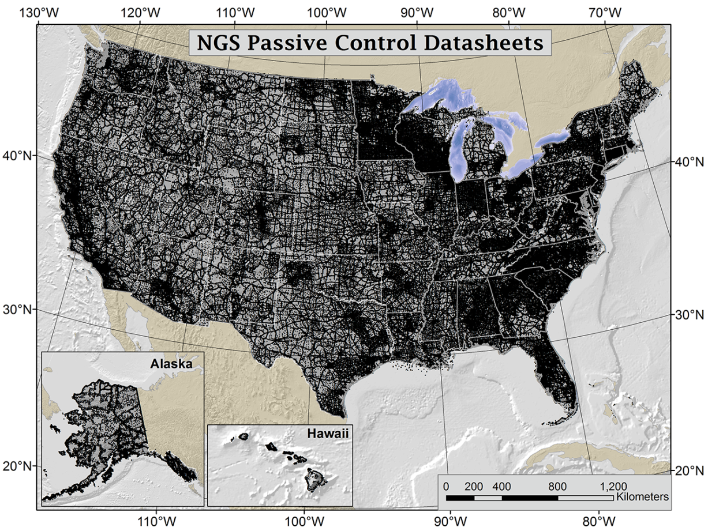
Geodetic Control Datasets – Passive Marks
Over 800,000 geodetic control datasheets
GPS on Benchmarks: Citizen science campaign to update GNSS coordinates on marks
8

Slide 9
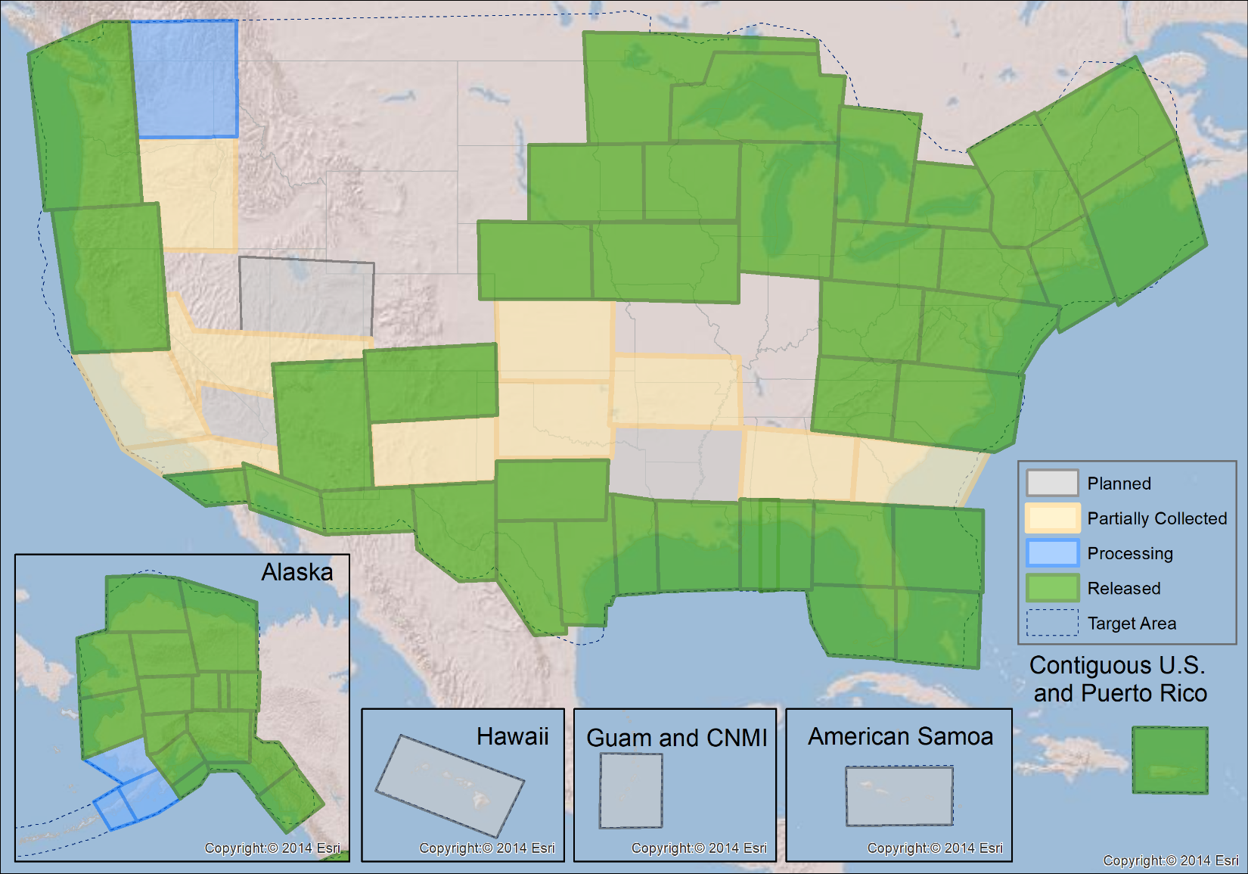
Geodetic Control Data Sets- Airborne Gravity
Gravity for the Redefinition of the American Vertical Datum (GRAV-D)
Part 1: Airborne Gravity Campaign
Status as of 9/30/18
72.1% complete
Completed 2018

Slide 10
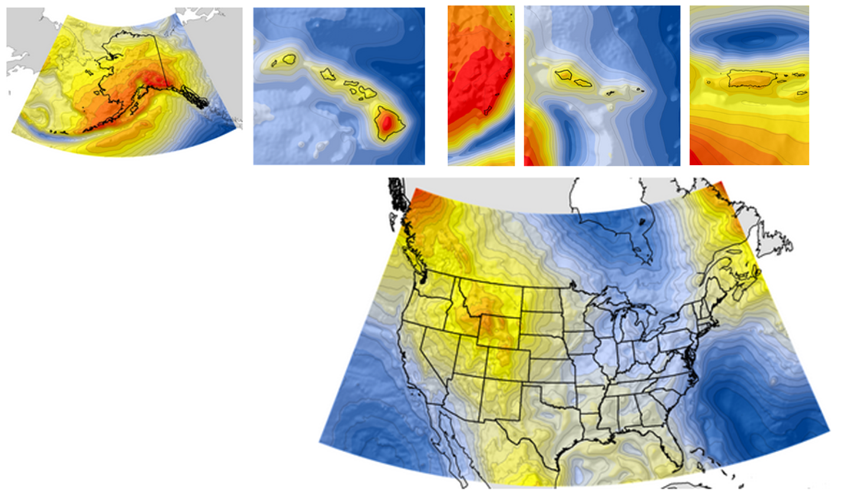
Geodetic Control Datasets – Geoid Models
Released new hybrid and gravimetric geoids in 2009 and 2012
Final new hybrid geoid release in 2019
Yearly experimental gravimetric geoid models, 2014 through 2021
CONUS
Alaska
Hawaii
American Samoa
Puerto Rico & US Virgin Islands
Guam and Northern Mariana Islands
10

Slide 11
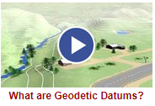
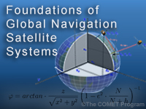
Enabling Research, Analysis, and Education
Internal research and analysis
  New GNSS software project: multi-constellation GNSS and RINEX 3
  New ITRF2014 CORS positions and velocities for early 2019
  Small grants to Oregon State and Ohio State
With The COMET Program
Educational Videos (11)
Education Activities
Monthly Webinar Series (7500 attendees, 40 recordings online)
In person training:
  Airborne Gravity for Geodesy Summer School
  OPUS Projects Manager Training
  Digital Leveling and GPS Training
■ Videos are 5 minutes or less
■ More than 185,000 views
Online Lessons (4)
geodesy.noaa.gov
■ More than 1,200 quizzes
■ More than 6,200 sessions

Slide 12
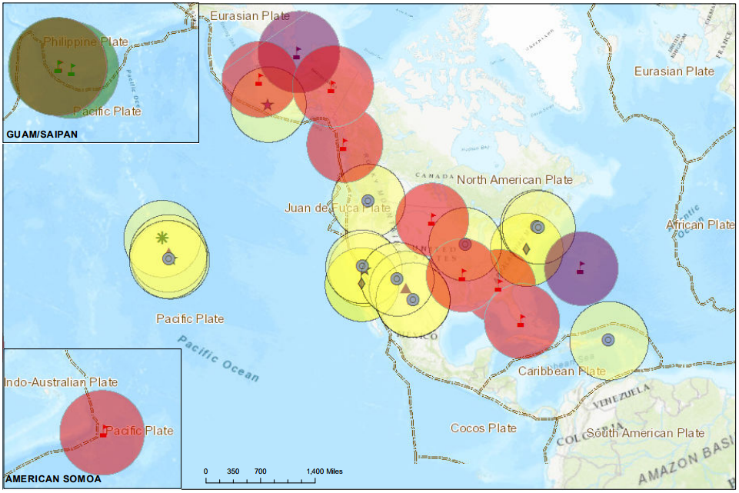
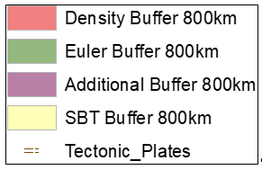
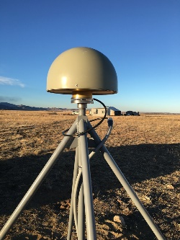
Foundation CORS Project
Recommendation #3-
Twenty-Four Fundamental Stations
Federal Partners | Site ID | Location
National Science Foundation (NSF) Existing Sites Program: EarthScope Plate Boundary Observatory (PBO) | AB09 | Wales, AK
 | P777 | Dennard, AR
 | P804 | Georgia
 | AB51 | Petersburg, AK
 | ATQK | Atqasuk, AK
 | P043 | Wyoming
National Aeronautics and Space Administration (NASA) Existing Sites Program: Global GNSS Network (GGN), operated by Jet Propulsion Laboratory | CRO1 | Saint Croix, VI*
 | BREW | Brewster, WA*
 | FAIR | Fairbanks, AK
 | GODE | Greenbelt, MD*
 | GOL2 | Goldstone, CA*
 | MDO1 | McDonald Observatory, Texas*
 | MONP | Mount Laguna, CA*
 | NLIB | North Liberty, IA*
 | PIE1 | Pie Town, NM*
 | GUAM | GUAM
 | KOKB | Kauai, HI*
 | MKEA | Mauna Kea, HI*
 | HAL1 | Haleakala, HI*
NOAA- National Geodetic Survey (NGS) Existing and New Sites Program: Continuously Operating Reference Stations (CORS) | ASPA | American Samoa
 | CNMR | Saipan, TQ
 | GUUG | GUAM*
 | BRSG | Bermuda
 | FLF1 | Richmond, FL*
 | WES2 | Westford, MA*
 | TMG2 | Boulder, CO
 | NEW | Apache Point, NM*
 | NEW | Fort Davis, TX*
 | NEW | Fort Irwin, CA*
 | NEW | Hancock, NH*
 | NEW | Los Alamos, NM*
 | NEW | Kitt Peak, AZ*
 | NEW | Owens Valley, CA*
 | NEW | Cold Bay, AK*
TBD | TBD | Existing location in Caribbean
 | TBD | Existing location in Caribbean
A set of federally-operated, ultra-high-quality, high-reliability stations with the longevity to guarantee citizens access to official NSRS positions and support international positioning consistency efforts.
Target “fundamental” Foundation CORS: 21
12
Notes:
Three existing NGS-owned “fundamental” stations.
Build 8 new NGS-owned “fundamental” stations.
Proposed: Adopt 10 NASA partner “fundamental” stations.

Slide 13
Foundation CORS Goals
MOUs in place with NASA and NSF to support the project
All NGS-owned Foundation CORS submitted to the IGS for consideration as stations
Network availability of 90% at all times
Individual Station Down Time < 14 days
Stations provide definitional support for plate rotation models
5-year repeat of IERS site surveys for all Foundation CORS

Slide 14

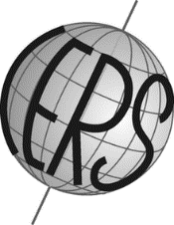
Recommendation #5-
Support International Geodetic Services
International GNSS Service (IGS) Support:
  GPS Orbits: NGS Analysis Center for 25 years
  GPS Orbits: NGS served as Analysis Center Coordinator for two terms (2008-2012, 2012-2016)
  Absolute Antenna Calibration (ANTEX, new robotic arm)
  NGS-owned IGS stations (3 existing, 8 more planned as Foundation CORS)
International Earth Rotation Service (IERS) Support:
  Experts in IERS site surveys at “fundamental” sites for ITRF
  Publishing new ITRF14 coordinates at CORS in early 2019
  Utilizing IERS geophysical models in GNSS processing
  MOU on Earth Orientation Parameters

Slide 15
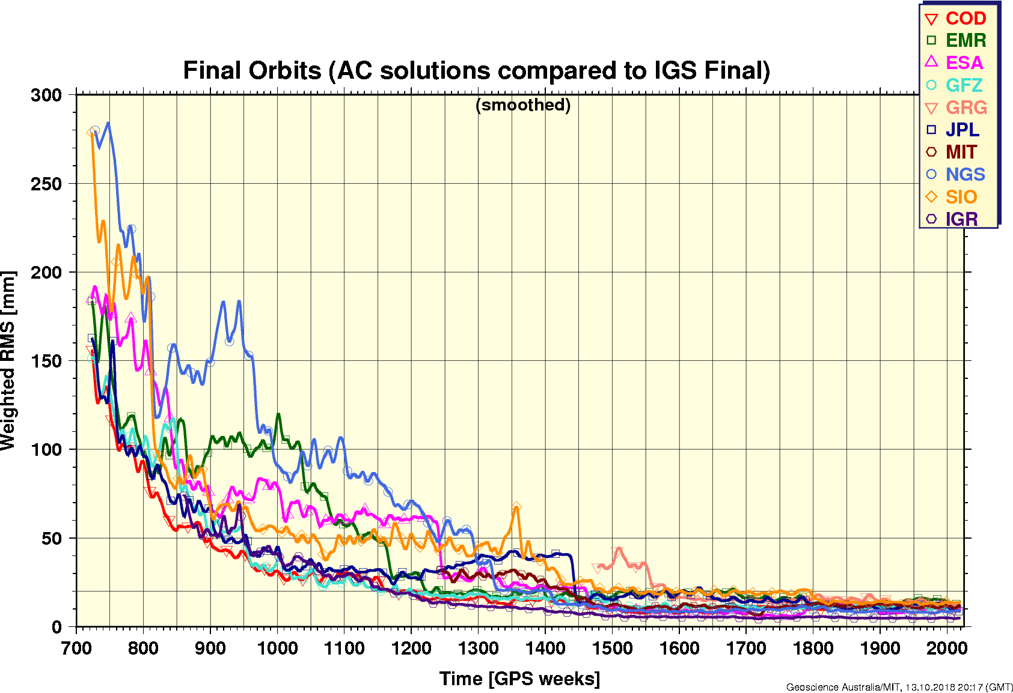
25 Years of NGS Orbit Products as an IGS Analysis Center

Slide 16

Recommendation #5-
Support International Geodetic Services
International Gravity Field Service (IGFS) Support:
  Chair:
    IAG Subcommittee 2.1 (Terrestrial Gravimetry Techniques)
    IAG Subcommittee 2.2 (Geoid Methodology) Working Group on Geoid Computation Validation
  Member:
    IAG Study Group 2.1.1 (Global absolute gravity reference system)
    Steering Committee for International Comparisons of Absolute Gravimeters 2017 (ICAG)
  Hosted 3 North American Comparisons of Absolute Gravimeters
    2017 “Key Comparison SIM.M.GK-1” with the National Institutes of Standards and Technology and the International Bureau of Weights and Measures (BIPM)
  Hosted Airborne Gravimetry for Geodesy Summer School (IAG Endorsed)
  Will evaluate the National Geospatial-Intelligence Agency’s Earth Gravitational Model 2020 (EGM2020)
    May become the basis of the International Height Reference System (IHRS)

Slide 17
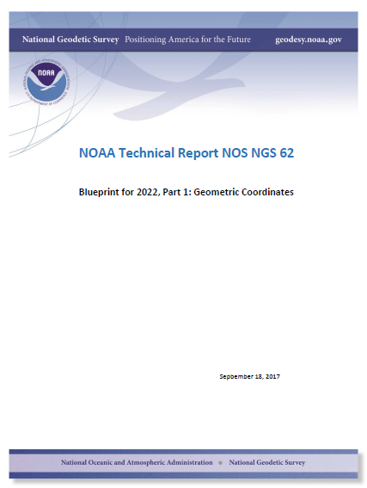
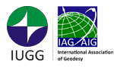



Recommendation #6-
Commit to Maintaining the ITRF
Blueprint Part 1: Commitment to tie the new NSRS reference frames to the ITRF
Foundation CORS
IERS site surveys
International participation with:
Geometric:
Sep 2017
International Union of Geodesy and Geophysics;
International Association of Geodesy;
Global Geodetic Observing System
Sistema de Referencia Geocéntrico
para las Américas
United Nations Committee of Experts on
Global Geospatial Information Management
(UN-GGIM)
Notes:
IAG Subcommission on Regional Reference Frames-
North America (NAREF), South America (SIRGAS), Pacific (APREF);
Global Geospatial Information Management

Slide 18




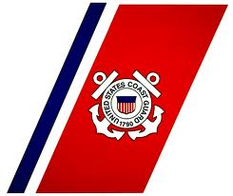





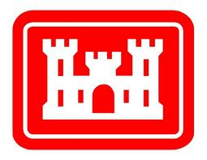
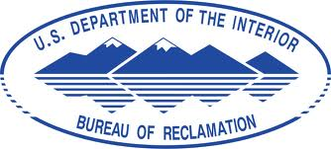
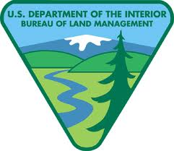

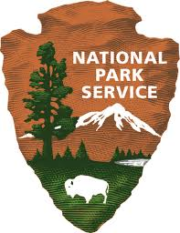

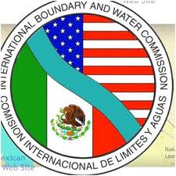

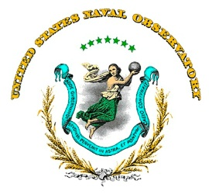
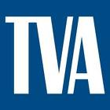
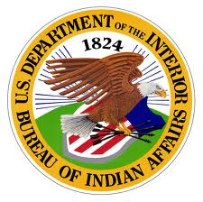




Recommendation #7-
Establish a Federal Geodetic Service
The Federal Geodetic Control Subcommittee (FGCS) of the Federal Geographic Data Committee (FGDC) helps coordinate the planning and execution of geodetic surveys, developing standards and specifications for these surveys, and exchanging geodetic survey data and technical information among Federal agencies.
Signed 5 October 2018
Notes:
Geospatial Data Act signed 10.5.18 (2 weeks ago)
There is established within the Department of the Interior an interagency committee to be known as the Federal Geographic Data Committee, which shall act as the lead entity in the executive branch for the development, implementation, and review of policies, practices, and standards relating to geospatial data.
Define roles and responsibilities and promote and guide cooperation and coordination among agencies of the Federal Government, State, tribal, and local governments, institutions of higher education, and the private sector in the collection, production, sharing, and use of geospatial information, the implementation of the National Spatial Data Infrastructure, and the identification of proven practices;
Coordinate with international organizations having an interest in the National Spatial Data Infrastructure or global spatial data infrastructures\
The National Spatial Data Infrastructure shall ensure that geospatial data from multiple sources (including the covered agencies, State, local, and tribal governments, the private sector, and institutions of higher education) is available and easily integrated to enhance the understanding of the physical and cultural world.
In accordance with section 216 of the E-Government Act of 2002 (44 U.S.C. 3501 note), the Committee shall establish standards for each National Geospatial Data Asset data theme

Slide 19
Commitments for the Future
Define a modern NSRS in 2022:
Four geometric reference frames and a geopotential datum
Include dynamic models in the NSRS:
plate motion, intra-frame velocities, and geoid change.
Complete Foundation CORS by 2023
to support national and international geodetic infrastructure
Create a CORS Comprehensive Plan
to grown and modernize the infrastructure.
Continue to invest in a strong NGS Gravity Program.
Notes:
All part of our 10 year plan goals (and objectives within the goals) through 2023.

Slide 20
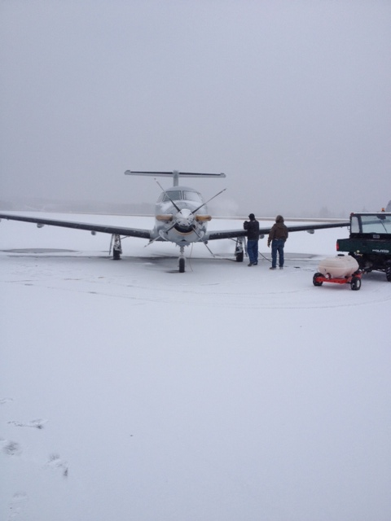
The Future of GRAV-D
Commitments:
Finish 100% of United States Airborne Gravity Collection
FY19 – Pacific Island Survey
FY20 – Aleutian Islands Survey
FY21-FY22 – Remaining areas
North America-Pacific Geopotential Datum (NAPGD2022)
Create new geopotential products: geoid, gravity, DOV…
Monitoring and Validation
Design and operationalize a Geoid Monitoring Service (GeMS) to track geoid change
Create first-ever dynamic geoid model for the U.S.
Aspirations:
Outside the United States
Target areas of interest that affect the U.S. geoid and support interests of NGA and neighbors- e.g. Mountains of Mexico and Canada, Caribbean nations
Support for other countries on airborne gravity (IGFS)
Notes:
Weather is a problem because, as the final area to be covered gets smaller, the flexibility to “move away from the weather” is removed.

Slide 21
Commitments for the Future
Improve the quality of orbit products and investigate Foundation CORS participation in IGS Real-Time Service
Support NOAA’s Center for Operational Oceanographic Products and Services (CO-OPS) water level observations
  Modernizing geodetic control at tide gauges
  Global Sea Level Observing System (GLOSS) Stations
  National Water Level Observation Network (NWLON) Stations
Increase engagement and cooperation with FGDC member agencies
Increase interactions with and education of users of U.S. geodetic infrastructure and observing systems in government, industry, and education
Notes:
Supports Permanent Service on Mean Sea Level and SONEL (Système d'Observation du Niveau des Eaux Littorales)
GNSS-R?

