Slide 1



What you need to know…
With only two years to go
Maine Society of Land Surveyors
January 31, 2020
Dan Martin
Northeast Regional Geodetic Advisor
ME, NH, VT, MA, CT, RI, NY, NJ
Dan.martin@noaa.gov
240-676-4762

Slide 2
National Spatial Reference System
(NSRS)
NGS Mission: To define, maintain & provide access to the National Spatial Reference System (NSRS) to meet our Nation’s economic, social & environmental needs
Consistent National Coordinate System
Latitude/Northing
Longitude/Easting
Height
Scale
Gravity
Orientation
& how these values change with time

Slide 3
GEODETIC DATUMS
  HORIZONTAL
  2 D (Latitude and Longitude) (e.g. NAD 27, NAD 83 (1986))
  VERTICAL
  1 D (Orthometric Height) (e.g. NGVD 29, NAVD 88, Local Tidal)
  GEOMETRIC
  3 D (Latitude, Longitude and Ellipsoid Height)
  Fixed and Stable - Coordinates seldom change
  (e.g. NAD 83 (1996), NAD 83 (2007), NAD 83 (CORS96) NAD 83 (2011))
  also
  4 D (Latitude, Longitude, Ellipsoid Height, Velocities) Coordinates change with time
  (e.g. ITRF00, ITRF08)

Slide 4
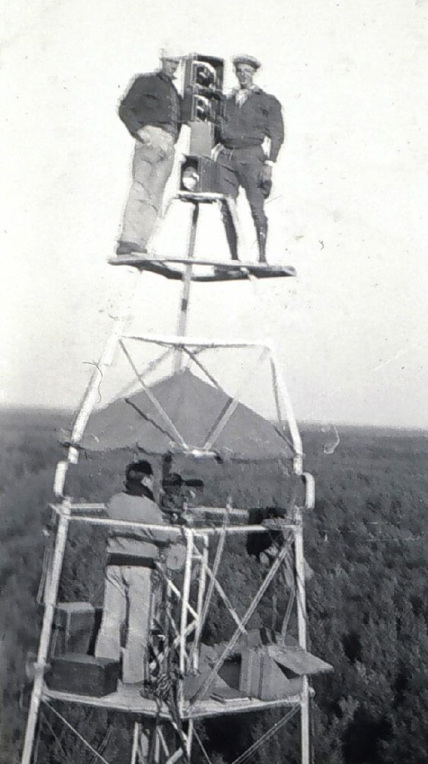
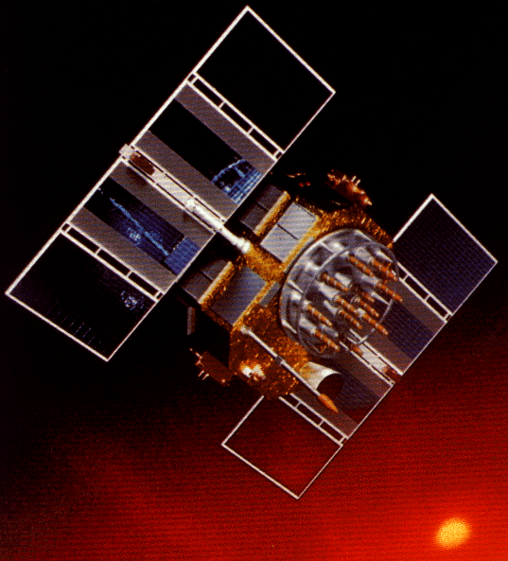
A (very) brief history of NAD 83
Original realization completed in 1986
  Consisted (almost) entirely of classical (optical) observations
“High Precision Geodetic Network” (HPGN) and “High Accuracy Reference Network” (HARN) realizations
  Most done in 1990s, essentially state-by-state
  Based on GNSS but classical stations included in adjustments
National Re-Adjustment of 2007
  NAD 83(CORS96) and (NSRS2007)
  Simultaneous nationwide adjustment (GNSS only)
New realization: NAD 83(2011) epoch 2010.00

Slide 5
Why change datums/Realizations
NAD27 based on old observations and old system
NAD83(86) based on old observations and new system
NAD83(96) based on new and old observations and same system (HARN)
NAD83(NSRS2007) based on new observations and same system. Removed regional distortions and made consistent with CORS
NAD83(2011) based on new observations and same system. Kept consistent with CORS

Slide 6
Horizontal Datums/Coordinates…What do we (you) use in your state?
NAD 27
NAD 83 (Lat-Lon) SPC
  Which one???
    NAD 83 (1986)
    NAD 83 (19xx) - HARN
    NAD 83 (1996) - FBN
    NAD 83 CORS96(2002)
    NAD 83 (NSRS2007)
    NAD 83 (2011) epoch 2010.00
WGS 84
  Which one???
    WGS 84 (1987)
    WGS 84 (G730)
    WGS 84 (G873)
    WGS 84 (G1150)
    WGS 84 (G1674)
    WGS 84 (G1762)
ITRFxx (epoch xxxx)
IGSxx (epoch xxxx)

Slide 7

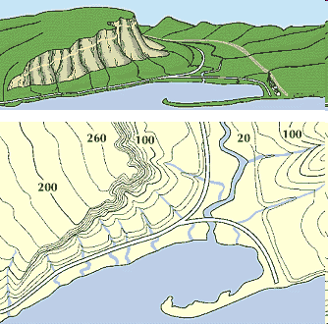
What is a Vertical Datum?
Strictly speaking, a vertical datum is a surface representing zero elevation
Traditionally, a vertical datum is a system for the determination of heights above a zero elevation surface
Vertical datum comprised of:
  Its definition: Parameters and other descriptors
  Its realization: Its physical method of accessibility
"topographic map." Online Art.
Britannica Student Encyclopædia.
17 Dec. 2008
<http://student.britannica.com/ebi/art-53199>

Slide 8
History of vertical datums in the USA
NGVD 29
  National Geodetic Vertical Datum of 1929
  Original name: “Sea Level Datum of 1929”
  “Zero height” held fixed at 26 tide gauges
    Not all on the same tidal datum epoch (~ 19 yrs)
  Did not account for Local Mean Sea Level variations from the geoid
    Thus, not truly a “geoid based” datum

Slide 9
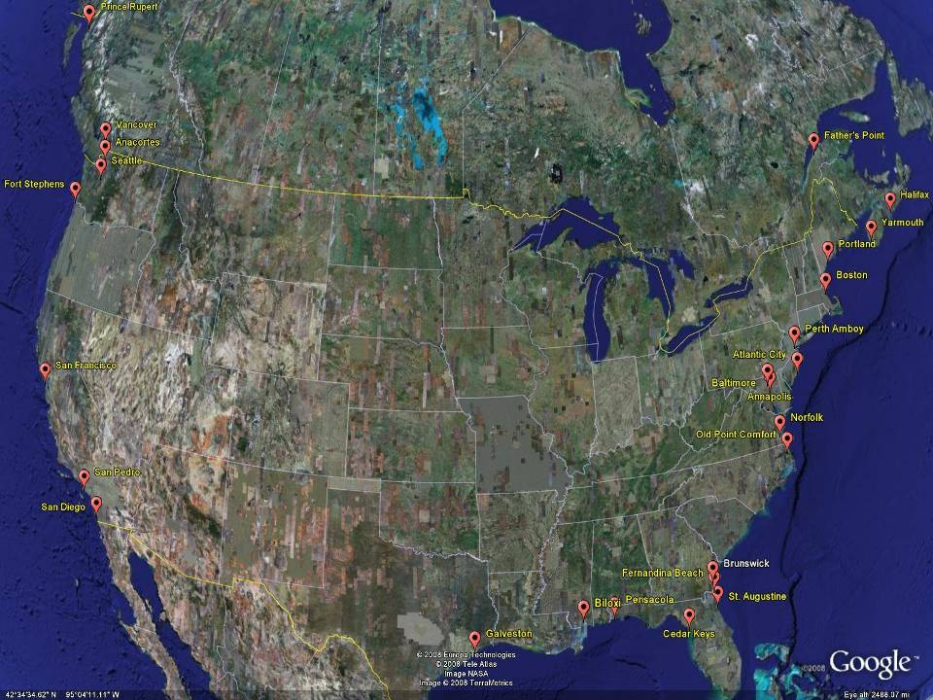
NGVD29
The National Geodetic Vertical Datum of 1929 is referenced to 26 tide gauges in the US and Canada
Notes:
It turns out that MSL is a close approximation to another surface, defined by gravity, called the geoid, which is the true zero surface for measuring elevations. Because we cannot directly see the geoid surface, we cannot actually measure the heights above or below the geoid surface. We must infer where this surface is by making gravity measurements and by modeling it mathematically. For practical purposes, we assume that at the coastline the geoid and the MSL surfaces are essentially the same. Nevertheless, as we move inland we measure heights relative to the zero height at the coast, which in effect means relative to MSL.
Definition: NGVD29 – The National Geodetic Vertical Datum of 1929…
The Sea Level Datum of 1929 was the vertical control datum established for vertical control surveying in the United States of America by the General Adjustment of 1929. The datum was used to measure elevation or altitude above, and depression or depth below, mean sea level (MSL).
Mean sea level was measured at 26 tide gauges: 21 in the United States and 5 in Canada. The datum was defined by the observed heights of mean sea level at the 26 tide gauges and by the set of elevations of all bench marks resulting from the adjustment. The adjustment required a total of 66,315 miles (106,724 km) of leveling with 246 closed circuits and 25 circuits at sea level.
Since the Sea Level Datum of 1929 was a hybrid model, it was not a pure model of mean sea level, the geoid, or any other equipotential surface. Therefore, it was renamed the National Geodetic Vertical Datum of 1929 (NGVD 29) in 1973. The NGVD 29 was subsequently replaced by the North American Vertical Datum of 1988 (NAVD 88) based upon the General Adjustment of the North American Datum of 1988.

Slide 10
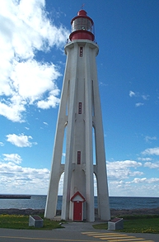
Current Vertical Datum in the USA
NAVD 88: North American Vertical Datum of 1988
Definition: The surface of equal gravity potential to which orthometric heights shall refer in North America*, and which is 6.271 meters (along the plumb line) below the geodetic mark at “Father Point/Rimouski” (NGSIDB PID TY5255).
Realization: Over 500,000 geodetic marks across North America with published Helmert orthometric heights, most of which were originally computed from a minimally constrained adjustment of leveling and gravity data, holding the geopotential value at “Father Point/Rimouski” fixed.
Father Point Lighthouse, Quebec
*Not adopted in Canada
Notes:
By fixing the geopotential value at the origin point, it was possible to ensure that the origins of IGLD 85 and NAVD 88 aligned.
*It should be pointed out that while the datum was defined in such a way as to be usable on the North American continent, it was never actually adopted in Canada. It can be used there, but it’s not their official civilian datum.
Note that the designation of the vertical control point at Father Point is “1250 G=NAVD 88 DATUM POINT” for PID# TY5255 and is not available from the publicly accessible NGSIDB.

Slide 11
History of vertical datums in the USA
NAVD 88
  North American Vertical Datum of 1988
  One height held fixed at “Father Point” (Rimouski, Canada)
  …height chosen was to minimize 1929/1988 differences on USGS topo maps in the eastern U.S.
  Thus, the “zero height surface” of NAVD 88 wasn’t chosen for its closeness to the geoid (but it was close…few decimeters)

Slide 12
History of vertical datums in the USA
NAVD 88 (continued)
  Use of one fixed height removed local sea level variation problem of NGVD 29
  Use of one fixed height did open the possibility of unconstrained cross-continent error build up
  H=0 surface of NAVD 88 was supposed to be parallel to the geoid…(close again)

Slide 13
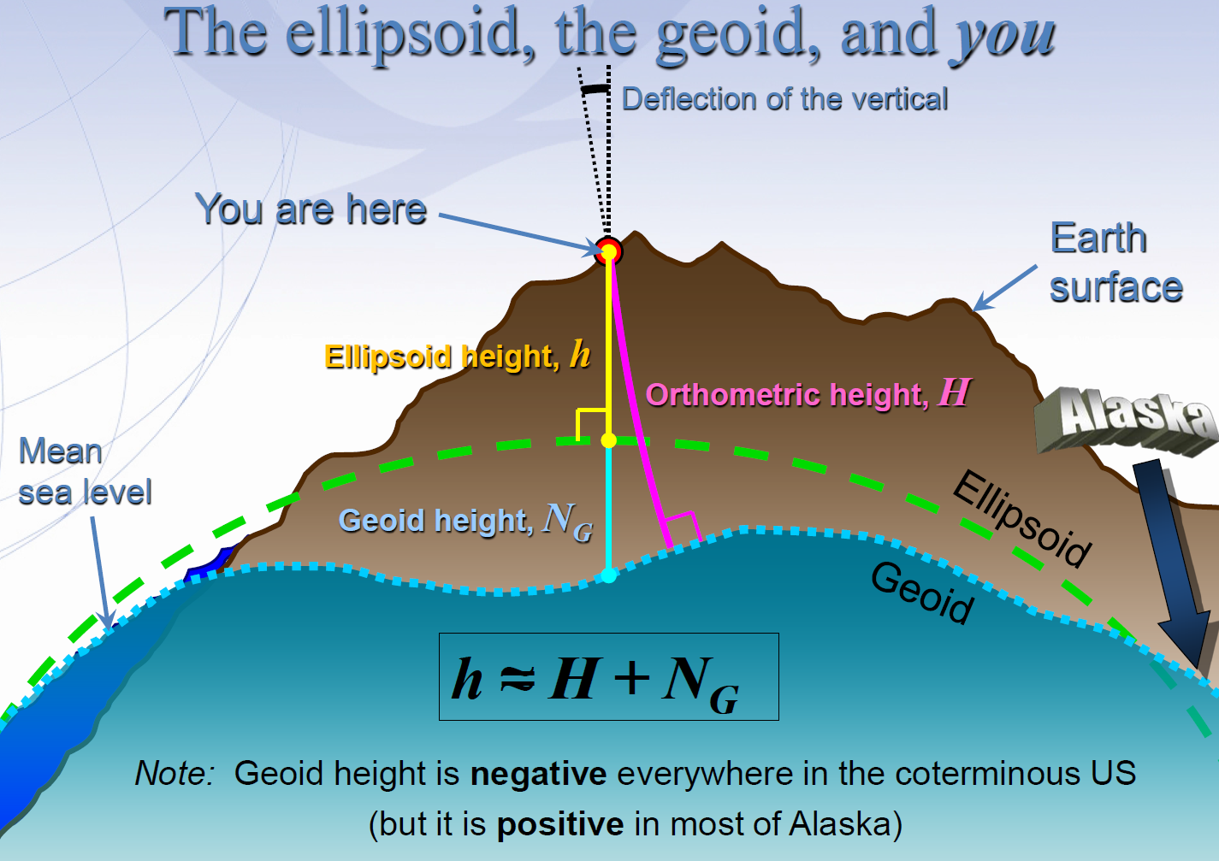
Notes:
GNSS Users get an ellipsoid height calculated from GNSS satellite data.
Ultimately we need an orthometric height (height in relationship to the geoid) to know where water will flow
Problem: we need to know the difference between the ellipsoid height and geoid (aka geoid height or undulation)
In the past this geoid height was calculated by NGS using large scale leveling and GNSS campaigns. Then provided to users through a realization of NAVD-88
The new NGS vertical datum North American-Pacific Geopotential Datum of 2022 will be based on gravimetric calculations rather than traditional leveling surveys

Slide 14
Types Uses and History of Geoid Height Models
Gravimetric (or Gravity) Geoid Height Models
  Defined by gravity data crossing the geoid
  Refined by terrain models (DEM’s)
  Scientific and engineering applications
Composite (or Hybrid) Geoid Height Models
  Gravimetric geoid defines most regions
  Warped to fit available GPSBM control data
  Defined by legislated ellipsoid (NAD 83) and local vertical datum (NAVD 88, PRVD02, etc.)
  May be statutory for some surveying & mapping applications

Slide 15
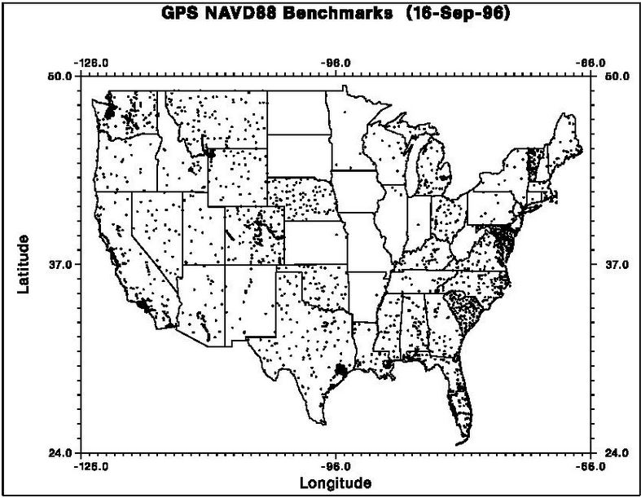
GPSBM1996: 2,951total 0 Canada STDEV ≈ 5 cm (2σ)

Slide 16

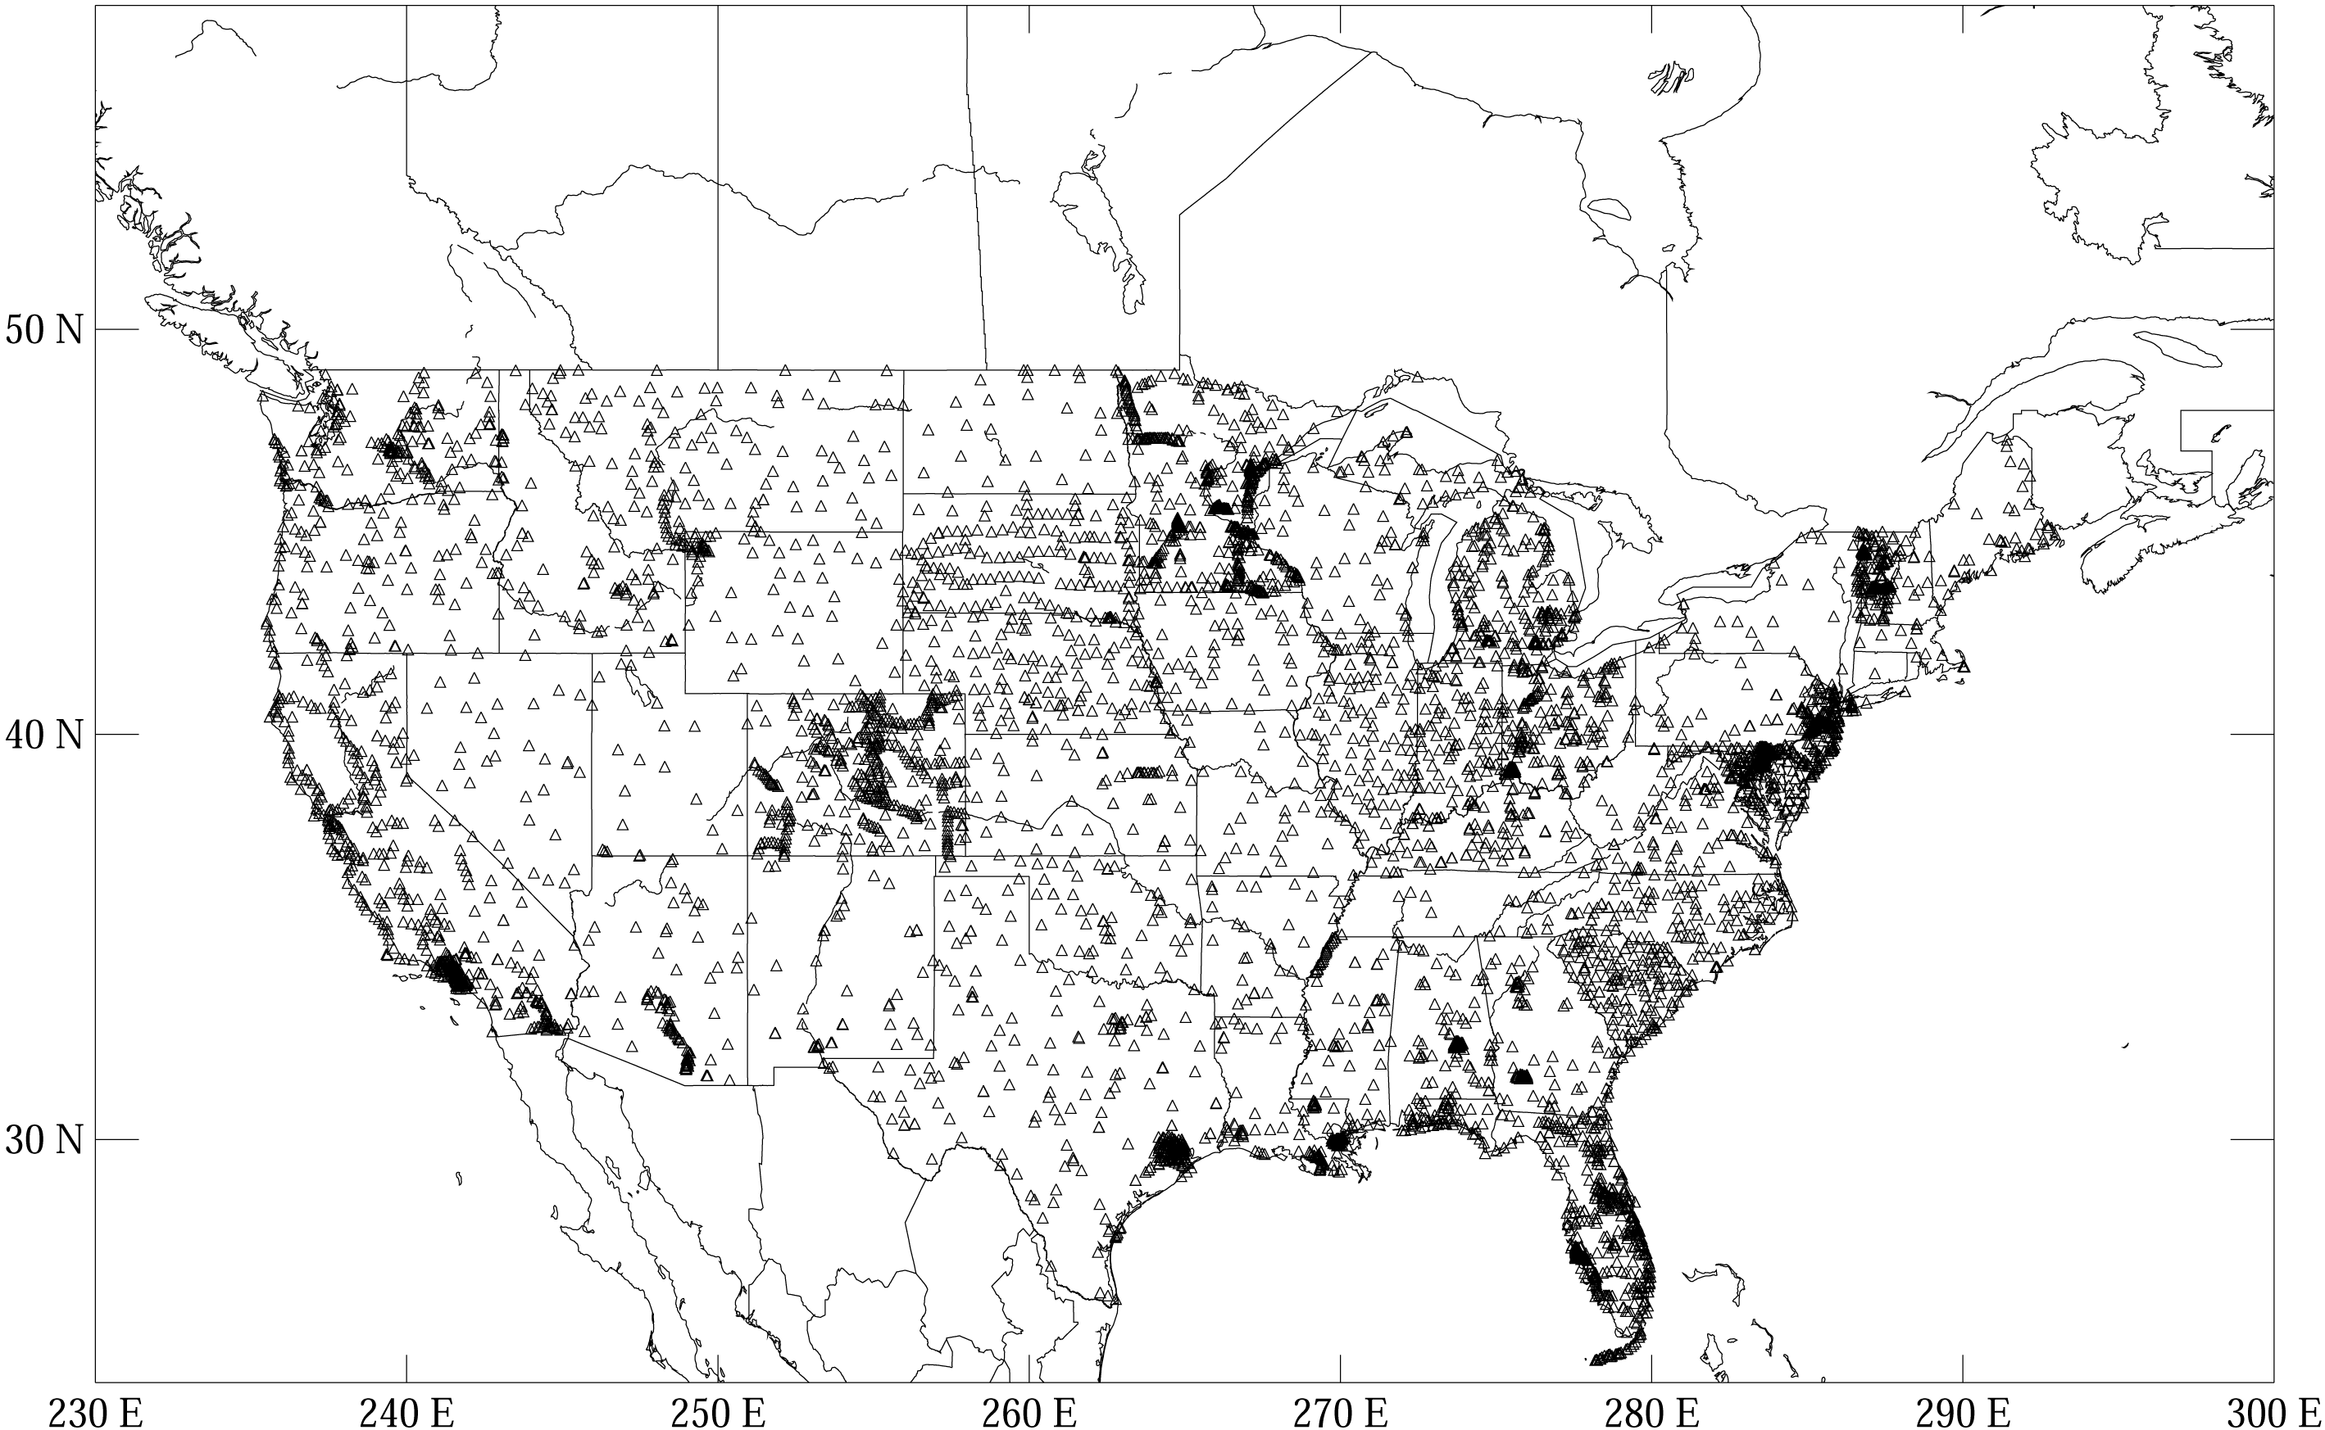
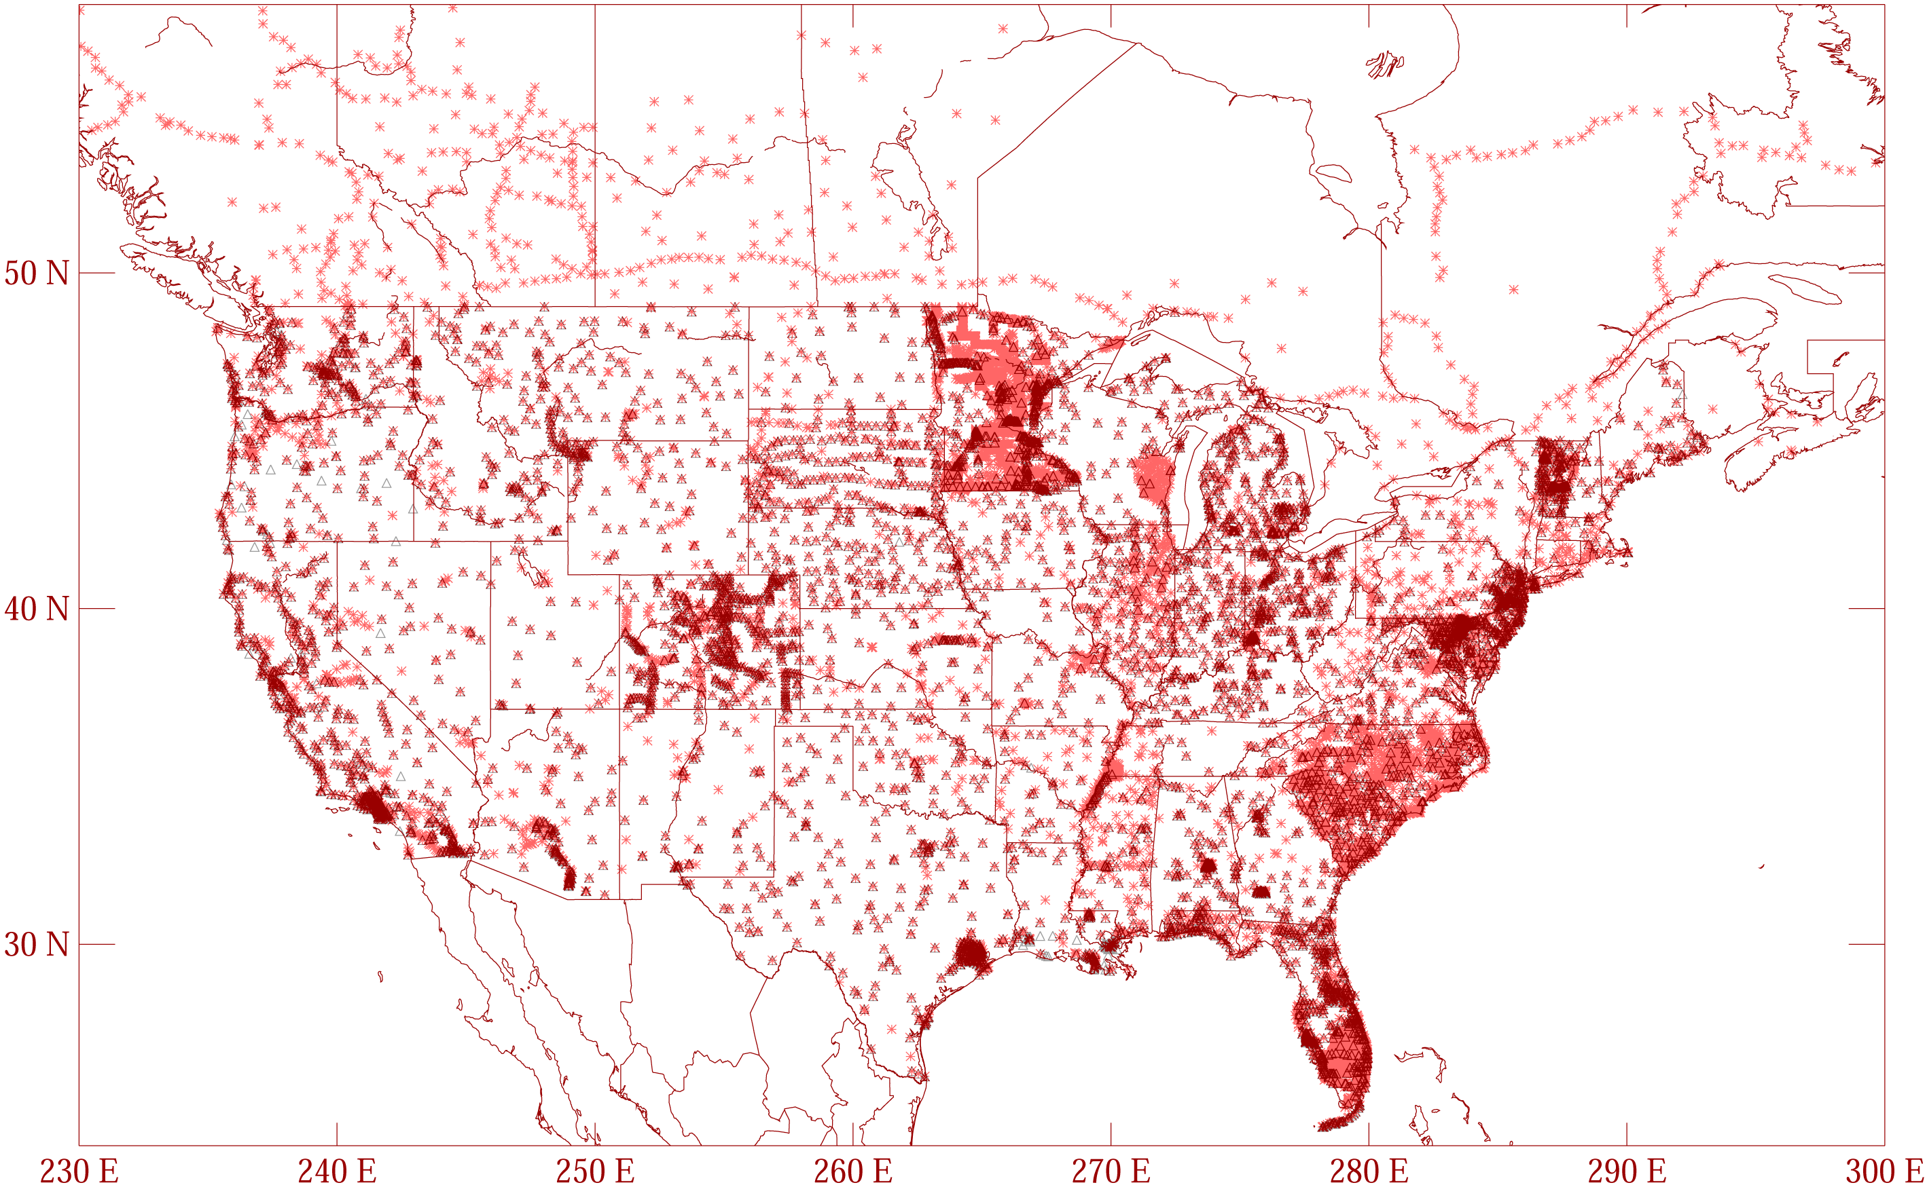
GPSBM1999: 6,169 total 0 Canada STDEV 9.2 cm (2σ)
GPSBM2003: 14,185 total 579 Canada STDEV 4.8 cm (2 σ)
Notes:
These are the control data used to make xGEOID06a, GEOID03 and GEOID99 (GPS on bench marks: GPSBM’s).
Improvements in Distribution are primarily due to obtaining data in Canada.
The bulk of the increase comes in one state: Minnesota (603 => 4161).
Note the inequitable distribution.
You could practically grid the GPSBM’s in South Carolina or Minnesota and get a good result.
Other places are not so fortunate…
Also note that this shows distribution but not quality of the points.
Some regions (e.g., Texas) have systematic quality problems (due to subsidence) that impact the GPSBM’s and the derived hybrid geoids.
Current techniques rely on creating models of the systematic effects at multiple wavelengths. If the spatial density doesn’t support the shorter wavelength models, then the quality of predictions will commensurately be reduced.
Note that a hyper-dense survey isn’t necessary to achieve optimal results. Later discussion on Minnesota will emphasize this.

Slide 17
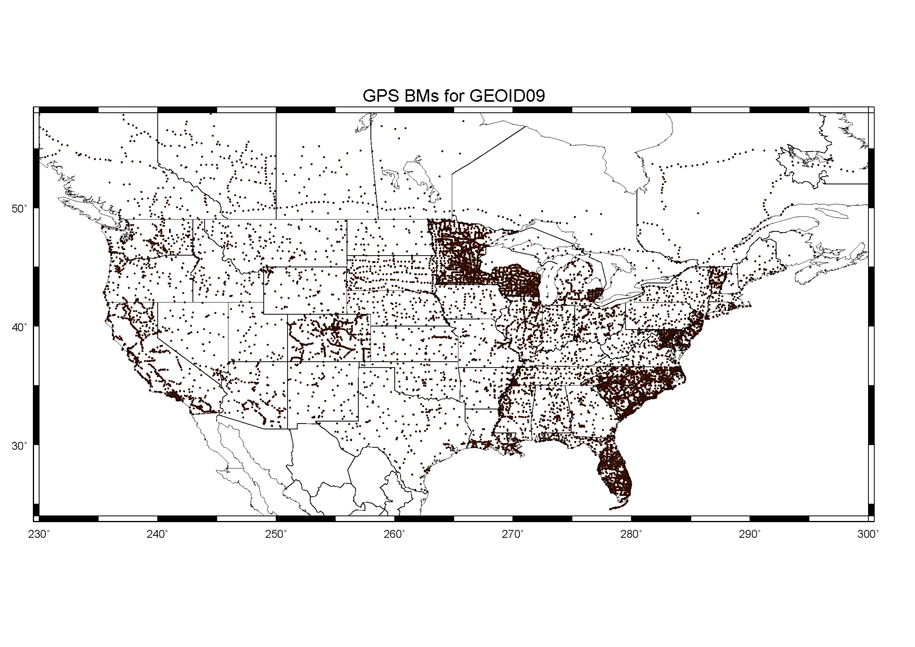
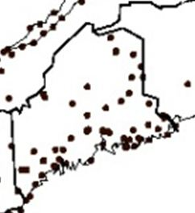
GGPSBM2009: 18,398 STDEV 2.8 cm (2σ)

Slide 18
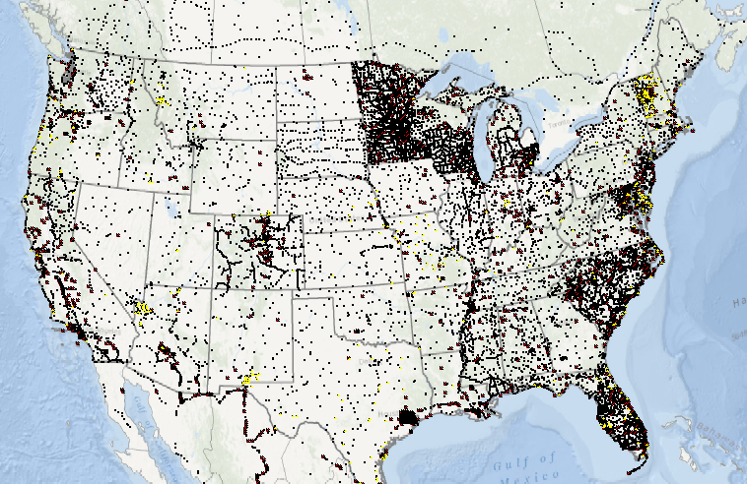
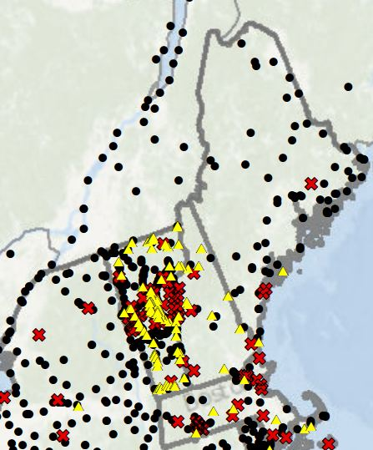
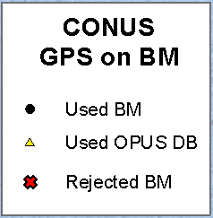
        GGPSBM2012A: 23,961 (CONUS)
        499 (OPUS on BM)
        574 (Canada)
        177 (Mexico)

Slide 19
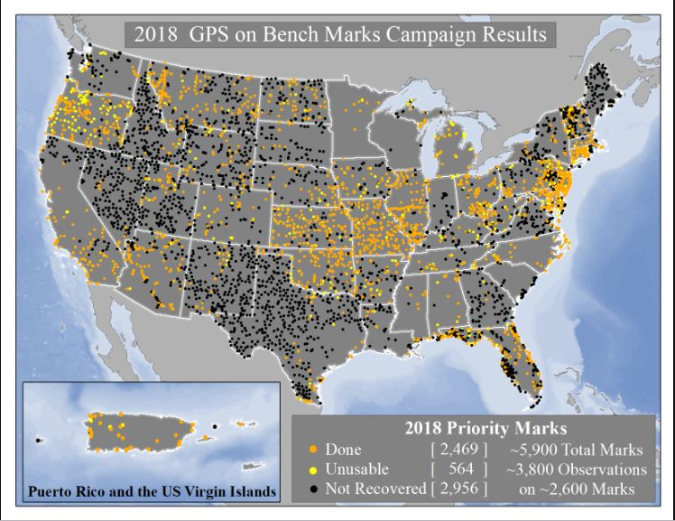
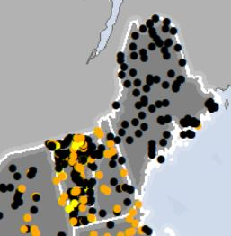

Slide 20
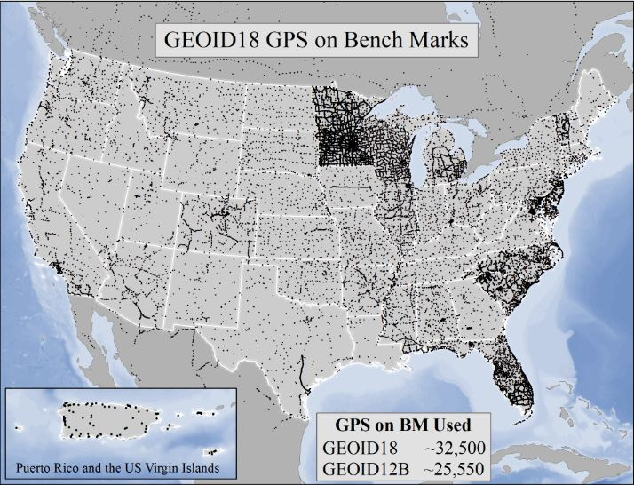
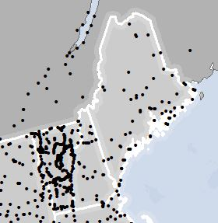
GPSBM2018 STDEV 2.5 cm (2σ)

Slide 21
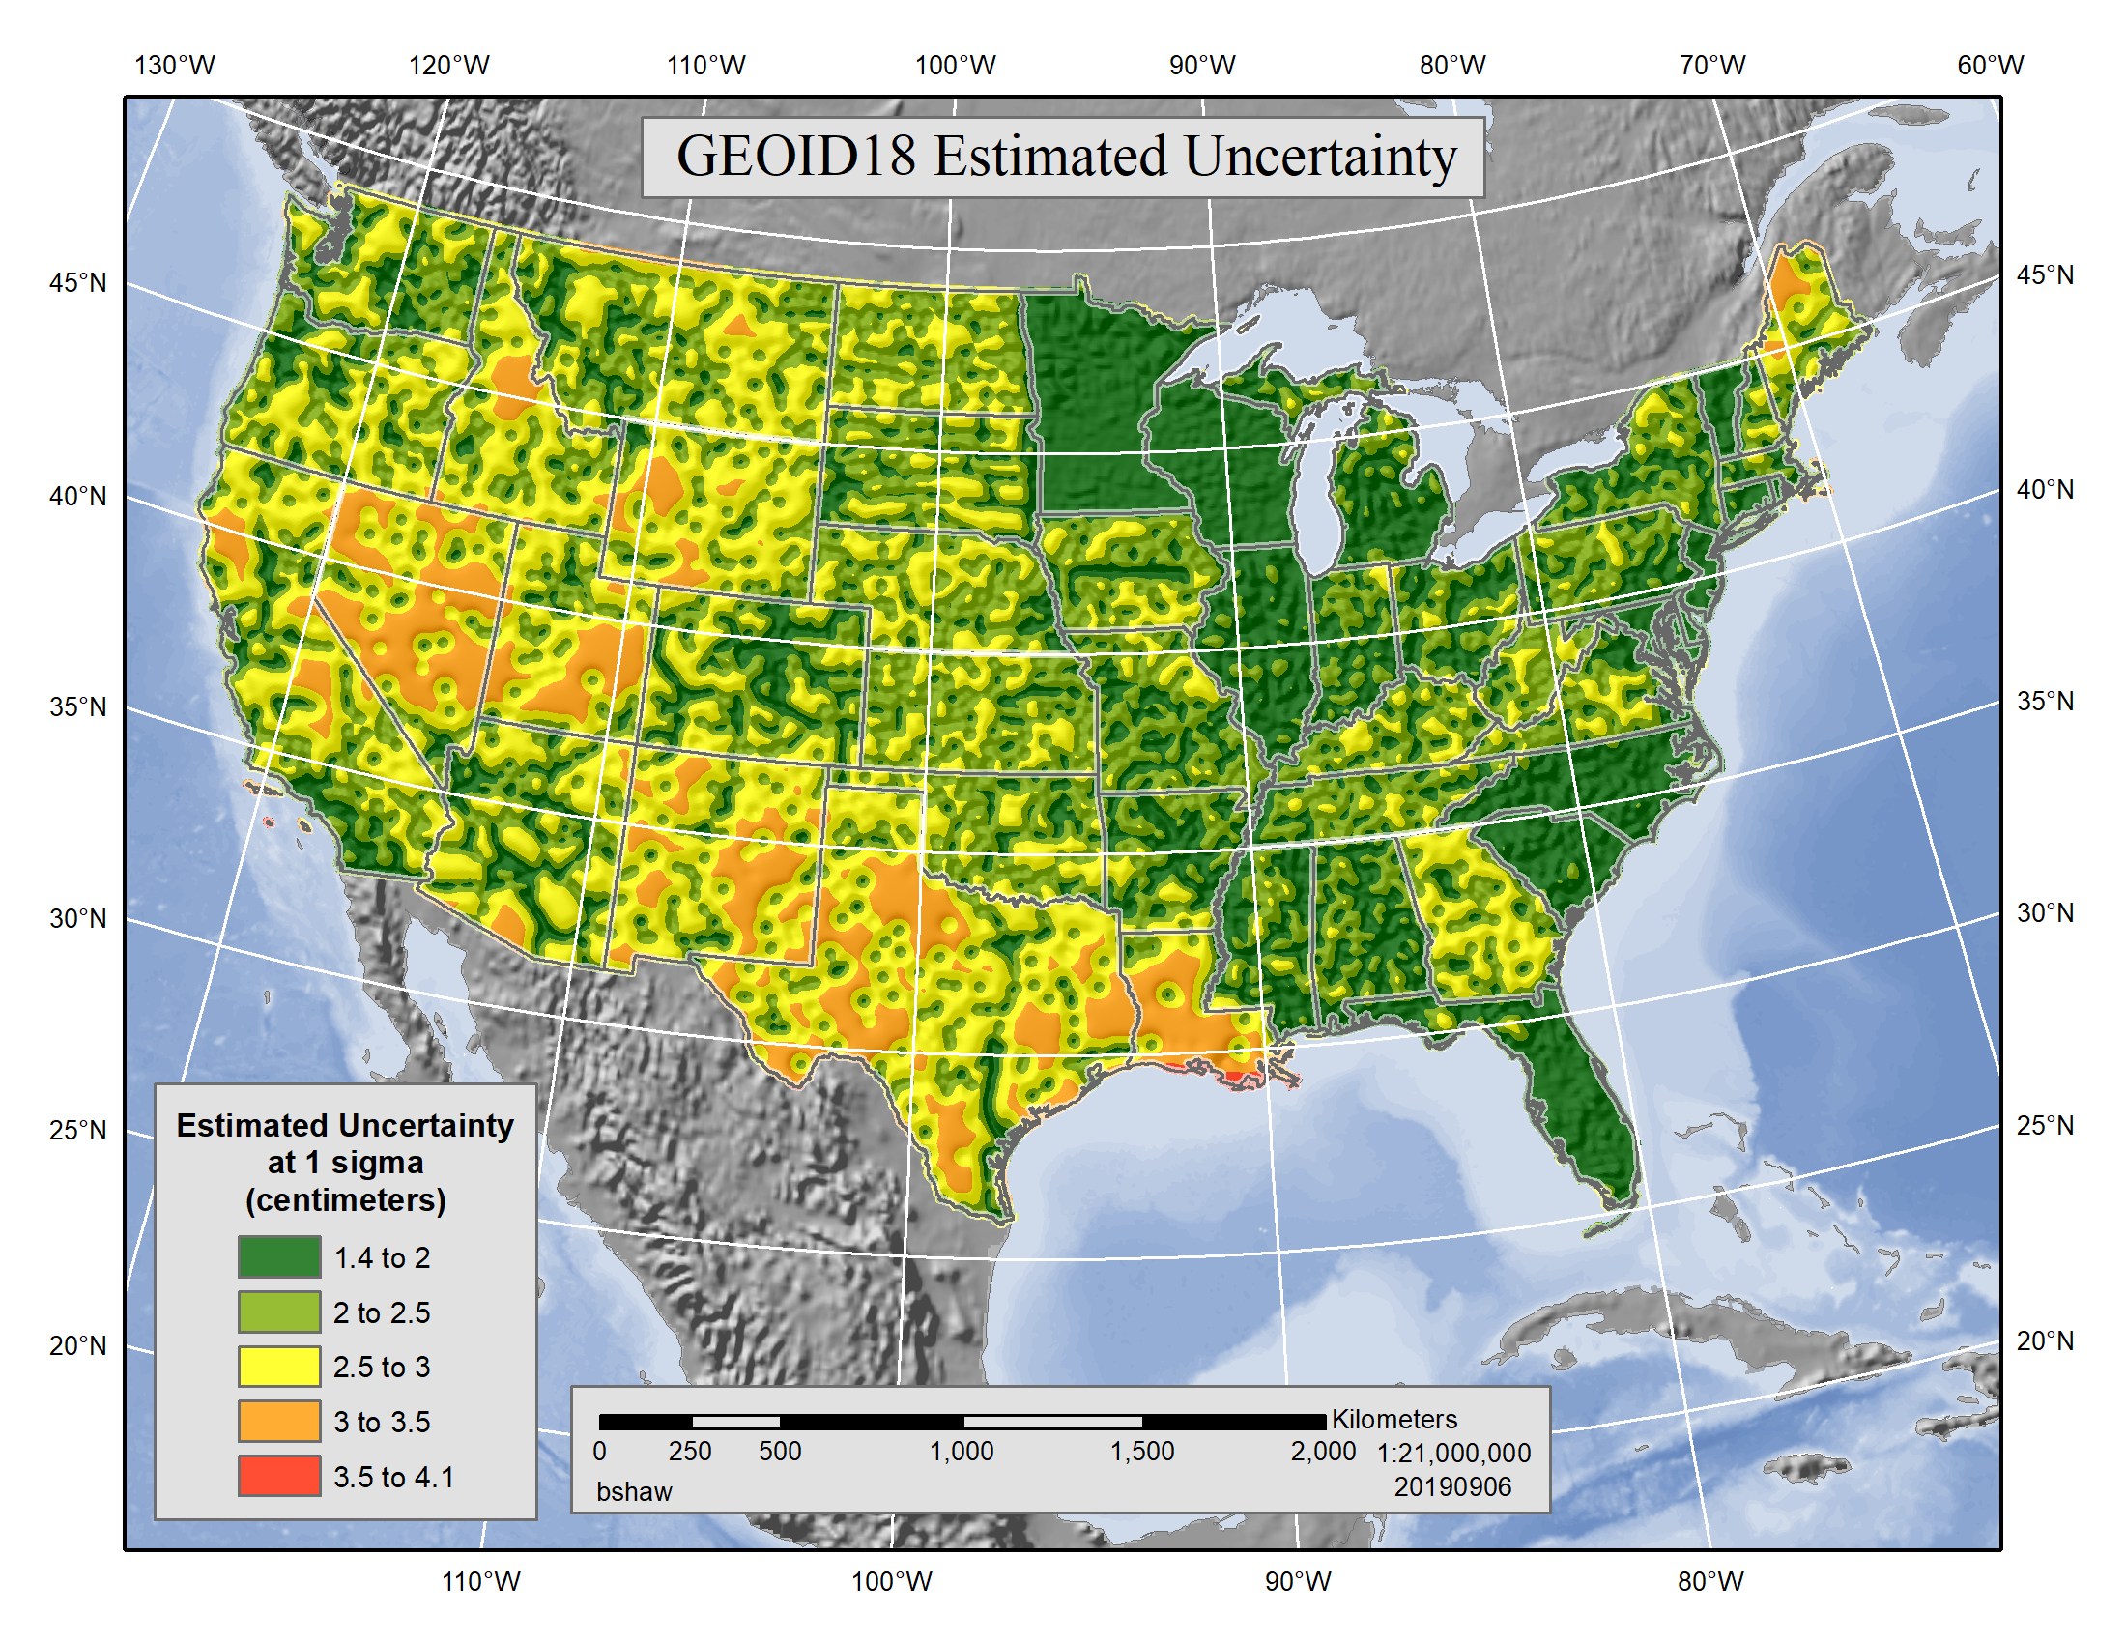
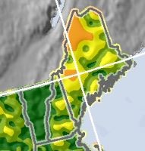

Slide 22
Which Geoid for Which NAD 83?
NAD 83(2011)
NAD 83(2007)
NAD 83(1996) & CORS96
Geoid18
Geoid12A/12B
Geoid09
Geoid06 (AK only)
Geoid03
Geoid99
Geoid96

Slide 23
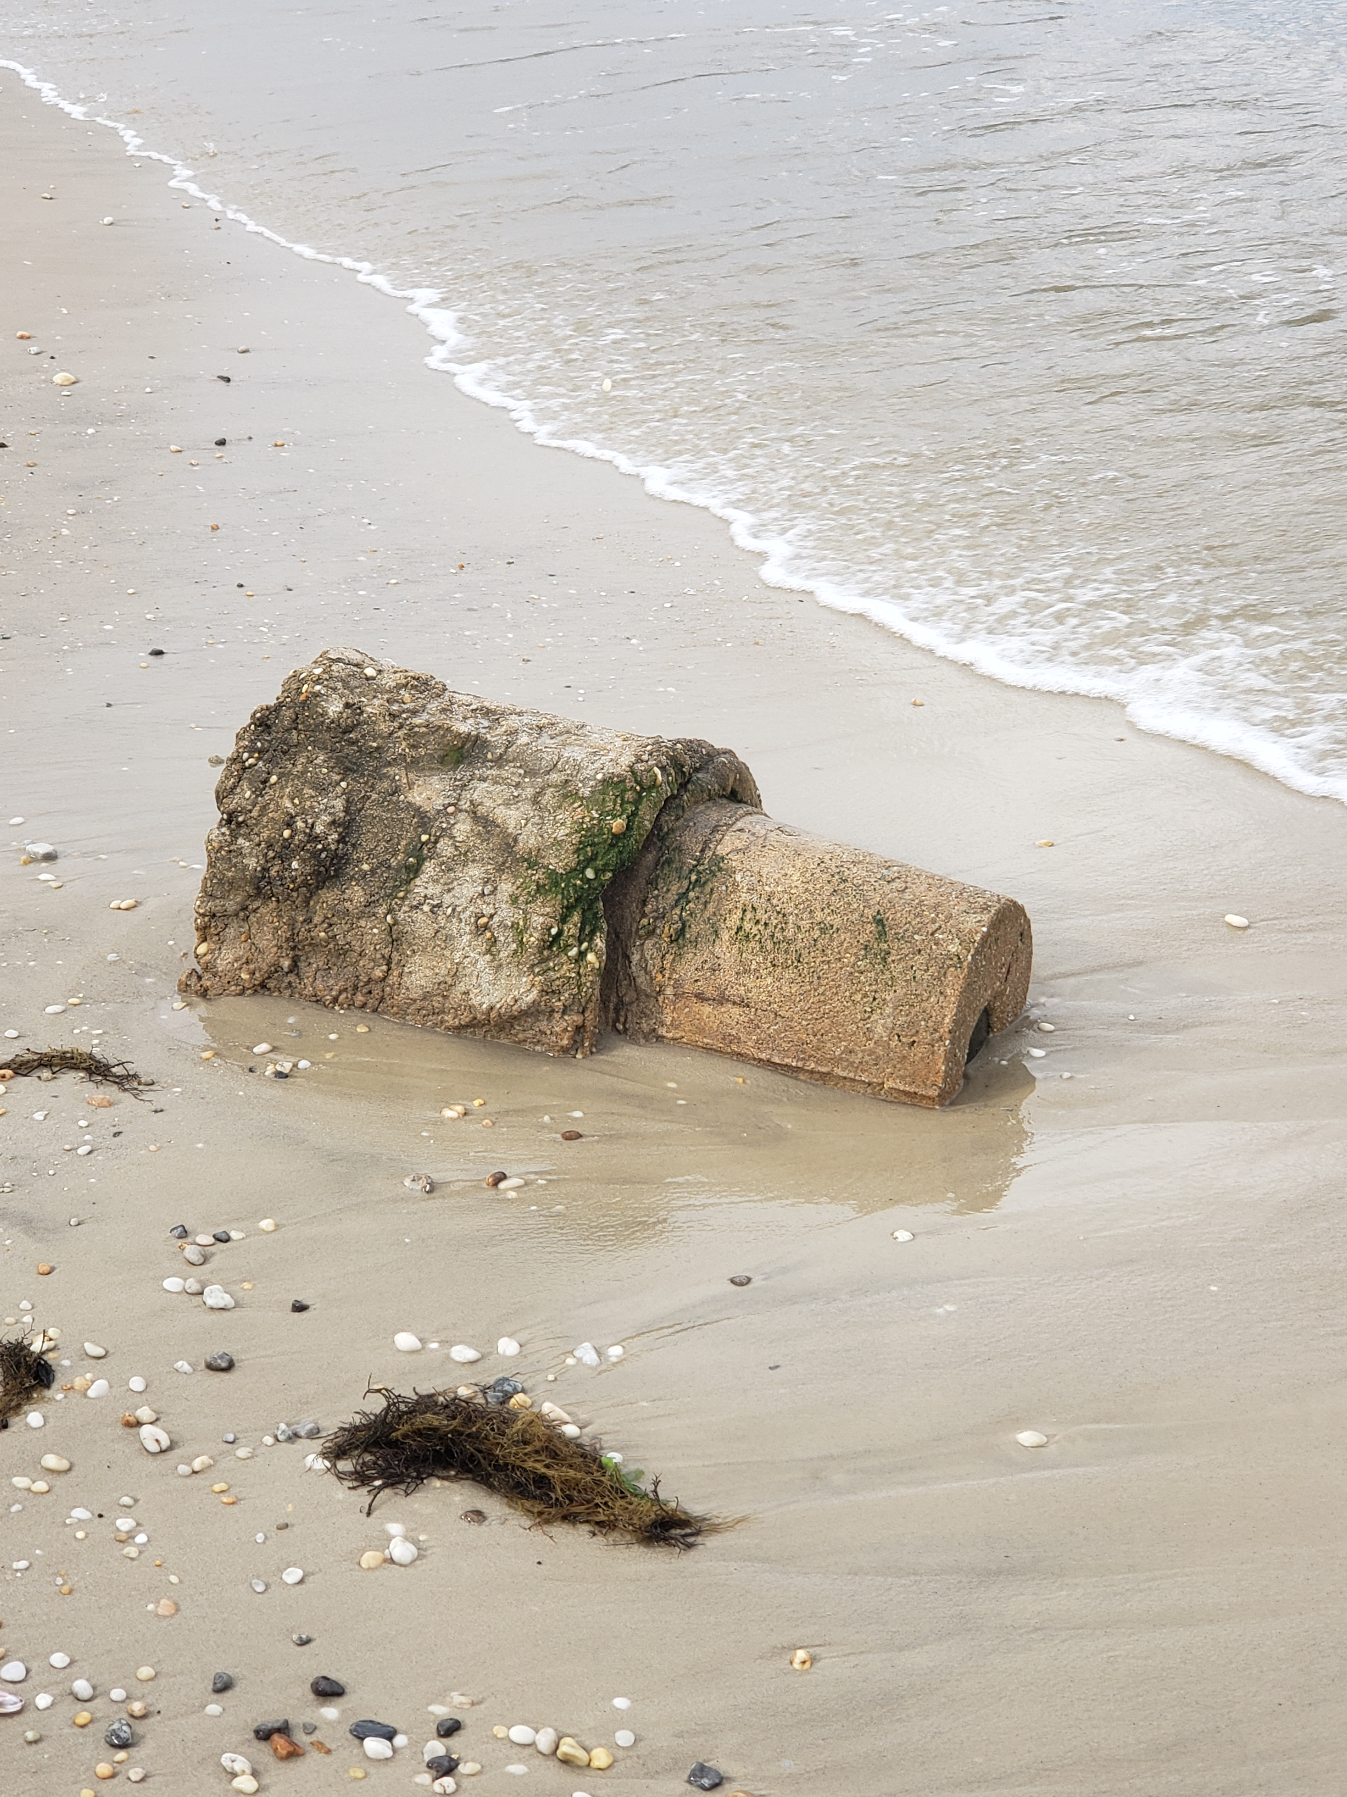
Problems with NAD 83 and NAVD 88
NAD 83 is not as geocentric as it could be (approx. 2 m)
  Positioning Professionals don’t see this - Yet
NAD 83 is not well defined with positional velocities
NAVD 88 is realized by passive control (bench marks) most of which have not been re-leveled in at least 40 years.
NAVD 88 does not account for local vertical velocities (subsidence and uplift)
  Post glacial isostatic readjustment (uplift)
  Subsurface fluid withdrawal (subsidence)
  Sediment loading (subsidence)
  Sea level rise (0.70 ft – 3.00 ft per 100 years)
    Bar Harbor, ME 2.0 mm/yr (0.007 ft/yr) 1947-2006
    Miami Beach, FL 2.39 mm/yr (0.008 ft/yr) 1931-1981
    Grand Isle, LA – 9.05 mm/yr (0.030 ft/yr) 1947- 2015
    Seattle, WA– 2.0 mm/yr (.007 ft/yr) 1899-2015

Slide 24
Why isn’t NAVD 88 good
enough anymore?
Earth’s
Surface
H (NAVD 88)
Η
NAVD 88 reference level
The Geoid
Errors in NAVD 88 : ~50 cm average,
100 cm CONUS tilt,
1-2 meters average in Alaska
Notes:
This slide shows what NGS now knows about the error in NAVD 88 itself. Using a continental geoid computed from the GRACE satellite, a bias and tilt in NAVD 88 has been computed using GPS derived ellipsoid heights on NAVD 88 bench marks. These are now known errors that exist in all NAVD 88 bench marks. This datum realization error, relative to the geoid, is over and above the errors from marks moving.

Slide 25
Why replace NAVD 88 and NAD 83?
ACCESS!
  easier to find the sky than a 60-year-old bench mark
  GNSS equipment is cheap and fast
ACCURACY!
  easier to trust the sky than a 60-year old bench mark
  immune to passive mark instability
GLOBAL STANDARDS!
  systematic errors of many meters across the US
  aligns with GPS, international efforts
  aligns with Canada, Mexico
Notes:
Things are looking up! GNSS technologies simplify and improve access to and accuracy of our spatial reference system.
While we can continue to leverage this technology to maintain the old datums, it makes sense to adopt GRAV-D results in an unpolluted form, and align it to modern global standards.

Slide 26

The National Geodetic Survey 10 year plan
Mission, Vision and Strategy
2008 – 2018, 2013-2023
http://www.ngs.noaa.gov/INFO/NGS10yearplan.pdf
Official NGS policy as of Jan 9, 2008
  Modernized agency
  Attention to accuracy
  Attention to time-changes
  Improved products and services
  Integration with other fed missions
2022 Targets:
  NAD 83 and NAVD 88 re-defined
  Cm-accuracy access to all coordinates
  Customer-focused agency
  Global scientific leadership
Notes:
Realization and unification of NAD83 in Canada and the U.S. via the ITRF.
http://www.geod.nrcan.gc.ca > Geodetic Survey Division > Publications > Papers

Slide 27
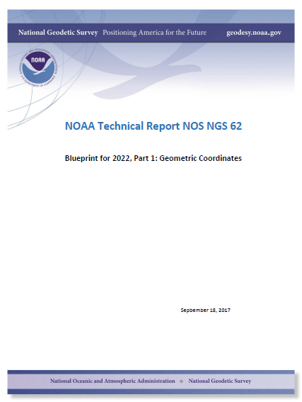
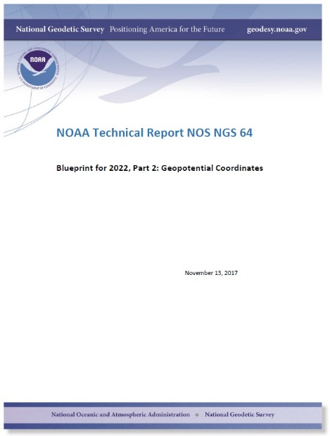
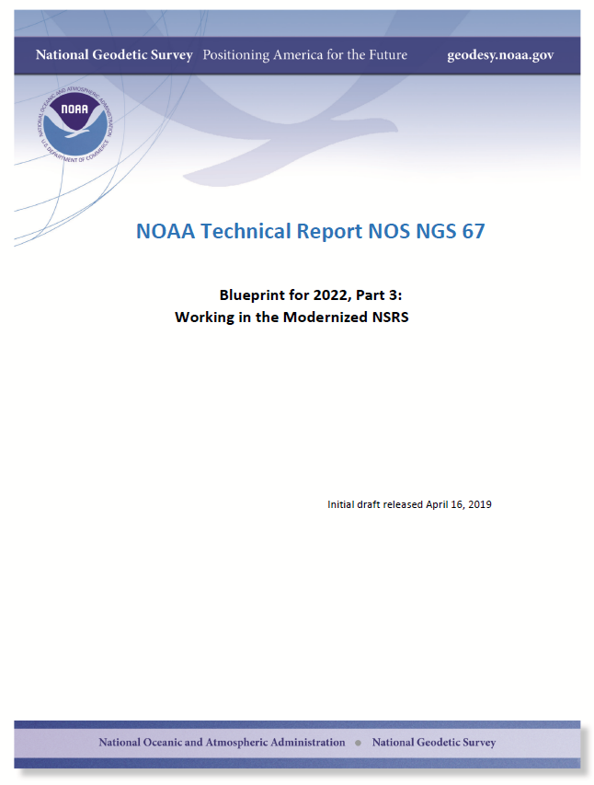
Modernizing the NSRS
The “blueprint” documents: Your best source for information
Geometric:
Sep 2017
Geopotential:
Nov 2017
Working in the
modernized NSRS:
April 2019

Slide 28
Scientific Decisions
Blueprint for 2022, Part 1: Geometric
  Four plate-fixed Terrestrial Reference Frames
    And what “plate fixed” means
  Mathematical equation between IGS and TRFs
    Plate Rotation Model for each plate
    Coordinates at survey epoch
  Intra-frame velocity model
    To compare coordinates surveyed at different epochs

Slide 29
Replacing the NAD 83’s
Three plate-(pseudo)fixed frames will be replaced with four plate-fixed reference frames
  N. Amer., Pacific, Mariana, Caribbean(new!)
Remove long-standing non-geocentricity of NAD 83 frames
All four : identical to IGSxx at a TBD epoch
  2020.00?
All four : differ from IGSxx by plate rotation only
  Updated Euler Pole determination for rigid plate only

Slide 30
Names
The Old:
NAD 83(2011)
NAD 83(PA11)
NAD 83(MA11)
The New:
The North American Terrestrial Reference Frame of 2022
(NATRF2022)
The Caribbean Terrestrial Reference Frame of 2022
(CTRF2022)
The Pacific Terrestrial Reference Frame of 2022
(PTRF2022)
The Mariana Terrestrial Reference Frame of 2022
(MTRF2022)

Slide 31
Scientific Decisions!!
Blueprint for 2022, Part 2: Geopotential
  Global 3-D Geopotential Model (GGM)
    Will contain all GRAV-D data
    Able to yield any physical value on/above surface
  Special high-resolution geoid, DoV and surface gravity products consistent with GGM
    Not global: NA/Pacific, American Samoa, Guam/CNMI
  Time-Dependencies
    Geoid monitoring service
      Impacts of deglaciation, sea level rise, earthquakes, etc

Slide 32
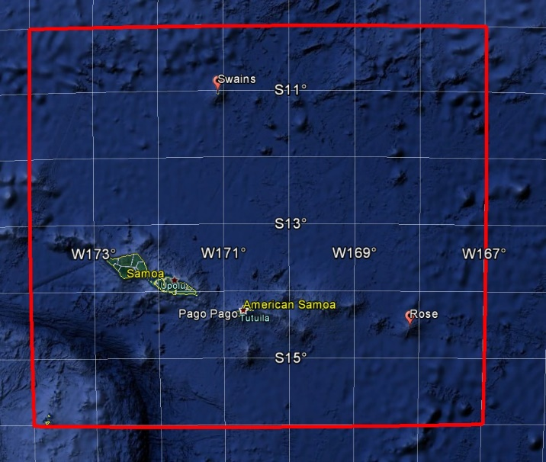
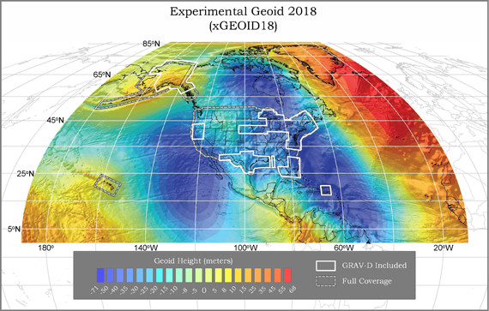
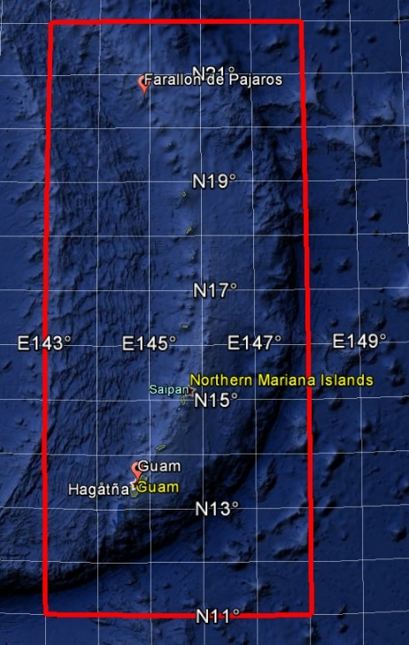
GEOID2022 (et al) over American Samoa:
-16 to -10, 186-193
GEOID2022 (et al) over Guam/CNMI:
11-22, 143-148
GEOID2022 (et al) over the North America/Pacific/Caribbean/Central America/Greenland region will range from
0 to 90 latitude and from 170 to 350 longitude.

Slide 33
Names
  The Old:
  NAVD 88
  PRVD 02
  VIVD09
  ASVD02
  NMVD03
  GUVD04
  IGLD 85
  IGSN71
  GEOID12B
  DEFLEC12B
Orthometric
Heights
  The New:
  The North American-Pacific Geopotential Datum of 2022 (NAPGD2022)
  - Will include GEOID2022
one vertical datum
pole-to-equator
Normal
Orthometric
Heights
Dynamic
Heights
Gravity
Geoid
Undulations
Deflections of
the Vertical

Slide 34
The wrong question, circa 2022:
“What’s the position of that point?”
The right question, circa 2022:
“What’s the position of that point, on some specific date?”
Drift…
Notes:
-why??
-because of that word down there: drift

Slide 35
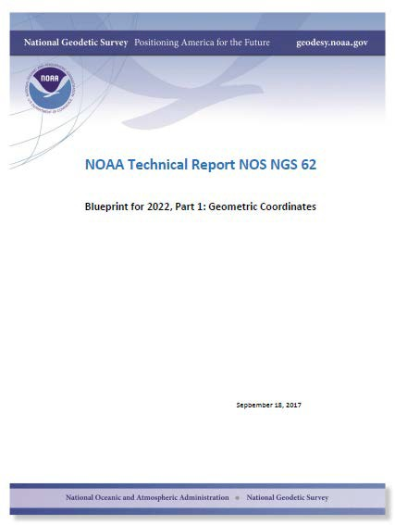
North American Terrestrial Reference Frame of 2022
(NATRF2022)
Notes:
-remember, we covered 4 reference frames but if you’re just working in this region, you only have to be concerned with NATRF
-almost everything I’ve covered thus far is in this TR or Technical Report available on our website

Slide 36
North American Terrestrial Reference Frame of 2022
NATRF2022
(pronounced: nat-ref)

Slide 37
Reference Frame ≈ Datum
Reference Frame is a more scientifically appropriate way of saying “datum”
could be debated that “datum” was misused
you will continue to see NGS use the phrase “New Datums” for 2022
Notes:
-for sanity and brevity’s sake…
-could be debated that “datum” was misused for many years in ellipsoidal coordinates
-even though the geometric/horizontal portion will officially be titled a “reference frame”

Slide 38
Reference Frame Defined
A point of view or a ‘frame of reference’.
If your reference frame is North America, you are standing somewhere within North America, seeing how other places move from your point of view.
Notes:
--Also table/podium example

Slide 39
Replacing NAD83
develop four "plate-fixed" reference frames
remove non-geocentricity of NAD83
align to ITRF2014 at epoch 2020.00
remove most of tectonic plate rotation from ITRF2014 via Euler Pole Parameters
(pronounced: “oiler”)
Shift and Drift…

Slide 40
Four “Plate-Fixed” Reference Frames
+
North American Terrestrial Reference Frame of 2022
(NATRF2022)
Pacific Terrestrial Reference Frame of 2022
(PATRF2022)
Caribbean Terrestrial Reference Frame of 2022
(CATRF2022)
Mariana Terrestrial Reference Frame of 2022
(MATRF2022)
Notes:
-We refer them as “plate-fixed” because the frame moves with the plate, to minimize time-based coordinate shift. We’ll cover that in more detail, I have some slides I put together that I guarantee you’ll understand it, if not I’ll buy you a beer later. No, not really.

Slide 41
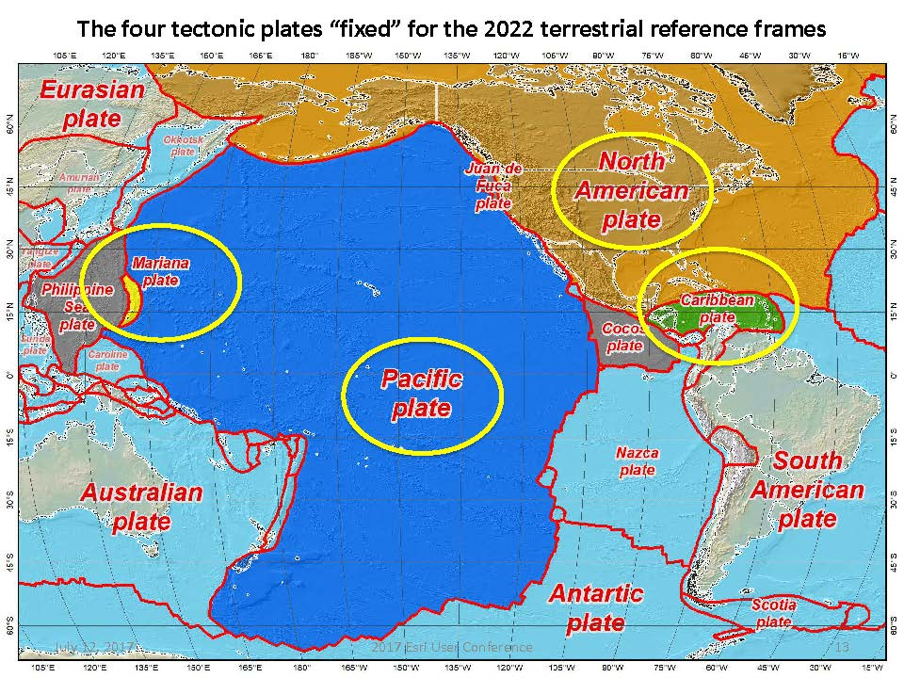
Notes:
-there’s four reference frames because there are four major tectonic plates within the NGS Area of Responsibility.
-As the National Geodetic Survey, we’re part of the DoC so we must cater to all US States and Territories
-thus we’ve got four tectonic plates in our Area of Operations, so four Ref Frames
-But…

Slide 42
Replacing NAD83
develop four "plate-fixed" reference frames
remove non-geocentricity of NAD83
align to ITRF2014 at epoch 2020.00
remove most of tectonic plate rotation from ITRF2014 via Euler Pole Parameters
(pronounced: “oiler”)
Shift and Drift…
Notes:
-NON-geocentricity… well the goal was a geocentric NAD but it was the 80s, so they were off a little bit

Slide 43
Non-geocentricity of NAD83
Earth’s
Surface
h₁₄
h₈₃
NAD83
origin
ITRF2014
origin
~2.2 meters
GRS80
ellipsoid
Notes:
-picture this, there’s one quarter of an ellipsoid, notice they are the same geometry (size, shape) but different origin

Slide 44
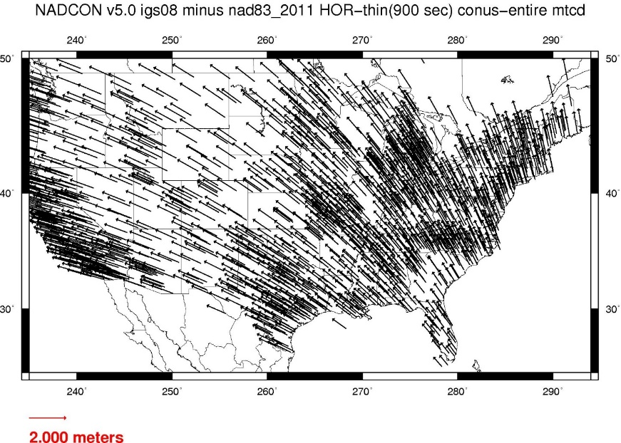
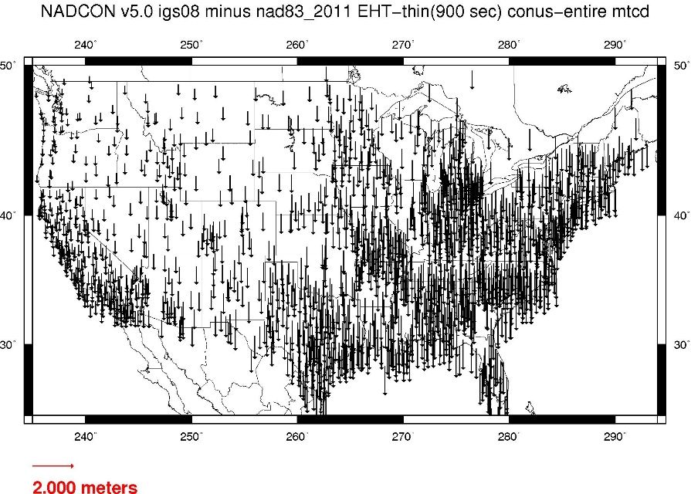
Geometric change due to ellipsoid non-geocentricity
Horizontal (Lat, Lon)
Ellipsoidal (h)
Shift…
Notes:
-Estimate of shift from NAD83(2011) epoch 2010.00 to NATRF2022 epoch 2020.00
-so this represents the positional shift due to non-geocentricity that we’re addressing/fixing
-now remember this is the Geometric component only, so the graphic on the right illustrates a somewhat constant shift because it is representing Ellipsoidal shift, not Orthometric
-Look at the size of those arrows, based on the scale bar there we’re looking at about 1 meter-ish lat,lon shift and somewhere around the same ellipsoidally around here
-REMEMBER, this is easy to address compared to geoid/ortho heights!

Slide 45
Replacing NAD83
develop four "plate-fixed" reference frames
remove non-geocentricity of NAD83
align to ITRF2014 at epoch 2020.00
remove most of tectonic plate rotation from ITRF2014 via Euler Pole Parameters
(pronounced: “oiler”)
Shift and Drift…
Notes:
We’ll talk about that ‘plate fixed’ later.
Now wait a minute Jeff, what is the IGS? You just explained the ITRF and told us about that!!
IGS Reference Frame is pretty much equivalent to the ITRF, created by the Intl. GNSS Service, of which NGS is a contributing partner.
The Intl. GNSS Service, let’s take a look at their website for a minute.
-pronounced “oiler” poles

Slide 46
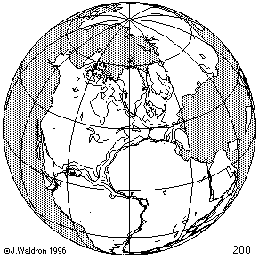
ITRF concept
Watch the grid!
Drift…
Notes:
Ok, now ITRF mentioned a couple slides ago.
Most simplistic way to explain ITRF is to watch this animation.
This is a very loose representation/visualization of what the ITRF is, a characterization only.

Slide 47
Replacing NAD83
develop four "plate-fixed" reference frames
remove non-geocentricity of NAD83
align to ITRF2014 at epoch 2020.00
remove most of tectonic plate rotation from ITRF2014 via Euler Pole Parameters
(pronounced: “oiler”)
Shift and Drift…
Notes:
We’ll talk about that ‘plate fixed’ later.
Now wait a minute Jeff, what is the IGS? You just explained the ITRF and told us about that!!
IGS Reference Frame is pretty much equivalent to the ITRF, created by the Intl. GNSS Service, of which NGS is a contributing partner.
The Intl. GNSS Service, let’s take a look at their website for a minute.
-pronounced “oiler” poles

Slide 48
Two types of drift
Tectonic Plate Rotation
    horizontal
Everything Else
    residual motions left after rotation
    regional linear motions
    localized subsidence or uplift
simple to model
complex
Notes:
-there’s two types of drift you’ll see

Slide 49
Tectonic Plate Rotation
    Horizontal
simple to model
Euler Pole Parameters
of 2022
EPP2022
Notes:
-there’s two types of drift you’ll see

Slide 50
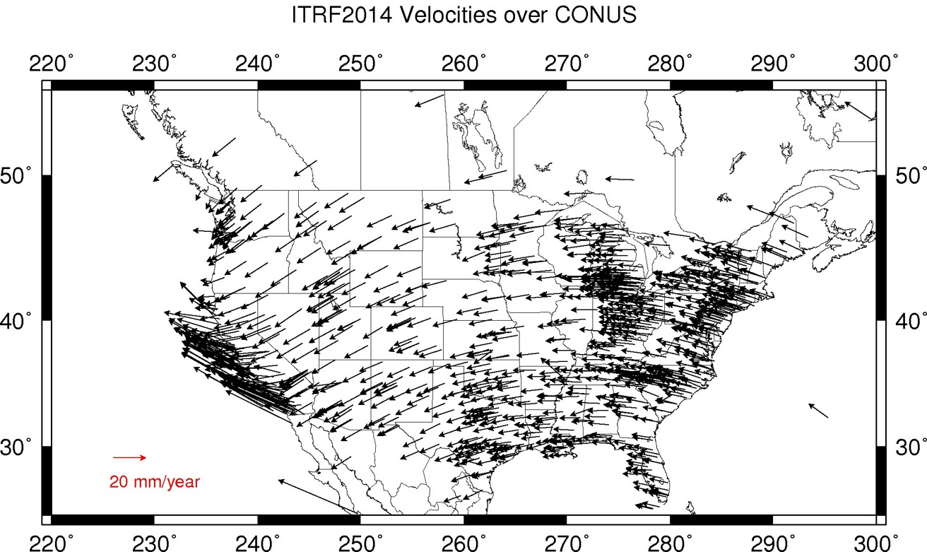
Plate Rotation visualized
Drift…
Notes:
-these are ground-level horizontal velocities
-the arrows illustrate the positions and velocities of CORS plotted in ITRF2014
-our scale is on the left there, with that arrow representing 20mm of motion per year
-so right thru Ohio it’s a little cluttered but we’re seeing arrows about that length so about 2cm/20mm per yr
-what do we notice about the direction of these arrows?
-they look rotational, don’t they?
CLICK HERE
-Note the arrows in California do not conform to the rotation… those are CORS on a different PLATE which is moving in a different direction
CLICK HERE
-so when you look at those arrows you can see the rotation, but the point of rotation is obviously off the map, way down below the screen right?
-that point is what’s known as an Euler Pole

Slide 51
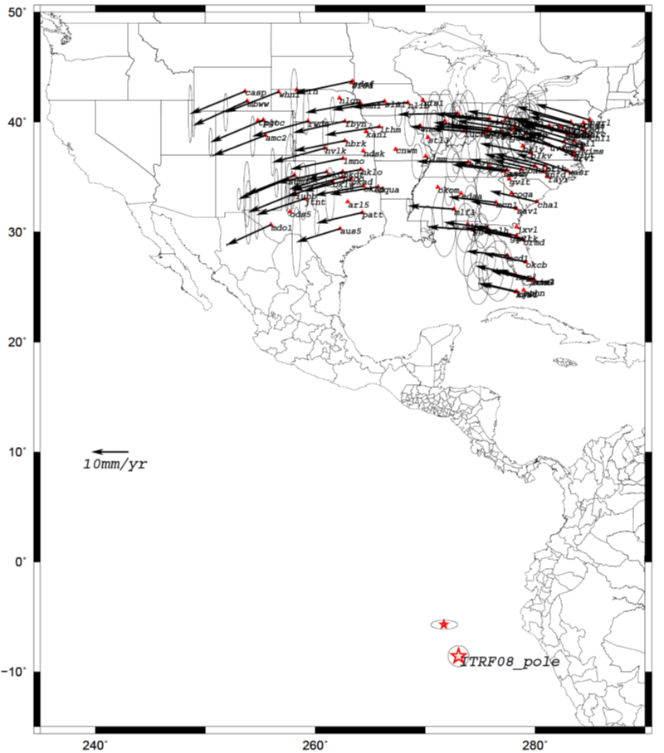
Euler Poles and “Plate-Fixed”
  In the ITRF, many tectonic plates have a dominant motion: rotation
  Euler Pole - point about which a plate rotates (yellow star)
  Euler Pole Parameters
    Lat
    Lon
    Rotation Rate
NATRF2022 Euler Pole
Notes:
We say “NATRF2022” is “fixed” to the N.A. Plate, making it a “plate fixed” frame
-the frame is constant to itself, but rotating within ITRF, and moving in a different direction than the other 3 frames

Slide 52
Euler Poles and “Plate-Fixed”
ITRF
Frame = constant
NA Plate = rotating
NATRF
Frame = rotating
(relative to ITRF)
NA Plate = constant
(relative to NATRF2022)
Notes:
We say “NATRF2022” is “fixed” to the N.A. Plate, making it a “plate fixed” frame
-the frame is constant to itself, but rotating within ITRF, and moving in a different direction than the other 3 frames

Slide 53
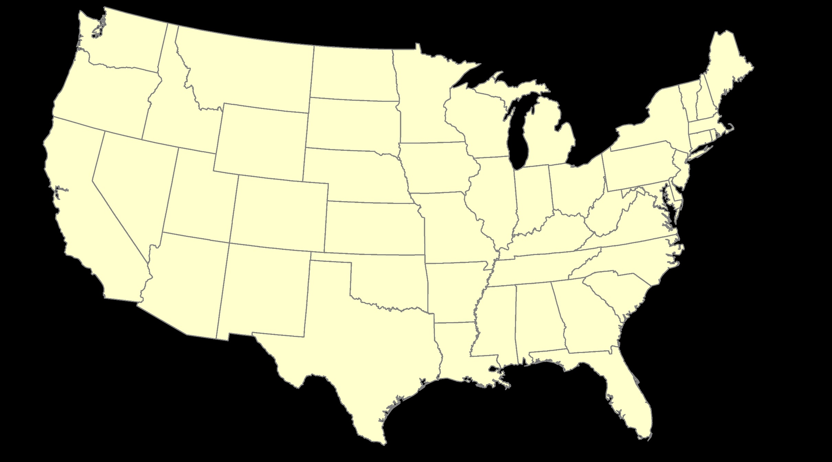
ITRF – constant frame, rotating plate

Slide 54
“Plate-Fixed”
NATRF – rotating frame, constant with plate

Slide 55
ITRF or NATRF – your choice, just use EPP

Slide 56
CORS Velocities in ITRF2014
Drift…

Slide 57
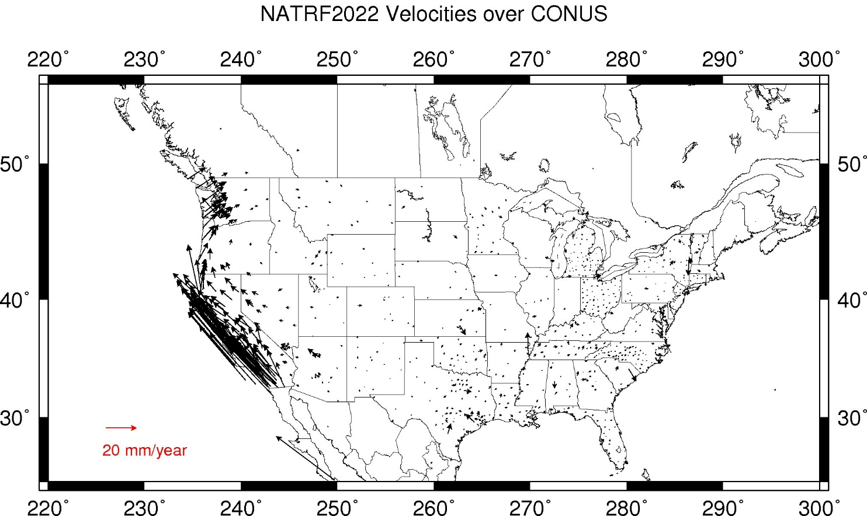
CORS Velocities in NATRF2022
Think of this map as ITRF2014 + EPP2022
Still SomeDrift…
Notes:
These velocities the motion that is left after removing Euler Pole rotation via it’s defining parameters, known simply as Euler Pole Parameters or EPP
These small bare visible arrows in our region are residual velocities leftover after modeling that Euler pole, which will then be modeled into the IFVM for NATRF2022.

Slide 58
ITRF2014 + EPP2022 = --TRF2022
Rotation of the
North American Plate
The North American Terrestrial Reference Frame of 2022
(NATRF2022)
The Caribbean Terrestrial Reference Frame of 2022
(CATRF2022)
The Pacific Terrestrial Reference Frame of 2022
(PATRF2022)
The Mariana Terrestrial Reference Frame of 2022
(MATRF2022)
Rotation of the
Caribbean Plate
ITRF2014
Rotation of the
Pacific Plate
Rotation of the
Mariana Plate
EPP2022
Notes:
-So it all starts with ITRF
-OPUS is already running all your processing in ITRF, take a look at one of your recent solution reports and you’ll see ITRF2014 coordinates on the right hand side (or IGS/IGb08)
-Not just North America, Each plate gets a set of EPP associated with it, as each plate is rotating around a different Euler Pole

Slide 59
Two types of drift
Tectonic Plate Rotation
    horizontal
Everything Else
    residual motions left after rotation
    regional linear motions
    localized subsidence or uplift
simple to model
complex
Notes:
-there’s two types of drift you’ll see

Slide 60
Everything Else
    residual motions left after rotation
    regional linear motions
    localized subsidence or uplift
Still SomeDrift…
complex
Notes:
-there’s two types of drift you’ll see

Slide 61
Intra-Frame Velocity Model of 2022
IFVM2022

Slide 62
Concept of goal of IFVM
Longitude (Easting) History of DI4044
Trend: -1.7 mm / year
RED IS NATRF2022
COORDINATE
Still Some Drift…
Trend: -14.3 mm / year
BLUE IS ITRF COORDINATE
2004 2006 2008 2010 2012 2014 2016 2018
Notes:
First look at that blue line, that is the velocity of DI4044 if we graph it’s easting coordinate in ITRF over 10+ years.
So look at the reddish line, that’s the longitude/easting of PID DI4044 after the EPP (rotation) is modeled and factored in, but before the IFVM is applied.
This is the velocity of the point in NATRF2022
Rotation of plate removed. It is not constant because the point still suffers small “intra-frame” velocities.
Such IFVs will be captured in a model by NGS.
The intent of the IFVM is to remove even that movement to better support coordinate comparisons, etc.

Slide 63
Still Some Drift…
  Everything in the world moves
  Coordinates will be associated with the actual date when the data was collected!
  Velocities at all marks can be estimated using this Intra-Frame Velocity Model
  IFVM goal is to move collected data thru time to Reference Epochs for coordinate comparisons/analysis

Slide 64
Intra-Frame Velocity Model
A model of all residual velocities, after removal of tectonic rotation via EPP:
  Horizontal residual motion
  Total vertical motion (ellipsoid heights)
  Replaces / Improves upon HTDP
Given t₁ and t₂, compute Df, Dl, Dh at any point, accounting for all motions (drifts, earthquakes, GIA, etc.)
Likely be built upon CORS data, geodynamic models and InSAR
Notes:
-Model of all residual/leftover horizontal velocities after applying those EPPs
HTDP hasn’t been updated, but the IFVM will be even better than HTDP.
That bottom bullet is what the current plan is stating

Slide 65
EPP2022 – Euler Pole Parameters – Simple Rotation
  Three parameters: lat, lon, rotation speed
  Horizontal only: just latitude and longitude
  Changes the frame: ITRF2014 + EPP2022 = NATRF2022
  Does not change the epoch
IFVM2022 – Intra-Frame Velocity Model - Complex
  Complex set of parameters
  Residual horizontal motion: all the motion leftover after Euler Pole rotation
  All vertical motion: localized subsidence or uplift
  Changes the epoch
  Does not change the frame: “intra” = on the inside; within

Slide 66
Example of application of EPP and IFVM
It’s 2039 and you are working in San Diego using NATRF2022
And you need to compare your work to another survey from 2028
Important: This slide only covers geometric coordinates.
…the catch is, that survey was done in PATRF2022
PATRF2022
ep. 2028.048
EPP2022
(PA)
ITRF2014
ep. 2028.048
EPP2022
(NA)
NATRF2022
ep. 2028.048
IFVM2022
(PA)
IFVM2022
(NA)
PATRF2022
ep. 2039.704
EPP2022
(PA)
ITRF2014
ep. 2039.704
EPP2022
(NA)
NATRF2022
ep. 2039.704

Slide 67
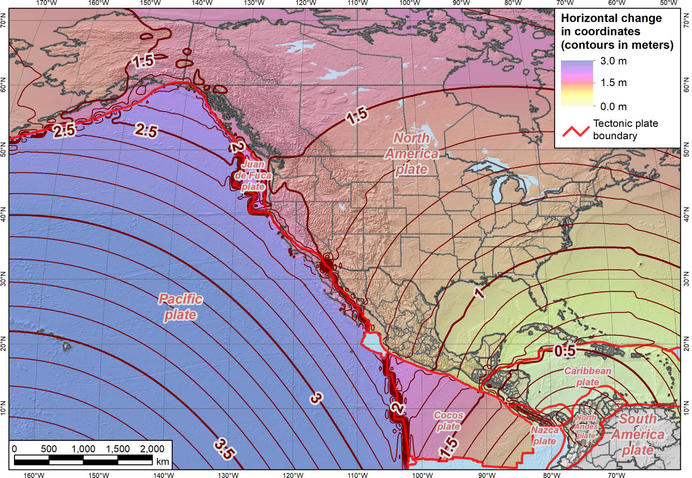
Notes:
-what’s the Magnitude of Horizontal Change?
-we will have tools online to simplify the process of estimating NAD83→NATRF2022
-see the 1.1 and 1.2m contour lines are south and just thru Northern OH, so you’ll see a northwesterly shift of less than 4 feet throughout the vast majority of Ohio, between 3.7 and 4 feet

Slide 68
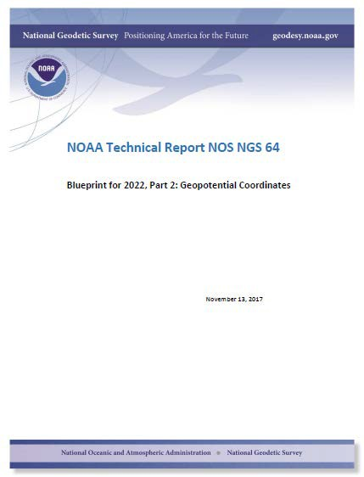
North American-Pacific Geopotential Datum of 2022
(NAPGD2022)
Notes:
-I already mentioned Blueprint Part 1, geopotential coordinates are covered in detail oin Blueprint part 2
-also easy to find on our website

Slide 69
North American-Pacific Geopotential Datum of 2022
NAPGD2022
(pronounced: nap-jee-dee)

Slide 70
Overview NAPGD2022
primary access via GNSS and geoid (think OPUS)
accurate continental gravimetric geoid
aligned with:
  --TRF2022
  global mean sea level (GMSL)
monitor time-varying nature of gravity
  via the Geoid Monitoring Service (GeMS)
Notes:
The goal stated in the NGS strategic plan is to achieve 2cm accuracy vertically with a 15 minutes GPS session.
Note the datum will be aligned to global mean sea level, not continental as with previous datums
Like I”d said, the community wants an easier to access, no need to go recover a BM, nationwide datum. GNSS is the most efficient way to accomplish that, which mean geoid-based ortho heights, which means gravity observations.
So let’s talk about that.

Slide 71
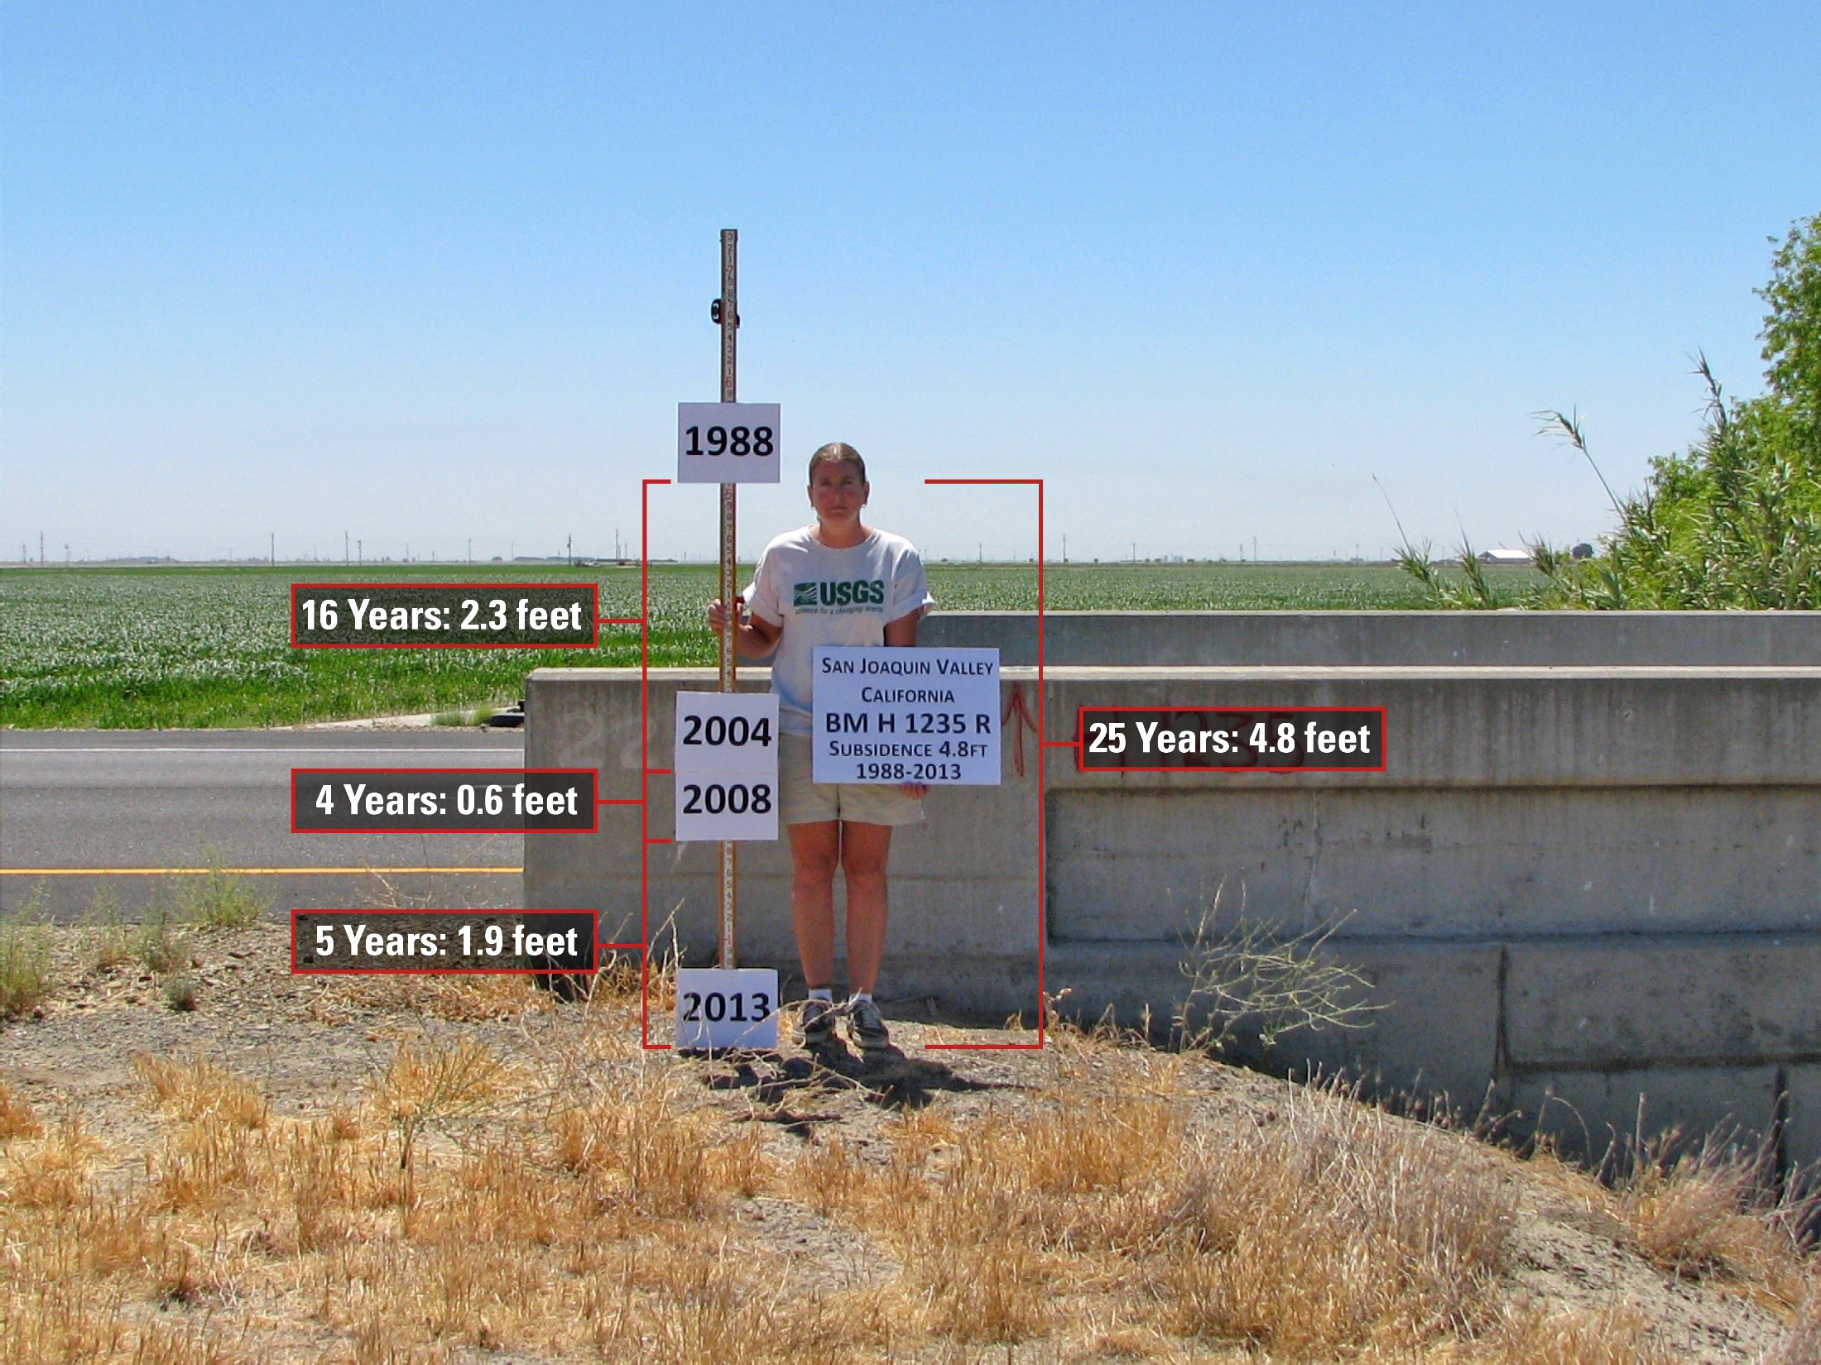
Passive marks may lie still… but they still may lie! small instability x long time = large inaccuracy
Notes:
Last leveling USGS ran in the area they quantified 6.2 feet of subsidence by 2016.

Slide 72
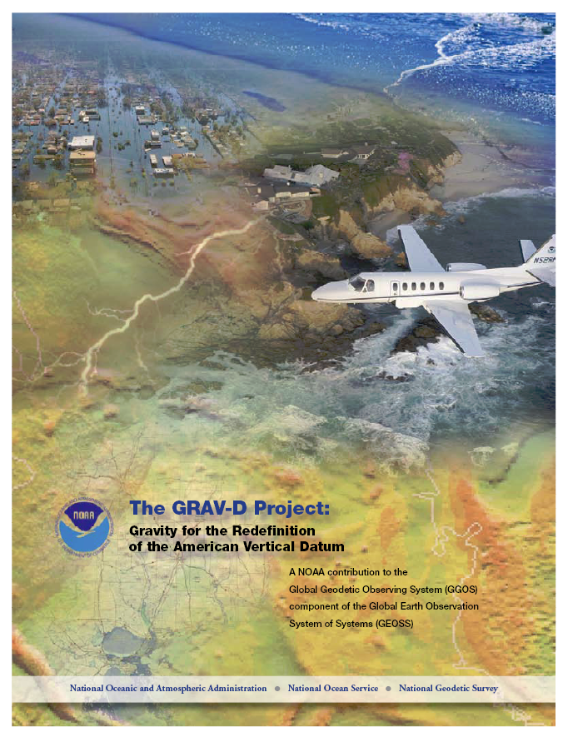
Gravity for the Redefinition of the American Vertical Datum
2022 Goal: 2 cm accurate ortho heights (H)
  GNSS plus geoid model
GRAV-D Goal: Gravimetric geoid (N_{g}) accurate to 1 cm where possible using airborne gravity data
Leverage partnerships to improve and validate gravity data
  State-based gravity programs?
Notes:
Target is to be able to achieve 2 cm accuracy orthometric heights (where possible) using a GNSS receiver and a geoid model
Roughly 1 cm uncertainty from GNSS and 1 cm from the geoid model
GRAV-D
Phase 1: snapshot of the entire country to provide a consistent data set
Phase 2: long term monitoring of geoid change – Geoid Monitoring Service (Kevin Ahlgren) will present during this session
Work with partners to incorporate additional gravity data, particularly surface gravity data, validate existing data, and monitor change

Slide 73
Gravity for the Redefinition of the American Vertical Datum
There are two major campaigns within GRAV-D
High-resolution snapshot of gravity
  primarily airborne observations, all relative gravity, covering the US and Territories at an estimated cost of ~$39 million
Low-resolution “movie” of gravity changes
  primarily terrestrial, episodic observations of absolute gravity sites to monitor long-term change
Notes:
-airborne gravimetry functions as the bridge for blending terrestrial/surface gravity data with satellite gravity data
-satellite data is global, airborne data is continental, terrestrial/surface is spot-shots or gridded
GRAV-D is one of the programs that will make the NSRS modernization possible, the NAPGD2022 relies on it. More on NAPGD2022 later.

Slide 74
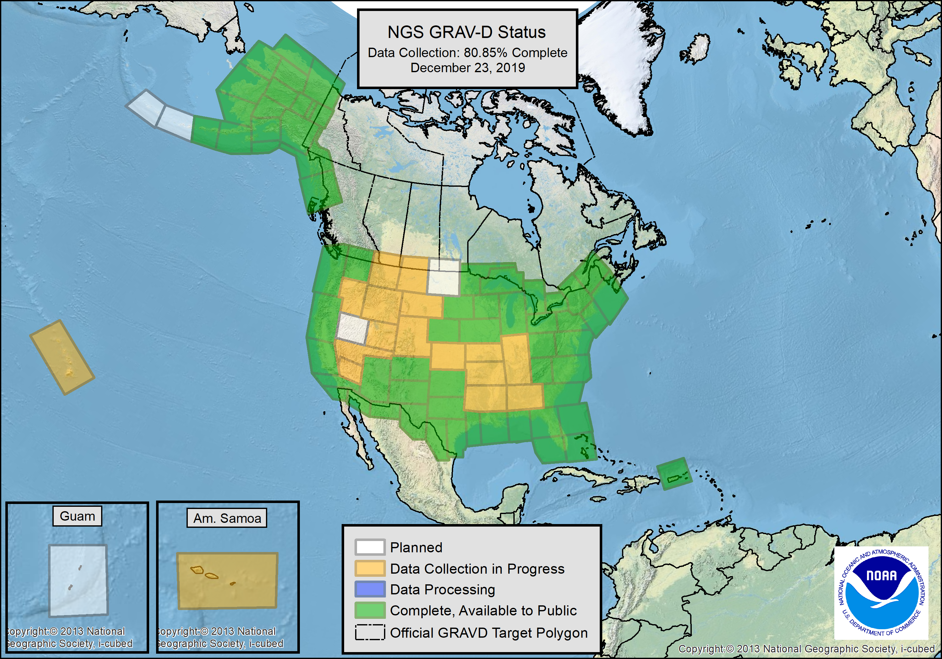

Slide 75
Year | Goal
FY10 | 7.5%
FY11 | 13%
FY12 | 20%
FY13 | 28%
FY14 | 36%
FY15 | 45%
FY16 | 53%
FY17 | 62%
FY18 | 70%
FY19 | 79%
FY20 | 87%
FY21 | 96%
FY22 | 100%
In Progress
Notes:
GRAV-D Performance Metric
Total area calculated using GIS: ~15.5M sq. km.
We have collected ~11.8M sq. km.
That is 75.8% of the target area.
Explain Slide
A set of yearly goals was created to keep us on track to have 100% collection done in time for the release of the new geopotential datum in 2022 (NAPGD2022).
Historically, GRAV-D has stayed on track each year.
We are on track to reach our FY19 goal of 79%
The FY22 goal is only a 4% increase to give time for processing and inclusion into NAPGD2022.
As we come to the end, we will lose flexibility of choosing locations based on best conditions and may experience some low productivity that will delay our completion.
We have several high risk locations to survey including Guam, American Samoa, Hawaii, and the Aleutian Island Chain. Inability to complete these regions could delay completion before 2022.

Slide 76
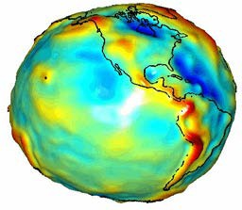


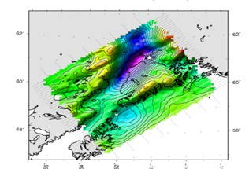

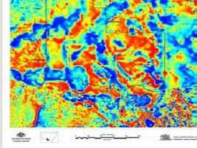

Building a Geopotential Field Model
Long Wavelengths (> 250 km)
GRACE/GOCE/Satellite Altimetry
+
Intermediate Wavelengths (20km to 300 km)
Airborne Observations
+
Short Wavelengths (< 100 km)
Terrestrial/Surface Observations and Predicted Gravity from Topography
Notes:
-gravity data used to create NAPGD will come from all of these sources
-The airborne observations are all a part of the GRAV-D program already discussed
-A relative gravity campaign of terrestrial was performed countrywide in the early 2000s. It was, as far as I was told, this one dude who just rode around the country hitting up all the major gravity points in the Intl Gravity Standardization Network of 1971.

Slide 77
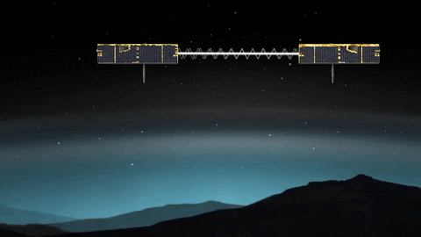
GRACE – satellite observations
Notes:
-Gravity and Climate Experiment
-2 Satellites measuring separation

Slide 78
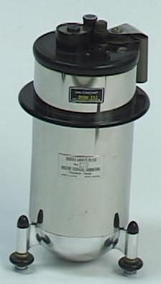
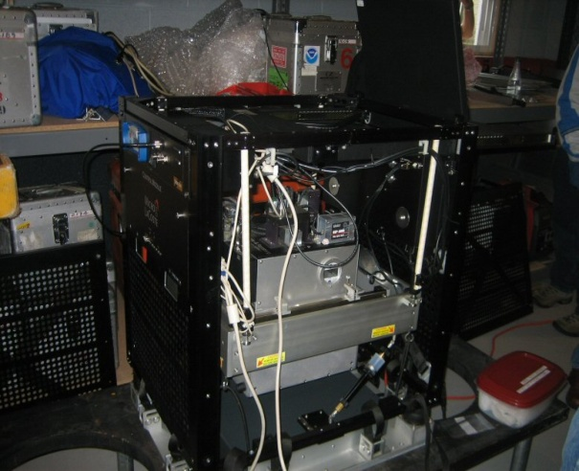
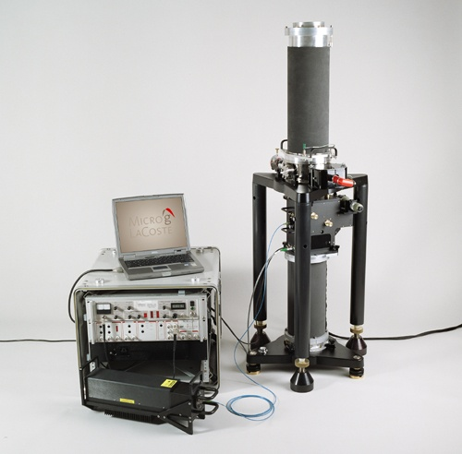
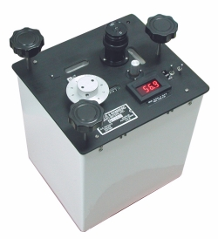
Gravity Survey Plan
National Scale Part 1
  Predominantly through airborne gravity
  With Absolute Gravity for ties and checks
  Relative Gravity for expanding local regions where airborne shows significant mismatch with existing terrestrial

Slide 79
Individual Components of NAPGD2022
global model of the geopotential field
  GM2022
geoid undulation models by region
  GEOID2022 aka “0 elevation”
deflection of the vertical (DoV) models by region
  DEFLEC2022
surface gravity models by region
  GRAV2022
    static – SGRAV2022
    dynamic – DGRAV2022
Notes:
So all those models work together to get you a 2cm height with a 15 minutes GNSS session

Slide 80
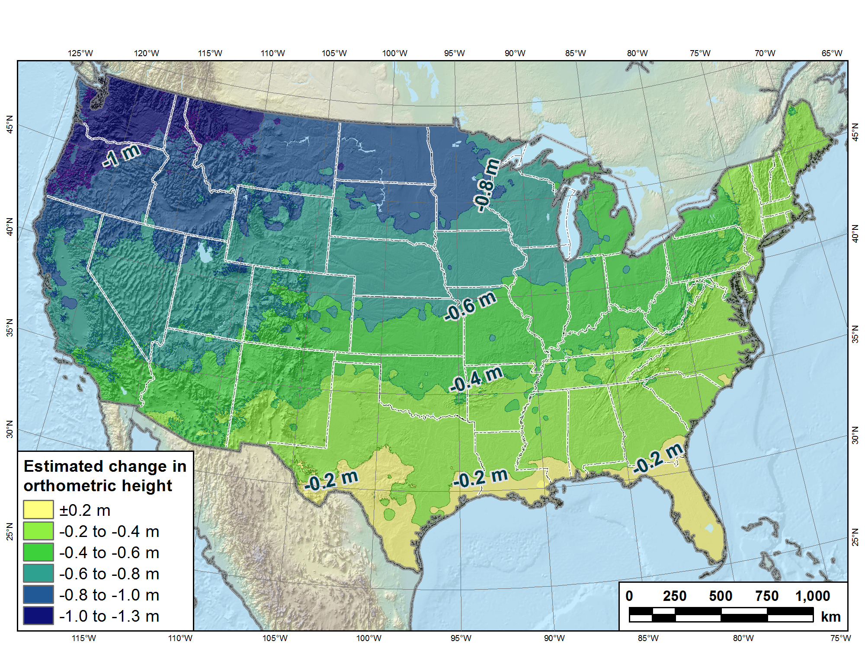
Estimated change in orthometric heights from NAVD88 to NAPGD2022
(NAPGD2022 approximated using xGEOID16B)

Slide 82
Outline
What is Blueprint for 2022, Part 3 (BP3)?
Terminology
New types of coordinates
New way of operating the NOAA CORS Network (NCN)
New way for USERS to process GNSS projects
New way of processing leveling projects
New way for NGS to process and store GNSS data
  Final Discrete Coordinates (FDCs)
New way for NGS to process and store GNSS data
  Reference Epoch Coordinates (RECs)
Miscellaneous / TBD

Slide 83
What is BP3?
BP3 is a companion to BP1 (geometric) and BP2 (geopotential), both released in 2017
  It is about “re-inventing bluebooking”
  It’s about how NGS will provide the frames/datum in the future
  It’s about how YOU will use the frames/datum in BP1 and BP2

Slide 84
Terminology
The following terms (and more) are defined meticulously in BP3 in a coordinated effort within NGS and with the IERS:
  Point, Mark, Station, Site, ARP, GRP, Site Marker, CORS, the NOAA CORS Network
    GRP = Geometric Reference Point – the official point on a station to which all coordinates refer
As a direct fallout: NGS will no longer provide CORS coordinates at an ARP, only to a GRP
  An antenna has an ARP.
    A CORS only sometimes has an antenna.
      Therefore a CORS only sometimes has an ARP.
      But it always has a GRP.
        The ARP and GRP are only sometimes coincident in space when the antenna is mounted at a CORS
  The GRP gets a Permanent Identifier (PID)

Slide 85
Terminology
“CORS” is an acronym
  It is singular (S means “Station”, not “Stations”)
  It will no longer be used to describe the network of all such stations
    That will, for now, be called the NOAA CORS Network, or NCN
      Which has a subset of stations called the NOAA Foundation CORS Network, or NFCN
  Its plural form is CORSs
    No apostrophe, No “es” and no skipping the “s”
    GODE is a CORS
      Not “a CORS site”
        And definitely NOT “a CORS Station”
          That’s like “an ATM machine”
    GODE and 1LSU are CORSs
    GODE and 1LSU belong to the NOAA CORS Network
    TMG2 is a NOAA Foundation CORS
    TMG2 and FLF1 are NOAA Foundation CORSs
    TMG2 and FLF1 belong to the NOAA Foundation CORS Network

Slide 86
Terminology
“OPUS”
  Online Positioning User Service
  Adopted as the general term for all of our online positioning software
    Rather than “-Projects” , “-S” , etc
    Basically “do it with OPUS” should be applicable to a wide variety of tasks
      Recon, Mark Recovery, GPS, Leveling, Gravity, Classical

Slide 87
Terminology
“GPS Month”
  A span of four consecutive GPS weeks, where the first GPS week in the GPS month is an integer multiple of 4
  GPS Month 0 = GPS weeks 0, 1, 2 and 3
  GPS Month 1 = GPS weeks 4, 5, 6 and 7
  Etc.

Slide 88
New Types of Coordinates

Slide 89
New Types of Coordinates
Reported
  “These are from any source where the coordinate is directly reported to NGS without the data necessary for NGS to replicate the coordinate.”
    Scaled
    From NCAT or Vdatum
      NGS Coordinate Conversion and Transformation Tool (NCAT)
    Hand Held / Smartphone
    Reported directly from an RTK rover without data files

Slide 90


Reported Coordinates

Slide 91
New Types of Coordinates
Preliminary
  “These are coordinates at survey epoch that have been computed from OPUS, but not yet quality checked and loaded into the National Spatial Reference System Database (NSRS DB).”
    User-computed values, such as they might get today from either OPUS-S or OPUS-Projects
    “Preliminary” coordinates are the only coordinates a user will get directly from OPUS

Slide 92
New Types of Coordinates
Reference Epoch
  “These are coordinates which have been estimated by NGS, from time-dependent (final discrete and final running) coordinates, at an Official NSRS Reference Epoch (ONRE)”
    NAD 83(2011) epoch 2010.00 (sort of) would’ve fallen under this category
    These will be computed by NGS every 5 years
      On a schedule 2-3 years past ONRE
        2020.00 coordinates will be computed in CY 2022
        2025.00 coordinates will be computed in CY 2027

Slide 93
New Types of Coordinates
Final Discrete
  “These are coordinates computed by NGS using submitted data and metadata, checked and adjusted and referenced to one survey epoch.”
    These represent the best estimates NGS has of the time-dependent coordinates at any mark
    Could be a:
      Daily solution on one CORS
      The single adjusted value coming from one or more occupations on a passive mark within 1 GPS Month
*
*
More on that in a moment…

Slide 94
New Types of Coordinates
Final Running
  “Of all types of coordinates on a mark, these are the only ones which will have a coordinate at any time.”
    At a CORS GRP, they will be the coordinate function
      Which will be generated by a “fit” to regularly computed Final Discrete Coordinates (FDCs) on a TBD basis, perhaps daily, perhaps weekly
    On a passive mark, they will come from a mixture of Final Discrete Coordinates (FDCs) and the Intra-Frame Velocity Model (IFVM2022)
      And possibly the time-dependent geoid, DGEOID2022

Slide 95
New Way of Operating the NOAA CORS Network (NCN)
Each CORS will get a coordinate function
  Actually three functions, X(t), Y(t), Z(t), in the ITRF2014 frame
  In the strict mathematical definition of “function”
    For any given “t”, there is one and only one X , Y and Z
    We actually do this today, just that the functions are piecewise linear
  We are NOT limiting our “modernized NSRS” discussions of CORS coordinate functions to linear functions only!
    But have made no further decisions yet

Slide 96


Examples of what non-linear CORS coordinate functions look like

Slide 97
New Way of Operating the NOAA CORS Network (NCN)
Philosophy:
  The NOAA CORS Network (NCN) will be self-consistent, meaning:
    The impact of a user’s CORS choices within their project will not exceed a small, statistically acceptable value:
      Horizontal < 5 mm, Vertical < 10 mm
  On a daily basis NGS must be able to detect, and react to, persistent disagreement between daily solutions and the current “coordinate function” assigned to any CORS in the NOAA CORS Network (NCN)

Slide 98
Persistent Disagreement
The point:
  It’s not enough to say “each CORS is good to 1 cm in ellipsoid height”.
    That phrase is vague, lacking what it means to be “good to 1 cm”.
  NGS will define and publish “persistent disagreement”
    Possible component: A persistent non-zero average disagreement
    Possible component: A persistently deviating disagreement
  And NGS will define what happens when a CORS exhibits “persistent disagreement”

Slide 99
New Way for NGS to Process and store GNSS Data:
Final Discrete Coordinates (FDCs)

Slide 100
GNSS: Monthly workflow…
Every GPS month (say the first Monday of that GPS month), NGS will “process the GPS month of 12-16 weeks ago” by doing the following:
  Ensure that the “final” IGS orbits for the GPS month that spans 12-16 weeks prior are available
    If not, hold off on this until they are
  Create an in-house project named for that prior GPS month
  Farm all data (collected during that GPS month) from all projects submitted to NGS, and put them all into the in-house project

Slide 101
Processing by GPS Month…
GPS Month 587
GPS Month 588
GPS Month 589
GPS Month 590
GPS Month 591
GPS Month 592
GPS Month 593
GPS Month 594
All GNSS data collected in this
GPS month…
…are processed in this GPS month…
…to create Final Discrete coordinates for
this GPS month….
…which are loaded into the
NSRS database in this GPS month.

Slide 102
Processing by GPS Month…
GPS Month 587
GPS Month 588
GPS Month 589
GPS Month 590
GPS Month 591
GPS Month 592
GPS Month 593
GPS Month 594
All GNSS data collected in this
GPS month…
…are processed in this GPS month…
…to create Final Discrete coordinates for
this GPS month….
…which are loaded into the
NSRS database in this GPS month.

Slide 103
Questions?
Dan Martin
Northeast Regional Geodetic Advisor
ME, NH, VT, MA, CT, RI, NY, NJ
Dan.martin@noaa.gov
240-676-4762

