Slide 1
Modernization Plan for the NOAA CORS Network
Mr. John Galetzka
CORS Branch Chief, Spatial Reference System Division
National Geodetic Survey
john.galetzka@noaa.gov
Notes:
CORS stands for Continuously Operating GNSS Reference Station, and GNSS stands for Global Navigation Satellite System of which America’s GPS is part of, as well as Russia’s GLONASS, Europe’s GALILEO, and China’s BEIDOU.
The NOAA CORS Network provides products and support for rapid and precise 3-D positioning and other geophysical applications throughout the United States and its territories. This webinar will provide an overview of the people, organizations, and infrastructure which make the NOAA CORS Network, and the efforts underway to improve and modernize it.
As we go through slides, look for QR codes which’ll take you to helpful websites! Now on with the show!
NEXT SLIDE
‹#›

Slide 2

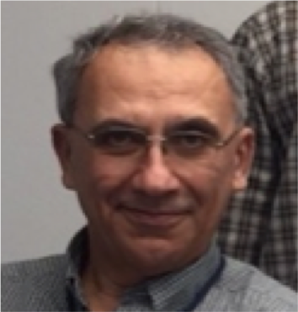
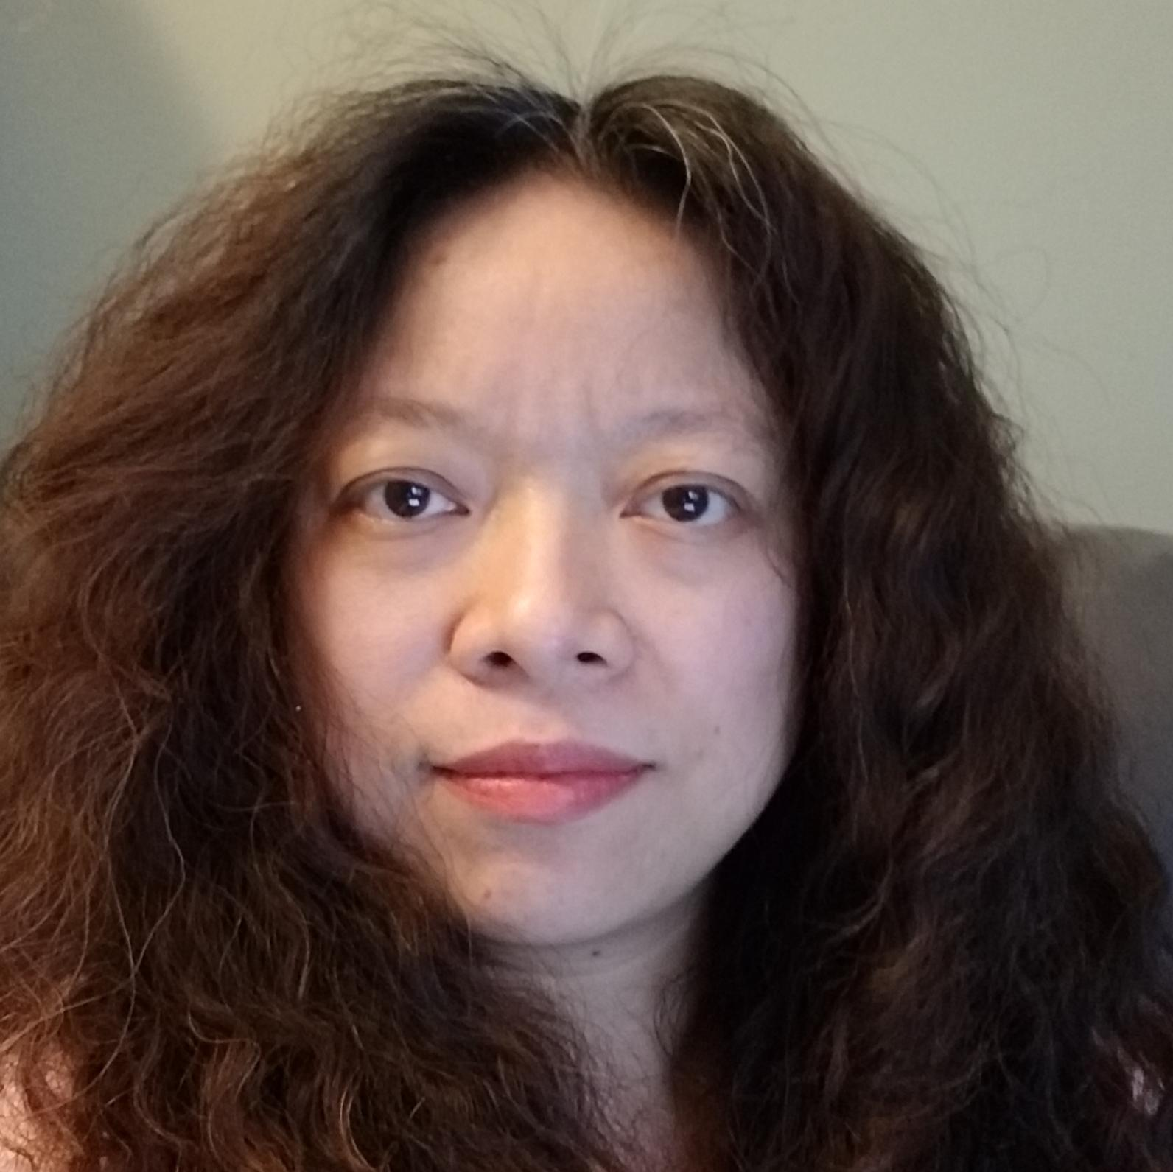
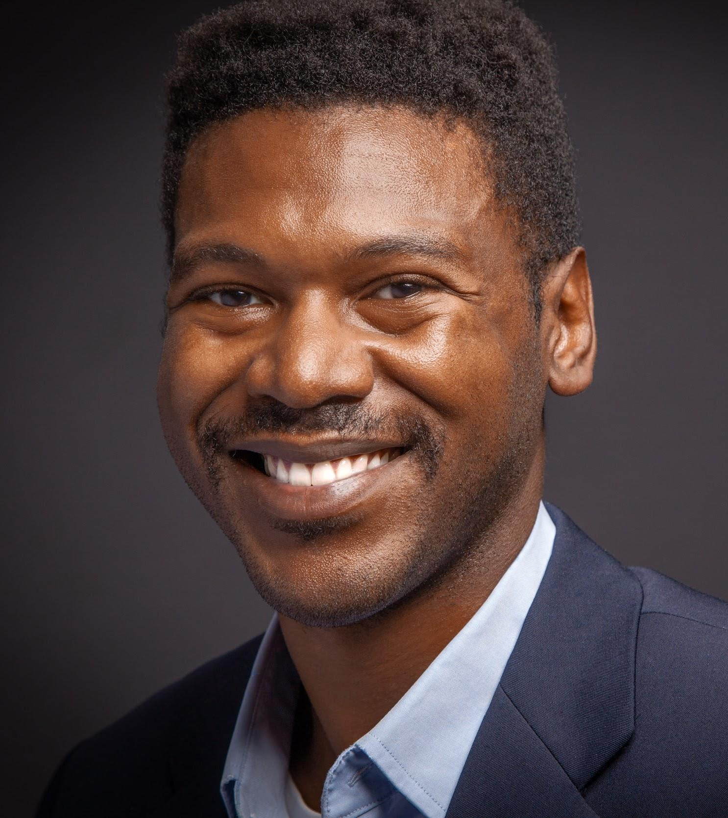
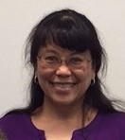
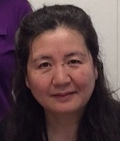
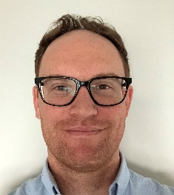
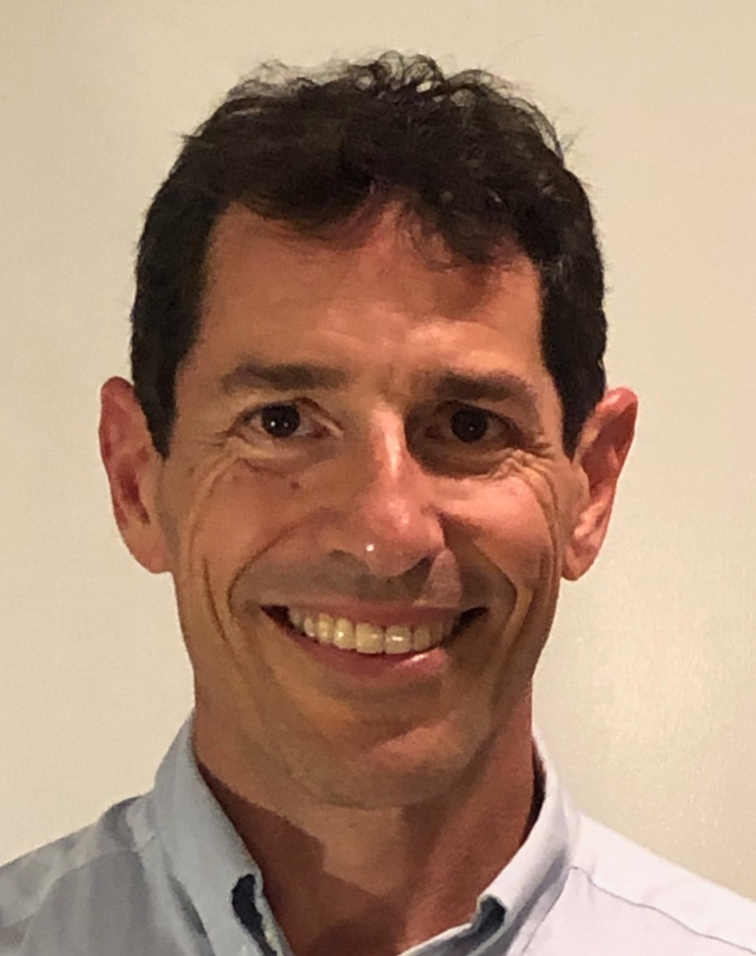
NGS CORS Team
Don
Haw
Jarir Saleh
Ira Sellars
Josh
Jones
Fran
Coloma
Lijuan
Sun
Phillip
McFarland
Will
Freeman
Notes:
The first thing I want to do is introduce you to the CORS team. I’ve only been at NGS for 15 months and heard from old timers that the CORS team was much larger in the past. The current handful of people are all who remain after many folks retired, or went on to better paying or less intensive jobs. The current team members are Don Haw, Jarir Saleh, Ira Sellars, Josh Jones, Fran Coloma, Lijuan Sun, Phillip McFarland and Will Freeman. Here’s a summary of these talented individuals:
--Will Freeman was a NOAA engineer for 15 years managing National Weather Service facilities and field equipment. He came to NGS about 2 years ago to be our CORS Program Manager, and let me tell you that he does the job of 5 or 6 people!
--Don Haw started working for NGS in 1986 right when I started jumping out of airplanes with the Army Rangers. Man--that was a LONG time ago! Don is like a juggler-- screening new stations wanting to get into the NOAA CORS Network, staying on top of a flood of hardware and firmware changes at CORStations, and leading an important effort to convert our CORS data ingest system from RINEX 2 to RINEX 3.
--Fran Coloma has been affiliated with the NOAA CORS Network going back to 2007. Fran became a federal employee in 2015 and is a guru of our CORS data ingest, distribution and archive system. Fran is now based on the Big Island of Hawaii with her husband who is deputy scientist in-charge at the USGS Hawaiian Volcano Observatory.
--Ira Sellars joined NGS in 2005 as a contractor, and became a federal employee in 2015. Ira is a master website and software developer, and is cranking away on the new OPUS 4 software and CORS website.
--Lijuan Sun has also been with NGS since 2005, first as a contractor, then as a federal employee. Lijuan’s superpower is attention to detail which is essential for publishing station coordinates and maintaining critical files used for data processing.
--Jarir Saleh has been working for NGS since 2006, first as a contractor, then as a federal employee. In 2017 Jarir was the atomic mushroom cloud behind our Multi-Year CORS Solution 2 which was the reprocessing of all stations in the NOAA CORS and IGS networks. Jarir currently monitors CORStation position time series, and revises station coordinates if necessary due to things such as earthquakes and hardware changes.
--And finally Phillip McFarland--who is supposed to be our NGS reference frame scientist--is training up our newest member, Josh Jones, on calculating the orbits of GNSS satellites. Josh joined NGS last month after getting his PhD in geodesy and tectonophysics from Virginia Tech.
In case you don’t know, there’s no precise GNSS positioning for us users here on the ground if there are no precisely determined GNSS orbits!
NEXT SLIDE
‹#›

Slide 3
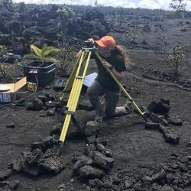
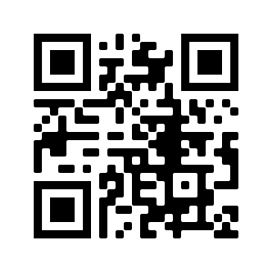
Sarah Conway, USGS
https://www.usajobs.gov
Keywords: “NOAA” “geodesist”
Notes:
So that’s the NGS CORS Team as it currently stands. Pictured here is Sarah Conway from USGS Hawaii Volcano Observatory who will be joining NGS CORS team at the end of August as our newest geodesist.
The other big news is that we’ll be hiring at least three more geodesists over the next year, SO PLEASE tell your students and colleagues to watch for our job postings!
NEXT SLIDE

Slide 4
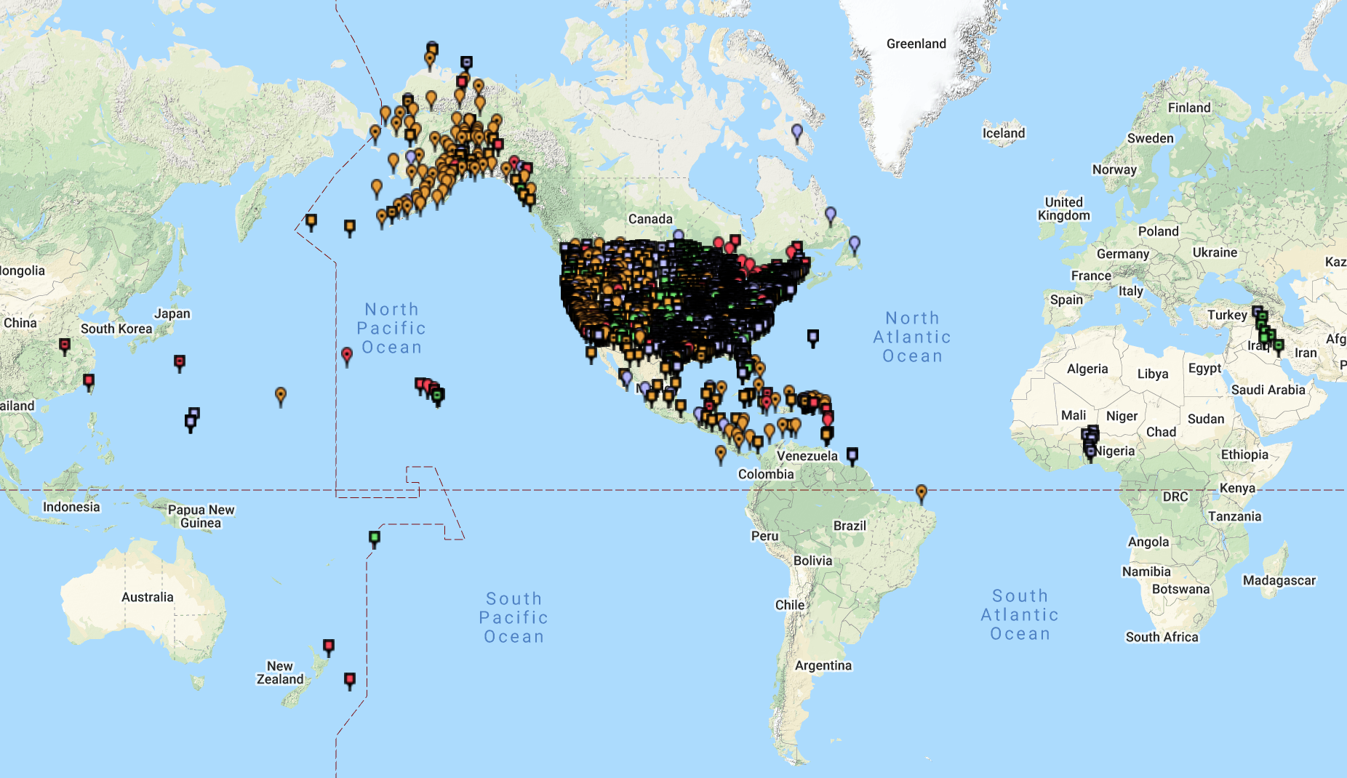

The NOAA CORS Network (NCN)
The NOAA CORS Network
Notes:
Let’s now talk about the organizations who help us. Plotted on this map are 1,887 GNSS reference stations contributed to the NOAA CORS Network by 239 government, academic and private partners.
The National Science Foundation’s geodetic facility--UNAVCO--is the biggest contributor at around 470 stations, followed by Texas Department of Transportation at 146. At the other end of the spectrum are many single-station contributors such as the City of Gillette, Wyoming, the Marion County Oregon surveyors office, and ESRI in southern California. What’s really funny or sad is that NOAA (which NGS is part of) actually owns only 43 stations--the rest are all crowd sourced!
NEXT SLIDE
‹#›

Slide 5
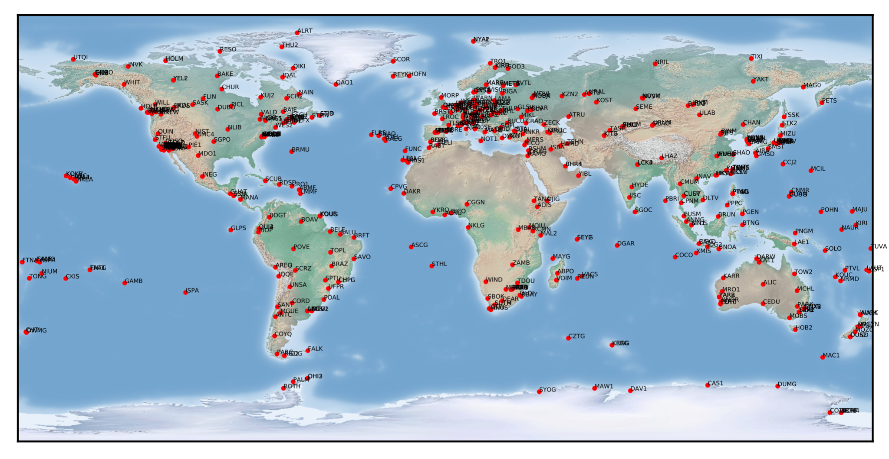

The IGS ground tracking station network
Notes:
I also have to mention an important organization. The International GNSS Service is in charge of a global network of high-quality crowd-sourced GNSS ground tracking stations which help establish the International Terrestrial Reference Frame (the ITRF).
The core function of the NOAA CORS Network is to define and maintain the geometric component (the latitude, longitude, and ellipsoid height) of the US National Spatial Reference System (or NSRS), but it’s important for you to know that the NSRS is intimately tied to the ITRF.
We also give back to the IGS with our GNSS orbit solutions, and a handful of stations for their global network.
NEXT SLIDE

Slide 6
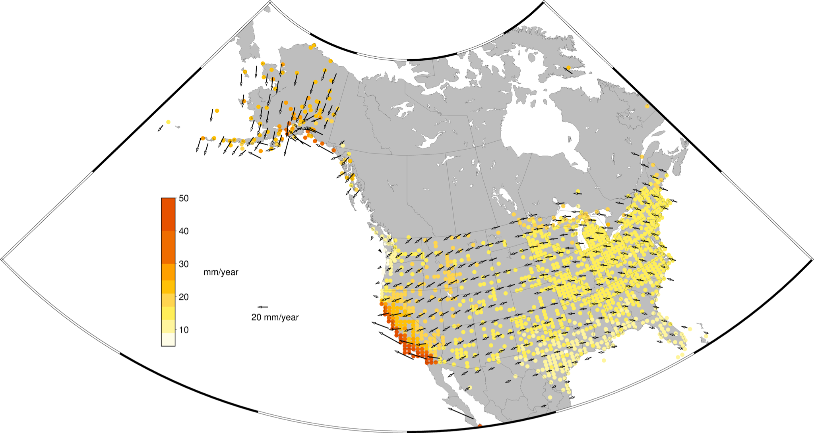

Horizontal velocity field derived from CORS relative to ITRF2014
Notes:
I’ll do my best to guide you through this graphic. This is the horizontal velocity field of the continental US, Alaska, and a few places in Mexico and Canada with respect to the International Terrestrial Reference Frame. It’s made by getting speed and direction from a bunch of good CORStations operating for 3 or more years.
--Pale yellow dots show places that are moving slow at a few mm per year. Red dots mean the ground is moving fast at 40 to 50 mm per year. The black arrows show both the speed and direction of points on a grid.
--Can you see the counter-clockwise rotation of the North American tectonic plate west of the Rockies. Think of Texas being near the center of a wheel, with Minnesota and Maine being farther away from the center.
--If you look at the west coast and Alaska you can see the impact of the Pacific and Juan de Fuca plates. Western California is actually on the Pacific tectonic plate being carried to the northwest. Oregon and Washington are currently being dragged eastward by the small offshore Juan de Fuca plate. Most of Alaska is rotating with the North American plate until in meets the Pacific plate on its southern shore.
The point of this slide is to show that the surface of the earth is moving around--nothing, not even the CORStations are fixed.
NEXT SLIDE

Slide 7
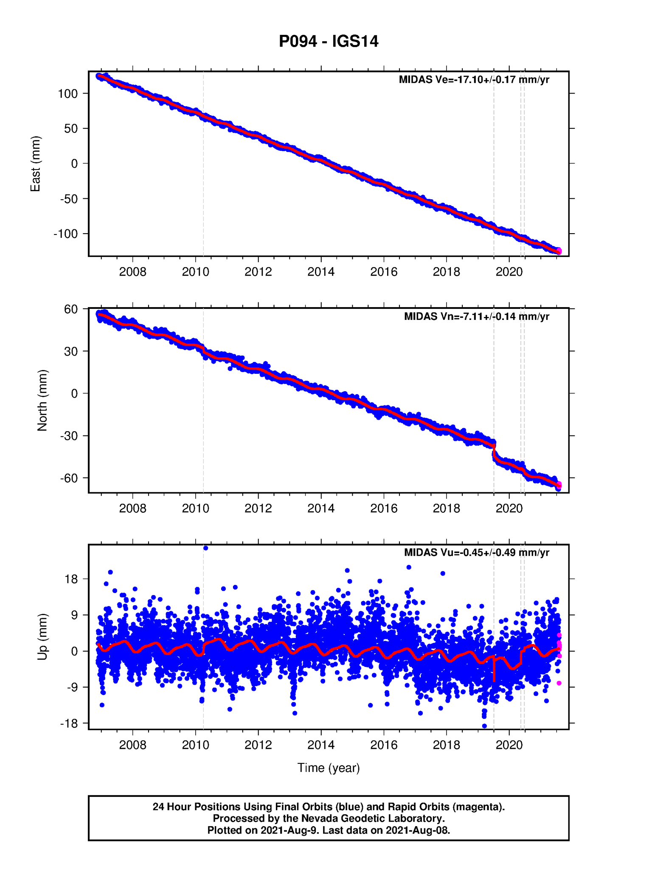
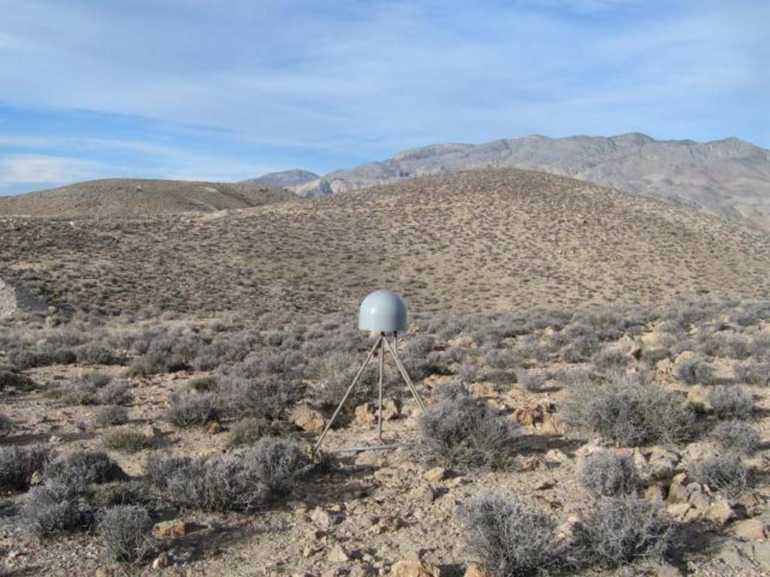
Offset caused by M7.1 Ridgecrest earthquake
By NGL
Notes:
One of those CORStations which contributed to the velocity field I just showed you is P094 in Death Valley, California. It has a nice 22-year time series made of daily east, north and up positions. The horizontal axis is time in years, and the vertical axis is millimeters. As you can see, this station is slowly moving negative east (in other words, west) at 17 mm per year and negative north (or south) at 7 mm with respect to the International Terrestrial Reference Frame.
NEXT SLIDE

Slide 8
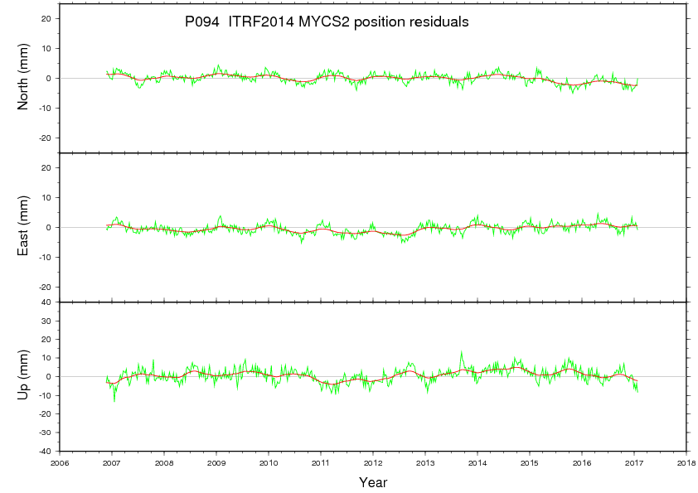
By NGS CORS team
Notes:
This is what the P094 position time series looks like with it’s carefully modeled ITRF velocity removed to give an official NSRS geometric coordinate. Sometimes there are deviations caused by natural events such as earthquakes and volcanic activity, or artificial movement caused by groundwater extraction. Sustained deviations of more than 2 cm in the horizontal and 4 cm in the vertical will trigger the CORS team to update the official coordinates of the station.
It’s stations like this that we rely on to define and maintain the NSRS, and to give the appearance that the stations are fixed.
NEXT SLIDE

Slide 9
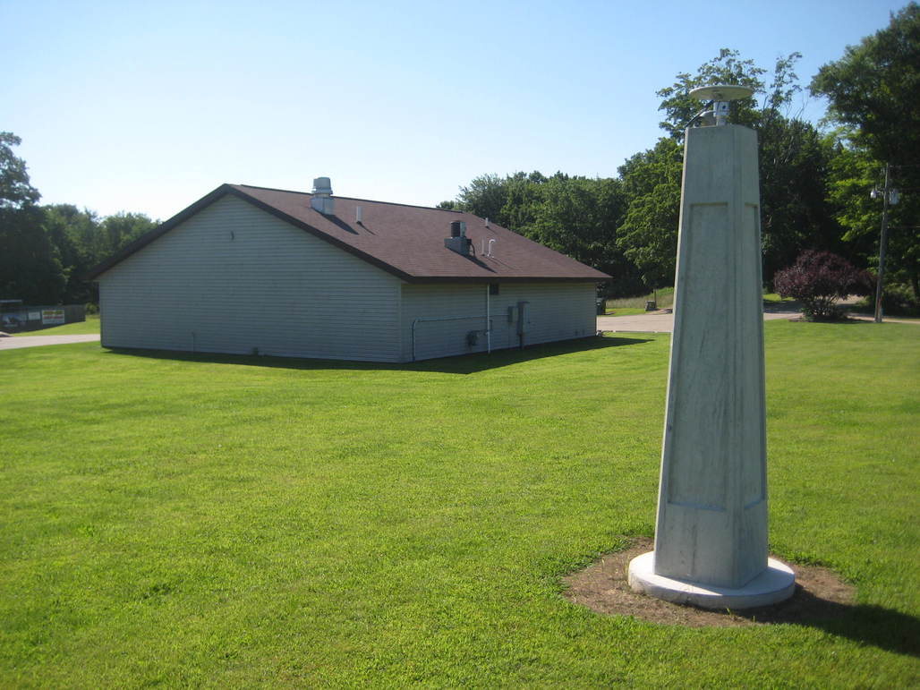
The NOAA CORS Network (NCN)
WITG Tigerton, WI
Notes:
We’ve covered infrastructure at a network scale, so now let’s zoom in on what individual CORStations look like. This is WITG in Tigerton, Wisconsin operated by Wisconsin Department of Transportation. The GNSS antenna in the yellow circle is attached to a concrete pillar monument which is attached to the earth. A good CORS site like this one is free of nearby obstructions such as trees and buildings which block or bounce GNSS signals, and affect the quality of the station coordinates.
NEXT SLIDE
‹#›

Slide 10
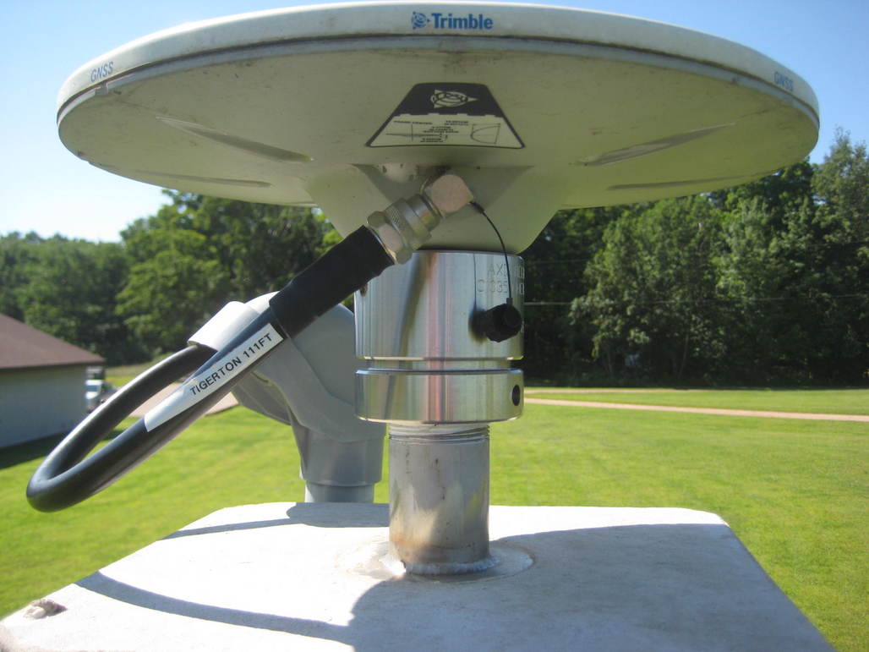
Notes:
Here’s a closer look at the GNSS antenna. GNSS signals picked up by the antenna are sent over that black cable to an expensive GNSS receiver safe inside the building to the left rear. The receiver gets power and internet from the building, processes the GNSS signals and stores the resulting data for the station operator and CORS team to collect each hour or day.
NEXT SLIDE

Slide 11
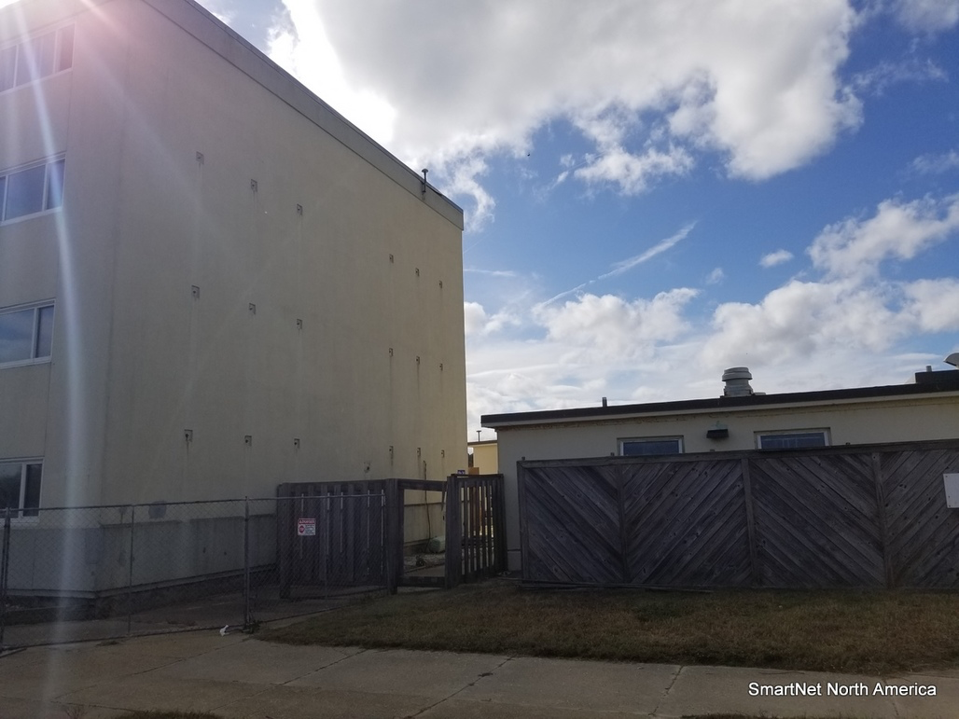
LOY3 Virginia Beach, VA
Notes:
Here’s another typical type of CORS found in the network. LOY3 in Virginia Beach, Virginia is operated by a commercial partner called SmartNet. Note that the monument for the GNSS antenna is a metal pipe attached to a four-story building. The view of GNSS satellites is good, but you have to make sure that the building is stable.
NEXT SLIDE

Slide 12
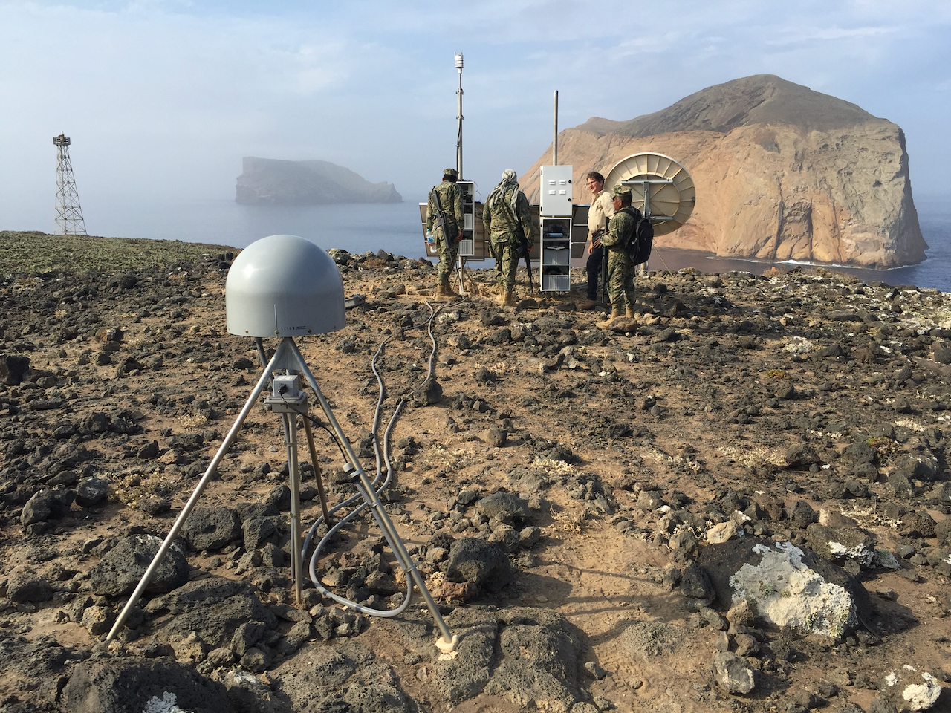
GUAX Guadalupe Island, Mexico
Notes:
This is GUAX on Guadalupe Island a few hundred kilometers off the west coast of Baja California. The GNSS antenna is inside the gray protective dome, and the tripod-looking structure it’s sitting on is the type of CORS monument I’m more accustomed to working with since starting my career in 1996. This BRACED monument consists of stainless steel legs anchored into the earth and welded together. The other thing that I’m accustomed to is that the station is solar powered, and has wireless communication to download data and monitor equipment. All these things together--the monument, solar, and wireless communication--allow high quality CORStations to be installed almost anywhere on land.
NEXT SLIDE

Slide 13
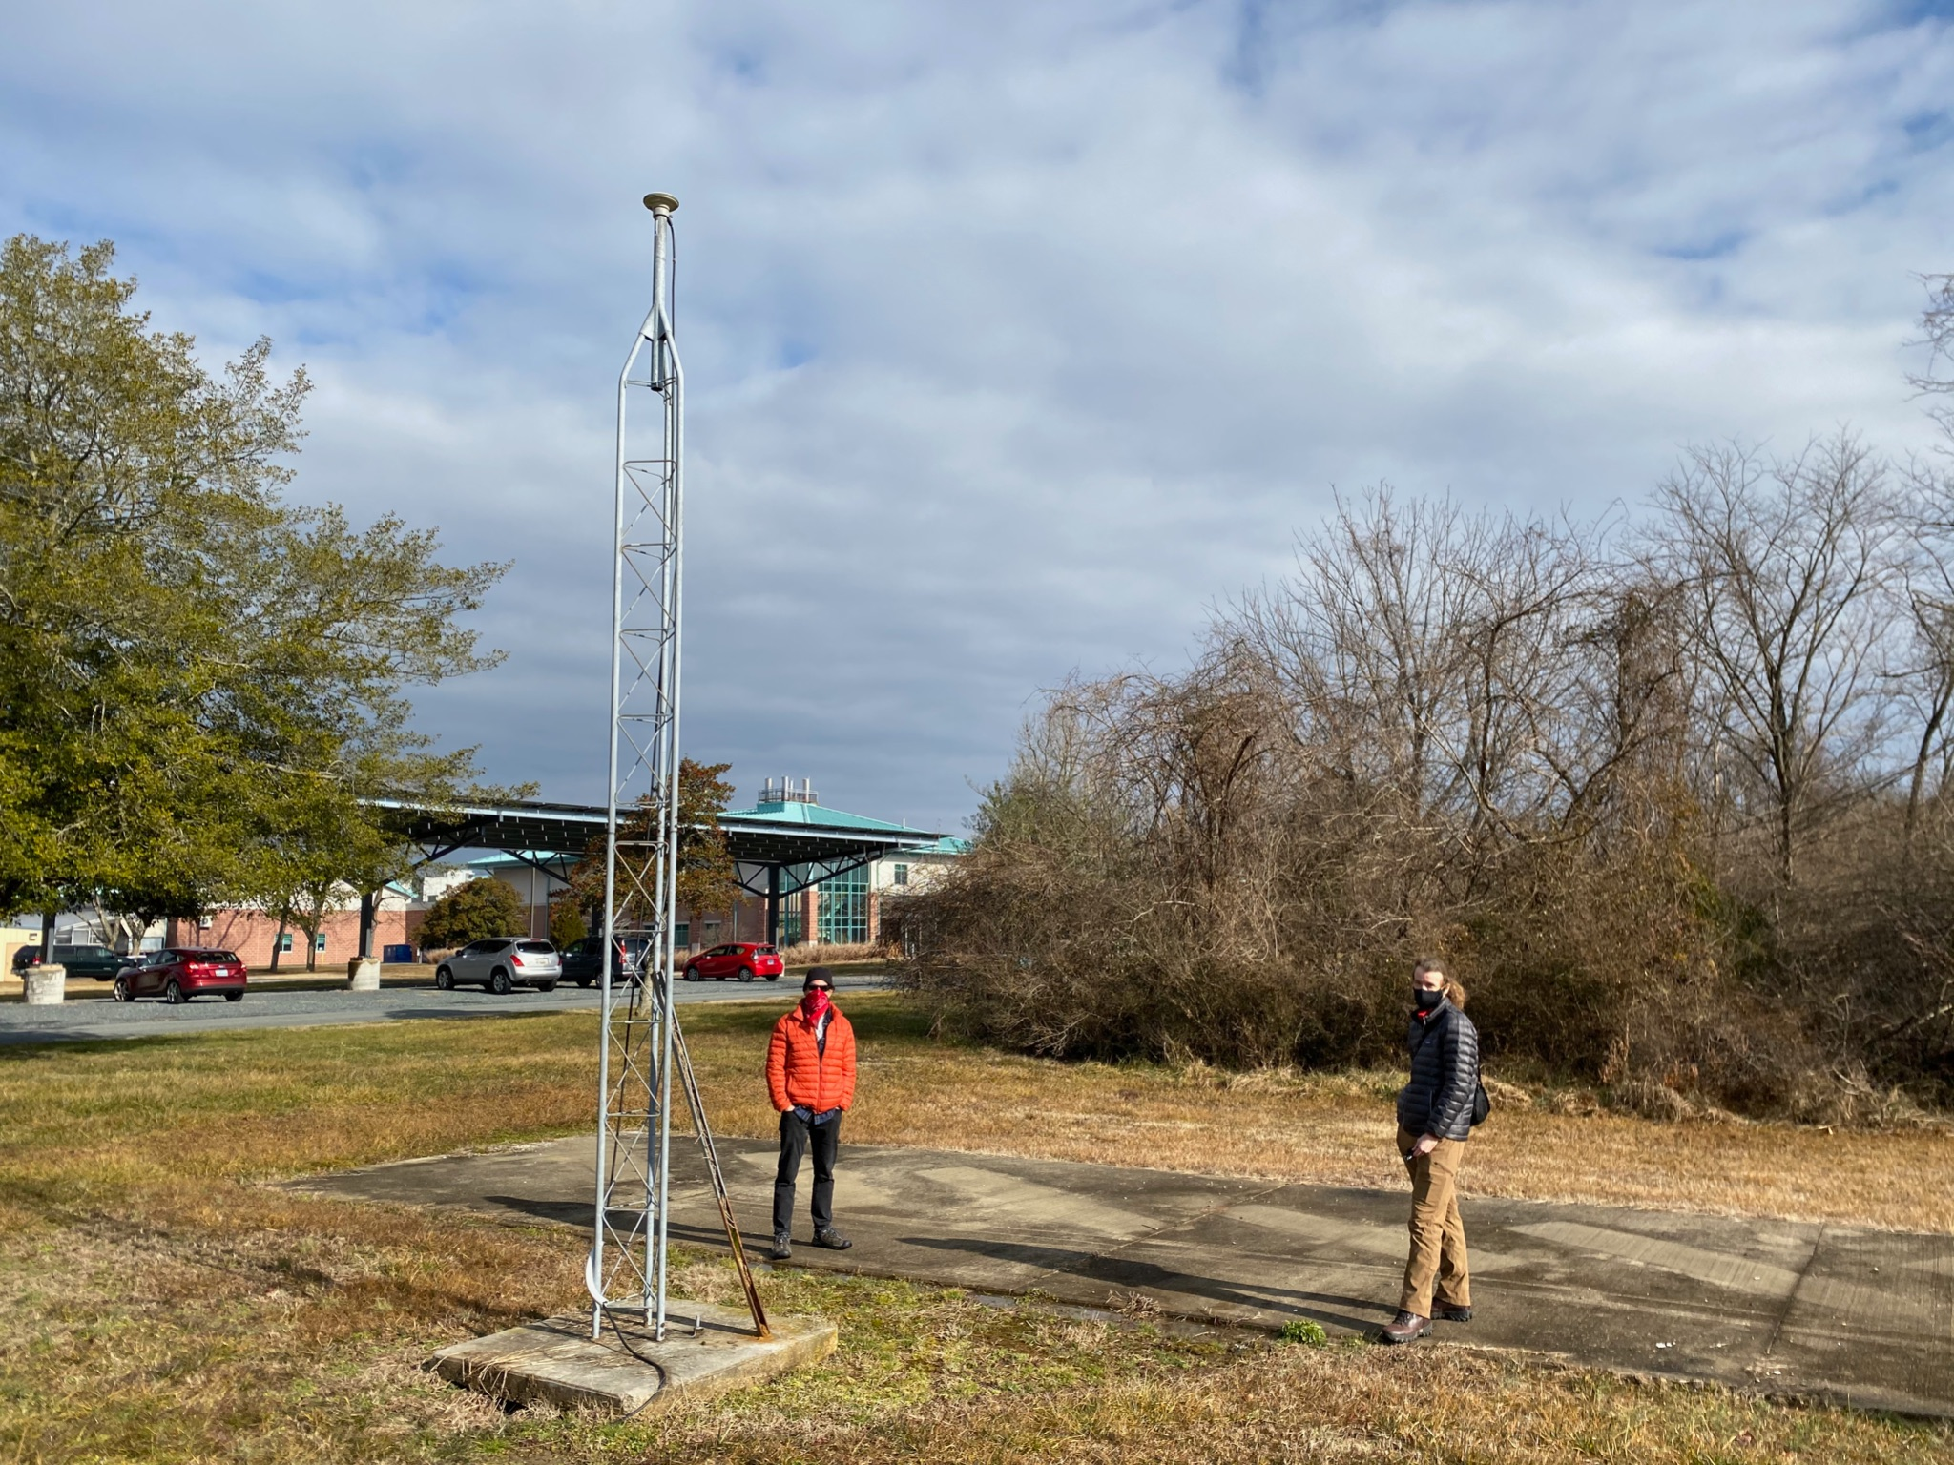
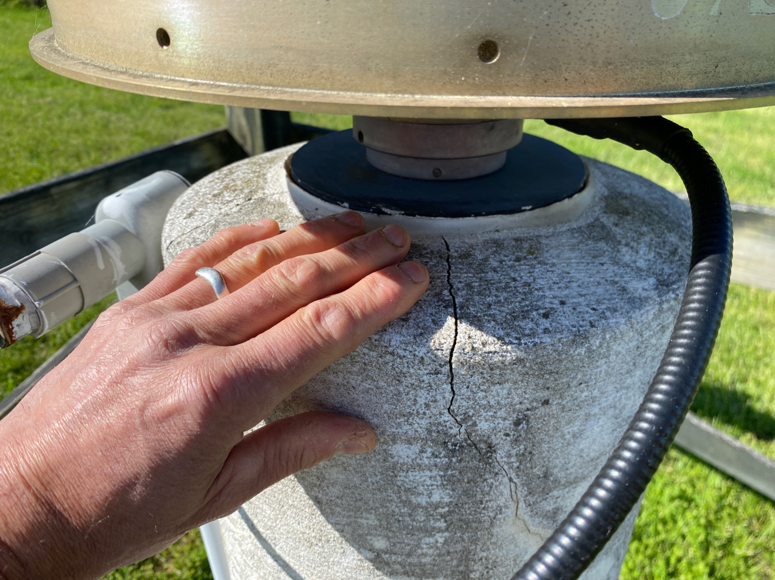
HNPT Cambridge, MD
UVFM Charlottesville, VA
Notes:
There’s a wide mix of monument types, receivers, and antennas out there in the NOAA CORS Network, and standards of maintenance and operation also vary between the contributors. Some operators don’t promptly report receiver or antenna changes, and this makes extra work for the CORS team trying to track down jumps in station position or investigate hardware change flags raised by data ingest software.
Trying to distinguish real earth movement from noise at many GNSS stations also consumes a lot of the CORS team’s time. Noise sources include unstable monuments, encroaching vegetation, and faulty GNSS hardware and antenna cables.
I have to say that NGS has been just as guilty of these violations as other contributors to the NOAA CORS Network. Our very own HNPT tower monument in the left image wobbles when you stand on the concrete pad base, and the 20-year old concrete pillar monument at our UVFM station is starting to crumble. We really need to be working smarter, not harder.
NEXT SLIDE

Slide 14
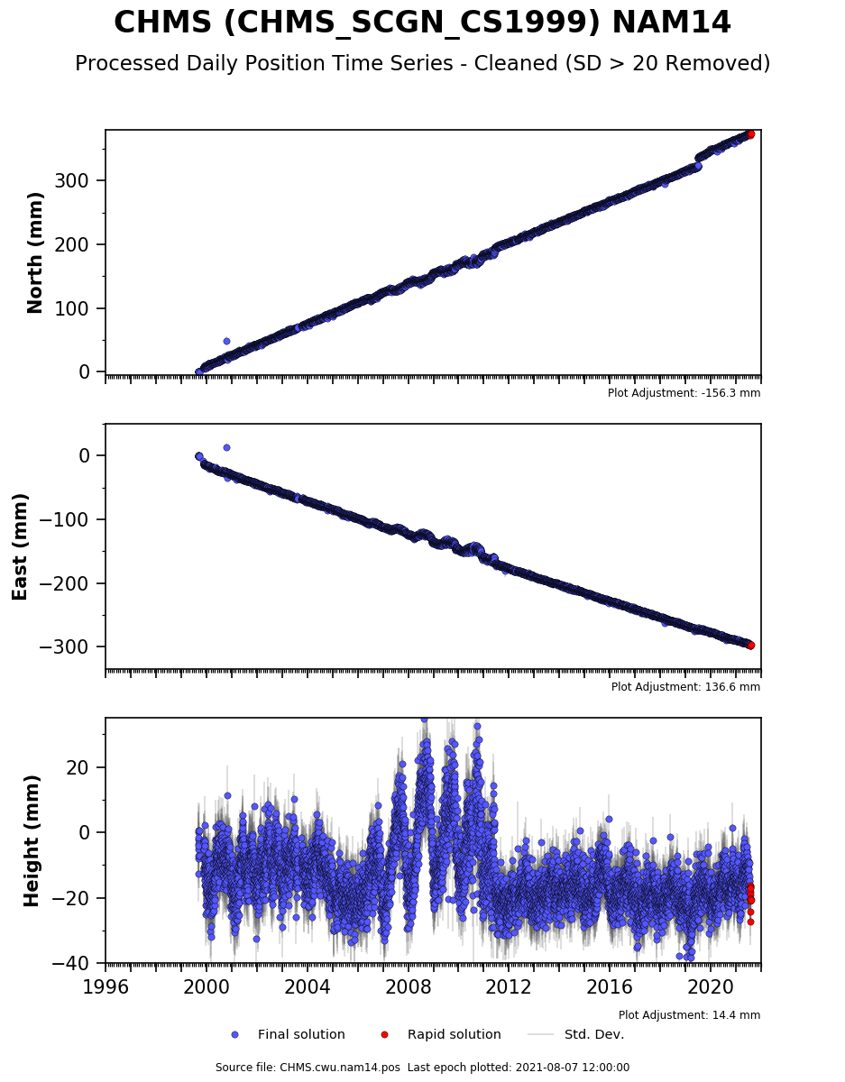
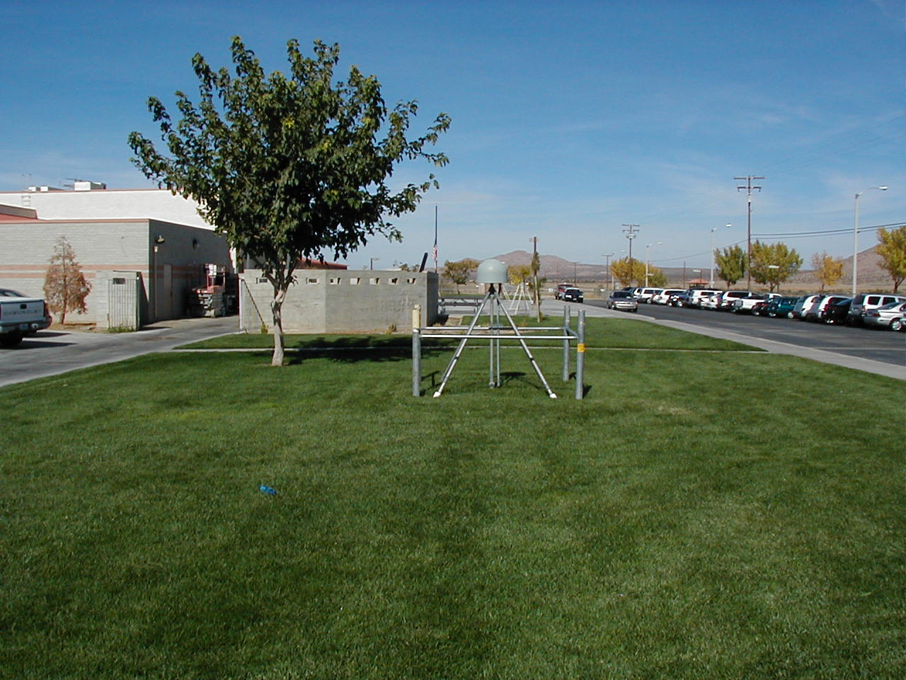
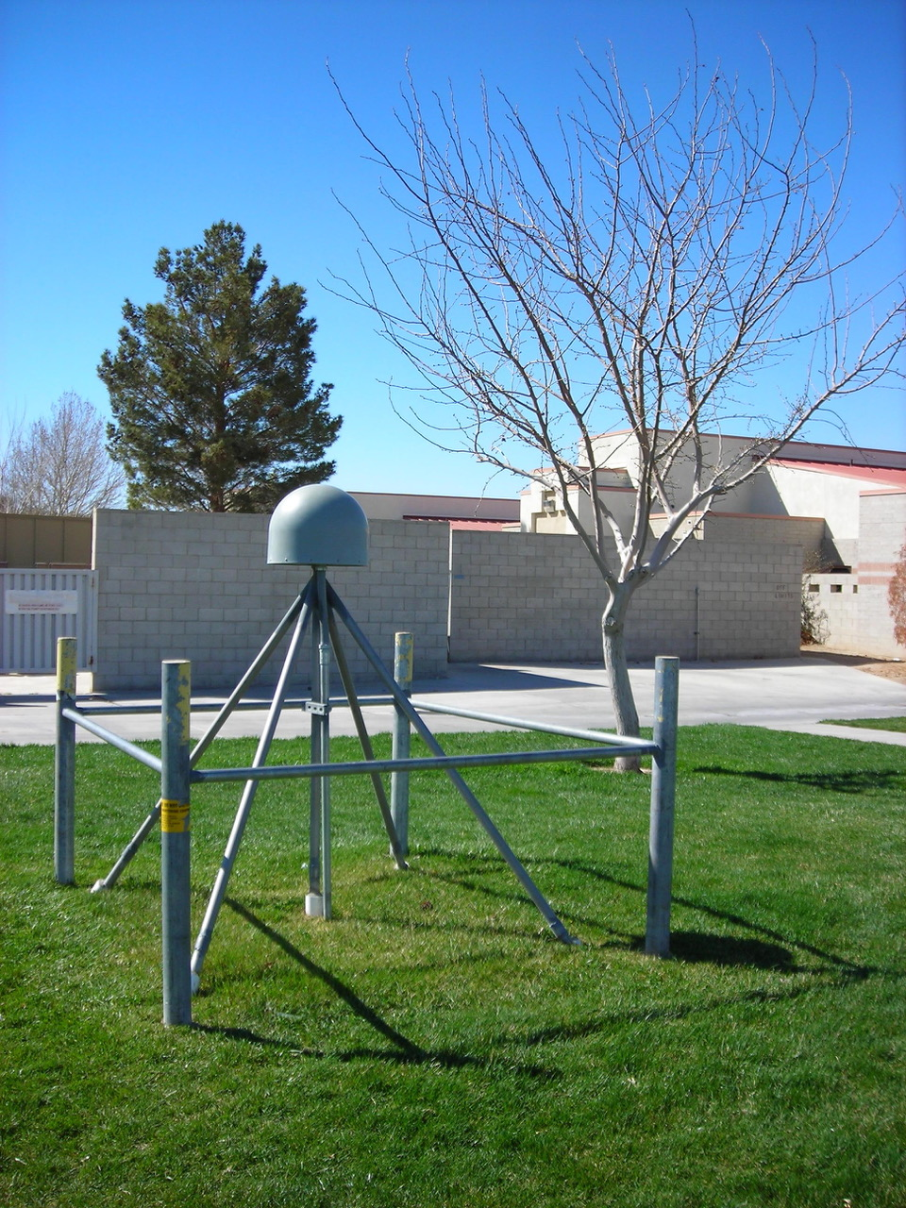
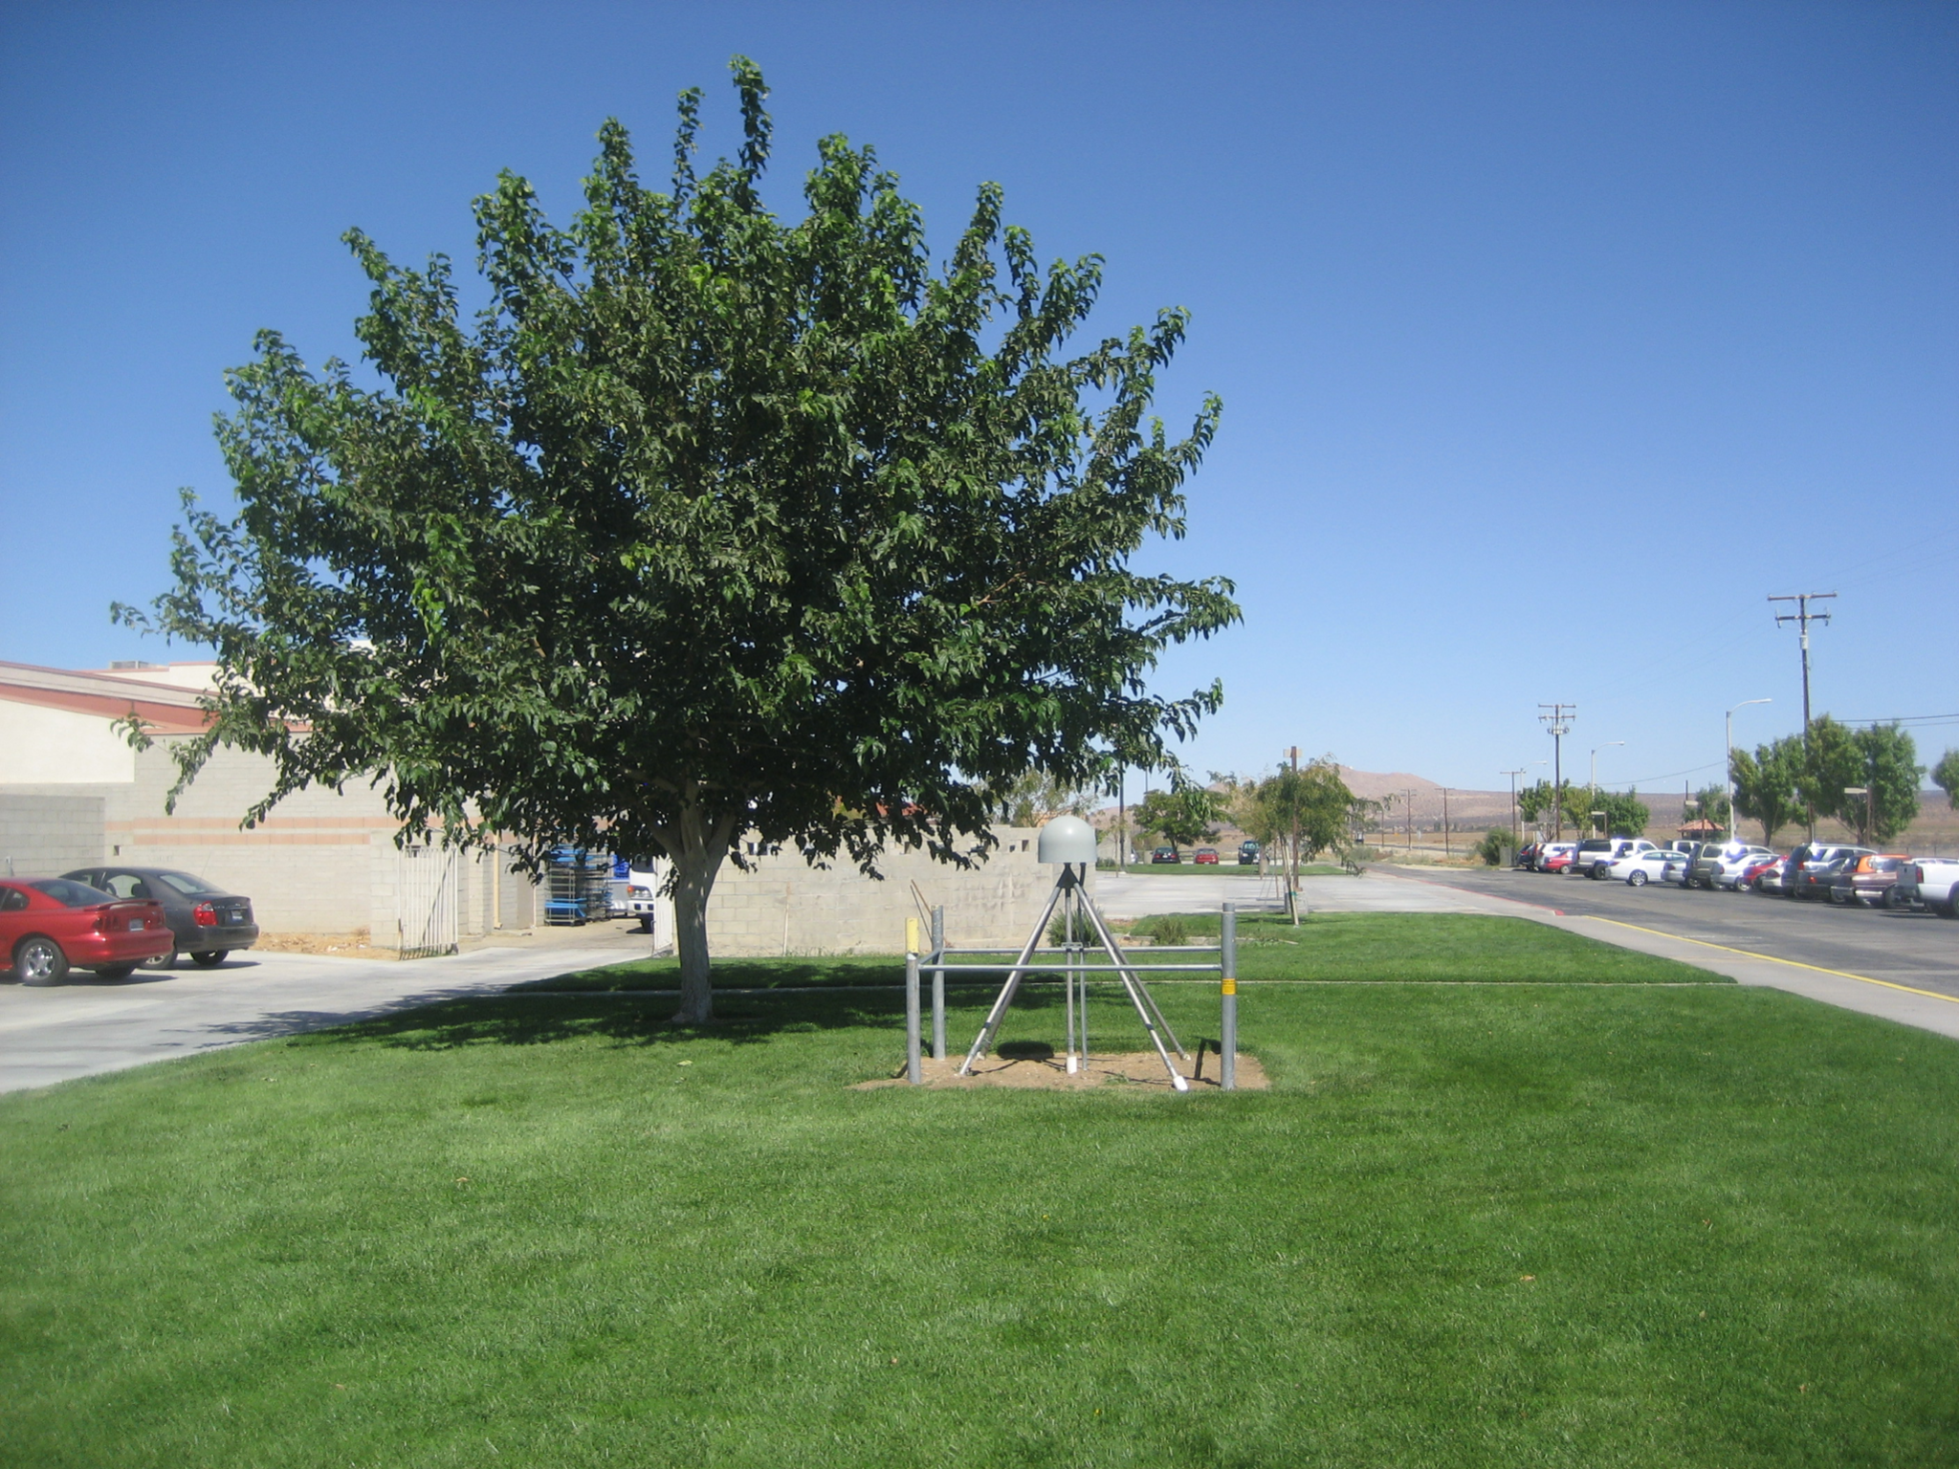
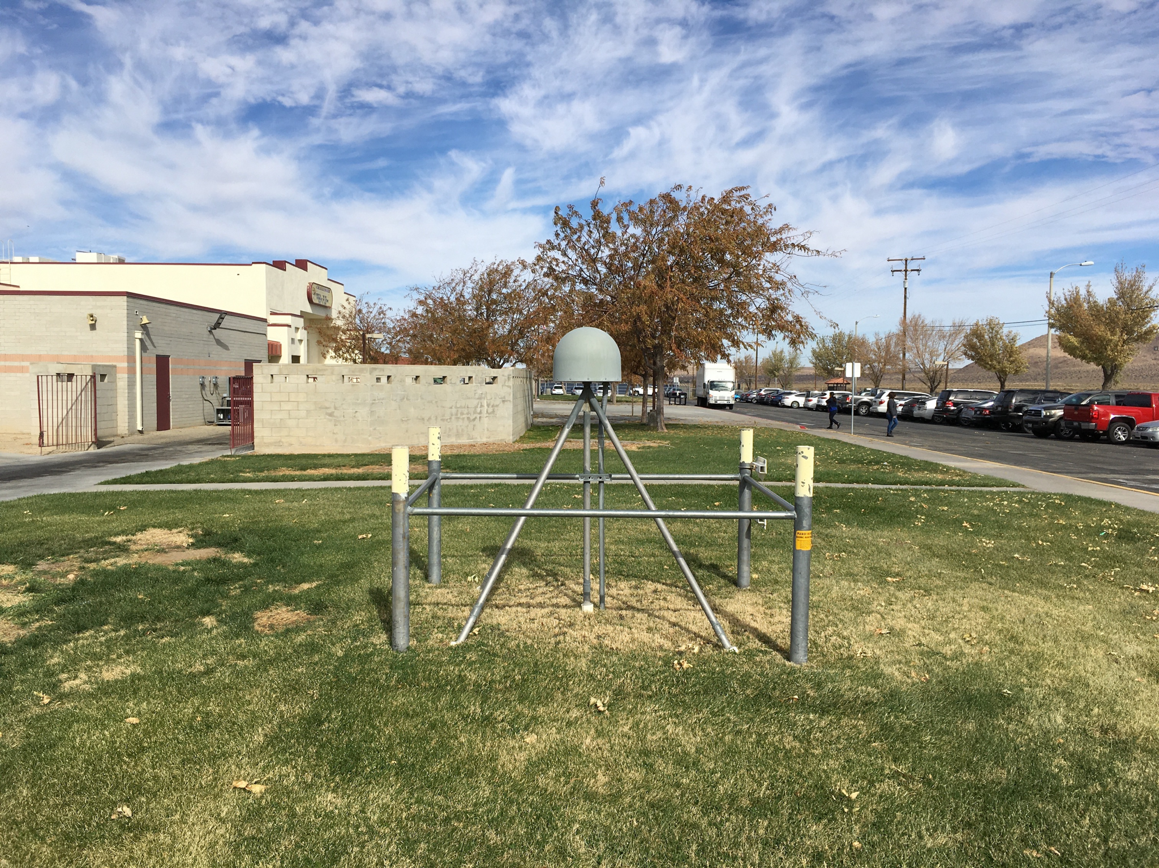
Ridgecrest
earthquake
Mulberry tree period
By UNAVCO and CWU
Notes:
In this slide I’d like to point out the need to prevent vegetation from overwhelming a CORStation. CHMS in California’s Mojave Desert, is not part of the NOAA CORS Network, but it’s a station I helped install and operate 20 years ago when I was with the SCIGN consortium. That tree circled in yellow was not there when we built the station in 2001. A few years later the school principal planted a mulberry tree next to the station, and it grew and grew. Each winter the leaves would fall off and each summer they would grow back again.
Look closely at the red rectangle. The 2-centimeter horizontal and 5-cm vertical oscillations in the position time series were not caused by the ground moving, but from the negative impact the tree had on the station from 2006 to when the tree was finally cut down in 2012.
Notice the small orange circle where there was real ground displacement of about 12 millimeters north. That was caused by the magnitude 7.1 Ridgecrest earthquake about 125 kilometers away.
The lesson here is even if you have a good stable monument, the CORStation will require good routine maintenance of hardware AND surroundings.
NEXT SLIDE

Slide 15
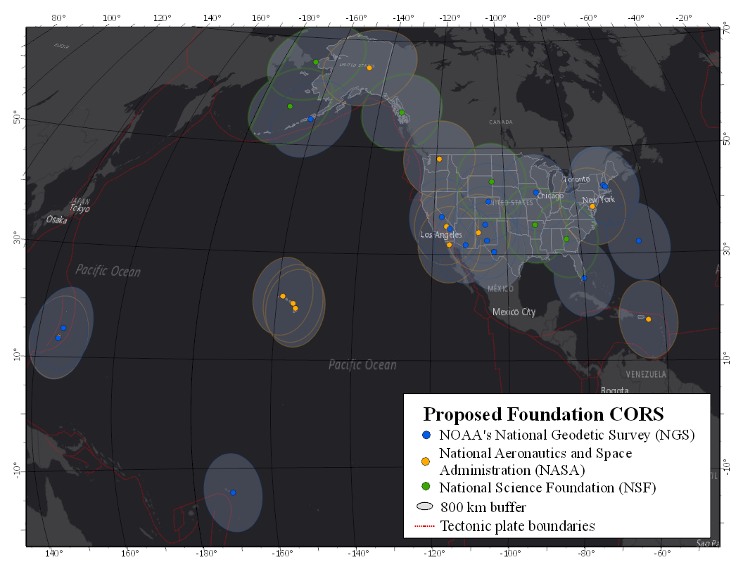
Notes:
So I’ve given you an overview of the people, organizations and infrastructure that make the NOAA CORS Network, but now I’d like to talk about efforts to improve and modernize the network.
Let’s start with Foundation CORS -- a set of at least 36 federally owned and operated, high quality, highly-reliable stations to guarantee support for the NSRS and ITRF for decades or even centuries to come. Federal partners include the National Science Foundation and NASA, and we are pushing to work with others such as the National Park Service and National Geospatial Intelligence Agency.
NEXT SLIDE
‹#›

Slide 16
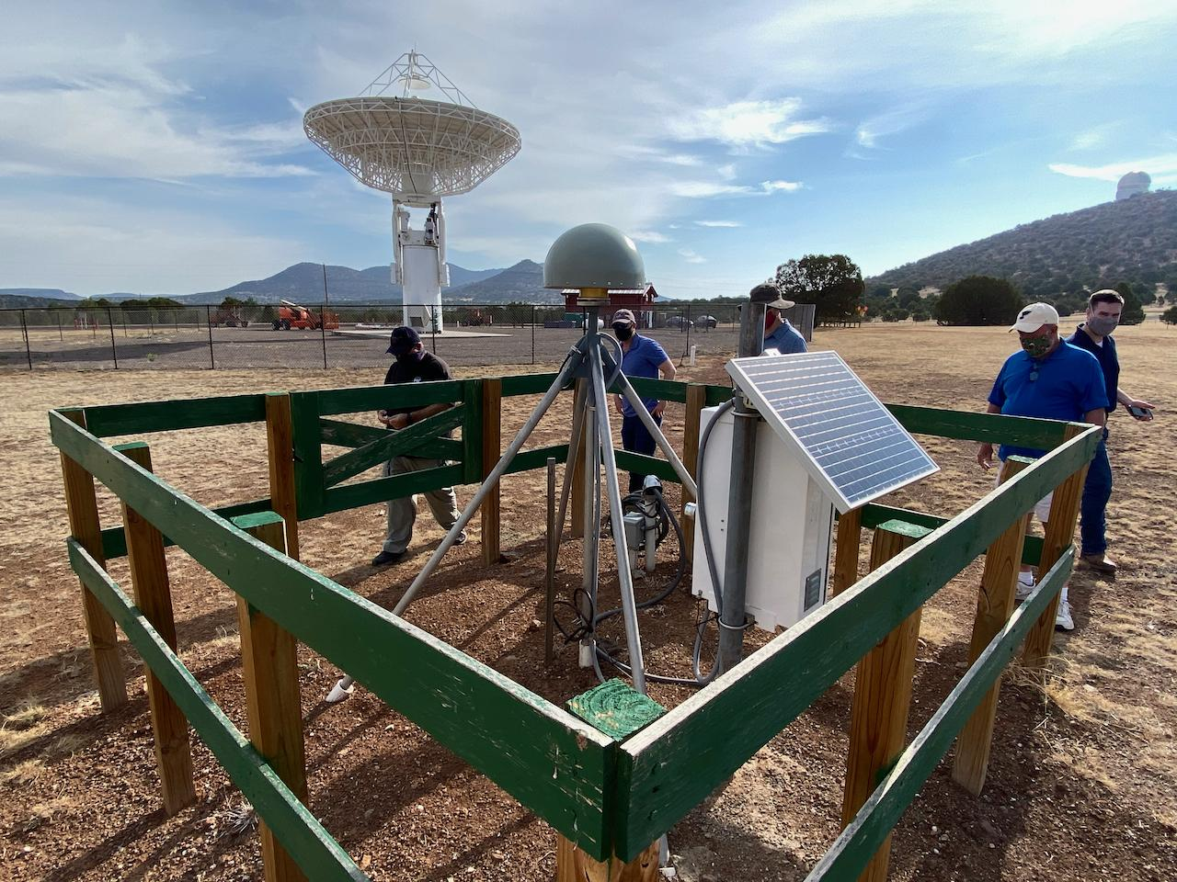
MG05 and VLBI antenna at McDonald Observatory, TX
Notes:
22 out of 36 Foundation CORStations will be co-located with other space geodetic techniques (like the VLBI radio telescope pictured here) which support the International Terrestrial Reference Frame. Other stations will fill in big gaps in the network and support our own rotation models for the Carribean, Mariana, Pacific and North America plates.
NEXT SLIDE
‹#›

Slide 17
efforts to improve and modernize
Notes:
We’re just starting to write a 5-year CORS comprehensive plan to guide NGS, inform our constituents and collaborators, and perhaps enlighten higher levels or other parts of federal government of the need for a high quality national CORS network.
The CORS Comprehensive Plan will address issues like coordinating with federal partners, neighboring countries and international organizations, and improving standards and giving better guidance to our partners for the installation, operation and maintenance of CORStations. I know from speaking to partners over the last year that they are hungry for better guidance, and some groups like UNAVCO have already been leading the way for decades.
While we are writing the CORS comprehensive plan, we’re not waiting to implement these and other initiatives:
Shift from GPS to multi-GNSS operations.
Train our NGS Field Operations Branch surveyors how to install CORStations and do maintenance on them.
Dismantle FTP access to CORS data due to IT security risks, and shift to HTTPS and Amazon Web Services. Our backup data ingest system is even going to be on AWS.
Encourage installation of GNSS stations at more tide gauges.
Evaluate transferring some mundane operational tasks to a third party so that we can focus on the science and innovations.
NEXT SLIDE
‹#›

Slide 18
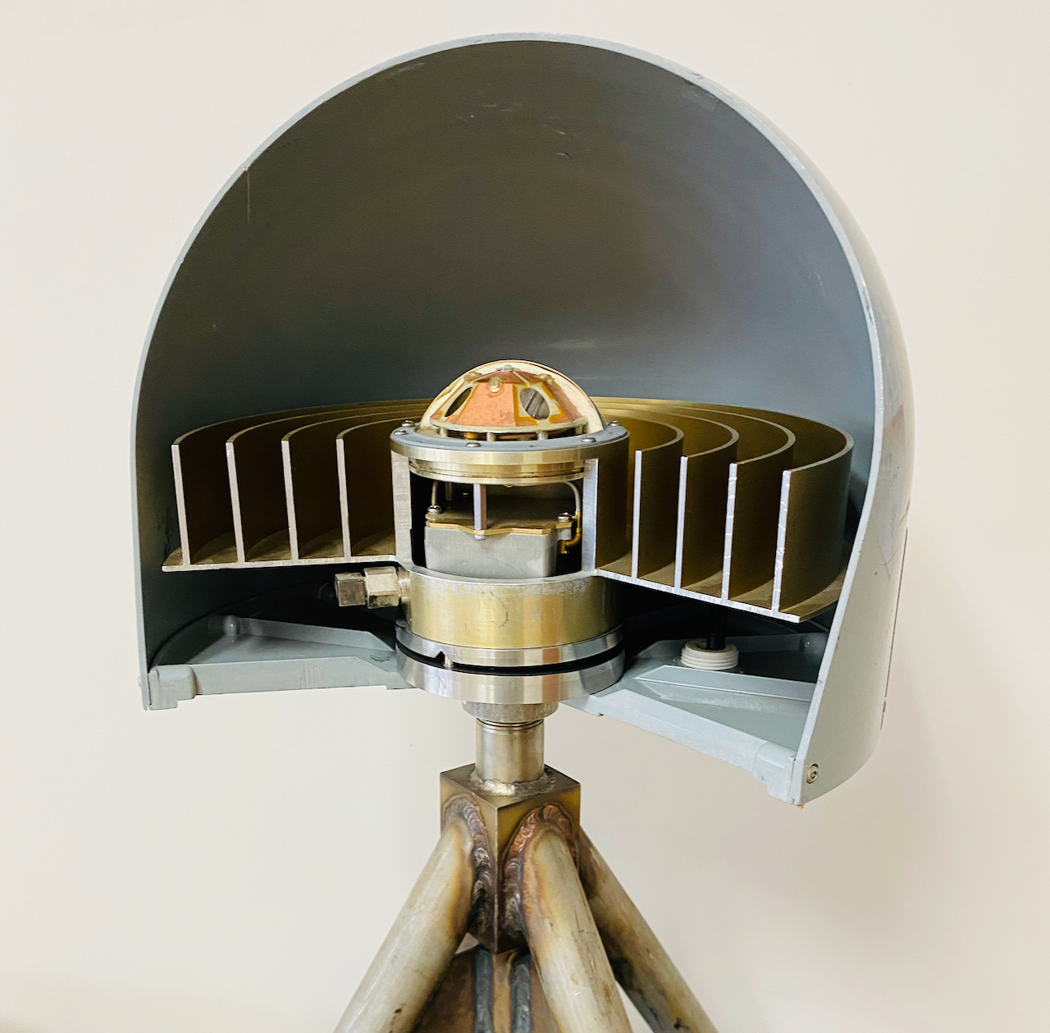
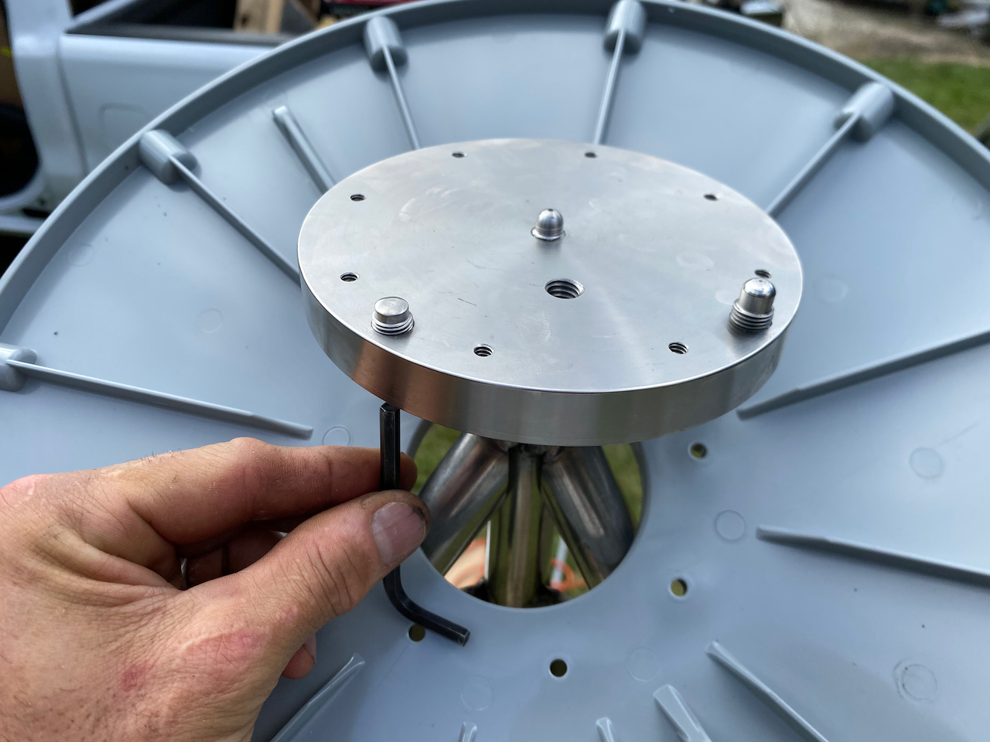
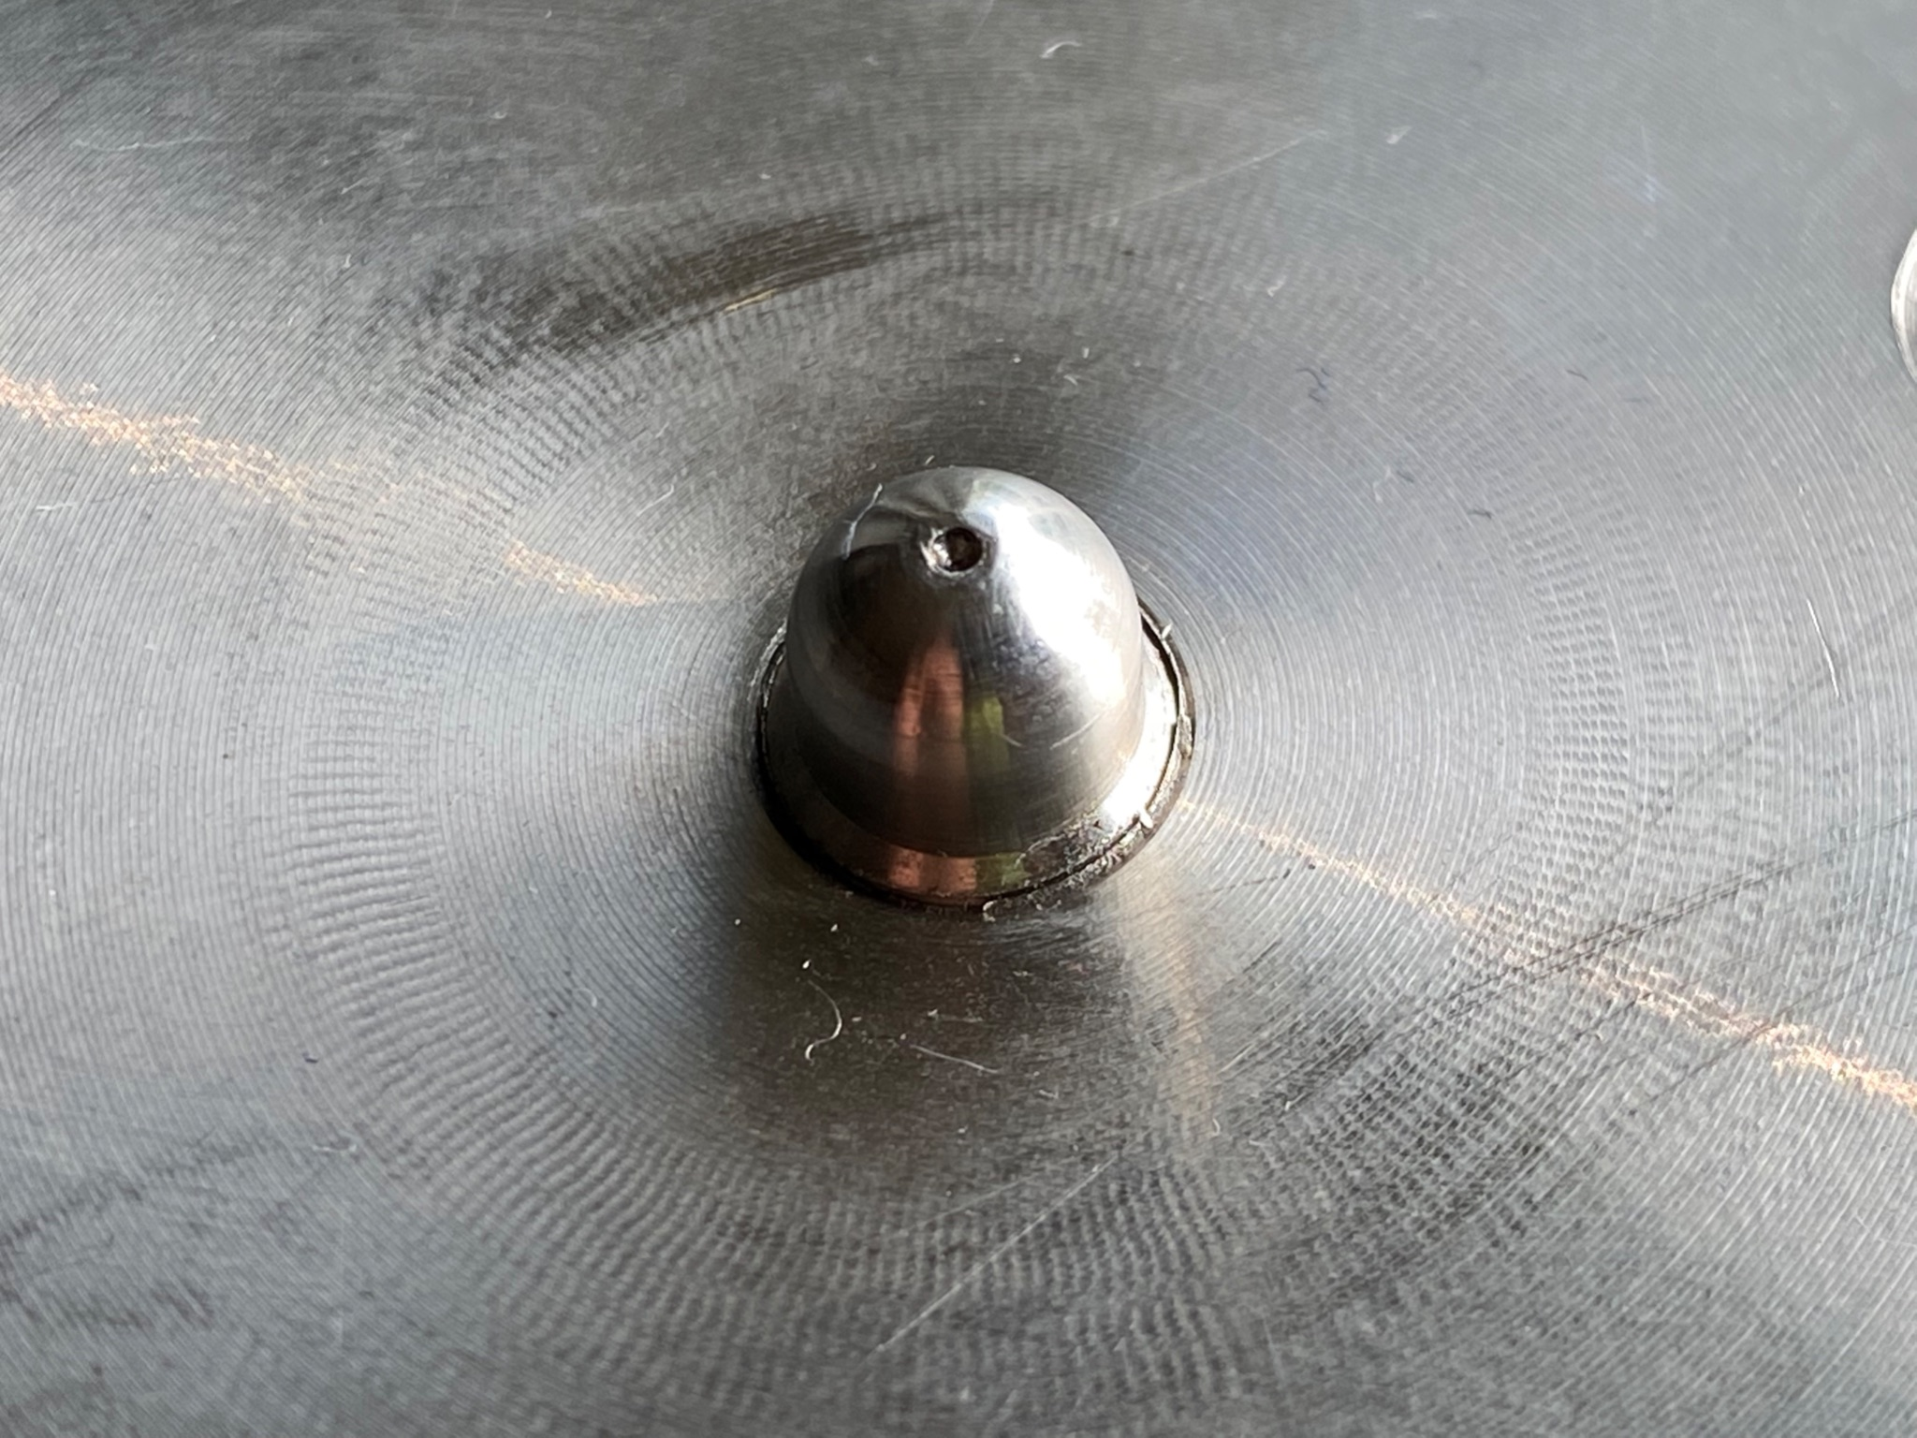
GRP
“Choke ring” GNSS antenna
GRP
SCIGN D3
Notes:
For new CORStations with modern antenna leveling adapters, we’re now requiring the use of the Geometric Reference Point (or GRP). It’s a physical non-moveable point on the bottom part of a modern antenna adapter to which the official coordinate function of a CORStation is referred to. With coordination and training from NGS, surveyors wanting to tie to or from a CORStation with non-GNSS survey methods can have access to its GRP.
The concept of a GRP is not new to the continuous GNSS community. The SCIGN D3 fixed-height antenna leveling adapter shown here has been extensively used in networks such as SCIGN, PANGA and PBO since it was developed by Scripps Institution of Oceanography 25 years ago.
NEXT SLIDE

Slide 19
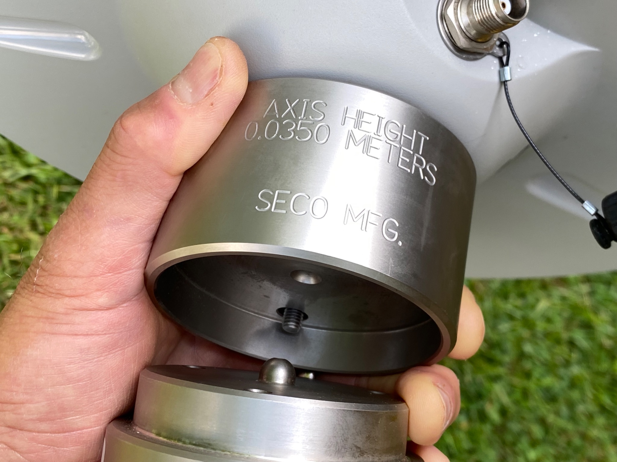
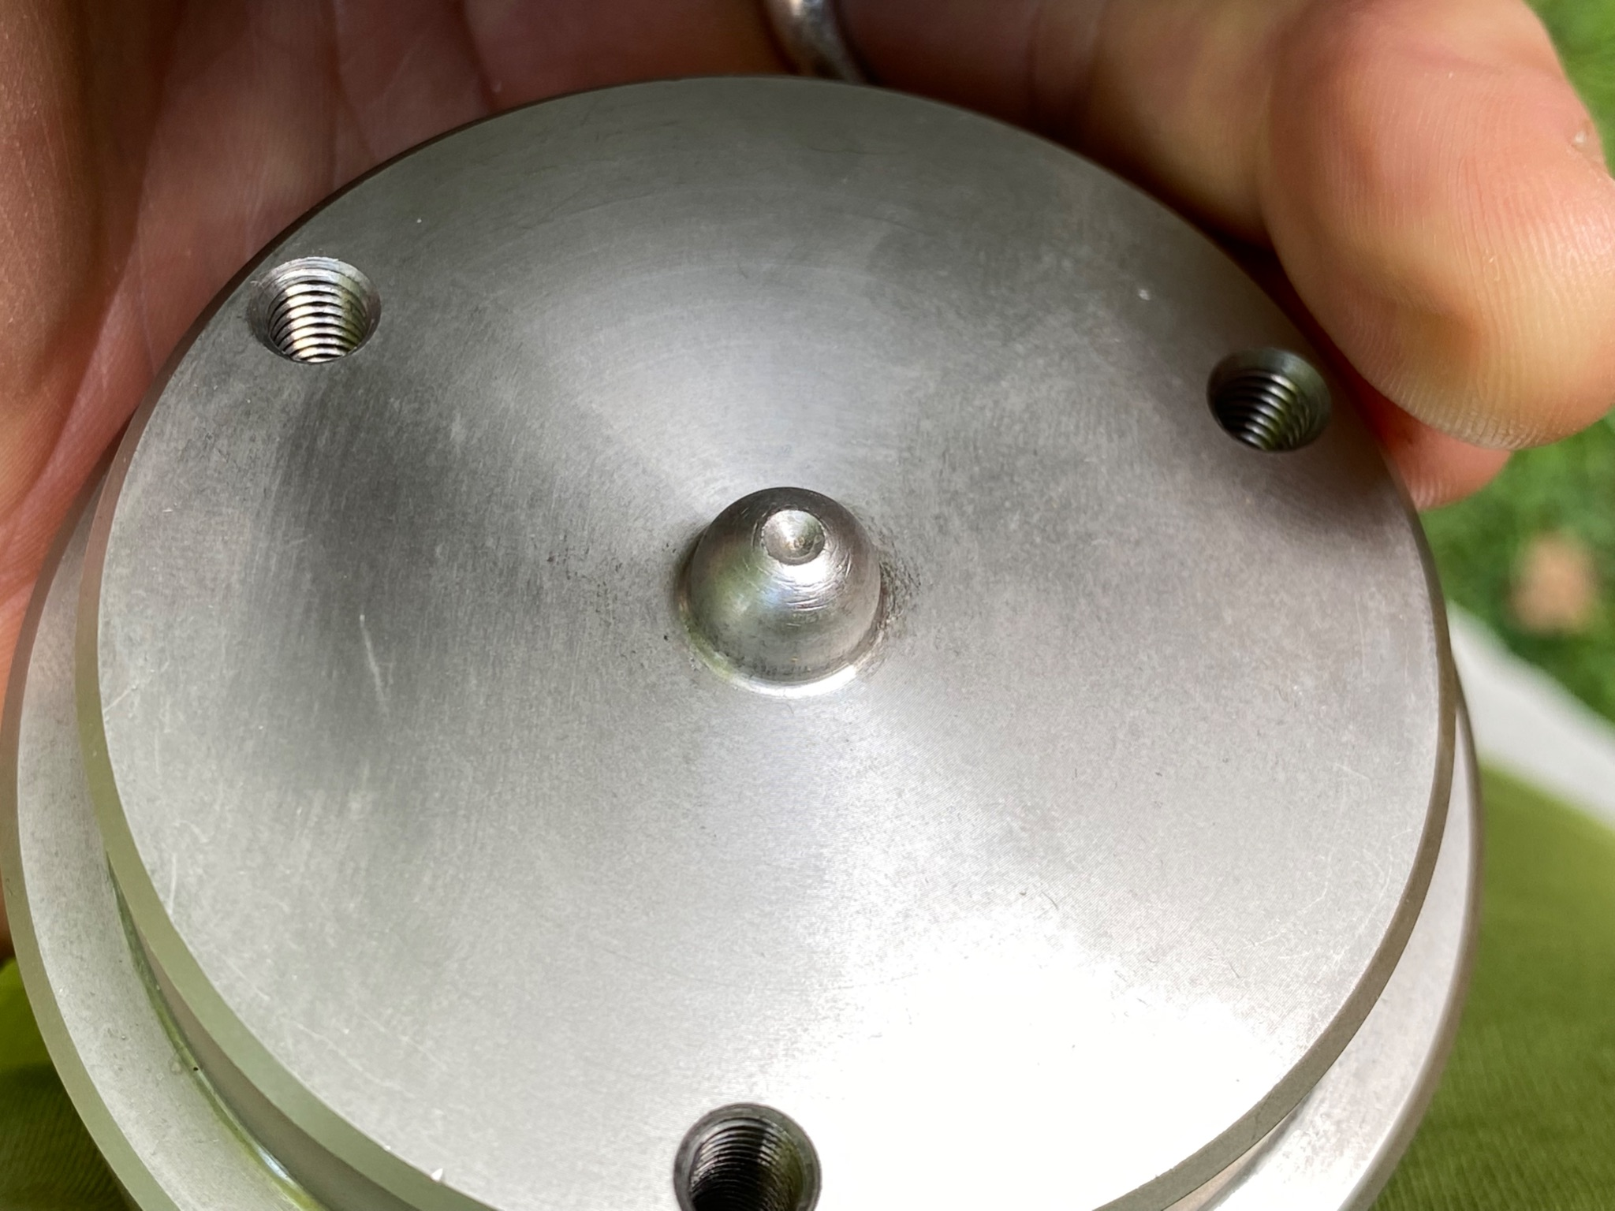
GRP
SECO 2072
Notes:
The SECO 2072 antenna leveling adapter is very common in the NOAA CORS Network. Here’s its GRP in case you don’t know. When properly leveled and oriented north, a GNSS antenna using this mount is exactly 35 mm above the GRP. It says so right on the adapter.
NEXT SLIDE

Slide 20
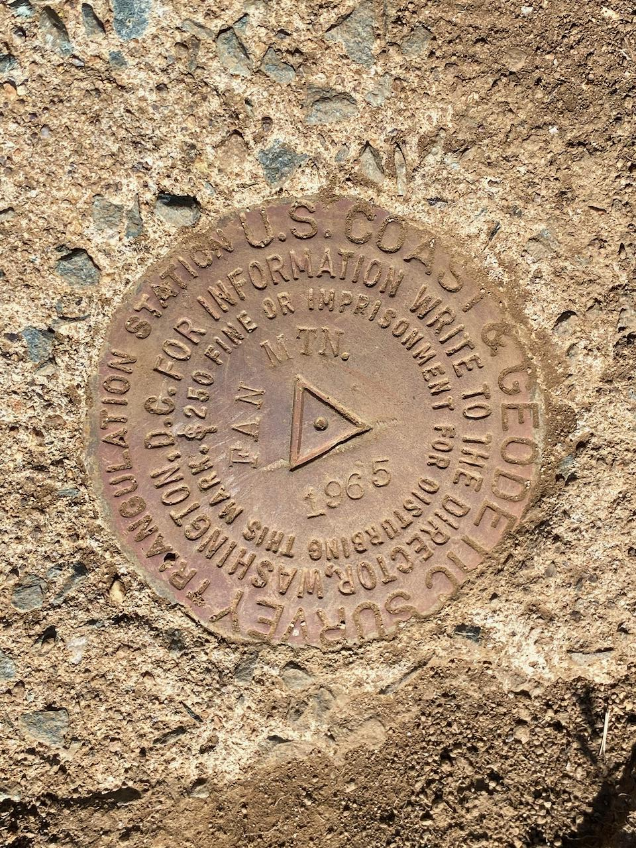
GRP of a SCIGN D3 adapter
Point on a brass disk mark
GRP of a SECO 2072 adapter
Notes:
If you’re a surveyor, the concept of a CORS Geometric Reference Point should make sense with this slide. The GRP is exactly the same as a point on a bench mark you survey to for your work. It’s that simple.
NEXT SLIDE
‹#›

Slide 21
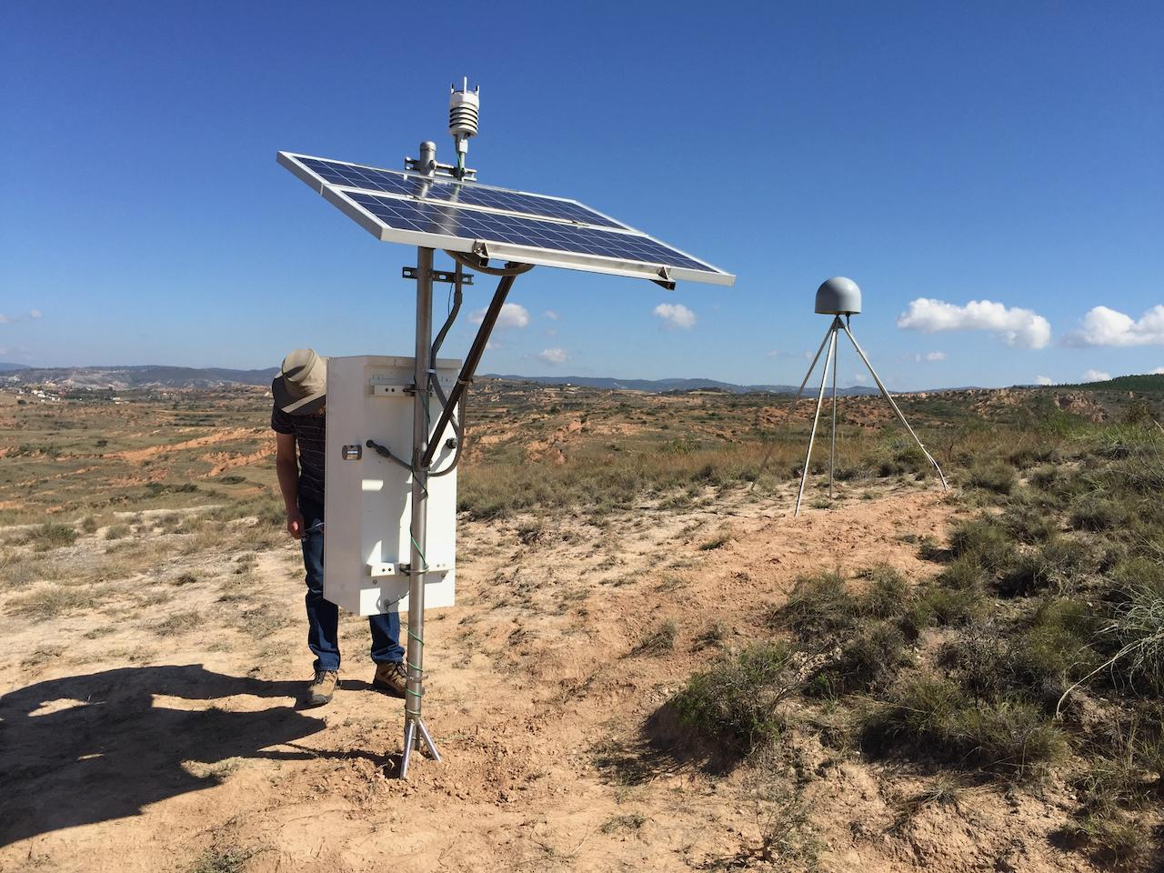
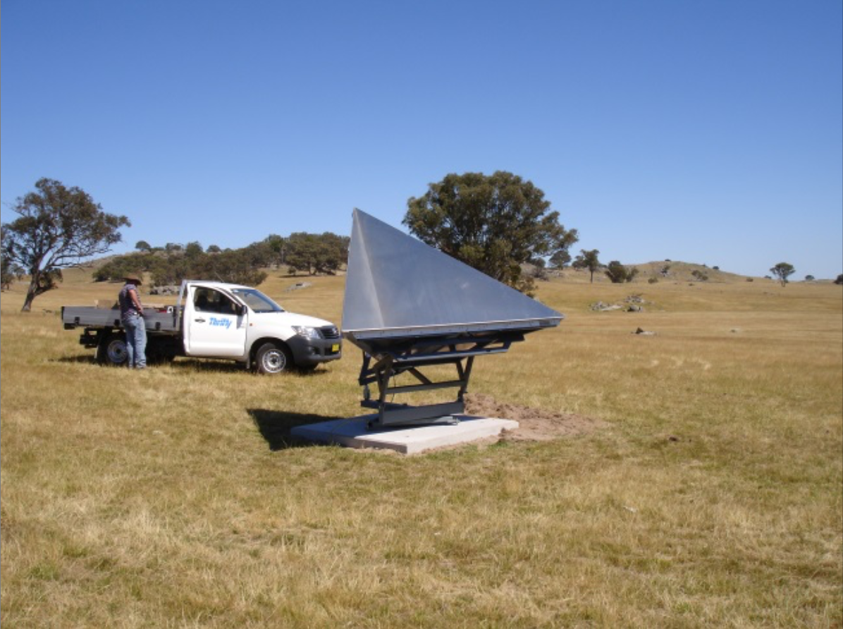
Metpack
GNSS-Met station, Oaxaca, Mexico
Satellite radar corner reflector, Gunning, Australia
Notes:
In my final 2 slides, I’d like to bring up a few emerging applications I think are very exciting and relevant to the NOAA CORS Network.
One is GNSS Meteorology. Water vapor in the lowest region of the atmosphere is a source of noise for precision GNSS measurements on the ground. By installing more meteorological instruments (or metpacks) at CORStations, we could be doing a better job of modeling that noise. At the same time, atmospheric scientists could also be using the GNSS signal delays caused by atmospheric water vapor to do better weather forecasting. One geodesist’s noise is another meteorologist’s signal!
Synthetic Aperture Radar satellites have orbits that allow them to pass over the same part the earth every couple of weeks or so. They take radar images of the ground during each pass, and if the ground moved during that time it will show up as an interference pattern when the two radar images are stacked. The left image shows a radar corner reflector developed by Geosciences Australia. If we have those kind of corner reflectors co-located with CORStations, we not only would be helping calibrate and validate the radar satellites, but also monitoring ground movement happening under and between CORStations. I just think that’s so cool!
NEXT SLIDE
‹#›

Slide 22
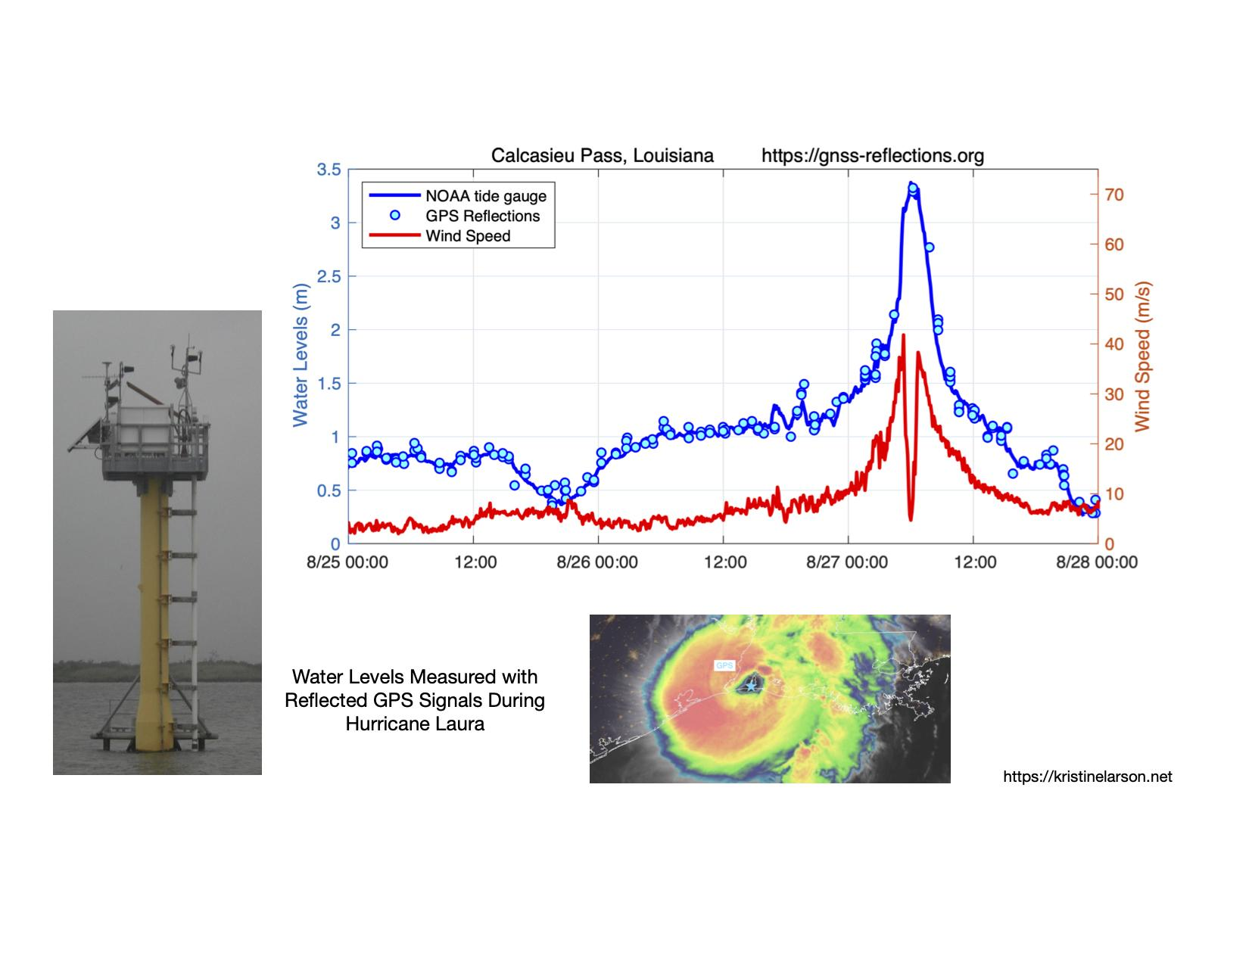

CALC
Notes:
What’s also amazingly cool is this graphic made by Kristine Larsen using data she got from a NOAA “Sentinel” instrument platform off the Gulf coast of Louisiana. The Sentinel not only collects traditional wind and water level data, but it has a CORS which is operated by Louisiana State University. Kristine measured sea surface levels using GPS signals reflected off the water as Hurricane Laura passed over in August, 2020.
Notice the wind speed plotted in red as it rises and falls—you can even see when the eye of the hurricane passed directly over the Sentinel. The blue line is the water level recorded by the traditional NOAA tide gauge, and the light blue dots are the water levels measured with Kristine’s GPS reflection technique. I hope you see tight agreement between the wind and water level data sets, and what an amazing tool GNSS reflections can be for measuring sea and lake levels, storm surges and tsunamis.
So in closing, if we at NGS do these improvements and the modernization right, the NOAA CORS Network will be an even more valuable and versatile resource for all of us.
NEXT and FINAL SLIDE
‹#›

Slide 23


Thank You
john.galetzka@noaa.gov
ngs.cors@noaa.gov
Notes:
Thank you so much for listening to me today. I’m ready for your questions.
‹#›

