Slide 1

Tides, King Tides, and Tidal Datums plus some NOS Resources
CLSA Sonoma County chapter meeting, Feb 2013
Marti Ikehara, Geodetic Advisor
NOAA’s NGS, Sacramento
Marti.ikehara@noaa.gov

Slide 2
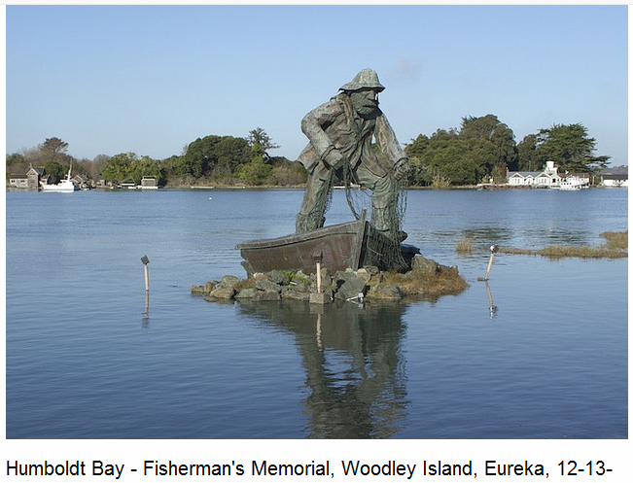
King Tide, Humboldt Bay, Dec ‘12 event
12
Photo by Steve Coppin, Humboldt Baykeeper

Slide 3
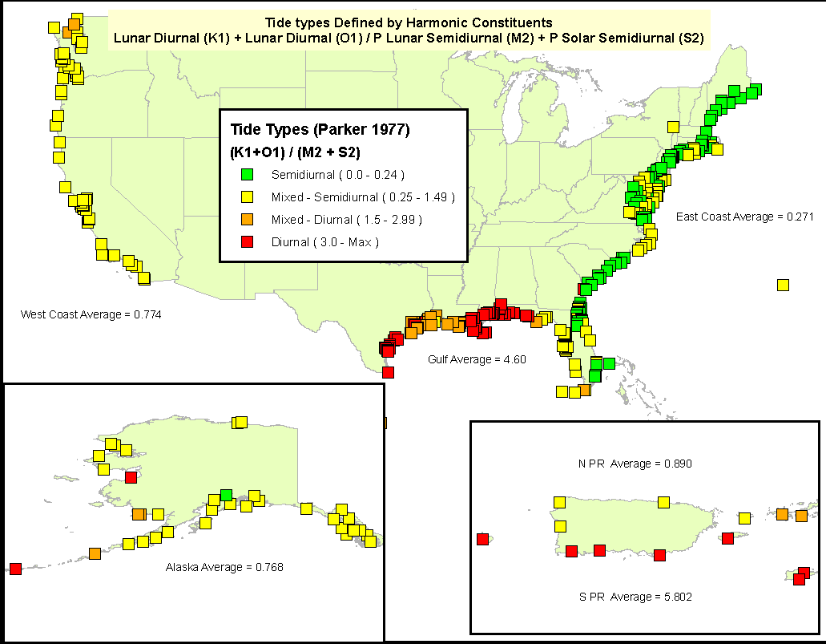
Types of Tides
Tide Type Varies by Region due to Local Hydrodynamics

Slide 4
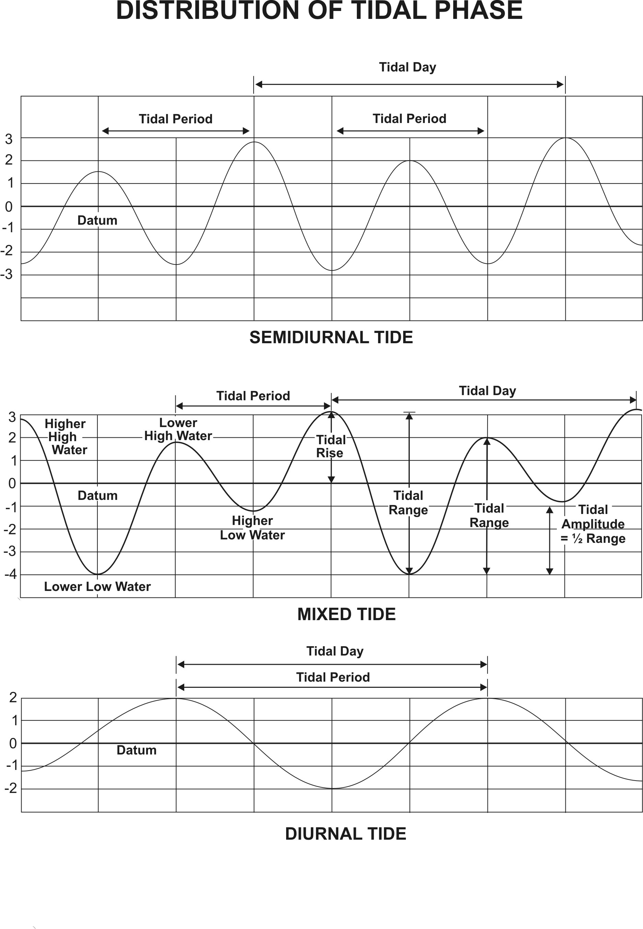
Types of Tides
Semidiurnal
two daily highs & lows
~ similar height
Most common
Mixed
two daily highs & lows
~ not similar height
Diurnal
one daily high & low

Slide 5
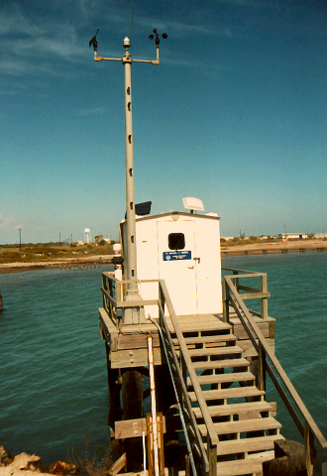
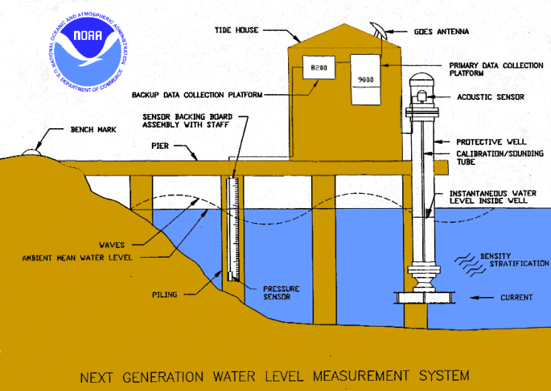
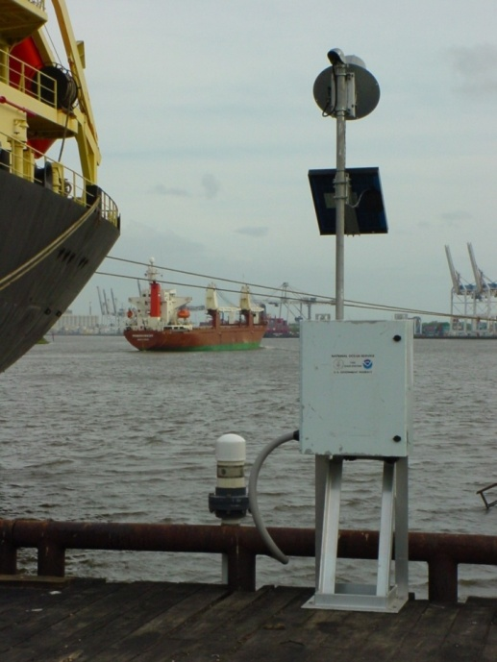
NWLON Stations
Essential Equipment
Control Stations
Automatic water level sensor
Backup water level sensor
Backup & Primary data collection platform
Protective well
Shelter
Solar Panel
GOES satellite radios
Telephone modem
Ancillary geophysical instruments
System of Bench Marks
Water Level
Wind Speed/Direction
Barometric Pressure
Air/Water Temp.
Conductivity/Temp
Chart Datum
Tsunami/Storm Surge
Short term stations
Data Collection Platform
Acoustic or pressure sensor
Solar Panel
GOES Transmitter
Observations
Collected

Slide 6
Definition of TIDE
Tides are actually the movement of water across the Earth’s surface caused by the combined effects of the gravitational forces exerted by the moon and the sun and the rotation of the earth
Tides are affected by the relative positions of the earth, moon, and sun, the elliptical orbits of the celestial bodies, land formations, and relative location on the earth.
The highest tides—called ‘spring tides’ occur roughly every 14 days, at the new and full moons, when the gravitational pull of the moon and the sun are in alignment.

Slide 7
Tide Generating Forces
Astronomical Forces:
  Gravitational pull of Moon creates bulge directly beneath Moon
  Centrifugal forces due to the Earth-Moon’s rotation creates second bulge opposite of Moon
Variations in the positions of the Moon & Sun relative to the Earth produce monthly variations in tides
Variations in the path of the Moon about the Sun produce decadal (18.6 yr) variations in tides
Variations in the distance of the Earth/Moon from the Sun/Earth due to their elliptical orbits produce annual/monthly variations in tides
Variations in the declination of the Moon (varying from 18.5 – 28.5 degrees pos and neg) produces daily variations in the tides
Tides:
  Deterministic; predictable
  With enough water level data, the tides can be predicted indefinitely for that location until/when there are changes to the geometry—bathymetrically or along the coastline

Slide 8
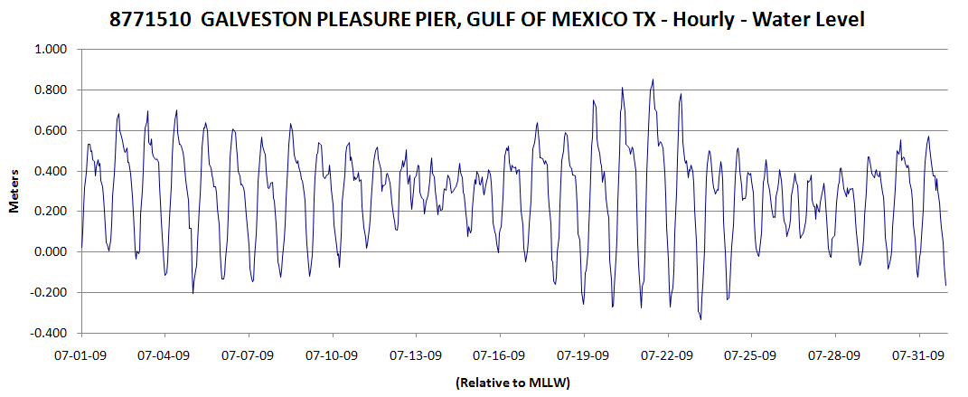
Moon Phase Inequality
Affects the amplitude of the tides (tidal range)
Moon Phases:
Spring
Neap
Spring
Neap

Slide 9
Data Processing
Criteria for determining a Tide
Programmed into the computer algorithms.
Two-hour rule: Adjacent high and low waters must be different by 2 hours or more in time in order to be counted as a tide.
One-tenth of a foot rule (same as 0.03 m rule): Adjacent high and low waters must be different in elevation by one tenth of a foot (or 0.03 m) or more in order to be counted as a tide for tabulation.
Difference in elevation
Difference in time
Notes:
So we know that there’s a lot of statistics in computing tidal datums, and many of them represent the mean of various water levels measured at the water-land interface over a period of time.

Slide 10
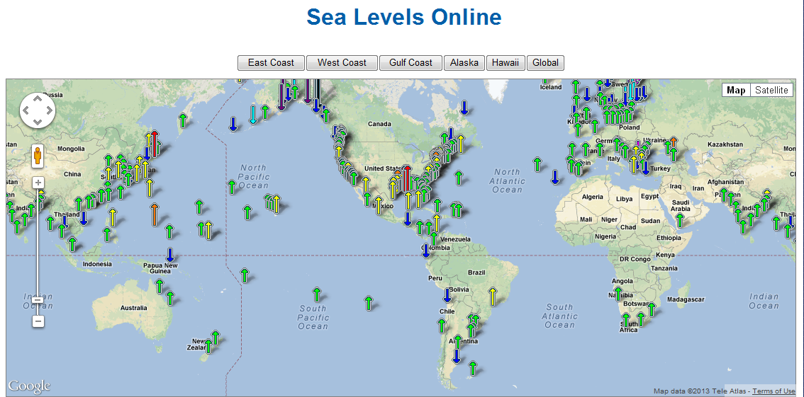

Slide 11
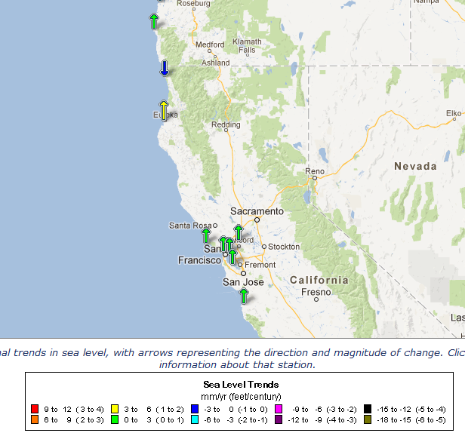
California RELATIVE Sea Level Trends

Slide 12
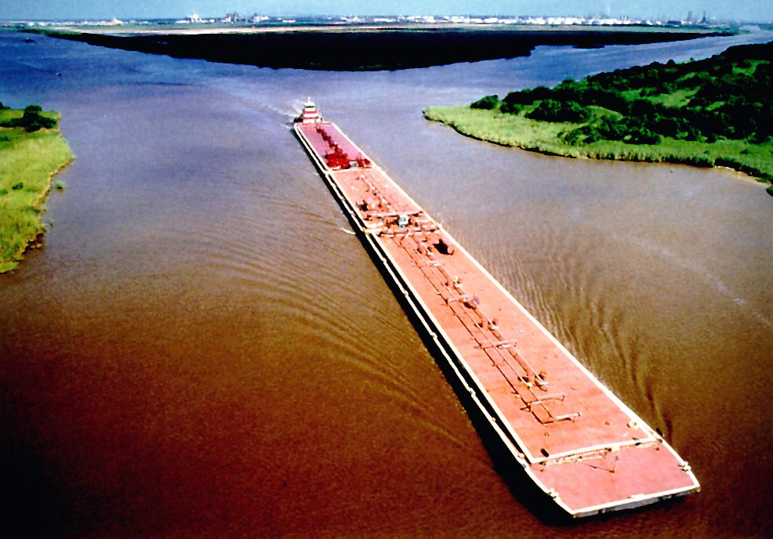
National Tidal Datum Epoch (NTDE)
A common time period to which tidal datums are referenced
A specific 19 year period that includes the longest periodic tidal variations caused by tide-producing forces of astronomical bodies.
Averages out long term seasonal meteorological, hydrologic, and oceanographic fluctuations.
Provides a nationally consistent tidal datum network (bench marks) by accounting for seasonal and apparent environmental trends in sea level that affect the accuracy of tidal datums.
The NWLON provides the data required to maintain the epoch and make determinations of tidal datums at primary and secondary tide (water level for the Great Lakes) gages.
Current epoch is 1983-2001; previous was 1960-78.
Notes:
To understand tidal datums, you need to understand what a tidal epoch is and why we have them. Other than both having ‘time’ in their basic meaning, a tidal epoch has nothing to do with a geodetic epoch (or a geological epoch). A geodetic is a moment in time, a geological is a really really long time, and a tidal epoch is 18.6 years.
Epoch is how long it takes for the Sun, Moon, & Earth to complete an epoch tidal cycle
This takes 18.6 yrs, so we use 19 yrs (because statistically the 0.4 is not significant out of the 19 yr avg.)

Slide 13
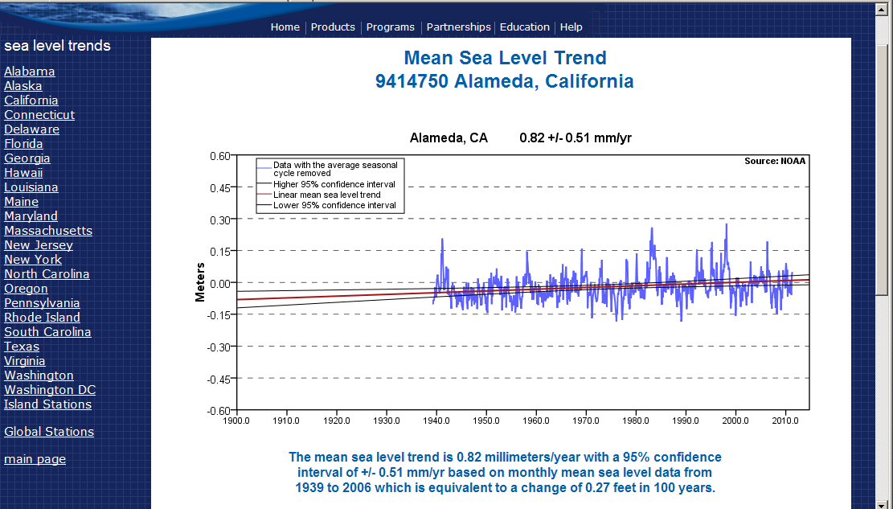
Long-term trends have to account for tidal epoch changes
Notes:
Each primary gage has a Sea Level Trend link at the bottom of the lower left column. These trends should be considered for anything that will or will likely be impacted, whether it’s wetland restoration, or STP inundation or highway flooding potential.

Slide 14
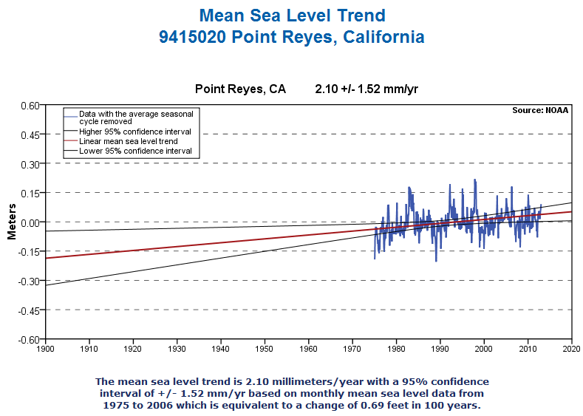

Slide 15

KING TIDES
The gravitational force is greatest when the moon is closest to the earth (perigee) and least when it is farthest from the earth (apogee – about two weeks after perigee). PERIGEAN SPRING TIDES
Gravitational force is greatest when the earth is closest to the sun: perihelion in early January. (Aphelion is in July)
King tides occur when the earth, moon and sun are aligned at perigee and perihelion, resulting in the largest tidal range seen over the course of a year.
King tides are higher than the average highest tides for three or four days in several winter (N. Hemi) months

Slide 16
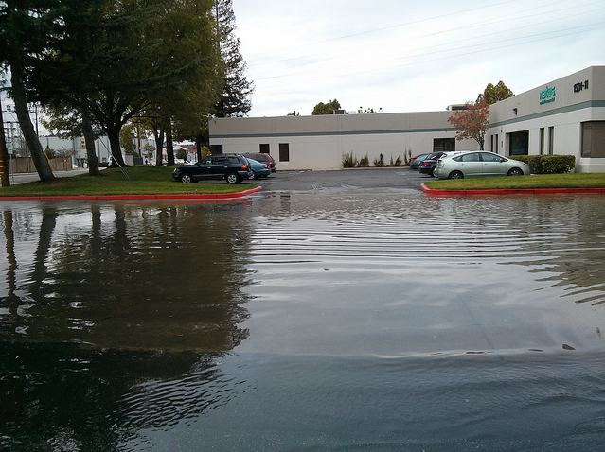
King Tide Websites/Info
http://www.californiakingtides.org/
Email: cakingtides@gmail.com
San Carlos
PHOTO LIBRARY:
  http://www.flickr.com/groups/cakingtides/pool/map?mode=group

Slide 17
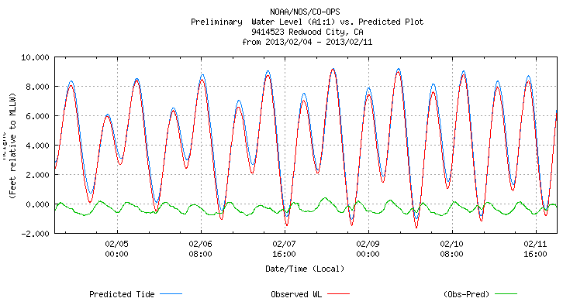
King Tide Dates, Tide Predictions
2013: Jan 9,10,11 and Feb 7,8,9
Redwood City (nr SanCarlos) for Feb 4-11
Notes:
Higher highs for Feb 7-9 are about 1 foot higher than for surrounding days. Note that lows are also lower, by > 1ft

Slide 18
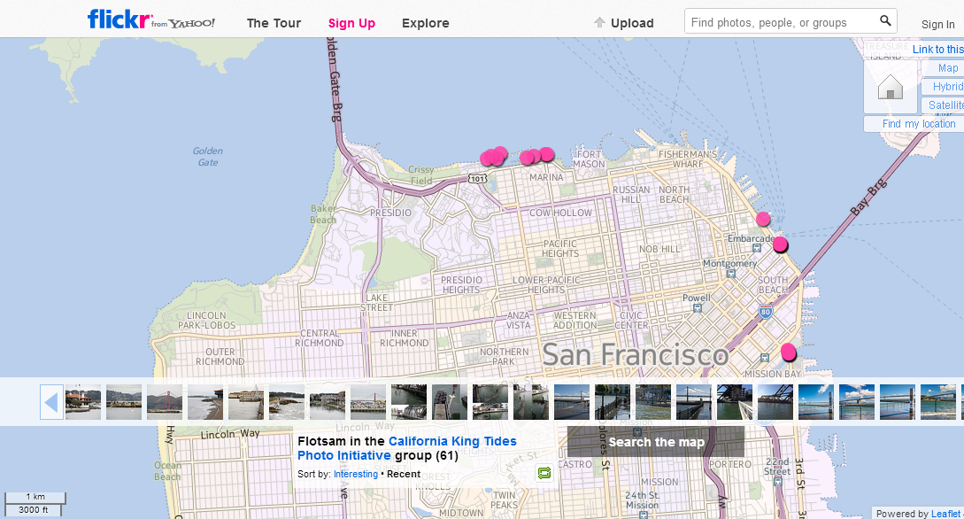

Slide 19
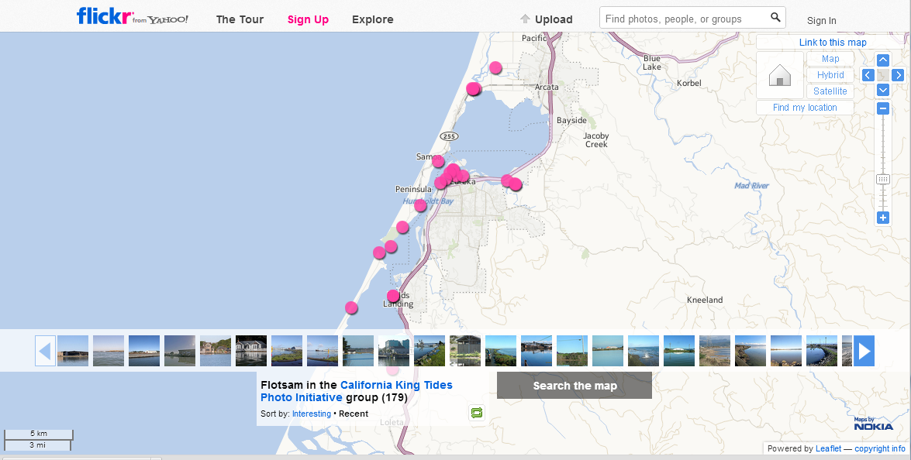

Slide 20
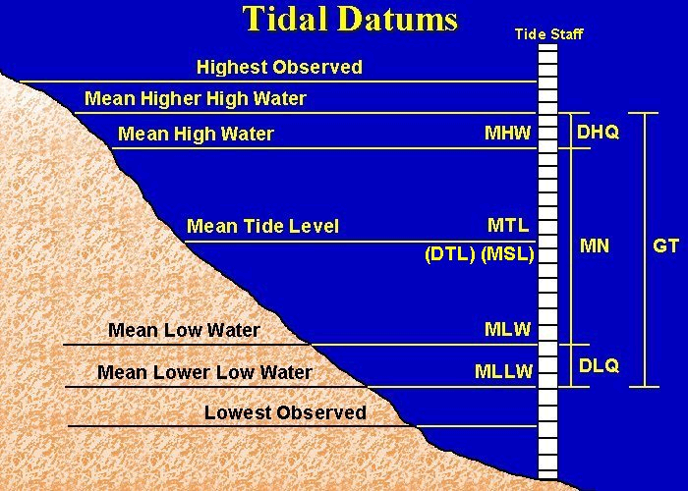

MHHW
Notes:
Highest and Lowest Observed are not a tidal datum or a computation.
The definitions can be found in a Glossary
What tidal datum is NOT the mean of water level observations? Trick question; see next slide
Standard Method (MTL, MSL, Mn, DHQ & DLG are known):
MLW= MTL-(0.5*Mn)
MHW= MLW+Mn
MLLW= MLW-DLQ
MHHW= MHW-DHQ
DTL= 0.5*(MHHW+MLLW)
GT= MHHW-MLLW
MRR Method (MTL, DTL, MSL, Mn & GT are known):
MLW= MTL-(0.5*Mn)
MHW= MLW+Mn
MLLW= MLW-0.5*GT
MHHW= MHW+GT
DHQ= MHHW-MHW
DLQ= MLW-MLLW
GT is known as the spring or diurnal range depending on what coast it is on.

Slide 21
Tidal Datums
Station Datum: Unique to each water level station
  - Established at a lower elevation than the water is ever expected to reach.
  - Referenced to the primary bench mark at the station
  - Held constant regardless of changes to the water level gauge or tide staff
MHHW: Mean Higher High Water
The average height of the higher high water of each tidal day observed over the NTDE MHW: Mean High Water
The average of all the high water heights observed over the NTDE
MTL: Mean Tide Level
The arithmetic mean of mean high water and mean low water
MSL: Mean Sea Level or LMSL: Local Mean Sea Level
The arithmetic mean of HOURLY heights observed over the NTDE
MLW: Mean Low Water
The average of all the low water heights observed over the NTDE
MLLW: Mean Lower Low Water
The average of the lower low water height of each tidal day observed over the NTDE
GT: Great Diurnal Range
The difference in height between mean higher high water and mean lower low water
Notes:
These tidal datums are recomputed every 19 or so years. In some parts of the country, the period is much shorter, eg, 5 years, because the land-sea interface is changing that rapidly, eg, plate tectonics causing upward land motion in Alaska.
Because LMSL includes the hourly values for the 19-yr period, it is the most accurately calculated tidal datum.
The 18.6 year period is called a NTDE.

Slide 22
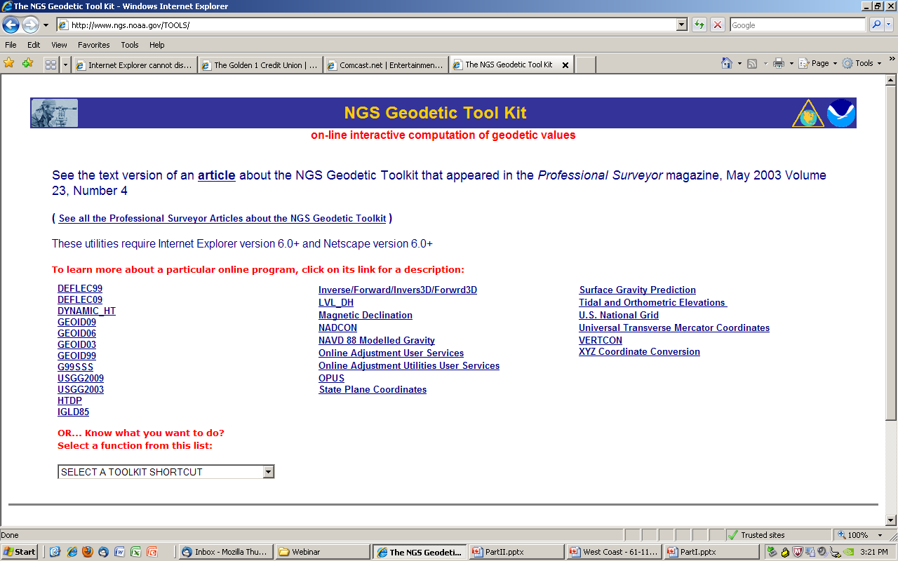

Slide 23
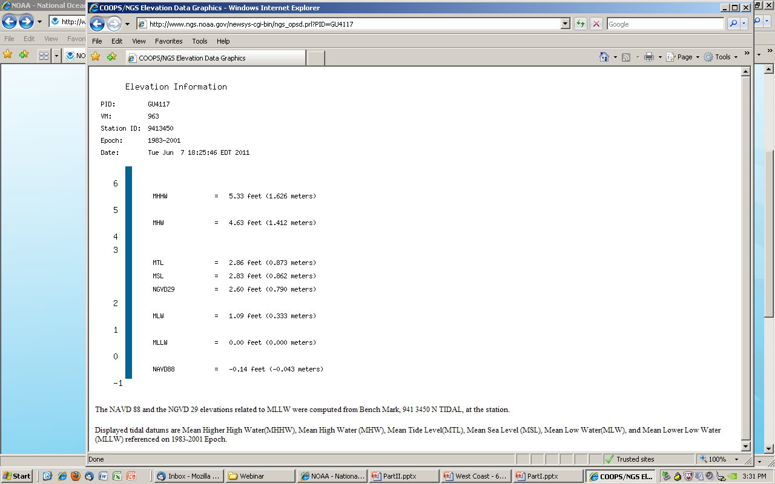
GU4117 DESIGNATION - 941 3450 N TIDAL
Feet AND meters
Primary Bench Mark for the tide gage
Notes:
The PID shown will be the Primary BM for the gage

Slide 24
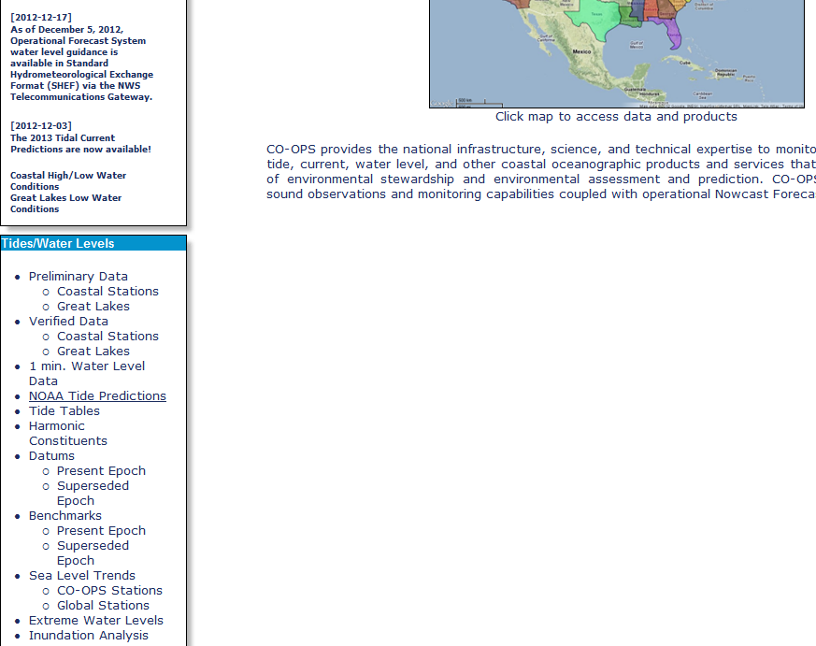

tidesandcurrents.noaa.gov

Slide 25
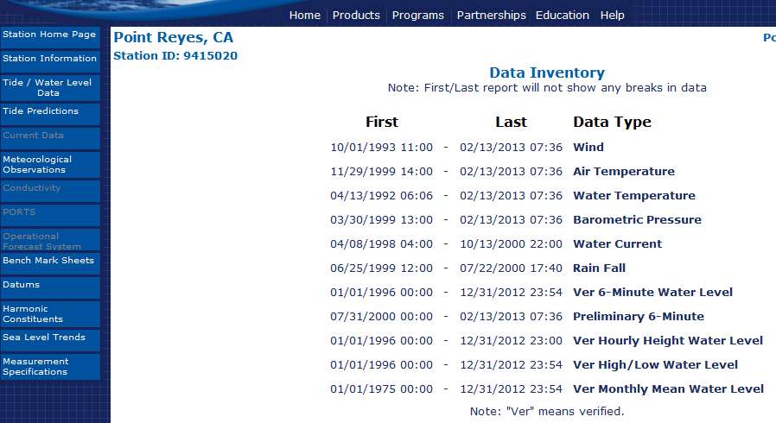

Data Inventory/ Bench Mark Sheets

Slide 26
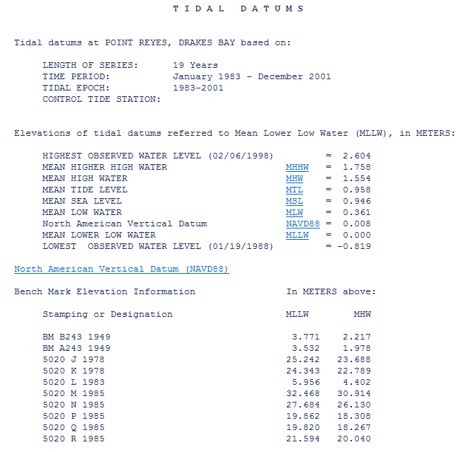

Slide 28
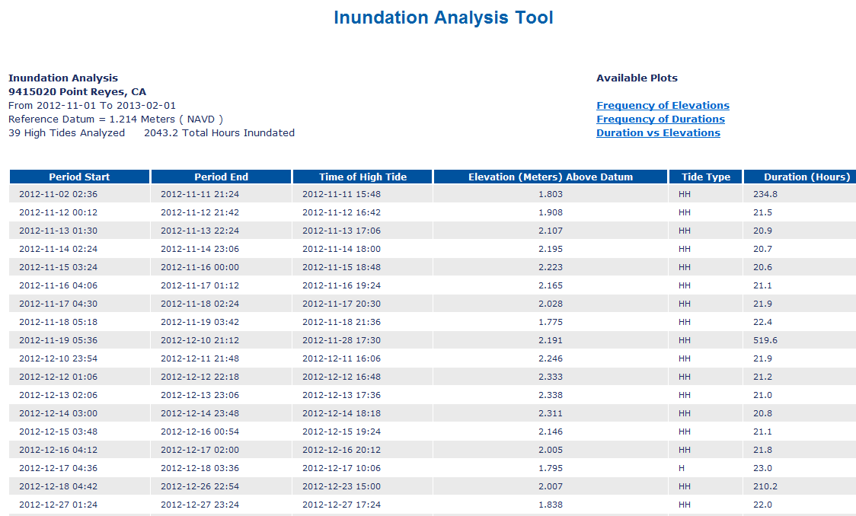

Slide 29
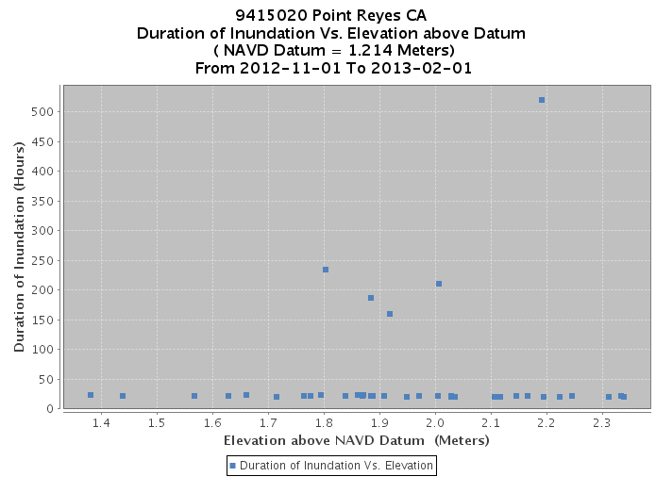

Slide 30
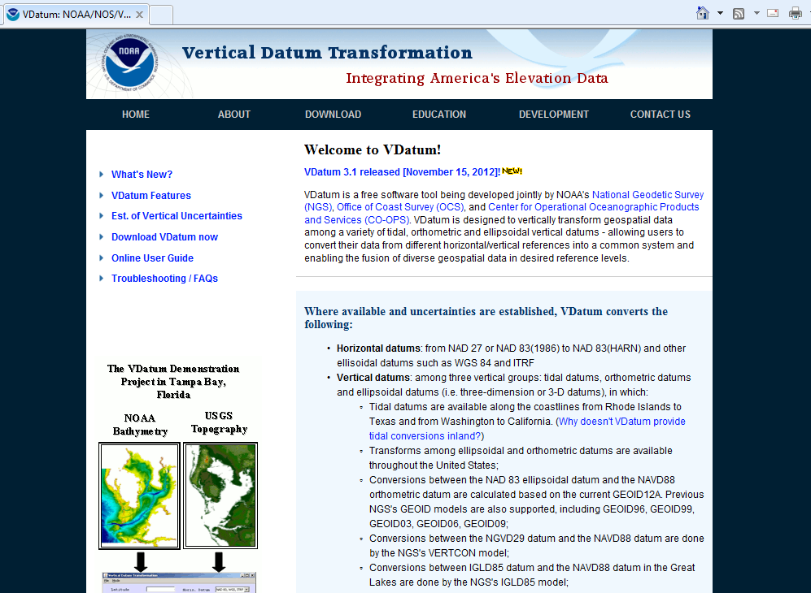
Vdatum.noaa.gov

Slide 31
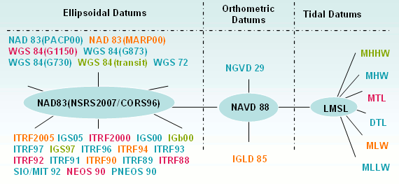
Datums available in VDATUM
NAD83 (2011)
Notes:
The most common datums are highlighted

Slide 32
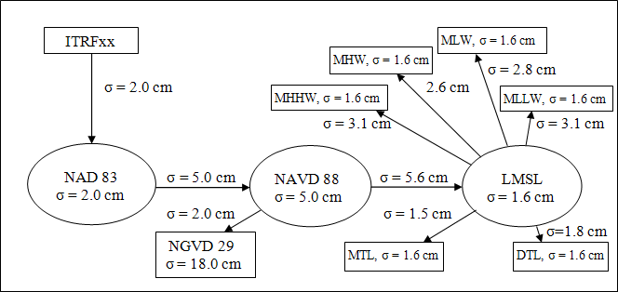
Errors from source data and transformations, using Chesapeake Bay dataset as an example
Notes:
Error in source data (eg, NAD83=2 cm) AND in transformations (eg going fr 83 to 88 = 5cm)

Slide 33
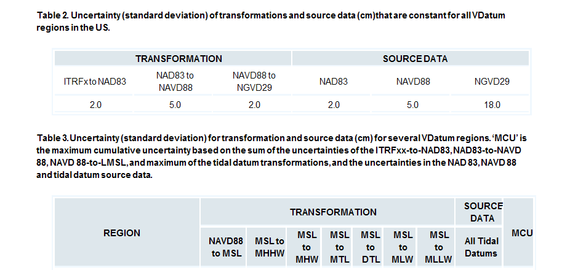
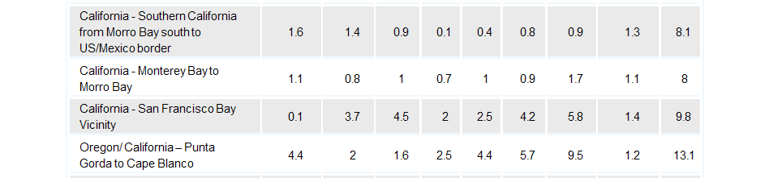
Each
Notes:
These show the actual errors for each of the 4 CA datasets for the vertical transformations as well as for the source data. If you involve another tidal datum besides just MSL, you have to add, for the SF Bay dataset, 1.4cm for MSL AND 1.4cm for another tidal datum.
So, if you start from a WGS ellipsoid height, which is equivalent to ITRF, and transform to MLLW:
2.0+5.0+2.0+5.0+0.1+5.8+1.4+1.4 –square each of those and add them= 93.61, sq rt of = 9.67 cm

Slide 34
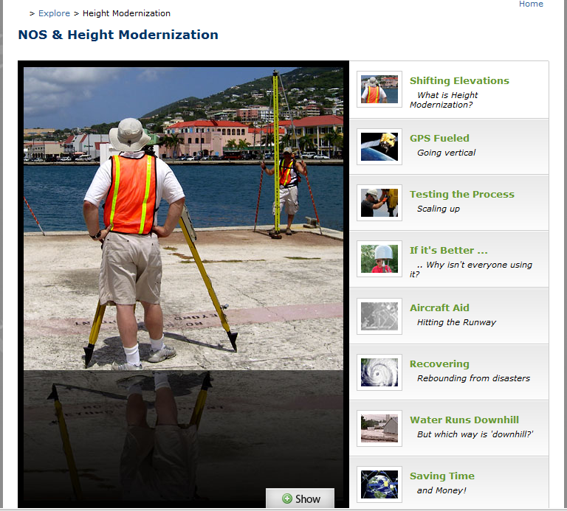
www.nos.noaa.gov
www.nos.noaa.gov

Slide 35
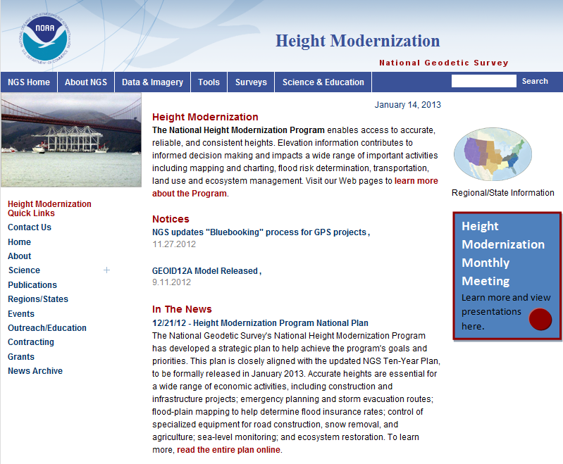
Height Modernization Program monthly meetings, presentations

Slide 36
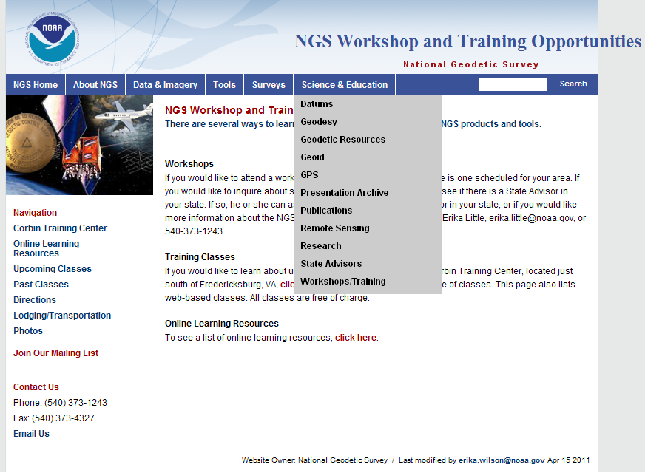

Slide 37
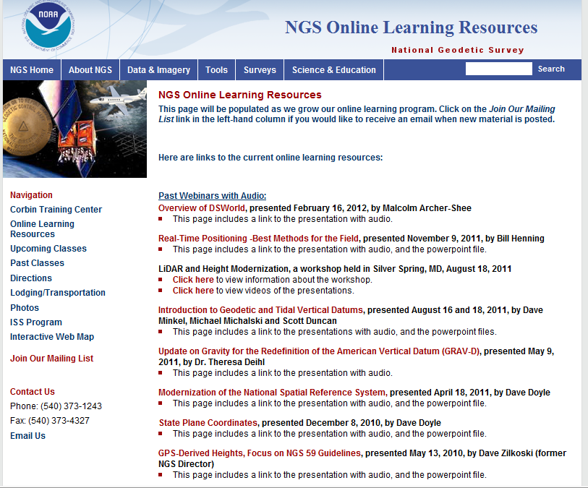

Slide 38

The Changing Face of the Geodetic Advisor Program
Provide equal service to non-coop states
REGIONALIZATION
15 advisors total for 50 states, PR, Pacific islands
Regions being discussed in NGS Advisory Group
Ross.Mackay@noaa.gov is Chair (SAB Chief)
Proposal includes “State Coordinator” as POC
Transition in next 4 years, with attrition due to retirements

Slide 39


