Slide 1

The Challenges of Change: The Evolution of the NSRS and NGS Geodetic Advisor Program, Part II
Marti Ikehara: marti.ikehara@noaa.gov
California Geodetic Advisor
Sacramento, CA
916-227-7325
www.ngs.noaa.gov

Slide 2
Table of Contents
Changing Geodetic Advisor Program
LEARNING/CONT EDUCATION: NGS Resources
Non-NGS CGPS Data/Info—PBO and CSRC
OPUS: S, RS, DB, Projects
HTDP
Datasheet Format/Content Changes
VDATUM
DSWORLD Demonstration

Slide 3

The Changing Face of the Geodetic Advisor Program
1. What are we not?
GEODENTIST
2. What/who are we?
3. How is it changing?

Slide 4
The Changing Face of the Geodetic Advisor Program
1. What are we not?
2. What are we?
We provide the link between
Geodesy and other customers, typically surveyors but also anyone wanting to connect to the NSRS
Who are we?
20 advisors; 3 are PLS, 2 of those also PE, 2 are PhD
1/3 transitioned from NGS field assignments; others came fr other gov, 2 came fr the cooperator

Slide 5
The Changing Face of the Geodetic Advisor Program
1. What are we not? 2. What/who are we?
3. How is it changing? We are…
Baby boomers! Aging…Retiring
Fewer cooperative partners (states)
can justify the financial agreement
Recommendation from some many years ago was for Fedgov to fully fund Advisor program
Advisors to be located at NOAA or Fed office

Slide 6
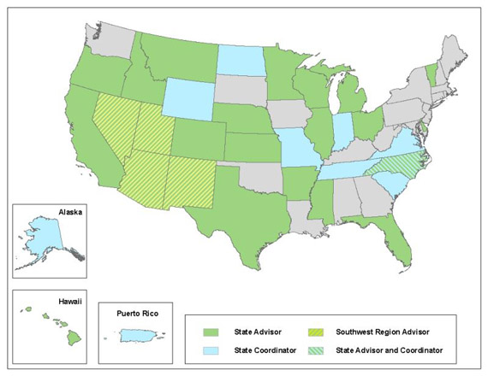
NGS Geodetic Advisors
@noaa.gov
California
Marti Ikehara
SW Region
(AZ,NM,NV,UT)
William Stone
Oregon
Mark. L. Armstrong
Idaho/Montana
Curt Smith
Geodetic Advisor Contacts: http://geodesy.noaa.gov/ADVISORS/AdvisorsIndex.shtml
Advisor Branch Chief: Ross.Mackay@noaa.gov

Slide 7

The Changing Face of the Geodetic Advisor Program, Geography
Provide equal service to non-coop states
REGIONALIZATION
15 advisors total for 50 states, PR, Pacific islands
Regions being discussed in NGS Advisory Group
Ross.Mackay@noaa.gov is Chair (SAB Chief)
Situated in a city with decent airport!
Proposal includes “State Coordinator” as POC
Transition in next 4 years, with attrition

Slide 8
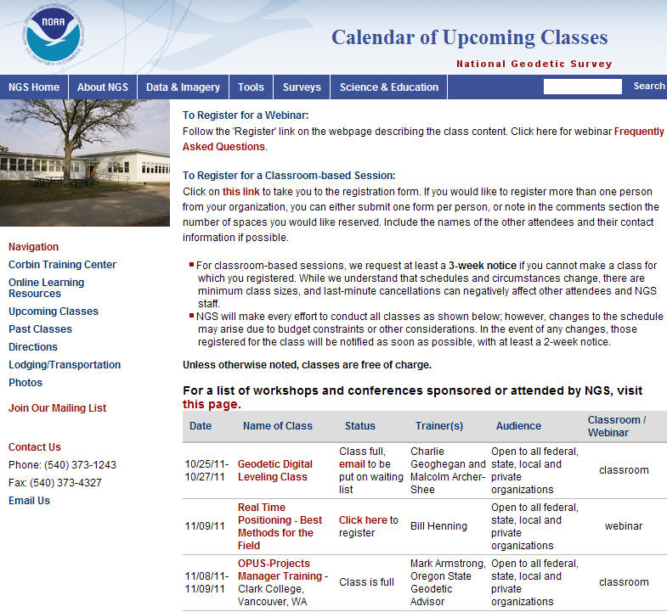
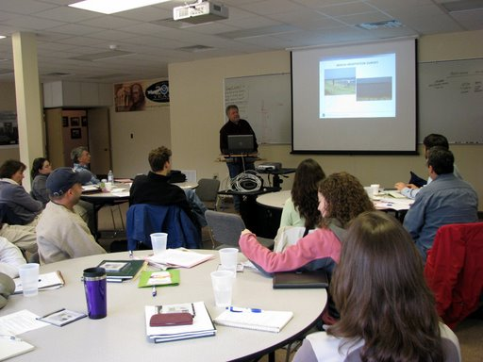
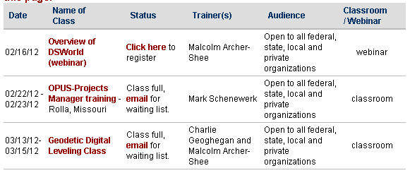
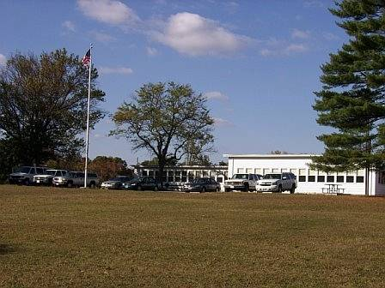
NGS Training Center

Slide 9
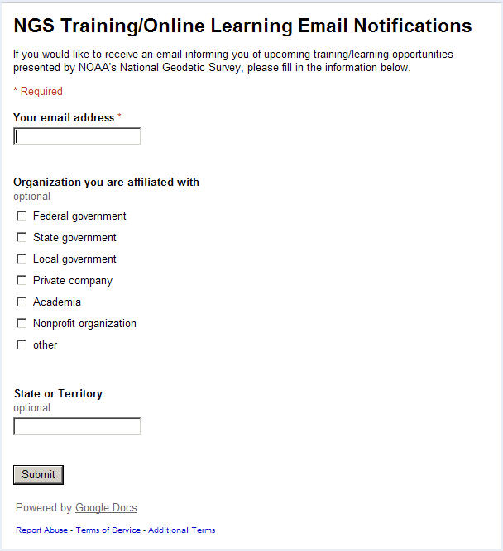

Slide 10
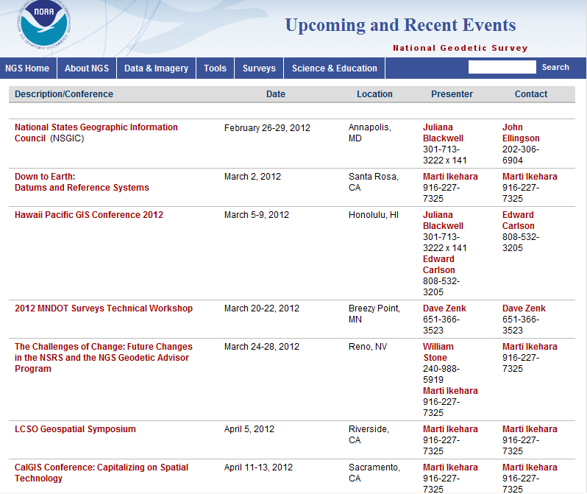

Slide 11
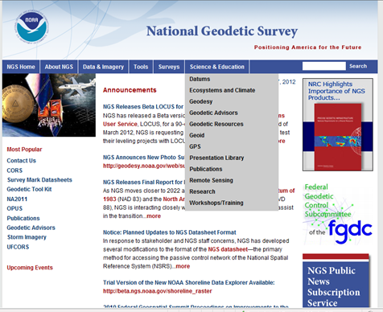


Slide 12
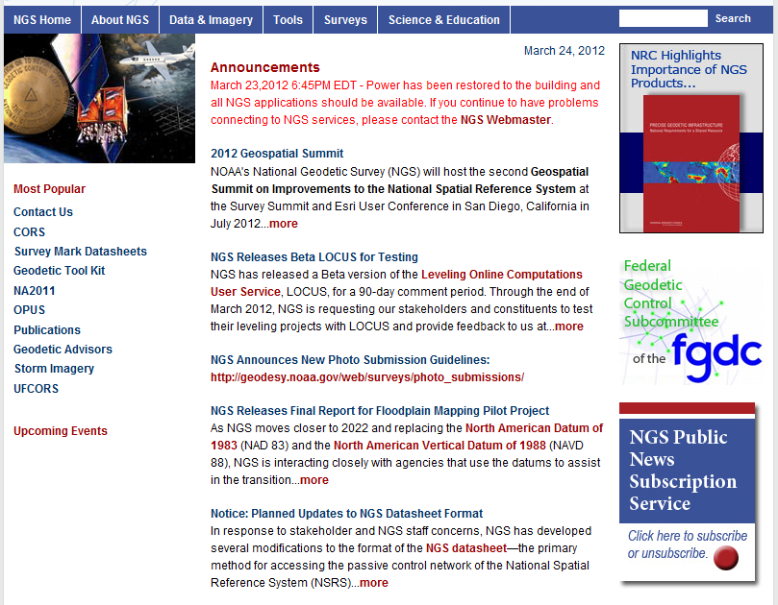

Slide 13
Non-NGS Sources of CGPS Data/Info
Plate Boundary Observatory (PBO)
http://pbo.unavco.org/network/gps
  1137 stations in the West
  No NAD83 coordinates (from them)
  Some real-time: Navigate to Data Products

Slide 14
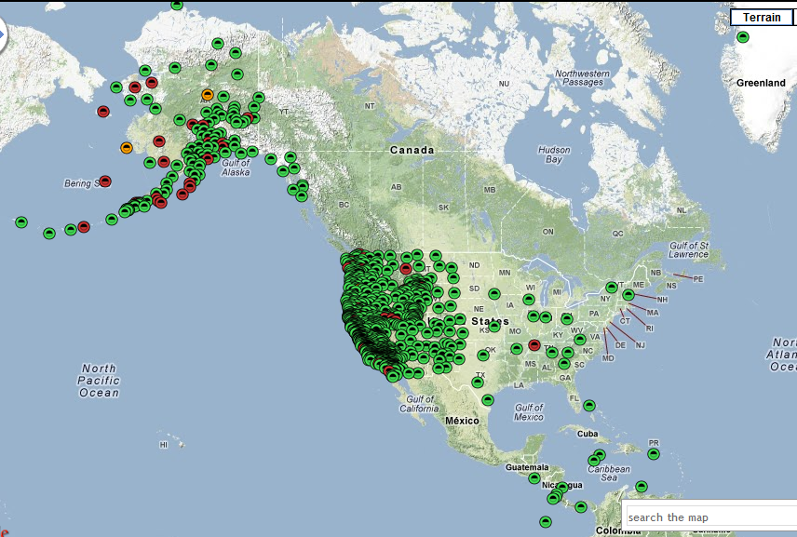
PBO GPS Network (3/23/12)

Slide 15
Review PBO GNSS station Time Series
http://pbo.unavco.org/data/gps/plotviewer/P334/GPS
Change ‘P334’ to your site, shown as Yellow
Scrolling over symbol in map shows site name
Colors indicate station health
Green: Nominal; Orange: Warning; Red: Failure

Slide 16
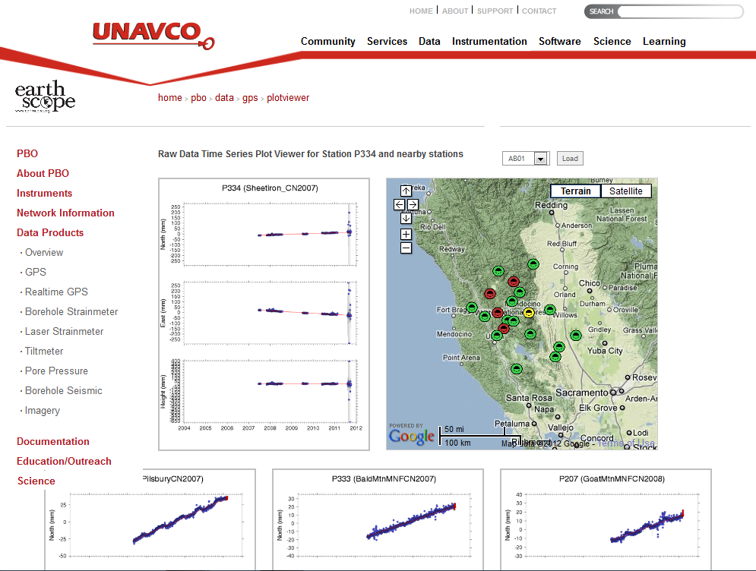

Slide 17
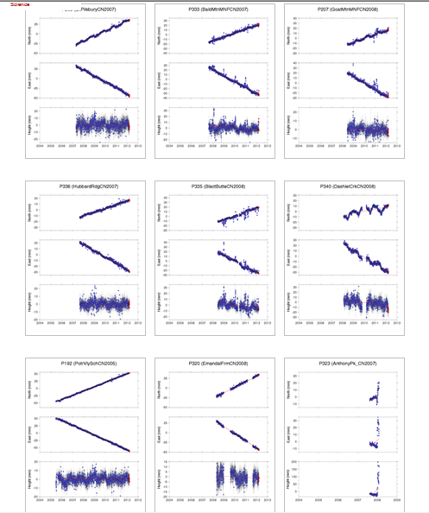

Slide 18
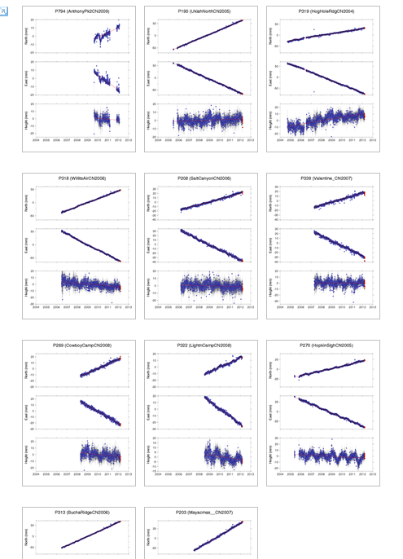

Slide 19
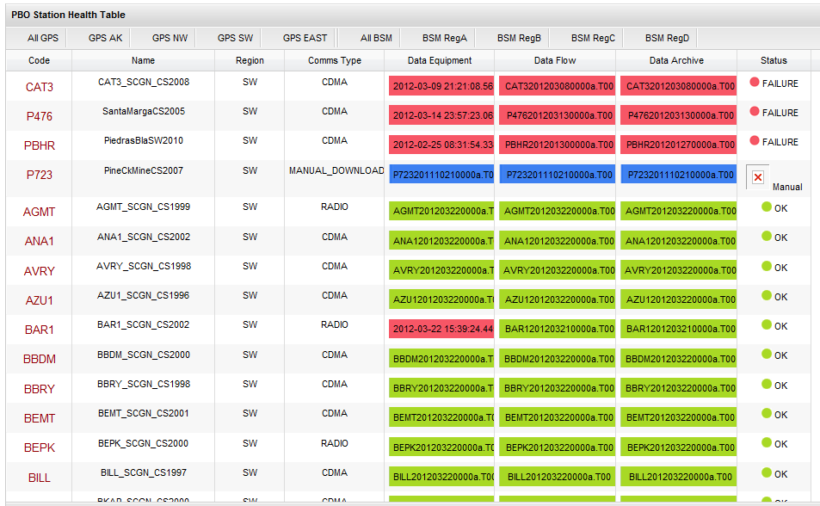
Station Health (SW): failures at top; Comms Type

Slide 20
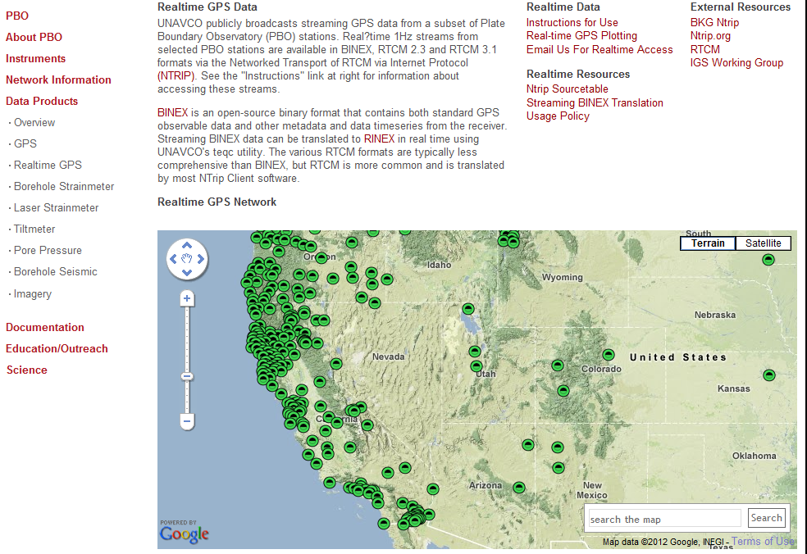

Slide 21
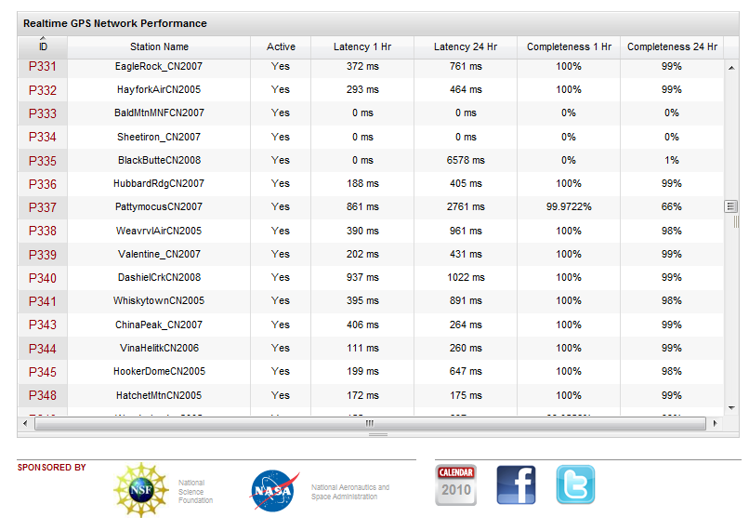

Slide 22
Non-NGS Sources of CGPS Data/Info
CA Spatial Reference Center
http://csrc.ucsd.edu/
830 CGPS sites with ITRF05 and NAD83 (2007) 2011.00 epoch coordinates, 766 with 2009.00
Link/access to CRTN via NTRIP protocol (3/1/12)
67 of backbone CRTN sites have become NGS CORS in the last year, by request fr CSRC
These stations now selectable in OPUS processing
Central Coast Height Mod project (not in NGSIBD)

Slide 23
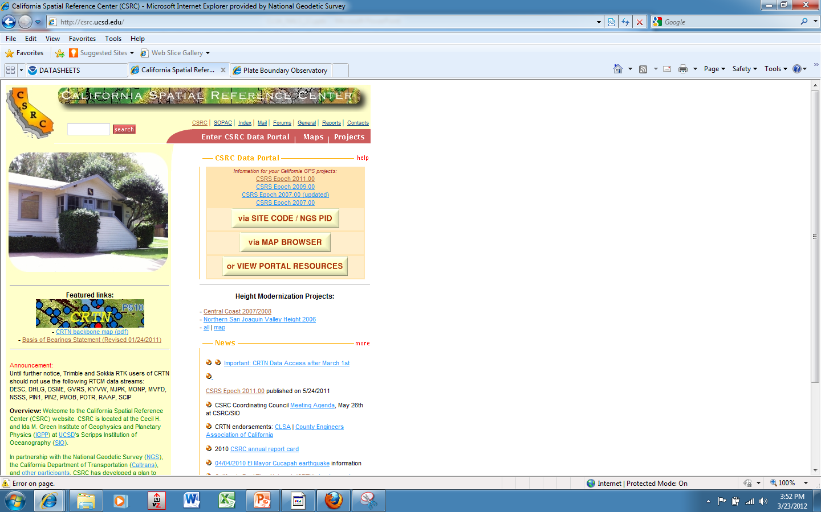

Slide 24
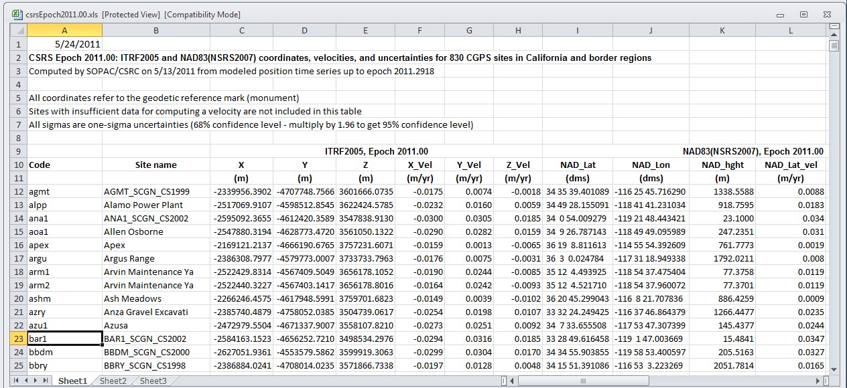
Notes:
Note ITRF on left
1-sigma
All ellipsoid heights refer to GRM
Bar1, eg, is also PBO; note name format

Slide 25
Notes:
The NAD83 data are on the right half

Slide 26
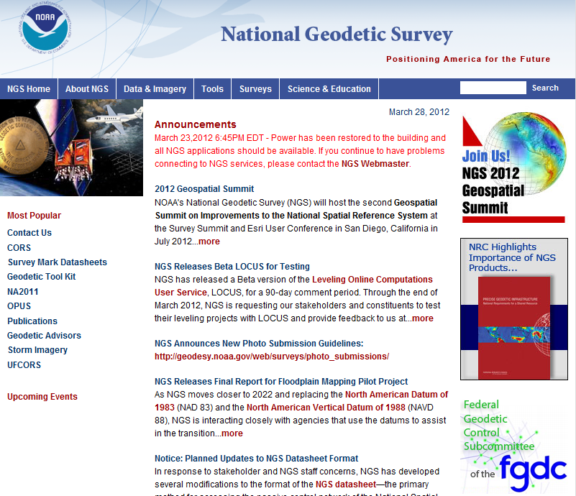

Slide 27
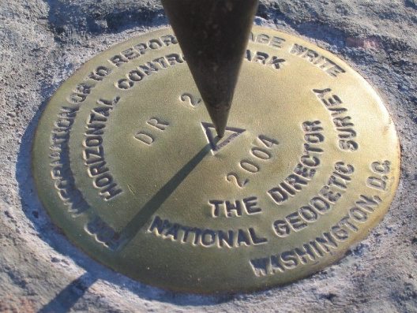
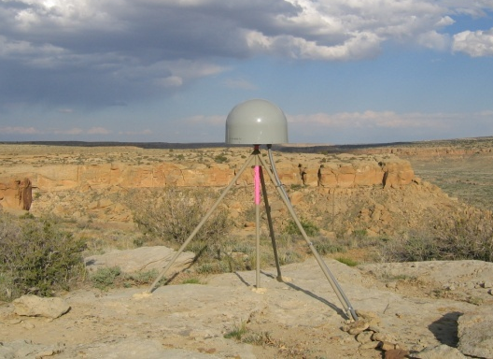
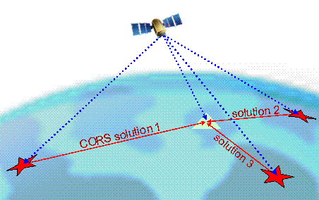
Online Positioning User Service (OPUS)
>15 min of L1/L2 GPS data >>> www.ngs.noaa.gov/OPUS
Processed automatically on NGS computers
Solution via email - in minutes
Fast, easy, consistent access to NSRS

Slide 28
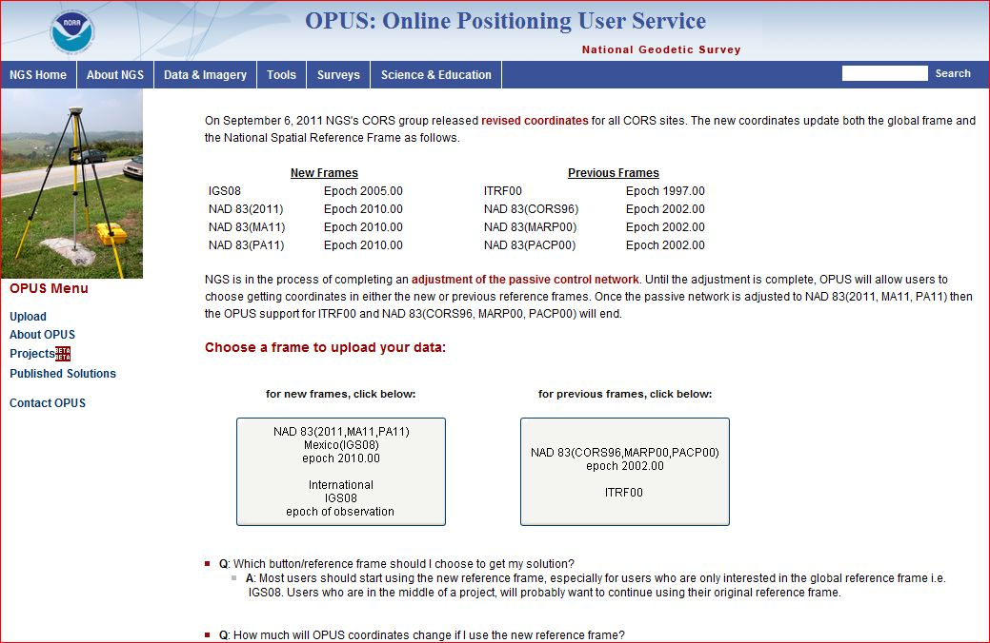
OPUS Reference Frame Choices
Notes:
Both available until the passive adjustment is published.

Slide 29
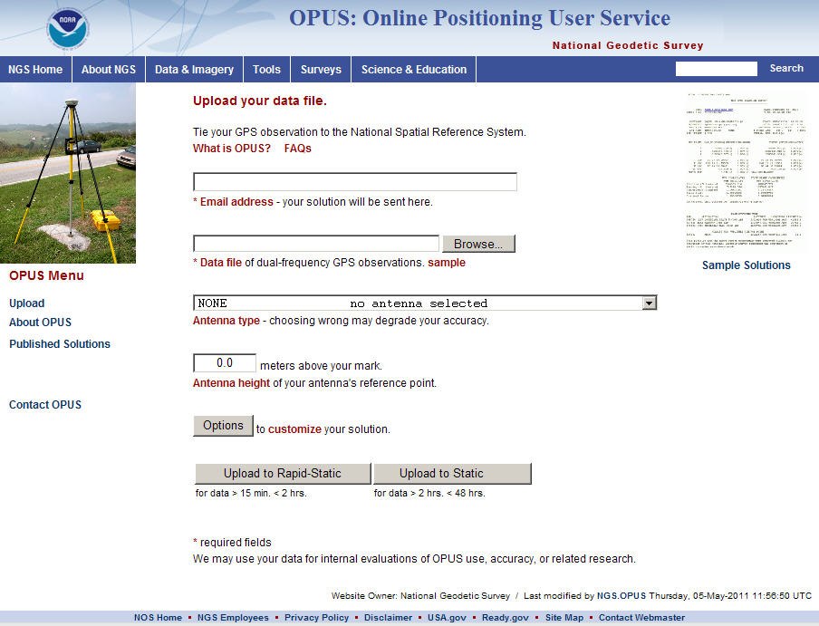
e-mail
GPS file
antenna
antenna height
(OPTIONS)
OPUS-RS or OPUS-Static
(15 min-2 hr) (2-48 hr)

Slide 30
How Does OPUS-RS Work?
OPUS-RS selects three to nine “best” CORS based upon:
    Common satellite visibility with the user data.
    Distances from the user’s site being <250 km.
The star represents the user’s
site. The triangles are CORS.
The three CORS minimum is shown.
No more than nine are used.
s
>250km
250km

Slide 31
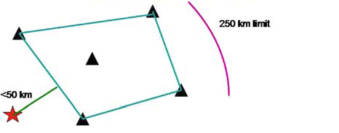
How Does OPUS-RS Work?
In addition, user’s site must be no more than 50 km from the (convex) polygon created by the selected CORS.
Again in this figure, the star represents the user’s site; the
triangles are CORS. Five CORS and their resulting polygon are shown in this example.
If the user’s site, the star, is
more than 50 km outside
this polygon, alternate
CORS will be considered.
If none can be found,
the processing will abort.
Schwarz et al., “Accuracy assessment of the National Geodetic Survey's OPUS-RS utility”, 2009, GPS Solutions, 13(2), 119-132.

Slide 32
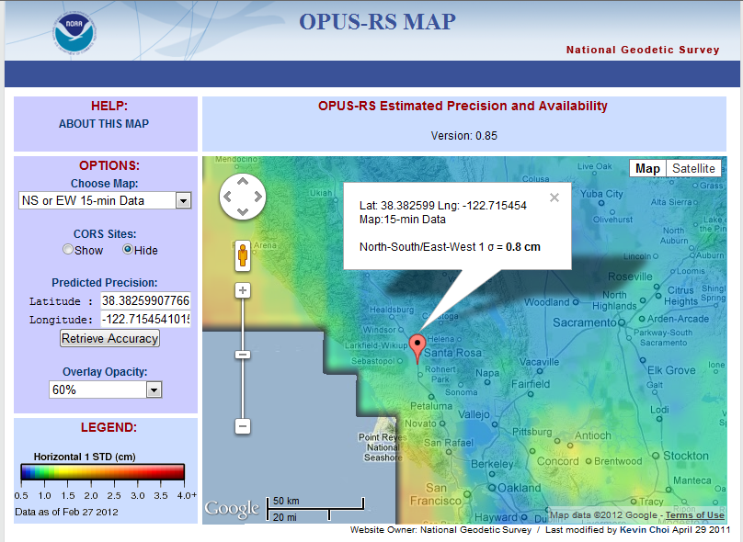
Horizontal accuracy, 1sigma, 2/27/12

Slide 33
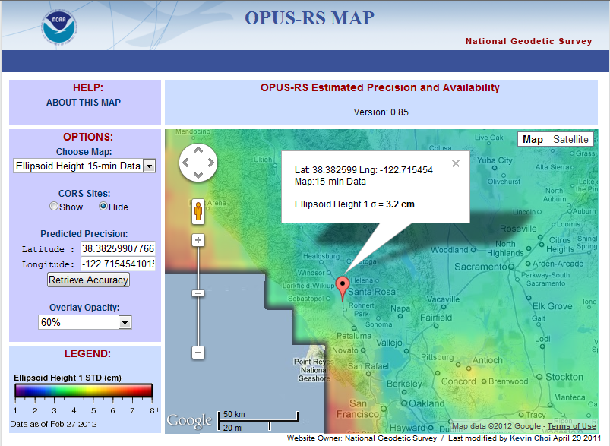
Ellipsoid ht accuracy, 1sigma, 2/27/12

Slide 34
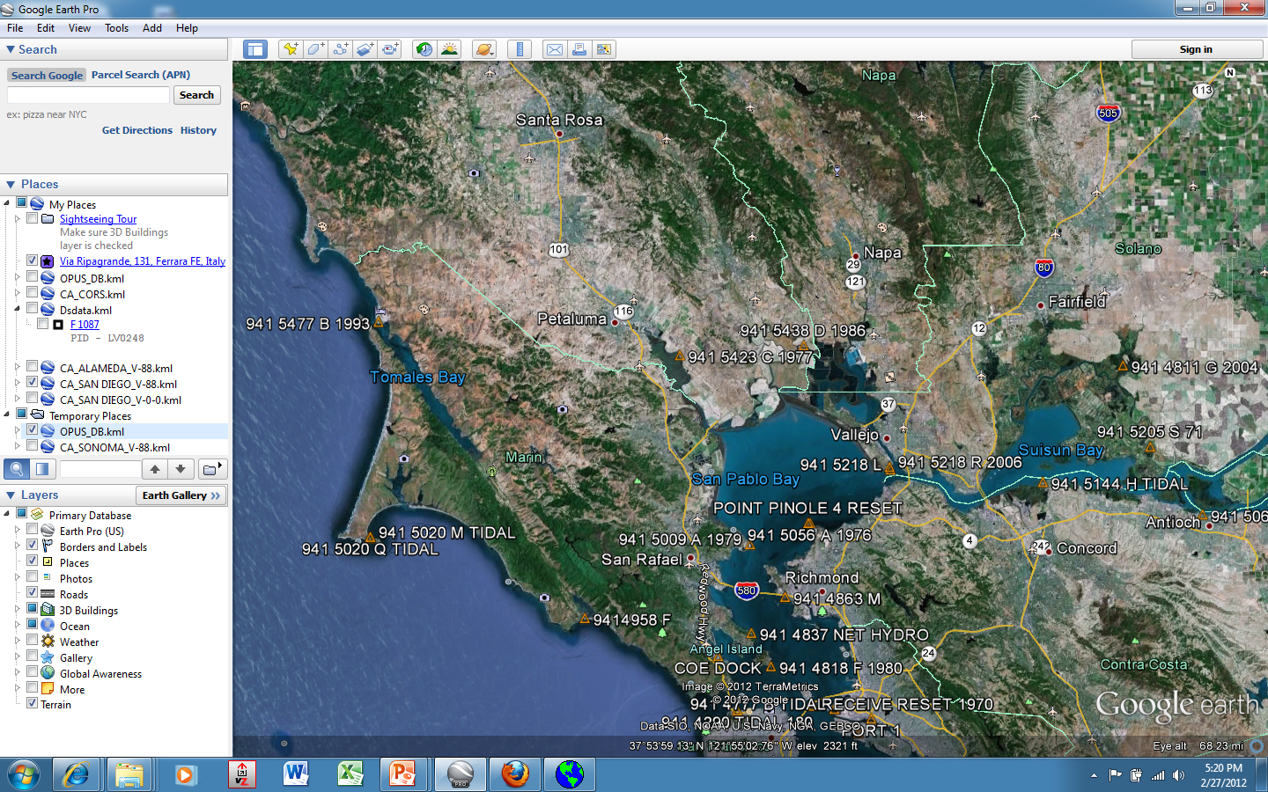
OPUS-DB
Notes:
An option for data collected at least 4 hrs is to publish in the OPUS database online.
Until the new vertical RS is adopted the next geoid models might be tapping OPUS-DB results. Would need a rough (eg, 0.1 dm) comparison between computed and last published Oht to help determine vertical stability/reliability

Slide 35
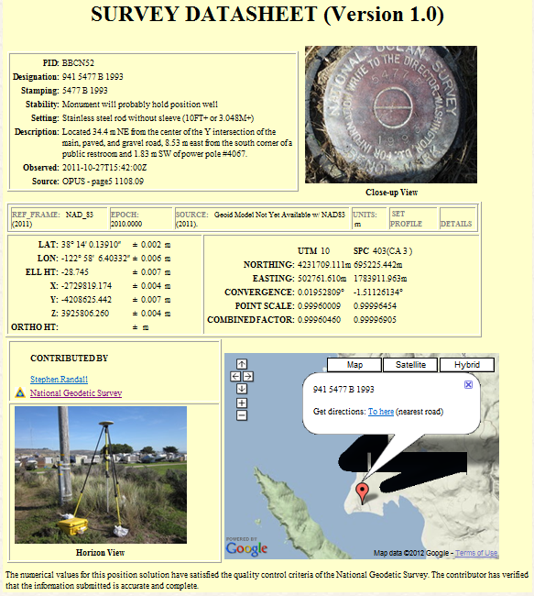
OPUS –
Datasheet Publishing
Publishing Criteria:
NGS-calibrated GPS antenna
> 4 hour data span
> 70% observations used
> 70% fixed ambiguities
< 0.04m H peak-to-peak
< 0.08m V peak-to-peak
Uses:
  GPS on BMs
  PLSS / GCDB
  Data archive
  Data sharing
Notes:
No Oht because (2011) realization; geoid model not working with these ellipsoid hts (yet)

Slide 36
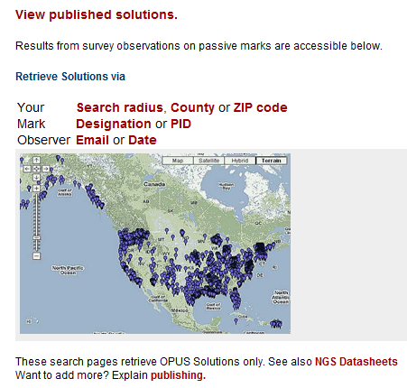
OPUS-DB (DataBase Publishing)
Notes:
Besides via DSWorld, can also view them from the website

Slide 37
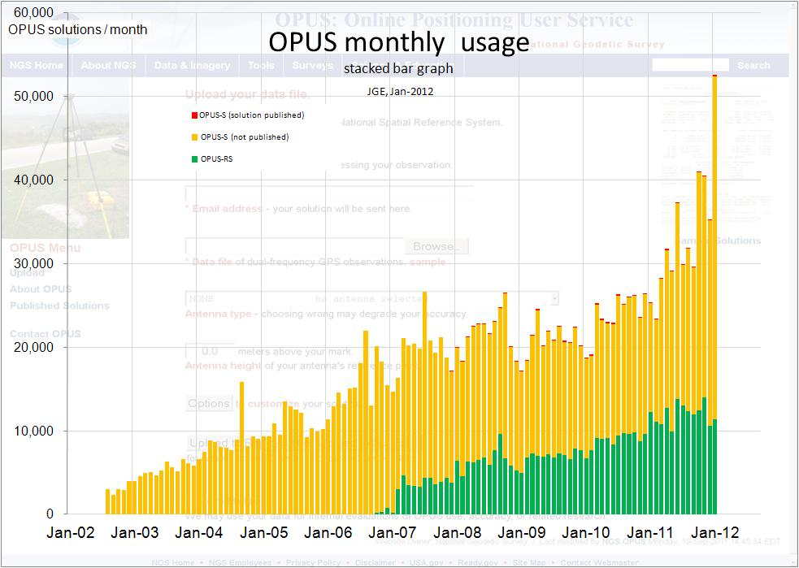

Slide 38
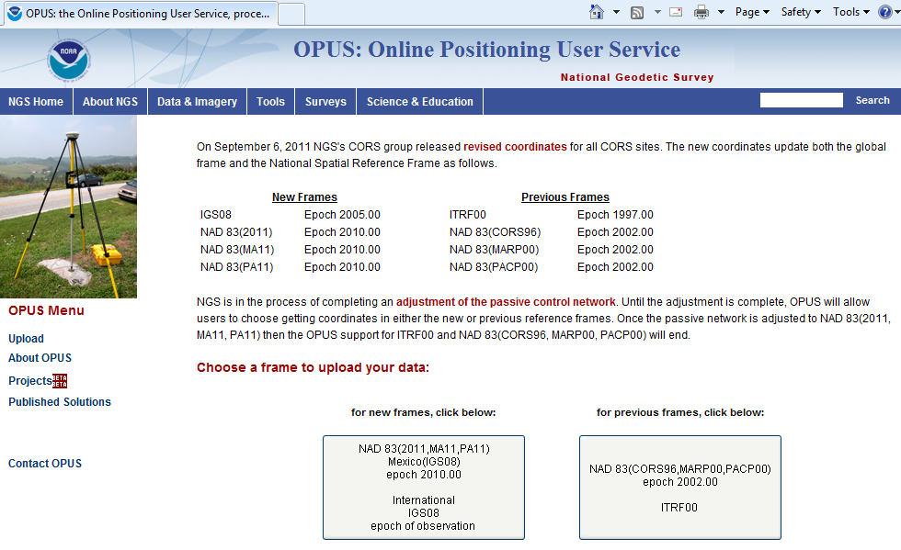
OPUS-Projects: BETA phase

Slide 39
OPUS-Projects: BETA
Need to have training before being given Username/ProjectID access
Will eventually eliminate bluebooking
Working out bugs; has not been great with short times, using PAGE-NT processing engine
Critical that Ht Mod Guideline durations, eg, 30 minutes, work well in OPUS-P
In-person training now, maybe webinar later

Slide 40
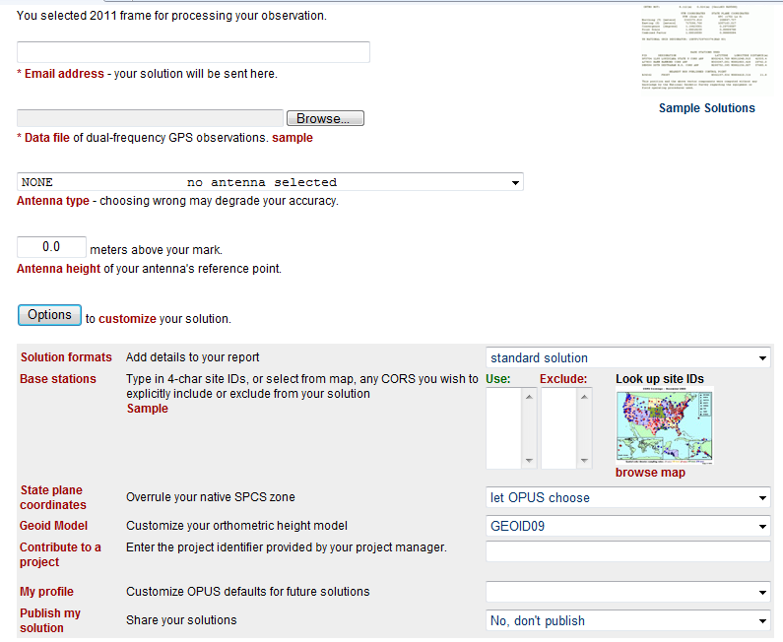

Slide 41
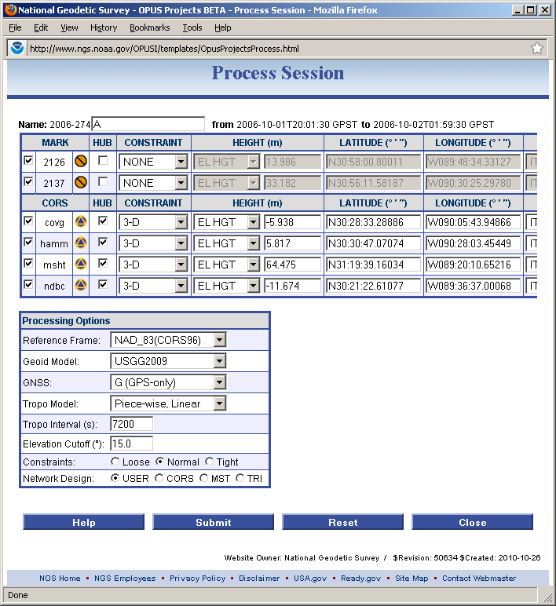
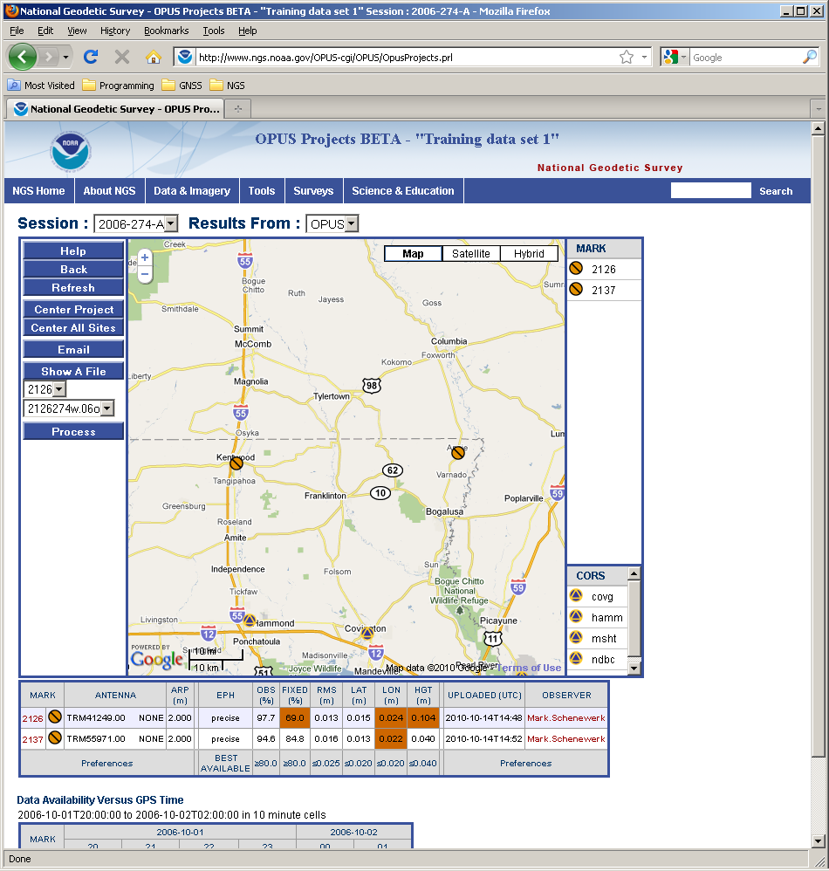
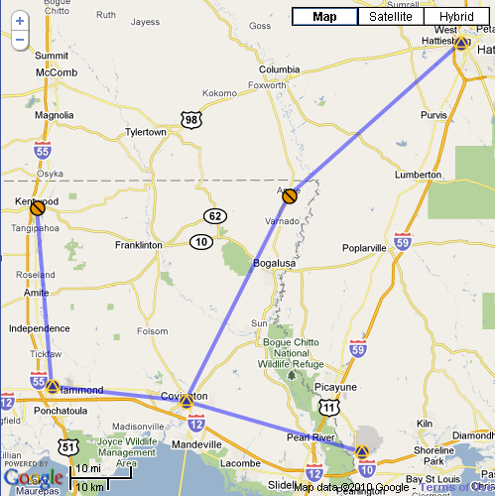
Process the session’s data.

Slide 42
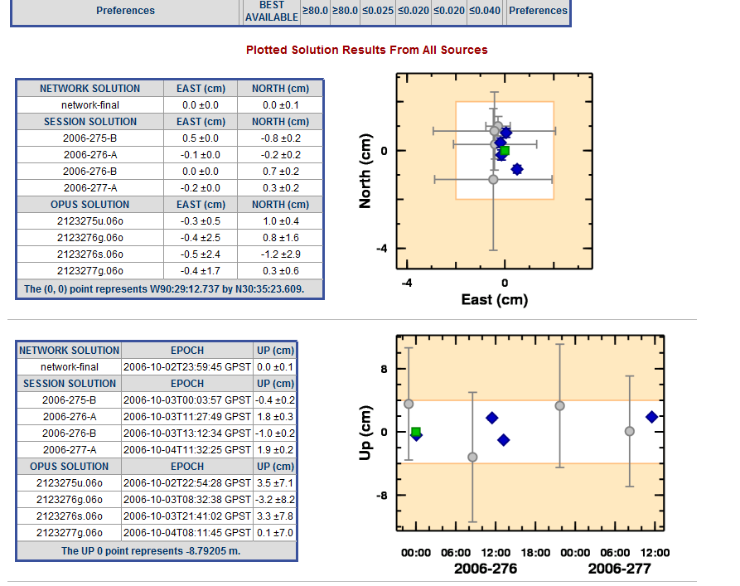
And at the bottom are summary plots and tables for comparison of different solutions.
The orange parts of the plots indicate regions outside the thresholds set by the project manager.

Slide 43
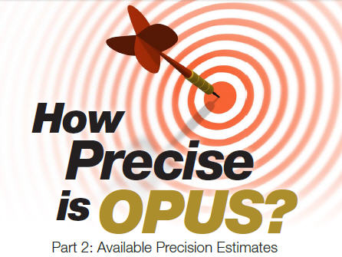
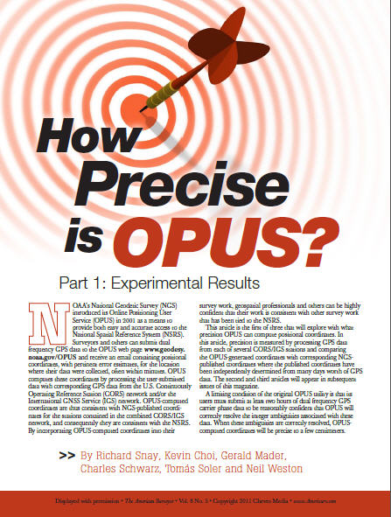
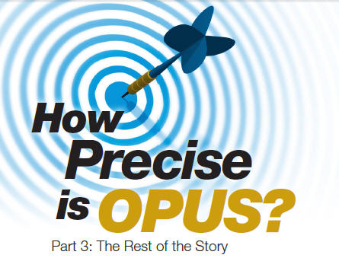
see The American Surveyor vol 8 (no. 5,6,7)

Slide 44
HTDP, v. 3.1.2
4th option: Interactively transform positions between reference frames and/or dates.
Epoch date format now includes deci-year
All NAD83 realizations are treated the same
After new realization published, will have transforms available between 2007 & 2011
  Changes due to RF very small—mm—versus changes due to velocity (time)—dm to m

Slide 45
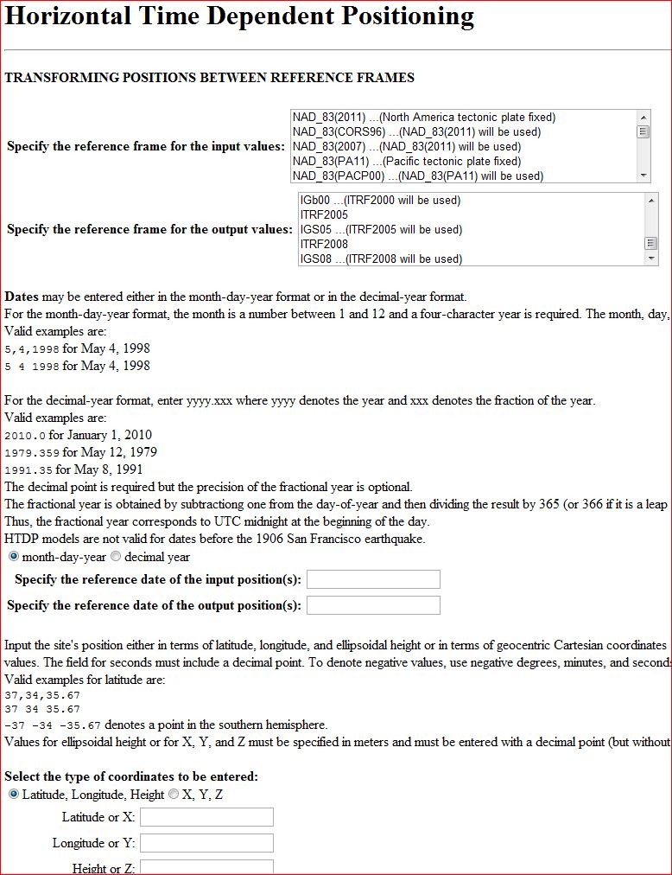
HTDP
v 3.1.2

Slide 46
HTDP examples
1991.35 to 2012.21
38 38 38; 121 21 21 | Sacramento
38 38 38; 122 21 21 | nw of Lake Berryessa
38 38 38; 123 21 21 | e of Stewart’s Point
N, E, Up, meters:
.192, -.180; -.028
.270, -.266; -.029
.687, -.444, -.029

Slide 48
DATASHEET Change highlights
Better grouping of geometric elements, eg, ellipsoid height and epoch date
CLARITY about geoid model usage, including for superceded ortho height data
Note: last year, NGS started publishing superceded GPS-derived ortho heights
Inclusion (hyperlink) to Local Ties & Accuracies
http://www.ngs.noaa.gov/web/surveys/datasheet/AC6803_htmod.pdf

Slide 49
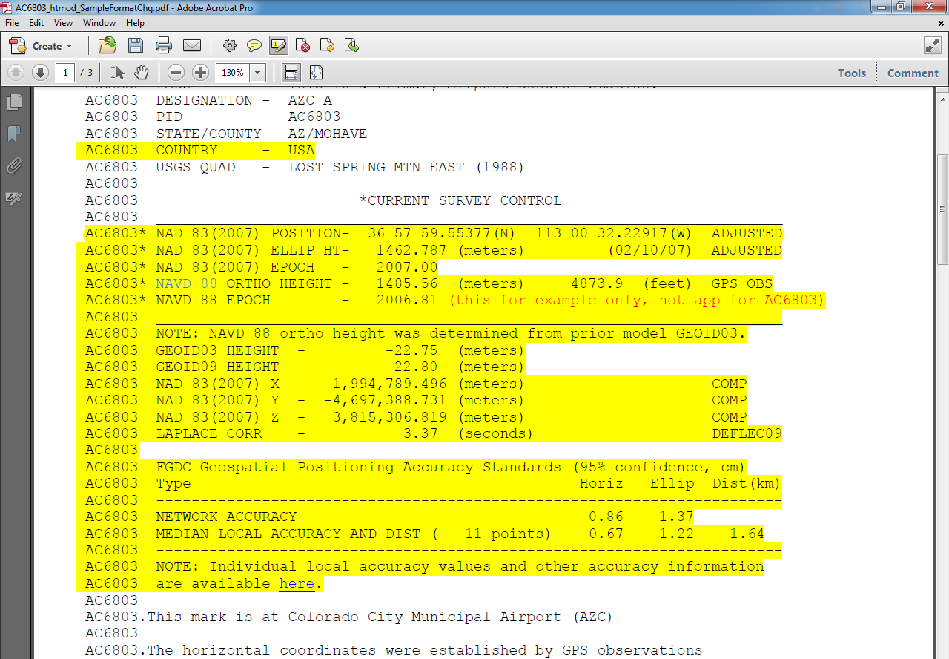
Datasheet Format/Content Changes
Move ell ht and epoch info into top box
Note when GPS Ortho Ht computed with previous geoid model, and provide that model ht
Better way to quantify accuracies

Slide 50
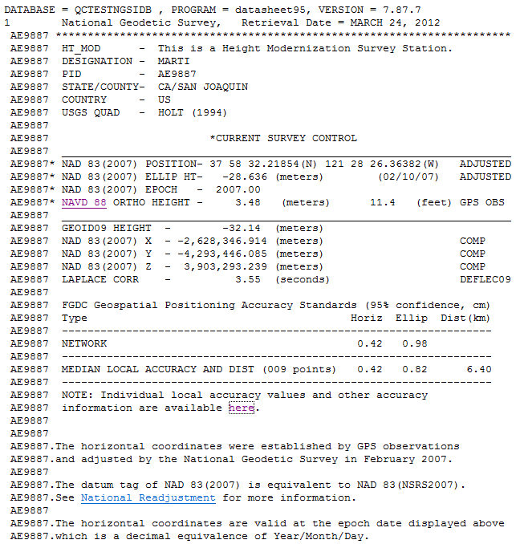

Slide 51
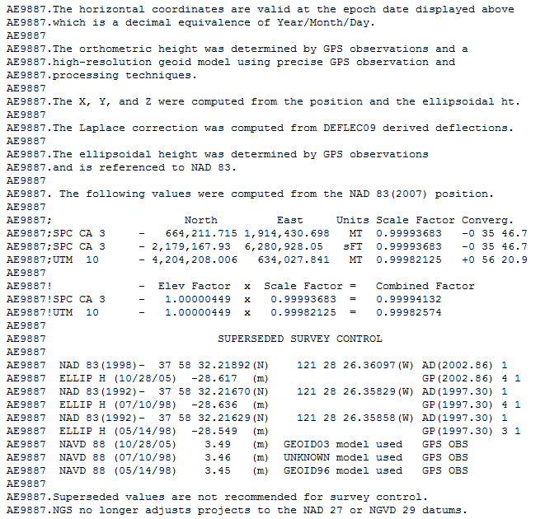

Slide 52
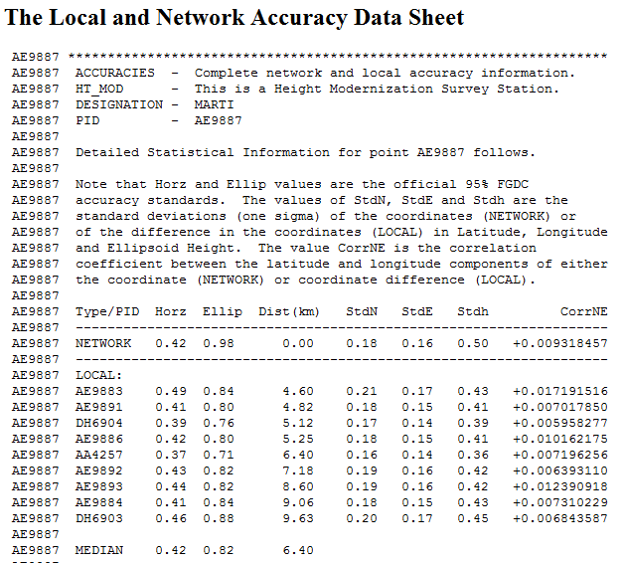
Beta sample of Datasheet, HM point

Slide 53
VDATUM
Modeling program that enables conversions between multiple vertical datums—ellipsoidal, geodetic, tidal- at your specified location
Be fully aware of the errors, eg, Standard Deviation, from transformations among datums, and from source data; types of error include:
  variations in the tidal range, tidal phase differences, bathymetric and coastal features, the density and proximity of nearby stations used in the corrections

Slide 54
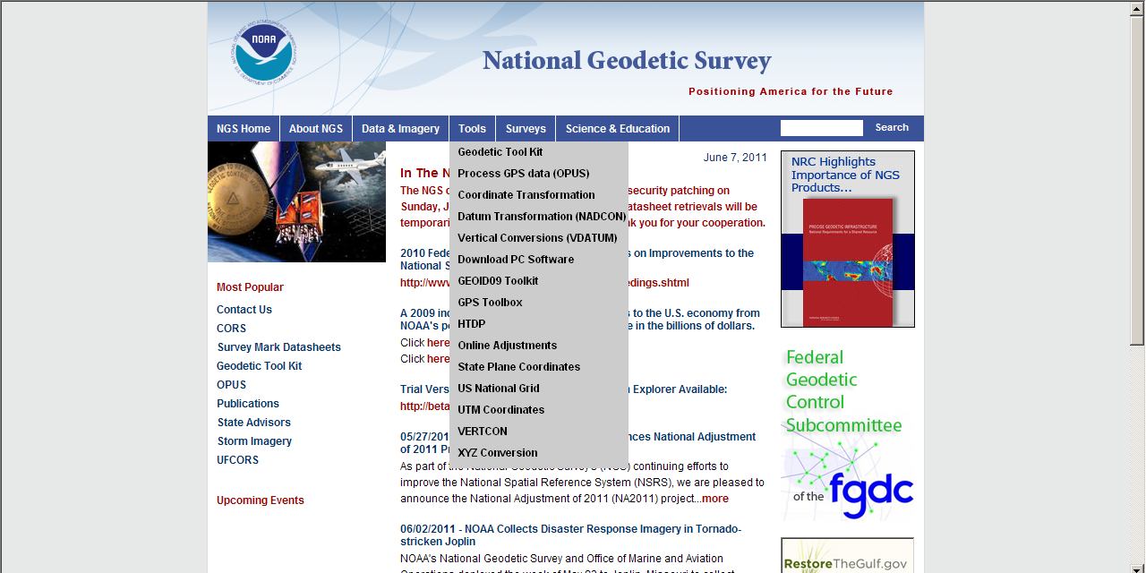

Slide 55
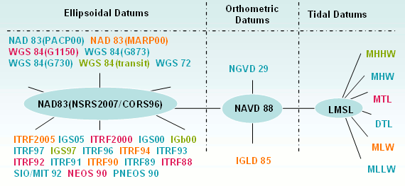
Datums available in VDATUM
Notes:
The most common datums are highlighted

Slide 56
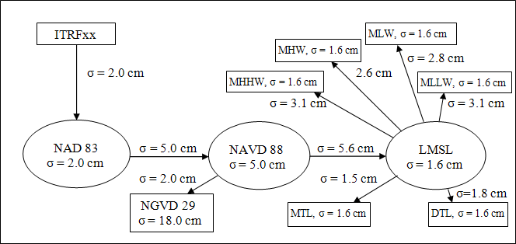
Vdatum.noaa.gov
Example: Chesapeake Bay uncertainties
MCU is dependent on how many transformations

Slide 57
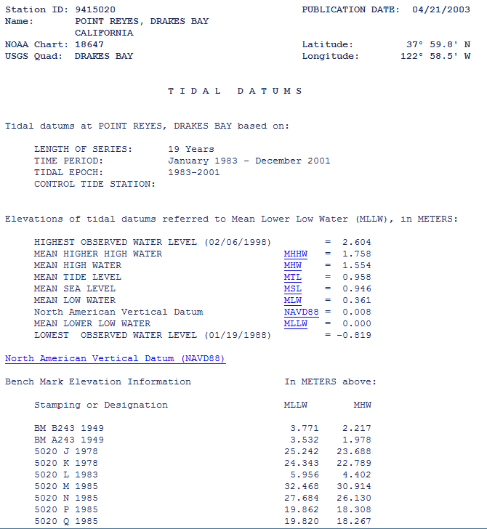

Slide 58
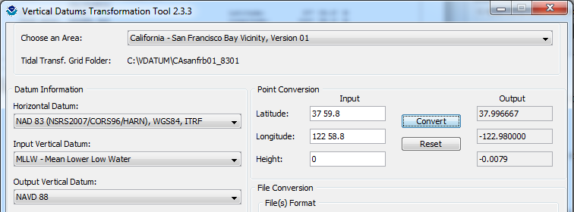


Slide 59
CGAR: CA Geodetic Advisor Resources website
http://www.dot.ca.gov/hq/row/landsurveys/geodetic/geodetic_control.html
Superceded by DSWorld now that “Vertical-NAVD88 only” is an available Datatype (IF you update downloaded version)
But if database unavailable or DSWorld crashes, these kmls (2008+) could be an option

Slide 60

http://www.dot.ca.gov/hq/row/landsurveys/geodetic/geodetic_control.html

Slide 61

DSWorld: mapping tool and more
Need to have Google Earth installed
Tools, Download PC Software, USER-CONTRI-BUTED SOFTWARE, DSWorld
http://www.ngs.noaa.gov/PC_PROD/PARTNERS/index.shtml
FIRST: Tools, Update program to 4.10.22
Enhancement enables you to distinguish VERTCON NAVD88 from other(control) NAVD88
Windows7 (settings) could preclude easy updates

Slide 62
Updating Malcolm software, workaround for W7
FIRST Change permissions for folders, as follows:
1) Log into the PC as an administrator.
2) Right-click on the WinDesc folder.
3) Left-click on 'Properties'
4) Click the 'Read-only' box to remove the check mark.
5) Click the 'Security' tab.
6) Scroll down and click on 'Users'.
7) In the 'Permissions for Users' window, click 'Modify' (or 'Full control‘)
Modify allows users to read, write, execute, delete. Full control allows
users to take ownership and change permissions.
8) Click 'Apply'.
9) Click the radio button that says 'Apply changes to this folder,
subfolders and files.'
10) Click 'OK', 'OK'.
11) log out of .la account.

Slide 63
Workaround, cont
http://www.ngs.noaa.gov/web/tools/updates
Select the folder of the pertinent software:
WinDESC, DSWorld, or Translev
Download the .exe file, at the least. All the others can be as well.
If permissions not changed, then cannot download directly to any folder under C:\Program Files (x86) EVEN logged in as admin; put in Downloads, then move into appropriate software folder.

Slide 64
DSWorld Demonstration
MAPPING
County example, Toggle between V & V-88only
CORS: Tools/Options/4char; OPUS-DB
All NGSIDB: color represents CONDITION
SUBMISSIONS
Recovery Notes, incl Destroyed; Photo Naming Convention, Editing Tools; Correct County, Photo

Slide 65

With knowledge comes clarity

Slide 66

Marti.ikehara@noaa.gov

