Slide 1
Case Study of USA Session 4, 1700, 01 MAY 2016
Dr. Daniel R. Roman
Chief, SRSD, NGS
GRAV-D P.I.

Slide 2
Topics
Current horizontal and vertical datums in USA
North American Datum of 1983 (NAD 83)
North American Vertical Datum of 1988 (NAVD 88)
Geodetic Reference Datum of 2022
Replaces both NAD 83 and NAVD 88
Geometric component based on IGS 14 or follow on model
Geopotential component based on EGM and aerogravity
GRAV-D project for a centimeter geoid
How will heights be determined in 2022

Slide 3
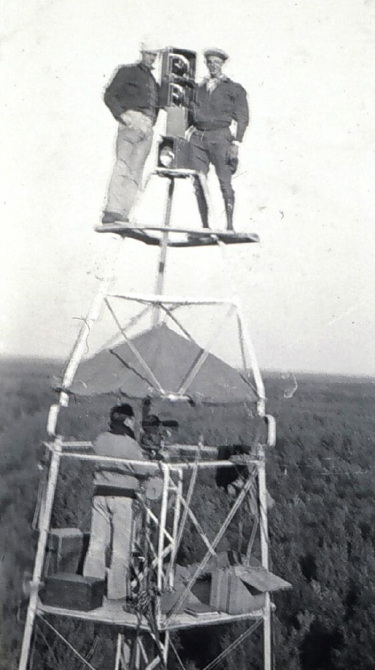
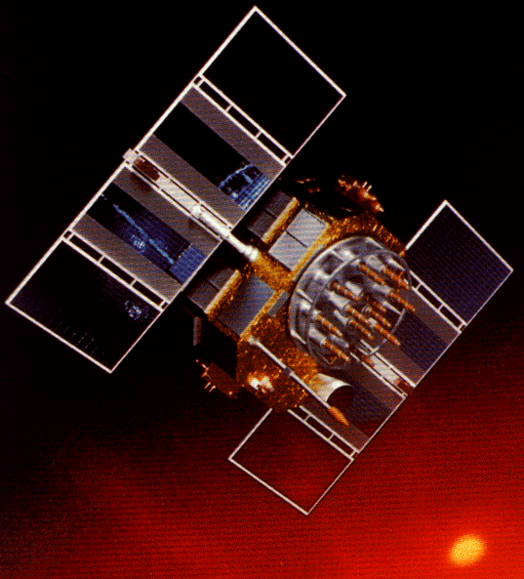
A brief history of NAD 83
Original realization completed in 1986
Consisted (almost) entirely of classical (optical) observations
“High Precision Geodetic Network” (HPGN) and “High Accuracy Reference Network” (HARN) realizations
Most done in 1990s, essentially state-by-state
GNSS based, with classical obs. incl. in adjustments
Did NOT use CORS as constraints
National Re-Adjustment of 2007
NAD 83(CORS96) and (NSRS2007)
Simultaneous nationwide adjustment (GNSS only)
New realization: NAD 83(2011) epoch 2010.00
Notes:
Remember, in large part, the existing datum NAD83 pre-dates the satellite geodesy era. The bulk of observations in the original NAD 83 were angles and distances measured with theodolites and iron bars, later electronic distance measurements. The last-minute addition of some early transit doppler measurements allowed us to look forward and anchor the frame not in Kansas, but at the (then measured) center of the earth.
The lack of doppler control over Russia and south Atlantic laid the foundation for the 2 meter offset in geocenter.

Slide 4
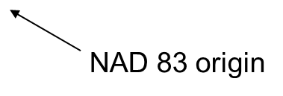
Datum Defect in NAD 83

Slide 5
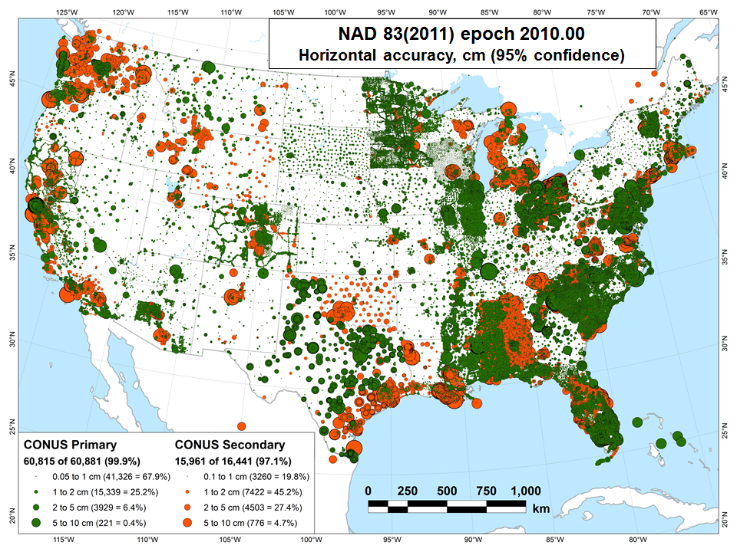

Slide 6
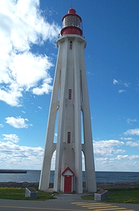
Current Vertical Datum in the USA
NAVD 88: North American Vertical Datum of 1988
Definition: The surface of equal gravity potential to which orthometric heights shall refer in North America*, and which is 6.271 meters (along the plumb line) below the geodetic mark at “Father Point/Rimouski” (NGSIDB PID TY5255).
Realization: Over 500,000 geodetic marks across North America with published Helmert orthometric heights, most of which were originally computed from a minimally constrained adjustment of leveling and gravity data, holding the geopotential value at “Father Point/Rimouski” fixed.
Father Point Lighthouse, Quebec
*Not adopted in Canada
Notes:
By fixing the geopotential value at the origin point, it was possible to ensure that the origins of IGLD 85 and NAVD 88 aligned.
*It should be pointed out that while the datum was defined in such a way as to be usable on the North American continent, it was never actually adopted in Canada. It can be used there, but it’s not their official civilian datum.
Note that the designation of the vertical control point at Father Point is “1250 G=NAVD 88 DATUM POINT” for PID# TY5255 and is not available from the publicly accessible NGSIDB.

Slide 7
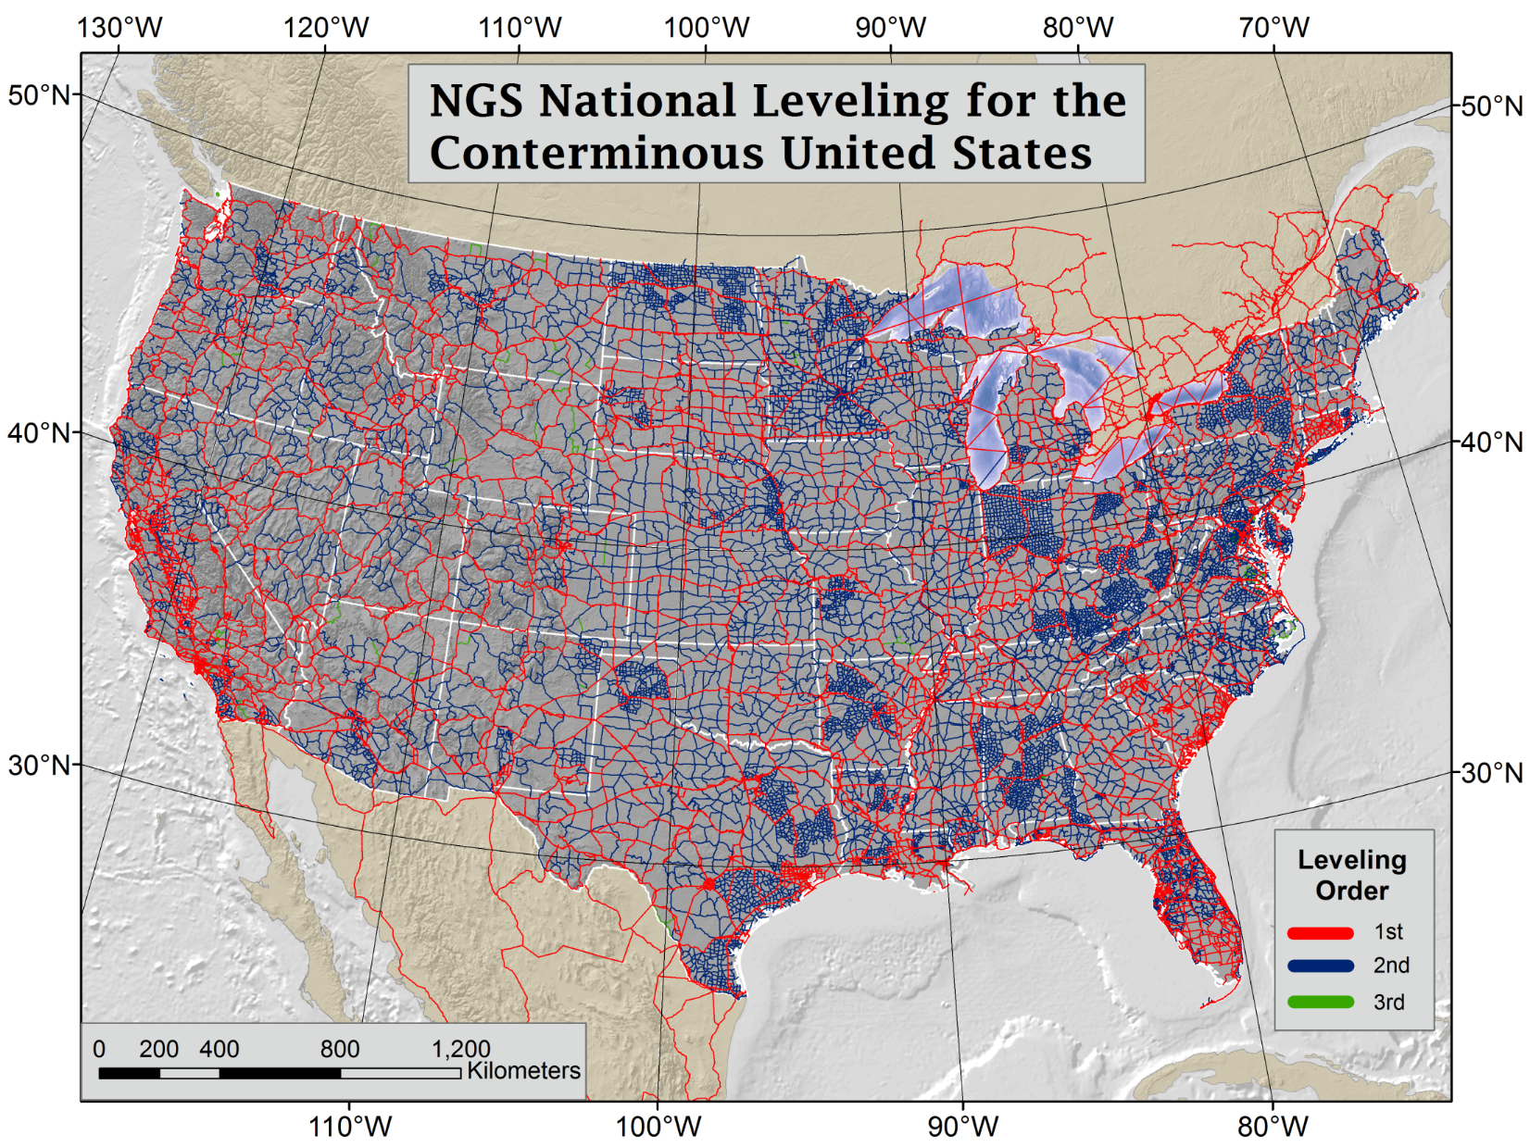

Slide 8
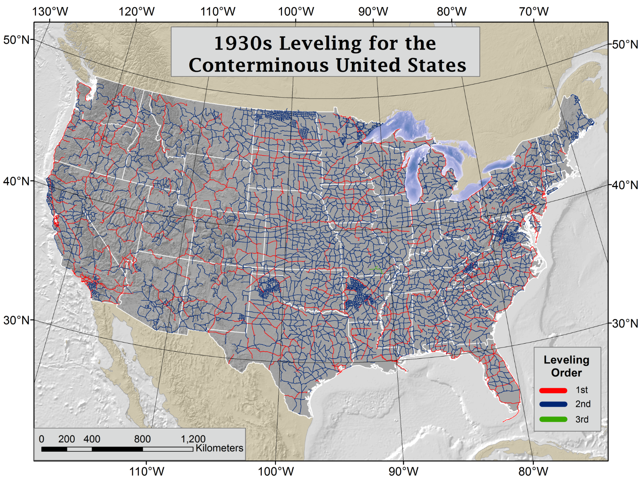
Notes:
Explanation of 1930s leveling by Dave Doyle:
Why more activity in the 30s. First of all it was both triangulation as well as leveling. The development of the portable Bilby Steel Tower in 1927 was a major advancement in the ability of USC&GS to conduct triangulation. With Roosevelt's election in 1933 and his initiative of the New Deal there was improved funding for many of the C&GS programs. As to specifically the leveling there were actually two parts - 1) new hires and improved funding for the full array of C&GS surveying and charting programs and 2) the instigation of the Civil Works Administration (CWA) which set up geodetic surveying programs in virtually all 48 states some of which are still in place today (NC, NJ and SC). The CWA surveying programs were funded by congress and the monies passed through C&GS but they had little control beyond that. Each state had their own coordinator and in some cases thousands of marks were set and surveyed. For example go into the archives and look for two red books "Geodetic Survey of Georgia." There was a really significant amount of traverse and leveling that was conducted under the CWA effort - regrettably virtually all of it was never submitted to C&GS for inclusion in the national reference frame - while many of the marks still exists only a very small percentage were ever later tied in by C&S/NGS field parties into the reference frame. In most cases the marks used were inscribed U.S. Coast & Geodetic Survey and State Survey.

Slide 9
Subsidence and Bench Mark Height
1954: Leveling Performed
to bench mark
House
1954-1991: Subsidence
House
BM
BM
1991: Original 1954 leveling data is used to compute the NAVD 88 height which is then published for this BM
H₈₈(published)
H₈₈(true)
NAVD 88 zero height surface
Obviously the true height relative to the NAVD 88
zero surface is not the published NAVD 88 height

Slide 10
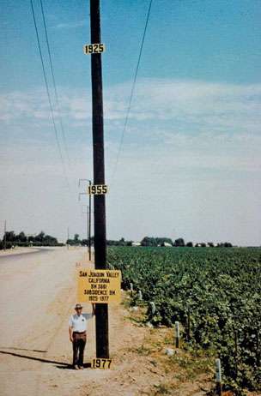
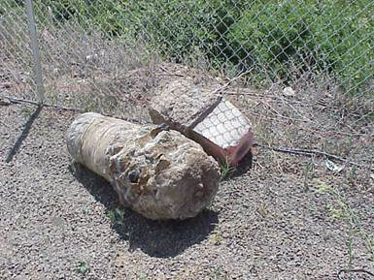
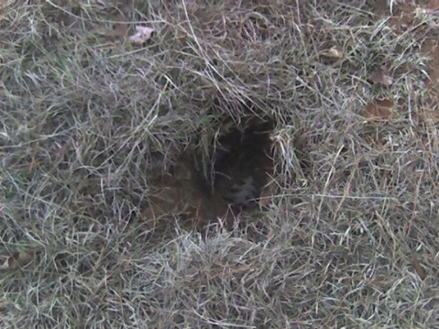
Bench marks
NAVD 88 uses bench marks that:
Are rarely re-checked for movement
Disappear by the thousands every year
Are not funded for replacement
Are not necessarily in convenient places, particularly for GPS measurements
Don’t exist in most of Alaska
Weren’t adopted in Canada
Were determined by leveling from a single point, allowing cross-country error build up
PID: EZ0840
Notes:
Clarification on the word “convenient” – this is used to mean “there isn’t always a bench mark around when you need one – sometimes you have to find one far away and level from it to your site of interest”

Slide 11
Earth’s
Surface
H (NAVD 88)
H
NAVD 88 reference level
The Geoid
Errors in NAVD 88 : ~50 cm average,
100 cm CONUS tilt,
1-2 meters average in Alaska
NO tracking
Notes:
This slide shows what NGS now knows about the error in NAVD 88 itself. Using a continental geoid computed from the GRACE satellite, a bias and tilt in NAVD 88 has been computed using GPS derived ellipsoid heights on NAVD 88 bench marks. These are now known errors that exist in all NAVD 88 bench marks. This datum realization error, relative to the geoid, is over and above the errors from marks moving.

Slide 12
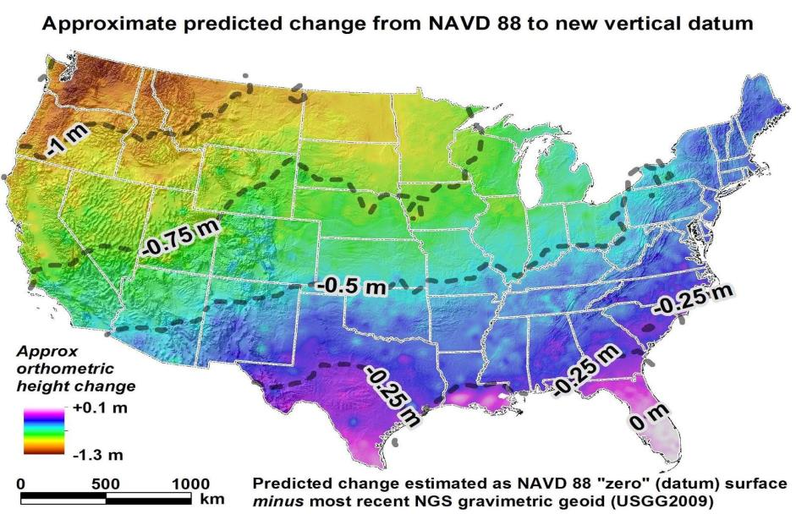
How will the new datums affect you?
The new geometric datum will change latitude, longitude, and ellipsoid height by between 1 and 2 meters.
The new vertical datum will change heights on average 50 cm (20''), with a1 meter (39'') tilt towards the Pacific Northwest.

Slide 13
Geodetic Reference Datum of 2022 (tentative)
Replaces both NAD 83 and NAVD 88
Resulting datum is combined
Will also include update to IGLD 85, which was based on NAVD 88
Geometric component
Based on IGS 14 or follow on model to define reference frame
CORS will be used to augment velocities to better access NSDI
Provides consistent coordinates over time referenced to common epoch
Geopotential component based on EGM and aerogravity
Satellite data provides long wavelengths (GRACE, GOCE, CHAMP)
GRAV-D project for a centimeter geoid improves mid-wavelengths
Terrestrial data provides shortest wavelengths
GSVS lines, TBM’s and other data used to validate

Slide 14
Implementation
Foundation CORS tied to IGS solutions
Reprocessing yields consistent CORS coordinates and velocities
Bench Marks are then adjusted to fit CORS control
GNSS/OPUS coordinates supersede bench mark values
Velocities applied to revert back to datum epoch (2022.0)
Effectively provides “fixed” plate & state plane coordinates
Permits use for RTK positioning at current epoch
Notes:
OPUS-RS meets 15 minute data requirement with supplemental information from CORS processing and modeling of atmospheric effects
OPUS and OPUS Projects required to establish base stations of higher quality in regions of insufficient CORS coverage
RTN/RTK will be possible but must use OP to succeed

Slide 15
CORS Network

Slide 16
OPUS-RS Quality Directly Depends on CORS Spacing
Notes:
70 km rule => simplifies number of stations we must maintain
Need more stations where they are too thin to model atmospheric effects
Ties in to Canadian CORS?
Expand beyond the immediate area

Slide 17
What will a future geopotential frame look like?
Scientific basis that can be modeled & updated
Tied to global MSL, geoid change, MSL rise, local effects
Built from multiple data sets:
Long wavelength (400+ km scale) from satellite (GRACE, GOCE, Champ)
Middle wavelengths (40-400 km) GRAV-D aerogravity
Short wavelength (40- km) terrestrial gravity and DTM’s
More consistency in heights across the region
cm=-level agreement at all scales
Better ties between geoid (MSL), TBM’s (LMSL) & MODT
Geoid (MSL) = LMSL - MODT
Applicable to all countries in the regions (U.S., Canada, etc.)
Better basis for comparisons with SIRGAS
Notes:
Both NA and SA have regional geoid working groups focused on developing geopotential models based on actual earth
Hence, both should have same targey – not trying to express regional datums.
Better overlap and agreement.

Slide 18
A Geopotential Model has Infinite Layers
The relationships between the ellipsoid surface (solid red), various geopotential surfaces (dashed blue), and the geoid (solid blue). The geoid exists approximately at mean sea level (MSL). Not shown is the actual surface of the earth, which coincides with MSL but is generally above the geoid.

Slide 19
Which geopotential to pick for datum level or W₀?

Slide 20
Gravity Field Power Spectrum
Power Spectrum plot of gravity field (blue line). Most power is at longest
wavelengths (λ) at left on the lowest degree harmonics, where satellite
(light blue bar) data dominate. Surface data (brown bar) contain the shortest
to the right. Aerogravity (green bar) overlaps both parts of spectrum (red boxes).

Slide 21
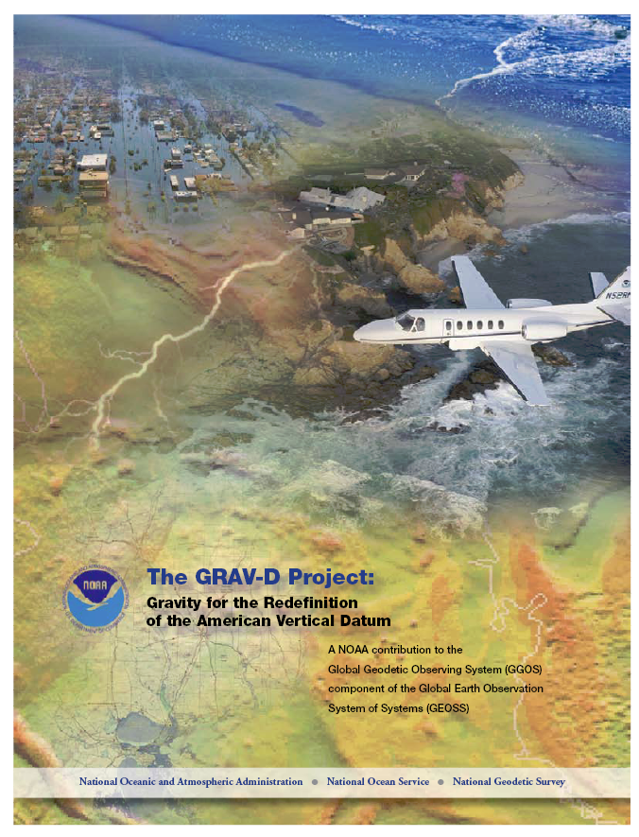
GRAV-D Project Overview
Overall Target: orthometric heights accurate to 2 cm from GNSS and a geoid model
GRAV-D Objective: Create gravimetric geoid accurate to 1 cm where possible using airborne gravity data
GRAV-D: two phases
Airborne gravity survey of entire country and its holdings
Long-term monitoring of geoid change
Notes:
Target is to be able to achieve 2 cm accuracy orthometric heights (where possible) using a GNSS receiver and a geoid model
Roughly 1 cm uncertainty from GNSS and 1 cm from the geoid model
GRAV-D
Phase 1: snapshot of the entire country to provide a consistent data set
Phase 2: long term monitoring of geoid change – in development
Work with partners to incorporate additional gravity data, particularly surface gravity data, validate existing data, and monitor change

Slide 22
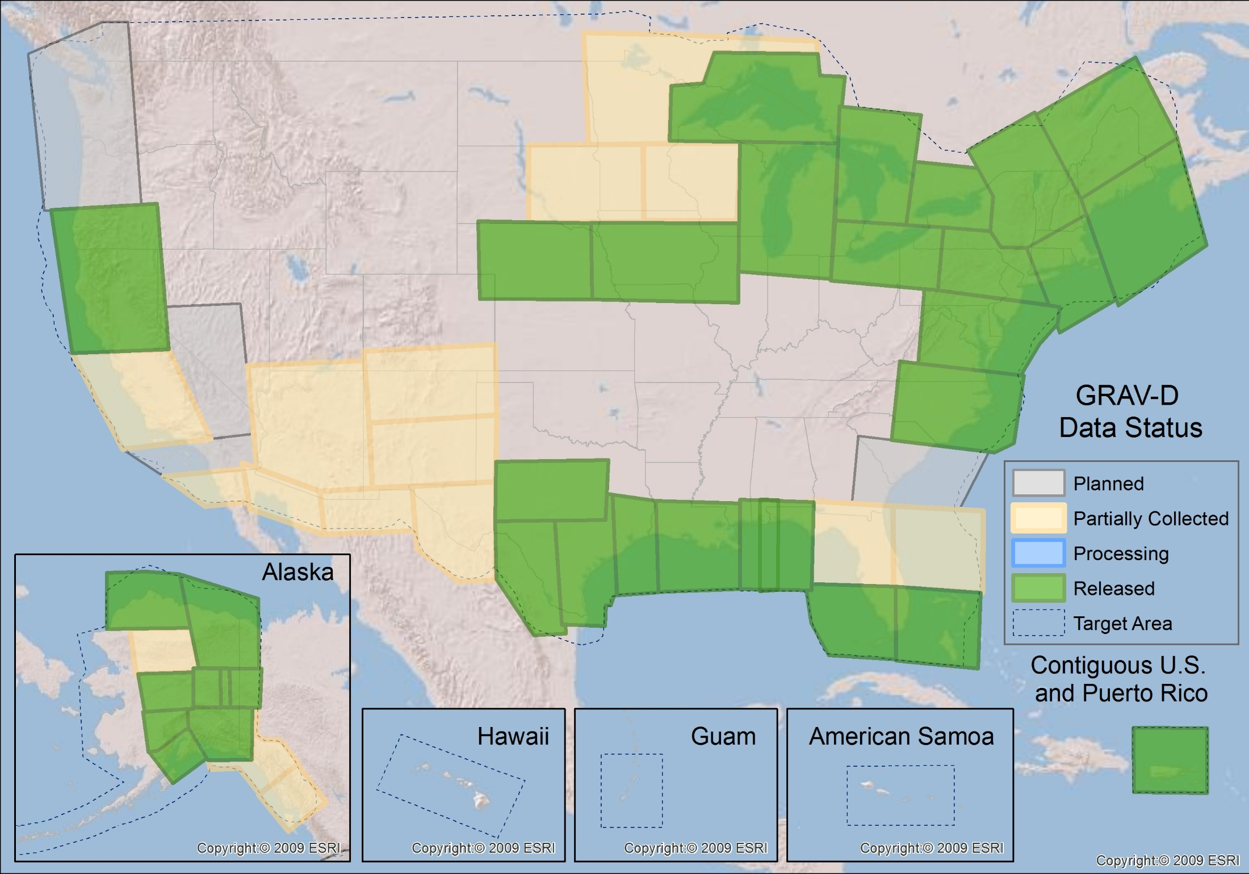
GRAV-D Status 2-1-16: 48%

Slide 23
Survey and Block Plans
Layout rectangular survey 400 x 500 km
Extends beyond the shelf break
Block size will be limited to the endurance of the aircraft or areas remaining to be collected
Notes:
Size of survey based on aircraft legs (how far it can go)
Location dependent on aircraft (over water?), in this case only a 2 engine aircraft

Slide 24
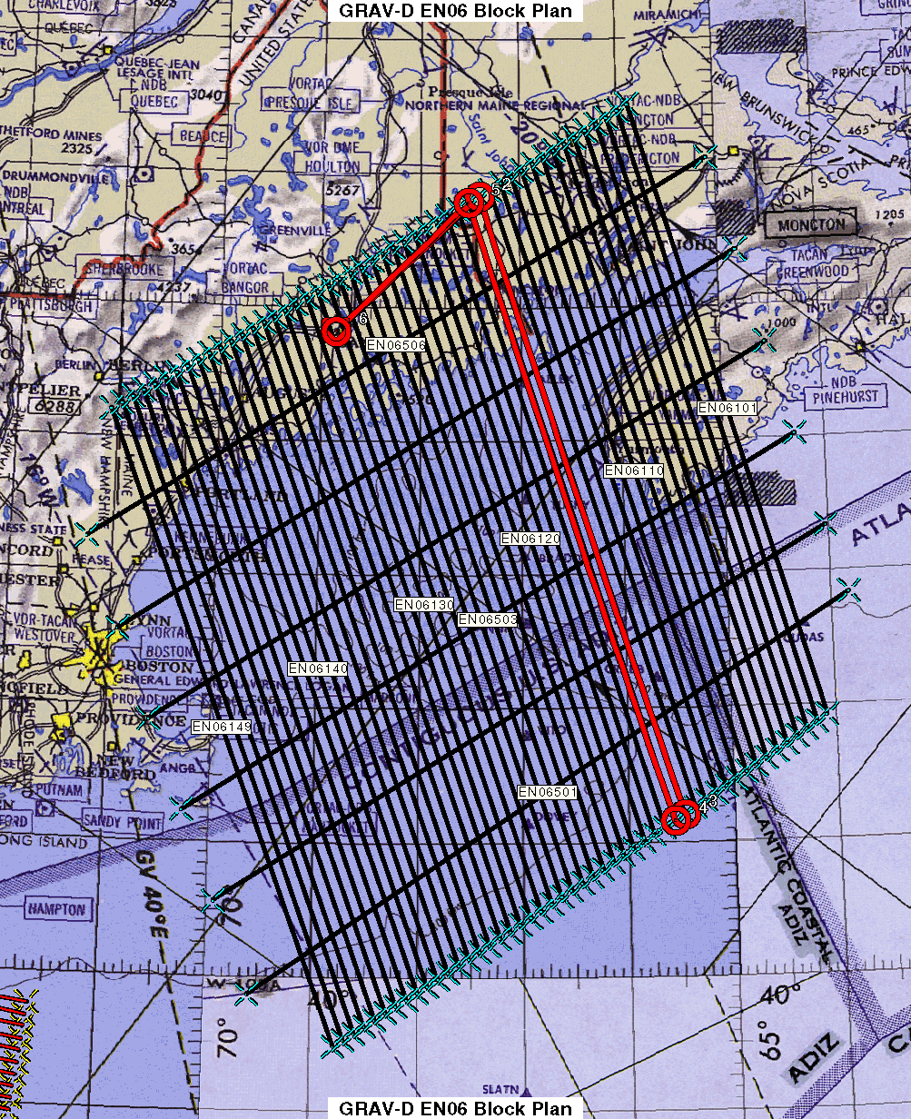
Survey and Block Plans
Data lines spaced 10 km apart
Cross lines spaced 60-80 km apart
Flight altitude 20,000 ft
Nominal speed 220-250 kts
Notes:
Block layout based on aircraft, adjust size of block if needed

Slide 25
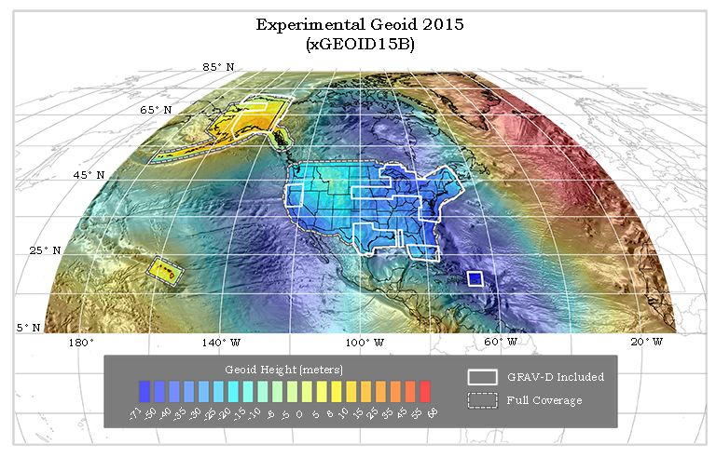
Experimental Geoids
The gravity data from satellites, airborne, corrected surface data, and terrain predictions will be blended into a gravity field
Methods for blending will be tested to prepare for 2022
Available on the Website
http://beta.ngs.noaa.gov/GEOID/xGEOID/

Slide 26
Summary
Existing datums have known meter level errors
New datum will combine geometric and geophysical datums
Geometric coordinates from 15 minutes GNSS data at cm-level
Requires significant improvements to existing infrastructure
Possibly achieved using OPUS-RS or similar product
Geometric coordinates access the geopotential model
Determines orthometric heights for leveling base stations
RTN/RTK provides potential extender but is not a part of NSRS

Slide 27
Questions?
Daniel R. Roman Ph.D.
+1-301-713-3200
Dan.roman@noaa.gov

