Slide 1

Modernization of the United States National Spatial Reference System
Dana J Caccamise II
&
Daniel R Roman
NOAA's National Geodetic Survey (NGS)
dana.caccamise@noaa.gov & dan.roman@noaa.gov

Slide 2
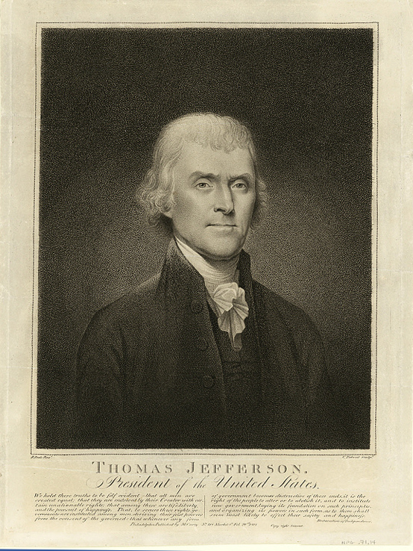
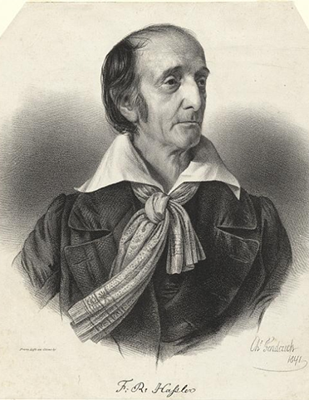



NOAA and NGS
Our Nation’s First Civilian Science Agency
1807
Thomas Jefferson
Survey of the Coast
1811
Ferdinand Hassler
Superintendent
1836
U.S. Coast
Survey
1878
U.S. Coast and
Geodetic Survey
1970
NOAA is established
Notes:
NGS has been around a long time. For more than 200 years, NGS and its predecessor agencies have collaborated with public and private organizations to establish reference stations at precisely determined locations.
We began on a mission established by Thomas Jefferson in 1807 to conduct a “Survey of the Coast” (as the United States Coast Survey).
(Pictured are Thomas Jefferson and Ferdinand Hassler, the first Superintendent of the Coast Survey). We were renamed the U.S. Coast and Geodetic Survey in 1878. NOAA was established in 1970.
Traditionally, precise positioning locations have been identified by setting a survey mark—usually a brass, bronze, or aluminum disk. Locations might also be identified by a deeply driven rod, or a prominent object, such as a water tower or church spire.

Slide 3
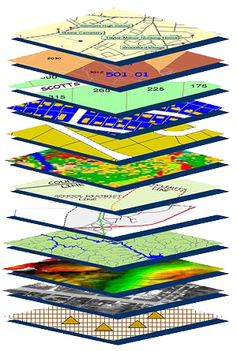
NGS’s Mission Statement
To define, maintain and provide access to the National Spatial Reference System (NSRS) to meet our Nation’s economic, social, and environmental needs.
The NSRS is a consistent coordinate system that defines latitude, longitude, height, scale, gravity, orientation, and shoreline throughout the United States.
Notes:
NGS develops and maintains the National Spatial Reference System. This national coordinate system provides the foundation for transportation, navigation, land record systems, mapping and charting efforts, and many scientific and engineering applications.
This system defines position (latitude, longitude, and elevation), distances and directions between points, strength and direction of gravity (no, it is not simply “straight down”), shoreline, and how these change over time.
The combined use of this system provides a consistent framework that allows people to use data in the same “reference” system to perform analysis, make meaningful comparisons, and ultimately make decisions from that analysis.

Slide 4



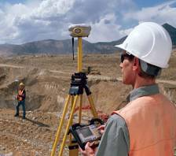

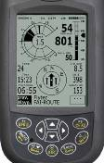

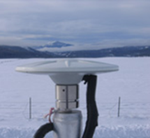



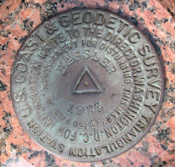
NGS Provides the Geospatial Infrastructure Critical to Our Economy through the NSRS
Aviation
Satellite
Operations
Precision Agriculture
Trucking and Shipping
Surveying and Mapping
Disaster Response
Personal Navigation
CORS
Navigation
Oil Exploration
Fishing and Boating
Survey Marks

Slide 5





The NSRS Supports:
National Oceanic and Atmospheric Administration
NSRS positioning data provides the reference for NOAA’s nautical charts, among many other geospatial applications.
Federal Emergency Management Agency
FEMA uses NSRS elevations to determine flood zones for the National Flood Insurance Program.
United States Army Corps of Engineers
USACE uses NSRS elevations to determine levee heights and positions in their Levee Safety Program.
United States Geological Survey
USGS uses the NSRS to reference their Topographic Maps
and interior water data for the nation.
National Geospatial Intelligence Agency
NSRS gravity data contributes to NGA’s geospatial mission.

Slide 6
NSRS Modernization Delay
Operational, workforce retention, and other issues have delayed NSRS Modernization.
SPCS2022 zones should be finalized in 2022 but will not be rolled out until all of the NSRS is modernized.
GPS on Bench Marks deadline extended
September 30, 2023
Find out
More:
https://geodesy.noaa.gov/datums/newdatums/delayed-release.shtml
https://geodesy.noaa.gov/datums/newdatums/FAQNewDatums.shtml

Slide 7
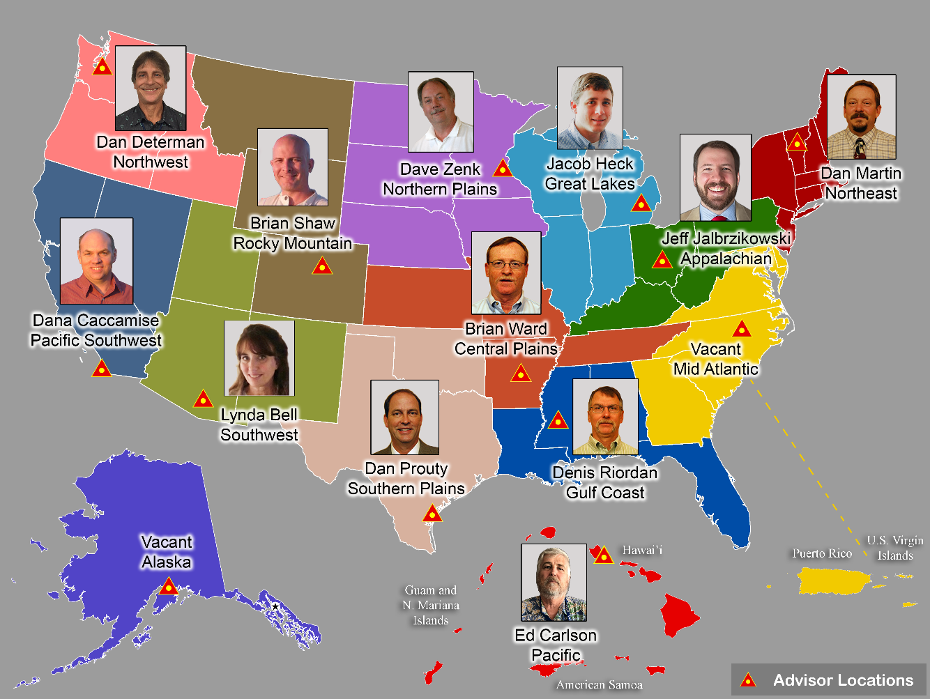
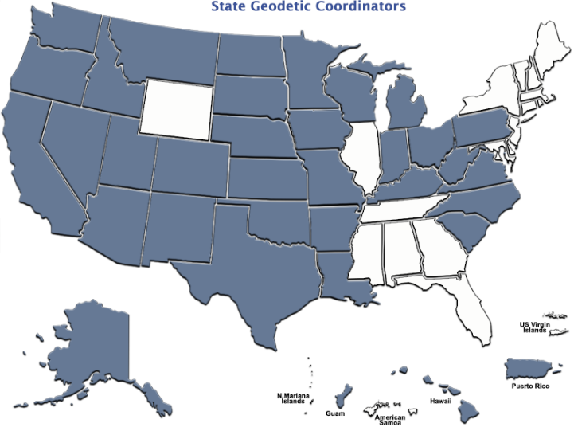
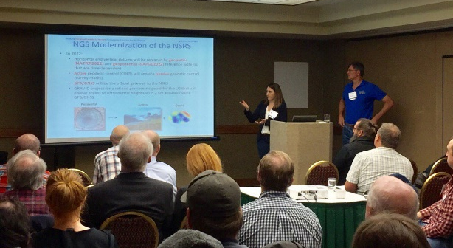
Importance of Coordination
14 Advisors
(2 acting)
38 Coordinators
Notes:
NGS Regional Geodetic Advisors
https://geodesy.noaa.gov/ADVISORS/
State Geodetic Coordinators
https://geodesy.noaa.gov/ADVISORS/state-geodetic-coordinators.shtml

Slide 8

NGS Resources
NGS Training Center
https://geodesy.noaa.gov/web/science_edu/training/
Educational Videos
https://geodesy.noaa.gov/datums/newdatums/WatchVideos.shtml
NGS Webinar Series
https://geodesy.noaa.gov/web/science_edu/webinar_series/
Geospatial Summit (2021, 2019 recorded sessions)
https://geodesy.noaa.gov/geospatial-summit/
Presentation Library
https://geodesy.noaa.gov/web/science_edu/presentations_library/

Slide 9
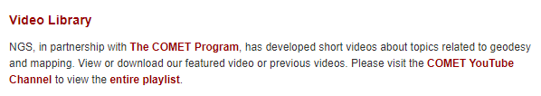
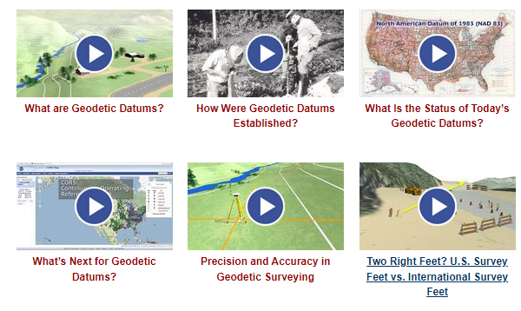
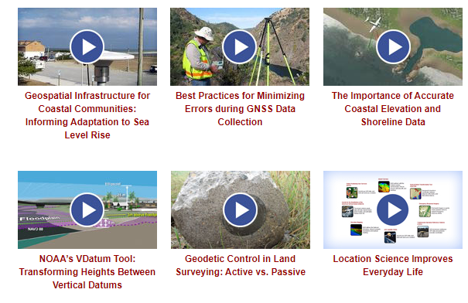
NGS Resources – Educational Videos
https://geodesy.noaa.gov/datums/newdatums/WatchVideos.shtml

Slide 10

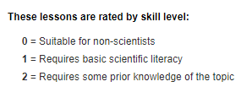
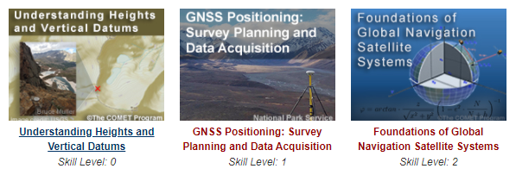
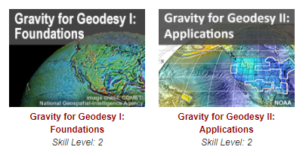
NGS Resources – Online Lessons
https://geodesy.noaa.gov/web/science_edu/online_lessons/index.shtml

Slide 11

The National Geodetic Survey Strategic Plan
Support the users of the National Spatial Reference System.
Modernize and improve the National Spatial Reference System.
Expand the National Spatial Reference System stakeholder base through partnerships, education, and outreach.
Develop and enable a workforce with a supportive environment.
Improve organizational and administrative functionality.
https://www.ngs.noaa.gov/web/about_ngs/info/documents/ngs-strategic-plan-2019-2023.pdf
11
Notes:
The NGS Strategic Plan has four major goals and an enterprise goal:
Goal 1: Support the Users of the National Spatial Reference System.
Goal 2: Modernize and Improve the National Spatial Reference System.
Goal 3: Expand the National Spatial Reference System Stakeholder Base through Partnerships, Education and Outreach.
Goal 4: Develop and Enable a Workforce with a Supportive Environment.
Enterprise Goal: Improve Organizational and Administrative Functionality.

Slide 12
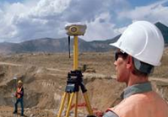
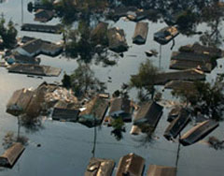
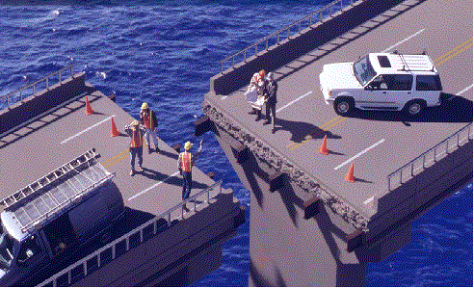

NSRS Modernization
Revolutionize professional surveying
No more need for installing and locating bench marks
Absolute, consistent positioning autonomously, anywhere
Vastly improve flood plain mapping
Water “sees” and flows due to differences in gravity. These are mapped directly using GNSS.
Critical importance in low-lying, flat communities
Impacts on infrastructure
Any application requiring precise positioning - bridges, tunnels, railways, agriculture, navigation - will be easier and more accurate
Fundamental support for new technologies
“Smart Highways” for autonomous vehicles

Slide 13

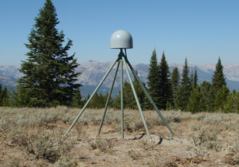

Socio-Economic Benefits
NSRS worth $2.4 billion per year, $22 billion over 15 years at a discounted rate.
CORS worth $758 million per year; $6.9 billion over 15 years at a discounted rate.
GRAV-D worth $522 million per year through the implementation of a new national vertical datum, $4.8 billion over 15 years at a discounted rate, including $2.2 billion for improved floodplain management alone.
https://geodesy.noaa.gov/PUBS_LIB/Socio-EconomicBenefitsofCORSandGRAV-D.pdf
One-page handout available at: https://geodesy.noaa.gov/INFO/OnePagers/socio_eco_handout.pdf
Notes:
The NSRS provides more than $2.4 billion in potential annual benefits to the U.S. economy, according to a 2009 independent study. The study found that the NOAA CORS network alone provides an estimated $758 million per year in benefits. The study estimates that an additional $522 million in annual economic benefits could be generated by the implementation of a new vertical reference system, allowing users to determine more precise elevations using the Global Positioning System (GPS), with approximately $240 million saved from improved floodplain management alone.
Rollout to Congress June 15, 2009

Slide 14
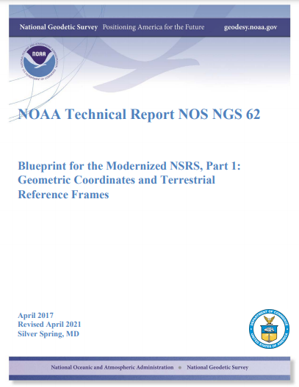
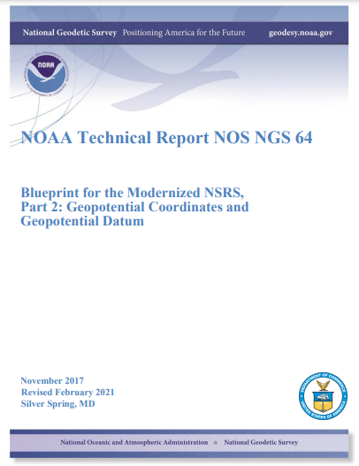
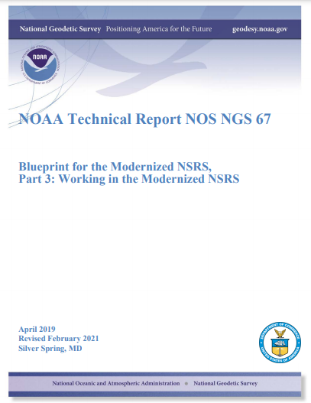
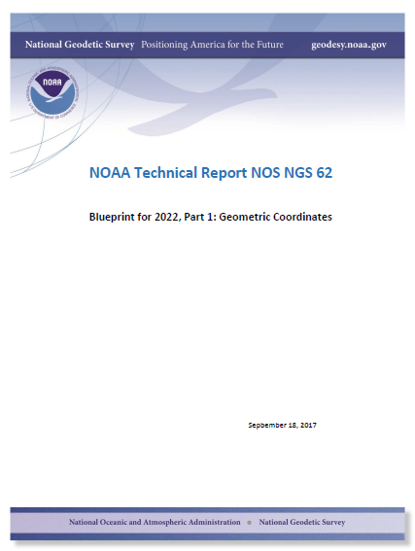
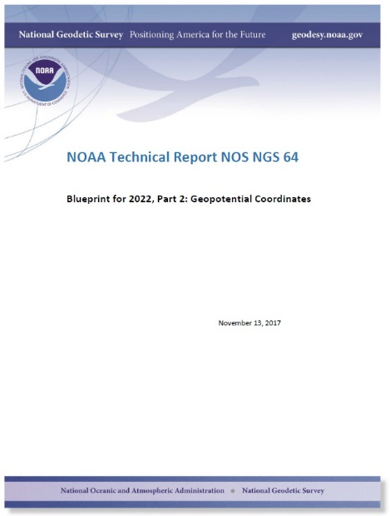
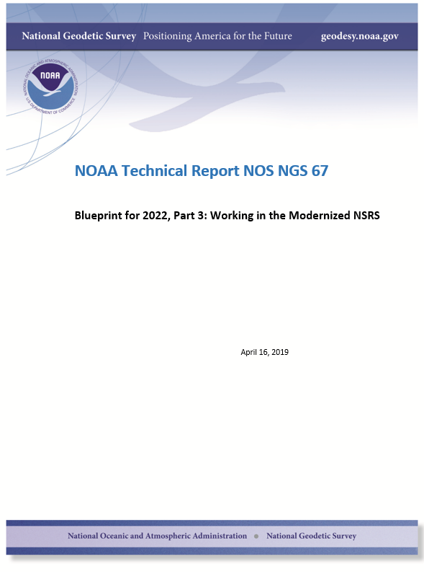
Updated Blueprint documents
Available in the NGS Publications Library: https://geodesy.noaa.gov/library/
Geopotential:
Nov 2017
Revised Feb 2021
NOAA TR NOS NGS 64
53 pages
Working in the
Modernized NSRS:
April 2019
Revised Feb 2021
NOAA TR NOS NGS 67
133 pages
Geometric:
Sep 2017
Revised April 2021
NOAA TR NOS NGS 62
61 pages
Notes:
NGS is in process of creating “blueprint” documents for modernization of the NSRS
This is best source of detailed and specific information; living documents that get updated as necessary
Three blueprint documents:
First on geometric coordinates (terrestrial reference frames), latest version Sep 2017
Second on geopotential coordinates (“vertical” datum, gravity, etc.), latest version Nov 2017
Third on working in the modernized NSRS, first version will be published in May 2019. This is the “how to” document for using the new 2022 NSRS. Emphasis is on practical applications. Later versions will include case studies.

Slide 15
Recent & Relevant Publications
Blueprint Documents for 2022
Part 1: Geometric Coordinates
Part 2: Geopotential Coordinates
Part 3: Working in the modernized NSRS
The State Plane Coordinate System History, Policy, and Future Directions
NOAA Special Publication NOS NGS 13
Notes:
Links on the slide.

Slide 16
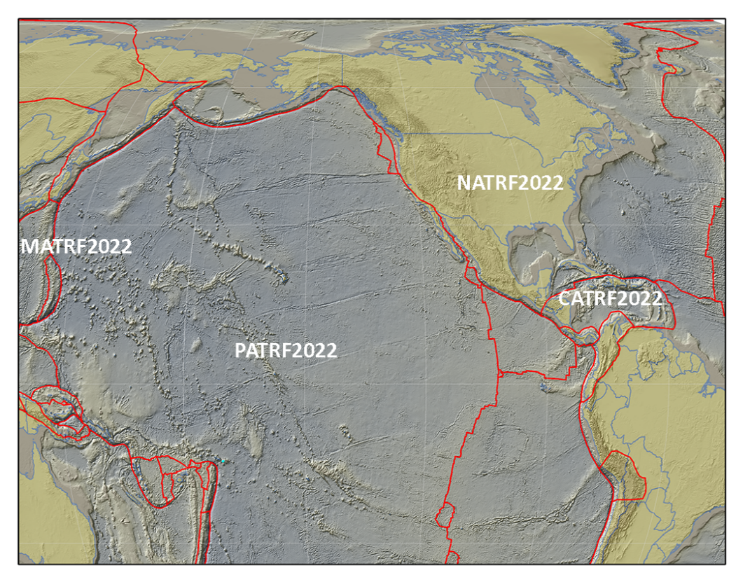
The Future Reference Frames
Will be based on a densified ITRF model (Eg. SIRGAS)
Tectonic Plate based
Each Plate is based on the same densified
ITRF model
North America
Caribbean
Pacific
Mariana
NATRF
CATRF
PATRF
MATRF
Notes:
ITRF fixed PLATE specific reference frame. 5th frame will be SIRGAS
NSRS Modernization Naming Conventions https://geodesy.noaa.gov/datums/newdatums/naming-convention.shtml

Slide 17

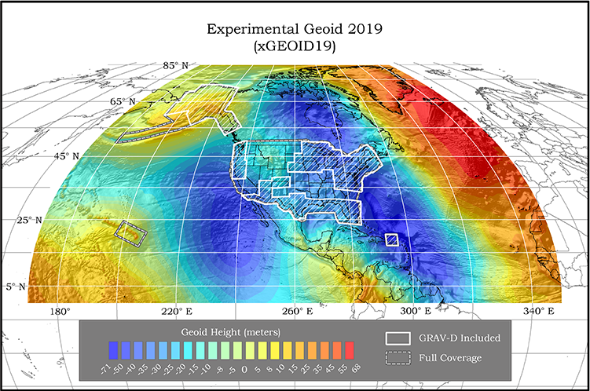
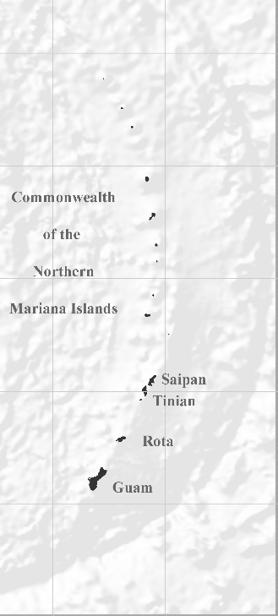
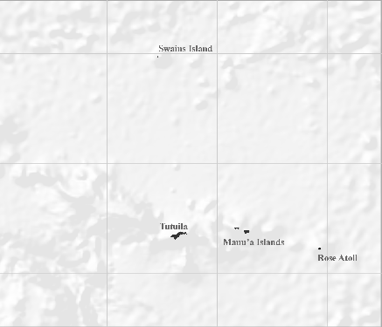
NAPGD2022 Geopotential Datum
Not just a vertical datum, it is more than just heights.
Models included:
¼ Earth’s Surface
Geopotential, Geoid Deflection of Vertical,
& Gravity
SIESTA BIEN
SESTA BOM
Guam/CNMI
American Samoa
Notes:
As noted in the Blueprint 2 document
https://geodesy.noaa.gov/library/pdfs/NOAA_TR_NOS_NGS_0064.pdf
NAPGD2022 will include all of the following
Geopotential Model of 2022 (GM2022) will include:
Static Geopotential model of 2022 (SGM2022)
Dynamic Geopotential model of 2022 (DGM2022)
GEOID2022 will include:
Static Geoid model of 2022 (SGEOID2022)
Dynamic Geoid model of 2022 (DGEOID2022)
DEFLEC2022 will include:
Static Deflection of the Vertical model of 2022 (SDEFLEC2022)
Dynamic Deflection of the Vertical model of 2022 (DDEFLEC2022)
GRAV2022
Static Gravity model of 2022 (SGRAV2022)

Slide 18
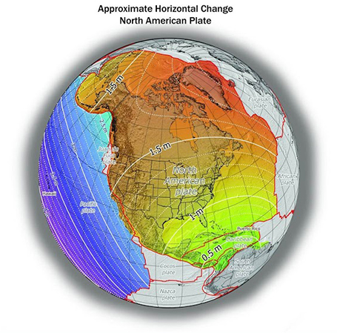
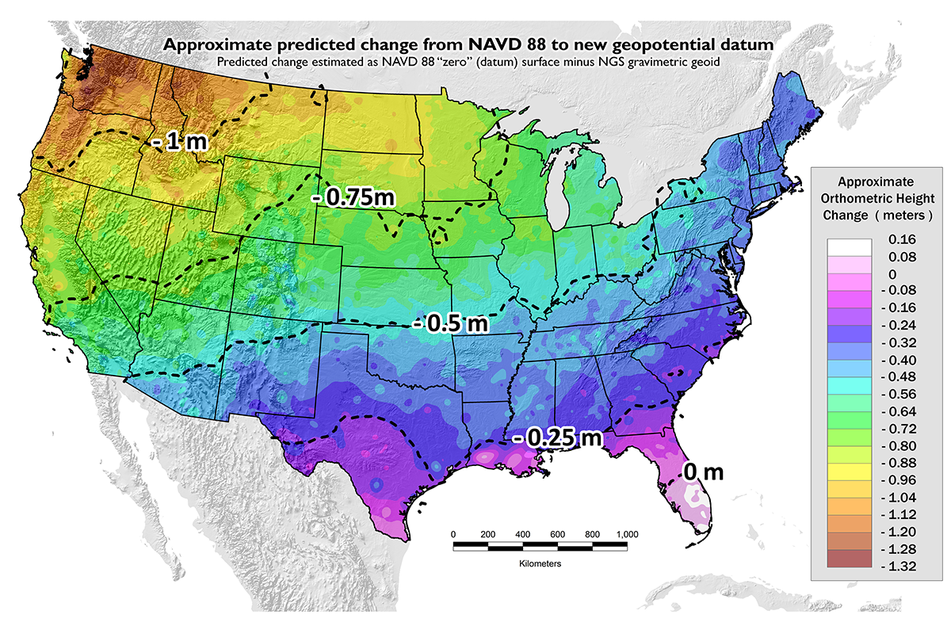
Once we get to 2022: What to Expect?
~1 to 1.5 meters North America
~2.5 to 4 meters in Pacific
0 to 1.3 meters CONUS
Notes:
New Datums What to expect https://geodesy.noaa.gov/datums/newdatums/WhatToExpect.shtml
NGS is not shifting the land, merely shifting the reference surfaces to which we reference the geospatial data to.

Slide 19
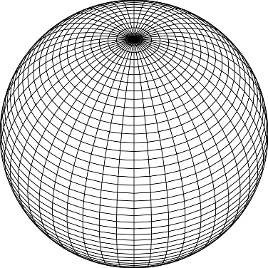
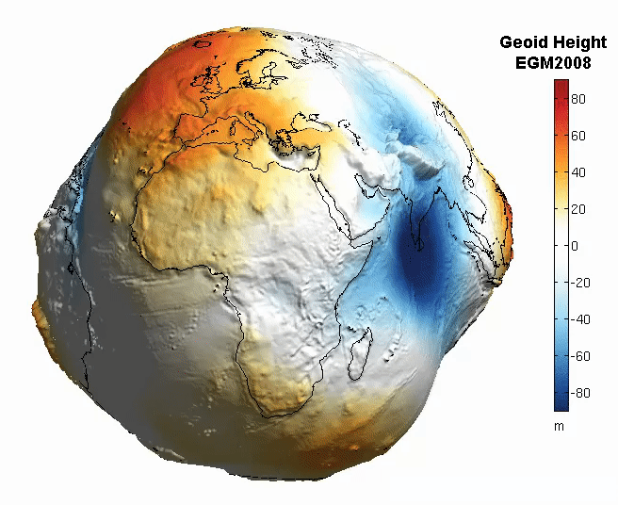
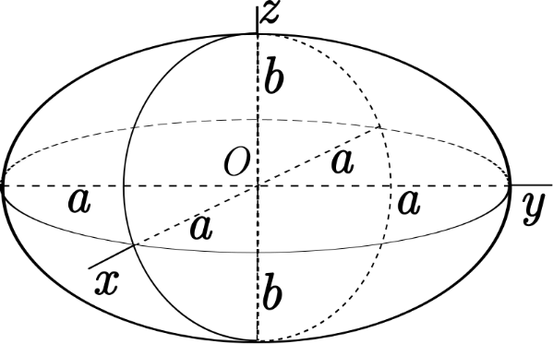
The Earth is Infinitely Complex
Build Models to Simplify
Notes:
Models are used to simplify complex phenomena for humans and computers to understand and perform calculations and analysis.
The geoid is an approximation of sea level and used to calculate elevations (orthometric heights) above this “sea level” surface
Spheroid image https://www.kisspng.com/png-sphere-shape-ball-grid-line-circle-draw-5378189/
Ellipsoid image https://www.kisspng.com/png-figure-of-the-earth-oblate-spheroid-ellipsoid-4129812/
Geoid Image https://www.reddit.com/r/MapPorn/comments/3xf6a0/geoid_height_of_new_global_gravity_field_models/

Slide 20
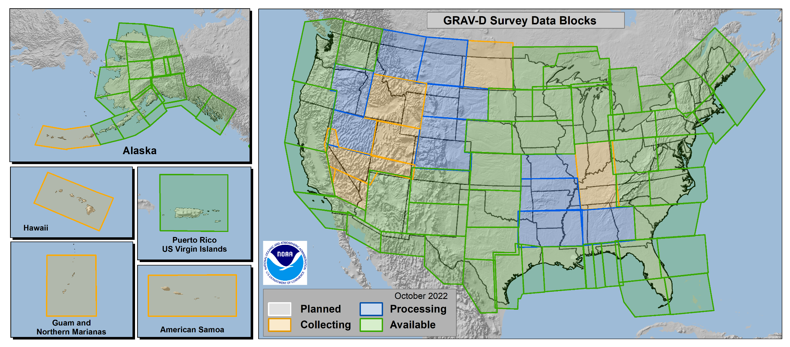
Gravity for the Redefinition of the
American Vertical Datum
GRAV-D
96.8% Complete
(11/21/2022)
Notes:
10 km data lines
70 km cross lines
20,000 ft altitude
230 kt flight speed
More information on GRAV-D
https://geodesy.noaa.gov/GRAV-D/
Data Download for GRAV-D blocks
https://geodesy.noaa.gov/GRAV-D/data_products.shtml

Slide 21
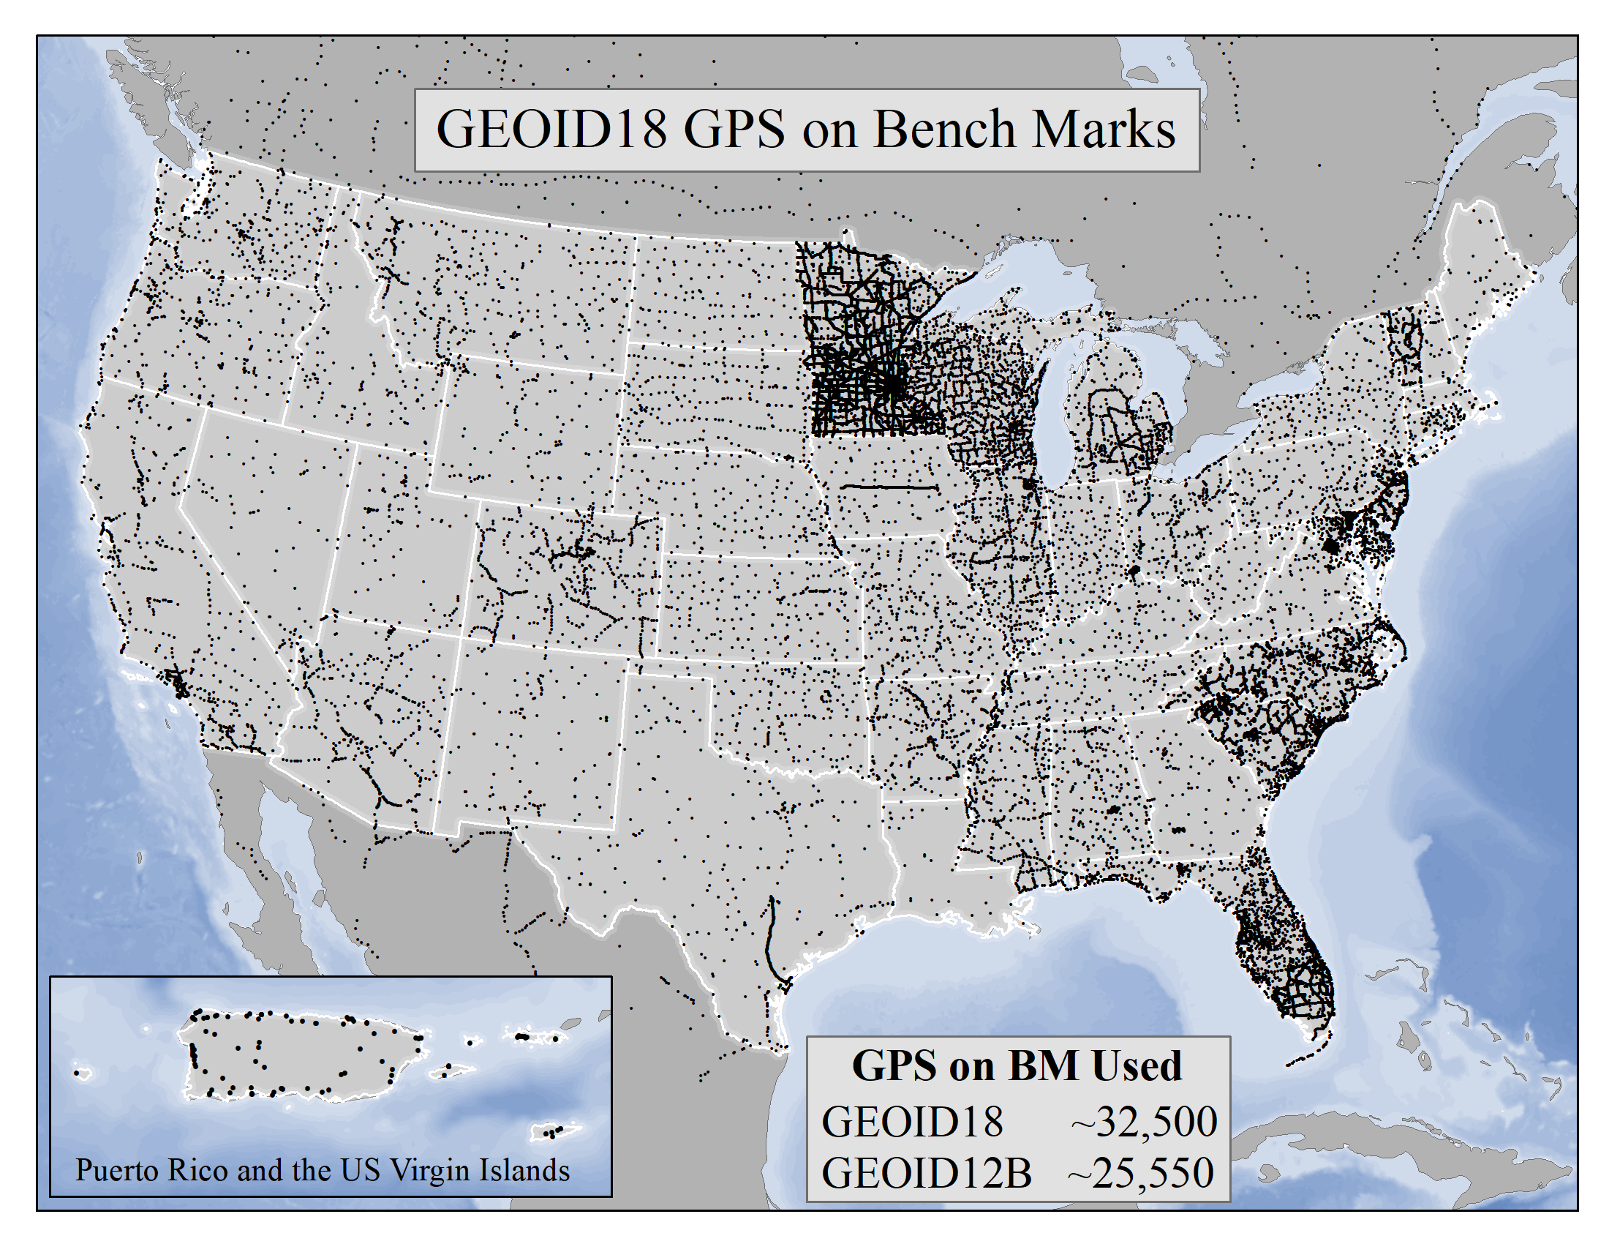
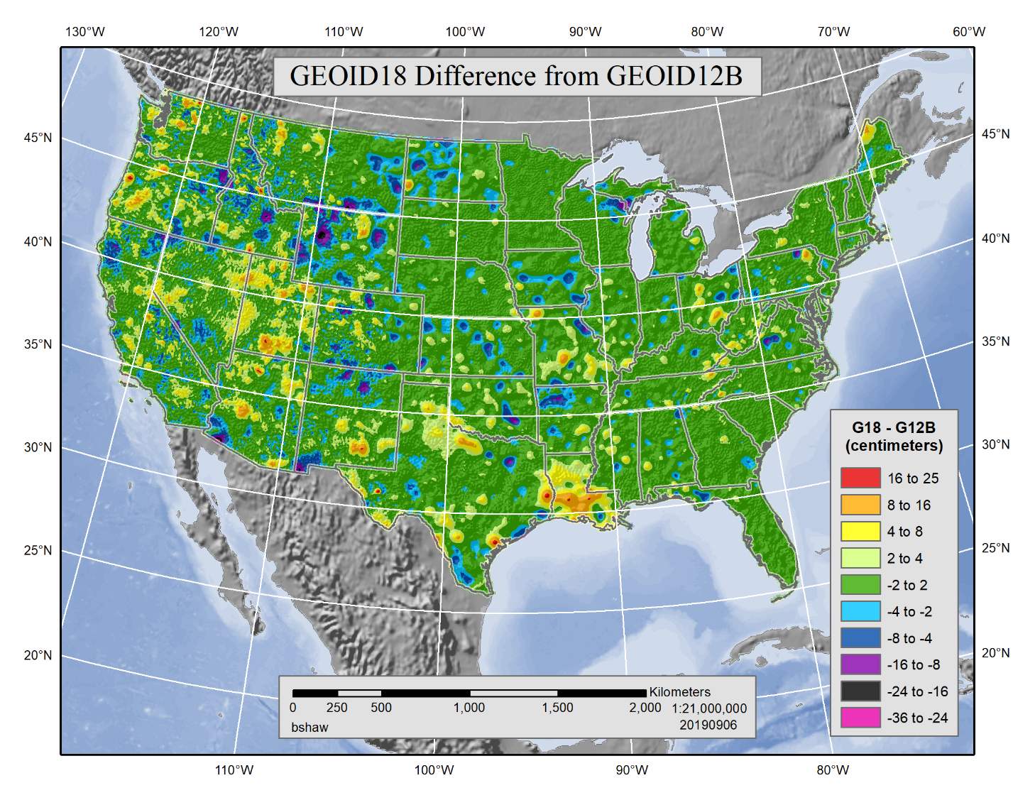
GEOID18
Released:
September 11, 2019
https://geodesy.noaa.gov/GEOID/GEOID18/
Notes:
Hybrid geoid models are used to convert NAD83 ellipsoid heights from Global Positioning Systems (GPS) observations to orthometric heights (elevation). Hybrid geoid models are created by constraining a gravimetric geoid model to published heights using GPS observations on leveled bench marks. GEOID18 is intended to be the last hybrid geoid model that NGS creates before the current vertical datums are replaced by the North American-Pacific Geopotential Datum of 2022 (NAPGD2022) .

Slide 22
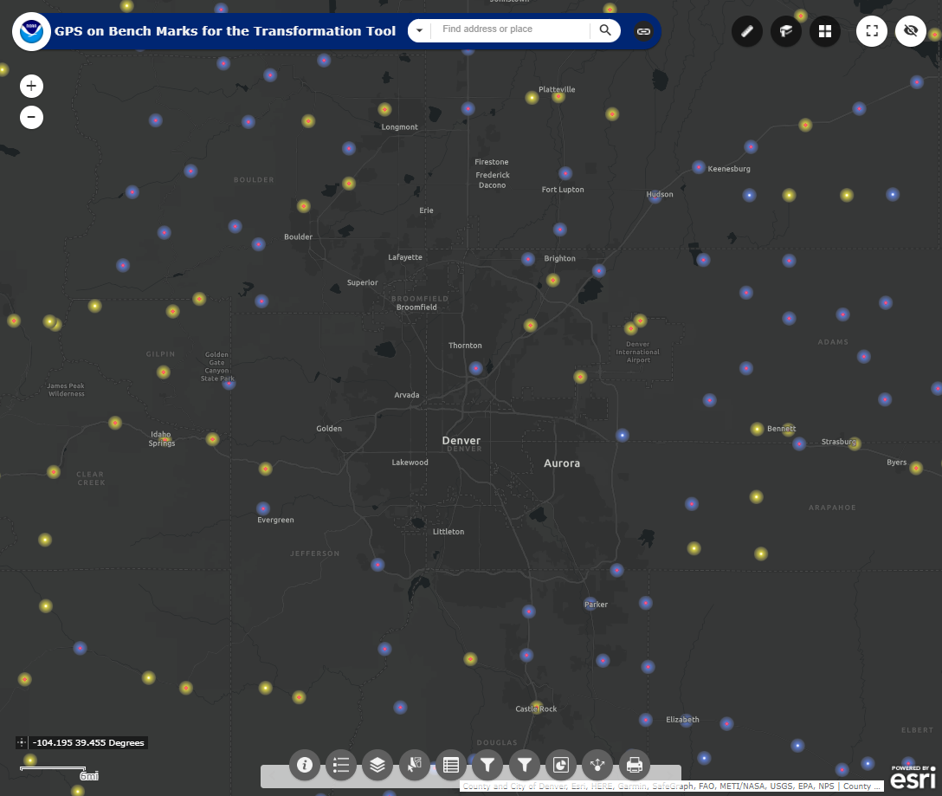
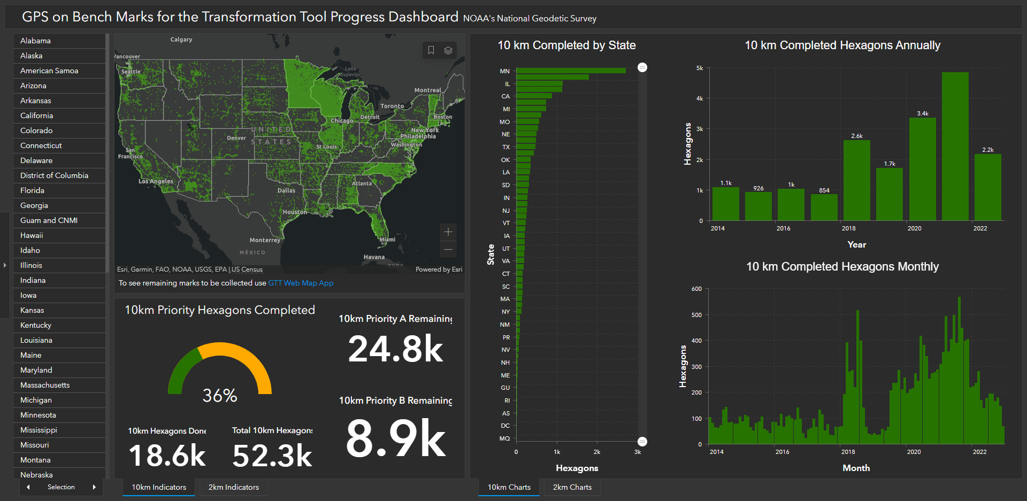
GPS on Bench Marks
Web Map Application
Dashboard
~3,400 Completed in 2020
~4,800 Completed in 2021
~2,200 Completed in 2022
Notes:
GPS on Bench Marks Web Map
https://noaa.maps.arcgis.com/apps/webappviewer/index.html?id=6093dd81e9e94f7a9062e2fe5fb2f7f5
GPS on Bench Marks Dashboard
https://noaa.maps.arcgis.com/apps/dashboards/449e3051fbf44202ba6606e2dbcb0e29

Slide 23
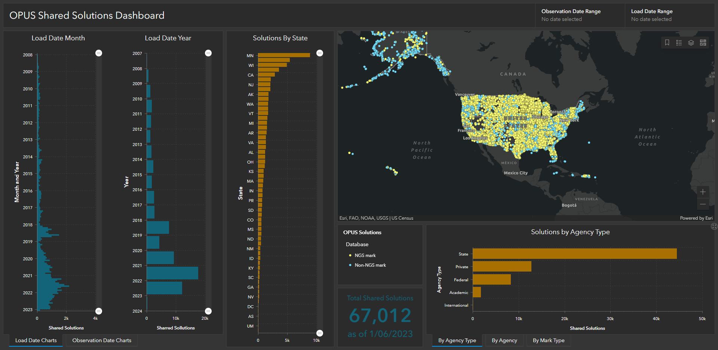
OPUS Shared Solutions Dashboard
Dashboard enables sorting and visualization of Shared Solutions by
Month & Year, State, Agency Type, and submitting agency
Agency type | # Shared Solutions on NGS marks
State | ~35,900
Private Sector | ~6,200
Federal | ~3,900
Academic | ~1400
2018
Note the impact of GPSonBM Campaigns
2020
2021
Notes:
Links on the slide.

Slide 24
NGS Resources
NGS Training Center
https://geodesy.noaa.gov/web/science_edu/training/
Educational Videos
https://geodesy.noaa.gov/datums/newdatums/WatchVideos.shtml
NGS Webinar Series
https://geodesy.noaa.gov/web/science_edu/webinar_series/
Presentation Library
https://geodesy.noaa.gov/web/science_edu/presentations_library/

Slide 25
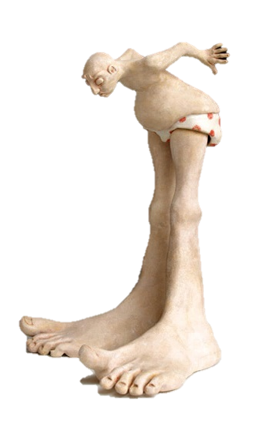
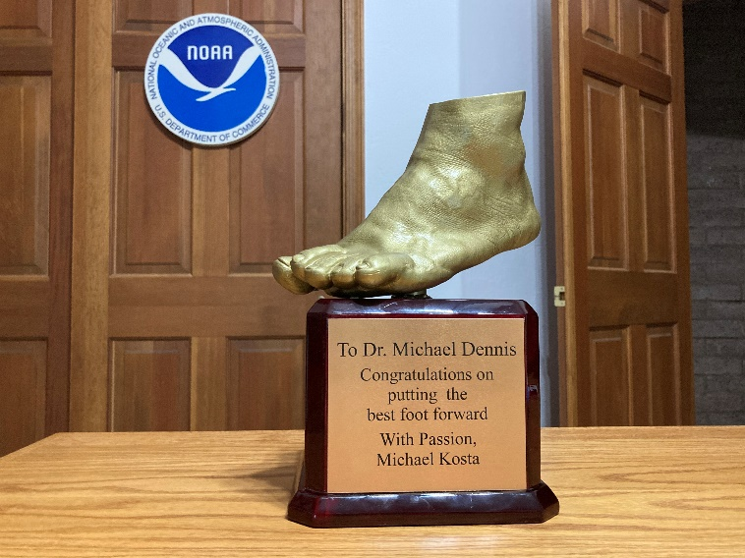
Deprecation of US Survey Foot
December 31, 2022
Will NOT impact current SPCS 83 coordinates. The US Survey Foot (sft) will
continue to be supported in the SPCS 83 system indefinitely.
The International Foot (ift) will be used in the Modernized NSRS and SPCS2022
Find out more:
Webinar
https://geodesy.noaa.gov/web/science_edu/webinar_series/ending-us-survey-foot.shtml
FRN
https://www.federalregister.gov/documents/2020/10/05/2020-21902/deprecation-of-the-united-states-us-survey-foot
Notes:
Links on the slide.

Slide 26
Thank You !
QUESTIONS?

Slide 27
Transformations
2D
3D
NCAT/NADCON5
φ, λ, h
φ, λ
φ, λ
CONUS
UTM
SPCS
φ
λ
h
- Latitude
- Longitude
- Ellip. Height
UTM
SPCS
X, Y, Z
USNG
USNG
NAD 83
USSD
NAD 27
(1986)
(HARN)
(FBN)
(NSRS2007)
(2011)
NATRF2022
(No SPCS)
Notes:
NCAT (implementation of NADCON5) - https://geodesy.noaa.gov/NCAT/
NADCON 5 Technical Report - https://geodesy.noaa.gov/PUBS_LIB/NOAA_TR_NOS_NGS_63.pdf
USSD – United States Standard Datum https://geodesy.noaa.gov/datums/horizontal/us-standard-datum.shtml
NAD 27 – North American Datum of 1927 https://geodesy.noaa.gov/datums/horizontal/north-american-datum-1927.shtml
NAD 83 – North American Datum of 1983 https://geodesy.noaa.gov/datums/horizontal/north-american-datum-1983.shtml
NATRF2022 – North American Terrestrial Reference Frame of 2022 https://geodesy.noaa.gov/datums/newdatums/naming-convention.shtml

Slide 28
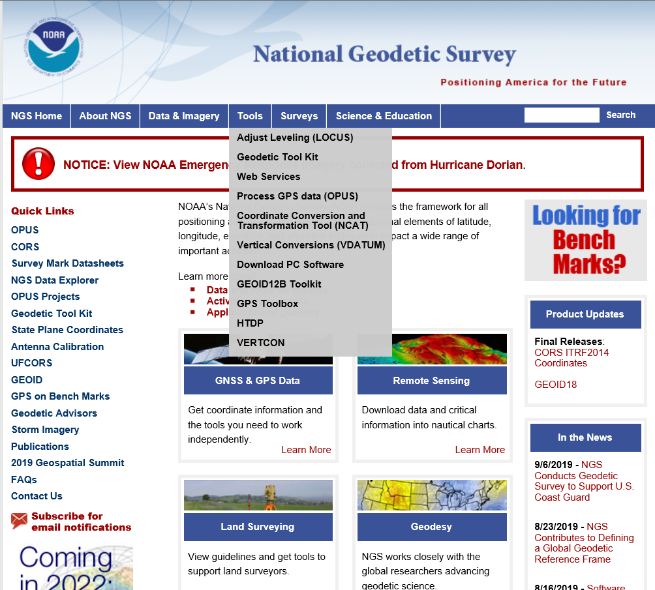
NGS Products Update - NCAT

Slide 29
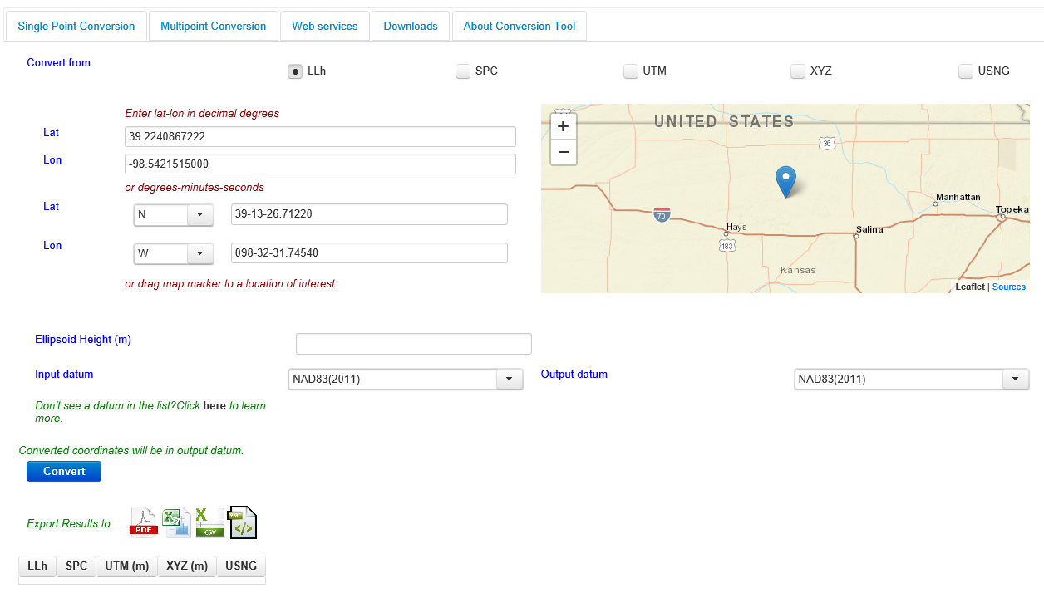
NGS Products Update - NCAT

Slide 30
X, Y, Z
φ, λ, h
SPC
φ, λ, h
Region: CONUS
2022
X, Y, Z
UTM
USSD
USNG
UTM
φ, λ, h
GEOCON 11
φ, λ, h
NAD 27
NAD 83 (2011)
X, Y, Z
SPC
X, Y, Z
SPC
USNG
UTM
NADCON
GEOCON
USNG
UTM
NAD 83 (NSRS2007)
φ, λ, h
NAD 83 (1986)
φ, λ, h
NAD 83 (FBN)
NAD 83 (HARN)
φ, λ, h
X, Y, Z
SPC
X, Y, Z
SPC
φ, λ, h
USNG
UTM
USNG
UTM
X, Y, Z
SPC
X, Y, Z
SPC
USNG
UTM
USNG
UTM

Slide 31
X, Y, Z
φ, λ, h
Region: CONUS
2022
SPC
UTM
φ, λ, h
USSD
X, Y, Z
NCAT (NADCON 5)
USNG
UTM
φ, λ, h
φ, λ, h
NAD 27
NAD 83 (2011)
X, Y, Z
SPC
X, Y, Z
SPC
USNG
UTM
USNG
UTM
NAD 83 (NSRS2007)
φ, λ, h
NAD 83 (1986)
φ, λ, h
NAD 83 (FBN)
NAD 83 (HARN)
φ, λ, h
X, Y, Z
SPC
X, Y, Z
SPC
φ, λ, h
USNG
UTM
USNG
UTM
X, Y, Z
SPC
X, Y, Z
SPC
USNG
UTM
USNG
UTM

Slide 32
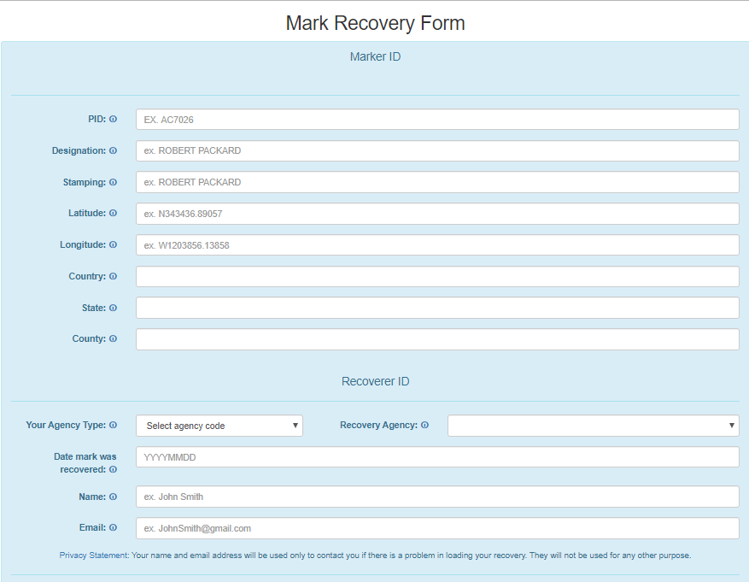
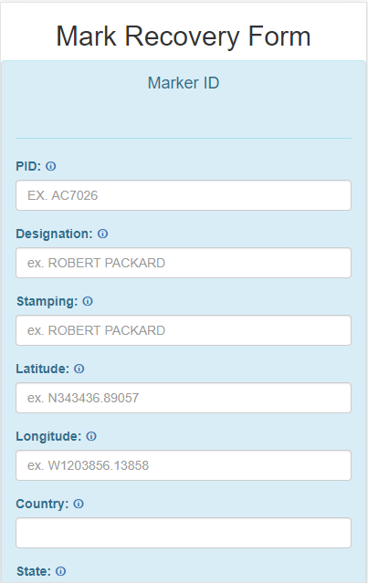
Beta Mark Recovery Form
Desktop and Mobile friendly
https://beta.ngs.noaa.gov/cgi-bin/recvy_entry_www.prl

Slide 33
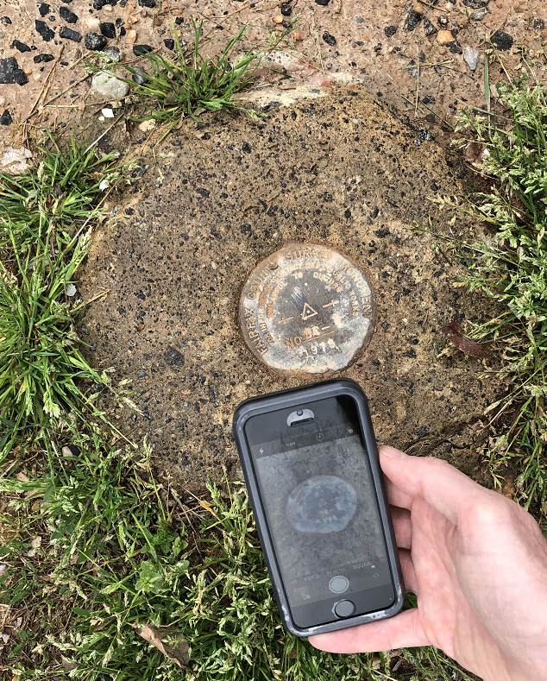
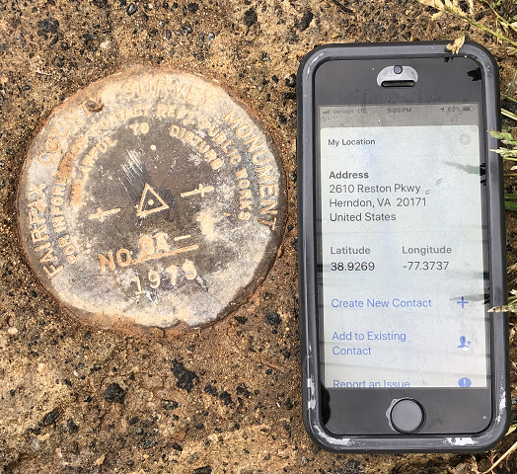
August 6, 2019
SaGES 2019
33
Reported Coordinates

Slide 34
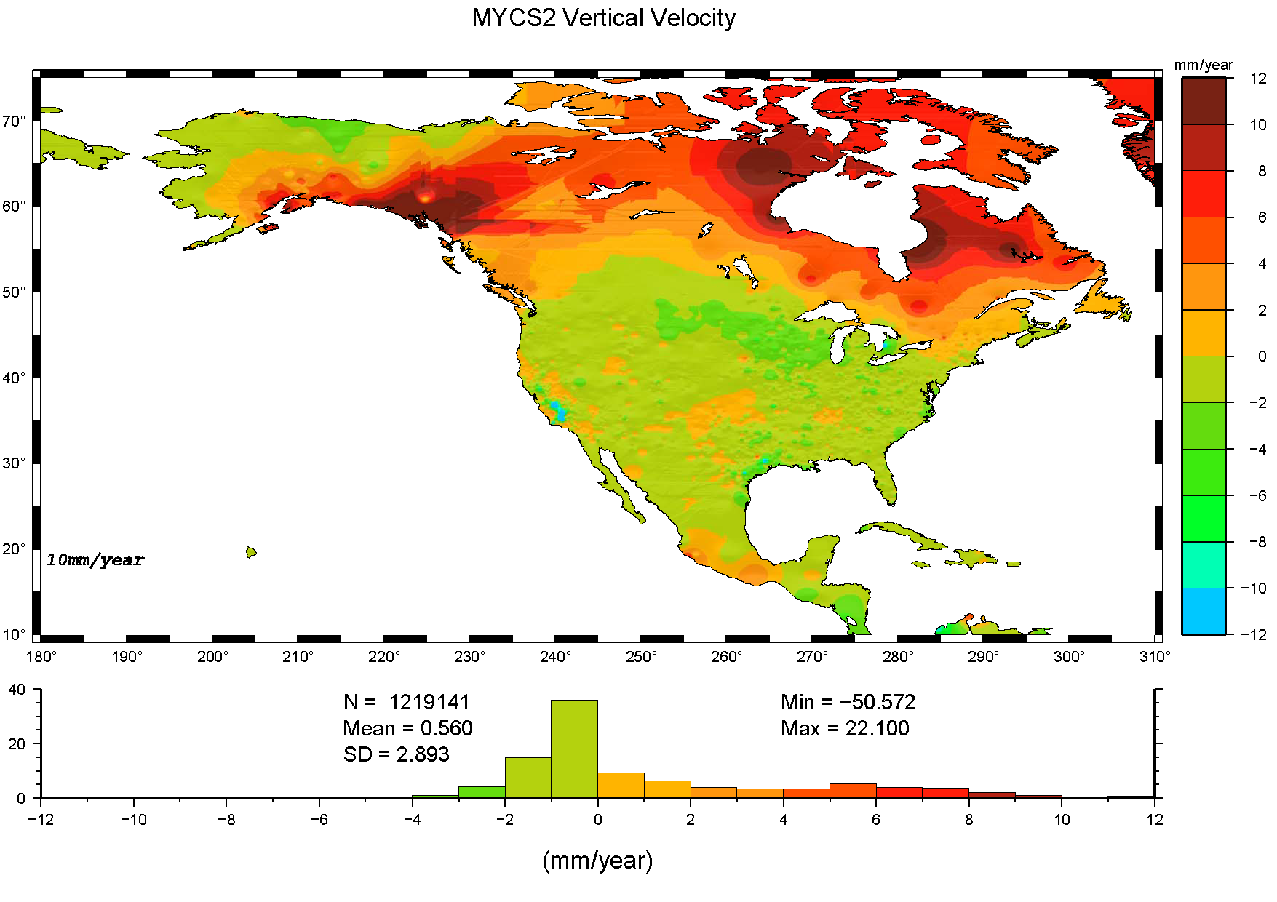



ITRF2014 and MYCS2
CORS Coordinates and Velocities Update
Vertical Velocities
Horizontal Velocities
https://geodesy.noaa.gov/CORS/cords.shtml

Slide 35


RTK GVX Format
Requesting Feedback
https://geodesy.noaa.gov/data/formats/GVX/
Notes:
GVX: The GNSS Vector Exchange File Format
The RTK-GVX format will be incorporated into the GeodseyML (Markup Language) international standard for geodetic data
Background
GVX aims to provide a standard file format for exchanging GNSS vectors derived from varying GNSS survey methods and manufacturer hardware.
The file format includes all of the necessary data of a GNSS vector for inclusion in a survey network for least squares adjustment, as well as crucial metadata. The format is meant for any type of GNSS vector, whether it was derived in a real-time kinematic (RTK) survey or from baseline post-processing. One goal for developing GVX is so that vector data can be uploaded to OPUS-Projects. NGS requests feedback on this file format. Please send comments to NGS.Feedback@noaa.gov.

Slide 36
Why Modernize the NSRS
Current models built on old technology and data
NAD 83 not truly Geocentric (~2.2m)
NAVD 88 relies on marks in the ground
and is not easily maintained
Today’s technology needs better accuracy
Data is collected exponentially faster
In addition, the US has agreed to adopt the GGRF
Notes:
NSRS Modernization News
https://geodesy.noaa.gov/datums/newdatums/TrackOurProgress.shtml

Slide 37
NSRS is a Paradigm Shift in Data & Technology
NAD 83
NAVD 88
Triangulation (150 years)
TRANSIT/BC-4
DORIS
GRS80 Ellipsoid
Leveling (150+ years)
Water-Level Transfers
Surface Gravity
Theodolite Vertical Angles
Technology
Main Frames (MB), Theodolites, Dumpy Levels

Slide 38

Plate Tectonics and Velocities
“drift” : Annual changes to ITRF2014 coordinates
Notes:
All plates are moving and through the constant collection of GNSS data using CORS we can now model where the land is moving. In the center of tectonic plates there is generally motion that can be measured but where plates converge can be thought of as a crunch zone and the modeling has much more uncertainty due to geophysical phenomena.

Slide 39
NSRS is a Paradigm Shift in Data & Technology
TRFs
Geopotential
GNSS (25 years)
VLBI
SLR
DORIS
Leveling (180+ years) – Now Digital
Satellite, Airborne, Surface Gravity
Digital Elevation Models
SRTM, LIDAR, IFSAR
Technology
Cloud/Servers, Satellites, Many new surveying technologies

Slide 40



8.5 meters
50 years
Vertical Motion
May 2015
to
Sept 2016
Hudson Bay Uplifting
8 -13 mm/year
San Joaquin Subsiding
20-24” in 16 months
Notes:
San Joaquin Subsidence article
http://www.digitaljournal.com/tech-and-science/technology/sinking-san-joaquin-valley-of-california-seen-from-space/article/487393
Hudson Bay Uplift article
https://www.researchgate.net/figure/Contour-map-of-observed-CBN-vertical-rates-Preliminary-results-from-the-combination-of_fig3_286867540
GIA

Slide 41



State Plane Coordinate Systems of 1927 (134 zones) and 1983 (125 zones)
SPCS of 2022
Special Publication, Policy, Procedures, and FRN
https://geodesy.noaa.gov/SPCS/
Notes:
State Plane Coordinate System
https://geodesy.noaa.gov/SPCS/index.shtml
2022 Policy Changes
https://geodesy.noaa.gov/SPCS/policy.shtml

