Slide 1



Datums & Control: Where We’ve Been,
Where We’re Going
Alabama Society of Prof. Land Surveyors
2017 Annual Conference
Pelham, Alabama
October 18, 2017
Denis Riordan, PSM
NOAA, National Geodetic Survey
denis.riordan@noaa.gov

Slide 2
Presentation Outline
1. - Introductions.
- National Geodetic Survey.
- Horizontal / Geometric Datums.
- Vertical Datums.
- GRAV-D and what it’s about.
- New Reference Frames (Geometric & Vertical).
- Questions.

Slide 3
U.S. Department of Commerce
National Oceanic & Atmospheric Administration
National Geodetic Survey
Mission: To define, maintain & provide access to the
National Spatial Reference System (NSRS)
to meet our Nation’s economic, social & environmental needs
National Spatial Reference System
* Latitude * Scale
* Longitude * Gravity
* Height * Orientation
& their variations in time
Notes:
- NSRS benefit to the nation = $2.5B/year
est. 300K precision GPS users worldwide (2008); ¼ in US
- Very exciting to us at NGS to see how it has evolved over the years – now cm-accuracy capability / tracking with time

Slide 4
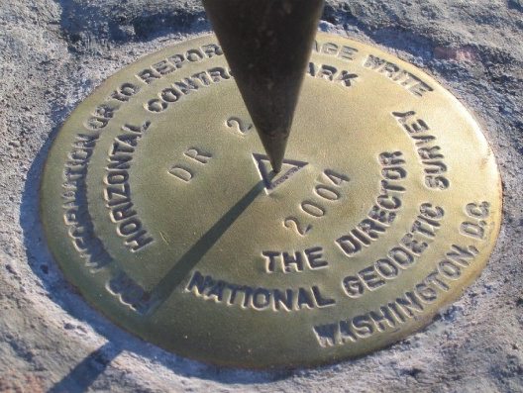
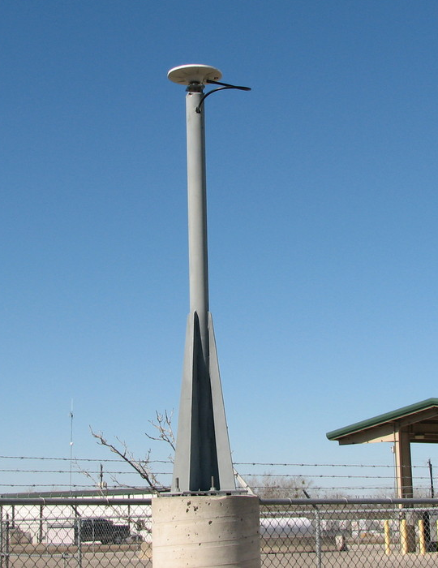
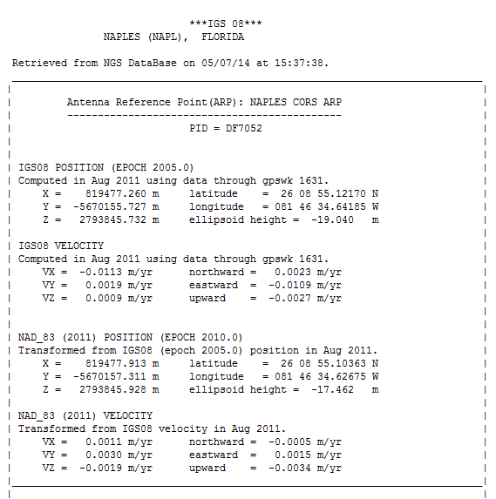
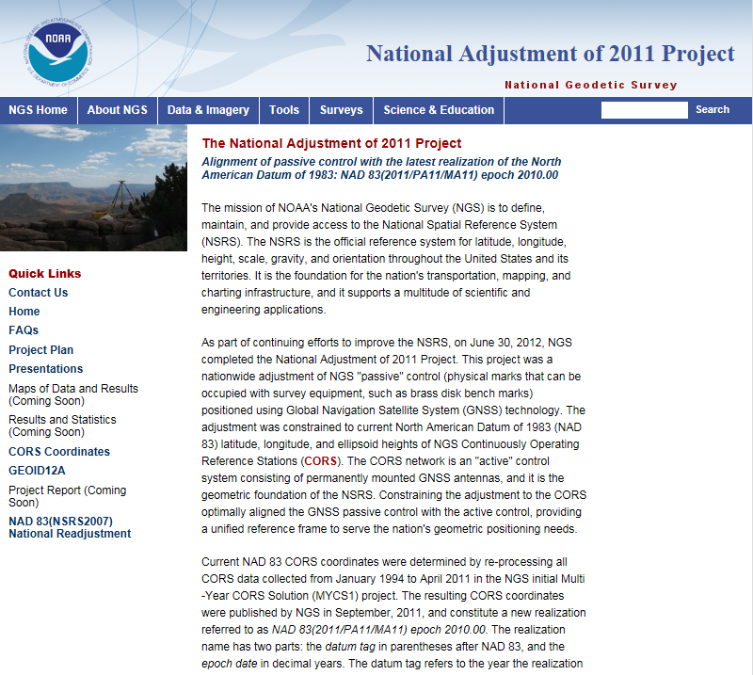
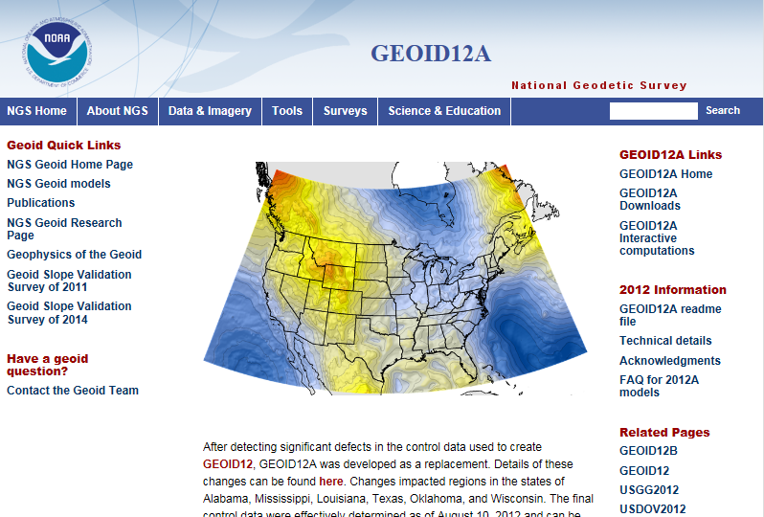
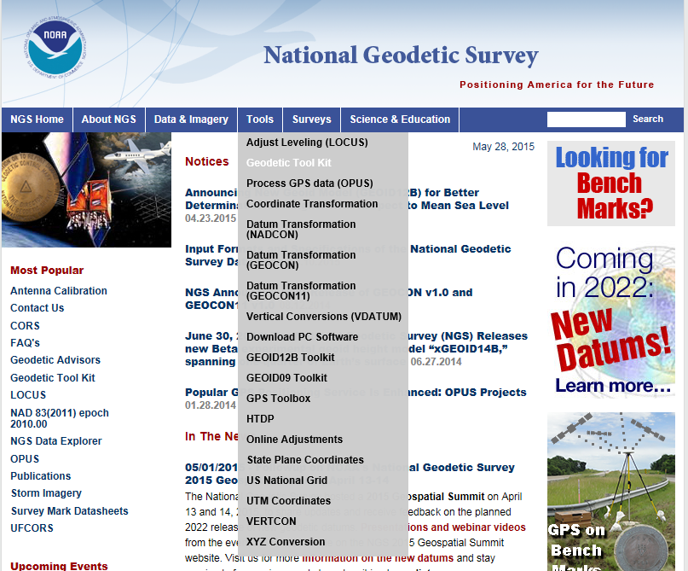
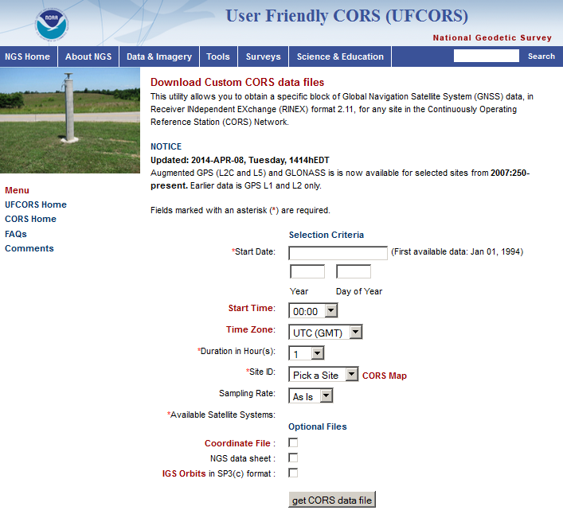
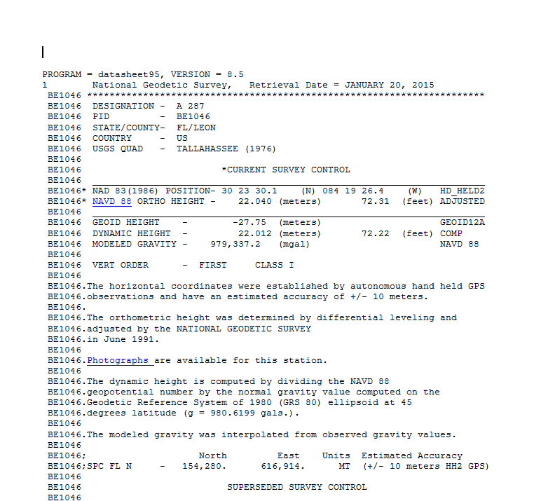

NGS MISSION - The NSRS
Define - National Coordinate Sys. (NSRS)
Maintain - the NSRS
Provide Access
Notes:
Define: explain how NSRS was developed through the passive network, status of passive network, and how NSRS now based on CORS network.
Maintain: determination of CORS positions and the changes to those positions, datum (ref. frame) updates (ex. NAD (2011), updated hybrid geoid models, programs and tools for transformations, inverses, on-line vertical leveling adjustments, Geodetic Tool kit.
Access: provide access to the NSRS through CORS static data, control mark datasheets, and the suite of OPUS products.

Slide 5
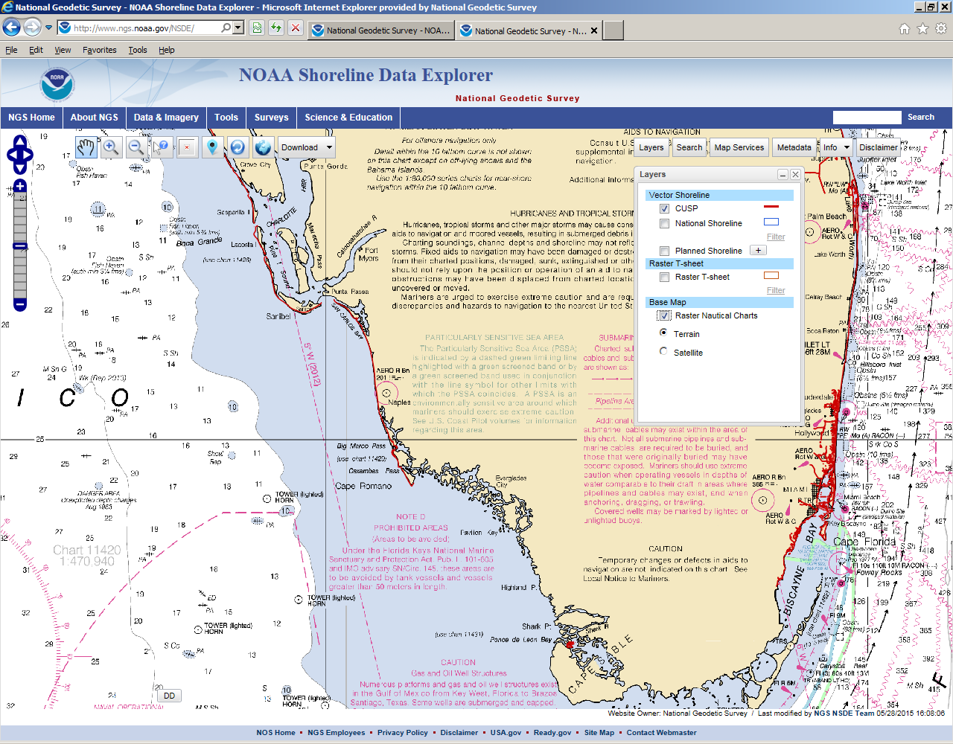

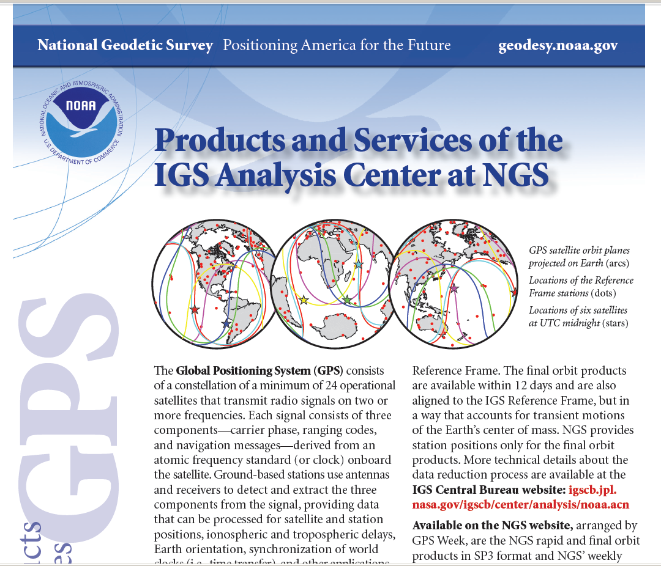
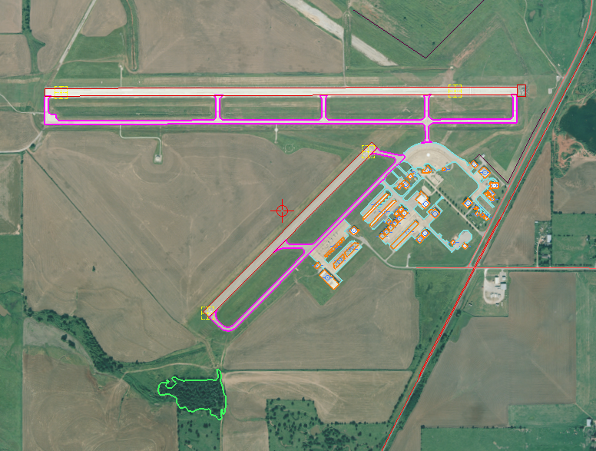
More NGS MISSION and Products
Notes:
NGS is also mandated to define the National Shoreline.
Product & Services Outreach: Presentation library, publications, videos, webinars, Corbin Training Center, participate in production of GNSS orbits, aeronautical surveys, emergency response imagery, etc.

Slide 6

























Federal Users of the NSRS
Notes:
Many of these users also sit on the Federal Geodetic Control Subcommittee, so there is a feedback loop between the providers of geodetic control (NGS) and the users of that control.

Slide 7
GEODETIC DATUMS
  VERTICAL
  1 D (Orthometric Height) (e.g. NGVD 29, NAVD 88, Tidal)
  HORIZONTAL
  2 D (Latitude and Longitude) (e.g. NAD 27, NAD 83 (1986))
  GEOMETRIC
  3 D (Latitude, Longitude and Ellipsoid Height)
  Fixed and Stable - Coordinates seldom change
  (e.g. NAD 83 (1994), NAD 83 (2007), NAD83 (2011))
  also
  4 D (Latitude, Longitude, Ellipsoid Height, Velocities) Coordinates change with time
  (e.g. ITRF00, ITRF05, ITRF08)

Slide 8

The National Geodetic Survey 10 year plan
Mission, Vision and Strategy
2013 – 2023
http://www.ngs.noaa.gov/INFO/NGS10yearplan.pdf
Official NGS policy as of Jan 9, 2008
  (updated in 2013)
  Modernized agency
  Attention to accuracy
  Attention to time-changes
  Improved products and services
  Integration with other fed missions
2022 Targets:
  Replace NAD 83 and NAVD 88
  Cm-accuracy access to all coordinates
  Customer-focused agency
  Global scientific leadership

Slide 9
U.S. Horizontal Datums

Slide 10
Datums - Horizontal
Horizontal
North American Datum Of 1927
- Used early triangulation surveys (first called US Std Datum).
- Based at Meades Ranch, KS & used Clarke 1866 spheroid.
North American Datum of 1983 (1986)
- Used 250,000 points (triangulation, Doppler, a few GPS pts).
- Based at geocentric location using Geodetic Ref. Sys. 1980.
Updates*
NAD83 (1990’s) – State HARN / FBN surveys.
NAD83 (late 90’s – early 2000’s) – Efforts to establish ellipsoid heights.
NAD83 (2007) – Remove regional distortions, better with align CORS.
NAD83 (2011) – Adjustment to realign CORS / passive control.
* Not a new datums

Slide 11

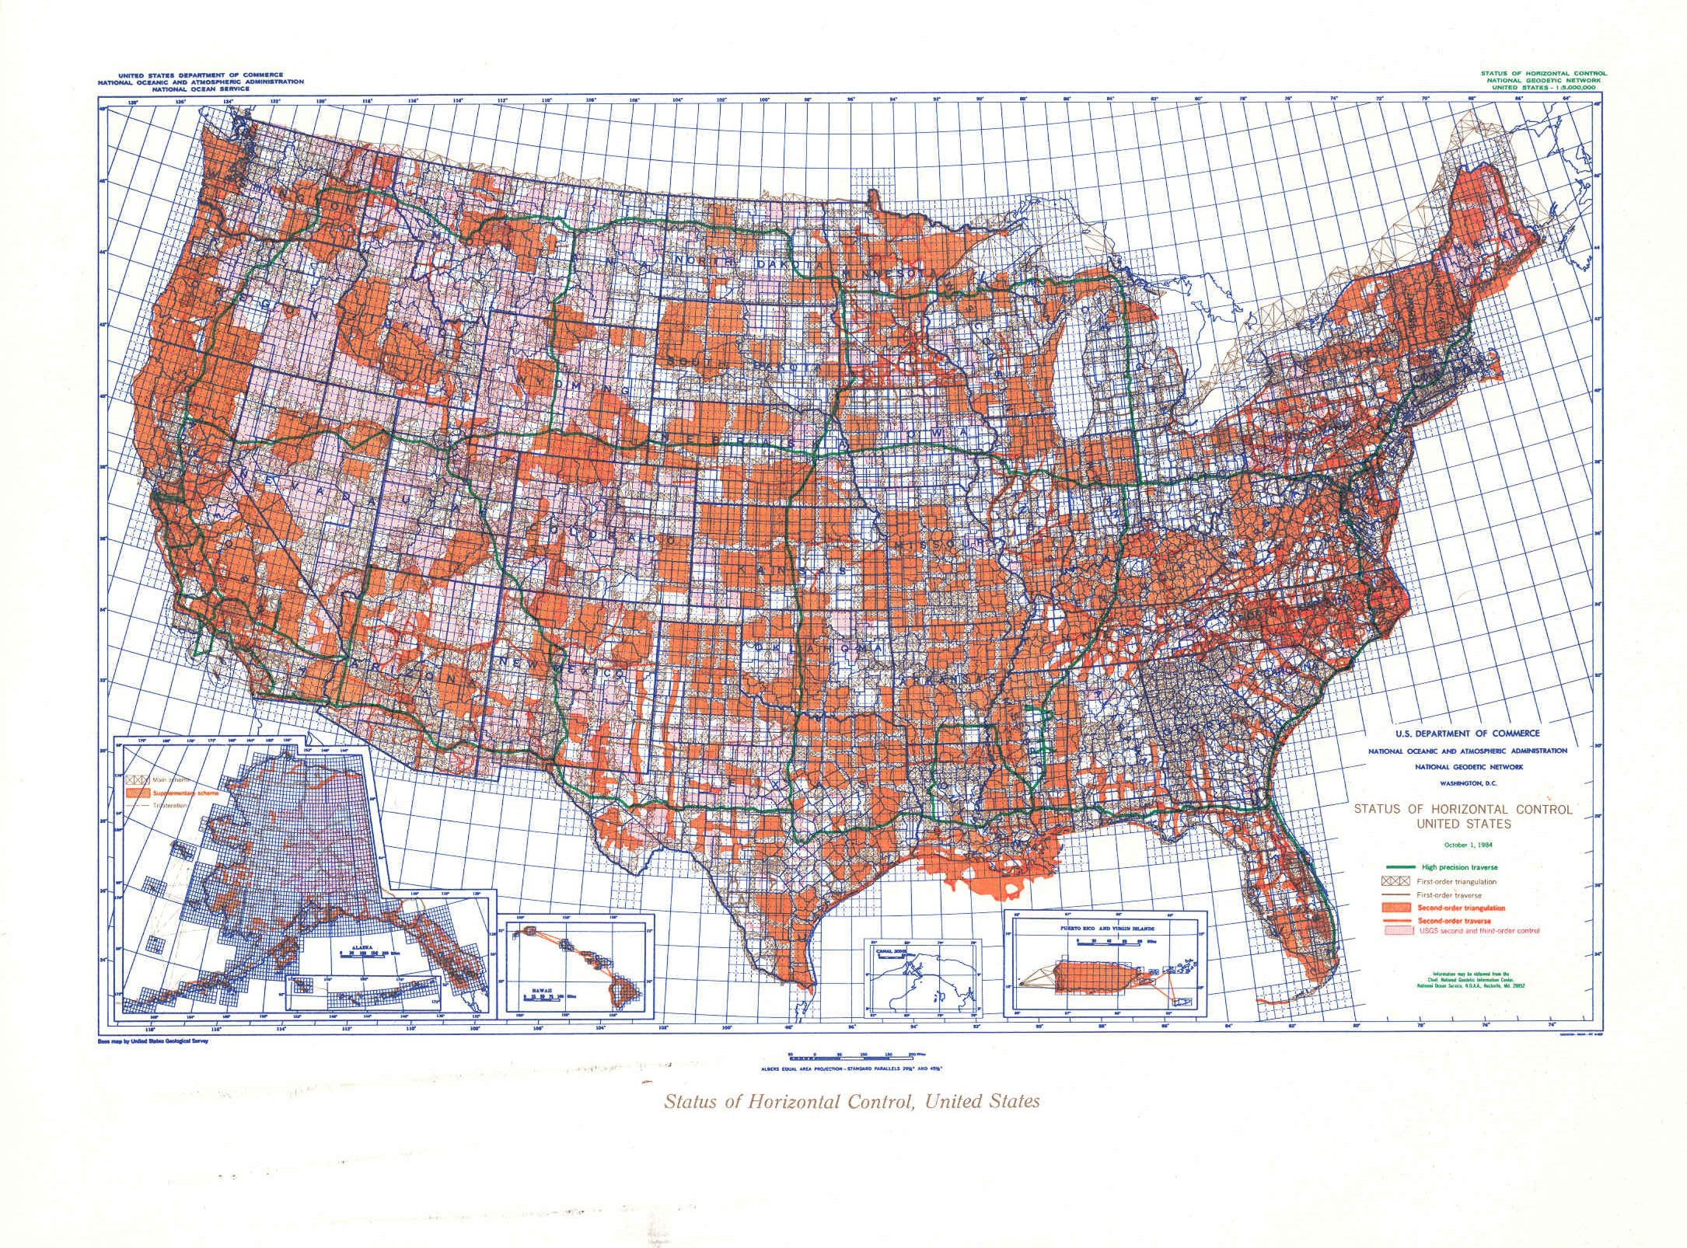
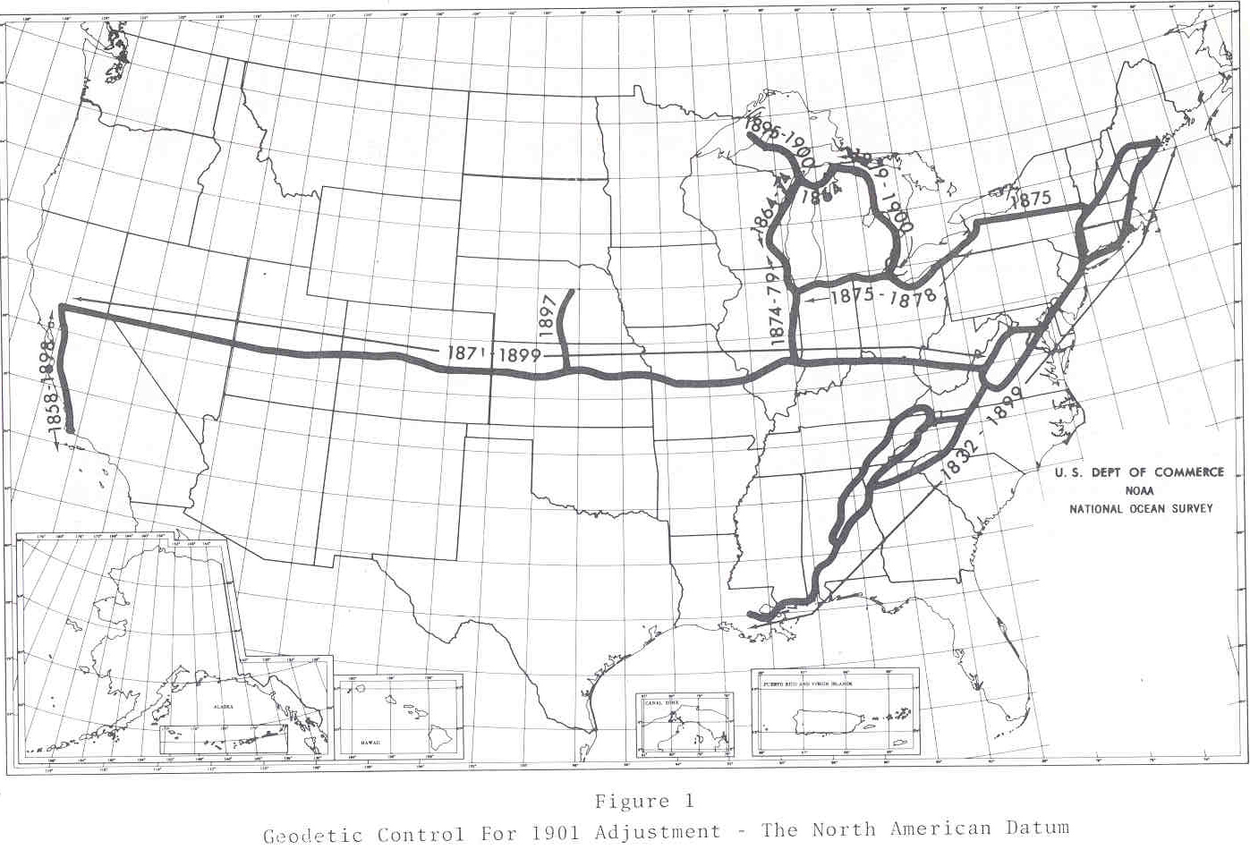
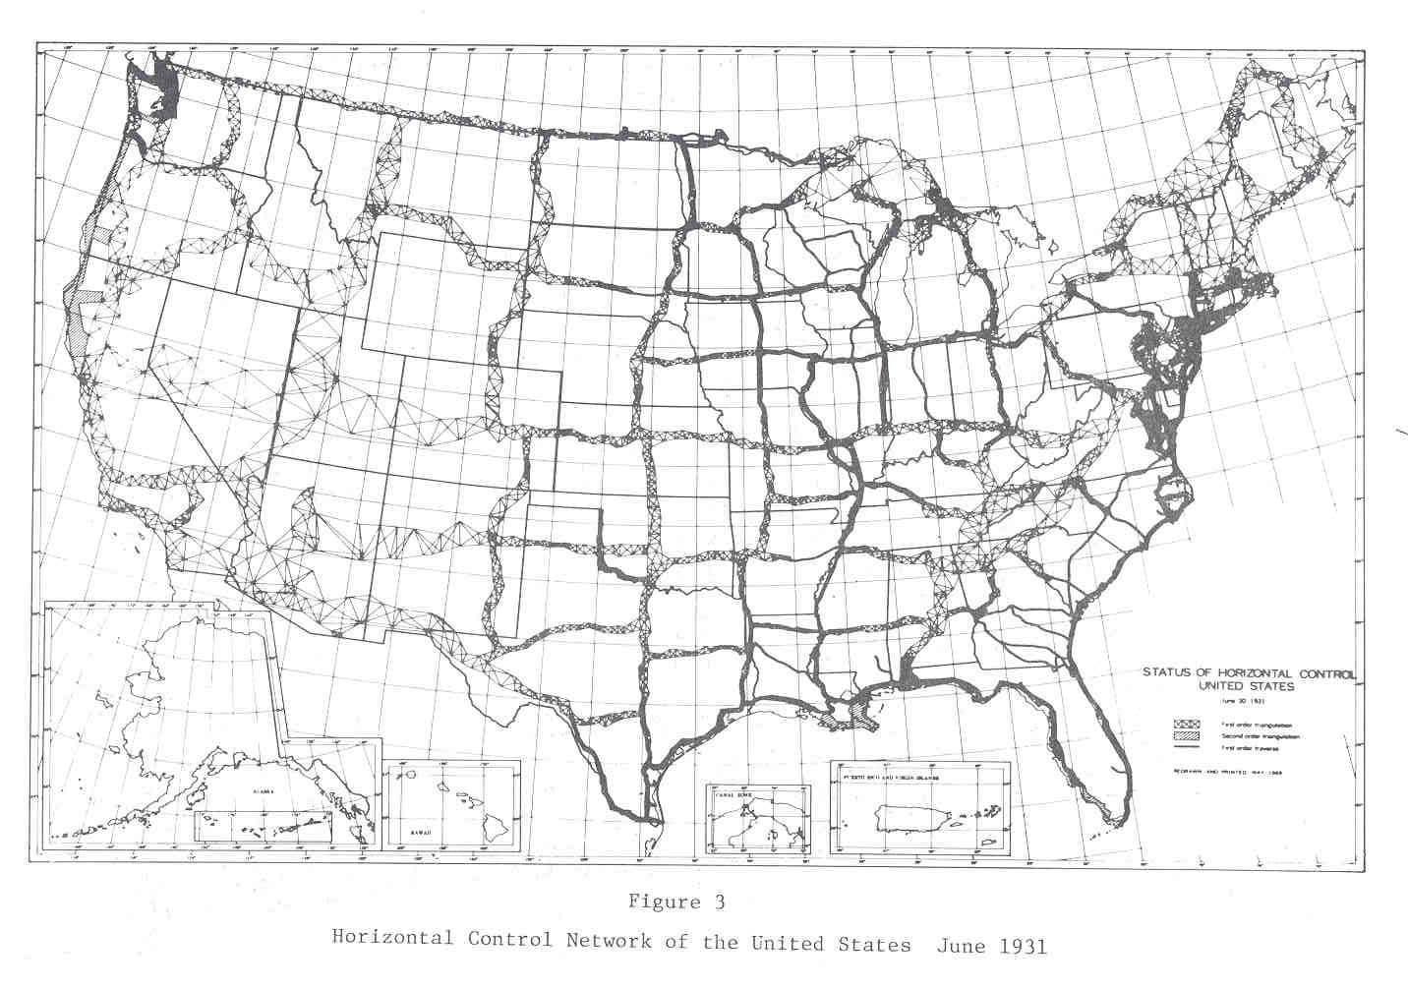
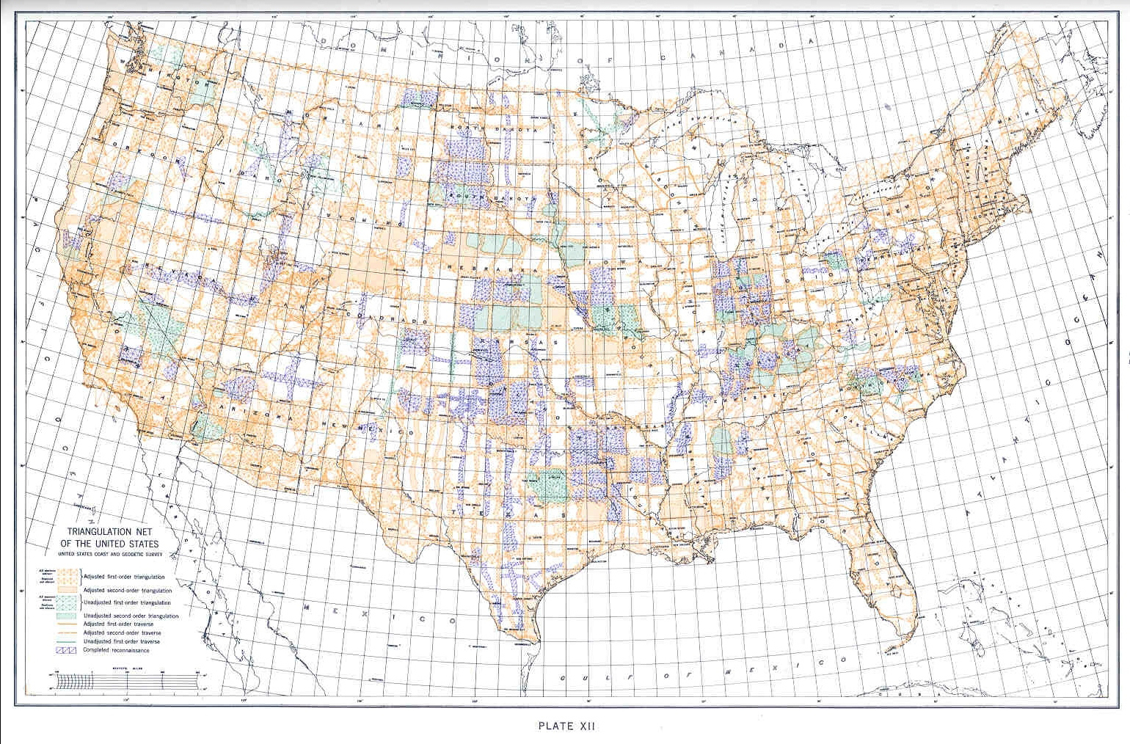

Slide 12
National Spatial Reference System(NSRS)
Improvements in the Horizontal Datums
TIME NETWORK LOCAL
NETWORK SPAN ACCURACY ACCURACY
NAD 27 1927-1986 10 meter (1 part in 100,000)
NAD83(86) 1986-1990 1 meter (1 part in 100,000)
NAD83(199x)* 1990-2007 0.1 meter B-order (1 part in 1 million)
HARN A-order (1 part in 10 million)
NAD83(NSRS2007) 2007 - 2011 0.01 meter 0.01 meter
(CORS)
NAD83(NSRS2011) 2011 - 2022 0.01 meter 0.01 meter
(CORS)

Slide 13
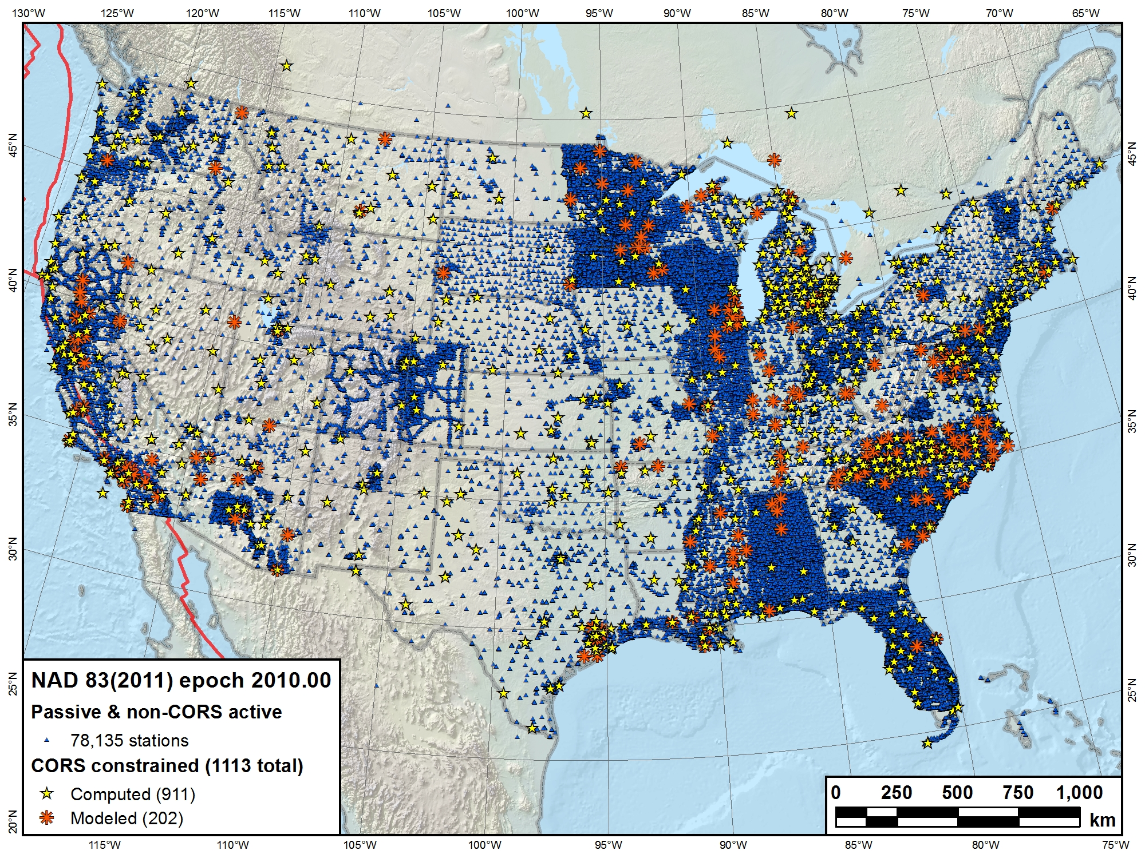

Slide 14
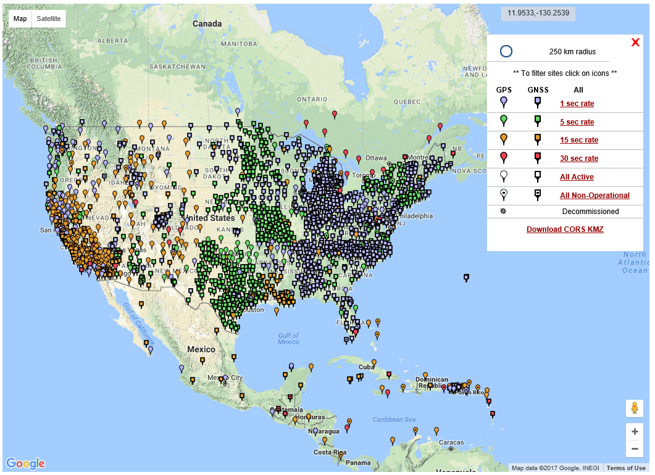
NGS Published CORS

Slide 15
Why Replace NAD83?
NAD83 is NON-geocentric & hence inconsistent w/GNSS
Difficult to maintain consistency between CORS & passive networks
NAD 83 does not track/report passive mark motion
Lack of monumentation stability / permanency
Necessary for agreement with future ubiquitous positioning capability

Slide 16
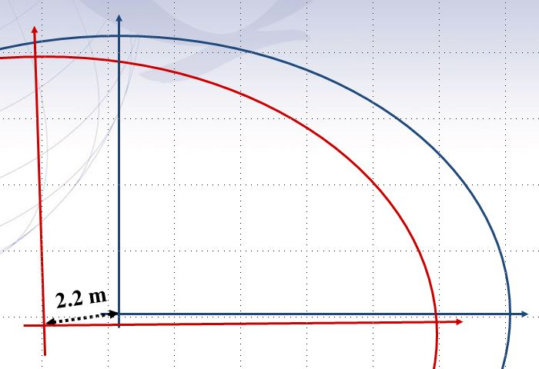

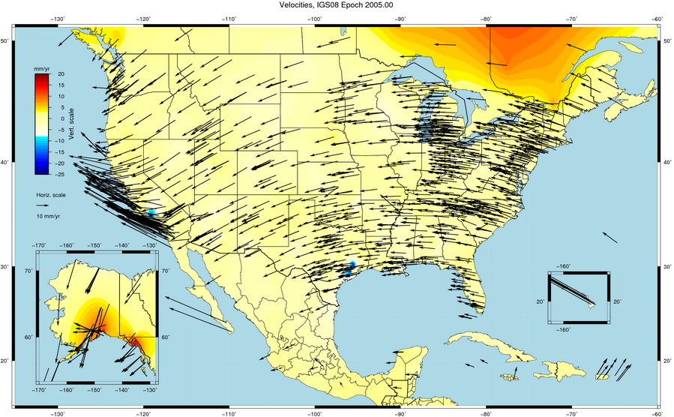
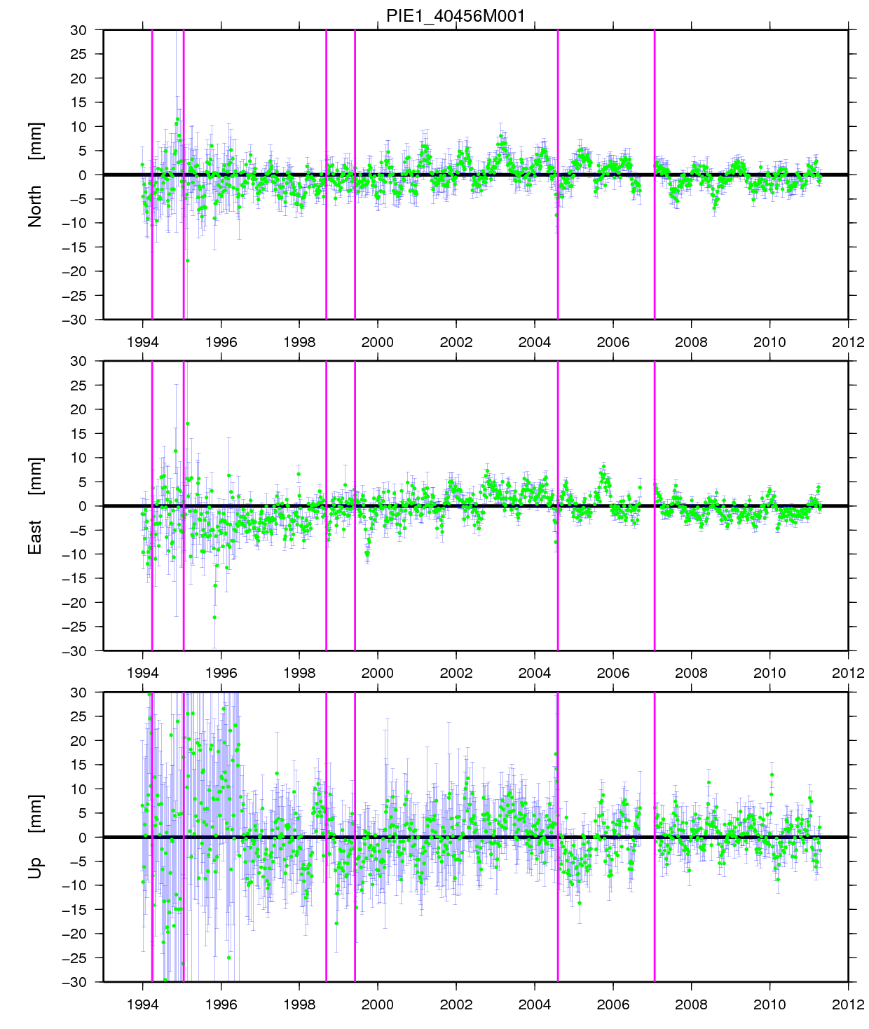
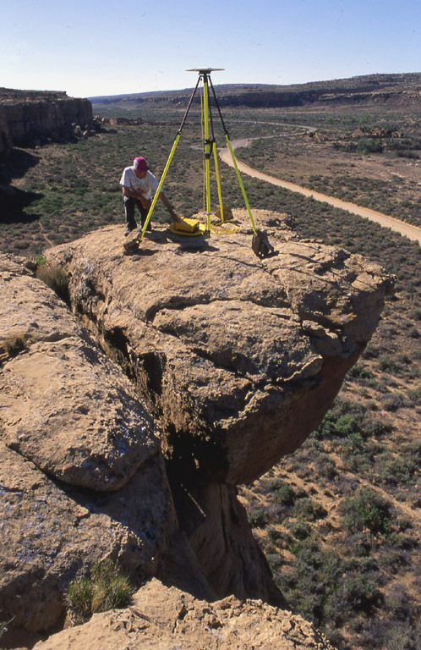
North American Datum 1983 (NAD83) Shortcomings
Inconsistency of NAD83 vs.
- International Terrestrial Reference Frame
[ITRF08]
- World Geodetic System 1984
[WGS84 (G1762)]
CORS & passive network inconsistency / challenges
ITRF08/WGS84
NAD83
vs.

Slide 17
Future Geometric (3-D) Reference Frame
Replace NAD83 with new geometric reference frame – by 2022
CORS-based, accessed via GNSS observations
Coordinates & velocities in ITRF & new US reference frame
Passive control tied to new reference frame (not a component)
Transformation tools will relate NAD83 to new US
reference frame ( NADCON / GEOCON / GEOCON11 / ….. )

Slide 18
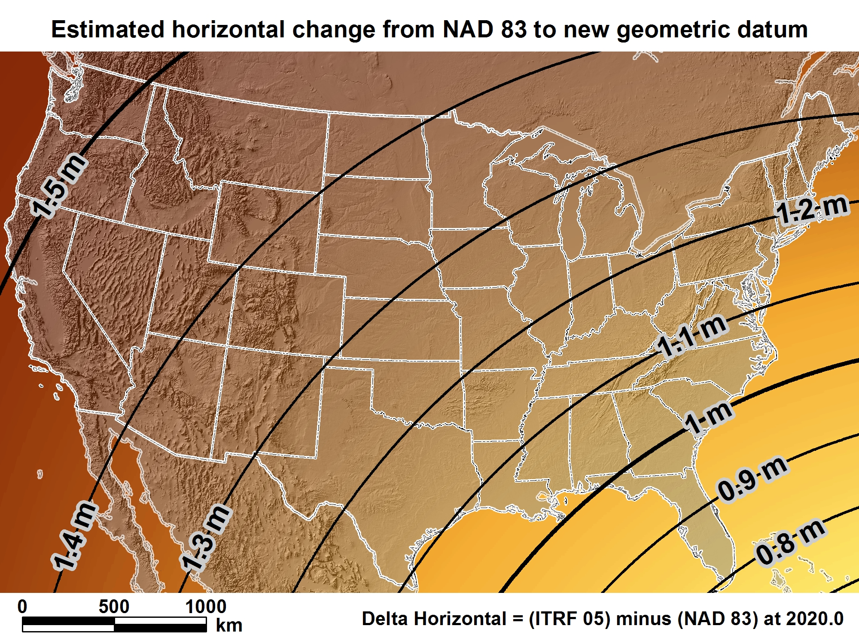
New geometric datum minus NAD 83 (horizontal)

Slide 19
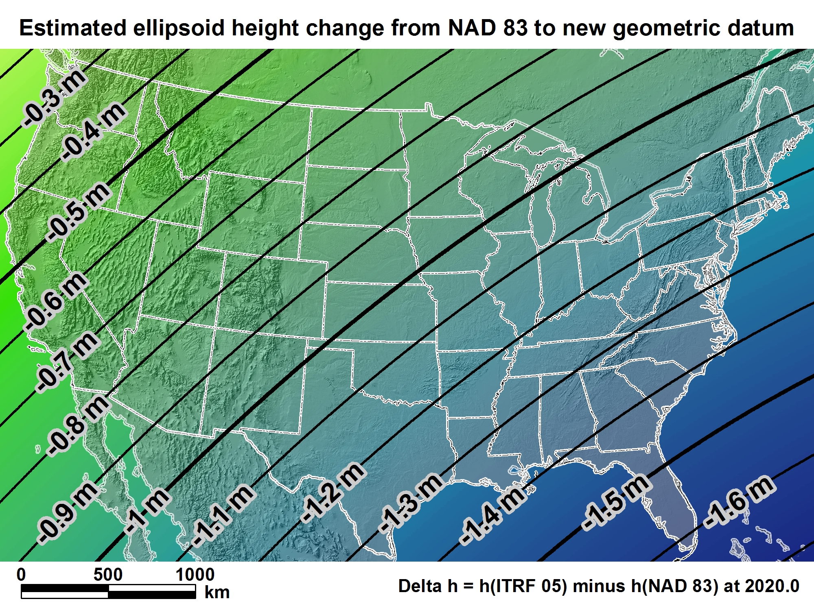
New geometric datum minus NAD 83
(ellipsoid height)

Slide 20
U.S. Vertical Datums

Slide 21
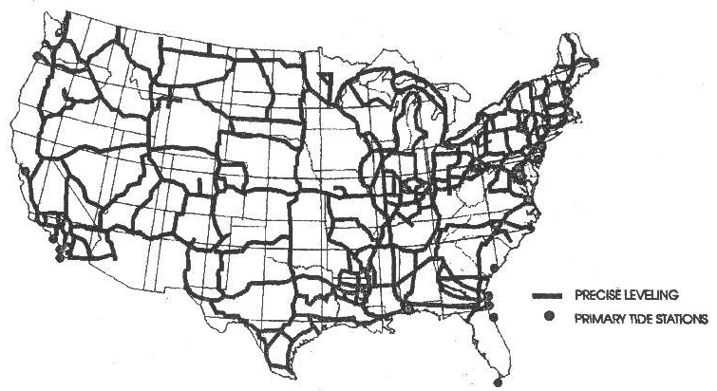
VERTICAL CONTROL USED FOR NGVD 1929 DATUM

Slide 22
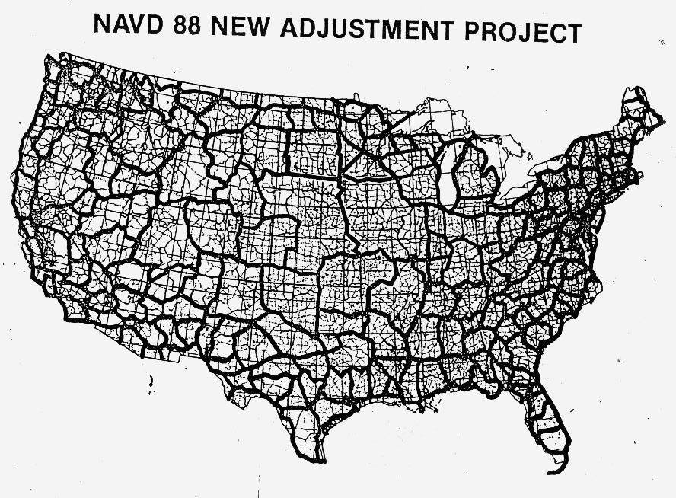

Slide 23
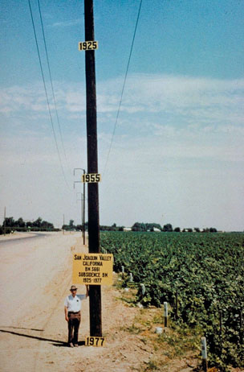
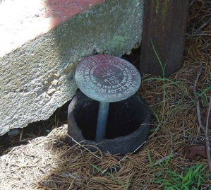
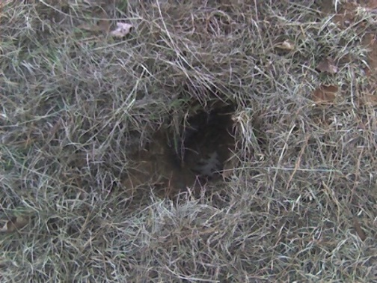
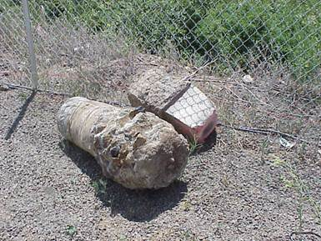
Why isn’t NAVD 88 good enough anymore?
NAVD 88 suffers from use of bench marks that:
  Are almost never re-checked for movement
  Disappear by the thousands every year
  Are not funded for replacement
  Are not necessarily in convenient places
  Don’t exist in most of Alaska
  Weren’t adopted in Canada
  Were determined by leveling from a single point, allowing cross-country error build up

Slide 24
Can NAVD 88 be fixed?
Long term fix: Re-level some/all of NAVD 88
  81,500 km of 1st order leveling at least
  625,000 km of mixed 1st and 2nd order leveling
Re-leveling NAVD 88 estimated to cost between
  $200 Million and $2 Billion
Time factor in that amount of leveling
Still would have problems related to passive control
Notes:
Re-leveling NAVD 88 won’t fix:
Sparseness of the bench marks
Continued subsidence or uplift of bench marks
Destruction of bench marks
Canada’s decision not to adopt NAVD 88
Whatever errors caused a continent-wide 1 meter build up in the leveling the first time around

Slide 25
NEW VERTICAL DATUM (Rationale)
  A move away from differentially leveled passive control as the defining mechanism of the reference surface
  To be consistent with the shift in the geometric reference frame/ellipsoid (2022)
  Improvement in our technical abilities in reference surface realization (geopotential gravimetric reference surface - 1cm accuracy of the geoid (GNSS/GRAV-D))
  Goal - ability to establish 2cm orthometric height anywhere in U.S. using a minimum of 15 min. of GNSS data.
  The new geopotential reference surface will be aligned with the geometric reference frame/ellipsoid (i.e., no hybrid geoid)

Slide 26
Can NAVD 88 be fixed?
Best long term fix:
Replace NAVD 88 with a 1cm vertically accurate geopotential reference frame (surface)……..but how?
First, let’s talk a little bit about geoids.

Slide 27
Definitions: GEOIDS vs GEOID HEIGHTS
GEOID - “The equipotential surface of the Earth’s gravity field which best fits, in the least squares sense, (global) mean sea level.”*
Can’t see the surface or measure it directly.
Can be modeled from gravity data as they are mathematically related.
Note that the geoid is a vertical datum surface
A geoid height is the height from an ellipsoidal datum to a geoid.
Hence, geoid height models are directly tied to the geoid and ellipsoid that define them (i.e., geoid height models are not interchangeable).
*Definition from the Geodetic Glossary, September 1986
Notes:
-What does equipotential surface mean?
-If we could see or measure the geoid, this could be our vertical datum.
-It may be in the future, and we must plan for a transition.
-For now, we are dependent on leveling observations on the surface to create our datum.
-The leveling datum may or may not be a true equipotential surface (i.e., NAVD 88 =/ true geoid).
-use the geoid height models to transform between the ellipsoidal and vertical datums.

Slide 28
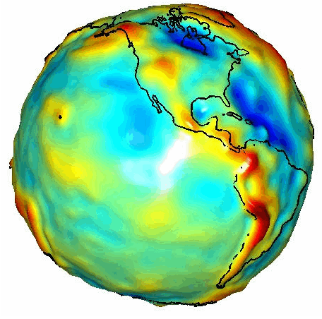
  Why do we need Geoid Models?
The geoid surface is mathematically related to gravity
Understanding the gravity field is important because it:
  impacts survey measurements
  dictates the direction water flows
  improves development of natural resources (iron ore, oil, water, etc.)
Geoid models allow us to relate different kinds of heights
GRACE Satellite Gravity
Notes:
Why do we care about geoid models?

Slide 29
Measuring and relating different kinds of heights
Ellipsoid heights
  Inherent to GNSS measurements
  Need accurate ellipsoid height control
  Better field procedures = better heights
Orthometric heights
  Measure by leveling surveys
  Most accurate but most expensive
  Difficult to maintain over time, esp. on national scale
Geoid heights
  Derived from model developed from gravity observations
  Can provide relationship between e.h. and o.h.
Notes:
Ellipsoid height - height of ground referenced to the ellipsoid
Orthometric height – distance of the ground from geoid (along plumb line)
Geoid height – distance between ellipsoid and geoid (perpendicular to ellipsoid)

Slide 30
The ellipsoid, the geoid, and you
Deflection of the vertical
You are here
Earth surface
Ellipsoid height, h
Orthometric height, H
Mean
sea level
Geoid height, N_{G}
Ellipsoid
Geoid
h = H + N_{G}
Note: Geoid height is negative everywhere in the coterminous US

Slide 31

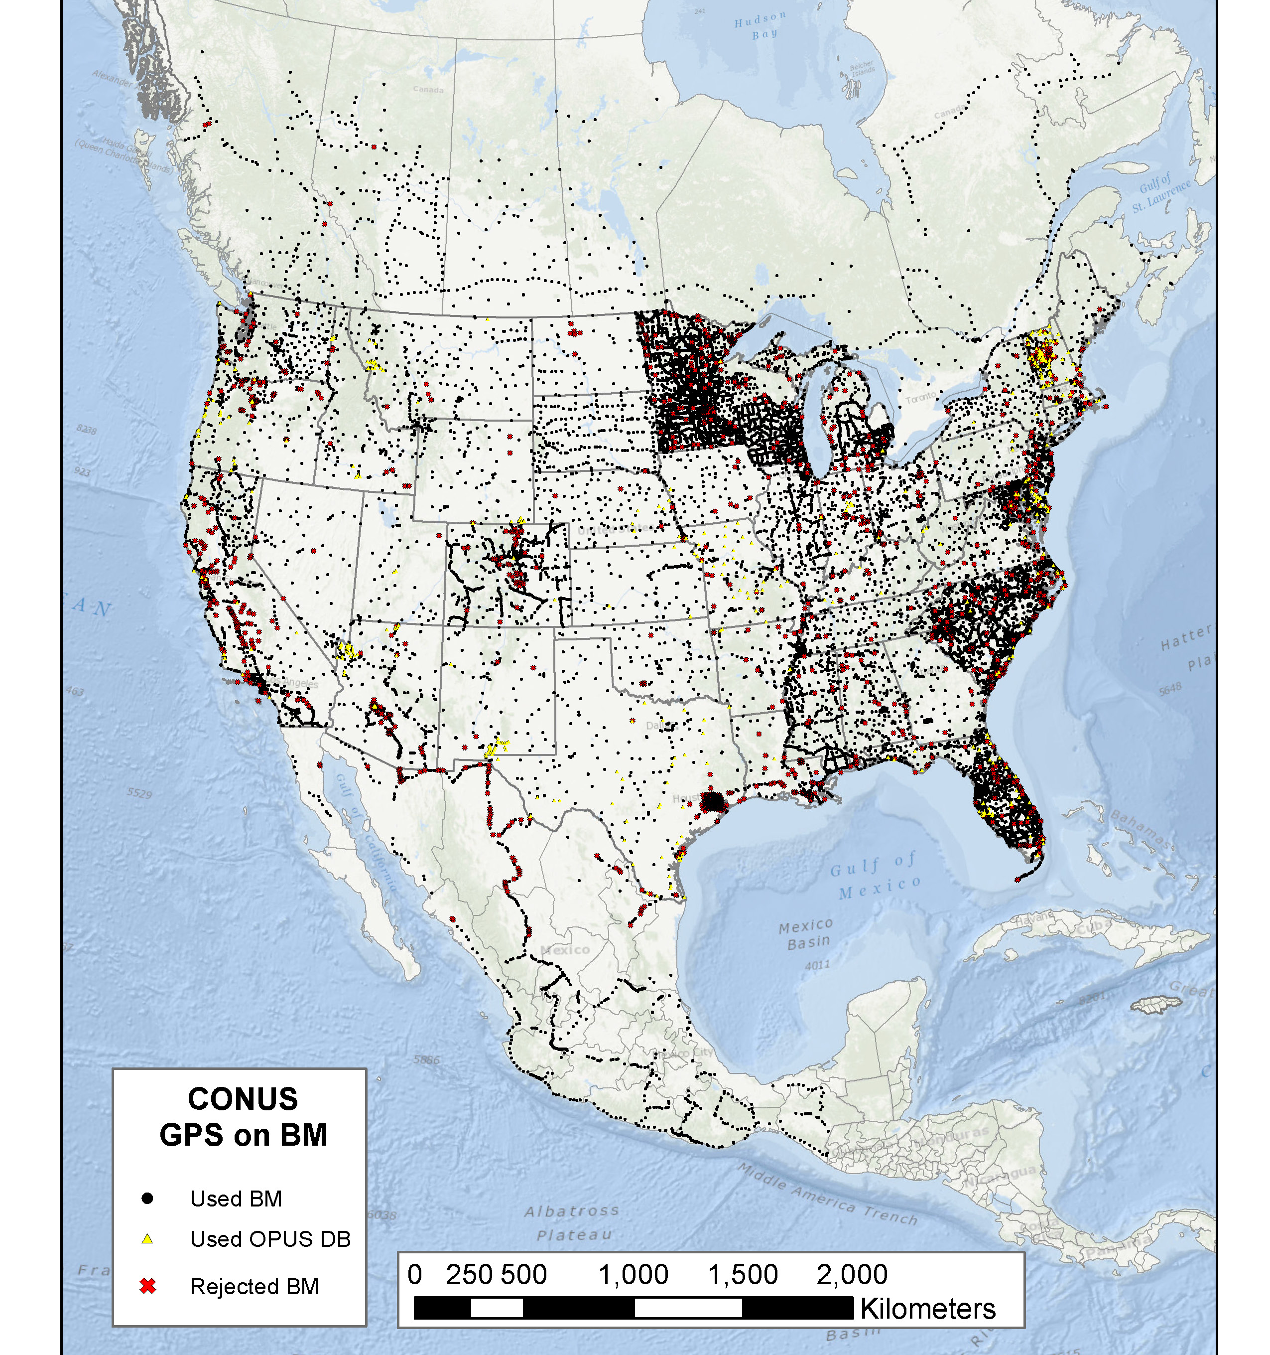
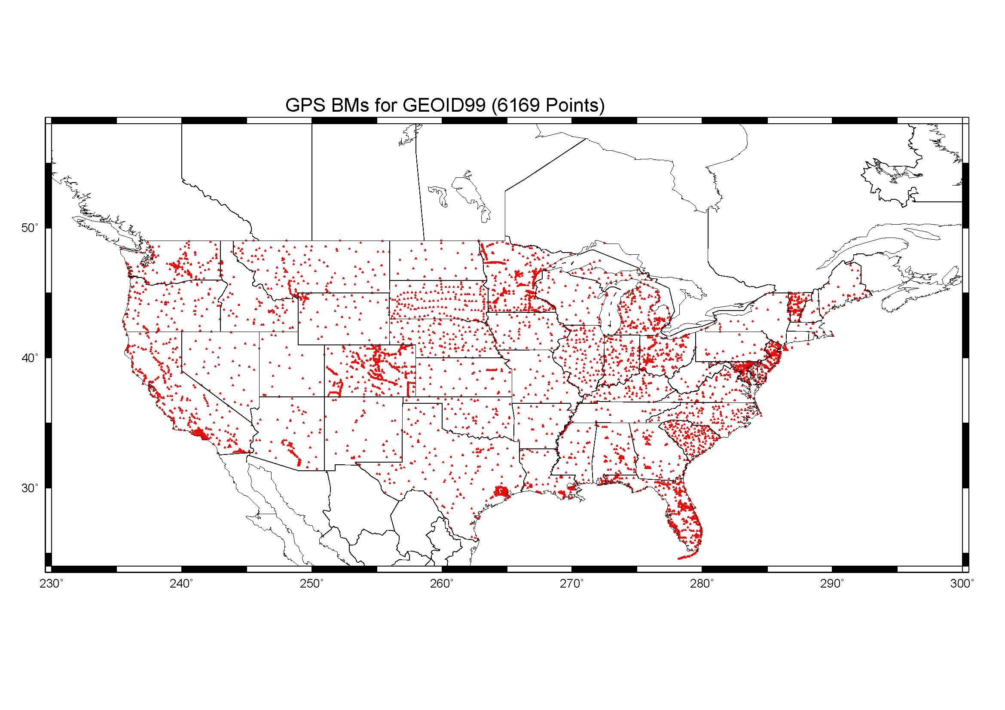
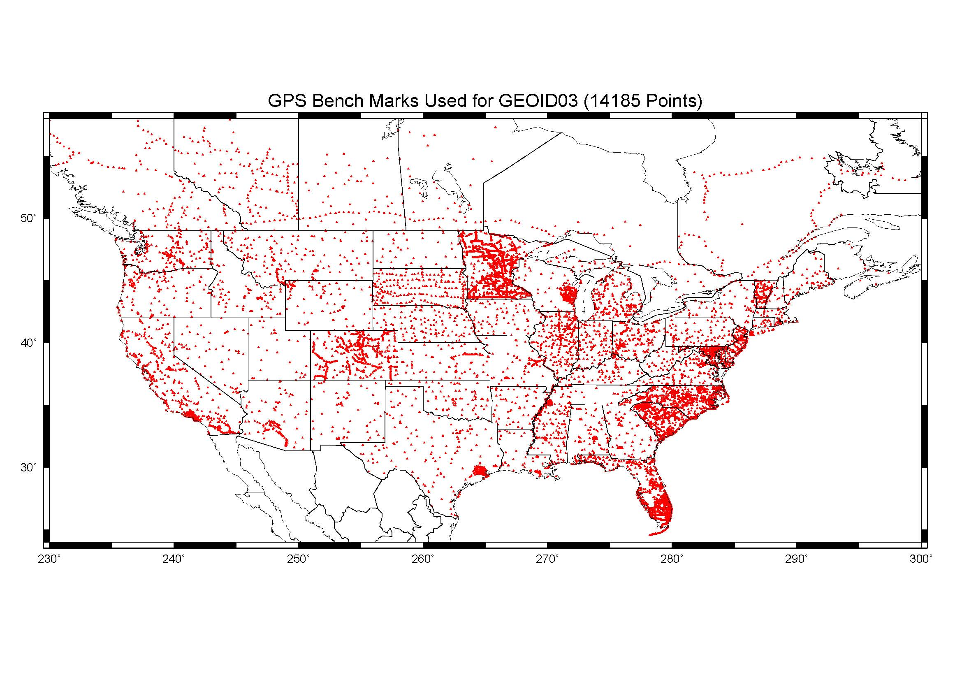
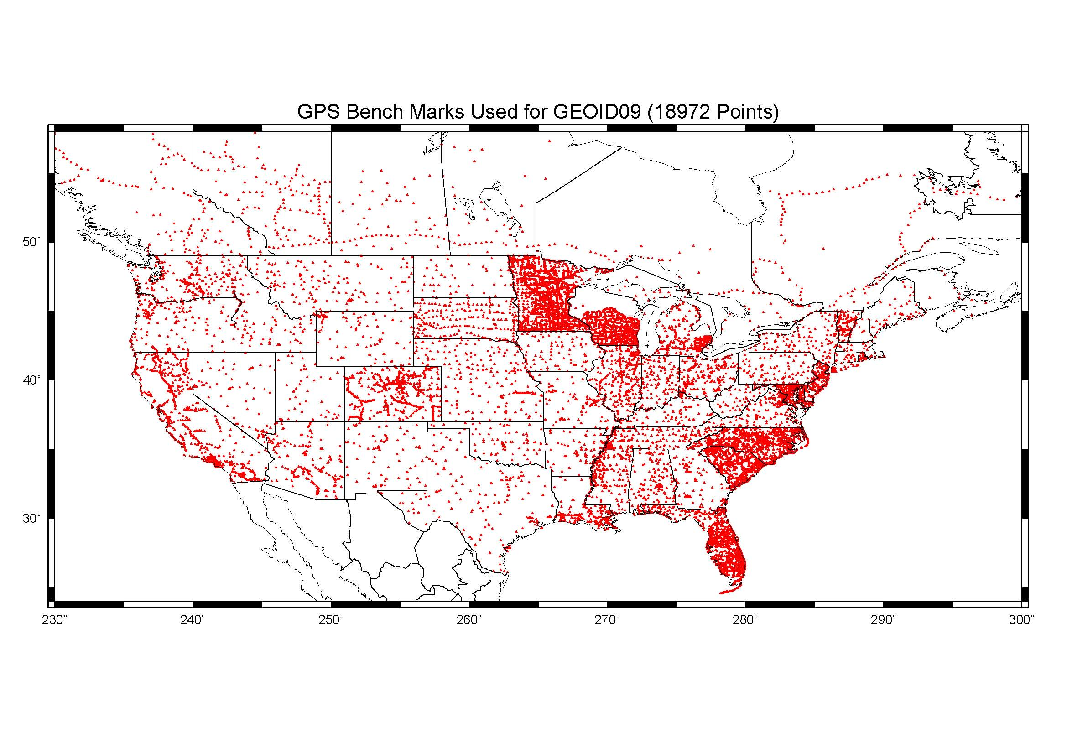
GPS Bench Marks used for Geoid 12B (23,961)
GPSBM1999: 6,169 total 0 Canada STDEV 9.2 cm (2σ) GPSBM2003: 14,185 total 579 Canada STDEV 4.8 cm (2σ) GPSBM2009: 18,291 total 576 Canada STDEV 2.8 cm (2σ)
Notes:
GPSBM for G12A = 23,961 used.
These are the control data used to make GEOID99, GEOID03 and GEOID09 (GPS on bench marks: GPSBM’s).
Improvements in Distribution are primarily due to obtaining data in Canada.
The bulk of the increase comes in one state: Minnesota (603 => 4161).
Note the inequitable distribution.
You could practically grid the GPSBM’s in South Carolina or Minnesota and get a good result.
Other places are not so fortunate…
Also note that this shows distribution but not quality of the points.
Some regions (e.g., Texas) have systematic quality problems (due to subsidence) that impact the GPSBM’s and the derived hybrid geoids.
Current techniques rely on creating models of the systematic effects at multiple wavelengths. If the spatial density doesn’t support the shorter wavelength models, then the quality of predictions will commensurately be reduced.
Note that a hyper-dense survey isn’t necessary to achieve optimal results. Later discussion on Minnesota will emphasize this.

Slide 32
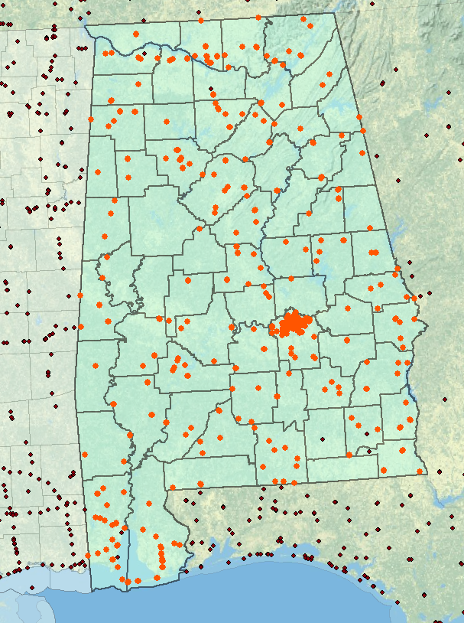
AL GPSBM Marks for Geoid 12B (415)

Slide 33
Which Geoid for Which NAD 83?
NAD 83(2011) --- Geoid12B
NAD 83(2007) --- Geoid09
NAD 83(19xx) --- Geoid03
--- Geoid99
--- Geoid96

Slide 34
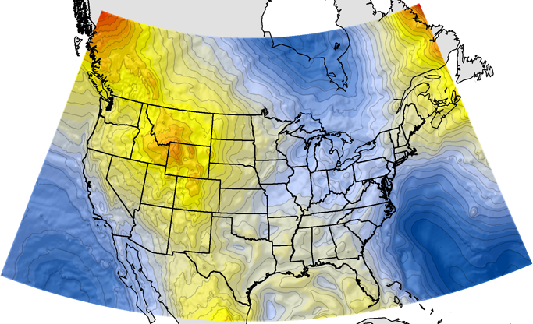
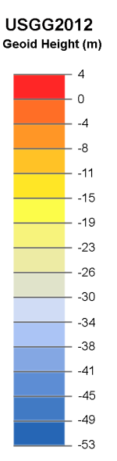
Current and Best NGS Geoid: USGG2012
GRACE + 2 yrs of GOCE + other satellite data
+ World Gravity Model (EGM2008)
+ Estimated Gravity from Topography
+ Around Two Million Surface Gravity Points
But even this isn’t good enough for a 1-2 cm accuracy vertical reference surface

Slide 35
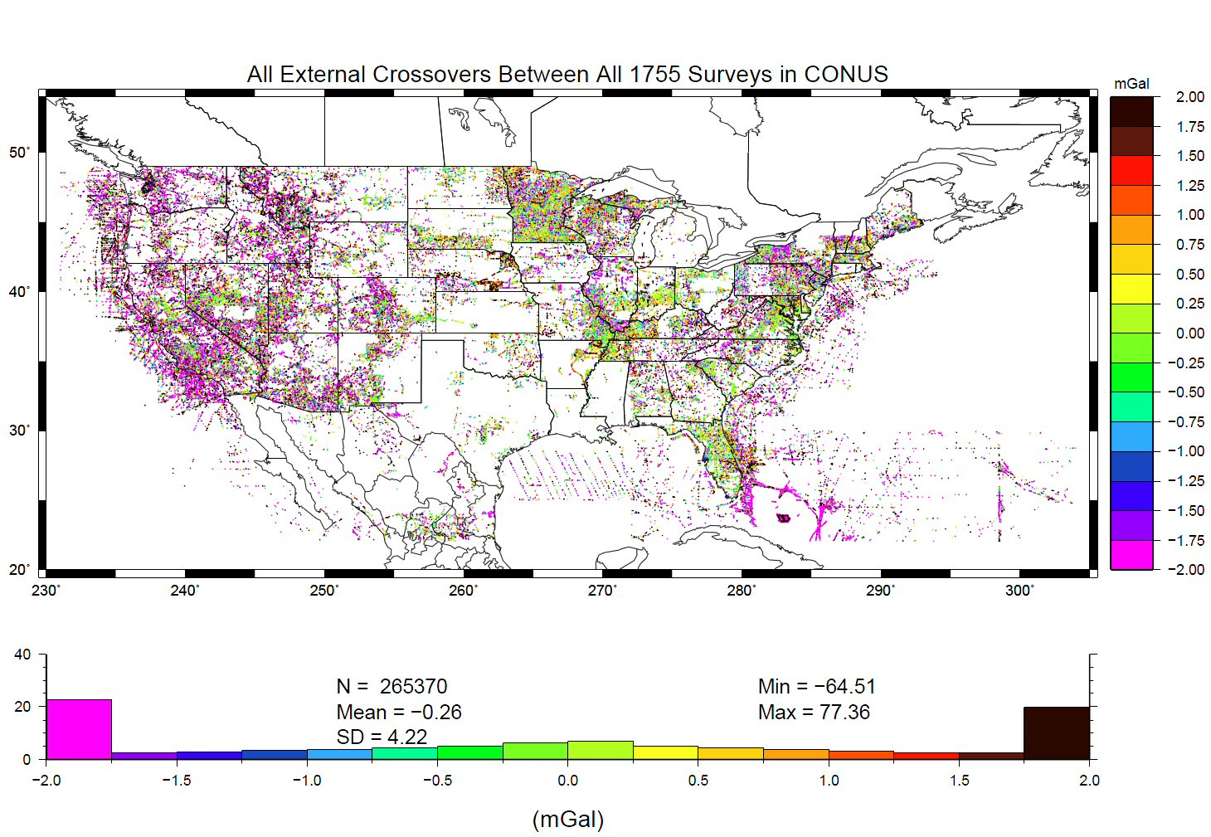
Problems with Gravity Holdings
Decades of gravity surveys are inconsistent with one another (1755 surveys)
Airborne gravity will provide a baseline for removing these inconsistencies…
… as well as “filling in” information between the resolutions of satellite and ground data.
%
Notes:
This slide shows “crossovers” between any of the 1755 terrestrial gravity surveys which NGS holds in its database. These are
basically mismatches between surveys that overlap one another, plotted at the point of overlap. Note that the color bar
is +/- 2 mGals, and how many surveys disagree with one another at that level. GRAV-D flights should yield about 2 mGal
accuracy surveys, and help reduce the level of disagreement to that range.
The vertical axis of the lower plot is “Percent of points with this level of crossover error” So while it is bell-shaped around -0.26 mGals, the “wings” at the >+2 or <-2 range contain a good 45-50% of all crossovers.
Added October 2010.

Slide 36
Can NAVD 88 be fixed?
Best long term fix: Replace NAVD 88 with geopotential reference frame
  GRAV-D: Gravity for the Redefinition of the American Vertical Datum
  GRAV-D will:
    define the datum as a given geoid model
    realize it through GNSS technology
    spanning at least the United States and its territories
    datum will be tracked (maintained) over time
Notes:
Why is this the best option? Because it addresses:
Different datums existing for CONUS, Hawaii, PR/VI (and, theoretically, Canada, Mexico, and the Caribbean and Central American countries)
Sparseness of bench marks
Error build up as one gets far from an origin point
Financial and personnel realities
Fragility of bench mark network

Slide 37
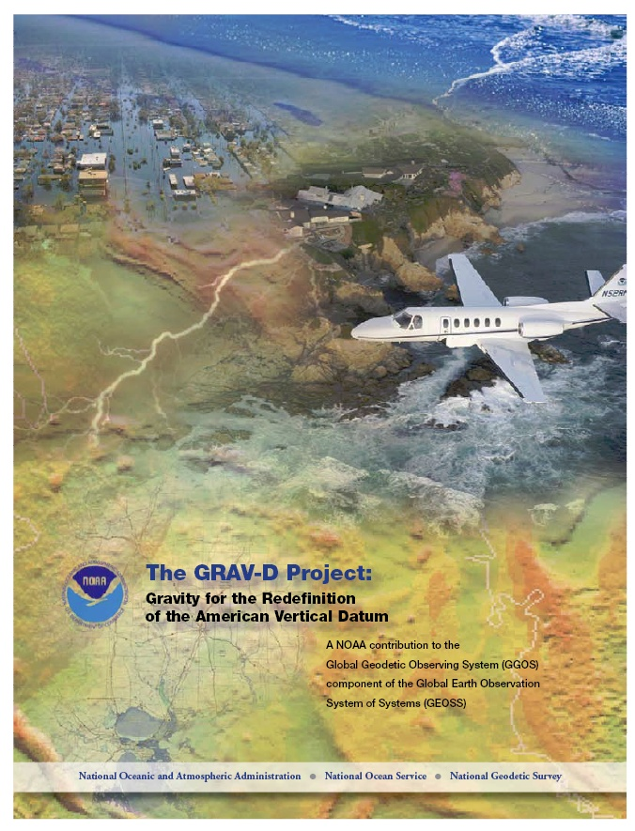
Gravity for the Redefinition of the American Vertical Datum (GRAV-D)
Replace the Vertical Datum of the USA by 2022 (at today’s funding)
GRAV-D is:
  An airborne gravity survey of the entire country and its holdings
  A 2022 gravimetric geoid accurate to 1 cm
  Long-term monitoring of geoid change over time
  Partnership surveys
Working to launch a collaborative effort with the USGS for simultaneous magnetic measurement
Acting Manager: Monica Youngman
Monica.Youngman@noaa.gov
Gravity and Heights are
inseparably connected
Notes:
GRAV-D is the NGS project designed to replace NAVD88 with a vertical datum based upon a gravimetric geoid accurate to 1 cm. Heights above this datum will be accessed via GNSS measurements. Three thrusts of project. Launch USGS collaboration for simultaneous mag measurement.

Slide 38
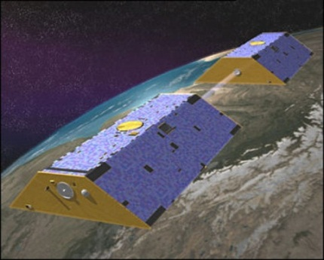
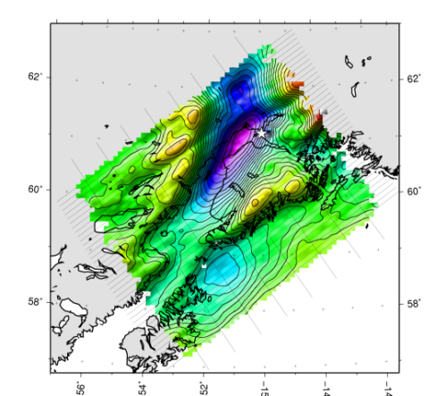

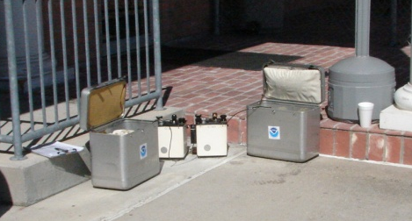
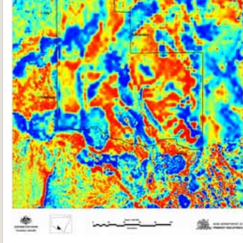
Building a Gravity Field
Long Wavelengths
(≥ 250 km)
GRACE/GOCE/Satellite Altimetry
+
Intermediate Wavelengths
(500 km to 20 km)
Airborne Measurement
+
Short Wavelengths
(< 100 km)
Surface Measurement and
Predicted Gravity from Topography
Notes:
Give example of how short wavelength information is like low altitude aerial photos (1/2” pixel accuracy) in that it provides very accurate and detailed information. The long wavelength gravity can be likened to the old LANDSAT imagery (3 meter pixel accuracy) in that it was good over large areas, but didn’t give much detail for local areas. The intermediate wavelength gravity data gives us a connection between the two (the short and long), allowing the NGS gravity team to use all available gravity information in working toward the production of a 1 cm accurate gravitational surface.

Slide 39
Priority- Greatest Datum Need
Alaska
Puerto Rico/US Virgin Islands (PRVI)
Coastal US and Great Lakes
  Great Lakes
  Gulf of Mexico & FL
  Eastern Seaboard
  Western Seaboard
Hawaii and Pacific Islands
Aleutian Islands
Interior CONUS
  Mountainous areas first

Slide 40
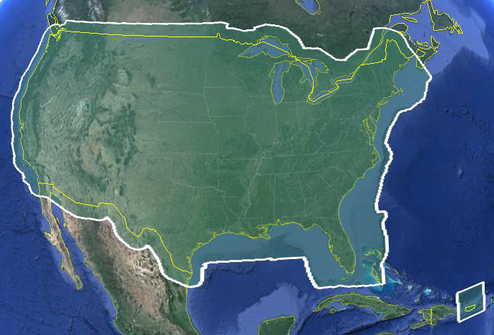
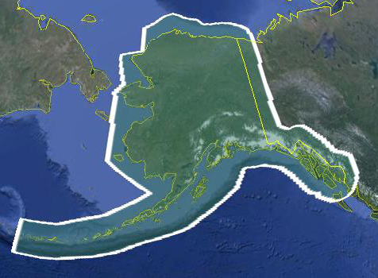
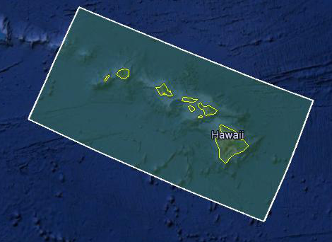
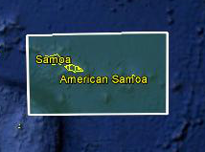
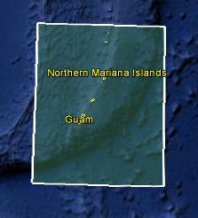
Data Collection Scope
Entire U.S. and territories
  Total Square Kilometers: 15.6 million
  ~200 km buffer around territory or shelf break if possible
  Initial target area for 2022 deadline
Notes:
Project Scope:
Scope of the project: cover roughly 15.6 million square kilometers – contiguous united states, Alaska, Hawaii, Guam, and American Samoa
In order to blend with satellite altimetry data the airborne survey is done to the continental shelf where possible or ~ 200 km beyond the shoreline or border, whichever is further
Deadline of 2022 for datum rollout, which means a target of 2021 to finish the airborne survey
Priority areas were defined as Alaska and coastal areas
Challenges:
Fixed annual budget and time → design of surveys had to fit within an annual budget of $3.5 million and meet the deadline
This was a major factor in setting altitude and line spacing

Slide 41
Performance Metric
For Airborne Surveys
FY09 Baseline | Targets vs Actual
 | FY10 | FY11 | FY12 | FY13 | FY14 | FY15 | FY16 | FY17 | FY18 | FY19 | FY20 | FY21 | FY22
6.14% | 7.5% | 12% | 20% | 28% | 36% | 45% | 53% | 62% | 70% | 79% | 87% | 96% | 100% and Implement
6.14 | 8% | 15% | 24% | 31% | 38% | 45% | 55% | 59%
Measure: Percentage of the U.S. and its territories with GRAV-D data available
to support a 1 cm geoid supporting 2 cm orthometric heights.
Notes:
We’ve set up a basic GIS GPRA monitoring in the War Room. We will report the coordinates of our survey monthly and they will calculate our percentages.

Slide 42
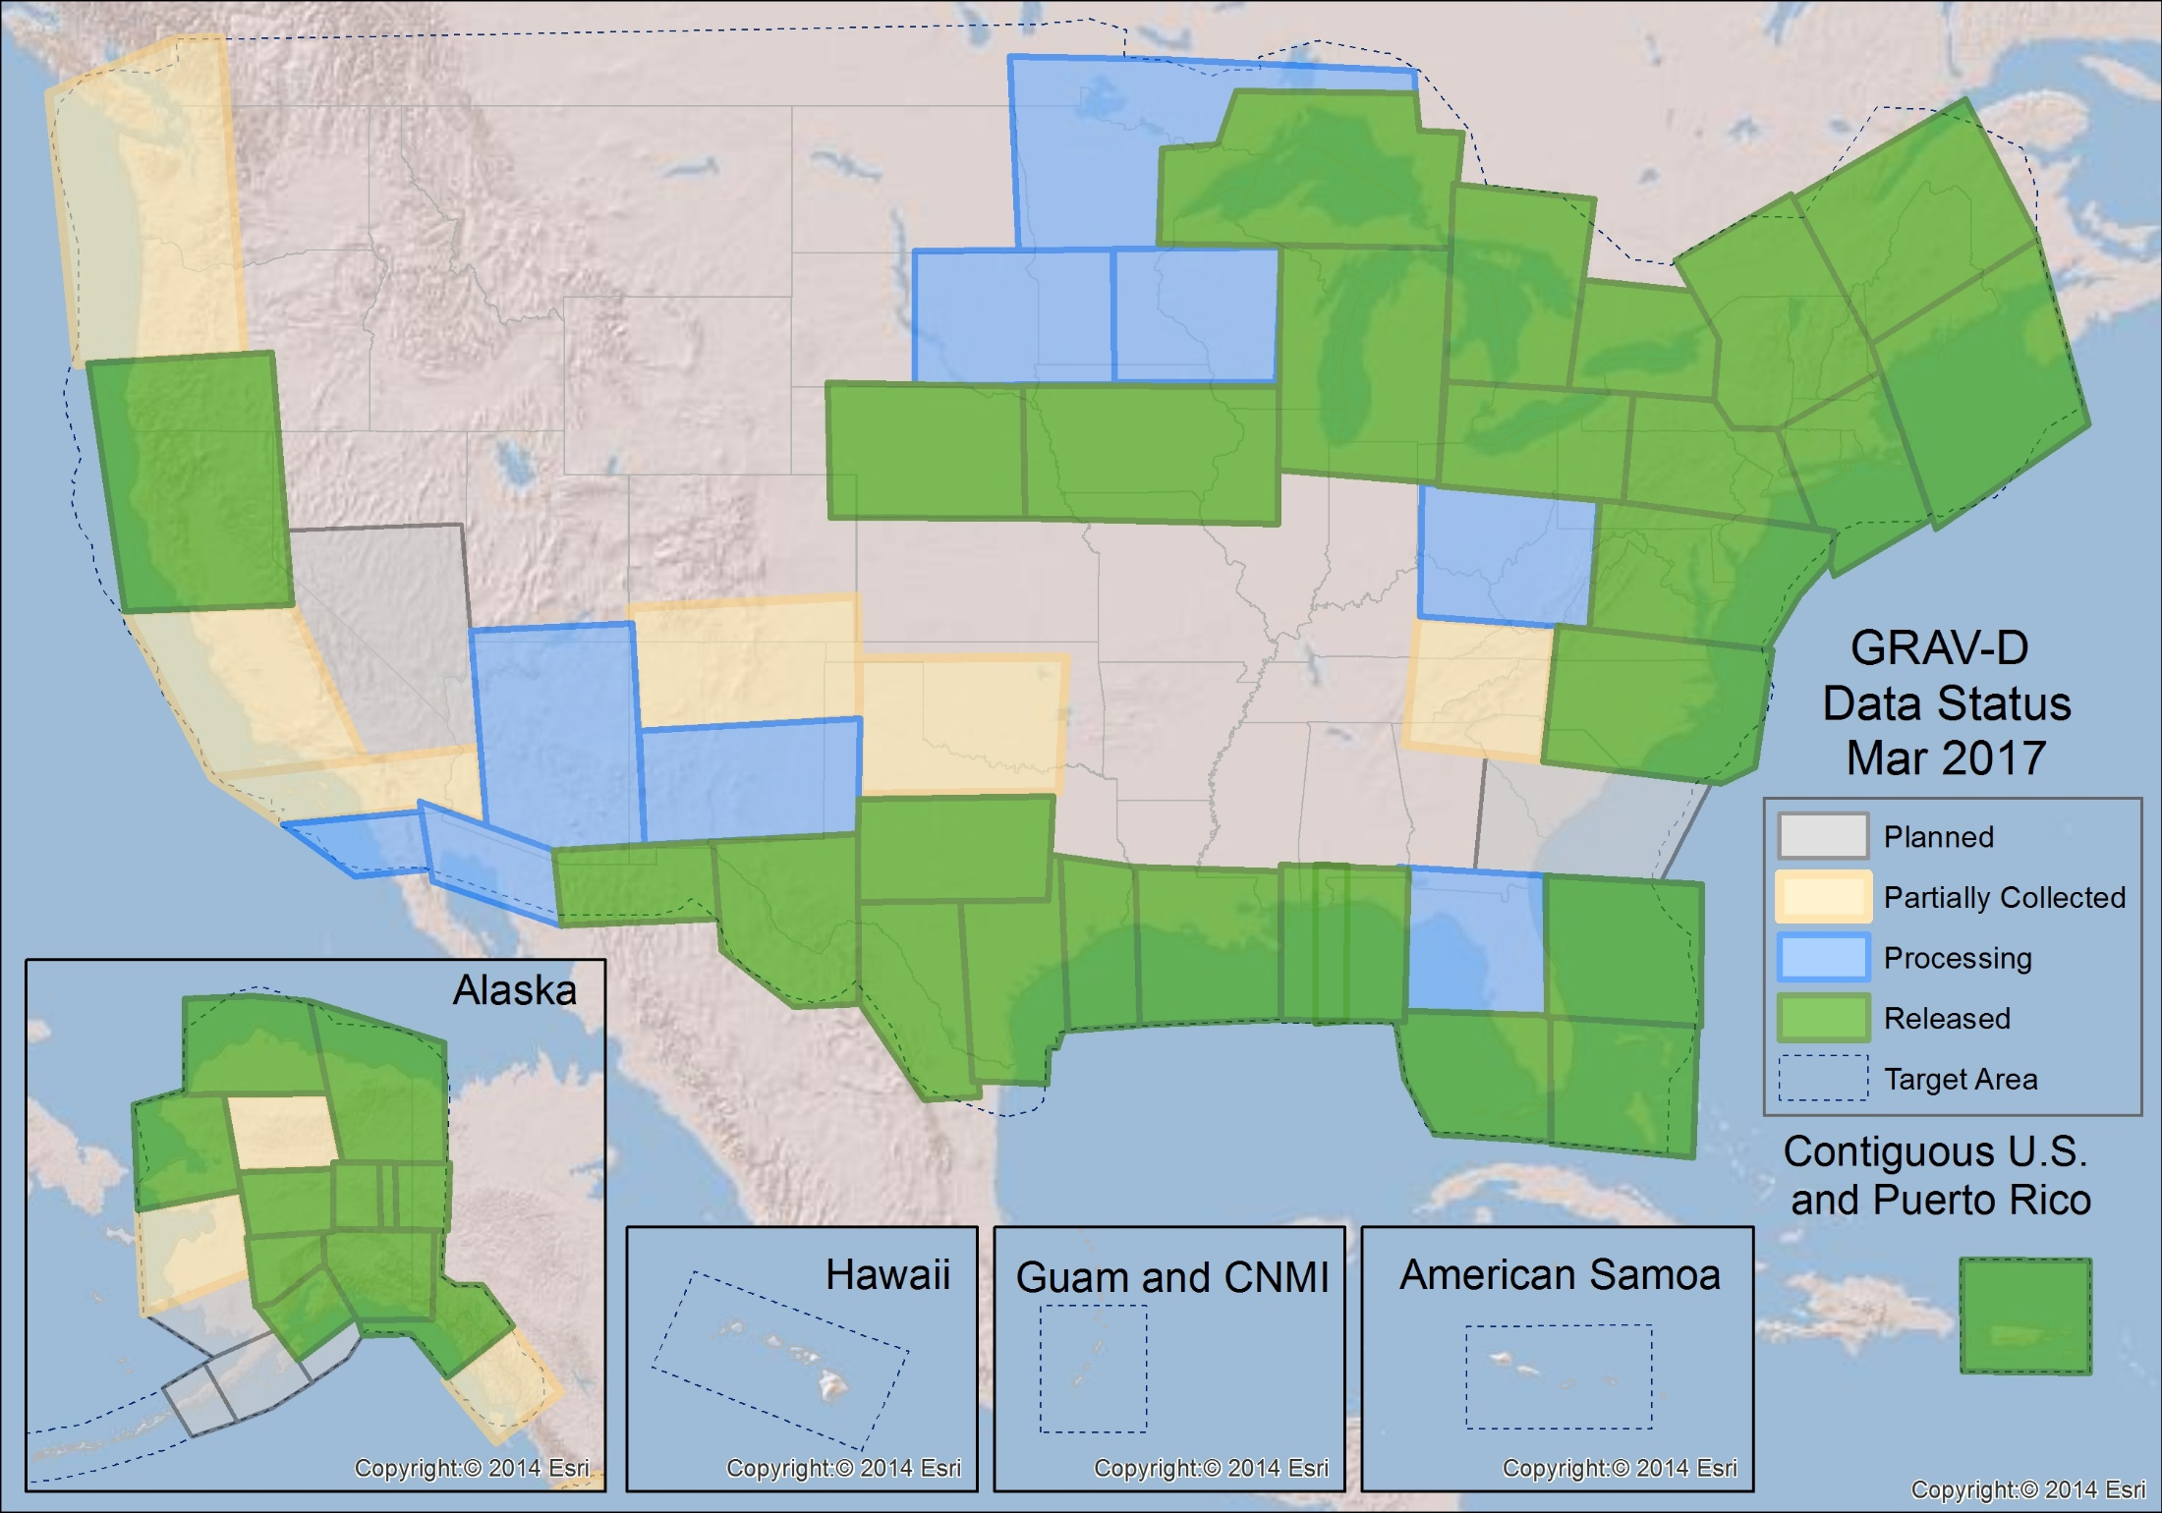
GRAV-D Status 3-31-17: 59%

Slide 43
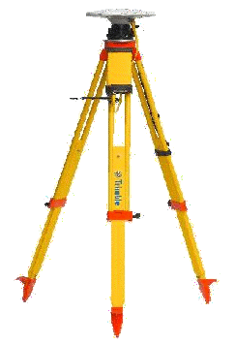

Requirements
Geodetic quality results require accurate aircraft positions, velocities, and accelerations
High-altitude, high-speed, long baseline flights for gravimetry
INS
GPS Antenna
Gravimeter
Absolute Gravity Tie

Slide 44




Methods: Survey Reconnaissance
Parking spot ID
A10 measurement
GPS Base Stations
Vertical gravity gradient
Notes:
Airport survey prior to every airborne survey
Goal is to establish an absolute gravity tie at the height of the aircraft as well as coordinate logistics
Parking spot is identified, marked, and surveyed with Micro-g A10 absolute gravimeter and a gradient is done with the Lacoste and Romberg D or G meter
Gravity value is transferred to the height of the aircraft and used for all processing
GPS base station locations are identified and tested to provide differential positioning during the airborne survey

Slide 45

Survey and Block Plans
Data lines spaced 10 km apart
Cross lines spaced 60-80 km apart
Flight altitude 20,000 ft
Nominal speed 220-250 kts
Notes:
Block layout based on aircraft, adjust size of block if needed

Slide 46

Data Processing
Field Quality Control Processing
  GPS/IMU combined solution using differential positioning
  Gravity processing with Issac (internal software)
Final Processing
  GPS/IMU combined solution using Precise Point Positioning (PPP)
  Gravity processing with Newton (internal software)
  Quality evaluated and data minimally trimmed
  Processed data and documentation released
Notes:
Data Processing
In the field a differential GPS-IMU solution is used to evaluate daily whether flights need to be reflown because precise ephemeris are not available
Final processing is done using Precise Point Positioning (PPP) – an analysis was done comparing differential and PPP, there was either no effect or small improvements in the gravity solutions from PPP
Gravity processing done using in-house software, Newton, which applies the absolute gravity tie, removes drift, and applies a vertical acceleration, Eotvos, and offlevel corrections and then is filtered three times with a time-domain frequency filter
End of line trimming
Data documentation produced and package released on the website
This plot is an example of part of the output. We aim for +/- 5 mGals from EGM08 – as you can see in this plot there is a significant section that deviates from that. However, part of the goal of the airborne campaign is to improve upon EGM08, so while it is a good guide, it cannot be the final determination. This line, for example, if you compare to an adjacent line it looks like this.

Slide 47




Green = EGM08, Blue = Airborne
Lake Michigan
Notes:
These are two lines over Lake Michigan where the airborne data (blue) shows significant deviations from EGM08 (Green). However, the x-axis is latitude and you can see that the deviations are supported independently by both lines. This type of visual analysis is extremely useful day-to-day in the field as we determine which lines need to be reflown. In the final processing we also do line to line cross correlation to evaluate overall line agreement.

Slide 48


Online Data Portal http://www.ngs.noaa.gov/GRAV-D/data_products.shtml
Interactive Google Map:
  Up-to-date info on all blocks
  27 blocks released (Was 20 in Jan. 2014)
  Clicking a block pops up basic info and a link to the block’s page if data is available

Slide 49

Experimental Geoids
Combining most recent satellite, airborne, and terrestrial gravity data to test methods for 2022
Published annually
  Updated with airborne gravity data
  Available on the website
Testing methods
  Blending techniques
  Density
  Terrestrial data improvements
http://beta.ngs.noaa.gov/GEOID/xGEOID/

Slide 50
“Action speaks louder than words
but not nearly as often.” ― Mark Twain
Prove that our goal with GRAV-D is possible:
“...the gravimetric geoid used in defining
the future vertical datum of the United States should have an absolute accuracy of 1 centimeter at any place and at any time.”
-- The NGS 10 year plan (2008-2018)
Notes:
The above quote refers to one of many ambitious goals in the NGS 10 year plan. While admirable, its achievability remains an open question. In order to begin addressing the actual achievable accuracy of a gravimetric geoid model, NGS will engage in a variety of testing methods prior to the 2022 date when the gravimetric geoid will serve as the reference surface for a new vertical datum. The first such testing method took place in the summer of 2011 and is known as the Geoid Slope Validation Survey of 2011, or GSVS11. As its name implies, this survey tested the accuracy of differential geoid undulations between points ("geoid slopes") from NGS's gravimetric geoid models. The baseline for comparison will be independently computed geoid slopes from two methods, GPS and leveling as well as Deflections of the Vertical.

Slide 51
Validating Geoid Accuracy
NGS plans up to 3 surveys to validate the accuracy of the gravimetric geoid model
  GSVS11
    2011; Low/Flat/Simple: Texas; Done; Success!
  GSVS14
    2014; High/Flat/Complicated: Iowa; Field work Complete
  GSVS17
    2017?; High/Rugged: Colorado? Wyoming?
COLORADO

Slide 52

Geoid Slope Validation Survey
Austin
Observe geoid shape (slope) using multiple independent terrestrial survey methods
  GPS + Leveling
  Deflections of the Vertical
Compare observed slopes (from terrestrial surveys) to modeled slopes (from gravimetry or satellites)
  With / Without new GRAV-D airborne gravity
325 km
218 points
1.5 km apart
Rockport
Notes:
But will this method produce a sufficiently accurate geoid?
This summer, we conducted an experiment to determine the accuracy of our geoid. We selected a line that extended 325 km from downtown Austin, Texas (North end) to Rockport, Texas (South end). There were 218 official survey points along the line, with an average spacing of 1.5 km between them. We compared the slope of the geoid along the line determined with GPS + leveling with deflections of the vertical as measured by the ETH Zurich DIADEM zenith camera. We also compared the observed geoid slope with slopes calculated from various geoid models to evaluate the their quality. As for NGS models, we tested geoids that both included and didn’t include new GRAV-D airborne gravity.

Slide 53
Surveys Performed
GPS: 20 identical units, 10/day leapfrog, 40 hrs ea.
Leveling: 1st order, class II, digital barcode leveling
Gravity: FG-5 and A-10 anchors, 4 L/R in 2 teams
DoV: ETH Zurich DIADEM GPS & camera system
LIDAR: Riegl Q680i-D, 2 pt/m² spacing, 0.5 km width
Imagery: Applanix 439 RGB DualCam, 5000’ AGL
Other: RTN, short-session GPS, extra gravity marks around Austin, gravity gradients

Slide 54





GPS
LIDAR/
Imagery
DoV
Gravity
Leveling
Notes:
These are just a small sampling of the field crews in action. Not shown are the RTN, FG-5, short-session GPS, relative gravity and mark setting crews.

Slide 55
GSVS11 Results
Geoids
without
GRAV-D
xUSGG2011
Geoids with
GRAV-D
“1 cm geoid”
Notes:
This slide is a companion to the previous one, but the h-H errors have been removed, in an RMS sense, from the total h-H-N errors, leaving gravimetric geoid model errors only.
As seen previously, the geoids based on airborne gravity data are the best performers, and the very slight degradation using new high resolution software at short wavelengths is noticeably offset by the significant improvement at medium wavelengths.
In fact, as a general statement, it could be said that adding airborne gravity data to the gravimetric geoid model has yielded about 1 cm differential geoid undulation accuracy across all distances (orange and red bars), in the region of GSVS11, and that this can be further improved by continued improvement to the high resolution modeling software.

Slide 56

GSVS – 2014 (Iowa)
Cedar Rapids, IA
Denison, IA
Central Iowa
330 km
205 points
Minimal Trees (GPS)
No major bridges/water crossings (Leveling)
Along roads (ease of access)
Mostly cloud-free nights
Under GRAV-D coverage (or will be)
With at least some existent bench marks/NAVD 88 level lines
A "significant enough" geoid slope to be interesting
For GSVS11, we wanted "low and flat" topography. For GSVS14 we'll want to step this up to "high and flat" or possibly "medium high, more-or-less flat and gravimetrically complex"

Slide 57



GSVS17 Colorado
The third (and likely final) GSVS has taken place along US160, from Durango to Walsenburg, in southern Colorado.
High elevation and rugged topography. “Worst case” for geoid modeling.
Variation from 6,000’ (MSL) to 11,000’, over two passes.
12

Slide 58

Estimated change in orthometric heights from NAVD 88 to NAPGD2022
NAPGD2022: North American Geopotential Datum of 2022
NAPGD2022 approximated using xGEOID16B

Slide 59


Slide 60

Extent of 2022 gravimetric geoid model used for new geopotential reference frame

Slide 61
New Reference Frames for U.S.

Slide 62


Slide 63



Notes:
https://www.youtube.com/playlist?list=PLsyDl_aqUTdFY6eKURmiCBBk-mP4R10Dx

Slide 64
Details: Blueprint documents
Blueprint for 2022, Part 1: Geometric Coordinates
  A.K.A. NOAA Technical Report NOS NGS 62 (April 2017 release)
  Time-dependency
  Four terrestrial reference frames
  Intra-frame velocity models
Blueprint for 2022, Part 2: Geopotential Coordinates
  A.K.A. NOAA Technical Report NOS NGS 64 (September 2017 release)
  Time-dependency
  One geopotential datum
    Interrelated global geopotential model, regional geoid grids, regional DoV grids, regional surface gravity grids

Slide 65
Scientific Decisions
Blueprint for 2022, Part 1: Geometric
  Four plate-fixed Terrestrial Reference Frames
    - And what “plate fixed” means
  Mathematical equation between IGS and TRFs
    - Plate Rotation Model for each plate
    - Coordinates at survey epoch
  Intra-frame velocity model
    - To compare coordinates surveyed at different epochs

Slide 66
Names (Geometric)
The Old:
NAD 83(2011)
NAD 83(PA11)
NAD 83(MA11)
The New:
The North American Terrestrial Reference Frame of 2022
(NATRF2022)
The Caribbean Terrestrial Reference Frame of 2022
(CATRF2022)
The Pacific Terrestrial Reference Frame of 2022
(PATRF2022)
The Mariana Terrestrial Reference Frame of 2022
(MATRF2022)

Slide 67


Four Frames/Plates in 2022
Tectonic plates modeled by NGS
July 12, 2017
2017 Esri User Conference
13

Slide 68
Euler Pole
Each frame will get 3 parameters
Euler Pole Latitude
Euler Pole Longitude
Rotation rate (radians / year)
This will be used to compute
time-dependent TRF2022
coordinates from time-dependent
IGS coordinates.
Euler's fixed point theorem states: any motion of a rigid body on the surface of a sphere may be represented as a rotation about an appropriately chosen rotation pole (“Euler Pole”)

Slide 69
Non-Eulerian motions in the TRFs
Non-Eulerian motions at CORS
Note the obvious impact of the plate boundary in western CONUS
Note the non-zero nature of all vectors even in “stable North America”
Notes:
Potential outline and speaker assignments; can be adjusted as needed.

Slide 70
Intra-frame velocities
This is the velocity of the
point in NATRF2022.
Rotation of plate removed.
It is not constant because
the point still suffers small
“intra-frame” velocities.
Such IFVs will be captured
in a model by NGS.
This is the velocity of the
point in ITRF. Includes all
movements, but the
dominant one is the
rotation of the N.A. Plate.

Slide 71
Scientific Decisions
Blueprint for 2022, Part 2: Geopotential
  Replace leveling based datums with a gravimetric geoid model
  Global 3-D Geopotential Model (GGM)
    - Will contain all GRAV-D data
    - Able to yield any physical value on/above surface
  Special high-resolution geoid, DoV and surface gravity products consistent with GGM
    - Not global: NA/Pacific, American Samoa, Guam/CNMI
  Time-Dependencies
    - Geoid monitoring service
    Heights will be determined using GNSS technology and the high resolution geoid

Slide 72
Names (Vertical)
  The Old:
  NAVD 88
  PRVD 02
  VIVD09
  ASVD02
  NMVD03
  GUVD04
  IGLD 85
  IGSN71
  GEOID12B
  DEFLEC12B
Orthometric
Heights
  The New:
  The North American-Pacific Geopotential Datum of 2022 (NAPGD2022)
  - Will include GEOID2022
Normal
Orthometric
Heights
Dynamic
Heights
Gravity
Geoid
Undulations
Deflections of
the Vertical

Slide 73
Preparing for New Reference Frames

Slide 74
How to Plan for 2022
Move to newest realizations
  NAD 83(2011) epoch 2010.00
  GEOID12B (hybrid geoid)
Move to NAVD 88
  understand the accuracy of VERTCON in your area
Utilize passive marks that are up to date
  Stay aware of what marks are included in datum updates
  Use OPUS & Hgt. Mod procedures to update mark positions
Use OPUS for GPSBMs
  Help improve future geoid models & relationship with new datum
NGS Outreach Efforts
  Participate in NGS webinars, Geospatial summits, contact NGS Regional Advisor, etc.

Slide 75
Metadata is Critical
Your positional metadata should include:
  datum
  epoch
  source / methods
These will facilitate transforming from current to new datum
Maintaining your original survey data will provide more accurate results
Notes:
Metadata related to how someone establishes control is important. Important for today’s positions, but especially as we moving toward and into the coming new datums in 2022.

Slide 76
NGS Outreach – New Ref. Frames
Notes:
Subscriber service, webinar series, videos, NSRS Newsletter

Slide 77

GPS on Bench Marks
http://www.ngs.noaa.gov/heightmod/GPSonBM.shtml
2014 prioritized bench marks (needing GPS observations) by GEOID12A estimated accuracy, vertical order, stability, and distance from road
2017
Collaborating with NSPS for another Surveyors Week Campaign
NGS is making new maps of priority marks
NGS is making new associated materials to be ready in Feb. 2015
Becoming year-round campaign
Notes:
Talk about the GPSBM efforts and how these OPUS – Share solutions are being used to help improve the hybrid geoid models.

Slide 78



Find this article at:
http://www.amerisurv.com/content/view/13361/153/
  Four-part series
The first part, covering the NGS Ten Year Plan, OPUS-DB,
OPUS-Projects, and Foundation CORS appeared in the January 2015 issue.

Slide 79

? ? QUESTIONS ? ?

