Slide 1

A Modernized National Spatial Reference System in 2022: Focus on the Caribbean Terrestrial Reference Frame
Daniel R. Roman
Chief Geodesist
Abstract: G13A-07

Slide 2
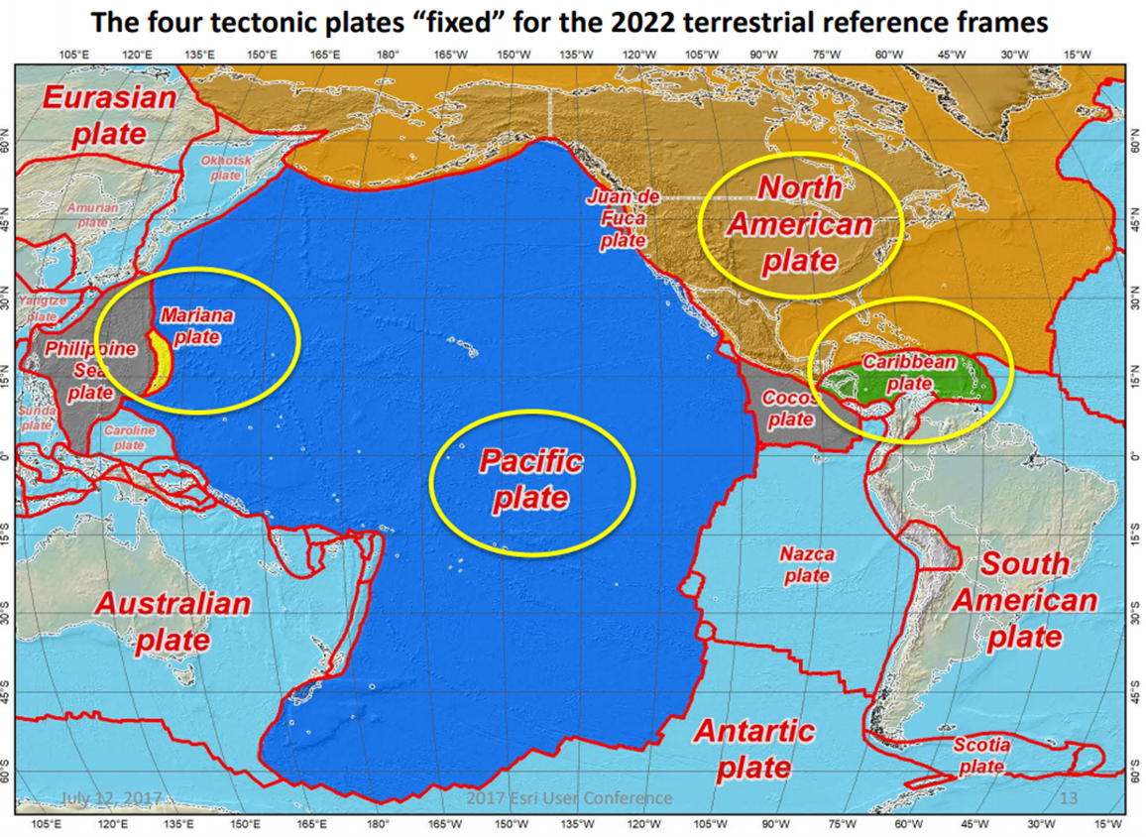
NSRS in 2022
Densified ITRF model
Control stations
  FCORS/IGS sites <=> ITRF
  Subset chosen for EPP
Four Frames after EPP
  CATRF (w/SIRGAS)
  MATRF (~ w/GGIM-AP)
  NATRF (IAG 1.3c)
  PATRF (w/GGIM-AP)
Intra-Frame Velocity Models
Notes:
We have four plates/regions in which we are involved

Slide 3
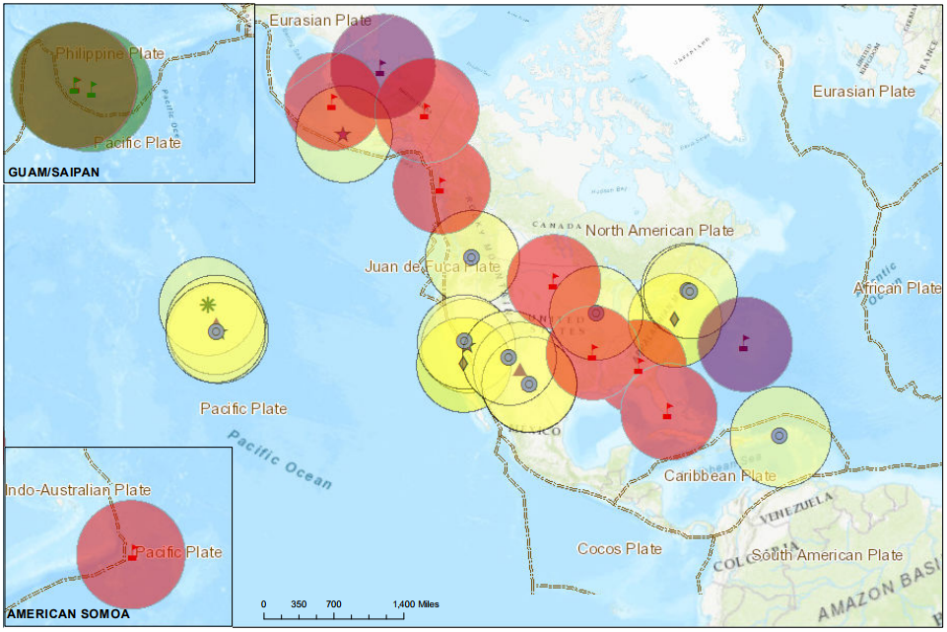
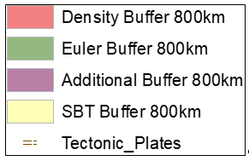
Collocated + Density + Euler + Additional
Notes:
Plenty of sites are available.
Guam/CNMI is a unique issue but one we’re moving forward on with recent work
The Pacific has nominally enough for the EPP but we’ll collaborate with GGIM-AP to make it more robust (use of IGS sites)
NA has plenty of options
However, only site exists on the Caribbean
Plenty of other stations exist, but we necessarily want them to be
in a stable region – eliminates boundary sites (the most numerous)
have demonstrated stability
have a time series of several years
not have too many gaps (though this would be mitigated by adoption as FCORS through a MOA)

Slide 4
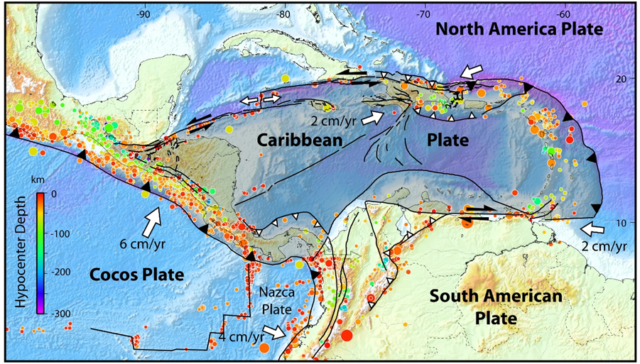
Structure (DEMETS 2007)
Notes:
Much work on determining geologic stability already exists.
However, the more stable regions typically don’t have many islands and, therefore, available cGNSS stations in these regions.
With St. Croix in he east, another station in the west and one near the middle would be optimal.

Slide 5
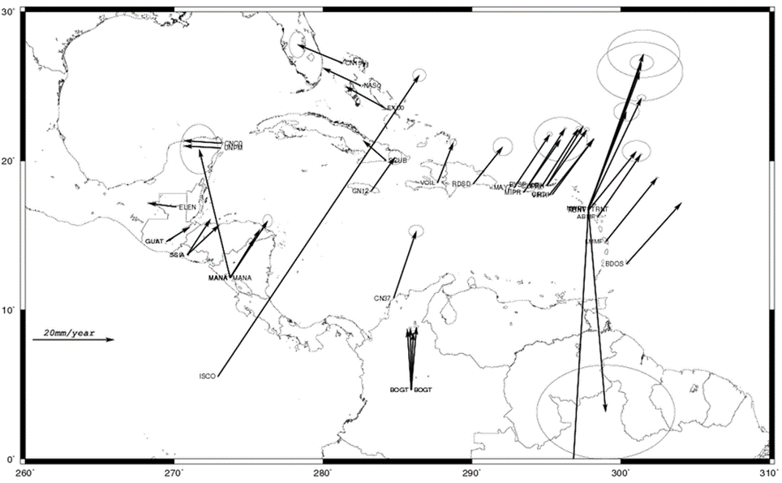
IGS Velocities in IGS08 (43)
Notes:
Doesn’t use SAN0 or CN10. Does use CRO1.

Slide 6
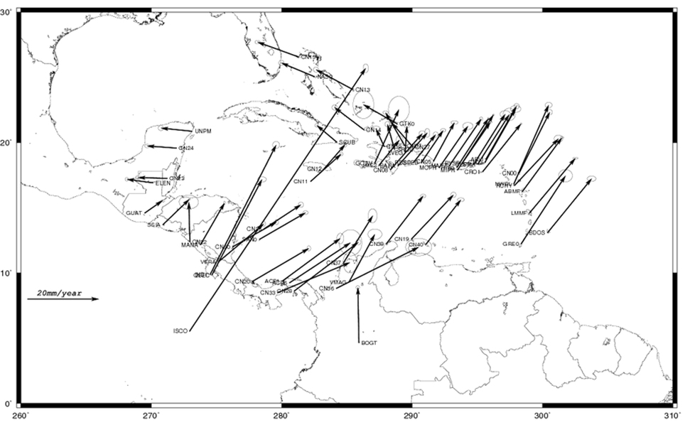
MEASURES Velocities in IGS08 (64)

Slide 7
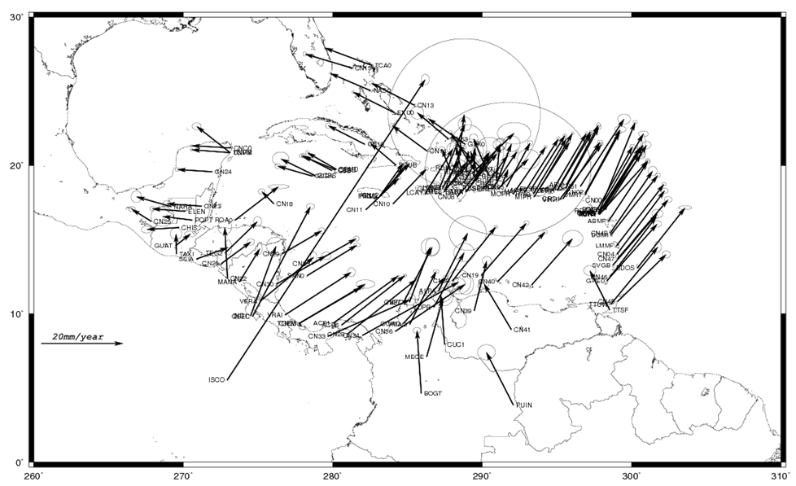
COCONet Velocities in IGS08 (140)
Notes:
Newer network but many sites in the ground now for five years. Station CN10 is in middle just south of Jamaica. SAN0 is in the west just off Nicaragua.

Slide 8
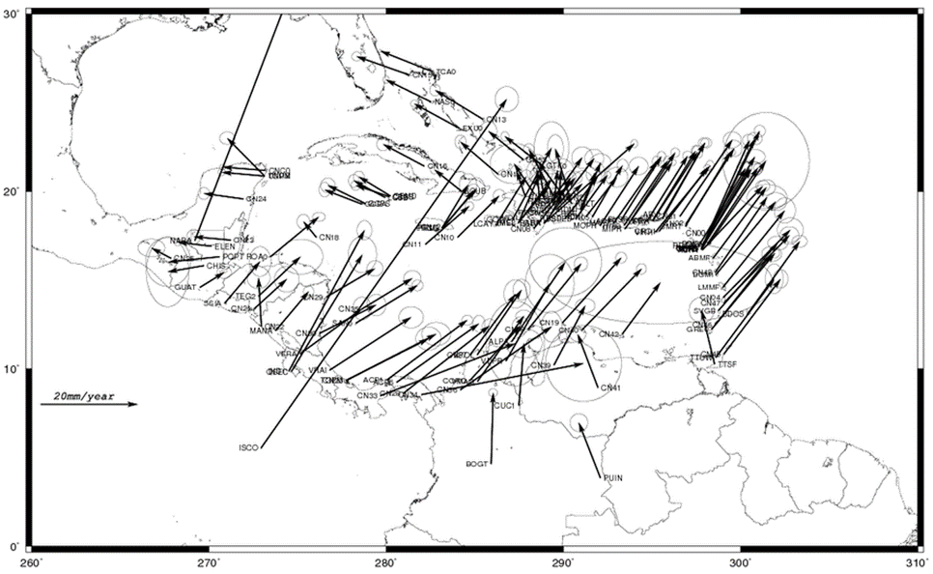
UNR Caribbean Velocities in IGS08 (136)
Notes:
Geoff Blewitt & Company. Includes SAN0 and CN10. Results consistent with our REPRO2 efforts to date.

Slide 9
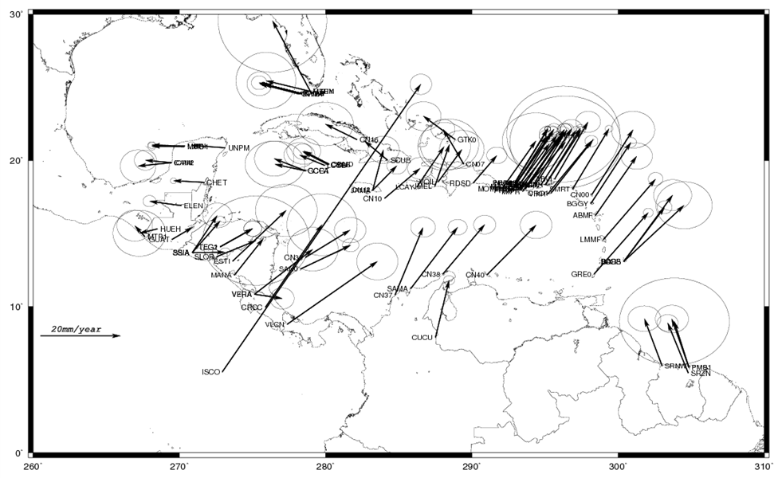
REPRO2 Velocities in IGS08 (98)
Notes:
Slightly different solution than IGS08 or UNR but very similar. Many of the same stations are used.

Slide 10
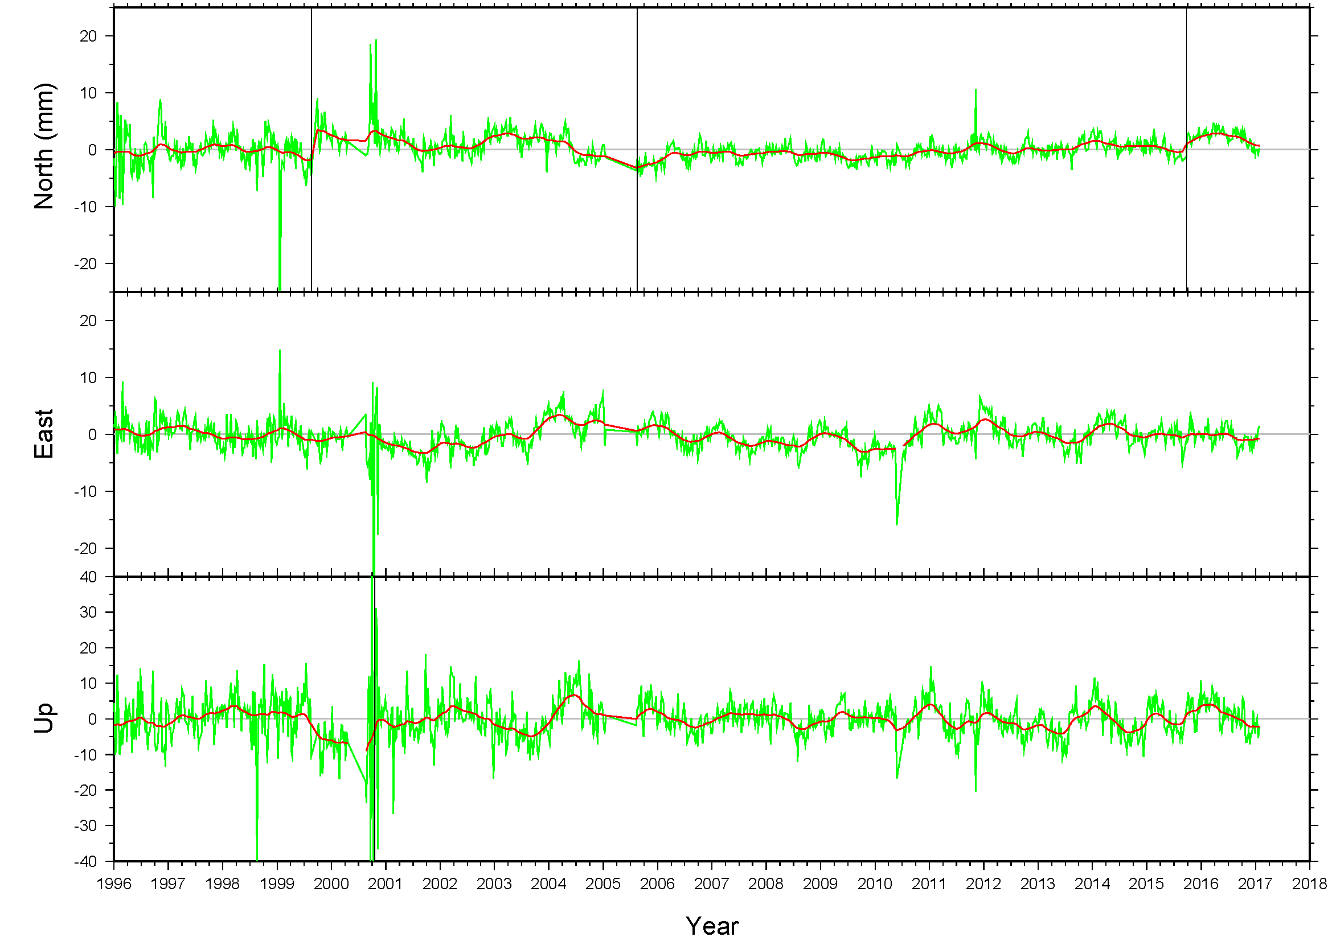
Residual Velocities on CRO1
Notes:
This will be one of the FCORS. Still current. Use as template for searching for stability for other sites.

Slide 11
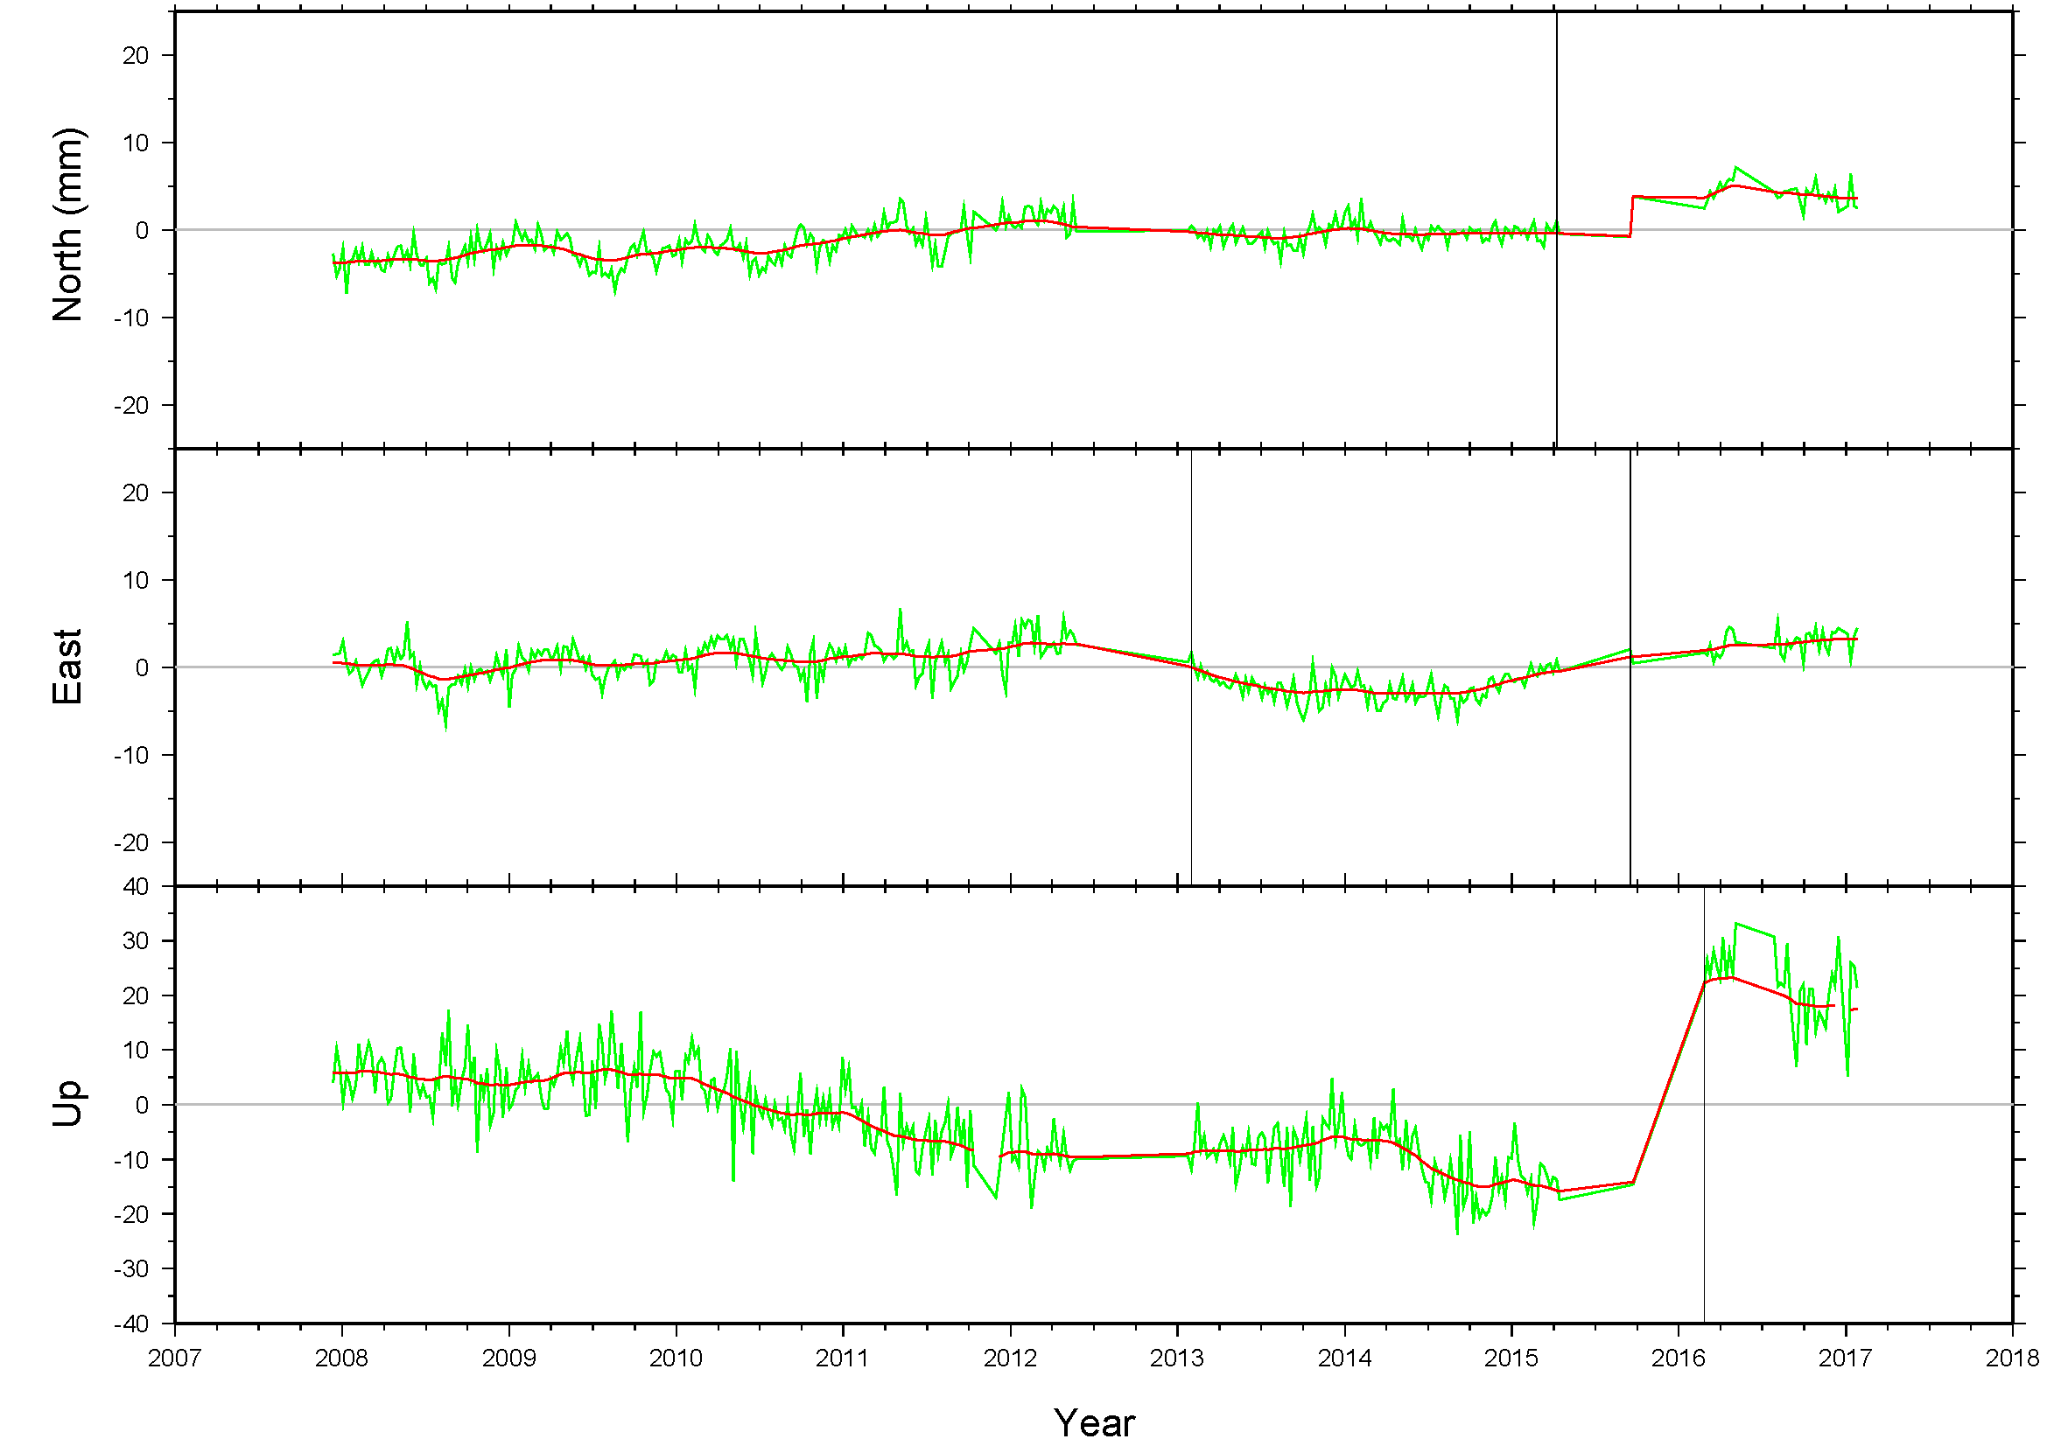
Residual Velocities on SAN0
Notes:
Geographically desirable but has departures. Ten year history but with gaps. Still current.

Slide 12
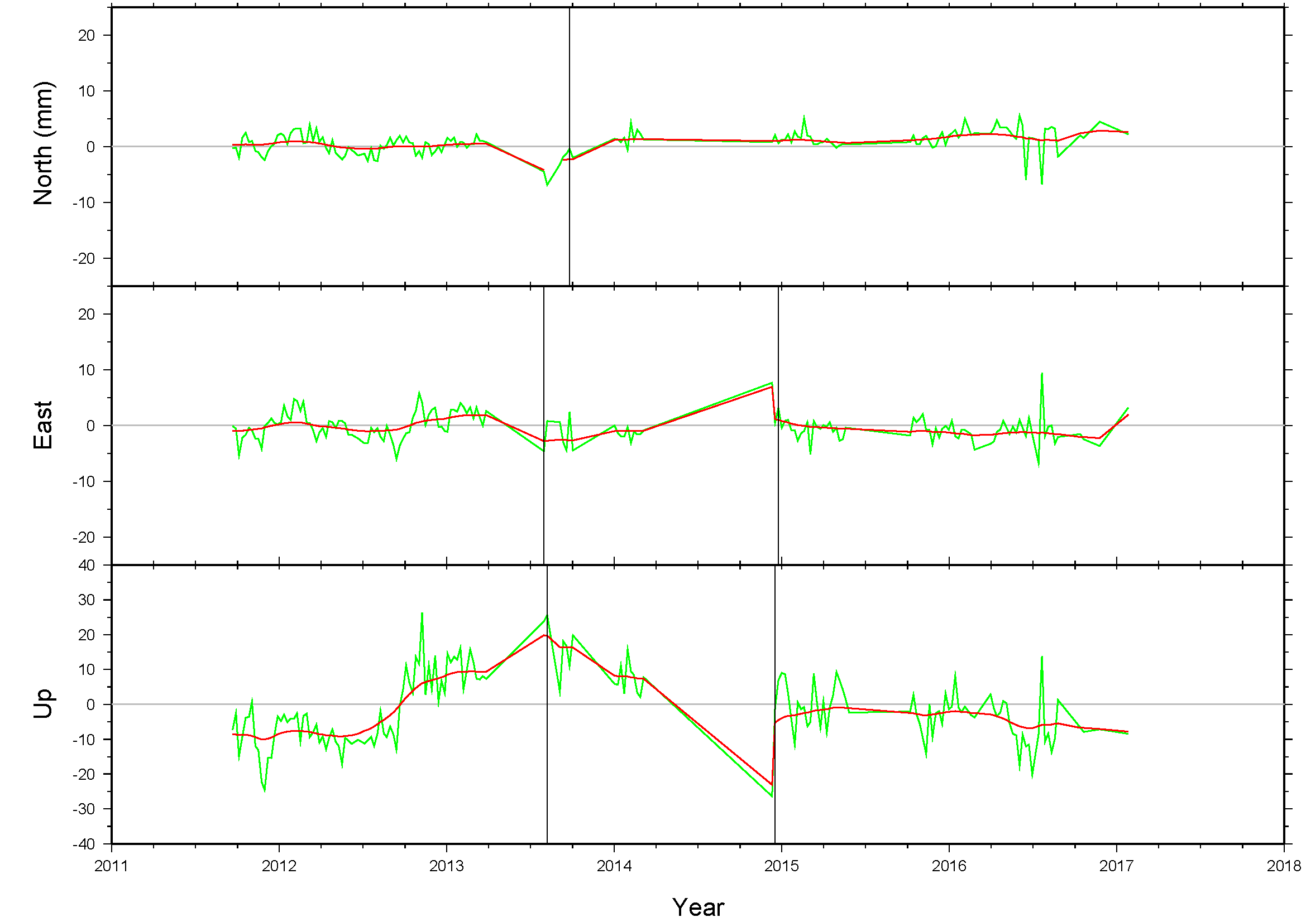
Residual Velocities on CN10
Notes:
Geographically desirable but has some departures. Six year history with gaps. Still current.

Slide 13
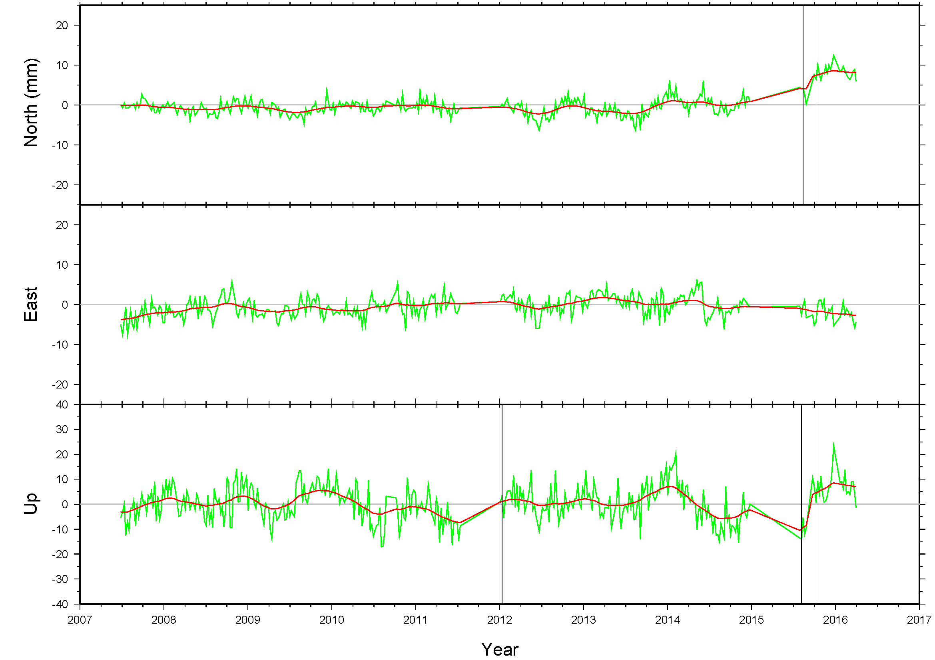
Residual Velocities on GRE0
Notes:
Ten year history with some gaps. Some ½ dm variations. Grenada.

Slide 14
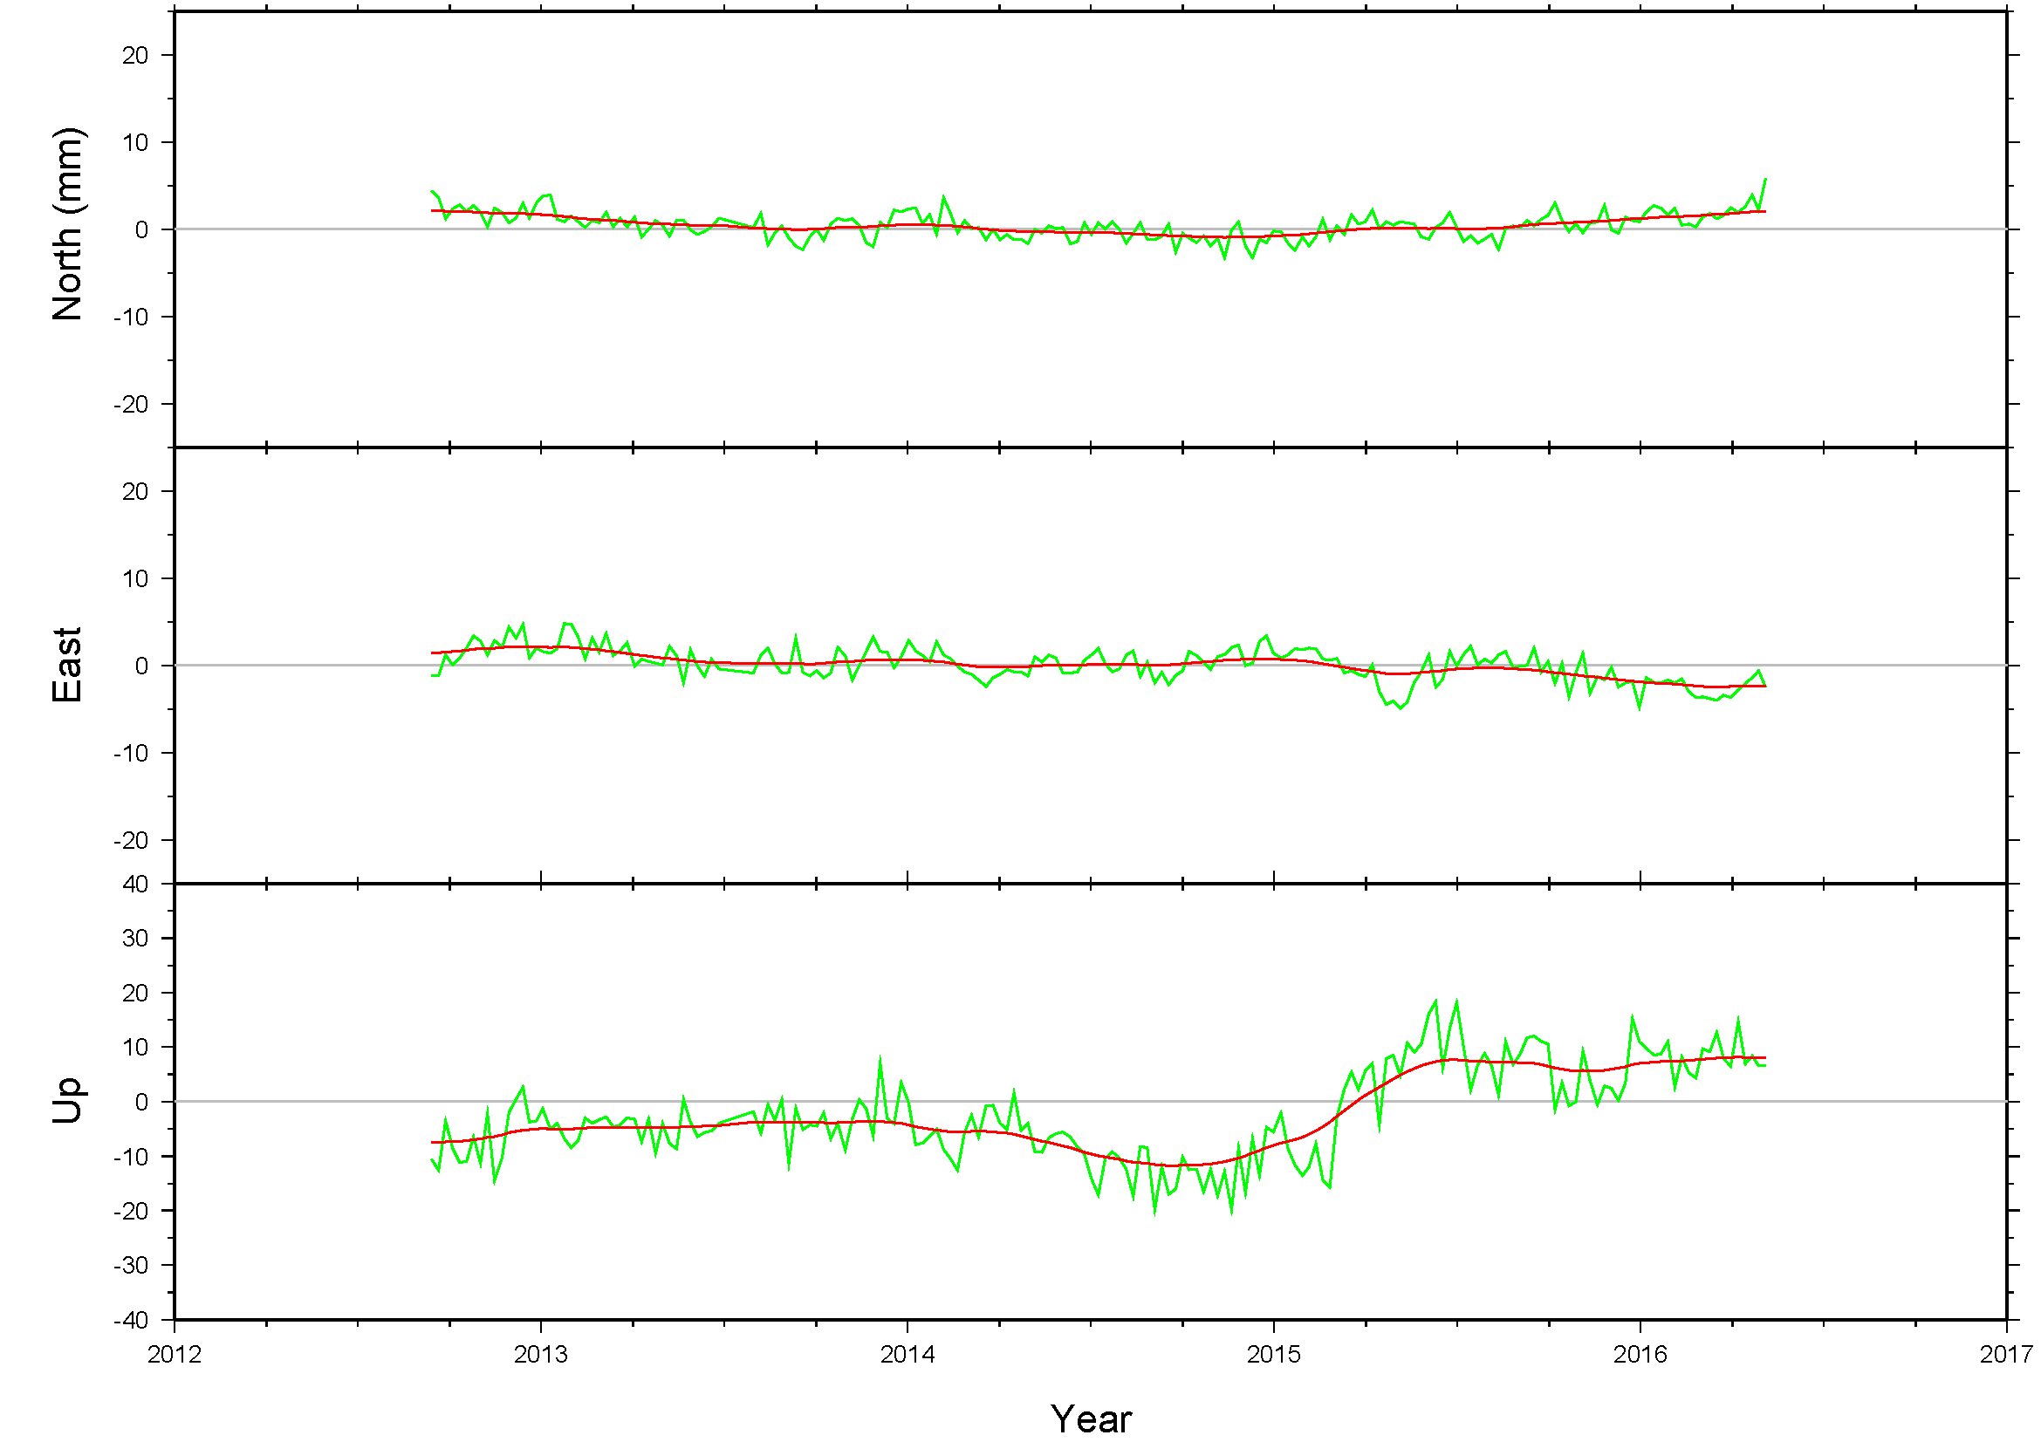
Residual Velocities on CN35
Notes:
Four year time series with vertical motion. No gaps though. Near SAN0.

Slide 15
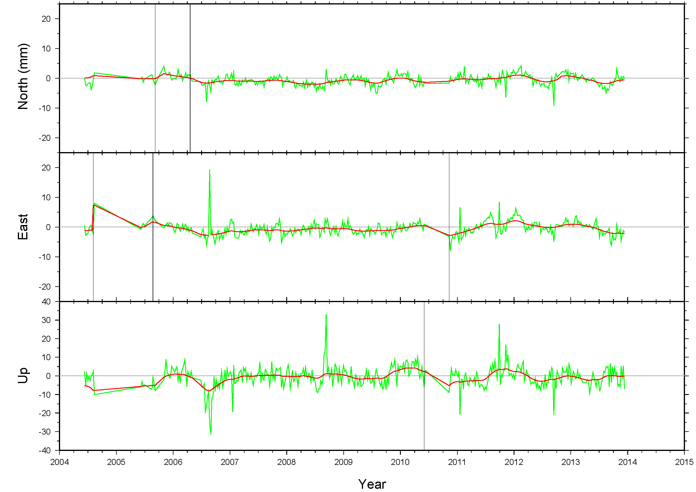
Residual Velocities on BDOS
Notes:
10+ time series but not since 2014. Very stable looking. Barbados.

Slide 16
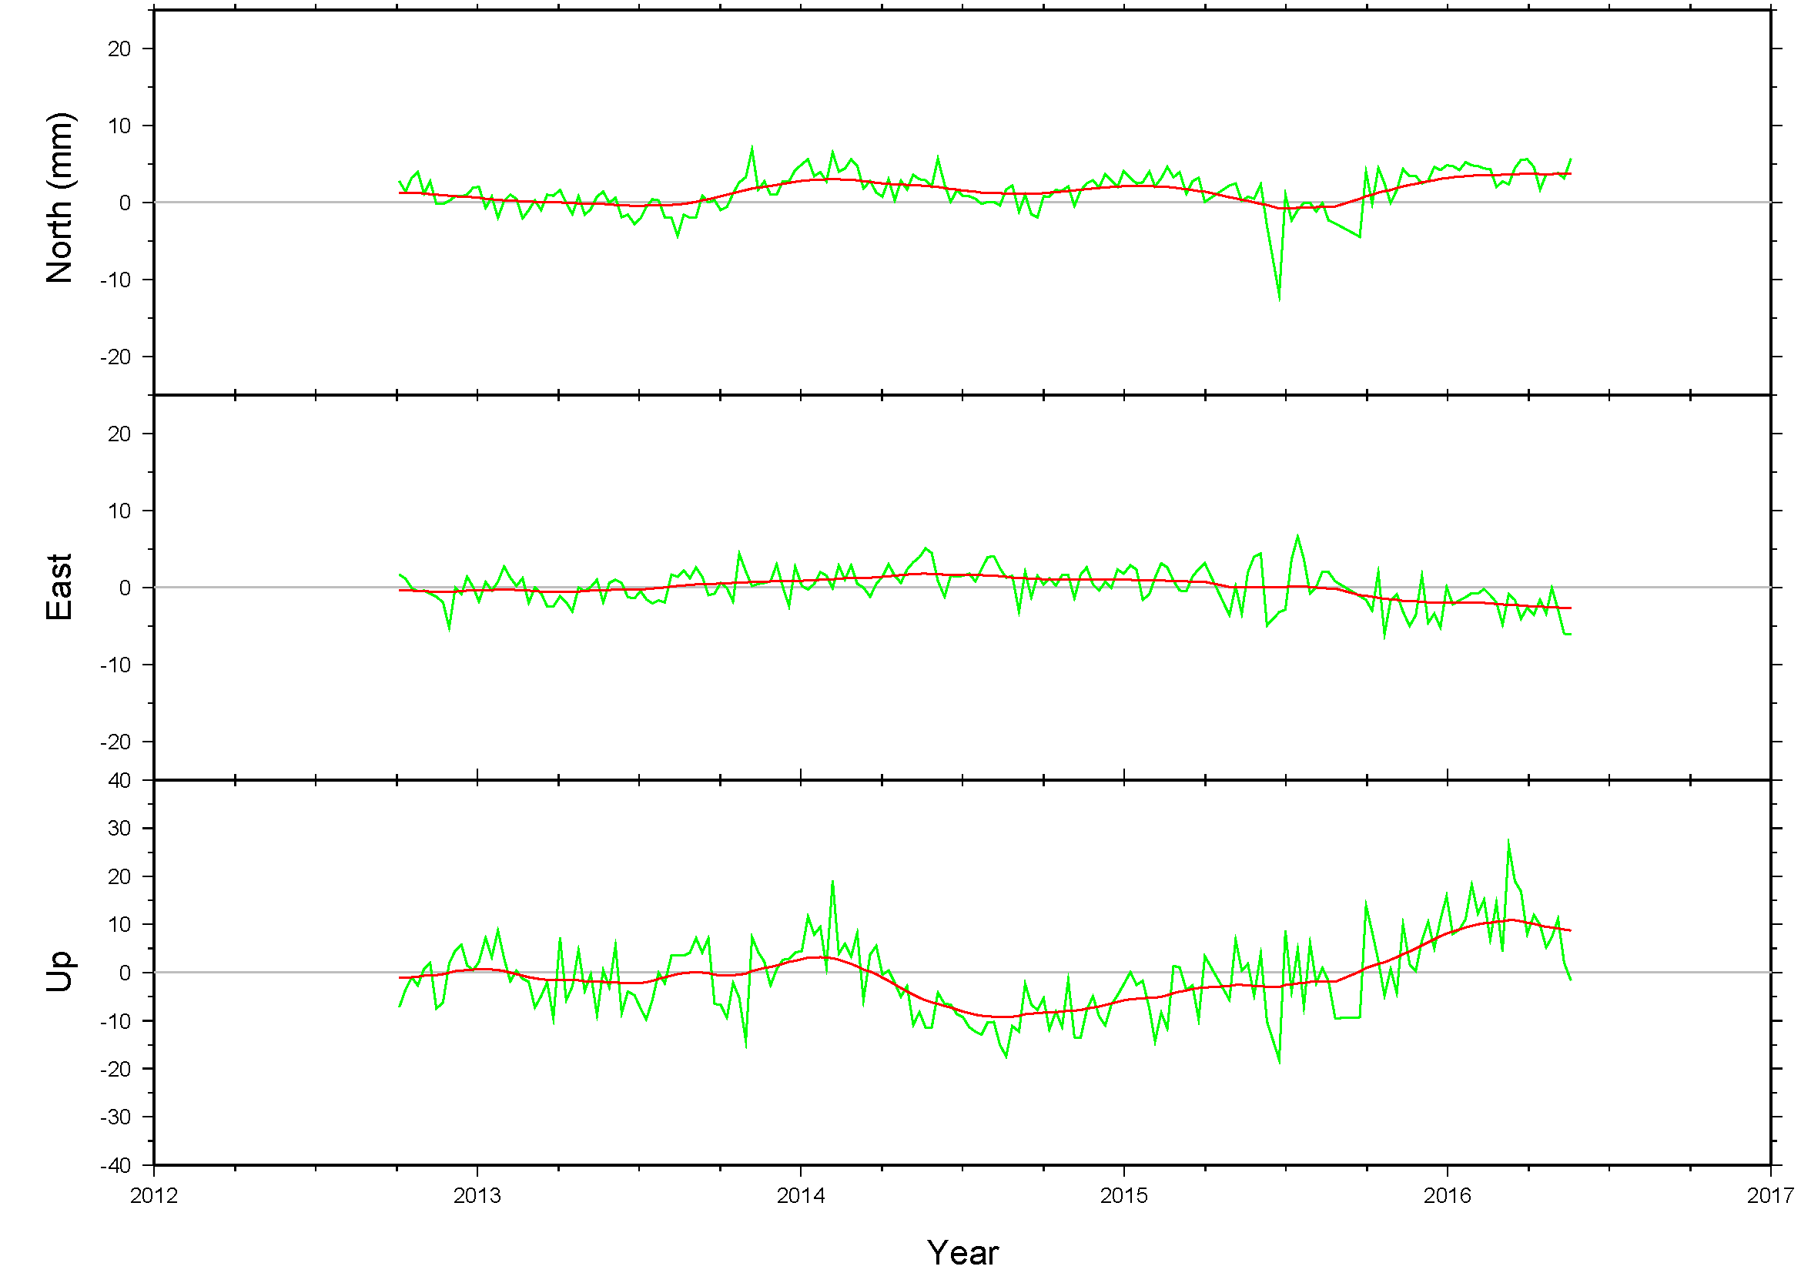
Residual Velocities on ABMF
Notes:
Vertical motion. Guadalope.

Slide 17
Summary
Of the four plates, CATRF requires most care
CRO1 is definite as FCORS
Two other sites needed for continuity for EPP
Coordinating with SIRGAS to optimize choice
Selected sites will be:
  In a stable area
  Have a sufficiently long time series
  Supported by NGS to maintain continuity

