Slide 1

Achieving Great Heights
A New Vertical Datum for the U.S.
Esri International User Conference
San Diego
July 9, 2013
Michael Dennis (for Mark Eckl)
Observation and Analysis Division
National Geodetic Survey

Slide 2
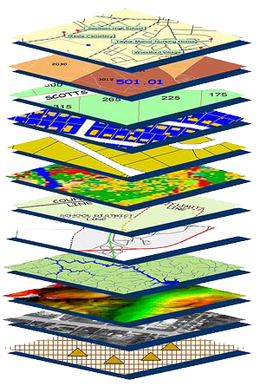
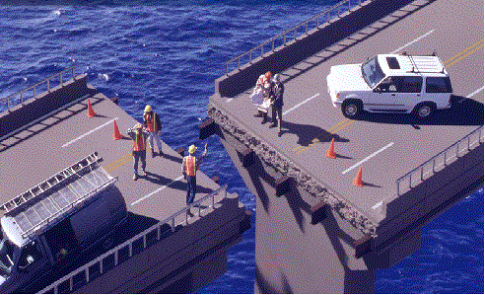
Coordination begins with good coordinates
Geodetic control is the foundation
for all geospatial products.
Geodetic Control is the critical “basemap” layer for GIS applications
Source: Zurich-American Insurance Group

Slide 3
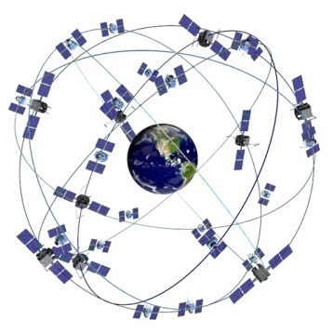
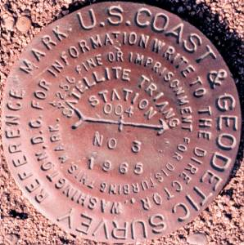
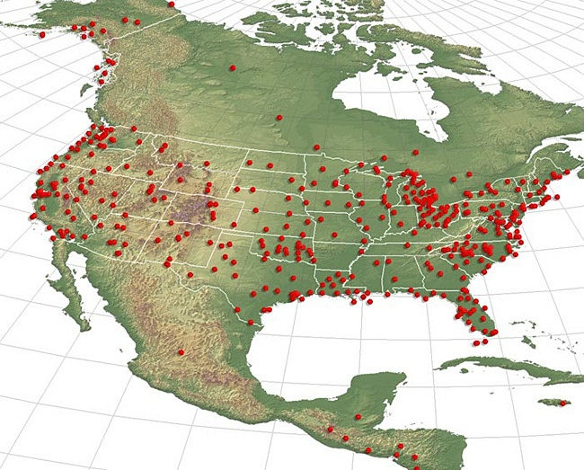
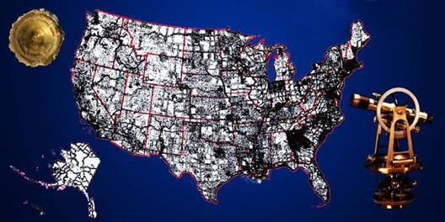
National Spatial Reference System (NSRS)
The NSRS is a consistent coordinate system that defines latitude, longitude, height, scale, gravity, and orientation throughout the United States.
One common datum for all FGDC products (yours too?)
Evolving from passive to active to real-time augmentations→
Geodetic control: overview & evolution
Notes:
NGS provides users with a consistent national coordinate system, which includes:
Latitude
Longitude
Height
Scale
Gravity
Orientation

Slide 4
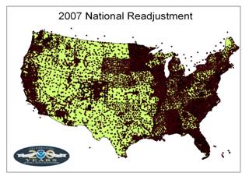
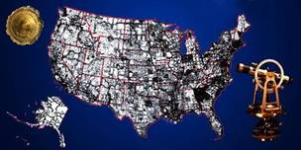
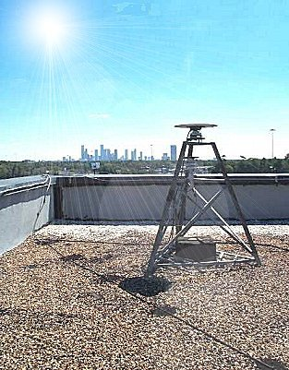
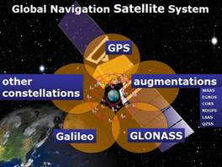
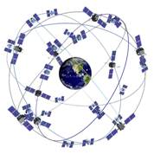
The NSRS has evolved
Evolving from passive to active to real-time augmentations
1 Million Monuments
(Separate Horizontal and Vertical Systems)
~80,000
Passive GPS Marks
(3-Dimensional)
→
Passive Marks
(Limited Knowledge of Stability)
~2000 CORS
(Time Dependent System Possible;
4-Dimensional)
→
GPS CORS → GNSS CORS
Notes:
This is what we will talk about – how you can access this data and use it for your projects and what tools we have available to assist you to ensure you are accurate.
ACCURATE -- cm accuracy on a global scale
MULTIPURPOSE -- Supports Geodesy, Geophysics, Land Surveying, Navigation, Mapping, Charting and GIS activities
ACTIVE -- Accessible through Continuously Operating Reference Stations (CORS) and derived products
INTEGRATED -- Related to International services and standards (e.g. International Earth Rotation and Reference Systems Service, International GNSS Service etc.)

Slide 5
Geodetic Datums
  Horizontal
  2-D (Latitude and Longitude) (e.g. NAD 27, NAD 83 (1986))
  Vertical/Geopotential
  1-D (Orthometric/Dynamic Height) (e.g. NGVD 29, NAVD 88, IGLD 85)
  Geometric
  3-D (Latitude, Longitude and Ellipsoid Height)
  Fixed and Stable(?) - Coordinates seldom change
  (e.g. NAD 83 (1993), NAD 83 (2007), NAD 83 (2011))
  also
  4-D (Latitude, Longitude, Ellipsoid Height, Velocities)
  Coordinates change with time
  (e.g. NAD 83, ITRF00, ITRF05)
Notes:
Geodetic Datums
A set of constants specifying the coordinate system used for geodetic control, i.e., for calculating coordinates of points on the Earth. Specific geodetic datums are usually given distinctive names. (e.g., North American Datum of 1983, European Datum 1950, North American Vertical Datum of 1988)
Characterized by:
A set of physical monuments, related by survey measurements and resulting coordinates (horizontal and/or vertical) for those monuments

Slide 6
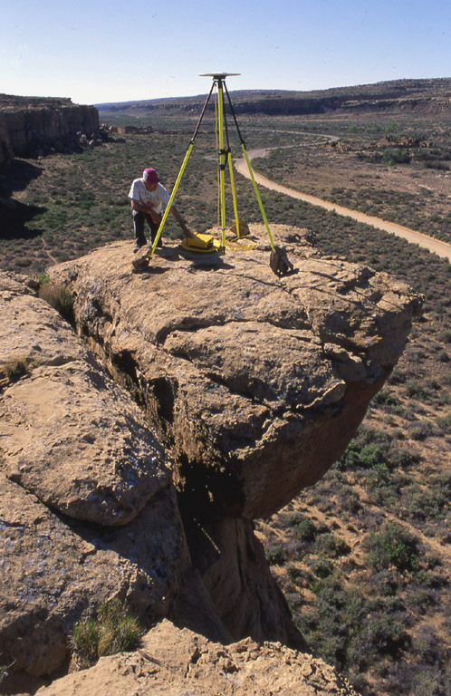
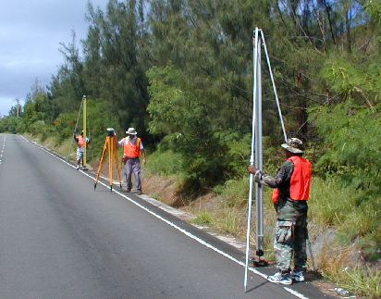
Height Modernization
Height
Modernization
-faster
-cheaper
Differential Leveling
GNSS + …

Slide 7
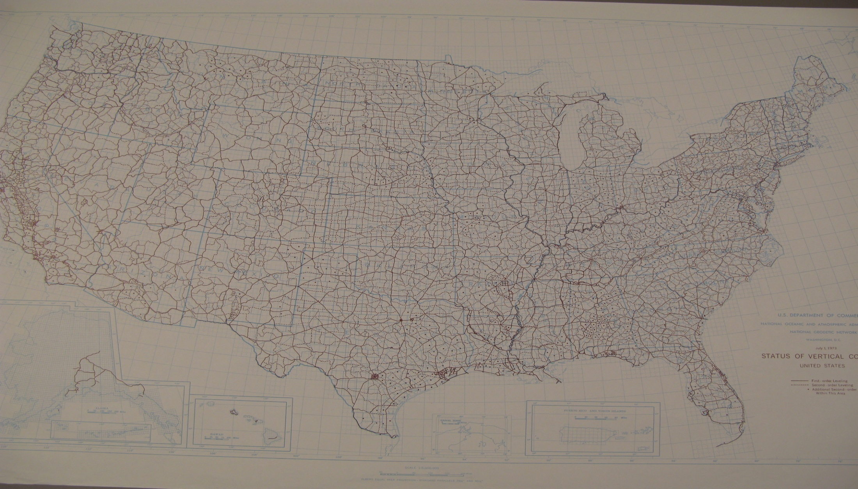
NORTH AMERICAL VERTICAL DATUM 1988

Slide 8
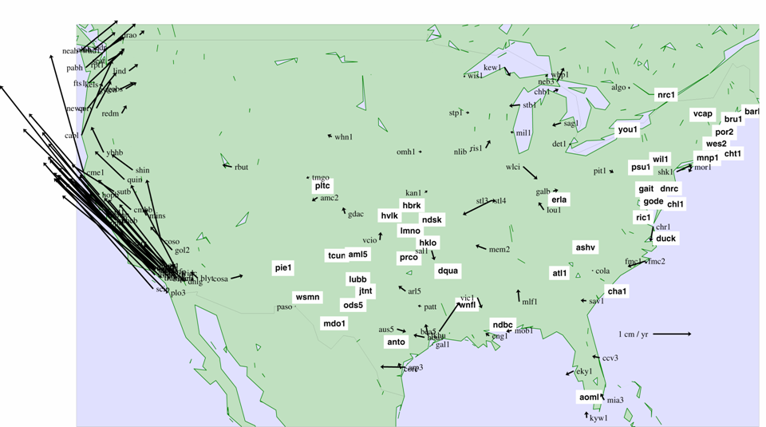
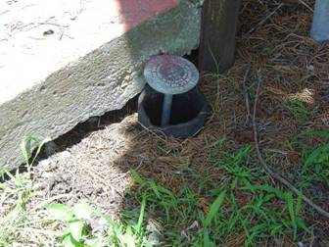
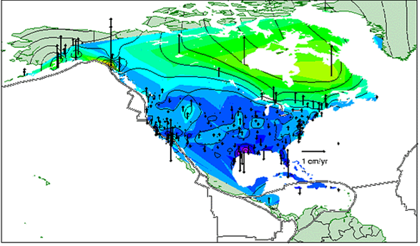
How accurate is the NSRS?
Crustal velocities
Passive networks are aging
(instability, accessibility, loss)

Slide 9
NEW VERTICAL DATUM
(Rationale)
  To be consistent with the shift in the geometric reference frame/ellipsoid (2022)
  Improvement in our technical abilities in reference surface realization (geopotential gravimetric reference surface - 1cm accuracy of geoid (GNSS/GRAV-D))
  The new geopotential reference surface will be aligned with the geometric reference frame/ellipsoid (i.e., no hybrid geoid)
  A move away from differentially leveled passive control as the defining mechanism of the reference surface

Slide 10
NEW VERTICAL DATUM
(Rationale)
  The technology to make accurate vertical heights measurements with GNSS technology
  To provide vertical access to formerly prohibitive places
  To allow monitoring of physical or geophysical datum deformation

Slide 11
Orthometric Height (H)
The distance along the plumb line from the geoid
to the point of interest
Earth’s
Surface
H (NAVD 88)
H
NAVD 88 reference level
The Geoid
Errors in NAVD 88 : ~50 cm average,
100 cm CONUS tilt,
1-2 meters average in Alaska
NO tracking

Slide 12
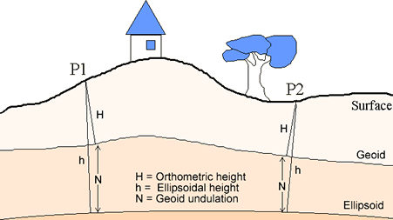
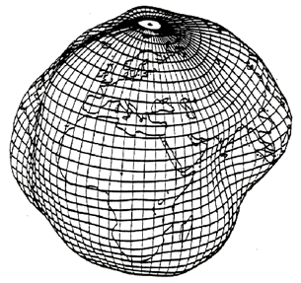
What is Geodesy?
Geodesy (geodetic control) is a foundational science that defines position & height
Why is Geodesy important?
The Earth is an irregular surface and is difficult to model. Accurate positions are required for a wide variety of applications

Slide 13
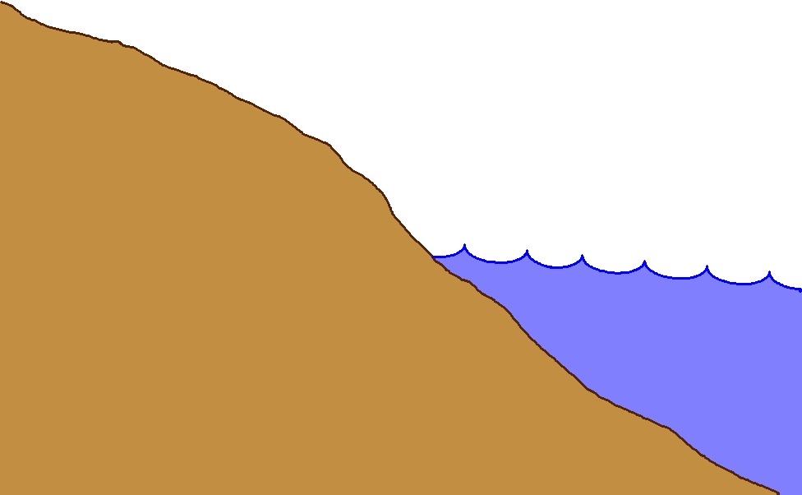
Gravity measurements help answer two big questions…
How “high above
‘sea level’ ” am I?
(FEMA, USACE,
Surveying and
Mapping)
How large are
hydrodynamic processes?
(Coast Survey, CSC,
CZM)
Earth’s
Surface
Geoid
Coast
Ocean
Surface
Ellipsoid
From
Gravity
From
GPS
From
Satellite Altimetry
Notes:
This slide is an idealized situation demonstrating the usefulness of near-shore gravity, specifically the use of such gravity to accurately compute a gravimetric geoid model. (The geoid is the one unique equipotential surface of the Earth’s gravity field which best fits, in a least-squares sense, global mean sea level).
On land, the use of the Global Positioning System (GPS) for fast, accurate surveying is well documented. However the height determined by GPS refers to a highly idealized, mathematically simple surface known as the ellipsoid. Thus GPS heights are “ellipsoid heights”. Unfortunately, ellipsoid heights are non-intuitive in many ways. First, they can be dozens of meters different from heights above the geoid (known as orthometric heights, or more colloquially, but less correctly as “heights above sea level”). Secondly, ellipsoid heights do not give an accurate portrayal of how water will flow, due to their complete disconnect from the gravity field of the Earth. If one has an accurate model of geoid undulations (the separation between the geoid and ellipsoid), then one can take the GPS-derived ellipsoid heights, remove the geoid undulation, and arrive at your orthometric height (a.k.a. “height above sea level”). This is a significantly faster method of determining orthometric heights compared to traditional surveying methods of spirit leveling.
On the ocean, satellite altimetry is used to monitor sea level. However, because the satellite orbits are known relative to the ellipsoid, and the altimetric measurement is from satellite to sea surface, the resulting information is the height of the sea surface above the ellipsoid, often called the “sea surface height” or SSH. If one is interested, however, in the impact of winds, heating, currents and other phenomena on the ocean surface, then one must remove the gravitational impact on the ocean surface. That is, one must know the separation between the ellipsoid and the geoid over the ocean in order to remove this signal, and arrive at the residual value. This residual, the distance from the geoid up to the sea surface, is known by many names, the most common being “sea surface topography” (SST) or “dynamic ocean topography”.
Coastal areas prone to flooding would benefit both by knowing accurate land elevations (to aid in construction planning, floodplain mapping, etc) as well as knowing accurately how the near shore ocean processes work (to better model responses to hurricanes and other dynamic ocean phenomena). It is an unfortunate fact that the largest areas missing accurate gravity measurements are those areas immediately offshore. This is because ships with gravimeters can not get into these shallows, altimetrically derived gravity models are unreliable due to the inability to accurately compute near-shore tides, and terrestrial gravimeters can not measure in the water. The only practical option to collecting the near-shore ocean gravity data is through airborne based technologies.
Dr. Dru A. Smith
Chief Geodesist
NOAA, National Geodetic Survey
Dru.Smith@noaa.gov
1/11/2006

Slide 14
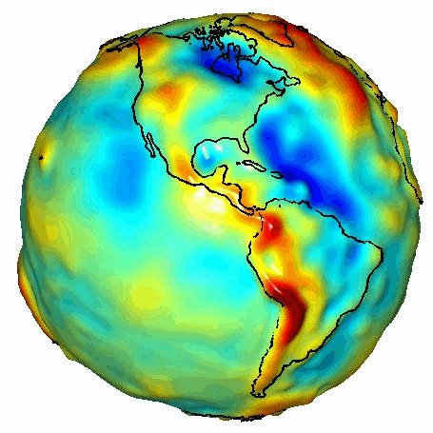
Exaggerated view of Earth’s gravity equipotential surface (“geoid”)
Notes:
The Geoid

Slide 15
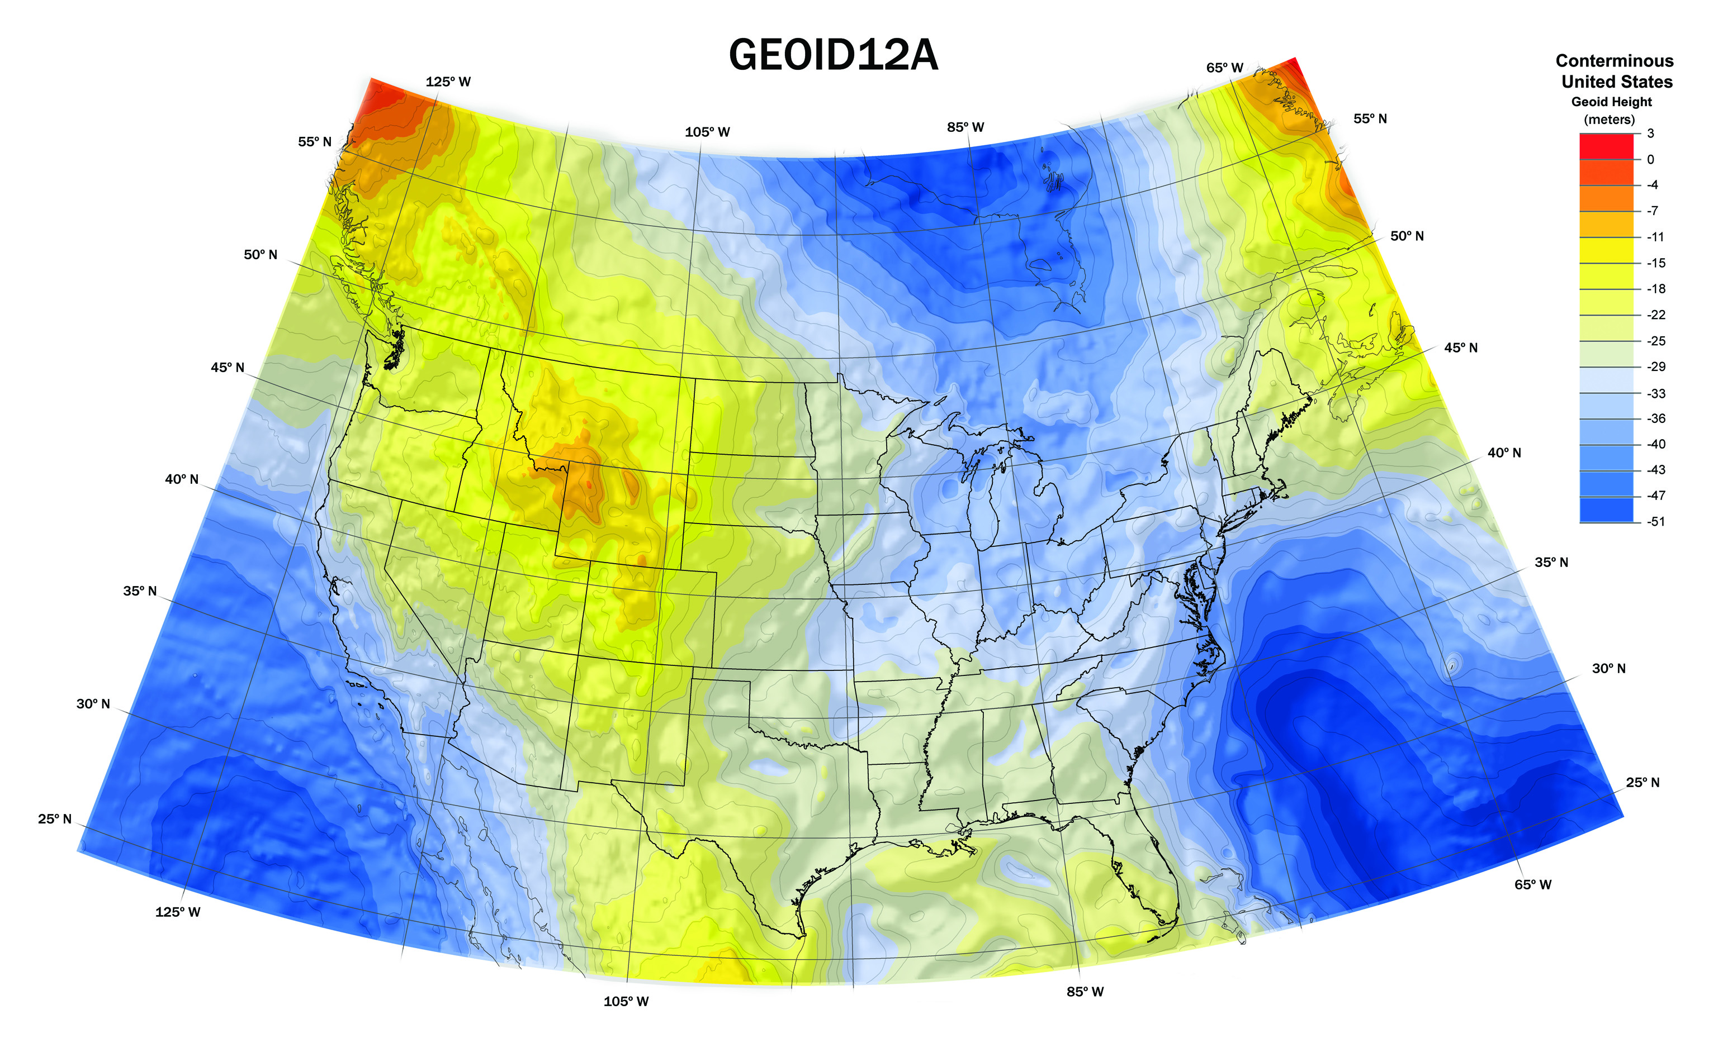
Approximate NAVD88 Reference Surface
Created by Brian Shaw
February, 2013

Slide 16
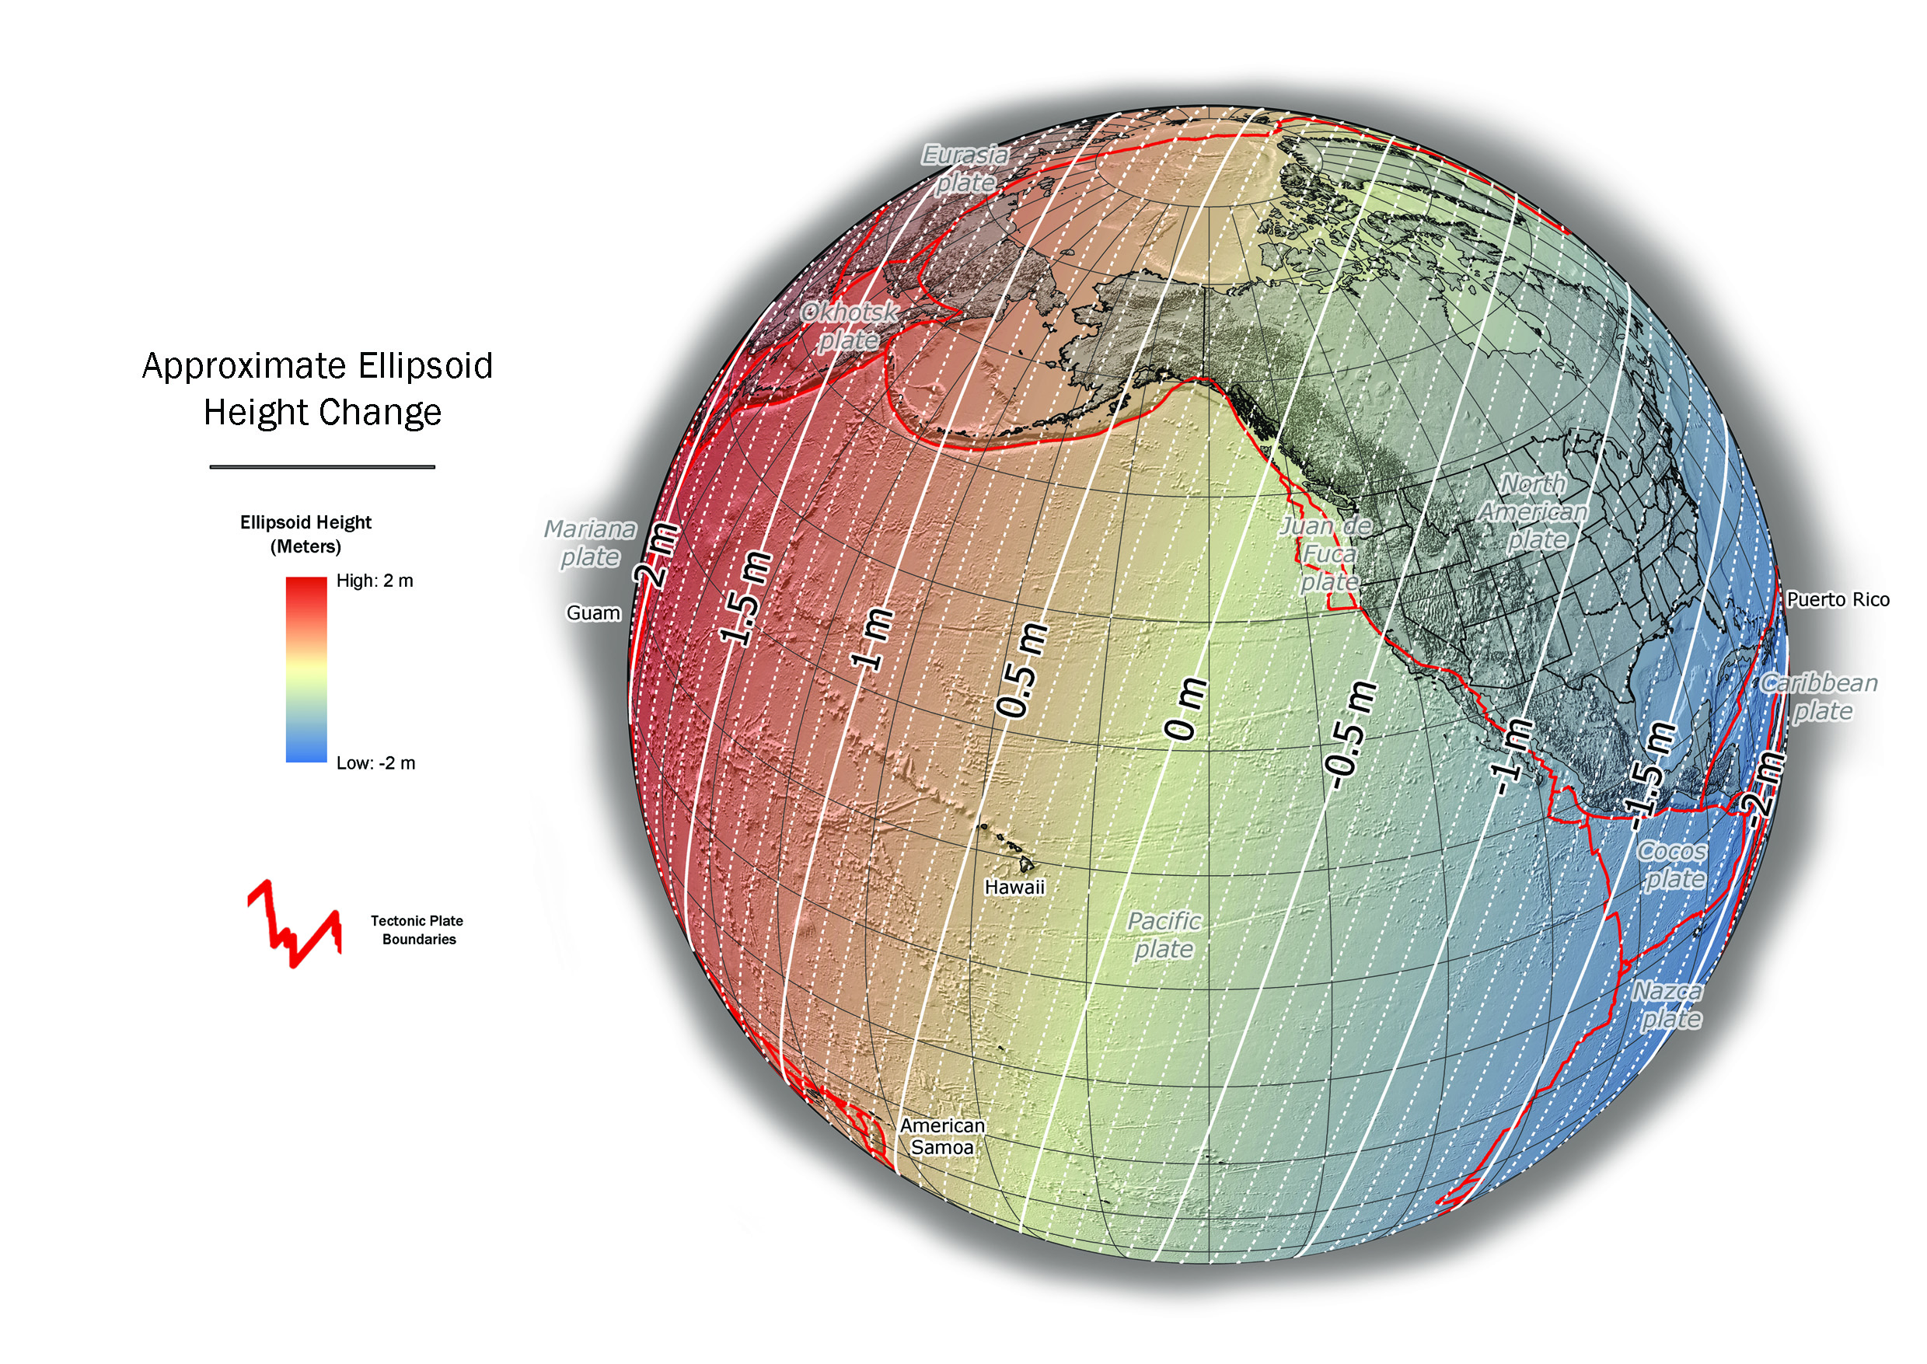
Approximate Ellipsoid Height Change

Slide 17
NEW VERTICAL DATUM
(Components)
Design and adopt new geometric reference frame (Geometric Datum Project)
Realize new geometric datum with existing passive/active control, i.e., a horizontal (geometric) adjustment
Definition of the W₀ surface as the new datum reference surface
Build a gravimetric geoid with an overall accuracy of 1 cm (GRAV-D Project)

Slide 18
Vertical Datum
(Status)
United States Gravimetric Geoid 2012 (USGG12)
Hybrid Geoid 2012 (GEOID12A)
2022 Definition of the Vertical Reference Surface

Slide 19
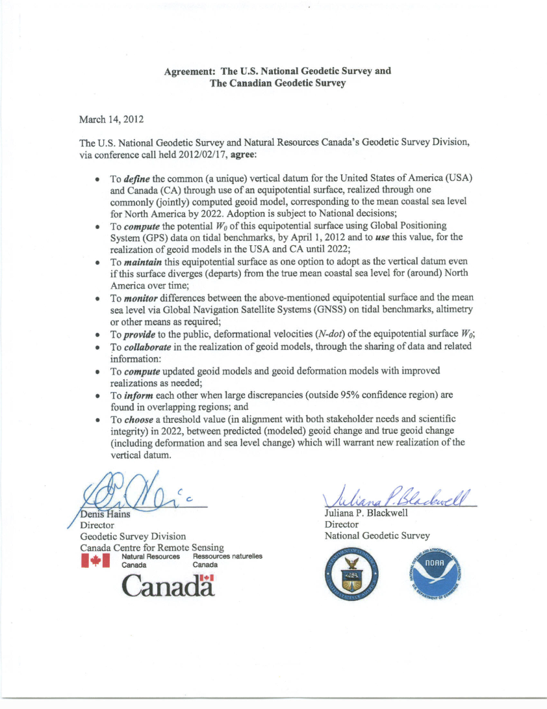
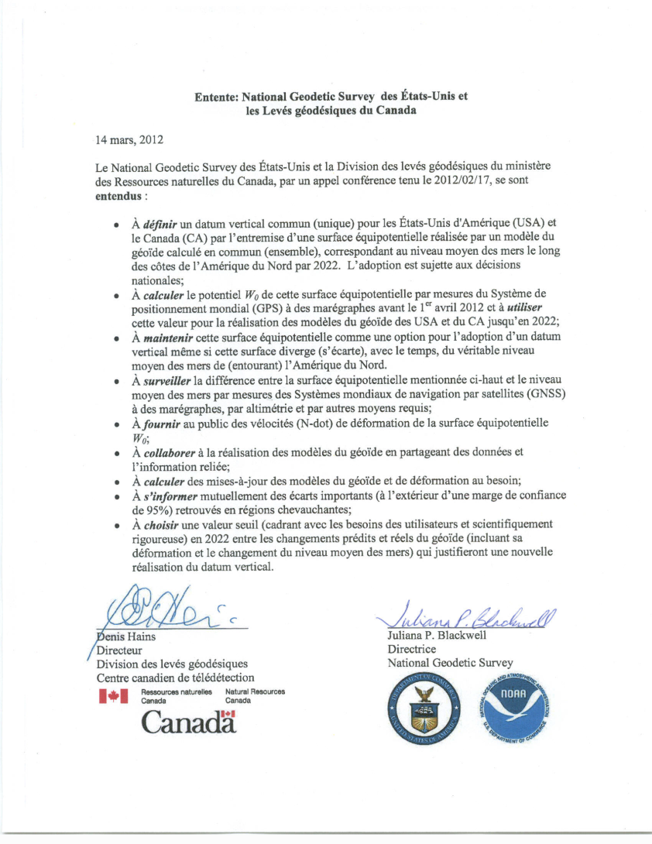
Agreement on W₀ Value

Slide 20
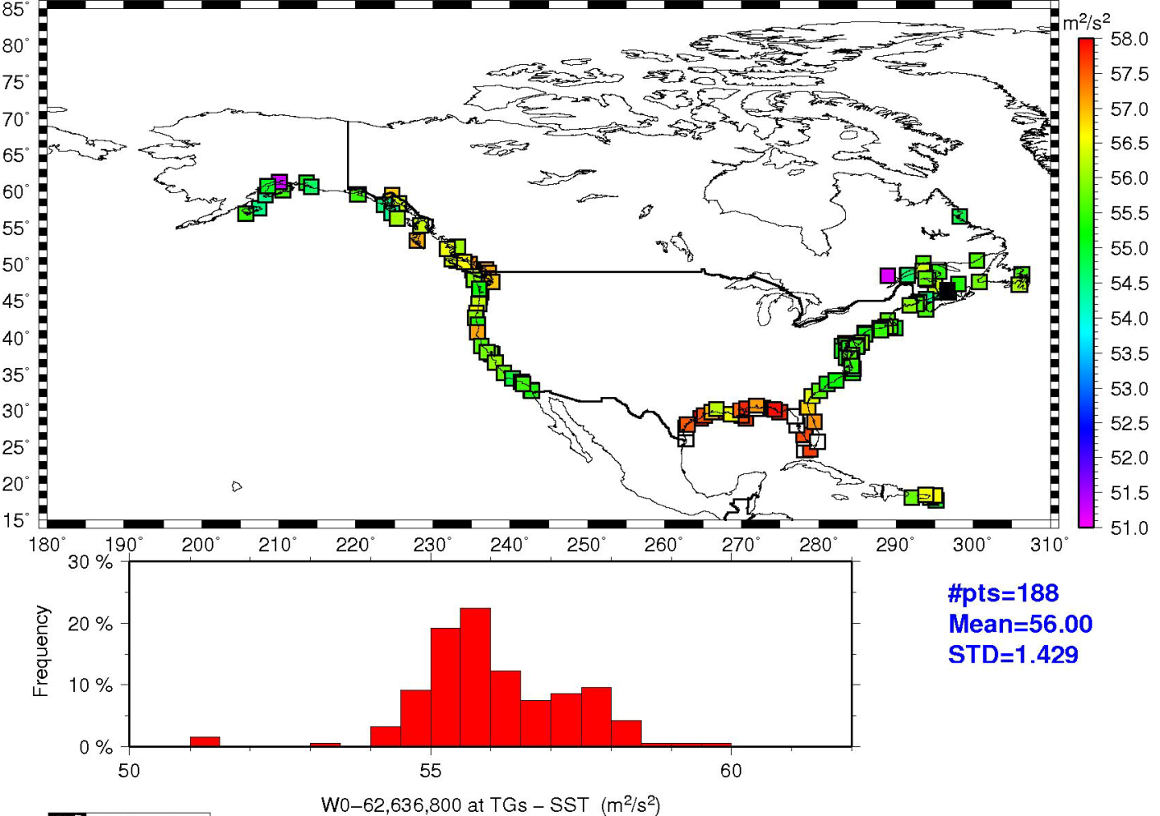
Tide Gauge comparisons limited to where SST models exist
62,636,856.00 m²/s²

Slide 21
Gravity for the Redefinition of the American Vertical Datum
(GRAV-D)

Slide 22
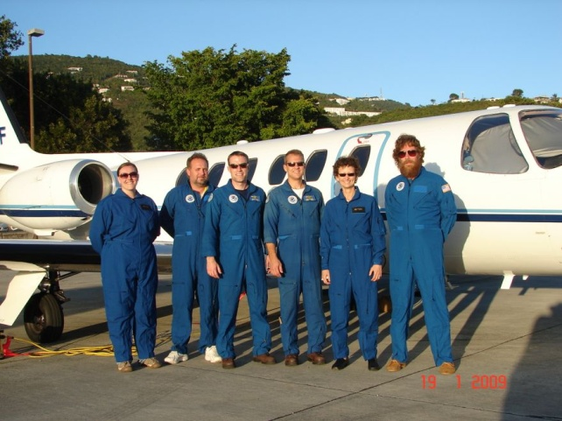
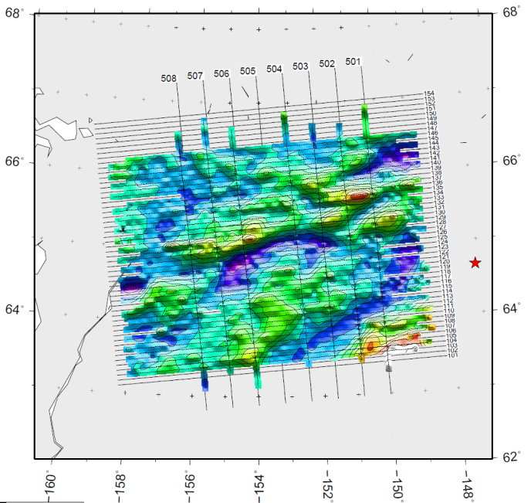
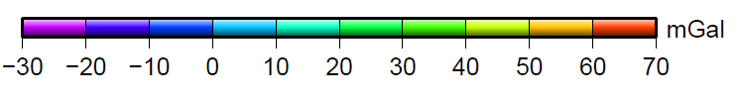
Gravity for the Redefinition of the
American Vertical Datum (GRAV-D)
GRAV-D
  Airborne gravity survey (10 years)
  Gravity monitoring into the future
  Coastal areas surveyed first
  All USA states and territories
  www.ngs.noaa.gov/GRAV-D
Targets:
  Orthometric heights (elevations relative to sea level) improved from meter level errors to 2 cm accuracy anywhere, anytime from GPS/GNSS technology
  Height changes easily monitored using new vertical datum

Slide 23
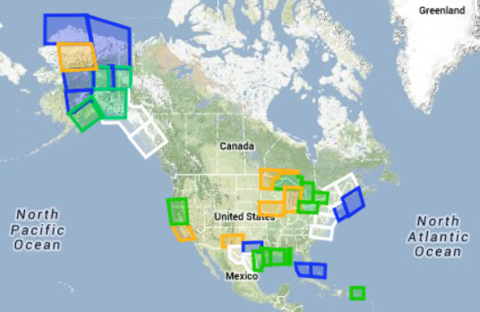
GRAV-D status
Data collection over 25% complete!
Green: Available data and metadata
Blue: Data being processed
Orange: Data collection underway
White: Planned for data collection

Slide 24
NEW VERTICAL DATUM
(Components)
Prepare a forward and backward vertical datum conversion strategy - points and maps/charts (ref: NC Pilot Project)
Work with FGCS for adoption of new/updated (FGCS Vertical Working Group):
  Standards of Accuracy
  Specifications
  Procedures, and
  Guidelines
Outreach

Slide 25
Using GNSS is cheaper, easier than leveling
To use GNSS we need a good geoid model
Future of Heights
GNSS – Global Navigation Satellite System
Notes:
GPS doesn’t provide the same results that you can get from leveling
We are still a long way off from completely replacing leveling
You can get mm accuracy from leveling. GPS can not provide that, at least not today. The biggest limitation is the fact we can not see the satellites on the other side of the hemisphere. Basic geometry applies.

Slide 26
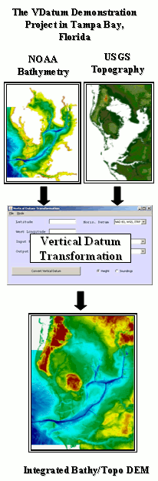
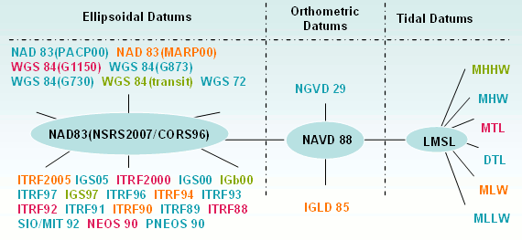
VDatum: Vertical Datum Transformation Tool
VDatum is a software tool capable of transforming coastal bathymetry and land topographic elevations between 36 different vertical datums.
http://vdatum.noaa.gov/

Slide 27
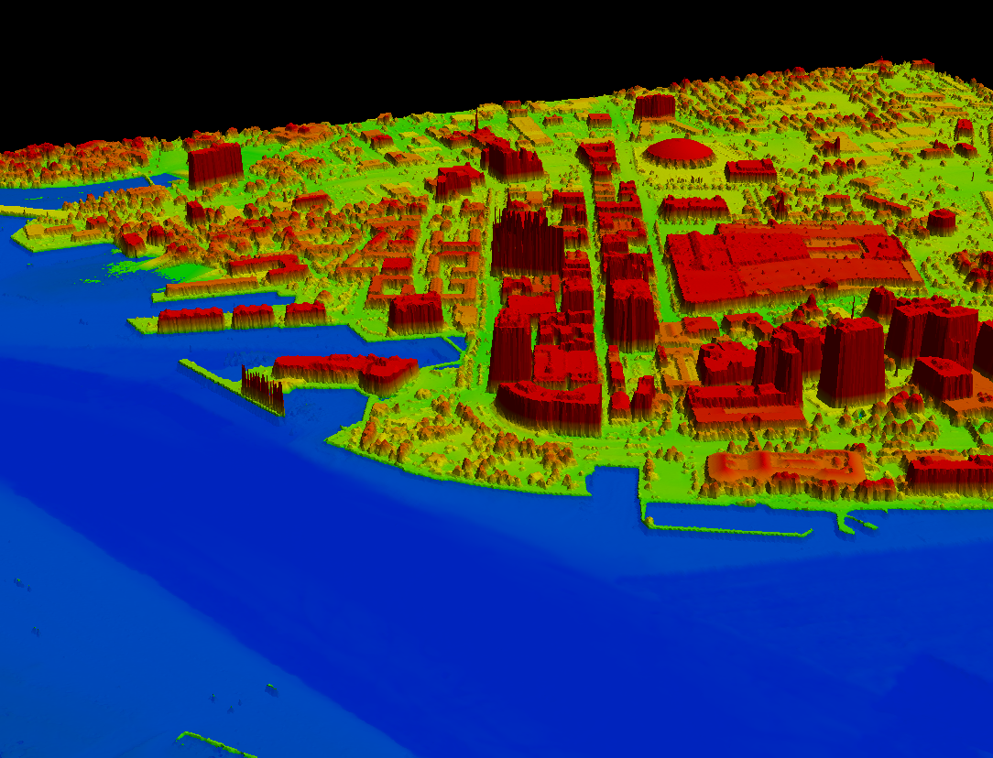
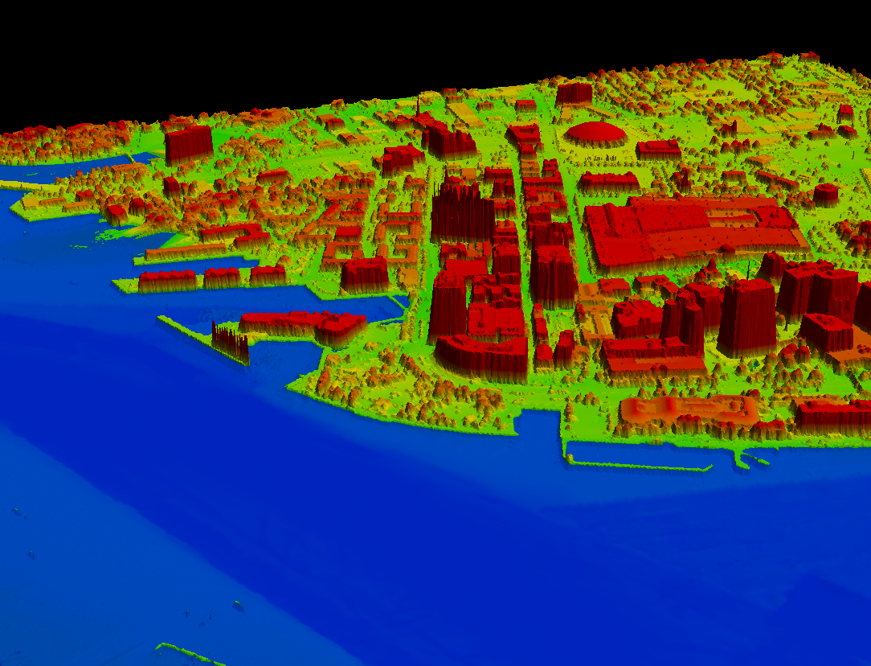



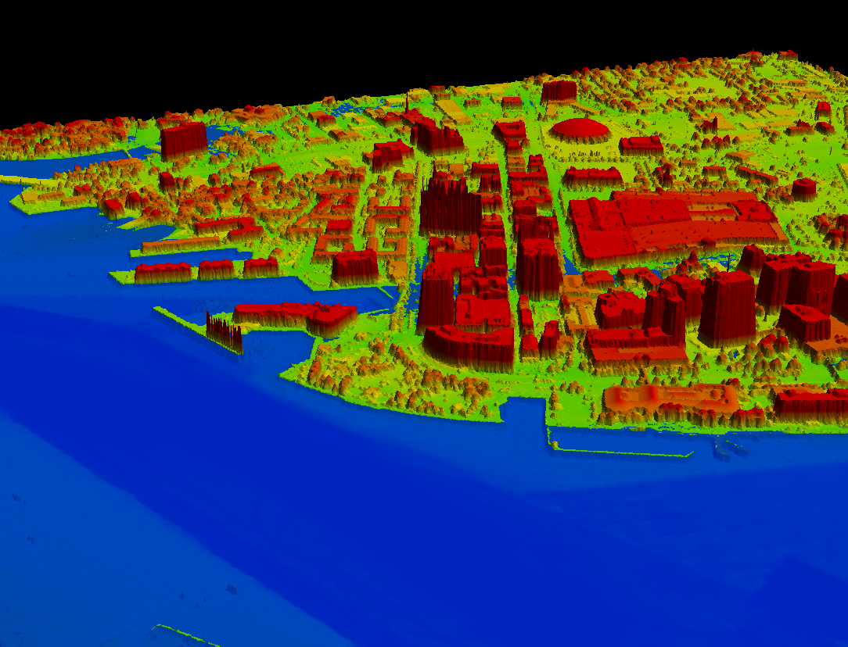
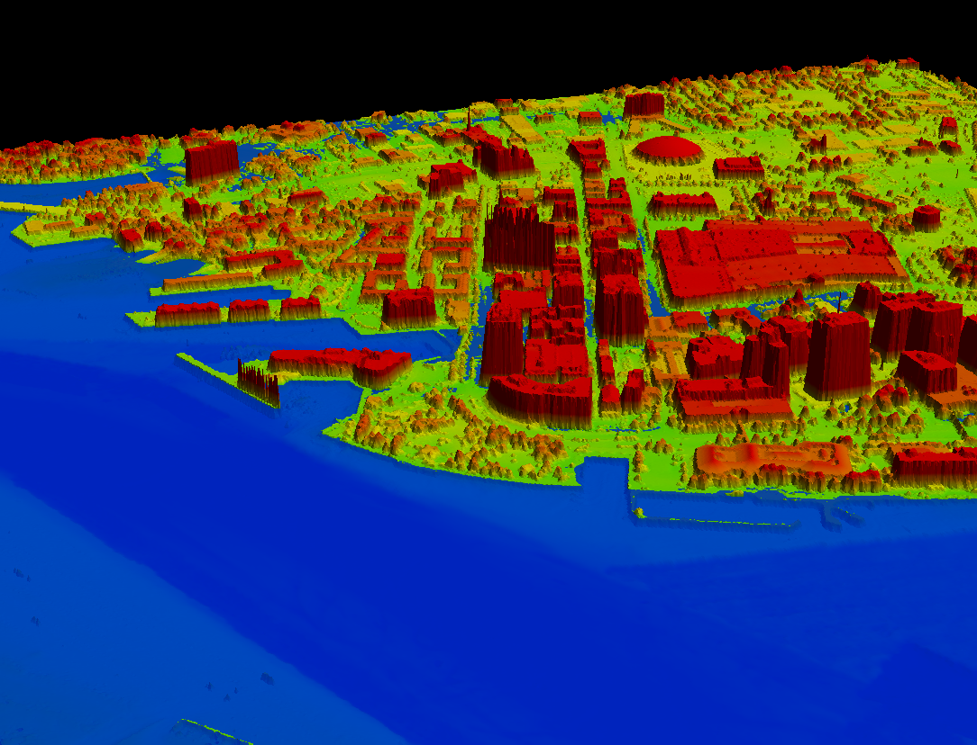
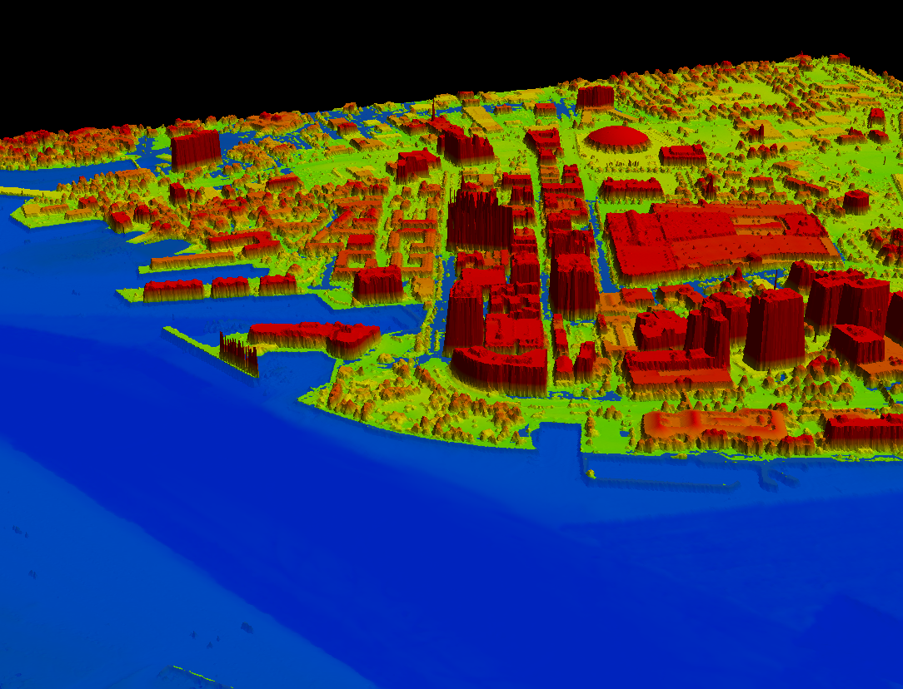
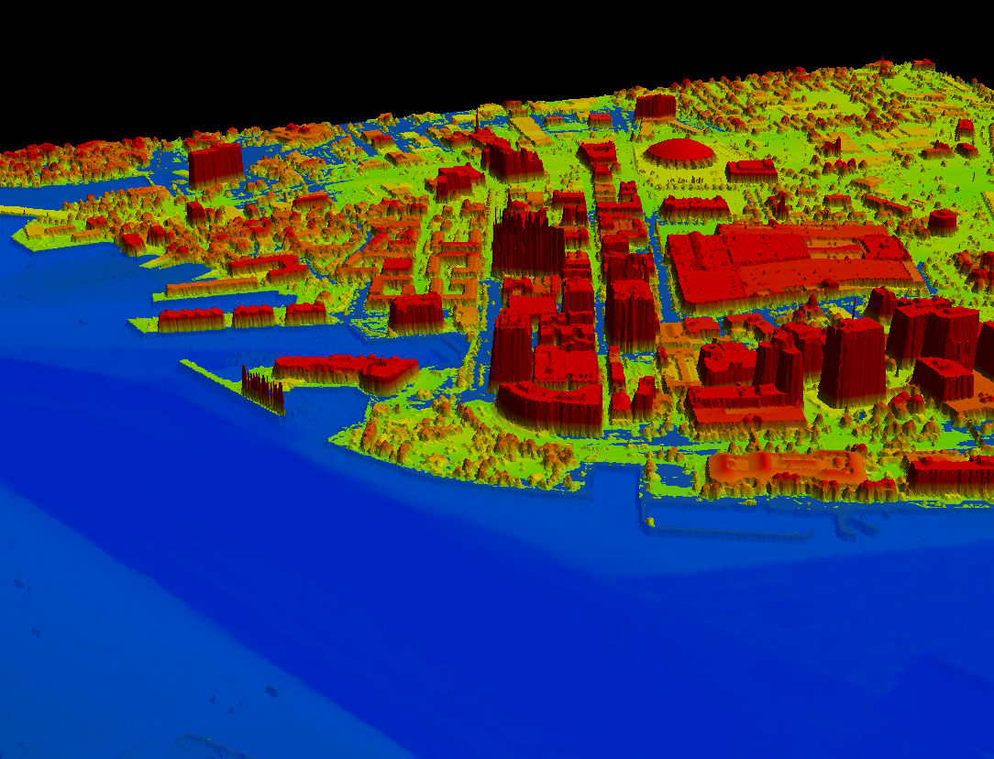
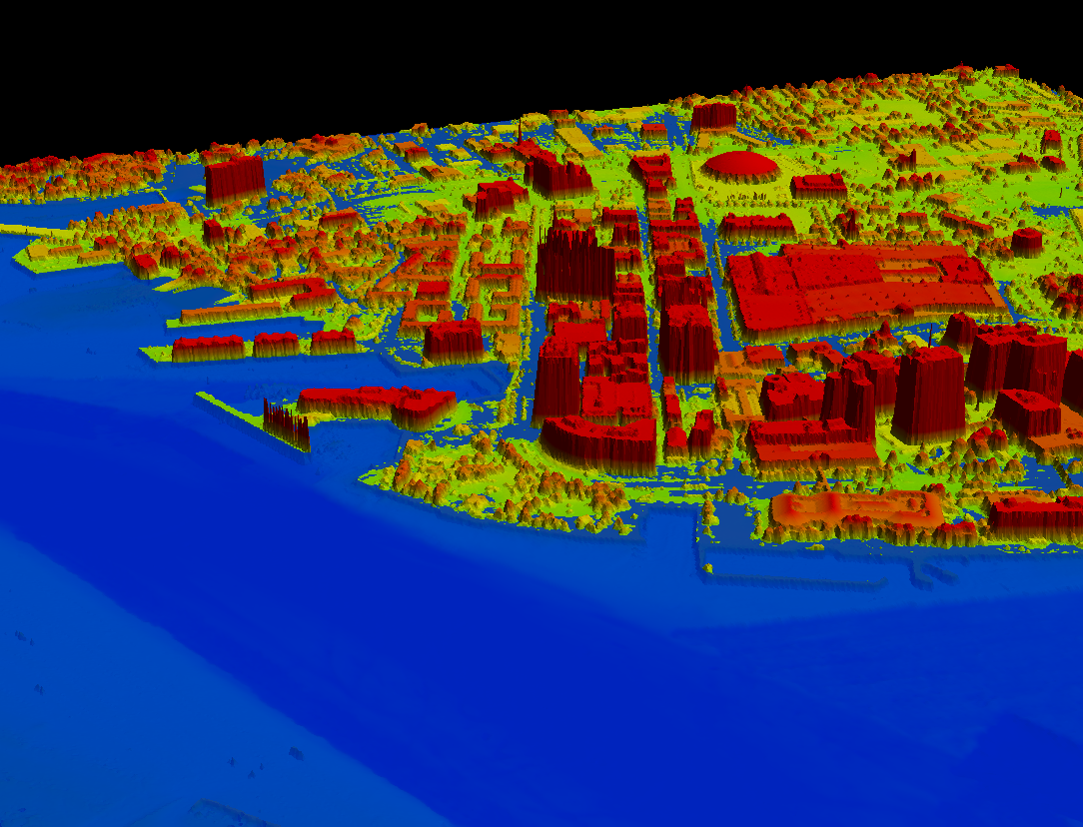

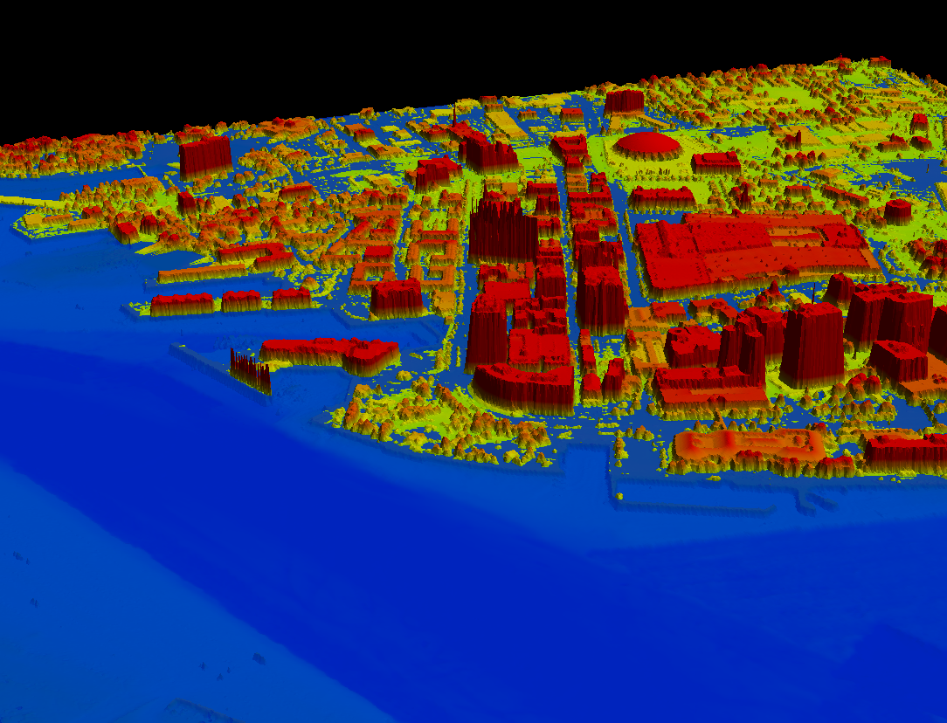
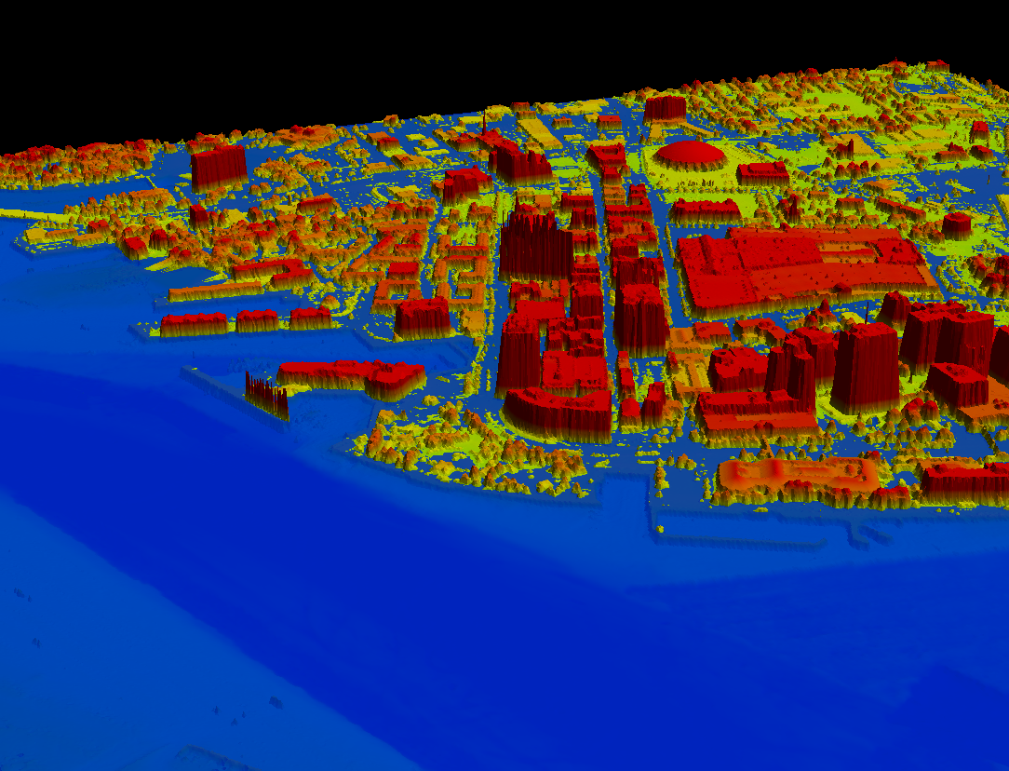
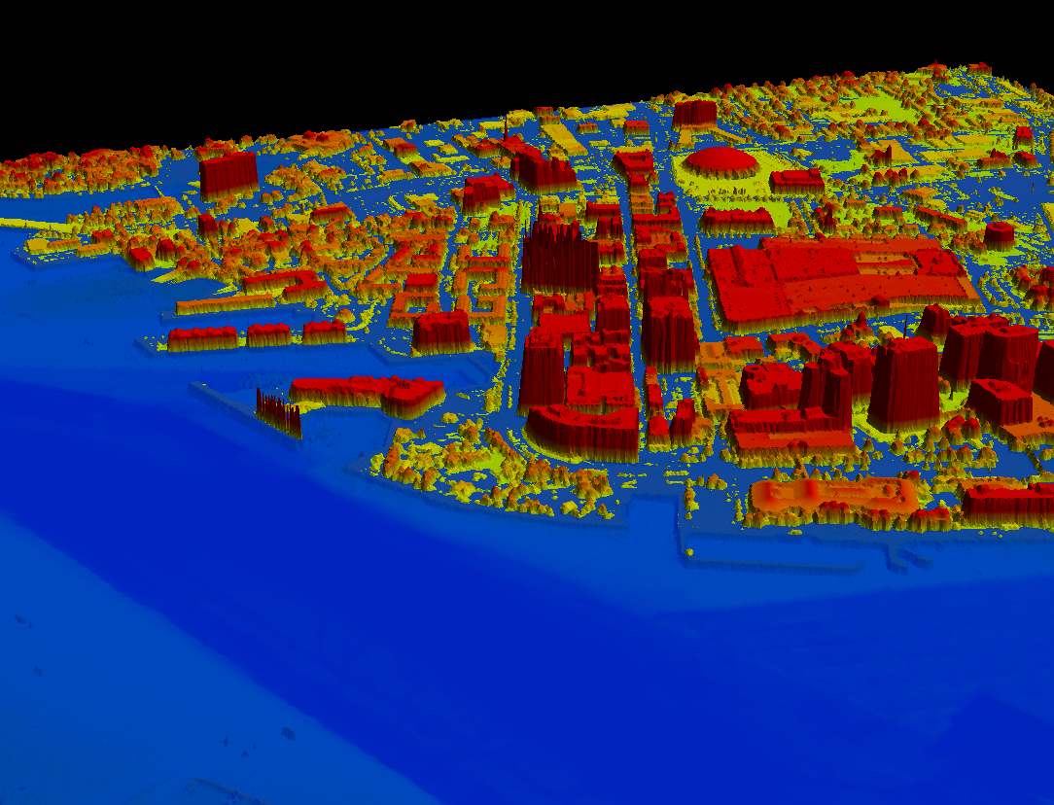
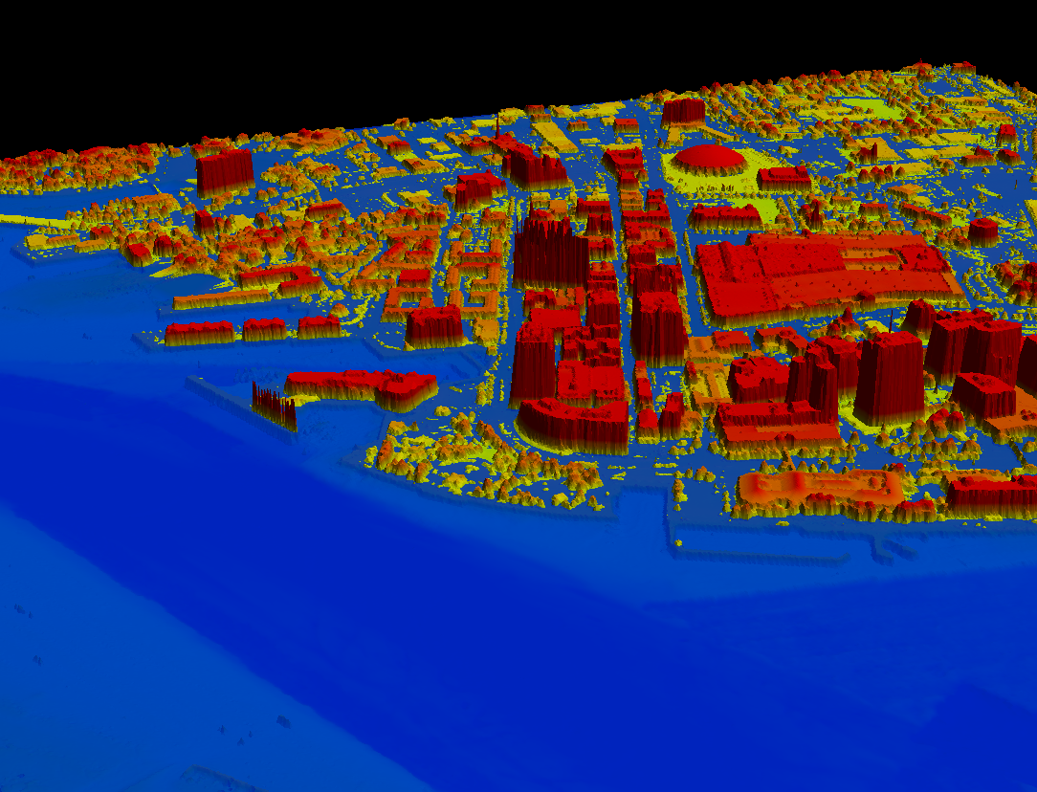
The future: Integrated products and services to help predict local flooding, such as this Norfolk, Virginia model.
Simulation of 11.5 ft. increase in water level
Notes:
an example of how integrating the data through GIS and other tools can provide solutions to a challenging future….
Example of integrating water level, geodetic, remote sensing and bathymetry data
Simulates a storm surge of 11.5ft in downtown Norfolk, VA
Airborne topographic LiDAR data collected by NGS was merged with MLLW referenced hydrographic survey data from NOAA’s Office of Coast Survey
VDatum for Chesapeake Bay used to resolve datum differences and to transform to a common NAVD88 vertical reference
Result is an integrated high resolution model of both topography and bathymetry that can be used for a wide variety of coastal flooding applications.

Slide 28
The End!
Questions?
mark.eckl@noaa.gov
michael.dennis@noaa.gov

