Slide 1
VDatum
Vertical Datum Transformation Tool
Stephen A. White
(Program Manager)
May
10, 2018

Slide 2
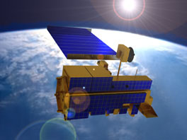
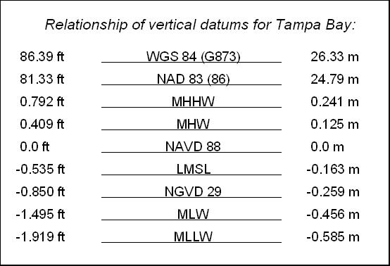
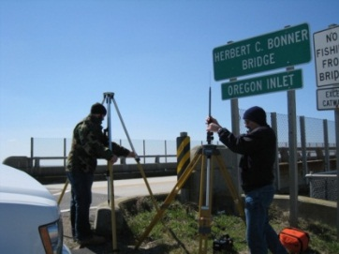
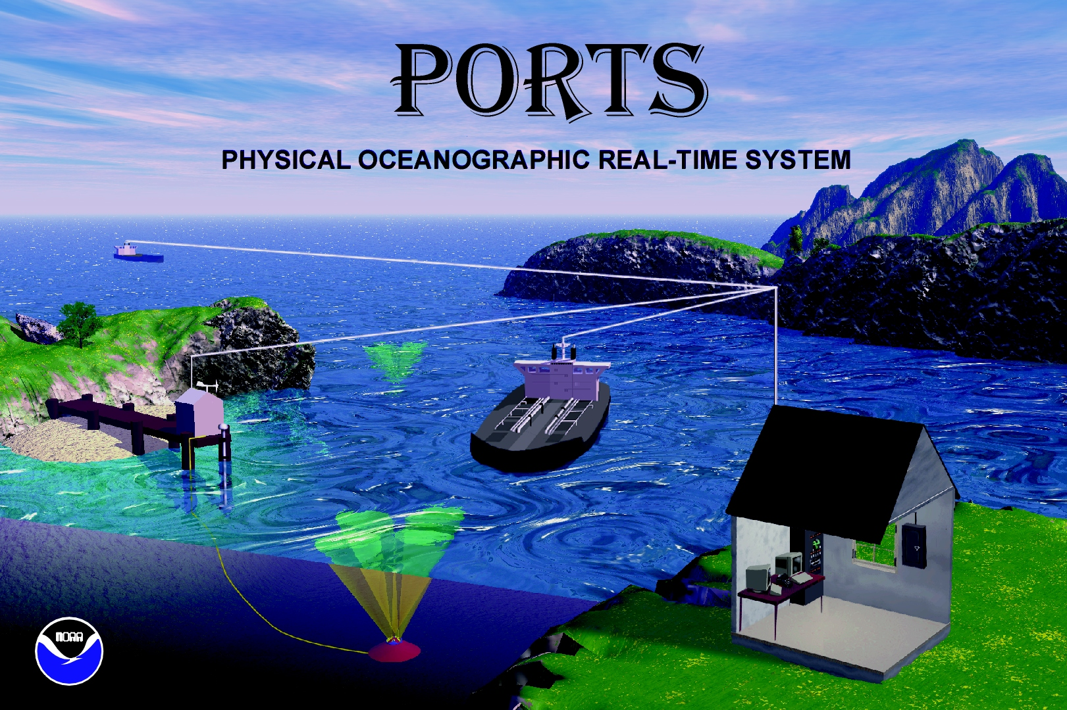
All elevation data is referenced to a vertical datum.
Ellipsoid Datums
BUT there are a many different vertical datums in use around the nation
ITRF,
WGS 84,
NAD 83 (NSRS)
```
Orthometric Datums
NAVD 88, NGVD 29
Tidal Datums
For elevation data sets to be blended together they must be referenced to same vertical datum.
MHHW, MHW, MTL, DTL, LMSL, MLW, MLLW

Slide 3
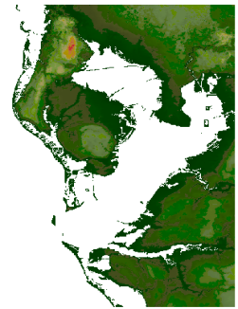
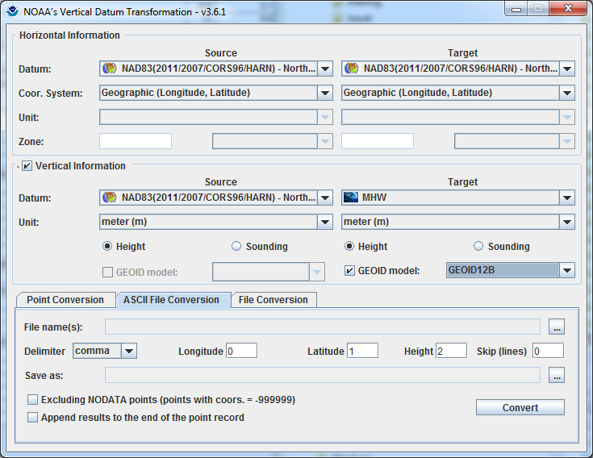
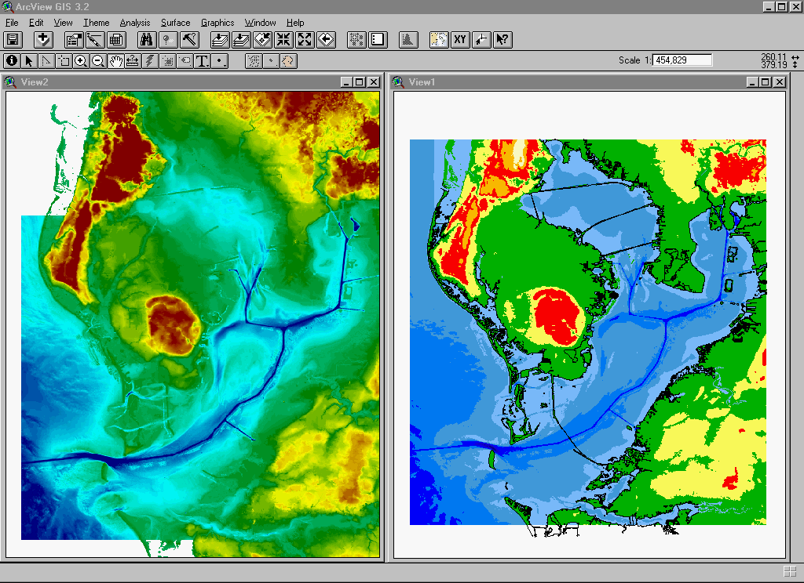
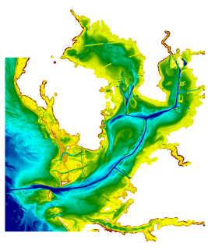
Development and Use of VDatum
Mapping the Land-Sea Interface: VDatum converts elevation data (heights and soundings) among different vertical datums
USGS Topography
NOAA Bathymetry
VDatum is a Java application developed jointly by :
National Geodetic Survey (NGS)
Office of Coast Survey (OCS)
Center for Operational Oceanographic
Products & Services (CO-OPS)
Notes:
Vertical Datum Transformation (VDatum) is a free software tool under development jointly by NOAA's National Geodetic Survey (NGS), Office of Coast Survey (OCS) and Center for Operational Oceanographic Products and Services (CO-OPS). VDatum is designed to vertically transform geospatial data among a variety of tidal, orthometric and ellipsoidal vertical datums - allowing users to convert their data from different vertical references to a common system , enabling the fusion of diverse geospatial data onto a preferred vertical datum.

Slide 4
3 Categories of Vertical Datums:
3D/Ellipsoidal Datums:
  Realized through space-based systems, such as GNSS/GPS
Orthometric Datums:
  Based on a form of mean sea level
Tidal Datums:
  a standard elevation defined from water level observations during a specific phase of the tide

Slide 5
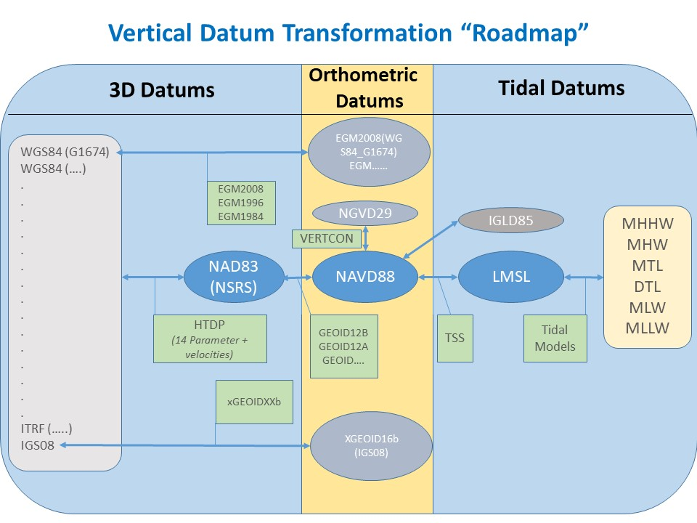

Slide 6
VDatum
Applications

Slide 7
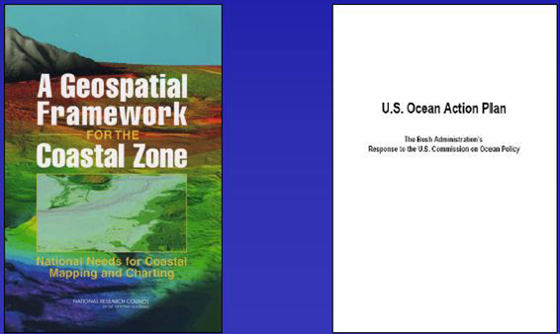
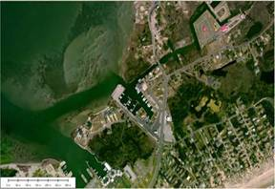
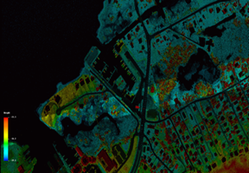
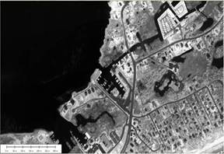
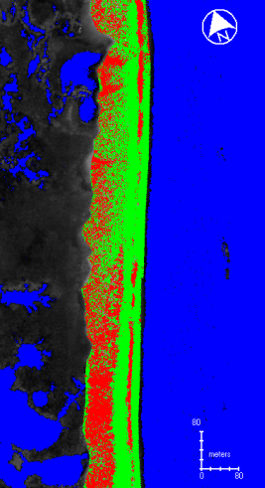
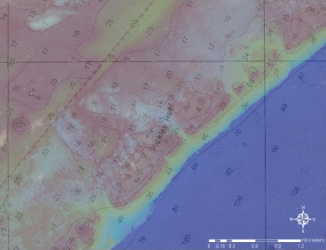
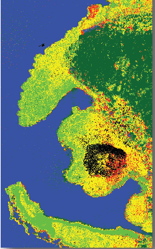
Integrated Ocean and Coastal Mapping (IOCM)
The practice of acquiring, managing, integrating and disseminating ocean and coastal geospatial mapping data in such a manner that permits these data and their derivative products to be easily accessed and used by and for the greatest range of users and purposes.
IOCM requires intra- and inter-agency coordination with a focus on streamlining operations, reducing redundancies, improving efficiencies, developing common standards, and stimulating innovation and technological development.
Notes:
These objectives of increasing intra- and interagency coordination and promoting multi-use of geospatial data are gaining a lot of traction.
One important driver was a 2004 National Research Council Report titled “A Geospatial Framework for the Coastal Zone: National Needs for Coastal Mapping and Charting.”
Key recommendation: increasing coordination and collaboration on ocean and coastal mapping across the federal gov.
Stimulated several other reports/initiatives, including the U.S. Ocean Action Plan. It turn, that led to the creation of the Interagency Working Group on Ocean and Coastal Mapping (IWG-OCM).
NRC Report
Consistent spatial framework for coastal data the allows a seamless transition from onshore to offshore
Increased collection and availability of data including land cover, shallow-water bathymetry, seafloor imagery, habitat distribution and classification standards
Easy access to up to date digital, geospatial data, imagery and mapping products
Compatibility among data formats – or standards and transformation protocols that allow each data exchange – and a means to evaluate data accuracy.
Increased inter- and intra-agency coordination, cooperation and communication.
U.S Ocean Action Plan
Develop and annual inventory of federal, federally-funded, and non-federal governmental ocean and coastal mapping programs and operations
Assess and report on common and shared needs for development of coordinated programs
Coordinate and leverage resources and efforts across the federal sector with industry, academic, NGO and non-federal government entities
Set priorities for standards development and developing strategies for promulgation of standards for data acquisition, data, metadata, tools and products
Develop shared and standardized mechanisms for processing, archiving, and distributing geospatial data, tools, products and services

Slide 8
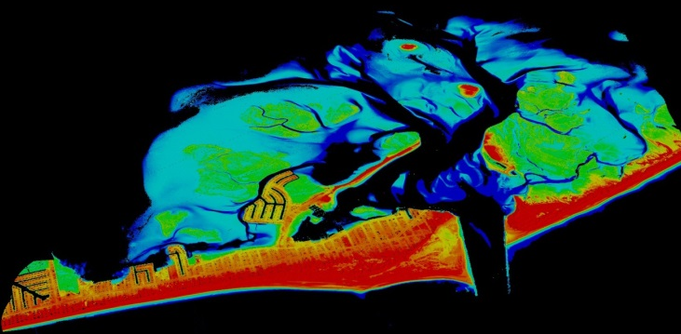
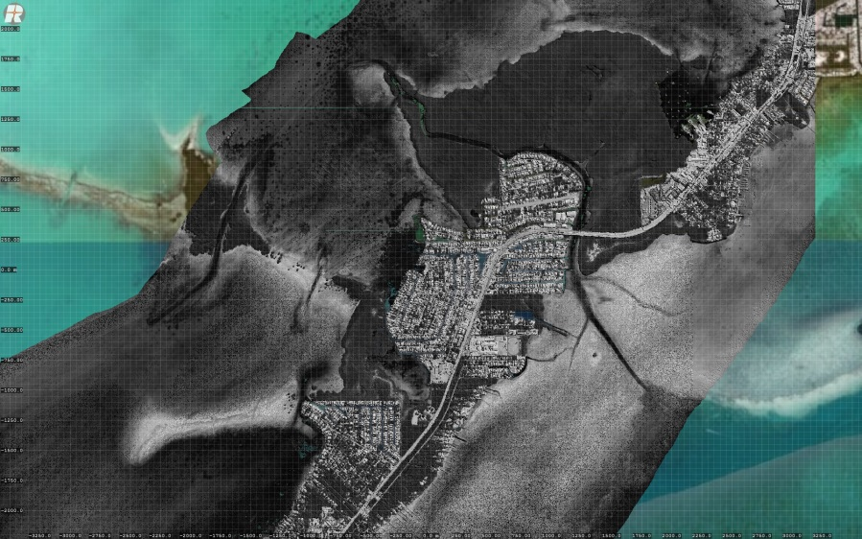
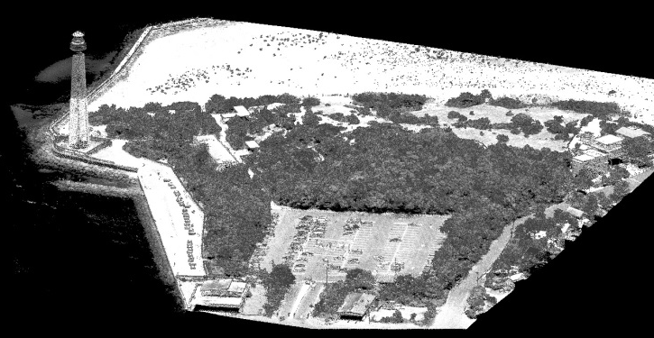
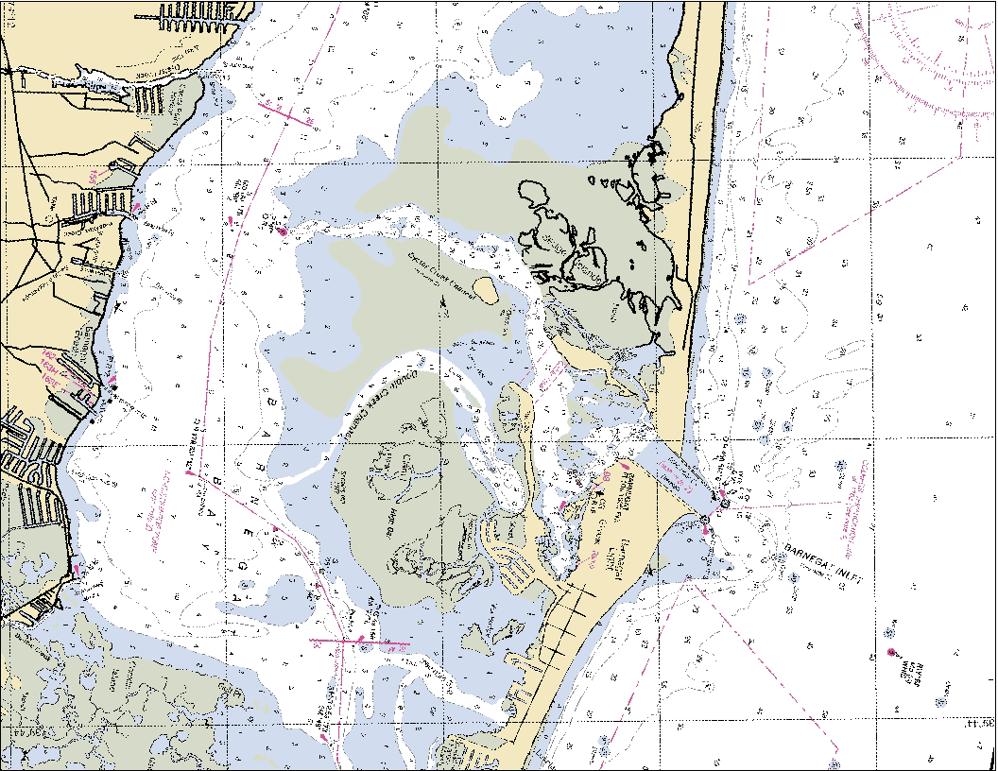
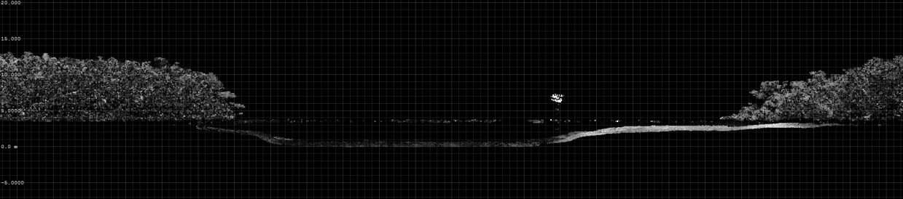
TopoBathy Lidar

Slide 9

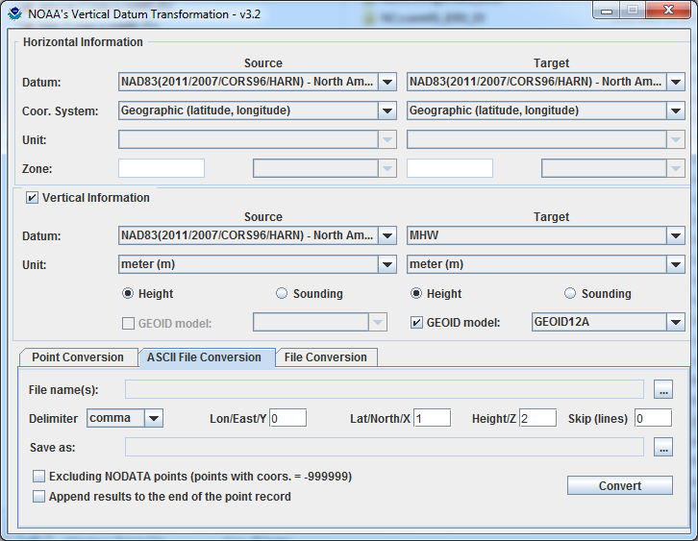
VDatum: Used to Create Digital Elevation Models
Topo/ Bathy
Digital Elevation Model
Topography
VDatum
Bathymetry
Applications for Seamless Bathy/Topo Datasets:
Inundation modeling from storm surge, tsunamis, and sea level rise.
Erosion, accretion, renourishment
Analyzing storm impacts
Determining setback lines
Determining local, state, and national boundaries
Navigation products and services
Habitat restoration
Shoreline Change Analysis
Analyzing environmental and natural resources
Permitting
Notes:
Merging data sets in coastal areas is important in a range of applications. VDatum enables spatial information from different environmental sectors to be mapped onto one uniform surface.

Slide 10
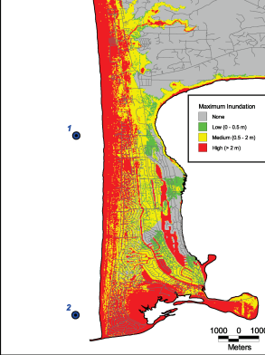
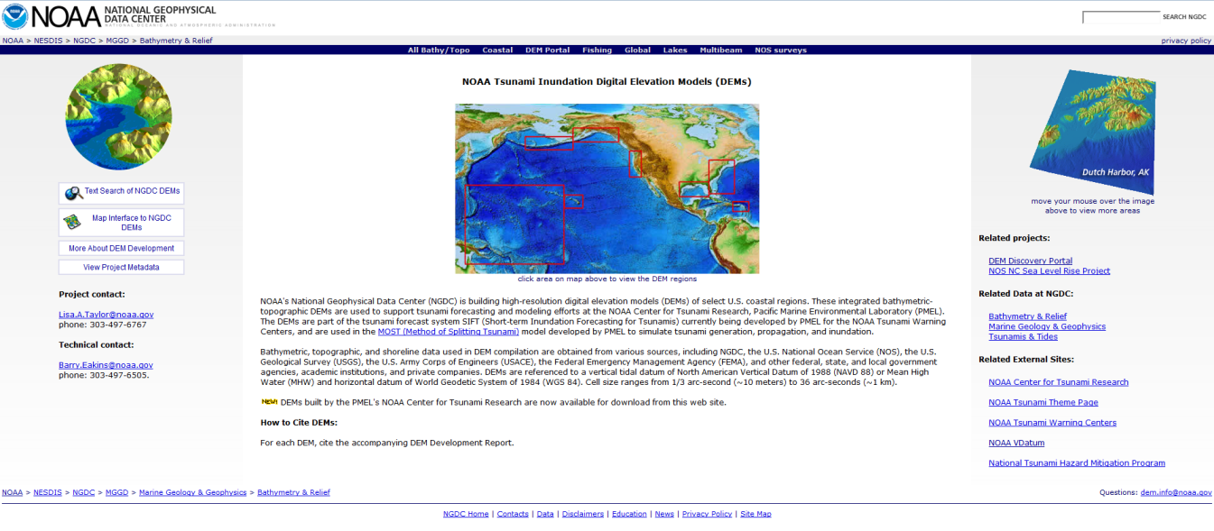
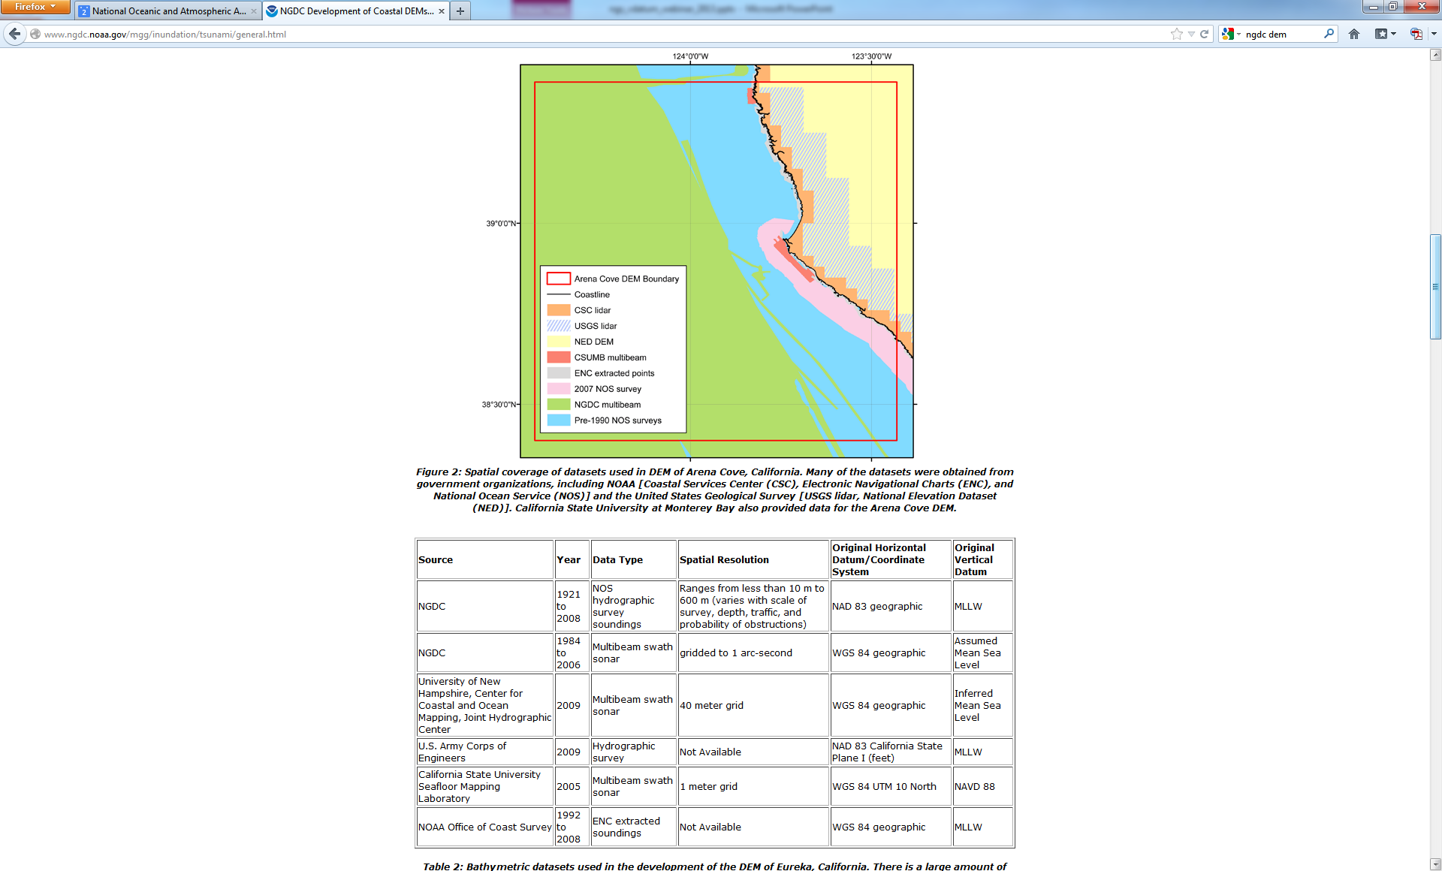
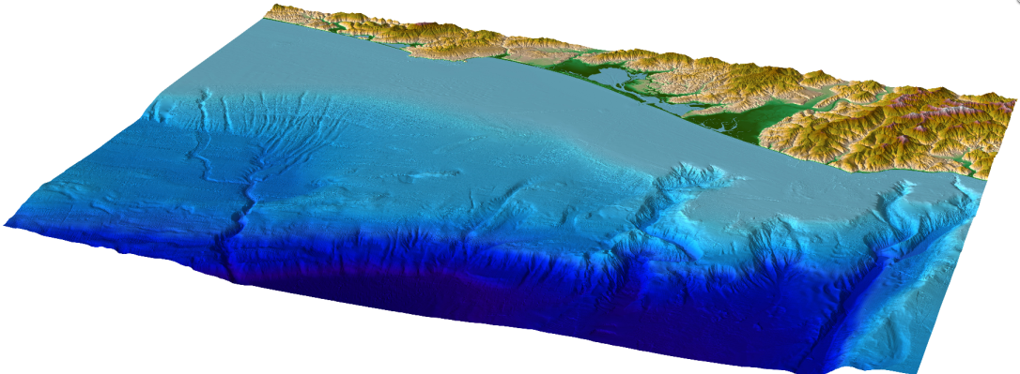
Utilizing VDatum for Digital Elevation Model Creation: Tsunami Inundation

Slide 11
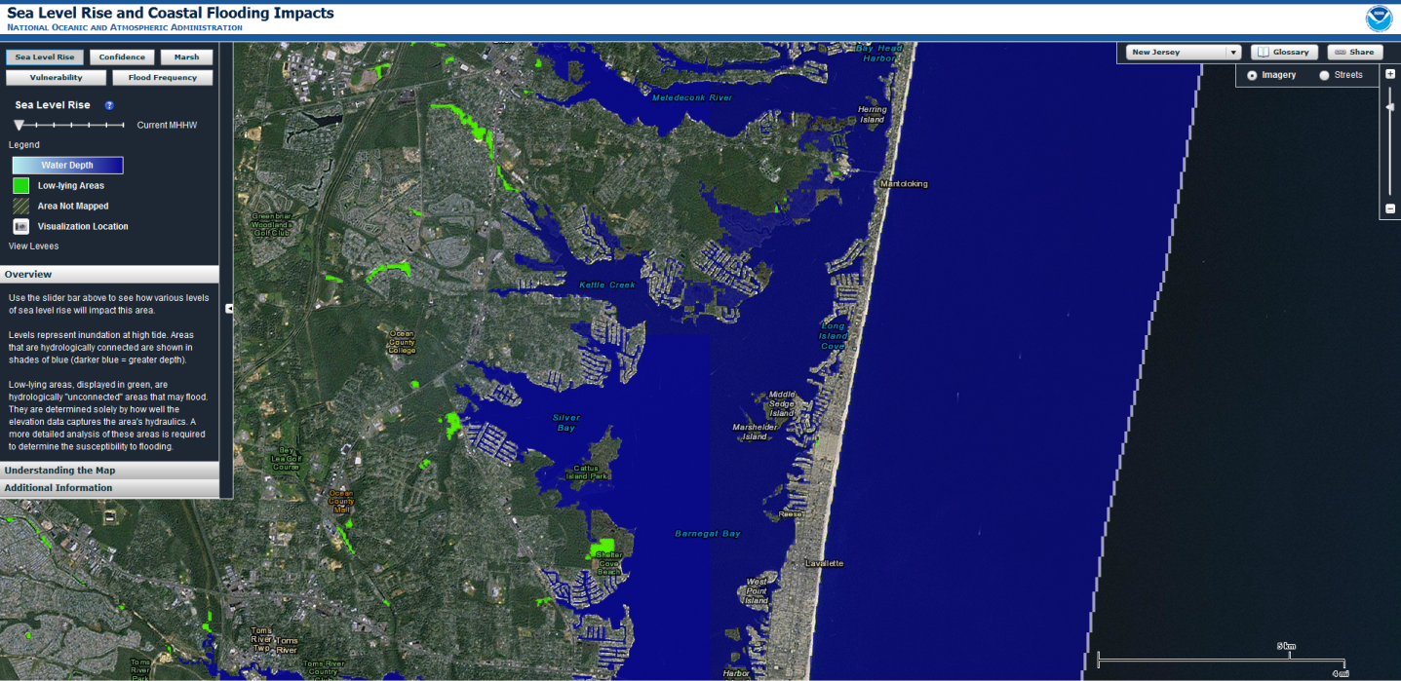
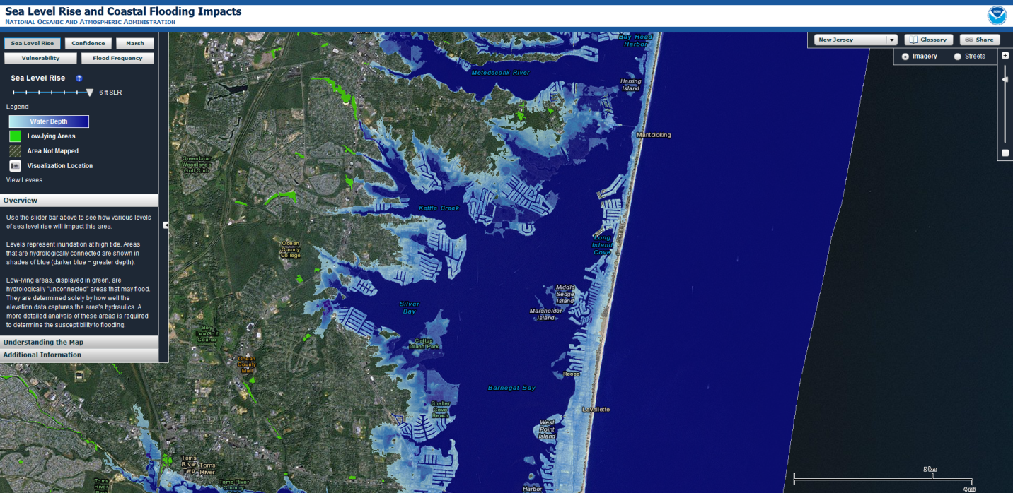
Sea Level Rise/Coastal Flooding

Slide 12
Additional Applications
  Coastal Inundation/Sea Level Rise/Tsunami Modeling
  Erosion/Accretion/Shoreline
  Change
  Habitat/Wetland Restoration
  Dredging and Infrastructure Engineering (levees, jetties)
  Floodplain Mapping
  Topobathy DEM Creation
  Civil and Water Works Projects
  Easement and Setback Planning
  Marine Construction
  Coastal Engineering
  Coral Reef Mapping
  Analyzing Storm Impacts
  Real Estate Mapping
  Evacuation Route Mapping
  Site Management
  Insurance Studies
  Hazardous Waste Site Studies
  Groundwater mapping and modeling
  Feasibility Studies and Planning,
  Determining Local, State and National Boundaries
  Permitting
  Analyzing Environmental and Natural Resources
  Emergency Response
  ??? What Can You Imagine ???

Slide 13
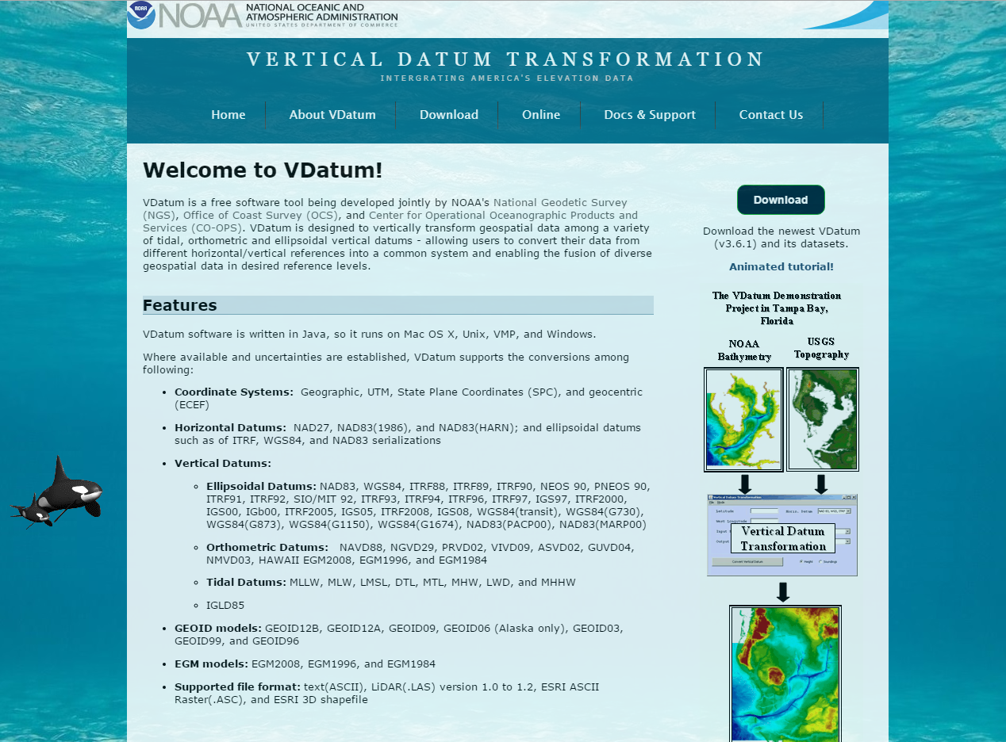
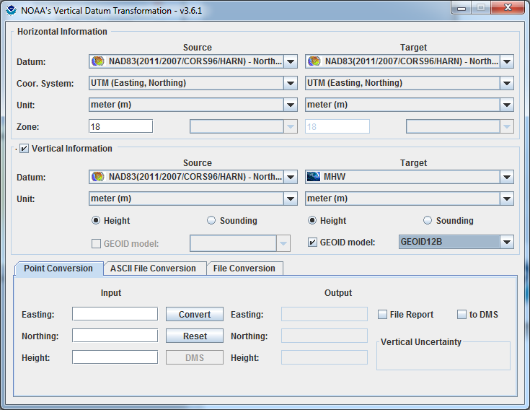
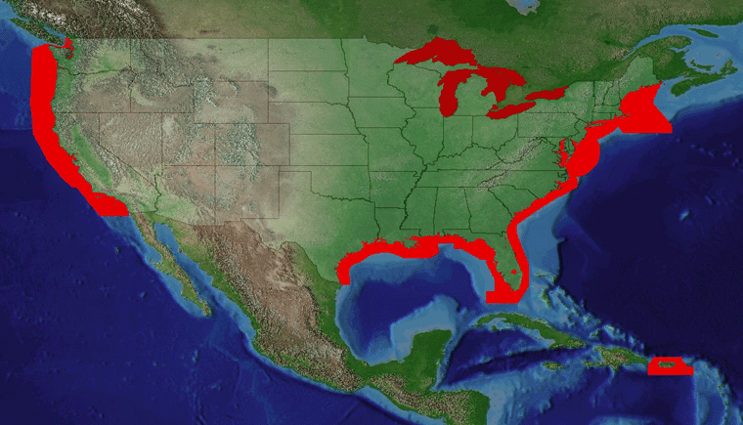
VDatum Website: vdatum.noaa.gov
(Version 3.8 Released, March 6, 2018)

Slide 14
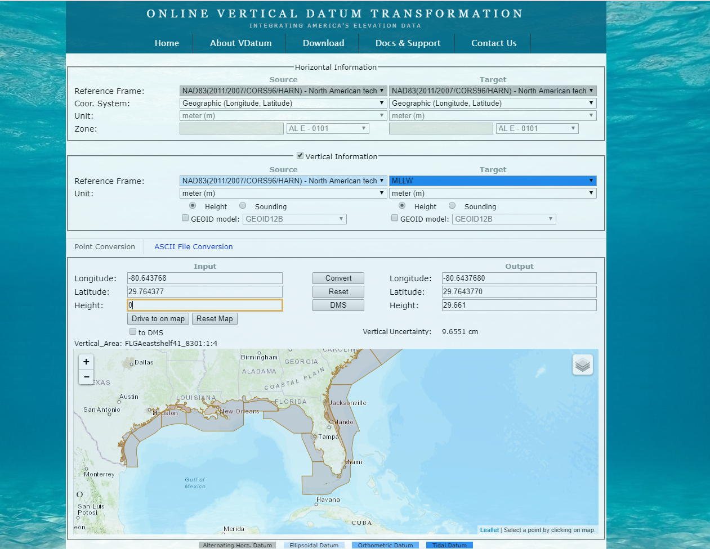
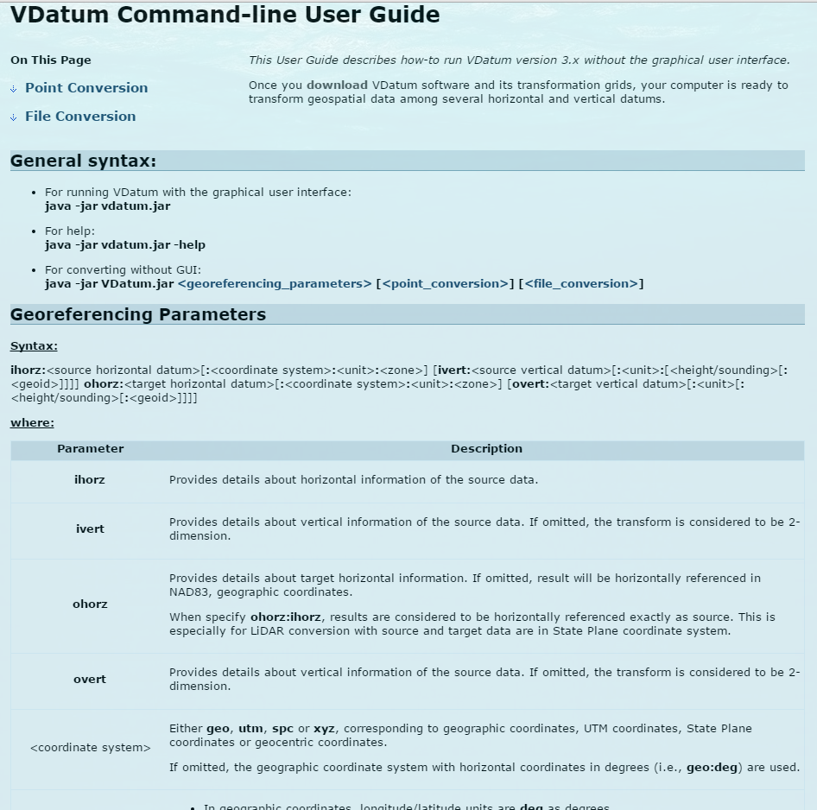
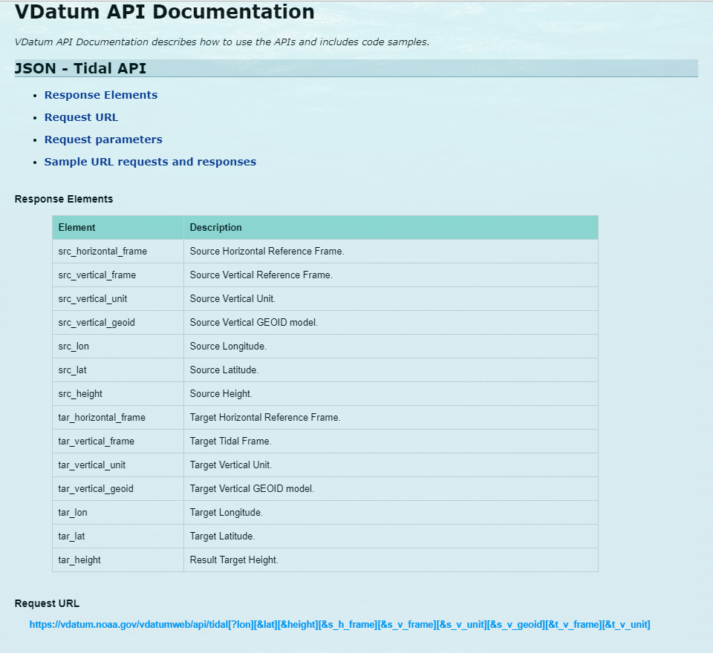
VDatum: Interfaces

Slide 15
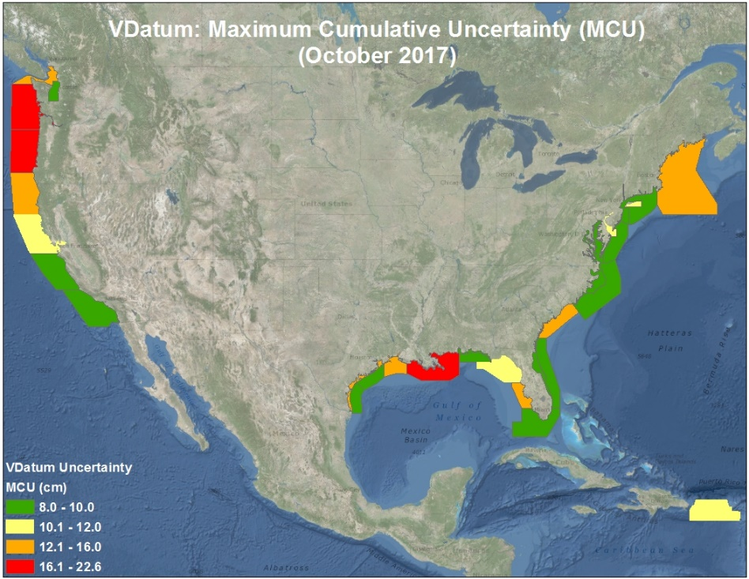
Vertical Datum Uncertainties By Region

Slide 16
Summary
The VDatum transformations tool from NOAA allows us to transform vertical datasets between ellipsoidal, orthometric and tidal datums...
Assuring data is transformed correctly
Enabling multiple uses for datasets across applications (Coastal Resilience, Intelligence, and place-based)
Permitting merging of disparate data sets to a common reference
And providing transformation uncertainty estimates for intelligent decision-making and analysis.

Slide 17
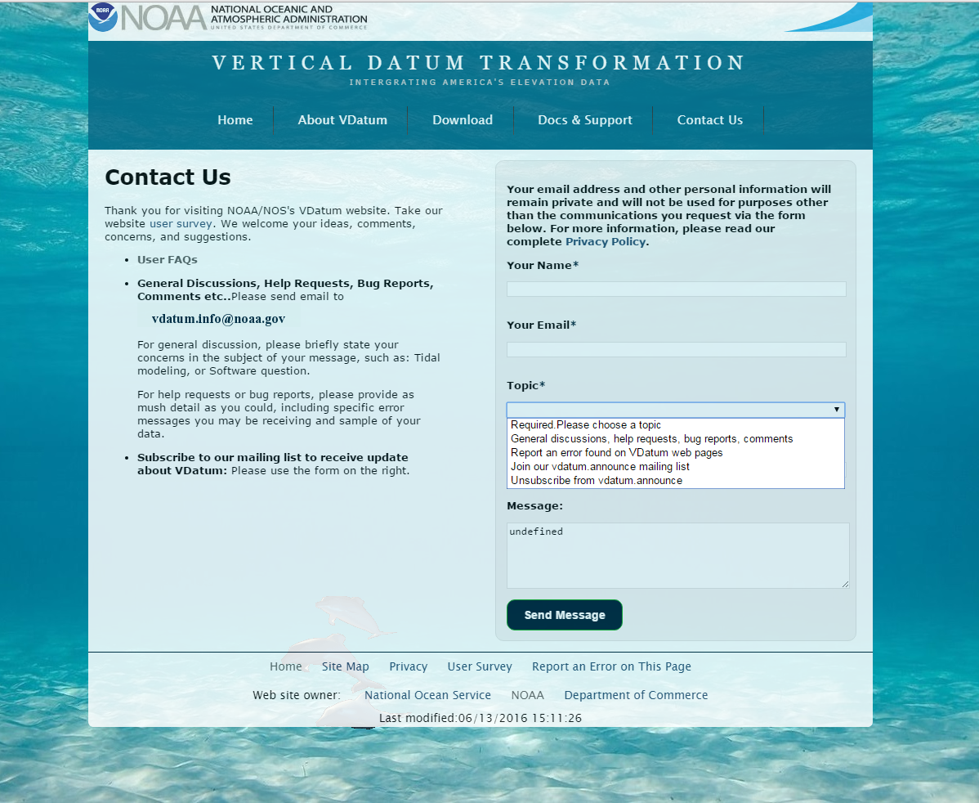
VDatum: Contact Us

Slide 18
Thank You!
Contact Information:
Email: vdatum.info@noaa.gov
Website: http://vdatum.noaa.gov
Stephen White
Email: stephen.a.white@noaa.gov
Phone: (240) 533-9588

