Slide 1

Small Unmanned Aerial Systems (sUAS) for Mapping
Jason Woolard, NOAA /NOS/NGS

Slide 2
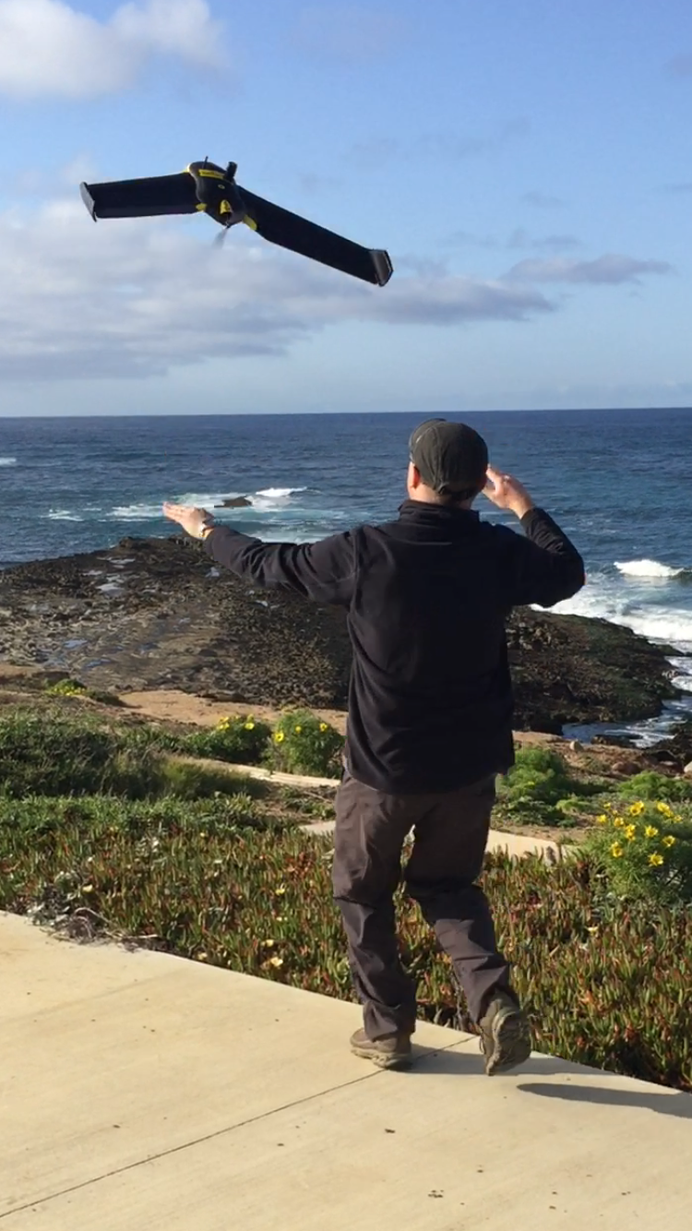
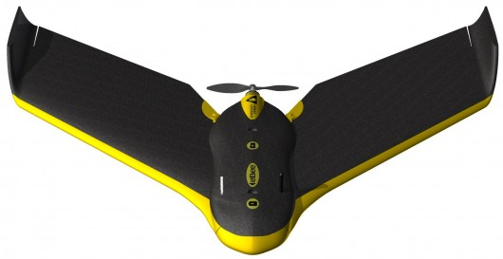

eBee RTK Hardware specs
Weight (w/ supplied camera) : ~1.16 lb
Wingspan : 96 cm (38 in)
Material: EPP foam, carbon structure & composite parts
Propulsion: Electric pusher prop, 160 W brushless DC motor
GNSS/RTK receiver : L1/L2, GPS & GLONASS
Battery: 11.1 V, 2150 mAh

Slide 3
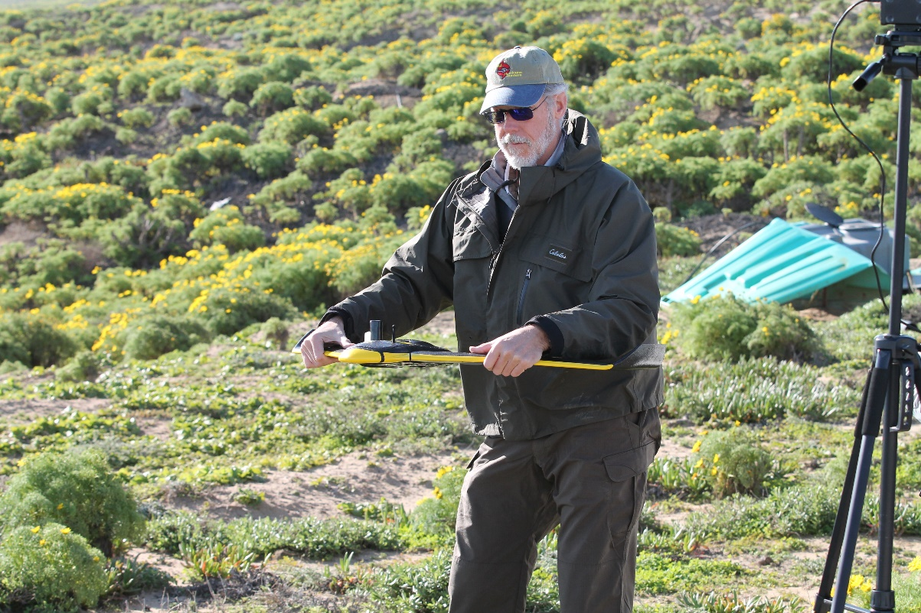
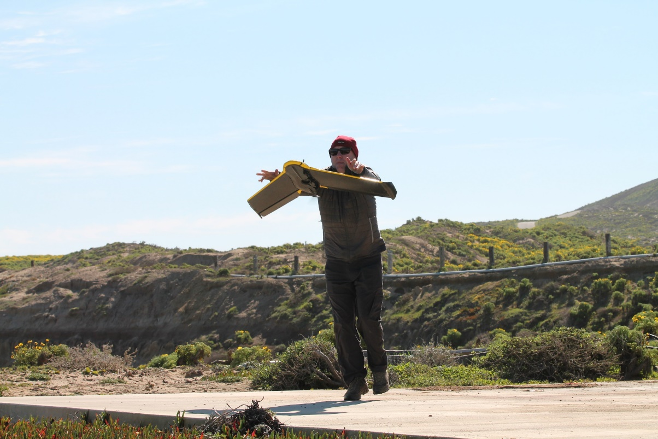
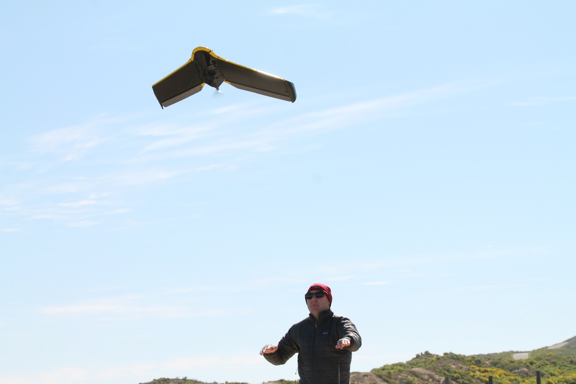
Hand launched
Maximum flight time: 40 mins
Nominal cruise speed : 40-90 km/h (25-56 mph)
Radio link range: Up to 3 km (1.86 mi)
Wind resistance: Up to 45 km/h (12 m/sec or 28 mph)
GSD: Down to 1.5 cm per pixel
Relative orthomosaic/ 3D model accuracy: 1-3 x GSD
Absolute accuracy (no GCPs): Down to 3 cm horizontal / 5 cm vertical
Linear landing accuracy: Approx 5 m / 16.4 ft
eBee RTK Operations

Slide 4
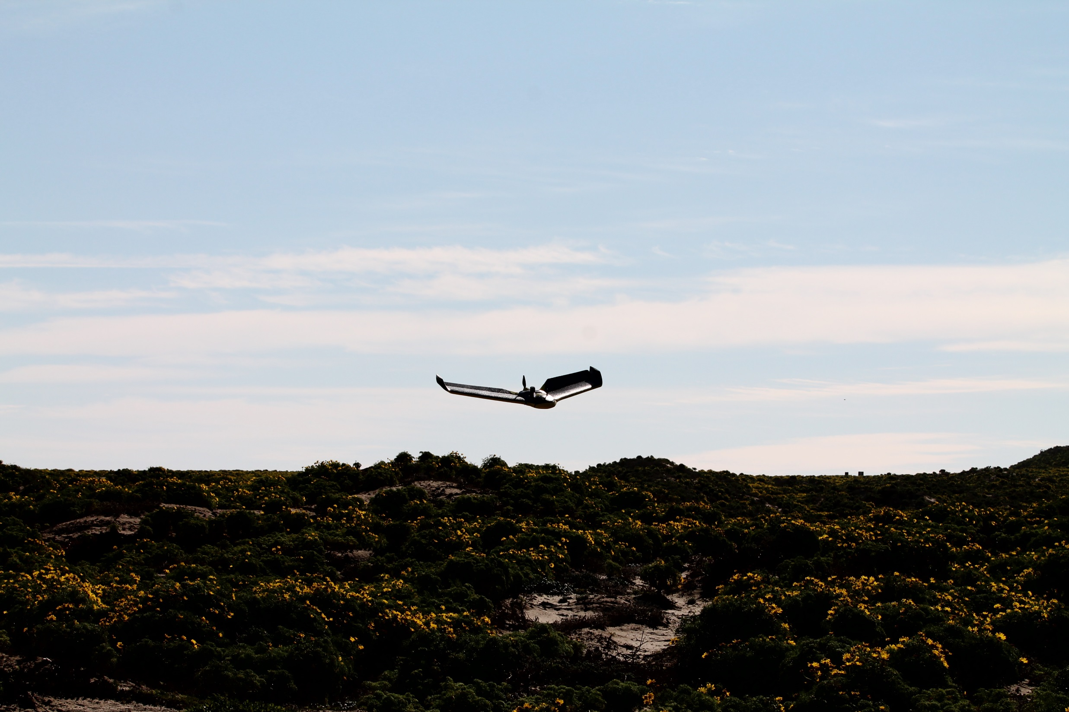

Slide 5
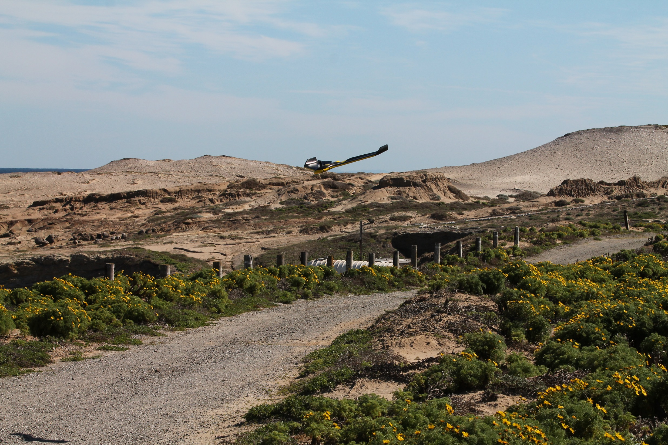

Slide 6
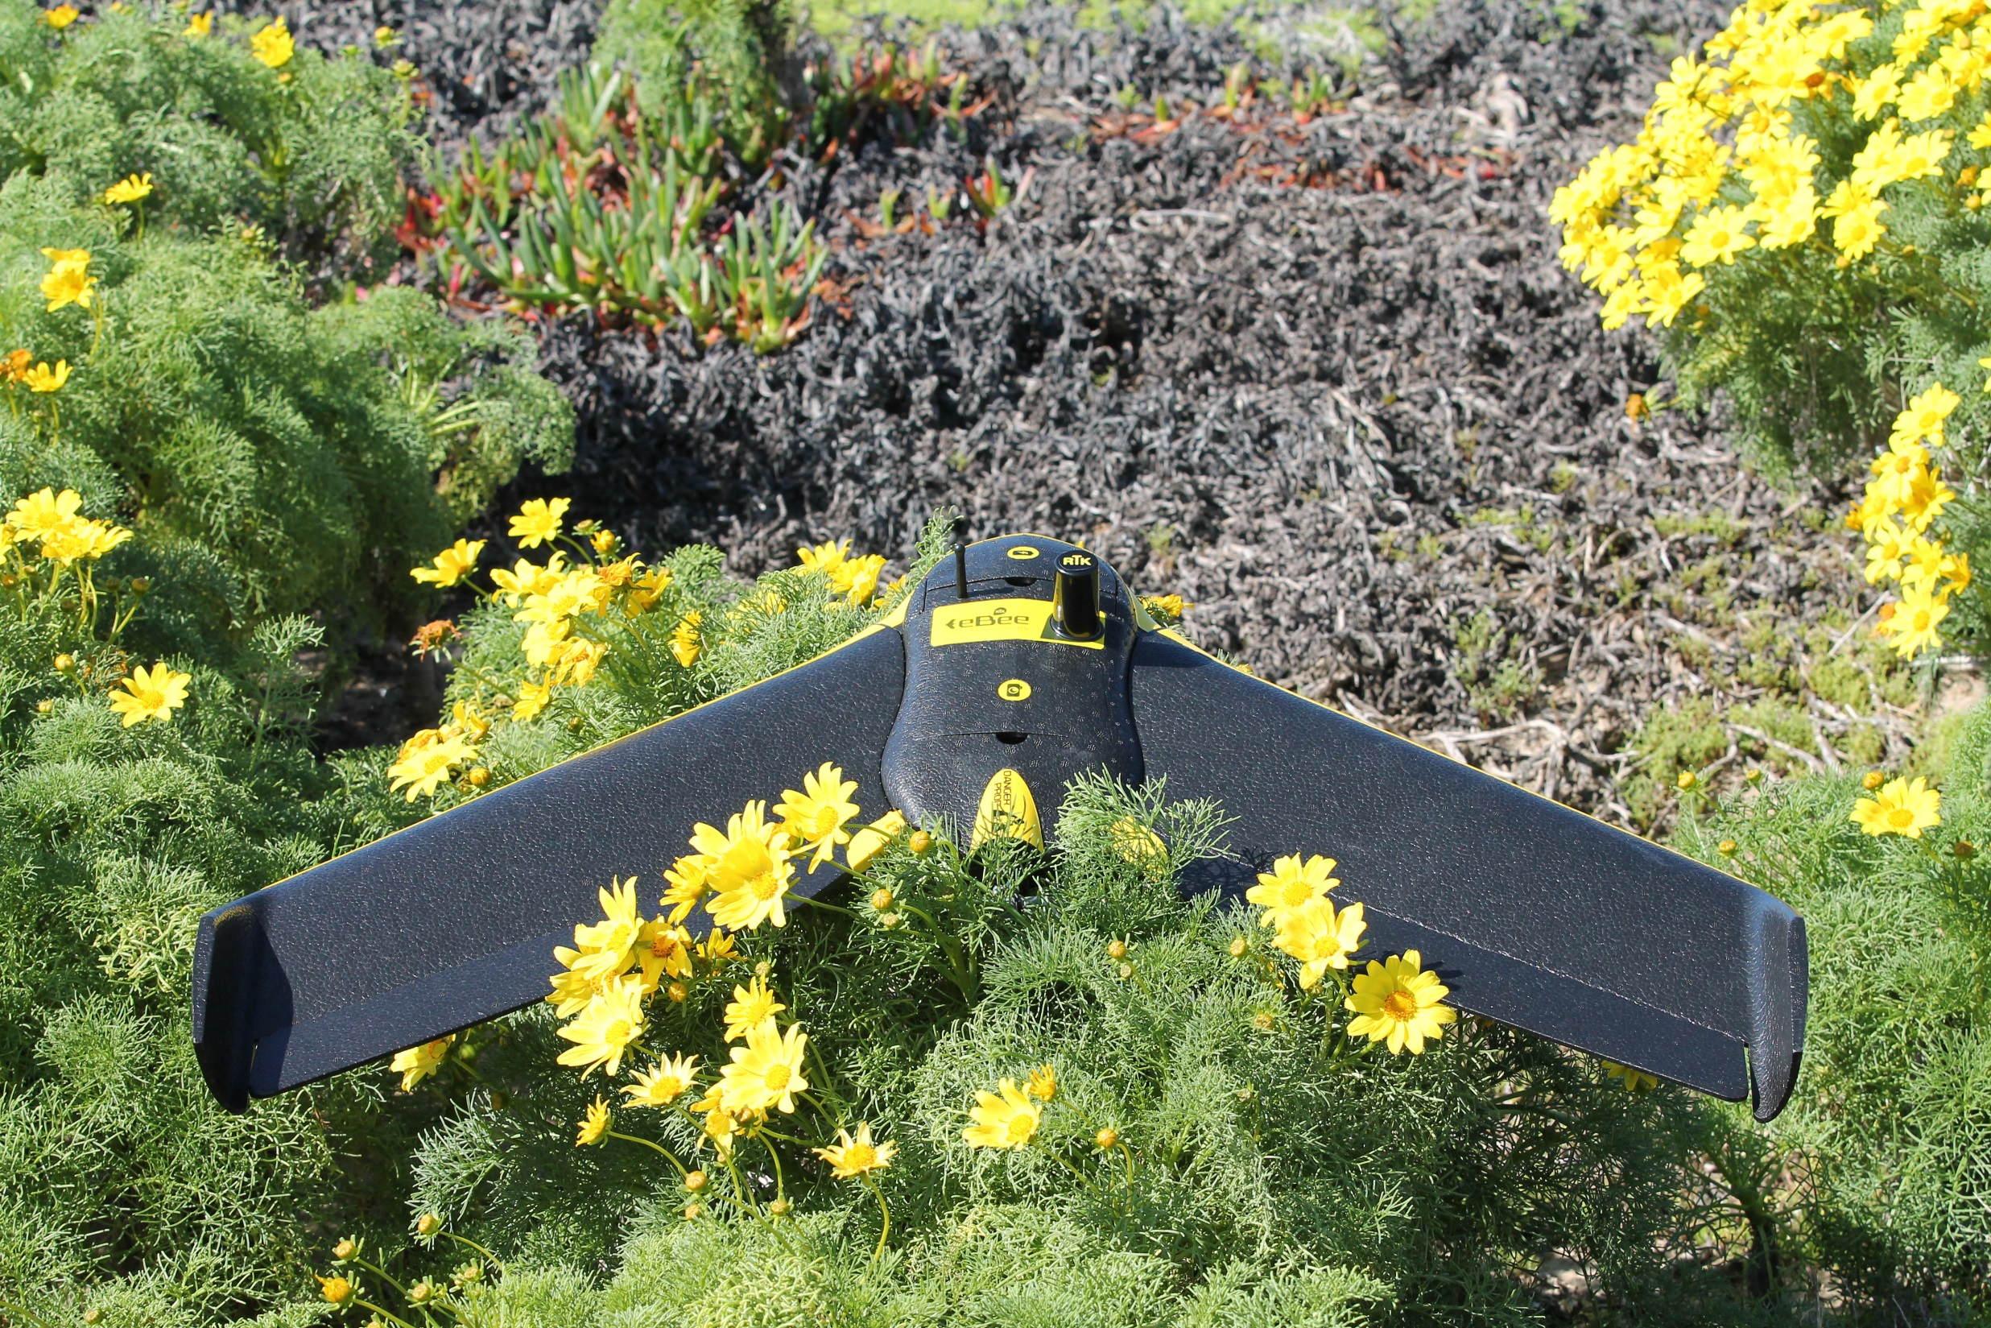

Slide 7

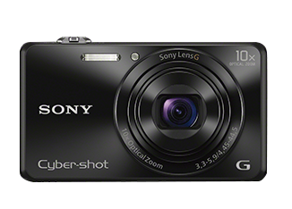
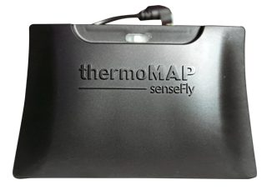
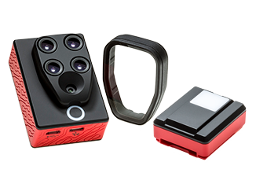
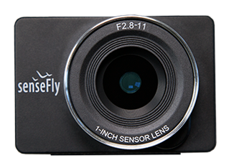

eBee Payloads
Canon S110 RGB (16 MP)
Canon S110 NIR (12 MP)
Sony WX RGB (18.2 MP)
Thermomap
S.O.D.A – Sensor Optimized for Drone Applications (20 MP)
Parrot Sequoia Multi-Spec
  Green/Red/Red-Edge/NIR

Slide 8
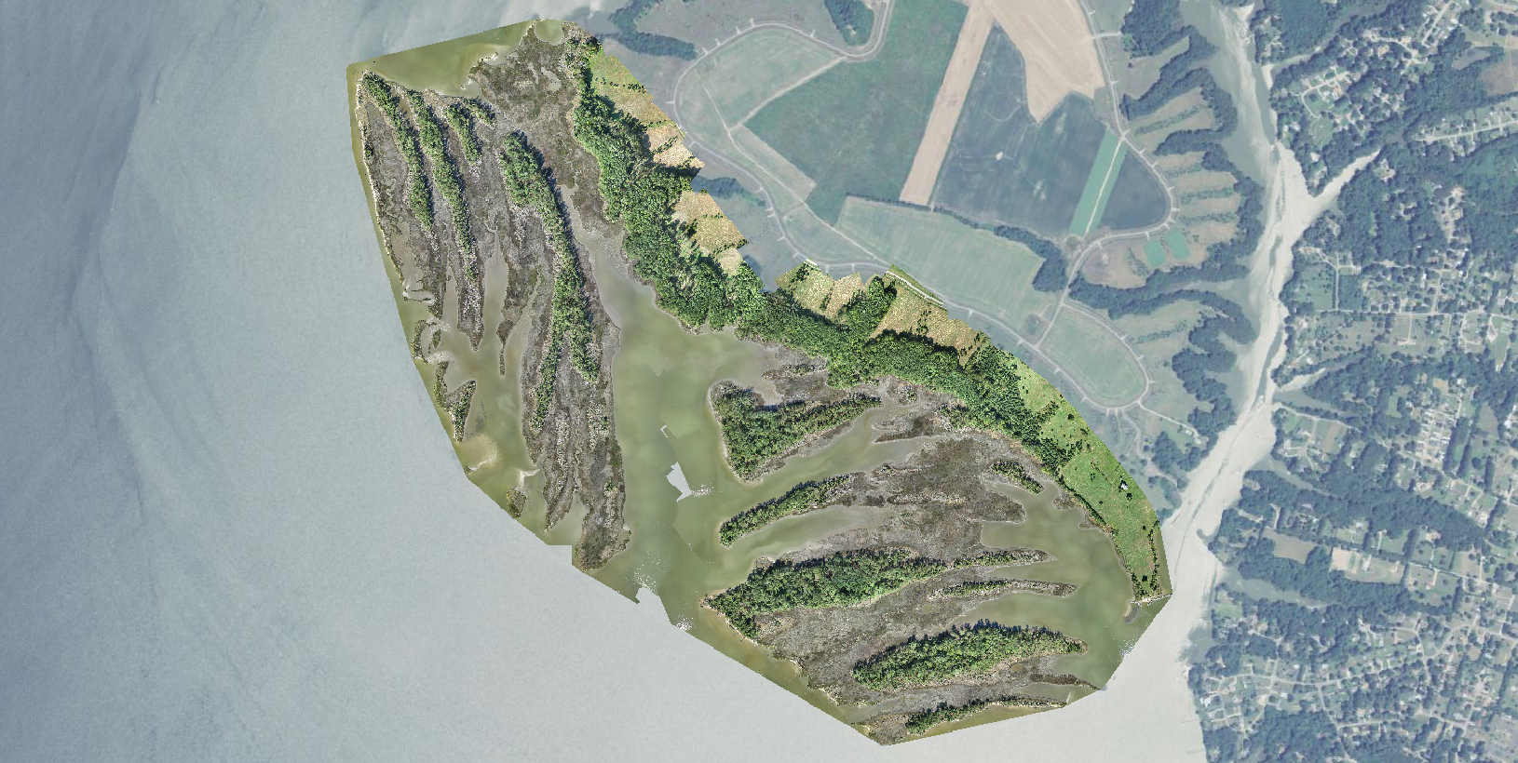
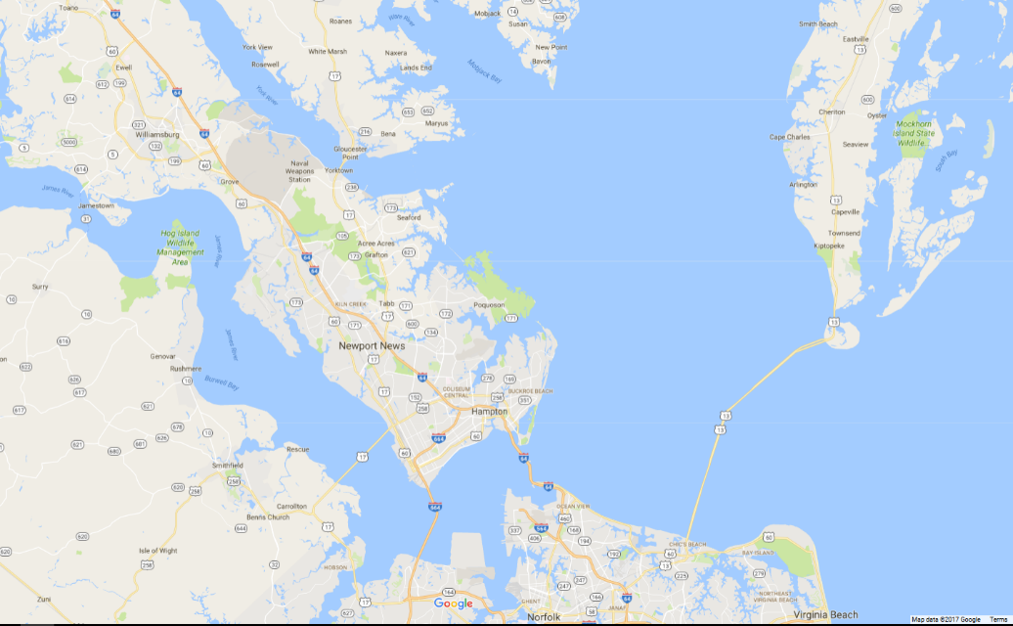
Chesapeake Bay National Estuarine Research Reserve (CBNERR or Reserve) Catlett Island.
5 cm RGB orthomosaic
Notes:
Chesapeake Bay National Estuarine Research Reserve (CBNERR or Reserve) is one of 28 protected areas that make up the National Estuarine Research Reserve System (NERRS) established to promote informed management of the Nation's estuaries and coastal habitats.
Catlett Islands encompass 280 ha (690acres) and displays a ridge-and-swale geomorphology. The islands consist of multiple parallel ridges of forested wetland hammocks, forested upland hammocks, emergent wetlands and tidal creeks surrounded by shallow subtidal areas that once supported beds of submerged aquatic vegetation.

Slide 9
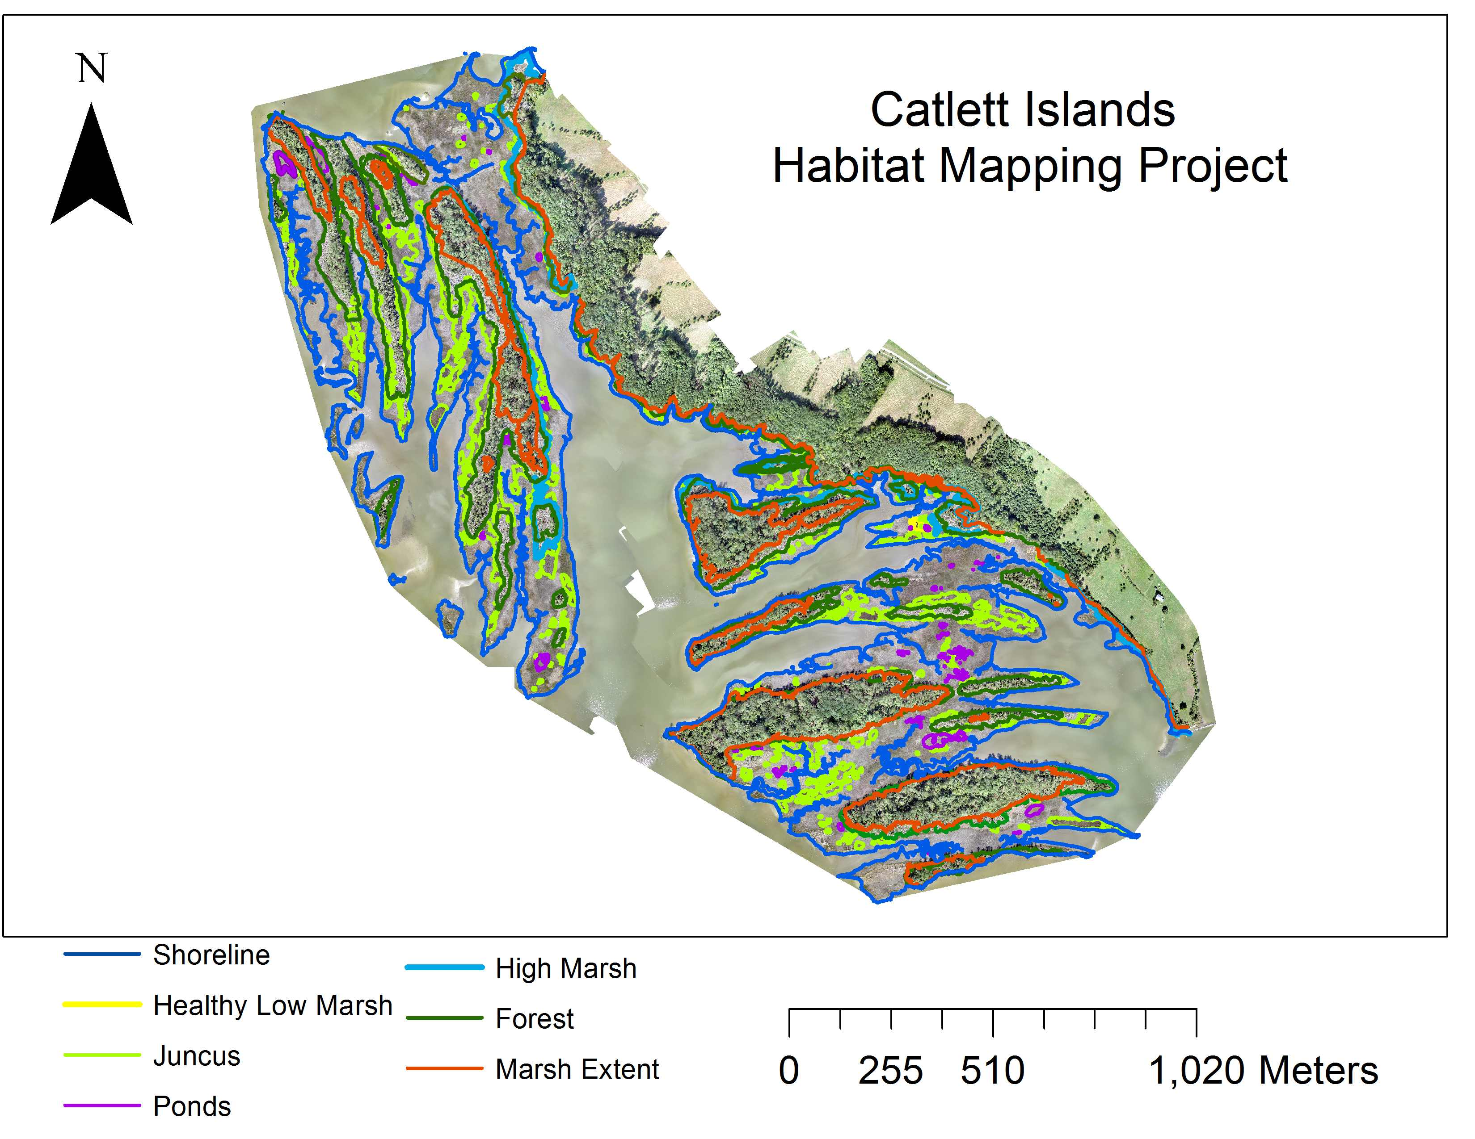



Slide 10
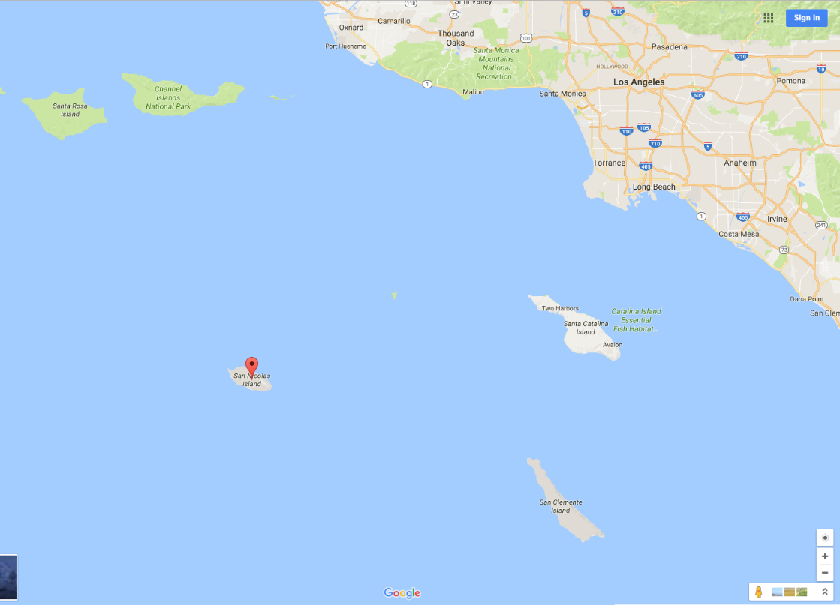
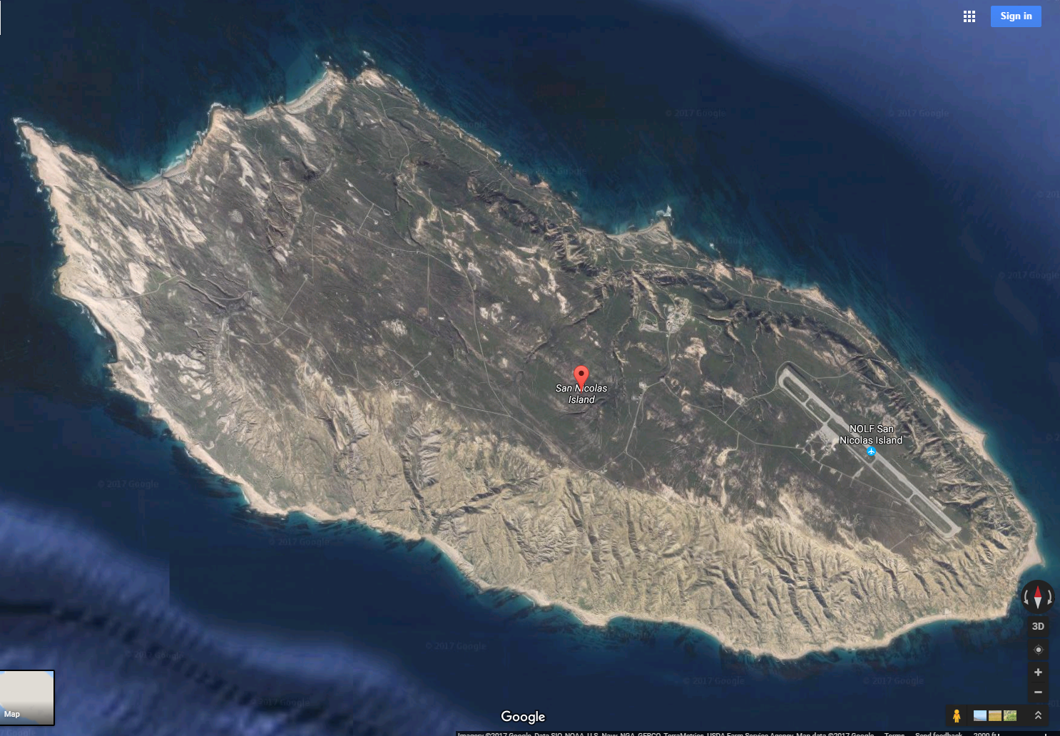
San Nicolas Island - U.S. Navy test and evaluation site
Joint USN, NOAA, USFWS,
and USGS habitat mapping and living
marine resources.
Notes:
SNI’s Mission has two functions: a launch platform for short and medium missile testing, and an observation facility for missile testing. Primarily, SNI’s mission is to support the primary research, design, development, test, and evaluation of Air Weapons and associated aircraft systems into strike, anti-surface and anti-air warfare aircraft within the Sea Test Range for Naval Air Weapons Station (NAWS) China Lake.
The US Navy's Naval Air Systems Command, Naval Air Warfare Center Weapons Division (NAWCWD) has been working with local NOAA staff over the past year to develop a cooperative agreement for the use and development of Unmanned Aircraft Systems (UAS) for coastal habitat mapping and living marine resource surveys. CDR Matt Pickett, NOAA (ret) (cc'd here) and our staff have discussed several joint operations that would mutually benefit NAWCWD and NOAA.
An initial joint operation is being proposed in late February utilizing NOAA owned UAS (the md4-1000 and ebee RTK) to test the efficacy of sea otter monitoring offshore our San Nicolas Island facility. The Navy is currently implementing new federally mandated sea otter monitoring requirements, working cooperatively with USFWS and USGS. All three agencies agree that UAS surveys would significantly improve monitoring and reduce long term costs. We are requesting support from NOAA Remote Sensing Division to provide operational support and access to the NOAA UAS. We do not have the in-house expertise to conduct UAS-based natural resources monitoring.

Slide 11
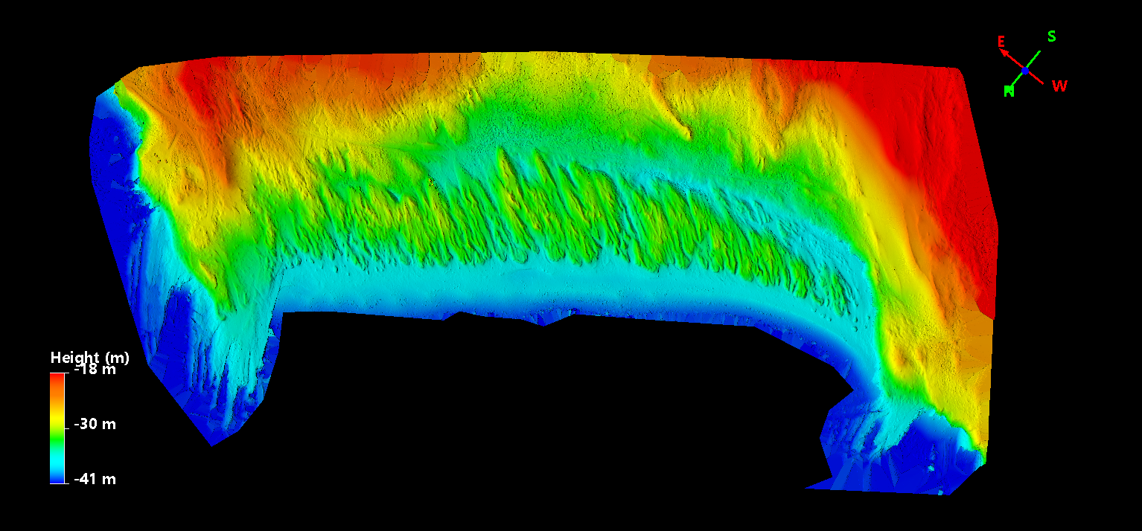
Tender Beach Digital Surface Model / Feb 26 2017

Slide 12
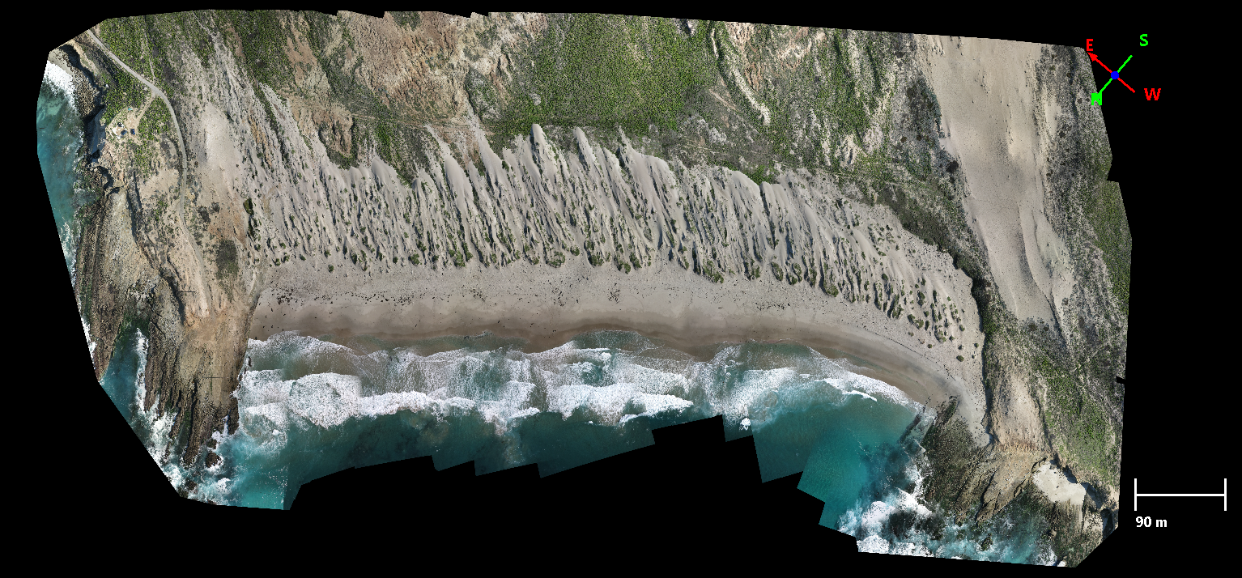
Tender Beach RGB Orthophoto / Feb 26 2017

Slide 13
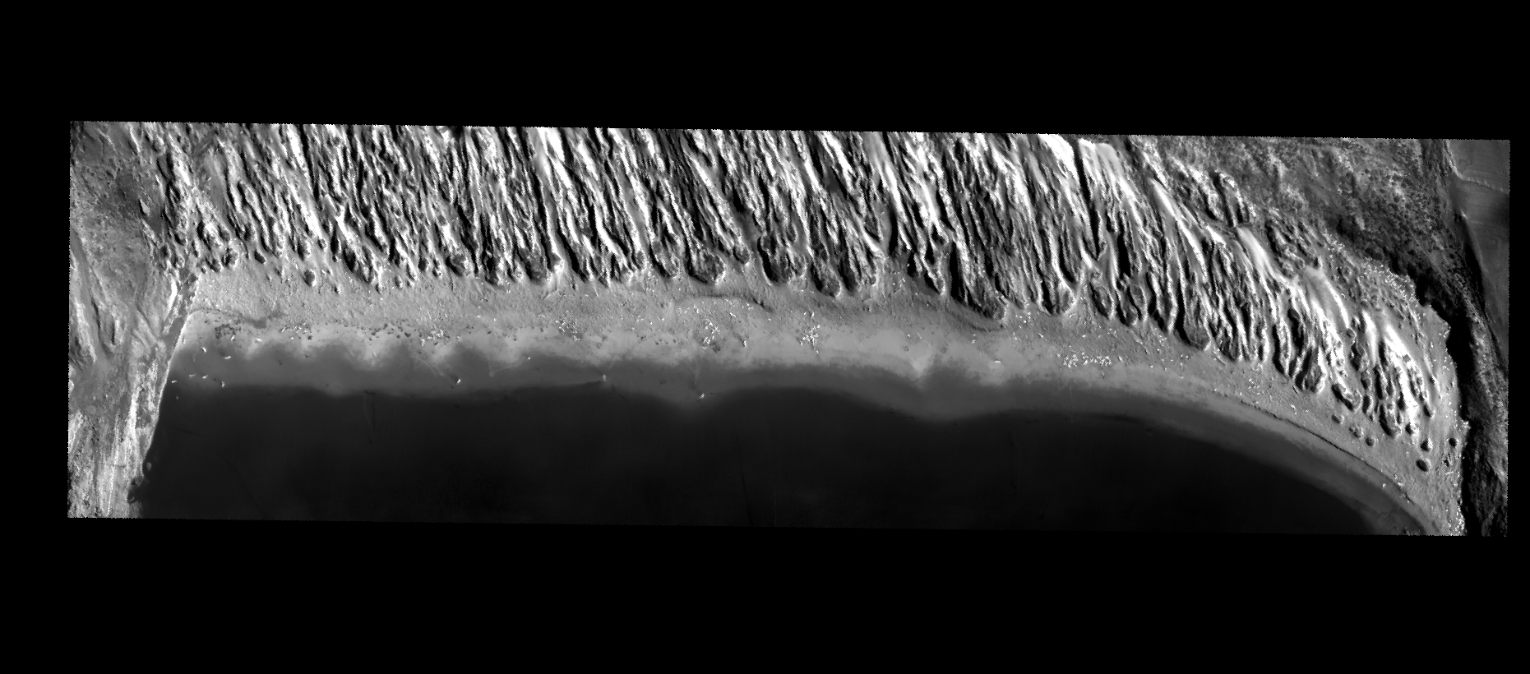
Tender Beach Thermal IR from eBee Thermomap / Feb 26 2017

Slide 14
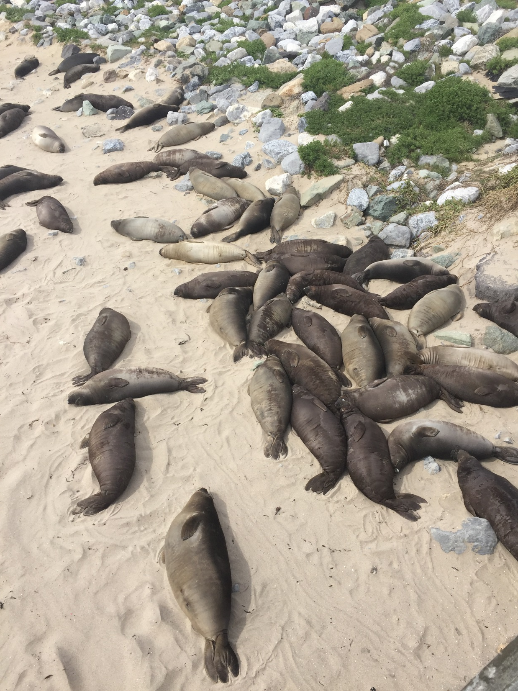
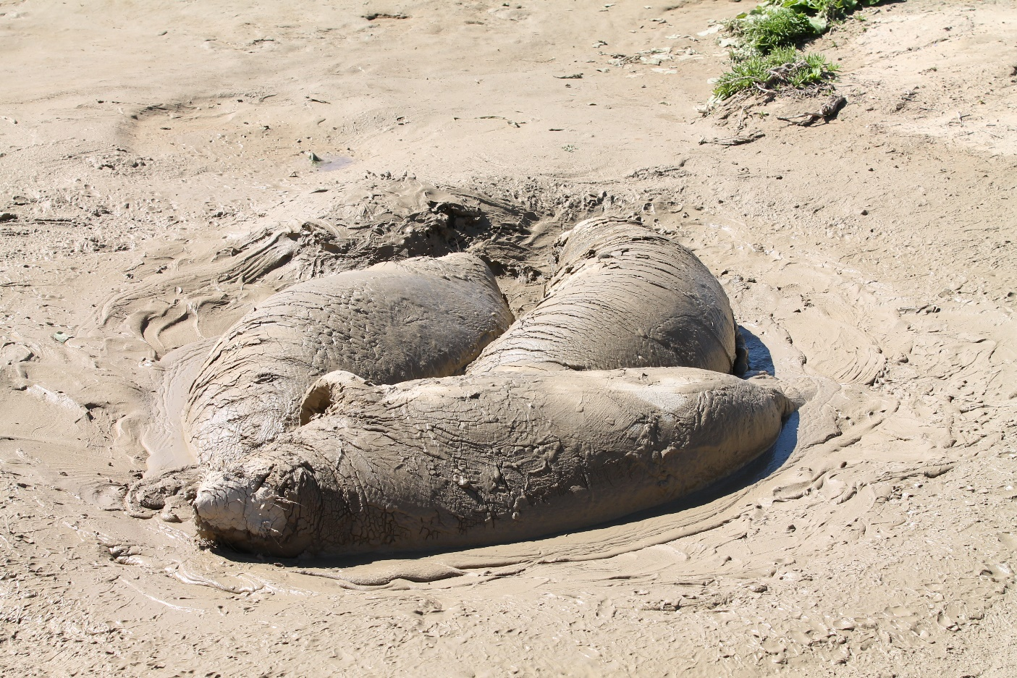

Slide 15
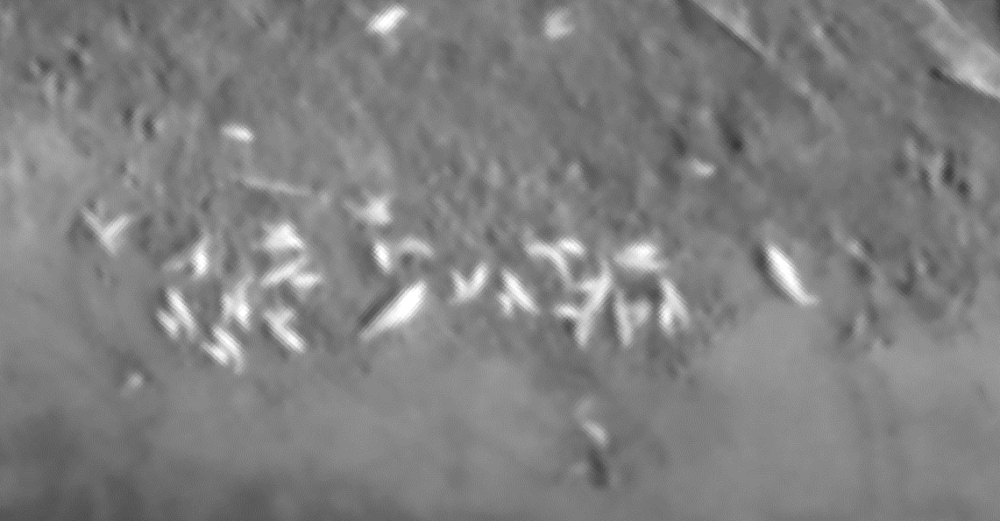
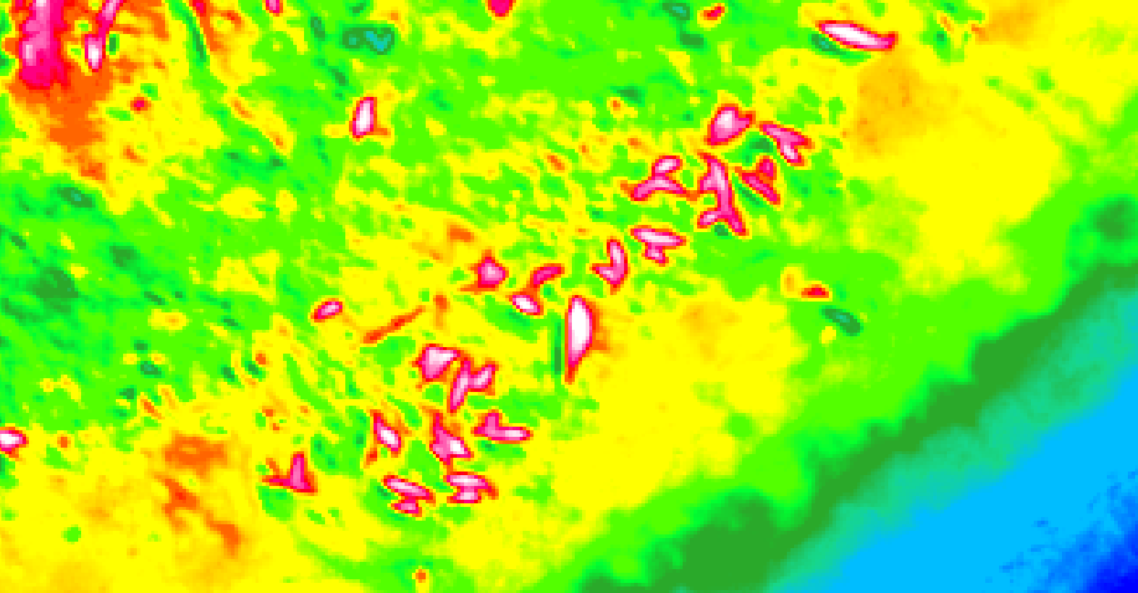

Tender Beach Thermal IR Pinniped Survey / Feb 26 2017
Temp F°
56.9
65.1
77.0

Slide 16
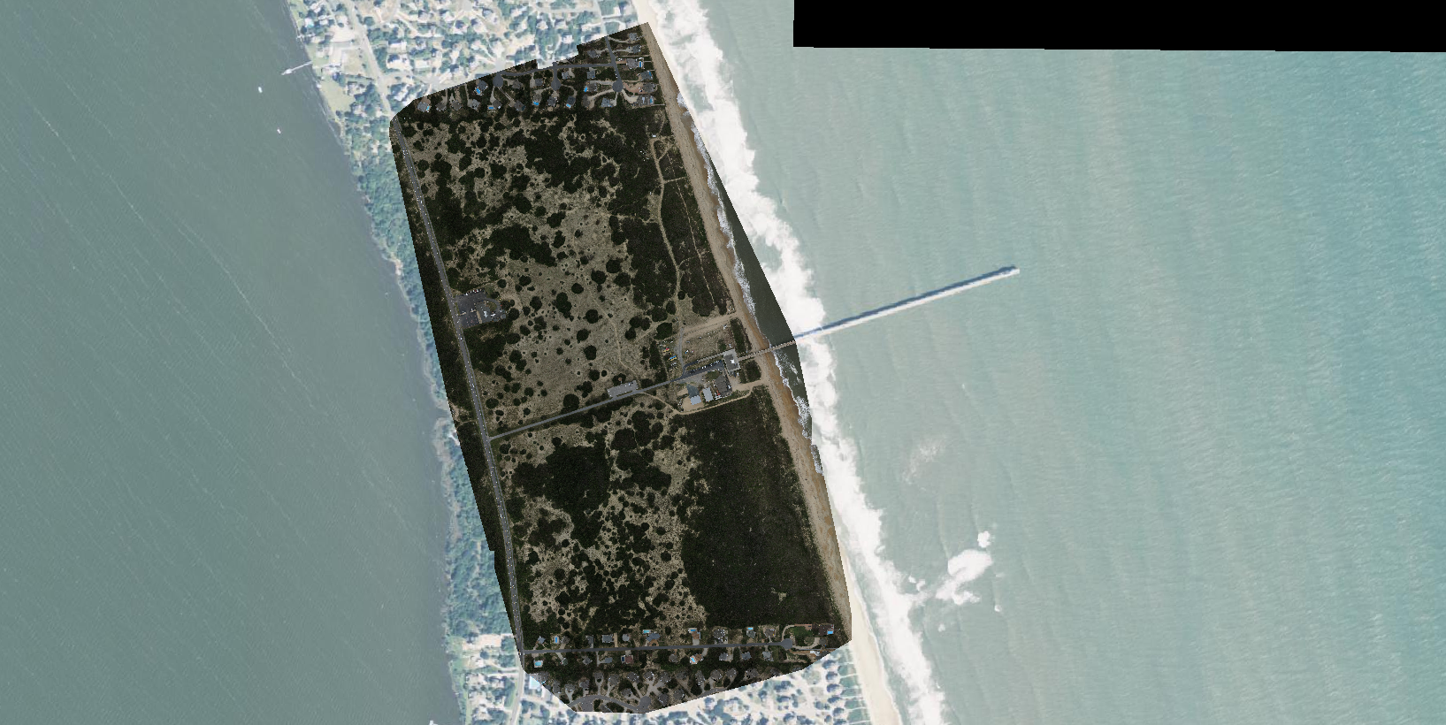
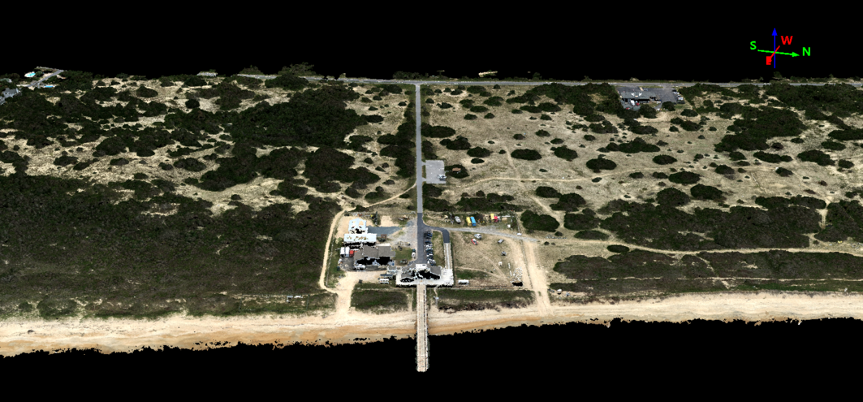
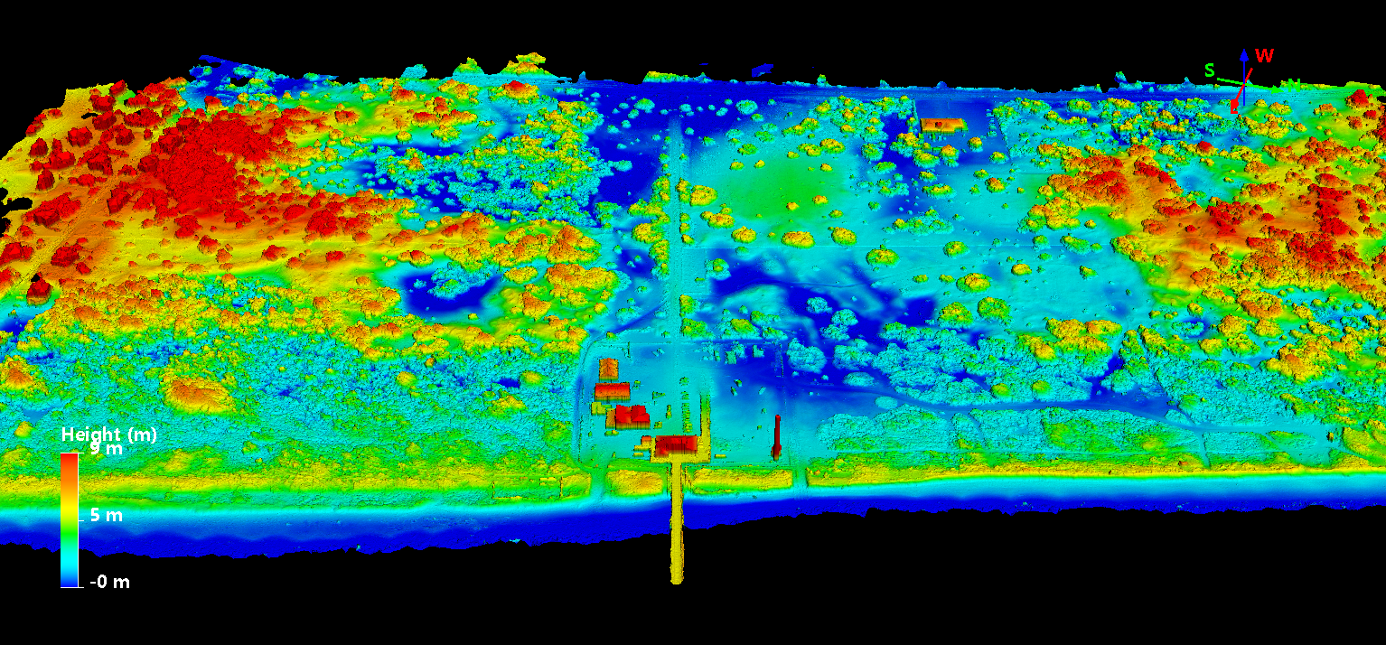
sUAS for Shoreline Mapping at Duck, NC FRF
Photogrammetric Points
RGB Orthomosaic
Digital Surface Model
Digital Surface Model

Slide 17
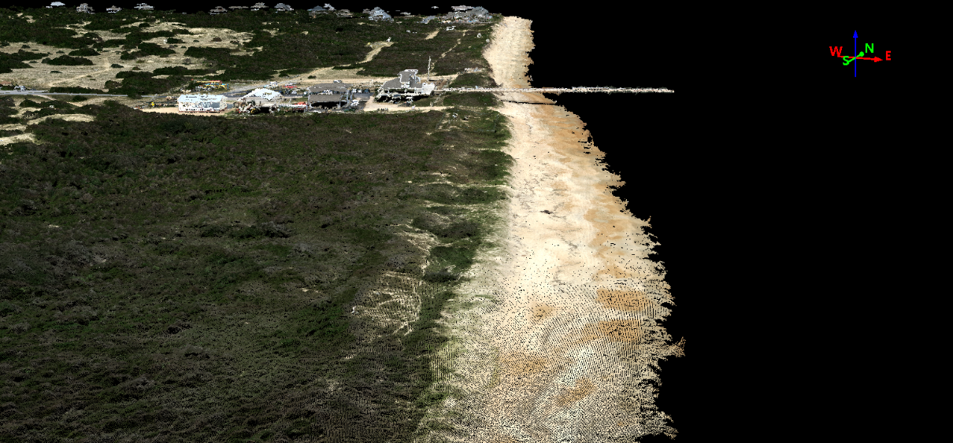
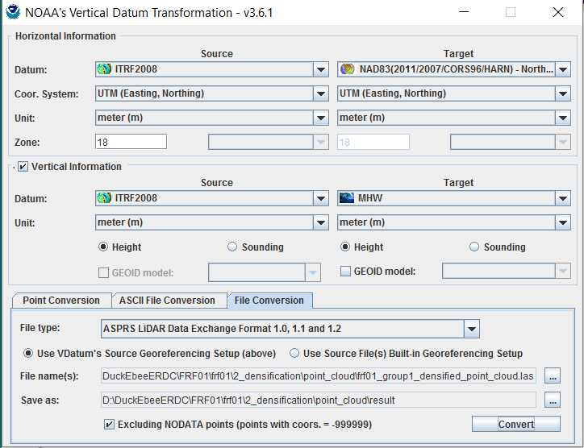
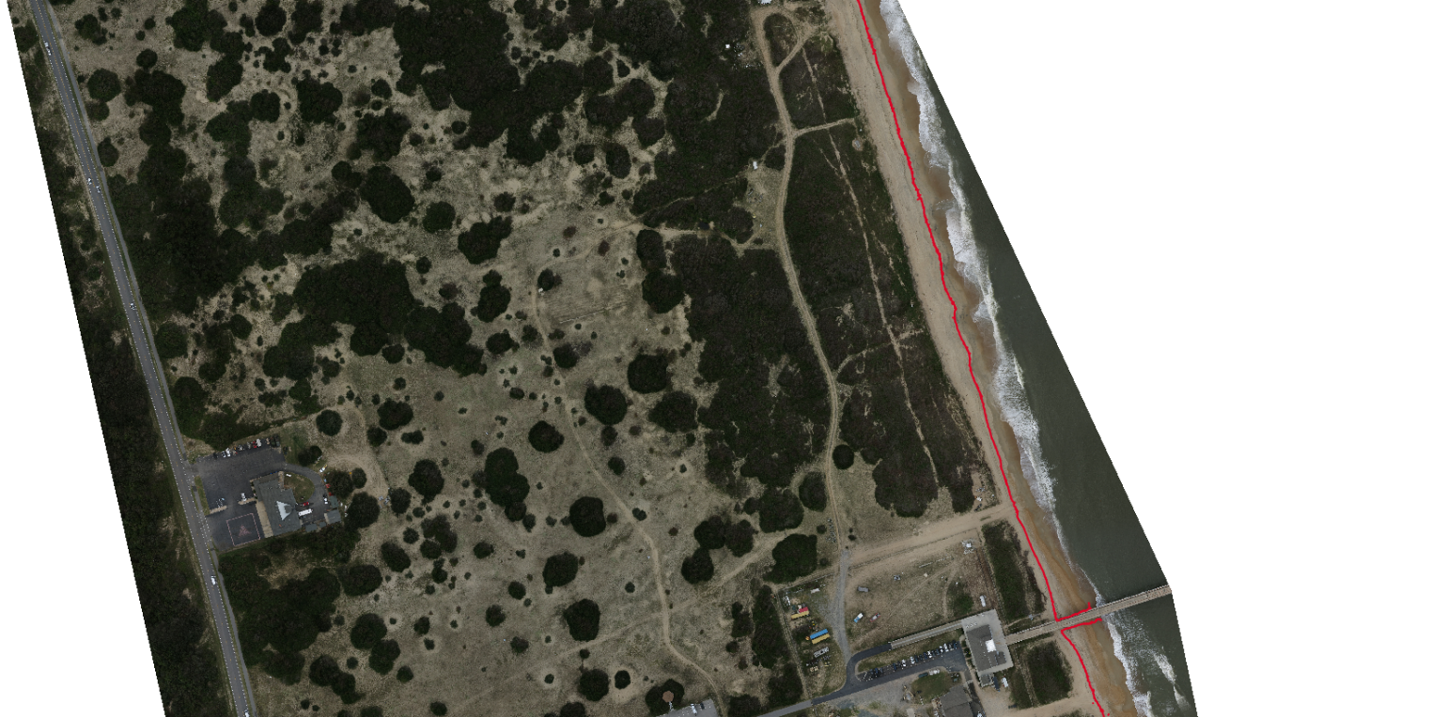
Duck, NC FRF Photogrammetric Points (LAS FMT)
eBee Derived Shoreline Using VDatum
Mean High Water (MHW) Shoreline

