Slide 1
NOAA’s Coastal Mapping Program
and the utilization of
Topobathy Lidar
to Support Charting Needs
Stephen White
NOAA/National Geodetic Survey/Remote Sensing Division
NGS Convocation
May 9-10, 2017

Slide 2
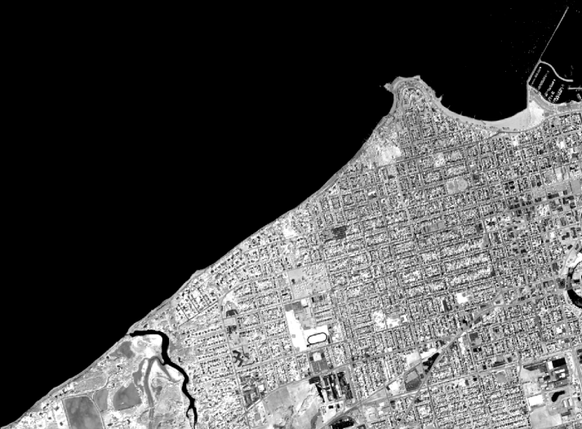
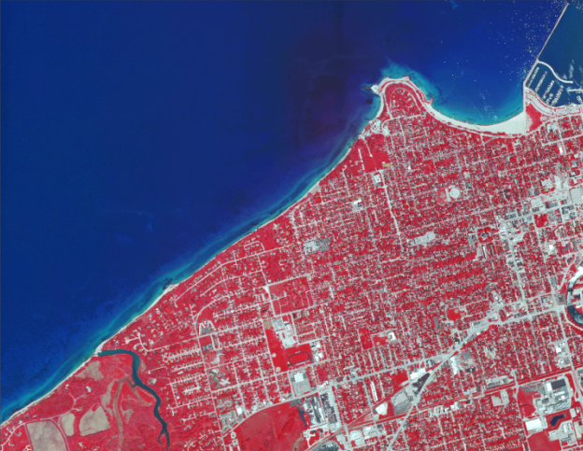
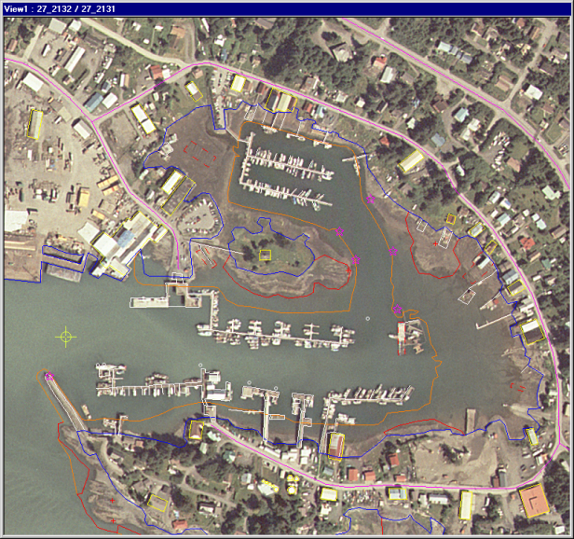
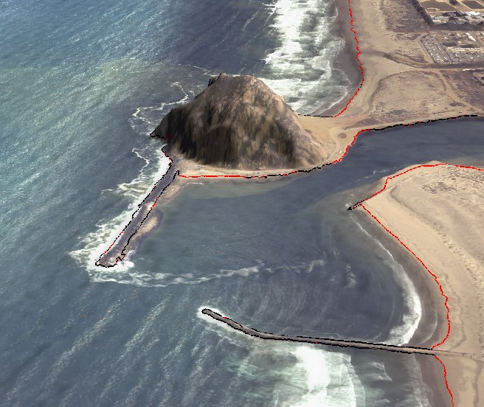
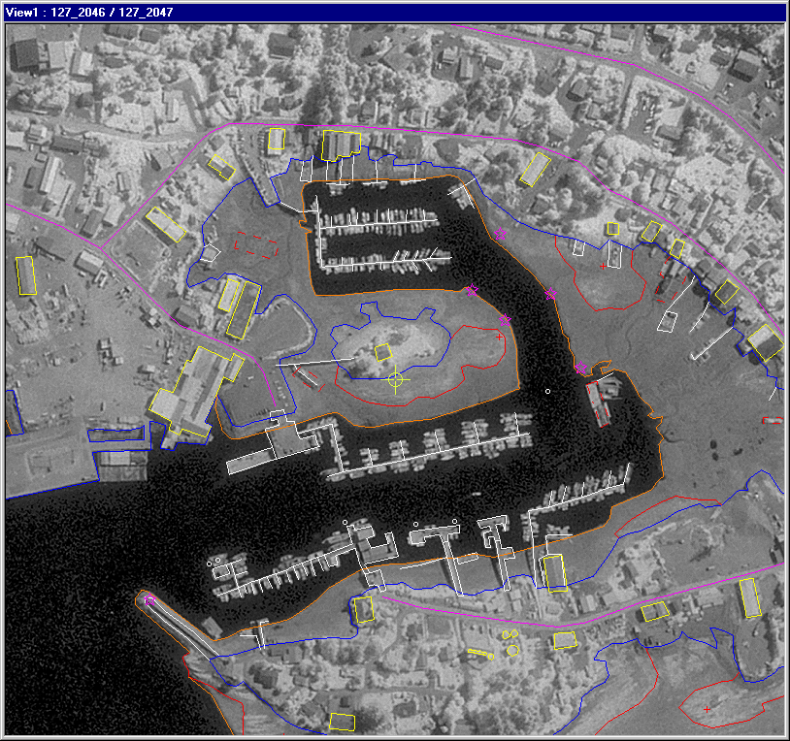
The Coastal Mapping Program
A congressional mandate to conduct remote sensing surveys of coastal regions of the United States and its possessions for demarcating the nation’s legal coastline.
Goals:
Provide the Nation With Accurate,
Consistent, Up-to-Date
National Shoreline
Acquire Nearshore
Elevation Data
Sources:
Lidar
Digital Cameras
High Resolution Satellites
Notes:
Support of other applications:
NOAA nautical charts
Used in defining the United States’ territorial limits
Coastal resource management
Storm surge and coastal flooding modeling
Coastal geomorphology studies
GIS analysis
Coastal Intelligence, Resiliency and Place-Based Conservation Applications
Integrated Ocean and Coastal Mapping : ! Map Once-Use Many Times !

Slide 3
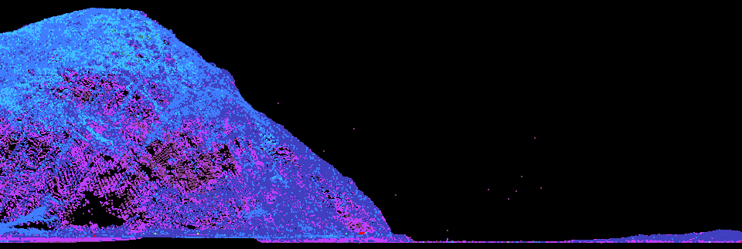
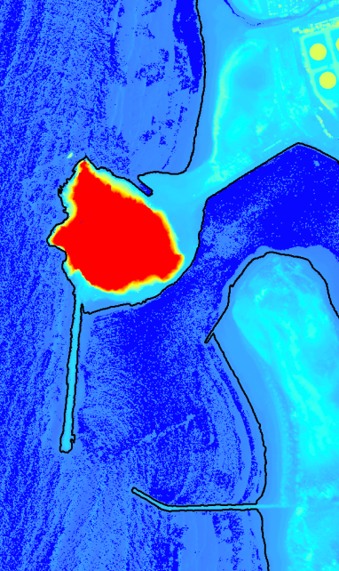
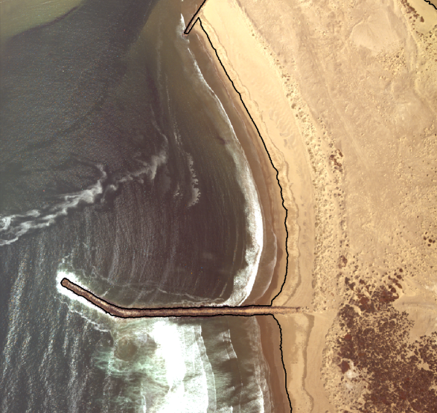
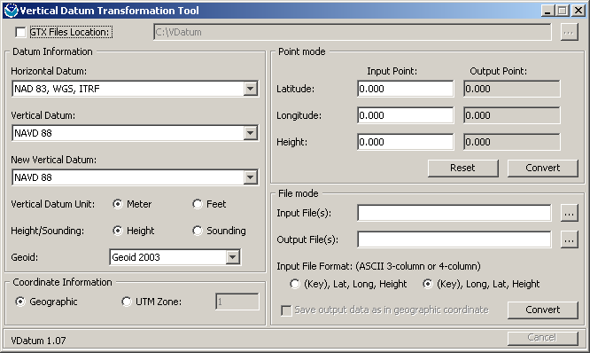
Lidar Shoreline Extraction
Edit Lidar Point Cloud
VDatum
Contour Shoreline from DEM
Quality Control &
Feature Attribution

Slide 4
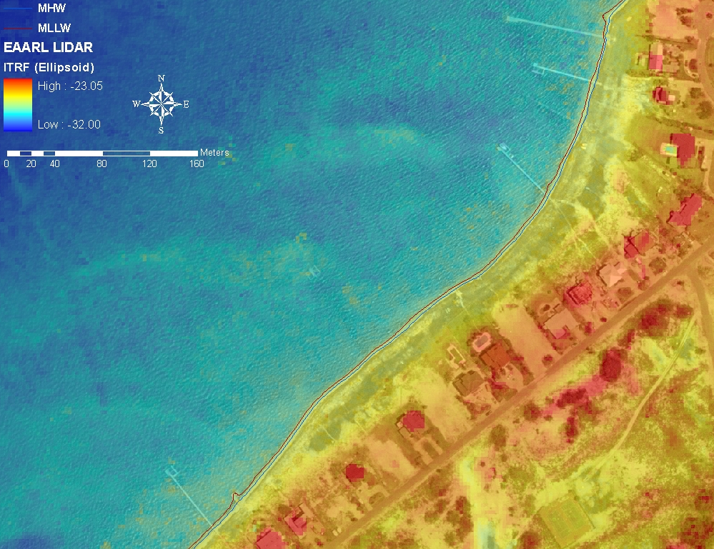
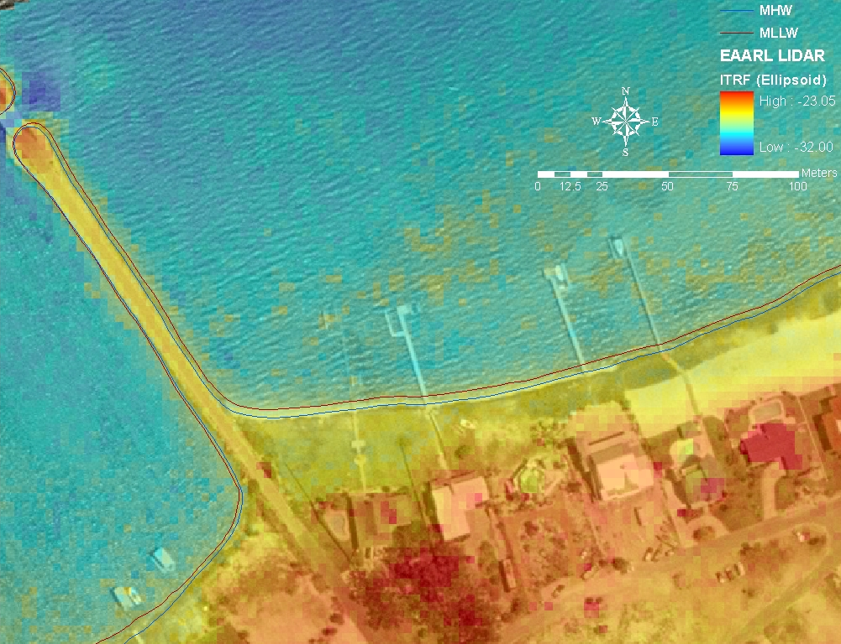
The EAARL Project: Shoreline Extraction (Pensacola)

Slide 5
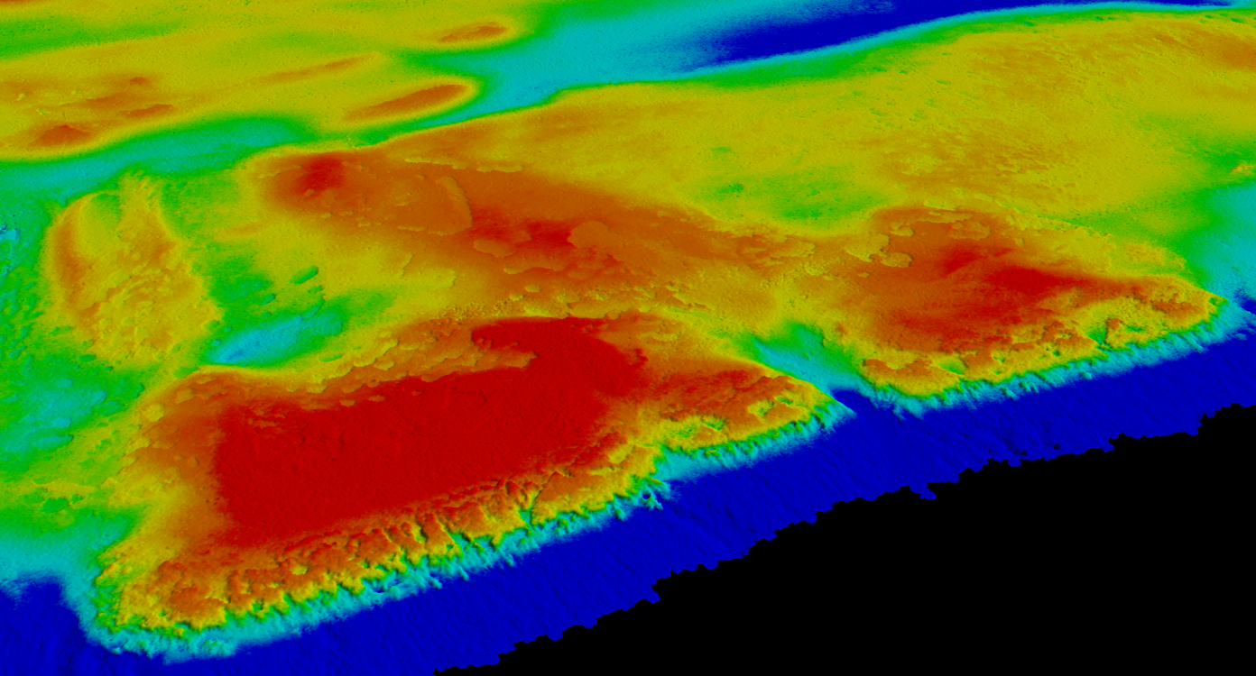
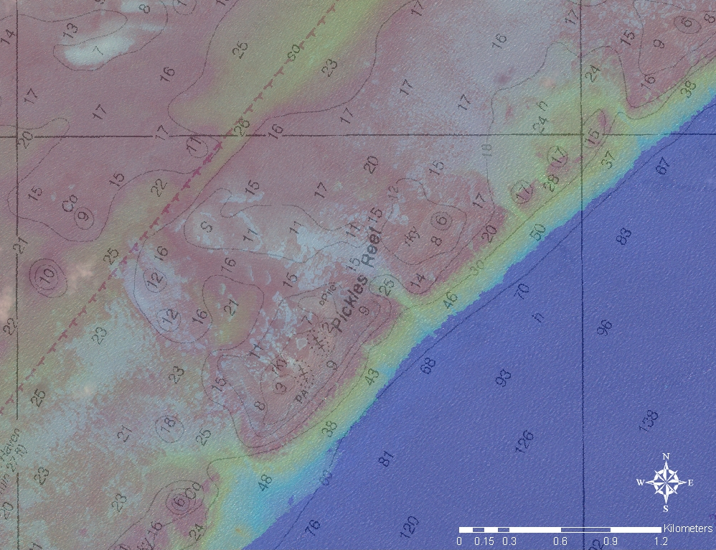
The EAARL Project: Florida Keys
Nautical Charting
Rugosity Measurements
Habitat Structure and Cover
Ecosystem Management

Slide 6
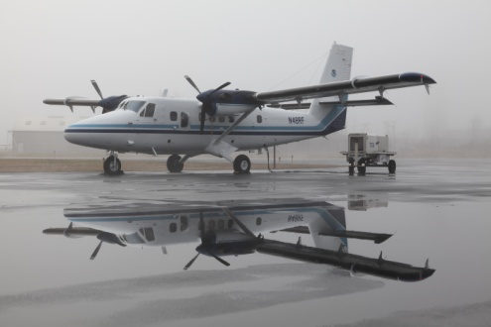
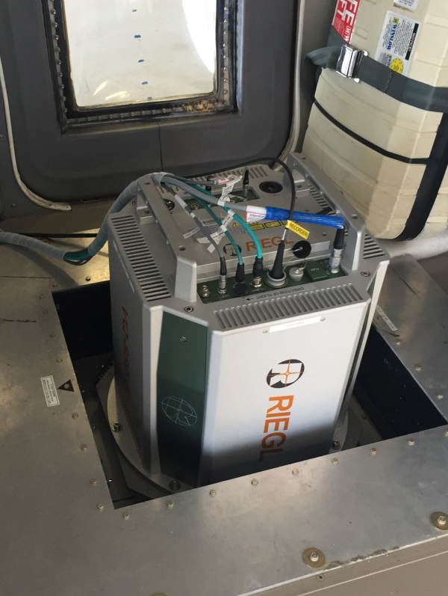
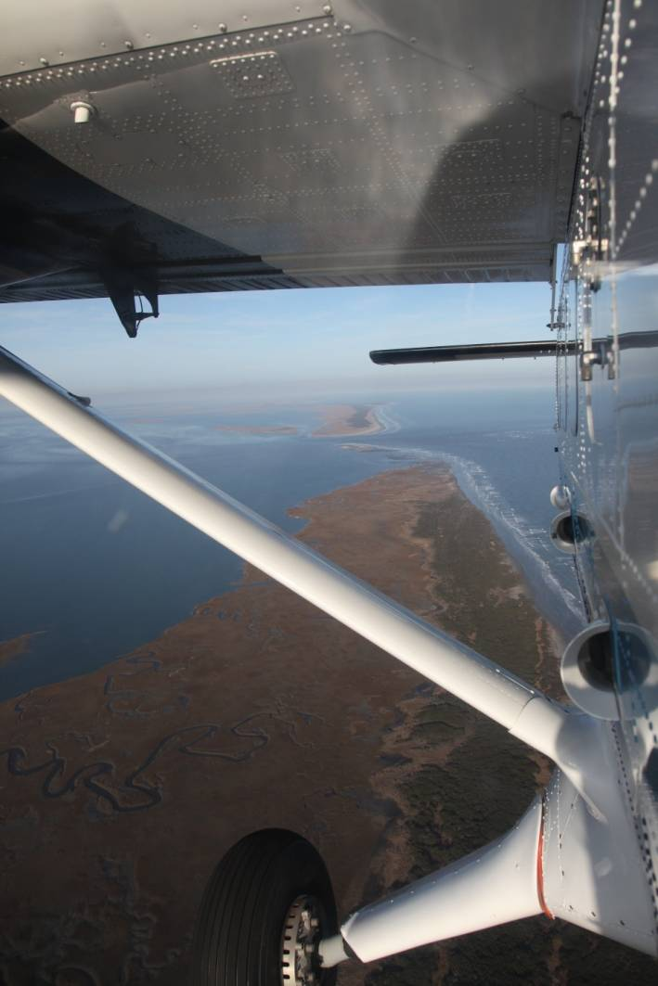
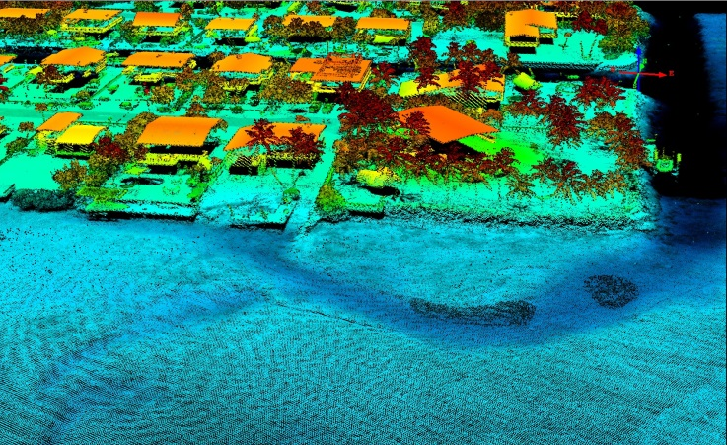
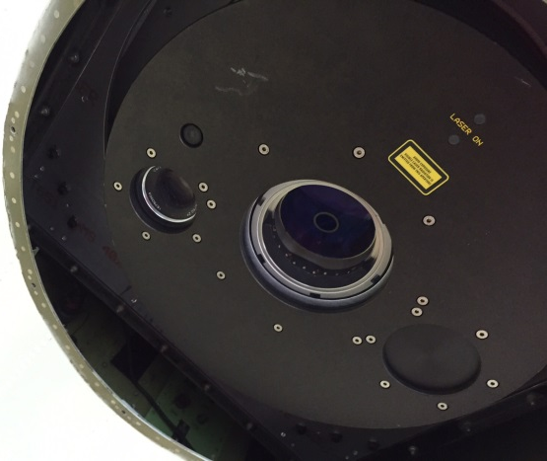
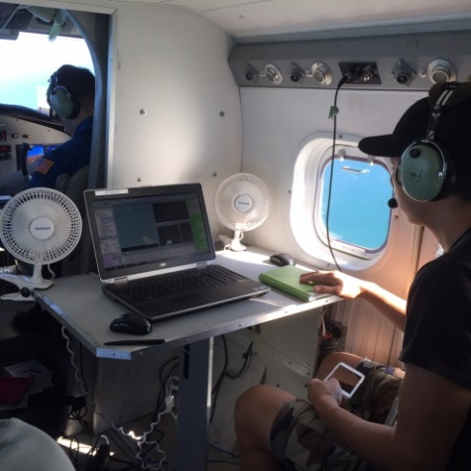
Topobathy Lidar

Slide 7
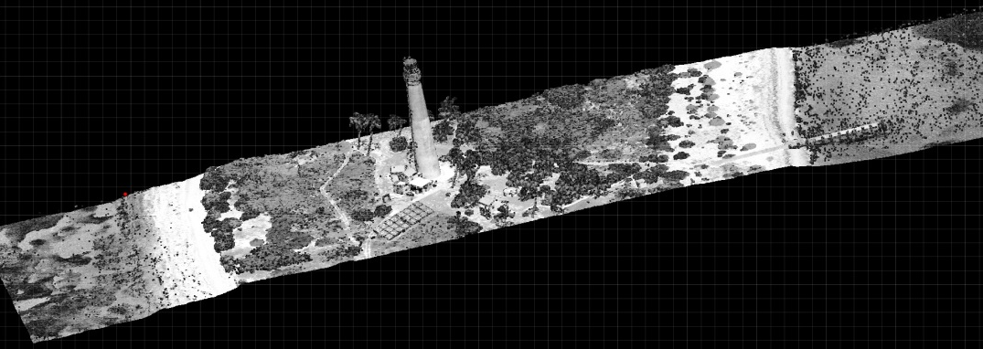
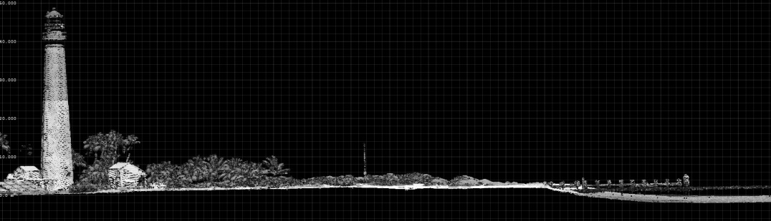
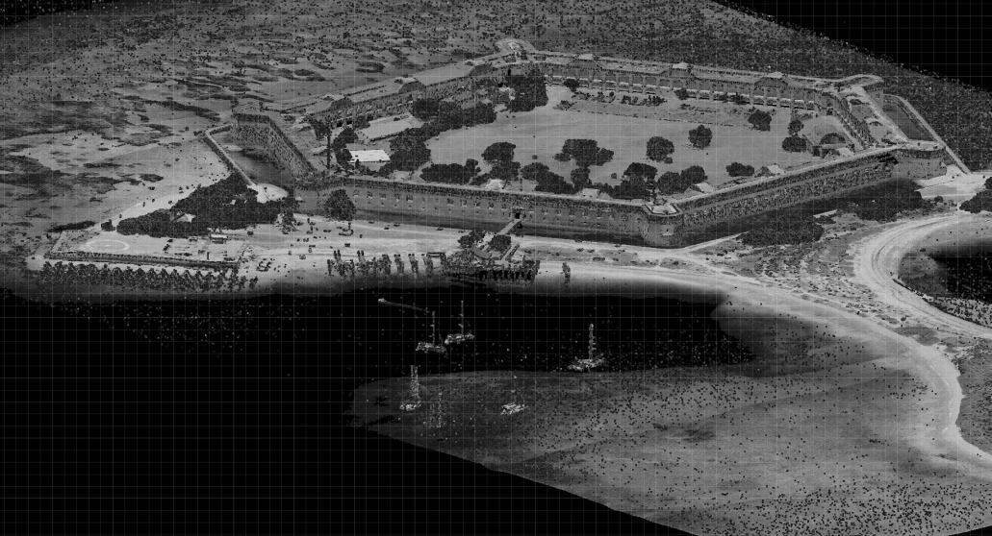
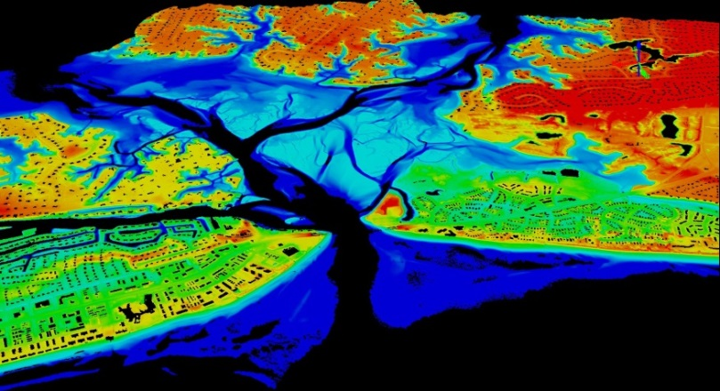
Topobathy Lidar
Occupies middle ground between conventional topographic and bathymetric systems:
Narrow Beam,
Low Power,
Small FOV,
Very High Sampling Rates
Focus is on shallow water and environmental applications
Uniquely suited for shoreline mapping
Seamless, high-resolution data across
backshore, intertidal, and nearshore
marine zones
Fill in shallow water gap
(shoreward of NALL line)

Slide 8
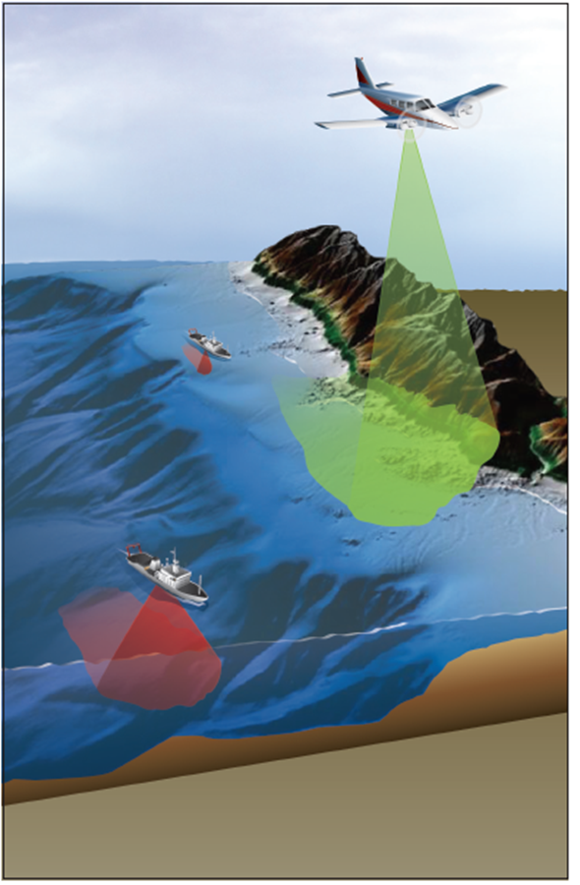
Support of Hydrographic Surveys
RSD collects nearshore topobathy lidar to the 4m NALL in the year prior to ship ops
RSD will provide both shoreline and nearshore bathymetry
Hydro operations will use this data to plan operations and overall situational awareness
Increases efficiency and safety of launch and ship operations
Graphic courtesy of Dewberry

Slide 9
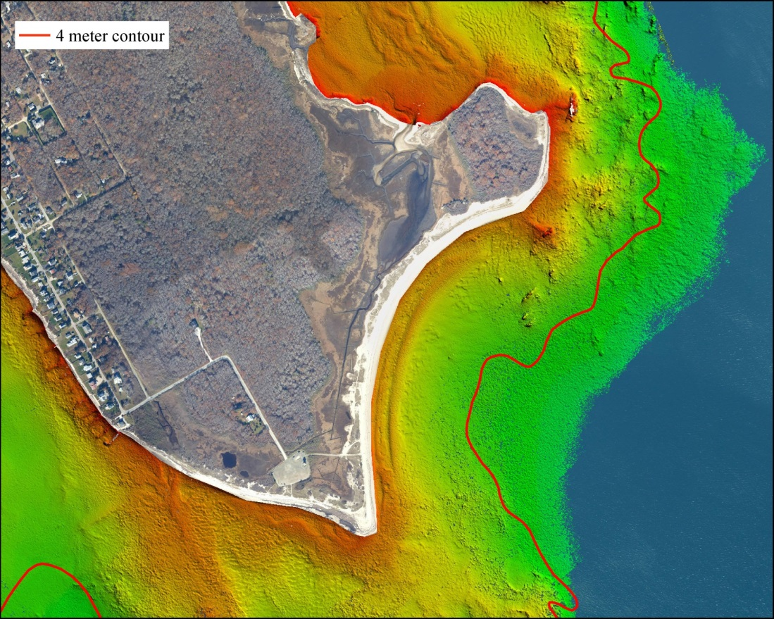
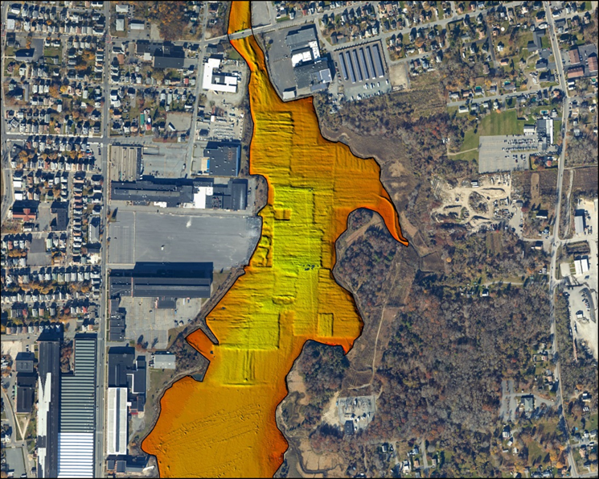
Support of Hydrographic Surveys
Notes:
West Island 820. Area had fairly turbid conditions in the surf zone during the lidar collect. 4m isobath in red.

Slide 10
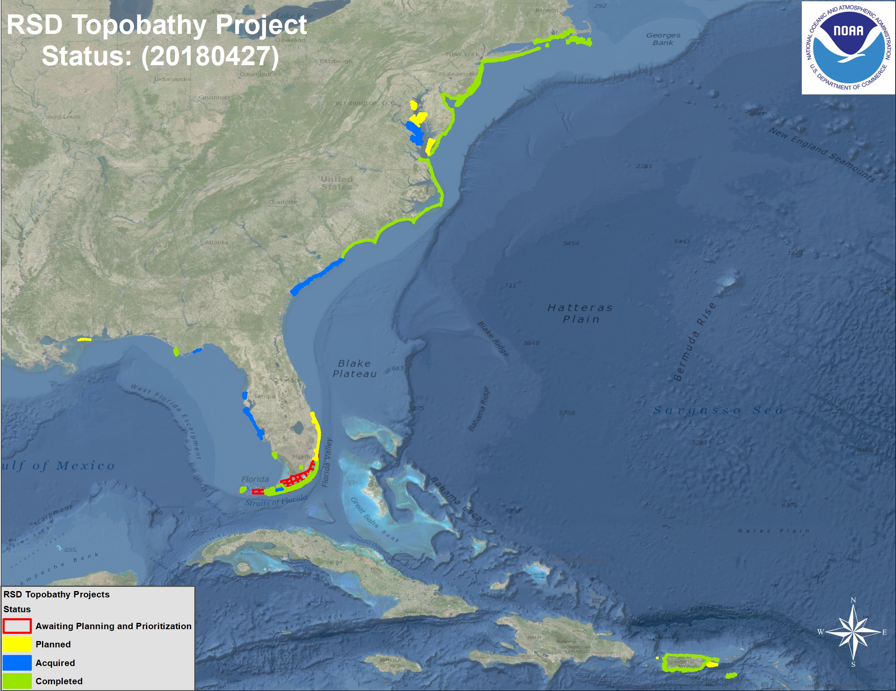
Project Status: Overview

Slide 11
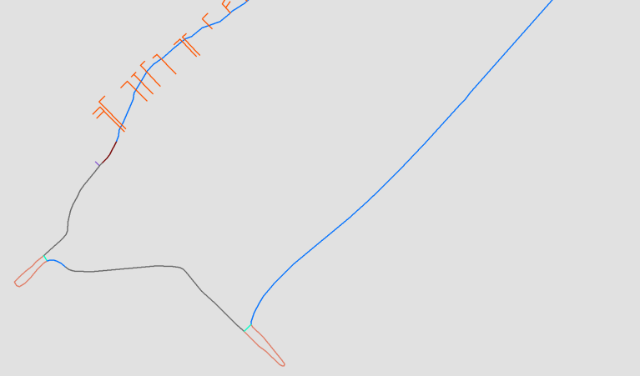
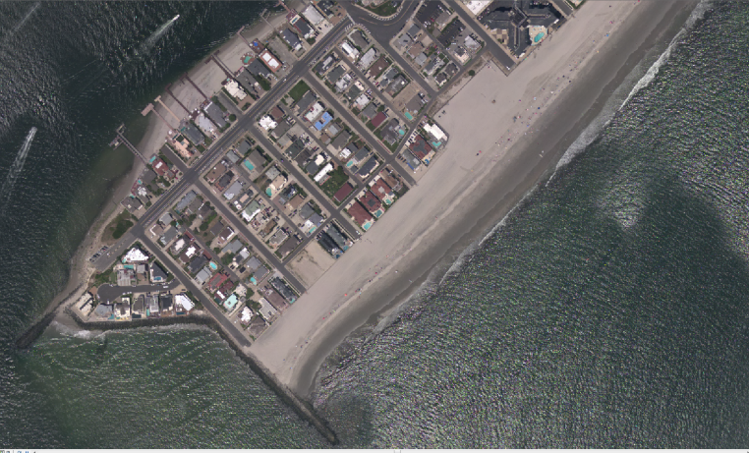
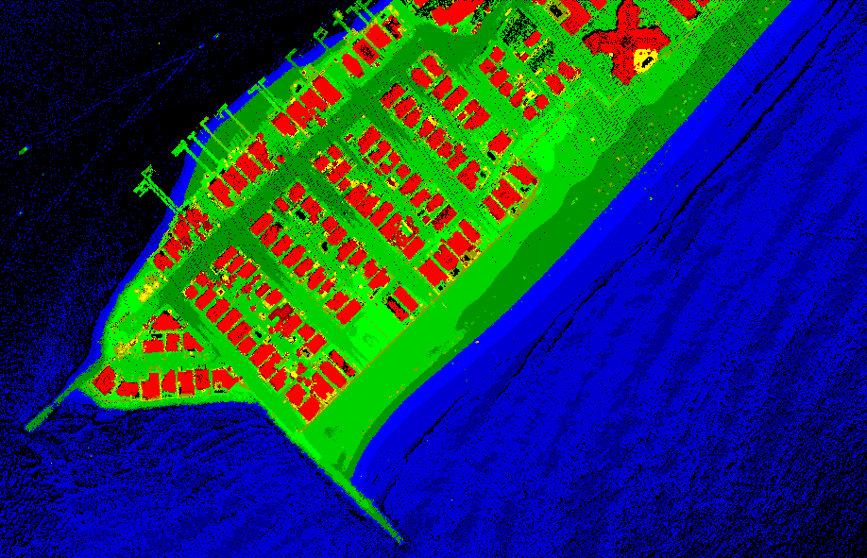
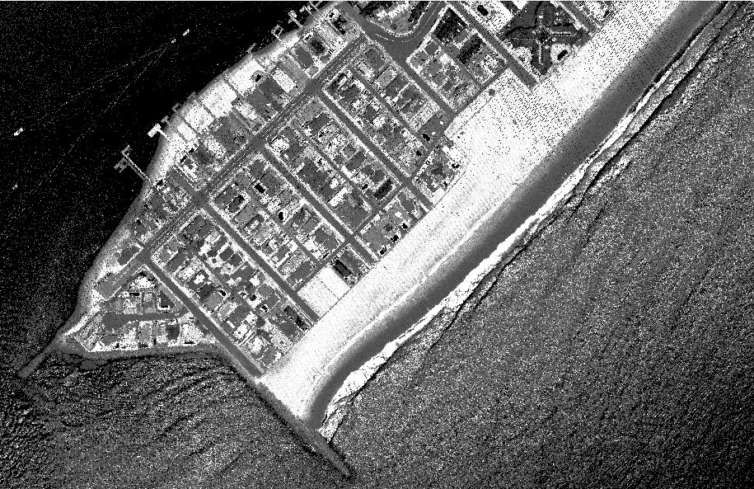
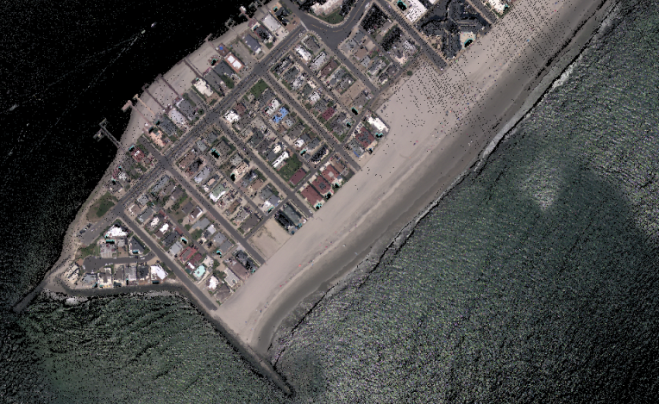
IOCM Products/Deliverables
Shoreline (CUSP and Charting Scale)
Ortho Mosaic Imagery
Lidar Point Cloud
(elevation)
Lidar Point
Cloud
(intensity)
RGB
Colorized Lidar
Point Cloud

Slide 12
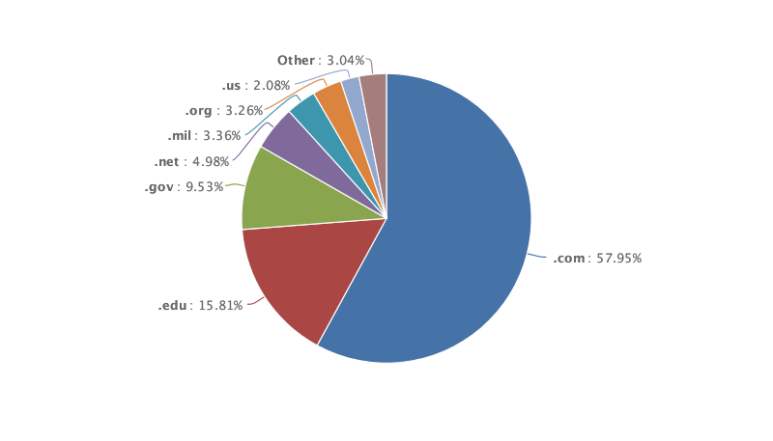
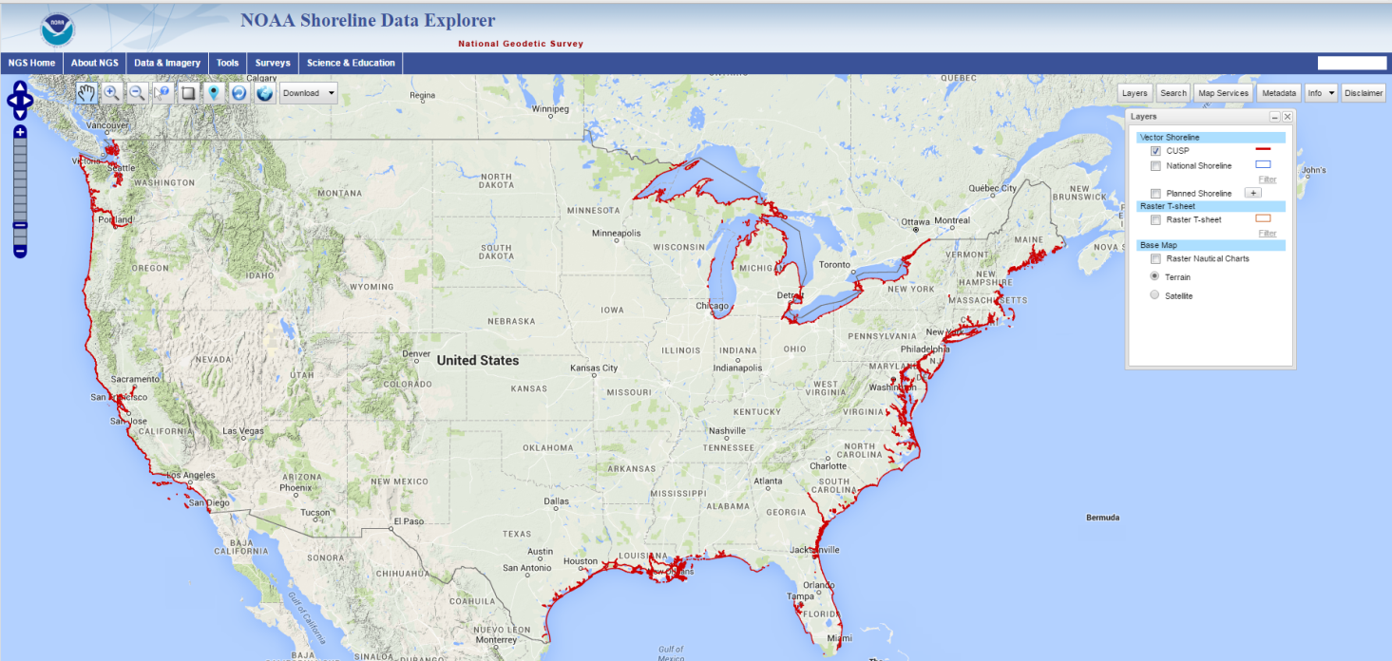
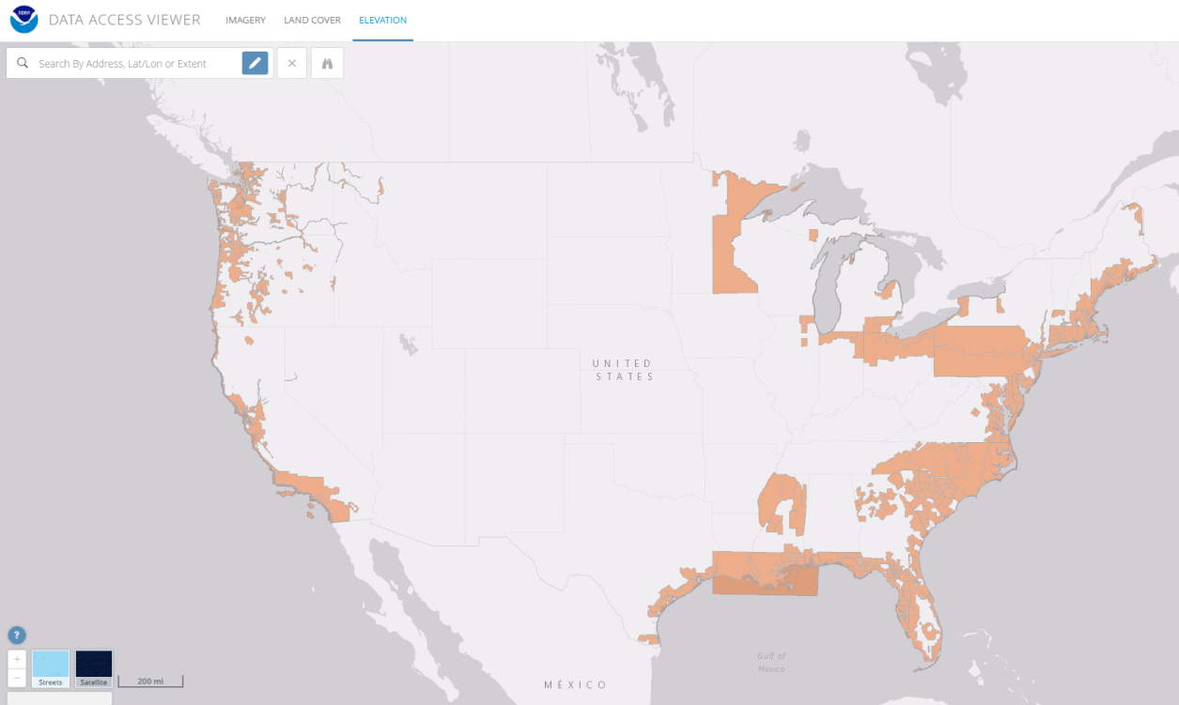
Distribution of Data
Shoreline:
http://www.ngs.noaa.gov/NSDE/
Lidar and Imagery:
https://coast.noaa.gov/dataviwer
Notes:
Coastal Focus
USACE, USGS, and NOAA topobathy data
Customized download
4 Terabytes

Slide 13
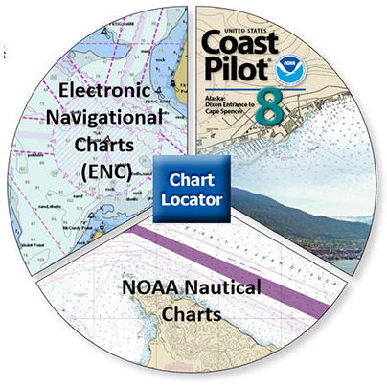
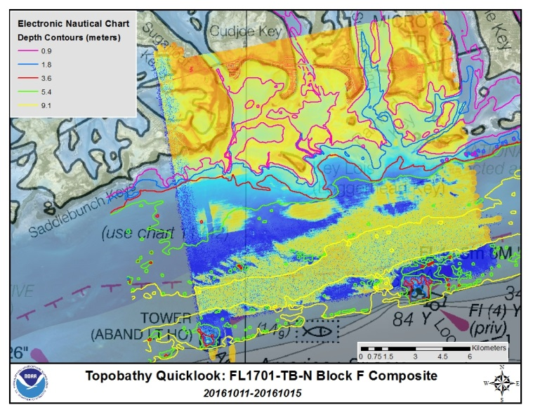
Utilization for Nautical Charting (Office of Coast Survey)
Developing Quicklook DEMs for quicker utilization by NOAA Ships
Streamlined Data Package for quicker application to Nautical Charts
5m Shoal-biased DEM in MLLW
Metadata (has info for DR)
Initial CUSP Shoreline (MHW and MLLW)
MQUAL (generated by MCD)
Working to get both NOAA and JALBTCX data ingested where appropriate
Notes:
Prioritization and Consideration Criteria for Topobathy Lidar
Direct support to NOAA Hydrographic operations that have coastal requirements
Increases safety and efficiency
Vessel Traffic
Outdated survey based from CATZOC (earlier than 1980s).
-In many cases, earlier than 1950s
Not covered by existing data or data with poor quality and/or coverage
Areas likely to support ABL operations based on Satellite Derived Bathymetry and other information

Slide 14
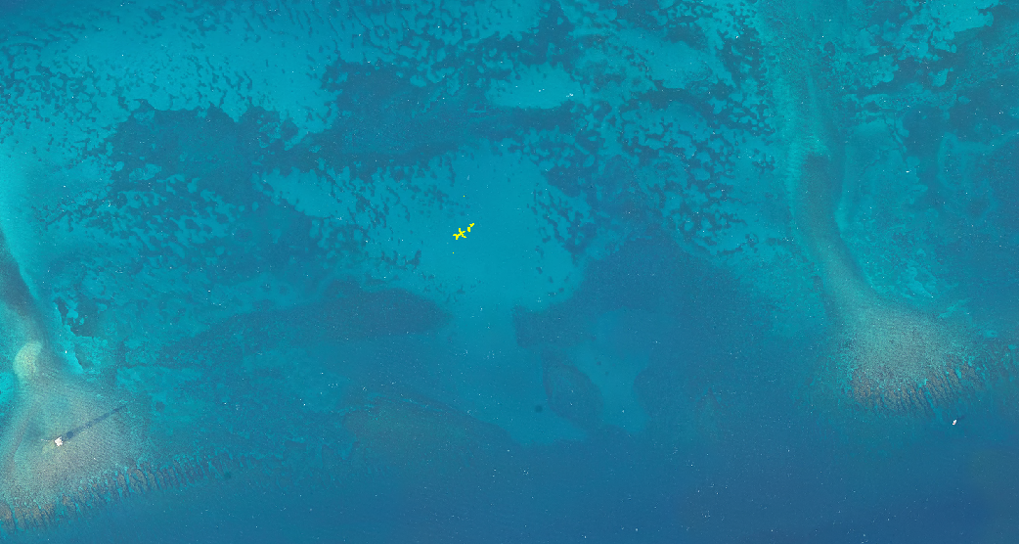
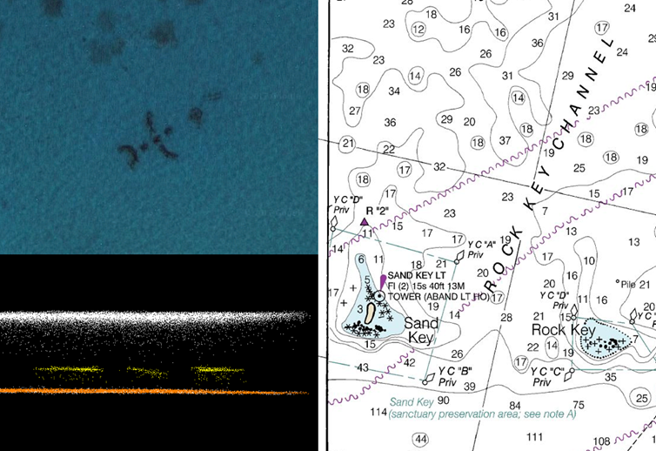
Submerged Object – Outer Reef, Florida
Chart 11446 1:40,000
Notes:
24 27' 29.9'' -81 52' 06'‘
South of Key West

Slide 15
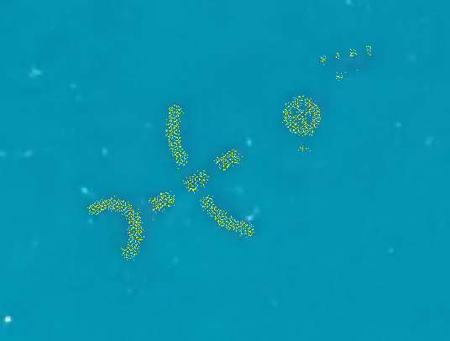
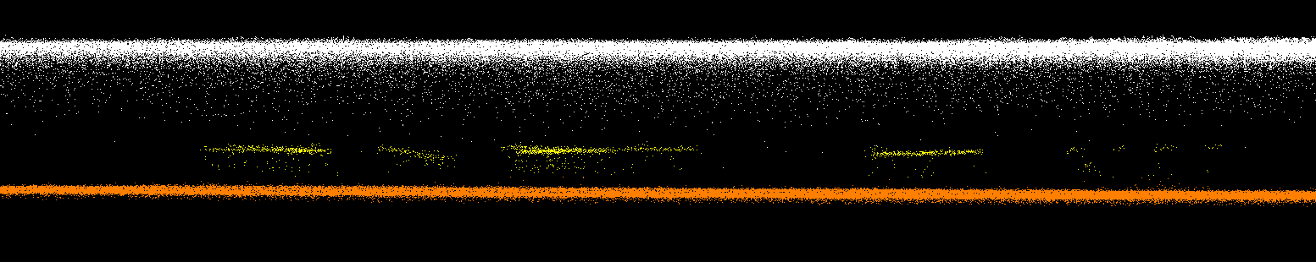
Point density of the object ranged from ~12 to 13 pts per m²
Water depth: ~7.7m
Object height: 2m
~26m
~7m
~26m
~7.7 m
2 m

Slide 16
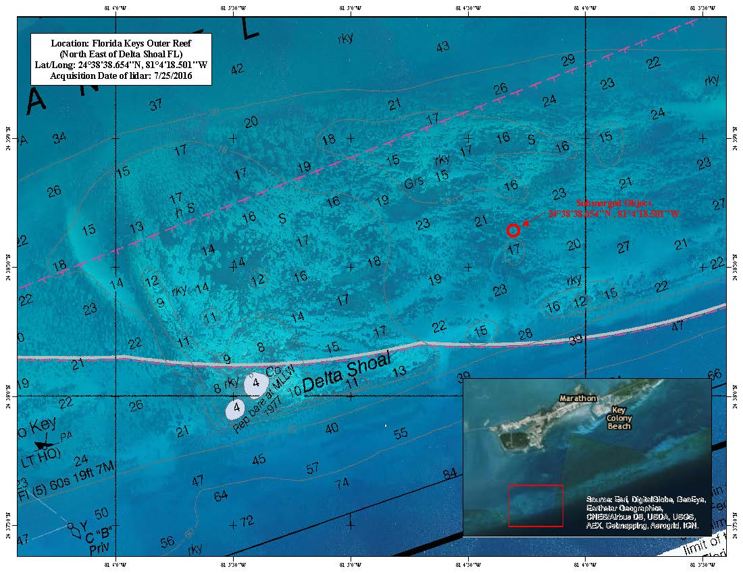
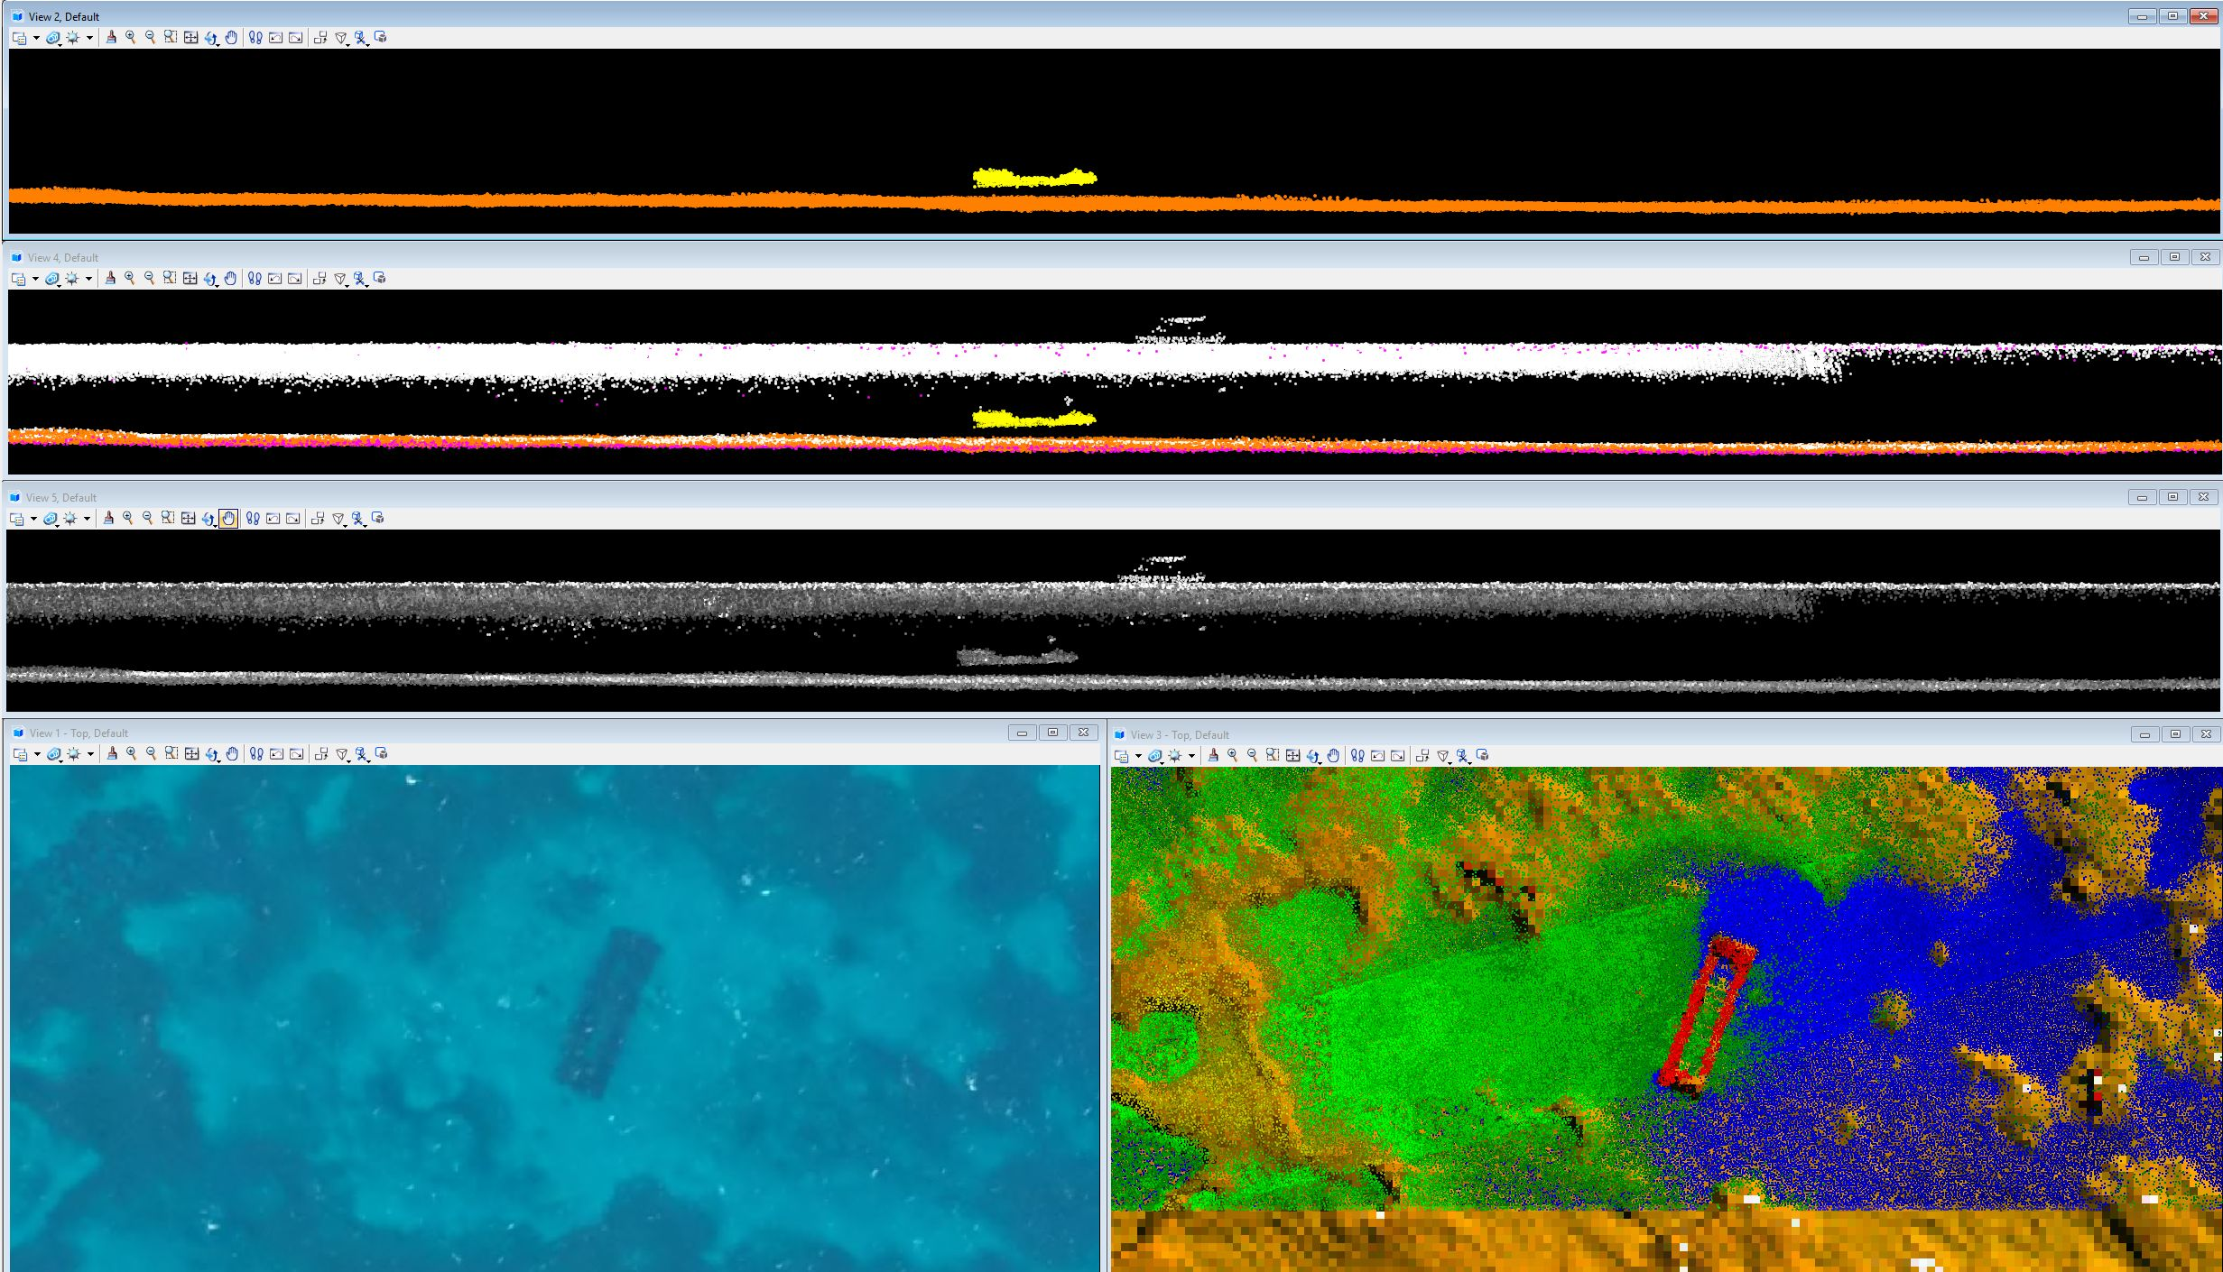
Detection of Unknown Submerged Objects

Slide 17
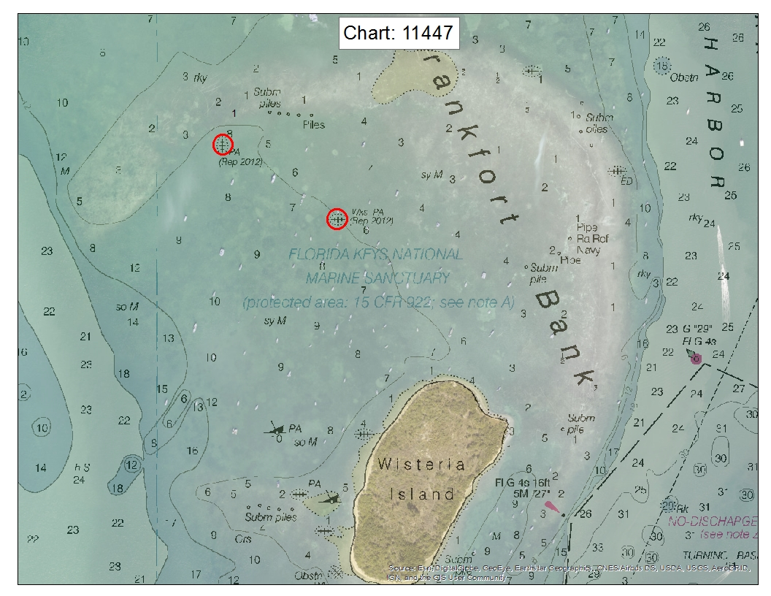
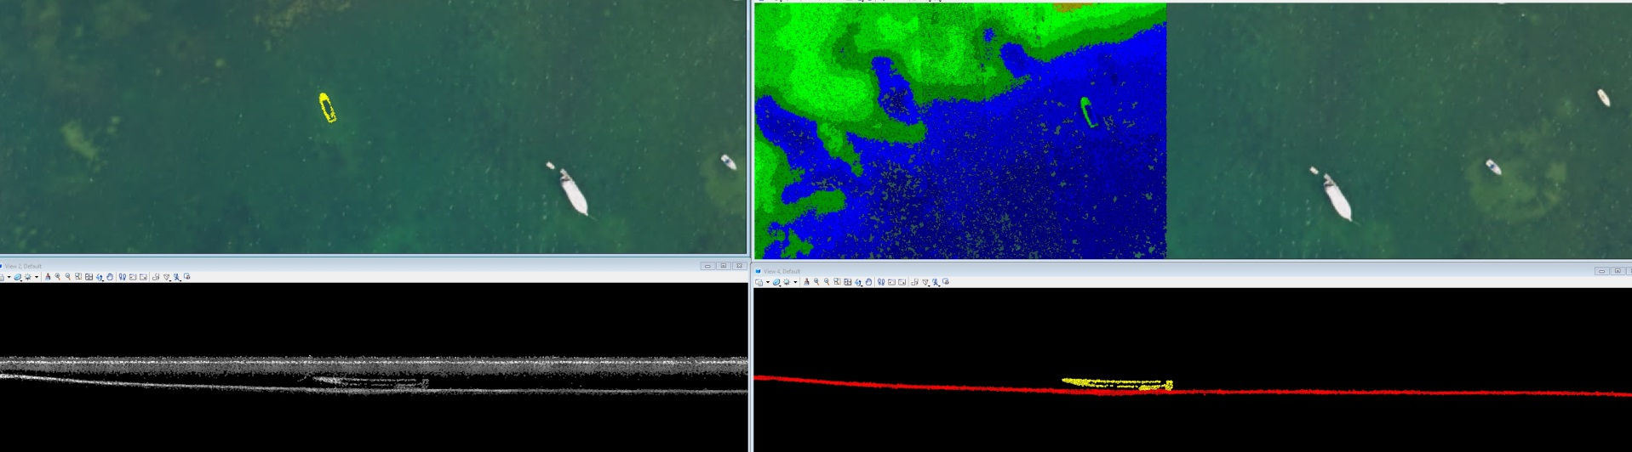
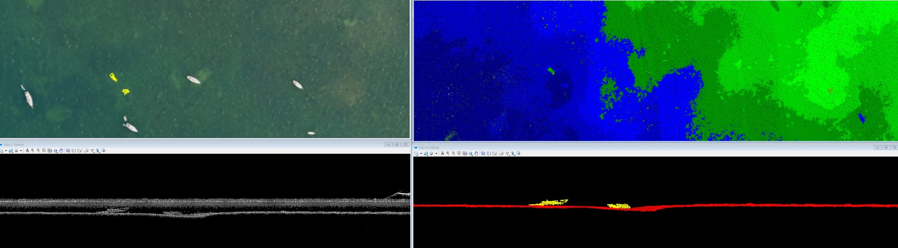
Confirmation of Submerged Objects

Slide 18
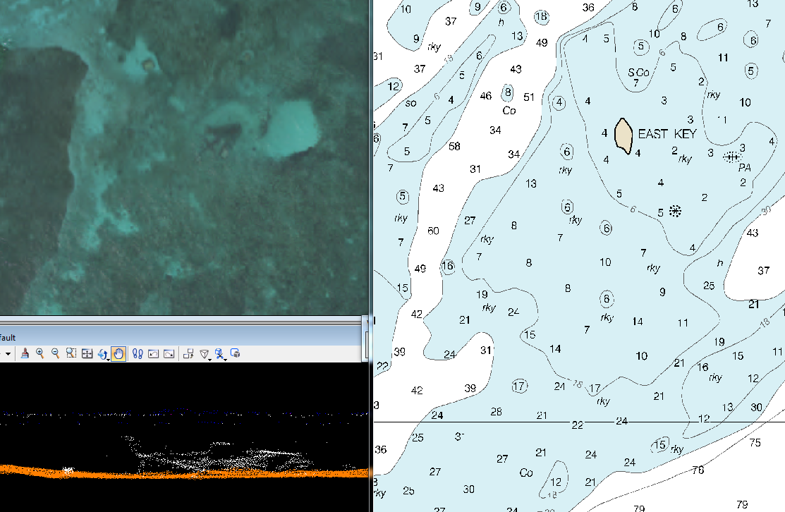
Wreck with Position Approximate (PA) updated near East Key, Dry Tortugas, FL
115m
Notes:
Wreck found near PA at East Key - ENC updated. Wreck moved ~115m

Slide 19
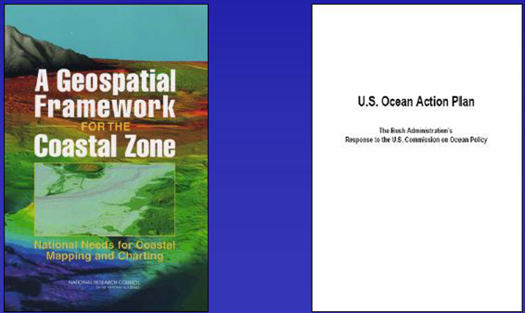
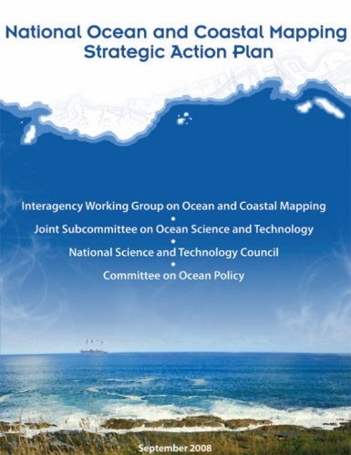
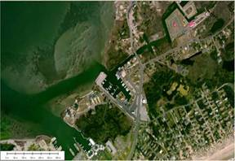





Integrated Ocean and Coastal Mapping (IOCM)
IOCM is planning, acquiring, integrating, and managing ocean and coastal geospatial data and derivative products for easy access and use by the greatest range of users.
Charged with facilitating “the coordination of ocean and coastal mapping activities and avoid[ing] duplicating mapping activities…”
Notes:
These objectives of increasing intra- and interagency coordination and promoting multi-use of geospatial data are gaining a lot of traction.
One important driver was a 2004 National Research Council Report titled “A Geospatial Framework for the Coastal Zone: National Needs for Coastal Mapping and Charting.”
Key recommendation: increasing coordination and collaboration on ocean and coastal mapping across the federal gov.
Stimulated several other reports/initiatives, including the U.S. Ocean Action Plan. It turn, that led to the creation of the Interagency Working Group on Ocean and Coastal Mapping (IWG-OCM).
NRC Report
Consistent spatial framework for coastal data the allows a seamless transition from onshore to offshore
Increased collection and availability of data including land cover, shallow-water bathymetry, seafloor imagery, habitat distribution and classification standards
Easy access to up to date digital, geospatial data, imagery and mapping products
Compatibility among data formats – or standards and transformation protocols that allow each data exchange – and a means to evaluate data accuracy.
Increased inter- and intra-agency coordination, cooperation and communication.
U.S Ocean Action Plan
Develop and annual inventory of federal, federally-funded, and non-federal governmental ocean and coastal mapping programs and operations
Assess and report on common and shared needs for development of coordinated programs
Coordinate and leverage resources and efforts across the federal sector with industry, academic, NGO and non-federal government entities
Set priorities for standards development and developing strategies for promulgation of standards for data acquisition, data, metadata, tools and products
Develop shared and standardized mechanisms for processing, archiving, and distributing geospatial data, tools, products and services

Slide 20







Evaluating the Utility of EAARL-B Waveforms for Characterizing Benthic Habitats
Project Area
Location: Flat Cay, St. Thomas
Depths: 0 – 28 m
Data Density: 1 - 4 pts/m²
Dominant Benthic Habitats:
Draft, corrected EAARL-B waveform products

Slide 21







National Centers for Environmental Information (NCEI):
Acquisition & Processing
Discovery & Dissemination
Long Term Archiving & Stewardship
Topo-Bathy DEM Development

Slide 22





National Centers for Environmental Information-Boulder (NCEI): DEMs developed at the NOAA support improved tsunami and storm surge inundation modeling and mapping
Integrated topo-bathy DEM along
RI/CT border developed in the wake
of Hurricane Sandy (utilizes 2014
post-storm data)
Modeling tsunami generation, propagation, and inundation (NOAA
Tsunami Program
And National
Tsunami Hazard Mitigation Program)
Improved hazards mitigation (inundation vulnerability, evacuation planning)
Refinement of Hurricane Surge On-Demand Forecast System grids (NWS; COASTAL Act)

Slide 23
Thank You!
Contact Information:
Stephen White
Email: stephen.a.white@noaa.gov
Phone: (301) 713-1428 x167
www.noaa.gov
www.nos.noaa.gov
www.ngs.noaa.gov

