Slide 1
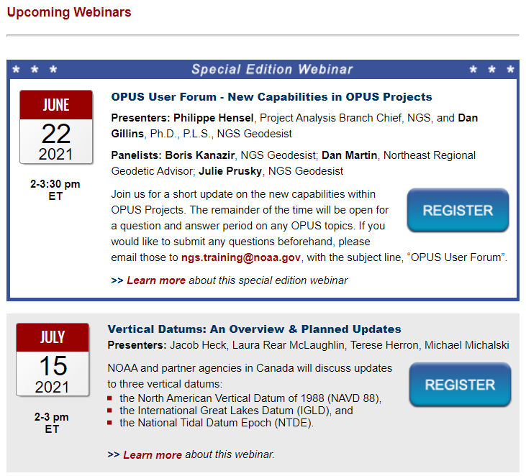

Welcome to the Online Positioning User Service
(OPUS) User Forum
Our presentation will begin shortly
The audience will be muted by default. Submit questions using
the webinar’s question function.
Audio is available via computer speakers (VoIP).
Certificates of Attendance will be provided for those attending the entire webinar.
Recorded presentation available in ~1 week
For live captioning, visit http://www.fedrcc.us/
Click: Join Now, and enter event number 4957022
Please complete the brief evaluation form after the webinar.
TIP: Slides stop advancing? Refreshing your browser ( ) usually fixes the problem!

Slide 2
Welcome to the Online Positioning User Service
(OPUS) User Forum
The audience will be muted by default. Submit questions using
the webinar’s question function.
Audio is available via computer speakers (VoIP).
Certificates of Attendance will be provided for those attending the entire webinar.
Recorded presentation available in ~1 week
For live captioning, visit http://www.fedrcc.us/
Click: Join Now, and enter event number 4957022
Please complete the brief evaluation form after the webinar.
TIP: Slides stop advancing? Refreshing your browser ( ) usually fixes the problem!

Slide 3


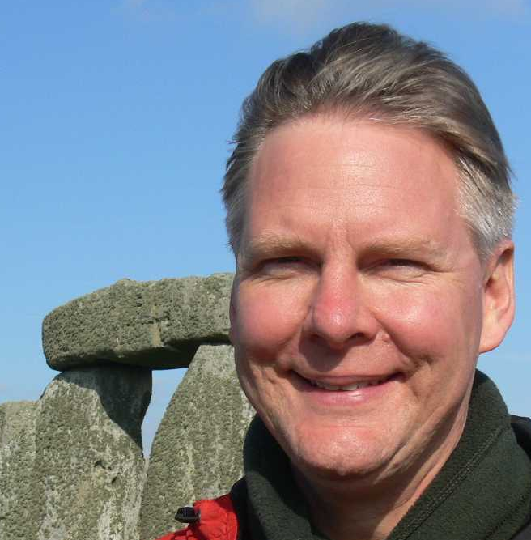
OPUS User Forum - Tips on Successful Use
of OPUS Shared Solutions
Presenters/Panelists
Dave Zenk, Northern Plains Regional Advisor, NGS
Galen Scott, NGS Constituent Resources Manager
Joe Evjen, NGS Geodetic Standards and Applications Branch Chief

Slide 4



OPUS User Forum - Tips on Successful Use
of OPUS Shared Solutions
Moderators/Support Team
Erika Little, NGS Training Coordinator
Jeff Jalbrzikowski, Appalachian Regional Geodetic Advisor
Sonja Bowen, NGS Communications and Outreach Team

Slide 5
Tips on Successful Use of OPUS SHARE
OPUS User Forum
Webinar
November 30, 2021
Notes:
Welcome to “How to Submit an OPUS Share Observation”

Slide 6
HANDOVER to JOE,
ERIKA retains control of transitions

Slide 7
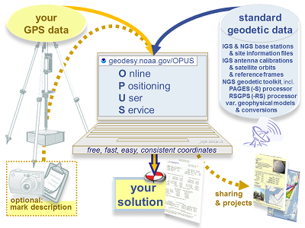
OPUS User Forum –
Tips on Successful Use of OPUS Shared Solutions
learn more about sharing your OPUS solutions
hear an update on the GPS on Bench Marks campaign
sharing demos; some common reasons Shared Solutions may fail
question and answer period on any OPUS topics.
November 30, 2021 | 2-3:30 pm
Content Rating: Beginner- No prior knowledge of this topic is necessary.
Target Audience: OPUS Users
Certificate of Attendance: Yes
Notes:
Let’s talk about OPUS today,
OPUS: as the name suggests, is a service for positioning, designed for online users.
I’ll begin with a brief overview of what the service does now, describe some planned enhancements, then we’ll pivot, as this is a user forum, to answering your questions

Slide 8
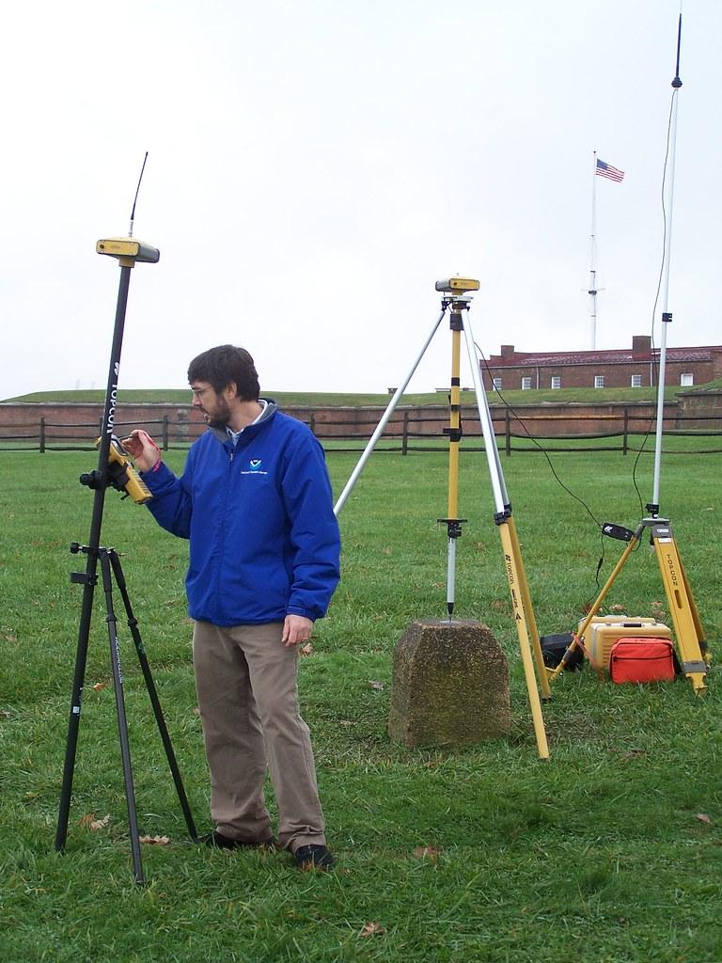

Today’s Panel
Joe Evjen
joe.evjen@noaa.gov
National Geodetic Survey
Chief, Geodetic Standards and Applications Branch
David Zenk
dave.zenk@noaa.gov
National Geodetic Survey
Advisor, Northern Plains Region
Minnesota, North Dakota, South Dakota, Iowa, and Nebraska
Galen Scott
galen.scott@noaa.gov
National Geodetic Survey
Constituent Resources Manager
Notes:
And here we are, I’m on the left, Dan and Dave will cut in as needed to correct me, and to answer your questions later.
Thanks also to the folks in the Geodetic Services division for organizing and facilitating the webinar.

Slide 9
Today’s Outline
Tips on Successful Use of OPUS SHARE
Introductory remarks - Joe Evjen
Play 11 minute video (by Dave Zenk). https://geodesy.noaa.gov/corbin/class_description/opus-share-tutorial/
Dave does 2 demos of filling out the OPUS SHARE form – for a new mark & an existing mark.
Then, Galen Scott will discuss GPS on BM contributions.
Finally, Joe Evjen will discuss the NGS review/approval process of shared marks to explain why some submissions fail.
Questions and answer period

Slide 10
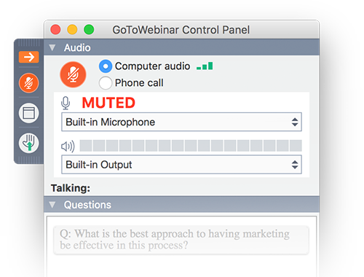
This is an interactive forum!
Use your GoToMeeting question box.
We will answer them today, or soon.
Notes:
And YOU will ask most of the questions! You can start right now
You should have a GoToMeeting control panel which looks like this on your screen;
Use the QUESTION function on the bottom of that panel to send questions to us as they come to you.
We’ll harvest your questions while I’m speaking, then highlight the most popular seeming questions in part two.
Later, we’ll try to send out answers to ALL the questions asked.

Slide 11
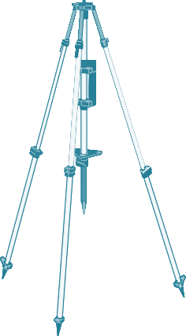
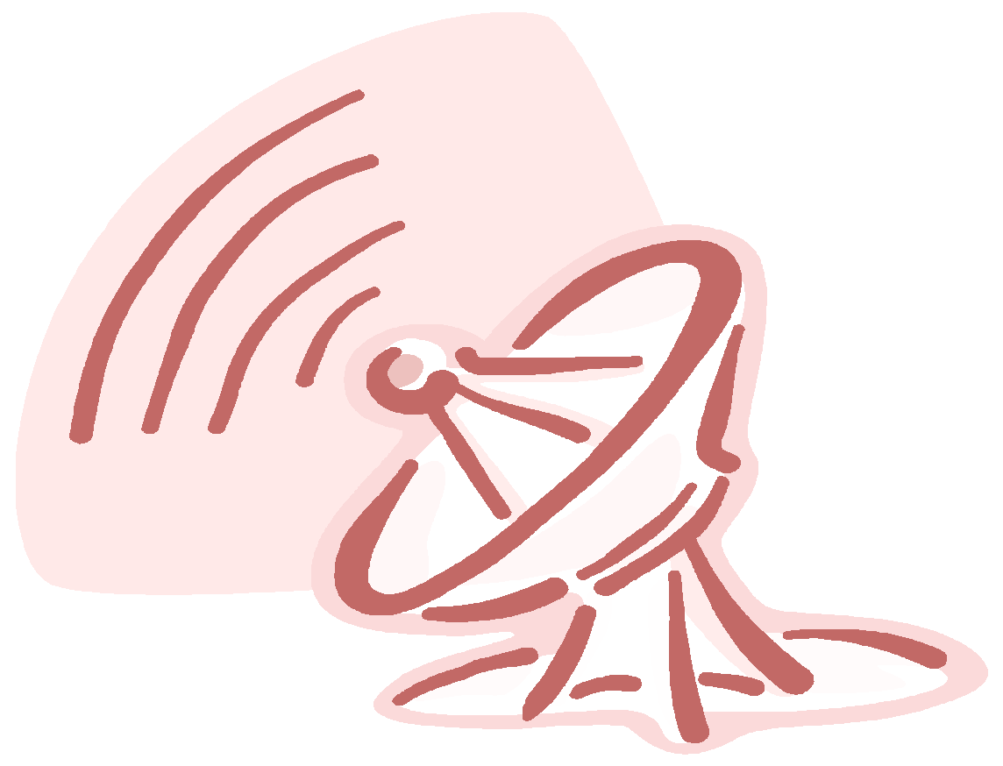


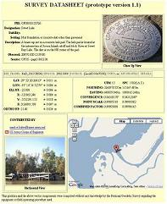
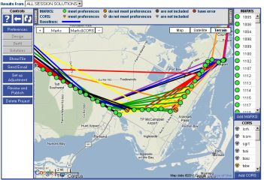
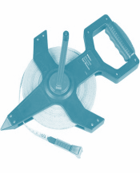
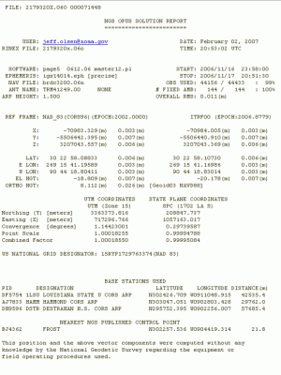


your
GPS data
IGS & NGS base stations
& site information files
IGS antenna calibrations
& satellite orbits
& reference frames
NGS geodetic toolkit, incl.
PAGES (-S) processor
RSGPS (-RS) processor
var. geophysical models
& conversions
standard geodetic data
O nline
P ositioning
U ser
S ervice
geodesy.noaa.gov/OPUS
JGE 2021 v1
free, fast, easy, consistent coordinates
your
solution
sharing
& projects
optional:
mark description
Notes:
Here’s a simple schematic. You we both have data. When you combine them in OPUS, your data align to the National Spatial Reference System.
Adding mark information facilitates sharing and projects options.

Slide 12
Data Contribution Routes
 | via OPUS option “share my solution” | via OPUS option “project ID”
WHAT DATA? | minimal one receiver, one 4+ hour observation | more; many receivers, redundant sessions, network adjusted by project manager
USE, in transformation tool | Will be used in modeling, existing BMs only (published ortho hgts) | Will be used in modeling, all marks, as projects publish ortho hgts
 | news! Data contributed by Dec 31, 2022 will be considered for use in creating the transformation tool
USE, in current generation datasheets | for all marks, results appear as ‘shared solutions’ = not published geodetic control for existing BM datasheets only, updates “SCALED”>“HD_HELD2” coordinates | for all marks, results appear as NGS datasheets =published geodetic control
USE, in next generation datasheets | will be published with 2020.00 RECs in the modernized NSRS
see also, mark recovery to update mark descriptions and add photos

Slide 13
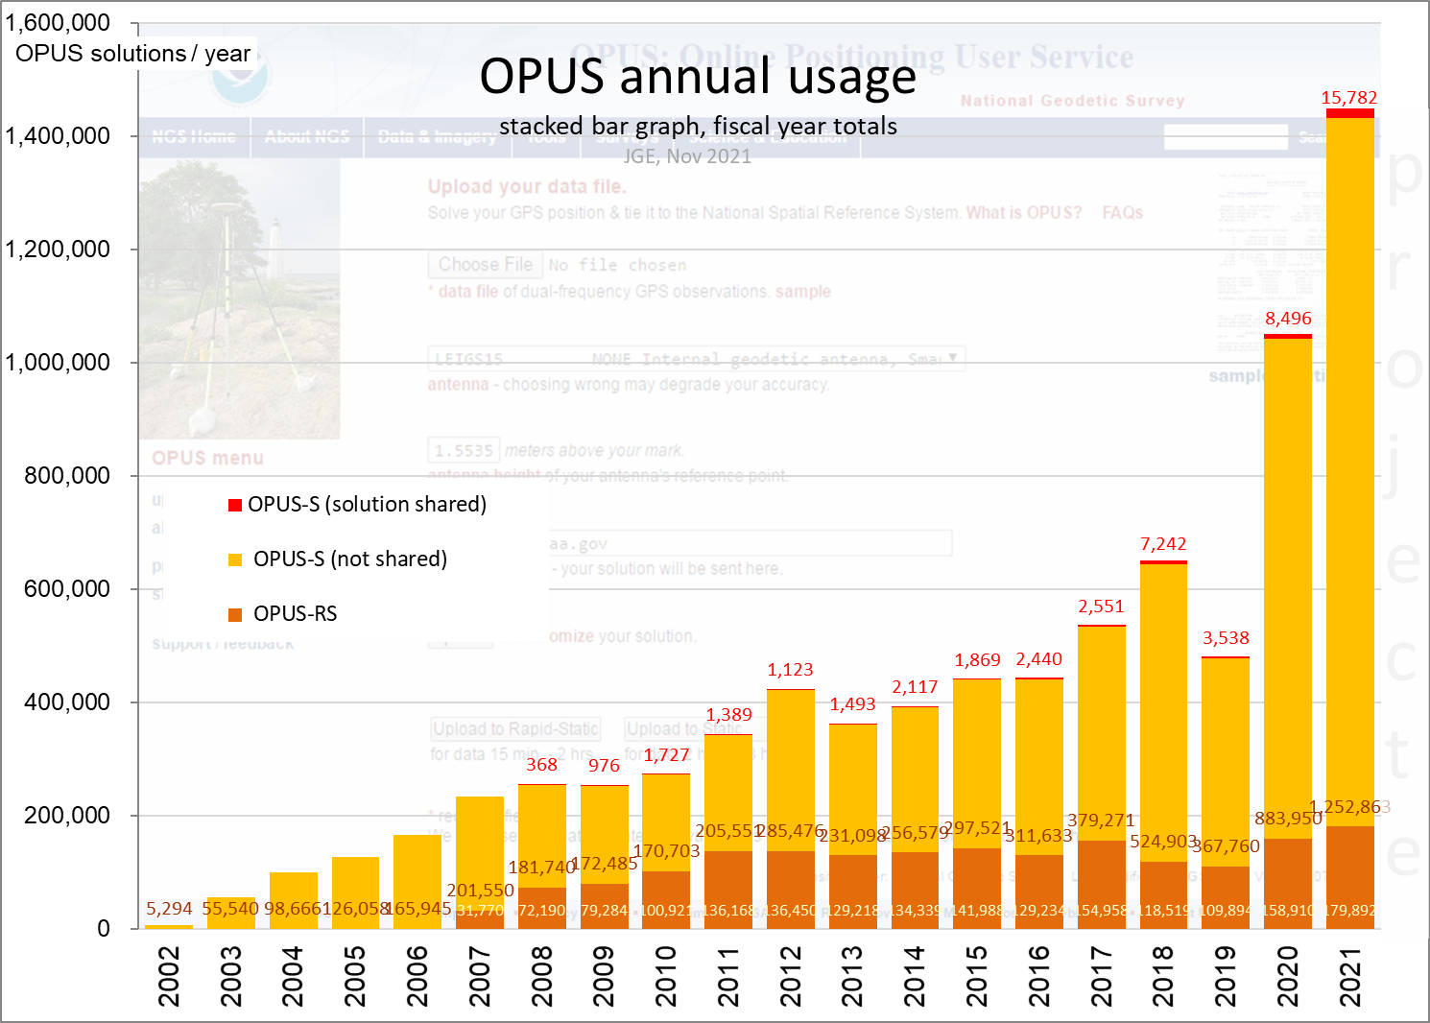
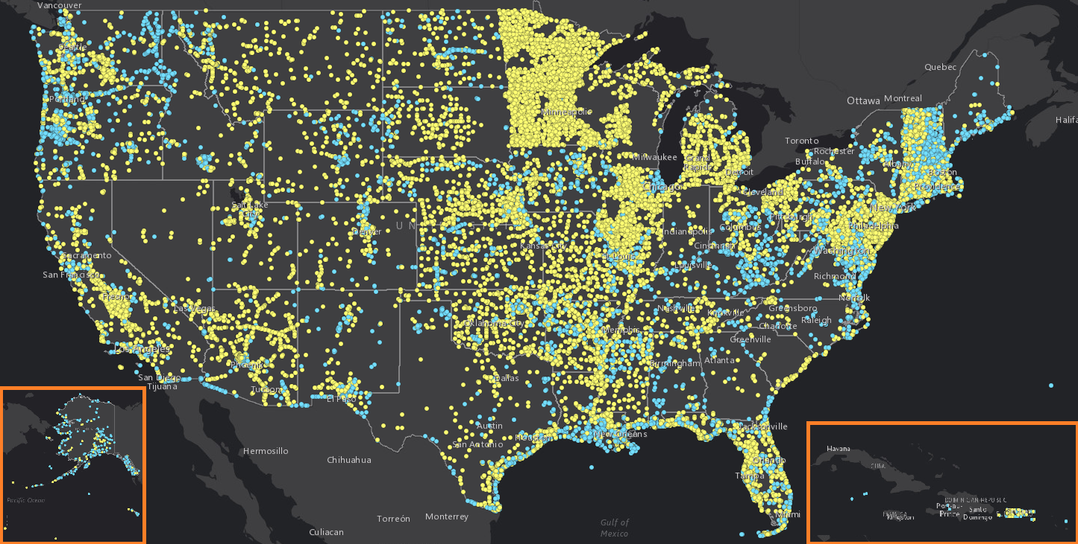
Notes:
OPUS has grown to be quite popular over time.
OPUS now serves over a million data submissions per year!
Over 40,000 of those have been shared, improving datasheets and giving us the observations to improve height models such as GEOID18

Slide 14
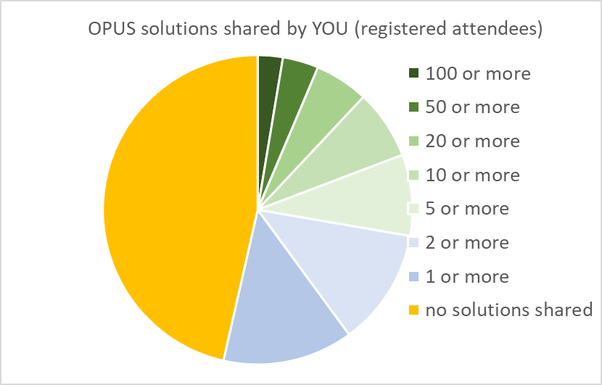

Slide 15
planned rollouts
version | Working title | Adds what? | Removes what? | when?
in production www.ngs/OPUS | OPUS adds publishing | Upgrade -projects to facilitate IDB publishing | --
in BETA now beta.ngs/OPUS | OPUS adds RTK | Upgrade -projects to ingest GVX vectors | --
pending | reference frame maintenance | updated reference frame: ITRF2020 | old version: ITRF2014 | 2022
DEV | OPUS adds GNSS (M-PAGES) | Upgrade CORS data & OPUS-static processing to add GNSS constellations beyond GPS. Use RINEX3 header metadata to make upload form more optional? | vendor data format support is eroding! OPUS-RS killer? | 2022?
DEV | OPUS adds everything | Overhaul OPUS interface and reports Upgrade -projects to ingest leveling and other standard data formats | outdated interfaces, old report formats | ??
pending | reference frame upgrade | Support new datums: NAPGD2022, NATREF epoch 2020.0, SPCS2022 | old datums: NAVD88, NAD83, SPCS83, USFt | 2023/5?
Notes:
Here’s a list of six different enhancements to OPUS in various stages of planning, on the following slides we’ll address each one-by-one

Slide 16
HANDOVER to DAVE,
ERIKA retains control of transitions

Slide 17
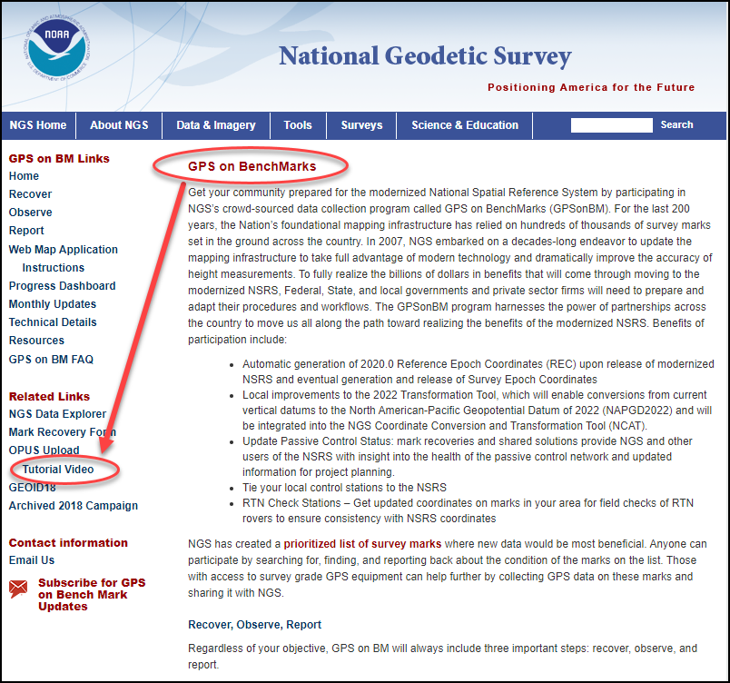
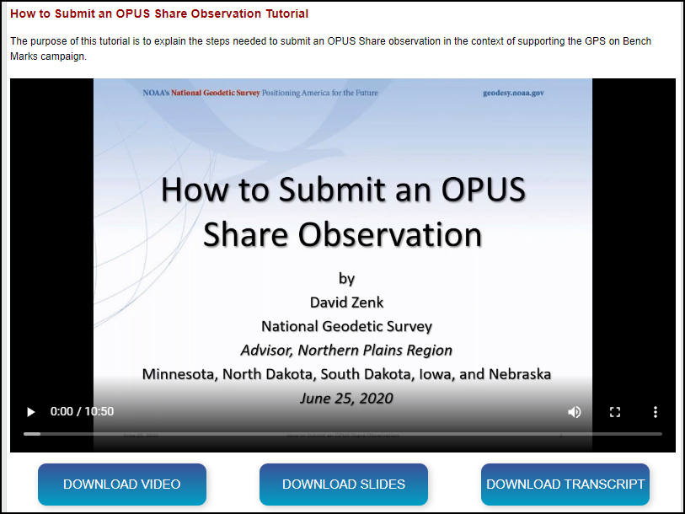
“How to Submit an OPUS Share Observation”
11 minute video – on NGS website:
https://geodesy.noaa.gov/corbin/class_description/opus-share-tutorial/
“GPS on Benchmarks” page
Left side column
  “Tutorial Video”

Slide 18
Post Video Demo
Zenk submitted 2 OPUS Share observations
  A new mark (ZENK DECK)
  An existing mark (PARKER RESET)
Resulting email series captured – (a live demo will not fit time allowed).

Slide 19
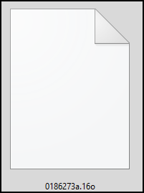
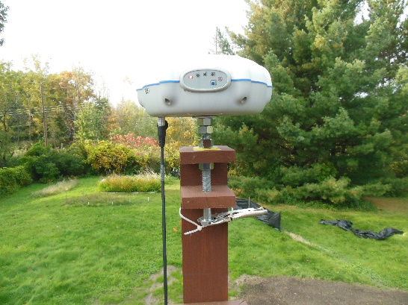
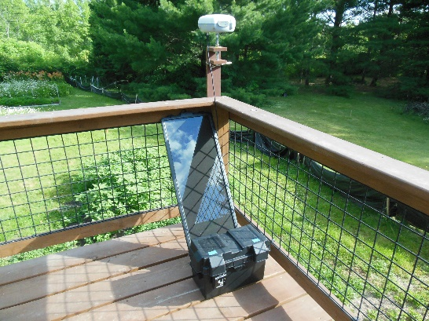
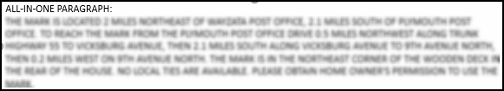
ZENK DECK – prepare to submit – gather files
Observation RINEX FILE – 4+ hour needed.
2 photos – close-up & horizontal
Prepared descriptive text recommended
RINEX File

Slide 20
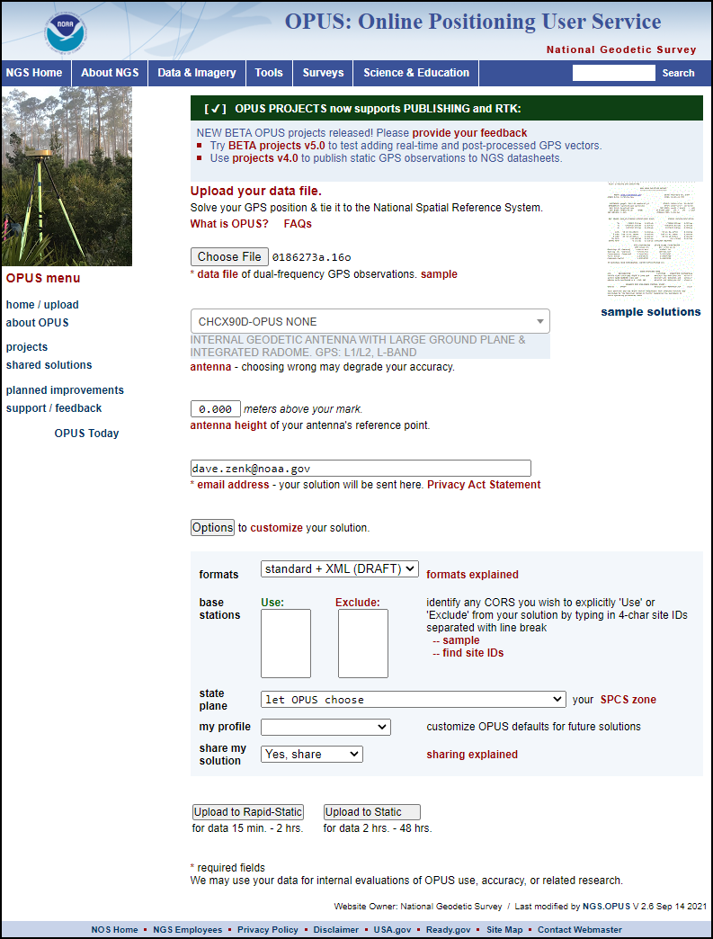
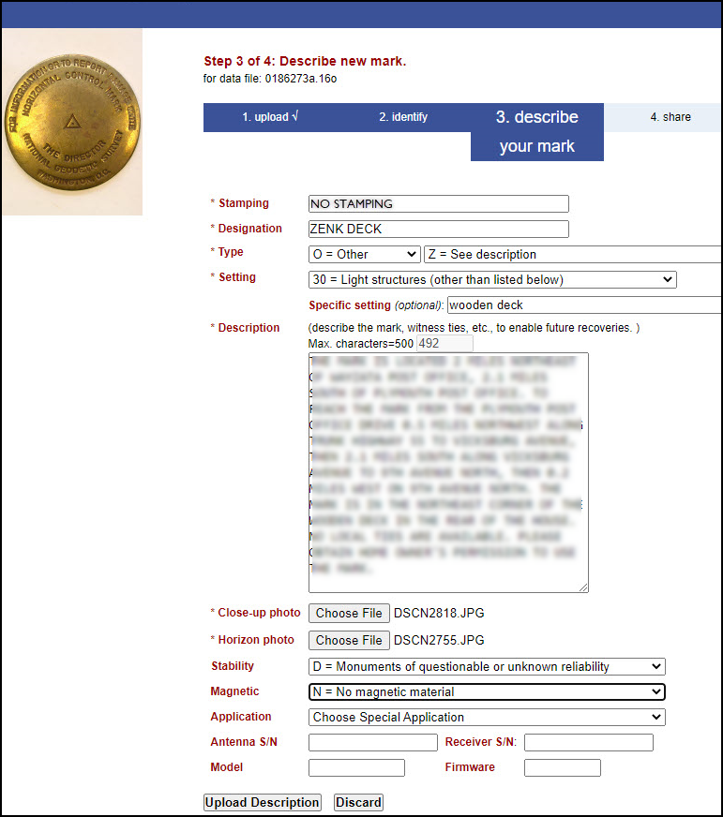
Submit to OPUS SHARE - choose NEW MARK - Upload

Slide 21
The First Email arrives - OPUS Static Solution
Inspect for QA/QC – note “nearest mark”
Wait for Second Email – might be a few minutes!
NGS OPUS SOLUTION REPORT
========================
All computed coordinate accuracies are listed as peak-to-peak values.
For additional information: https://www.ngs.noaa.gov/OPUS/about.jsp#accuracy
USER: dave.zenk@noaa.gov DATE: September 23, 2021
RINEX FILE: 0186273a.16o TIME: 15:44:15 UTC
SOFTWARE: page5 2008.25 master78.pl 160321 START: 2016/09/29 00:00:00
EPHEMERIS: igs19164.eph [precise] STOP: 2016/09/29 07:59:00
NAV FILE: brdc2730.16n OBS USED: 17162 / 20036 : 86%
ANT NAME: CHCX90D-OPUS NONE # FIXED AMB: 137 / 150 : 91%
ARP HEIGHT: 0.000 OVERALL RMS: 0.016(m)
-
-
-
NEAREST NGS PUBLISHED CONTROL POINT
DP6855 PARKER RESET N445948.497 W0932816.168 1564.6
8 hrs OK, exceeds 4 hr
OK
OK
0.000 is OK, intentional choice
OK
Advisory Message – may help you discover nearby marks

Slide 22
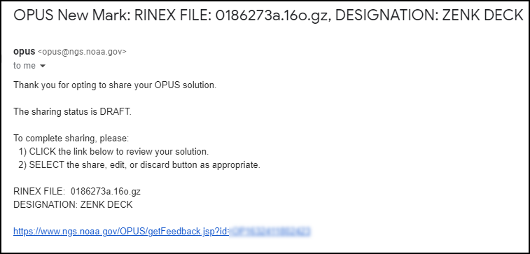
The Second Email arrives
Follow the hyperlink

Slide 23
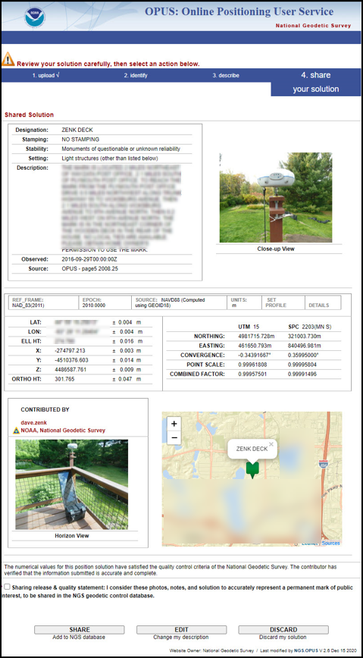
MOCK- UP Shared Solution
Inspect, then
  SHARE
    Wait for Third Email
  EDIT
    Then, wait for Third Email
  DISCARD
    End of action

Slide 24
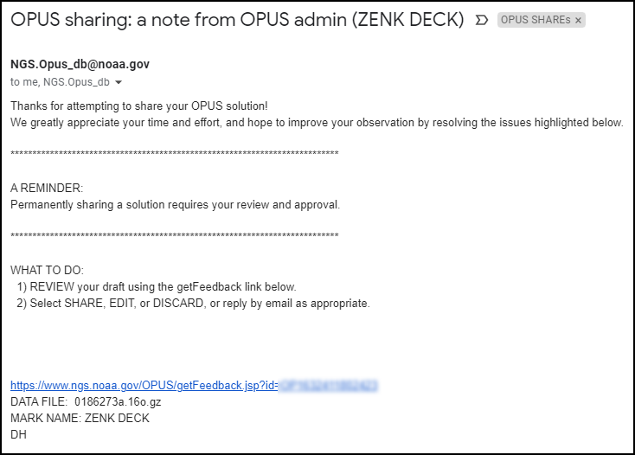
The Third Email arrives
The text of this email reminds me that I need to Review and Approve.
I will not do that since the mark is not of public interest.
I will select DISCARD.

Slide 25
What if Something Goes Wrong?
OPUS SHARE applies several behind the scenes QA/QC steps.
  (more on this later)
I made a mistake on PARKER RESET
  Let’s see what happened.

Slide 26
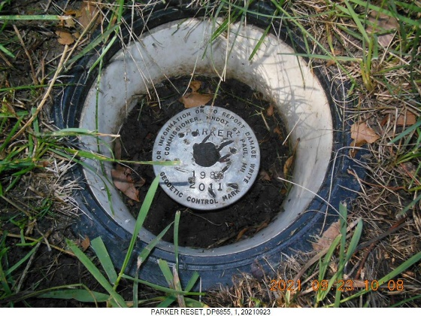
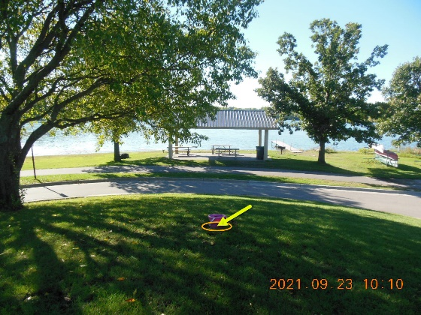
PARKER RESET– prepare to submit – files
RINEX File

Slide 27
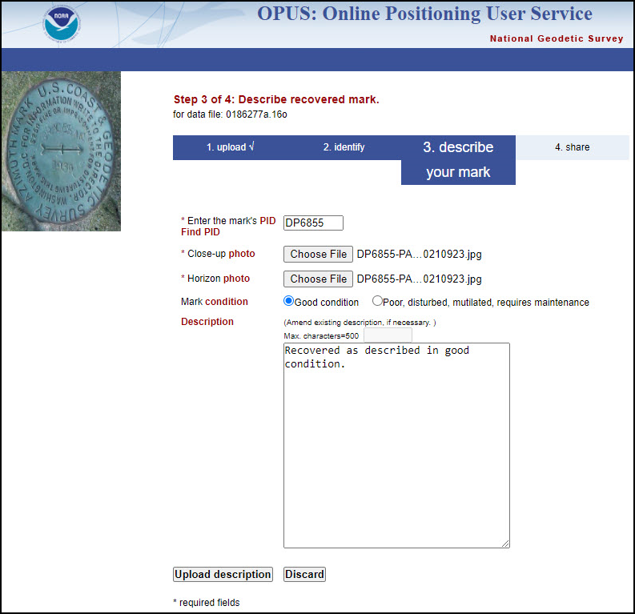
PARKER RESET
Followed usual steps
Upload to Static
Since this is an EXISTING MARK, the dialog box is much simpler.

Slide 28
The First Email arrives - OPUS Static Solution
QA/QC looks good – except for Nearest Mark.
  I missed this the first time, too.
NGS OPUS SOLUTION REPORT
========================
All computed coordinate accuracies are listed as peak-to-peak values.
For additional information: https://www.ngs.noaa.gov/OPUS/about.jsp#accuracy
USER: dave.zenk@noaa.gov DATE: September 23, 2021
RINEX FILE: 0186273a.16o TIME: 15:44:15 UTC
SOFTWARE: page5 2008.25 master78.pl 160321 START: 2016/09/29 00:00:00
EPHEMERIS: igs19164.eph [precise] STOP: 2016/09/29 07:59:00
NAV FILE: brdc2730.16n OBS USED: 17162 / 20036 : 86%
ANT NAME: CHCX90D-OPUS NONE # FIXED AMB: 137 / 150 : 91%
ARP HEIGHT: 0.000 OVERALL RMS: 0.016(m)
-
-
-
NEAREST NGS PUBLISHED CONTROL POINT
DP6855 PARKER RESET N445948.497 W0932816.168 1564.6
8 hrs OK, exceeds 4 hr
OK
OK
0.000 is OK, intentional choice
OK
I should have noticed that this isn’t correct! Distance should have been nearly ZERO (0.000)

Slide 29
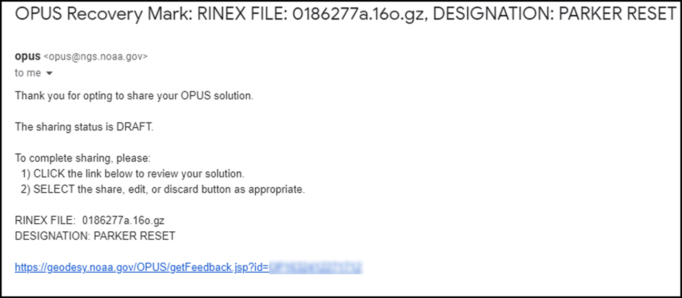
The Second Email arrives
The Second Email seems normal.

Slide 30
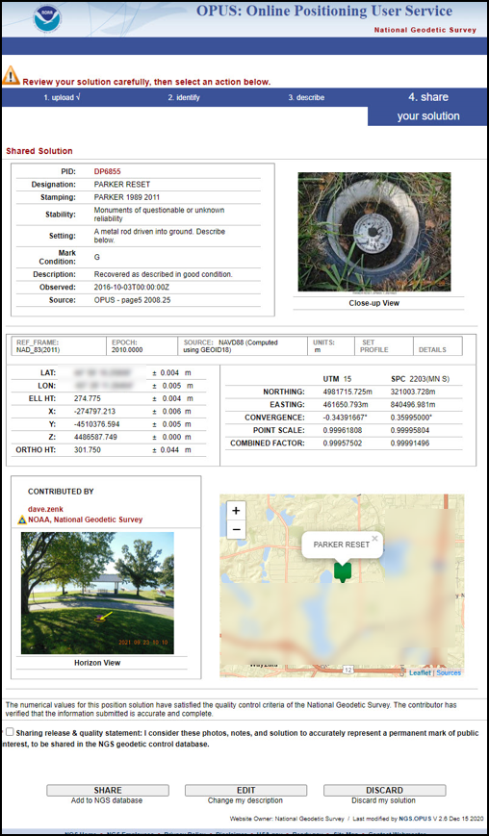
The Mock Up Solution
Following the hyperlink, the Mock Up solution seems OK, if you don’t look closely.
  Map marker is same as ZENK DECK
I didn’t notice and clicked SHARE

Slide 31
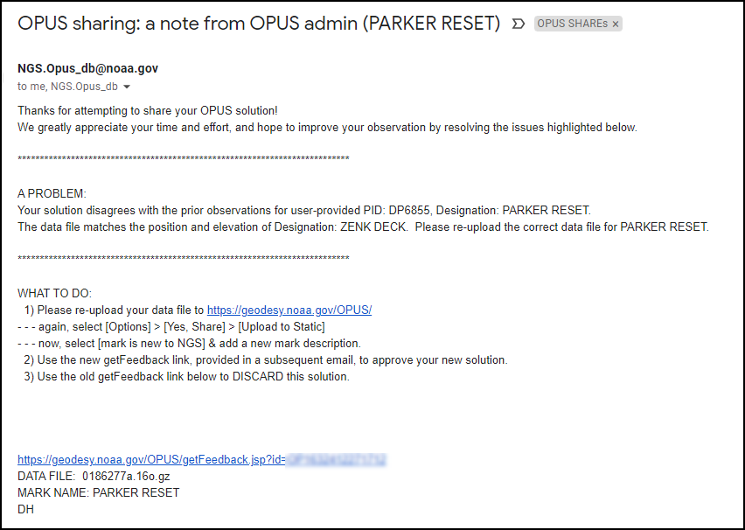
The Third Email arrives
The text of this email advises me that I need to REVIEW, REMEDIATE, and RESUBMIT.
Since I’ve LOST the correct RINEX file, I will select DISCARD.

Slide 32
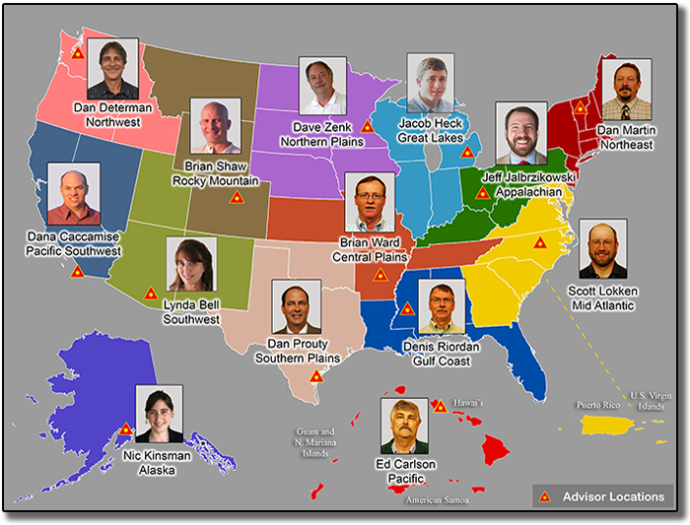
Contact
If you need assistance contact your NGS Regional Advisor.
https://www.geodesy.noaa.gov/ADVISORS/index.shtml
Or send email to:
ngs.opus@noaa.gov
Notes:
If you need assistance, please contact me or your regional NGS Advisor.
And good luck with your OPUS SHARE submissions.
Thank you.

Slide 33
HANDOVER to GALEN,
ERIKA retains control of transitions

Slide 34
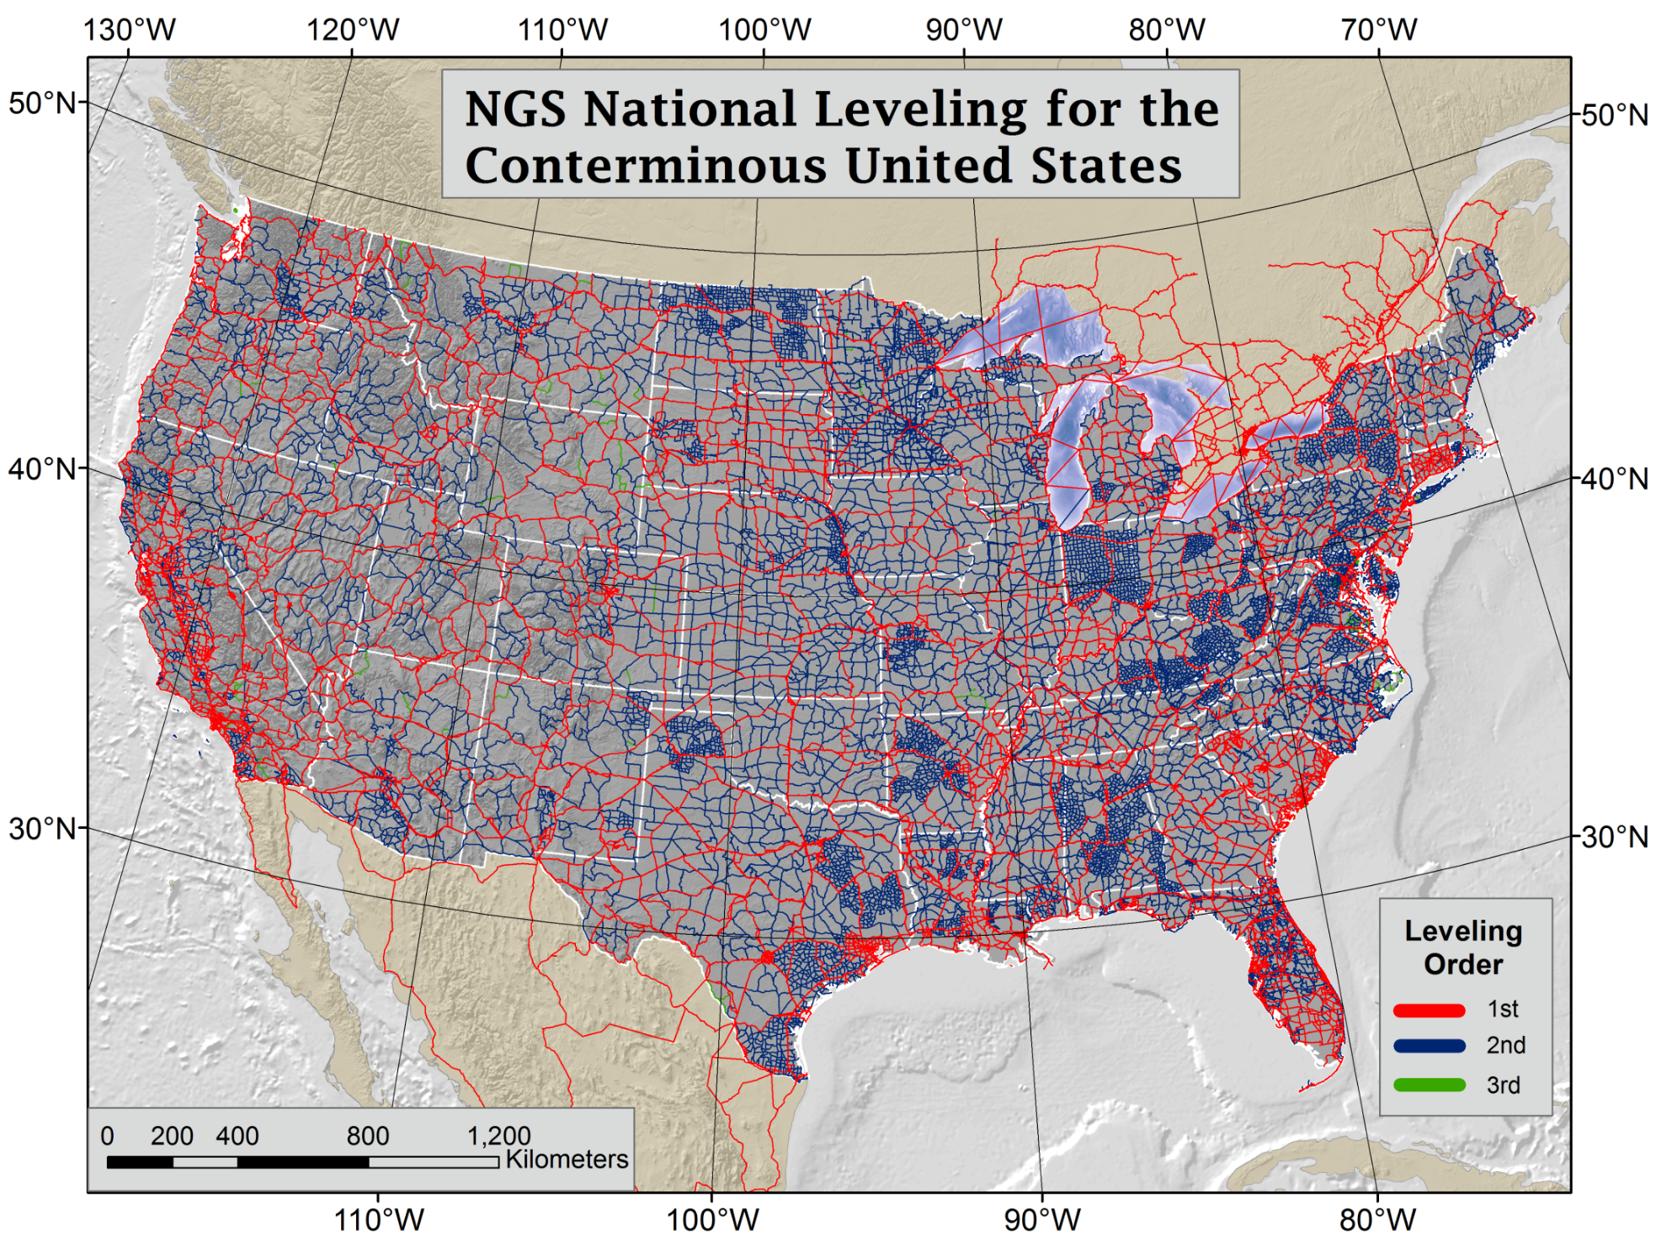
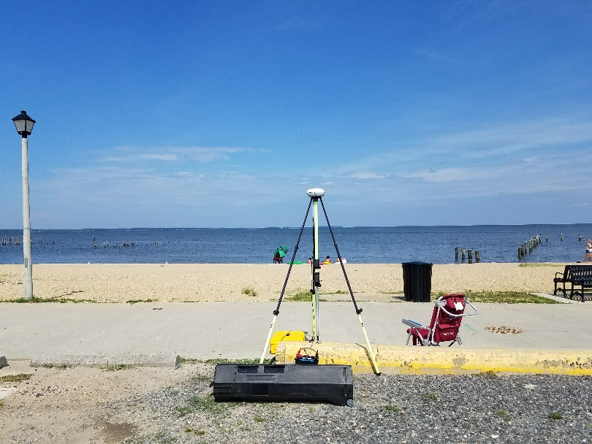
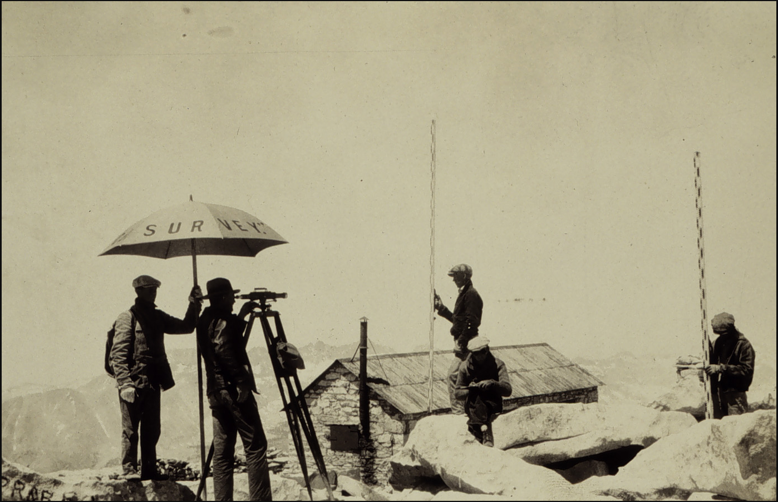
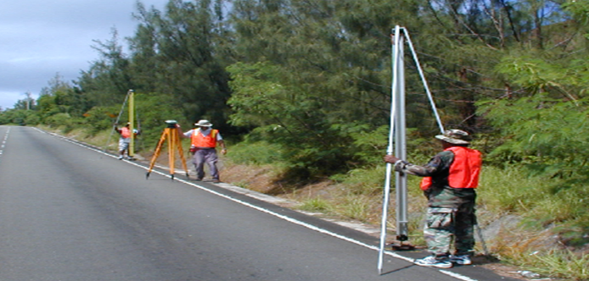
North American Vertical Datum of 1988 is Based on Continental Scale Geodetic Leveling
Orthometric Heights tell you which way water will flow
And then came GPS…
NAVD 88 consists of about 800,000 bench marks connected by about 2.2M km of leveling observed over a span of 80+ years and all adjusted together.
Notes:
NAVD 88 consists of about 800,000 bench marks and ~2.2M km of leveling. Data was collecting over many decades by roving bands of surveyors who walked across the country multiple times over the years, east to west, north to south and back again. It is currently the official vertical datum of the US and is required for federal mapping projects.
GPS data on those leveled marks were used to create GEOID18 – the model used to derive NAVD88 heights from GPS ellipsoid heights, as well as the transformation tools that will be released with NAPGD2022.
NAVD 88 was an incredible effort and employed the best technology and scientific understanding at the time
BUT:
ACCESS!
Leveling is time intensive and expensive
Access has historically been through passive control, bench marks that you must find
Accuracy!
Distance dependent errors can build up, making the overall network less reliable
Bench mark can move over time , Only as reliable as the last observation
Consistency!
Modernized NSRS will eliminate systematic errors in current datums
Aligned with global reference frames
Integrated system for both positions and heights (“elevations”)
But, long time period during which things were moving that we could not adequately account for
New reference frames will give coordinates at specific reference epochs and the IFVM will move coordinates through time from the survey epoch to the reference epoch.

Slide 35
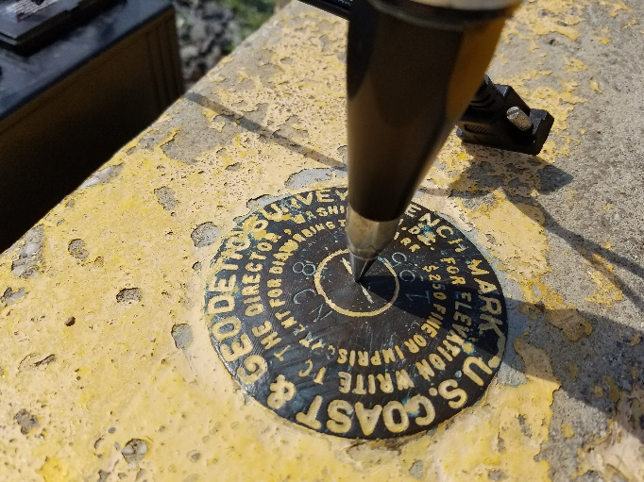
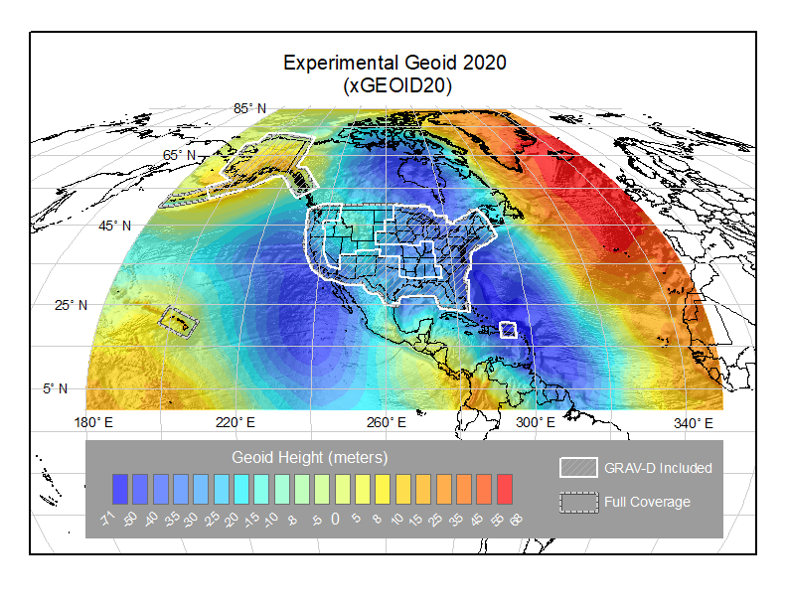
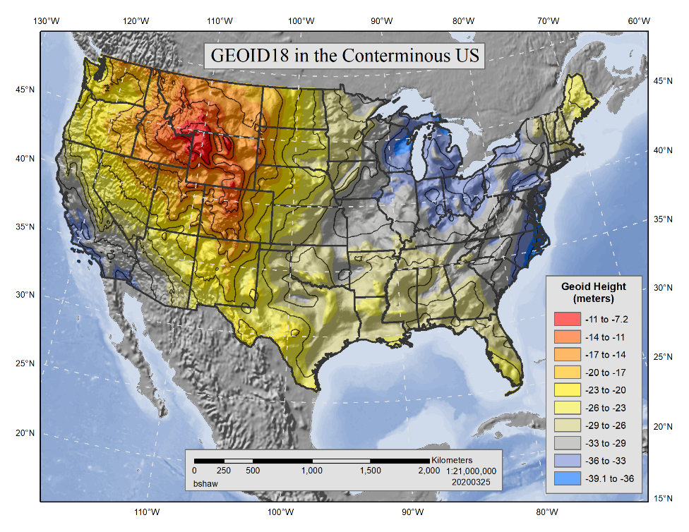

Building on the Past to Prepare for the Future
GPS on Bench Marks is about collecting new GPS / GNSS data on existing NGS marks with published NAVD 88 orthometric heights. It's about building the Transformation Tool to connect the past and future Datums and preparing the country and our communities to take full advantage of the benefits of the Modernized NSRS
Benefits of Participating in GPSonBM:
Improve local results of NAVD 88 – NAPGD2022 Transformation Tools
Receive 2020.00 Reference Epoch Coordinates (REC’s) with initial release of Modernized system
Go 4D - Track changes over time with Survey Epoch Coordinates (SEC’s)
GEOID18
Update Passive Control Status
Check your RTN results
Notes:
Historically used to create the hybrid geoid models used to provide GPS derived NAVD 88 orthometric heights (GEOID99 – GEOID18)
Evaluate the experimental gravimetric geoid models (xGEOIDs) as team iterates toward GEOID2022, the foundation for NAPGD2022
Create transformation tools between NAVD88 and NAPGD2022
Gathering data to generate 2020.0 Reference Epoch Coordinates and (eventually) a series of Survey Epoch Coordinates

Slide 36
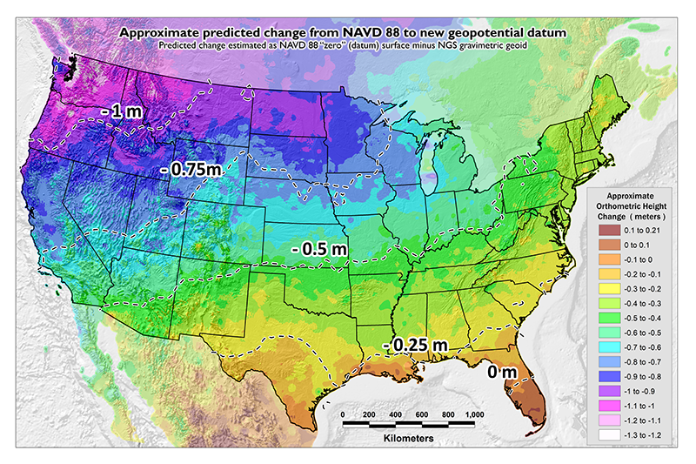
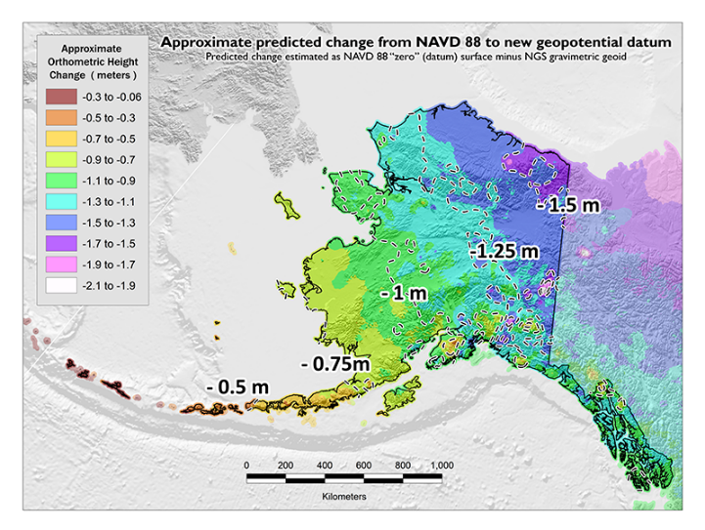
GPSonBM Measurements
Connect Current and Future Datums
The relationship between the old and new datums varies by location due to biases and tilts in NAVD88. The accuracy of the transformations will be directly related to the density of GPSonBM data available in that area.
  In moving from NAVD 88 to NAPGD2022 there will be a Shift:
  A one-time jump in orthometric heights in the 0 to 2 meter range (From fixing biases and tilts in NAVD 88)
PID: EZ0840
GPSonBM data is used to measure the Shift
Notes:
The relationship between the old and new datums varies by location due to biases and tilts in NAVD88 relative to the gravimetric geoid model

Slide 37
Why some submissions fail
Discussion of the NGS review/approval process of shared marks to explain why some submissions fail

Slide 38
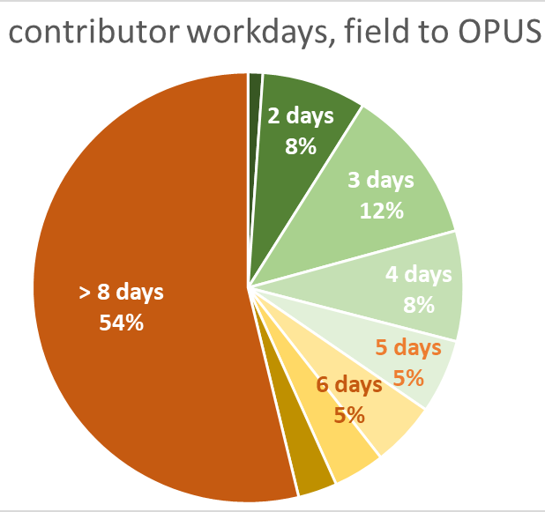
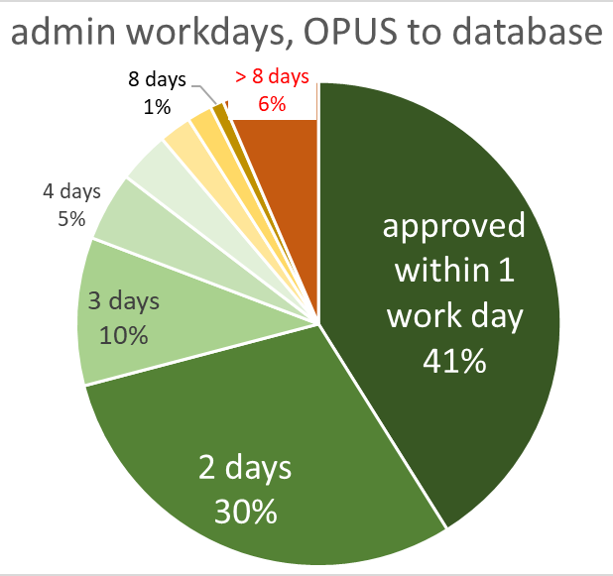
Sharing can be quick, usually
no need to wait for precise orbits! solutions without problems
are quickly approved, but ...

Slide 39

some solutions fail robo-review
5001 OPUS sharing REJECTED
5001 SORRY your data file failed our initial quality control tests.
5001 Please re-upload to OPUS if you can correct the errors listed below
5001
5001 See also hints at https://geodesy.noaa.gov/OPUS/about.jsp#accuracy
5001 and alternate sharing methods at https://geodesy.noaa.gov/marks/descriptors.shtml
RINEX FILE: 5703068p.21o.gz
DESIGNATION: X 1008
EPHEMERIS: OK igs21482.eph.
OBS USED: FAILED --> Need 70 % or more, file had 69.57 %.
DURATION: OK (hrs)
# FIXED AMB: OK 85.34 %.
ANT NAME: TRMR10 NONE.
ARP HEIGHT: OK 2.05 (m).
OVERALL RMS: OK 0.021 (m).
LAT RANGE: OK 0.004 (m).
LON RANGE: OK 0.008 (m).
EL HGT RANGE: OK 0.020 (m).
wait a day for rapid-orbits
consider trimming poor-performing satellites,
or a few minutes from start or end of your data file
improve peak-to-peak ranges with upload option
base stations exclude those with the highest
“Residuals of position determined by individual
baselines from the final position”

Slide 40
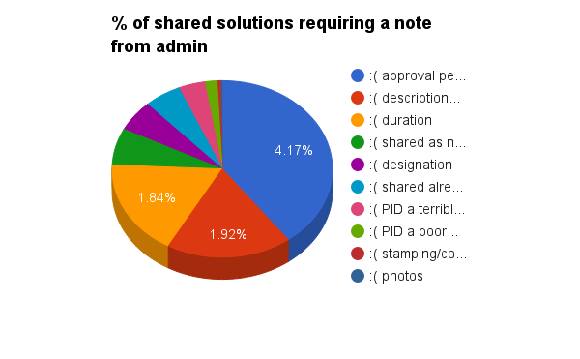
some solutions fail admin review
pending contributor action to approve
description is vague
duration < 4 hour minimum
existing mark, was shared as new
designation doesn’t follow traditional pattern
duplicate: you shared this already!
PID is wrong! mark appears misidentified
PID? Obs? Position mismatches datasheet
stamping or condition conflict with photo
photos are poor

Slide 41
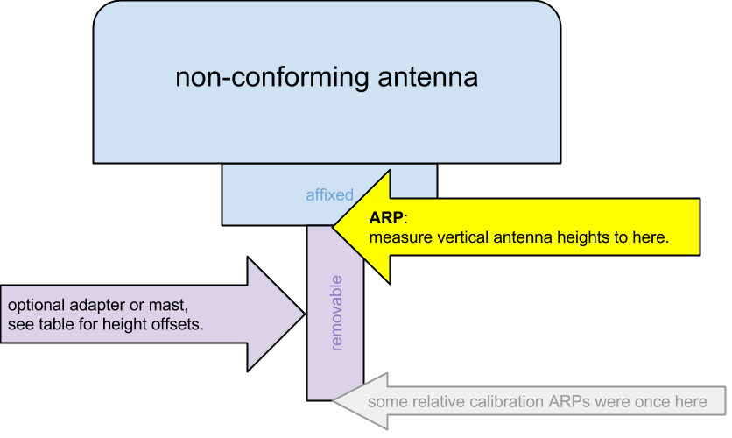
Check your antenna types and heights!

Slide 42
Questions submitted prior to the start of the webinar:
I have submitted OPUS shared solutions, but inadvertently added the wrong company to associate with my solutions. How do I modify my personal information and fix this error?
  email ngs.opus@noaa.gov with the needed correction information
I have not utilized OPUS in a very long time since I am in an area where VRS is readily available. My question pertains to the Big Island of Hawaii. Does OPUS provide a good solution for establishing State Plane Coordinates and vertical datum in Hawaii, specifically Hawaii Island? Operational CORS sites are not prevalent out there and all to the west of BI, quite a distance away. So it seems to me that it would not be good for establishing survey control relative to SPC. What are your thoughts?
  SPCS should be consistent with datasheets everywhere. Hawaii has no vertical datum officially, so geoid model uses surface akin to NAPGD2022.

Slide 43
Questions submitted prior to the start of the webinar:
I have static gps data on benchmarks collected over the past 10+ years throughout the southeast seven counties in Idaho. I don’t have the necessary meta-data… updated to-reach description, photos, etc.… to submit my static observations to opus shared solutions. Is there a way NGS can accept this data in the GPS on benchmarks campaign without having that metadata?
  no, unfortunately.
  You can use these data to determine the potential value of observations in your area, if OPUS heights already match published, that’s good news, your observations confirm but won’t impact the model

Slide 44
Contact Us
OPUS Questions:
NGS.OPUS@noaa.gov
Feedback on any NGS Products:
NGS.Feedback@noaa.gov

Slide 45
The End

