Slide 1
Modernizing the National Spatial Reference System (NSRS)
Big Sky GeoCon
Brian Shaw
brian.shaw@noaa.gov
April 7, 2021

Slide 2
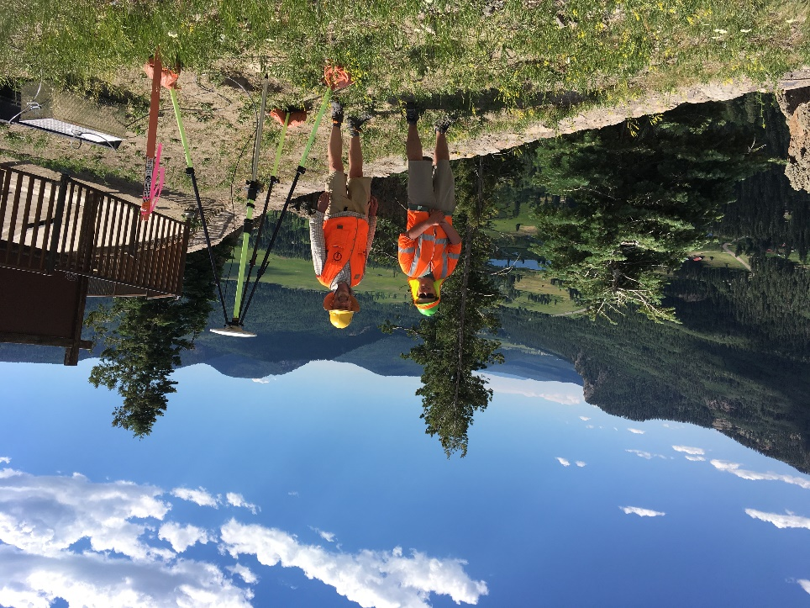
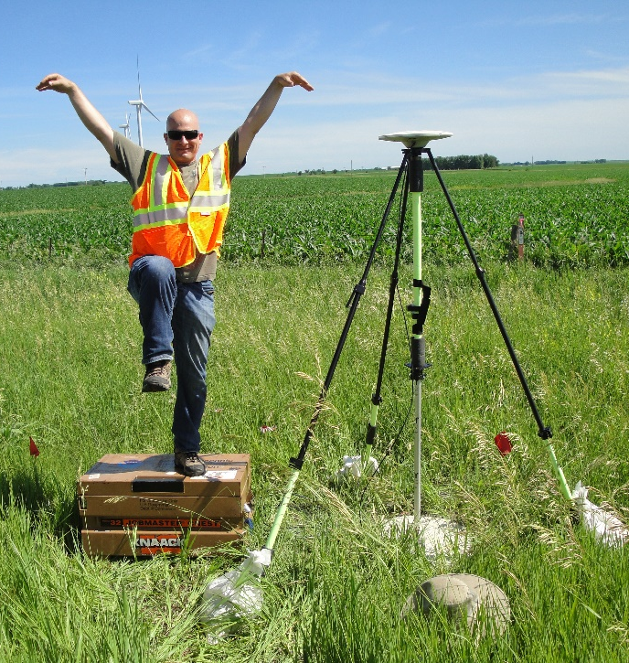
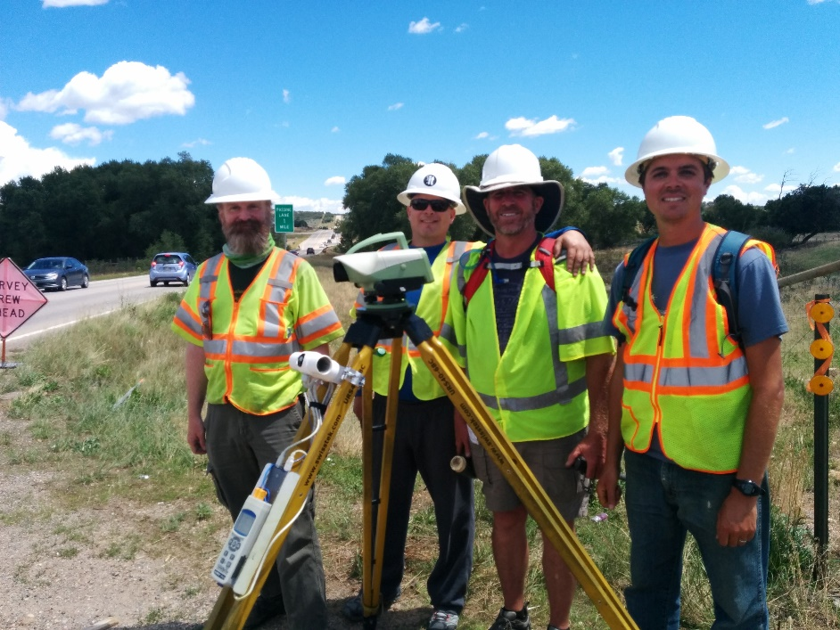
Brian Shaw
Rocky Mountain Advisor
brian.shaw@noaa.gov

Slide 3
Planned Schedule
Split into two ~25 min sections with a 5 minute break:
First section: 8:30 am to ~8:55 am
5 min Break
Second section: ~9:05 am to 9:30 am
Will leave ~10 minutes for questions

Slide 4
NGS Resources
NGS Training Center
https://geodesy.noaa.gov/web/science_edu/training/
Educational Videos
https://geodesy.noaa.gov/datums/newdatums/WatchVideos.shtml
NGS Webinar Series
https://geodesy.noaa.gov/web/science_edu/webinar_series/
Geospatial Summit (register for 2021, 2019 recorded sessions)
https://geodesy.noaa.gov/geospatial-summit/
Presentation Library
https://geodesy.noaa.gov/web/science_edu/presentations_library/

Slide 5
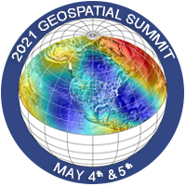
2021 NGS Virtual Geospatial Summit
May 4th and May 5th
11am to 3pm Mountain Time
Register
https://geodesy.noaa.gov/geospatial-summit/

Slide 6
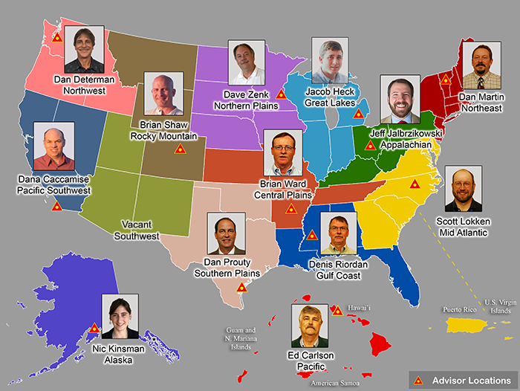
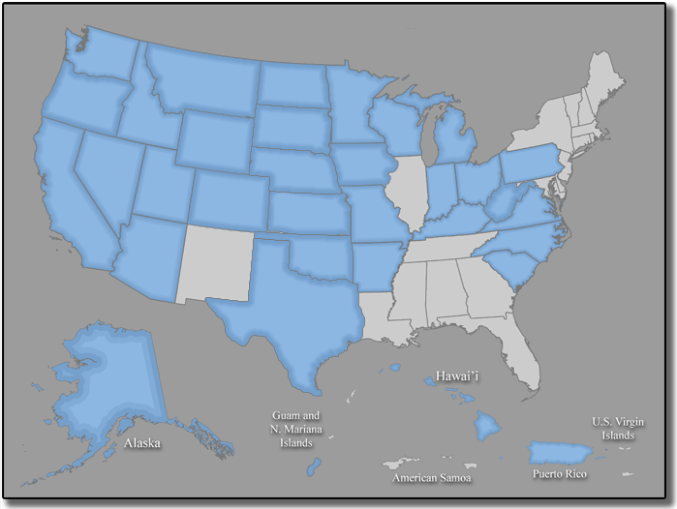
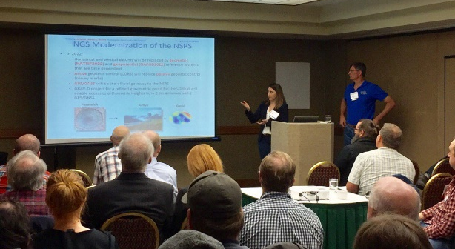
Importance of Coordination
14 Advisors
37 Coordinators
Notes:
NGS Regional Geodetic Advisors
https://geodesy.noaa.gov/ADVISORS/
State Geodetic Coordinators
https://geodesy.noaa.gov/ADVISORS/state-geodetic-coordinators.shtml

Slide 7
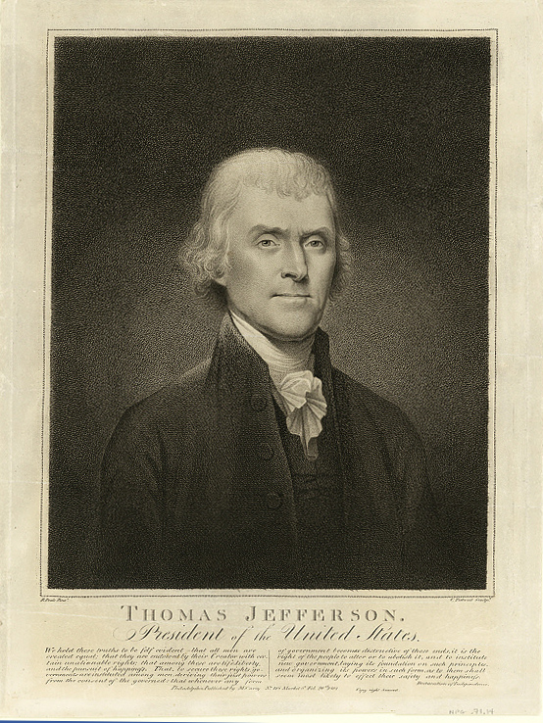
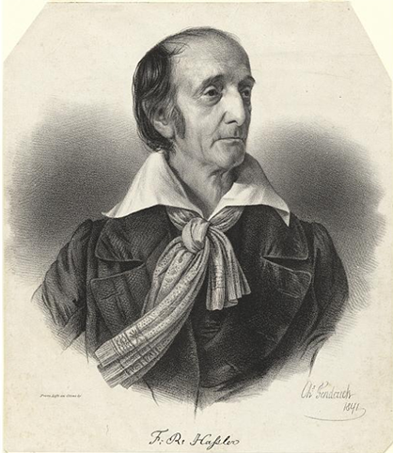
NOAA and NGS
Our Nation’s First Civilian Science Agency
1807
Thomas Jefferson
Survey of the Coast
1811
Ferdinand Hassler
Superintendent
1836
U.S. Coast
Survey
1878
U.S. Coast and
Geodetic Survey
1970
NOAA is established
Notes:
NGS has been around a long time. For more than 200 years, NGS and its predecessor agencies have collaborated with public and private organizations to establish reference stations at precisely determined locations.
We began on a mission established by Thomas Jefferson in 1807 to conduct a “Survey of the Coast” (as the United States Coast Survey).
(Pictured are Thomas Jefferson and Ferdinand Hassler, the first Superintendent of the Coast Survey). We were renamed the U.S. Coast and Geodetic Survey in 1878. NOAA was established in 1970.
Traditionally, precise positioning locations have been identified by setting a survey mark—usually a brass, bronze, or aluminum disk. Locations might also be identified by a deeply driven rod, or a prominent object, such as a water tower or church spire.

Slide 8
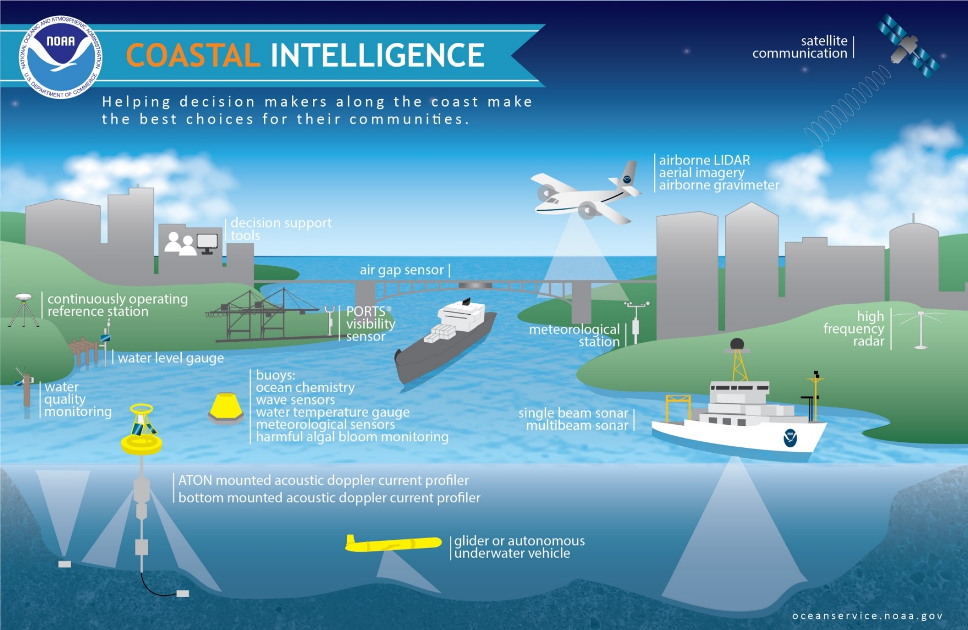
Notes:
The National Spatial Reference System is our nations geospatial infrastructure from which all positioning (with the exclusion of military/DOD) is referenced to.
This system provides a consistent framework that allows people to use data in the same reference system to perform analysis and make meaningful comparisons and decisions from that analysis.

Slide 9
NGS’ Mission
To define, maintain and provide access to the National Spatial Reference System (NSRS) to meet our Nation’s economic, social, and environmental needs.
…………………………………………….........................
The NSRS is a consistent coordinate system that defines latitude, longitude, height, scale, gravity, orientation, and shoreline throughout the United States.
Notes:
The National Spatial Reference System is our nations geospatial infrastructure from which all positioning (with the exclusion of military/DOD) is referenced to.
This system provides a consistent framework that allows people to use data in the same reference system to perform analysis and make meaningful comparisons and decisions from that analysis.

Slide 10
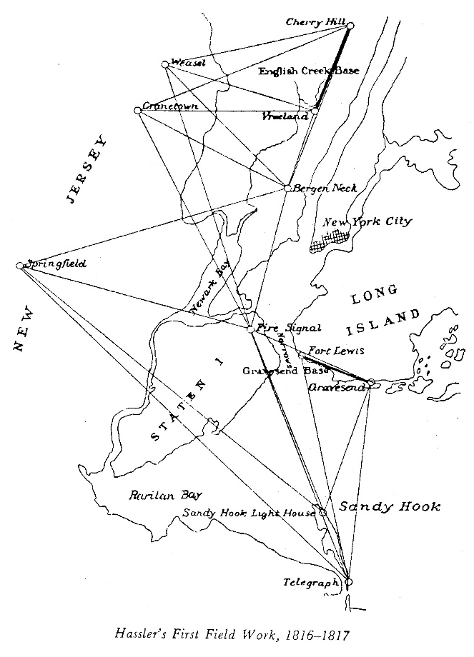
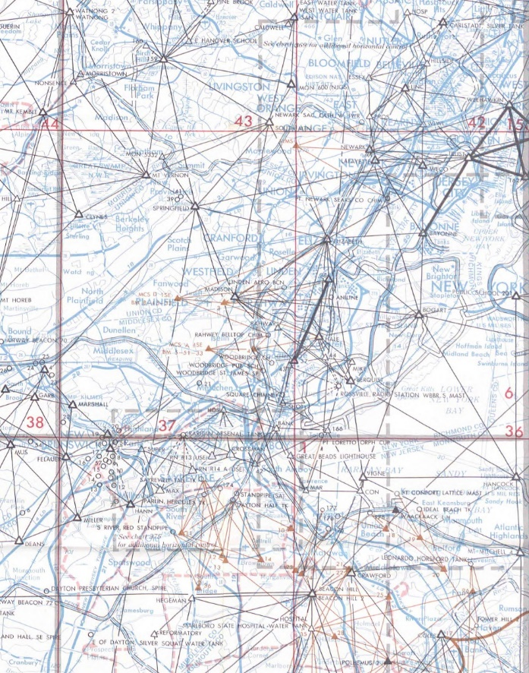
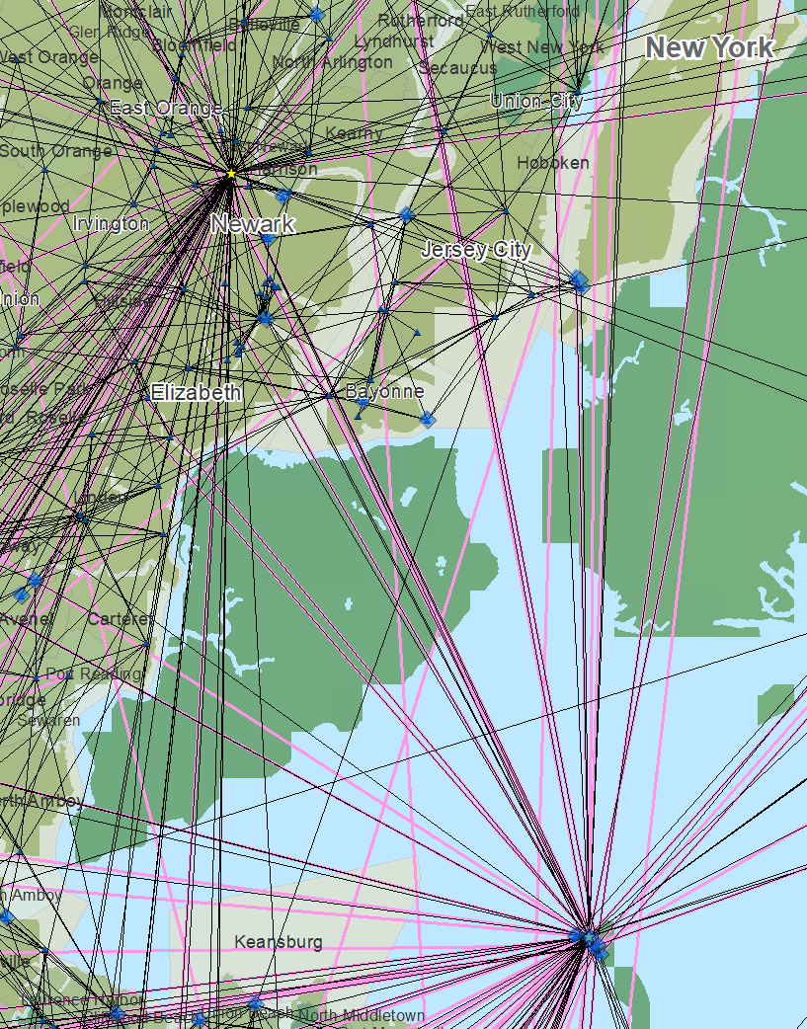
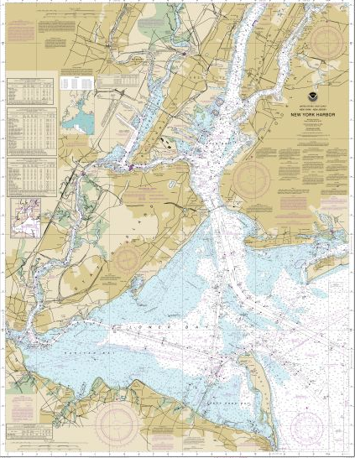
The Importance of Geodesy
1816-1817
1969
Today
Notes:
In 1807 Thomas Jefferson created the Survey of the Coast. Ferdinand Hassler was later appointed the first superintendent and completed the first survey of New York Harbor. Commerce from shipping has always been important and for safe shipping you need to know the bathymetry of the harbors. To understand the bathymetry accurately requires you to know where the land is and the bathymetry relative to these points on land which is where geodesy comes in. This is the reason why in 1878 the name was changed to the U.S. Coast and Geodetic Survey and remained in the name until it was combined with other agencies to form the National Oceanic and Atmospheric Administration.

Slide 11
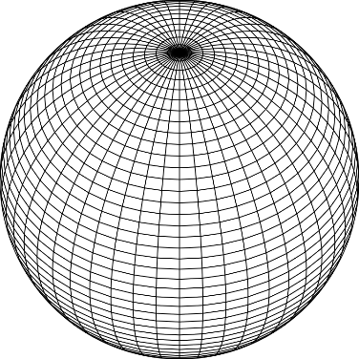
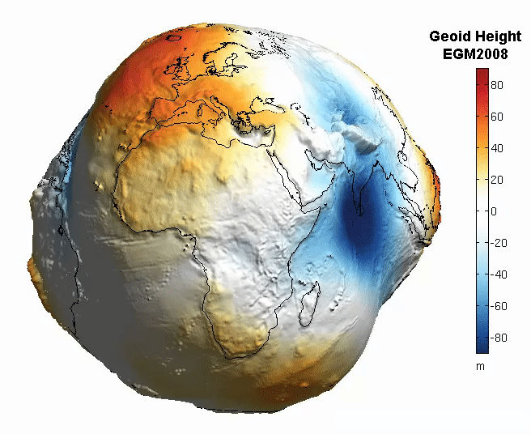
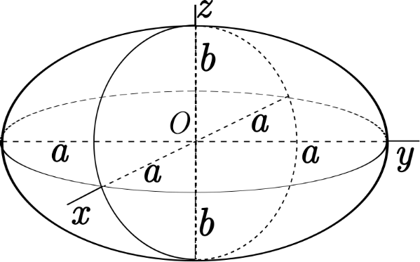
The Earth is Infinitely Complex
Build Models to Simplify
Notes:
Models are used to simplify complex phenomena for humans and computers to understand and perform calculations and analysis.
The geoid is an approximation of sea level and used to calculate elevations (orthometric heights) above this “sea level” surface
Spheroid image https://www.kisspng.com/png-sphere-shape-ball-grid-line-circle-draw-5378189/
Ellipsoid image https://www.kisspng.com/png-figure-of-the-earth-oblate-spheroid-ellipsoid-4129812/
Geoid Image https://www.reddit.com/r/MapPorn/comments/3xf6a0/geoid_height_of_new_global_gravity_field_models/

Slide 12
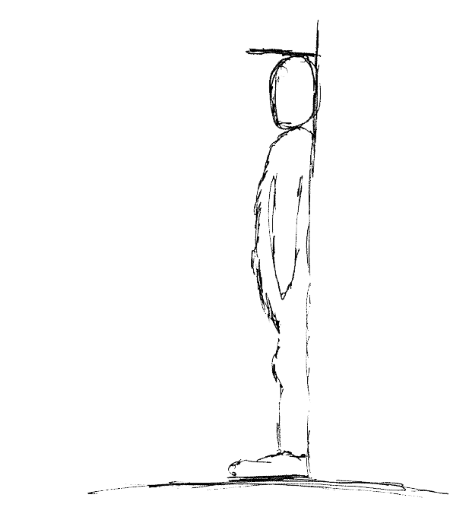
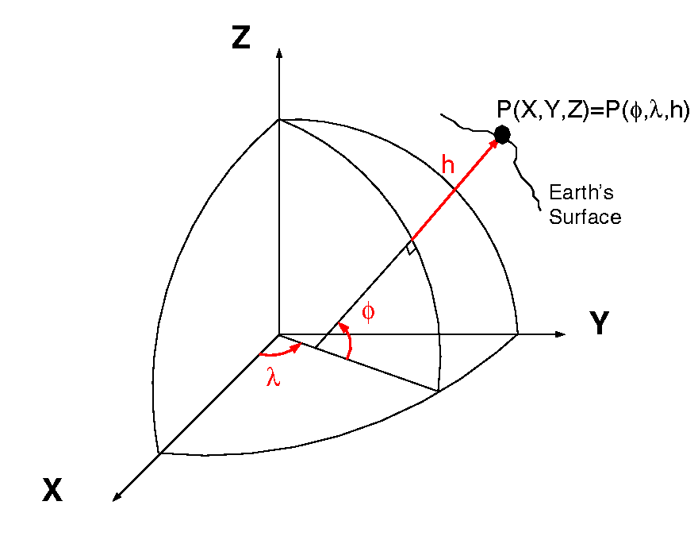
Datums and Reference Frames
60”, 2019
52”, 2018
46”, 2017
aka P(Lat,Lon,Ht)
= ht.
= lat.
= long.
X,Y,Z vs Lat,Lon,Ht
A reference surface or framework to reference your data to for consistency
Notes:
What is a datum? https://oceanservice.noaa.gov/facts/datum.html
Datums Overview https://geodesy.noaa.gov/datums/
New Datums https://geodesy.noaa.gov/datums/newdatums/
Horizontal and Geometric Datums https://geodesy.noaa.gov/datums/horizontal/
Vertical Datums https://geodesy.noaa.gov/datums/vertical/
A Datum or reference frame is in essence a reference surface or framework to reference your data to for consistency.
In the first image on the right there is a person who has been measuring their height over time (2017-2019 in this example). For consistency you can imagine that the floor next to the wall they are being measured is this ‘reference surface’ or datum. Lets say the first measurement was taken when the floor was carpet and you installed hard wood floors before the 2018 measurement you would have in essence changed the ‘reference surface’ and it would be inaccurate to compare the 2018 and 2019 values without a proper transformation, or height offset value.
The second image (when animating) shows why you should not try to compare values when using two different reference surfaces.

Slide 13
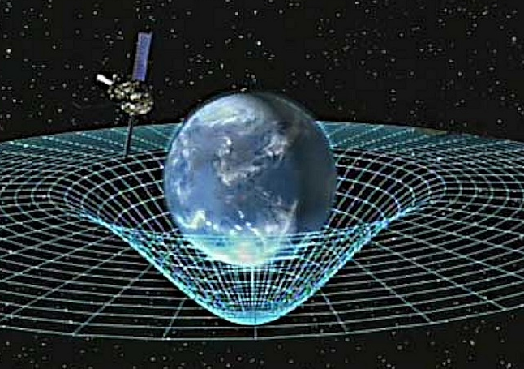
Gravity is Fundamental
Aristotle (350BC)
Al-Khazini (1121)
Galileo (1590)
Newton (1687)
Einstein (1913)
Objects fall proportional to mass
Gravitational potential energy
Terminal velocity
Gravity inverse-square law
Theory of general relativity
Notes:
Galileo graphic https://commons.wikimedia.org/wiki/File:GalilEXP.jpg
Spacetime curvature graphic https://www.nasa.gov/mission_pages/gpb/gpb_012.html
Aristotle (384–322 BCE)
Objects fall at a speed proportional to their mass.
The Aristotelian explanation of gravity is that all bodies move toward their natural place. For the elements earth and water, that place is the center of the (geocentric) universe;
al-Khazini (11th to 12th centuries)
In 1121, al-Khazini, in The Book of the Balance of Wisdom, proposed that the gravity and gravitational potential energy of a body varies depending on its distance from the centre of the Earth.
Galileo Galilei (1564-1642)
Leaning Tower of Pisa Experiment (1589-92) - Law of Falling Bodies
Objects fall at the same speed, independent of their mass or shape
Isaac Newton (1643-1727)
In 1687, English mathematician Sir Isaac Newton published Principia, which hypothesizes the inverse-square law of universal gravitation.
Albert Einstein (1879-1955)
Between 1911-1915 Einstein developed the theory of general relativity. In general relativity, the effects of gravitation are ascribed to spacetime curvature instead of to a force. To deal with this difficulty, Einstein proposed that spacetime is curved by matter, and that free-falling objects are moving along locally straight paths in curved spacetime. (This type of path is called a geodesic).

Slide 14
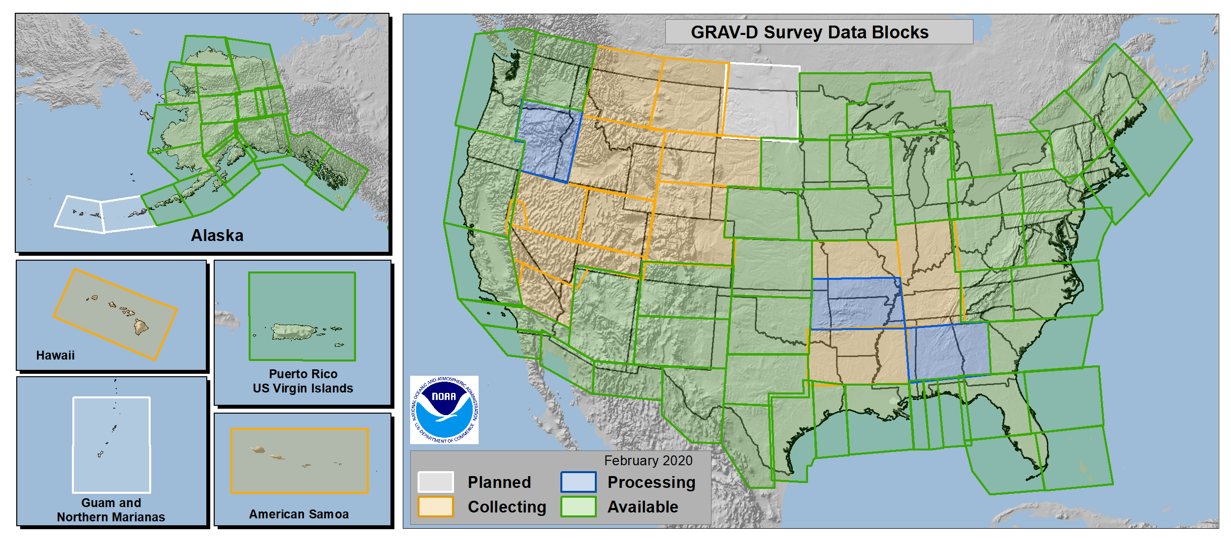
Gravity for the Redefinition of the
American Vertical Datum
GRAV-D
85.3% Complete (3/30/2021)
Notes:
More information on GRAV-D
https://geodesy.noaa.gov/GRAV-D/
Data Download for GRAV-D blocks
https://geodesy.noaa.gov/GRAV-D/data_products.shtml

Slide 15
Why Modernize the NSRS
Current models built on old technology
NAD 83 not truly Geocentric (~2.2m)
NAVD 88 relies on marks in the ground
and is not easily maintained
Today’s technology needs better accuracy
Notes:
NSRS Modernization News
https://geodesy.noaa.gov/datums/newdatums/TrackOurProgress.shtml

Slide 16
Main Benefits of Modernized NSRS
Fast, Accurate, Consistent Elevations Everywhere
Improved Public Safety
Flood Plain Maps
Emergency Route Planning
Accurate Positioning
Autonomous vehicles, BIMs, Smart Cities
Notes:
NSRS Modernization News
https://geodesy.noaa.gov/datums/newdatums/TrackOurProgress.shtml

Slide 18
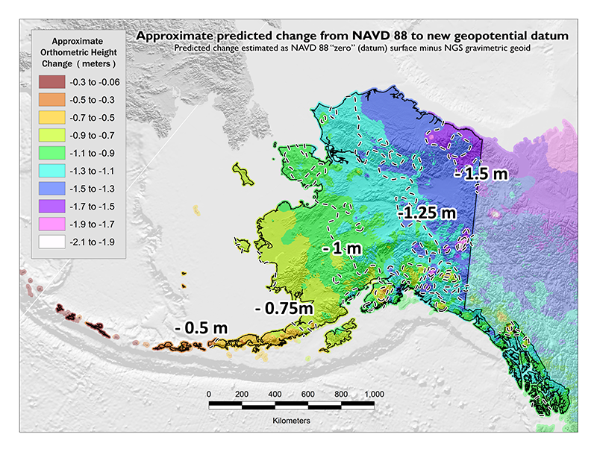
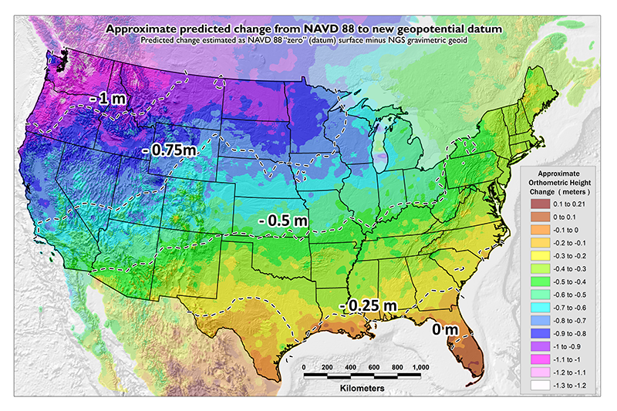
NAVD 88 Issues
Date of this slide: Sept 3, 2020
Modernized NSRS: 4 hour version
NAVD 88 suffers from a known bias (50 cm) and tilt (about 1 meter across CONUS) relative to the gravimetric geoid
PID: EZ0840

Slide 19
NAVD 88 Issues
Modernized NSRS: 4 hour version
Date of this slide: Sept 3, 2020
NAVD 88 suffers from unknown movements before, during and after its original adjustment
By way of example…
1954: Leveling Performed to bench mark
House
House
House
BM
BM
BM
1991: Original 1954 leveling data is used to compute the NAVD 88 height which is then published for this BM
1954-1991: Subsidence
H₈₈(published)
H₈₈(true)
NAVD 88 zero height surface
Obviously the true height relative to the NAVD 88
zero surface is not the published NAVD 88 height

Slide 20
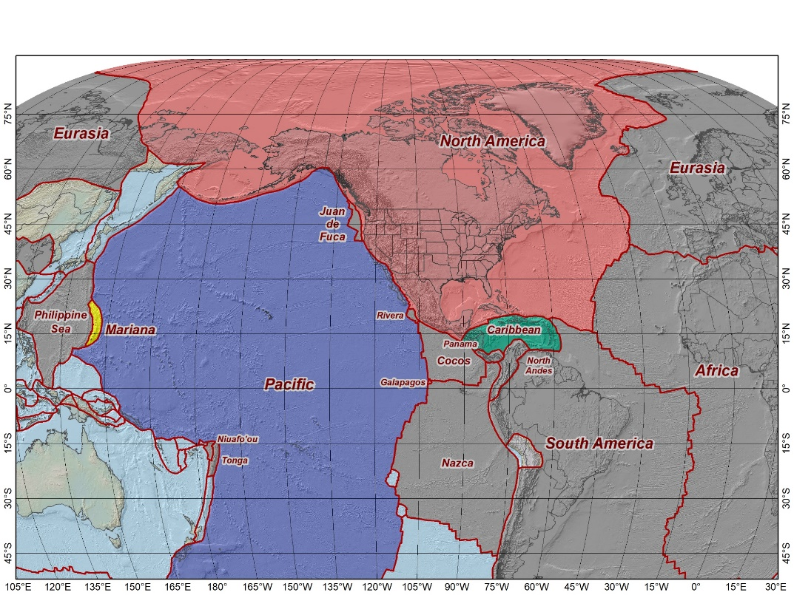
The Future Reference Frames
The tectonic plates “fixed” for the
2022 Terrestrial Reference Frames
Tectonic Plate based:
North America
Caribbean
Pacific
Mariana
NATRF2022
MATRF2022
PATRF2022
CATRF2022
Notes:
NSRS Modernization Naming Conventions https://geodesy.noaa.gov/datums/newdatums/naming-convention.shtml

Slide 21
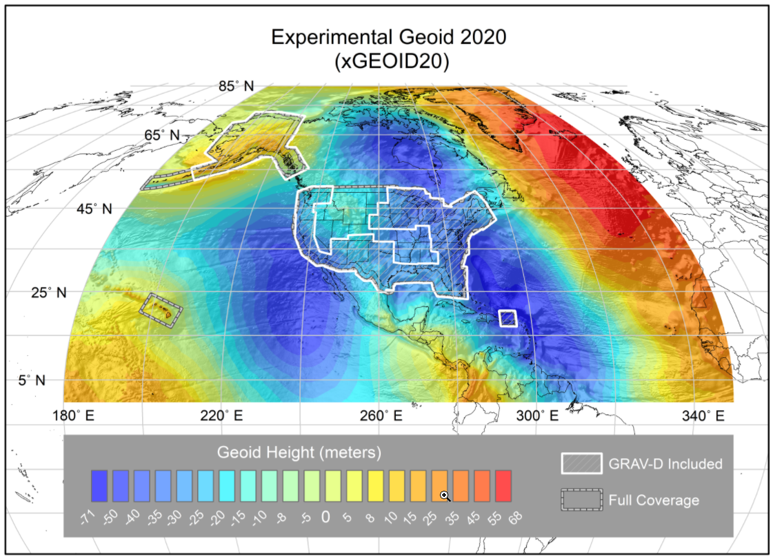
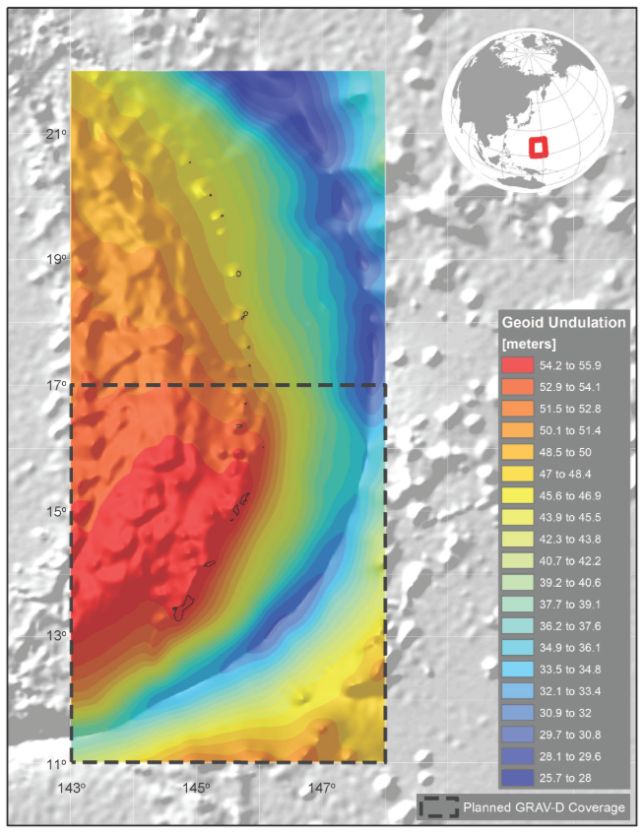
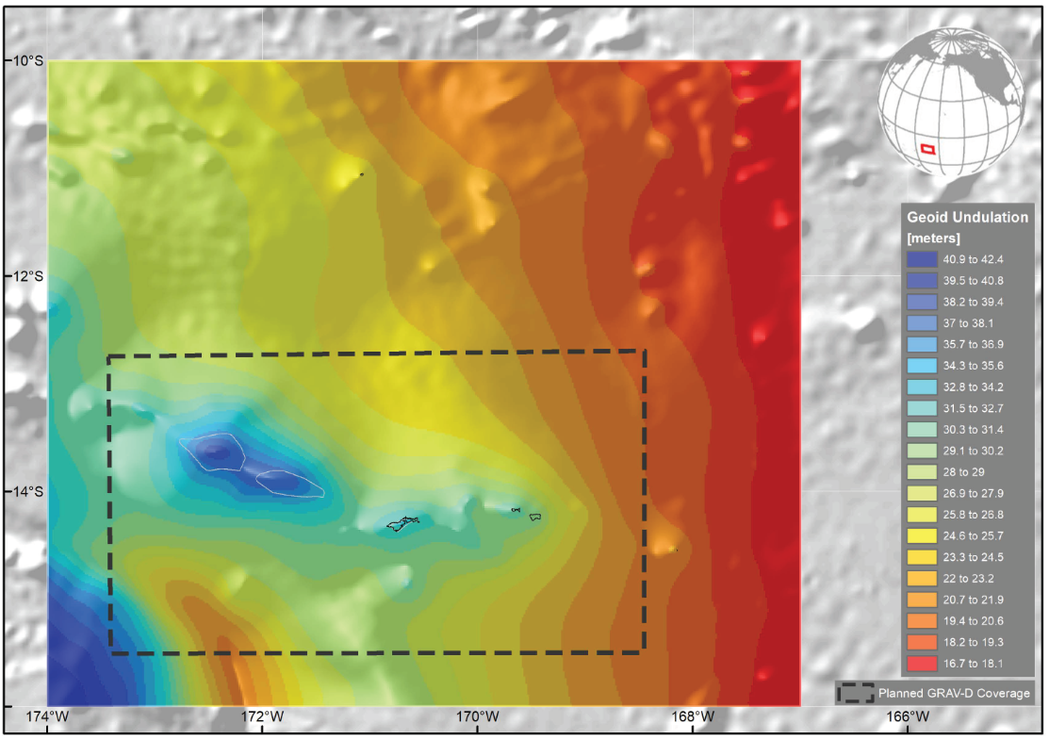
NAPGD2022 Geopotential Datum
Not a vertical datum, it is more than just heights.
Models included:
Geopotential
Deflection
Gravity
Geoid
¼ Earth’s Surface
Guam/CNMI
American Samoa
Notes:
Experimental Geoid Models
https://beta.ngs.noaa.gov/GEOID/xGEOID20/
As noted in the Blueprint 2 document
https://geodesy.noaa.gov/library/pdfs/NOAA_TR_NOS_NGS_0064.pdf
NAPGD2022 will include all of the following
Geopotential Model of 2022 (GM2022) will include:
Static Geopotential model of 2022 (SGM2022)
Dynamic Geopotential model of 2022 (DGM2022)
GEOID2022 will include:
Static Geoid model of 2022 (SGEOID2022)
Dynamic Geoid model of 2022 (DGEOID2022)
DEFLEC2022 will include:
Static Deflection of the Vertical model of 2022 (SDEFLEC2022)
Dynamic Deflection of the Vertical model of 2022 (DDEFLEC2022)
GRAV2022
Static Gravity model of 2022 (SGRAV2022)

Slide 22
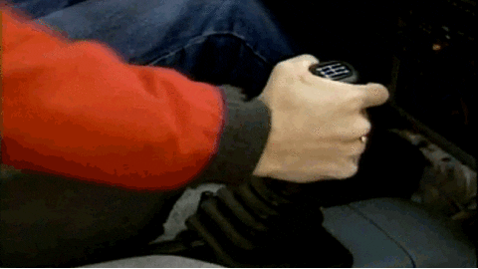
Notes:
New Datums What to expect https://geodesy.noaa.gov/datums/newdatums/WhatToExpect.shtml
NGS is not shifting the land, merely shifting the reference surfaces to which we reference the geospatial data to.

Slide 23
Shift and Drift
A sudden shift
Horizontal change: 0.5 to 4 m (1.5 to 13 ft)
Ellipsoid height change: ±2 m (±6 ft)
Elevation change: -0.5 to +2 m (-1.5 to +6 ft)
A continuous drift
Coordinates associated with specific dates
Two components of drift:
Tectonic plate rotation (easy to model, 2D only)
All other residual motion (hard to model, 3D)
Notes:
New Datums What to expect https://geodesy.noaa.gov/datums/newdatums/WhatToExpect.shtml
NGS is not shifting the land, merely shifting the reference surfaces to which we reference the geospatial data to.

Slide 24
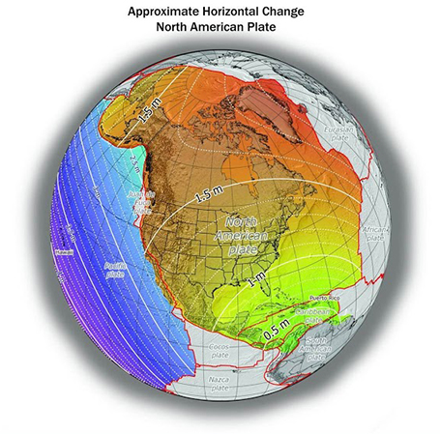
Shift: datum changes
~1 to 1.5 meters North America
~2.5 to 4 meters in Pacific
0 to 1.3 meters CONUS
Notes:
New Datums What to expect https://geodesy.noaa.gov/datums/newdatums/WhatToExpect.shtml
NGS is not shifting the land, merely shifting the reference surfaces to which we reference the geospatial data to.

Slide 25
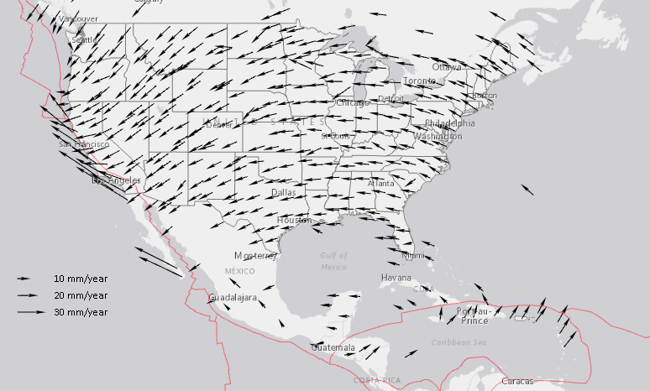
Drift: Plate Tectonics and Velocities
Annual changes to
ITRF2014 coordinates
Notes:
All plates are moving and through the constant collection of GNSS data using CORS we can now model where the land is moving. In the center of tectonic plates there is generally motion that can be measured but where plates converge can be thought of as a crunch zone and the modeling has much more uncertainty due to geophysical phenomena.

Slide 26
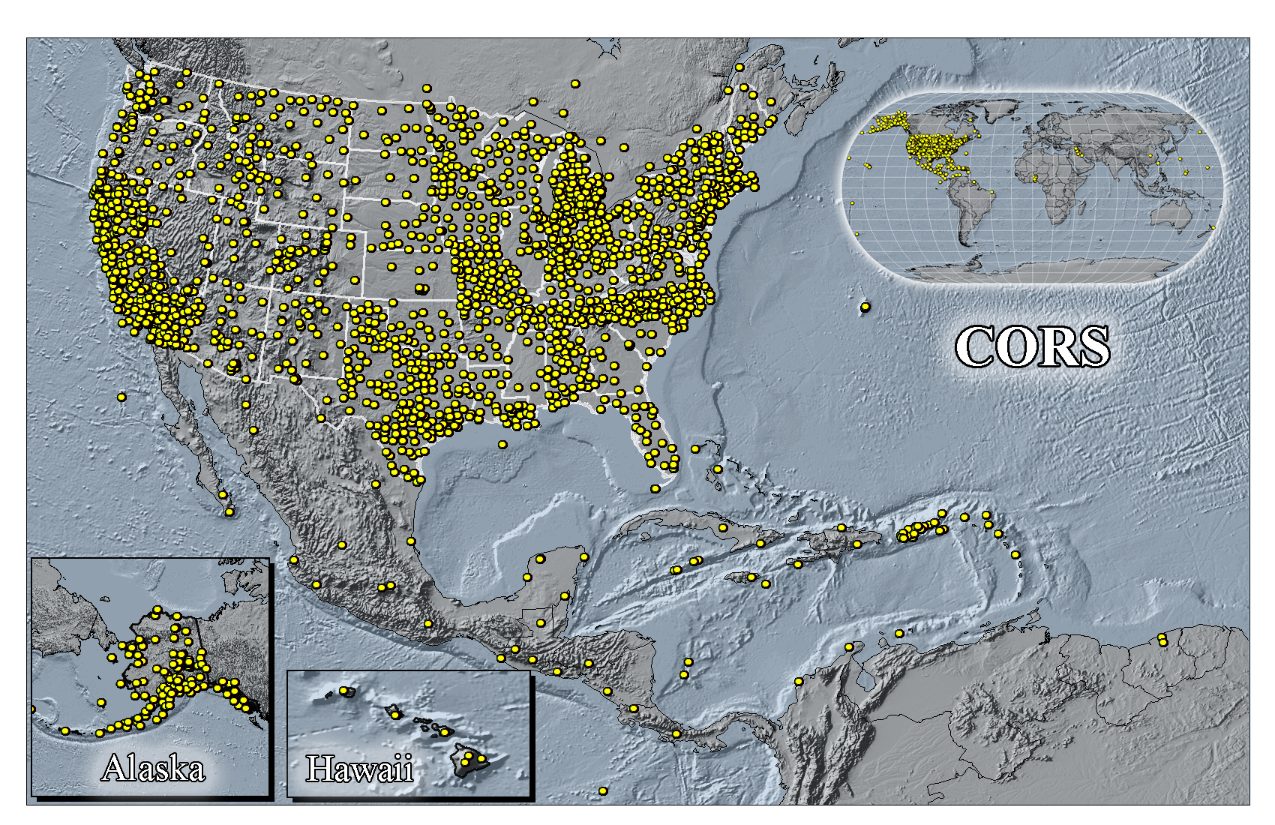
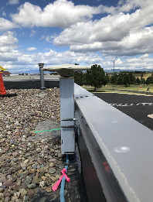
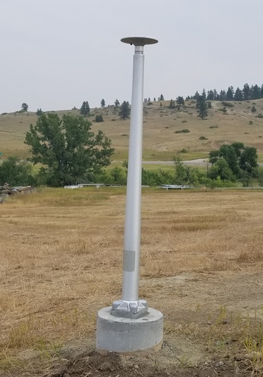
Continuously Operating Reference Stations
MFTV
Kalispell
Montana
MTLG
Lodge Grass
Montana
Notes:
All plates are moving and through the constant collection of GNSS data using CORS we can now model where the land is moving. In the center of tectonic plates there is generally motion that can be measured but where plates converge can be thought of as a crunch zone and the modeling has much more uncertainty due to geophysical phenomena.

Slide 27
Vertical Motion
Subsidence
Ground fluid withdrawal, sedimentation
Glacial Isostatic Adjustment (GIA)
Crustal rebound from glaciers (uplift)
Geophysical Phenomena
Earthquakes, calderas, Earth tides

Slide 28
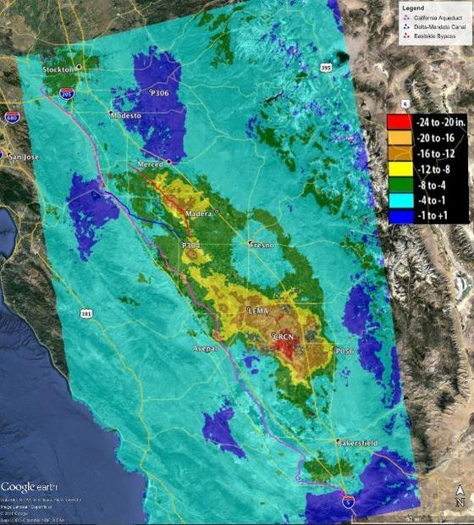
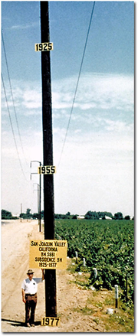
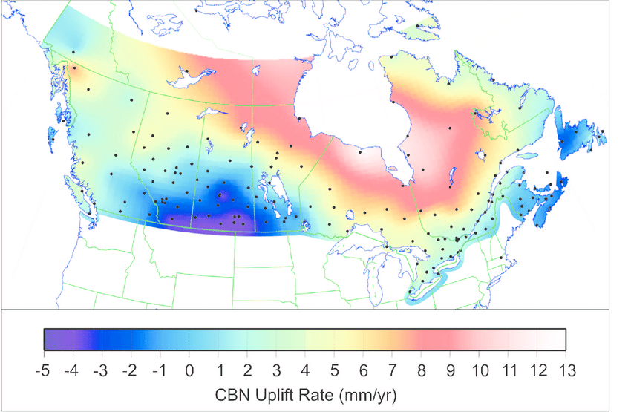
8.5 meters
50 years
Vertical Motion
May 2015
to
Sept 2016
Hudson Bay Uplifting
8 -13 mm/year
San Joaquin Subsiding
20-24” in 16 months
Notes:
San Joaquin Subsidence article
http://www.digitaljournal.com/tech-and-science/technology/sinking-san-joaquin-valley-of-california-seen-from-space/article/487393
Hudson Bay Uplift article
https://www.researchgate.net/figure/Contour-map-of-observed-CBN-vertical-rates-Preliminary-results-from-the-combination-of_fig3_286867540
GIA

Slide 29
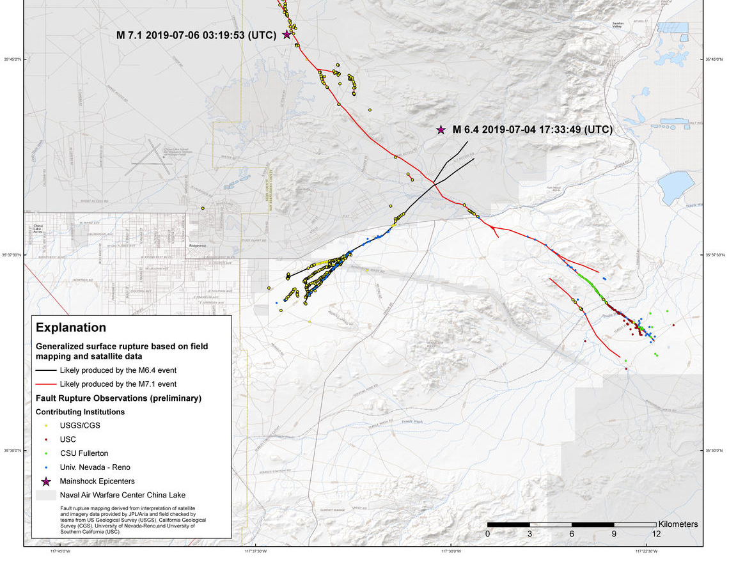
Horizontal and Vertical Motion - Earthquakes
China Lake, CA
6-10 feet Horizontally
Puerto Rico
16 cm Vertically
Notes:
China Lake Earthquake
https://www.usgs.gov/news/update-magnitude-71-earthquake-southern-california?qt-news_science_products=7#qt-news_science_products
Puerto Rico Earthquake
https://cunycis.maps.arcgis.com/apps/webappviewer/index.html?id=5f516f41baa84f9ba9e8207c2005ee4d
GIA

Slide 30
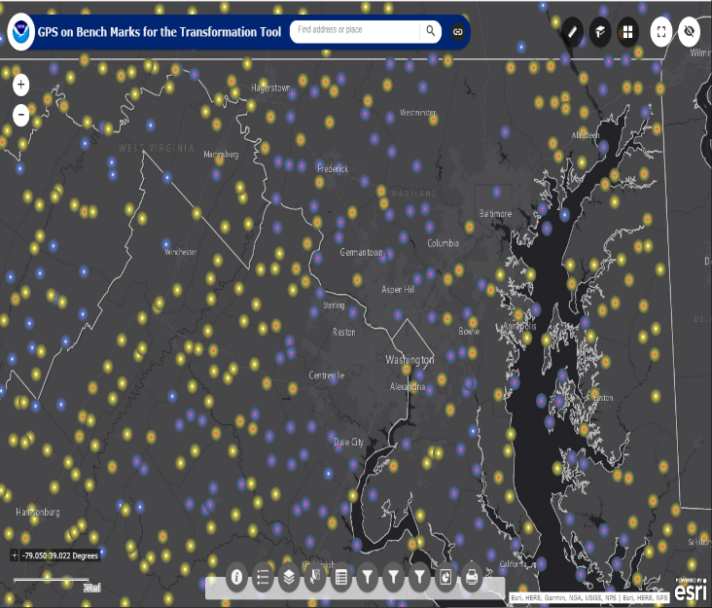
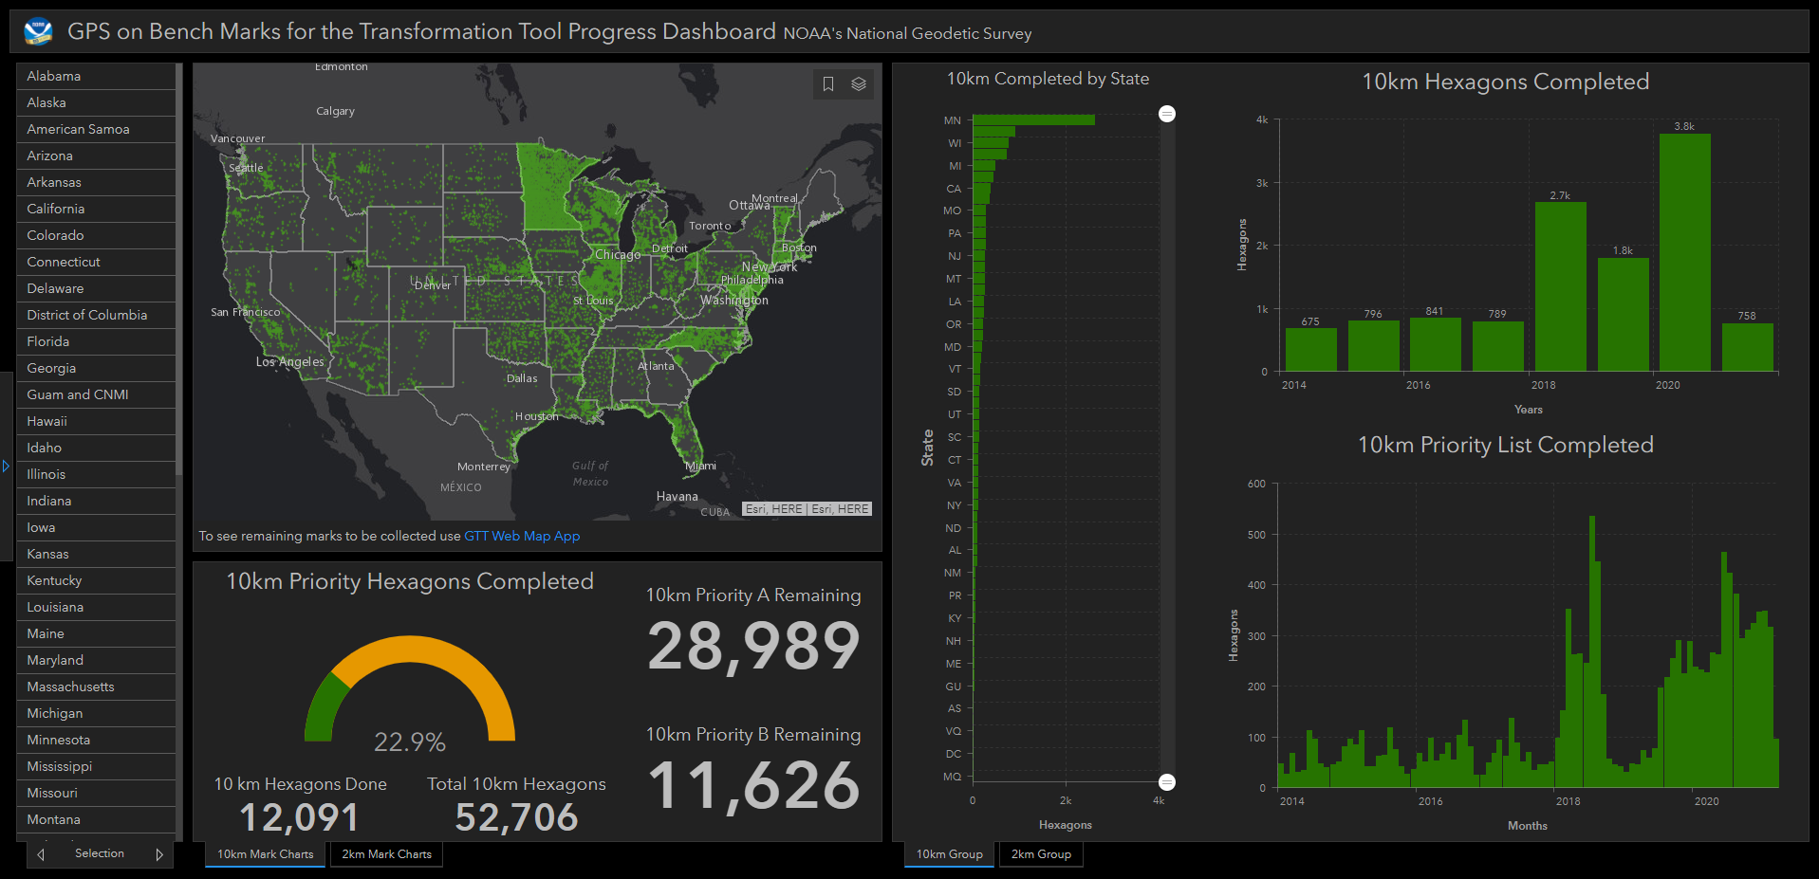
GPS on Bench Marks
Dashboard
Web Map Application
~3,800 Completed in 2020
Notes:
GPS on Bench Marks Web Map (2018)
https://geodesy.noaa.gov/GPSonBM/webmap/

Slide 31
Shift and Drift
Date of this slide: Sept 3, 2020
Modernized NSRS: 4 hour version
31
When transitioning from NAVD 88 or another vertical datum, your coordinates will shift and drift:
GPSonBM data is used to measure the Shift
Shift: A one-time jump somewhere in the 0 to 2 meter range (orthometric height)
Drift: Coordinates are now time-dependent. The shift will take you to 2020.00. Working at any other epoch means you must account for the drift (velocity) of your coordinates
As well as any other motions over time
Intraframe Velocity Model* will be used to compute the Drift
Notes:
Links on the slide.

Slide 32
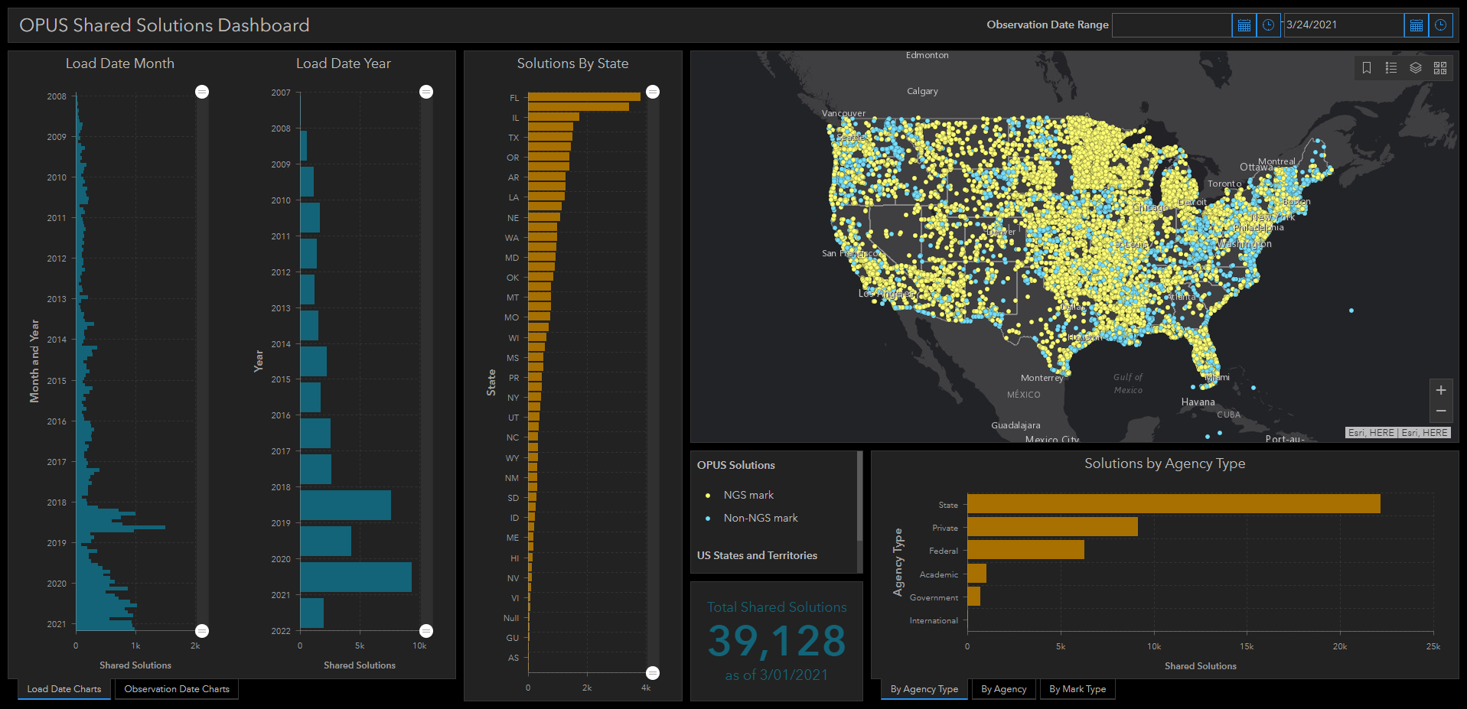
OPUS Shared Solutions Dashboard
Dashboard enables sorting and visualization of Shared Solutions by
Month & Year, State, Agency Type, and submitting agency
Agency type | # Shared Solutions on NGS marks
State | ~18,500
Private Sector | ~4,300
Federal | ~3,100
Academic | ~800
2018
Note the impact of GPSonBM Campaigns
2020
Notes:
Links on the slide.

Slide 33
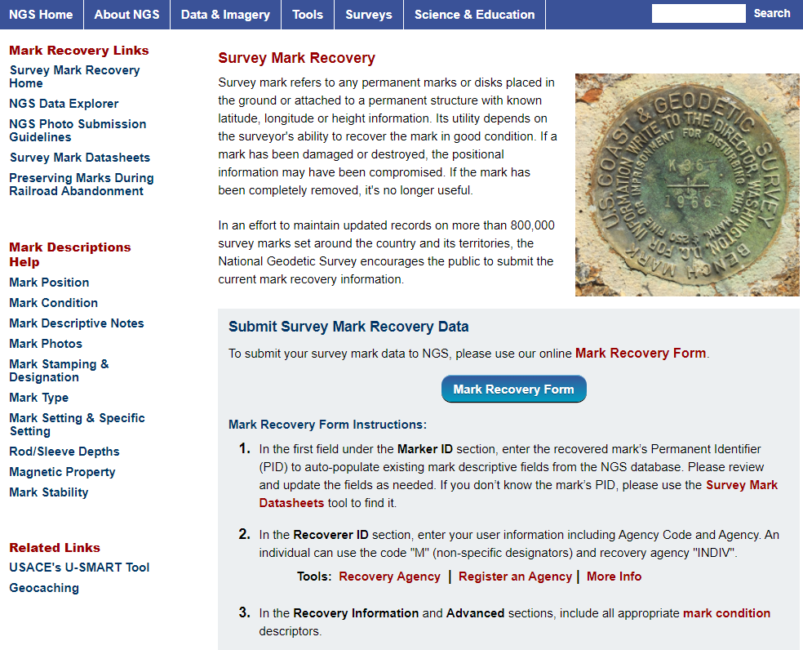
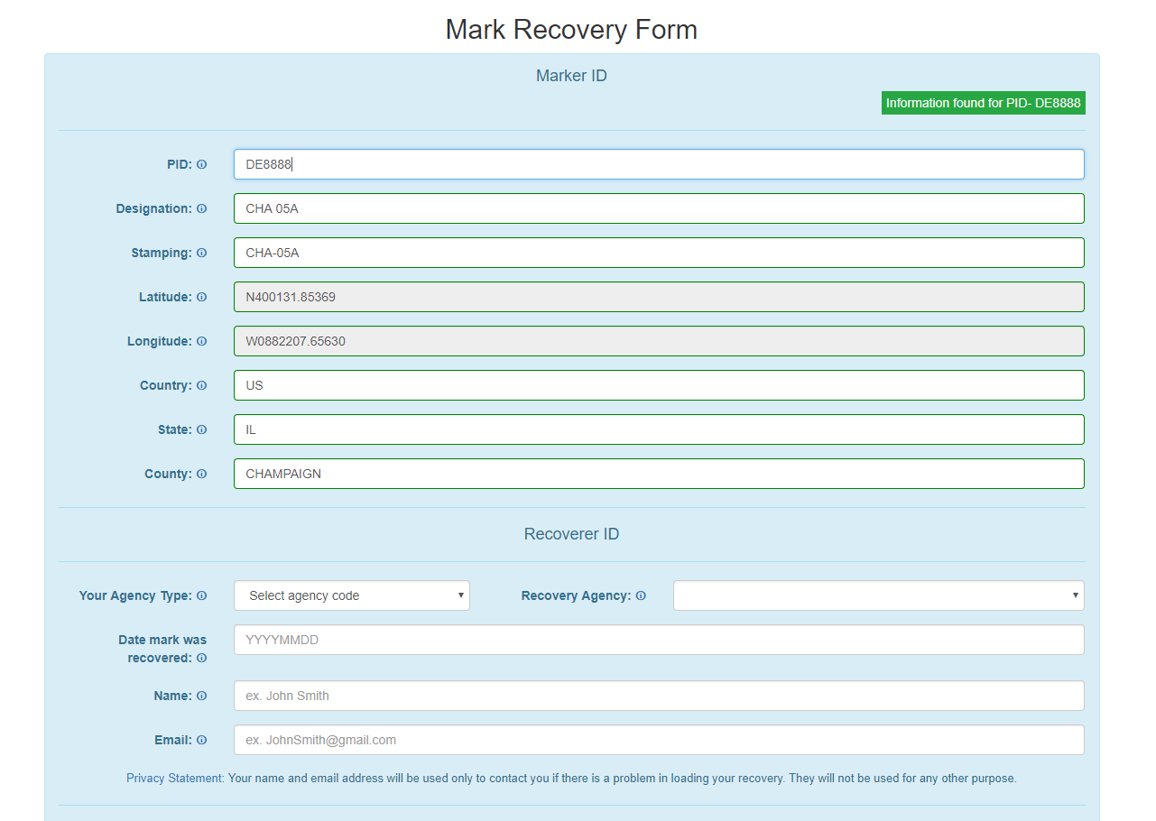
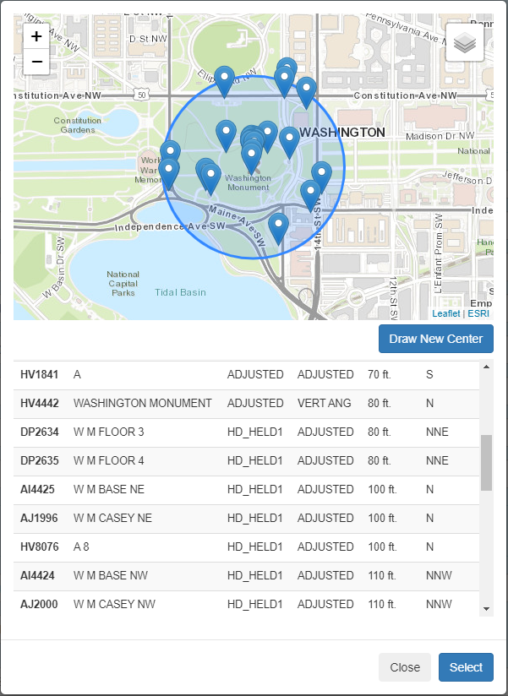
NGS Mark Recovery Webpage
Crowd sourced mark recoveries help update the GPSonBM map, let NGS and others know if the mark is still usable, and pictures make it easier to find.
www.ngs.noaa.gov/surveys/mark-recovery
Now with Find Marks Near Me!
Maintain you local control network: Submit a Recovery Note for each mark you find (up to once per year)
Did you find it?
Is it GPSable?
Got new photos?
Notes:
Links on the slide.

Slide 34
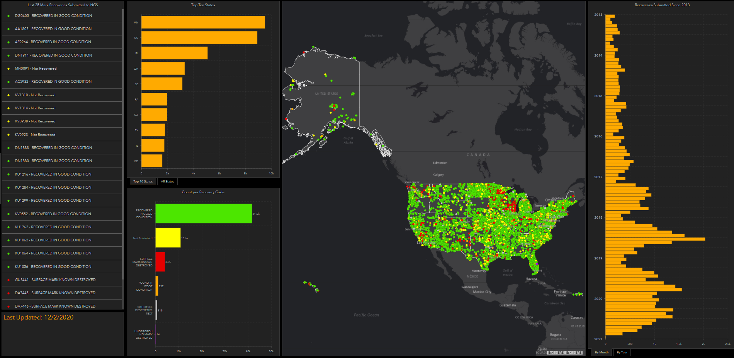
Mark Recovery Dashboard
https://geodesy.noaa.gov/surveys/mark-recovery/index.shtml
Notes:
Links on the slide.

Slide 35
Best ways to determine coordinates in Modernized NSRS
Resurvey: Return to the field and collect new observations, relying upon geodetic control that has coordinates in the new datum
Readjust: Using existing observations, re-compute new coordinates based upon geodetic control (CORS) that has been defined in the new datum
Transform: Take finished products which have coordinates in the old datum and use transformation software to estimate coordinates in the new datum
Notes:
Links on the slide.

Slide 36
How Can You Prepare
Metadata is essential
Improves reliability and accuracy of data
Increases value and usefulness
Transform and collect data in current datums
NAD 83 (2011), NAVD 88
Make sure to note Geoid Models used for GNSS data

Slide 37
Recent Publications
Blueprint Documents for 2022 (Updates coming)
Part 1: Geometric Coordinates
Part 2: Geopotential Coordinates
Part 3: Working in the Modernized NSRS
The State Plane Coordinate System History, Policy, and Future Directions
NOAA Special Publication NOS NGS 13
Notes:
Links on the slide.

Slide 38
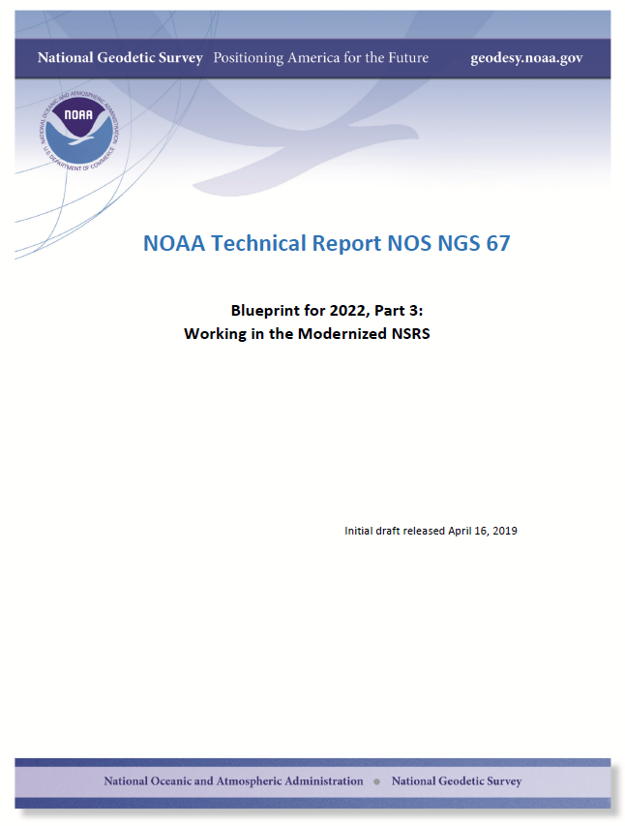
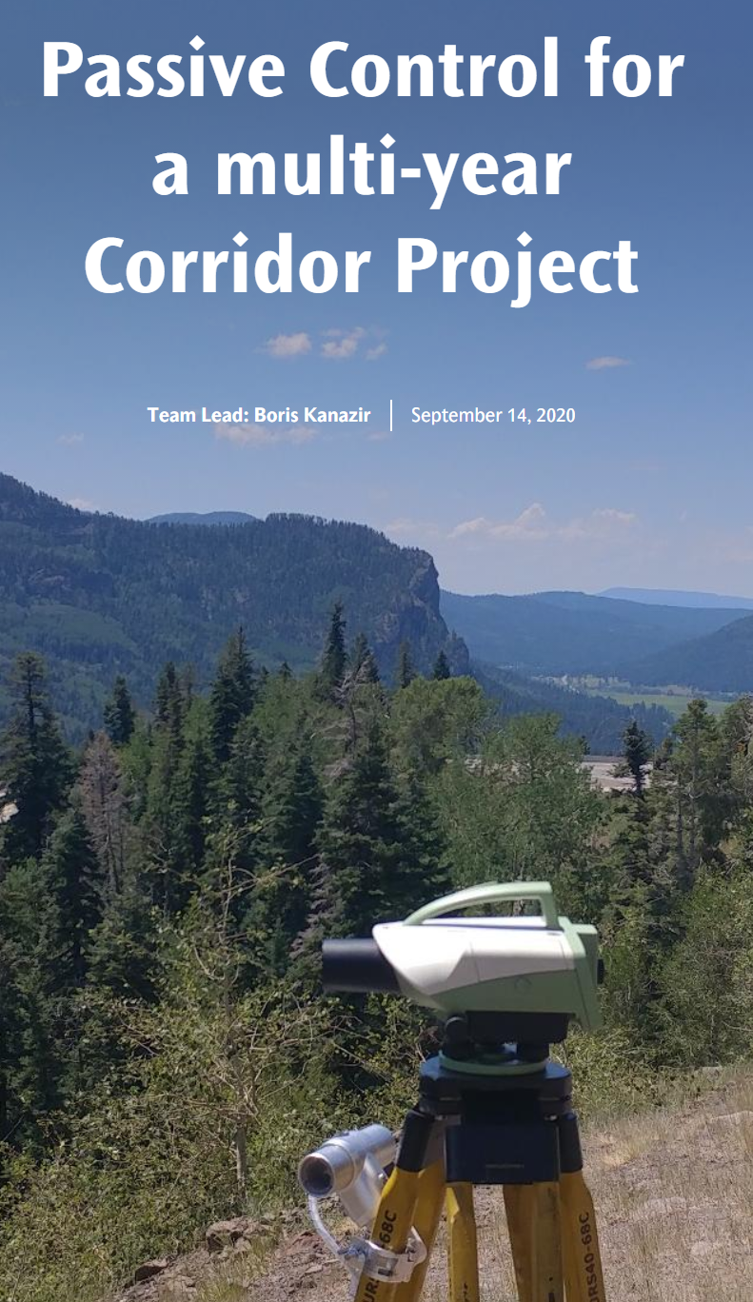
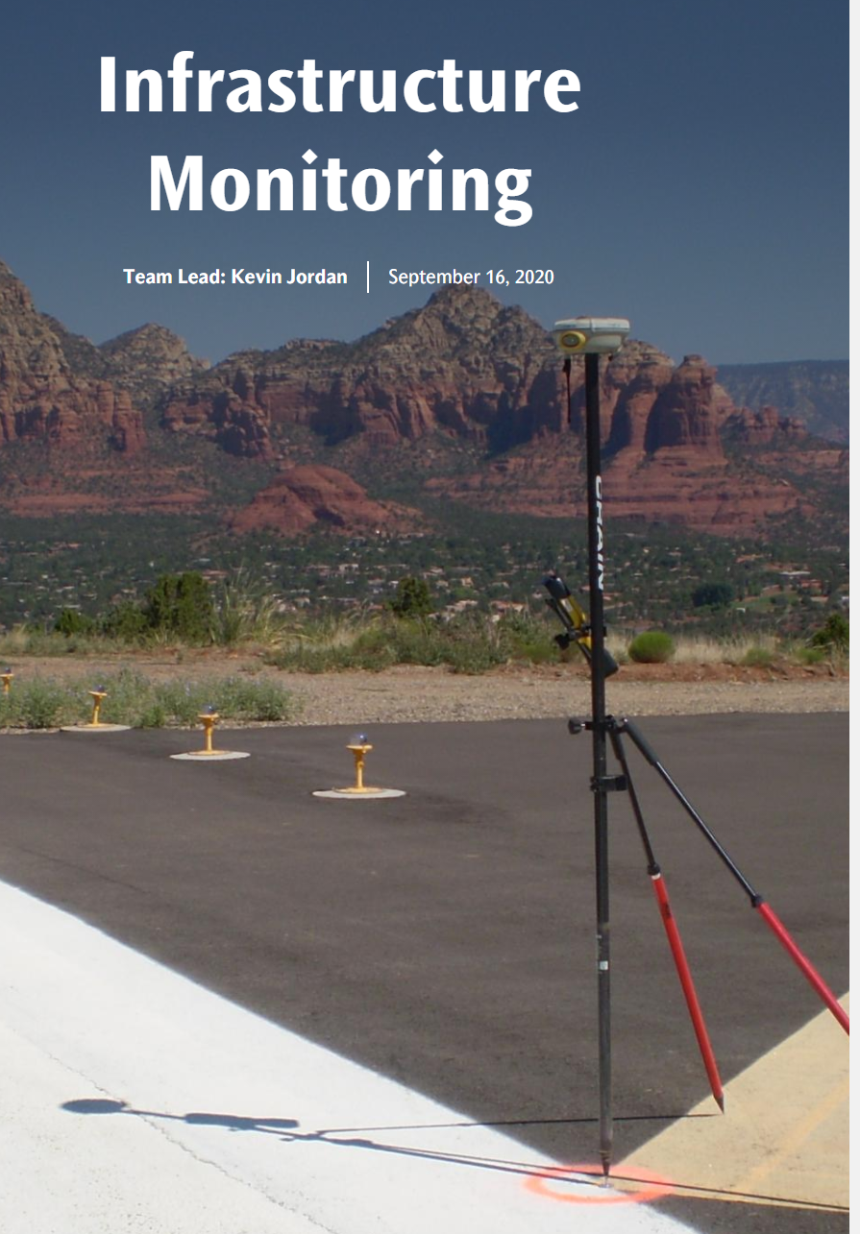
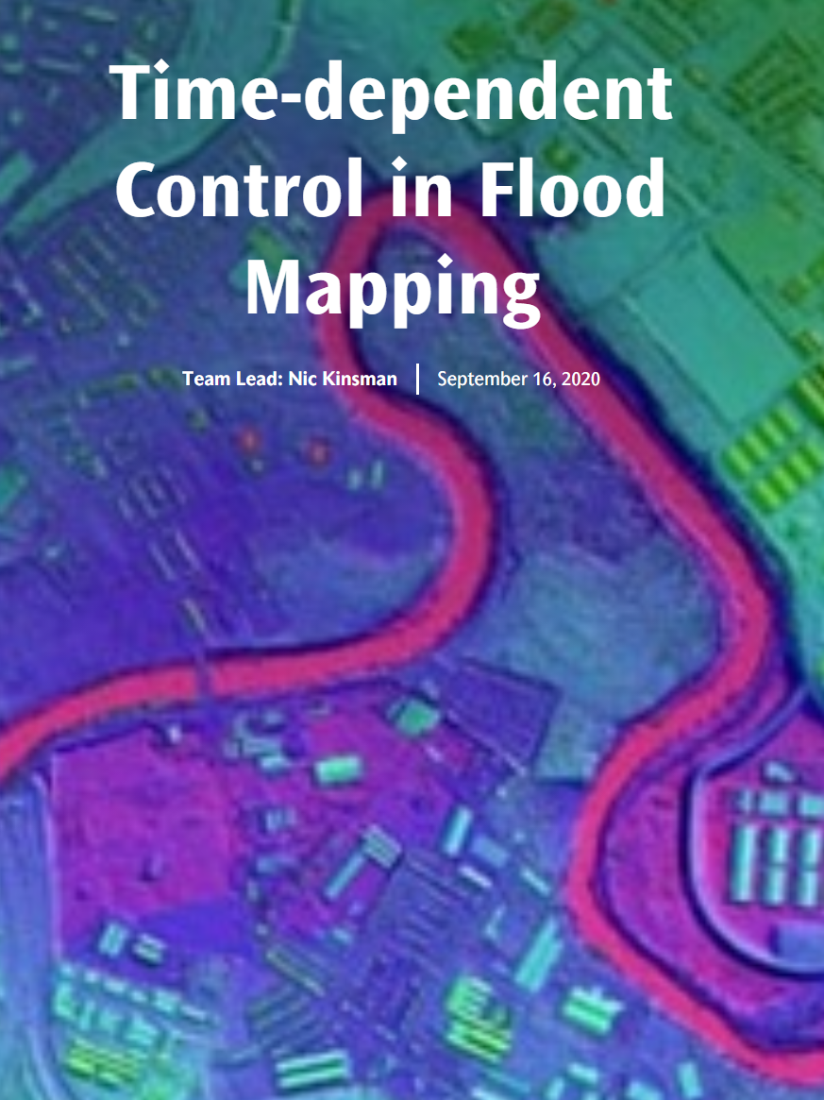
Blue Print 3: Working in the Modernized NSRS 2020 Updated Edition with Use Cases
Currently out for technical review.
March 2021 NGS Webinar Series Roll-out
Coming Soon
Working in the modernized NSRS:
April 2019
NOAA TR NOS NGS 67
Notes:
Links on the slide.

Slide 39
New coordinates in Modernized NSRS
Reference Epoch Coordinates
Survey Epoch Coordinates
“These are coordinates which have been estimated by NGS, from time-dependent age-limited historic survey data, CORS coordinate functions and an intra-frame velocity model, at an official NSRS reference epoch”
An estimated “snapshot” of entire network
Every 5 or 10 years
Similar to NAD 83(2011) epoch 2010.00
“These are coordinates computed by NGS using submitted data and metadata, checked and adjusted and referenced to distinct epochs through time.”
Provides what a mark’s coordinates when it was last surveyed?
NGS will adjust multiple surveys in timespans called “adjustment windows”, to a single epoch within that window.
Multiple SECs can show changes over time
Notes:
Links on the slide.

Slide 40
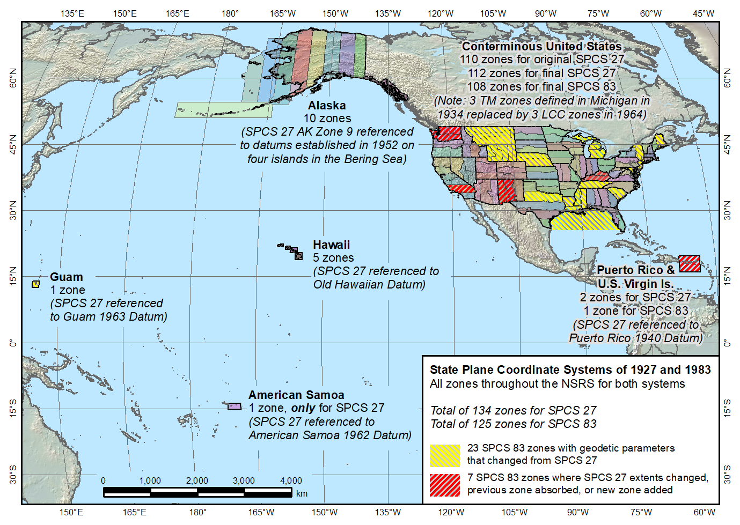
State Plane Coordinate Systems of 1927 (134 zones) and 1983 (125 zones)
SPCS of 2022
https://geodesy.noaa.gov/SPCS/
Notes:
State Plane Coordinate System
https://geodesy.noaa.gov/SPCS/index.shtml
2022 Policy Changes
https://geodesy.noaa.gov/SPCS/draft-policy.shtml

Slide 41
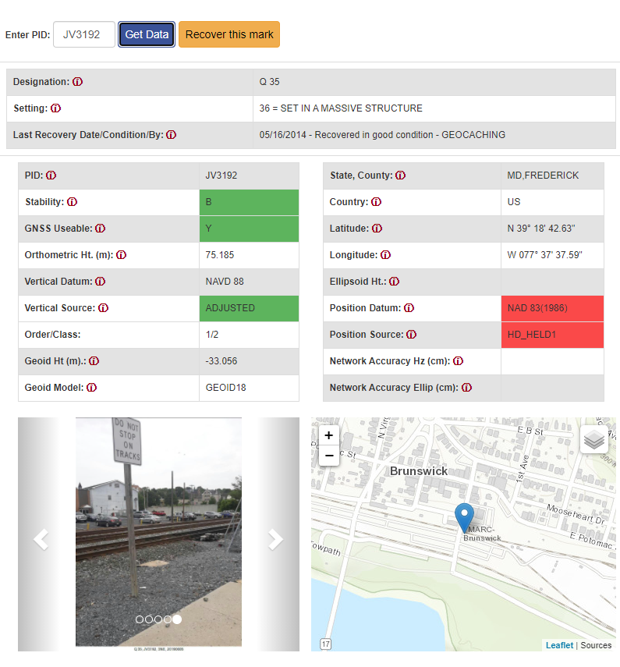
Beta Passive Marks Page
Notes:
Links on the slide.

Slide 42
Beta Leveling Projects Page
Notes:
Links on the slide.

Slide 43
Coming Soon: OPUS-Projects for RTK
NGS is developing a new Standardized GNSS Vector EXchange Format (GVX) that will be used to ingest vectors into OPUS Projects
Notes:
Links on the slide.

Slide 44
OPUS-Projects for RTK: Get Ready for Beta Testing
Notes:
Links on the slide.

Slide 45
Magnitude of the Deflection of the Vertical
Questions?
Big Sky GeoCon
Brian Shaw
brian.shaw@noaa.gov

