Slide 1
NOAA’s National Geodetic Survey
Update
Esri Survey Summit July 6-9, 2013 ● San Diego, CA
®
Michael Dennis, RLS, PE
michael.dennis@noaa.gov

Slide 2
Since last we met…
Improvements to the National Spatial Reference System
Update and refinement of North American Datum of 1983
New geoid and deflection of vertical models
Facilitating user contribution of data
OPUS Data Base, OPUS-Projects, updating “Bluebooking” process
Embracing GIS at NGS
NGS Data Explorer web app and updated datasheet shapefiles
New GIS tools and datasets
New software
NAD 83 coordinate transformations (GEOCON and GEOCON11)
Looking toward the future
New Ten Year Strategic Plan
GRAV-D status and Geoid Slope Validation Surveys
Emergency response: Hurricane Sandy
Recent retirements: The NGS family getting smaller
Many changes and challenges, but our mission remains the same

Slide 3
At NOAA’s NGS, location is our mission
National Spatial Reference System
NSRS
Define
Maintain
Access

Slide 4
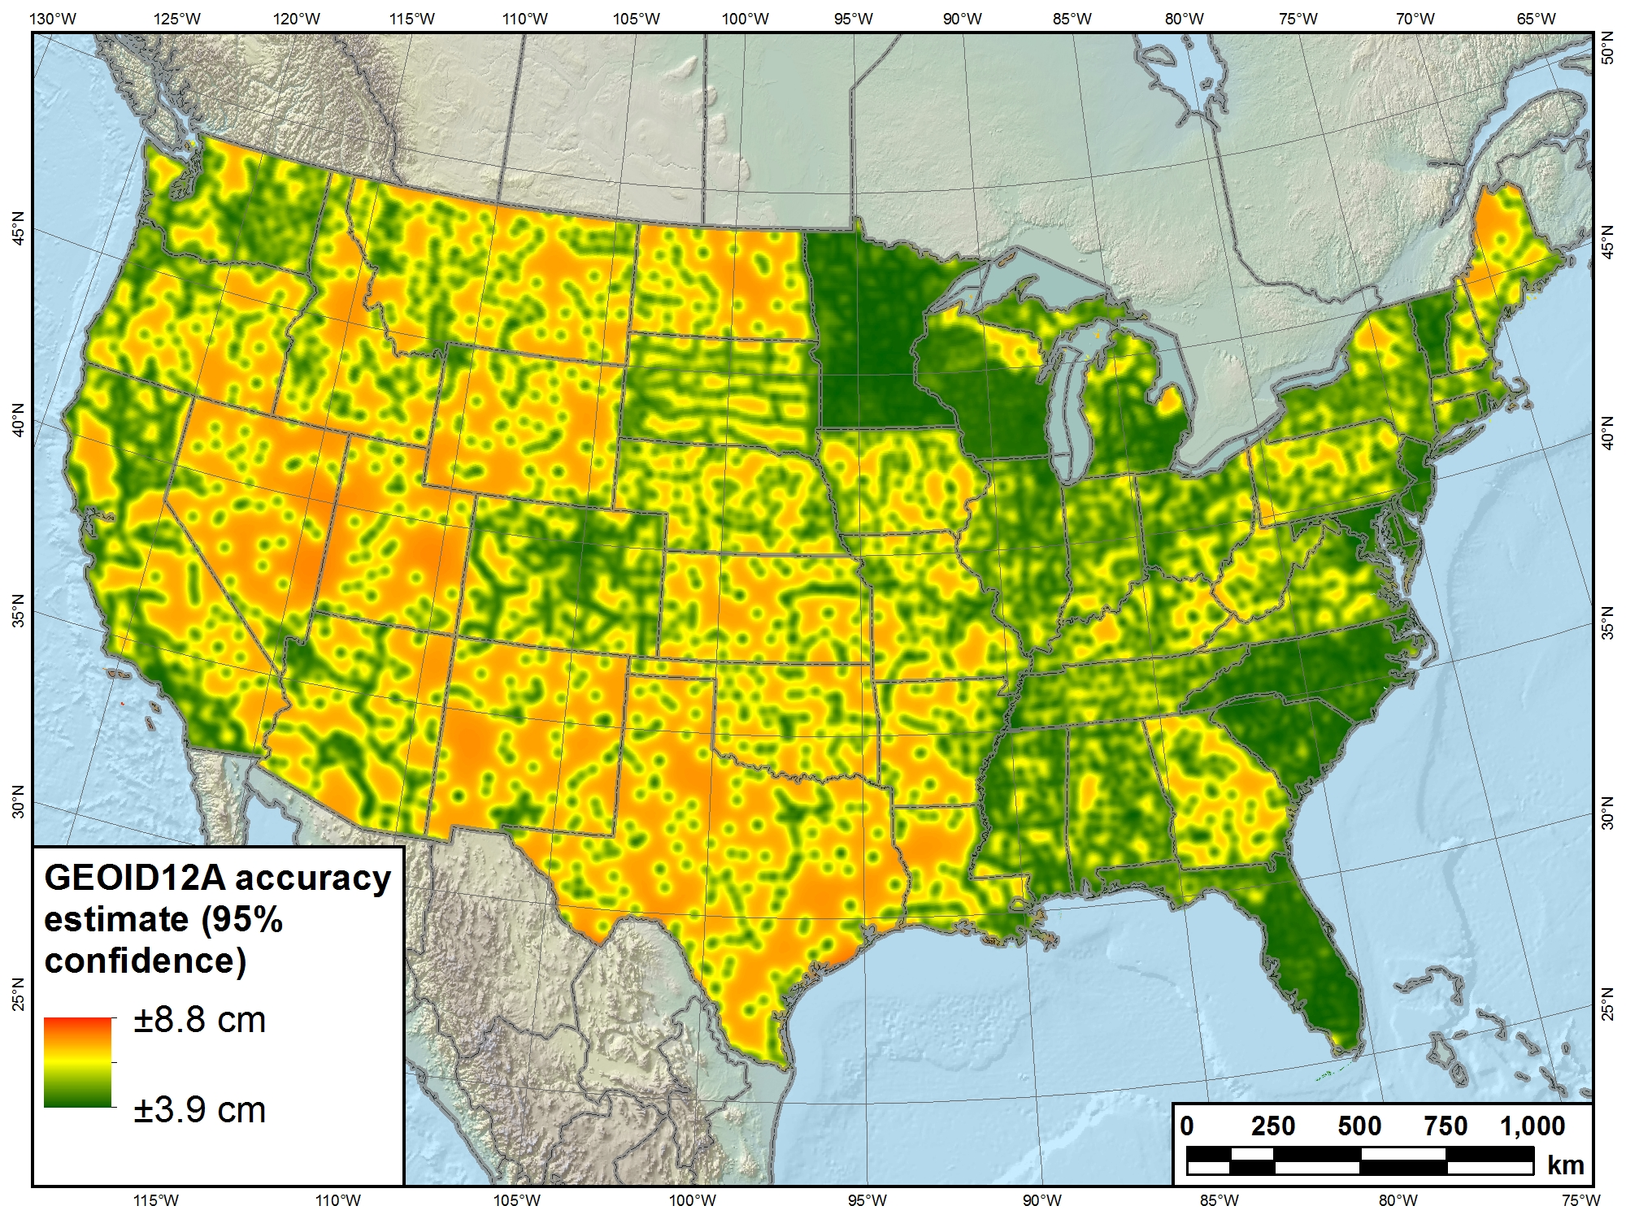
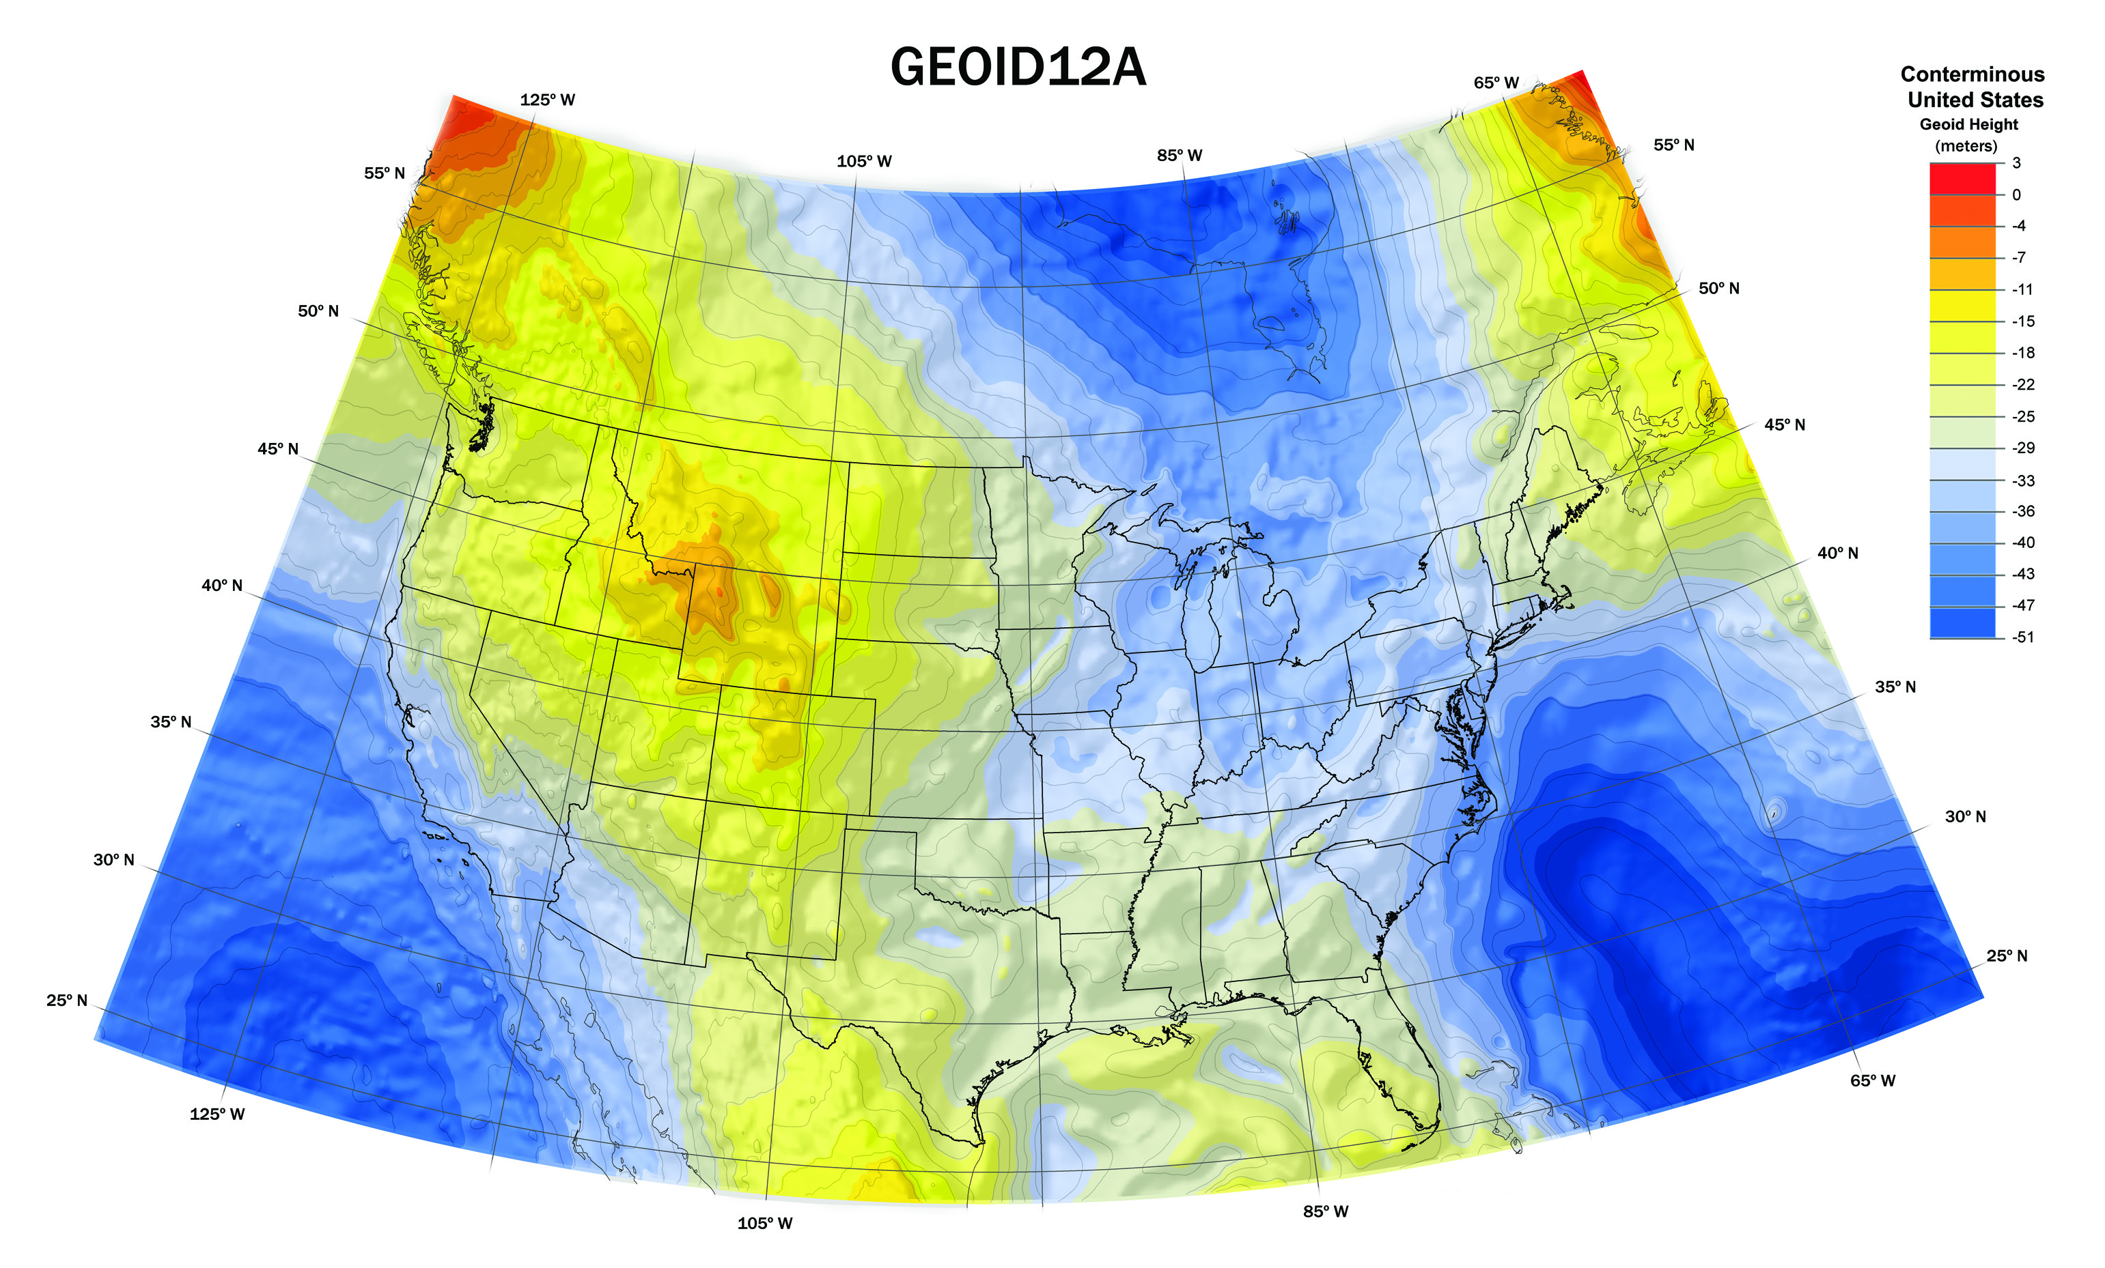
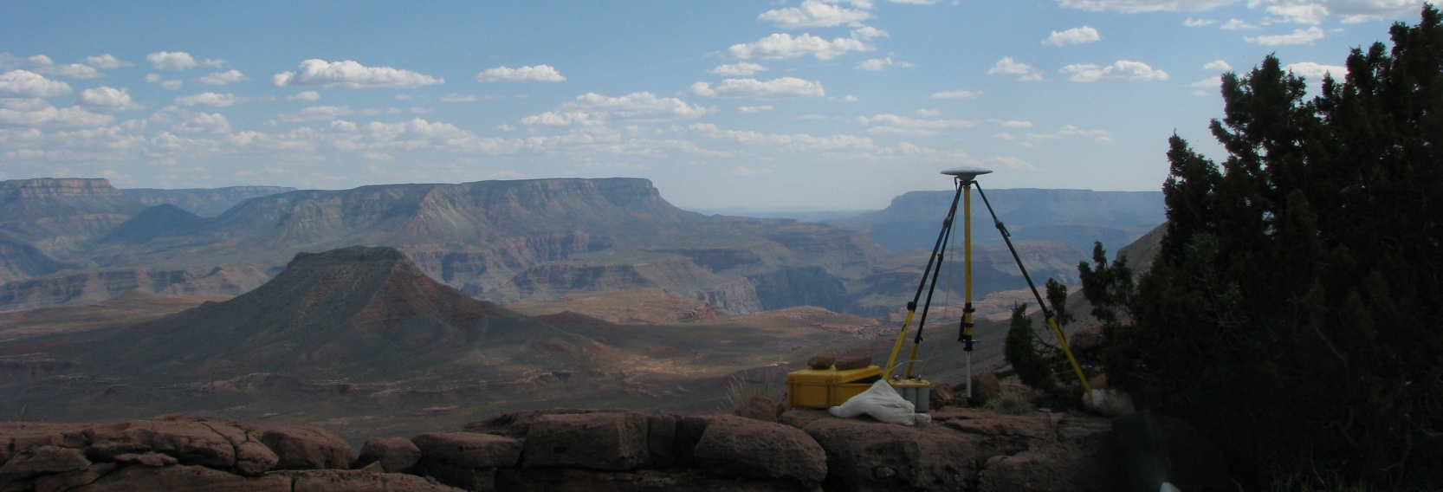
Improvements to the NSRS
Update and refinement of North American Datum of 1983
NAD 83 (2011/PA11/MA11) epoch 2010.00
Passive control results released June 30, 2012
New geoid and deflection of the vertical models
Hybrid models based (in part) on new passive control
GEOID12A released Sep 2012
DEFLEC12A and USDOV2012 released Oct 2012
New GEOID12A accuracy estimate model

Slide 5
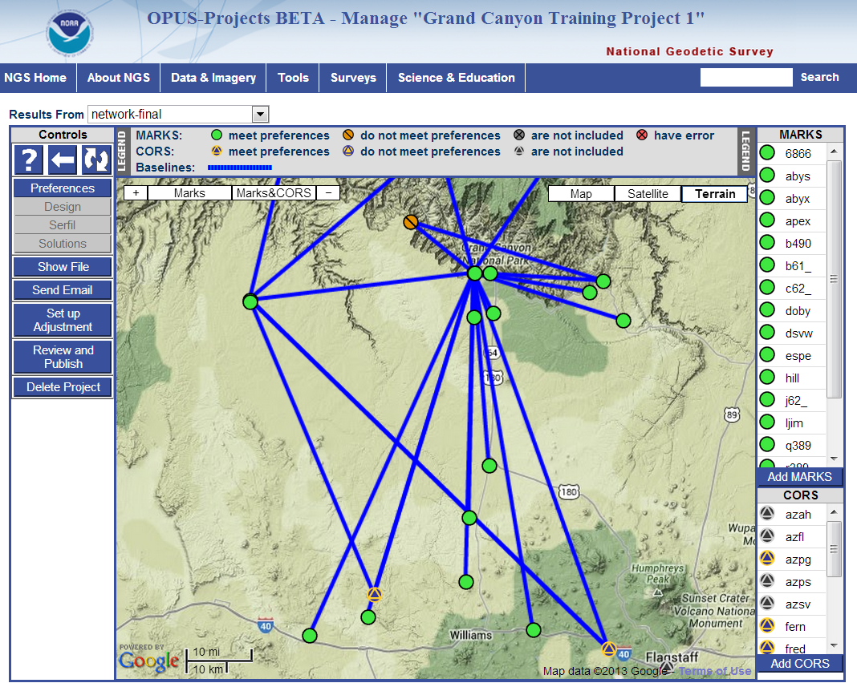
Facilitating user contribution of data
Online Positioning User Service (OPUS)
Over 5000 OPUS Data Base coordinates updated to NAD 83(2011/PA11/MA11)
OPUS-Projects will be released by late July 2013
Updating the “Bluebooking” process
This is how users submit data to NGS Integrated Data Base (NGSIDB)
Improving software, workflow, and tools (including GIS!)
Will be able to use OPUS-Projects results for Bluebooking
NGSIDB

Slide 6
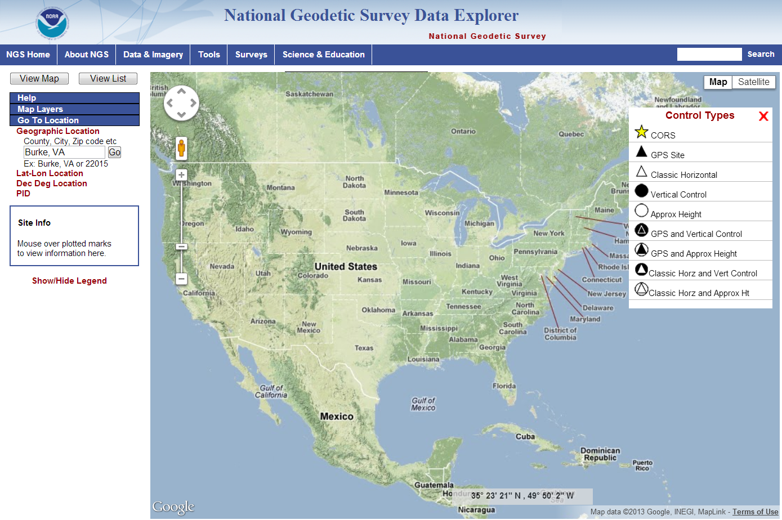
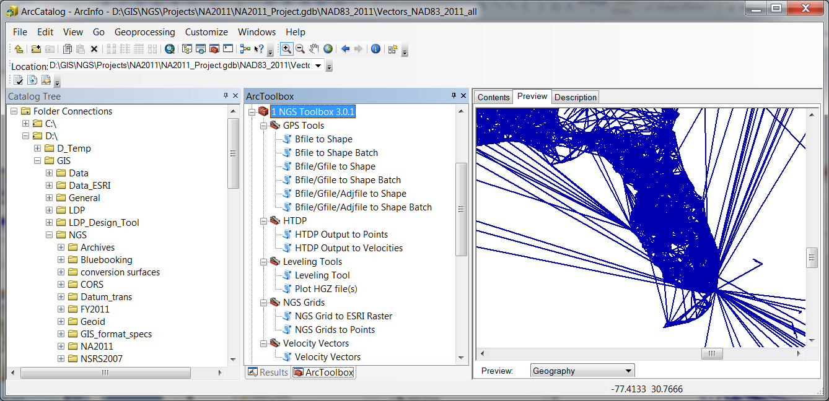
Embracing GIS at NGS
NGS Data Explorer web application
Browse interactively to geodetic control with map interface
Updated datasheet shapefiles available (beta)
Many new attributes added
New GIS tools and datasets under development
NGS GIS Toolbox creates GIS features from NGS software output
Products in GIS format

Slide 7
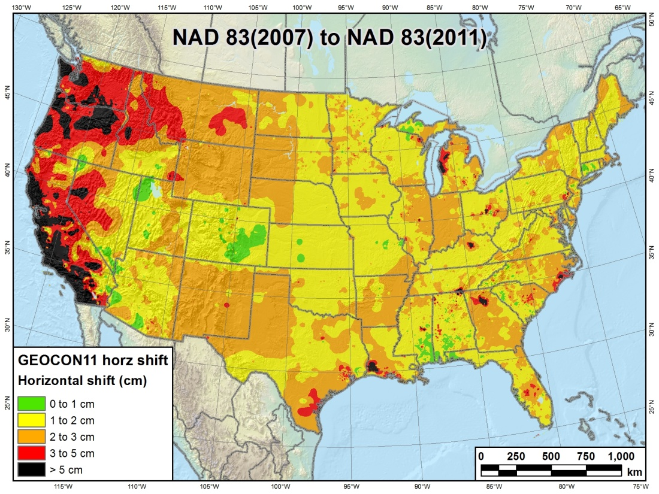
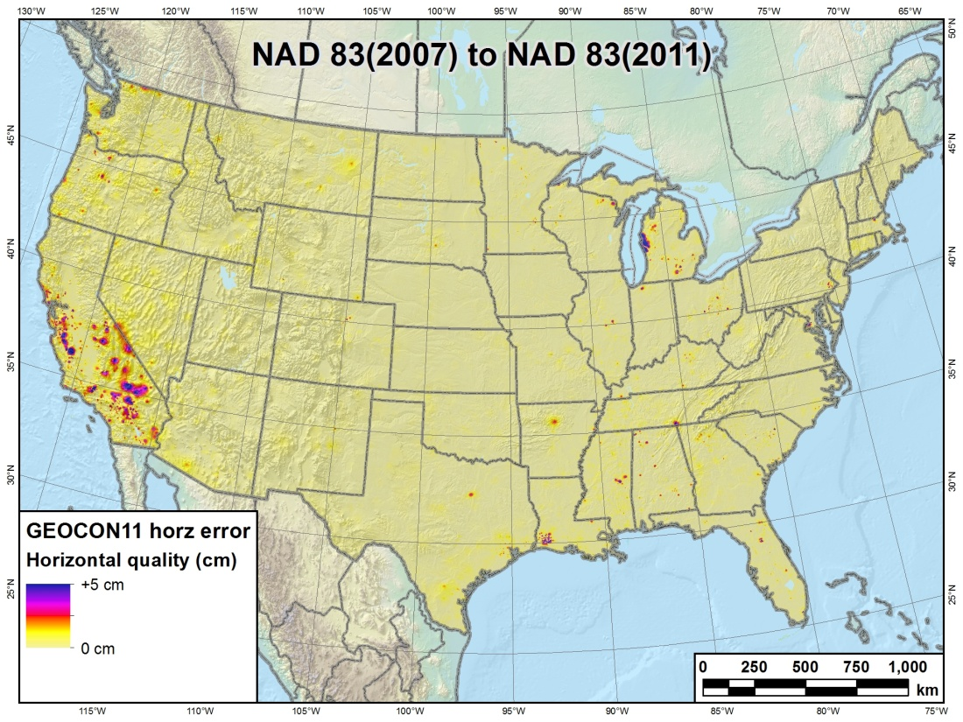
New and updated software
New 3-D NAD 83 coordinate transformation software
GEOCON: NAD 83(“HARN”) ←→ NAD 83(NSRS2007)
GEOCON11: NAD 83(NSRS2007) ←→ NAD 83(2011)
Both horizontal AND “vertical” (i.e., ellipsoid height)
Include output that indicates quality of transformation
New input data format will soon be available

Slide 8
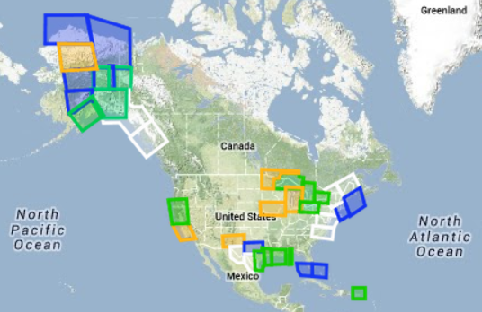
Looking toward the future
New Ten Year Strategic Plan released Jan 2013
GRAV-D status: Data collection over 25% complete
Geoid Slope Validation Surveys
2011 survey results available (TX); 2014 fieldwork work started (IA)
Green: Available data and metadata Blue: Data being processed Orange: Data collection underway White: Planned for data collection

Slide 9
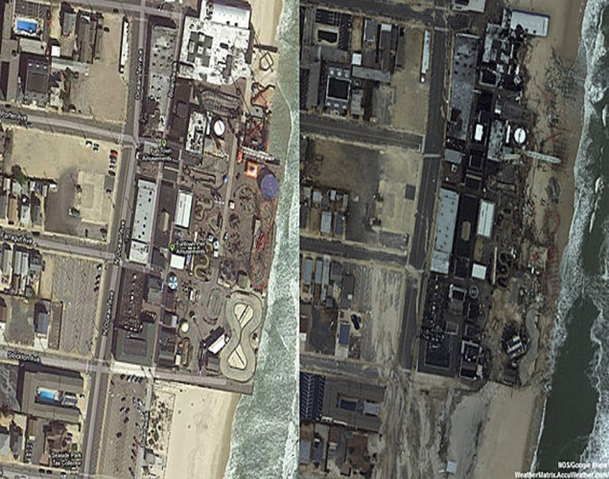
Emergency response
Seaside Heights, NJ
Damage assessment flights
Collect imagery of effects of disasters
Such as hurricanes, tornados, earthquakes
Hurricane Sandy
12,664 images across 6 states
Over 33 million visits to NGS emergency response website
Downloaded 7.6 TB of data in less than a month
Data used by other agencies to assess damage (e.g., FEMA)
Before 2012 Google Earth®
After NOAA Imagery 30 Oct 2012

Slide 10
The NGS family getting smaller
Feeling the impact of recent retirements
Dave Doyle
Marti Ikehara
Renee Shields
Bill Henning
Ronnie Taylor
Gilbert Mitchell
and others…
Currently under a hiring freeze
But plan to hire new employees as quickly as we can
The NSRS mission shall not be compromised!
Define
Maintain
Access

