Slide 1
YEAR IS 1806
- NATION IS 30 YEARS YOUNG
- THOMAS JEFFERSON IS PRESIDENT
- MOST U.S. CITIES ALONG EASTERN COAST
- COMMERCE, BOTH PEOPLE & GOODS MOVE BY SEA
PROBLEM – LOSSES FROM SHIPWRECKS
THREAT OF ATTACK BY BRITAN
Notes:
Cities at head of navigation
Boston, New York, Phil. Baltimore, Wash. Richmond, Norfolk, Charleston, Savannah

Slide 2
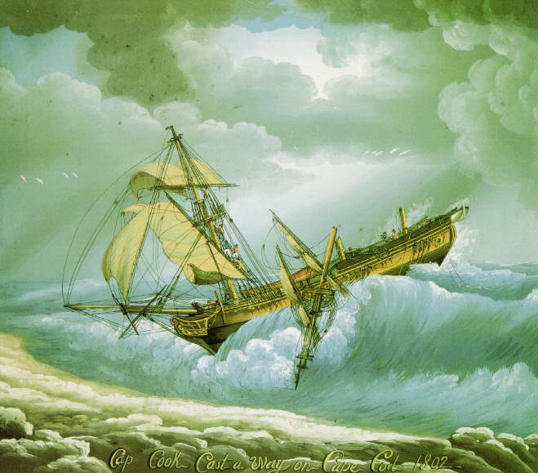
… to prevent this,
Shipwreck on Cape Cod
Notes:
… to prevent this from happening. A shipwreck, this one on Cape Cod, Mass in 1802. In those days, an all too common occurrence along our poorly charted shores.

Slide 3

AMERICAN PHILOSOPHICAL SOCIETY
- DISCUSSIONS OF MARITIME COMMERCE PROBLEM
- PRESIDENT JEFFERSON IS MEMBER
- NEW SWISS IMMIGRANT F.R. HASSLER IS MEMBER
- SOLUTION; NAUTICAL CHARTS NEEDED

Slide 4
ACT OF 1807
- PRES. JEFFERSON SIGNS BILL ON FEBRUARY 10, 1807
- …to cause a survey to be taken of the coasts of the U.S.,
- in which shall be designated the islands, and shoals, with the roads or places of anchorage
- within twenty leagues of any part of the shores of the U.S.,
- and also the respective courses and distances between the principal capes, or head lands,
- completing an accurate chart of every part of the coasts…
Notes:
“Road” = anchorage
“League” – 3 miles

Slide 5
FERDINAND R. HASSLER’S PROPOSAL
- SURVEY NETWORK ALONG COAST
- TRIANGULATION SURVEY METHOD
- SHORELINE MAPS & HYDROGRAPHY TIED TO NETWORK
- MOST PRECISE & SCIENTIFIC METHODS TO BE USED
        RESULT
- HASSLER’S PROPOSAL ACCEPTED

Slide 6
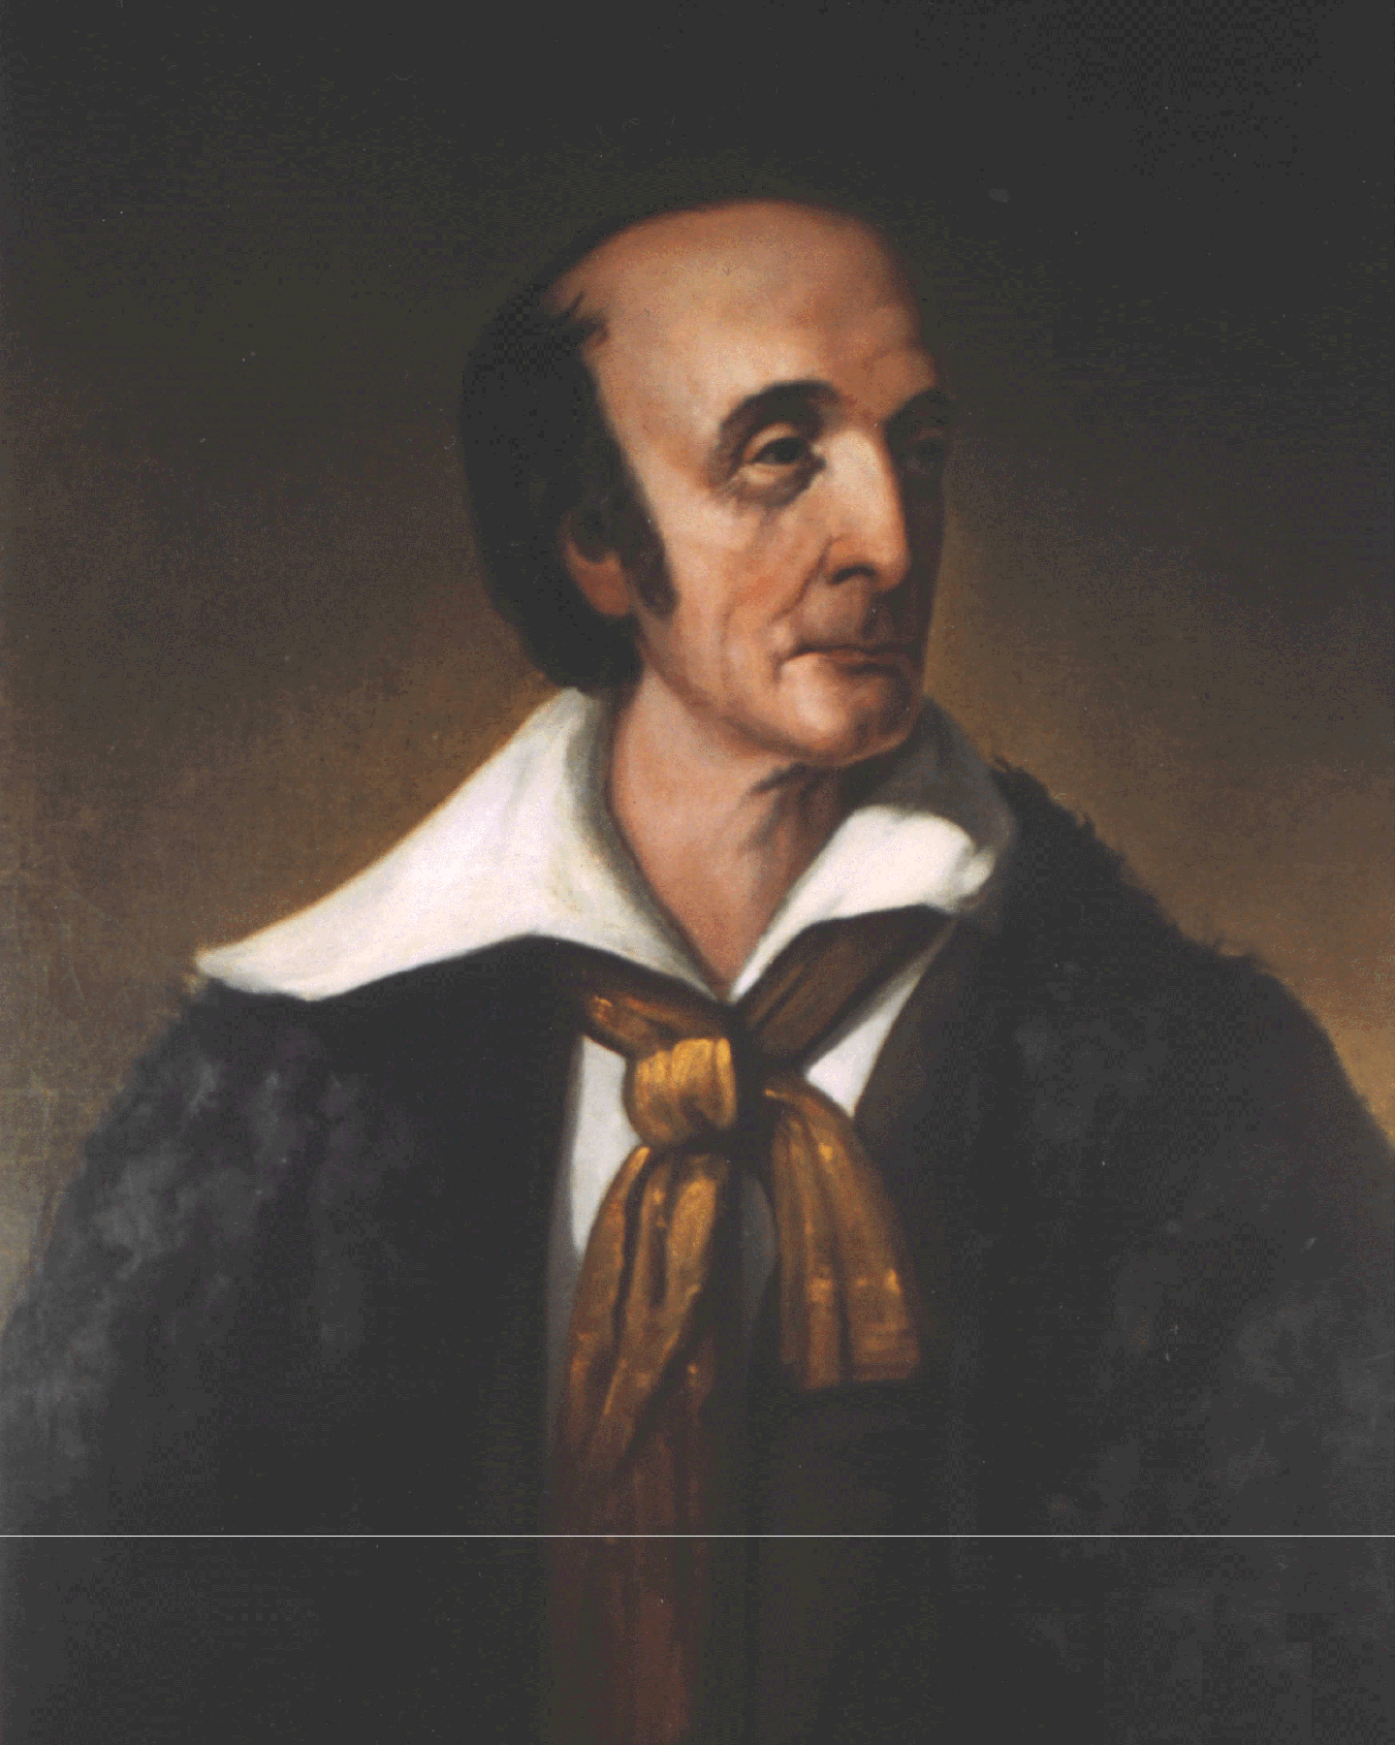
FERDINAND R. HASSLER
FIRST SUPERINTENDENT, SURVEY OF THE COAST

Slide 7
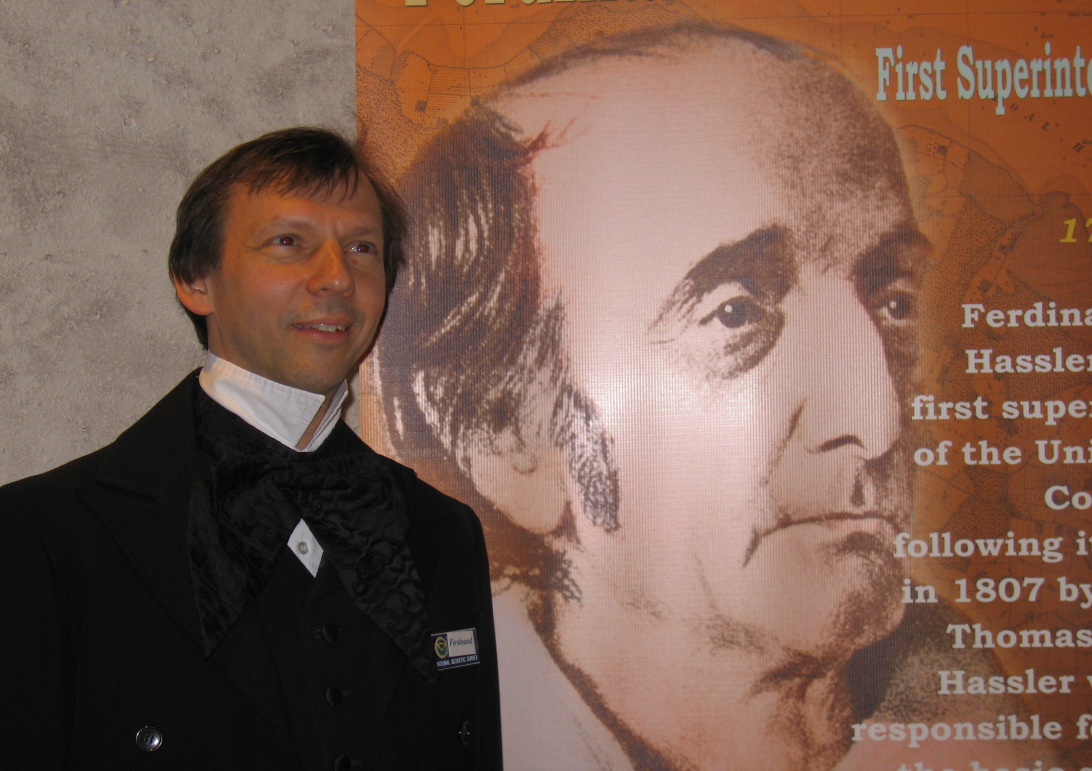
Notes:
Young Hassler

Slide 8
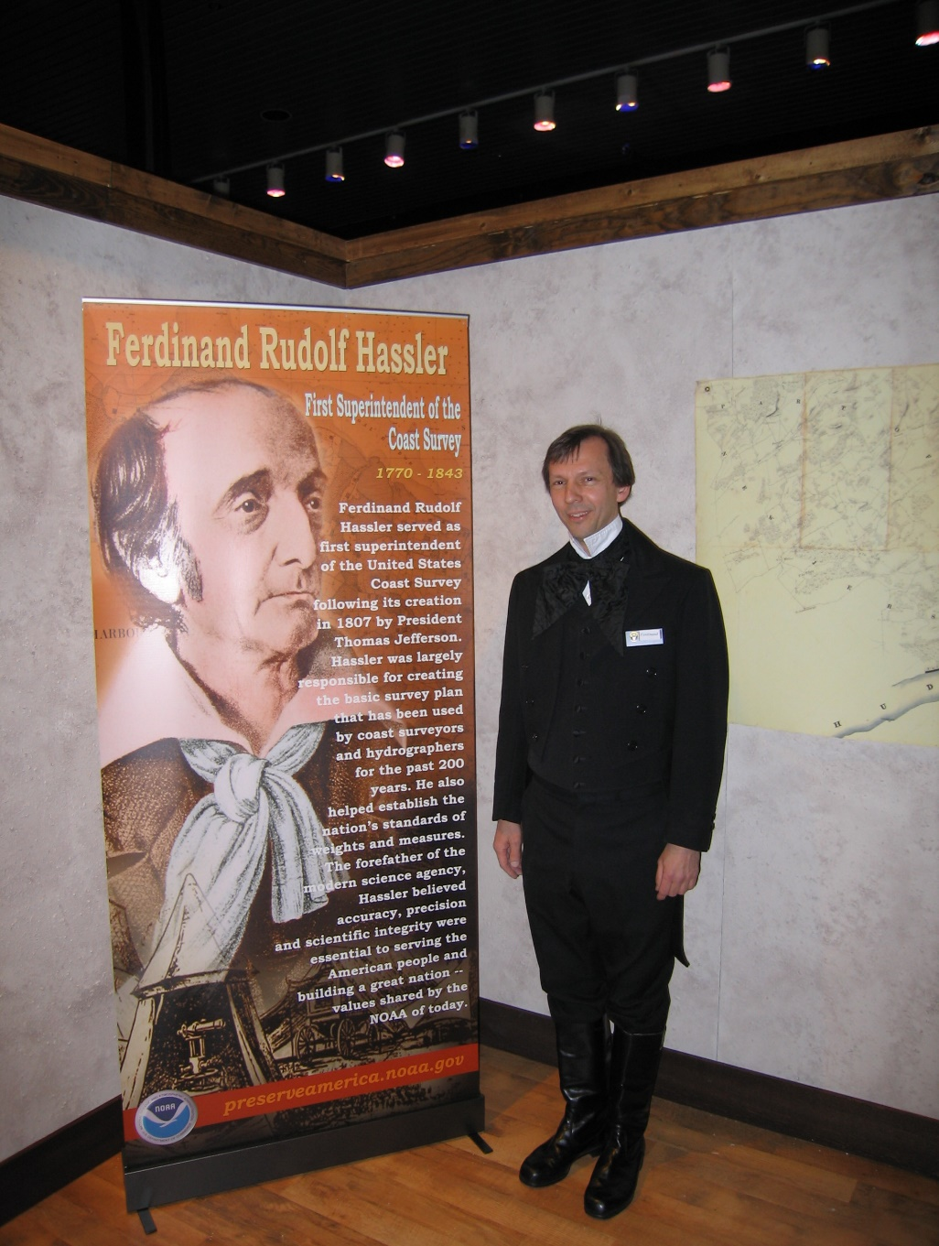

Slide 9
SUPERINTENDENT HASSLER
- HASSLER TRAVELED TO EUROPE TO ACQUIRE INSTRUMENTS
- HASSLER’S RETURN DELAYED BY WAR OF 1812
- WORK BEGAN IN 1816-17 IN NEW YORK

Slide 10
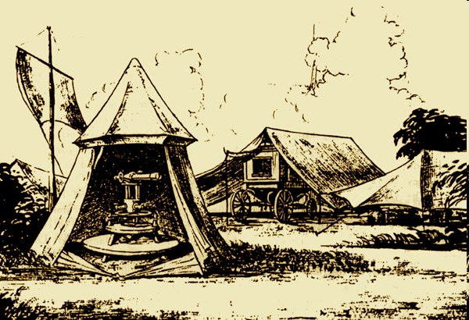
24 INCH THEODOLITE IN HASSLER’S CAMP

Slide 11
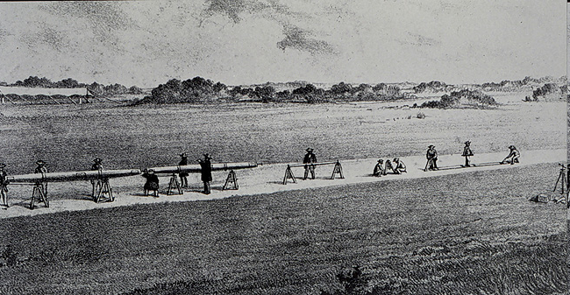
BAR FOR MEASURING BASELINE

Slide 12
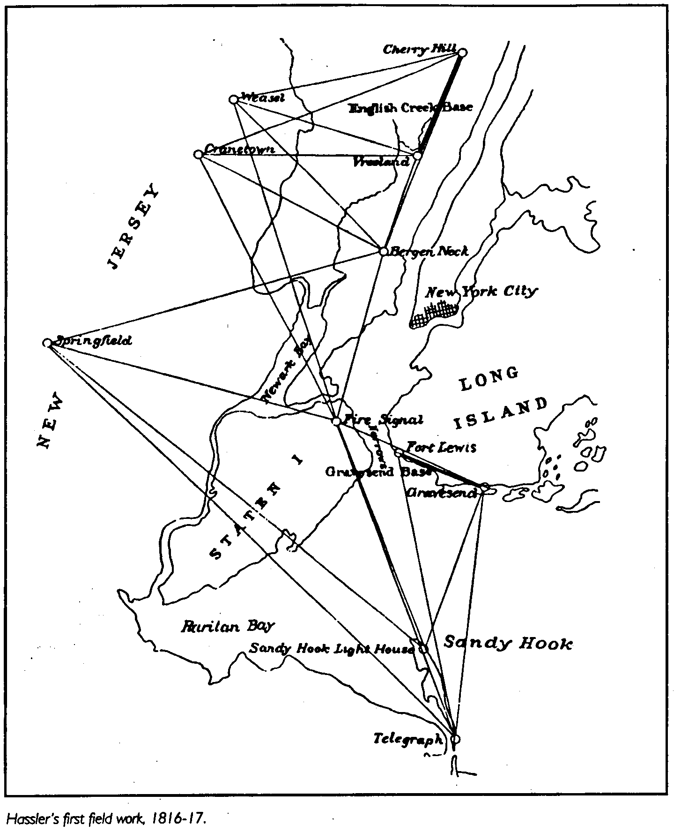
FIRST FIELD WORK OF THE “SURVEY OF THE COAST”
Notes:
Only pt remaining is Sandy Hook Lt – and its top portion was rebuilt in the 1850’s
Name later change to “Coast Survey” and later to USC&GS

Slide 13
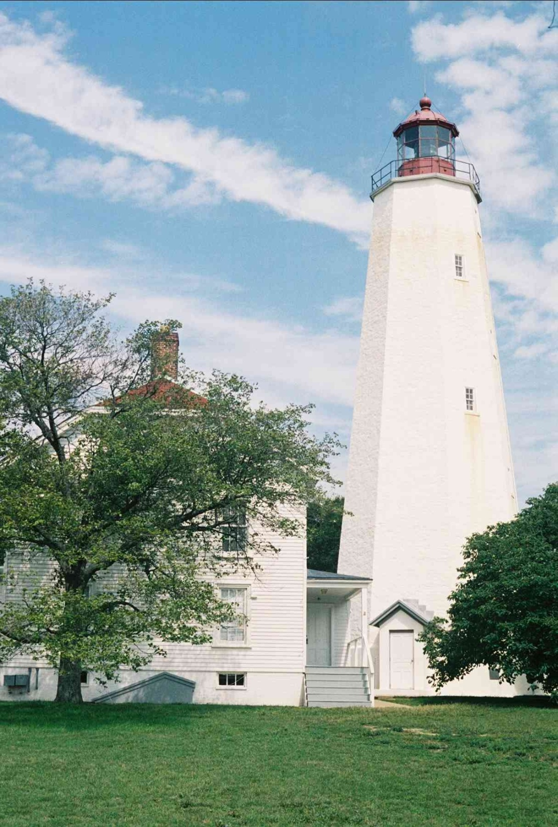
SANDY HOOK LIGHTHOUSE
ONLY REMAINING STATION FROM HASSLER’S FIRST PROJECT
METAL CUPOLA REBUILT IN 1850’S
Notes:
2006 photo

Slide 14
DELAY 1817 - 1832
- NO PROGRESS DUE TO CONGRESSIONAL ACTION
RESTART 1832
- 1832 RECONNAISSANCE
- 1833 NEW YORK SURVEY RESUMED
- FIRST STATION OCCUPPIED WAS BUTTERMILK 1833

Slide 15
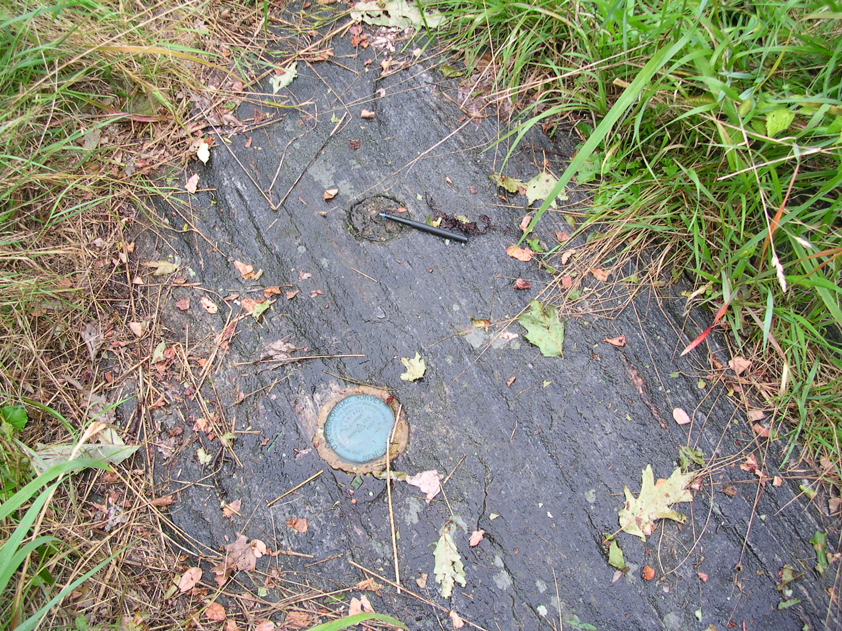
BUTTERMILK 1833
Notes:
Photo 2 years ago
My pen
Disk is USGS mark from 1930’s

Slide 16
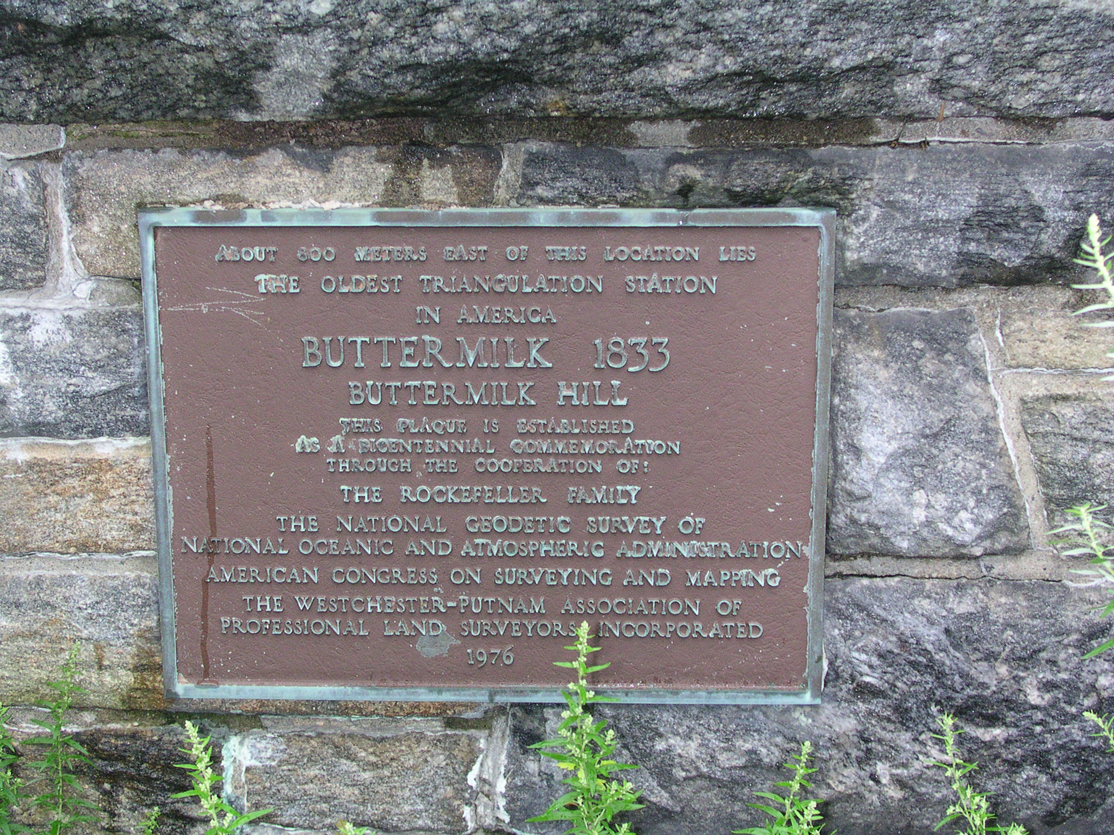
Notes:
Plaque set in 1976 by NGS Director Baker as part of Nation’s Bi-Centennial activities

Slide 17
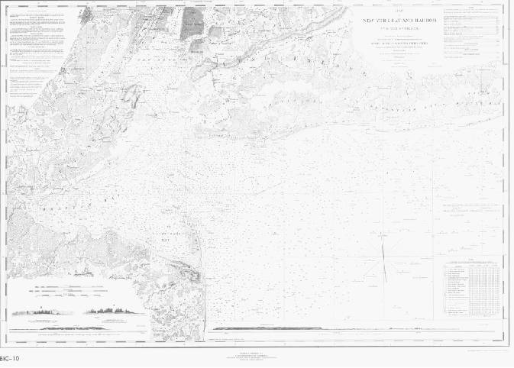
1845 – FIRST USC&GS NAUTICAL CHART
Notes:
Hassler died 2 years earlier
Next slide is enlargement of lower Manhattan area

Slide 18
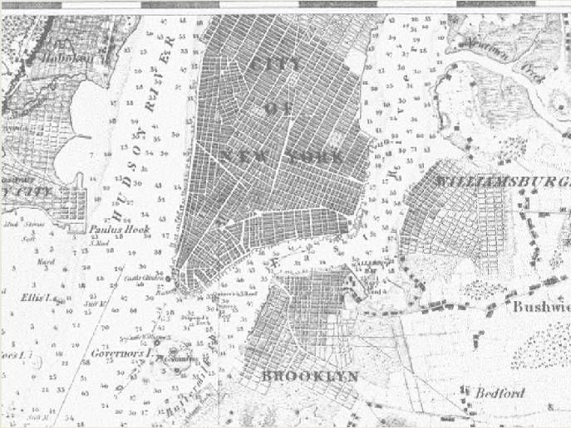

Slide 19
U.S. Coast & Geodetic Survey/NOAA
Steps to Creating a Nautical Chart
Historic types of surveys required
  Astronomical Observations
  Land survey (triangulation)
  Tide Gauges
  Shoreline Mapping
  Hydrography

Slide 20
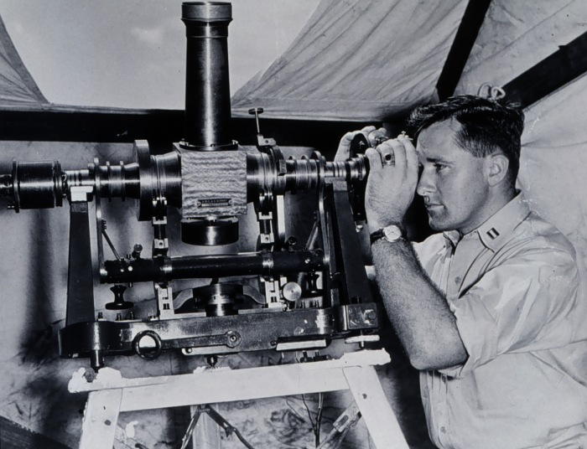
Theodolite instrument for precise astronomical observations to determine latitude, longitude, and azimuth
Astronomical observations were necessary to determine the position and orientation of selected points in a survey network.

Slide 21
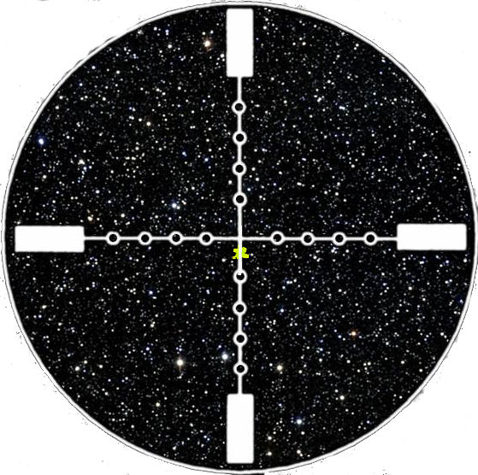
View through Telescope at desired star
Star aligned with cross-hair

Slide 22
Survey Network
Astronomical Observations performed at this site to determine initial latitude, longitude, and azimuth.

Slide 23
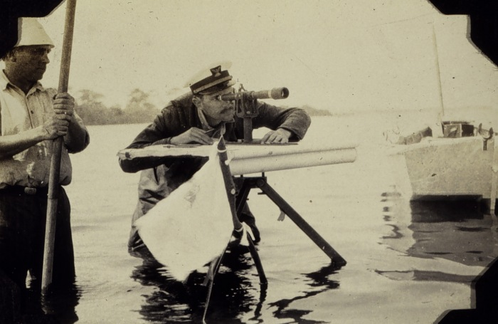
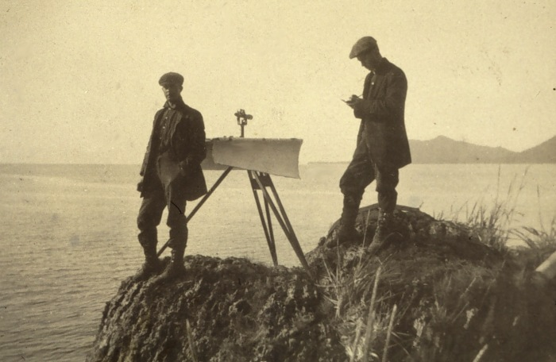
Plane table is set-up over known point
Paper map correctly oriented
Distant objects sighted upon and lines drawn from present position toward distant objects
Plane table moved to another location and procedure repeated
Points of intersection define position of distant objects
Shoreline is drawn through intersecting points; also range & bearing determine positions

Slide 24
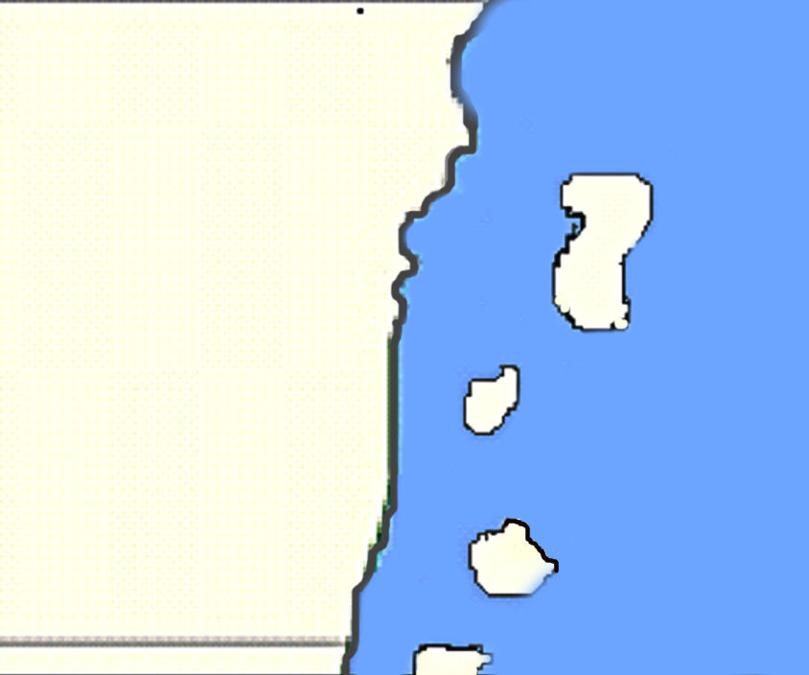
PLANE TABLE MAPPING

Slide 25
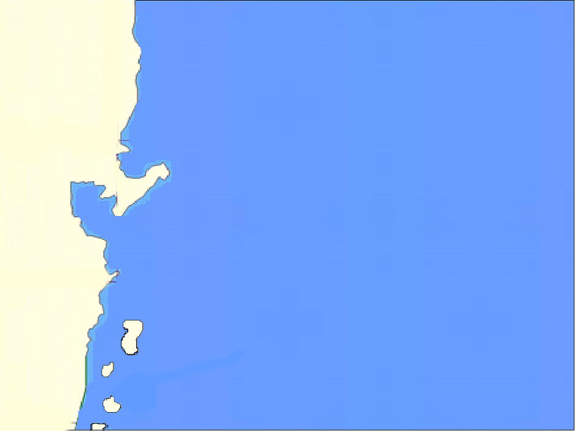
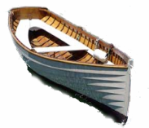
9.1
8.8
8.5
8.3
8
7.9
7.6
7.2
7.2
Depths (soundings) are measured continuously along dotted lines. Sextant angle fixes are taken at locations indicated by green bars.
6
7.2
9.1
9.5
5.1
7
7.9
9.3
9.4
5.7
6.1
7
8
8.5
5
6.5
7.8
8
8.9
5.2
6
7
9
9.2
5.5
7.1
8
9.2
9.5

Slide 26
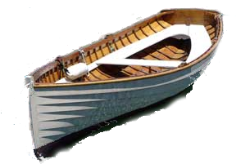
HYDROGRAPHY
Two sextant angles at periodic points along the launch’s path determine position of the launch

Slide 27
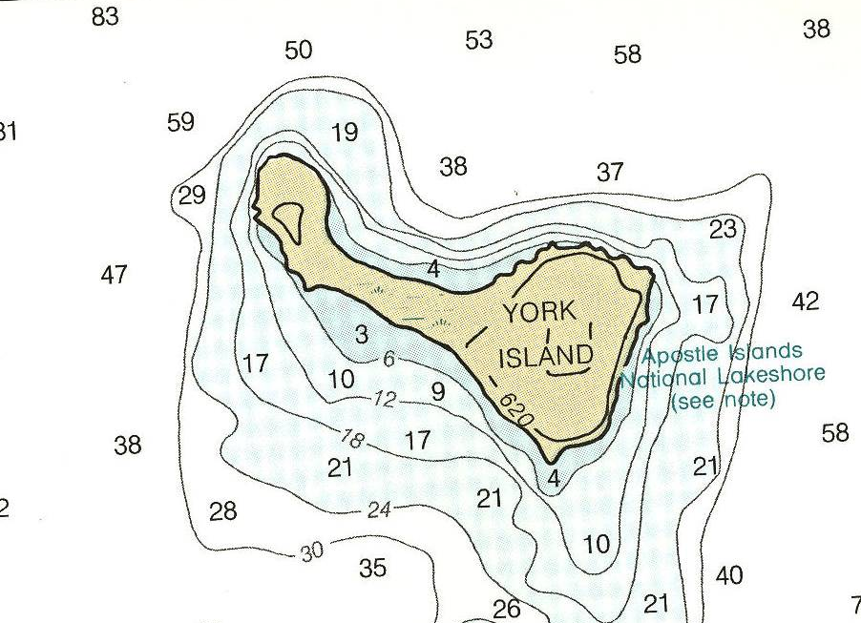
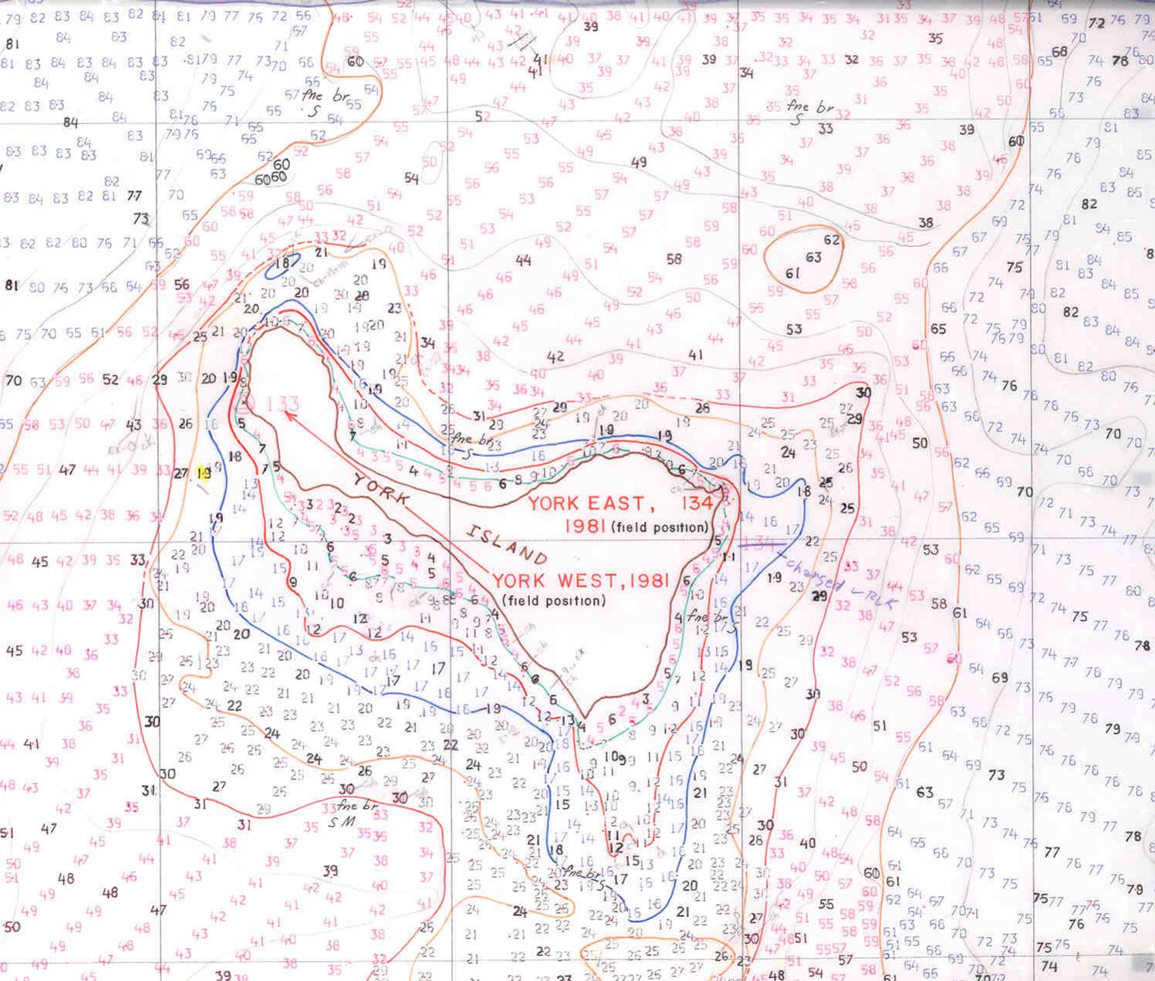
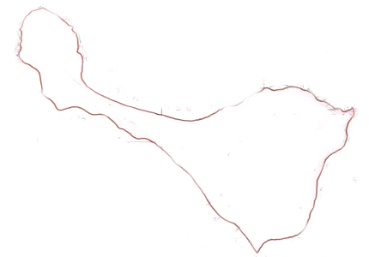
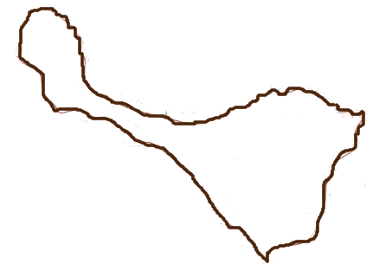
GEODETIC SURVEY
SHORELINE SURVEY
TIDAL SURVEY
HYDROGRAPHIC FIELD SHEET
FINISHED NAUTICAL CHART
= tide gauge
= survey mark

Slide 28
EASTERN OBLIQUE ARC OF TRIANGULATION
- SURVEY NETWORK TO TIE ALL NAUTICAL CHARTS
- BEGUN IN NEW YORK IN 1816
- PROGRESSED NE INTO NEW ENGLAND AND
SW THROUGH WASHINGTON AND ATLANTA TO NEW ORLEANS

Slide 29
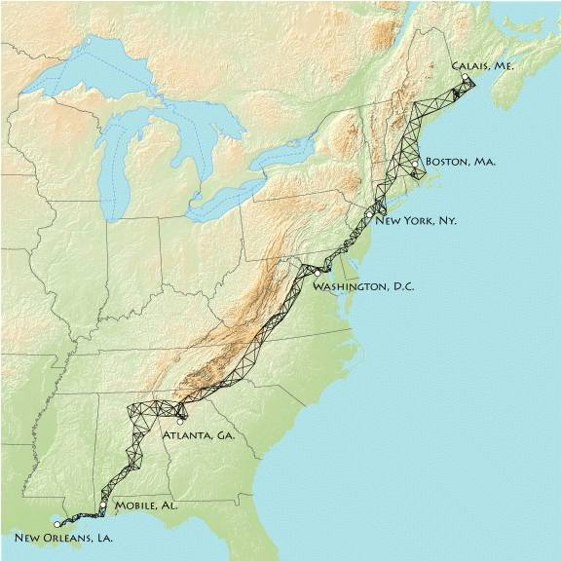
USC&GS EASTERN OBLIQUE ARC OF TRIANGULATION
http://www.holoscenes.com/images/bmwiki/arc/eastern_arc.png
Map courtesy of: Jim Irwin
Notes:
Next slide is enlargement of Wash. area

Slide 30
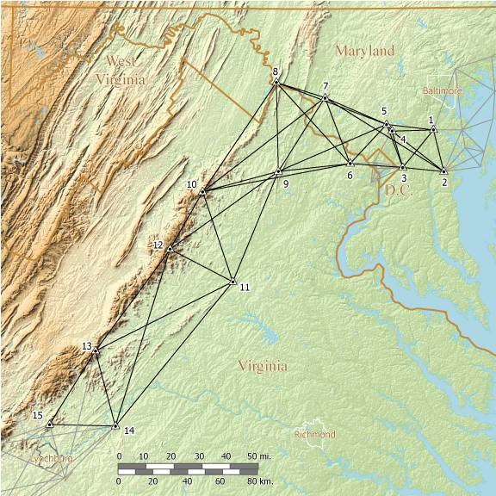
SUGAR LOAF
SSMC3
PORTION OF EASTERN OBLIQUE ARC FROM WASHINGTON AREA SW ALONG MOUNTAINS IN VIRGINIA
http://www.holoscenes.com/cgi-bin/moin.cgi/ObliqueArcKentIslandWestward
Map courtesy of Jim Irwin

Slide 31
WESTERN EXPANSION
EXPANSION OF U.S. WESTWARD LED TO:
1871 - AUTHORITY TO SURVEY ACROSS U.S.
1872 - 1898 – FIRST TRANSCONTINENTAL ARC OF TRIANGULATION ACROSS U.S.
1877 - 1900 – FIRST LEVEL LINE ACROSS U.S.
1878 - NAME CHANGE, U.S. COAST SURVEY TO
U.S. COAST & GEODETIC SURVEY
Notes:
1869 – COMPLETION OF TRANSCONTINENTAL RR
CA 1850
OR 1859
CO 1876

Slide 32
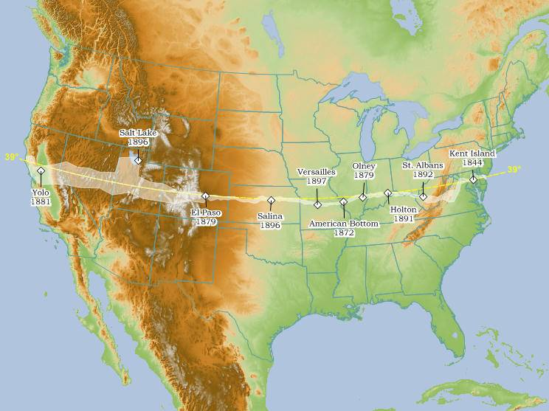
TRANSCONTINENTAL ARC OF TRIANGULATION
http://www.holoscenes.com/cgi-bin/moin.cgi/TranscontinentalTriangulation
Map courtesy of Jim Irwin
Notes:
Tied east and west coast survey networks together
Provided survey control all across the country
Names on map are the measured Baselines used for scale
Provided an arc to help determine precise size and shape of earth
Total cost $500K
Longest Arc of a parallel ever undertaken by any single gov’t
Completion called “One of the historic events in the progress of geodesy” (from SP#4)

Slide 33
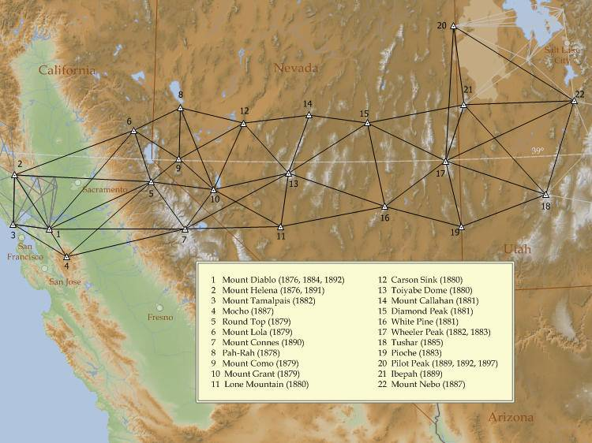
WESTERN PORTION OF TRANSCONTINENTAL ARC
Map courtesy of Jim Irwin
133 MILES
Notes:
On average, took 2 months to occupy a station
On at least one occasion, trenches were dug in the snow in order to clear the line-of-sight to neighboring stations

Slide 34
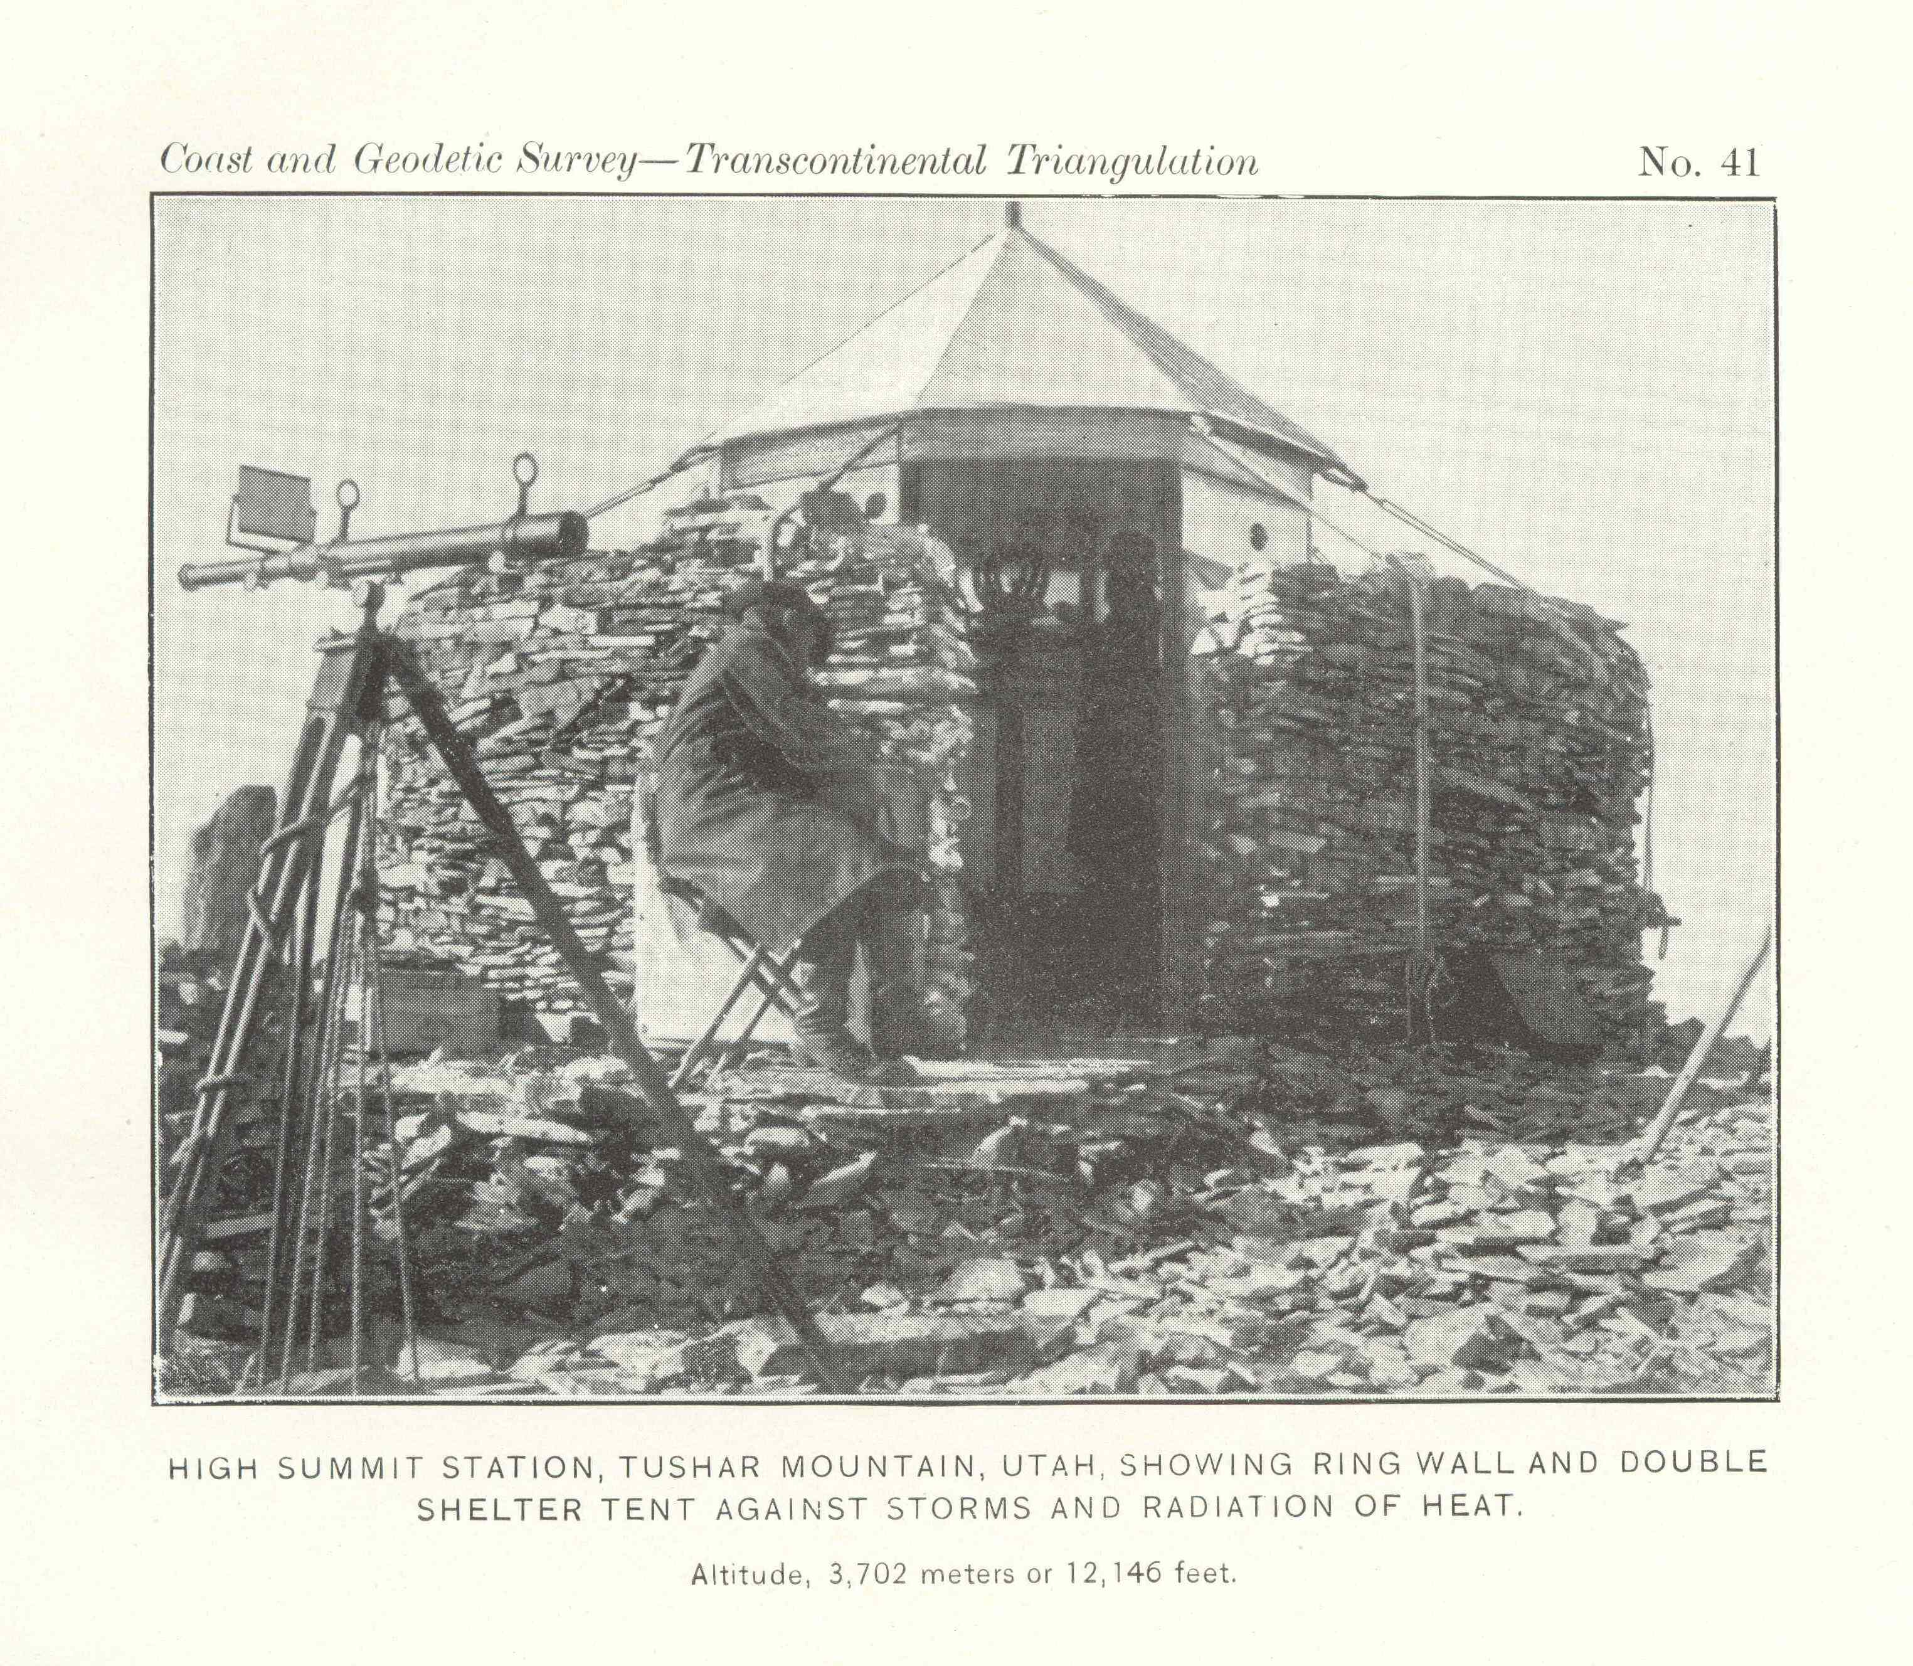

Slide 35
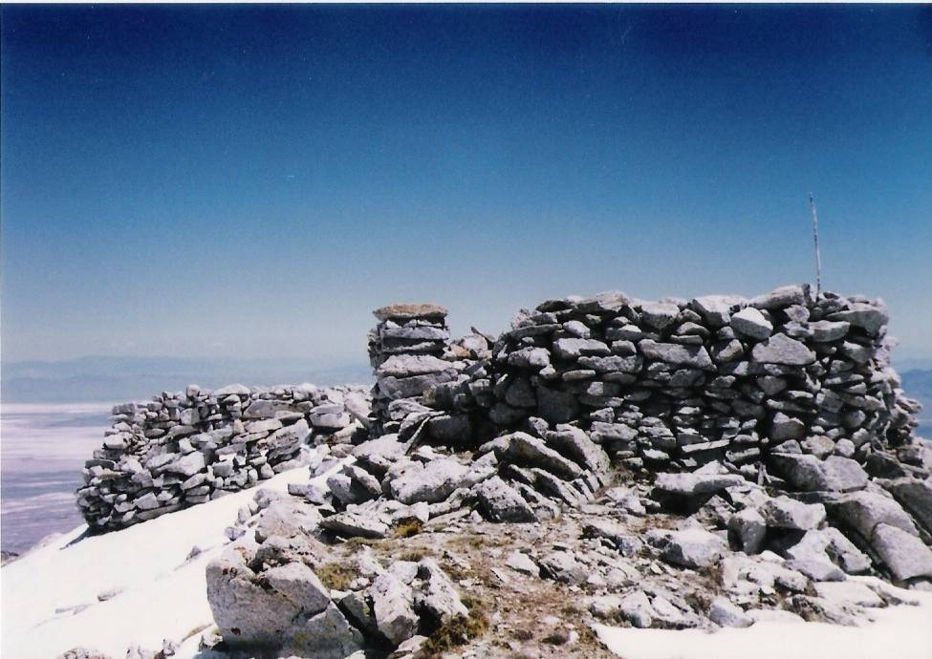
STATION IBEPAH; STONE WALLS FROM 1889 TRANSCONTINENTAL ARC SURVEY
1998 PHOTO COURTESY OF CPT JAROMY JESSOP, U.S. ARMY
Notes:
Station mark is a copper bolt
Jaromy said wooden floor boards remain
Ht 12,092 feet
Other mt tops also have remains of stone walls

Slide 36
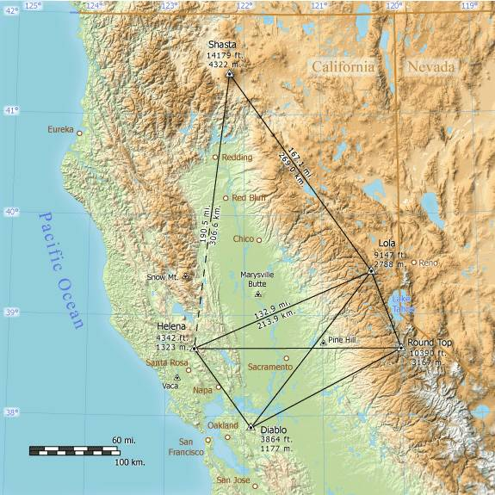
SURVEY LINE FROM MT SHASTA TO MOUNT HELENA IS THE LONGEST LINE EVER OBSERVED
Map by Jim Irwin
Notes:
Longest terrestrial line
USC&GS bragged about this line to Europeans
Line was not part of Transc. Arc

Slide 37
NATION-WIDE SURVEY NETWORK
- TRANSCONTINENTAL ARC AND LEVEL LINE WERE START OF NATIONWIDE NETWORK
- PLAN FOR GRID OF ARCS OF TRIANGULATION AND FOR LEVEL LINES

Slide 38
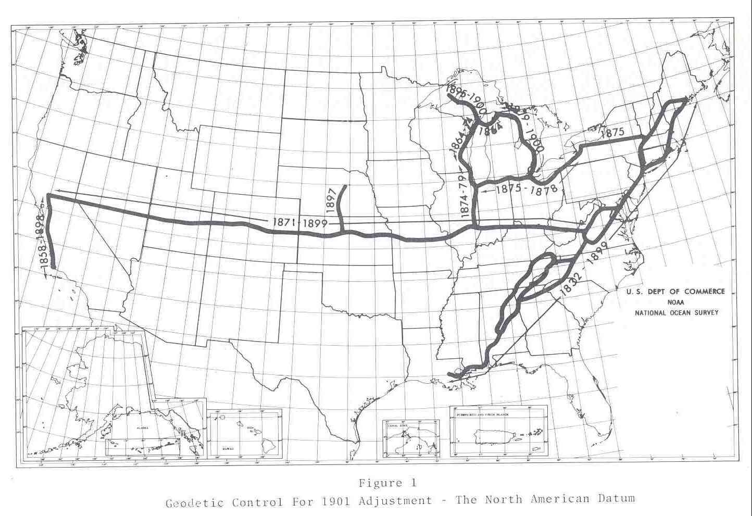

Slide 39
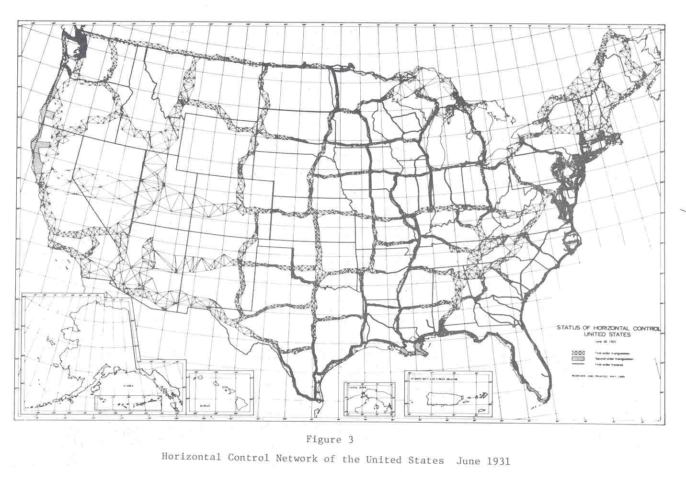
Notes:
Grid structure provide survey control across country
First disks used in ~1900 in TX, OK, KS
DUNCAN – nail in concrete with letters “USC&GS 1901”

Slide 40
NETWORK IMPORTANCE
NAME = NATIONAL SPATIAL REFERENCE SYSTEM
NETWORK DEFINES: LATITUDE, LONGITUDE, HEIGHT, SCALE, GRAVITY, AND NETWORK ORIENTATION; ALSO NATIONAL SHORELINE
NETWORK ESTABLISHES UNIFORM COORDINATE SYSTEM FOR THE COUNTRY

Slide 41
NETWORK IMPORTANCE
NETWORK TIES: FEDERAL, STATE, LOCAL, TRIBAL, AND PRIVATE PROPERTY BOUNDARIES
NETWORK TIES: HIGHWAYS, RAILROADS, BRIDGES, AIRPORTS, CANALS, DIKES, AND HARBORS
NETWORK ENABLES: FLOOD STUDIES, SEA LEVEL CHANGE STUDIES, COASTAL MONITORING; STORM EVACUATION ROUTE PLANNING
ALLOWS AIRCRAFT TO LAND IN LOW VISIBILITY
ALLOWS SHIPS TO KNOW UNDERKEEL AND OVERHEAD CLEARANCES

Slide 42
DATUMS
HORIZONTAL DATUMS
- NEW ENGLAND DATUM, 1879, 5000 STATIONS
- U.S. STANDARD DATUM, 1901
(CHANGED TO NORTH AMERICAN DATUM IN 1913)
- NORTH AMERICAN DATUM 1927 (NAD 27)
- NORTH AMERICAN DATUM 1983 (NAD 83), 272,000 STATIONS
- NAD 83(NSRS2007), ALL GPS STATIONS INCLUDED

Slide 43
DATUMS
VERTICAL DATUMS
- 1900, 5 TIDE GAUGES, 21,000 KM LEVELING
- 1903, 8 TIDE GAUGES, 31,800 KM
- 1907, 9 TIDE GAUGES, 38,400 KM (+ SEATTLE)
- 1912, 9 TIDE GAUGES, 46,500 KM (+ SAN DIEGO)
- 1929, 26 TIDE GAUGES, 106,700 KM
- 1988, 1 TIDE GAUGE, 625,000 KM

Slide 44
LEVEL LINE ACROSS U.S.
- FIRST GEODETIC LEVELING WAS LINE ALONG HUDSON RIVER, NEW YORK TO ALBANY, 1856
- FIRST MAJOR LINE ALONG 39TH PARALLEL; NJ TO CA
- RUN TO PROVIDE ELEVATIONS FOR TRANSCONTINENTAL ARC SURVEY
- 1877 – 1900
- 5590 MILES OF LEVELING
- DEVIATED FROM 39TH PARALLEL WEST OF CO

Slide 45
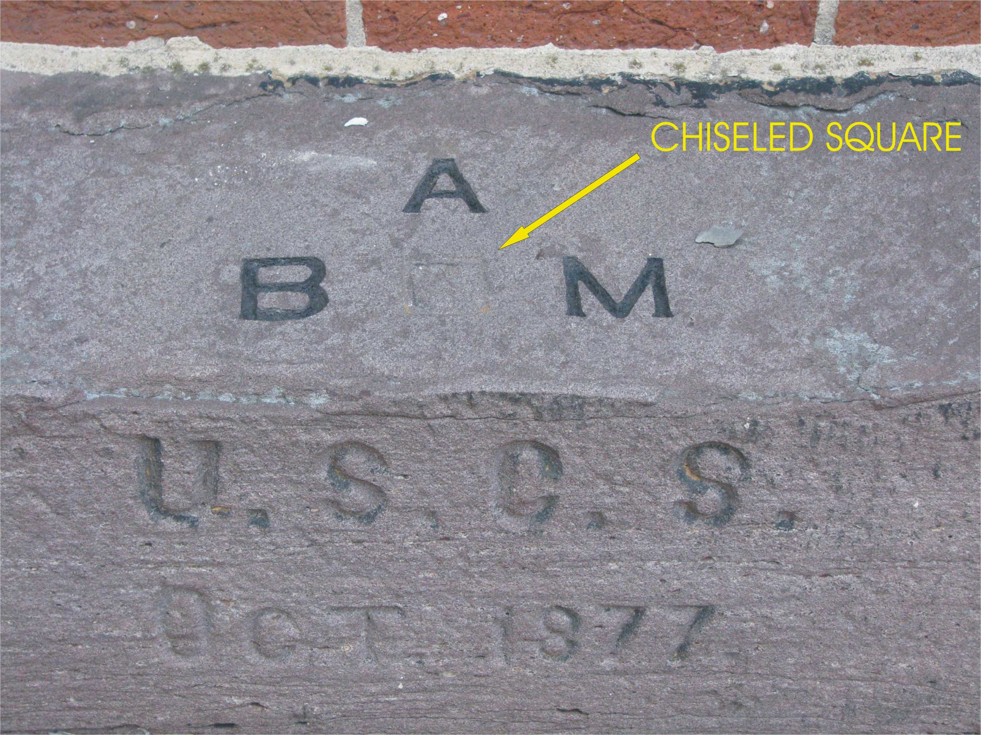
LEVEL LINE ACROSS U.S. BEGAN HERE
BENCH MARK “A”, HAGERSTOWN, MD

Slide 46
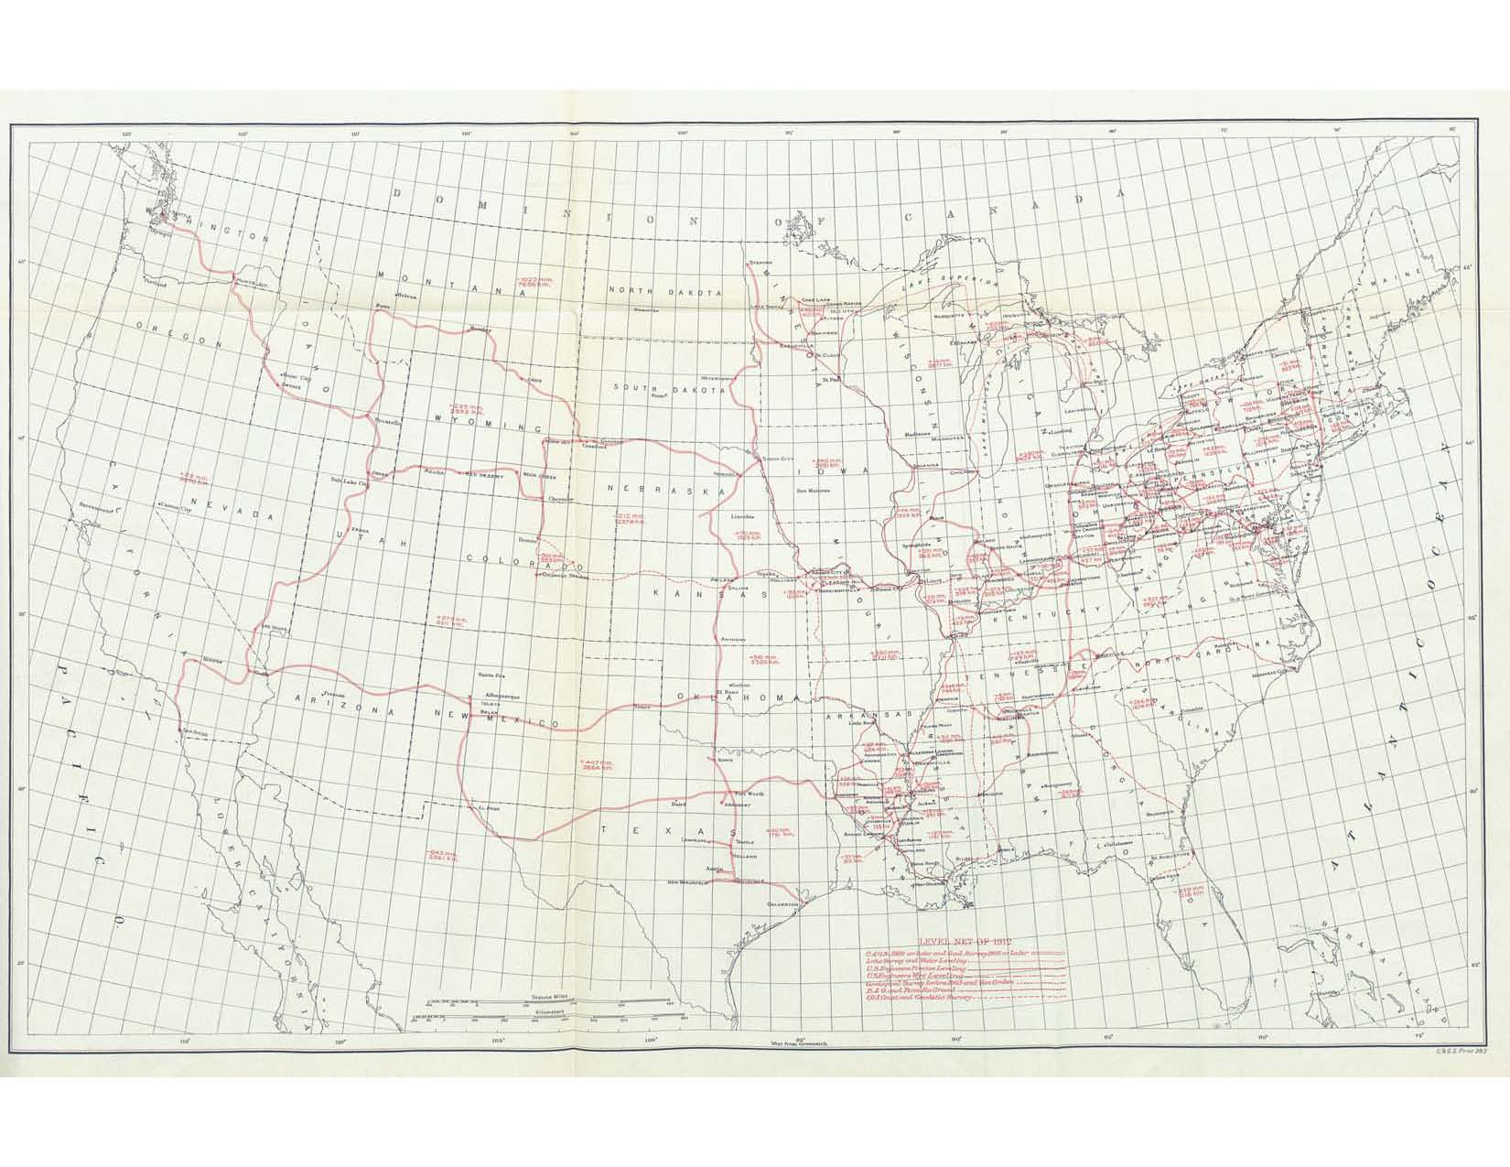
LEVEL NET AS OF 1912
39
Notes:
Note that the line along the 39th parallel did not reach the Pacific
It did reach all Baselines except Yolo in CA. It was tied to a TG on San Francisco Bay.
First cross nation tie was in Seattle, 2nd in San Diego

Slide 47
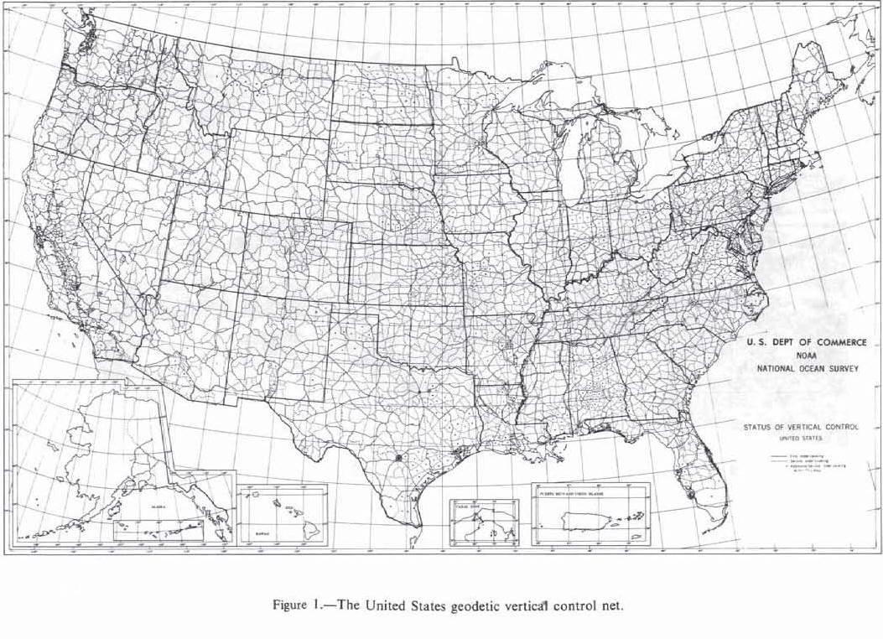
LEVEL NET AS OF 1978

Slide 48
STRENGTHENING THE HORIZONTAL NETWORK
- TRIANGULATION ERRORS CAN ACCUMULATE AND CAUSE NETWORK SCALE AND ORIENTATION PROBLEMS
- SOLUTIONS:
- TRANSCONTINENAL TRAVERSE (TCT); 1961-76
- SATELLITE TRIANGULATION; 1963-74
- NAVY TRANSIT SATELLITES (DOPPLER); 1974-84
- VERY LONG BASELINE INTERFEROMETRY (VLBI); 1977-95
- GPS; 1983-PRESENT

Slide 49
TRANSCONTINENAL TRAVERSE (TCT)
- PROVIDED SCALE TO HORIZONTAL NETWORK
- BEGAN AS PROJECT FOR U.S. AIR FORCE
- AFTER EXCELLENT RESULTS, EXPANDED TO NATIONWIDE PROGRAM
- TWIN BILBY TOWERS USED EARLY IN PROGRAM
Notes:
BC-4 sites: Moses Lake, WA and Beltsville MD

Slide 50
TCT (Con’t)
- ANGLES OBSERVED WITH EXTREME CARE
- NEW TECHNOLOGY OF EDMI USED TO MEASURE DISTANCES
- SURVEYS PROGRESSED ALONG STRAIGHT LINES
- PROVIDED SCALE BETWEEN TWO BC-4 SITES IN U.S.

Slide 51
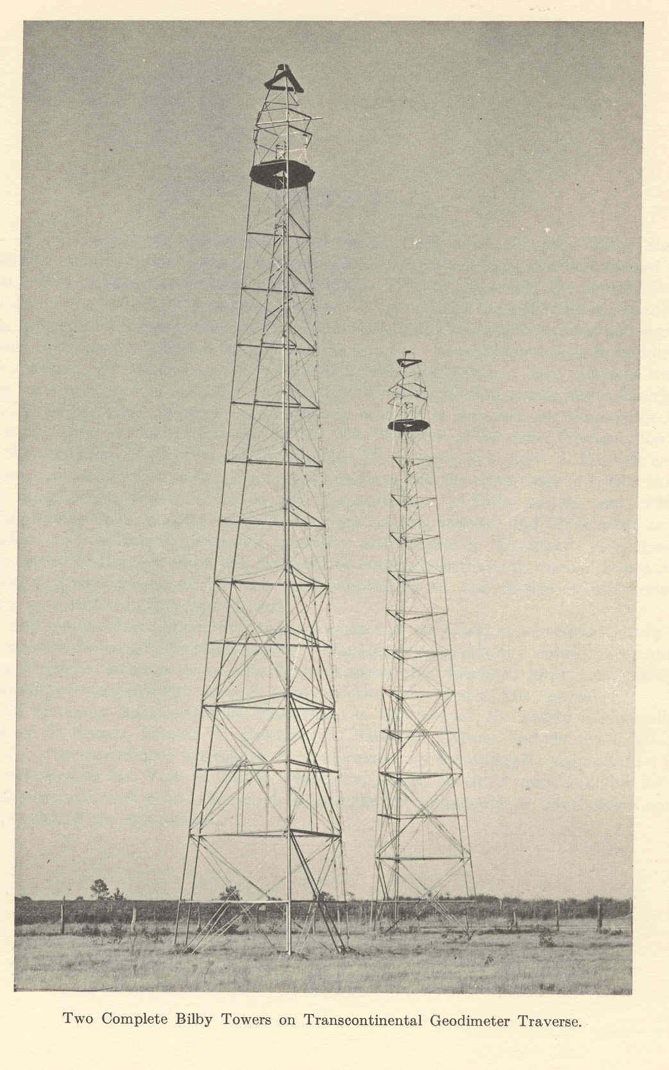
PHOTO OF TWIN BILBY TOWERS FOR TCT

Slide 52
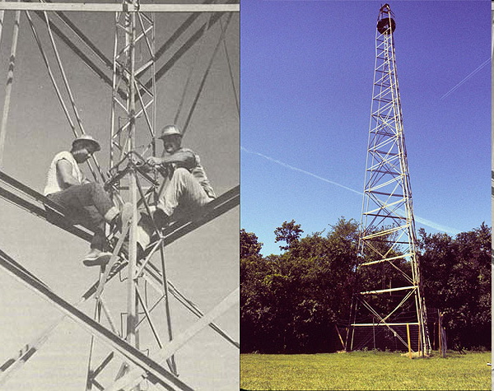
STEEL BILBY TOWER
Notes:
123 FT TOWER

Slide 53
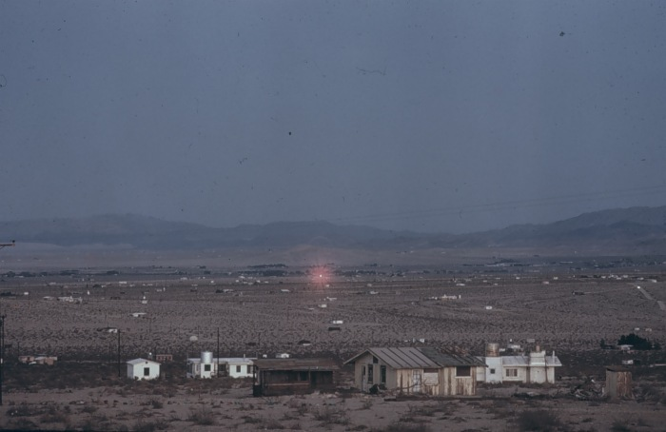
RED LASER LIGHT RETURNING FROM PRISMS OVER DISTANT SURVEY STATION

Slide 54
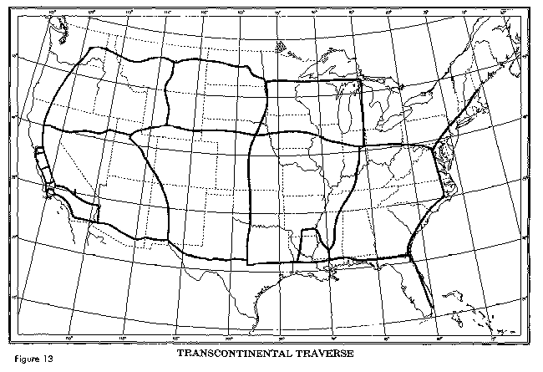
Insert map

Slide 55
SATELLITE TRIANGULATION
- BALLISTIC CAMERAS PHOTOGRAPHED BALLOON SATELLITES AGAINST STAR BACKGROUND
- MYLAR SATELLITE 100 FEET IN DIAMETER
- WORLD WIDE NETWORK OBSERVED
- DETERMINED SHAPE OF NETWORK
- TCT PROVIDED SCALE

Slide 56
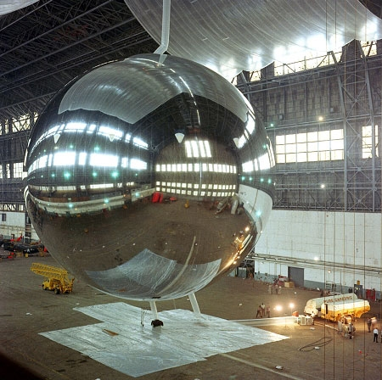
PAGEOS BALLOON SATELLITE
BUILT FOR USC&GS
LAUNCHED 1966

Slide 57
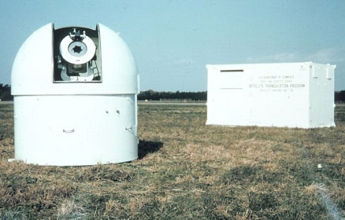
BC-4 BALLISTIC CAMERA

Slide 58
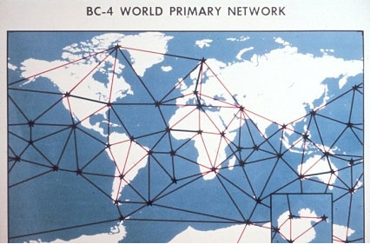
PHOTOS ON-LINE AT: http://www.photolib.noaa.gov/brs/geind1.htm

Slide 59
MORE INFORMATION
See the NOAA 200th Anniversary WWW Site at:
http://celebrating200years.noaa.gov
And “The Coast Survey 1807 – 1867” at the NOAA Library WWW Site at:
http://www.lib.noaa.gov/noaainfo/heritage/coastsurveyvol1/CONTENTS.html
And Joe Dracup’s “Geodetic Surveys in the U.S.” at:
http://www.history.noaa.gov/tools/surveytech.html
And the NGS History Power Point running in the NGS Museum area.

