Slide 1
Changes are coming
NGS 2022 - NSRS Modernization
Are you Ready?
Joshua Phillips
MARLS, MT CO-Coordinator
MTCoordinator@marls.com
Tyson Olinger
MDT, MT CO - Coordinator
Pam Fromhertz
Rocky Mountain Regional Advisor
Pamela.Fromhertz@noaa.gov
240-988-6363
MARLS
February 21, 2019
geodesy.noaa.gov

Slide 2
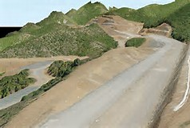
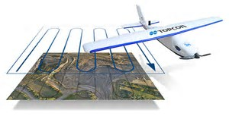
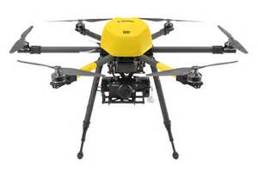
Technology Driving Changes

Slide 3
Agenda
MT Geodetic Coordinator and Working Group
NSRS Modernization
SPCS2022
Changes are coming – what do you want for MT
Your input critical: LDPs; International vs US Survey Foot
GPS on BM
Phase I - Geoid18
Phase II – keep collecting
RTN; subscriber services
Geospatial Summit
Panel and Roundtable Discussion – Impact of NSRS Modernization on various organizations

Slide 4
Panel and Roundtable Discussion – Impact of NSRS Modernization on various organizations
Private, MARLS, Joshua Phillips
MDT, Tyson Olinger
Tribal, Wally
Montana State Library, Michael Fashoway
Washington State, Gavin Schrock

Slide 5
Montana Coordinator Working Group
*Joshua Phillips, MT Association of Registered Land Surveyors (MARLS)
*Tyson Olinger, MT Department of Transportation (MDT)
Erin Fashoway, MT State Library
Wally Gladstone, Tribal
MT Association of Geographic Information Professionals (MAGIP)
Pam Fromhertz, NGS
Other interested??
MTCoordinator@marls.com
Marls.com
* Co-Coordinators

Slide 7
NSRS Modernization Who and What
The National Geodetic Survey, the federal agency responsible for establishing and maintain the positioning framework to support all federal civilian mapping and charting in the United States, is modernizing the National Spatial Reference System (NSRS).
What does this mean?
All horizontal and vertical datums in the NSRS (NAD 83, NAVD 88, etc.) will be updated with:
Four (4) new Terrestrial Reference Frames of 2022
North American-Pacific Geopotential Datum of 2022
New tools, products, services, and methodologies will be developed jointly to support the transition and access to an improved, modernized NSRS.

Slide 8
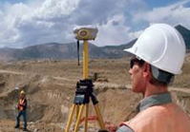
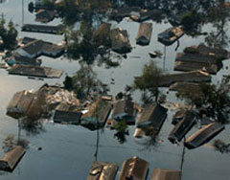
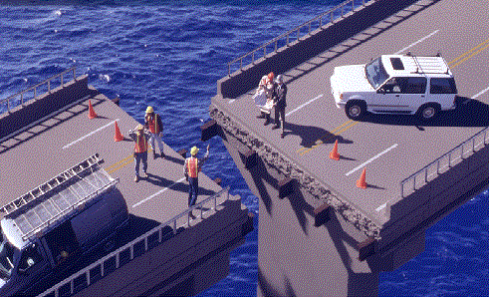
NSRS Modernization
Revolutionize professional surveying
No more need for installing and locating bench marks
Absolute, consistent positioning autonomously, anywhere
Impacts on infrastructure
Any application requiring precise positioning -- bridges, tunnels, railways, agriculture, navigation -- will be easier and more accurate
Vastly improved flood plain mapping
Water flows due to differences in gravity
Critically important in low-lying, flat communities
Fundamental support for new technologies
“Smart Highways” for autonomous vehicles

Slide 9
All coordinates and heights
will change!
In Montana by
4 feet horizontally and
-3 feet vertically

Slide 10
Montana CORS

Slide 11
ITRF14 (Beta)
New (beta) CORS coordinates referenced in ITRF14 are available for testing on NGS beta website: https://beta.ngs.noaa.gov/CORS/
More details about new (beta) CORS coordinates and the multi-year CORS solution (MYCS2) processing are here: https://beta.ngs.noaa.gov/CORS/coords.shtml
OPUS suite on NGS beta website for processing GPS observations with new (beta) CORS coordinates for testing here: https://beta.ngs.noaa.gov/OPUS/

Slide 13
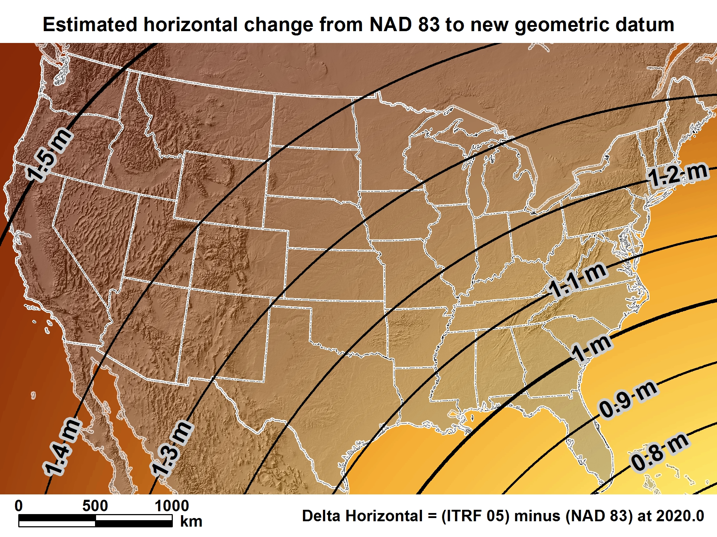
New geometric datum minus NAD 83 (horizontal)

Slide 14
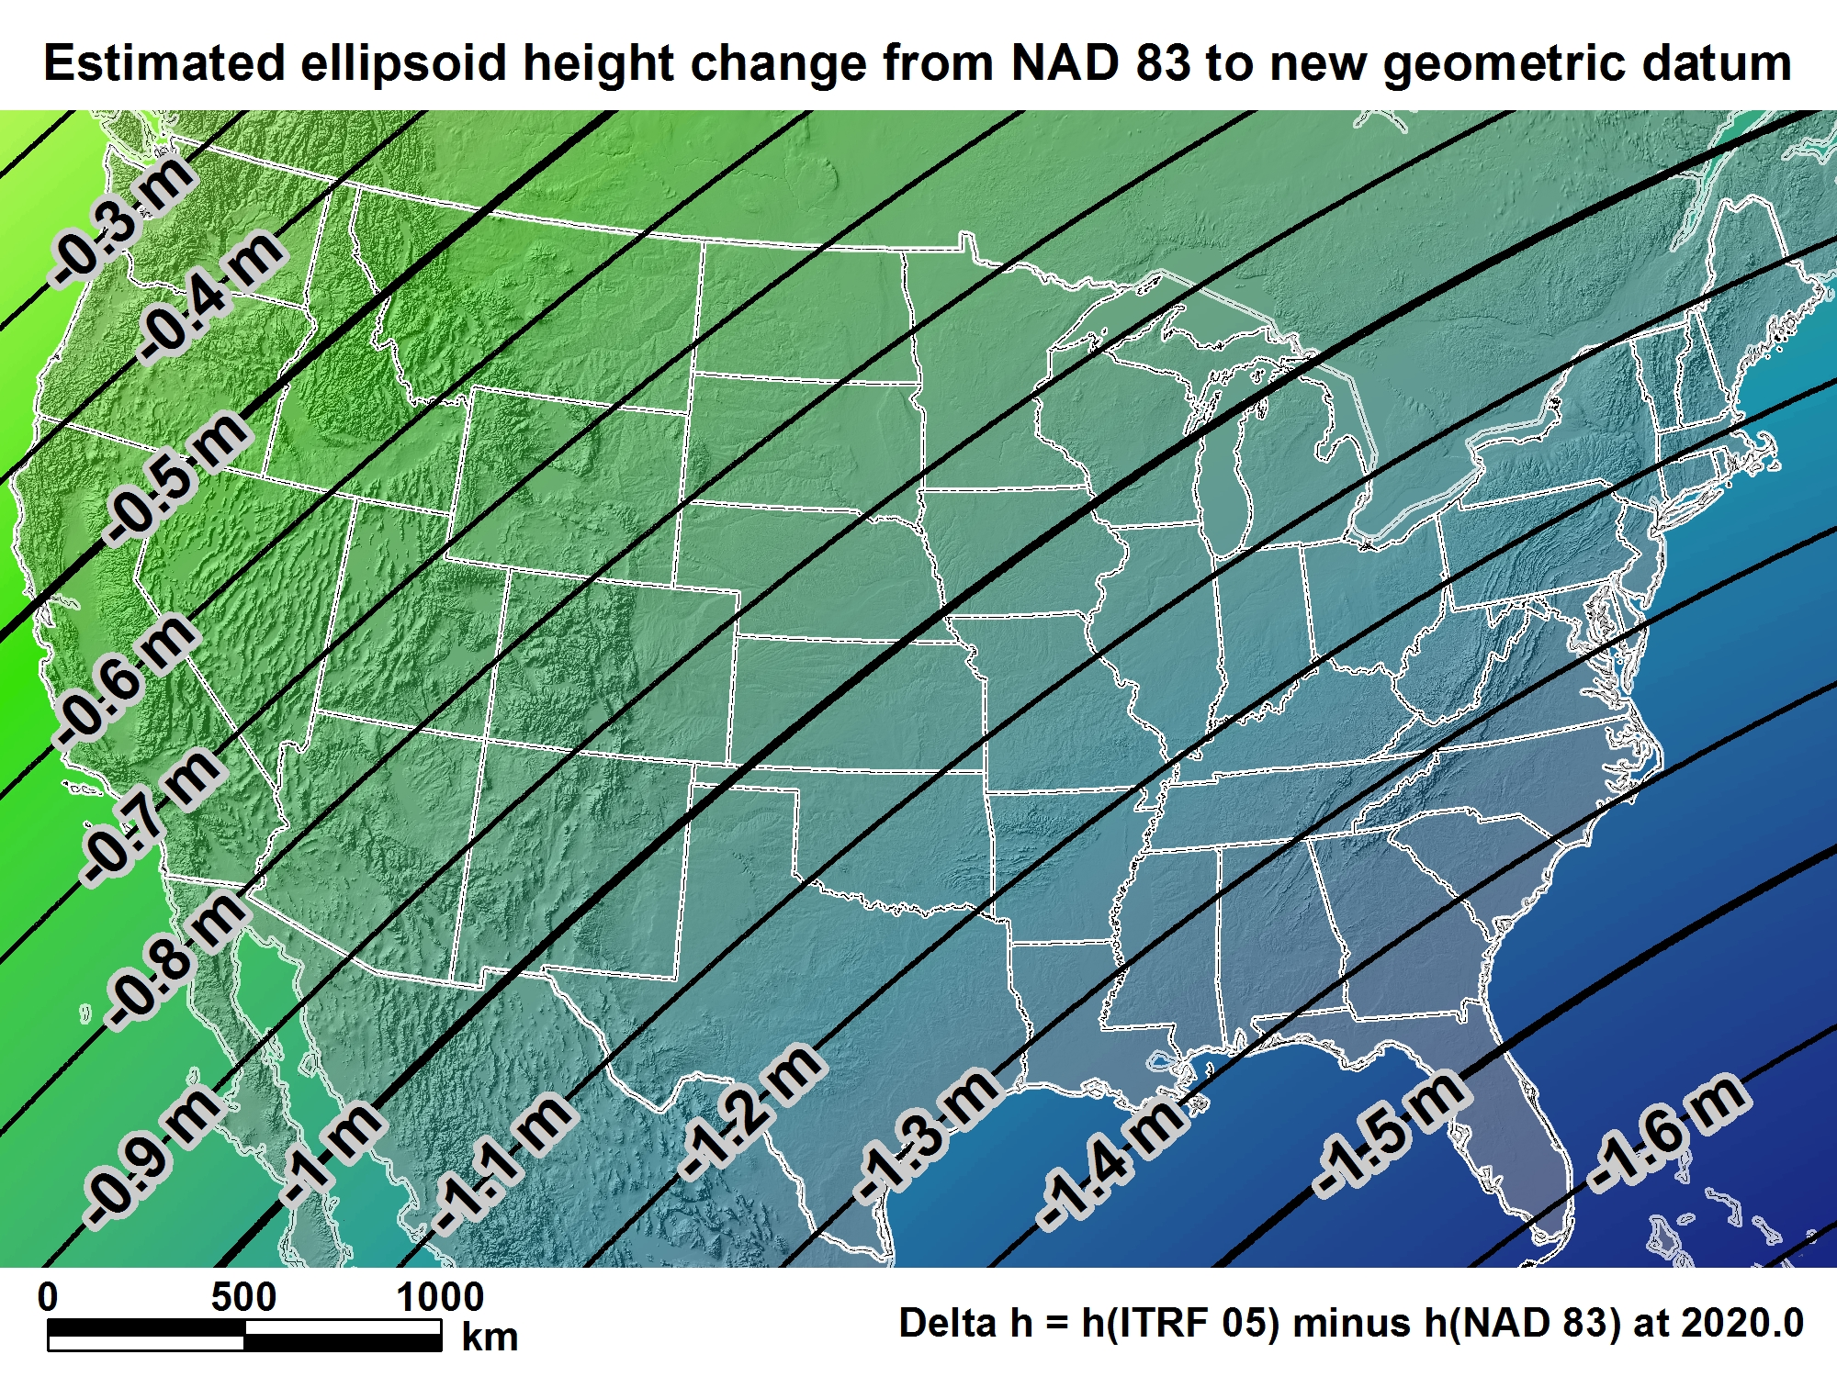
New geometric datum minus NAD 83 (ellipsoid height)

Slide 15
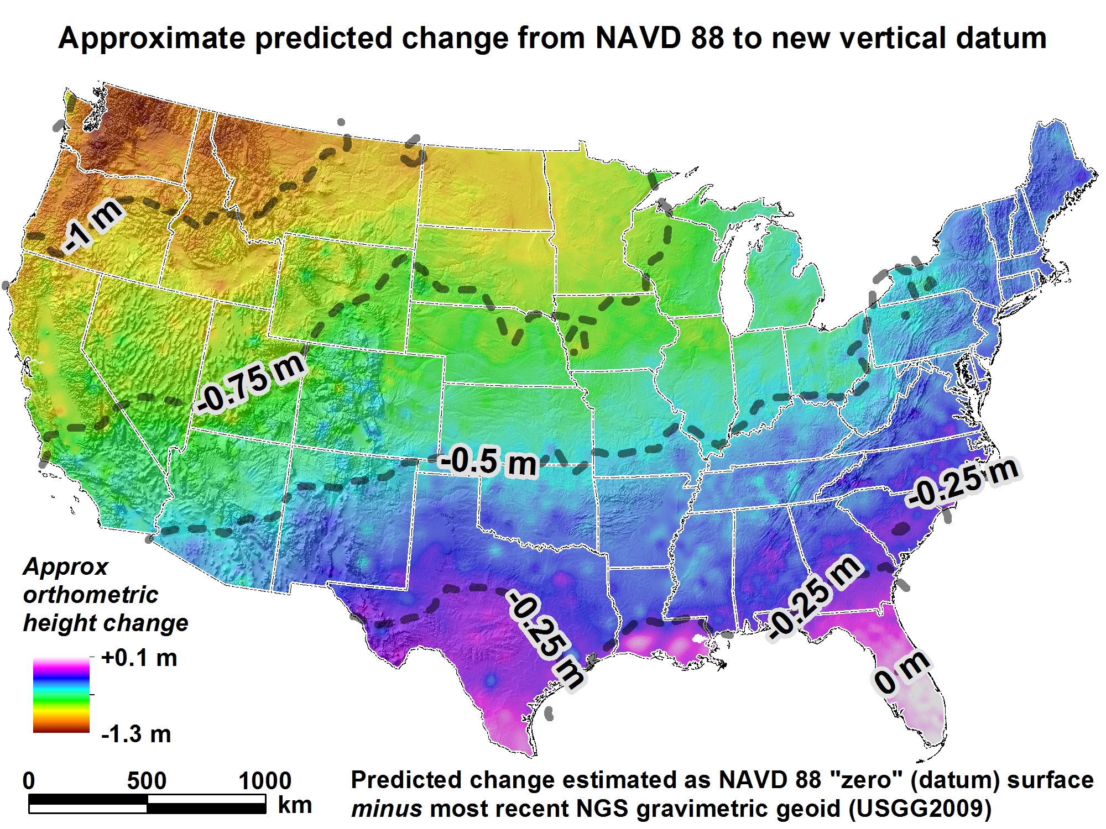
New Vertical Datum (Outcome)

Slide 16
Predicated Positional Changes in 2022
Computed for O 33(PY0374)
near West Yellowstone, MT
Ortho Height from Leveling (DS) 2024.853m (6643.21ft)
New computed Height(xGeoid16B) 2023.998m (6640.42ft)
Ortho Ht NGVD29 (DS) 2023.342m (6638.25ft)
Changes:
ORTHOMETRIC HEIGHT = - 0.855m (-2.80ft)
HORIZONTAL = 1.44m (4.72ft)
ELLIPSOID HEIGHT = - 0.63m (2.07ft)
Computed with HTDP, Inverse and xGeoid16B
Ellipsoidal Height (DS) 2015.918m (6613.90ft)
DS= Datasheet

Slide 17
Predicated Positional Changes in 2022
Computed for BOZEMAN SE BASE near Bozeman, MT
Ortho HT from Leveling (DS) 1436.345 m (4712.41 ft)
Ortho Ht NGVD29 1435.29* m (4708.9* ft)
New computed Height 1435.408 (4709.34 ft)
HORIZONTAL = 1.4508 m (4.76 ft)
ELLIPSOID HEIGHT = - 0.61 m (2.00 ft)
Computed with HTDP and Inverse
ORTHOMETRIC HEIGHT = - 0.937 m (-3.07 ft)
Computed with xGEOID16B
Ellipsoidal Height from DataSheet 1425.299 (4676.18 ft)
* Correction made

Slide 18
New Reference (Datums) Frames
Horizontal
Vertical
Geometric
Latitude
Longitude
Ellipsoidal Height
Euler Rotation and angle
Intra-frame Velocity Models
Geopotential
Geoid Model
Time Dependent Coordinates on a fixed Plate

Slide 19
NSRS Modernization News
Four Terrestrial Reference Frames
North American Terrestrial Reference Frame of 2022 (NATRF2022)
Pacific Terrestrial Reference Frame of 2022 (PATRF2022)
Mariana Terrestrial Reference Frame of 2022 (MATRF2022)
Caribbean Terrestrial Reference Frame of 2022 (CATRF2022)
Geopotential Datum for Heights and other Physical Coordinates
North American-Pacific Geopotential Datum of 2022 (NAPGD2022)
Geoid Model (time-dependent, provided in three regions)
GEOID2022
Notes:
Four Terrestrial Reference Frames
Replacing the three existing NAD 83 reference frames will be four plate-fixed terrestrial reference frames. The tectonic plate for each frame may be inferred from their names.
Geopotential datum
A geopotential datum will be created which will contain all of the information necessary to provide mutually consistent orthometric heights, geoid undulations, gravity anomalies, deflections of the vertical and all other geodetic coordinates related to the gravity field.
Geoid model
Within NAPGD2022, a variety of products will exist. The most prominent will be a time dependent model of the geoid, provided in three regions (the first covering the entirety of North and Central America, Hawaii, Alaska, Greenland and the Caribbean, the second covering American Samoa and the third covering Guam and the Commonwealth of the Mariana Islands).

Slide 20
These are part of the NSRS*
Horizontal Datums and Geometric Reference Frames | Vertical Datums | Great Lakes Datums | Geoid Models | Transformations and Conversions
USSD | NGVD 29 | IGLD55 | GEOID90 | NADCON
NAD 27 | NAVD 88 | IGLD85 | GEOID93 | VERTCON
NAD 83 | PRVD02 |  | ALASKA94
 | ASVD02 |  | GEOID96 | SPCS 27
 | NMVD03 |  | GEOID99 | SPCS 83
 | GUVD04 |  | GEOID03
 | VIVD09 |  | GEOID06
 |  |  | GEOID09
 |  |  | GEOID12(A,B)
*This not a complete list.

Slide 21
These are not part of the NSRS*
Horizontal Datums and Geometric Reference Frames | Vertical Datums | Great Lakes Datums | Geoid Models | Transformations and Conversions
WGS 84 | IHRS |  | OSU91A | CORPSCON
ITRF |  |  | EGM96 | Appendix B.6 of DMA TR 8350.2 (WGS 84)
IGS |  |  | EGM2008 | Oregon Coordinate Reference System
 |  |  |  | The Kansas Regional Coordinate System
*This is not a complete list.

Slide 22
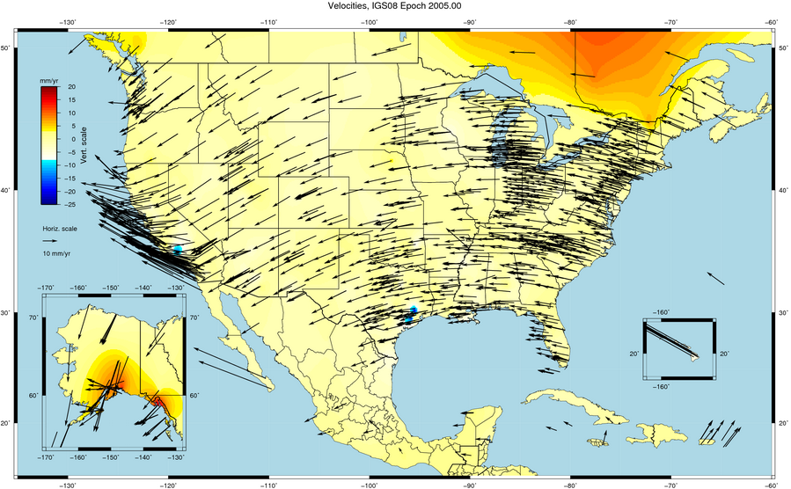
Things Are moving – we can not measure it accurately

Slide 23
Gravity for the Redefinition of the American Vertical Datum (GRAV-D)
https://www.geodesy.noaa.gov/GRAV-D/
Notes:
Pictured: Airborne gravity survey grid and the current status of GRAV-D, with more than 45 percent of the U.S. and its territories covered and GRAV-D airborne data collected.
In 2010, began operational collection of airborne gravity data to calculate a geoid model and ultimately a new vertical reference system for accurate height measurements up to 2 cm in the U.S. and territories.
Provides highly accurate height measurements to determine where water flows
Connects satellite and terrestrial gravity measurements for efficient and accurate gravity monitoring
Benefits include $240 Million from improved floodplain mapping alone

Slide 24
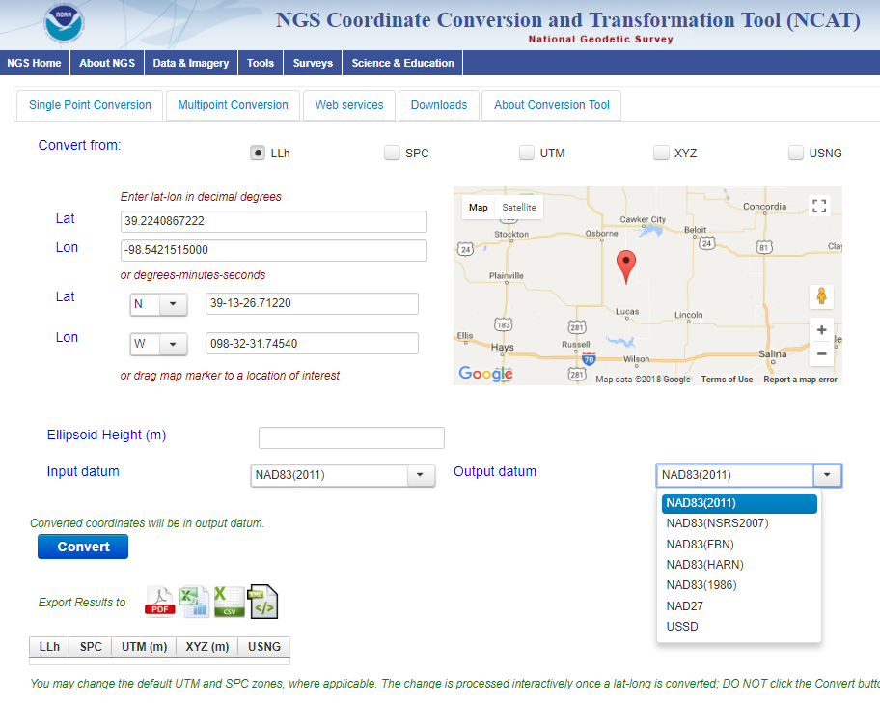
NCAT NGS Coordinate Conversion and Transformation Tool
Notes:
We also have a new tool available to convert between various coordinate systems using various projects.

Slide 25
Updating OPUS-Projects
OPUS-Projects is NGS’s workhorse survey adjustment suite
Currently 2 hour GPS sessions only
End of 2018: GPS + RTK/N
In 2019-2020: Leveling
Future: Multi-constellation GNSS, Classical, Gravity

Slide 26
Changes are underway OPUS will become one of the key tools
All aspects of the NSRS will change in 2022!
Everything comes from GNSS
OPUS will provide everything in 5 frames (ITRF2014 + TRFs)
OPUS will provide orthometric heights and other geopotential values
Look for new manuals for leveling and GPS-derived heights in the next year

Slide 27
Coming up in 2019…
NGS will build “alpha” versions of all aspects of the 2022 modernization, including:
Intra-Frame Velocity Model
Passive mark “datasheets” drawn from a completely new database of re-processed GPS data to show time-dependent coordinates on passive marks
CORS/OPUS running in the four TRFs
State Plane Coordinate system of 2022
After alpha testing, these will be publicly available in beta form for testing.
OPUS-Projects with RTK/N
A three-country (USA/Mexico/Canada) produced single geoid model
A new surface gravity interpolation tool

Slide 28
How to transition to 2022…
Embrace the dynamic planet upon which you work
Re-establish coordinates on passive marks every time you use them!
Use GPS in every project!
Rely upon the CORS
They are the only primary access point to the NSRS after 2022!

Slide 29
How to transition to 2022 (cont.)
Use whatever frame is best for you!
ITRF if you can live with changing coordinates
NATRF2022/etc if you need stability and don’t live near a deformation zone
Embrace the idea of RTN Alignment to the NSRS
Use OPUS, or not, but just submit those projects!
NGS will provide QC on anything submitted
It’ll go in the database for permanent archive and use by others!
Bring all of your old data forward using NGS tools (NCAT and/or Vdatum)

Slide 30
SPCS2022

Slide 31
Zone “layers” and LDPs
Each state may have max of THREE zone “layers”
One layer must be statewide zone (designed by NGS)
Other layers have two or more zones (“multi-zone”)
Only one layer can have discontinuous coverage
Multi-zone layer can consist of LDPs
Designed by stakeholders
Minimum zone width 50 km (if height range < 250 m)
LDP coverage can be discontinuous…
Notes:
Layered zones are allowed for SPCS2022 (for a max of 3 layers)
One state in SPCS 83 has 2 layers, Kentucky (statewide plus a pre-existing 2-zone layer)
States can have 1, 2, or 3 layers
One layer MUST be a statewide zone (so a state with 1 layer has only a statewide zone)
The other 1 or 2 layers will almost always have multiple zones (unless a state has, say, a single LDP in SPCS2022 that covers only part of the state)
Only 1 layer can be “discontinuous”, that is, consist of layers that do not collectively cover the entire state (will show an example of this)
Decision to go with 3 layers based on FRN responses, especially those from mountainous western states
The multi-zone layer(s) can consist of LDPs
Almost always means distortion criterion < ±50 ppm, so must be designed by others (i.e., “contributing partners”), not by NGS

Slide 32
SPCS2022 deadlines
Consensus input per SPCS2022 procedures
Requests for designs done by NGS
Proposals for designs by contributing partners
Submittal of approved designs
Proposal must first be approved by NGS
Designs must be complete for NGS to review
Later requests will be for changes to SPCS2022
NGS.SPCS@noaa.gov
by MARCH 31, 2020 for requests and proposals
by MARCH 31, 2021 for submittal of approved designs
Dates have changed from December 31, 2019 and 2020
Notes:
Deadlines for requests, proposals, and submittal of approved designs
Designs by “contributing partners” must first be approved as proposals by NGS
Contributing partners can be the stakeholders, or an individuals or organizations designing the zones for the stakeholders
It is expected that most (all?) proposed designs will be for LDP systems (with design criterion < ±50 ppm), since NGS will not design those
Any requests, proposals, or submittals that are not received by the deadlines will not be included in the initial release of SPCS2022 (in 2022)
However, these could still become part of SPCS2022 at a later time
Policy & procedures provide mechanism for changing SPCS2022, so there will still be an opportunity to change/add SPCS2022 layers even after 2022

Slide 33
State Plane Coordinates 2022
Documents
SPCS2022 Policy (to be finalized any day)
SPCS2022 Procedures (to be finalized any day)
NOAA Special Publication NOS NGS13
Webinar – March 8, April 12, 2018, Jan 10, 2019, March 7, 2019
MDT, Tribal leaders and MT Coordinator Working Group submitted letters

Slide 34
MT Letters submitted to NGS under Federal Register Notice
- 1 zone for entire state works well
LDPs
Special Zones perhaps
A method of translation between the NAD83 datum and the 2022 reference frame is paramount in being able to correlate older data with the newer data.

Slide 35
Overview of FRN feedback
FRN public comment period April 18-Aug 31
For draft SPCS2022 policy & procedures
Wide variety of formats and content
Individuals, organizations, and groups of organizations
Received 41 unique responses:
4 national in scope (3 from USGS)
3 for Native American tribes
1 regional (3 states)
33 from states
105 people represented by name
97 organizations represented

Slide 36
Organizations represented
1 federal agency (USGS)
10 Native American tribes
23 states (includes state and private organizations)
16 state DOTs
12 state GIS/GIO/cartographer offices
21 state professional societies (surveying and GIS)
12 universities and colleges
6 city and county groups
7 private companies
10 other state organizations

Slide 37
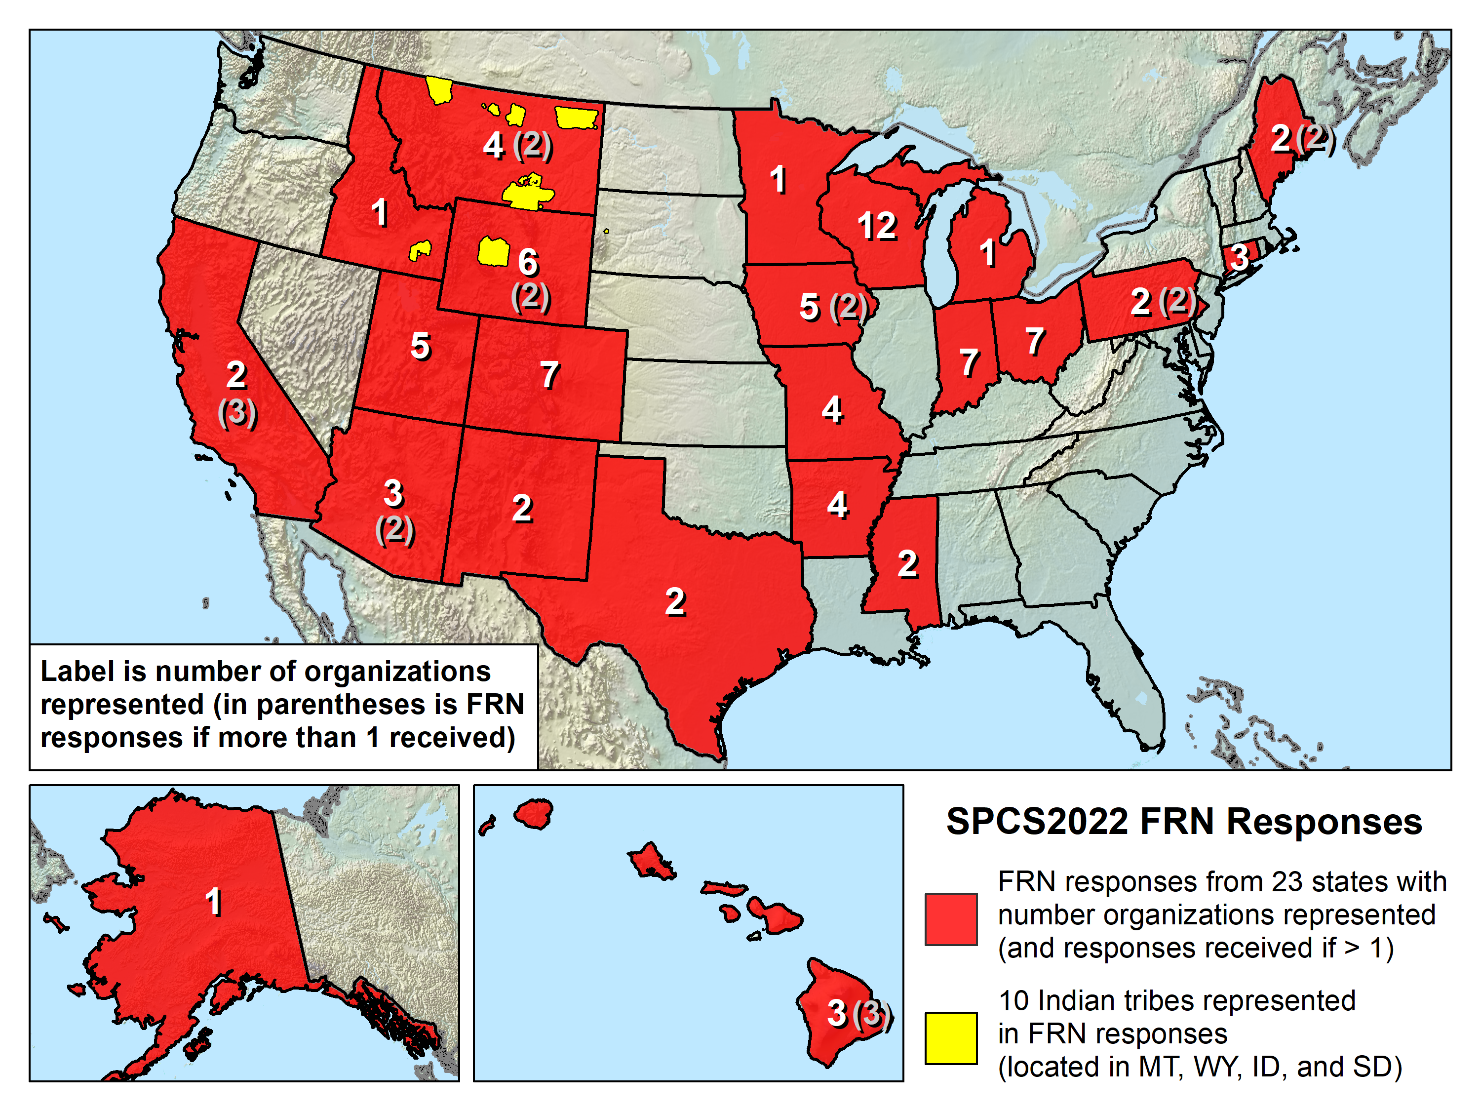

Slide 38
New DRAFT SPCS2022 Policy & Procedures
Summary of main proposed changes
Policy
Allow “special use” zones (but only for multiple states)
NGS will design statewide zone for every state
Allow max of 3 layers (1 statewide + 2 multi-zone)
Added requirement that all zones be unique
Procedures
Moved submittal details to fillable forms
Added section on zones numbers and names
Added details on linear distortion design criterion
Removed minimum distortion limit
Added 10 km min zone size for height range > 250 m
Notes:
A major component of SPCS2022 are stakeholders
Stakeholders have a role in helping define (and maintain) SPCS2022
A major stakeholder group is state DOTs, along with other geospatial groups as listed here
There is a formal process for stakeholders to submit REQUESTS and PROPOSALS for SPCS2022
Stakeholders must consist of one of the STATE groups listed, and
Input must be unanimous for NGS to act
NGS cannot act on input from individuals; they should work through a stakeholder group

Slide 39
New DRAFT SPCS2022 Policy & Procedures
Summary of main things that did NOT change
Policy
Limited to LCC, TM, and OM projections
Zones designed to reduce distortion at ground
Default zones designed by NGS if no consensus input
Parameters in meters, but feet allowed for output
Procedures
Stakeholders must submit requests/proposals
1-parallel LCC and local OM projection definitions
Specified a linear distortion design criterion
Limit NGS designs to minimum of ±50 ppm
50 km min zone size for height range of 250 m or less
Notes:
A major component of SPCS2022 are stakeholders
Stakeholders have a role in helping define (and maintain) SPCS2022
A major stakeholder group is state DOTs, along with other geospatial groups as listed here
There is a formal process for stakeholders to submit REQUESTS and PROPOSALS for SPCS2022
Stakeholders must consist of one of the STATE groups listed, and
Input must be unanimous for NGS to act
NGS cannot act on input from individuals; they should work through a stakeholder group

Slide 40
SPCS2022 stakeholders
State groups that formally interface with NGS
Departments of transportation
Cartographer/GIS office
Professional surveying, engineering, GIS societies
Colleges/universities with geospatial curriculum
Can submit requests and proposals for designs
Requests are for designs by NGS
Proposals are designs by stakeholders
Stakeholder input must be unanimous
Notes:
A major component of SPCS2022 are stakeholders
Stakeholders have a role in helping define (and maintain) SPCS2022
A major stakeholder group is state DOTs, along with other geospatial groups as listed here
There is a formal process for stakeholders to submit REQUESTS and PROPOSALS for SPCS2022
Stakeholders must consist of one of the STATE groups listed, and
Input must be unanimous for NGS to act
NGS cannot act on input from individuals; they should work through a stakeholder group

Slide 41
General SPCS2022 characteristics
Based on final policy & procedures
Distortion design requirements
Linear distortion minimized at topographic surface (not at ellipsoid surface)
Purpose: to reduce difference between and projected “grid” and actual “ground” distances
Units of Measure
Notes:
Will go over main general characteristics of SPCS2022 (not enough time to go into detail)
This is based on final SPCS2022 Policy & Procedures (not yet published but most decisions have been made on content)
Final policy & procedures created based in part on public response to the FRN
A key element of SPCS2022 is linear distortion (“scale error”) design requirements
Linear distortion is the difference between a “grid” distance (between the projected coordinates of a pair of points) and the true horizontal “ground” distance (at the topographic surface of the Earth)
SPC2022 zones are designed to minimize linear distortion at the topographic surface, NOT at the ellipsoid surface (as was done for SPCS 83 and 27)
Other relevant characteristics are listed; each will be discussed in this presentation

Slide 42
SPCS2022 zone designs by NGS
Linear distortion design criterion
Parts per million (ppm), e.g., ±20 , ±50 , ±100 ppm, etc.
Criterion must satisfy all of following:
90% of population
75% of all cities and towns (by location only)
50% of entire zone area
Limitations for designs by NGS
Minimum design criterion ±50 ppm (1:20,000)
May be less for default zones if existing zone small
Low distortion projections (LDPs)
Must be designed by others for distortion < ±50 ppm
Notes:
This is a quick description of the design method used by NGS for SPCS2022 zones
Designs are based on a “linear distortion design criterion”
Criterion can initially be estimated by width of zone perpendicular to the projection axis (central meridian for TM, central parallel for LCC, and skew axis for OM).
The value in parts per million (ppm) for the criterion are ranges of ±5, ±10, ±20, ±30, ±40, ±50, ±75, ±100, ±150, ±200, ±300, or ±400 ppm.
Standard values are used to facilitate design comparison and evaluation
Gives indication of performance at topographic surface, where it is actually used
Design criterion is the smallest standard range (listed above) that satisfies all three of the following minimum percentages:
90% of population (based on actual population distribution)
75% of cities and towns, based only on location, irrespective of population. Done to prevent excessive dominance of very large cities at expense of small communities. Concept here is similar to Congress being represented by the same number of senators for every state, in contrast to population-based matric being analogous to House of Representatives.
50% of entire zone area. This value is set to accommodate mountainous zones; zones with minor topographic relief will usually get much here percent coverage by area.
Zones design by NGS will use a minimum criterion of ±50 ppm (which is half the nominal ±100 ppm used for SPCS 83 and 27, with respect to the ellipsoid).
However, there are many states and existing zones within states that are small enough that a lower criterion will be used by NGS for default designs.
For new zones requested by stakeholders in multi-zone states, NGS will typically not design for less than ±50 ppm.
Low distortion projections (LDPs) must be designed by stakeholder “contributing partners” if the criterion is less than ±50 ppm.

Slide 43
Low distortion projections (LDPs)
Multi-zone layer can consist of LDPs
Designed by stakeholders
Coverage can be complete or partial (discontinuous)
Minimum zone width
50 km (31 miles) if height range <= 250 m
10 km (6 miles) if height range > 250 m
What is zone “width” anyway?
Width of rectangle that completely encloses zone
“Minimum bounding rectangle by width”
Rectangle in same projection as zone, any orientation
Notes:
Layered zones are allowed for SPCS2022 (for a max of 3 layers)
One state in SPCS 83 has 2 layers, Kentucky (statewide plus a pre-existing 2-zone layer)
States can have 1, 2, or 3 layers
One layer MUST be a statewide zone (so a state with 1 layer has only a statewide zone)
The other 1 or 2 layers will almost always have multiple zones (unless a state has, say, a single LDP in SPCS2022 that covers only part of the state)
Only 1 layer can be “discontinuous”, that is, consist of layers that do not collectively cover the entire state (will show an example of this)
Decision to go with 3 layers based on FRN responses, especially those from mountainous western states
The multi-zone layer(s) can consist of LDPs
Almost always means distortion criterion < ±50 ppm, so must be designed by others (i.e., “contributing partners”), not by NGS

Slide 44
Why restrictions on LDP design?
Avoid excessive number of very small zones
Objective: Largest area that meets distortion criterion
20 ppm (0.1 ft/mile) reasonable design criterion
Typically ~70% of area will be within ±10 ppm
Corresponds to zone width of 114 km (71 miles)
Reduces occurrences of projects in more than one zone
Consistency needed for nationwide implementation
Some sort of design criteria are necessary
Counties cannot be used as LDP zones throughout U.S.
Should be optimal system for long-term usage
Should choose best approach, not because already created
Prevent “buyer remorse”

Slide 45
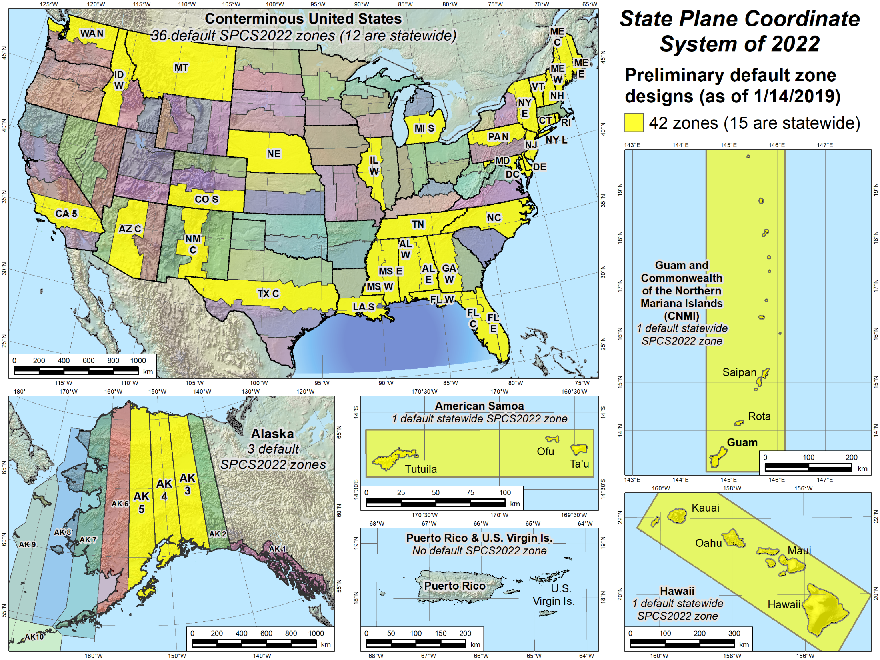
Default zones
Notes:
Larger scale maps of the areas included in the NSRS where SPCS2022 zones will be established
Yellow zones are preliminary designs of SPCS2022 default zones that have been completed.
Some of the default zones are statewide (or territory-wide, as the case may be)
Maps for (most of) these designs are currently available for download, along with maps of the corresponding SPCS 83 zones for comparison (will show examples).

Slide 46
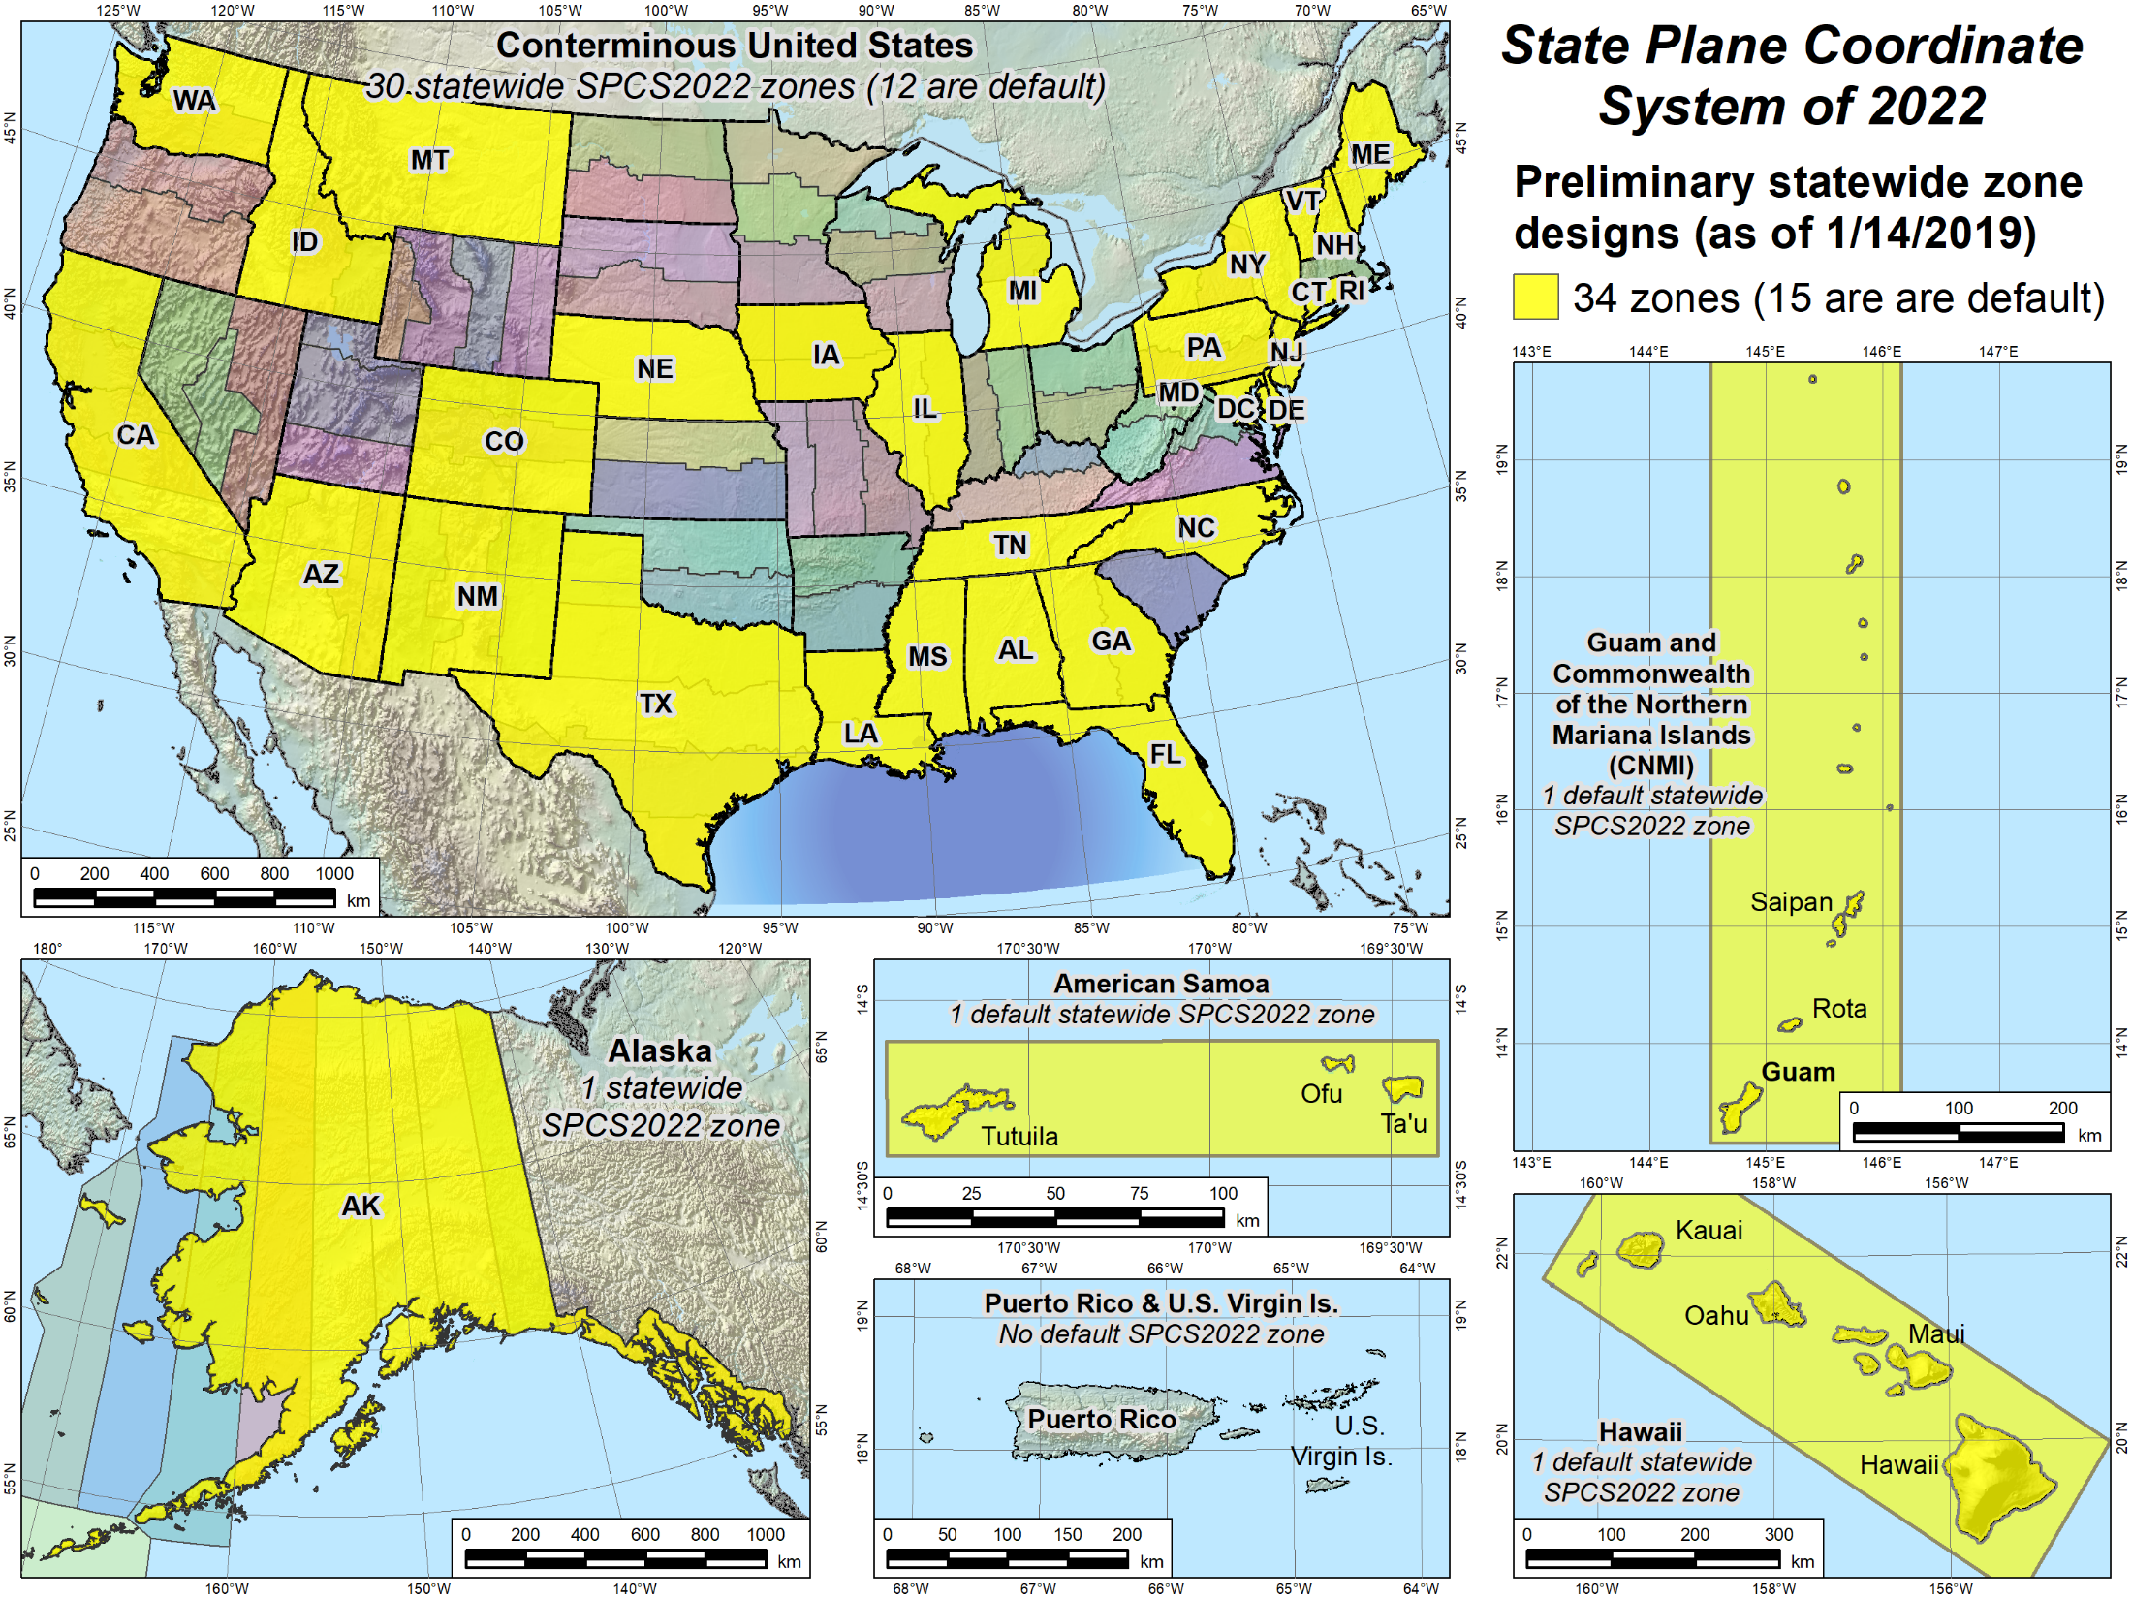
Statewide zones
Notes:
Similar to previous slide, but showing statewide SPCS2022 zones that have preliminary designs and maps available for download.
Note that some of the statewide zones are the same as the default zones in the previous slide
Note also that some states have a preliminary statewide zone design but no default zone design (e.g., Iowa).
States with no default design are ones that will design their own LDP system that provides statewide coverage and will not use the NGS default designs (that correspond to the existing SPCS 83 zones)
Reminder: All sates will get a statewide zone

Slide 47
Linear distortion magnitudes
Procedures§5.c.ii
Linear distortion (ppm = parts per million) | Corresponding zone dimension and height limits
 | Zone width perpendicular to projection axis (no variation in topo height) | Topographic height range (independent of zone width)
±5 ppm (1:200,000) | 57 km (35 miles) | 64 m (209 ft)
±10 ppm (1:100,000) | 81 km (50 miles) | 127 m (418 ft)
±20 ppm (1:50,000) | 114 km (71 miles) | 255 m (836 ft)
±50 ppm (1:20,000) | 180 km (112 miles) | 637 m (2,090 ft)
±100 ppm (1:10,000) | 255 km (158 miles) | 1,274 m (4,180 ft)
±400 ppm (1:2,500) | 508 km (316 miles) | 5,097 m (16,722 ft)

Slide 48
Linear distortion magnitudes
Parts per million | Centimeters per kilometer | Feet per mile | Dimensionless ratio
20 ppm | 2 cm/km | 0.1 ft/mile | 1:50,000
50 ppm | 5 cm/km | 0.3 ft/mile | 1:20,000
100 ppm | 10 cm/km | 0.5 ft/mile | 1:10,000
400 ppm | 40 cm/km | 2.1 ft/mile | 1:2,500

Slide 49
Practical impact of distortion
GNSS survey accuracy about 1-2 cm horizontal
What distance needed to see 1 cm (0.03 ft) error due to distortion?
±100 ppm: 100 m = 328 ft
±50 ppm: 200 m = 656 ft = 0.12 mile
±20 ppm: 500 m = 1640 ft = 0.31 mile
±10 ppm: 1000 m = 3281 ft = 0.62 mile
±5 ppm: 2000 m = 6562 ft = 1.24 miles

Slide 50
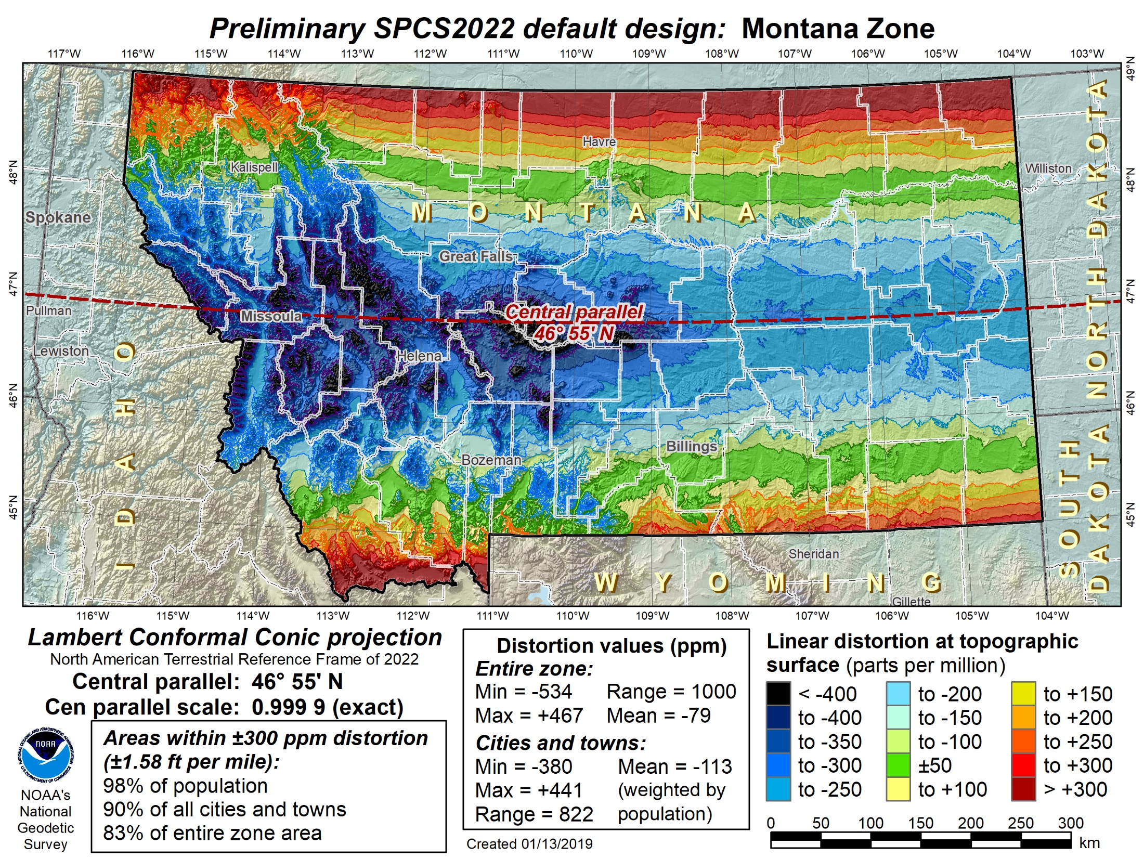
Montana statewide
Notes:
Map of preliminary default SPCS2022 design for Montana, which is also a statewide zone.

Slide 51
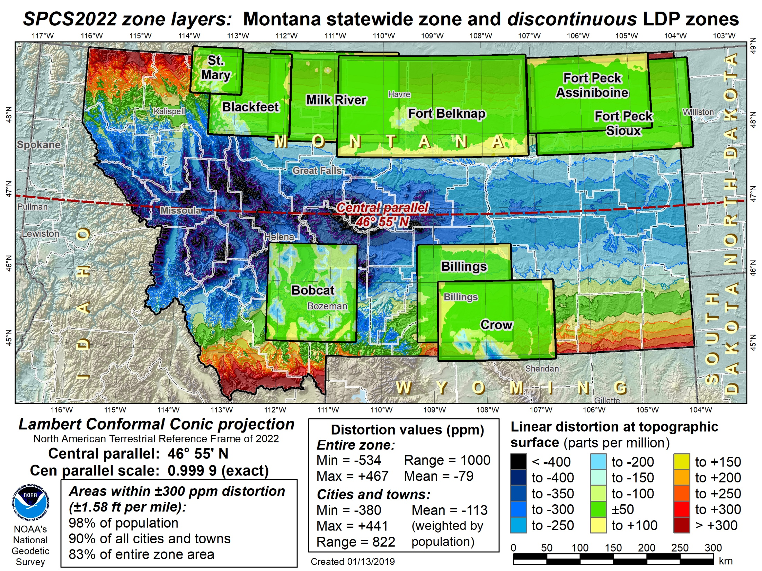
Montana statewide + discontinuous LDPs
Notes:
Map showing preliminary default SPCS2022 design for Montana with layer of discontinuous LDP zones
Both the statewide and LPD zones use the system distortion color ramp (±50 ppm increment)
LDP zones shown are from the existing Rocky Mountain Tribal Coordinate Reference System (RMTCRS)
If decided by Montana stakeholders, a modified (and likely augmented) version of the RMTCRS could coexist with the default statewide zone designed by NGS.

Slide 52
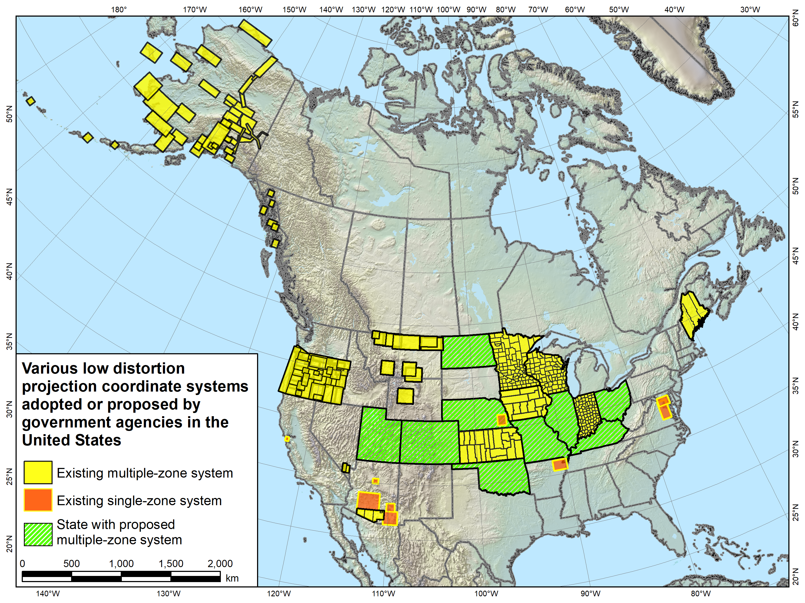
Advantages / Challenges

Slide 53
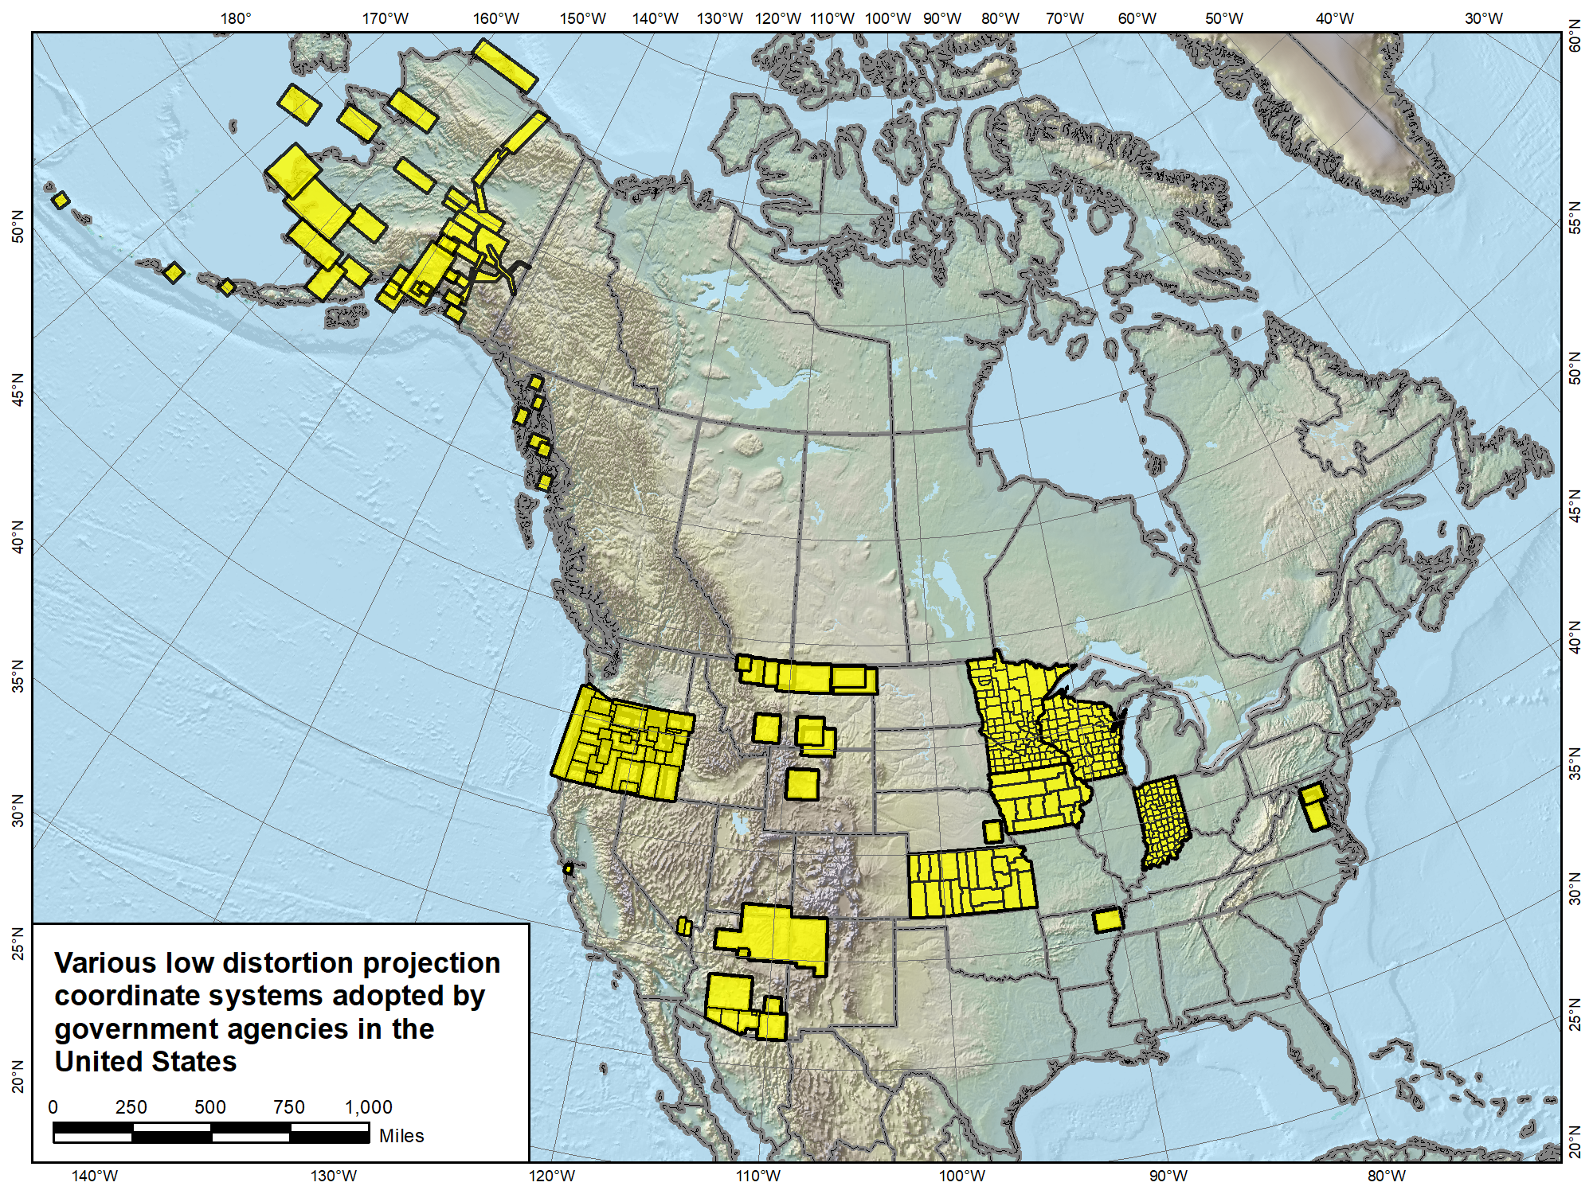
Versions of most of the LDP systems shown (as well as others) will likely become part of SPCS2022, both with complete and partial state coverage.
Navajo Nation Coordinate System not actually an LDP, and it falls in 3 states. It is something “special”…
Notes:
Map showing LDP systems adopted by government agencies and currently in use throughout the U.S. (there are likely quite a few others).
Note that discontinuous systems like that in Montana exist in other states, most notably Alaska
States with compete LDP zone coverage also exist, and it is expected that all shown will propose an LDP SPCS2022 layer, with no default layer corresponding to their existing SPCS 83 zones (i.e., they will have only 2 layers, statewide and LDP)
One zone shown is for the Navajo Nation
Too large (with too much distortion) to realistically be considered an LDP zone
Falls in 3 states (Arizona, New Mexico, and Utah)
Because it is in more than 1 state, it is a candidate for a “special use” zone, which is the topic of the next slide…

Slide 54
“Special use” SPCS2022 zones
Formerly “special purpose” zones
Zones for regions in more than one state
Categories:
Major urban areas (e.g., New York, Chicago, St. Louis)
Large American Indian reservations (e.g., Navajo Nation)
Large federal jurisdictions or applications (e.g., Yellowstone National Park, mapping of Atlantic Coast)
Requires NGS Director approval (case-by-case basis)
Notes:
Special use zones were not included in the draft SPCS2022 policy & procedures, but were asked about in the FRN
Most FRN responses indicated this zone type was desirable. Some had no preference, but none were opposed
Specification restricted to areas in more than 1 state (since 3 zone layers allowed in new policy & procedures)
Allowed for large urban areas in more than one zone under initial (1977) SPCS 83 policy (but never used)
Requires approval of NGS Director on case-by-case basis
Mainly because if more than 1 state, difficult to deal with under state stakeholder structure of all other SPCS2022 zones

Slide 55
SPCS2022 deadlines
Consensus input per SPCS2022 procedures
Requests for designs done by NGS
Proposals for designs by contributing partners
Submittal of approved designs
Proposal must first be approved by NGS
Designs must be complete for NGS to review
Later requests will be for changes to SPCS2022
NGS.SPCS@noaa.gov
by MARCH 31, 2019 for requests and proposals
by MARCH 31, 2020 for submittal of approved designs
Dates have changed from December 31, 2019 and 2020
Notes:
Deadlines for requests, proposals, and submittal of approved designs
Designs by “contributing partners” must first be approved as proposals by NGS
Contributing partners can be the stakeholders, or an individuals or organizations designing the zones for the stakeholders
It is expected that most (all?) proposed designs will be for LDP systems (with design criterion < ±50 ppm), since NGS will not design those
Any requests, proposals, or submittals that are not received by the deadlines will not be included in the initial release of SPCS2022 (in 2022)
However, these could still become part of SPCS2022 at a later time
Policy & procedures provide mechanism for changing SPCS2022, so there will still be an opportunity to change/add SPCS2022 layers even after 2022

Slide 56
NGS design request in practice
Minimum distortion criterion of ±50 ppm
Corresponds to nominal width of 180 km
State can request zones designs by NGS at ±50 ppm
Example: Request zones different from default
State has 3 SPCS 83 zones designed for ±100 ppm
State about 600 km wide
Wants new set of zones at ±50 ppm
Estimated number of new zones:
State width / 180 km, rounded up to next whole number
600 km / 180 km = 3.333 → 4 zones
So new SPCS2022 configuration will likely consist of 4 zones
Notes:
SPCS2022 is referenced to 2022 TRFs and thus part of new “datums”, and will replace existing SPCS 83 (referenced to NAD 83)
Similar to SPCS 83 in some ways:
Designed by state, using same reference ellipsoid and same projection types
Differs from SPCS 83 in other ways:
Designs minimize distortion at topographic surface rather than ellipsoid surface (reduces distortion where system is actual used)
NGS will design default zones for every state, and default zones corresponding to existing SPCS 83 zones for states that do not request or propose something different
Can have up to 3 zone layers (where one layer must be a statewide zone). The other layers can be default zones and/or LDP zones (but not designed by NGS). Only one layer can be discontinuous (i.e., zones do not completely cover a state); it is expected that discontinuous layers will always be LDP zones.
“Special use” zones are for major urban areas, American Indian reservations, or federal jurisdictions/applications that fall in more than one state. These must eb approved by the NGS Director on a case-by-case basis.
The stakeholder role is vitally important for states that want something other than default zones. But all requests and proposals from stakeholders must be unanimous to become part of SPCS2022.

Slide 57
Making requests and proposals
Two (draft) fillable PDF forms
Intent: make easy for stakeholders and NGS
Simple: pick lists, radio buttons, few free-form fields
SPCS2022 Zone Request and Proposal Form
Request zone designs or modifications by NGS
Propose zones designed by stakeholders (usually LDPs)
SPCS2022 Zone Design Submittal Form
For stakeholders to submit their own zone designs
Based on a previous proposal approved by NGS
Not required for requests
Notes:
SPCS2022 is referenced to 2022 TRFs and thus part of new “datums”, and will replace existing SPCS 83 (referenced to NAD 83)
Similar to SPCS 83 in some ways:
Designed by state, using same reference ellipsoid and same projection types
Differs from SPCS 83 in other ways:
Designs minimize distortion at topographic surface rather than ellipsoid surface (reduces distortion where system is actual used)
NGS will design default zones for every state, and default zones corresponding to existing SPCS 83 zones for states that do not request or propose something different
Can have up to 3 zone layers (where one layer must be a statewide zone). The other layers can be default zones and/or LDP zones (but not designed by NGS). Only one layer can be discontinuous (i.e., zones do not completely cover a state); it is expected that discontinuous layers will always be LDP zones.
“Special use” zones are for major urban areas, American Indian reservations, or federal jurisdictions/applications that fall in more than one state. These must eb approved by the NGS Director on a case-by-case basis.
The stakeholder role is vitally important for states that want something other than default zones. But all requests and proposals from stakeholders must be unanimous to become part of SPCS2022.

Slide 59
SPCS2022 Deadlines (could change)
August 31, 2018 for Federal Register Notice comments
On policy and procedures
Includes “special purpose” zones
Deadlines for consensus input (Procedures 1.d.i.)
Dec 31, 2019 for requests and proposals
Requests are for designs by NGS
Proposals are for designs by contributing partners
Dec 31, 2020 for submittal of approved designs
Proposal must first be approved by NGS
Designs submitted by contributing partners
Designs must be complete before NGS review
Dec 31, 2021 for NGS to confirm zone computations
After deadlines, will be a change request for SPCS2022
NGS.Feedback@noaa.gov
Recommend input by
August 31, 2019
NGS.SPCS@noaa.gov
Jan. 10, 2019

Slide 60
What matters to MT
All States will get 1 zone
Do you want other LDPs
Do you want Special Zones – in Yellowstone? Any place else? Could it merely be an LDP?
Your opinions and feedback critical to the outcome
How do you want MT to make final decisions?

Slide 61
What do you need to do?
6 months critical decision making
Outreach to associations (GIS, survey, parks,FS, tribal)
Chapters – local input
List options and get consensus (perhaps by votes at board mtgs)
Recommend target for decision August 2019

Slide 62
GPS on Bench Marks
Phase I
Geoid 18
You helped with the final hybrid Geoid Model
All About heights
How important will heights/elevation be in the future?
Phase II
Transformation Tools
Help needed with the transformation tools to the new systems over the next couple of years
Thank you

Slide 63
GPS on BM Efforts in MT
MT Submitters | August Observations | Aug 16-19 Observations
wiweber@mt.gov | 32 | 0
mickbrown@mt.gov | 11 | 2
dagraff@fs.fed.us | 6 | 0
mroedel@mt.gov | 3 | 0
tolinger@mt.gov | 2 | 0
sslotsve@signalpeakenergy.com | 2 | 0

Slide 64
GPS on BM
Phase I - Geoid18 Model Nearing Completion
Over 45% complete (2469 observations)
WY 22%
A Priority 163 provided, 36 observed 22%
B Priority 19 provided, 4 observed 21%
CO 54%
A Priority 40 provided, 15 observed 37%
B Priority 30 provided, 22 observed 76%
MT 53%
A Priority 233 provided, 137 observed 58%
B Priority 43 provided, 24 observed 56%
Numbers as of Oct 31, 2018

Slide 66
Ellipsoid, Geoid, and Orthometric Heights
Heights – why so important?
H = Orthometric Height (leveling)
H = h - N
h = Ellipsoidal Height (GPS)
N = Geoid Height (model)
h (NAD83)
TOPOGRAPHIC
SURFACE
(NAVD88) H
N
Geoid Height
(GEOID12B)
Geoid
Ellipsoid

Slide 67
Crowdsourcing GPS on Bench Marks
Find Bench Marks (priority and others)
Use our priority BM/tracking map
Use NGS Data Explorer
Use DS-World
Provide a recovery note
Use DS-World (or new NGS beta app)
Provide updated descriptions,
Coordinates, photos (use DS-World)
Collect GPS data
Share through OPUS
Create OPUS Data Sheet
GIS Community
can assist here
Requires Survey Grade
GPS data and
min. of 4 hrs of data

Slide 68
OPUS Share Data Sheet

Slide 69
MT maps Differences between Geoid12 and prototype Geoid18 red diamonds are priority stations Post residuals shown on next 9 maps

Slide 70
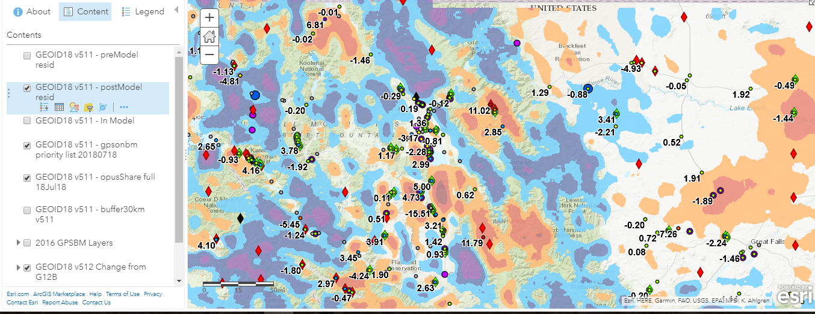

Slide 71
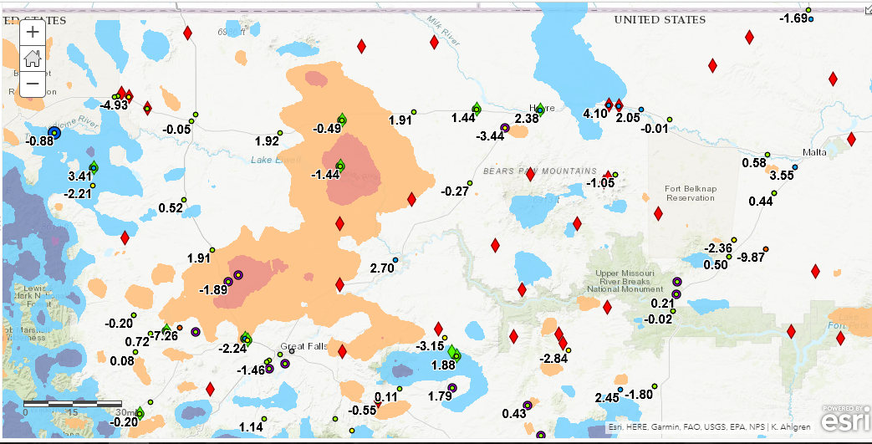

Slide 72
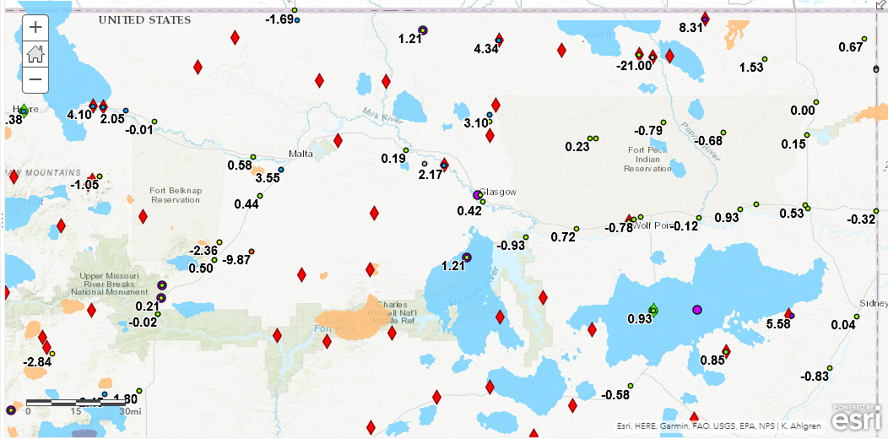

Slide 73
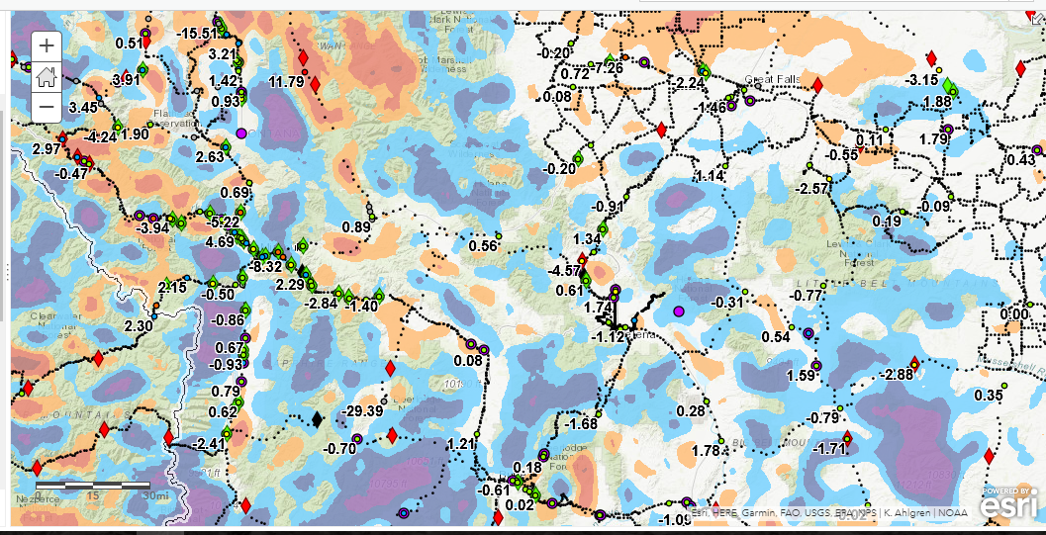

Slide 74
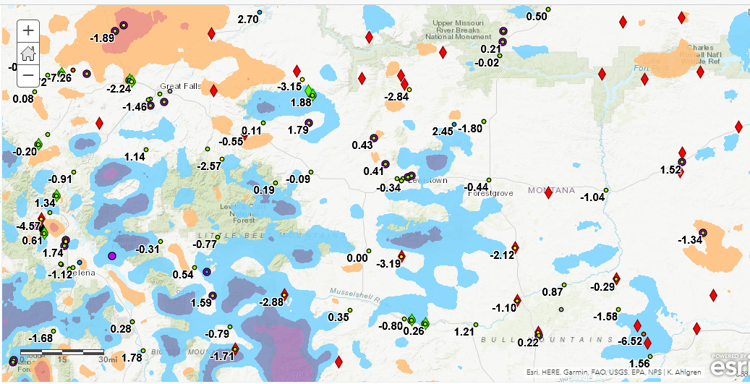

Slide 75
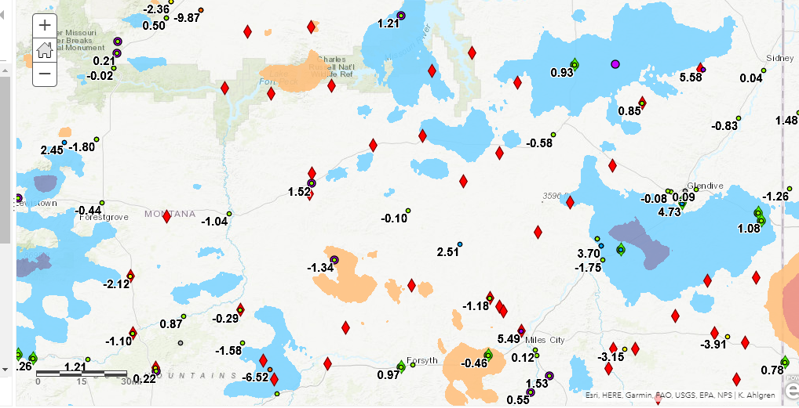

Slide 76
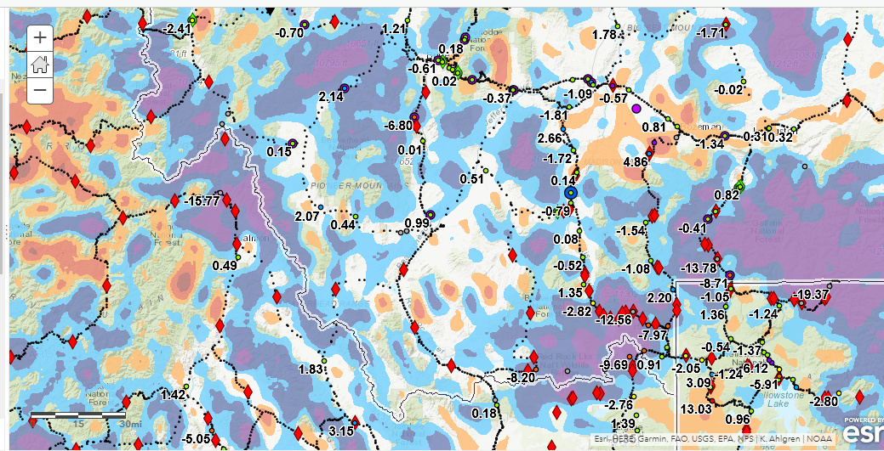

Slide 77
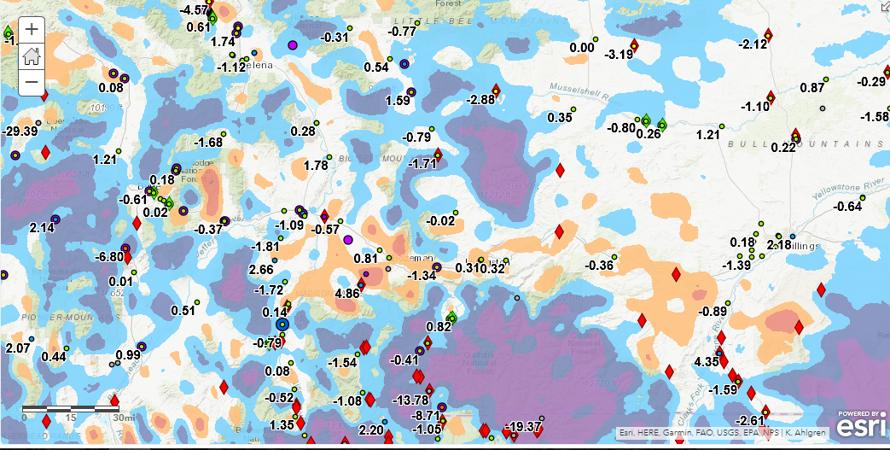

Slide 78
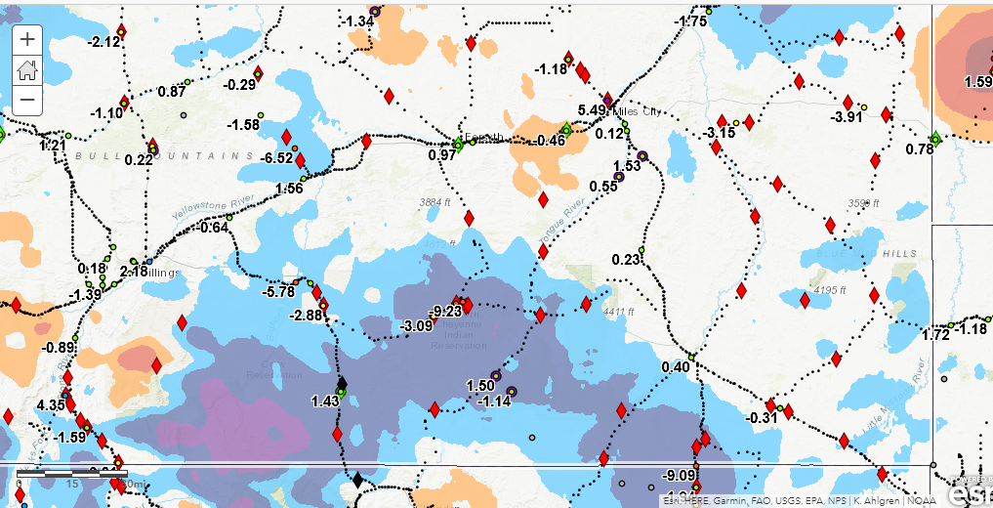

Slide 79
Priority BMs Identified
A Priority
B Priority

Slide 80
Rocky Mountain Region Map and Volunteer Sign up
Signup sheet:
https://survey123.arcgis.com/share/130be382350e4a38a71de3b2e4d92a98 (Must cut and paste)
Status Map:
https://www.arcgis.com/apps/webappviewer/index.html?id=0829616b6ec740b7a0bfbf057188e865
NGS Map:
https://geodesy.noaa.gov/GPSonBM/index.shtml

Slide 81
Priority Stations near Casper, WY

Slide 82
Priority Stations near Casper, WY

Slide 83
Rocky Mountain Regional Map

Slide 84
Why do we need 4 hours of data?
NGS is working on OPUS for RTK that will accept 3 minute observations, however the accuracy will NOT be as good as 4 hour observations.
1 sigma
Graph Courtesy of Dr. Daniel Gillins
Notes:
Better solutions with lower RMS are important for creating the hybrid geoid model. The Transformation Tools will need a higher density of data, so we are willing to trade a decrease in accuracy for the ability to get data on many more marks.

Slide 85
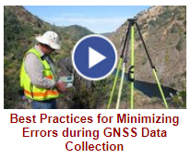
NGS GPS on BM Training Material
GPS on Bench Marks Webpages
NGS Video Library
NGS Online Lessons

Slide 86
Rocky Mountain Region Webinars GPS on BM
May 21, 2018 2:00 Basics, why, how, when
June 7, 2018 2:00 Mark Recovery (DS-World)
June 14, 2018 2:00 Collecting GPS data and Sharing through OPUS (Survey Grade, min. of 4 hrs) https://attendee.gotowebinar.com/recording/3222375402987297281
https://attendee.gotowebinar.com/recording/4100208993309956616
https://attendee.gotowebinar.com/recording/8767732610551898883

Slide 87
Next Steps
Phase II
New priority stations for Transformation tool
Many more stations
Design a more localized approach
Provide incentive
Utilize interns (request positions)
NGS is exploring use of RTK

Slide 90
geodesy.noaa.gov

Slide 91
2019 Geospatial Summit
SAVE THE DATE!
Geospatial Summit
Dates: May 6 - May 7, 2019
Location: Silver Spring Civic Center
Invitees: NSRS users plus NGS Subject Matter Experts

Slide 93
Geospatial Summit
May 6-7, 2019
Vertcon 3
GRAV-D
NOAA Technical Report NOS NGS 62, “Blueprint for 2022, Part 1: Geometric Coordinates
NOAA Technical Report NOS NGS 64, “Blueprint for 2022, Part 2: Geopotential Coordinates
Geodesy.noaa.gov

Slide 94
New Subscription Service
GPS on Bench Marks

Slide 95
Next steps and Future
SPCS 2022
US Foot or International Foot
Consensus needed across the State
Other LDPs, Special Zones?
GPS on BM for transformation tools
Need GIS communities assistance in identifying whether marks are in place and good for GPS
Interns
RTK
???

Slide 96
Panel and Roundtable Discussion – Impact of NSRS Modernization on various organizations
Private, MARLS, Joshua Phillips
MDT, Tyson Olinger
Tribal, Wally
Montana State Library, Michael Fashoway
Washington State, Gavin Schrock

Slide 97
NOAA’s National Geodetic Survey
Thank you
Joshua Phillips
MARLS, MT CO-Coordinator
MTCoordinator@marls.com
Tyson Olinger
MDT, MT CO - Coordinator
Pam Fromhertz
Rocky Mountain Regional Advisor
Pamela.Fromhertz@noaa.gov
240-988-6363
Geodesy.noaa.gov

