Slide 1
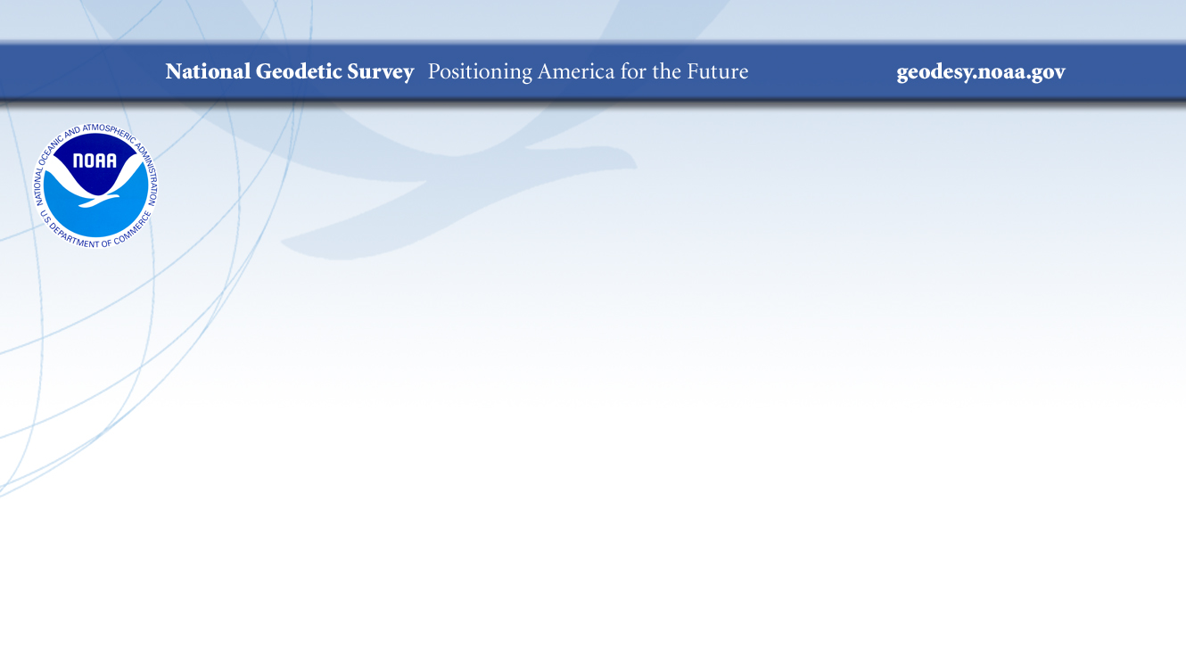
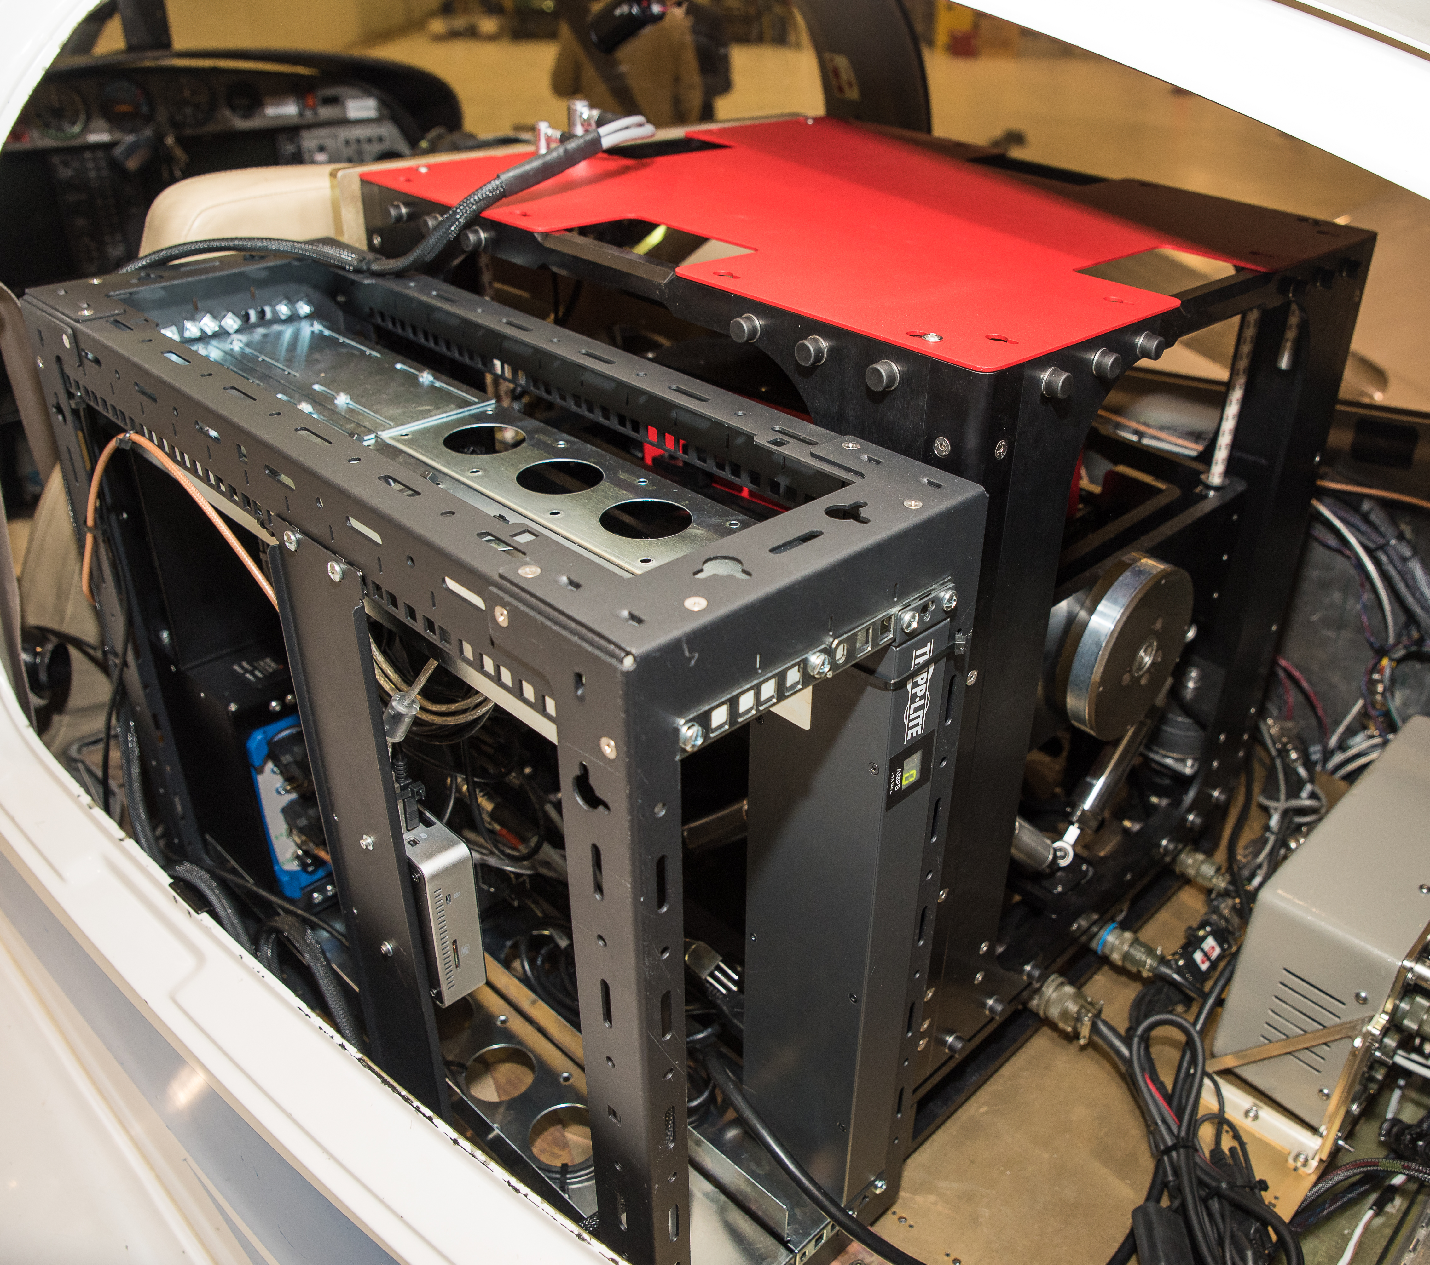
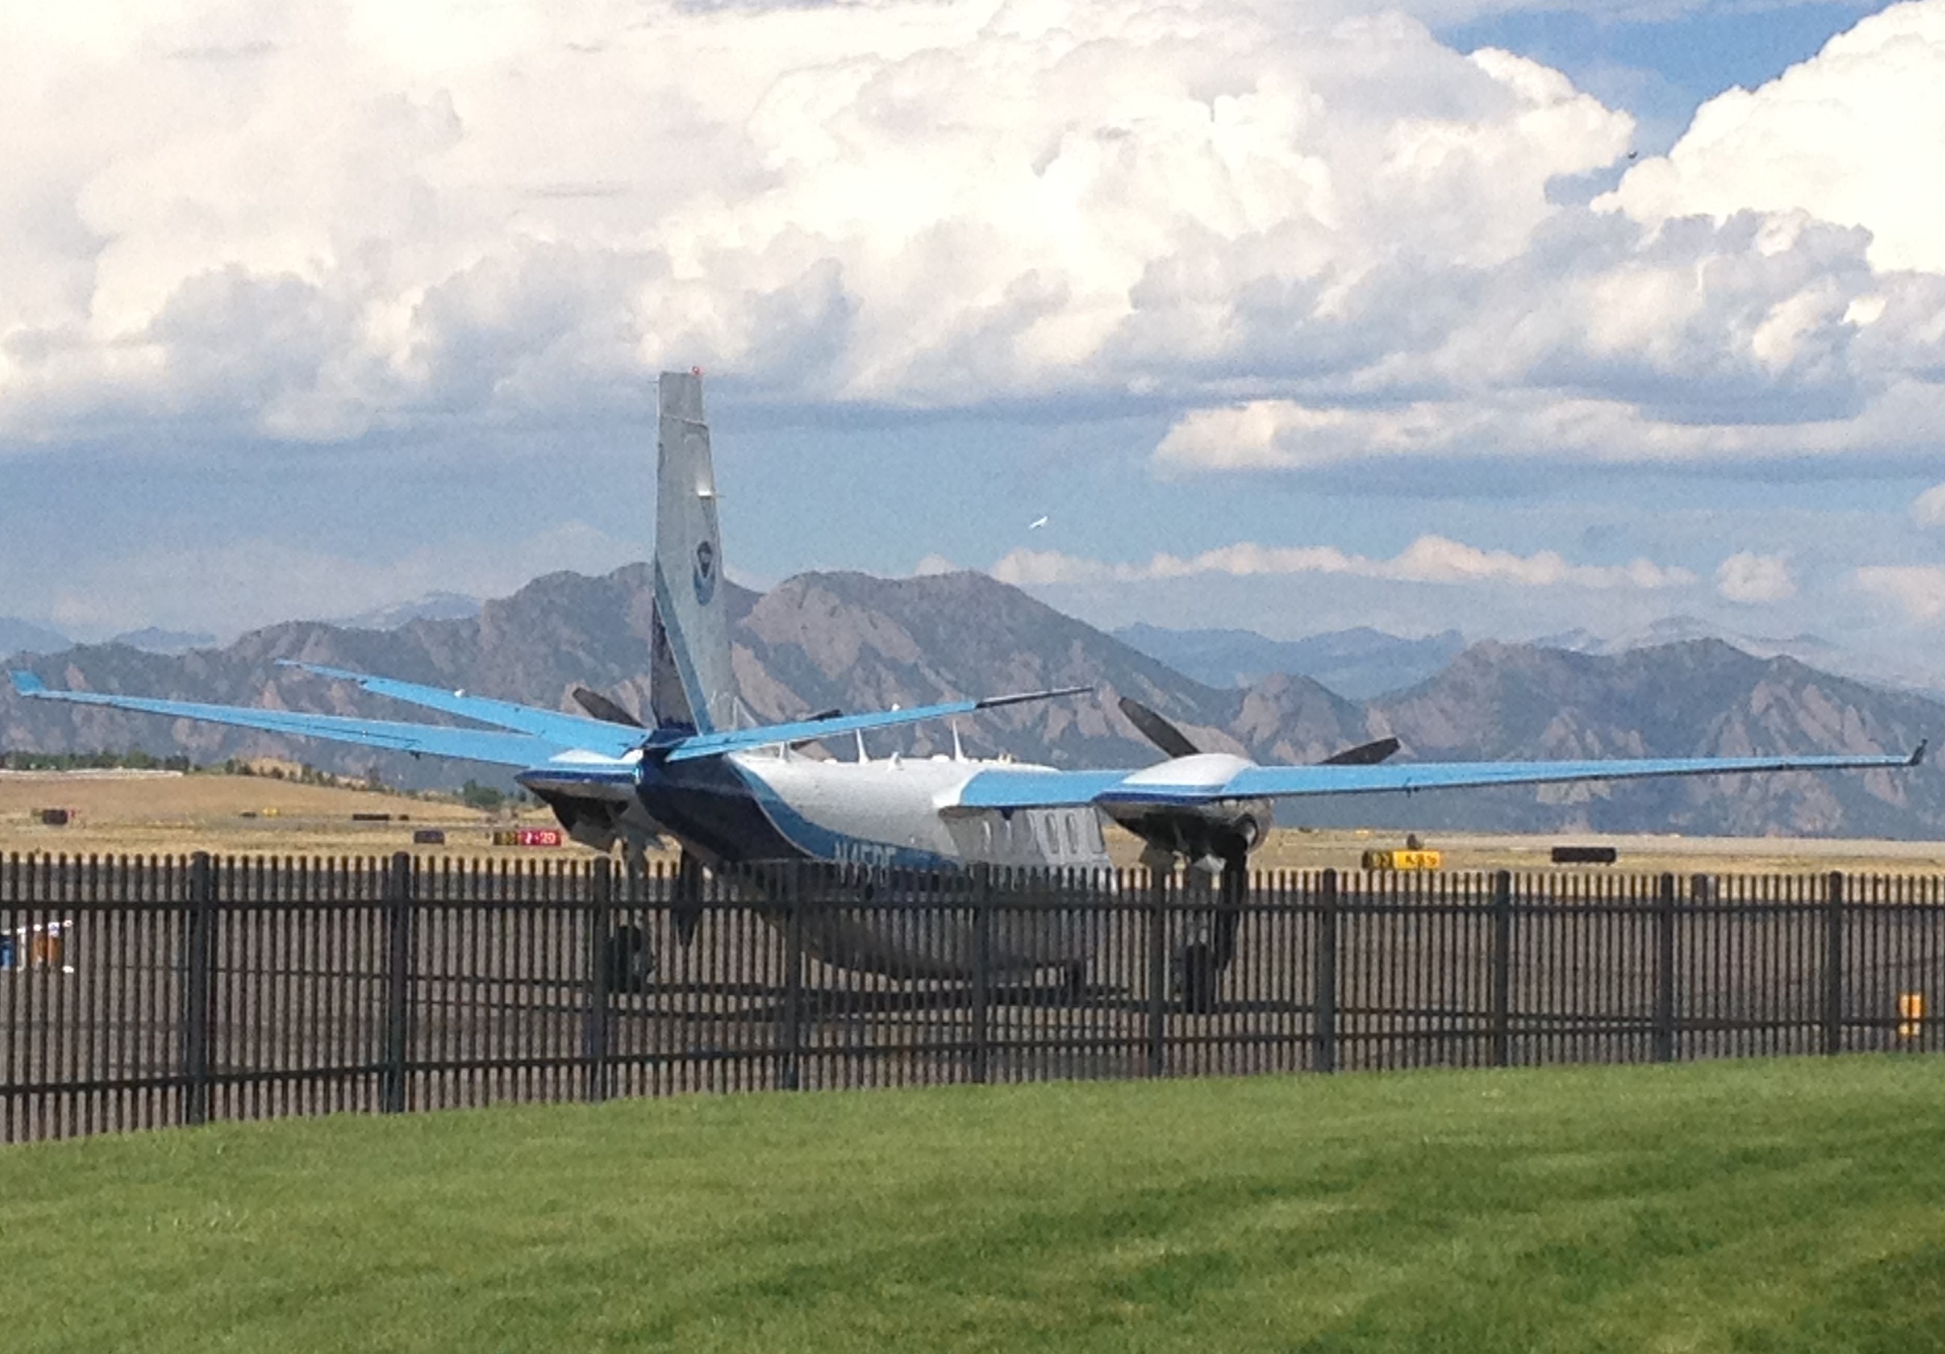
NGS Gravity Program
Monica Youngman
Gravity Section Chief
Observation and Analysis Division

Slide 2
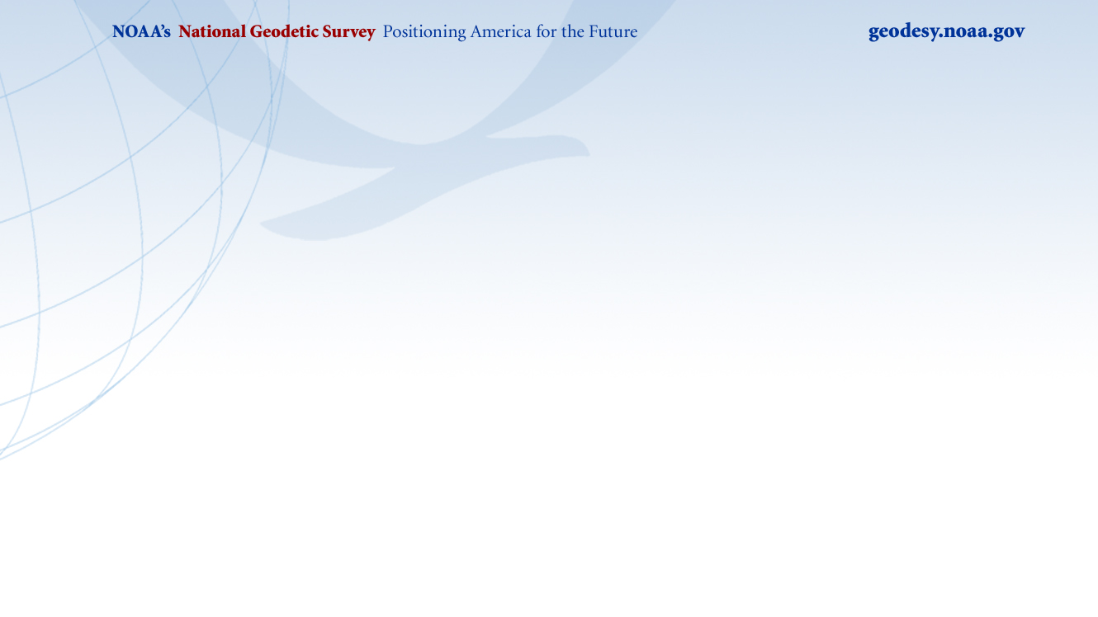
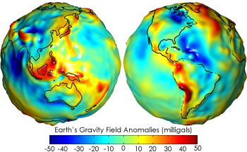
Overview of the Gravity Program
Purpose: To provide high quality gravity data to support the NGS mission
Vision: Stakeholders can easily find, measure, and access high quality gravity data for any location in the U.S., receiving gravity, uncertainty, and change over time

Slide 3
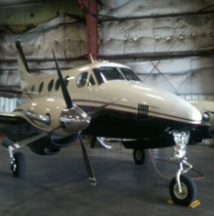
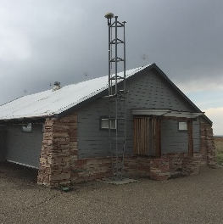
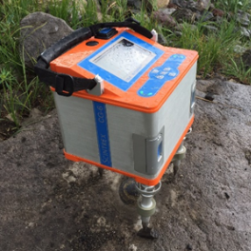
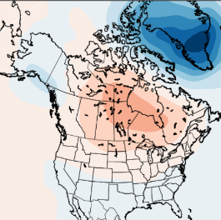
Gravity Program Components
Gravity for the Redefinition of the American Vertical Datum (GRAV-D)
Table Mountain Geophysical Observatory (TMGO)
Gravity Data for Stakeholders
Geoid Monitoring Service (GeMS)

Slide 4
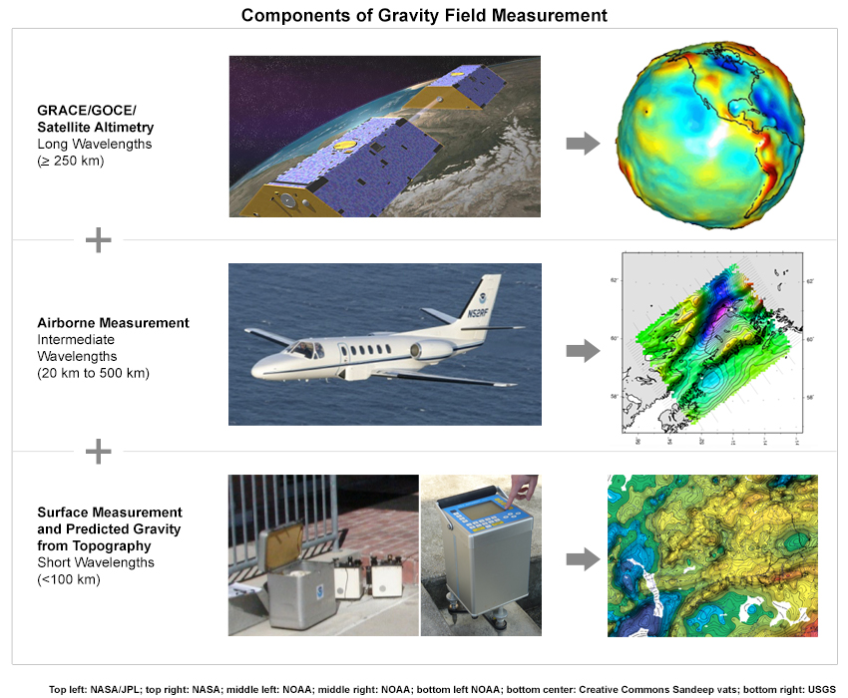
GRAV-D
GRAV-D Goal: Create gravimetric geoid accurate to 1 cm where possible using airborne gravity data

Slide 5
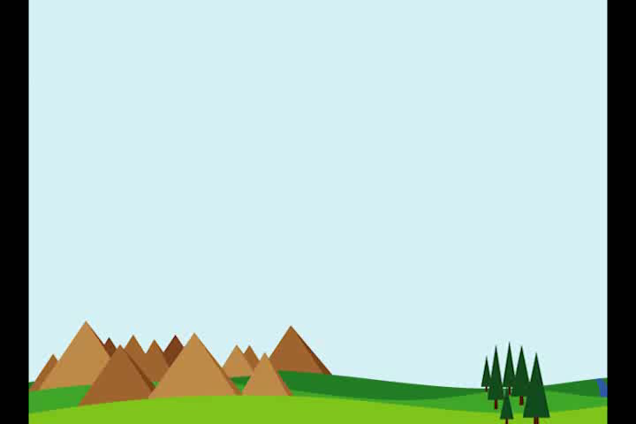
Measuring Gravity

Slide 6
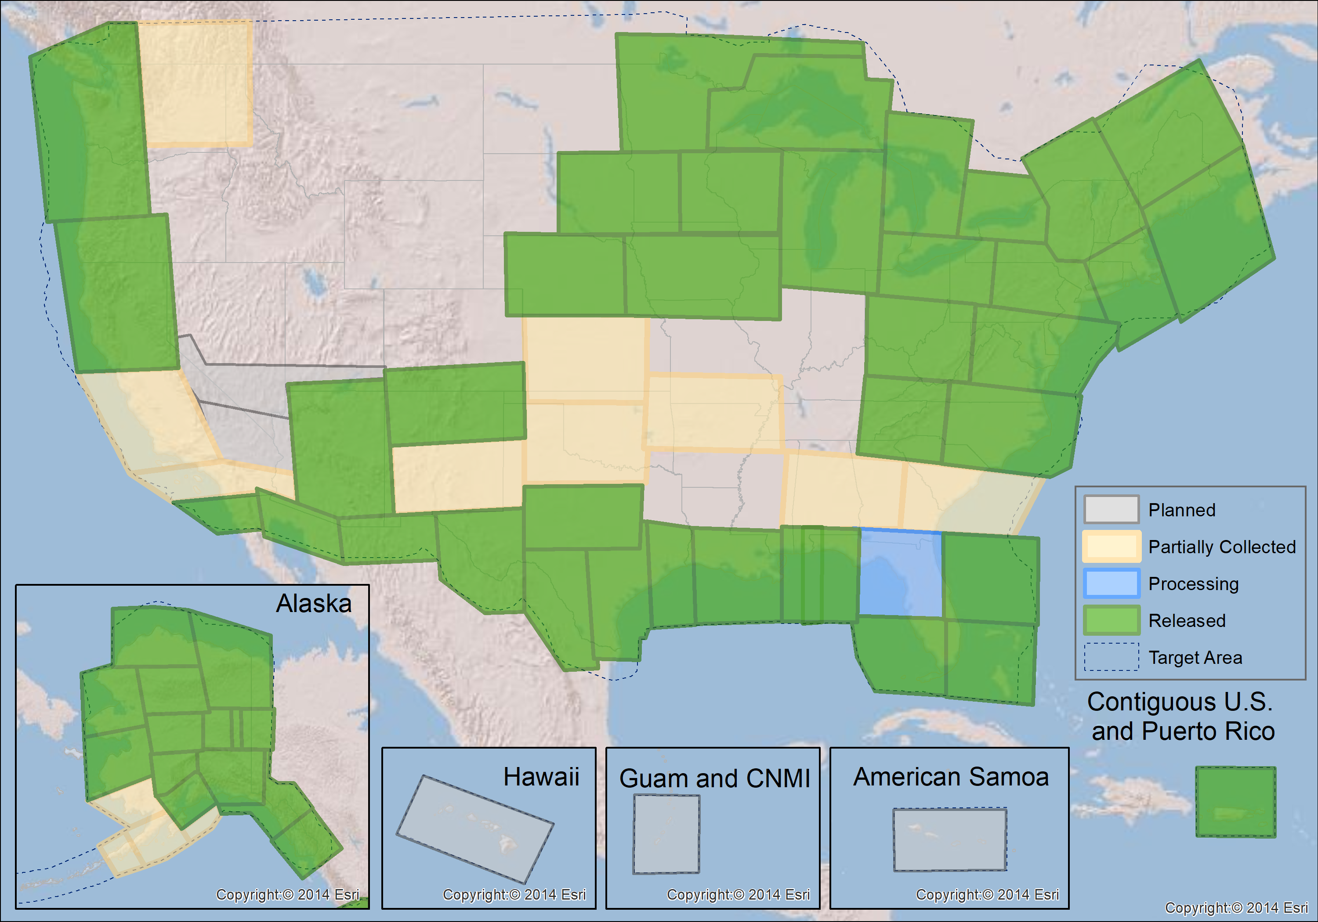
GRAV-D Collection
Status:
GRAV-D Data Release
Status:

Slide 7
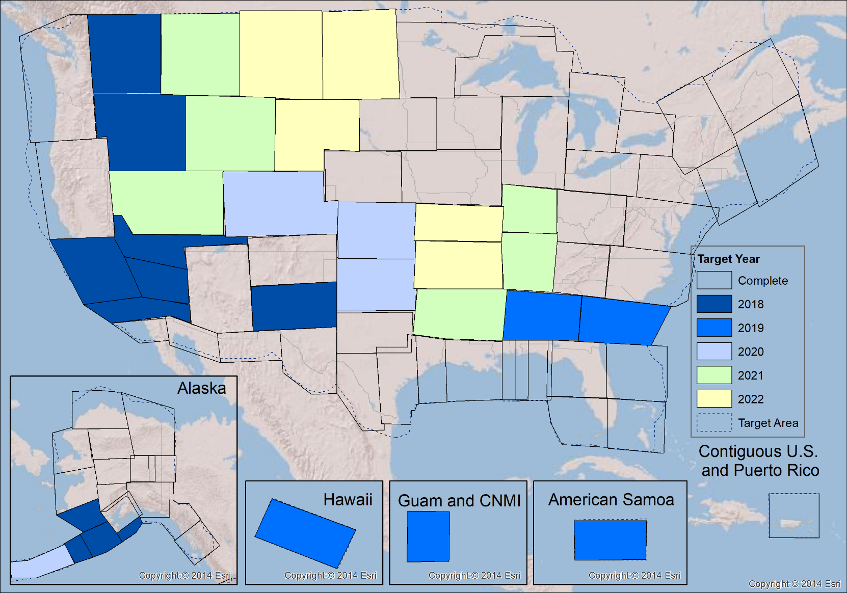
GRAV-D Plan:
FY18 (70%) – Mainland Alaska
FY19 (79%) – Pacific Islands
FY20 (87%) – Aleutian Islands
FY21 (96%) – CONUS
FY22 (100%) - CONUS

Slide 8
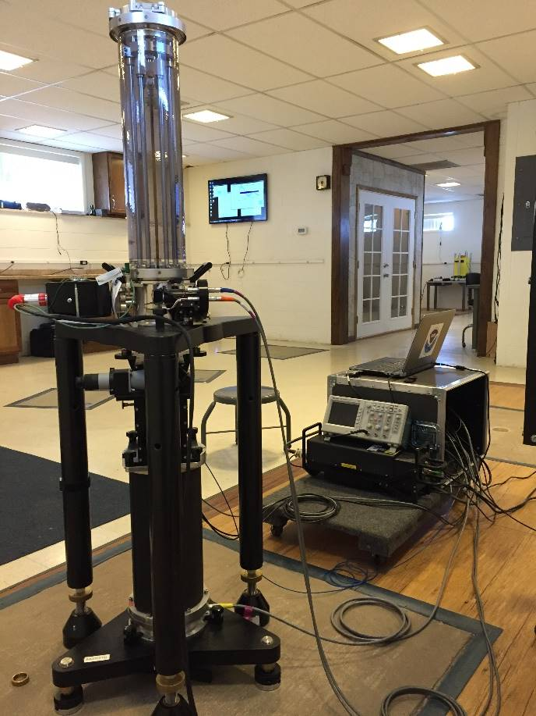
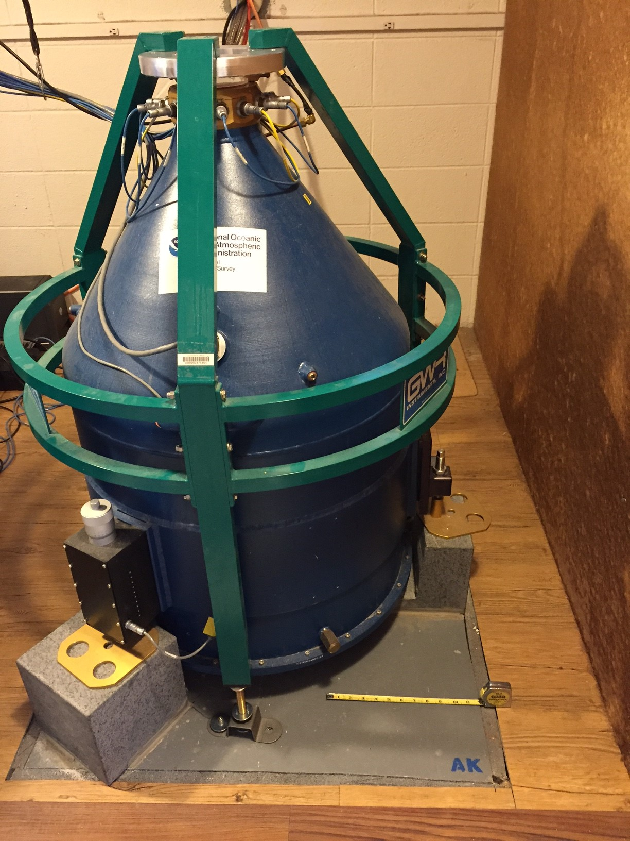
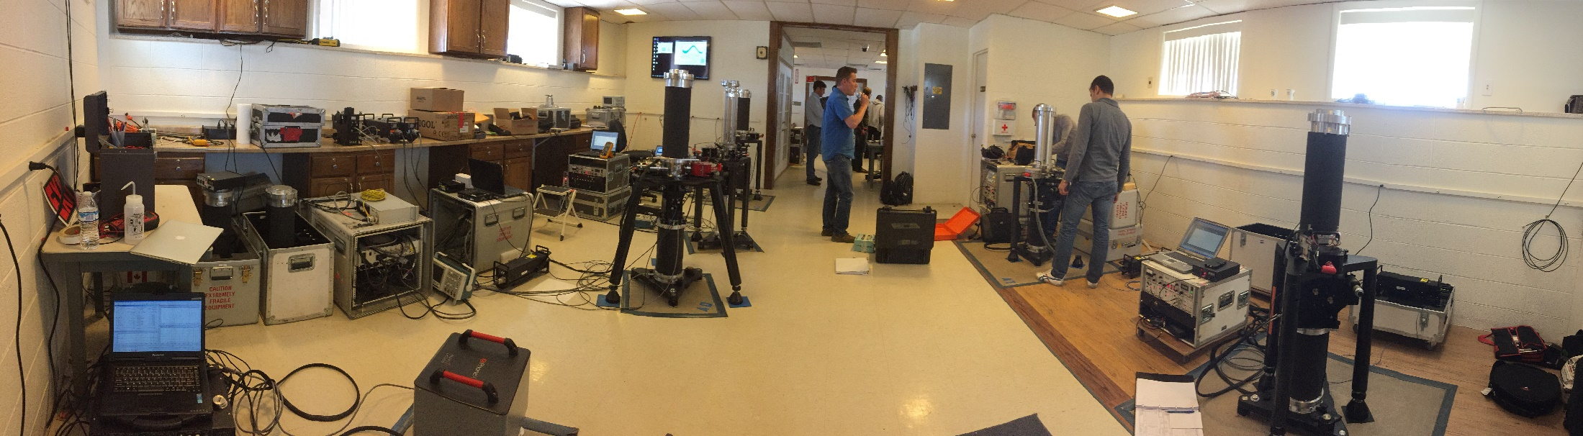
TMGO
Table Mountain Geophysical Observatory is located outside of Boulder, Colorado
Foundational site for gravity and DoV measurements
Defines gravity standard by hosting international comparisons of absolute gravimeters

Slide 9
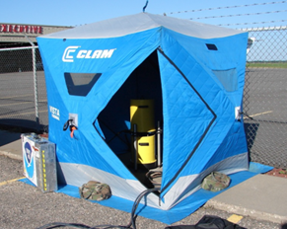
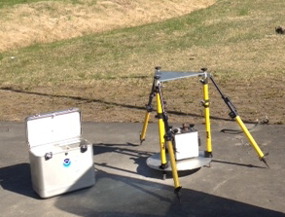
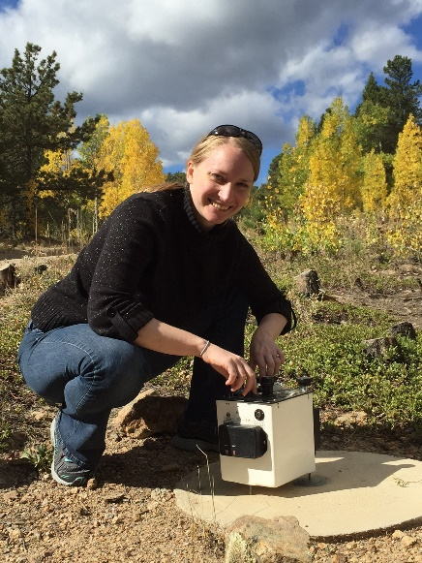
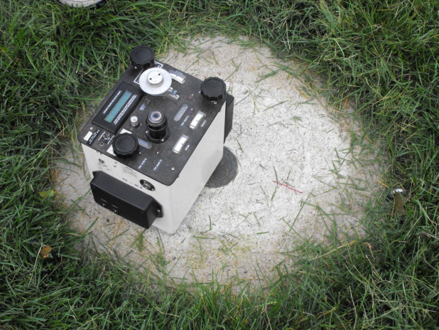
Gravity Data
Current Activities:
Provide guidance on gravity survey design, processing, and analysis
Provide information about gravity data
Perform gravity surveys for stakeholders
Update gravity standards and specifications
Analyze and use gravity data for operational geoid modeling
Reinvent the gravity portion of the database
Future Activities:
Manage gravity content in the database
Gravity data discovery, ingestion, and delivery tools and procedures

Slide 10
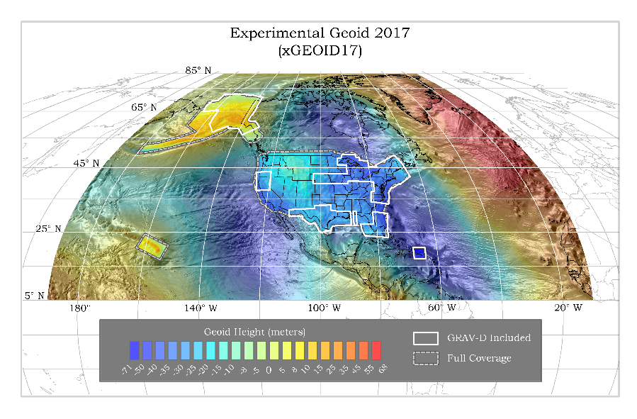
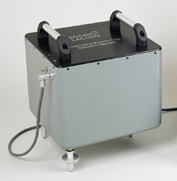
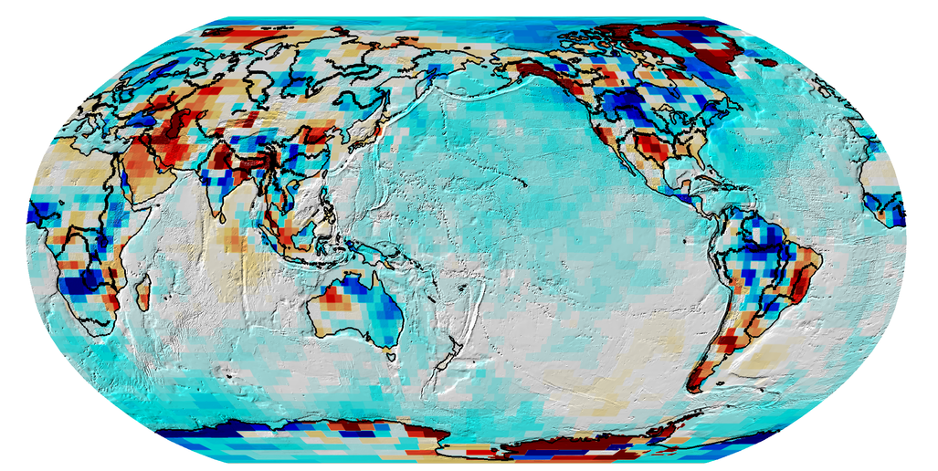
Geoid Monitoring Service (GeMS)
Current Activities:
Supporting research to determine spatial and temporal needs for monitoring gravity over time
Future Activities:
Implement the GeMS plan
Gravity data collection and analysis
Coordinating with partners
Prioritizing and communicating data needs

Slide 11
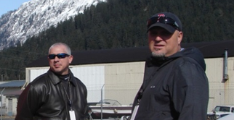
Gravity Team
Silver Spring Office
Monica Youngman - Gravity Section Chief
Kevin Ahlgren - Gravity/Geoid Modeling
Jeff Johnson - Gravity Data Analyst
Boulder Office
Derek van Westrum – Gravity Data Expert/TMGO Manager
Dan Winester – Terrestrial Gravity Data Expert
Jeff Kanney (contractor) – Gravity Operator/Processor
Field Team
Justin Dahlberg – Lead Airborne Gravity Operator
Chris Villarreal (contractor) – Airborne Gravity Operator
The Gravity Program is connected across NGS - we work with every division and appreciate your support!

