Slide 1
The Geoid Slope Validation Survey of Southern Colorado
NGS Convocation, May 2018
Derek van Westrum, Ph.D.
NGS Observations and Analysis Division
derek.vanwestrum@noaa.gov
NOAA’s National Geodetic Survey
geodesy.noaa.gov

Slide 2
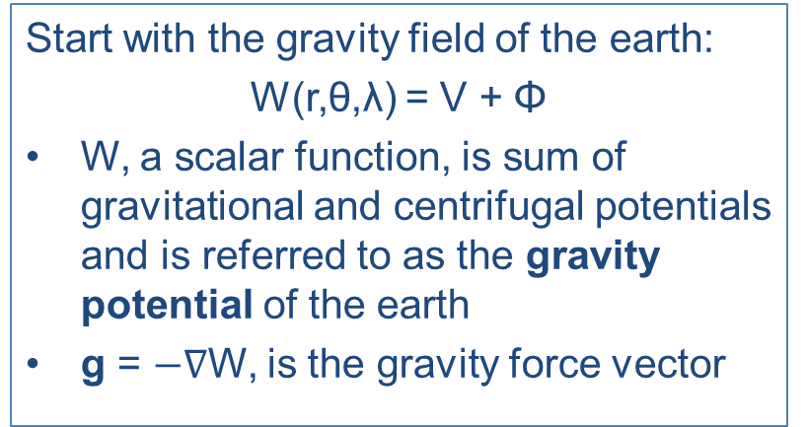
Earth’s Gravity Field and The Geoid
W = const defines a surface of equipotential or geopotential
There are infinitely many equipotential surfaces. They are not necessarily parallel to each other, but never intersect. Up close, they’re lumpy blobs.
Water doesn’t flow along an equipotential surface, or equivalently, such a surface is said to be “level”.
Plumb lines are always perpendicular to every surface they intersect.
The one equipotential surface that, on average, best matches sea level is a lumpy blob known as the geoid ≡ W₀. This is a natural “zero” (or datum) for height.
Notes:
Mention that the geoid is not an ellipsoid shape, but lumpier. Only 170m_pp though!

Slide 3
Aside #1: Understanding Geopotential
Imagine pouring water onto a dry lake bed. If everything is level it will simply pool up. It would “like” to get to lower potential (darker lines), but the lake bed is in the way.
If the lake bed is tilted (it’s now the side of a hill), the water can move towards lower potential (towards darker lines). Water appears to flow because of a change in height
If the lake bed appears flat, but there is an mass anomaly under one end, the resulting geopotential difference causes water to flow to lower potential (again, from light to dark lines). It appears to flow because of gravity.
In all scenarios, water only flows when it has a path to lower geopotential – this is always a combination of gravity and height, ∫g dH.
Notes:
Mention that the geoid is not an ellipsoid shape, but lumpier. Only 170m_pp though!

Slide 4
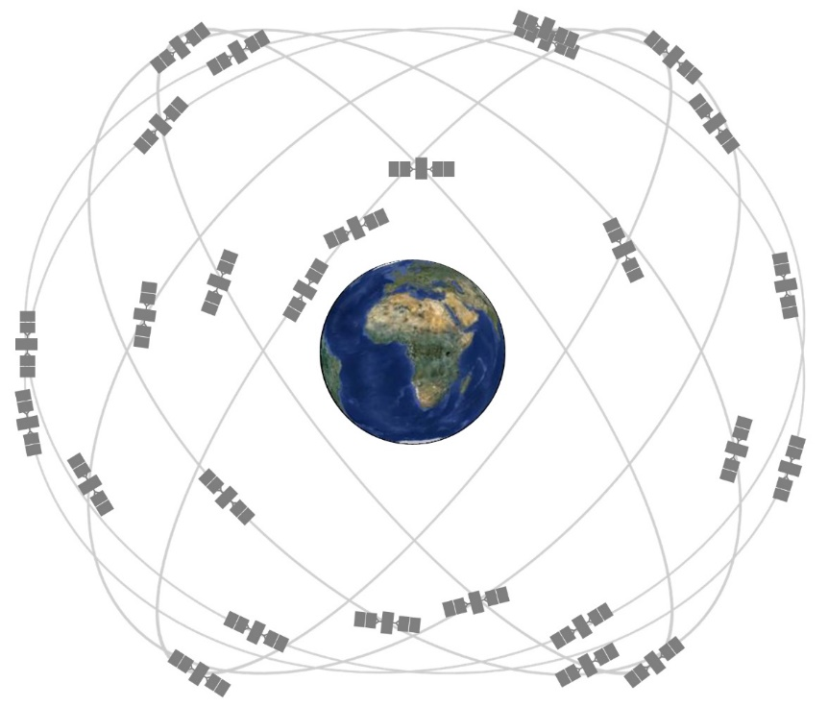
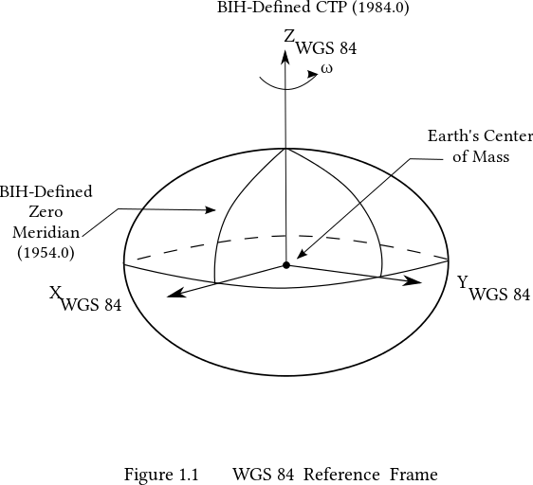
Aside #2: GNSS and the Ellipsoid
Way out at the altitudes of GNSS satellites (~20,000km), the Earth no longer looks like a lumpy blob. It looks like a perfectly smooth “egg” or more precisely, a squished sphere called the ellipsoid. GNSS allows for very precise (~1cm) location determinations relative to this mathematically well-defined ellipsoid.
The ellipsoid model currently used by GPS is WGS84. Its origin is located at the CM of the Earth.

Slide 5
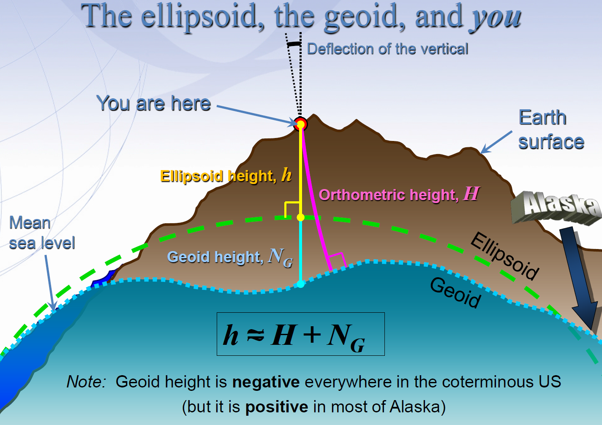
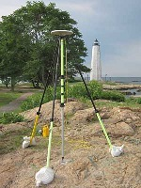
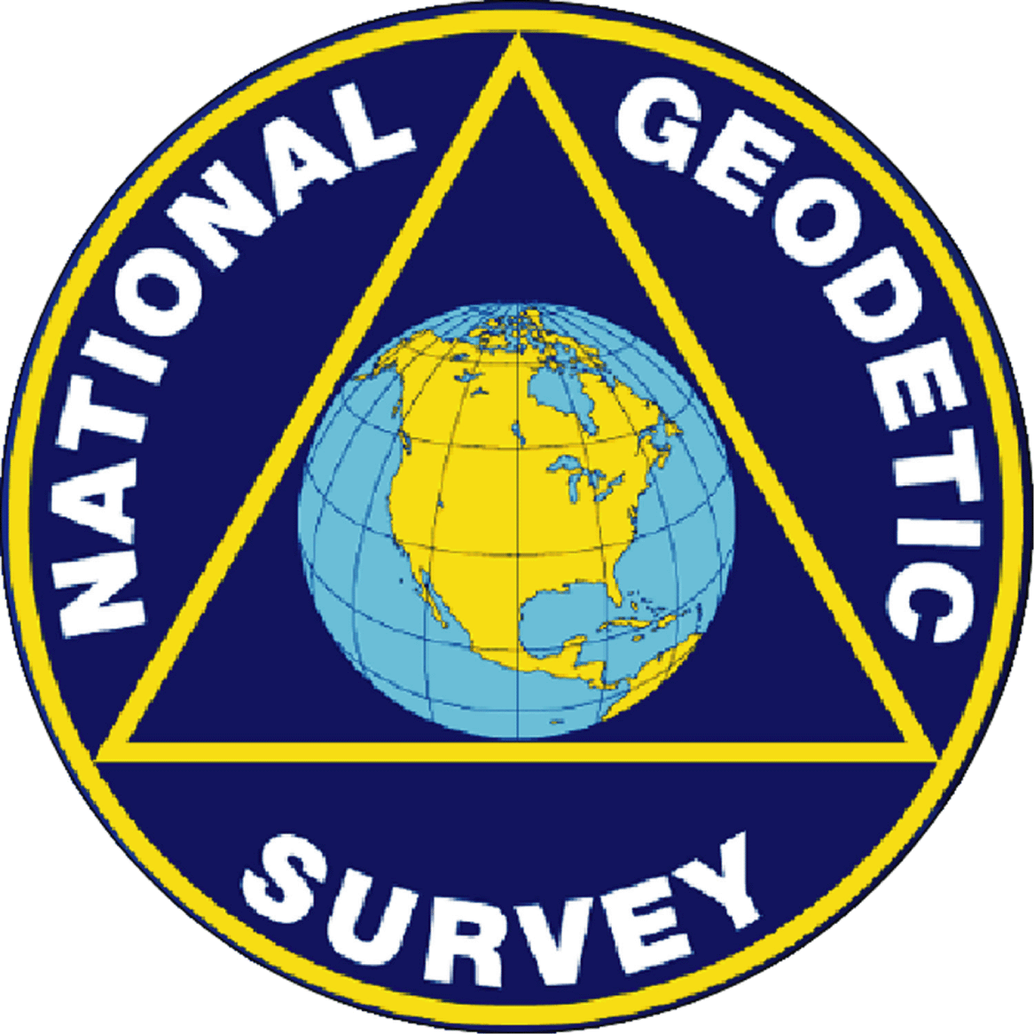
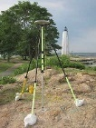
+ ≅ H

Slide 6
Geoid Slope Validation Surveys
Cool, but how do we know any of this is actually going to work?
The Geoid Slope Validation Surveys (GSVSs) use high precision, high resolution (~1.5km spacing), ground-based survey techniques to determine the shape of the geoid consistently along a large (~300km) distance.
This allows for the direct comparison of the geoid shape predicted by various, gravity-based geoid models.
This also allows for a quantification of the airborne gravity’s contribution to the improvement of these models.

Slide 7
Objective of the GSVSs (cont.)
But why compare the shape of the models?
The overall “height” of the geoid can “easily” be set to best match sea level (remember, there are an infinite number of level surfaces), but getting the overall shape right is critical (the undulations). So, it is actually more useful to look at the changes in the shape of the geoid over various distance scales (i.e. looking at slopes)
Method 1:
Leveling & Gravity provide terrain-corrected geodetic heights (“Rise”)
GNSS provides horizontal distance (“Run”)
Slope_{i} = Rise_{i} / Run_{i}
Ellipsoid
Geoid
Geoid Slope
Rise 3
Rise 2
Run 2
Run 3
Run 1
Rise 1

Slide 8
Slopes (cont.)
Method 2:
GNSS provides ellipsoidal position (lat, lon)
Deflection of Vertical measured directly with Astro-geodetic Camera (difference from normal to ellipsoid and local plumb line)
Camera knows what stars it “should” see normal to the ellipsoid at a specific time and location. DoV is difference between that and with what is actually “straight up”
Slope = Vector sum of North and East deviations of camera axis
Ellipsoid
Geoid
Geoid Slope

Slide 9
Objective of the GSVSs (cont.)
We thus have two independent methods of measuring geoid slopes.
Next, we look at the changes in the shape of the geoid over various distance scales (i.e. looking at the slope between various pairs of survey points separated by 1, 2, 5, 10, 20, 50, 100, 200 km, etc.)
Example of slopes over various distance scales:
Every 1 interval
Every 2 intervals
Finally, we compare these “ground truth” results to various geoid models.
Further, we can compare models with/without airborne gravity to quantify the contribution
Every 3 intervals
Every 4 intervals

Slide 10
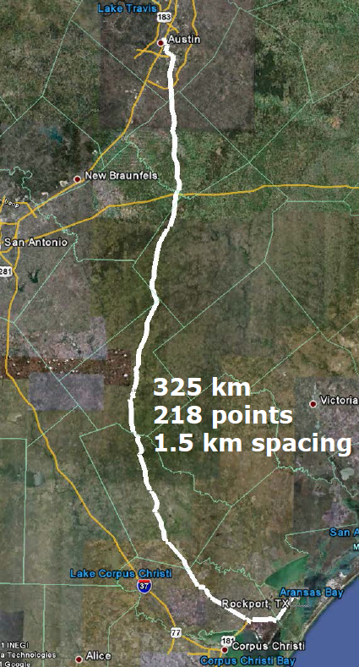
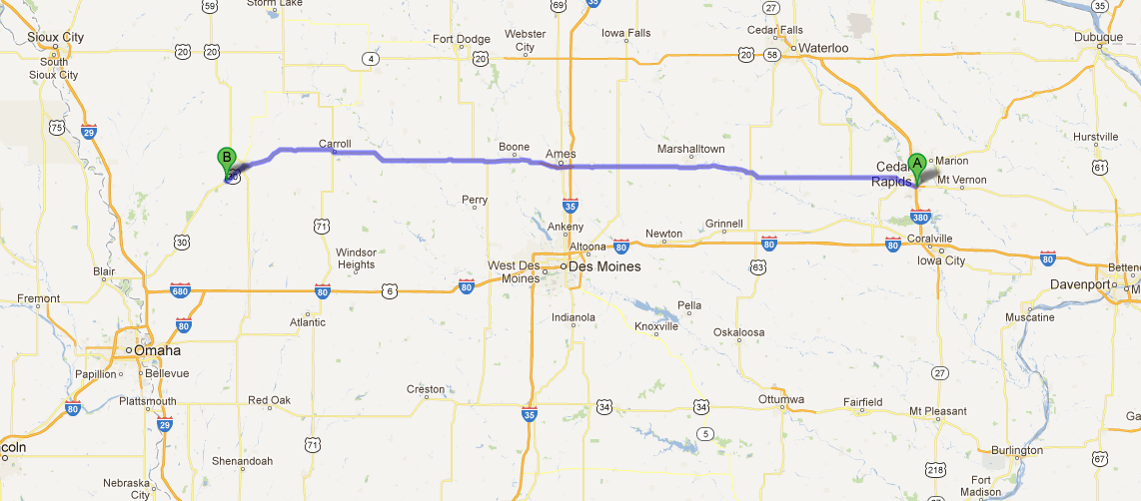
Previous GSVS Surveys
South Texas, 2011
Flat, close to the geoid
Iowa, 2014
Higher elevation and geologically interesting terrain (traversing the Midcontinent Rift System).

Slide 11
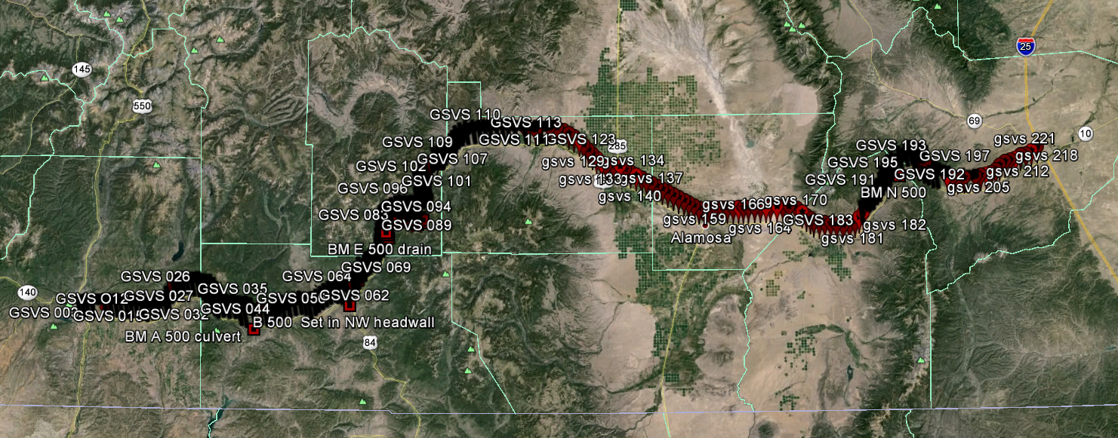
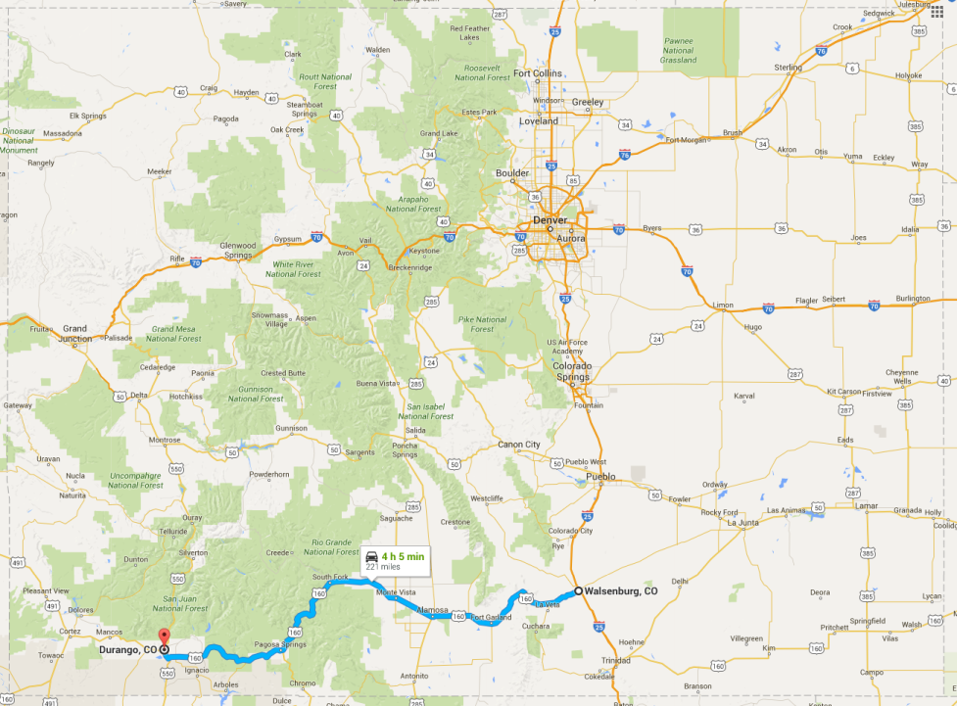
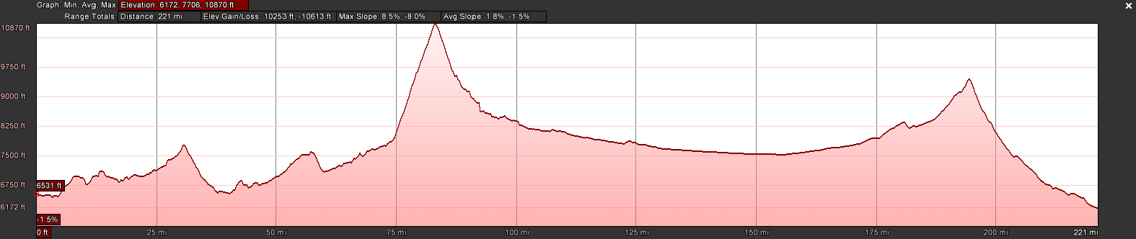
GSVS17 Colorado
The third (and likely final) GSVS took place along US160, from Durango to Walsenburg, in southern Colorado in the summer of 2017.
High elevation and rugged topography. “Worst case” for geoid modeling.
Variation from 6,000’ (MSL) to 11,000’, over two passes. 223 bench marks

Slide 12
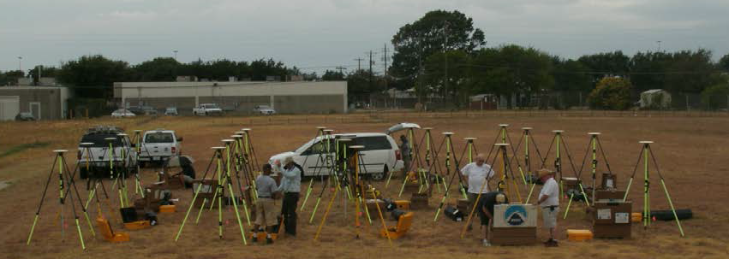
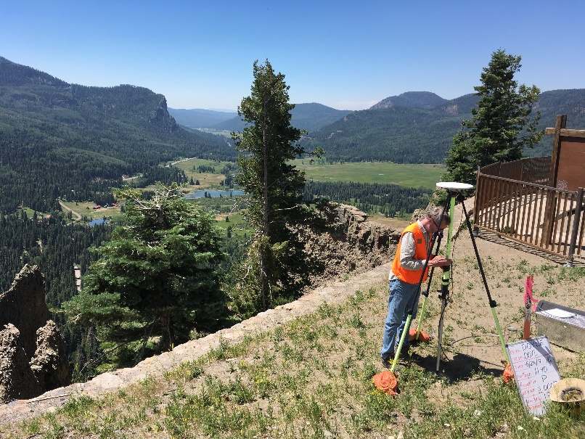
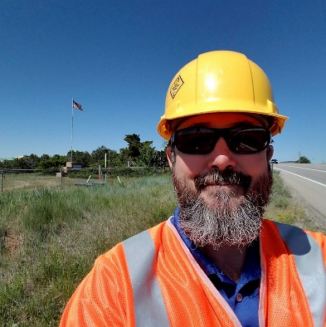
Survey Techniques: Long Period GPS
Calibrated, fixed-height antennas, all identical models
In Colorado 2017:
  24 complete sets of equipment (2 parties, 10 sets each)
  Each party observed 5 new stations each day
  24 hours & 16+ hours of observation each day
  Project processed with OPUS Projects

Slide 13
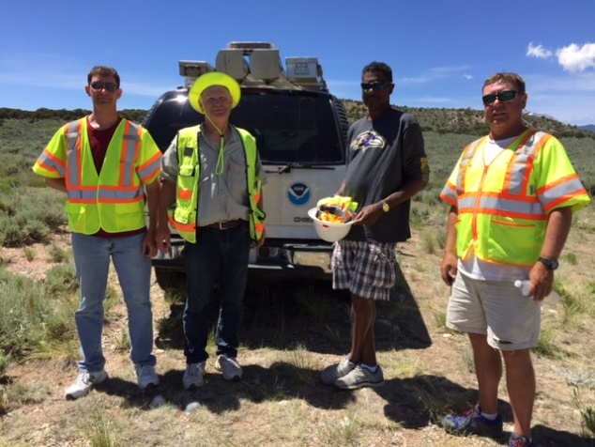
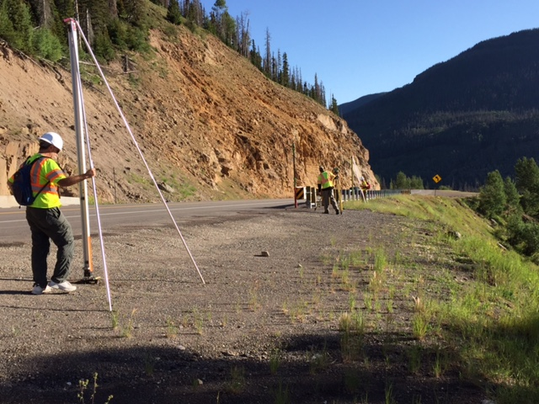
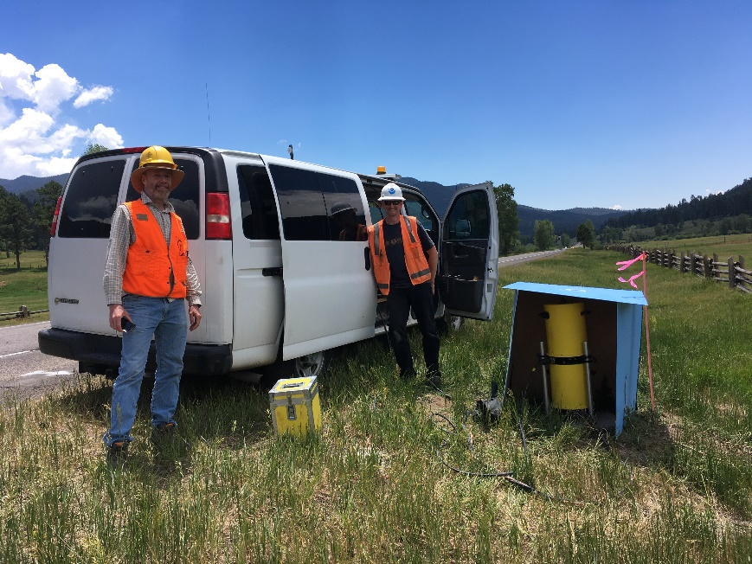
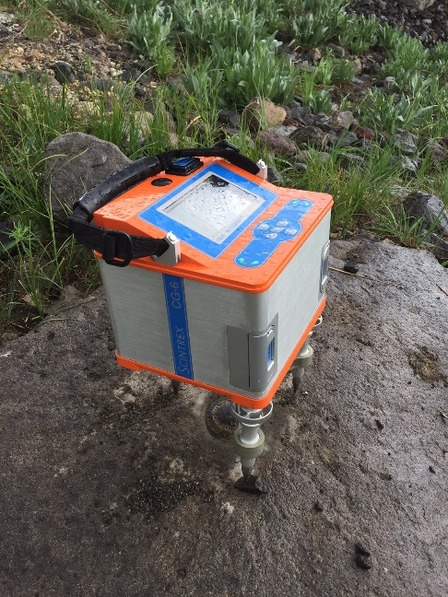
Survey Techniques: Leveling and Gravity
The entire line was leveled (double-run). Geodetic heights provided at each benchmark.
Leveling and gravity are both needed for orthometric height determination. Usually gravity is modeled, but in this case was actually measured at every point.
  Absolute gravity (A10 and/or FG5)
  Vertical gravity gradient (CG6)

Slide 14
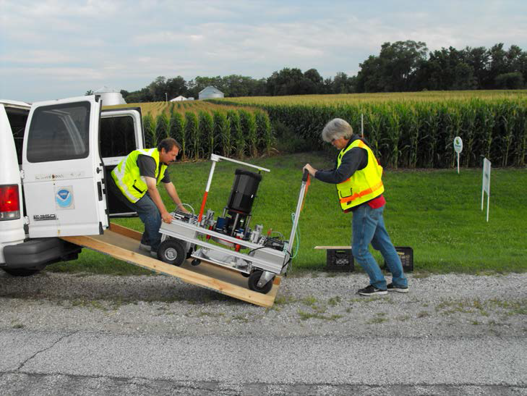
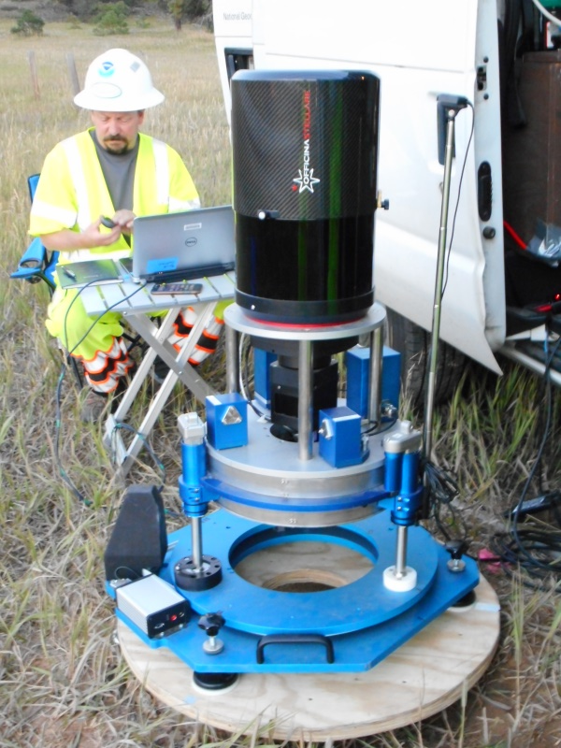
Survey Techniques: Deflection of the Vertical (DoV)
Measure the slope of the geoid directly!
Precision tilt meters provide alignment “level” to the geoid.
Celestial almanacs provide predicted alignment with star field (relative to ellipsoid).
The difference between the two vectors (broken into orthogonal components) are the Deflections of the Vertical (or “slopes”).
In Colorado, 2017:
  223 stations (14 repeat observations)
  39 nights
  ~6 stations/night
  Observing with Swiss CODIAC (COmpact DIgital Astrometric Camera), courtesy Technical University of Zurich.

Slide 15
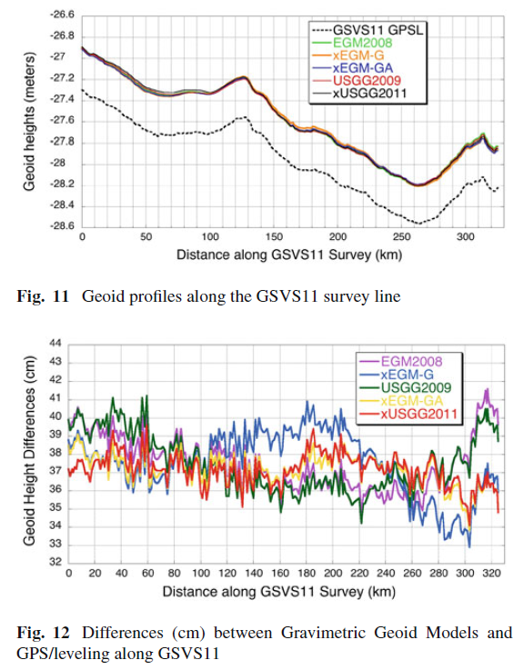
Results from Texas and Iowa*
Measured slopes were compared with NGS (and other) geoid models
Texas and Iowa GSVS both confirmed 1-2cm geoid accuracy, as expected!
Texas 2011
"Confirming regional 1 cm differential geoid accuracy from airborne gravimetry: the Geoid Slope Validation Survey of 2011", Smith et al., Journal of Geodesy, 2013.
Iowa 2014
“The Geoid Slope validation Survey 2014 and GRAV-D airborne gravity enhanced geoid comparison results in Iowa", Wang et al., Journal of Geodesy, 2017 91:1261-1276.
* Again, the 2017 Colorado data are still being analyzed

Slide 16
Summary
The new vertical height system, NAPGD2022, will use a surface of constant geopotential as the vertical datum (the geoid).
NGS will provide the geoid undulation “correction” to get orthometric heights from ellipsoidal heights.
To verify geoid precision, ground-based geoid slope measurements (derived from both classic techniques and direct measurements of DoV) over varying distance scales were used to compare various geoid models.
Comparing this “ground truth” to the models also allows for a direct quantification of the improvement when airborne gravity data are included.
To date, two such surveys have been conducted successfully in reasonably flat terrain.
Colorado has now been observed for a final, challenging test. Look for final results later in 2018!

