Slide 1
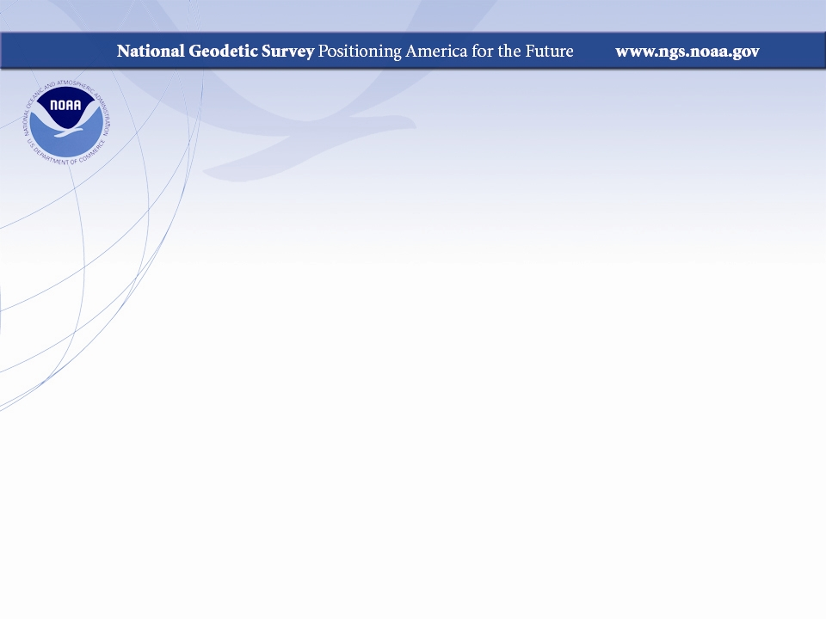
Geodesy for Coastal Science
Why NGS products/services matters to coastal partners
2018 NGS Convocation
May 10, NOAA Science Center

Slide 2
What’s so special about our coasts?
Notes:
44.8 percent of the US population lives in coastal counties (US Census, Sept. 2017
Coastal population grew at 9.4% rate from 2006-2016

Slide 3
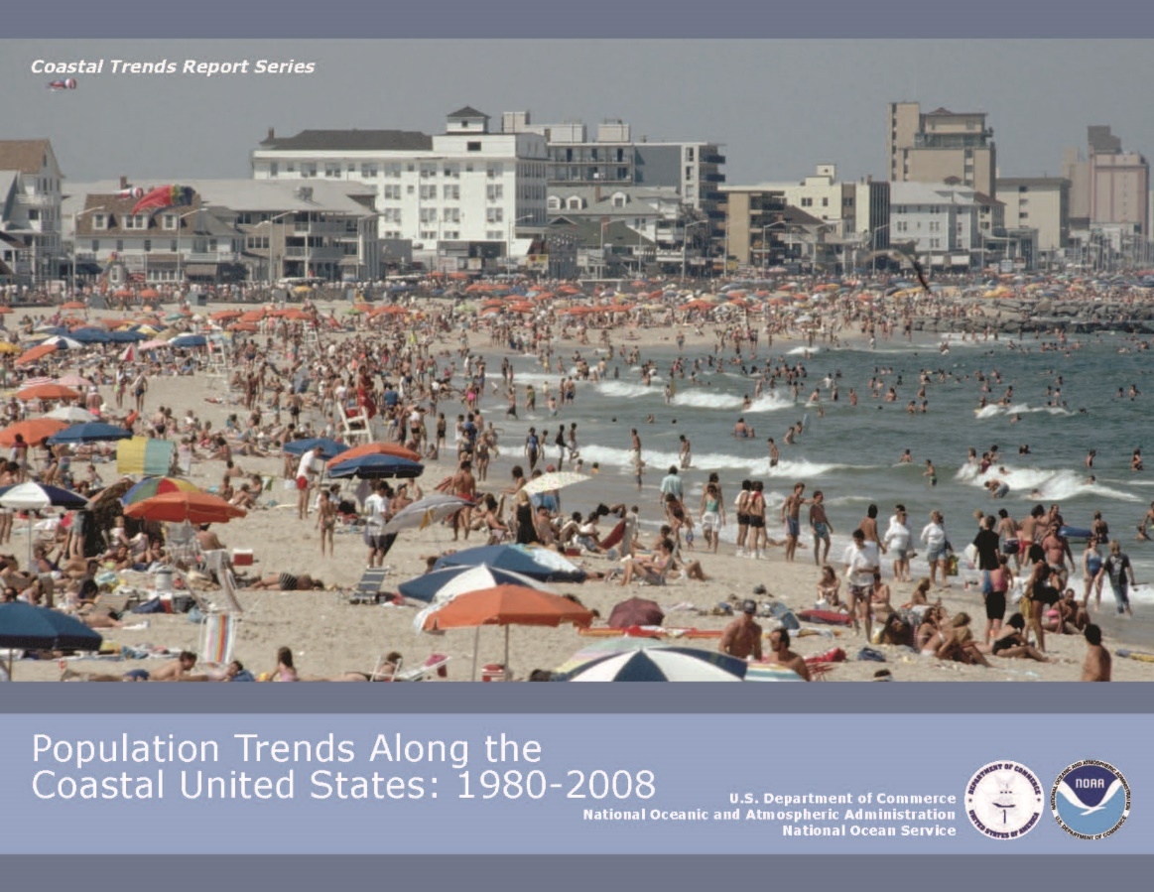
What’s so special about our coasts?
Lots of people live there!
Notes:
44.8 percent of the US population lives in coastal counties (US Census, Sept. 2017
Coastal population grew at 9.4% rate from 2006-2016

Slide 4
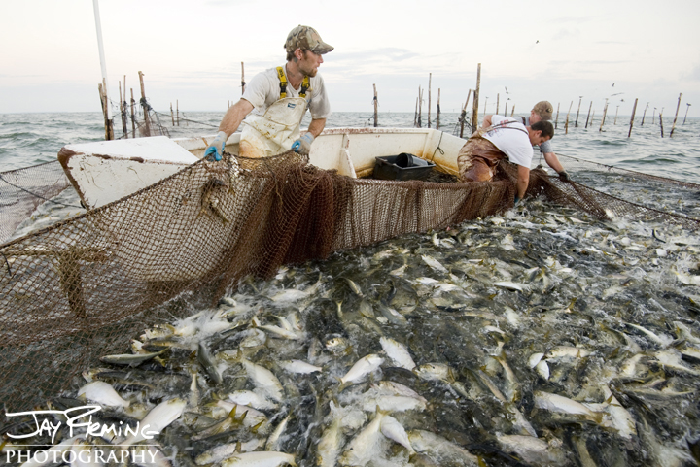

What’s so special about our coasts?
Lots of fish to harvest there!
Notes:
Coastal fisheries contributes nearly $90 billion yr⁻¹ (60/30 commercial/recreational) and over a half million jobs (The Hamilton Project, Sept. 2014, Brookings)

Slide 5
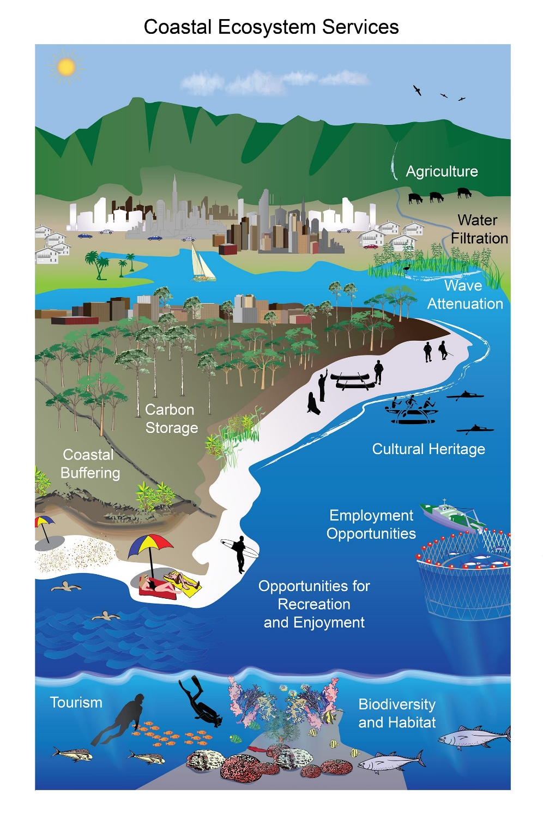

What’s so special about our coasts?
Coastal habitats provide ecosystem services essential to people and the environment
Source: National Climate Assessment, 2014
Notes:
Goods & services in the $ billions yr⁻¹ (Costanza et al. 1997, cited in EPA843-F-06-004)

Slide 6
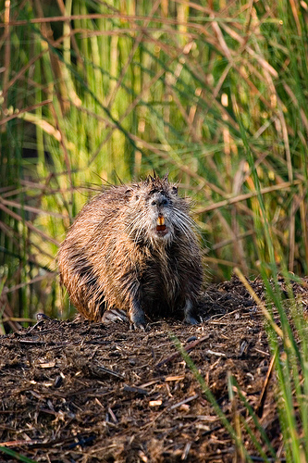

Coastal Habitats Ecosystem Services
Marshes are yummy!

Slide 7
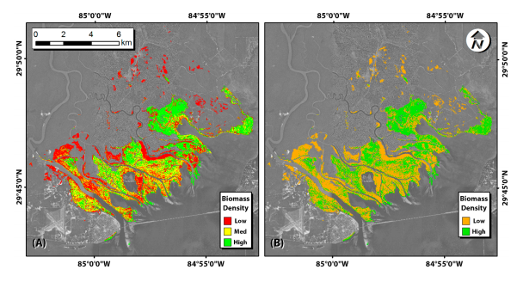


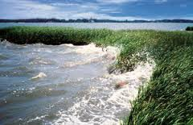
But why does Geodesy matter to coastal science and management?
Let’s ask some folks at NGS…

Slide 8
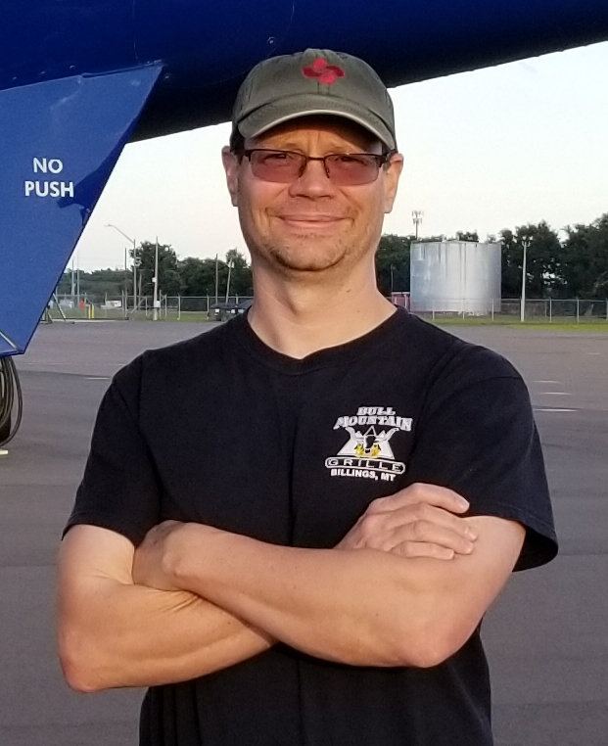
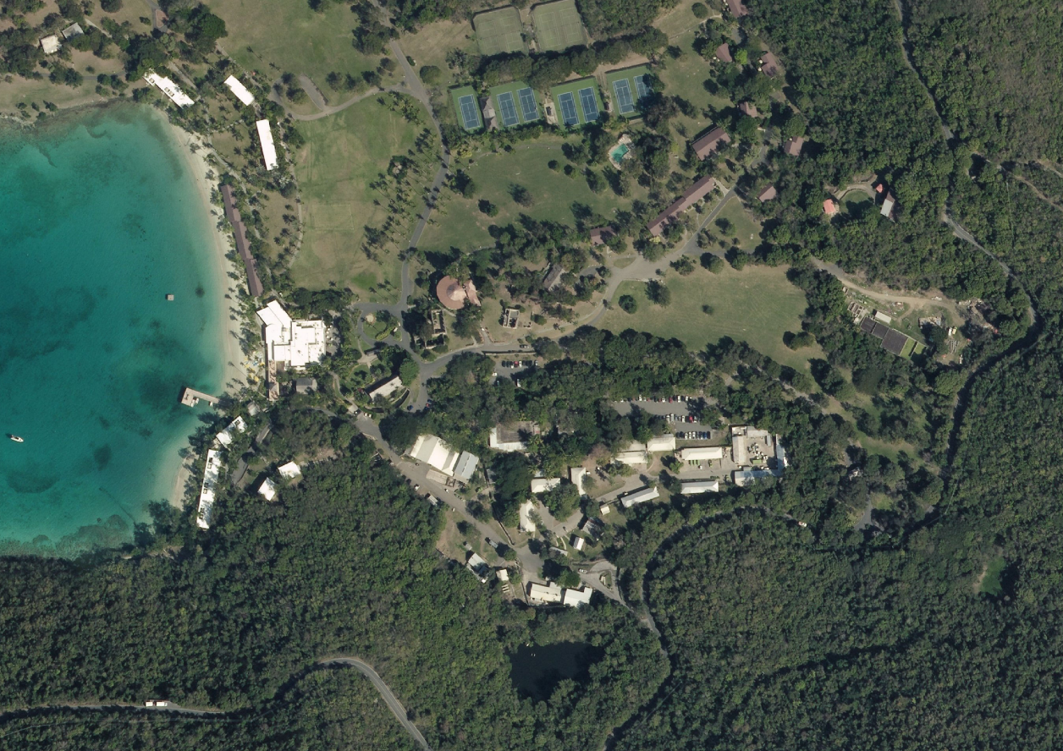
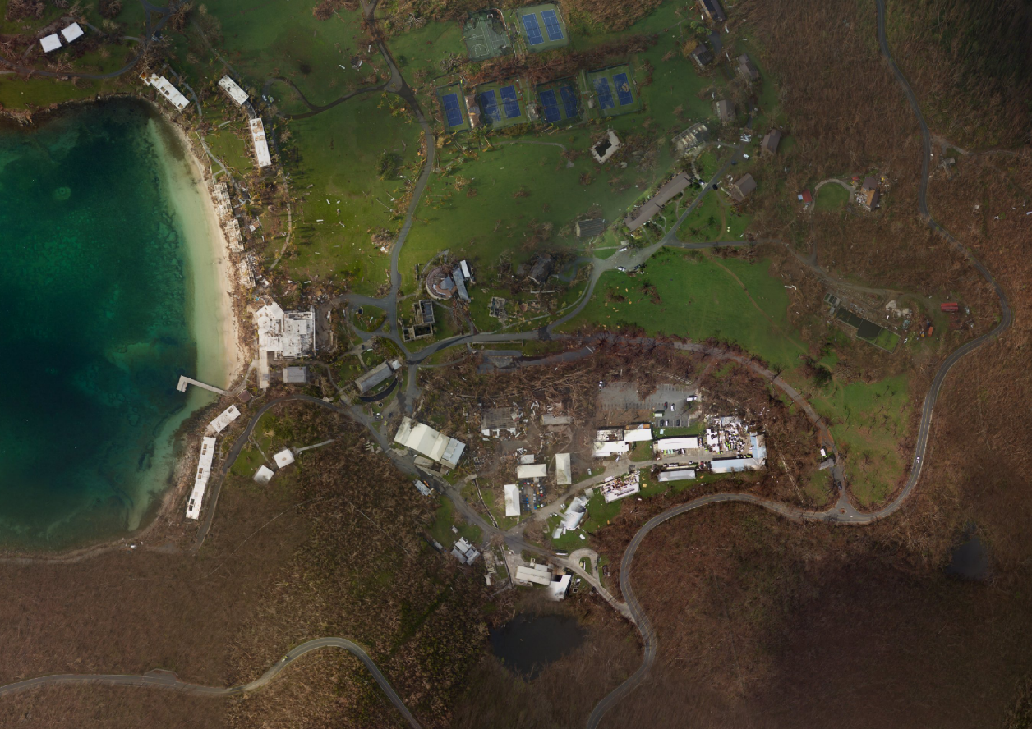
Jon Sellars Cartographer, Remote Sensing Division
“Accurate elevations are essential to processing emergency response imagery in a timely manner following hurricanes”
After Irma
Before Irma

Slide 9
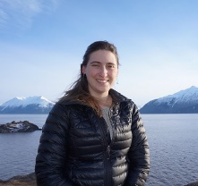
Nic Kinsman Alaska Regional Geodetic Advisor, Geodetic Services Division
Elevations matter for FEMA flood maps!

Slide 10
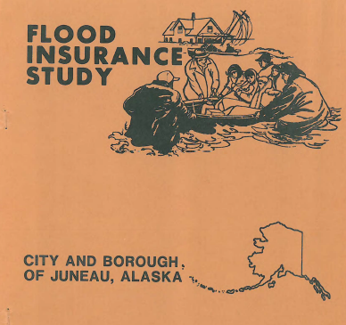


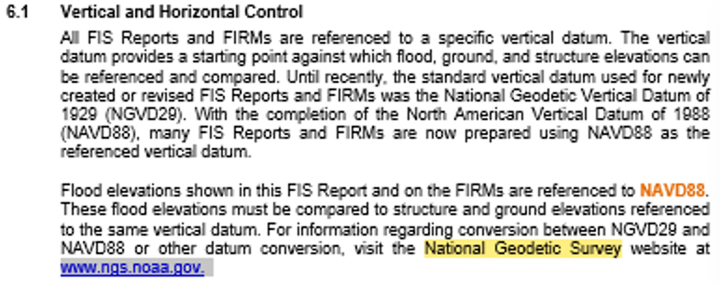
Critical Role of NSRS Outreach and Modernization to FEMA’s National Flood Insurance Program (NFIP)
Together, these two quintessential voice messages provide a clear, concise, and powerful illustration of why we need to work more closely with FEMA to ensure that Base Flood Elevations (BFEs) are reflective of true risk, and how NSRS modernization will improve flood mapping.
… this is why what we do matters to the Nation.
Example 1
Importance of outreach
Flood Plain Manager
Example 2
Importance of NSRS Modernization
NFIP Home Owner
14. 6ft NAVD88?
14. 9ft NAVD88?
In or out of 14.7 ft NAVD88 BFE??

Slide 11
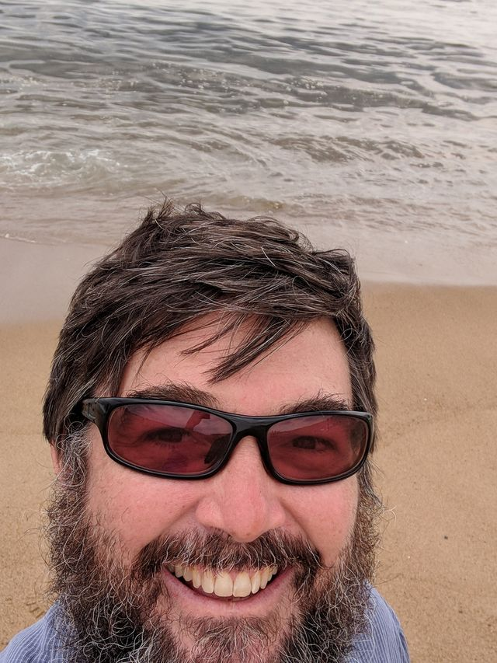
Galen Scott Program Analyst, Geosciences Research Division
What keeps coastal managers up at night?
According to Dave Carter, DE’s Coastal Zone Manager:
“When will storm events breach hazardous waste containment berms?”

Slide 12
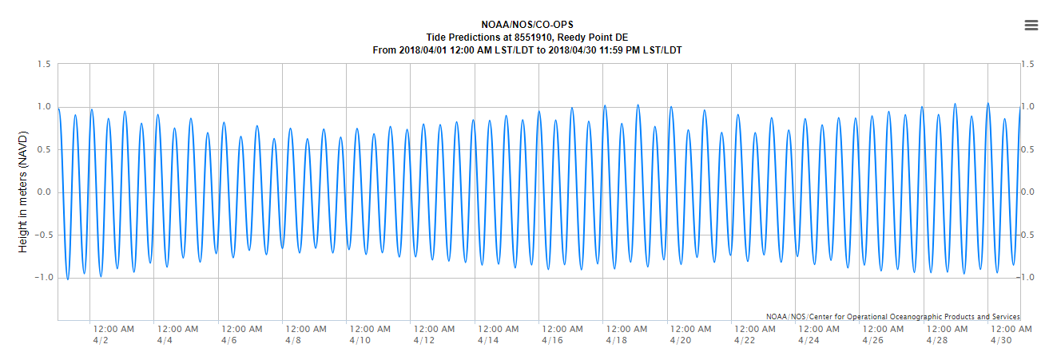
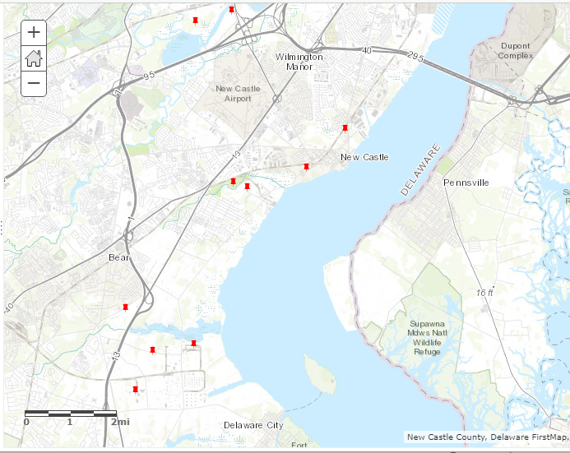
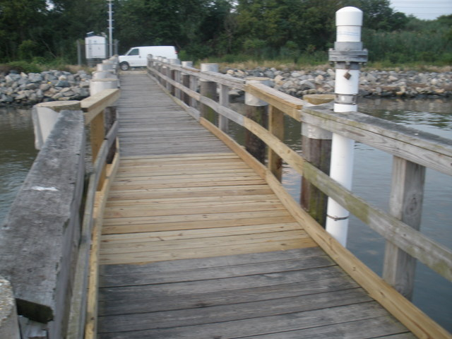
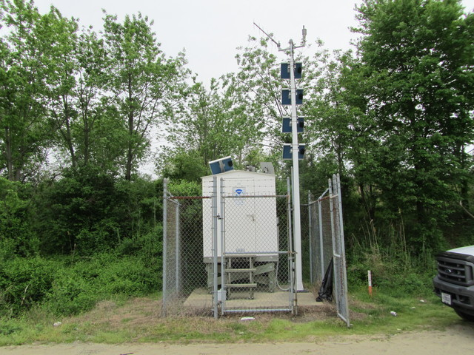

Station 8551910 Reedy Point, DE

Slide 13
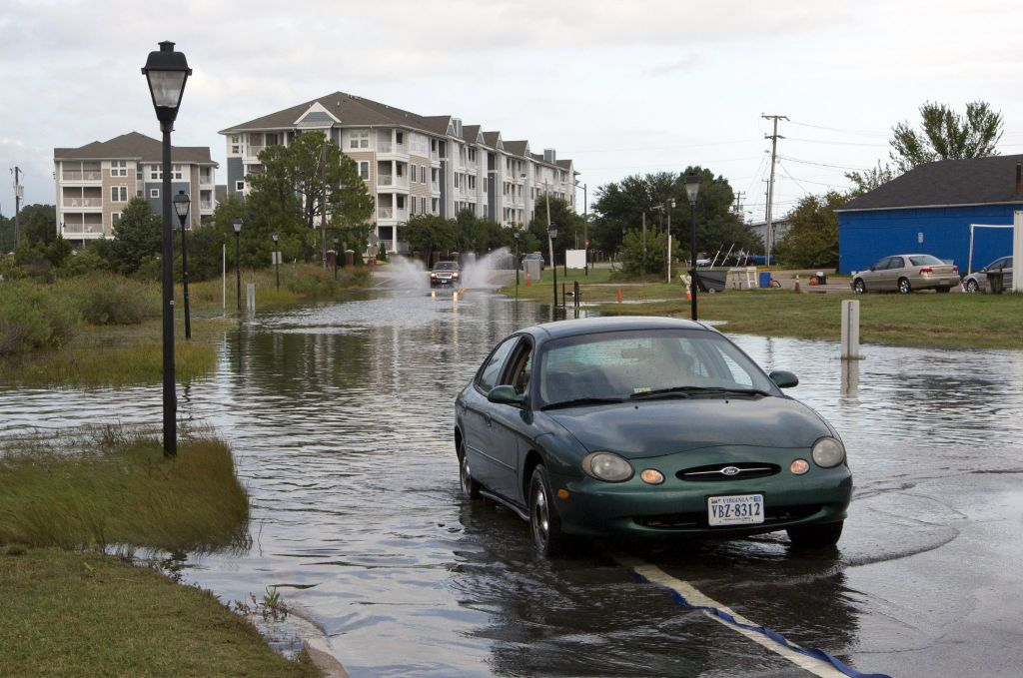
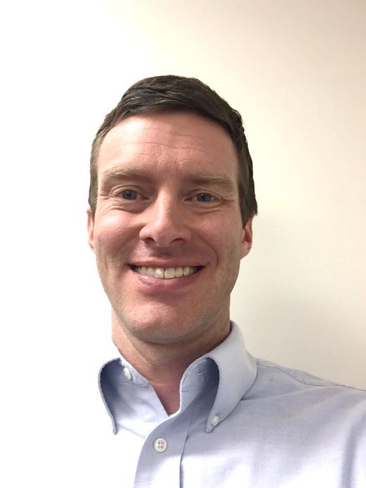
Ryan Hippenstiel, Chief, OAD Field Operations Branch
NGS is providing the geodetic expertise so the Hampton Roads Planning District Commission can better evaluate how vertical land motion is affecting nuisance flooding

Slide 14
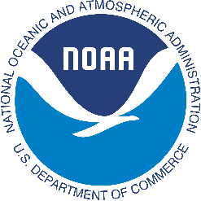
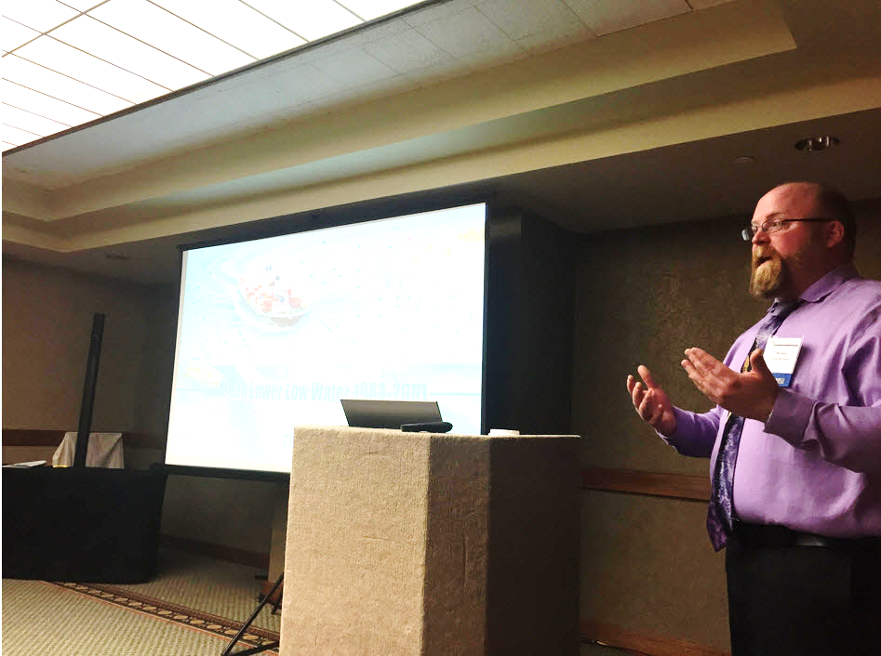


Michael Michalski Lead Oceanographer, Center for Operational Oceanographic Products & Services
Connecting the water with the land is a key need for end users.
Without the relationship between the tidal and geodetic datums the value of the real time as well as historic data has a significantly reduced functionality in supporting coastal communities.
GPS
Receiver
GPS Receivers collecting simultaneous data over existing bench marks allow for datum transformation.
Through the use of OPUS shared solution and IDB data sheets CO-OPS is able to provide that link to our customers and enhance the VDatum program.
Tide
Gauge
Tidal Bench mark
4811 G 2004
3.150 m
NOAA
Pier
1.150 m
(example)
MHW
2.736 m
Tidal Bench mark
4811 G 2004
Geodetic Benchmark
(and its WGS84 value)
Relative to Tidal Datum
2.000 m
1.220 m
Bench mark
with geodetic control
(NAVD88, WGS84,etc.)
MLLW
NAVD88
0.7428 m
Orifice
Station Datum

Slide 15

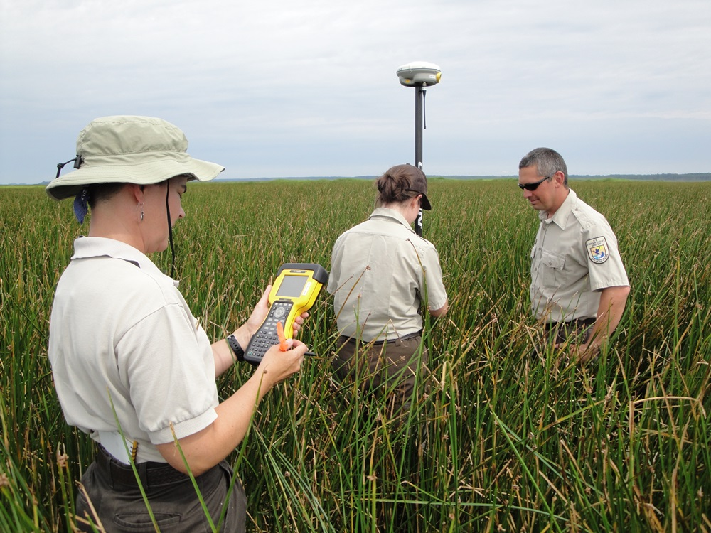
Laura Mitchell Biologist, US Fish & Wildlife Service
NGS supports FWS adaptive management by providing training and access to the NSRS so I can track how wetlands respond to sea level change over time

Slide 16

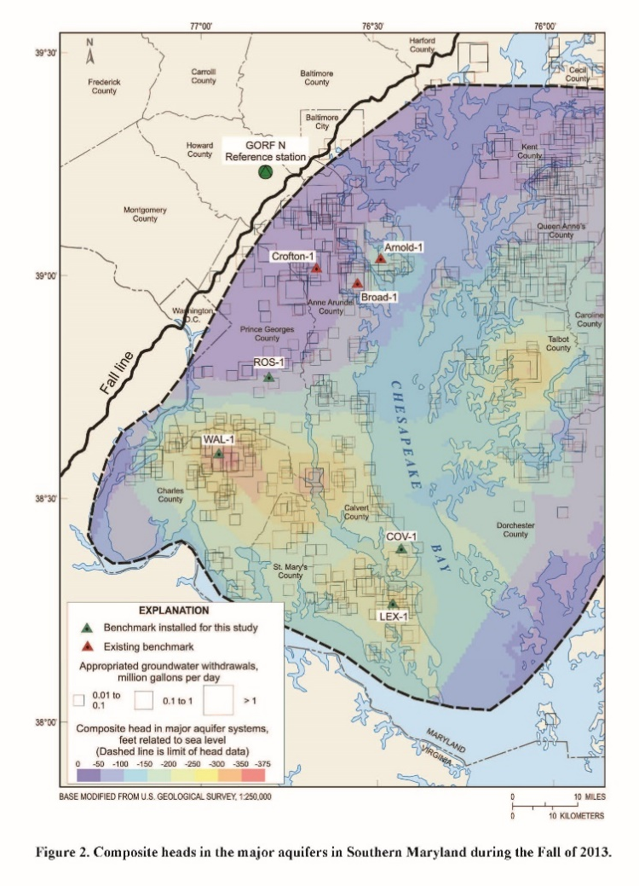
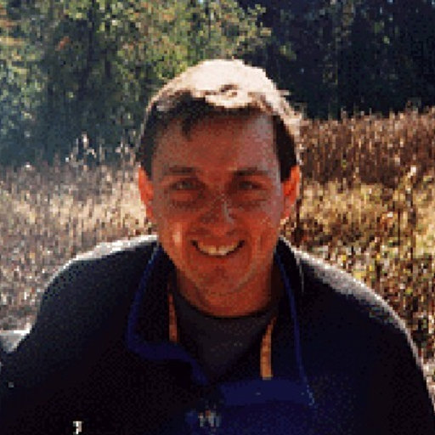
David Andreasen
Geologist, MD Geological Survey
OPUS Projects allows us to consistently process our GPS-based coastal subsidence monitoring project across Southern Maryland

Slide 17
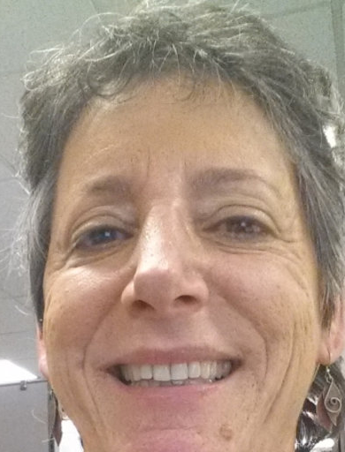
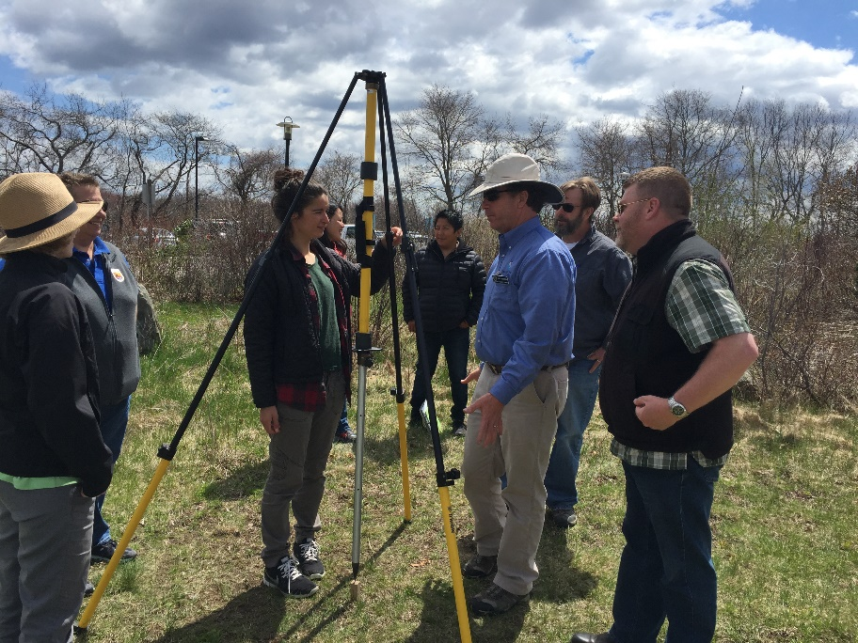
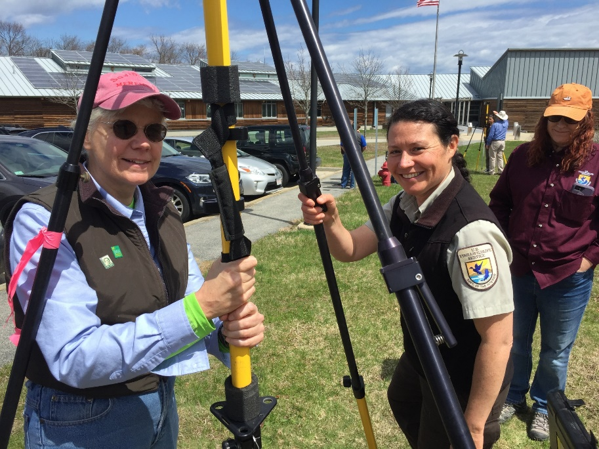
Nina Garfield
Stewardship Coordinator, Office for Coastal Management
Thanks to NGS for adapting surveying and observational technology to monitor impacts of sea level rise on marshes within the National Estuarine Research Reserve System (2017 NOAA bronze star for technology transfer)

Slide 18
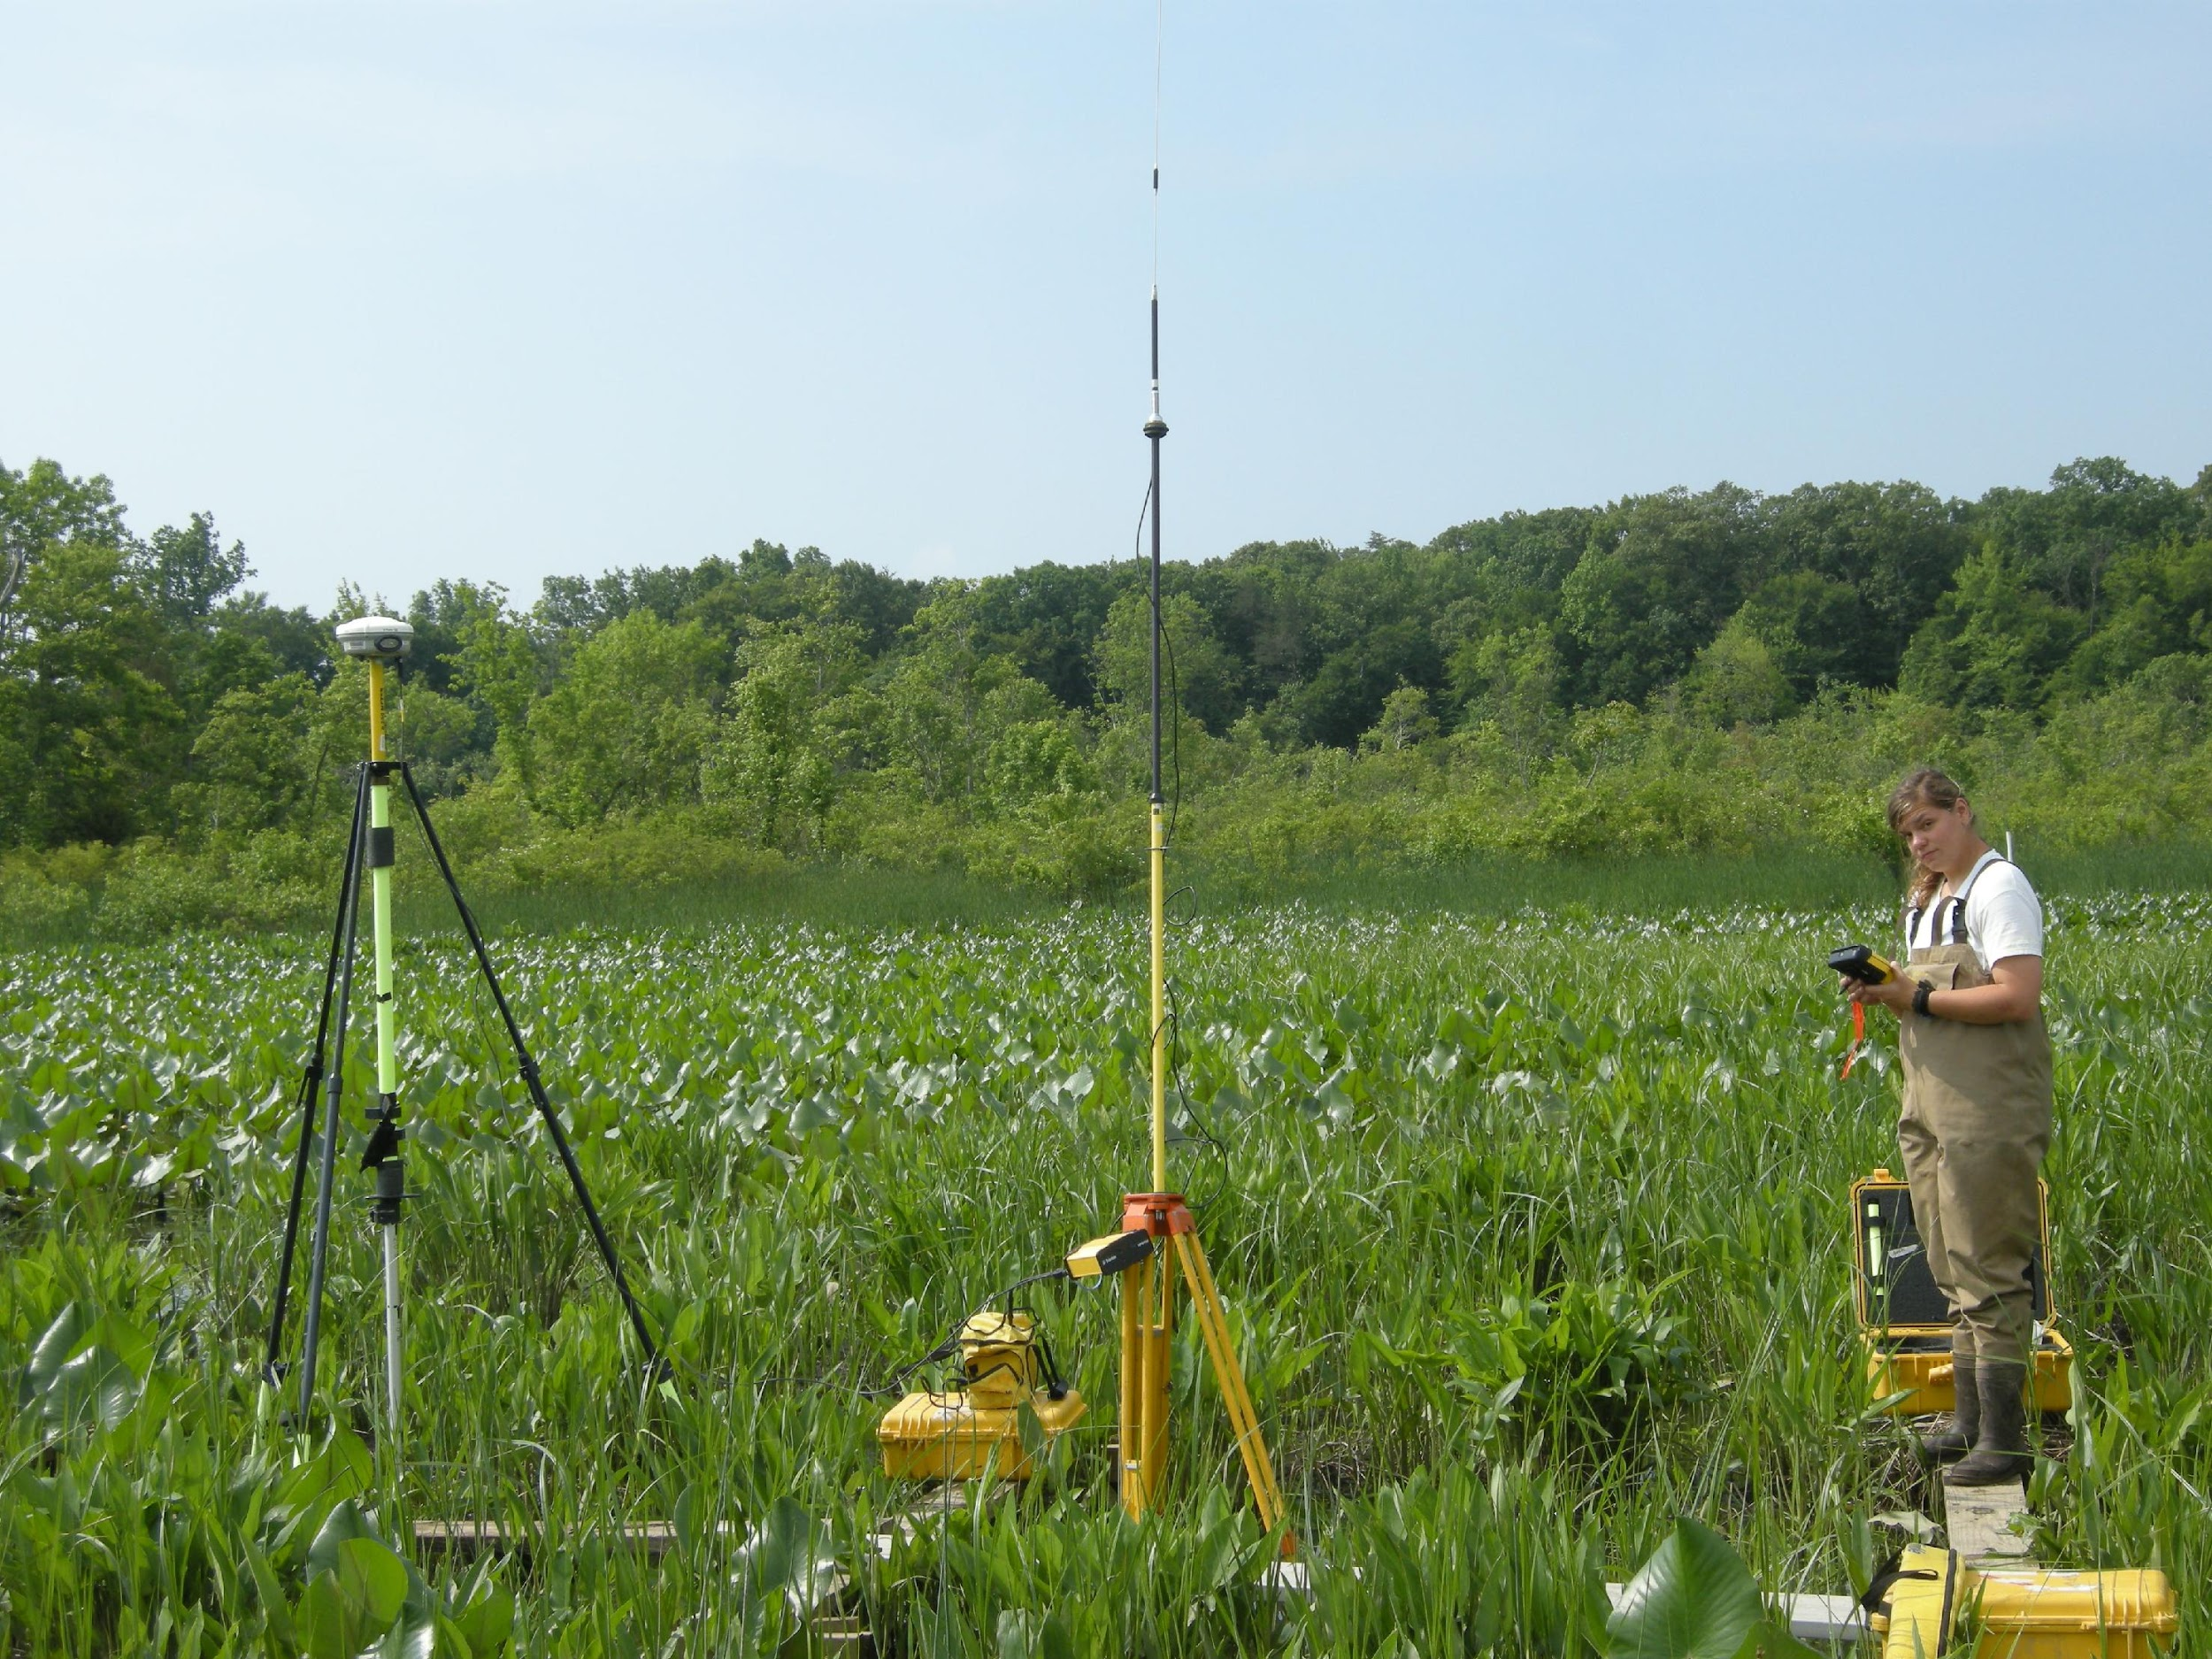
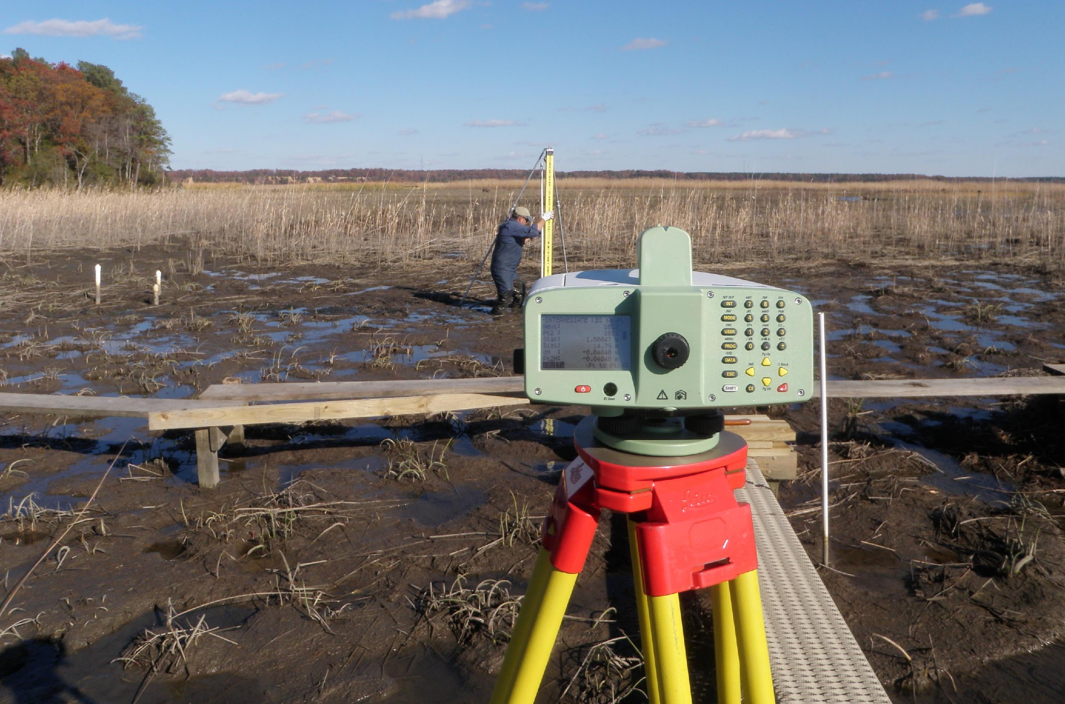
15 years of NGS Eco 2003-2018
Works closely with CO-OPS and other NOS partners to support coastal research and management needs
Supports the translation and training of geodesy and survey science to coastal practitioners
Researches traditional and novel applications of surveying to support coastal science and management
Help make the “grey” relevant to the “green” and “blue.”

