Slide 1
Development of a Modernized NSRS in the U.S.
Michael Dennis, PhD, PE, PLS
NOAA’s National Geodetic Survey

Slide 2

National Geodetic Survey (NGS) Mission
To define, maintain and provide access
to the National Spatial Reference System (NSRS) to meet our Nation’s economic, social, and environmental needs.
The NSRS is a consistent coordinate system that defines latitude, longitude, height, scale, gravity, orientation, and shoreline throughout the United States.

Slide 3
“Modernizing” the NSRS means:
Update all NSRS coordinates
  Replace existing datums with new datums
  Account for coordinates changing with time
Improve NGS products and services
Simplify customer contributions
Make the NSRS:
  More accurate
  More accessible
  More efficient
  More compatible with GNSS
Rollout in
2025

Slide 4
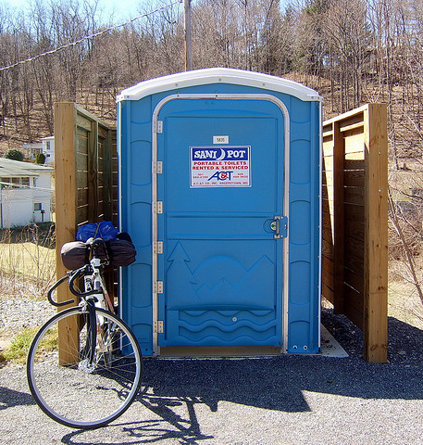
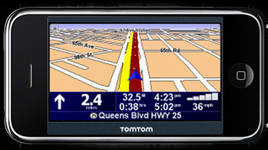
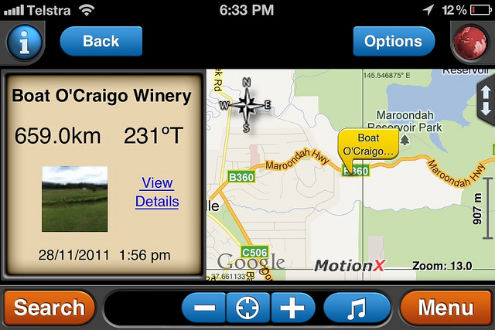
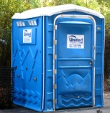
Why is NSRS Modernization important?
Because our society and economy are becoming increasingly “spatially enabled”
Geodesy: the science of where things are
Cycle
Pit Stop
GPS
Pee Here
iPoo - the GPS toilet locator

Slide 5
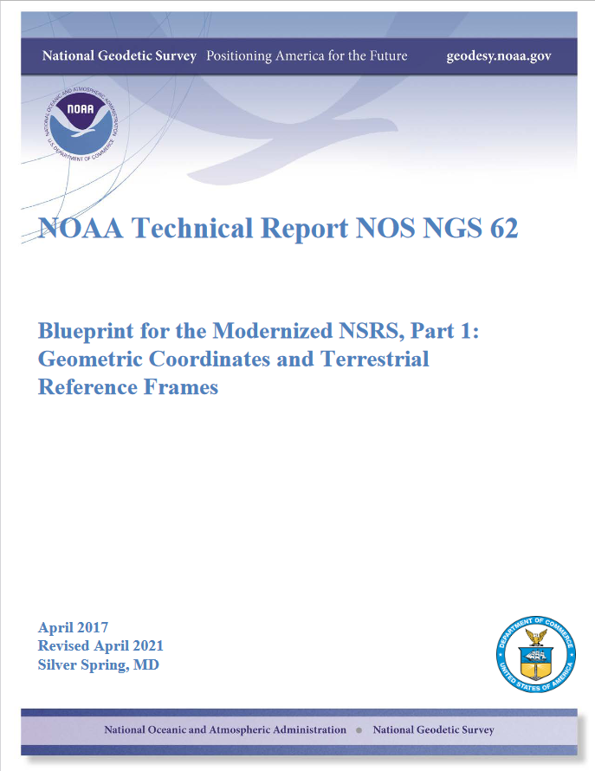


NSRS Modernization “Blueprint” documents
Geometric Coordinates and Terrestrial Reference Frames
Geopotential Coordinates and Geopotential Datum
Working in the Modernized NSRS

Slide 6
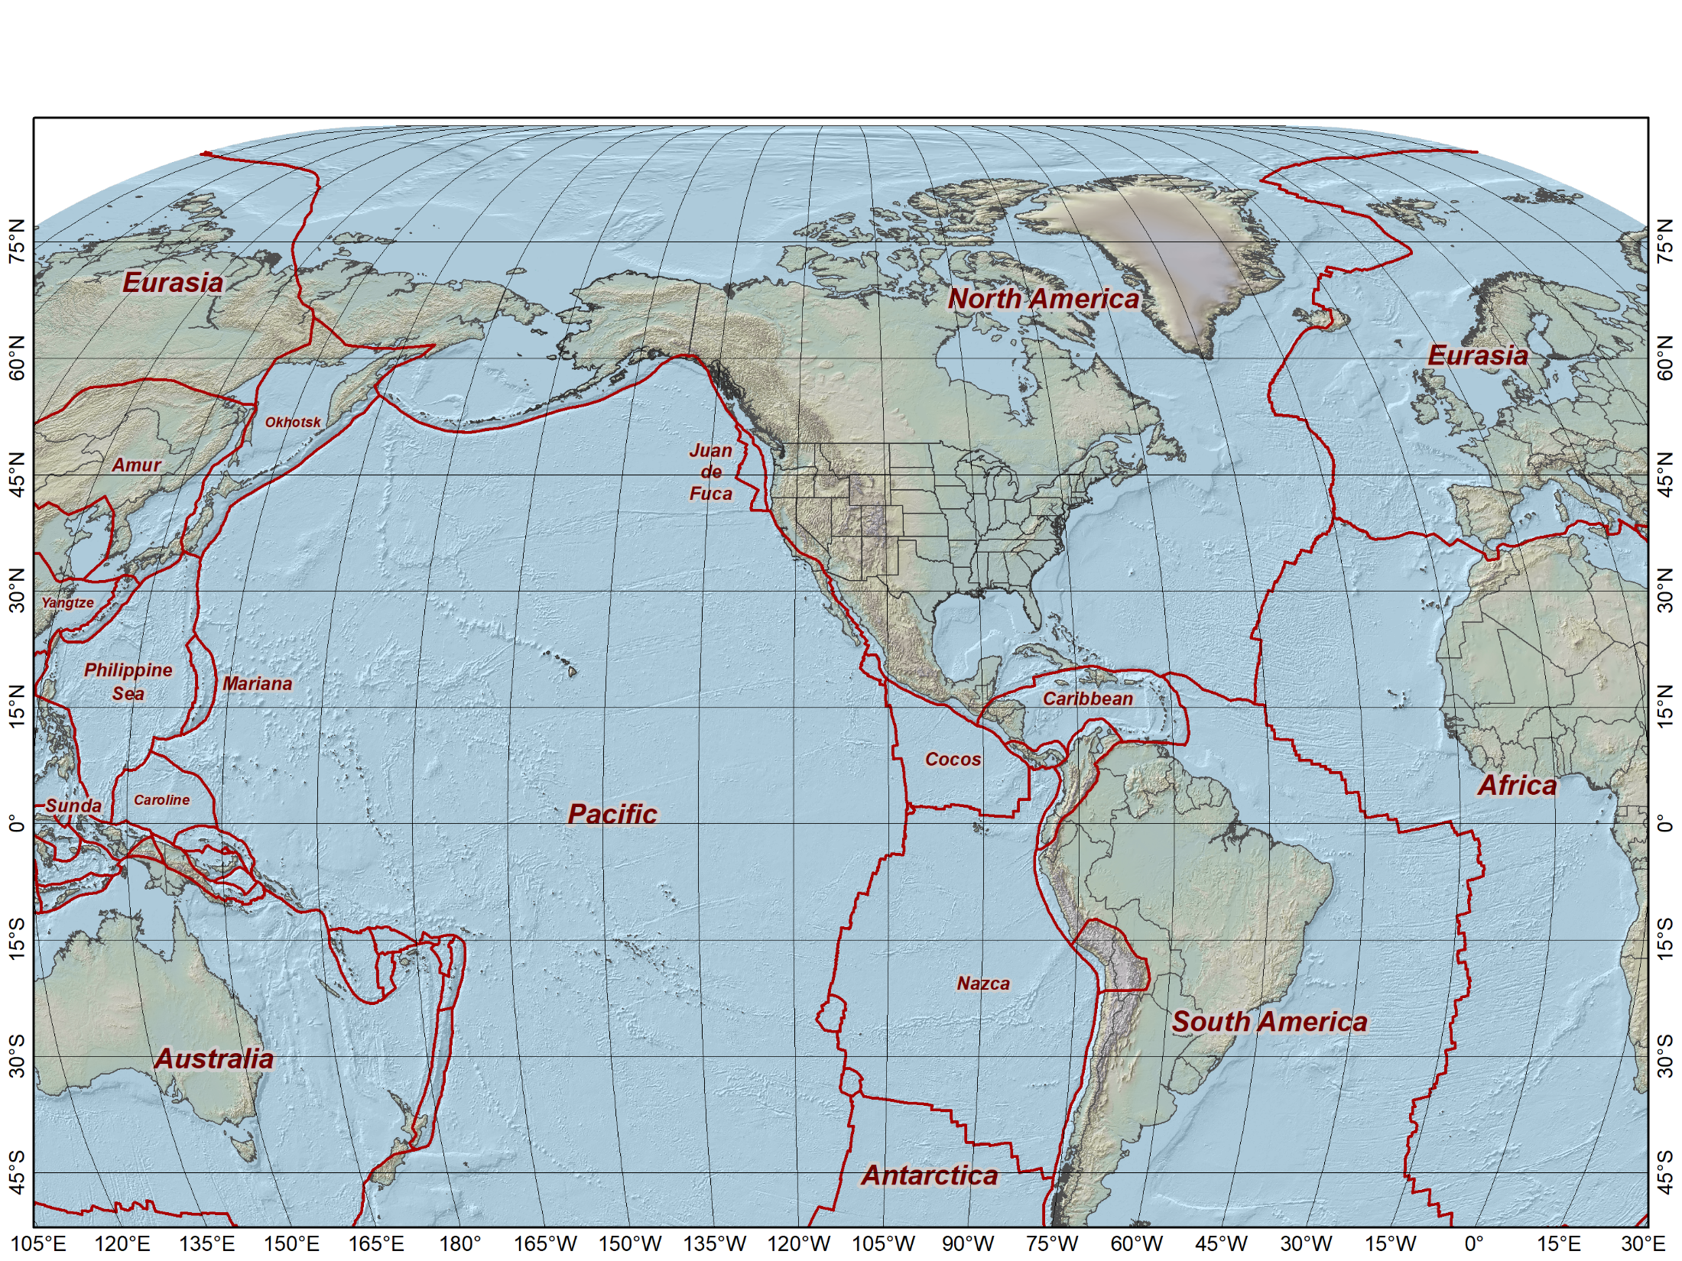
Tectonic plates

Slide 7
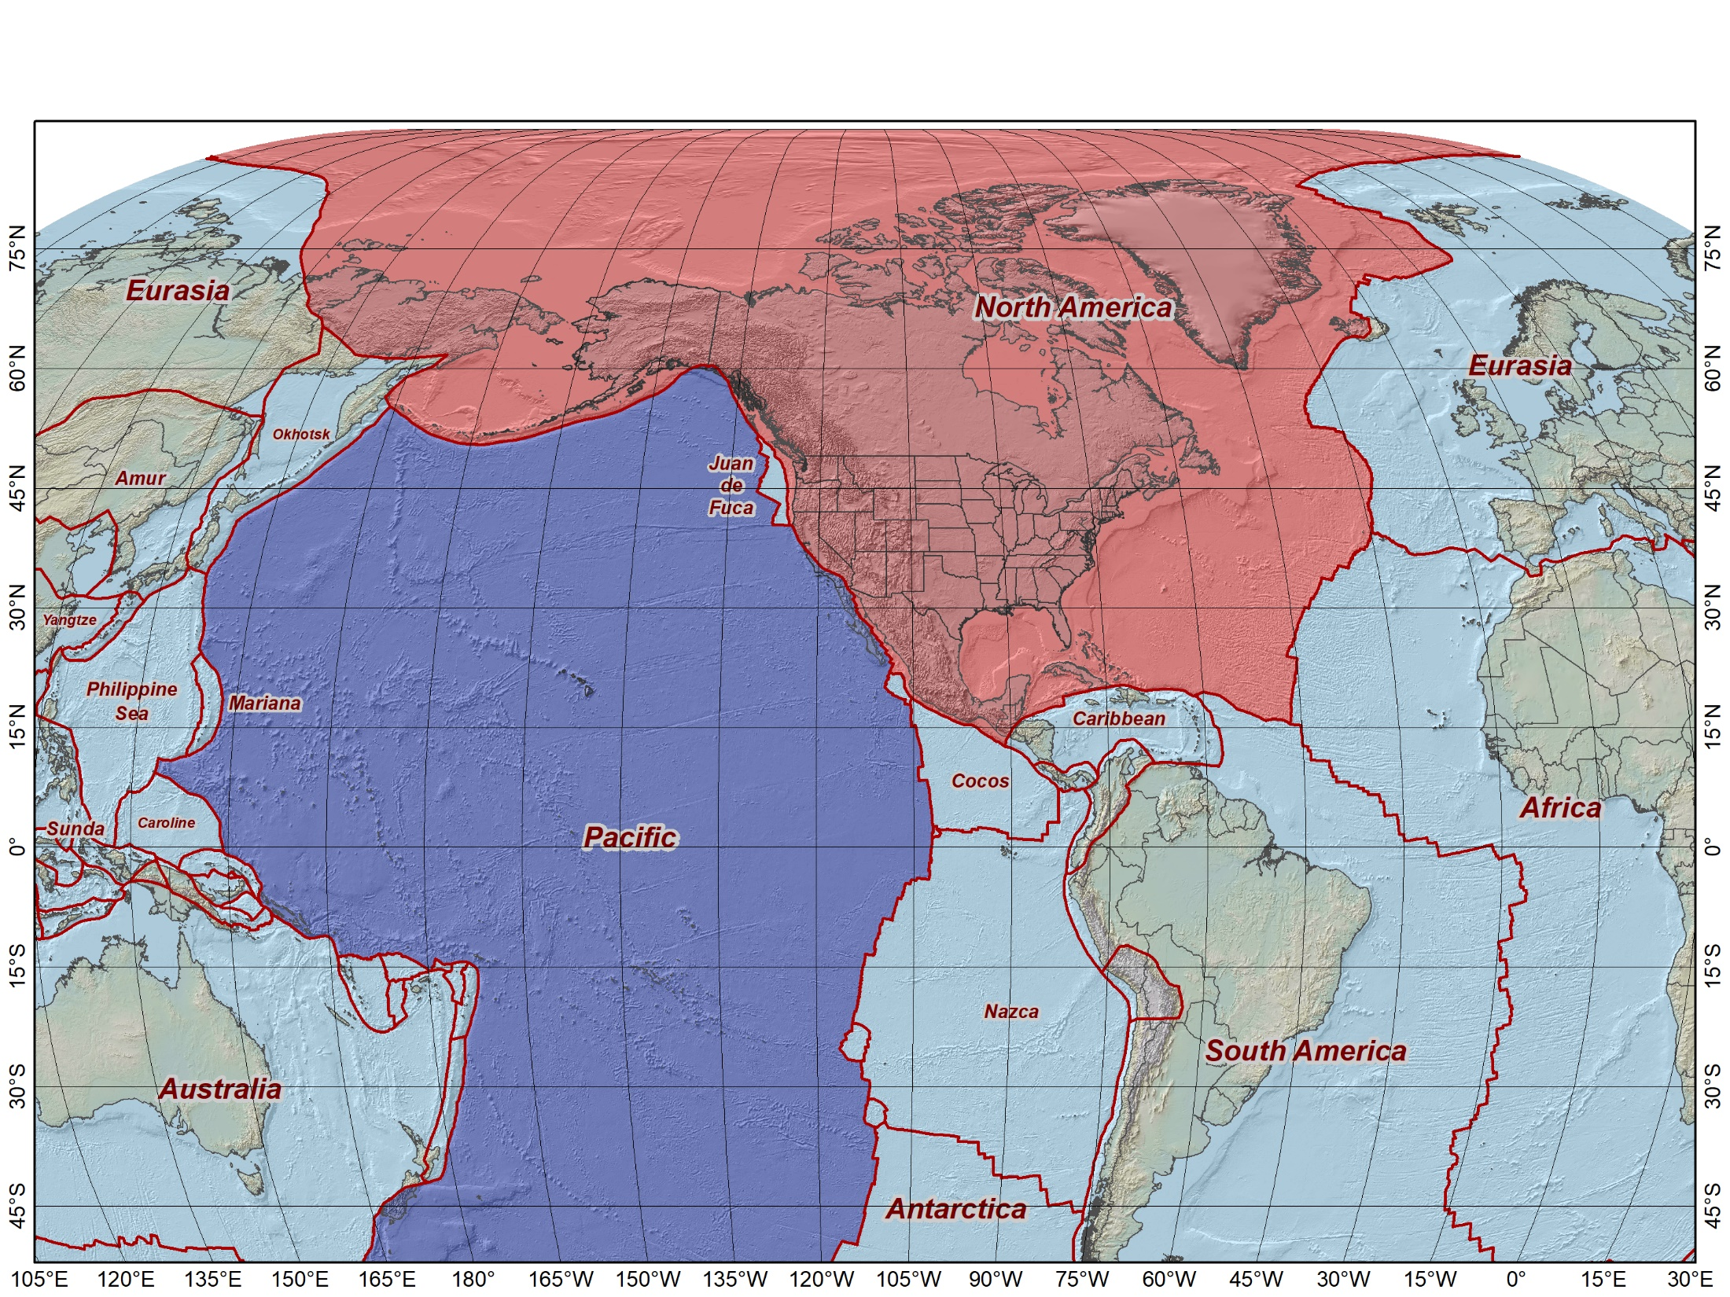

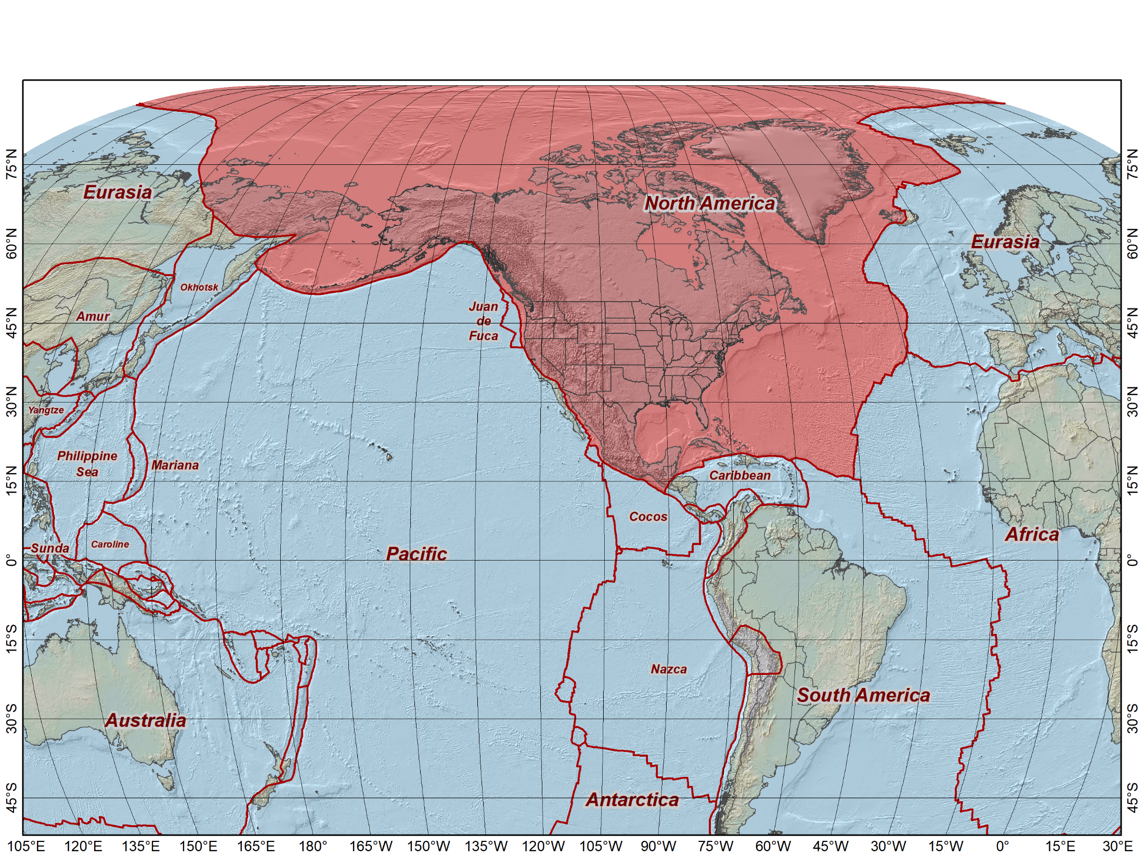
Tectonic plates “fixed” for the three existing NAD 83 frames
North American Datum of 1983 (2011) epoch 2010.0
North American Datum of 1983 (PA11) epoch 2010.0
North American Datum of 1983 (MA11) epoch 2010.0
NAD 83 (2011)
NAD 83 (MA11)
NAD 83 (PA11)
All at epoch 2010.0
(Jan 1, 2010)

Slide 8
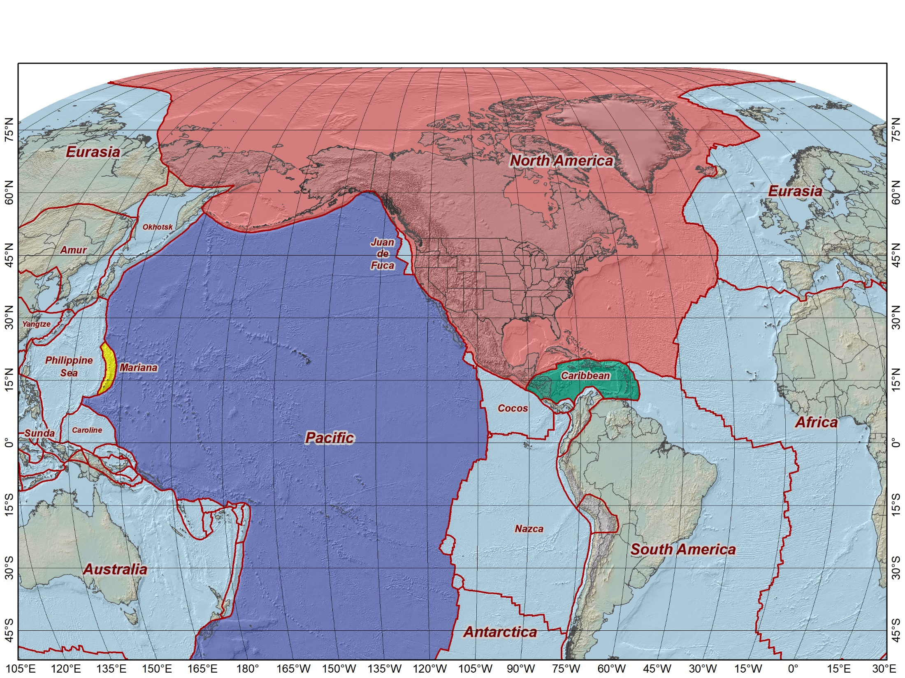
Tectonic plates “fixed” for the four 2022 Terrestrial Reference Frames
North American Terrestrial Reference Frame of 2022 (NATRF2022)
Pacific Terrestrial Reference Frame
of 2022 (PATRF2022)
Mariana Terrestrial Reference Frame
of 2022 (MATRF2022)
Caribbean Terrestrial Reference Frame
of 2022 (CATRF2022)
NATRF2022
MATRF2022
PATRF2022
CATRF2022
Initially at epoch 2020.0 (Jan 1, 2020) and identical to ITRF2020

Slide 9
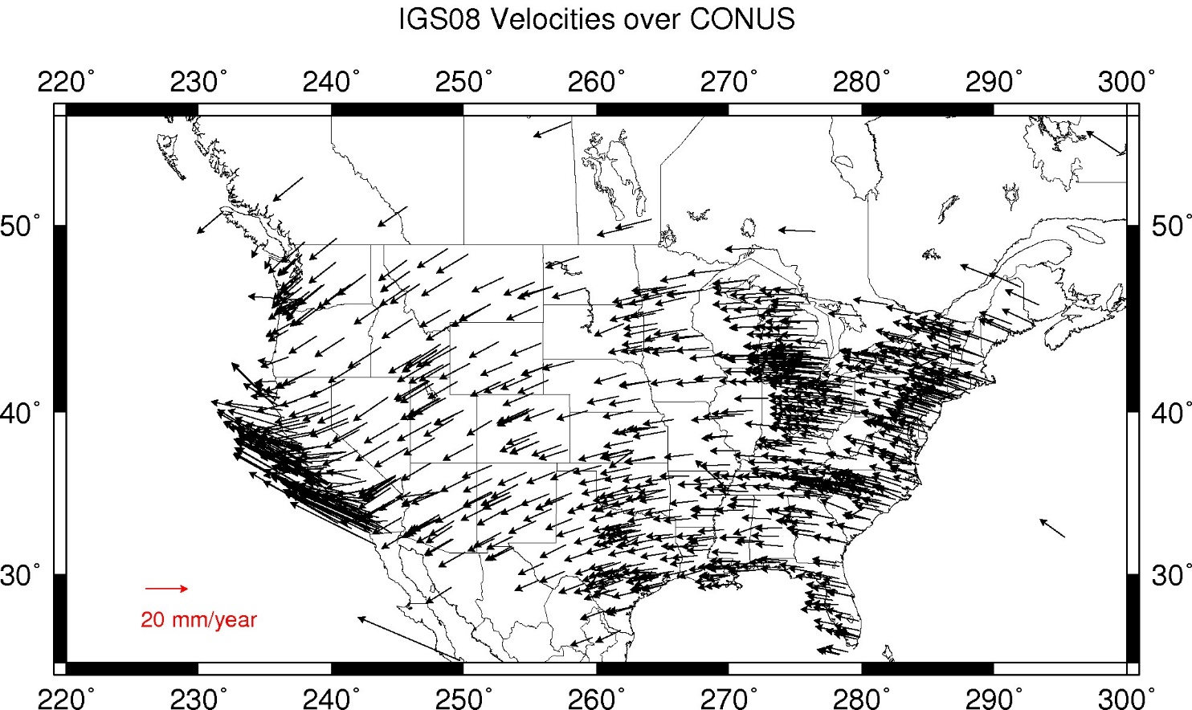
ITRF2020 velocities for CONUS

Slide 10
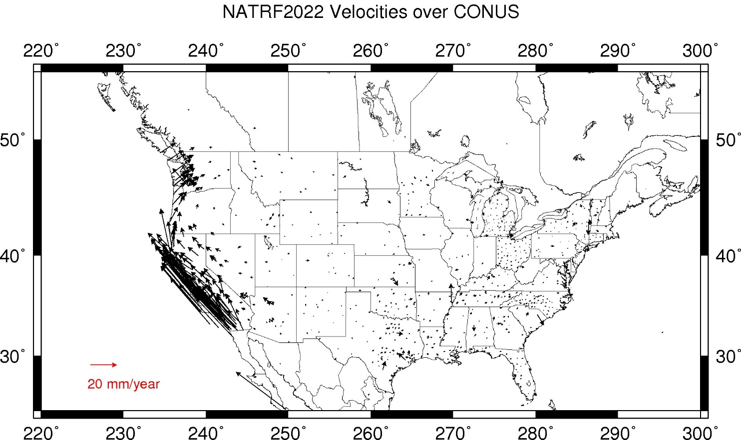
NATRF2022 velocities for CONUS

Slide 11
IFVM2022: Intra-Frame Velocity Model of 2022

Slide 12
IFDM2022: Intra-Frame Deformation Model of 2022
Crustal motion models
  Current NSRS: HTDP (Horizontal Time-Dependent Positioning)
  Modernized NSRS: IFDM2022 (Intra-Frame Deformation Model of 2022)
IFDM2022 v1.0 based (in part) on HTDP and TRANS4D
Will use TRANS4D velocity grids
  Higher resolution than HTDP
  Includes vertical component
  Includes velocity uncertainty estimates
Same earthquake models as HTDP (but likely modeled differently)

Slide 13
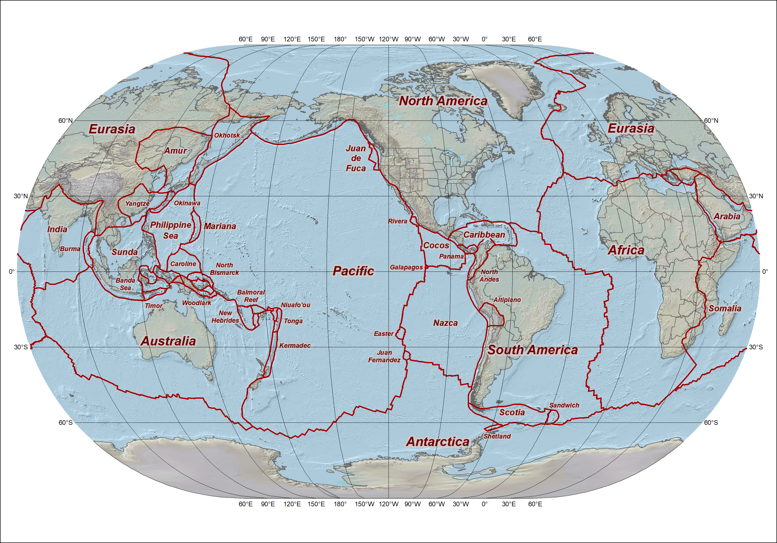
52 tectonic plates over entire planet modeled in HTDP v3.5.0

Slide 14
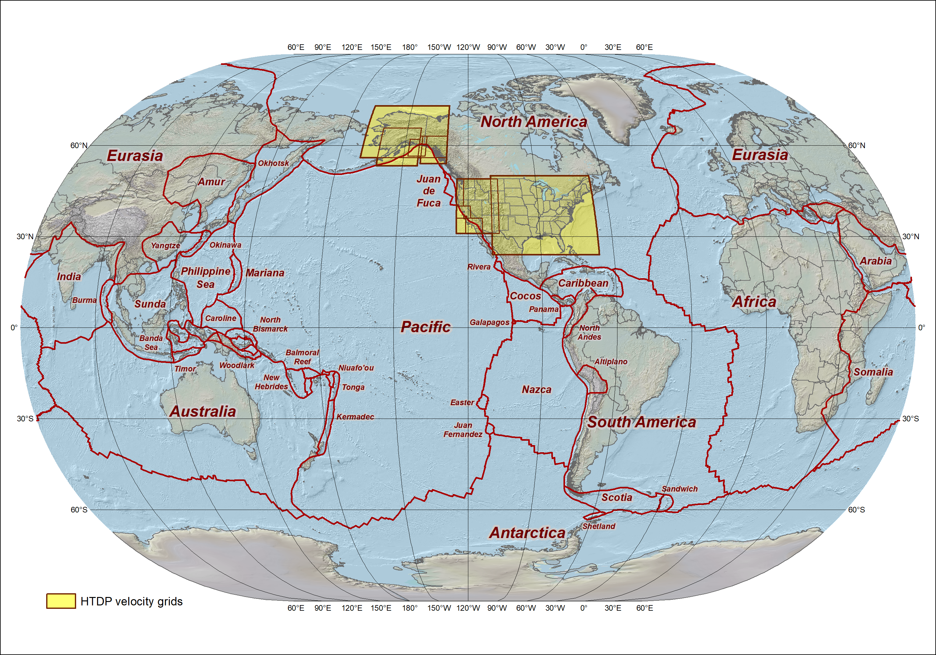
52 tectonic plates over entire planet modeled in HTDP v3.5.0
Plus 10 horizontal-only velocity grids

Slide 15
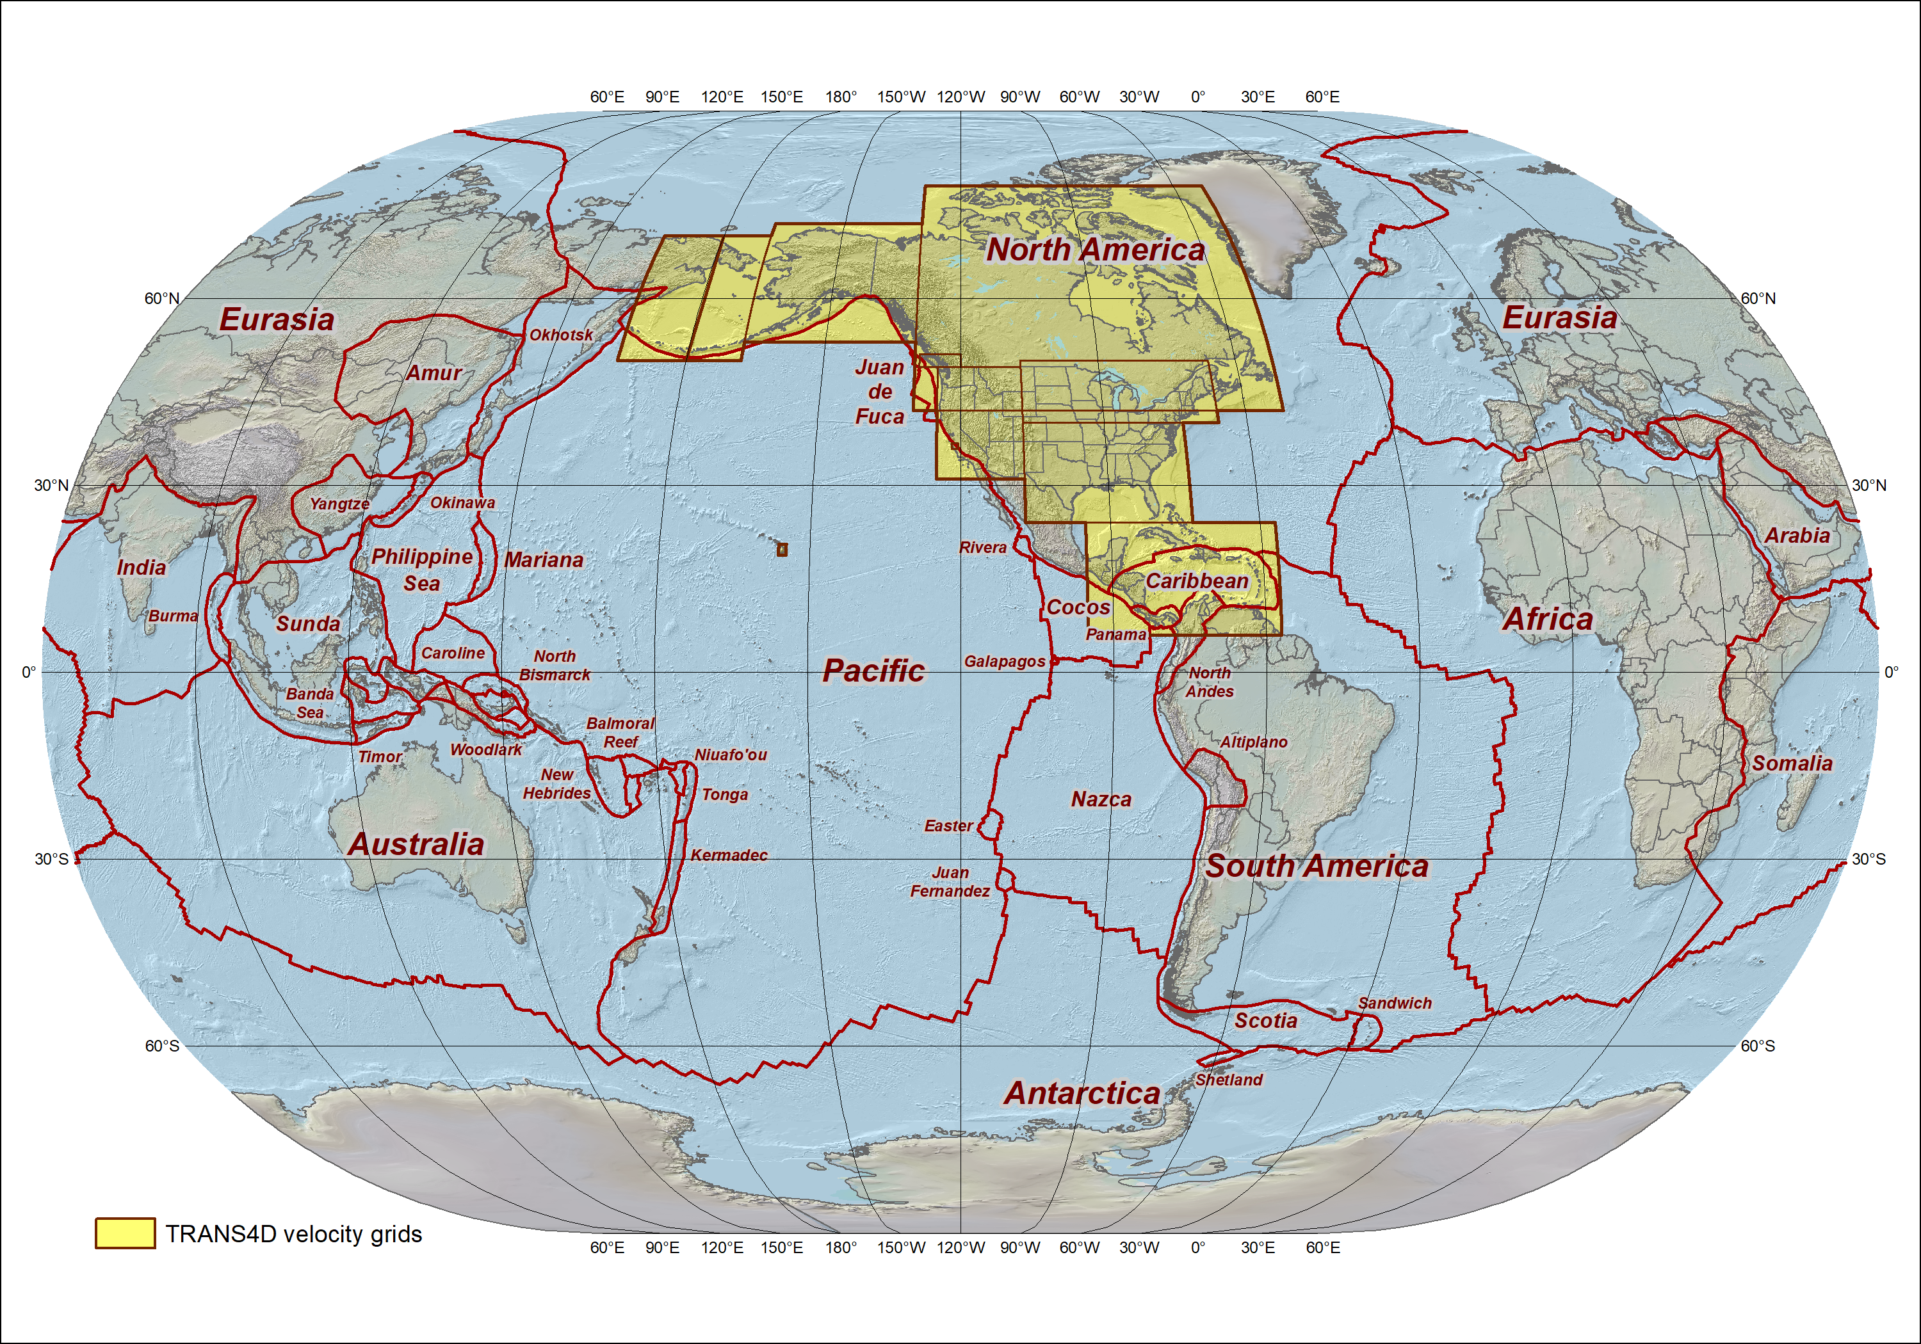
52 tectonic plates over entire planet modeled in IFDM2022 v1.0
Plus 10 3D velocity grids from TRANS4D (covering much larger area than HTDP)

Slide 16
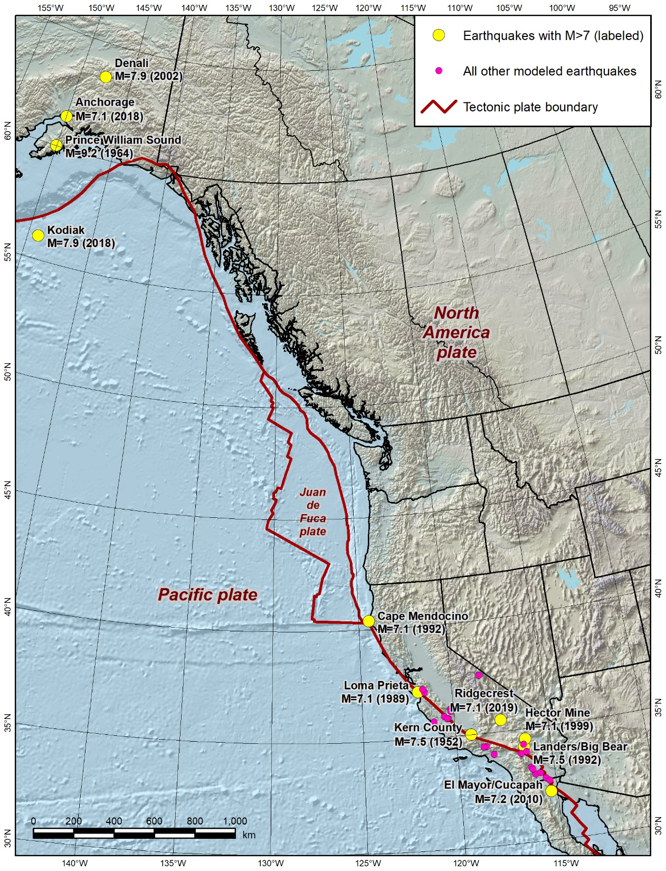
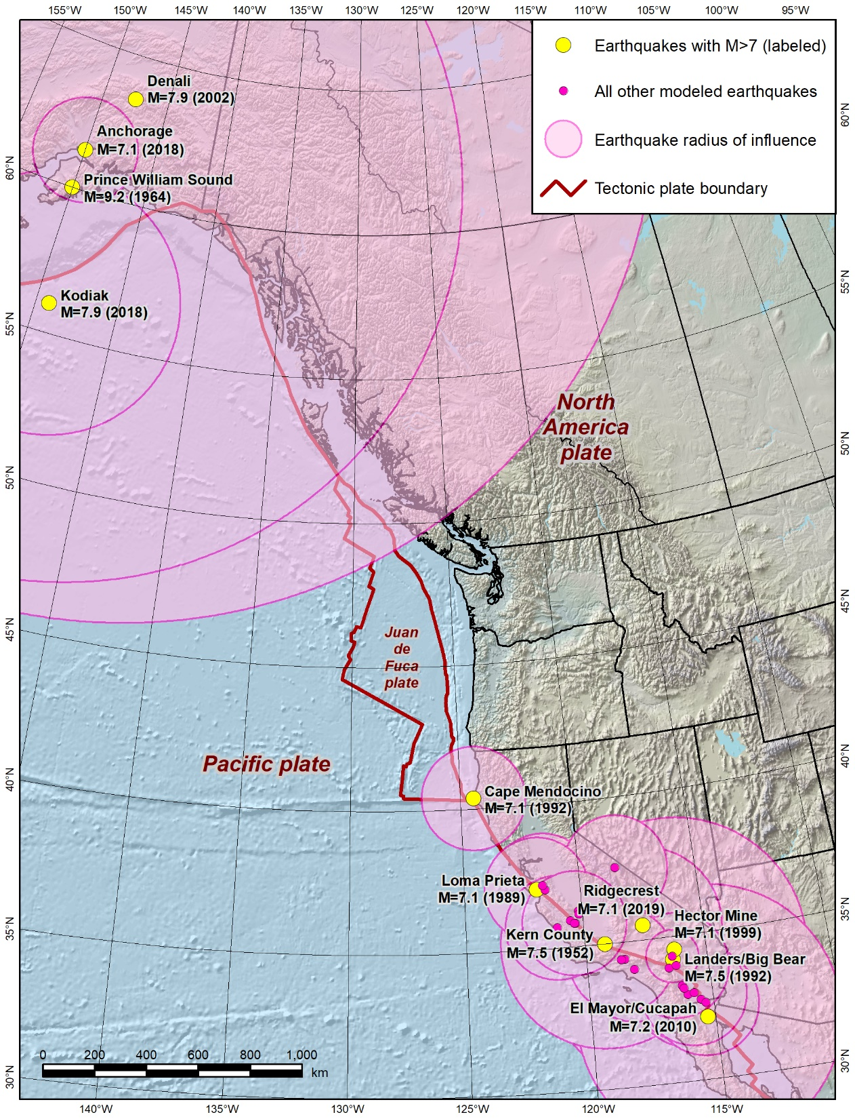
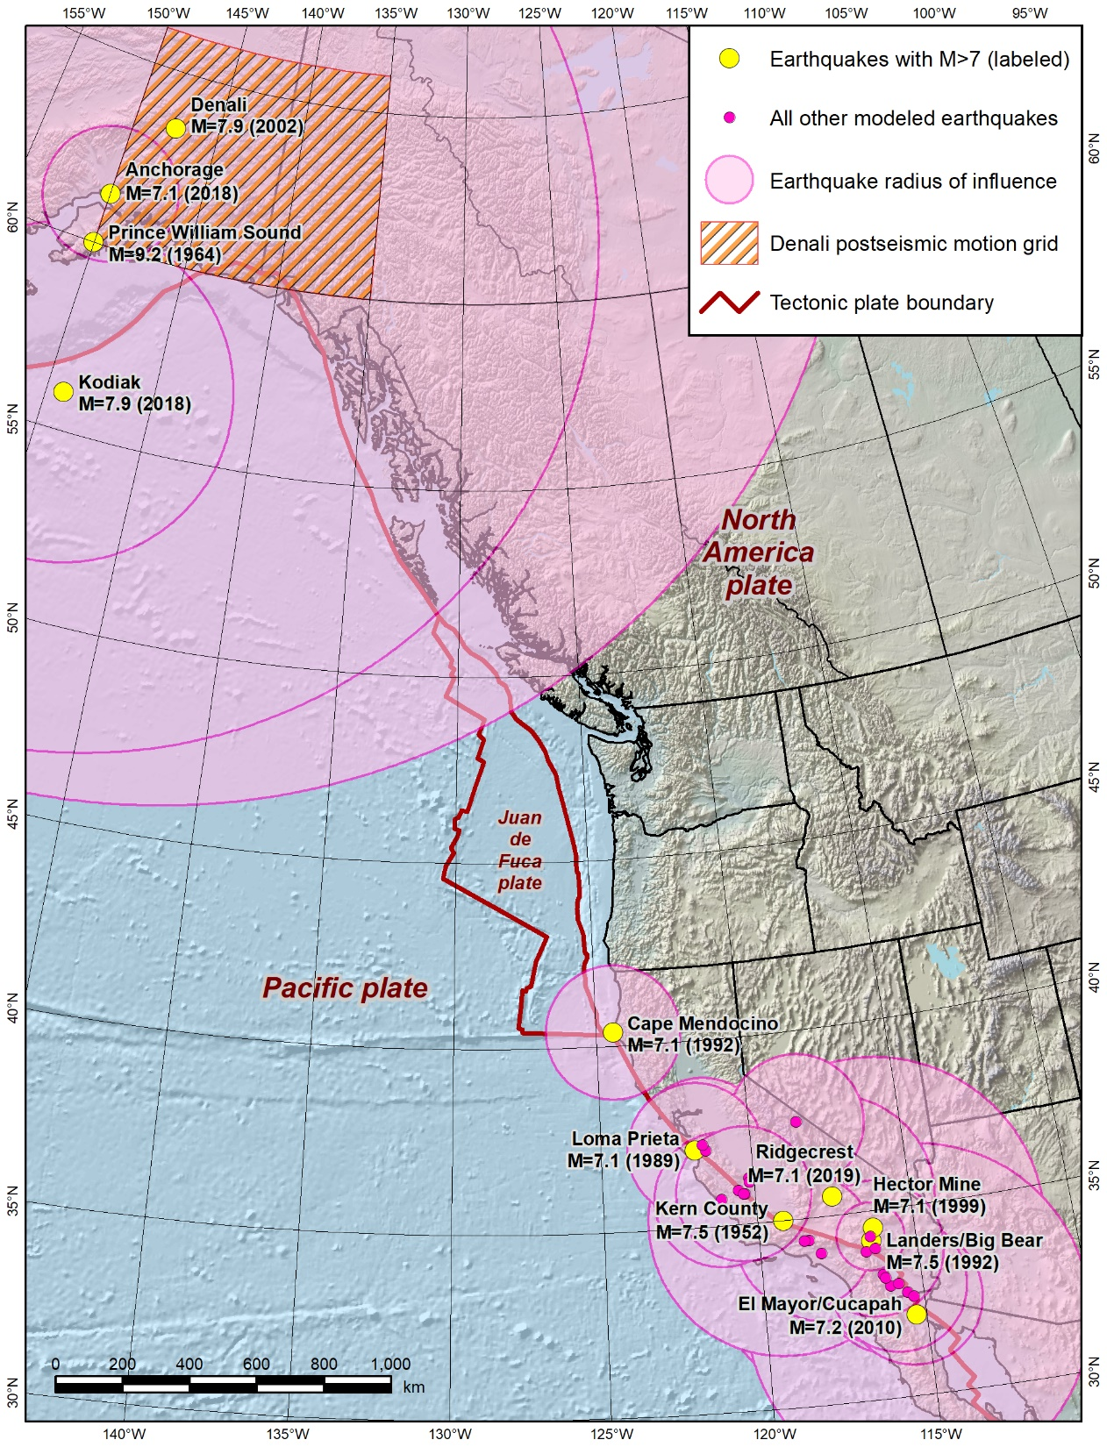
Earthquake models in HTDP v3.5.0
(and IFDM2022 v1.0)
Coseismic models
  Okada dislocation models (not grids in HTDP)
  Fault rupture surface modeled
  32 models (1934 – 2019)
Postseismic grid
  One in Alaska (2002 Denali earthquake)
  Time decay (motion decreases with time)
Problems:
  Long time lag for model development
  Models created outside NGS
  Often multiple models but must choose one
Modeled earthquakes that occurred between 2010.0 and 2020.0

Slide 17
IFDM for NSRS Modernization
Intend to use modern Open Geospatial Consortium (OGC) standards
  Geodetic Grid Exchange Format (GGXF) for grids
  Deformation Model Functional Model (DMFM), including coseismic events
Latitude/longitude grids in ITRF2020
Will give same results as NADCON at reference epochs
  Interval of 5 or 10 years (TBD)
  First is epoch 2020.0, second will be 2025.0 (or 2030.0), etc.
Coordinate with Canada to ensure consistent results across border

Slide 18
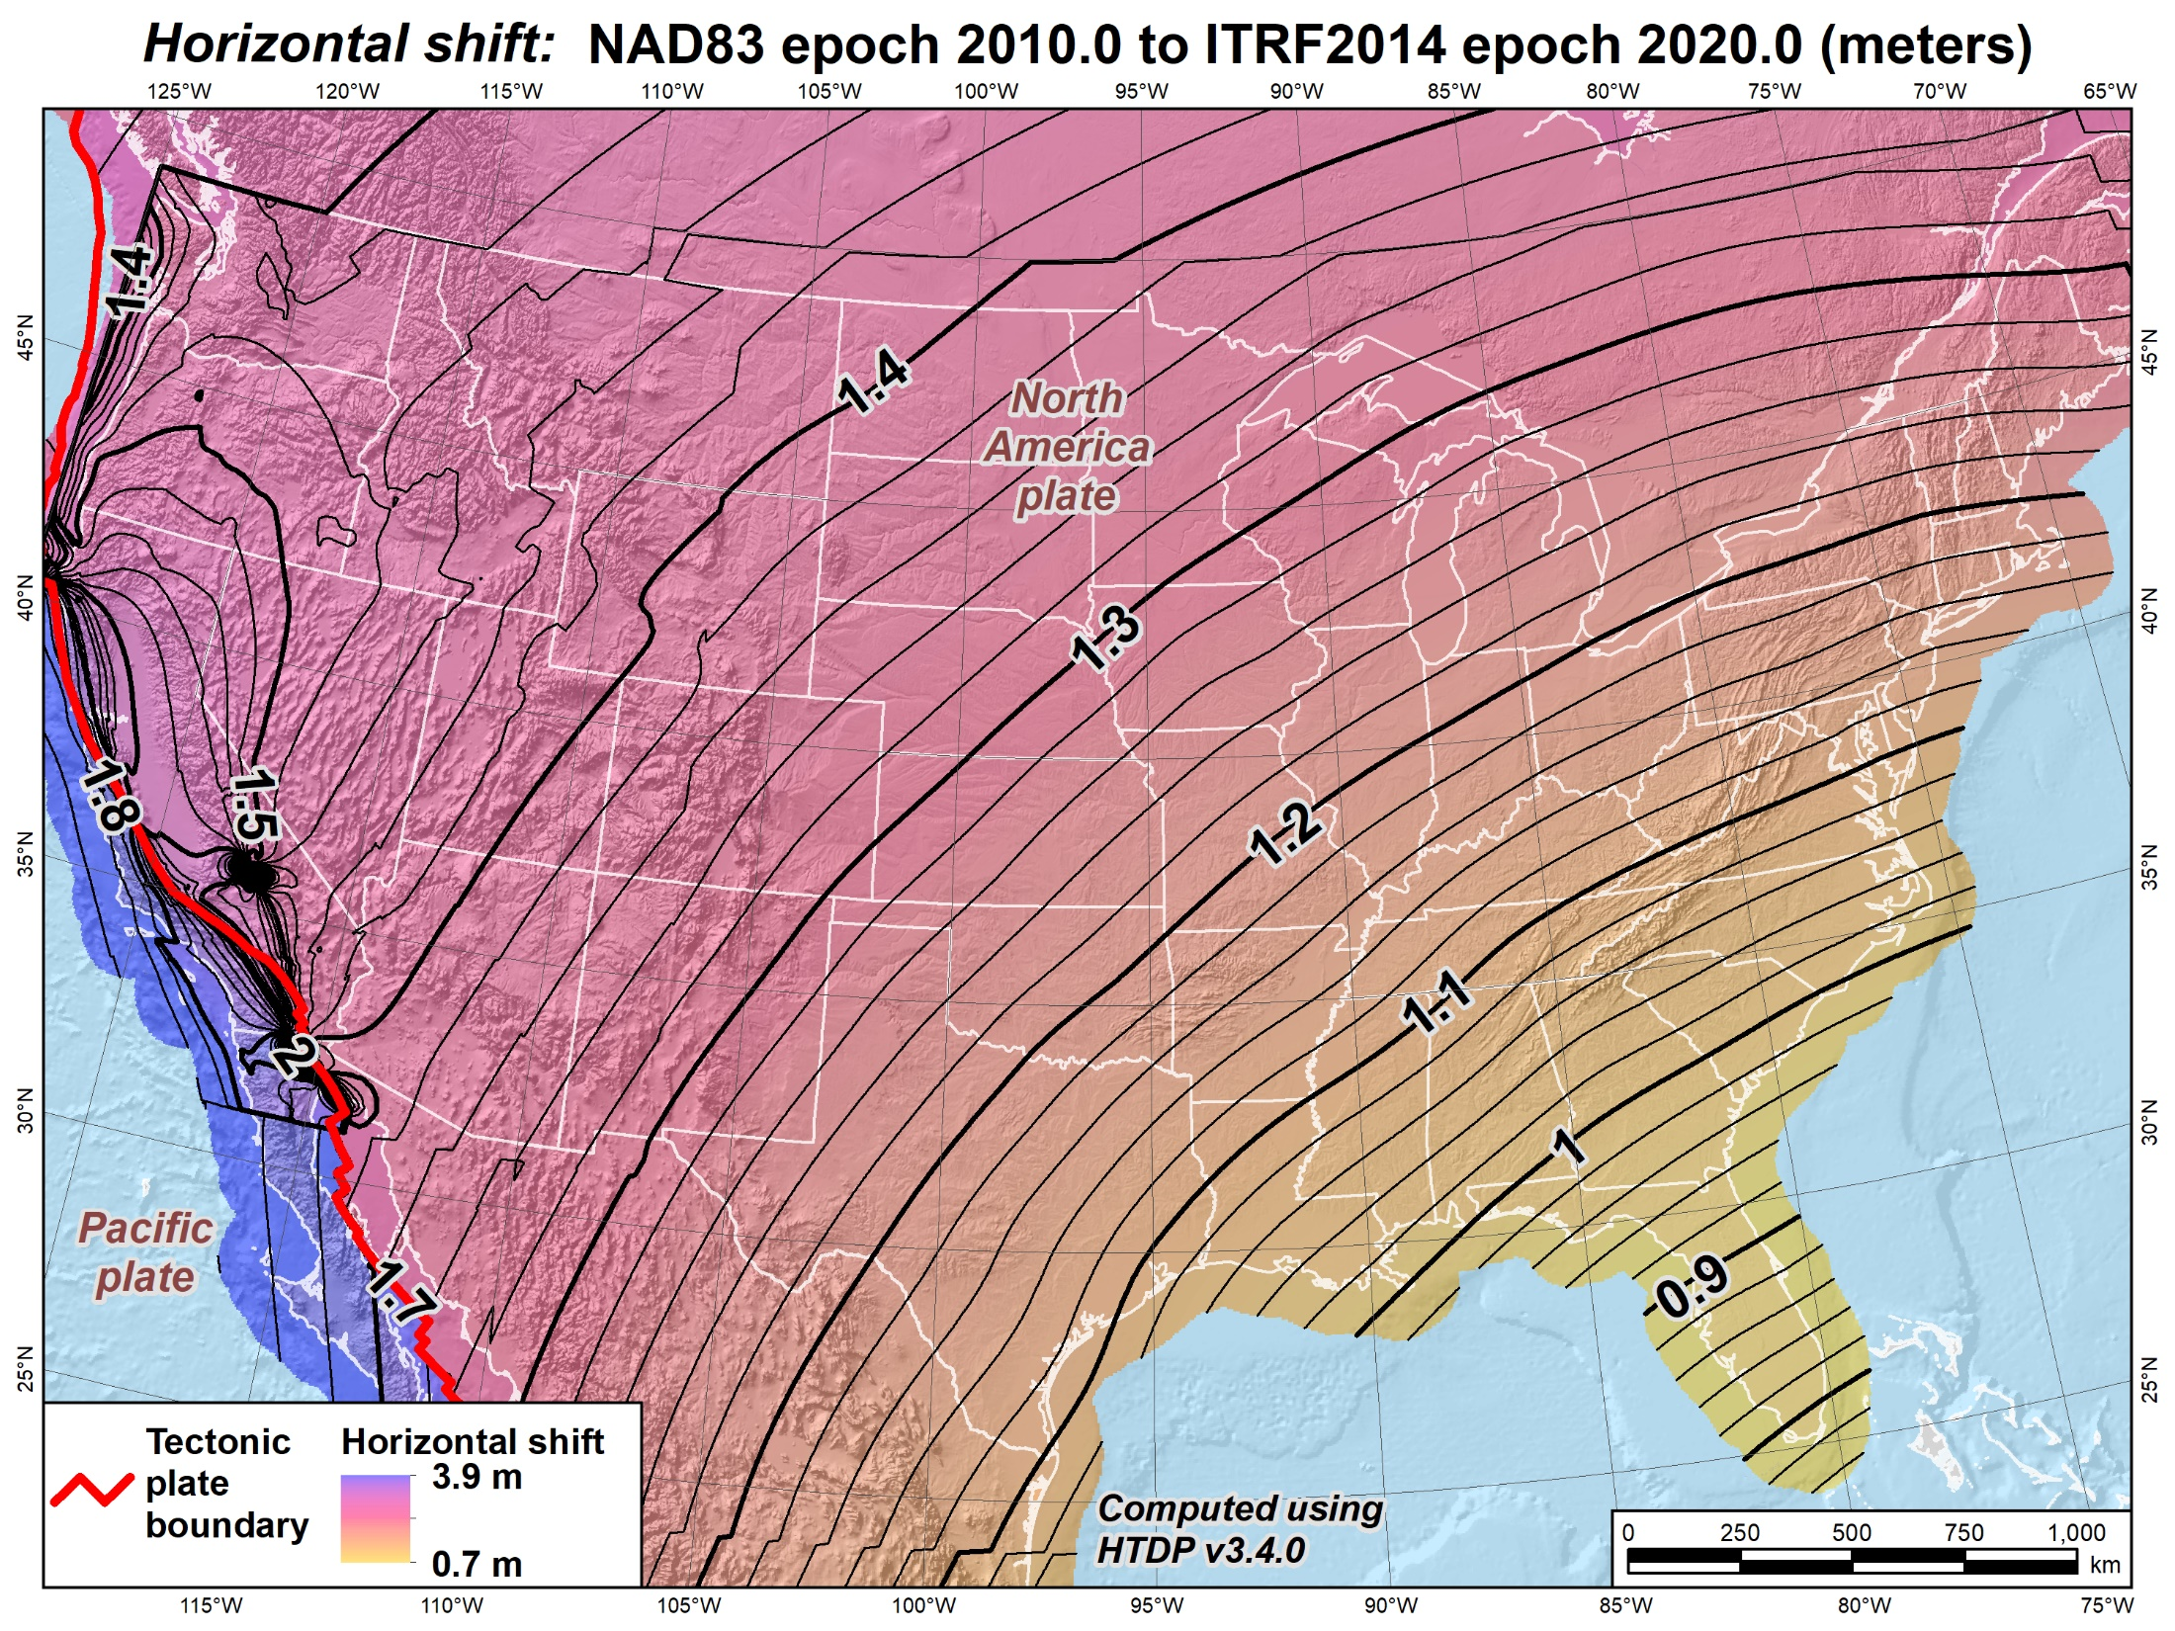
Current version of HTDP (3.50)
Horizontal shifts (CONUS):
NAD 83 epoch 2010.0 to NATRF2022 epoch 2020.0 (meters)
Ridgecrest earthquake (July 2019)
El Mayor-Cucapah earthquake
(April 2010)

Slide 19
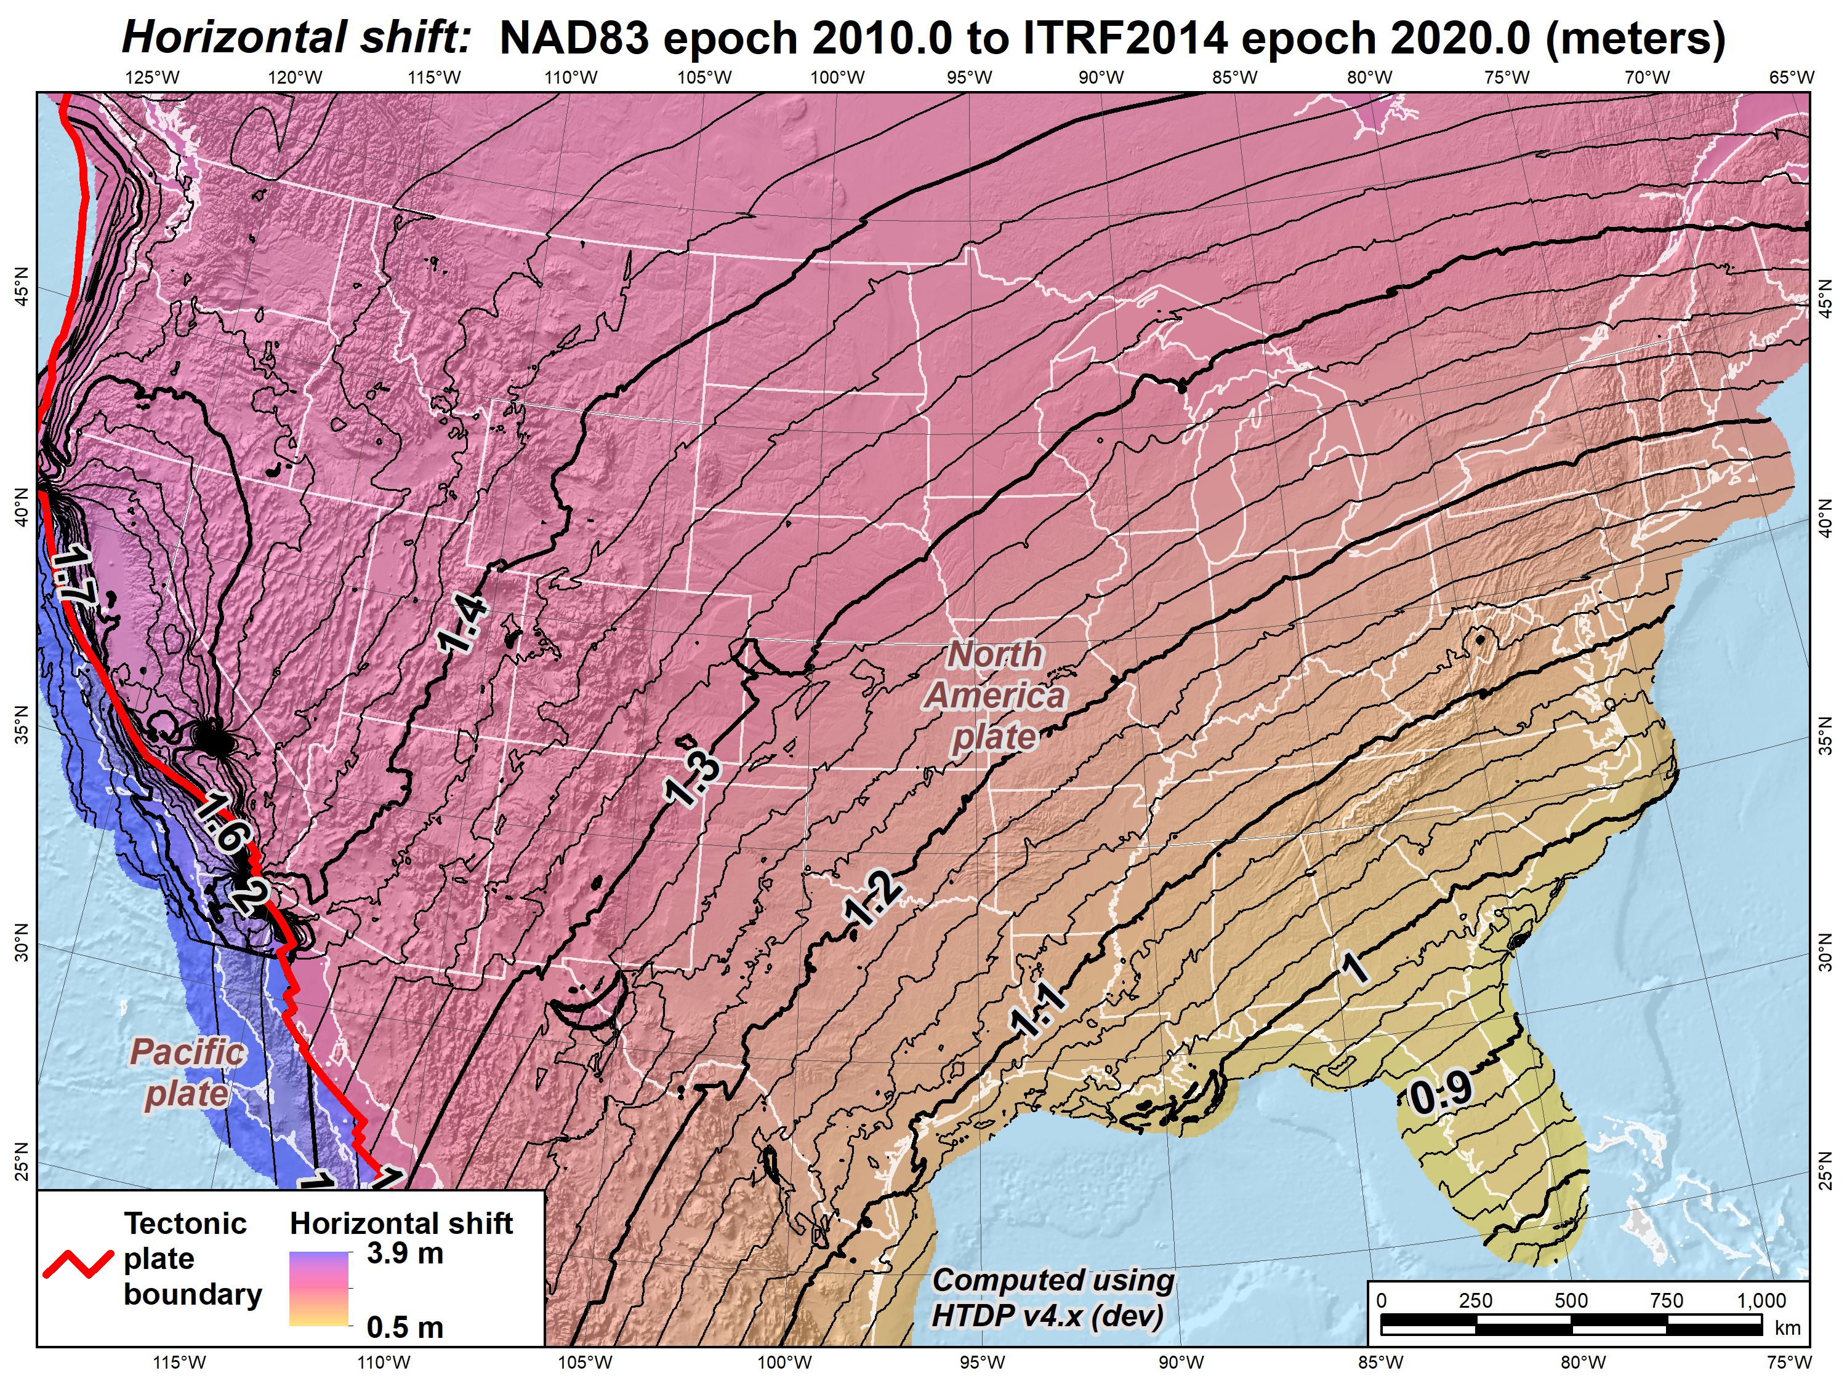
Preliminary version of IFDM2022
Horizontal shifts (CONUS):
NAD 83 epoch 2010.0 to NATRF2022 epoch 2020.0 (meters)
Ridgecrest earthquake (July 2019)
El Mayor-Cucapah earthquake
(April 2010)

Slide 20
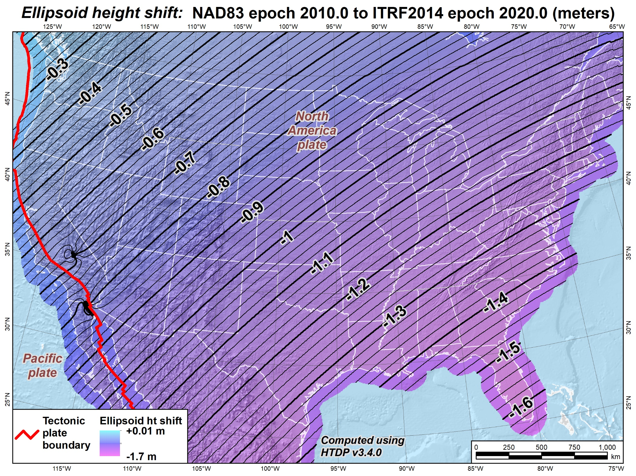
Current version of HTDP (3.50)
Ellipsoidal height shifts (CONUS):
NAD 83 epoch 2010.0 to NATRF2022 epoch 2020.0 (meters)
Ridgecrest earthquake (July 2019)
El Mayor-Cucapah earthquake
(April 2010)

Slide 21
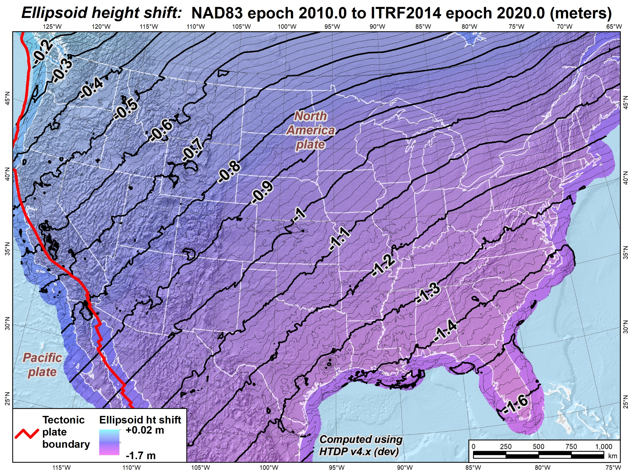
Preliminary version of IFDM2022
Ellipsoidal height shifts (CONUS):
NAD 83 epoch 2010.0 to NATRF2022 epoch 2020.0 (meters)
Ridgecrest earthquake (July 2019)
El Mayor-Cucapah earthquake
(April 2010)

Slide 22
“Shift & Drift”
Sudden SHIFT. For CONUS at epoch 2020.0 for change from NAD 83:
  Horizontal change of about 0.8 to 3 meters
  Ellipsoid height change of about -0.1 to -1.6 meters
Continuous DRIFT due to crustal motion
  Average about 2 cm/yr in CONUS (horizontal)
  Remove most by modeling tectonic plate (horizontal only)
  Remaining 3D motion minimized with crustal motion models
Purpose:
  Minimize change in coordinates with time
  Determine coordinates at any time (epoch)
Coordinates in modernized
NSRS will always have a date

Slide 23
NSRS Modernization “Blueprint” documents
Geometric Coordinates and Terrestrial Reference Frames
Geopotential Coordinates and Geopotential Datum
Working in the Modernized NSRS

Slide 24
Current vertical datums of the National Spatial Reference System
North America and Caribbean
NAVD 88
IGLD 85
PRVD02
VIVD09
Pacific Ocean
GUVD04
NMVD03
ASVD02
NAVD 88
IGLD 85
NAVD 88
NMVD03
PRVD02
GUVD04
VIVD09
ASVD02

Slide 25
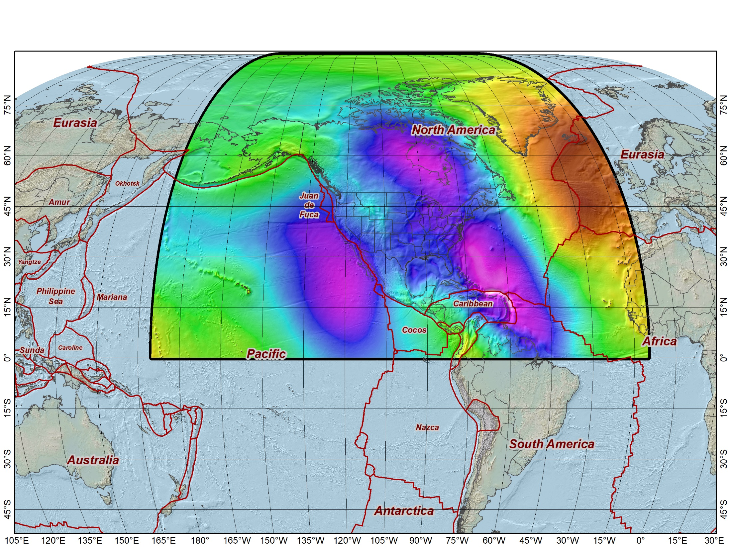
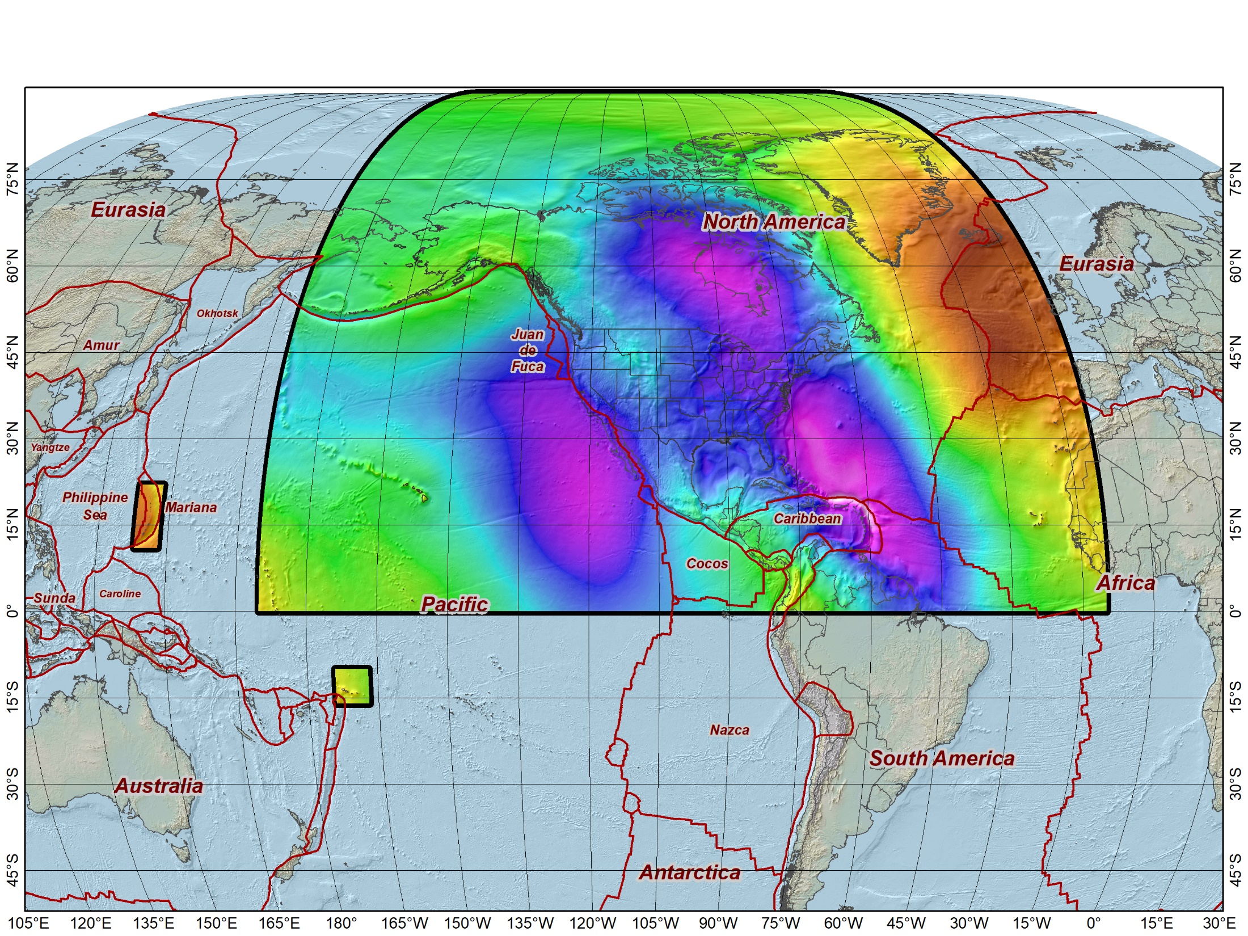
Extent of the new geopotential (“vertical”) datum
North American-Pacific Geopotential Datum of 2022 (NAPGD2022)
Includes the following (time-varying) models:
Geoid model (GEOID2022)
Surface gravity model (GRAV2022)
Deflection of the vertical model (DEFLEC2022)
Guam and Northern Marianas Islands
American Samoa

Slide 26
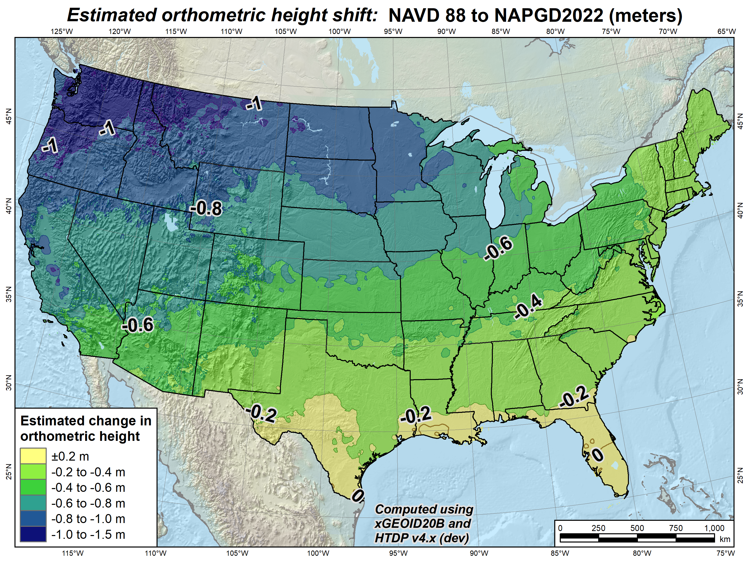
Orthometric height shifts (CONUS):
NAVD 88 (undefined epoch) to NAPGD2022 epoch 2020.0 (meters)

Slide 27
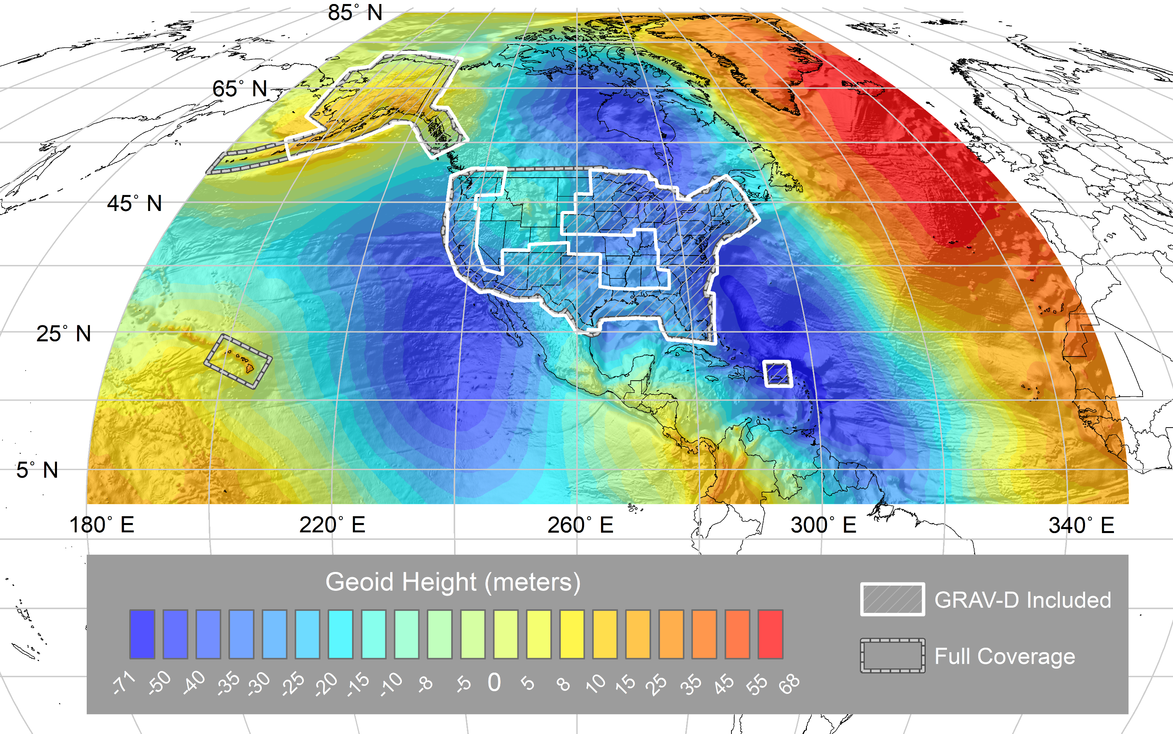
Experimental
Geoid 2020 (xGEOID20)
First xGEOID coordinated with Canada
GRAV-D data used for most areas (in version B of model)

Slide 28
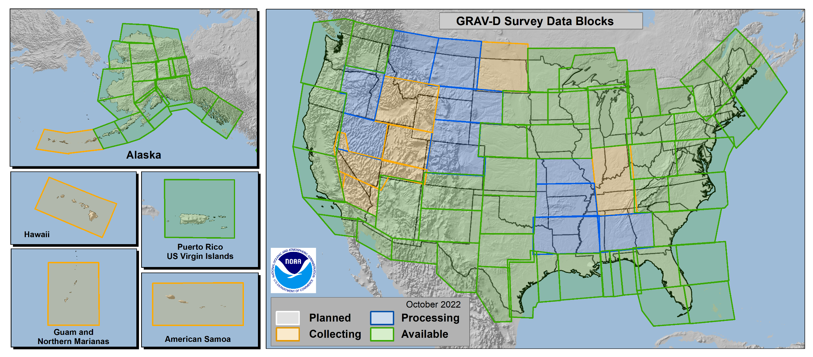
Gravity for the Redefinition of the American Vertical Datum (GRAV-D)
97.0% Complete
(as of April 2023)

Slide 29
Other things about NAPGD2022
Defined by GEOID2022 (not by leveling)
  Orthometric height = ellipsoidal height − geoid height
  Ability to determine dynamic heights using GNSS
But leveling will still be supported
  For high-accuracy orthometric height differences
  Constrained to orthometric heights from GNSS + geoid model
Will include time dependence
  Through NGS Geoid Monitoring Service (GeMS)
  Static geoid + “dynamic” geoid
  Likewise for other NAPGD2022 products

Slide 30
NSRS Modernization “Blueprint” documents
Geometric Coordinates and Terrestrial Reference Frames
Geopotential Coordinates and Geopotential Datum
Working in the Modernized NSRS

Slide 31
New types of coordinates
Reference Epoch Coordinates (RECs)
A temporal “snapshot” of entire network
Similar to NAD 83 (2011/PA11/MA11) epoch 2010.00
Initial epoch 2020.00
Every 5 or 10 years
Survey Epoch Coordinates
(SECs)
Time-dependent!
Gives coordinates at the time of observation
Time is at midpoint of a “geometric adjustment window”
Multiple SECs can show changes over time

Slide 32
What about (map) projected coordinates?
Surveyors (and engineers) projected coordinate reference systems
(geodesists, not so much)
SPCS2022
Making the Earth flat again
…one zone at a time

Slide 33
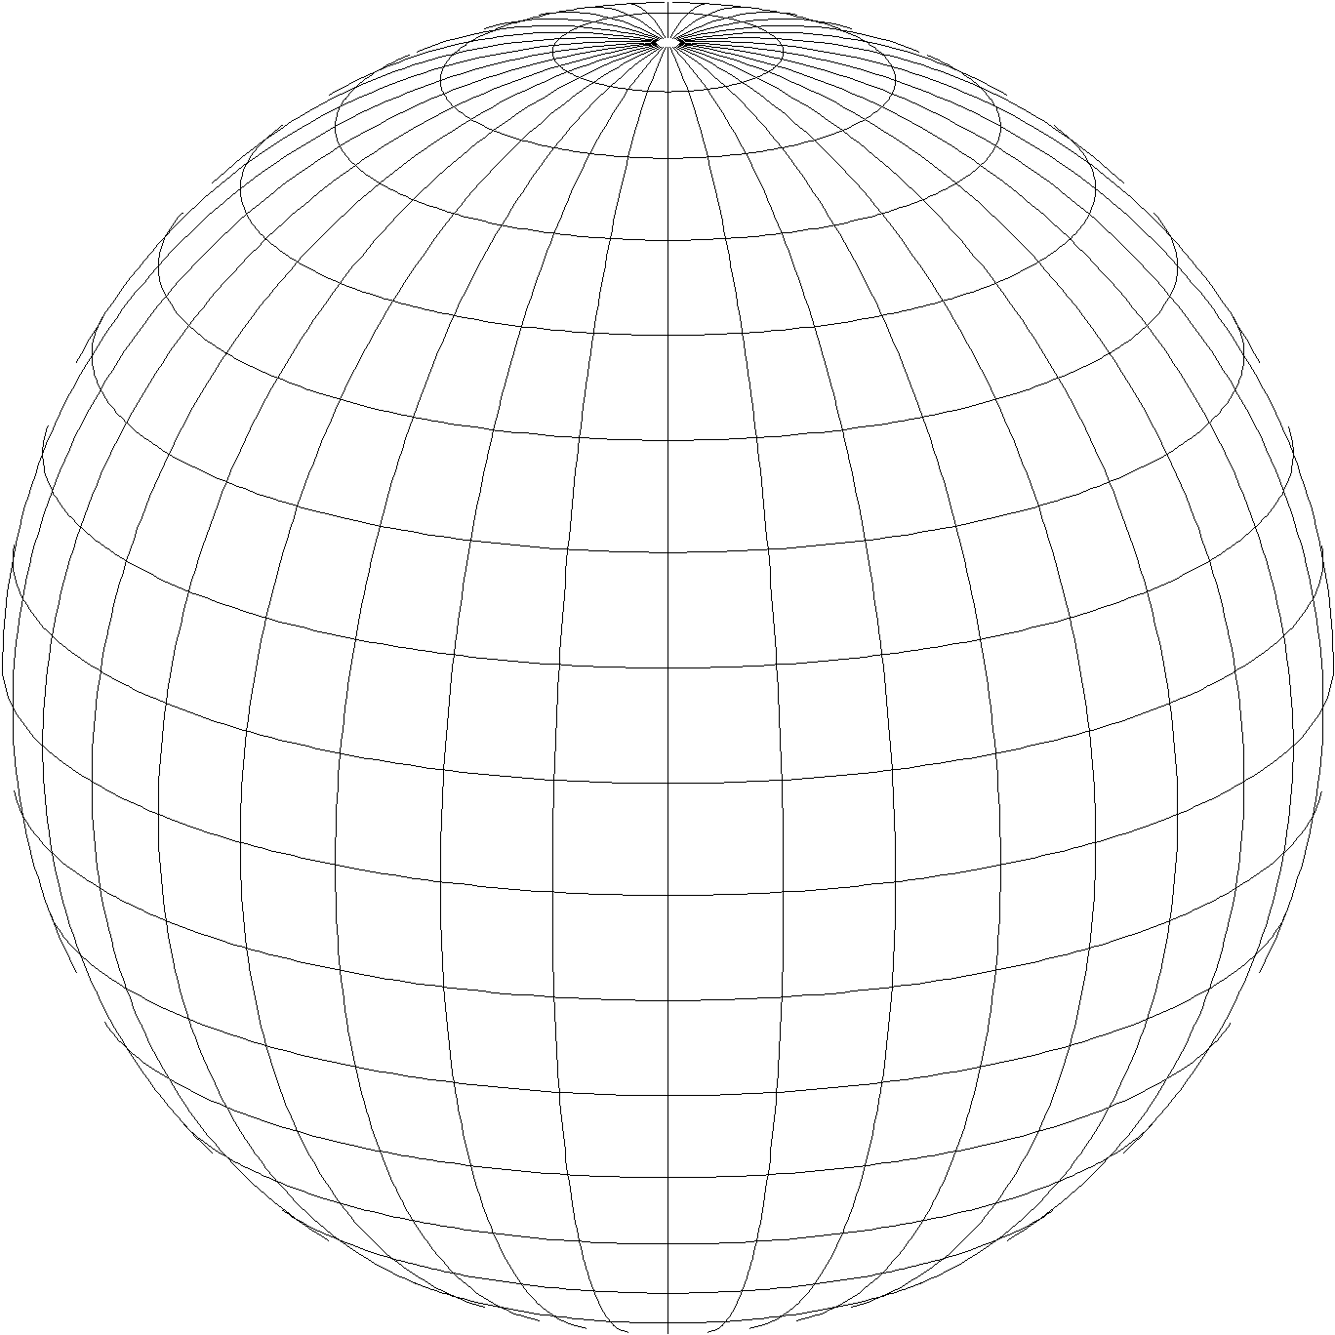
State Plane Coordinate System of 2022 (SPCS2022)
Lambert Conformal Conic
Third generation of State Plane
  First in 1930s, second in 1980s
  Same 3 map projection types
  Same ellipsoid as SPCS 83 (GRS 80)
The same, but different…
  Based on new terrestrial reference frames instead of NAD 83
  Designed to reduce linear distortion at topographic surface
  (i.e., reduce difference between “grid” and “ground” distances)
  More zones, most designed by state stakeholders
Transverse Mercator
Hotine Oblique Mercator

Slide 34
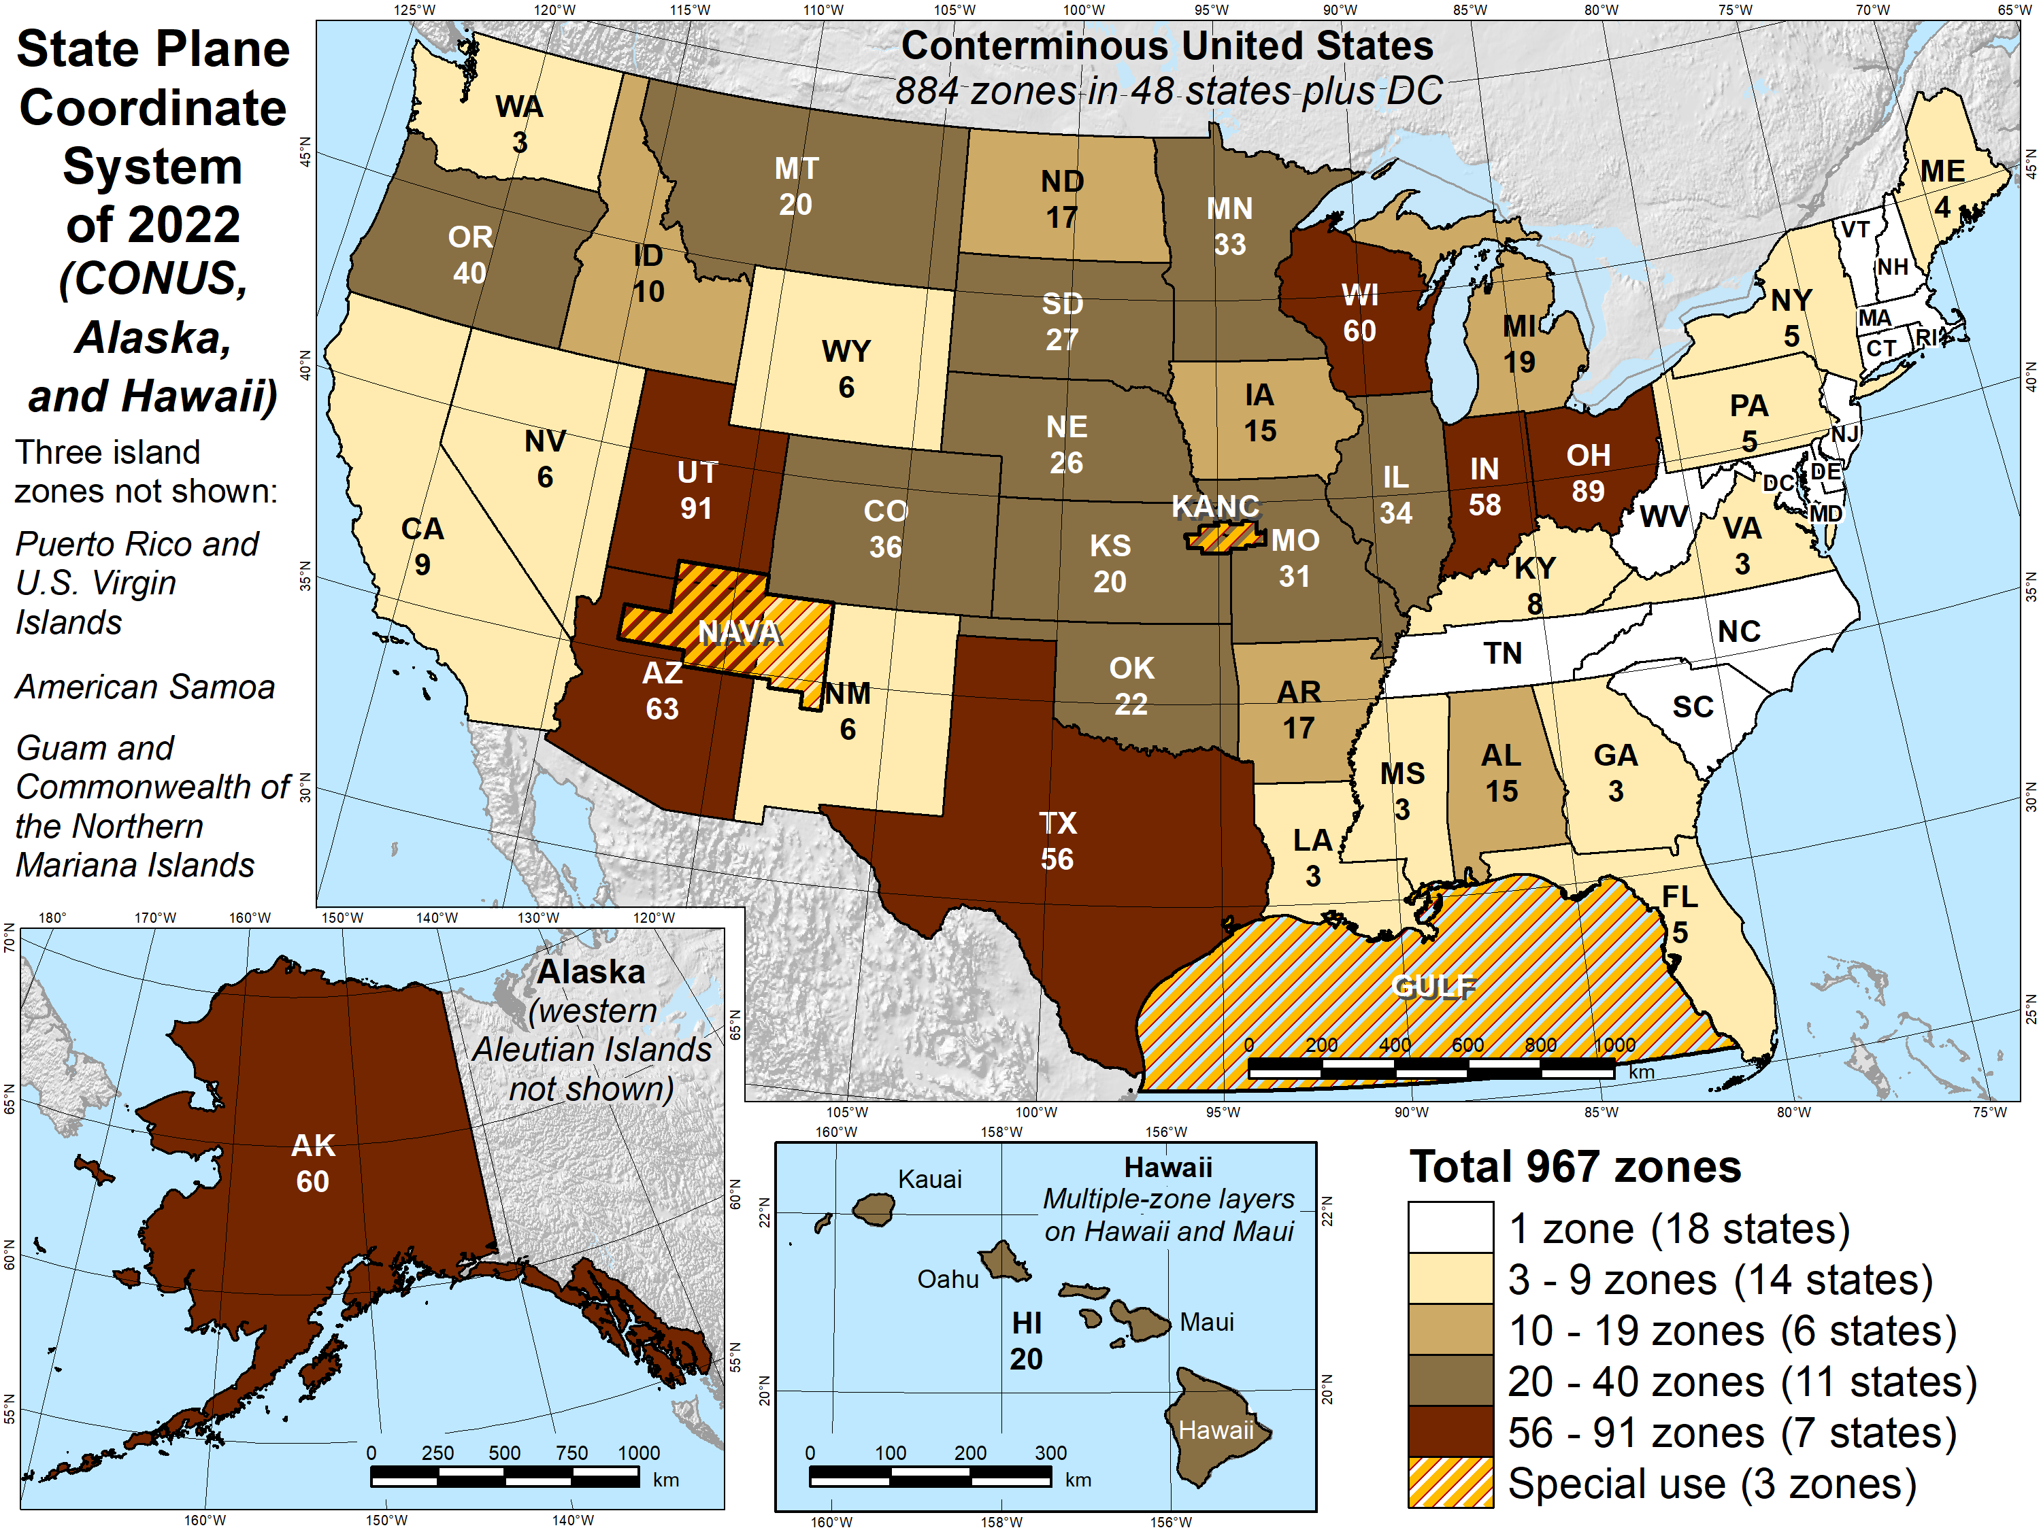
Number of SPCS2022 zones
Designs by NGS
  165 zones
  Includes 54 statewide zones
  and 3 “special use” zones
  (in more than one state)
Designs by state stakeholders
  802 zones in 28 states
Total = 967 zones
for 56 states
and territories
Compare to 125
zones in existing
State Plane

Slide 35
Overall SPCS2022 distortion design philosophy
Linear distortion minimized (or “optimized”) at topographic surface
(not at ellipsoid surface)
Purpose: to reduce difference between and projected “grid” and actual “ground” distances in areas where people actually work
What is linear distortion?
  Defined at a point (infinitesimal distances)
  Unique (i.e., same in every direction) only for conformal projections
  Often given in parts per million (ppm) = mm per km
Linear distortion | = | δ | = | Projected minus actual distance
 |  |  |  | Actual distance

Slide 36
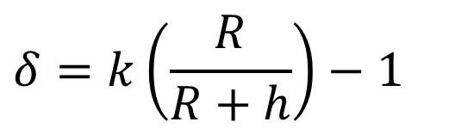
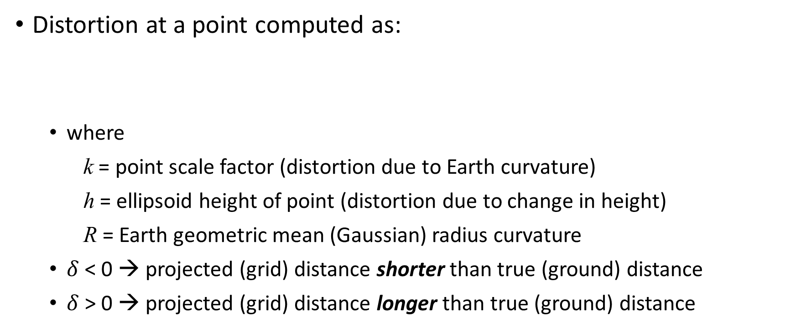
Map projection linear distortion
Distortion at a point computed as:
  where
    k = point scale factor (distortion due to Earth curvature)
    h = ellipsoid height of point (distortion due to change in height)
    R = Earth geometric mean (Gaussian) radius curvature
  $δ$ < 0 → projected (grid) distance shorter than true (ground) distance
  $δ$ > 0 → projected (grid) distance longer than true (ground) distance
Combined factor
Point scale factor
$$δ=k\left(\frac{R}{R+h}\right)−1$$
Height (“elevation”) factor

Slide 37
Map projection linear distortion
Map projection designed to minimize linear distortion on ellipsoid (at “sea level”)
Topographic surface
Horizontal ground distance
Projection surface
Grid (“map”) distance
Grid distance < ground distance
Ellipsoid surface
(~“sea level”)
This design approach
used for SPCS 83 and 27 (minimizes distortion with respect to ellipsoid)

Slide 38
Map projection linear distortion
Map projection designed to minimize linear distortion at
ground surface
Topographic surface
Projection surface
Grid distance ≈ ground distance
Ellipsoid surface
(~“sea level”)
This design approach is being used for SPCS2022 (minimizes distortion with respect to topography)

Slide 39
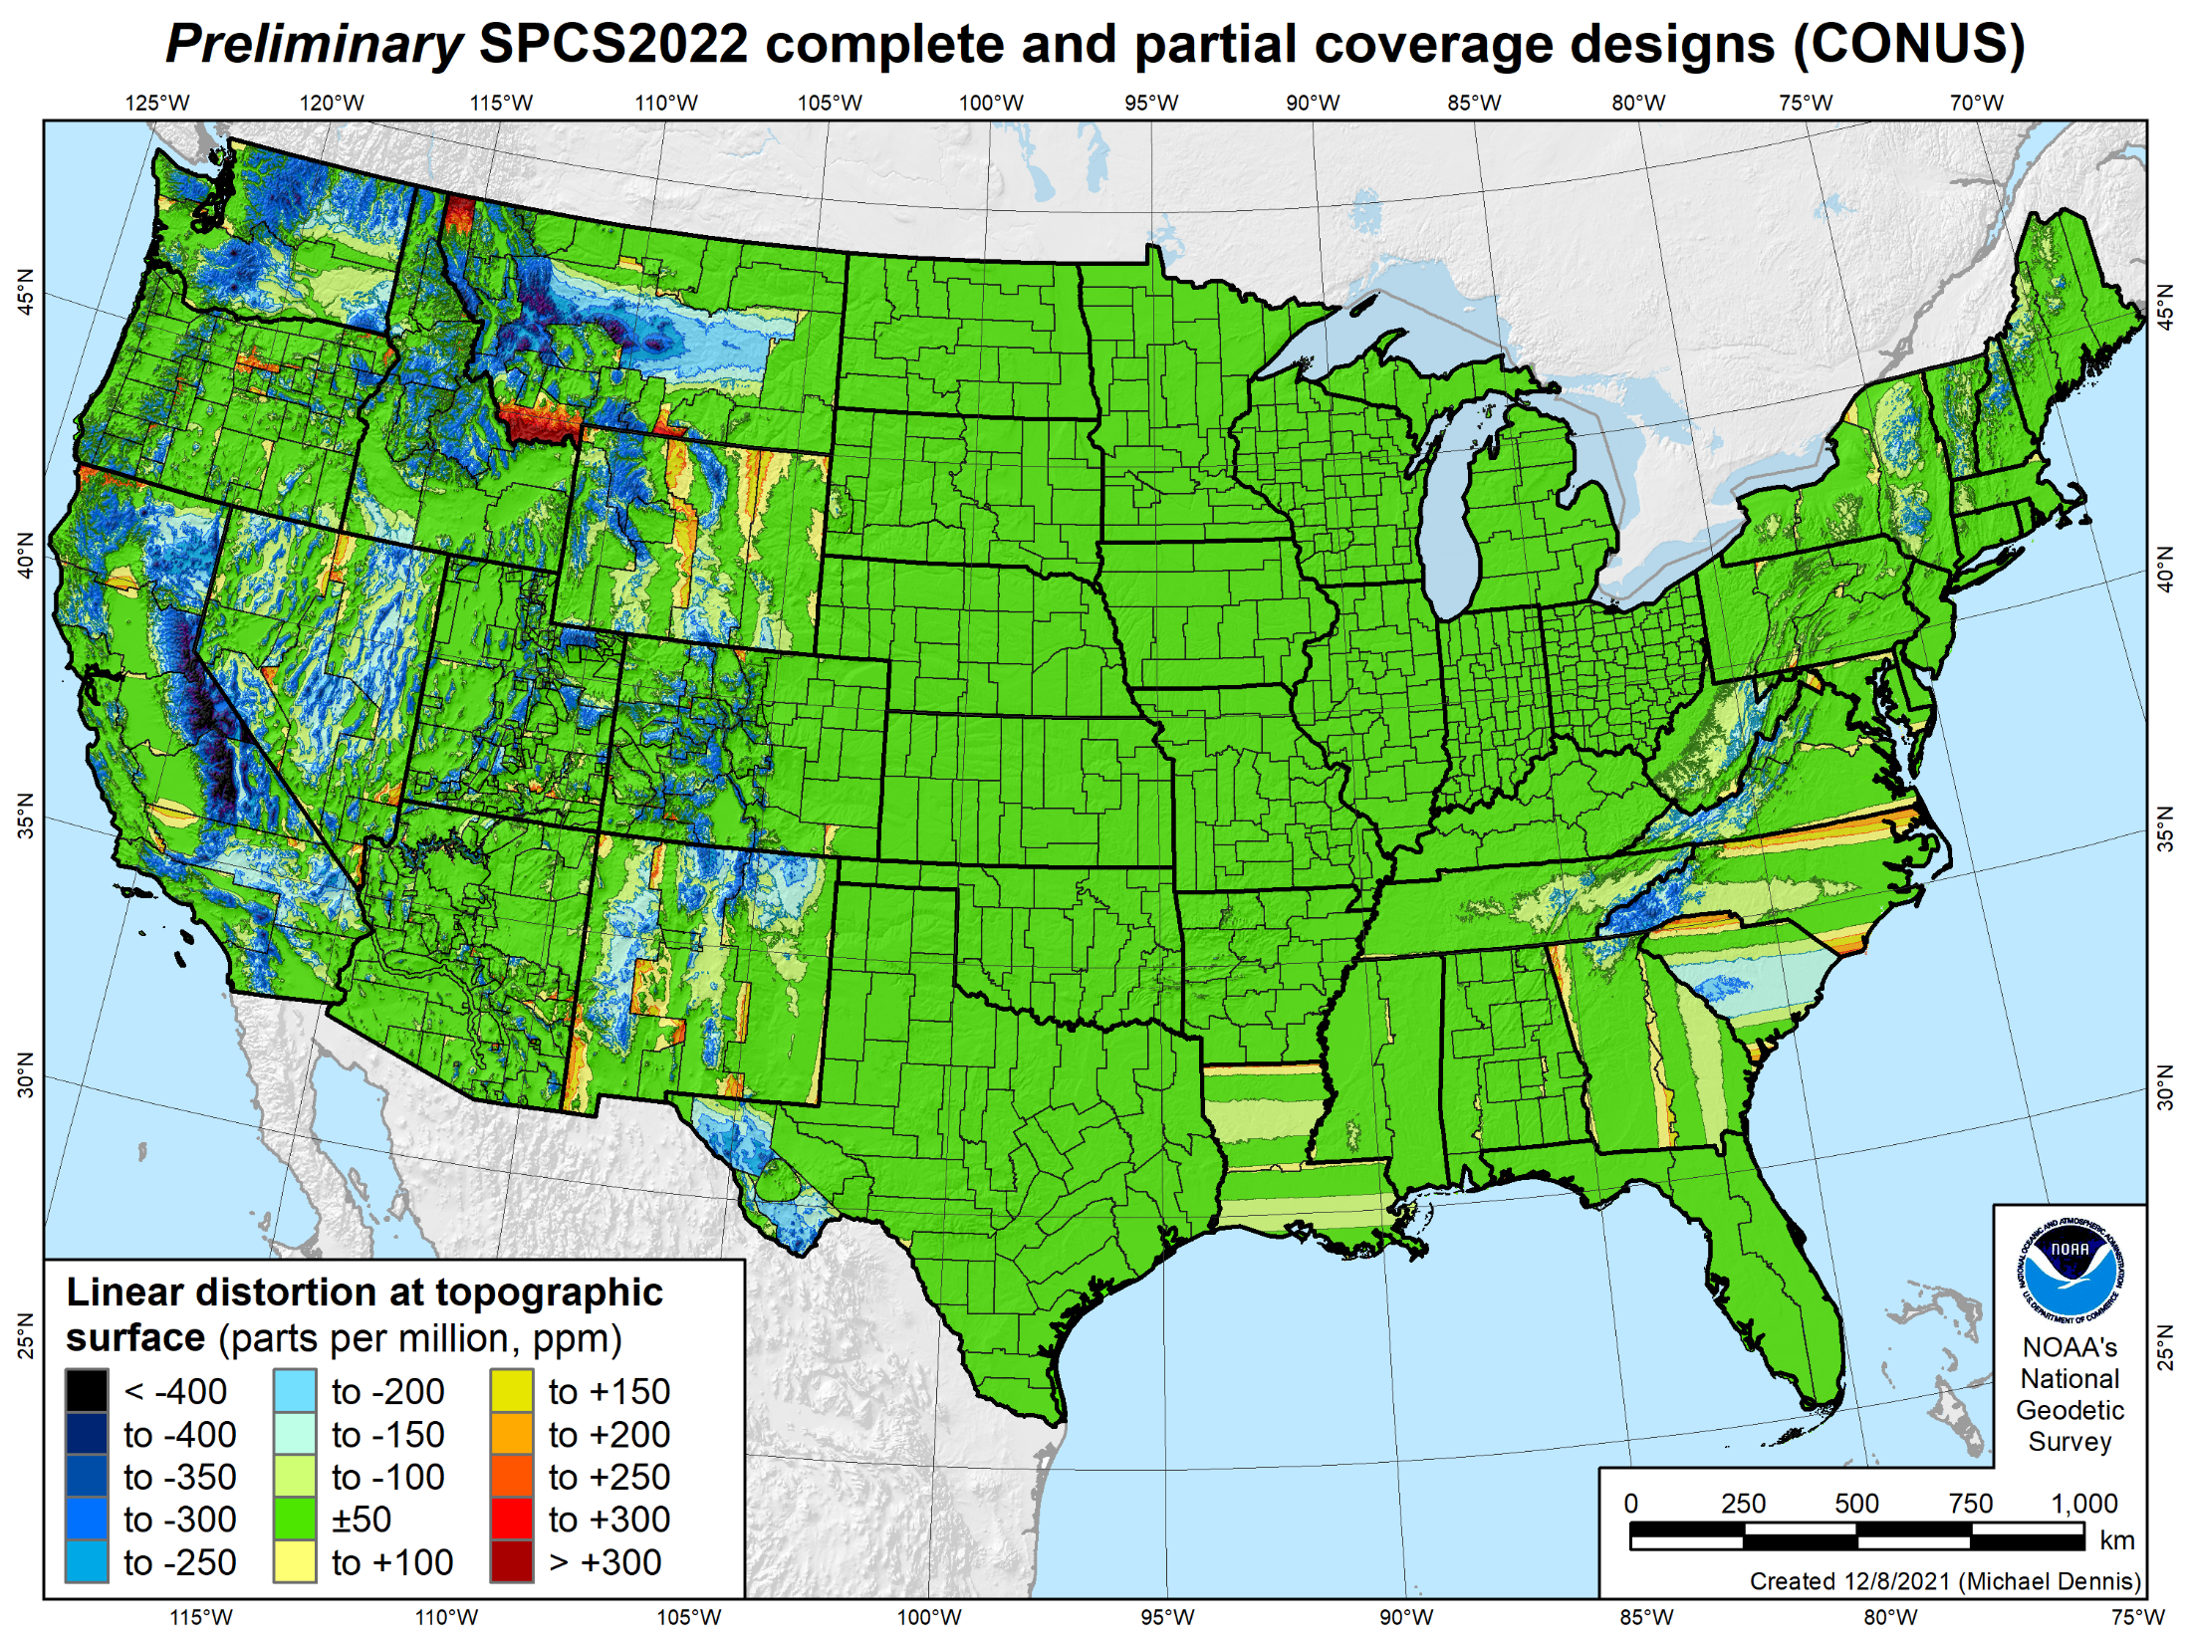
SPCS2022 linear distortion
846 zones (CONUS)
Percent within distortion (ppm):
Distor | Pop | Cities | Area
±20 | 76% | 71% | 58%
±50 | 92% | 89% | 76%
±100 | 98% | 97% | 89%
±400 | 100% | 100% | 99.9%
City and area statistics (ppm):
 | Min | -407 | -1438
 | Max | +486 | +2624
 | Range | 893 | 4062
 | Mean | -6 | -23
Mean weighted by pop = -4

Slide 40
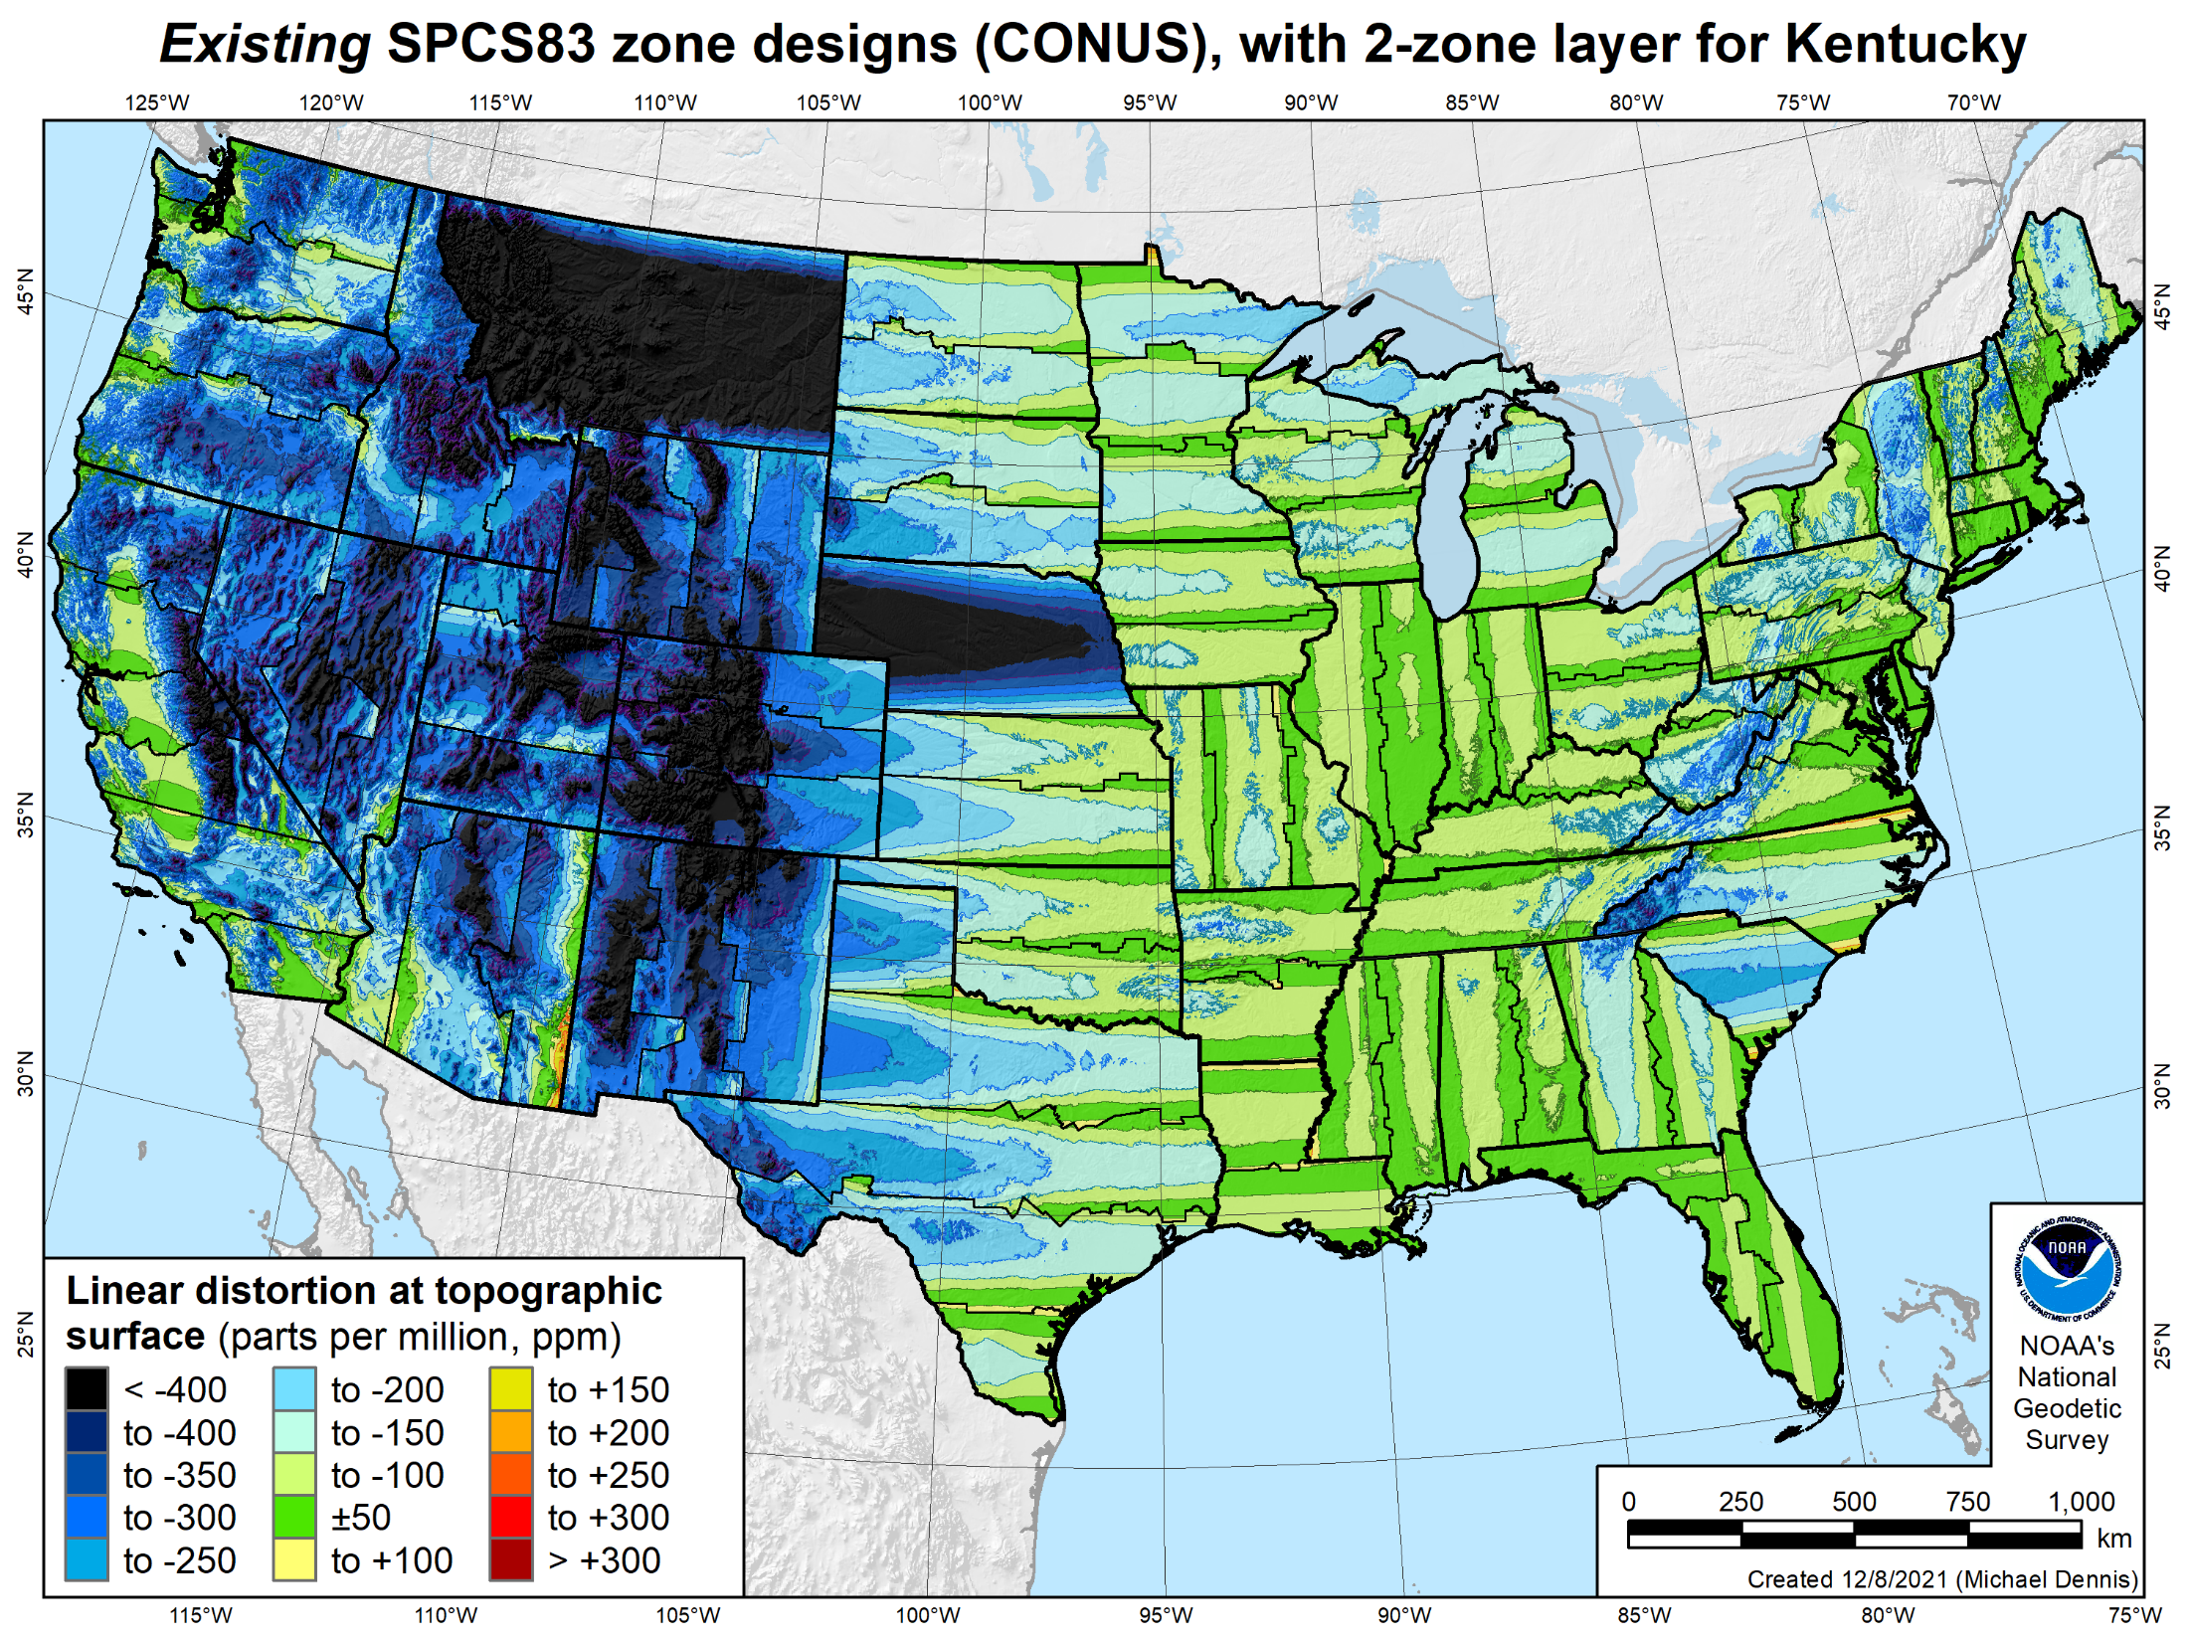
SPCS 83 linear distortion
106 zones (CONUS)
Percent within distortion (ppm):
Distor | Pop | Cities | Area
±20 | 17% | 11% | 6%
±50 | 40% | 30% | 17%
±100 | 74% | 68% | 41%
±400 | 99% | 98% | 91%
City and area statistics (ppm):
 | Min | -913 | -1038
 | Max | +206 | +223
 | Range | 1120 | 1261
 | Mean | -98 | -178
Mean weighted by pop = -75

Slide 41
Other exciting NSRS Modernization progress
LASER. Least squares Adjustments: Statistics, Estimates and Residuals
  Will be used for geometric and orthometric (leveling) adjustments
M-PAGES. Multi-constellation GNSS processing software
  Currently being tested in OPUS-Static
OPUS-Projects 5.1. Released to production
  Supports real-time and 3rd party processed GNSS vectors
GDX. Geodetic Data Exchange format
  Include GVX (GNSS Vector Exchange format)
  Plus total station, leveling, and gravity obsevations
And more…

Slide 42



geodesy.noaa.gov

Slide 43
Summary of NSRS Modernization
Geometric based on ITRF2020
Geopotential based on GRAV-D + satellite + terrestrial gravimetry
Explicit time-dependence for all components
Updated State Plane Coordinate System
Release in 2025
  But will start releasing preliminary (”alpha”) products next month!
  First will be alpha SPCS2022 and alpha GDX
Thank you!

