Slide 1
Emergency Response Imagery
Remotely sensed data is acquired to support NOAA’s requirements as well as Primary Mission Essential Function DOC-3
Pre-Scripted Mission Assignments (PSMA) With FEMA -NOAA Aerial Imagery/Lidar
Data has been acquired to support emergency response efforts due to hurricanes, flooding, earthquakes, and tornadoes
The remotely sensed data collected is disseminated to federal, state, and local government agencies, as well as the general public to facilitate support efforts
The data (typically nadir and/or oblique imagery) is collected, processed, and disseminated in GIS ready formats
Goal: processed and available 6-8 hours after landing
POC Mike Aslaksen mike.aslaksen@noaa.gov 301-801-9024
Notes:
National Oceanic and Atmospheric Administration
NSRS positioning data provides the reference for NOAA’s nautical charts, among many other geospatial applications.
Federal Emergency Management Agency
FEMA uses NSRS elevations to determine flood zones for the National Flood Insurance Program.
United States Army Corps of Engineers
USACE uses NSRS elevations to determine levee heights and positions in their Levee Safety Program.
United States Geological Survey
USGS uses the NSRS to geospatially reference their Topographic Maps and interior water data for the nation.
National Geospatial Intelligence Agency
NSRS gravity data contributes to NGA’s geospatial mission.

Slide 2
Pre-event Planning/Operations
-8/-5
Event of National Significance or NOAA interest
Approval by Director, NGS
-4
-4/-3
Preplanned flight lines developed/updated
Days Out
Disseminated to FEMA RS coordinator and partners (States, USGS, USACE, USCG) for coordination/additions
-4/-3
-3/-2
Prepositioning of assets and personnel
Refinement of Requirements
-2/0
0/+?
Daily Updates and continued coordination and refinement

Slide 3
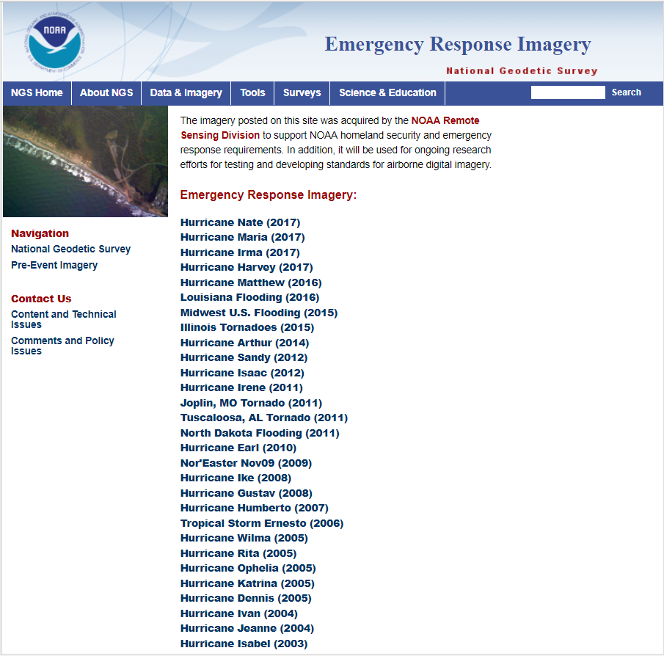
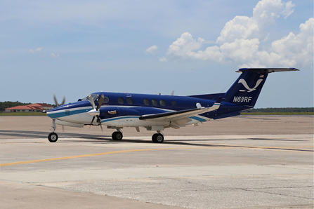
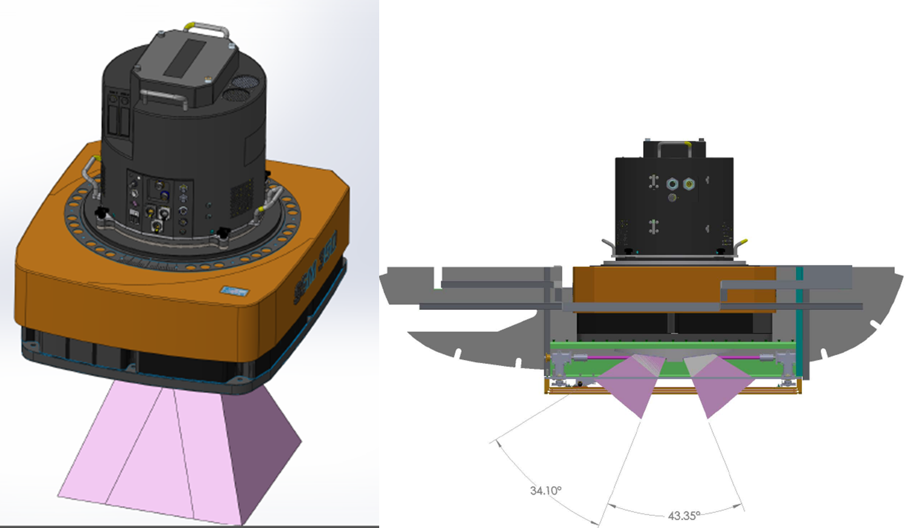
http://storms.ngs.noaa.gov/eri_page/index.html

Slide 4
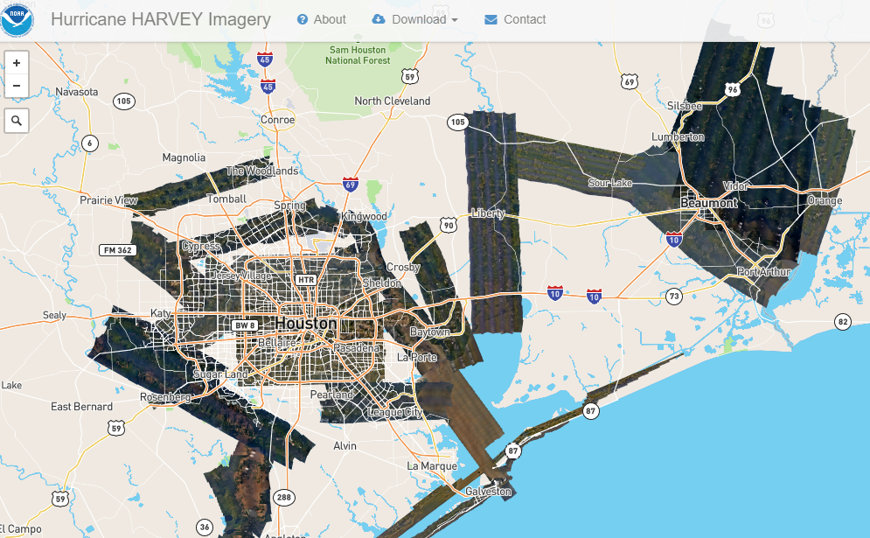
Fight Hours: 83.3hrs
Total Images: 25560
Total km2: 16421
8/27/2017-9/3/2017
Notes:
NGS Aerial Imagery collected for Corpus Christi and Back Bay areas, Houston and surrounding suburbs, Galveston, Liberty, Beaumont.
· Fight Hours: 83.3hrs
· Total Images: 25560
· Total km2: 16421
· * Campaign Days: 8/27/2017-9/3/2017

Slide 5
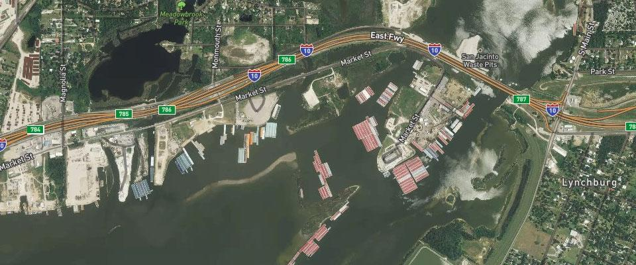
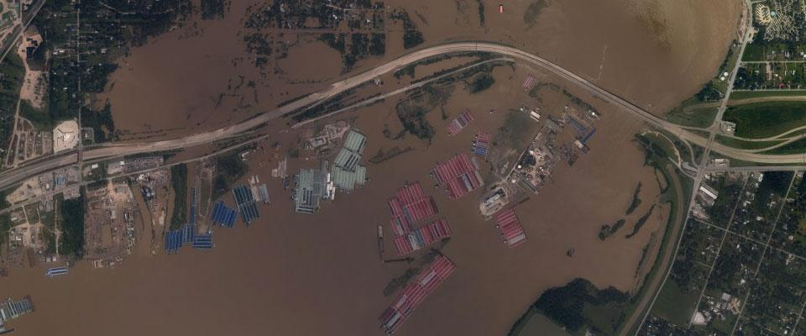
Aerial Imagery for Damage Assessment
Near Lynchburg, Texas
6
Notes:
SLIDE 6 - Emergency Response Imagery. Click for fade-in
As soon as weather permitted, we began aerial survey missions to assess damages to areas affected by the hurricanes.
The data we collected were rapidly processed and provided to emergency responders and coastal managers, often within hours of collection.
NOAA has developed this capability to capture high resolution mapping imagery to support NOAA Nautical Charting requirements as well as support Emergency Response.
We have responded to over 30 events of national significance since 2003 as well as updated thousands of miles of shoreline on NOAA Nautical Charts. This capability is the result of over three decades of investments and the support of the NOAA Corps.
The imagery facilitated search and rescue efforts, enabled expedited rental assistance, identified hazards to navigation and releases of hazardous materials, and has allowed for the identifications of substantial damage priorities for mitigation, and routing and logistics support. To just name a few of its uses.
This is also the first glance residents have of their property and is publically accessible information.
To give you a understanding of the operations support we provided – over a month of aircraft operations began on August 27, two NOAA aircraft (primarily the NOAA King Air) flew almost 40,000 miles for the hurricanes, including Nate. This is equivalent to flying cross country and back 17 times. For Hurricanes Harvey, Irma, and Maria more than 65,000 images were collected, covering the same area as the State of Maryland (9774 sq miles).
During the response efforts for Maria; the NOAA King Air worked from Curacao – 400 miles to the south of PR- and for 5 straight days flew two missions over PR and USVI for days that lasted 10-12 hours. This is remarkable considering other support assets – including DoD and the Civil Air Patrol were limited by distance and weather. This speaks to the resolve of the flight crews and the capability of the aircraft – one of the lessons learned from Hurricane Katrina I will talk about later.
I am going to let the utility of these images speak for themselves with a few examples.
This is near Lynchburg, Texas – East of Houston - following Hurricane Harvey [click]
The Gulf and especially Houston area is largely dependent on tug and barge providers to support intermodal transportation of goods and services. On two occasions we were asked to acquire imagery of areas where large concentrations of barges were located and had come lose during the storm in order to locate and determine how to pull them apart, as you can see in this image. With the this imagery they could see the barges and the extent of the flooding surrounding the navigation channel.
IMAGES
Near Lynchburg, Texas, following Hurricane Harvey
https://oceanservice.noaa.gov/news/sep17/hurricane-harvey.html

Slide 6
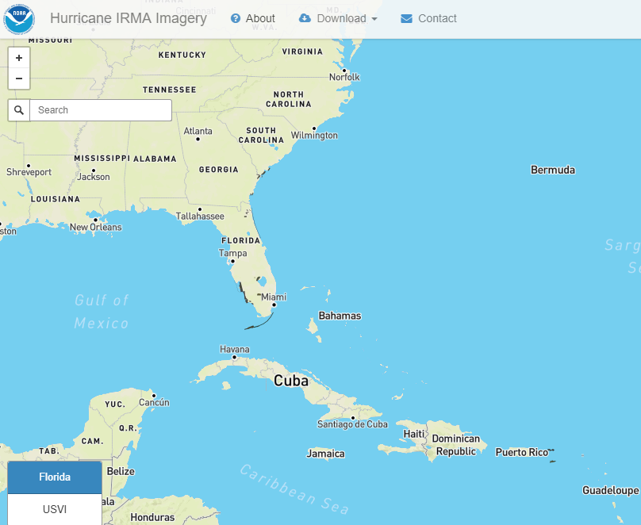
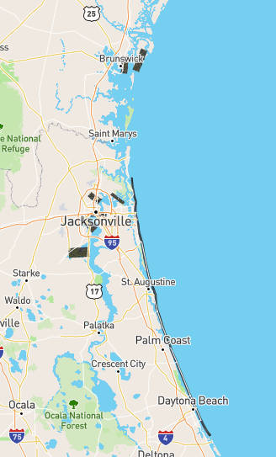
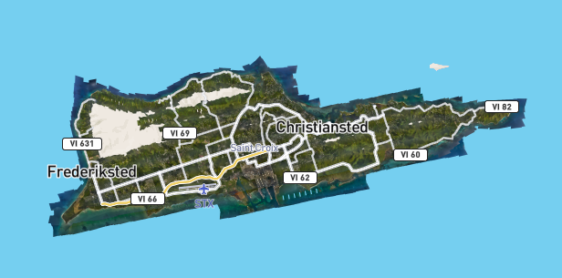
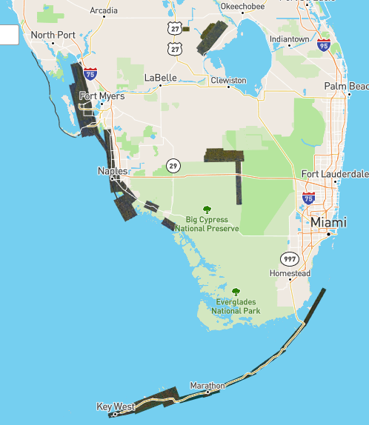
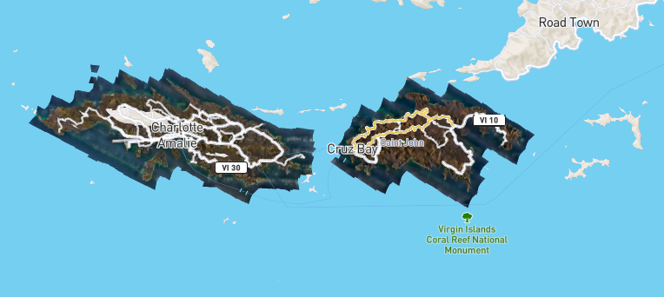
Fight Hours: 75.7hrs
Total Images: 23915
Total km2: 5865
9/11/2017 - 9/18/2017
Notes:
NGS Arial Imagery collected for Florida Keys, Naples, Fort Myers, Jacksonville, Savannah, Charleston, and Tampa.
· Fight Hours: 75.7hrs
· Total Images: 23915
· Total km2: 5865
· * Campaign Days 9/11/2017 - 9/18/2017

Slide 7
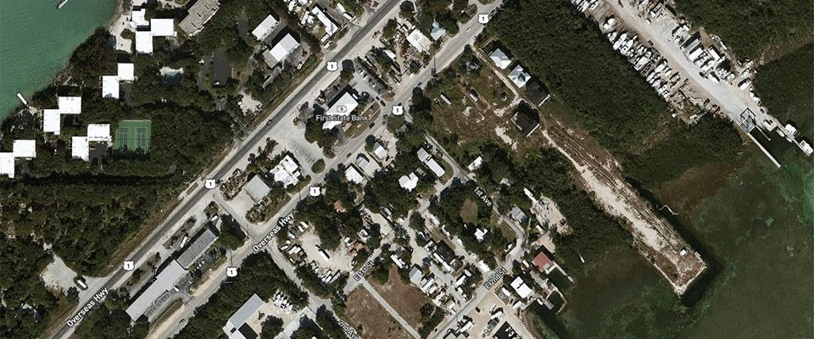
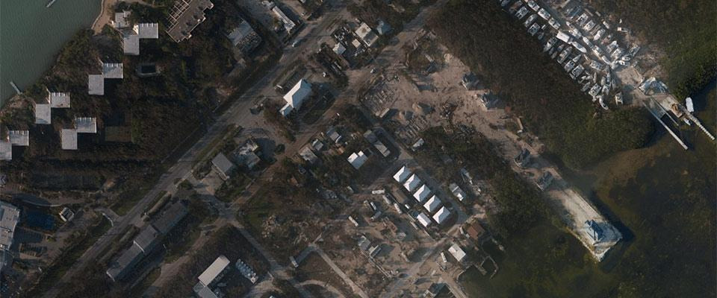
Key Largo, Florida
7
Notes:
SLIDE 7 - Emergency Response Imagery
This is Key Largo, Florida following Hurricane Irma (no click necessary).
For those familiar with the Keys, tourism and recreation is a huge part of the economy.
IMAGES
Key Largo, Florida, following Hurricane Irma
https://oceanservice.noaa.gov/news/sep17/hurricane-irma.html

Slide 8
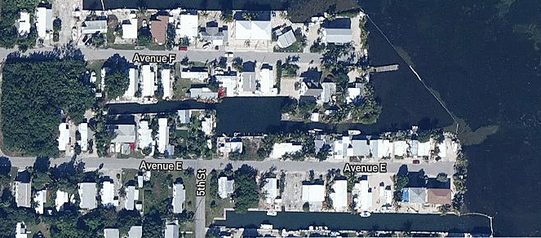
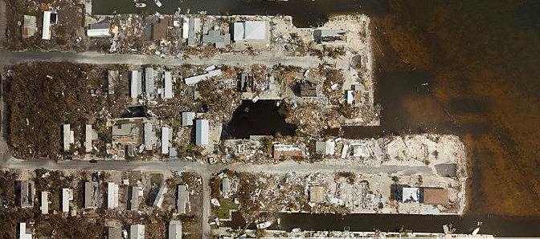
Big Pine Key, Florida
7
Notes:
SLIDE 7 - Emergency Response Imagery
This is Big Pine Key, Florida following Hurricane Irma (no click necessary).
For those familiar with the Keys, tourism and recreation is a huge part of the economy.
Many people were looking at our images not only to see if their property was still standing but if their boats were where they left them.
IMAGES
Key Largo, Florida, following Hurricane Irma
https://oceanservice.noaa.gov/news/sep17/hurricane-irma.html

Slide 9
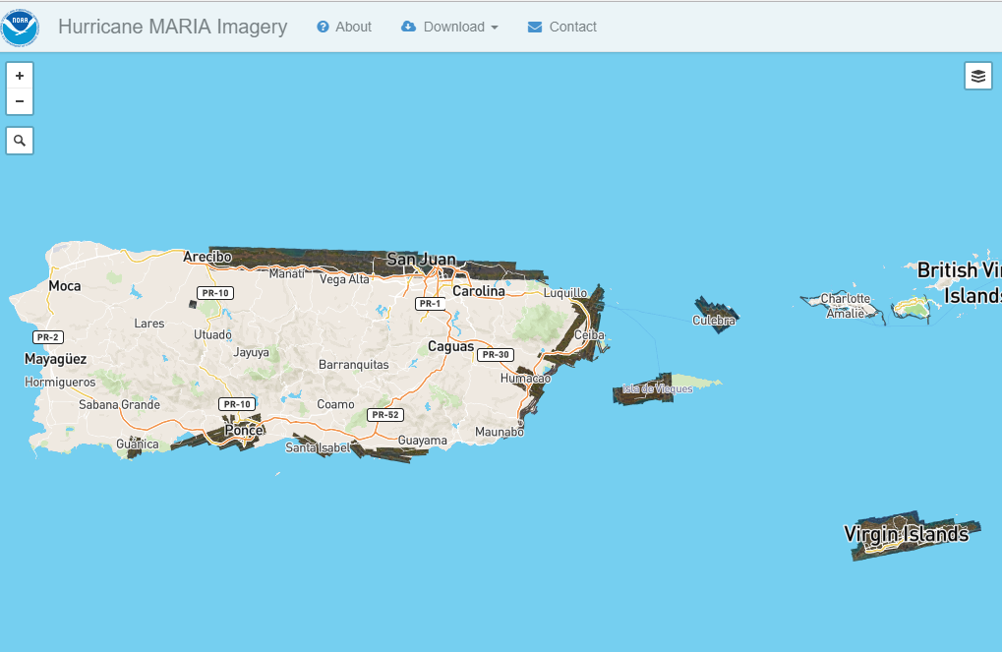
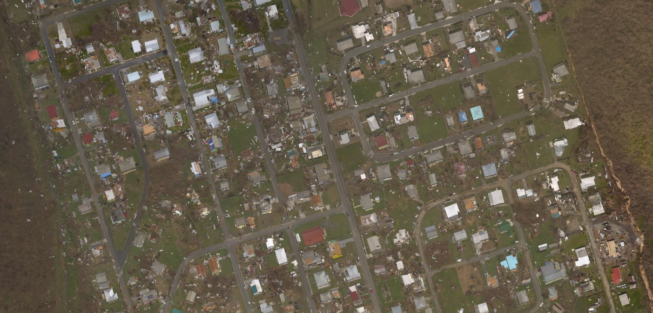
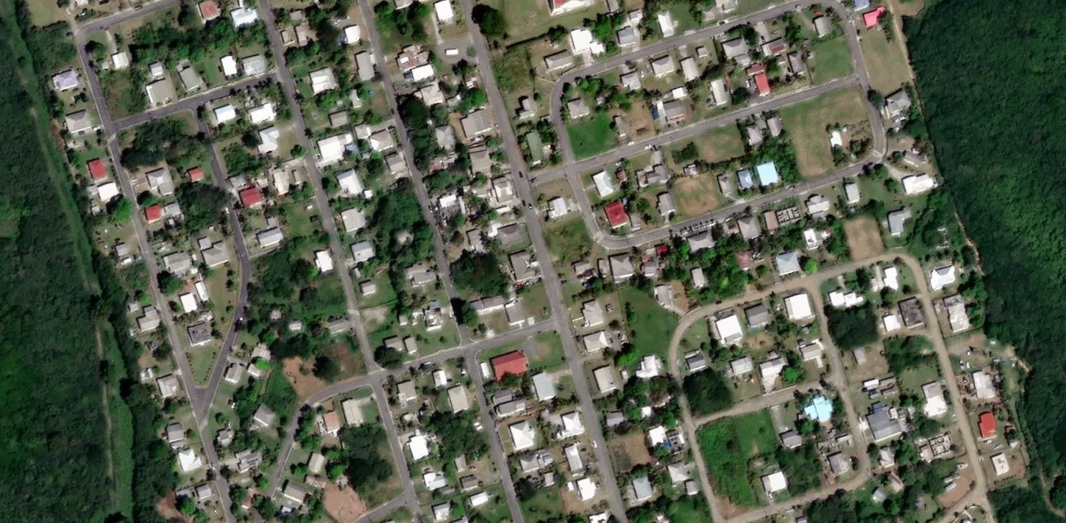
Fight Hours: 39.8
Total Images: 15373
Total km2: 1993
9/22/2017-9/26/2017
Notes:
NGS Arial Imagery collected for Puerto Rico.
· Fight Hours: 39.8
· Total Images: 15373
· Total km2: 1993
· *Campaign Days: 9/22/2017-9/26/2017

Slide 10
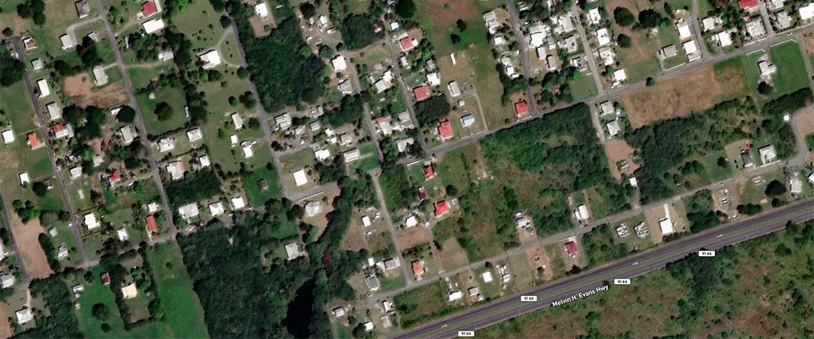
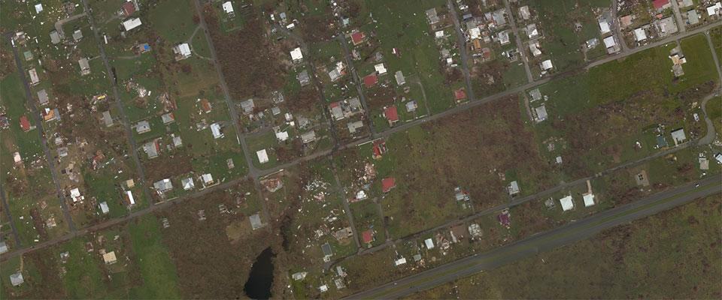
St. Croix, U.S. Virgin Islands
8
Notes:
SLIDE 8 - Emergency Response Imagery
This is St. Croix, US Virgin Island following Hurricane Maria (no click necessary)
With no cell service - this was a way to check on family members’ homes.
DoD and National Guard representatives have thanked NOAA for the imagery. It provided them with information on how to route supplies and equipment, as well as aid in debris removal, both on Puerto Rico and US Virgin Island.
A large benefit to the NOAA imagery to all users is our ability to collect imagery – fast – in all conditions including underneath clouds that are prevalent during this time of year and prevents satellite resources from being effective.
IMAGES
St. Croix, U.S. Virgin Islands following Hurricane Maria
https://oceanservice.noaa.gov/news/sep17/hurricane-maria.html

Slide 11
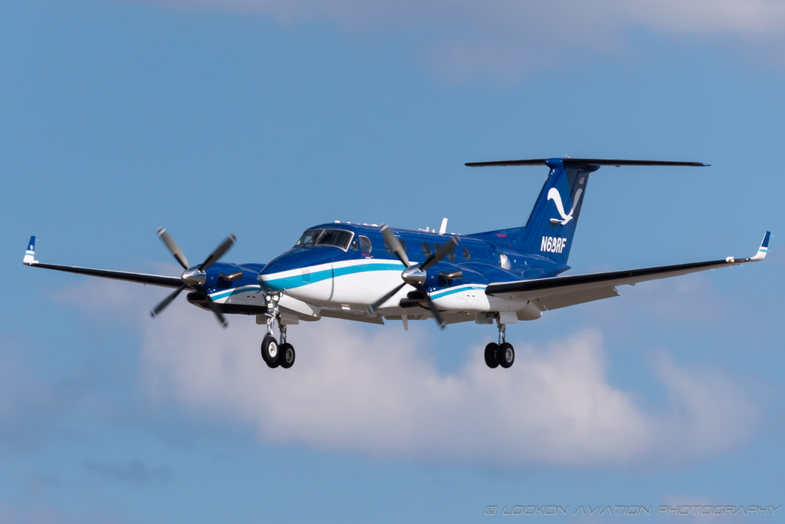




Local Processing on Airplane
FTP
Authoritative Source
NGS -> Storms
Contingency
Contingency
AZ VM
128 Cores
2 TB RAM
~1250 full resolution
geo-referenced
oblique images
to download
ready in 5 min
FTP
Government Partners
FEMA
USGS
AZ WebApp (PHP)
General Public
Emergency
Response on
Azure Cloud
storms.ngs.noaa.gov/storms
Azure Storage->WMTS
AZ Storage
Notes:
This would be equivalent to collecting from JAX – MIA. Additional 30 minutes would be up on the WMTS.

Slide 12
Storms.ngs.noaa.gov
Storm Hits Unique Visitors
Maria 7,990,274 855,909
Harvey 12,426,470 756,190
Irma 30,866,975 2,297,648
Total Downloads: 236 terrabytes
Total image requests from NOAA website and other map services (USGS, Google, ESRI, etc.) = 2.28 billion
Notes:
IMAGE: Before Hurricane Irma and After in Big Pine Key, FL

