Slide 1
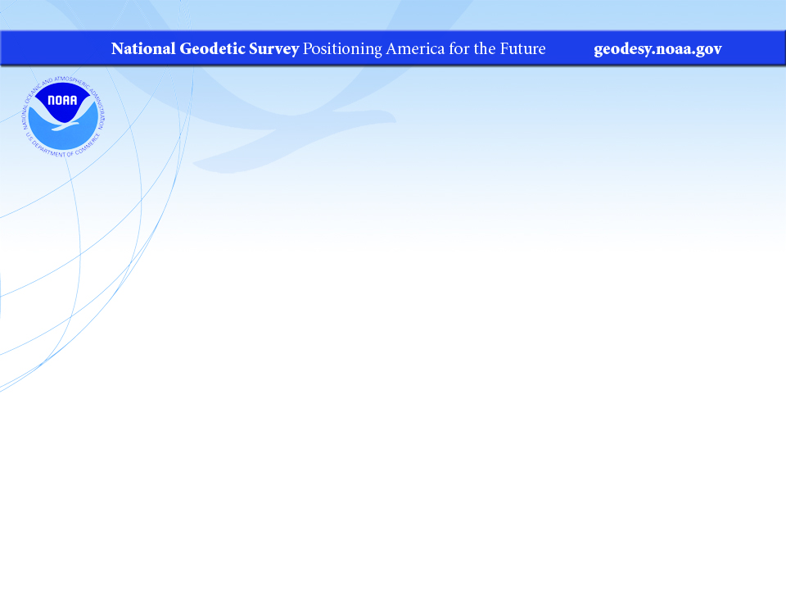
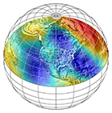
EDMI Calibration Base Lines
NGS’s Geodetic Services Division -
Instrumentation and Methodologies Branch
Charlie Geoghegan, Geodesist
2018 NGS Convocation
May 9 & 10, 2018

Slide 2
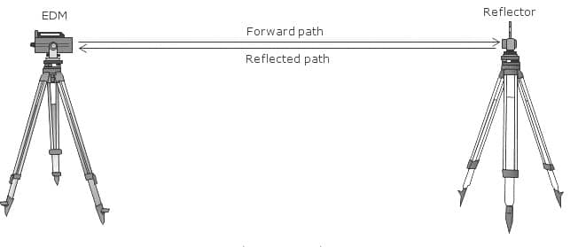
EDMI:
Electronic Distance Measuring Instrumentation
The IMB manages a program that helps anyone with precision EDMI to make sure it is measuring correctly.
EDMI consists of two parts:
An instrument that emits light of a known wavelength and
A reflector that bounces the light back to the instrument.
Instrument

Slide 3
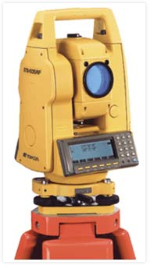
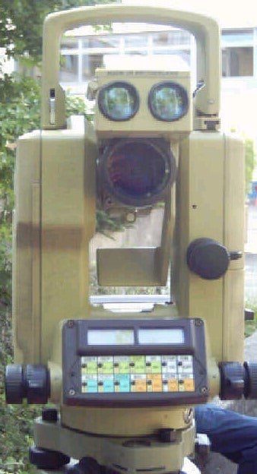
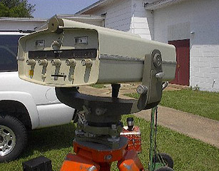
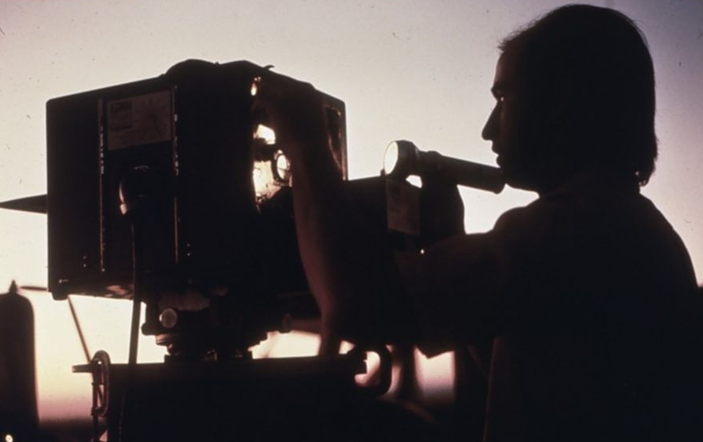
Instruments

Slide 4
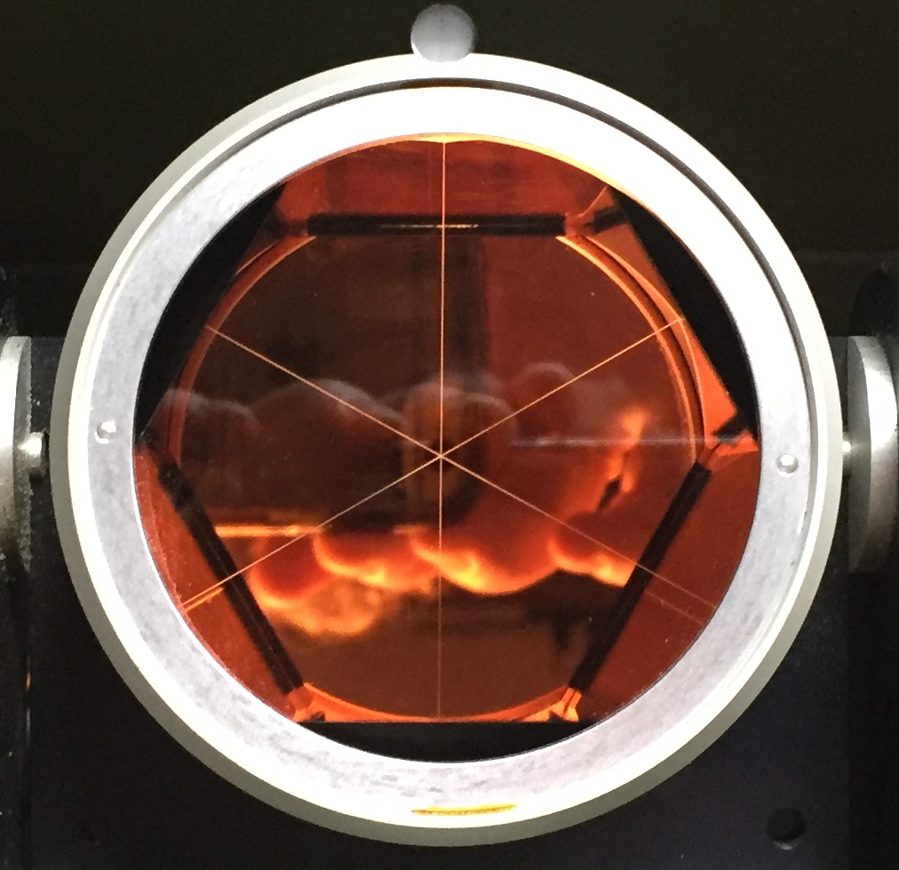
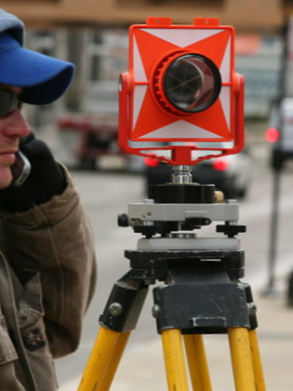
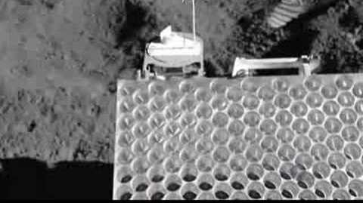
Reflector

Slide 5

Is your precision EDMI meeting the manufacturer’s specifications?
If ONLY we had some place where we could check it out…

Slide 6
The CBL Program manages over 400 Calibration Base Lines (U.S.)
The program has its beginnings 55 years ago when NGS’s predecessor, the U.S. Coast and Geodetic Survey, established the first CBL in Beltsville, MD.
0m 150m 400m 1400m
FROM STATION|ELEV.(M)|TO STATION |ELEV.(M)|HORIZONTAL|MARK-MARK |ERROR(MM)
RALEIGH 0 95.440 RALEIGH 150 92.778 149.9473 149.9710 0.1
RALEIGH 0 95.440 RALEIGH 400 87.377 399.8802 399.9615 0.2
RALEIGH 0 95.440 RALEIGH 1400 85.134 1399.9235 1399.9615 0.3
RALEIGH 150 92.778 RALEIGH 400 87.377 249.9329 249.9913 0.1
RALEIGH 150 92.778 RALEIGH 1400 85.134 1249.9760 1249.9994 0.2
RALEIGH 400 87.377 RALEIGH 1400 85.134 1000.0427 1000.0452 0.2

Slide 7
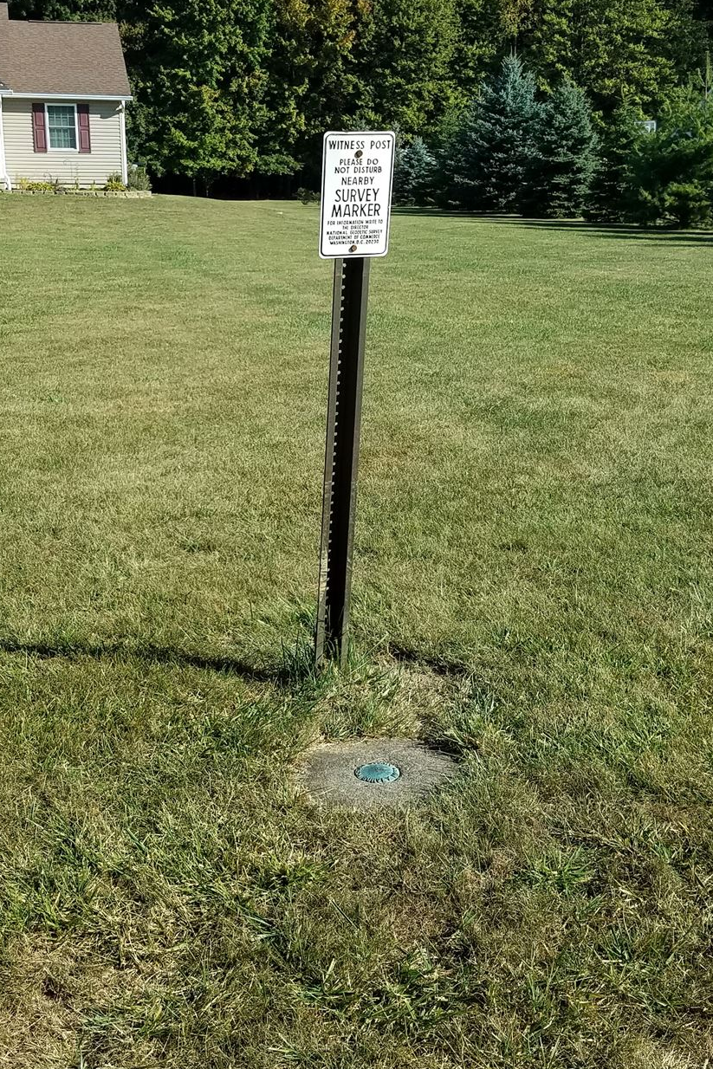
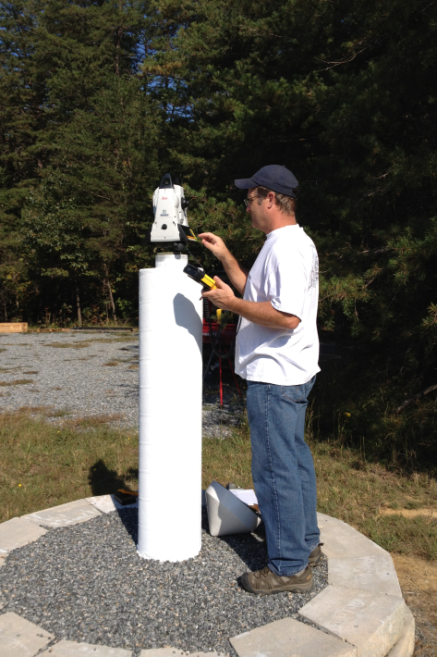
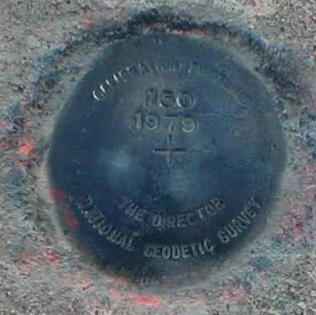
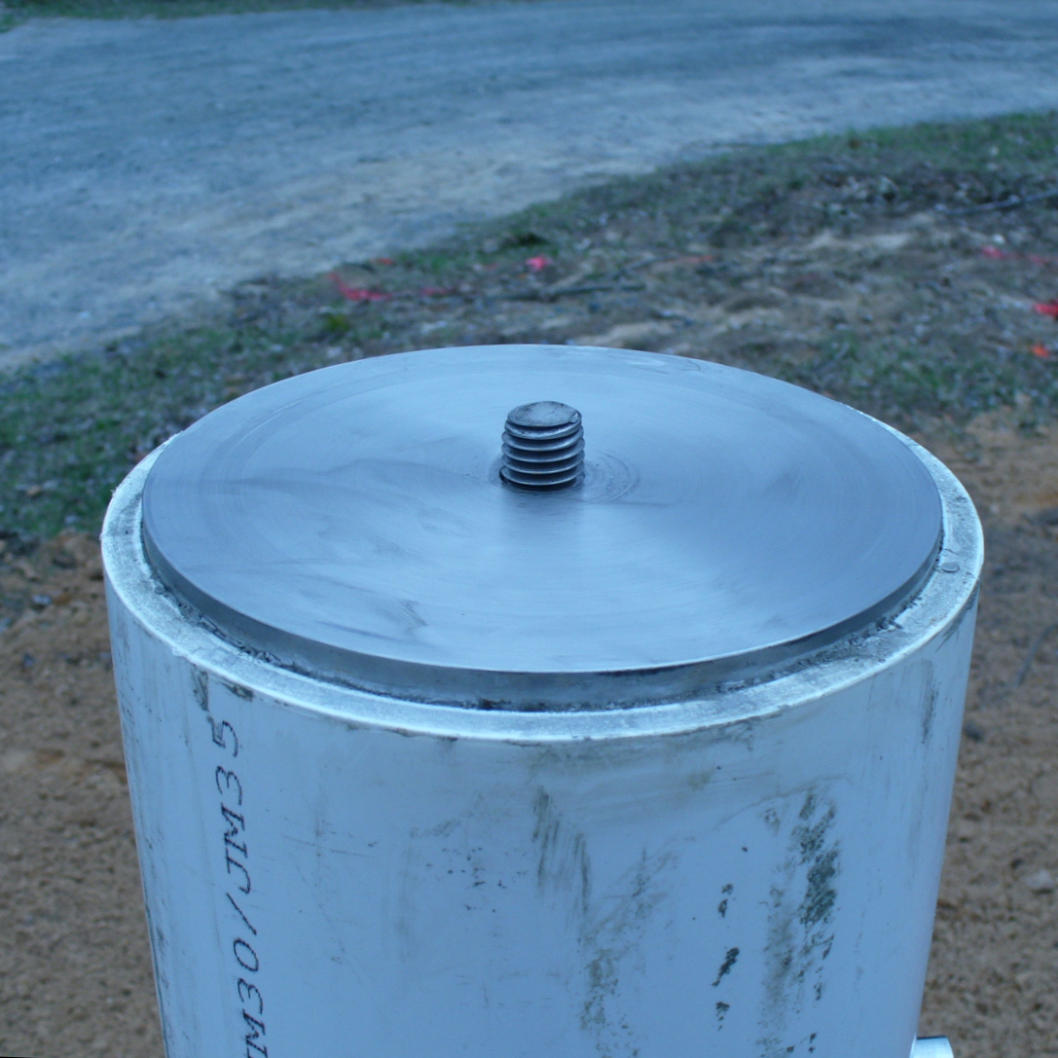
Typical CBL Monuments
Mark with Disk Forced-centering Pier

Slide 8
Sample CBL near Raleigh, NC
0m 150m 400m 1400m
0 - 150
Horz. Dist.: 149.9473m

Slide 9
Sample CBL near Raleigh, NC
0m 150m 400m 1400m
0 - 400
Horz. Dist.: 399.8802m

Slide 10
Sample CBL near Raleigh, NC
0m 150m 400m 1400m
0 - 1000
Horz. Dist.: 1399.9235m

Slide 11
Sample CBL near Raleigh, NC
0m 150m 400m 1400m
150 - 1400
Horz. Dist.: 1249.9760m

Slide 12
Sample CBL near Raleigh, NC
0m 150m 400m 1400m
150 - 400
Horz. Dist.: 249.9329m

Slide 13
Sample CBL near Raleigh, NC
0m 150m 400m 1400m
400 - 1400
Horz. Dist.: 1000.0427m
So, now let’s get set up to put our EDMI through the paces.

Slide 14
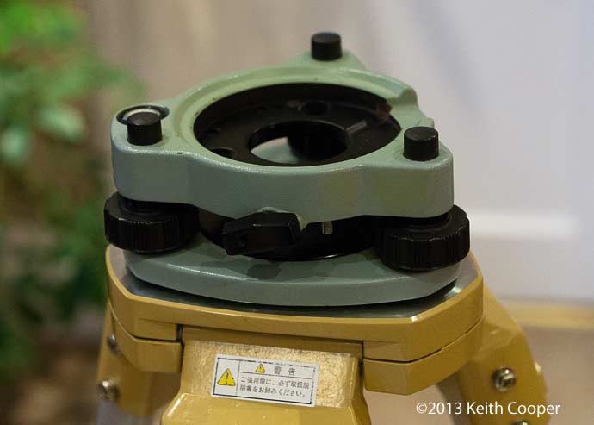
First, we have to center a tribrach on a tripod over each mark

Slide 15
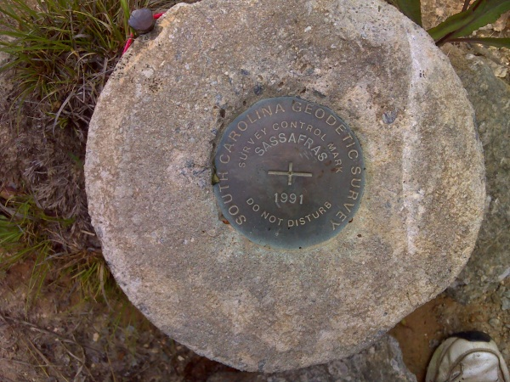
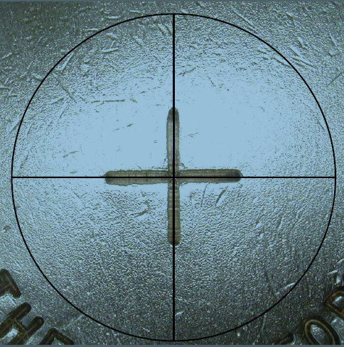
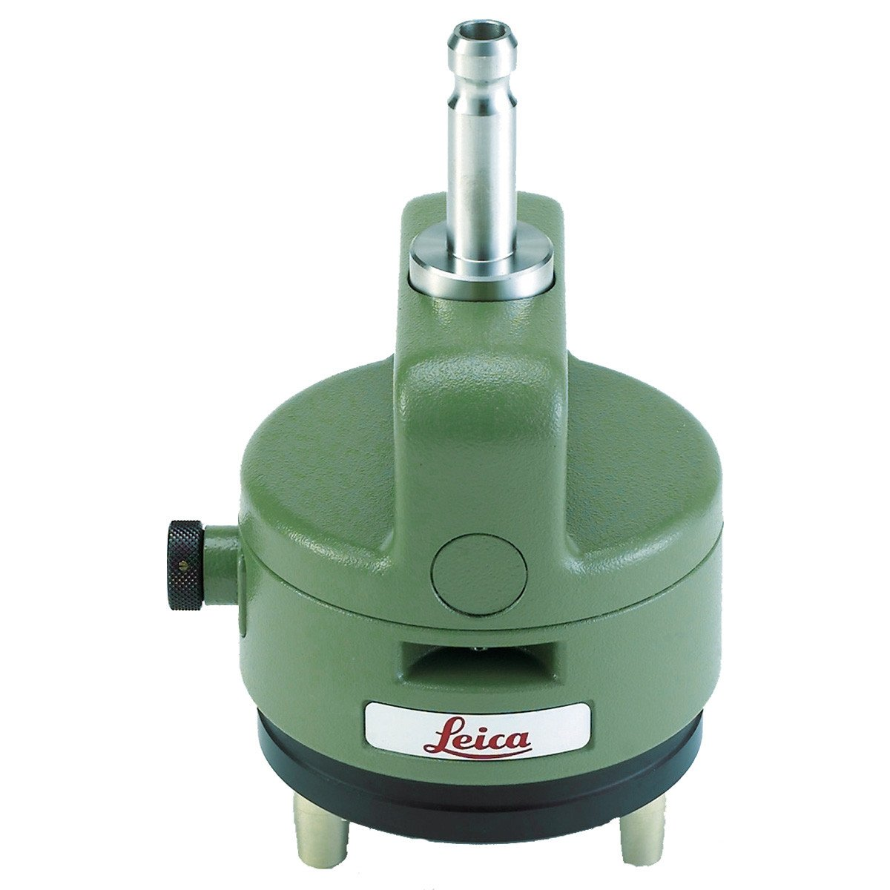
… using a reversible optical plummet

Slide 16
Sample CBL near Raleigh, NC
0m 150m 400m 1400m

Slide 17
Sample CBL near Raleigh, NC
0m 150m 400m 1400m
Redundancy is essential

Slide 18
Sample CBL near Raleigh, NC
0m 150m 400m 1400m

Slide 19
Sample CBL near Raleigh, NC
0m 150m 400m 1400m
Measured Horz. Distances
149.947
149.948
149.950
149.951
149.947
149.949
149.947
149.948
149.950
149.947
Mean: 149.9484m
Standard Error: 0.5mm

Slide 20
Sample CBL near Raleigh, NC
0m 150m 400m 1400m

Slide 21
Sample CBL near Raleigh, NC
0m 150m 400m 1400m

Slide 22

Sample CBL near Raleigh, NC
0m 150m 400m 1400m

Slide 23
Sample CBL near Raleigh, NC
0m 150m 400m 1400m

Slide 24
Sample CBL near Raleigh, NC
0m 150m 400m 1400m

Slide 25
Sample CBL near Raleigh, NC
0m 150m 400m 1400m

Slide 26
Sample CBL near Raleigh, NC
0m 150m 400m 1400m

Slide 27
Sample CBL near Raleigh, NC
0m 150m 400m 1400m

Slide 28
Sample CBL near Raleigh, NC
0m 150m 400m 1400m

Slide 29
Sample CBL near Raleigh, NC
0m 150m 400m 1400m

Slide 30
Sample CBL near Raleigh, NC
0m 150m 400m 1400m

Slide 31
Sample CBL near Raleigh, NC
0m 150m 400m 1400m
6 segments of differing lengths
X 20 measurements each
= 120 measurements
Accurate estimation of the EDMI’s performance

Slide 32
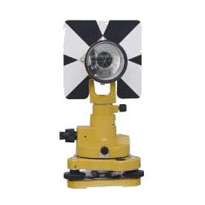
Two Ways to Check EDMI
1) Compare the measured mean distance to NGS’s accepted distance for each segment. The difference should not exceed the manufacturer’s specs.
1mm + 2ppm @ 150m = 1.3mm
Measured Horz. Distances
149.947
149.948
149.950
149.951
149.947
149.949
149.947
149.948
149.950
149.947
Mean: 149.9484m NGS distance: 149.9473 Diff. = 1.1mm

Slide 33
NGS’s CALIBRATE
Download CALIBRATE from NGS
https://www.ngs.noaa.gov/PC_PROD/CALIBRATE/
Compute EDMI constant and slope errors. Do they fall within manufacturer’s specs?
Constant Error Slope Error
1mm 2ppm

Slide 34
Sustaining a Nationwide CBL Infrastructure
*Open invitation to interested groups and individuals
*Provide guidelines
*Provide technical assistance
*Ensure every state has at least one federal CBL
*Review and share CBL observations
*Troubleshoot discrepancies
*QA/QC measurement sets for a data base (CALIBRATE)
Notes:
Federal/state/county/city surveyors

