Slide 1

Changes are coming
NGS 2022 - NSRS Modernization
Are you Ready?
Pam Fromhertz
Rocky Mountain Regional Advisor
Pamela.Fromhertz@noaa.gov
240-988-6363
John Hunter
CO State Geomatics Coordinator
DRCOG
March 7, 2019
geodesy.noaa.gov

Slide 2
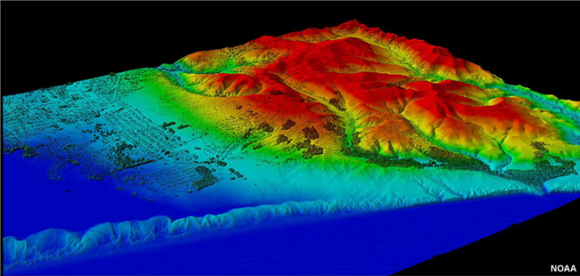

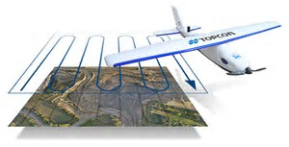
Agenda
CO Geodetic Coordinator and Working Group
NSRS Modernization
SPCS2022
  Changes are coming – what do you want for CO
  Your input critical: LDPs?
GPS on BM
  Phase I - Geoid18
  Phase II – keep collecting

Slide 3





Who
State Geomatics Coordinator:
* John Hunter, Professional Land Surveyors of Colorado (PLSC),
Denver Water
Members:
  Thomas Breitnauer, Denver International Airport
  Rick Corsi, Office of Information and Technology
  Annabelle Montoya, GIS Colorado, City of Wheatridge
  Joey Stone, Denver Water
  Darren Shanks, CDOT
Advisors:
  Todd Beers, President PLSC
  Pam Fromhertz, NGS Rocky Mountain Regional Advisor
  Becky Roland, PLSC Executive Secretariat
CoCoordinator@plsc.net

Slide 4
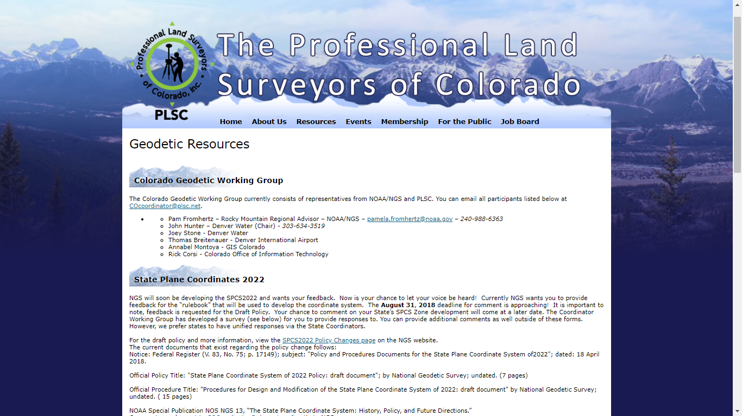

Slide 5
NSRS Modernization
Who and What
The National Geodetic Survey, the federal agency responsible for establishing and maintain the positioning framework to support all federal civilian mapping and charting in the United States, is modernizing the National Spatial Reference System (NSRS).
What does this mean?
  All horizontal and vertical datums in the NSRS (NAD 83, NAVD 88, etc.) will be updated with:
    Four (4) new Terrestrial Reference Frames of 2022
    North American-Pacific Geopotential Datum of 2022
  New tools, products, services, and methodologies will be developed jointly to support the transition and access to an improved, modernized NSRS.

Slide 6
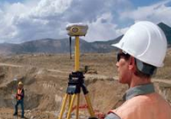
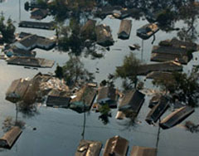
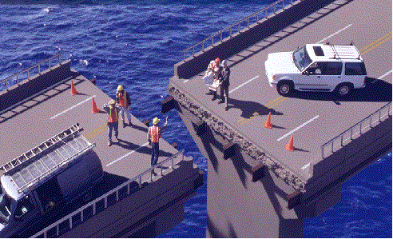

NSRS Modernization
Revolutionize professional surveying
No more need for installing and locating bench marks
Absolute, consistent positioning autonomously, anywhere
Impacts on infrastructure
Any application requiring precise positioning -- bridges, tunnels, railways, agriculture, navigation -- will be easier and more accurate
Vastly improved flood plain mapping
Water flows due to differences in gravity
Critically important in low-lying, flat communities
Fundamental support for new technologies
“Smart Highways” for autonomous vehicles

Slide 7
All coordinates and heights
will change!
In Colorado by over 4 feet horizontally and around -2 feet vertically

Slide 8
Predicated Positional Changes in 2022
Computed for S 411(KK1411) near Arvada, CO
HORIZONTAL = 1.3671 m (4.5 ft)
ELLIPSOID HEIGHT = - 0.87 m (-2.85 ft)
Computed with HTDP and Inverse
ORTHOMETRIC HEIGHT = - 0.35 m (-1.14 ft)
Computed with xGEOID16B

Slide 9
These are part of the NSRS*
Horizontal Datums and Geometric Reference Frames | Vertical Datums | Great Lakes Datums | Geoid Models | Transformations and Conversions
USSD | NGVD 29 | IGLD55 | GEOID90 | NADCON
NAD 27 | NAVD 88 | IGLD85 | GEOID93 | VERTCON
NAD 83 | PRVD02 |  | ALASKA94
 | ASVD02 |  | GEOID96 | SPCS 27
 | NMVD03 |  | GEOID99 | SPCS 83
 | GUVD04 |  | GEOID03
 | VIVD09 |  | GEOID06
 |  |  | GEOID09
 |  |  | GEOID12(A,B)
*This not a complete list.

Slide 10
These are not part of the NSRS*
Horizontal Datums and Geometric Reference Frames | Vertical Datums | Great Lakes Datums | Geoid Models | Transformations and Conversions
WGS 84 | IHRS |  | OSU91A | CORPSCON
ITRF |  |  | EGM96 | Appendix B.6 of DMA TR 8350.2 (WGS 84)
IGS |  |  | EGM2008 | Oregon Coordinate Reference System
 |  |  |  | The Kansas Regional Coordinate System
*This is not a complete list.

Slide 11
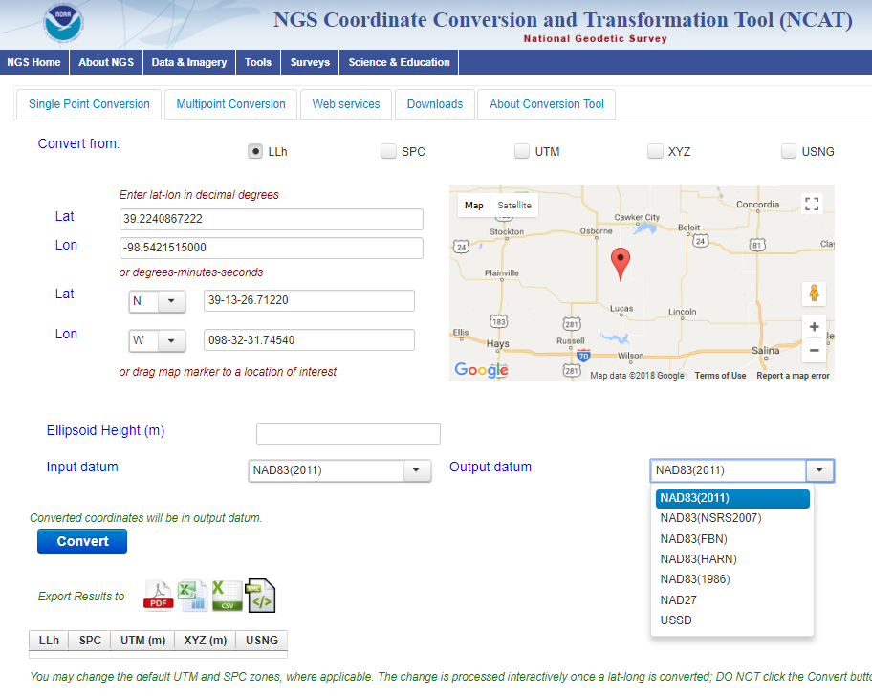
NCAT
NGS Coordinate Conversion and Transformation Tool
Notes:
We also have a new tool available to convert between various coordinate systems using various projects.

Slide 12
SPCS2022 Zone “layers” and LDPs
Each state may have max of THREE zone “layers”
  One layer will be statewide zone (designed by NGS)
  Other layers have two or more zones (“multi-zone”)
  Only one layer can have discontinuous coverage
Multi-zone layer can consist of LDPs
  Designed by stakeholders
  Minimum zone width 50 km (if height range < 250m)
  LDP coverage can be discontinuous…
Notes:
Layered zones are allowed for SPCS2022 (for a max of 3 layers)
One state in SPCS 83 has 2 layers, Kentucky (statewide plus a pre-existing 2-zone layer)
States can have 1, 2, or 3 layers
One layer MUST be a statewide zone (so a state with 1 layer has only a statewide zone)
The other 1 or 2 layers will almost always have multiple zones (unless a state has, say, a single LDP in SPCS2022 that covers only part of the state)
Only 1 layer can be “discontinuous”, that is, consist of layers that do not collectively cover the entire state (will show an example of this)
Decision to go with 3 layers based on FRN responses, especially those from mountainous western states
The multi-zone layer(s) can consist of LDPs
Almost always means distortion criterion < ±50 ppm, so must be designed by others (i.e., “contributing partners”), not by NGS

Slide 13
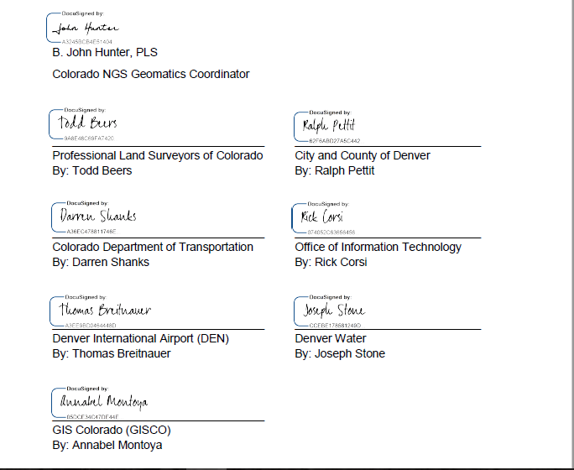
CO Letters submitted to NGS under Federal Register Notice from
NGS Colorado Geodetic Coordinator Group

Slide 14
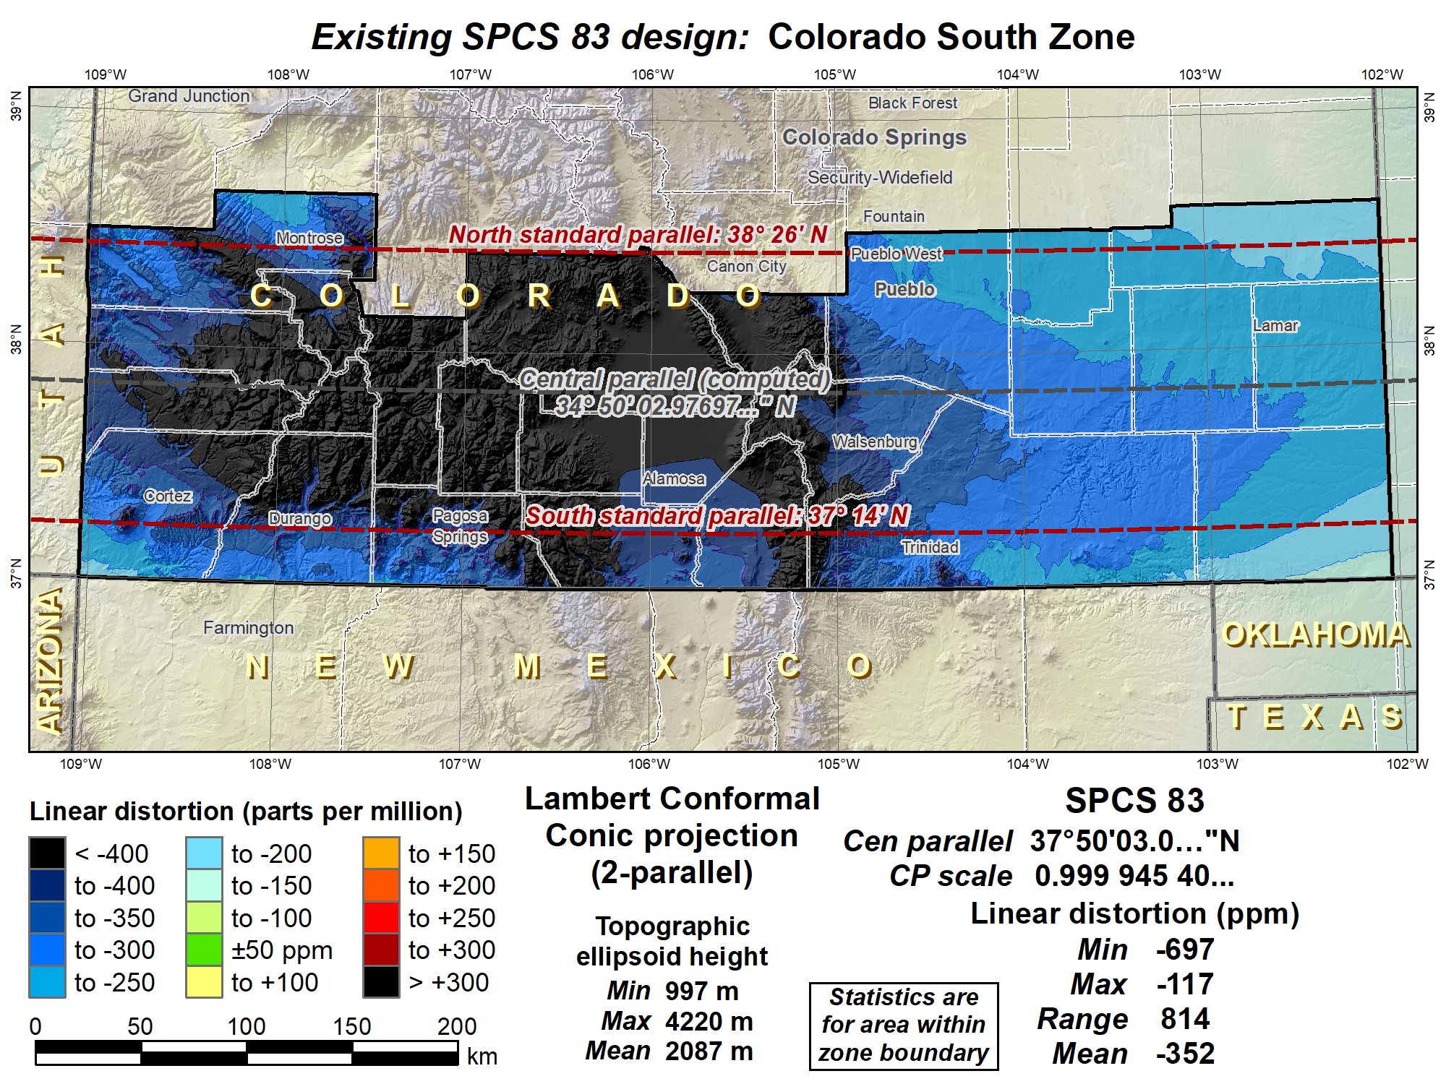

Slide 15
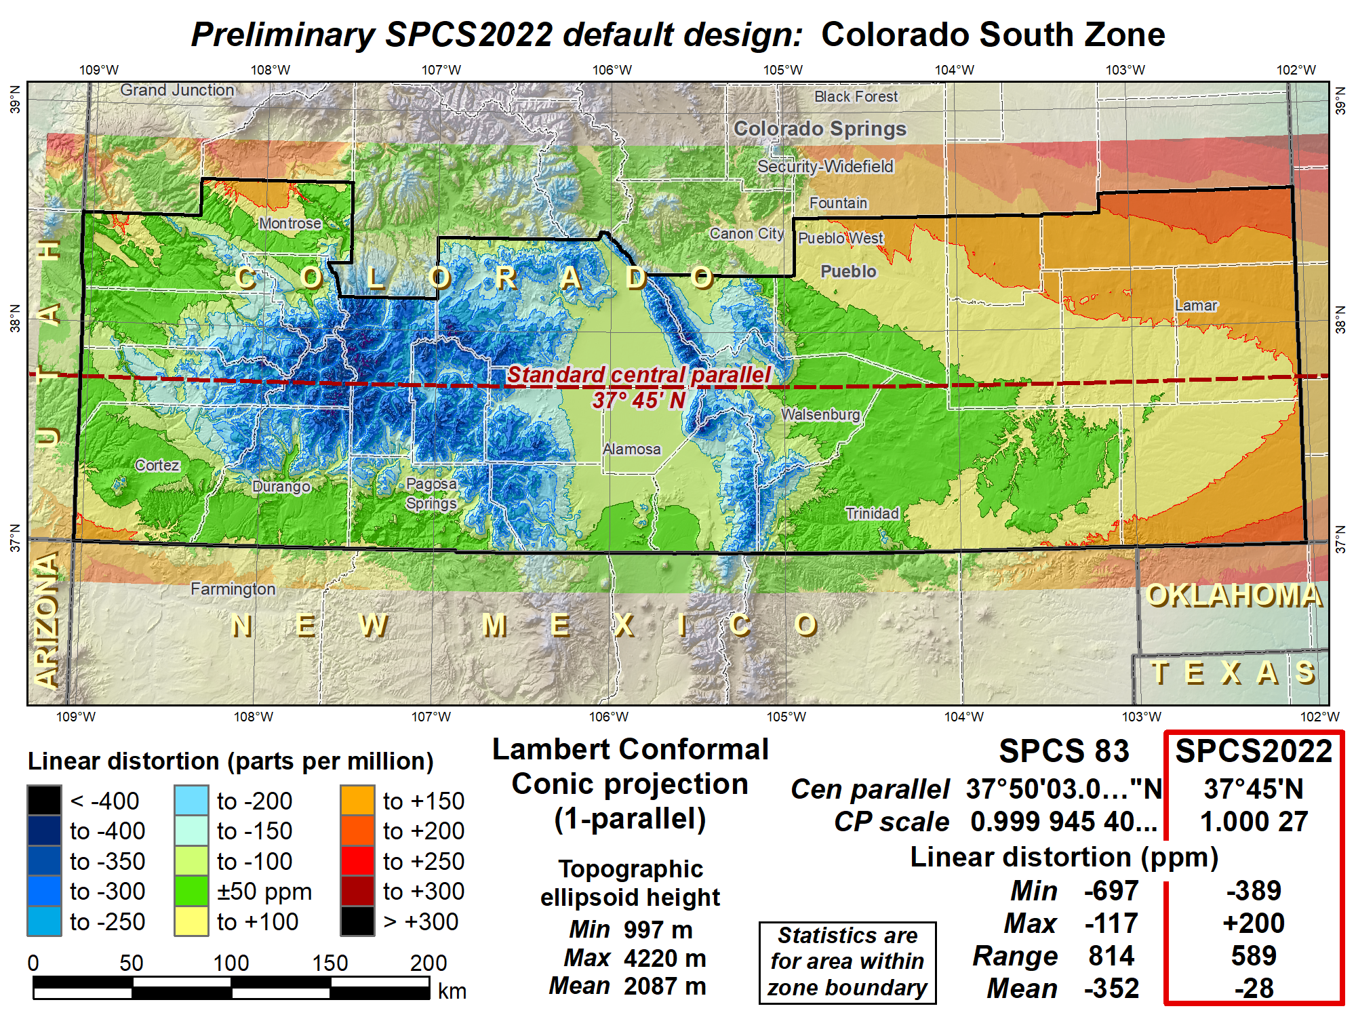
Shifted central parallel south to reduce distortion range, decreased scale to reduce distortion in cities.

Slide 16
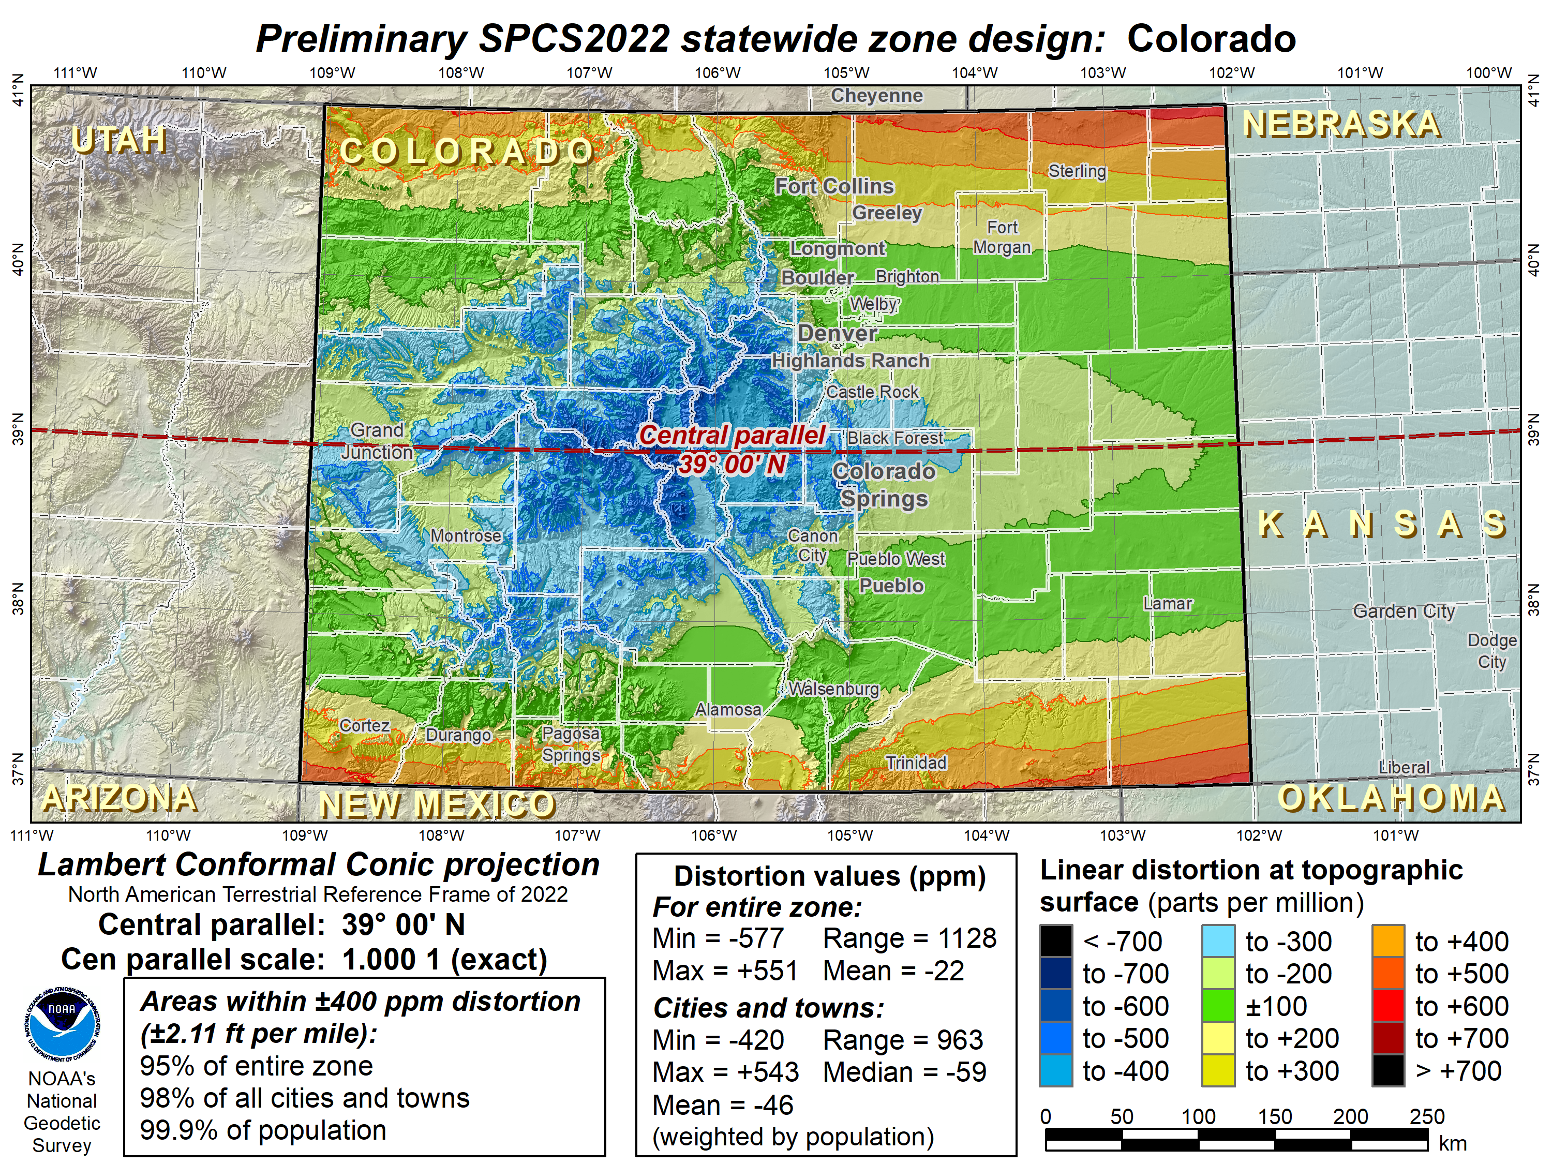
Preliminary
Preliminary

Slide 17
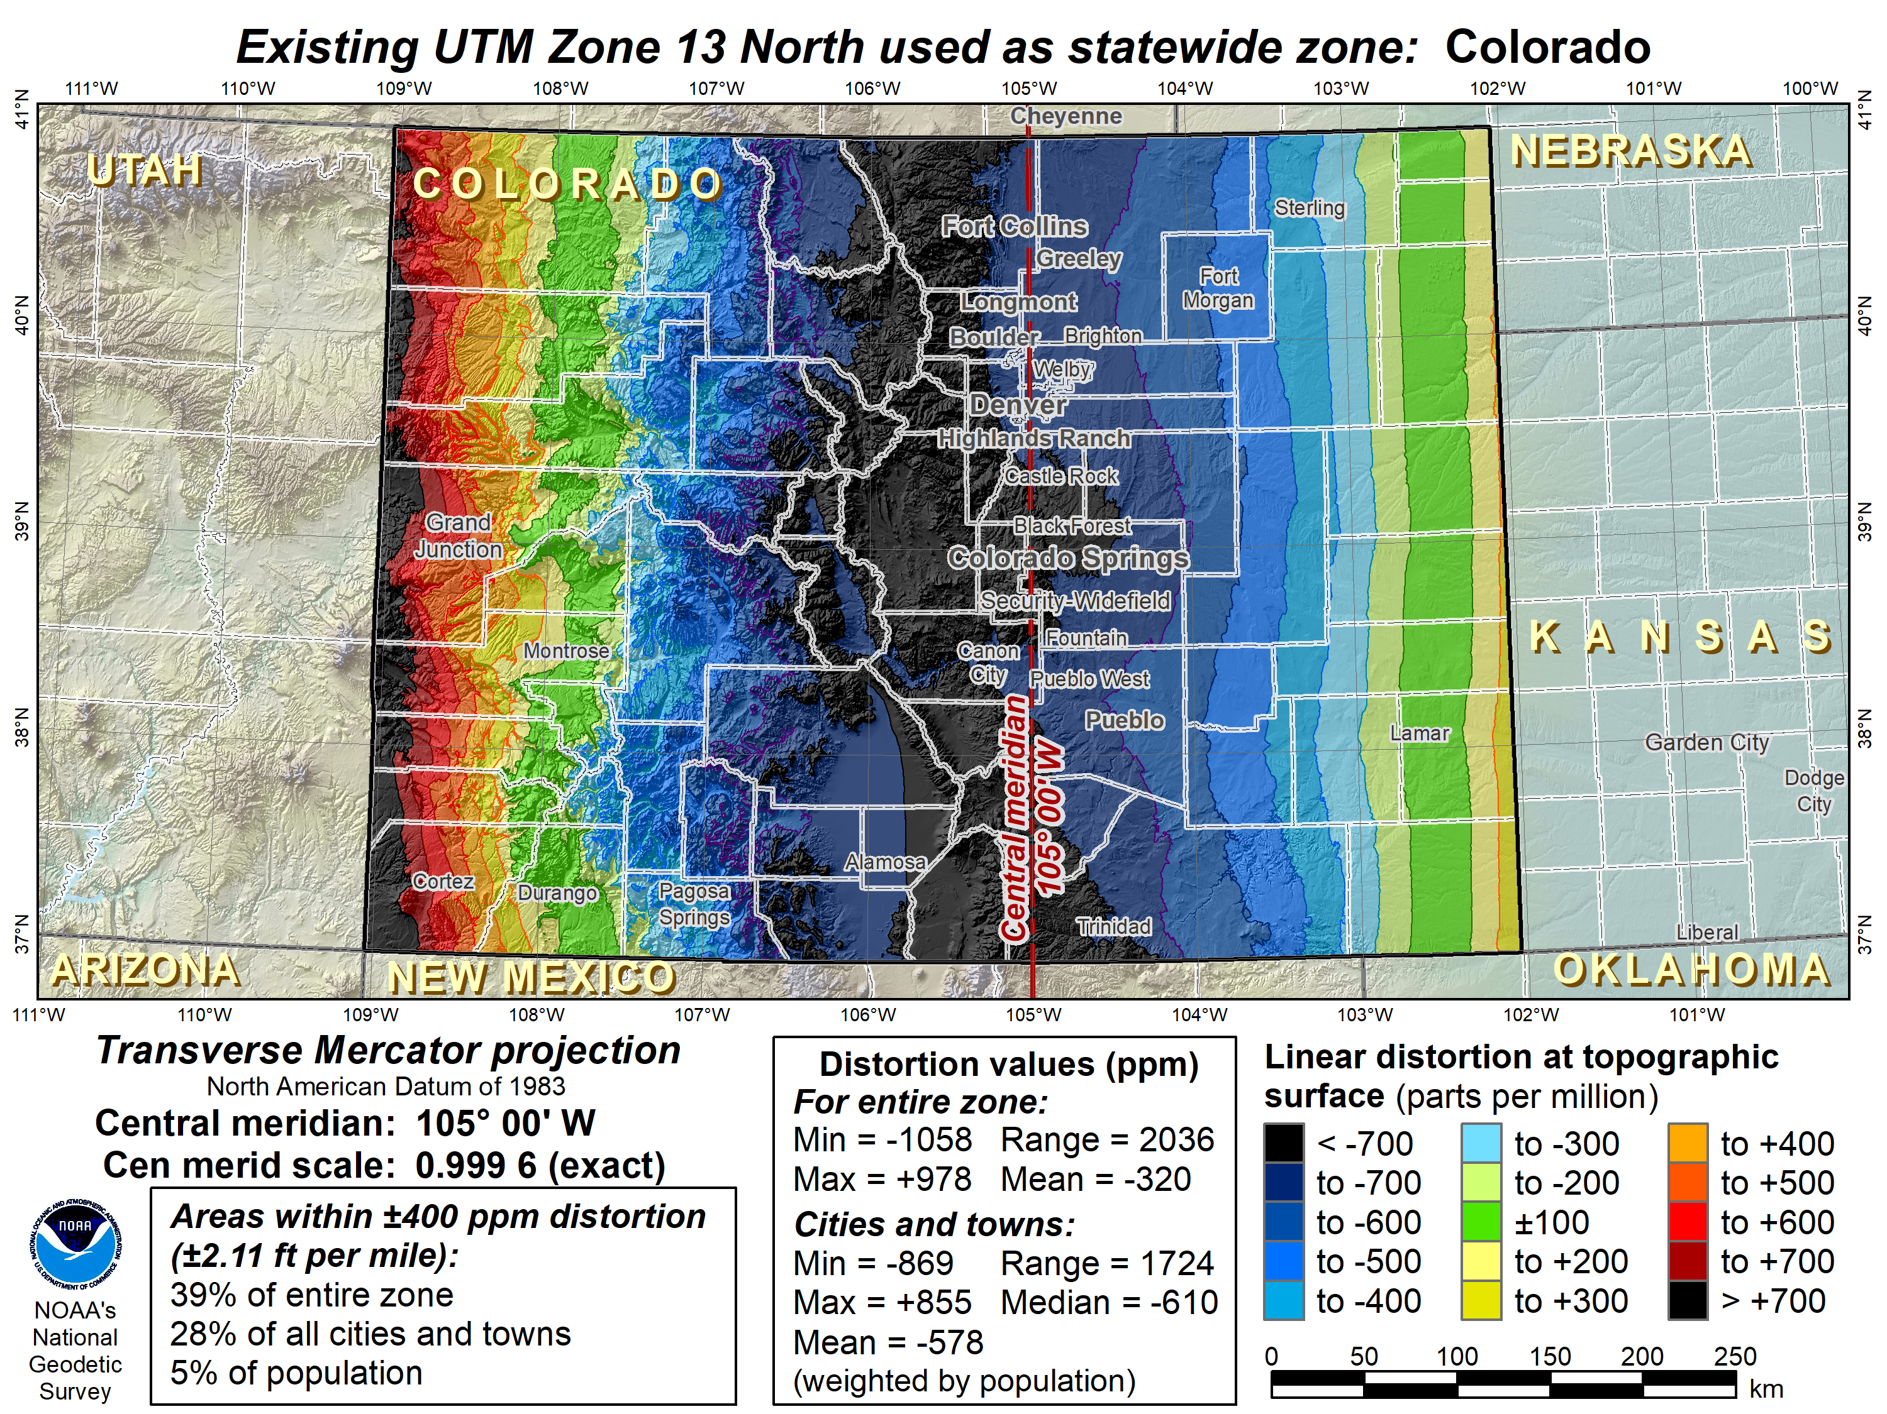
Prototype
Prototype

Slide 18
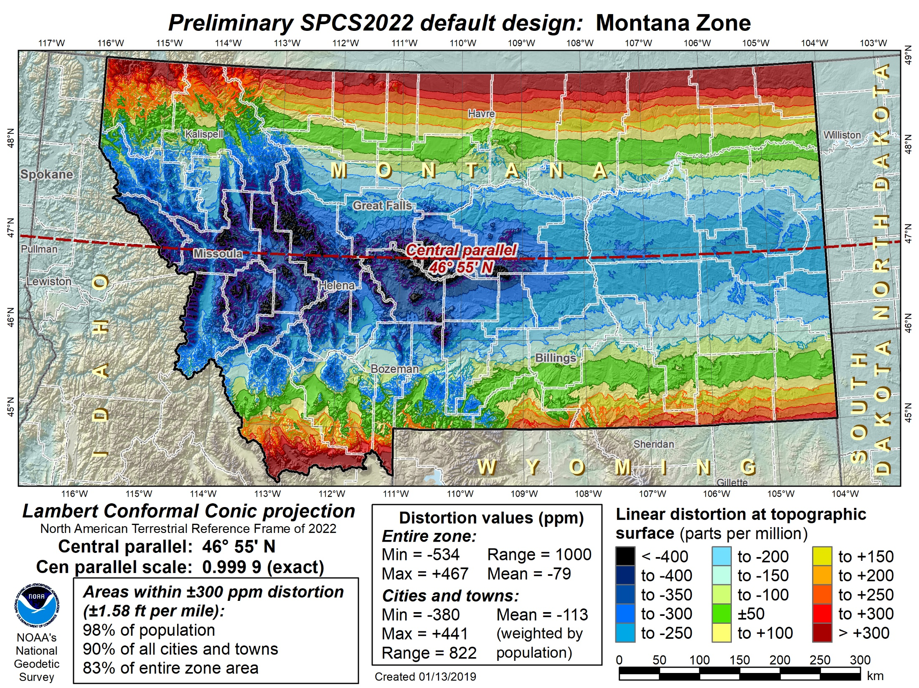
Montana statewide
Preliminary
Notes:
Map of preliminary default SPCS2022 design for Montana, which is also a statewide zone.

Slide 19
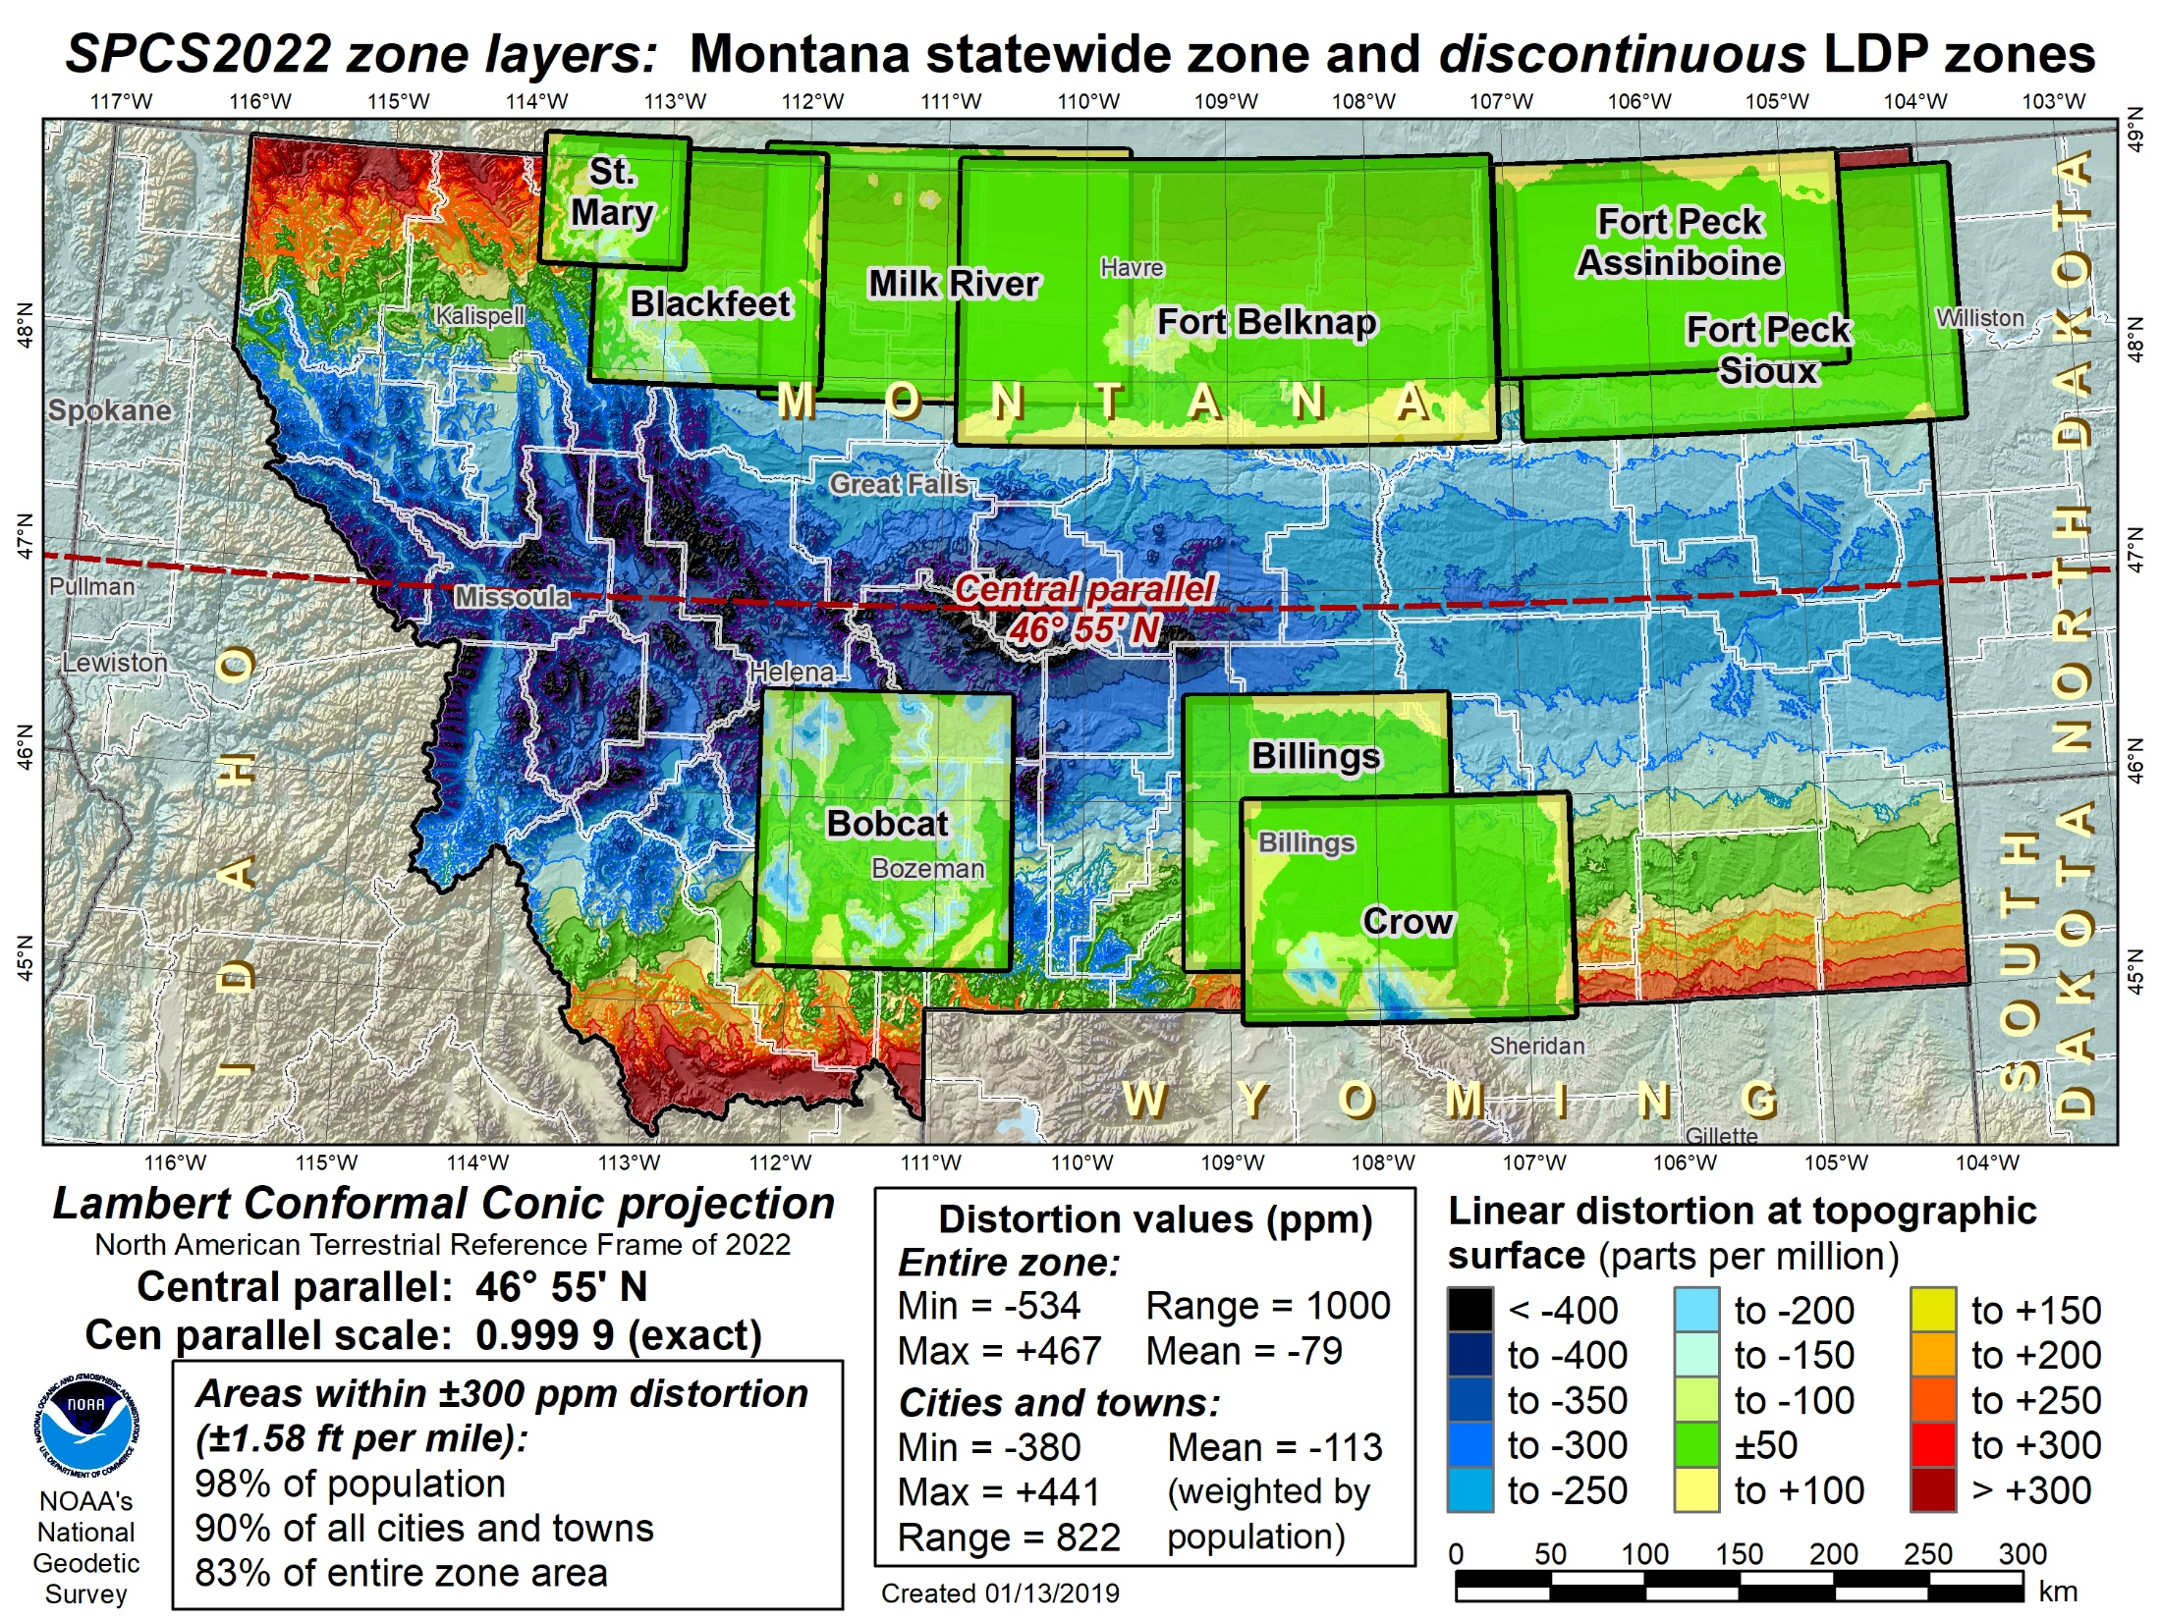
Montana statewide + discontinuous LDPs
Preliminary
Notes:
Map showing preliminary default SPCS2022 design for Montana with layer of discontinuous LDP zones
Both the statewide and LPD zones use the system distortion color ramp (±50 ppm increment)
LDP zones shown are from the existing Rocky Mountain Tribal Coordinate Reference System (RMTCRS)
If decided by Montana stakeholders, a modified (and likely augmented) version of the RMTCRS could coexist with the default statewide zone designed by NGS.

Slide 20
What matters to CO
All States will get 1 zone
Do you want any LDPs – Denver Metro Area
Your opinions and feedback critical to the outcome
How do you want CO to make final decisions?

Slide 21

GPS on Bench Marks
Phase I
  Geoid 18
  You helped with the final hybrid Geoid Model
  All About heights
  How important will heights/elevation be in the future?
Phase II
  Transformation Tools
  Help needed with the transformation tools to the new systems over the next couple of years
Thank you

Slide 22
Next Steps
Phase II
New priority stations for Transformation tool
  Many more stations
  Design a more localized approach
  Provide incentive
  Utilize interns (request positions)
  NGS is exploring use of RTK

Slide 23
Crowdsourcing
GPS on Bench Marks
Find Bench Marks (priority and others)
  Use our priority BM/tracking map
  Use NGS Data Explorer
  Use DS-World
Provide a recovery note
  Use DS-World (or new NGS beta app)
  Provide updated descriptions,
  Coordinates, photos (use DS-World)
Collect GPS data
  Share through OPUS
  Create OPUS Data Sheet
GIS Community
can assist here
Requires Survey Grade
GPS data and
min. of 4 hrs of data

Slide 24
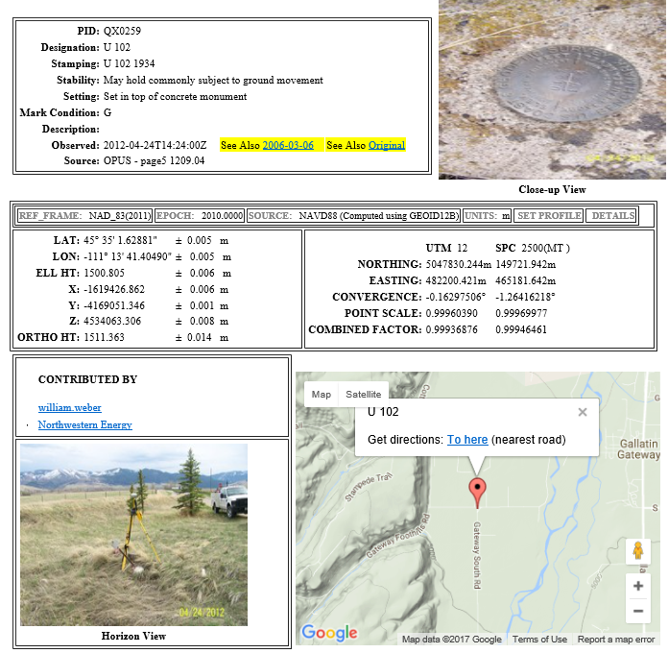
OPUS Share Data Sheet

Slide 25
Rocky Mountain Region Map and Volunteer Sign up
Signup sheet:
https://survey123.arcgis.com/share/130be382350e4a38a71de3b2e4d92a98 (Must cut and paste)
Status Map:
https://www.arcgis.com/apps/webappviewer/index.html?id=0829616b6ec740b7a0bfbf057188e865
NGS Map:
https://geodesy.noaa.gov/GPSonBM/index.shtml

Slide 26
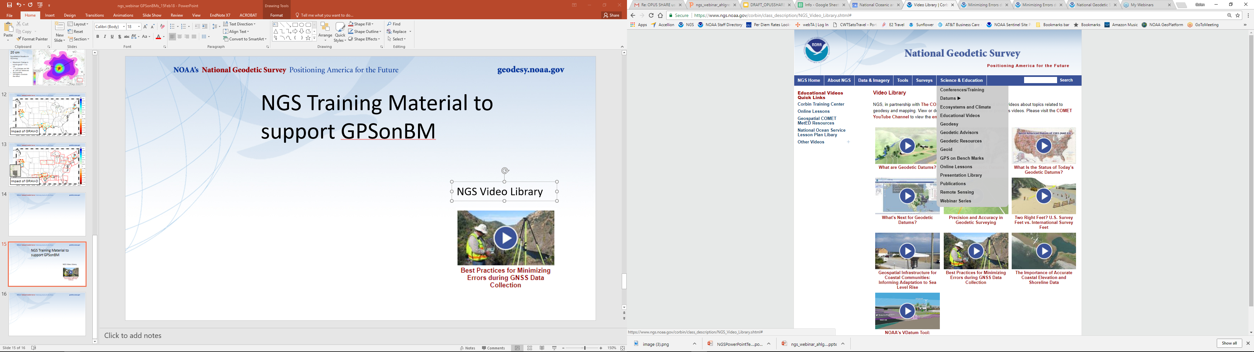
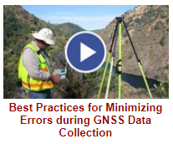

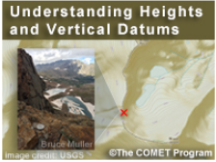
NGS GPS on BM Training Material
GPS on Bench Marks Webpages
NGS Video Library
NGS Online Lessons

Slide 27
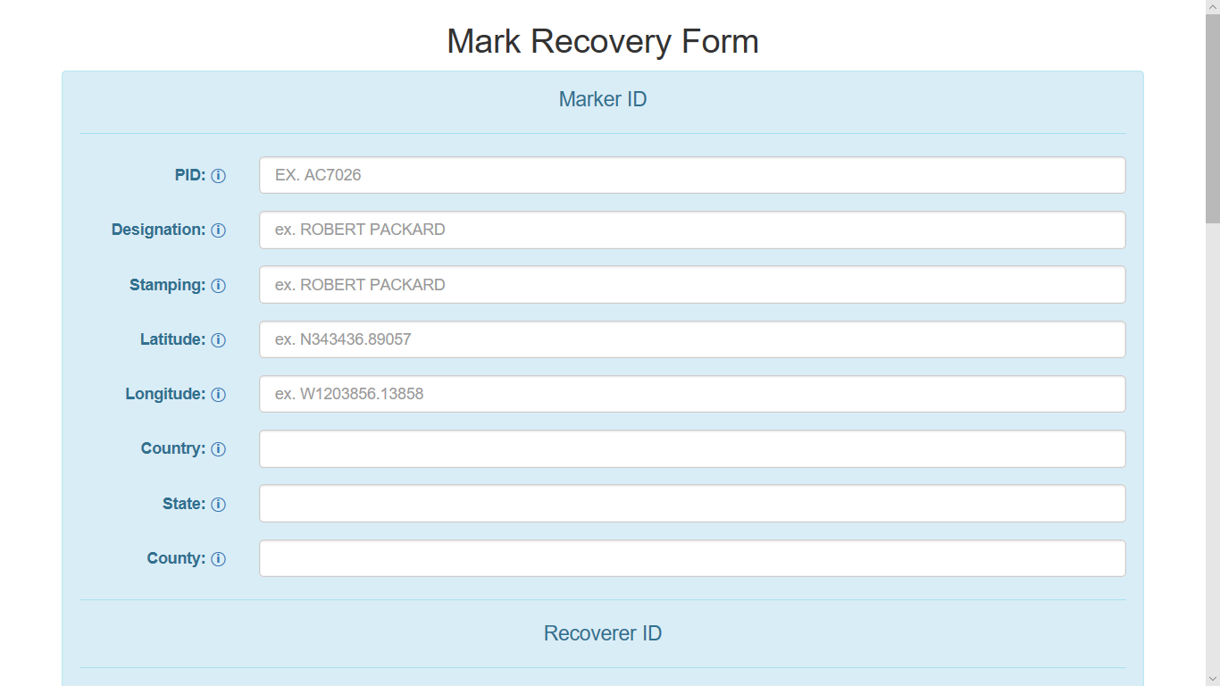

Slide 28
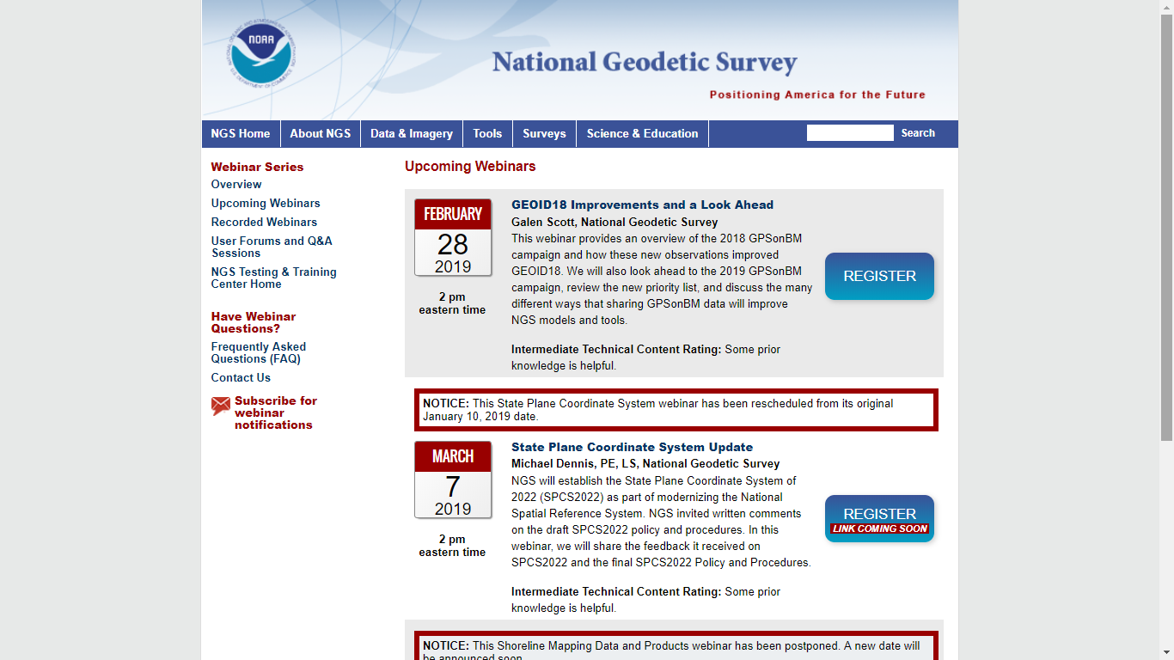

Slide 29
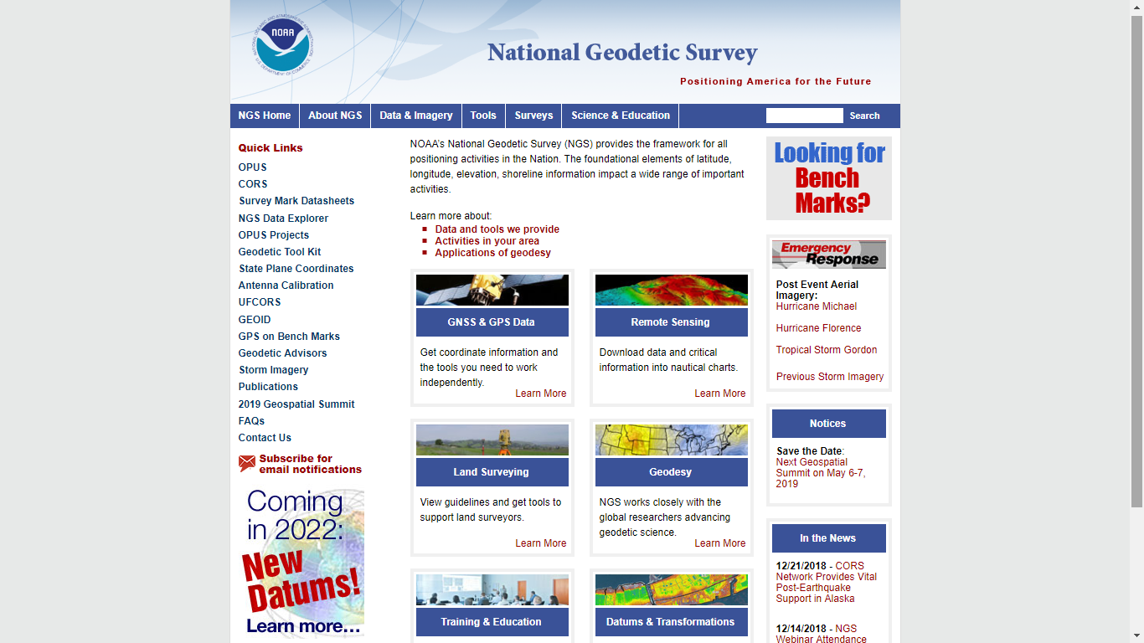
geodesy.noaa.gov

Slide 30
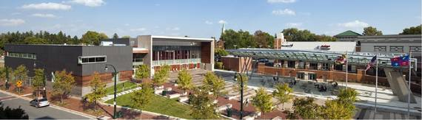
2019 Geospatial Summit
SAVE THE DATE!
Geospatial Summit
Dates: May 6 - May 7, 2019
Location: Silver Spring Civic Center
Invitees: NSRS users plus NGS Subject Matter Experts
Attend: In Person, webinar, Recordings – Register Now

Slide 31
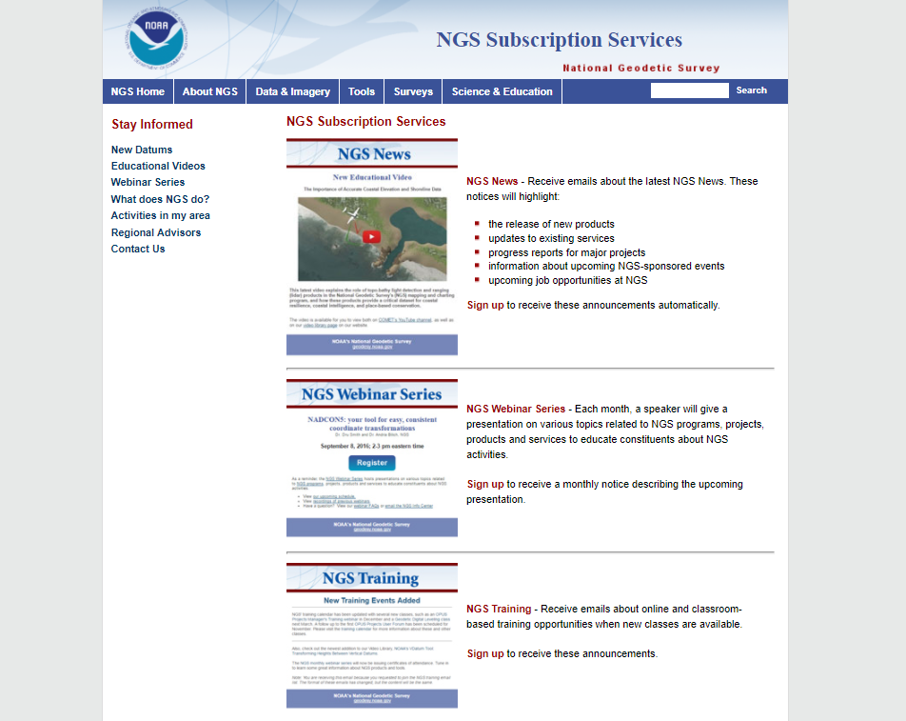

Slide 32
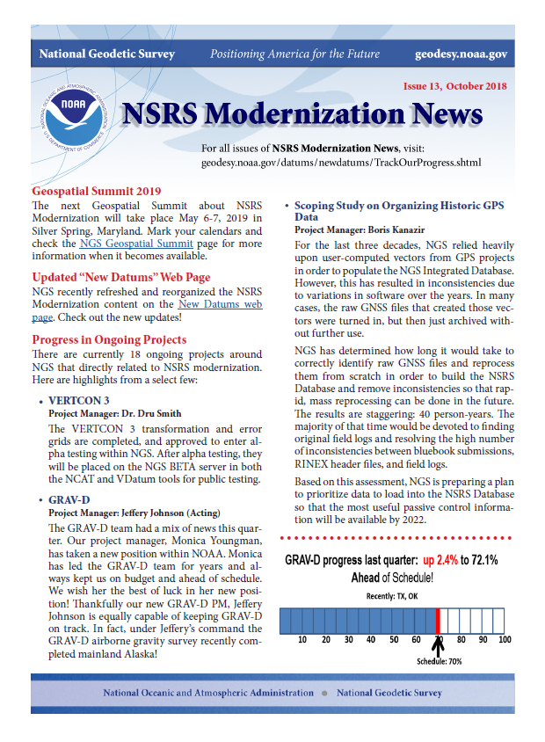
Geospatial Summit
May 6-7, 2019
Vertcon 3
GRAV-D
NOAA Technical Report NOS NGS 62, “Blueprint for 2022, Part 1: Geometric Coordinates
NOAA Technical Report NOS NGS 64, “Blueprint for 2022, Part 2: Geopotential Coordinates
Geodesy.noaa.gov

Slide 33
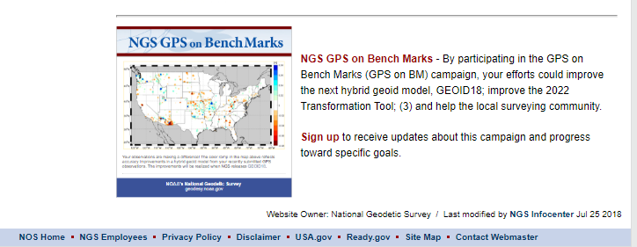
New Subscription Service
GPS on Bench Marks

Slide 34
Next steps and Future
SPCS 2022
  Consensus needed across the State
  Other LDPs?
GPS on BM for transformation tools
  Need GIS communities assistance in identifying whether marks are in place and good for GPS
  Interns
  RTK
???

Slide 35
NOAA’s National Geodetic Survey
Thank you
John Hunter
CO State Geomatics Coordinator
Denver Water
CoCoordinator@plsc.net
John.Hunter@denverwater.org
Pam Fromhertz
Rocky Mountain Regional Advisor
Pamela.Fromhertz@noaa.gov
240-988-6363
Geodesy.noaa.gov

