Slide 1
The NOAA CORS Network:
~1900 Crowd-Sourced Continuous GNSS Reference Stations
John Galetzka
Chief, CORS Branch
NOAA National Geodetic Survey
Notes:
In this presentation I’ll briefly explain who we are, what we’re doing, and where I hope to see us go. I’ll try to leave time at the end for questions, and hopefully we’ll have a good discussion. Your feedback is truly welcome.
NEXT SLIDE
‹#›

Slide 2
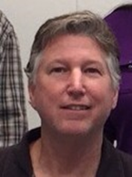
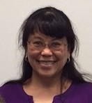
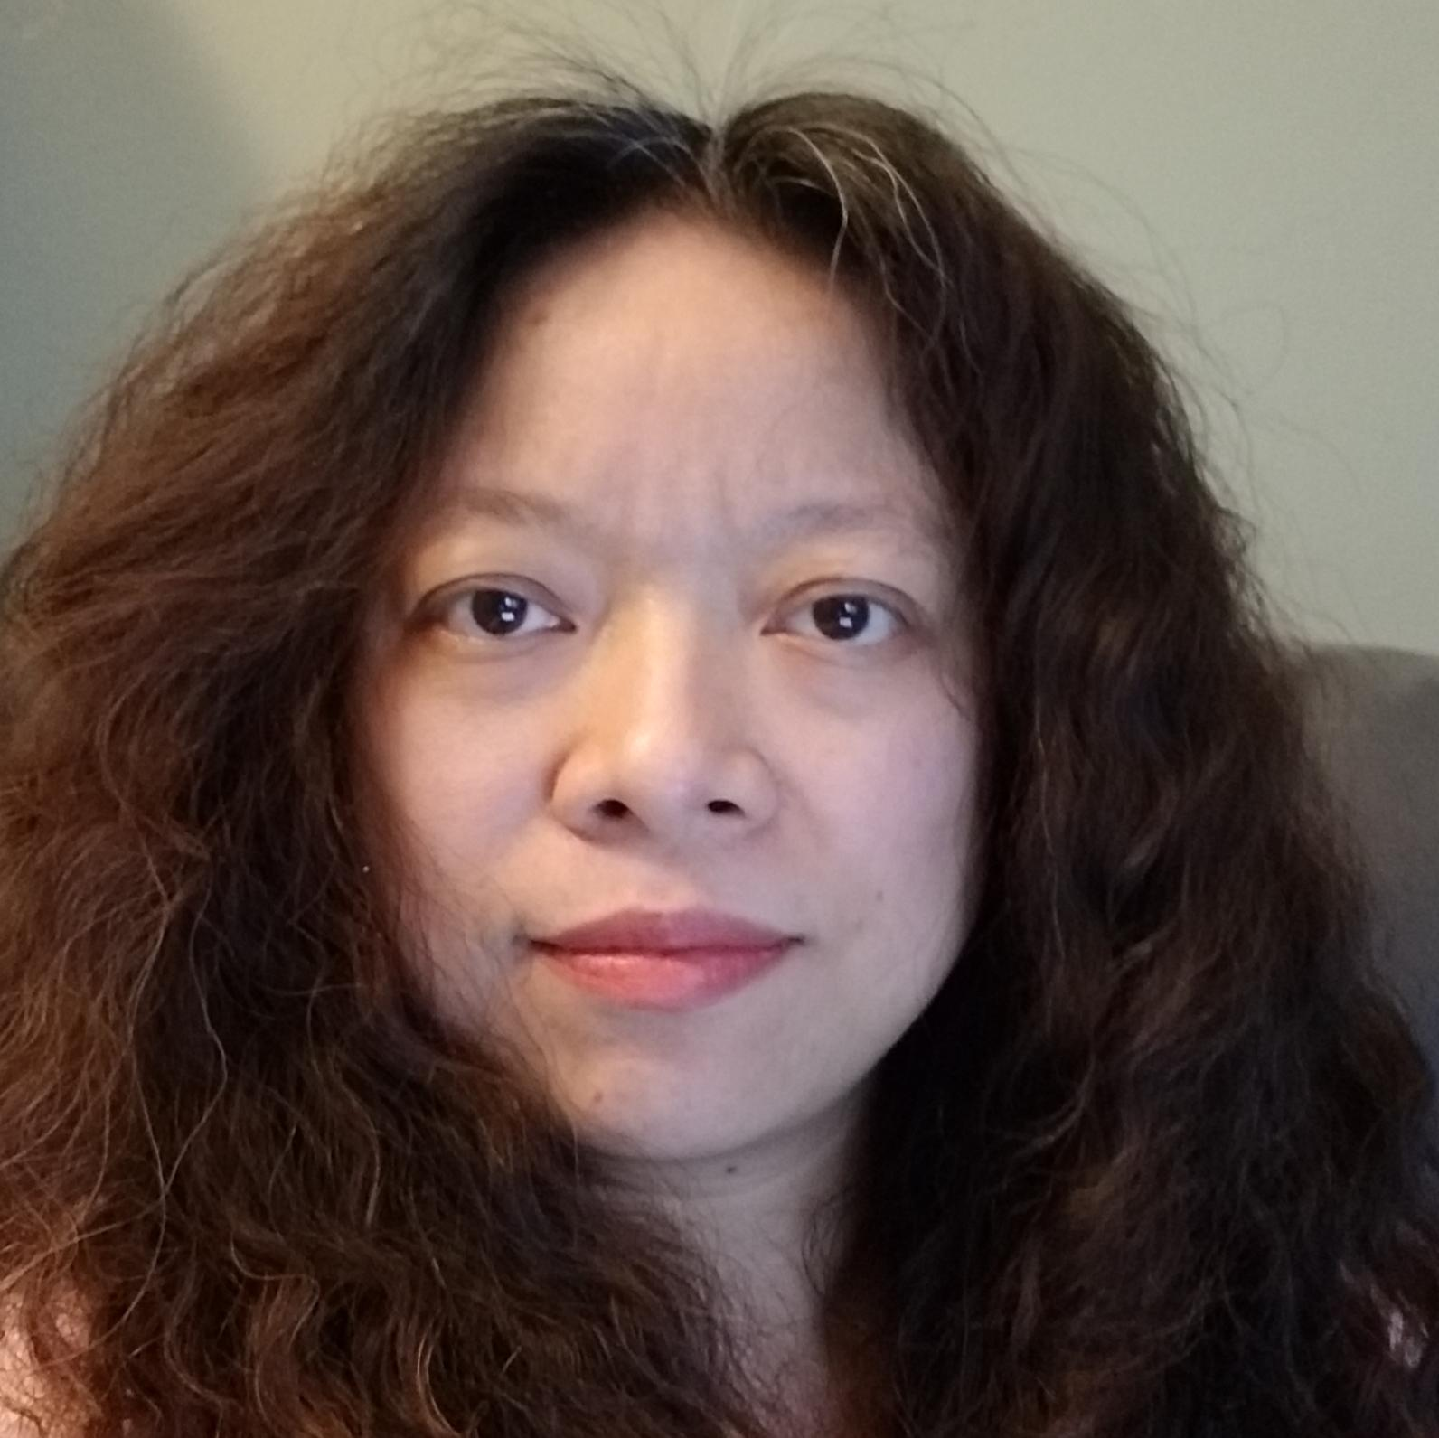
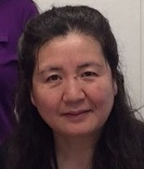
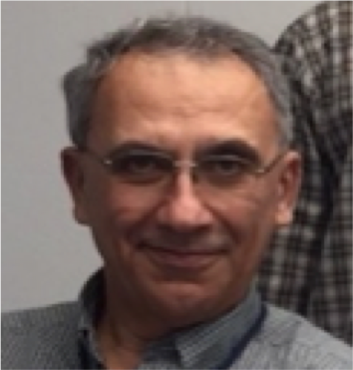
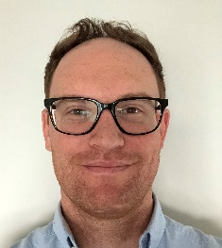
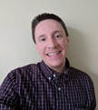
Who We Are
CORS Branch: Don Haw, Fran Coloma, Ira Sellars, Lijuan Sun, Jarir Saleh, Phillip McFarland, Michael Lucci, and John Galetzka
Notes:
I hear from the old timers at NGS that CORS Branch has been decimated over the years. The current handful of members are all doing multiple duties, but here are there main ones:
--Don Haw screens new stations wanting to get into the NOAA CORS Network, does weekly processing, handles ascii metadata, and leads the conversion to RINEX 3.
--Fran Coloma works on the data ingest, hourly and daily processing, and data distribution and archive.
--Ira Sellars works on a lot of software development, and on the CORS website look and feel.
--Lijuan Sun works on coordinates and plots, and maintains binary metadata.
--Jarir Saleh works on long-term CORS health and periodic reanalysis of entire data holdings.
--And finally Phillip McFarland and Mike Lucci are working on GNSS orbits and analysis.
That’s the CORS Branch in a nutshell.
NEXT SLIDE
‹#›

Slide 3
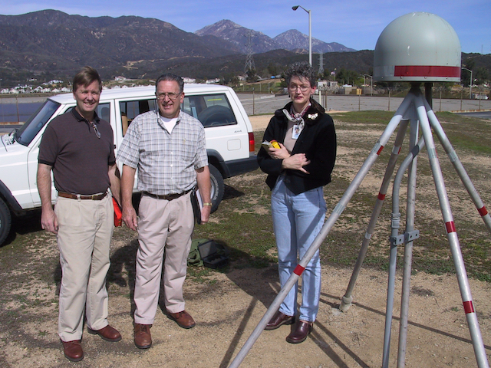
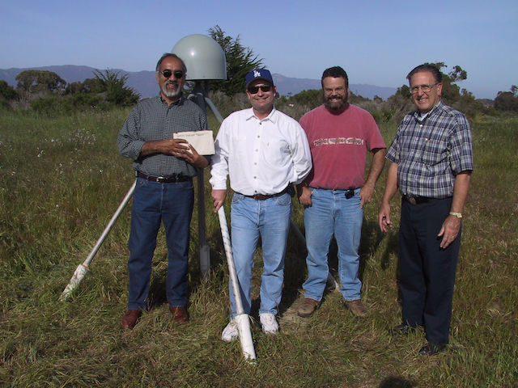
Who We Are
237 contributors including UNAVCO, SOPAC and members of the CRSC
Mike Duffy, Bob Packard, Cecilia Whiaker at LORS ?, Jon McKellar, ?, Bob Packard at COPR
Notes:
I want to give thanks to the community of 237 volunteer agencies and individuals, such as you all in the CSRC, for providing stations and resources towards making the NOAA CORS Network and the National Spatial Reference System.
I remember from my 6 years with the Southern California Integrated GPS Network just how important the contributions of the survey community were to the SCIGN scientists. Here are a couple of photos from that time showing some of those surveyors (Mike Duffy, Bob Packard, Cecilia Whitaker, ?, Jon McKellar, ?, Bob Packard), but there many others such as Bill Young, John Canas and Art Andrew. Back then were all stronger and better when we worked together, and the same applies now and in the future.
NEXT SLIDE
‹#›

Slide 4
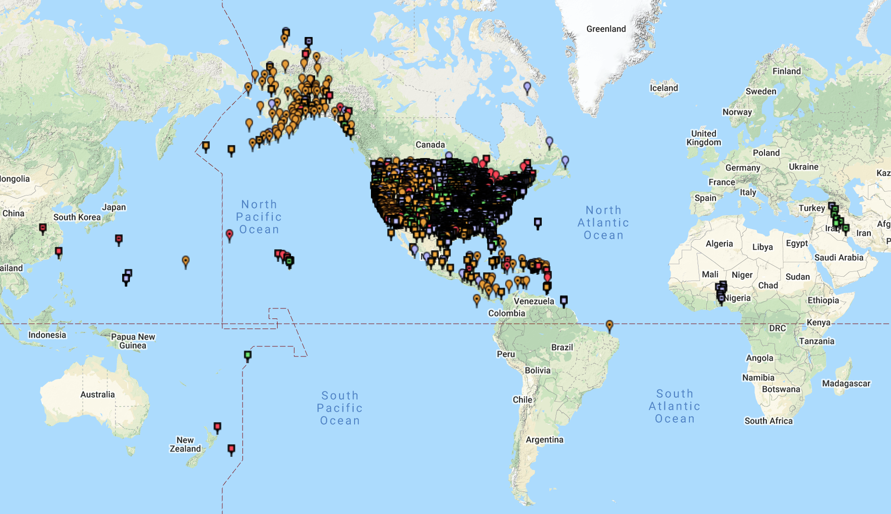
The NOAA CORS Network (NCN)
Notes:
At this moment, the NOAA CORS Network has over 1,900 continuous GNSS stations. Of these stations, NGS owns and operates only about 35 of them.
There’s a wide mix of monument types, receivers, and antennas out there in the NOAA CORS Network, and standards of maintenance and operation also vary between the contributors. Some operators don’t report receiver or antenna changes promptly, and this makes extra work for the CORS team trying to track down jumps in station position, or investigate flags raised by data ingest software.
Trying to distinguish real earth movement from noise at many GNSS stations also consumes a lot of my team’s time. Noise sources include unstable monuments, encroaching vegetation, faulty GNSS antennas and coaxial cables.
I have to say that NGS has been just as guilty of these violations as other contributors to the NOAA CORS Network.
NEXT SLIDE
‹#›

Slide 5
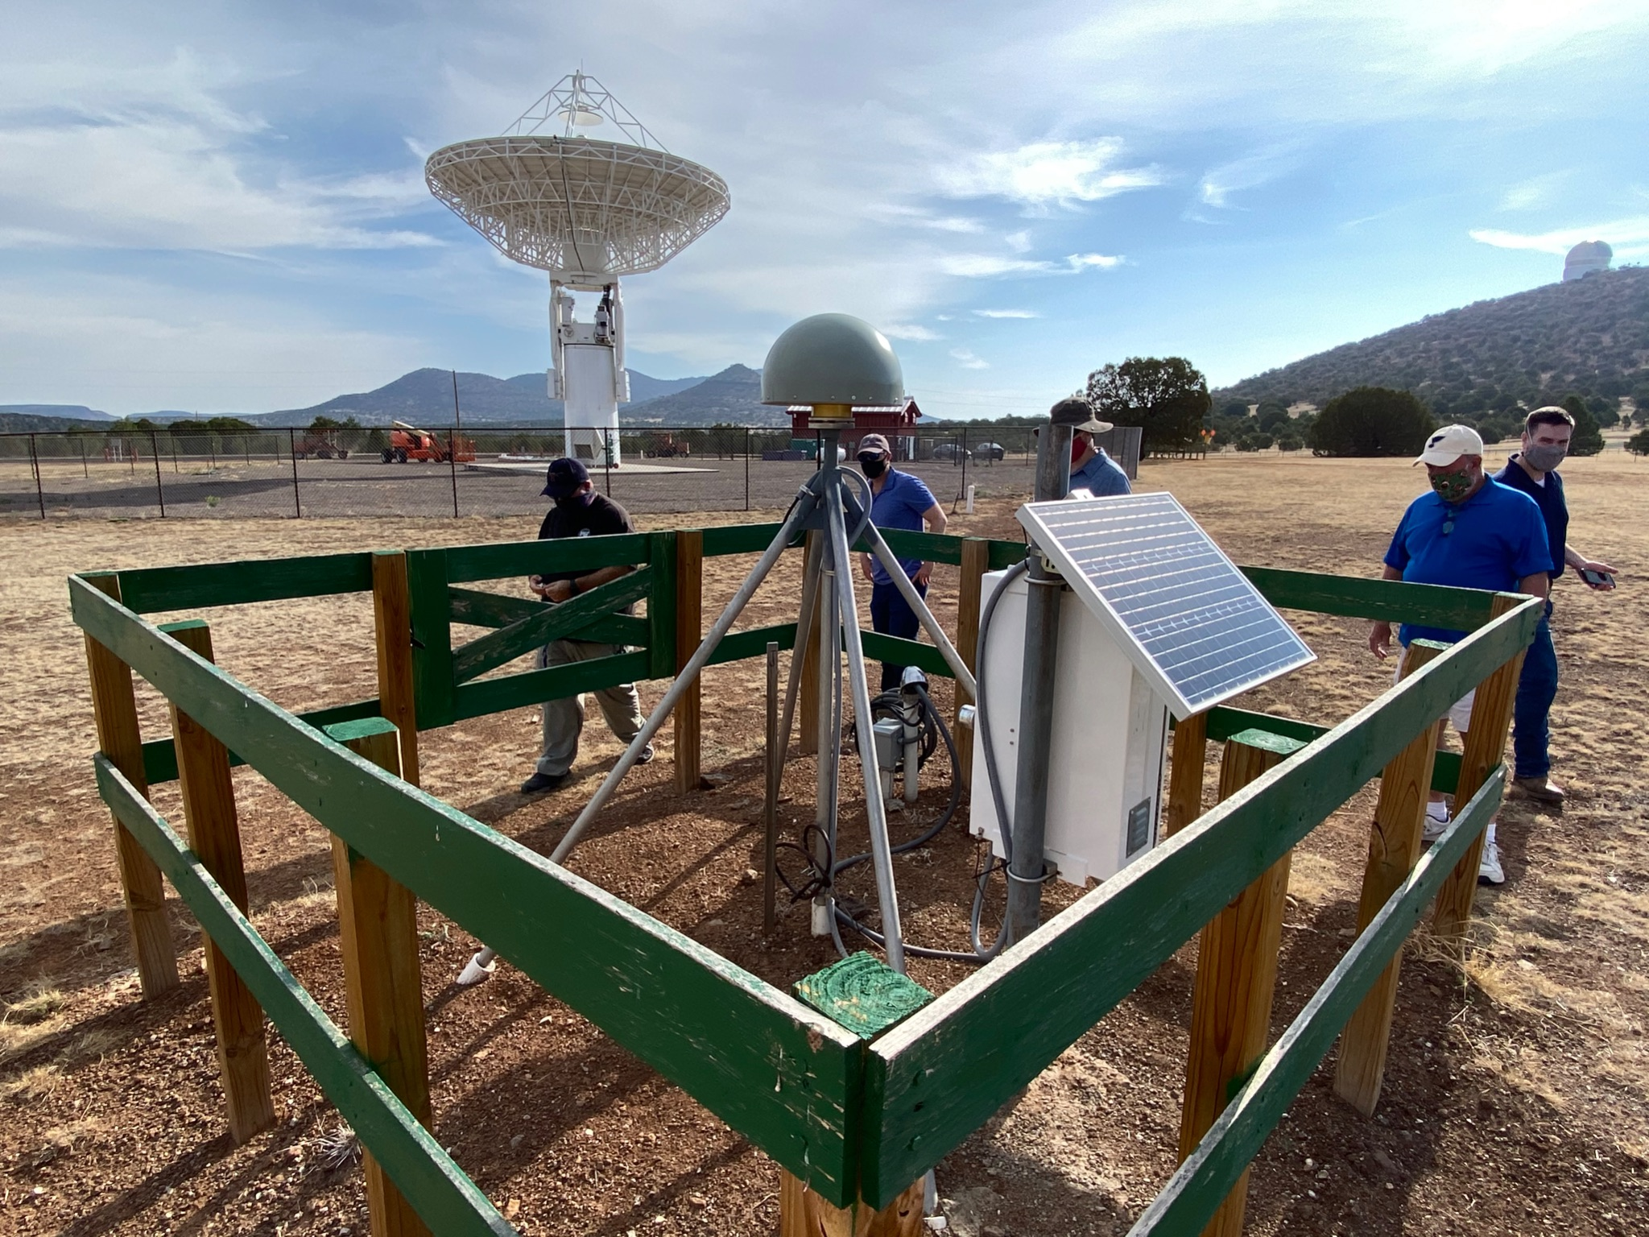
Guiding Principles for CORS Branch
VGOS and GNSS at McDonald Observatory, Texas
Notes:
We at CORS Branch are guided by these following principles:
1) CORS are an essential part of the NSRS.
2) The International Terrestrial Reference Frame maintained by International Earth Rotation and Reference Service is the worldwide standard reference system
3) The GNSS component of the ITRF is provided by the International GNSS Service and its reference stations. NGS will continue to strongly support the IGS through the stations of our Foundation CORS Network which I’ll talk about in the next slide.
4) The NSRS, and it’s future North American, Pacific and Caribbean plate reference frames for example, will all continue to be based on the International Terrestrial Reference Frame.
NEXT SLIDE
‹#›

Slide 6
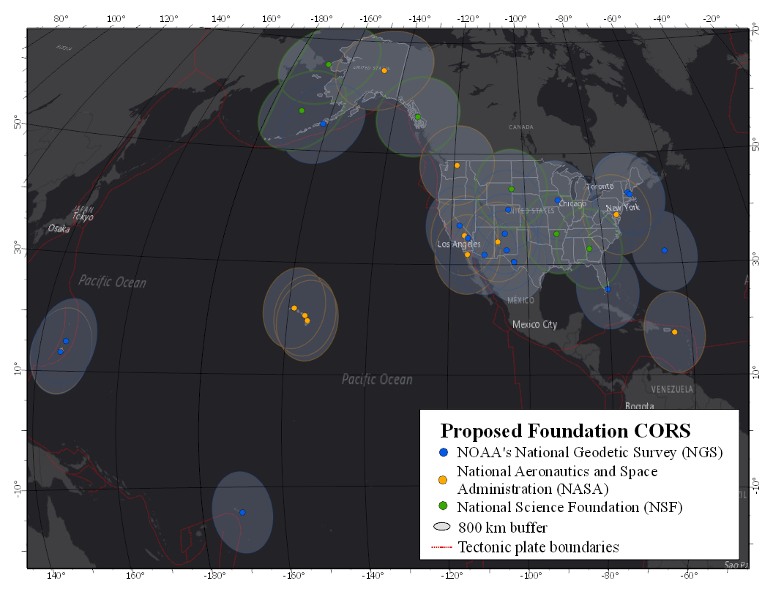
The NOAA Foundation CORS Network (FCN)
Notes:
The backbone of the NOAA CORS Network is the Foundation CORS Network -- a set of at least 36 federally-operated, high quality, highly-reliable stations with the longevity to guarantee citizens’ access to official NSRS positions and to support international positioning consistency efforts. Besides NGS, federal partners in the Foundation Network include NASA and National Science Foundation.
NEXT SLIDE
‹#›

Slide 7
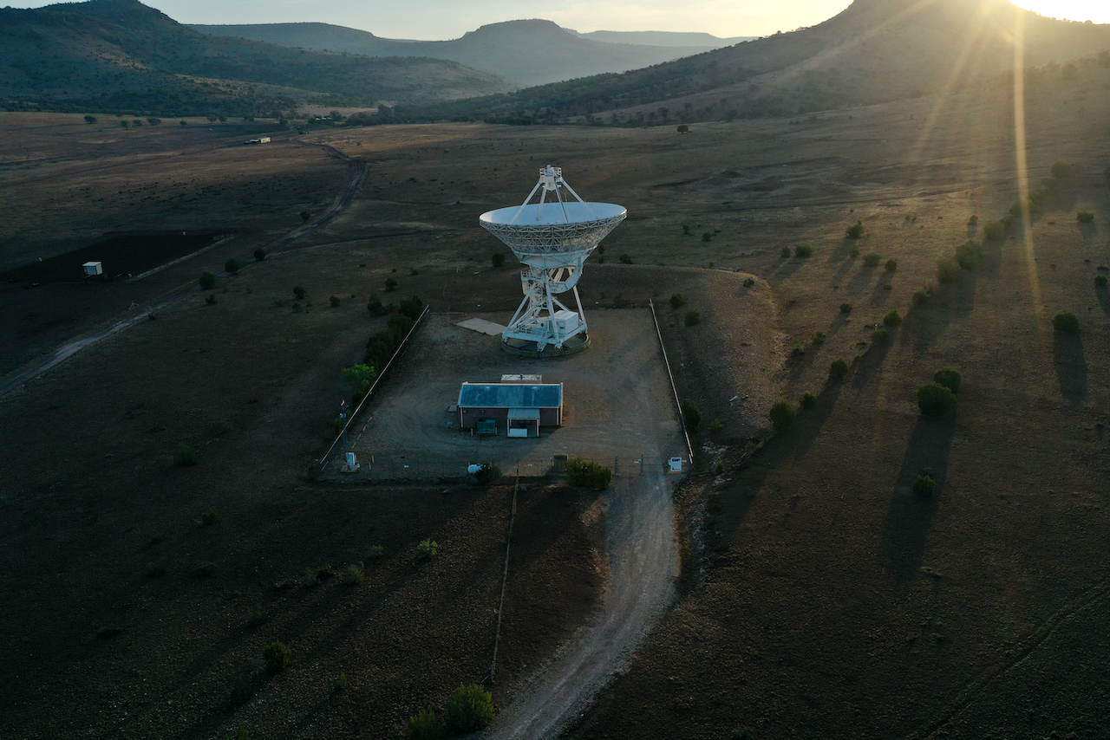
The NOAA Foundation CORS Network (FCN)
VLBA facility near Ft Davis, Texas
Notes:
22 out of 36 stations will be co-located with other space geodetic stations--such as the VLBA facility near Ft Davis, Texas—to better support the International GNSS Service, and International Terrestrial Reference Frame on which the NSRS depends on.
NEXT SLIDE
‹#›

Slide 8
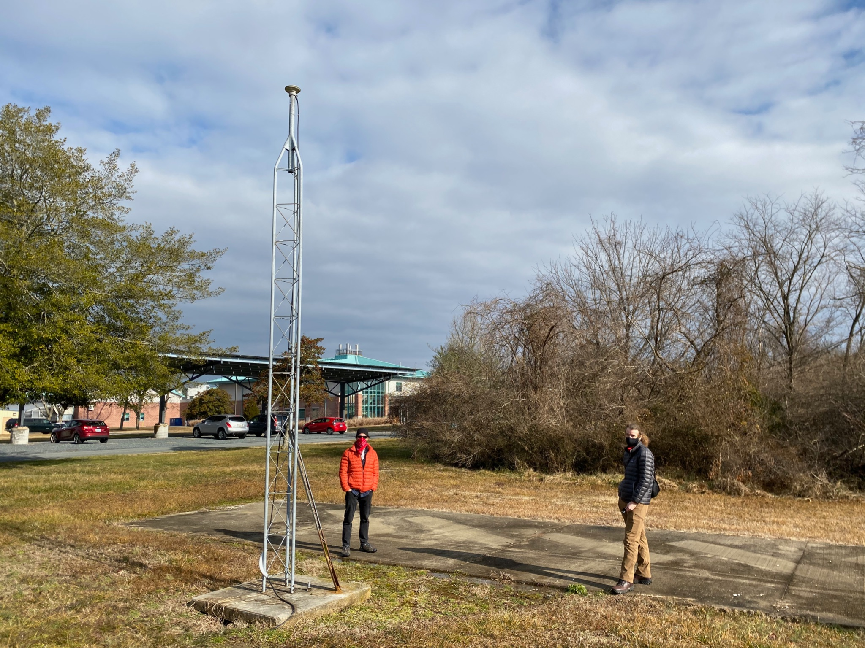
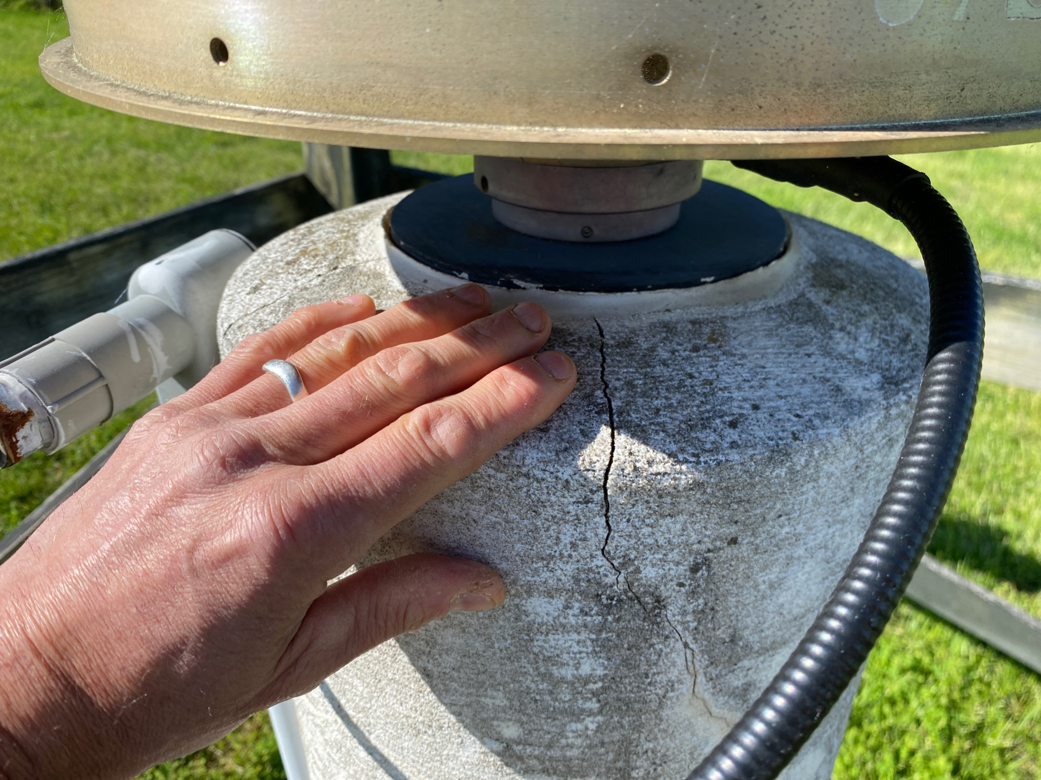
The NOAA Foundation CORS Network (FCN)
Notes:
Now that COVID is getting out of the way, we’re slowly resuming our efforts to construct at 9 remaining stations, and upgrade many existing stations with better monuments, new GNSS hardware, more robust power and communication systems, and even install satellite radar corner reflectors, permanent ground control targets, and meteorological packages.
If possible, I’d like to add more stations to the Foundation Network.
NEXT SLIDE
‹#›

Slide 9
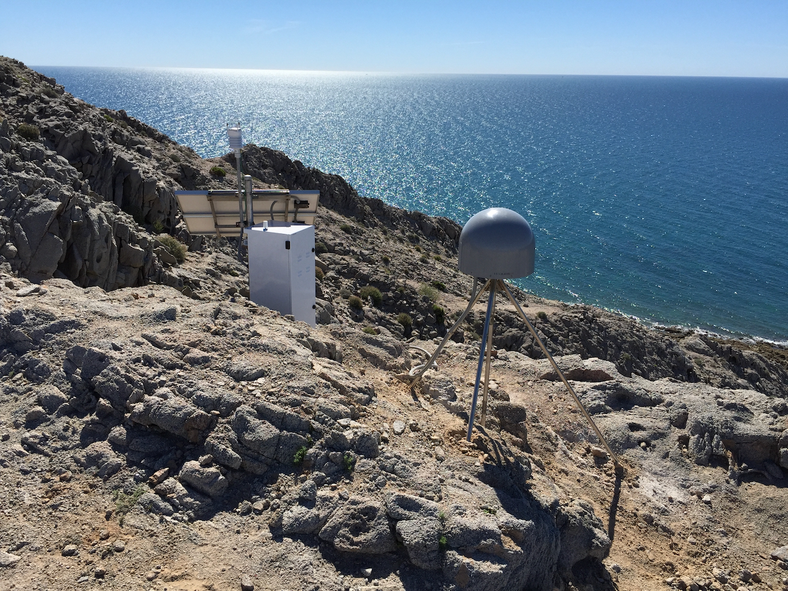
Where We Hope To Go
NOTA station TNPP
Notes:
For my final slide, I’ll talk about where NGS CORS Branch would like to go with the NOAA CORS Network.
We are just starting to implement goals of NGS Blueprint 3 and to write a 5 to 10-year comprehensive plan to improve our own operations, and give better guidance to the community for how to install, operate and maintain their GNSS stations. I’m also working to hard to hire more CORS analysts and orbiteers, but that’s turning out to be a really big challenge.
If we can get these things going, we can bring in more stations into the NOAA CORS Network and provide higher quality station coordinates and velocities to users working in the NSRS.
I also hope to make the NOAA CORS Network more versatile by advocating for better station placement and the addition of items such as meteorological packages and SAR corner reflectors. In this image of the NOTA station near Puerto Penasco, Mexico, you can see that it has a met sensor and overlooks the Gulf of California. The attributes enable the station to monitor atmospheric water vapor via delayed GNSS signals, and track sea level via GNSS reflections off the water surface. Done right, CORStations can also measure soil moisture, snow accumulation, better calibrate SAR interferograms, and more.
THANKS FOR LISTENING
‹#›

Slide 10
Thank You
john.galetzka@noaa.gov
Notes:
‹#›

